Slide 1
1
Research line: Medical physics
DISCOVER22
2
MUSICA
Scientific context: Microdosimetry
Biological effectiveness of ionizing radiation depends on the stochastic characteristics of radiation interaction at subcellular level. These characteristics are not described by absorbed dose and linear energy transfer (LET).
Same dose of different radiation types, albeit at the same LET, induce damages of different entities.
Can we measure physical quantities
that correlate with radiobiology?
3
DIODE
ep
ANTHEM & AMONG_US
Employees INFN
Valeria Conte
Anna Bianchi micro/nanodosimetry
Anna Selva
Stefania Canella control system and ambient environment parameters
M.Rossignoli & MW mechanical design and construction
L.Bellan etc. target design neutron field characterization for BNCT

Slide 2
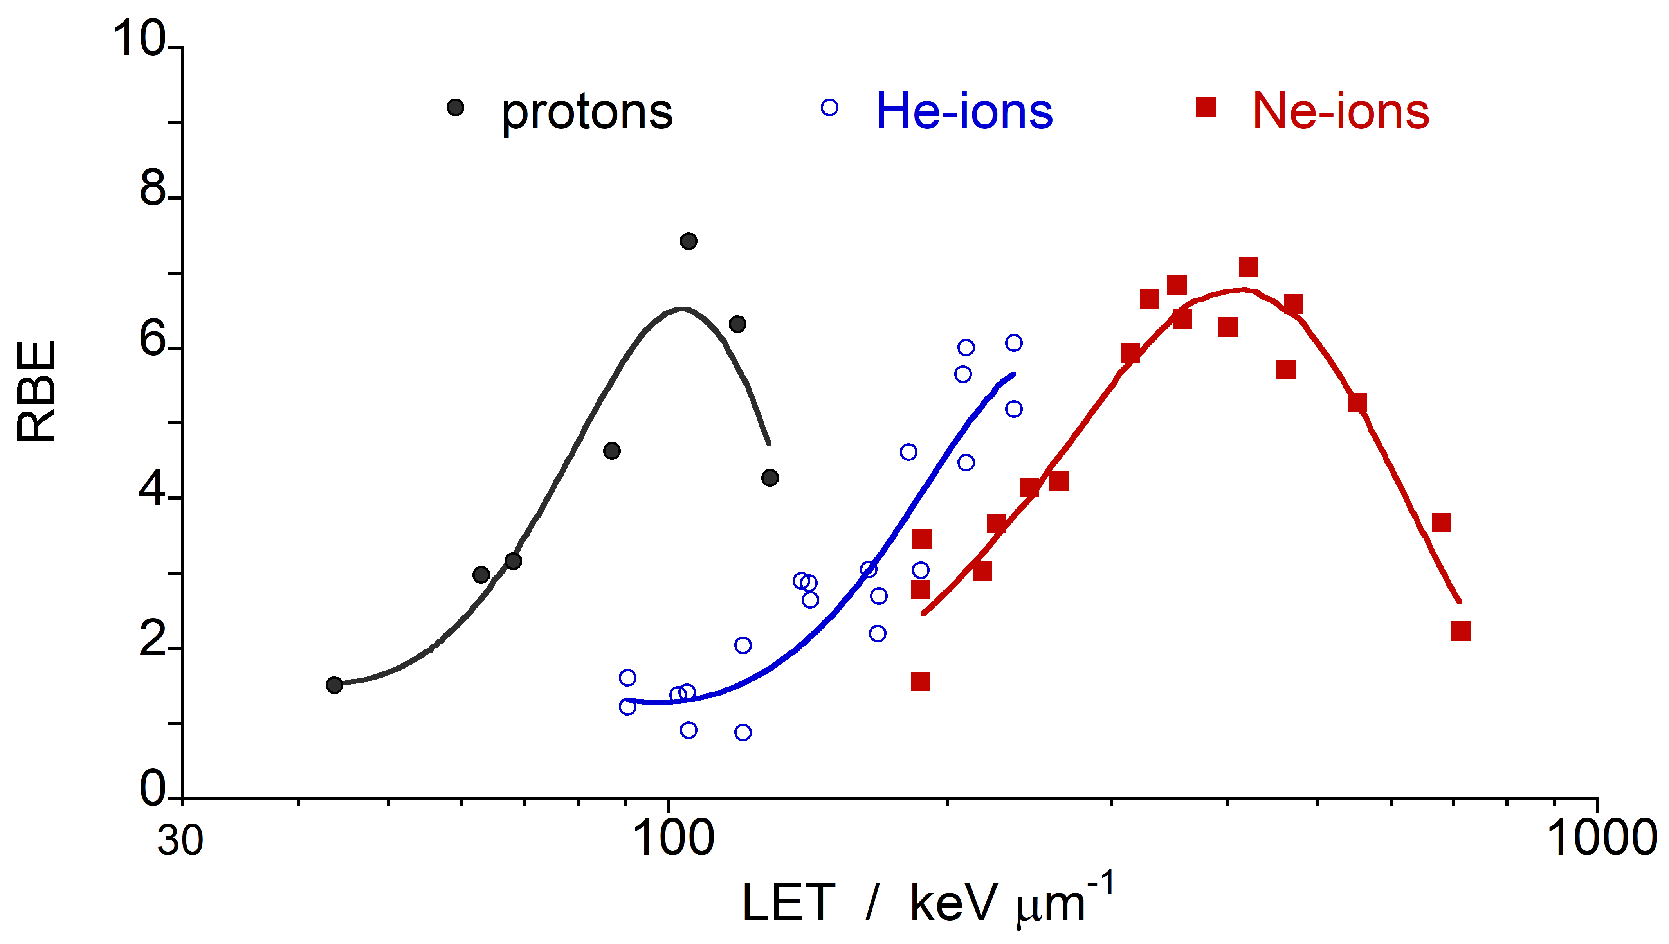
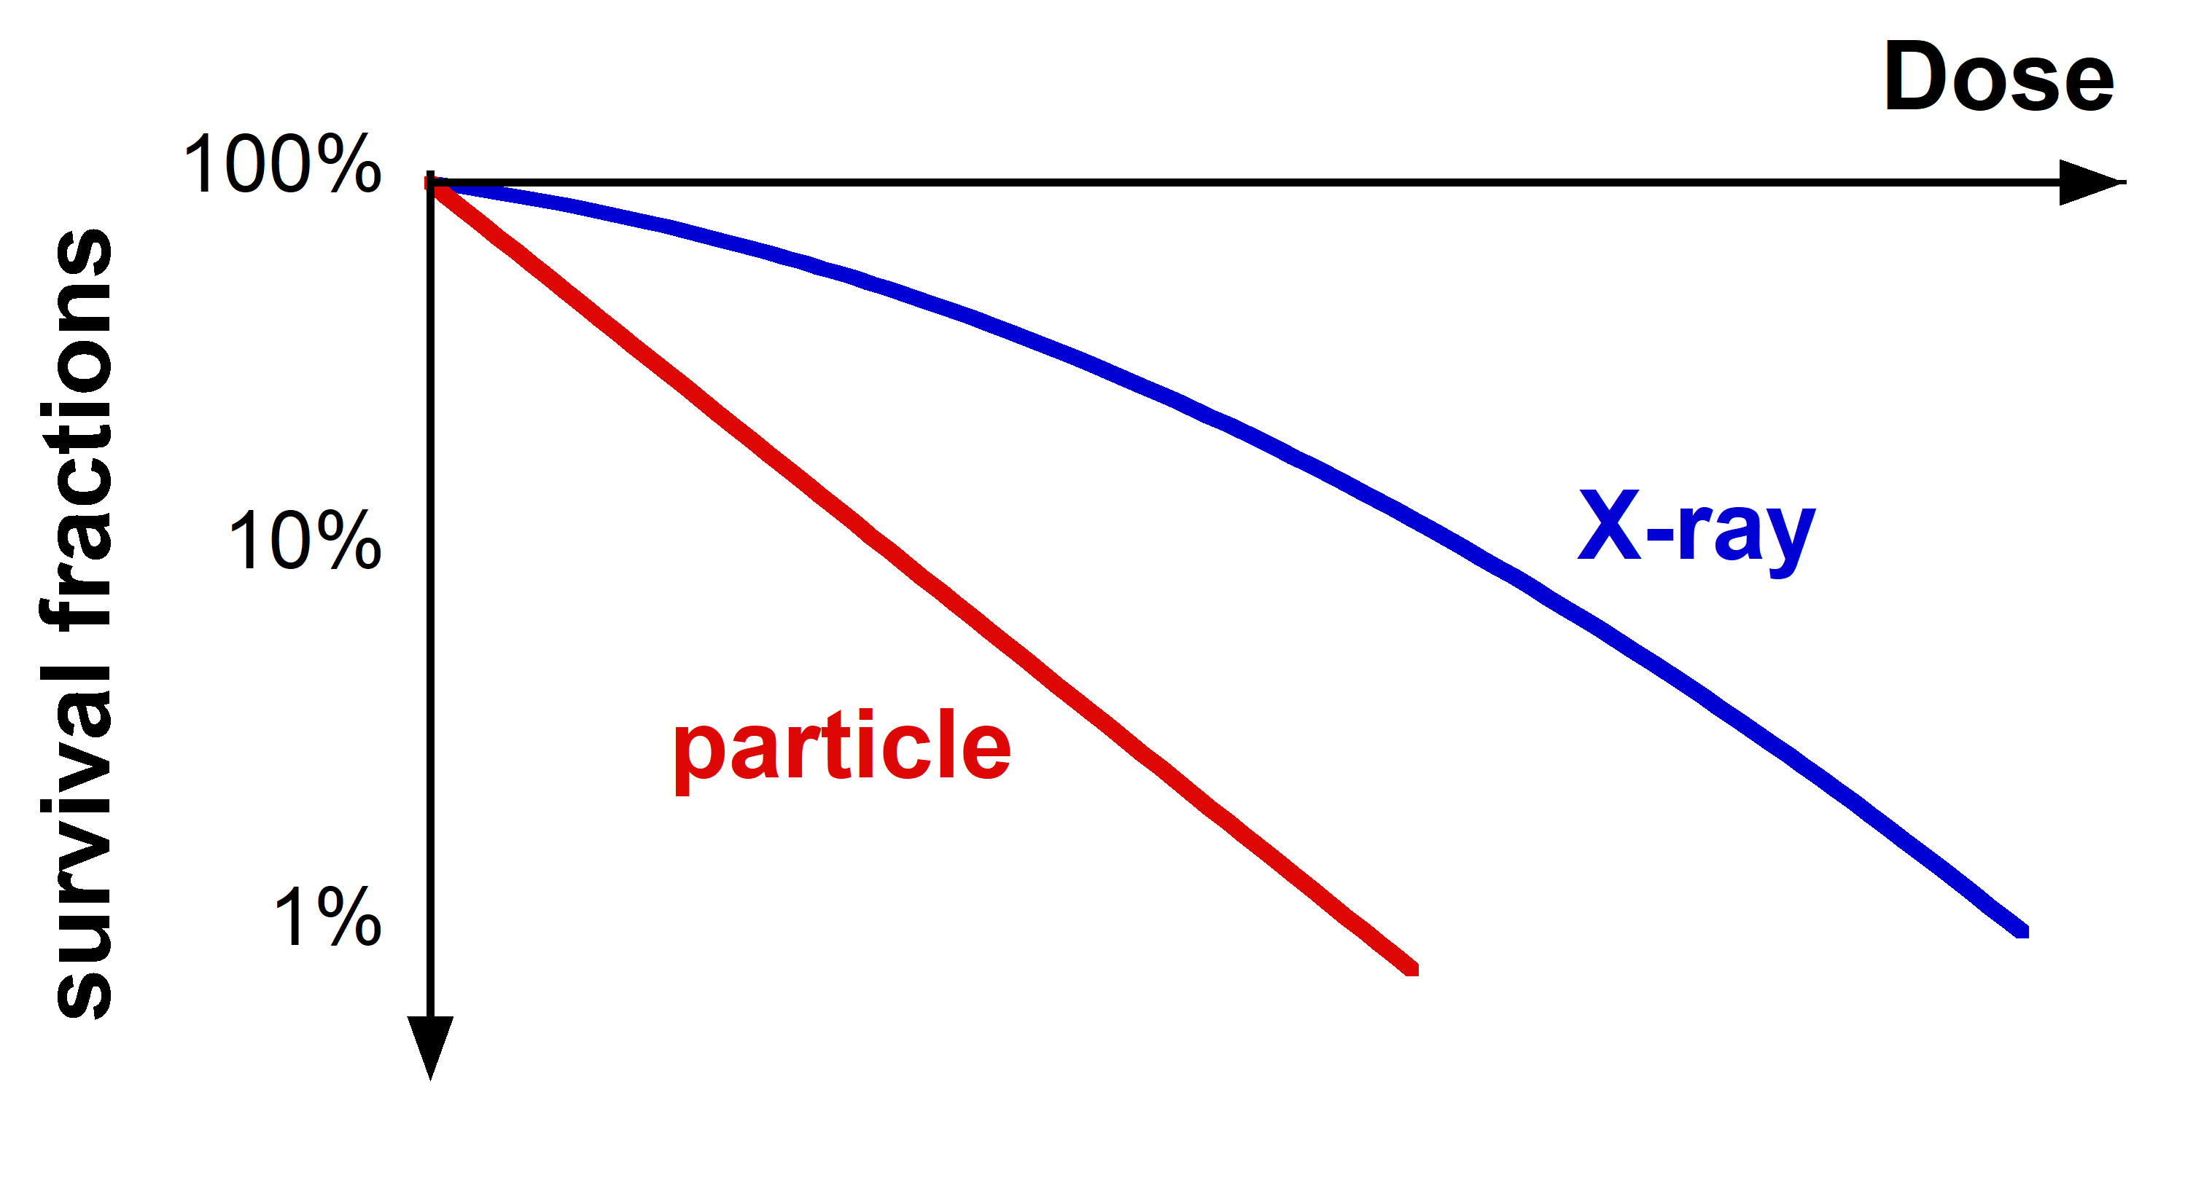
Scientific context
DOSE
LET
D_{part.}
D_{X-ray}
$$\text{RBE}\text{=}\frac{\text{D}\text{X}\text{−}\text{ray}}{\text{D}\text{part}\text{.}}$$
MICRODOSIMETRY
2 Gy - Photons
2 Gy - Protons
2 Gy – Carbon ions
Increased
Effectiveness

Slide 3
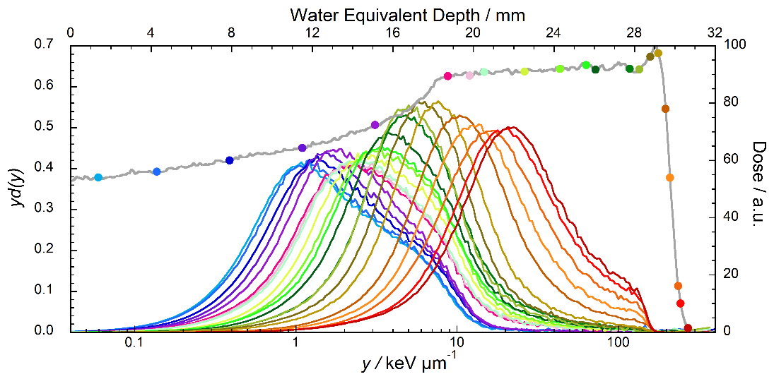
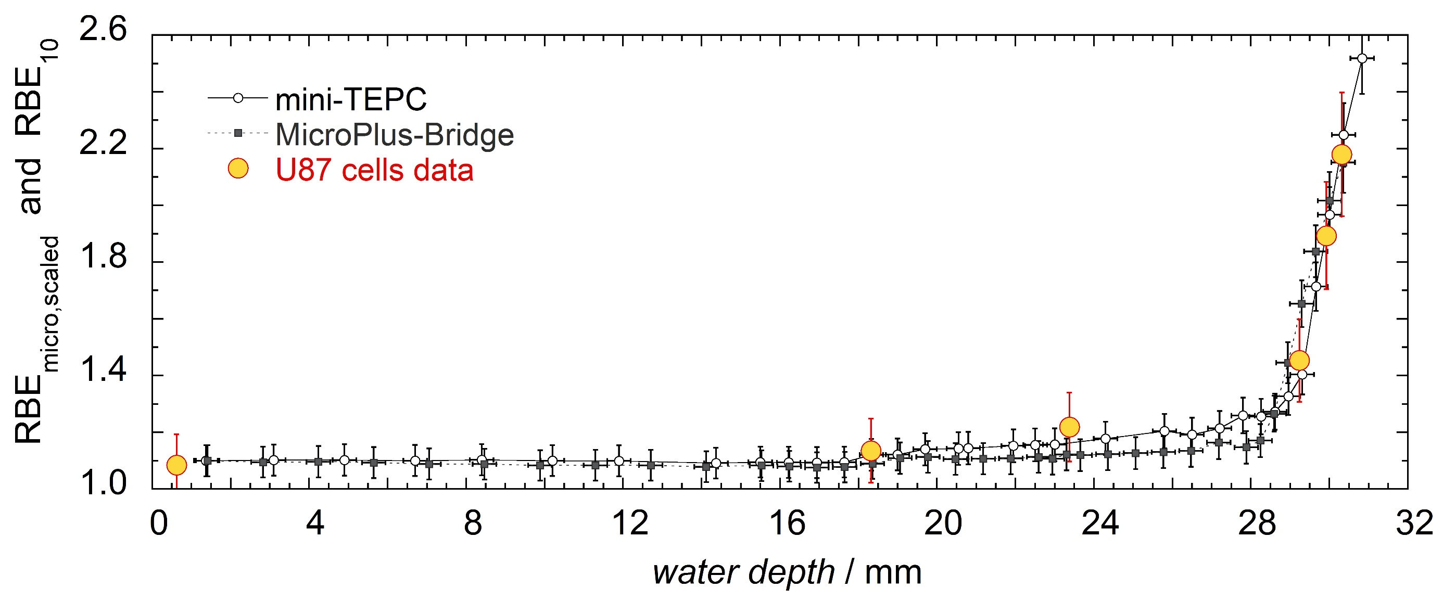
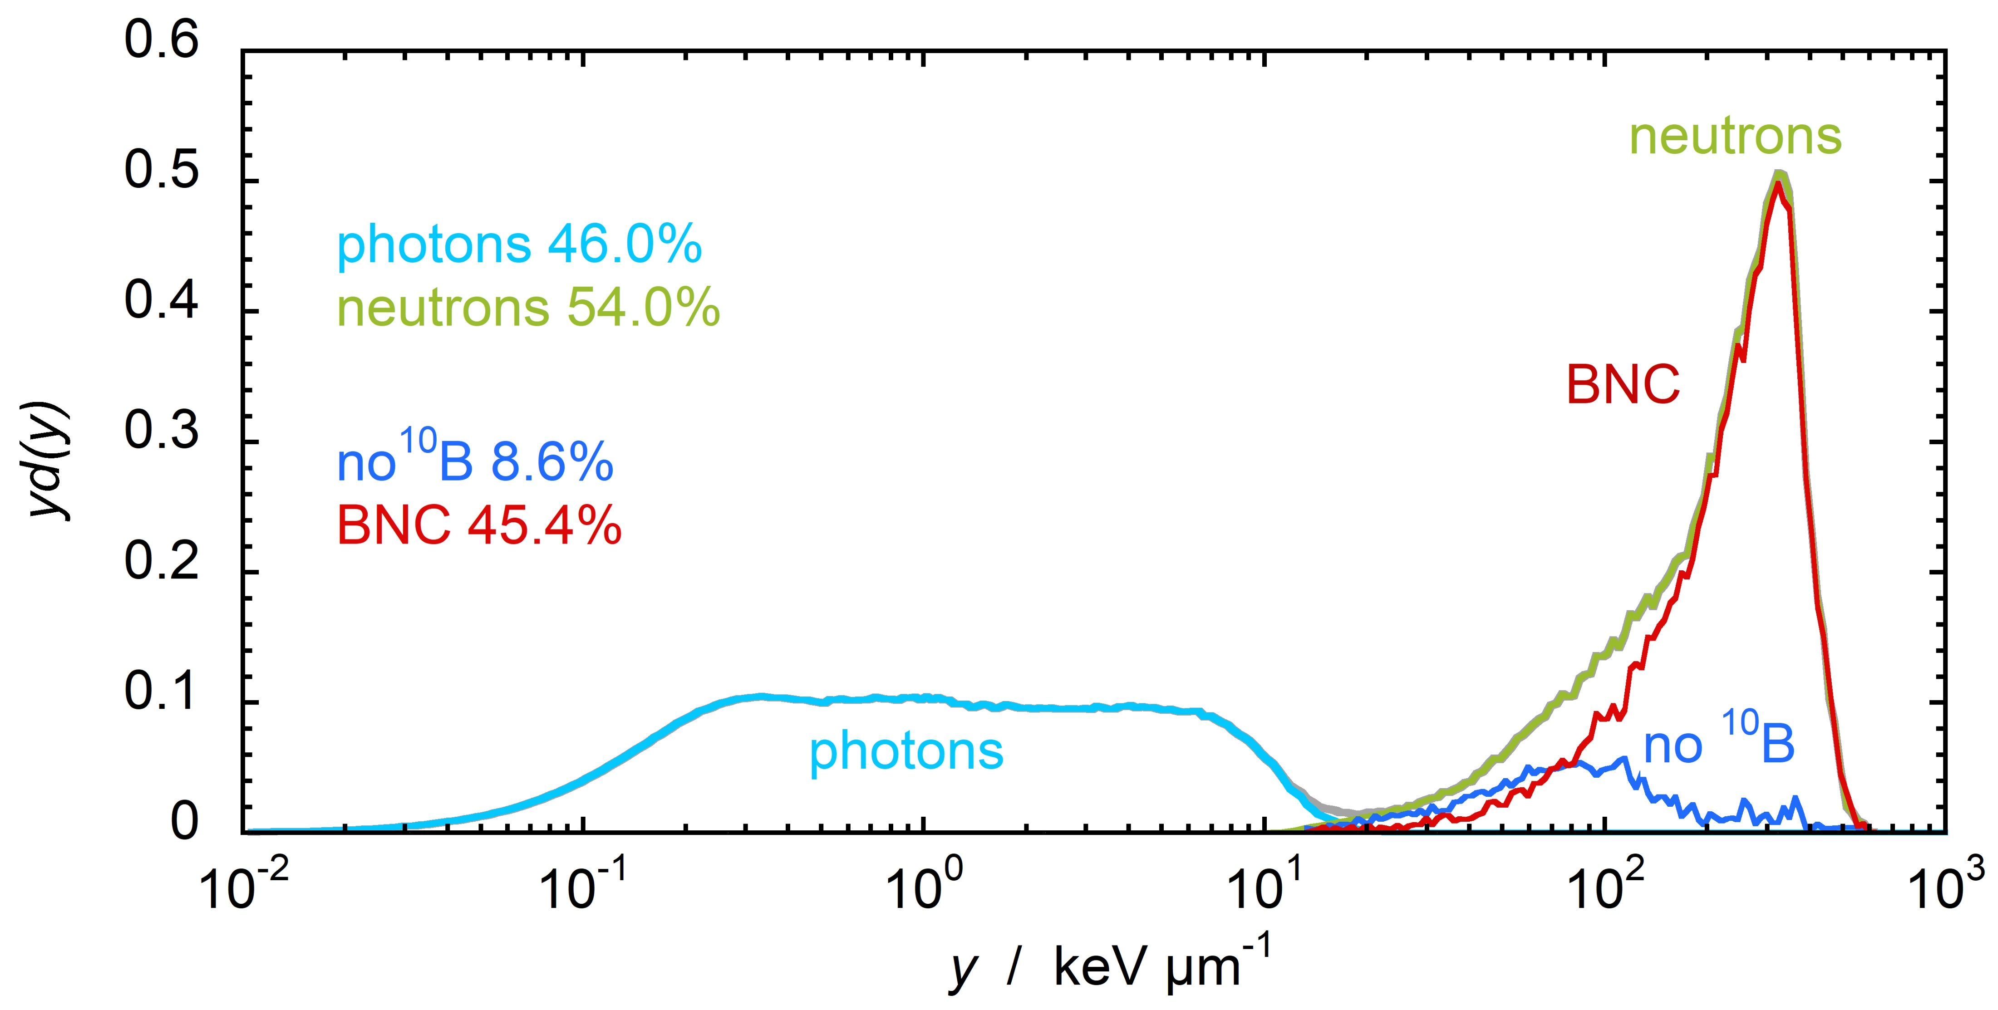
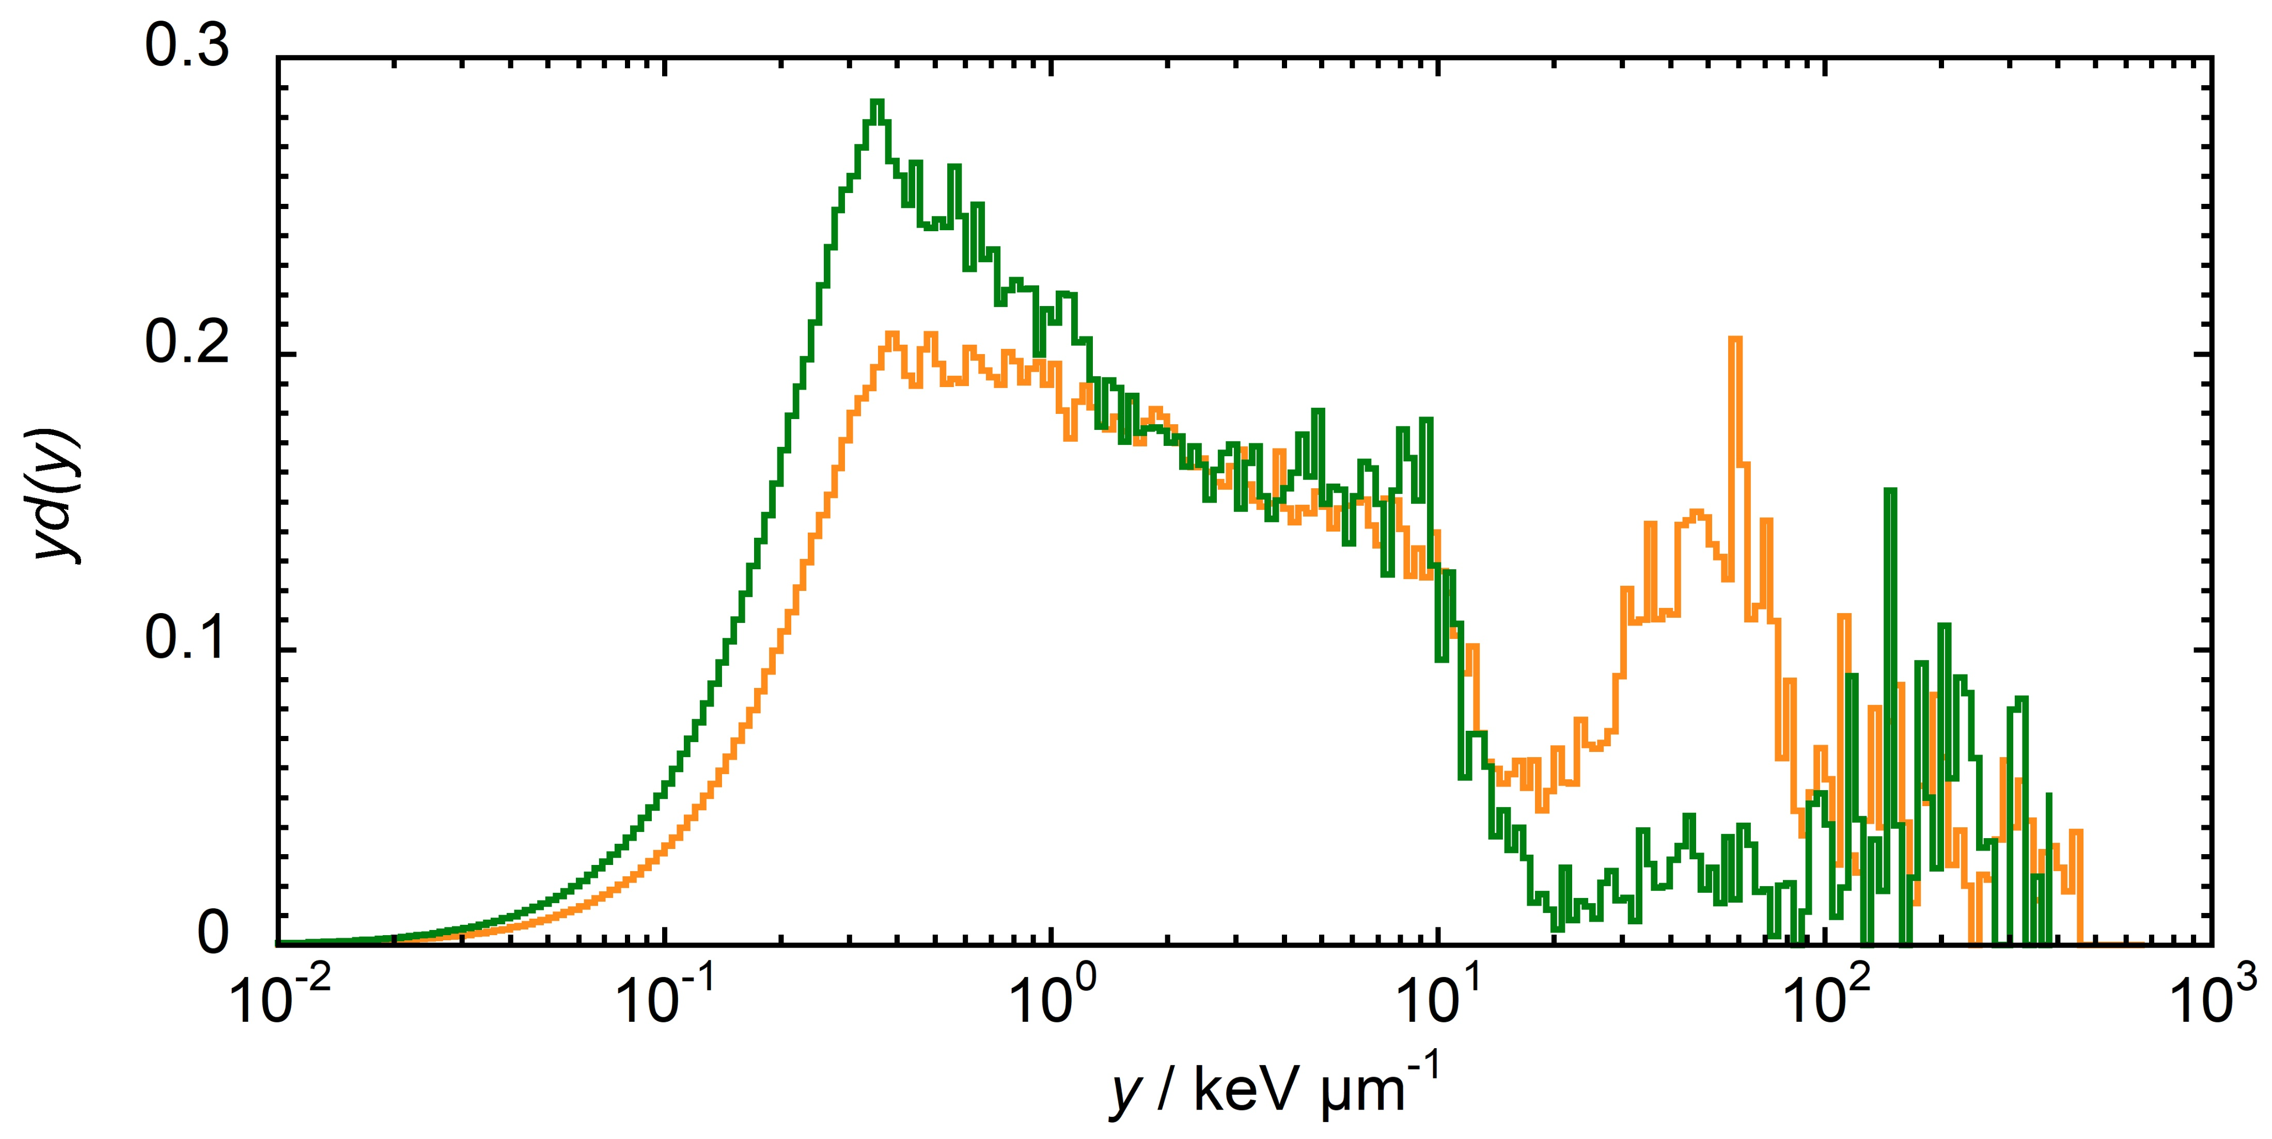
Scientific context
Particle Therapy
U87 cells
Microdosimetric RBE
BNCT
Environmental Monitoring

Slide 4
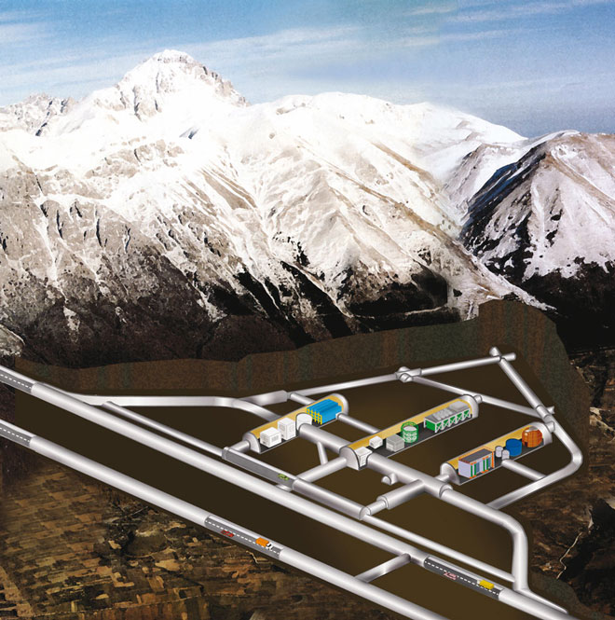
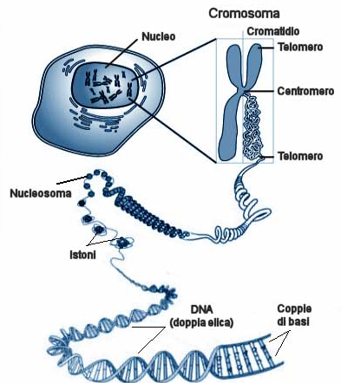
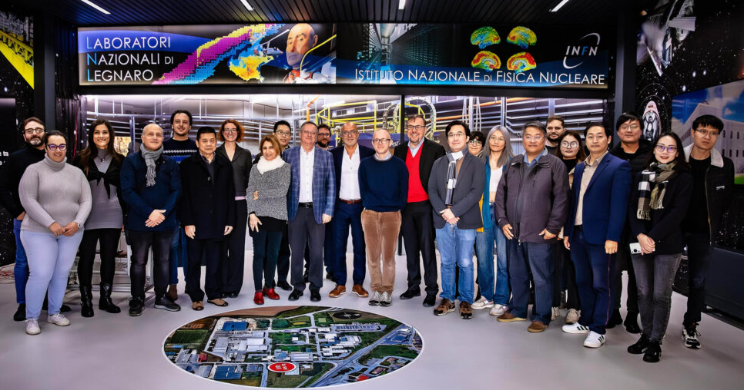
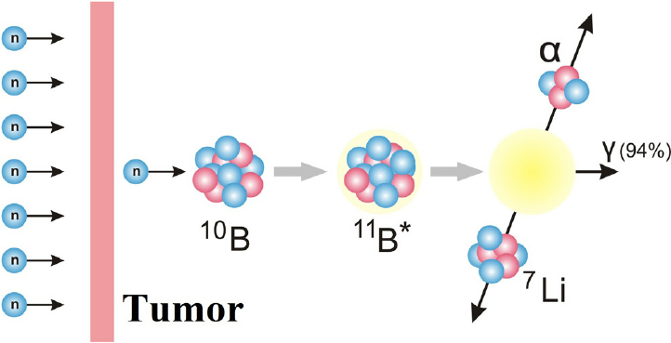
Objective of research
1
DISCOVER22
Low dose radiation field characterization
2
MUSICA
Development of a new concept detector
3
DIODE
Validation of a new device developed at RM2
ep
BNCT

Slide 5
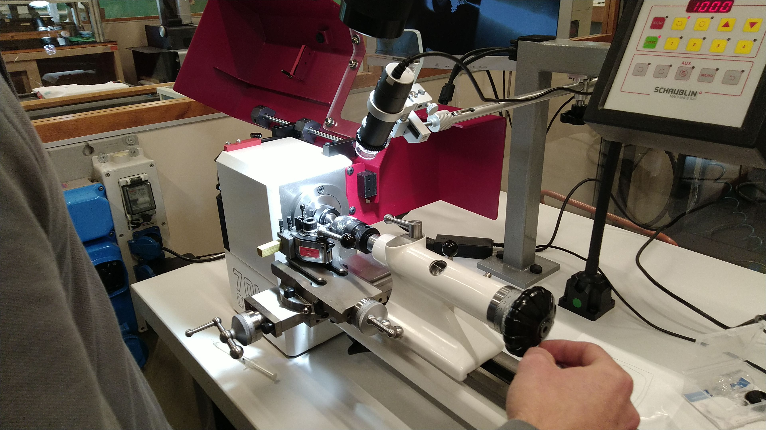
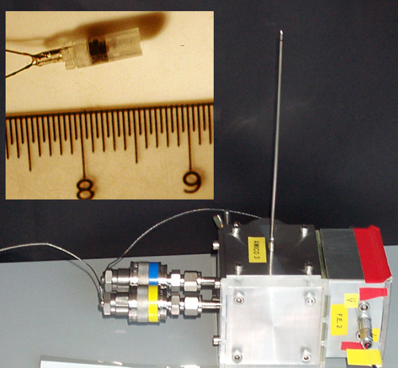
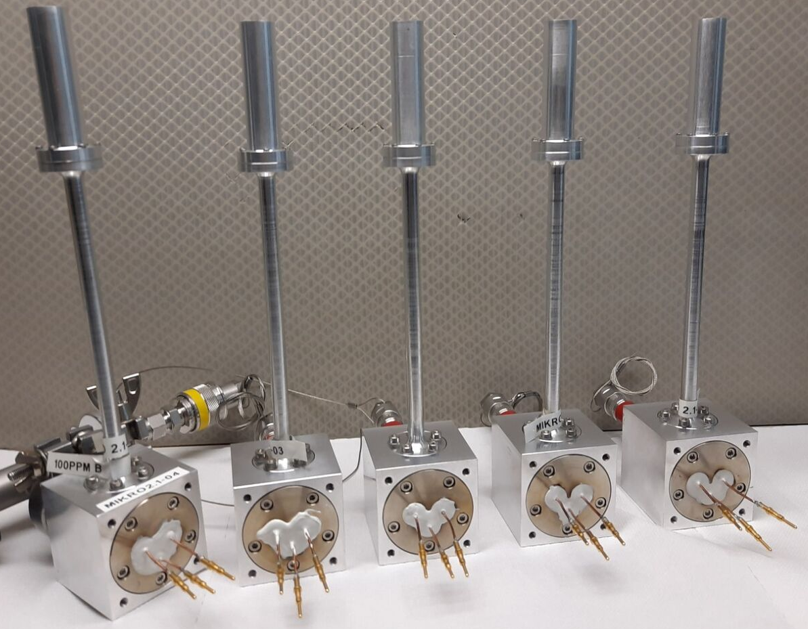
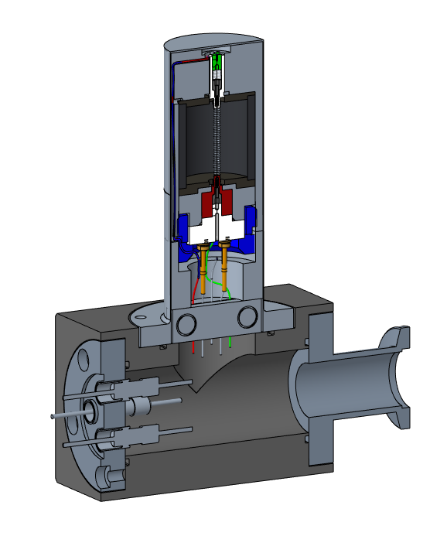
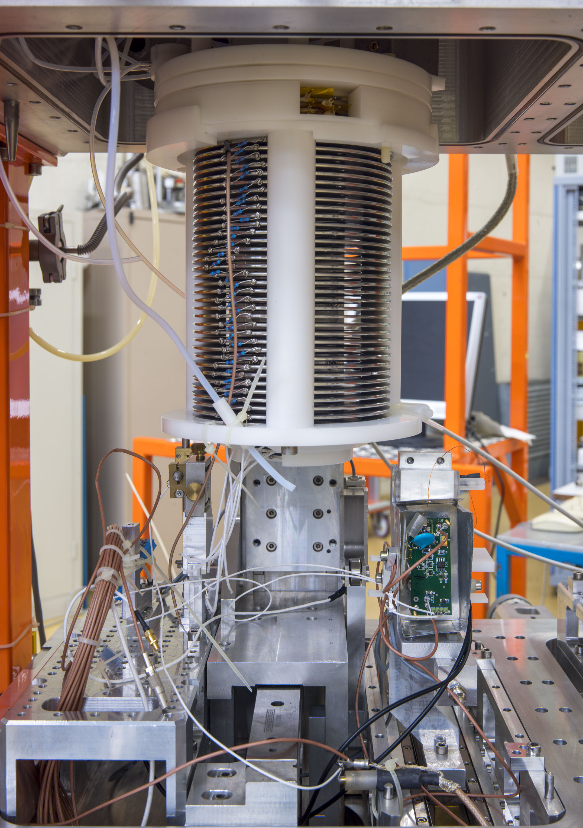
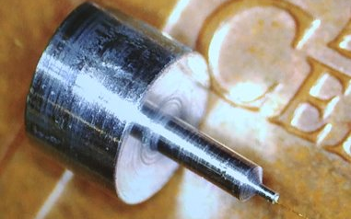
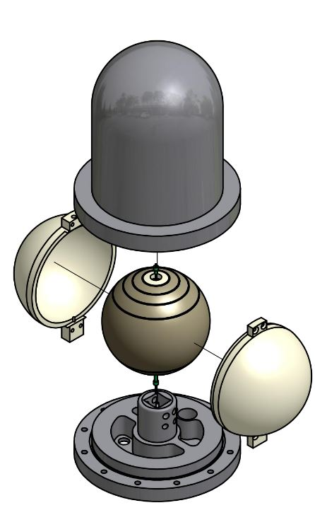
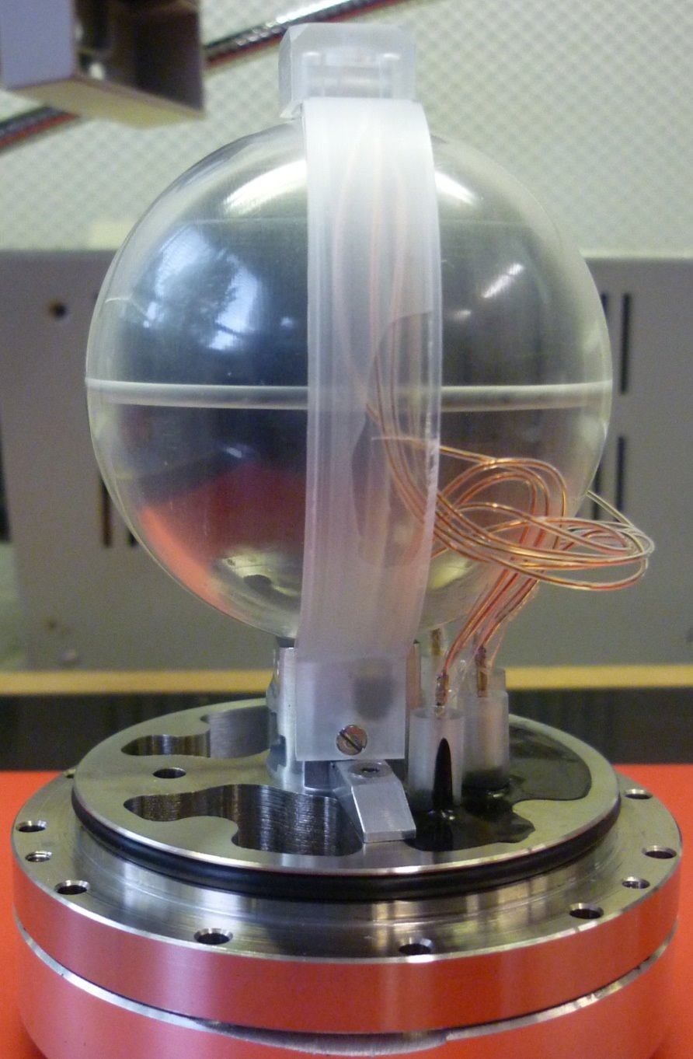
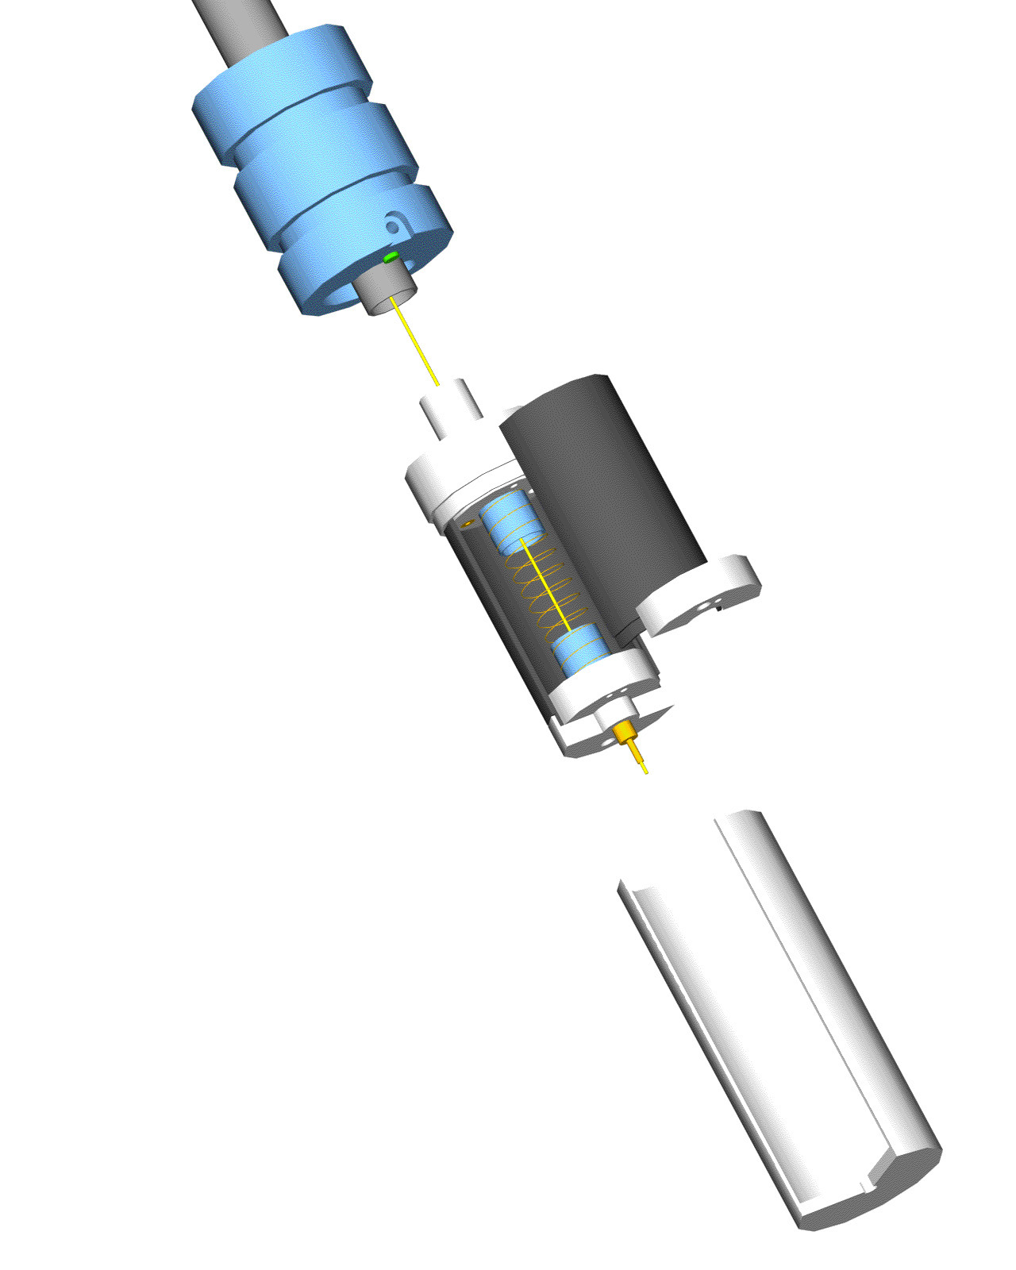
Expertise LNL
Innovative detectors for nanodosimetry and multi-site microdosimetry
Tech.design & machining
Miniaturized-TEPC for intense beams
new detectors
Large TEPC for space
TEPC for BNCT

Slide 6
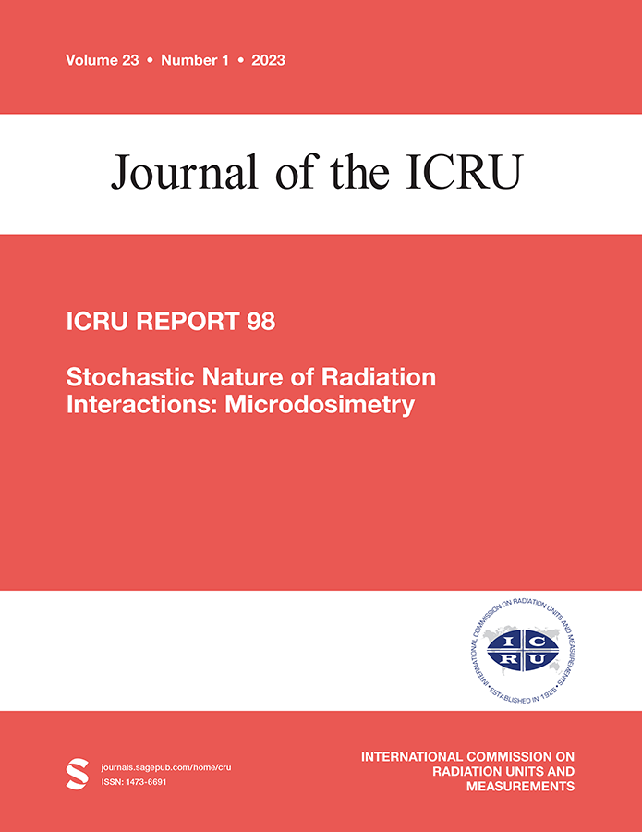
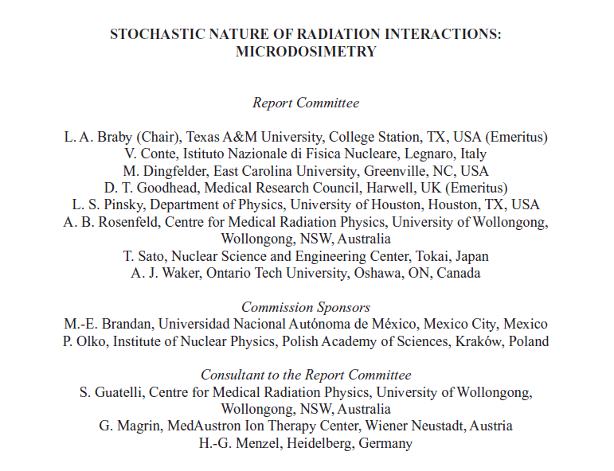
Stakeholder and international collaborations
When microdosimetry has to be used
When the mean number of charged particles, including delta rays originating outside the site, interacting with the volume of interest is small, the stochastic nature of the radiation interactions should be considered. Such a situation will arise when the reciprocal of the particle fluence is comparable to or larger than the cross-sectional area of the volume of interest. In mixed radiation fields the fluence of the higher LET components should be considered.
New:
applications in
particle therapy
Low ← z → High
$$\frac{1}{φ}>S$$
$$\frac{1}{φ}<S$$
S: cross-sectional area
φ: particle fluence
Microdosimetry is necessary
Conventional dosimetry is sufficient
This recommendation is rather common sense for researchers working on microdosimetry, but it has never been documented explicitly

Slide 7
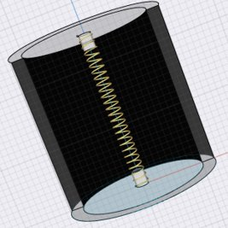
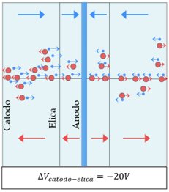
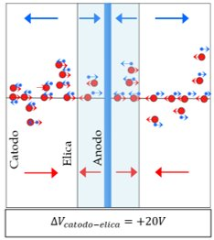
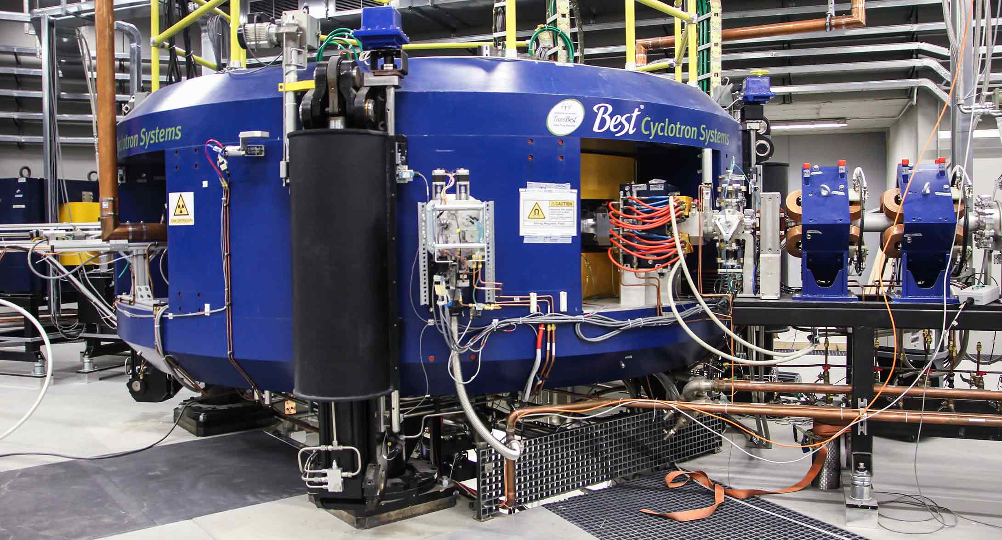
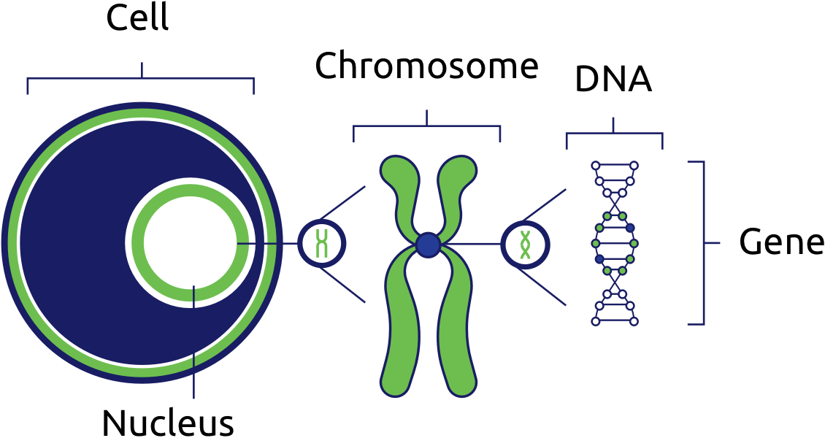
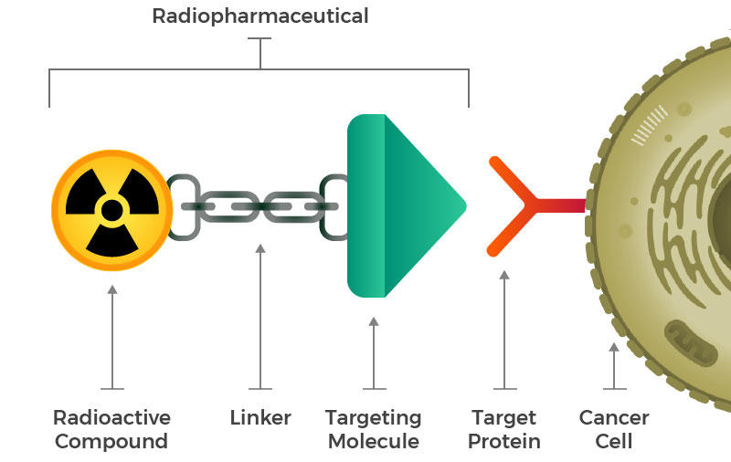
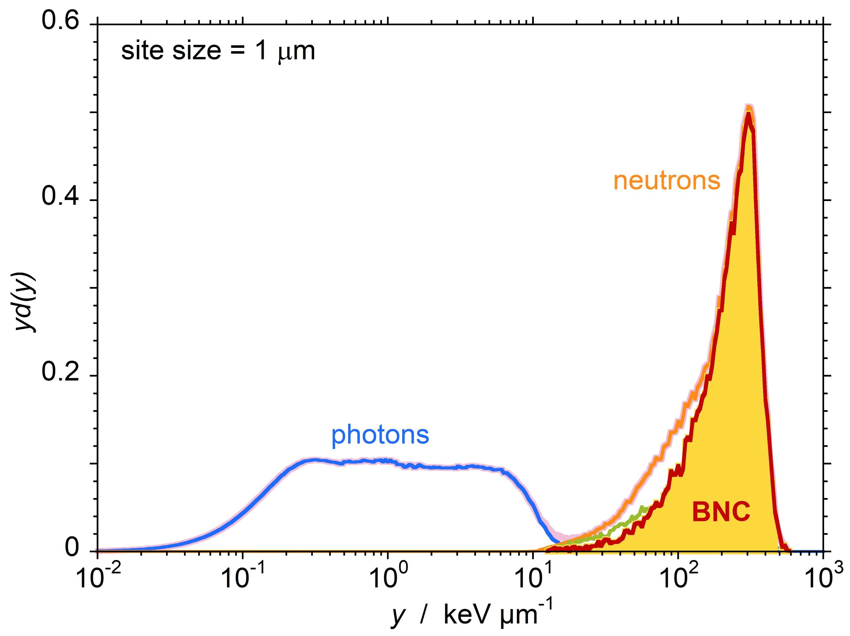
3 years-plan and possible applications
25 nm
2 nm
1-2 µm
10 µm
Challenge: internal microdosimetry for BNCT and targeted radiotherapy

