Slide 1
20 marzo: scadenza DB consuntivi
Oscar Adriani
https://web.infn.it/csn5/index.php/it/
Notes:
You can safely remove this slide. This slide design was provided by SlideModel.com – You can download more templates, shapes and elements for PowerPoint from http://slidemodel.com/

Slide 2
Agenda
9:00 Valeria Conte: General Introduction
ACCELERATORS
INTERDISCIPLINARY
DETECTORS ELECTRONICS
9:20 Cristian Pira
9:30 Marco Cavenago
9:40 Francesco Grespan
9:50 Mattia Manzolaro
10:00 Andrea Pisent
10:40 Esposito/ Cisternino
10:50 Alberto Andrighetto
11:00 Anna Bianchi
11:10 Oscar Azzolini
12:00 Sara Carturan
12:10 Davide De Salvador
12:20 Valentino Rigato
12:30 P.Antonini / G.Ruoso
10:10 Q.TIME DISCUSSION
11:20 DISCUSSION & COFFEE
12:40 Q. TIME DISCUSSION
14:00 Round table: perspectives and time-plan of Applied Physics at LNL

Slide 3
The experiments at LNL 2024
2−4 years experiments
ACCELERATORS / 5
INTERDISCIPLINARY / 5
DETECTORS ELECTRONICS / 7
ALPHA_DTL_BETA(+1)
HB2TF call (Mi)(+1)
HISOL
PLASMA4BEAM2(+2)
SAMARA
ADMIRAL(+1)
CUPRUM_TTD(+2)
DISCOVER22 (RM3)(+1)
EPISE (FE)(+2)
MUSICA
DIODE (RM2)
MANIFOLD (PV)
N3G call
OREO (BO)
PHYDES (PD)
QUANTEP call (RM2)
SHINE (BA)
79 people 47 LNL employees (include SPES)

Slide 4
The experiments at LNL 2024
2−4 years experiments
ACCELERATORS / 5
INTERDISCIPLINARY / 5
DETECTORS ELECTRONICS / 7
ALPHA_DTL_BETA(+1)
HB2TF call (Mi)(+1)
HISOL
PLASMA4BEAM2(+2)
SAMARA
ADMIRAL(+1)
CUPRUM_TTD(+2)
DISCOVER22 (RM3)(+1)
EPISE (FE)(+2)
MUSICA
DIODE (RM2)
MANIFOLD (PV)
N3G call
OREO (BO)
PHYDES (PD)
QUANTEP call (RM2)
SHINE (BA)
79 people 47 LNL employees (include SPES)

Slide 5
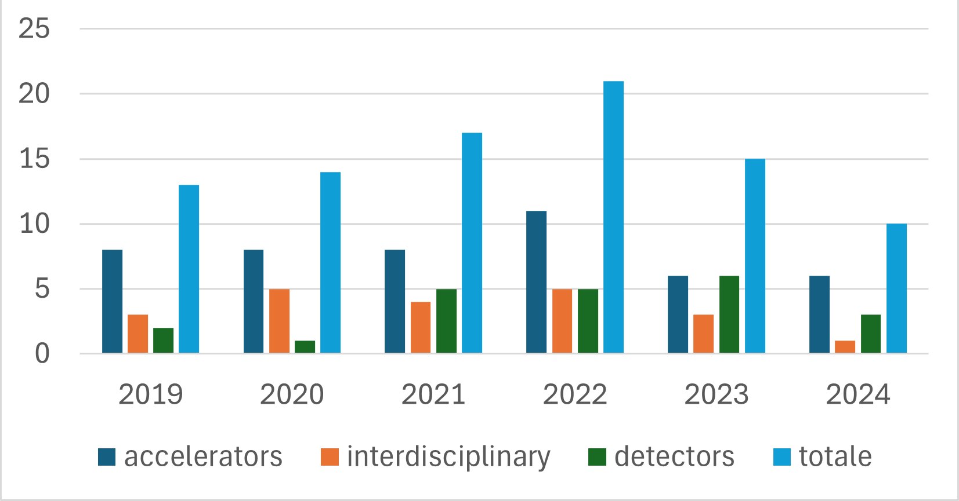
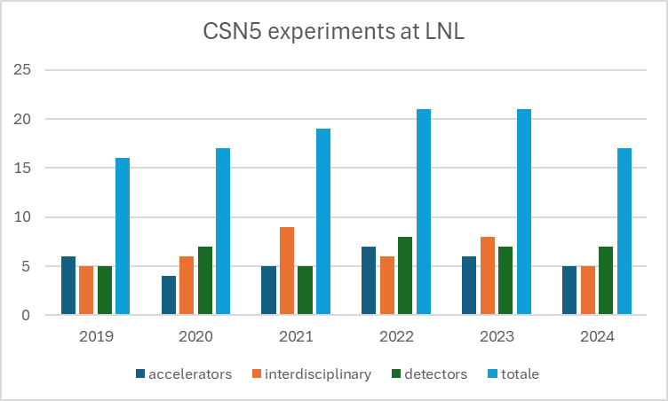
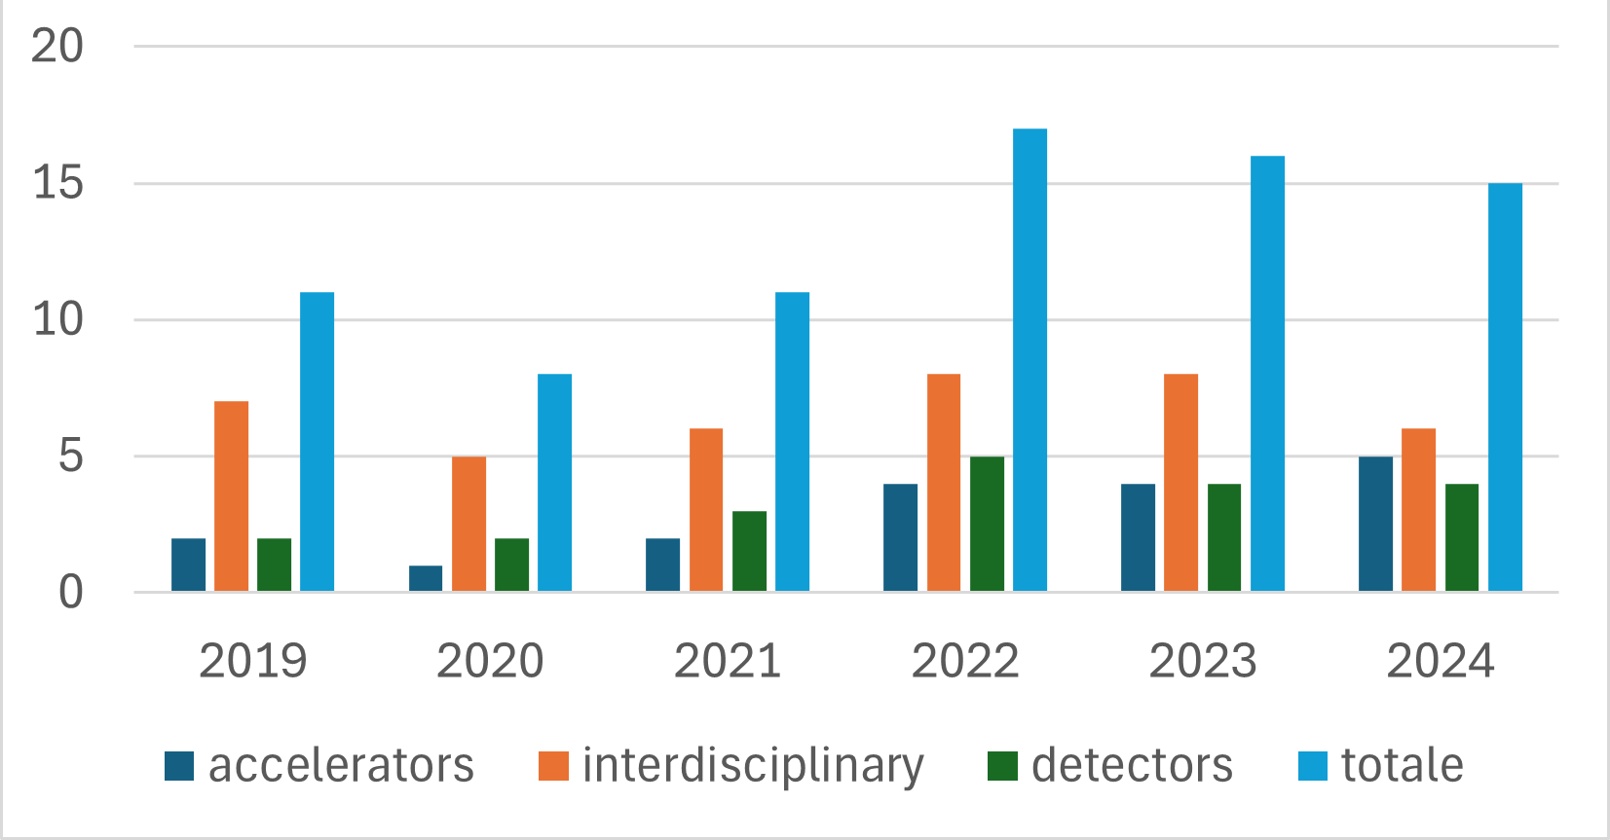
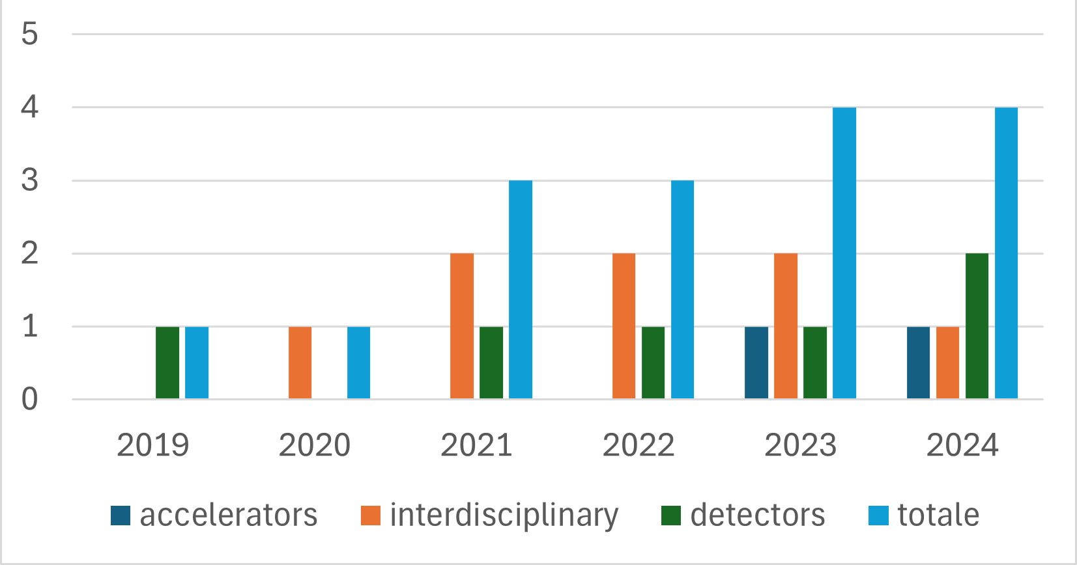
78 pers. 53 LNF
LNF
ACCELERATORS
INTERDISCIPLINARY
DETECTORS ELECTRONICS
79 pers. 47 LNL
79 pers. 25 LNS
LNS
17 pers. 8 LNGS
LNGS

Slide 6
Round table

Slide 7
perspectives and time-plan of Applied Physics at LNL
Ci sono attività con massa critica? Quale il loro futuro?
Linea di ricerca in radiobiologia.
CSN5 – Progetti esterni
Azioni di coordinamento e scambio di conoscenze (gr5 o div-ricerca).
Notes:
Alcune domande, non sono in ordine di priorità nè pretendono di essere esaustive.

