Slide 1
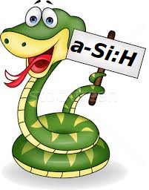
EB report
Roma, 15/03/2024

Slide 2
Under pubblication in journals
IEEE sensor journal (WP1 article on Batch 1(0))
JINST paper about SIENA conference accepted under pubblication
Syncrotron radiation journal. Marco’s paper under preparation
Nanomaterial paper in preparation from Maddalena + Francesca
Cinzia’s dosimetry paper in preparation

Slide 3
Under submission as proceedings
MeMeA summary just submitted
WP2 summary under preparation

Slide 4
Foreseen for the future
A paper on radiation damage with protons
A paper on radiation damage with neutrons
A summary paper on detector response to different beams
A paper on transient modelling
….
In a few days a new version of the authors list will be released

