Slide 1
Spin entanglement in time-dependent two-proton emission
Tomohiro Oishi
RIKEN Nishina Center, Nuclear Many-body Theory Laboratory
tomohiro.oishi@ribf.riken.jp

Slide 2
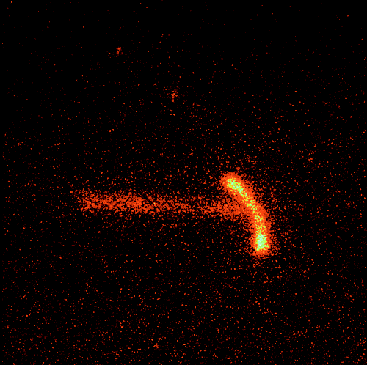
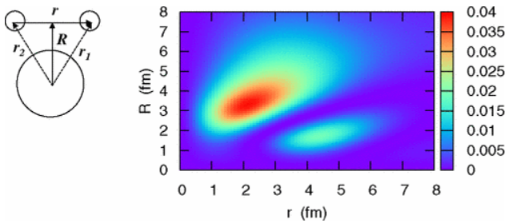
Two-proton (2p) radioactivity
Two-proton emission
Observed in 2000.
Radioactive decay by emitting two protons.
From the Z=even parent nuclei in the proton-rich side.
In the “true” 2p emission, so-called diproton correlation could exist.
Di-nucleon (S₁₂=0, T₁₂=1) correlation
Clustering of two neutrons or protons. Note that 2n/2p cannot be bound in vacuum.
By the nuclear pairing force around the surface of the core nuclei, i.e., in the dilute-density region.
Only theoretical predictions.
Are they entangled?
⁴⁵Fe
Expt. with time-projection chamber,
K. Miernik et al., PRL 99, 192501(2007).
In He-6, K. Hagino et al, PRL 99, 022506.

Slide 3
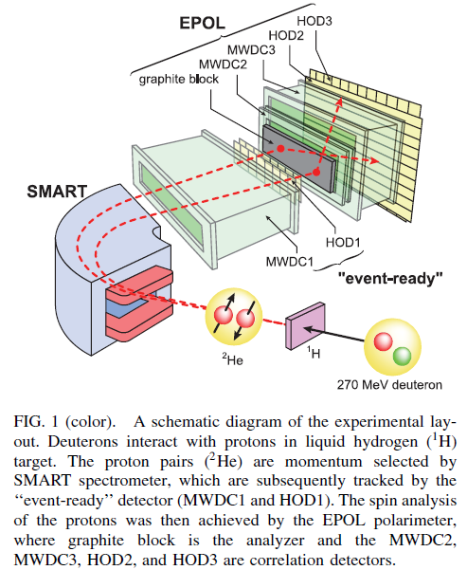
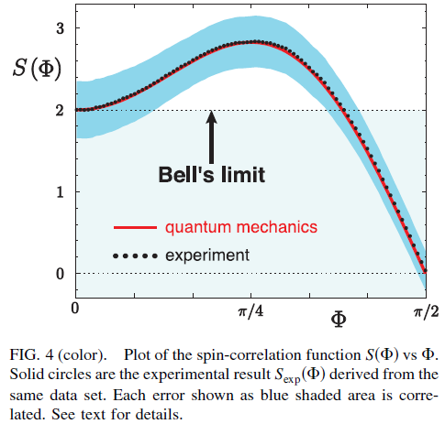
Can two nucleons become “entangled” ? → Yes.
H. Sakai et. al., Phys. Rev. Lett. 97, 150405 (2006):
Two protons in vacuum is shown to have the spin entanglement.

Slide 4
Motivation
Example of ⁶Be → ⁴He + 2p: TO, arXiv:2407.11136 (under review)
If the emitted two protons are in the spin-singlet state, a strong entanglement in terms of CHSH inequality is expected. Here CHSH inequality is one variant of Bell inequality.
Ref: J. F. Clauser, M. A. Horne, A. Shimony, and R. A. Holt, Phys. Rev. Lett. 23, 880 (1969).
This nuclear-spin entanglement can provide…
The first example of “natural entanglement”.
New probe to investigate the nuclear interaction and structure.
Identical-particle entanglement as the resource for quantum operations [B. Morris et. al., PRX 10, 041012 (2020)].
p
$$τ≅6.8$$
$$×{10}^{−21}[s]$$
α
p
$$|\left.pp\right\rangle ≅\frac{|\left.↑↓\right\rangle −|\left.↓↑\right\rangle }{\sqrt{2}}⟹S_{CHSH}≥2$$

Slide 5
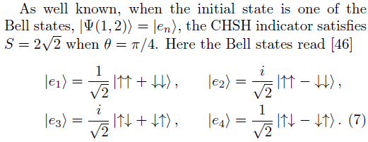
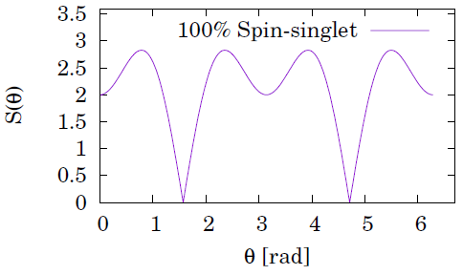
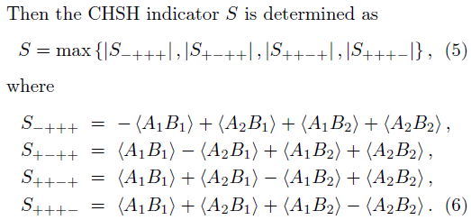
CHSH examination for ⁶Be = ⁴He + 2p
p
$$τ≅6.8$$
$$×{10}^{−21}[s]$$
Alice and Bob measure one proton’s spin independently:
α
p
Four options of spin-correlation measurement are used:
$$|\left.pp\right\rangle ≅\frac{|\left.↑↓\right\rangle −|\left.↓↑\right\rangle }{\sqrt{2}}⟹S_{CHSH}≥2$$

Slide 6
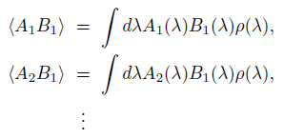
Quantum mechanics V.S. Local-hidden-variable (LHV) theory
If the local-hidden-variable (LHV) theory exists,
Therefore,
Note that
However, in many experiments, S_{CHSH} > 2 has been confirmed: the LHV theory is shown as “phantom”.
Ref: J. S. Bell, “Speakable and Unspeakable in Quantum Mechanics”, Collected Papers on Quantum Philosophy (Cambridge University Press, Cambridge, UK, 2004).

Slide 7
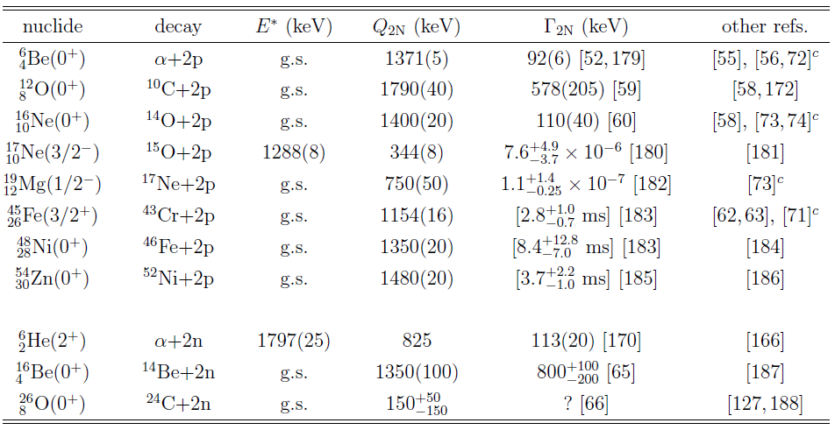
Experimental search for 2p & 2n emitters
2p-emitting decay
Found for even-Z nuclei beyond the proton-drip line.
Three-body quantum-mechanical problem.
The simplest case of multi-particle resonance state with quantum-tunneling effect.
Methods of study
Invariant mass
Implantation and decay
In-flight decay
Today’s talk.
And more to be found in the future RIBF(!?)
TO, Ph.D. Thesis (2014): https://arxiv.org/abs/2303.10529

Slide 8
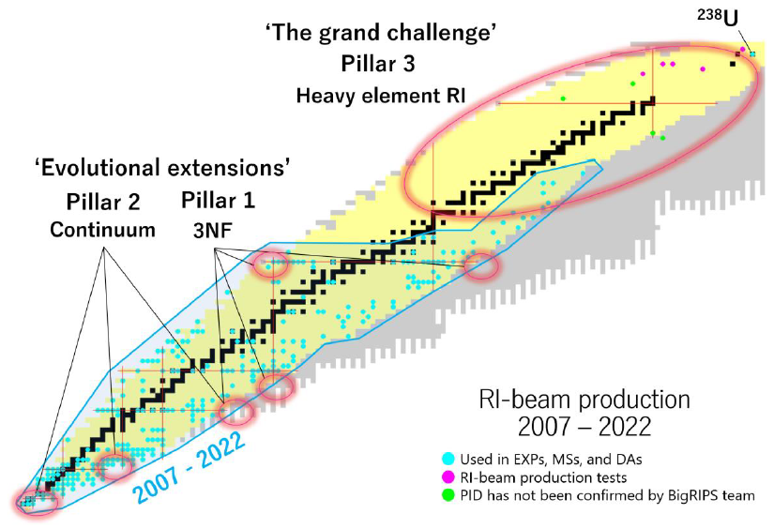
New 2p emitters expected in the future RIBF
https://www.nishina.riken.jp/researcher/RIBFupgrade/index_e.html
In “RIBF Facility Upgrade Project”,
[Page 12, Section 2.2.3] The proton-rich nuclei with heavier masses delivered by RIBF has the potential to open new era of modern nuclear physics.
[Page 38, Section 4.2.1] At the proton rich side, about 110 isotopes are produced by the projectile fragmentation reaction of the ²³⁸U beam. Another 20 are produced from other primary beams, such as ¹²⁴Xe or ⁷⁰Zn. The majority of new isotopes (210) are thus concentrated in the high Z region from Z = 70 to 92.

Slide 9
⁶Be = ⁴He + 2p
Time-dependent three-body model calculations for 2p emission:
E [MeV]
$$J^{π}=\text{3/}{\text{2}}^{−}$$
$$E=\text{1.96}(5) \\ Γ≈\text{1.5}$$
2.0 -
Core-proton potential is adjusted to reproduce these 1p-energy and width.
$$J^{π}=0^{+}$$
$$E=\text{1.37} \\ Γ=\text{0.092}(6)$$
1.0 -
2p
NOTE: there is not the “intermediate resonance” in ⁵Li, and thus, the sequential 1p-1p emission is suppressed.
⁶Be
⁵Li
⁴He

Slide 10
Potentials used in this three-body model
Hamiltonian:
Core-nucleon potential V(r) = Woods-Saxon + Coulomb adjusted to reproduce the energy levels of the core-nucleon subsystem.
Proton-proton potential:
Vacuum term reproduces the pp scattering in vacuum.
Additional term = density-dependent contact force to reproduce Q_{2p}.
$${\vec{r}}_{1}$$
$${\vec{r}}_{2}$$

Slide 11
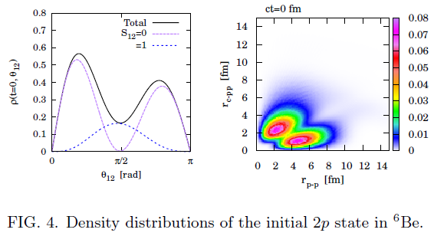
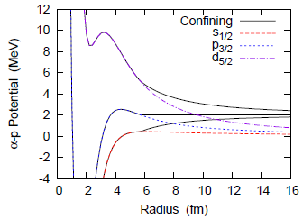
Initial setting of 2p confined in ⁶Be
$${\vec{r}}_{1}$$
$${\vec{r}}_{2}$$
$$r_{c−pp}$$
V_{C}(r) ⬅ 1p-resonance of ⁵Li
v_{pp}(r₁₂) ⬅ Vacuum p-p scat. & Q_{2p} = 1.37 MeV
For fixing the t=0 state, the V_{C}(r) potential is modified (confining method):
$$θ_{12}$$
$$r_{p−p}$$
Then the time development is computed:

Slide 12
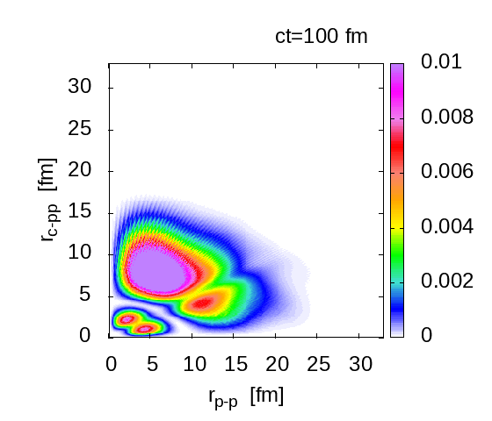
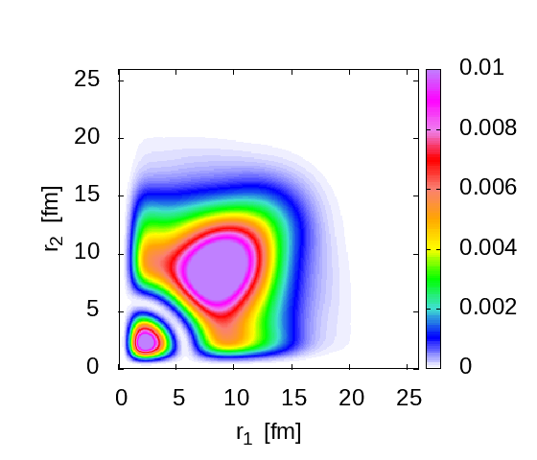
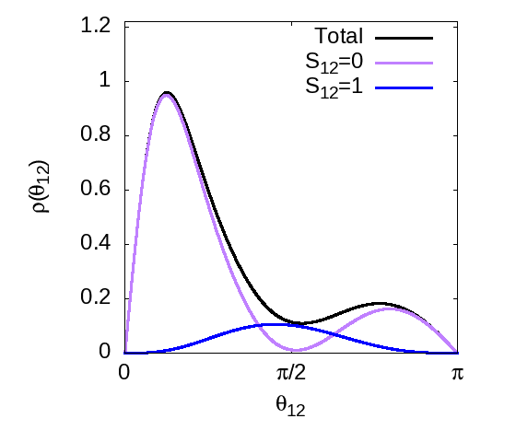
Time-dependent calculations for 2p emission
Example of ⁶Be → ⁴He + 2p: TO, arXiv:2407.11136 (under review)
Two protons are confined at t=0 around the core → This decaying state represents the out-going state = 2p emission.
$$r_{c−pp}$$
$${\vec{r}}_{1}$$
$$r_{p−p}$$
$$θ_{12}$$
$${\vec{r}}_{2}$$
θ₁₂ = opening angle between 2p

Slide 13
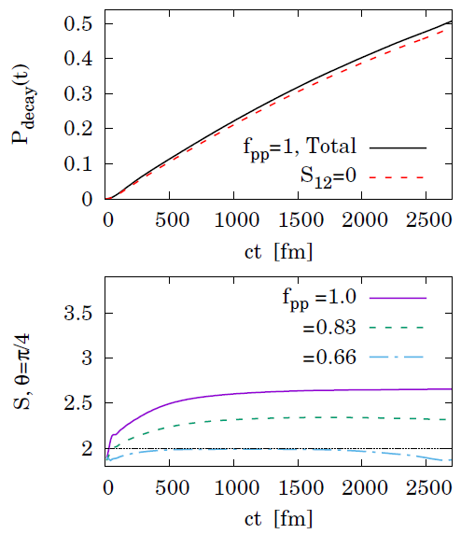
Time-dependent calculations for 2p emission
Example of ⁶Be → ⁴He + 2p: TO, arXiv:2407.11136 (under review)
➔ A spin correlation beyond the LHV-theory limit is predicted. ➔ This correlation is sensitive to the 2p interaction.

Slide 14
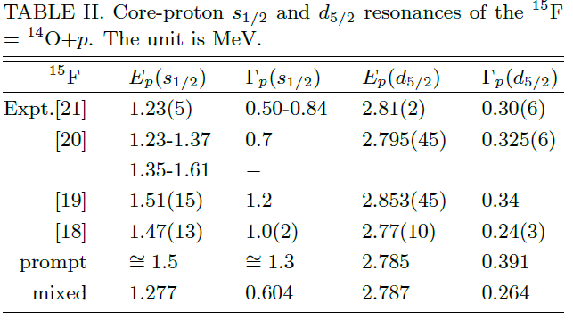
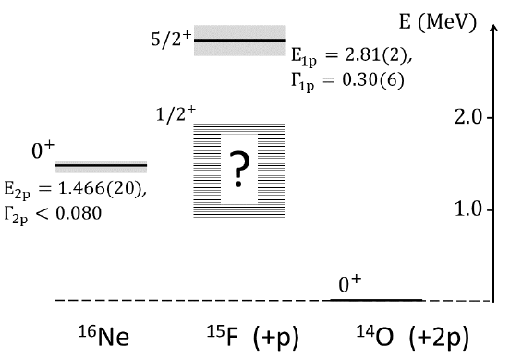
¹⁶Ne = ¹⁴O + 2p
Core-proton potential is adjusted to reproduce these 1p-energy and width.
If the intermediate s_{1/2} resonance in ¹⁵F exists, the sequential 1p-1p emission can take place.

Slide 15
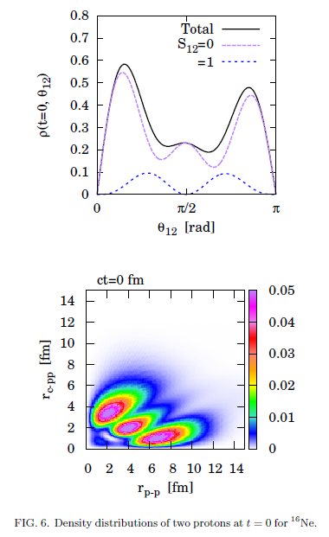
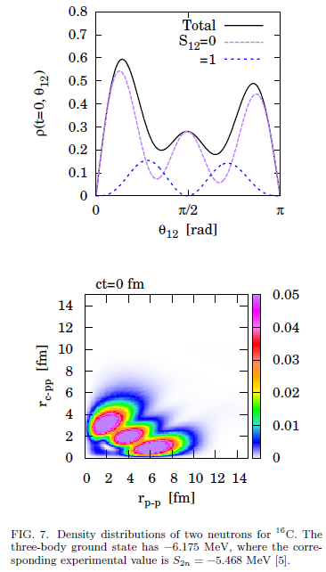
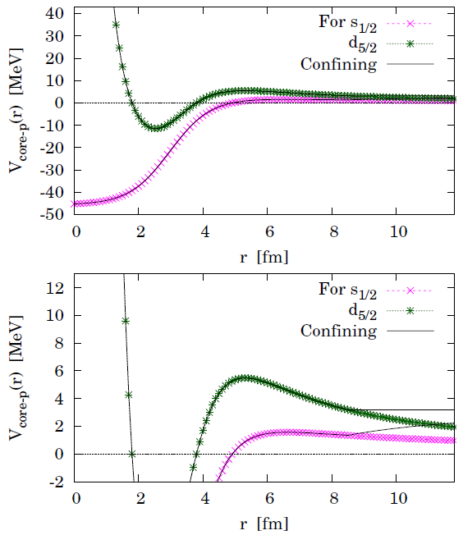
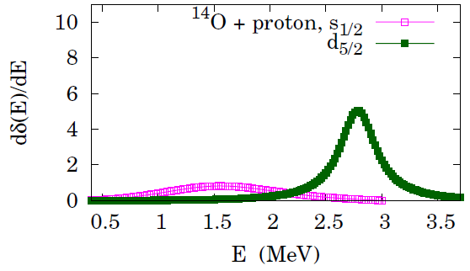
¹⁶Ne = ¹⁴O + 2p: initial state
Preliminary
Initial 2p state is fixed with the confining potential.
¹⁶Ne = ¹⁴O +2p (unbound)
¹⁶C = ¹⁴C +2n (bound)

Slide 16
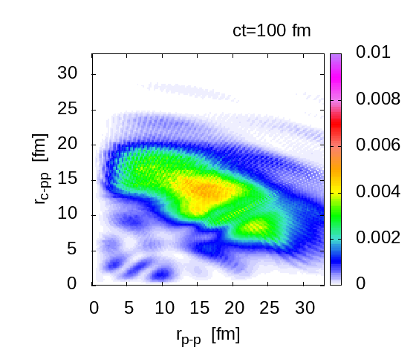
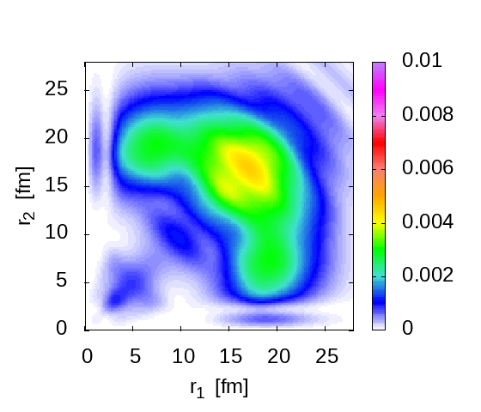
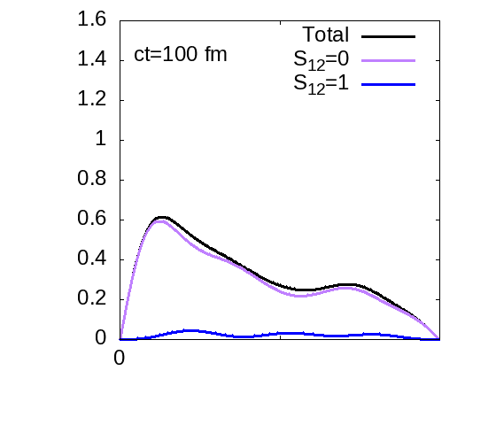
¹⁶Ne = ¹⁴O + 2p: time evolution
Preliminary
Two protons are confined at t=0 around the core → This decaying state represents the out-going state = 2p emission.
$${\vec{r}}_{1}$$
$$r_{c−pp}$$
$$r_{p−p}$$
$$θ_{12}$$
$${\vec{r}}_{2}$$
θ₁₂ = opening angle between 2p

Slide 17
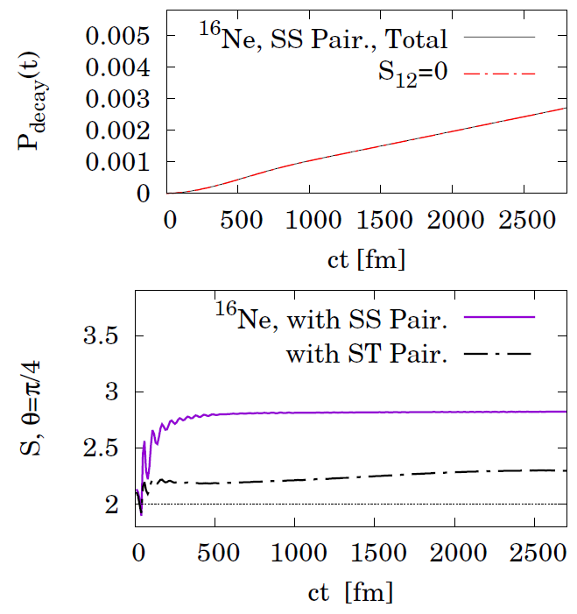
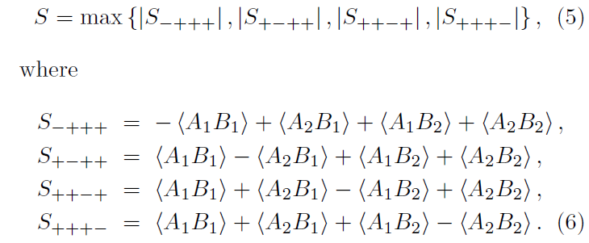
¹⁶Ne = ¹⁴O + 2p: spin correlation
Preliminary
¹⁶Ne (0⁺) | E_{2p} [MeV] | Γ_{2p} [MeV] | S_{CHSH}
This work (SS) | 1.404 | 1.4 x 10⁻⁴ | 2.81
Expt. | 1.466(20) | (< 0.08) | ?
➔ A spin correlation beyond the LHV-theory limit is predicted. ➔ This correlation is sensitive to the 2p interaction. [SAME to ⁶Be]

Slide 18
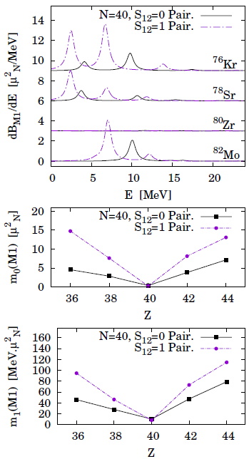
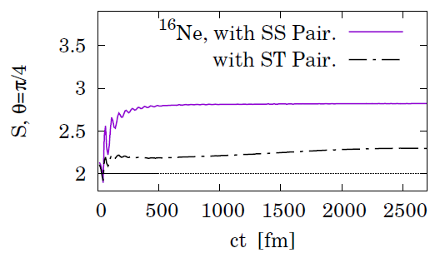
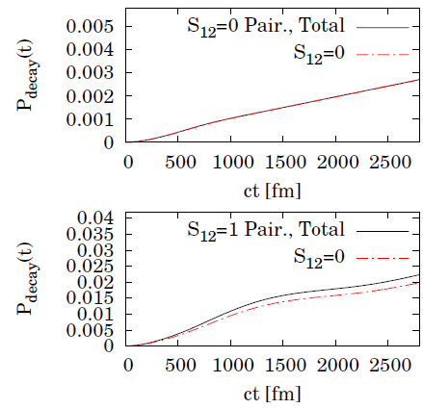
M1 excitation and spin correlation with S₁₂=0/1 pairing models
With the S₁₂=0 (S₁₂=1) pairing models,
M1 excitation gets reduced (enhanced);
Spin correlation gets enhanced (reduced);
in the proton-rich region.
preliminary

Slide 19
Summary
With the time-dependent 3-body model, a strong spin correlation (S>2) in 2p emissions is suggested.
⁶Be (0⁺) | E_{2p} [MeV] | Γ_{2p} [MeV] | S_{CHSH} | Type
This work | 1.356 | 0.055 | 2.65 | True 2p
Expt. (1991Selov) | 1.372(5) | 0.092(6) | ? | True 2p
¹⁶Ne (0⁺) | E_{2p} [MeV] | Γ_{2p} [MeV] | S_{CHSH} | Type
This work | 1.404 | 1.4 x 10⁻⁴ | 2.81 | True + Seq. 2p
Expt. (2014Brown) | 1.466(20) | (< 0.08) | ? | True 2p
Future interests:
Other kinds of entanglement, e.g., by the Shannon/von-Neumann entropy: how to measure it in nuclei?
Other, heavier 2p emitters. After the future upgrade of RIBF, new 2p emitters can be observed. Is S_{CHSH}>2 common for them? If yes, is it from the same origin, e.g. the nuclear force inside nuclei?
2n emitters. Does the same conclusion (S_{CHSH}>2) apply to them?
Comparison with pp/nn (identical-particle) and pn (distinguishable-particle) entanglements.
Applications, including (i) quantum tomography of atomic nuclei, (ii) entangled-2p beam, (iii) quantum teleportation and cryptography, etc.

Slide 20
Back Up

Slide 21
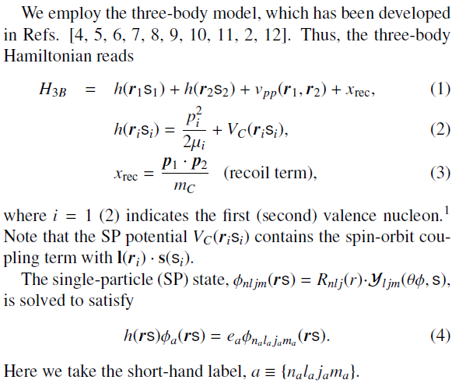
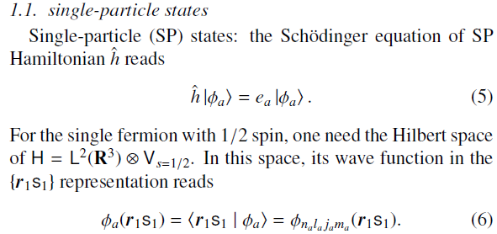
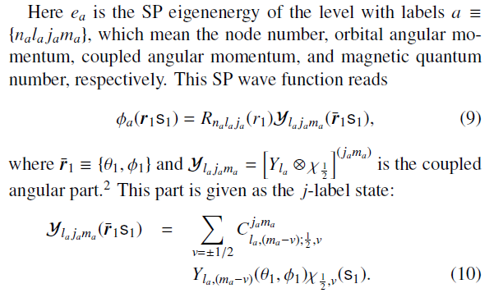
Formalism

Slide 22
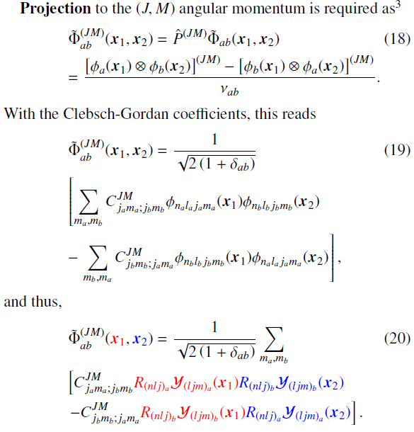
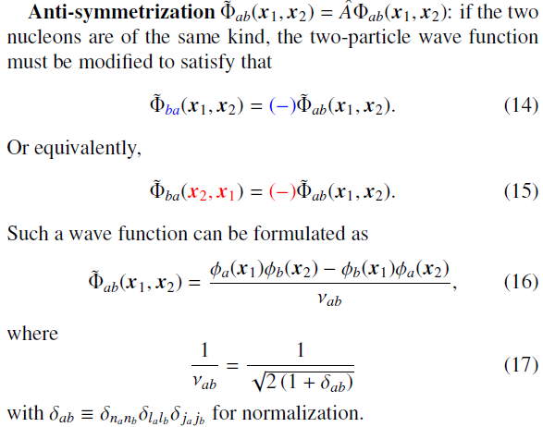
Formalism

Slide 23
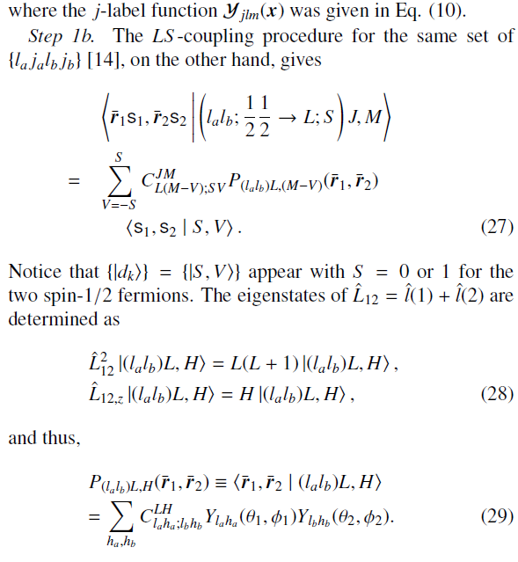
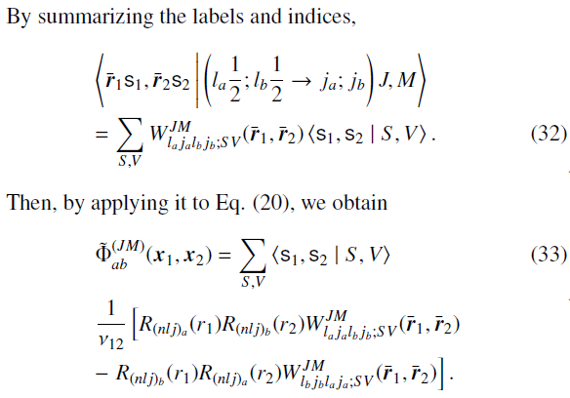
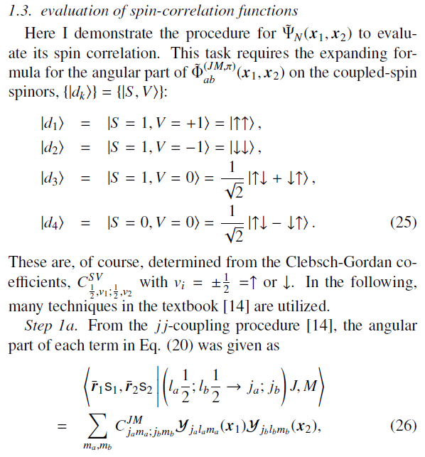
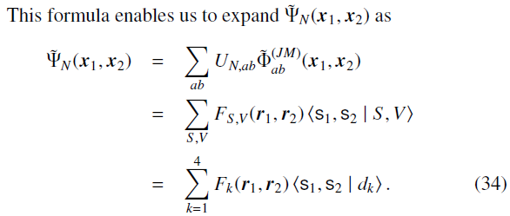
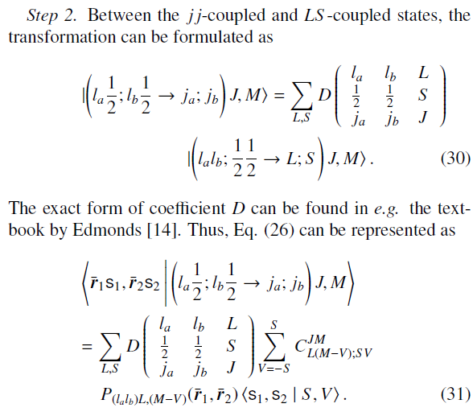
Formalism

Slide 24
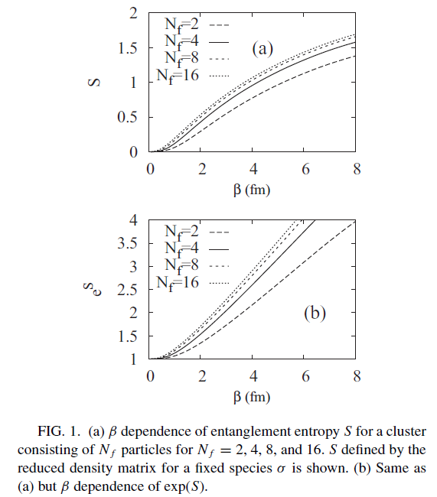
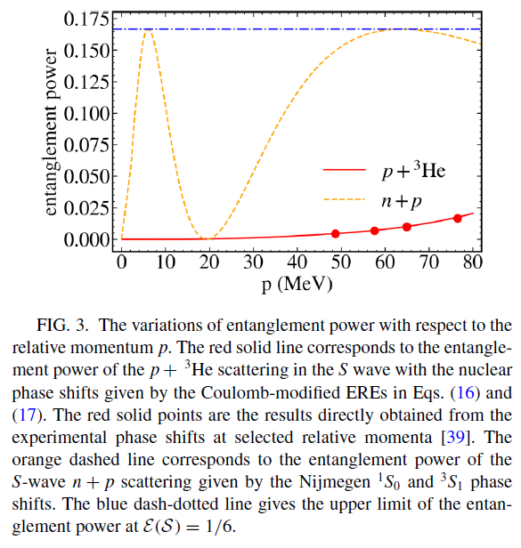
Quantum entanglement in nuclear systems
Y. Kanada-En’yo, Phys. Rev. C. 91, 034303 (2015).
D. Bai and Z. Ren, Phys. Rev. C. 106, 064005 (2022).

Slide 25
Summary
Pillar 2: How do nuclear many body systems get organized in continuum?
For nuclear superfluidity (Cooper pairing), M1 excitation, spin correlation, entanglement, etc., the new proton-rich nuclei produced in future RIBF can provide a nice testing field.
↓
Knowledge obtained there may help us to widely explore the nuclear chart, and to drive the quantum science based on the atomic nuclei.

Slide 26
Three pillars in the future upgrades of RIBF
https://www.nishina.riken.jp/researcher/RIBFupgrade/index_e.html
Pillar 1: How does the three body force organize nuclear many body systems?
Pillar 2: How do nuclear many body systems get organized in continuum?
Pillar 3: Heavy element RIs under an extraordinarily high Coulomb field.

Slide 27
Key question
T.O., and N. Paar, Phys. Rev. C 100, 024308 (2019); T.O., G. Kruzic, and N. Paar, Eur. Phys. J. A 57, 1-7 (2021); N. Hinohara, T.O., and K. Yoshida, Phys. Rev. C 109, 034302 (2024).
Which mode of the nuclear Cooper pairing is dominant?
S₁₂=0
Like BCS coupling for electrons
S₁₂=1
Like Helium-3 superfluidity
OR/AND
Usually S₁₂=0 is considered, but without a direct measurement. No hopes for S₁₂=1 mode?
➔ Spin correlation in 2p emitters can give the hint.

