Slide 1



The experiments on VEPP-2000
e⁺e⁻ collider in Novosibirsk
Vassili Kazanin
(for CMD-3 collaboration)
Budker Institute of Nuclear Physics,
SB RAS, Novosibirsk, Russia
Pisa, September 2011

Slide 2
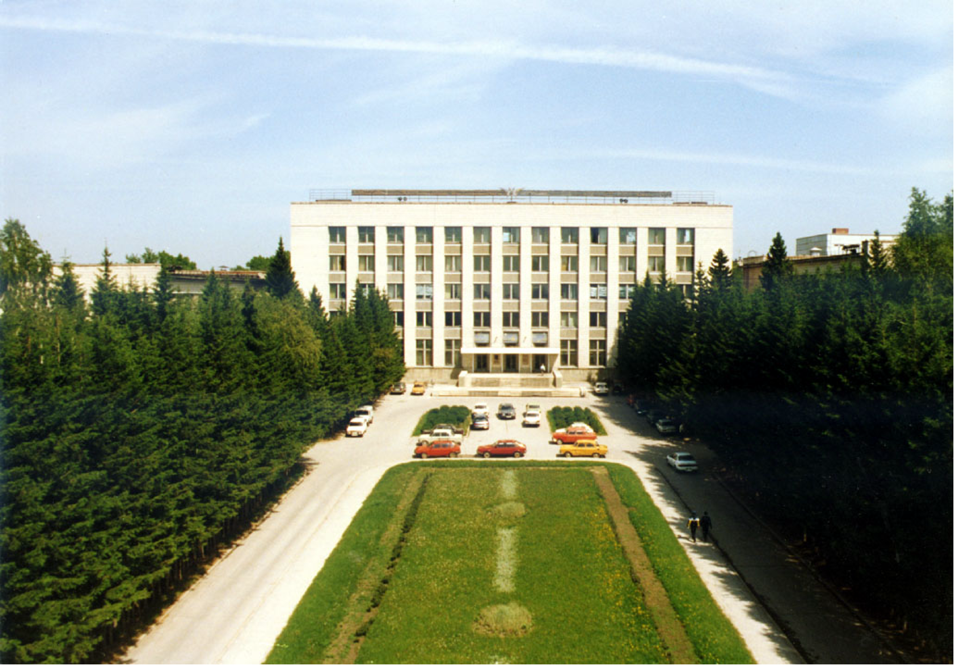
  OUTLINE
  1 - VEPP-2000 collider, motivation, construction, performance
  2 - Physics program
  3 - SND and CMD-3 detectors
  4 – first preliminary results
  5 – status of (g-2)/2 calculations

Slide 3
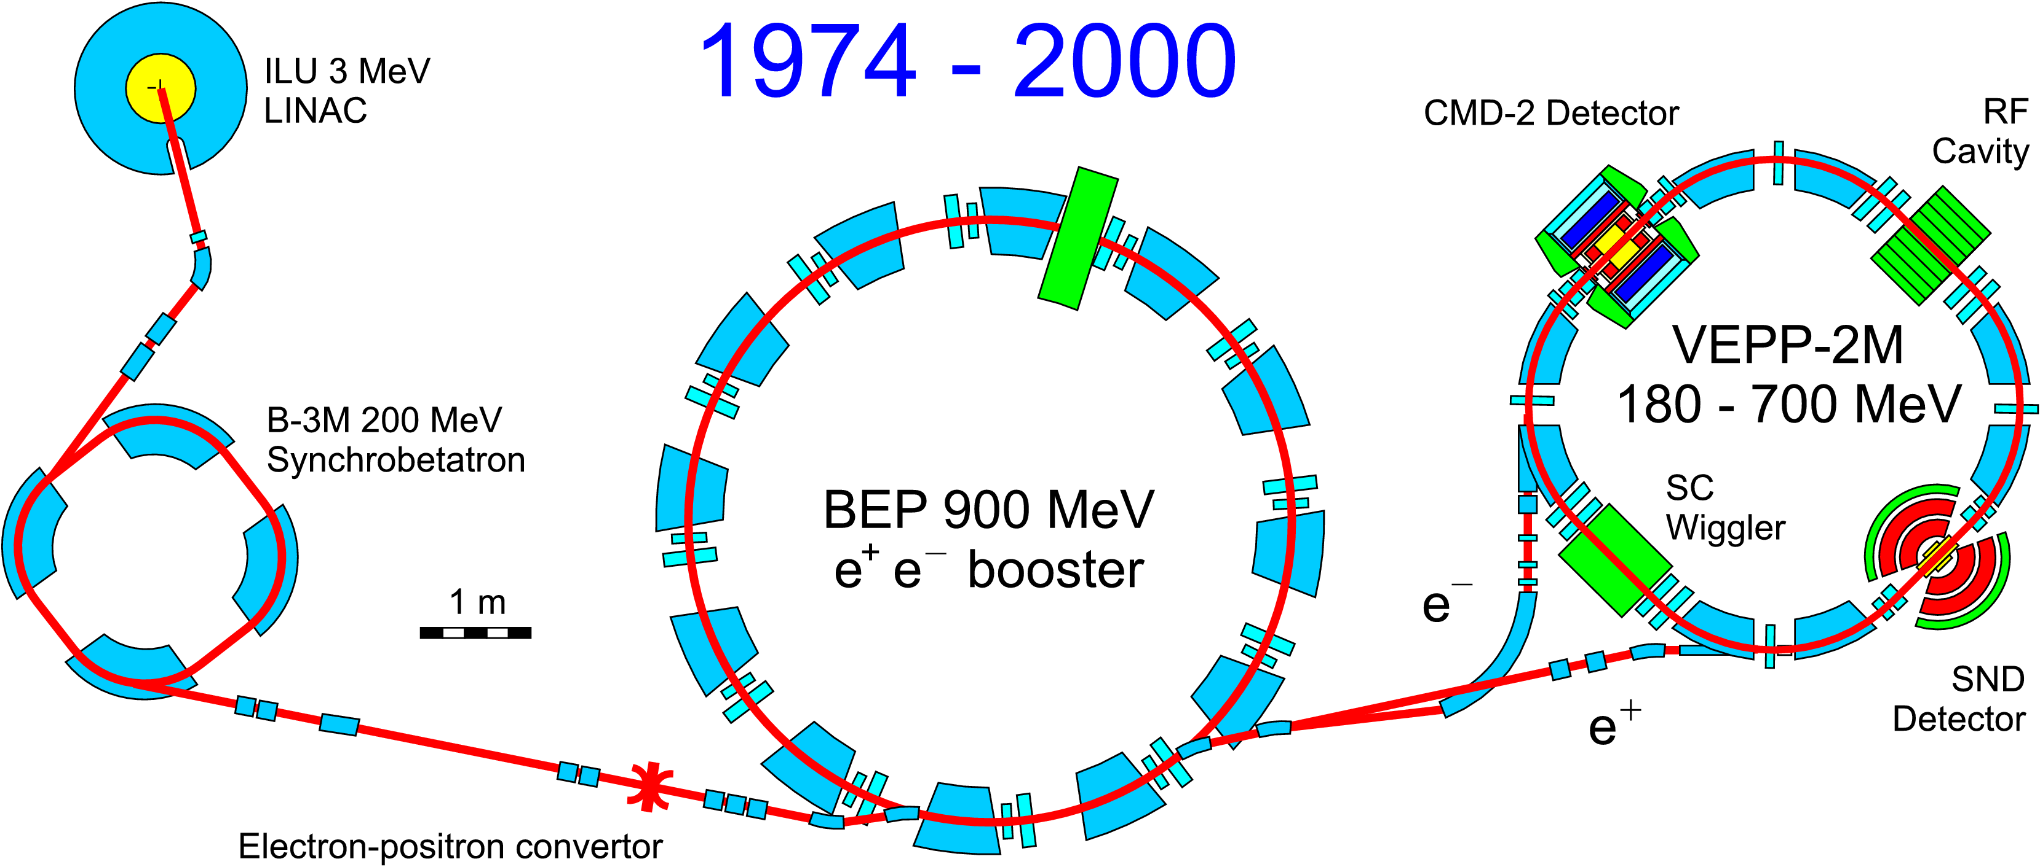
VEPP-2M collider complex
(1974-2000)
High luminosity: L=3×10³⁰ cm⁻²s⁻¹:
Energy range 360 – 1400 MeV
Method of resonant depolarization – precise value of energy beam
mass measurements
e⁺e⁻ anomalous magnetic moment comparison (10⁻¹¹)

Slide 4
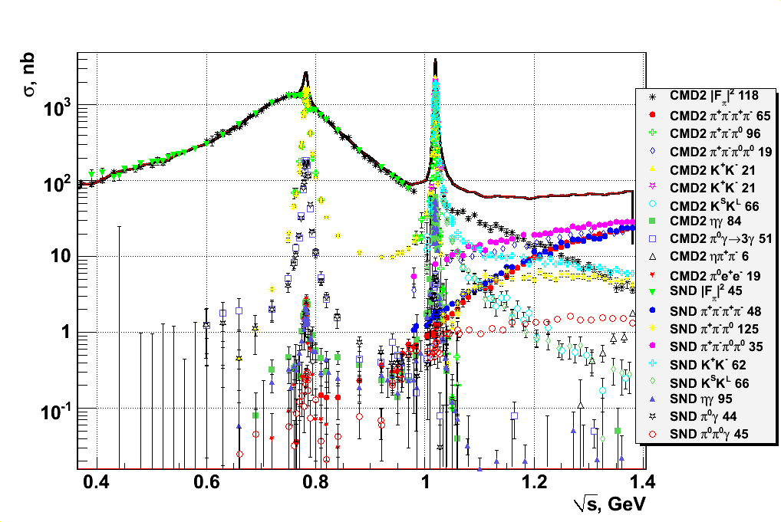
Overview of VEPP-2M results
1-5% systematic error for major channels

Slide 5
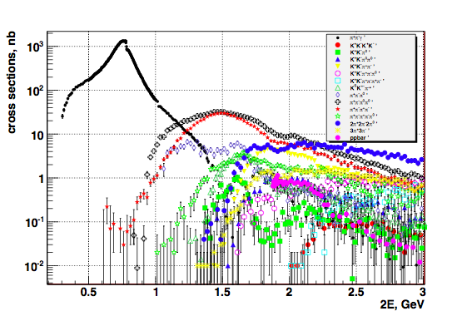
More BaBar data are available
New VEPP-2000 region
1-5% systematic
errors
to obtain R in the energy range 1-2 GeV the processes
π⁺π⁻3π⁰, π⁺π⁻4π⁰, K⁺K⁻, K_{S}K_{L}, K_{S}K_{L}ππ, K_{S}K⁺ π⁻π⁰
remain to be measured

Slide 6
VEPP-2M VEPP-2000
(2000-2007)
ILU
3 MeV
RF cavity
Linac
CMD
-2
–+
e,e
B
-3M
VEPP-2M
200 M
eV
BEP
SC
–+
synchro-
e,e
wiggler
betatron
booster
900 M
eV
e
–
SND
e
+
180–700 M
eV
–
→
+
ee
convertor

Slide 7
VEPP-2M VEPP-2000
(2000-2007)
ILU
CMD
-3
3 MeV
Linac
VEPP-2000
B
-3M
200 M
eV
BEP
–+
synchro-
e,e
betatron
booster
900 M
eV
SND
2 m
2 m
–
→
+
ee
convertor
♦ E ≈ 1 GeV (per beam)
♦ L ≈ 1×10³² cm⁻² sec⁻¹ (1×1 bunch)

Slide 8
Round beams design
Bunch-by-bunch luminosity
Round Beams:
Geometric factor (gain=4)
Beam-beam limit enhancement (gain~4)
revolution time – 82 ns
beam current – 200 mA
beam length – 3.3 c
energy spread – 0.7 MeV
circumference – 24.4 m
beta function in IP β_{x}= β_{z} =4.3 cm
L = 10³² cm⁻²s⁻¹ at 2E=2.0 GeV
L = 10³¹ cm⁻²s⁻¹ at 2E=1.0 GeV
Integrated luminosity ~ 100 pb⁻¹ per detector/year
Total integrated luminosity with all detectors on VEPP-2M ~ 70 pb⁻¹

Slide 9
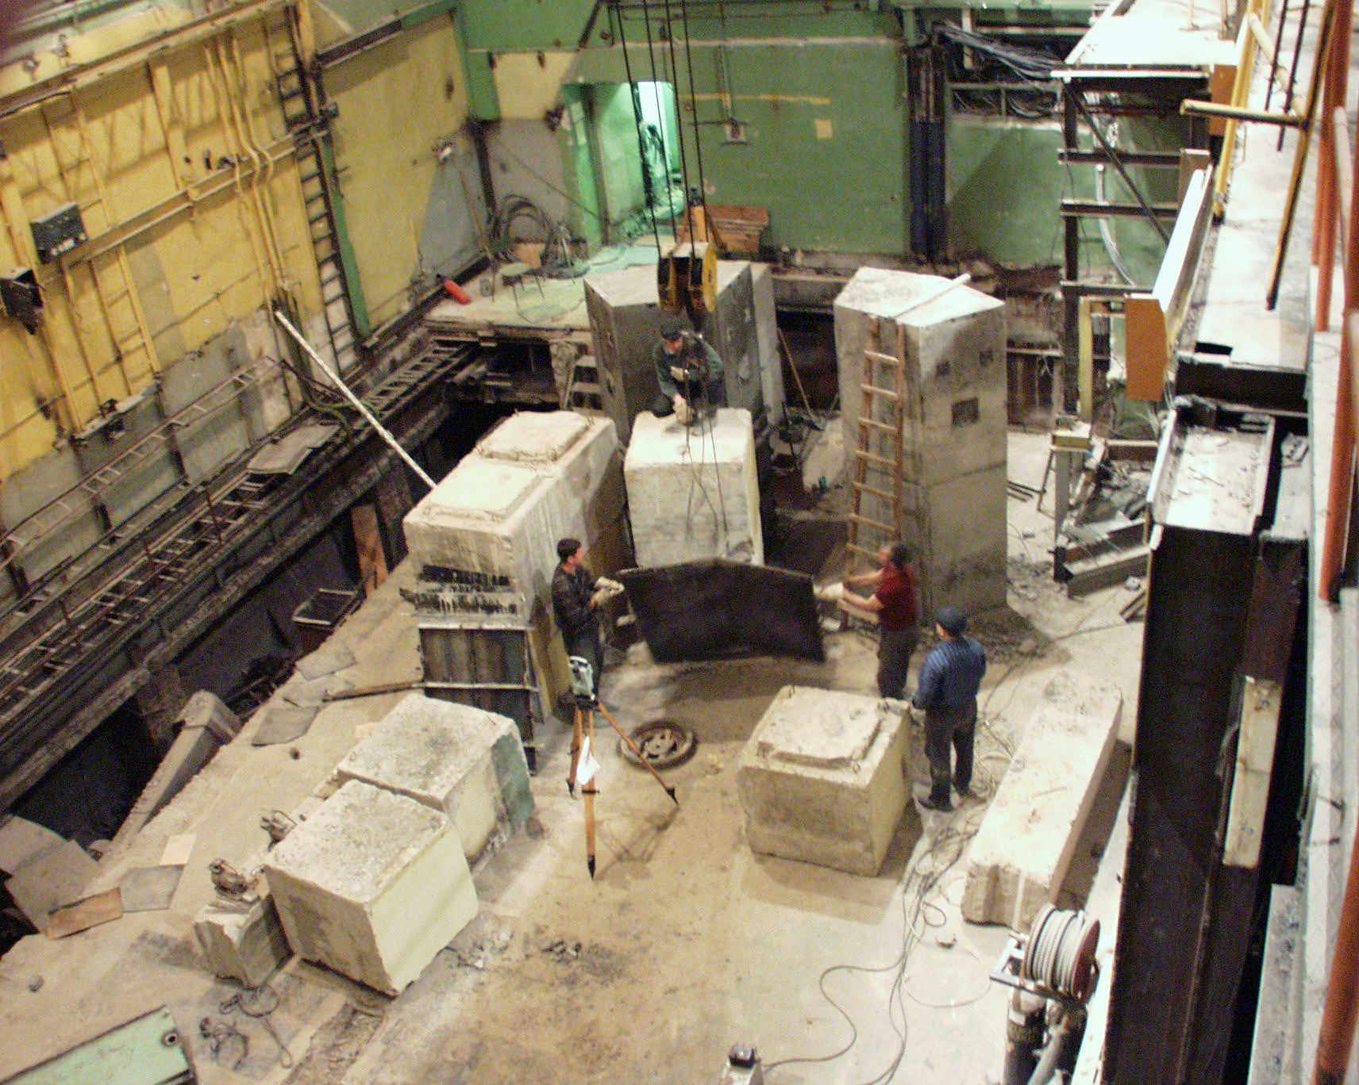
First “mile stones” of VEPP-2000
(14.05.2001)

Slide 10
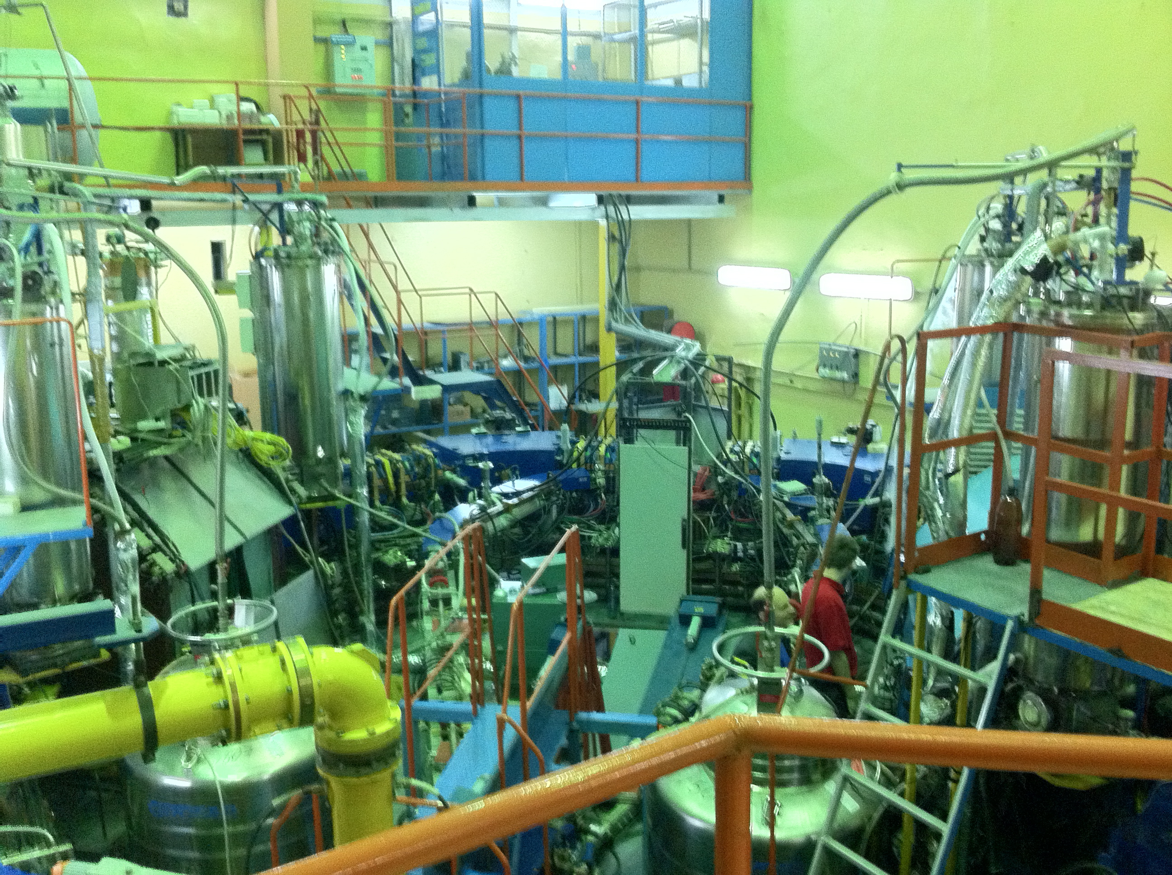
NOW

Slide 11
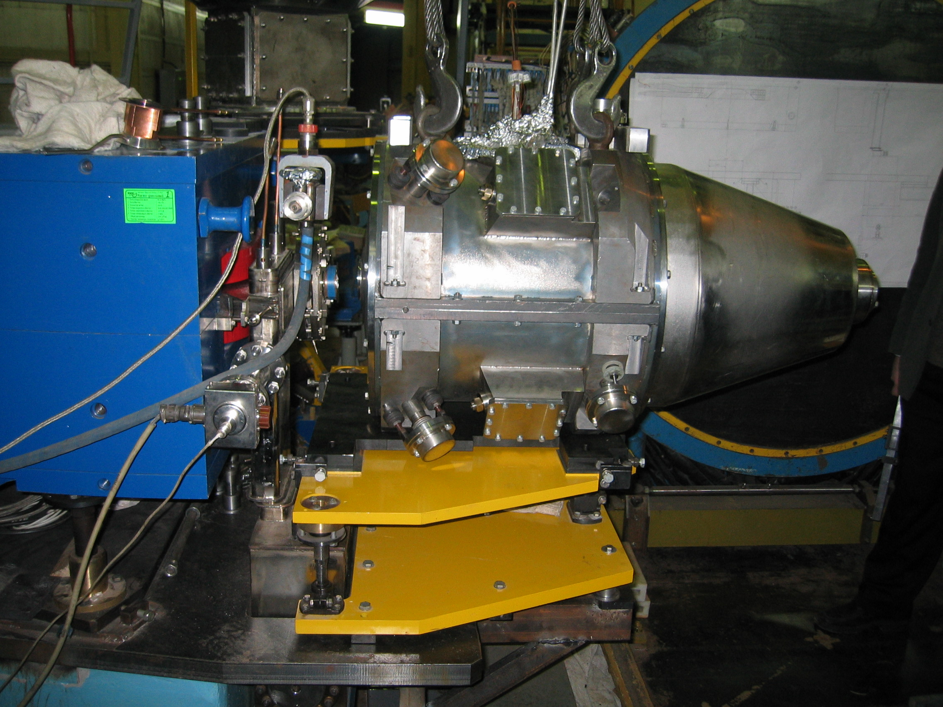
Solenoid 13.0 T at VEPP-2000

Slide 12
Solenoid 13.0 T at VEPP-2000
Project value of the LHe consumption 3.5 l/h was achieved

Slide 13
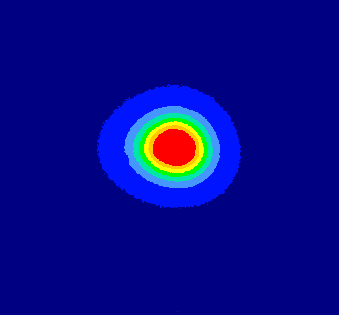
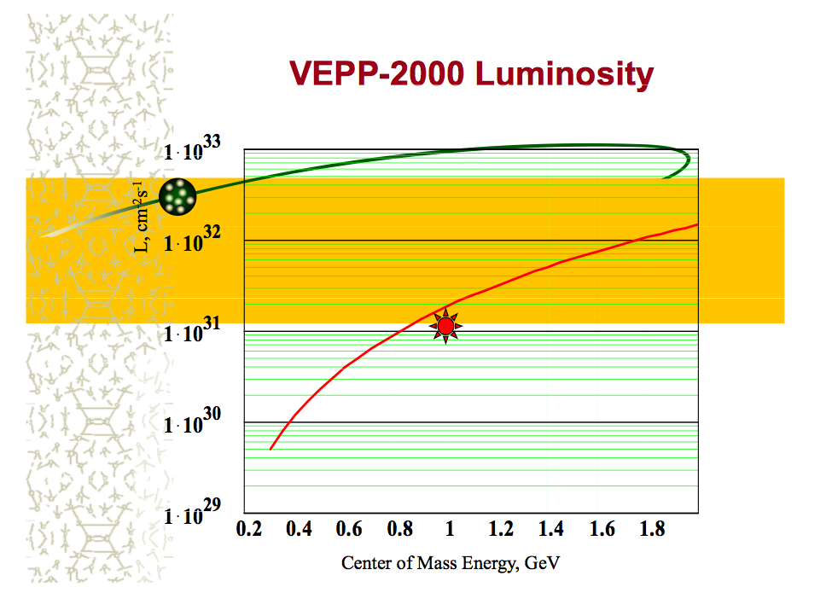
Round beams
#1 (1M2)
#1
Experimentally achieved
Positrons limited

Slide 14
Physics program at VEPP-2000
1. Precise measurement of the quantity
R=σ(e+e⁻⁻ > hadrons)/ σ(e+e⁻⁻>μ+μ⁻⁻) – GOAL <1% systematic for major channels (now 1 – 5 %)
2. Study of hadronic channels:
e+e⁻⁻ > 2h, 3h, 4h …, h= π,K,η
3. Study of ‘excited’ vector mesons: ρ’, ρ’’, ω’, ϕ’,..
4. CVC tests: comparison of e+e⁻ -> hadr. (T=1)
cross section with τ-decay spectra
5. Study of nucleon-antinucleon pair production –
nucleon electromagnetic form factors,
search for NNbar resonances, ..
6. Hadron production in ‘radiative return’
(ISR) processes
7. Two photon physics
8. Test of the QED high order processes 2->4,5
Two detectors have been build for the study

Slide 15
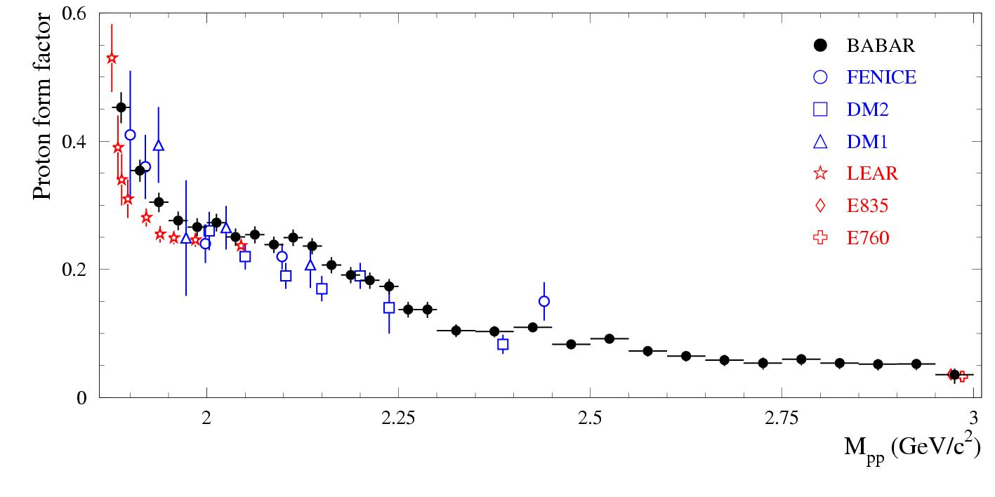
Physics program at VEPP-2000
1. Precise measurement of the quantity
R=σ(e+e⁻⁻ > hadrons)/ σ(e+e⁻⁻>μ+μ⁻⁻) – GOAL <1% systematic for major channels (now 1 – 5 %)
2. Study of hadronic channels:
e+e⁻⁻ > 2h, 3h, 4h …, h= π,K,η
3. Study of ‘excited’ vector mesons: ρ’, ρ’’, ω’, ϕ’,..
4. CVC tests: comparison of e+e⁻ -> hadr. (T=1)
cross section with τ-decay spectra
5. Study of nucleon-antinucleon pair production –
nucleon electromagnetic form factors,
search for NNbar resonances, ..
6. Hadron production in ‘radiative return’
(ISR) processes
7. Two photon physics
8. Test of the QED high order processes 2->4,5
< vepp2000>
Two detectors have been build for the study

Slide 16
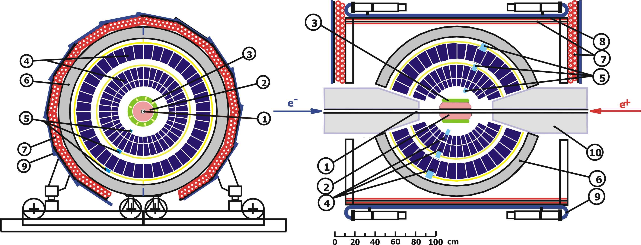
Spherical Neutral Detector
1 – VEPP-2000 vacuum chamber, 2 – tracking system,
3 – aerogel counters, 4 – electromagnetic calorimeter NaI(Tl), 5 – vacuum phototriodes, 6 – absorber, 7-9 – muon system,
10 – VEPP-2000 phocusing solenoid

Slide 17
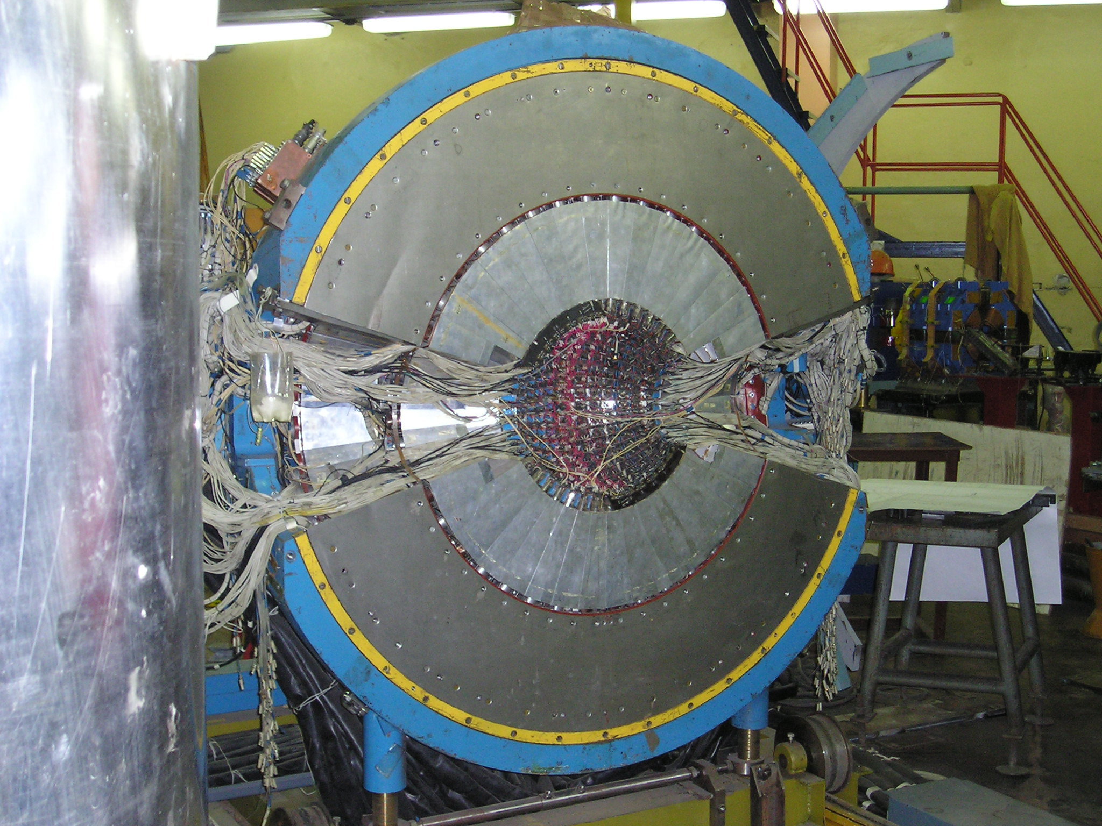
Spherical Neutral Detector
1 – VEPP-2000 vacuum chamber, 2 – tracking system,
3 – aerogel counters, 4 – electromagnetic calorimeter NaI(Tl), 5 – vacuum phototriodes, 6 – absorber, 7-9 – muon system,
10 – VEPP-2000 phocusing solenoid

Slide 18
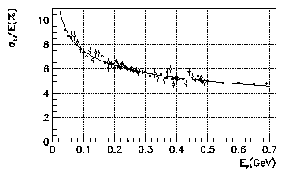
Spherical Neutral Detector
Energy resolution
1 – VEPP-2000 vacuum chamber, 2 – tracking system,
3 – aerogel counters, 4 – electromagnetic calorimeter NaI(Tl), 5 – vacuum phototriodes, 6 – absorber, 7-9 – muon system,
10 – VEPP-2000 phocusing solenoid

Slide 19
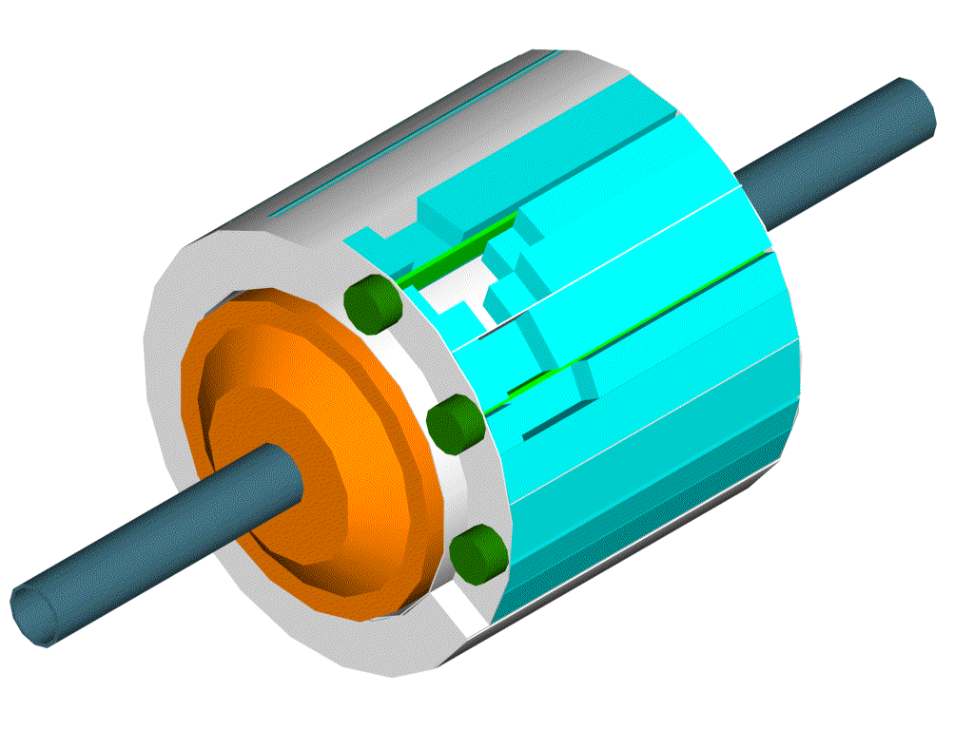
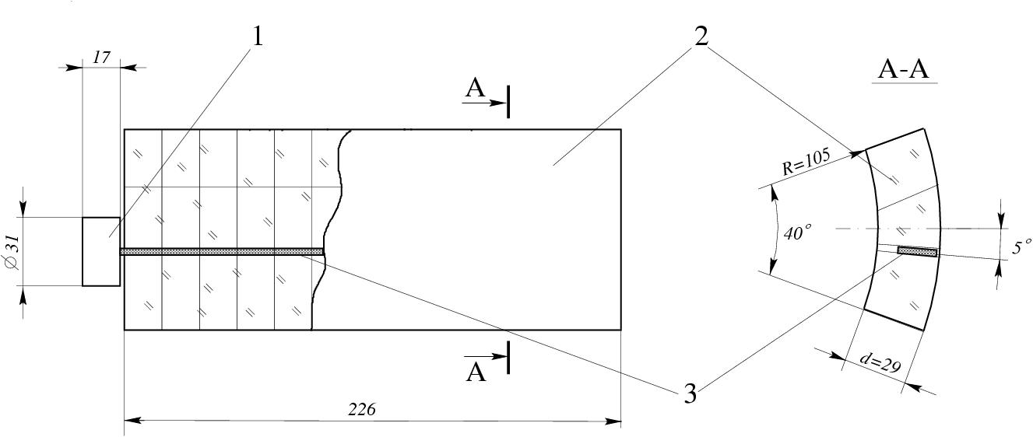
Particle ID Aerogel Counters
e/π, π/K separation
μ₀=10ph.e.
μ₀=5ph.e.
π
K
n
1,14
1,12
Counter efficiency
Aerogel + shifter + PMT
Aerogel thickness 31 mm
Shifter turned by 5˚
Teflon coverage (R=0.98)
Nucl.Instrum.Meth.A315:517-520,1992

Slide 20
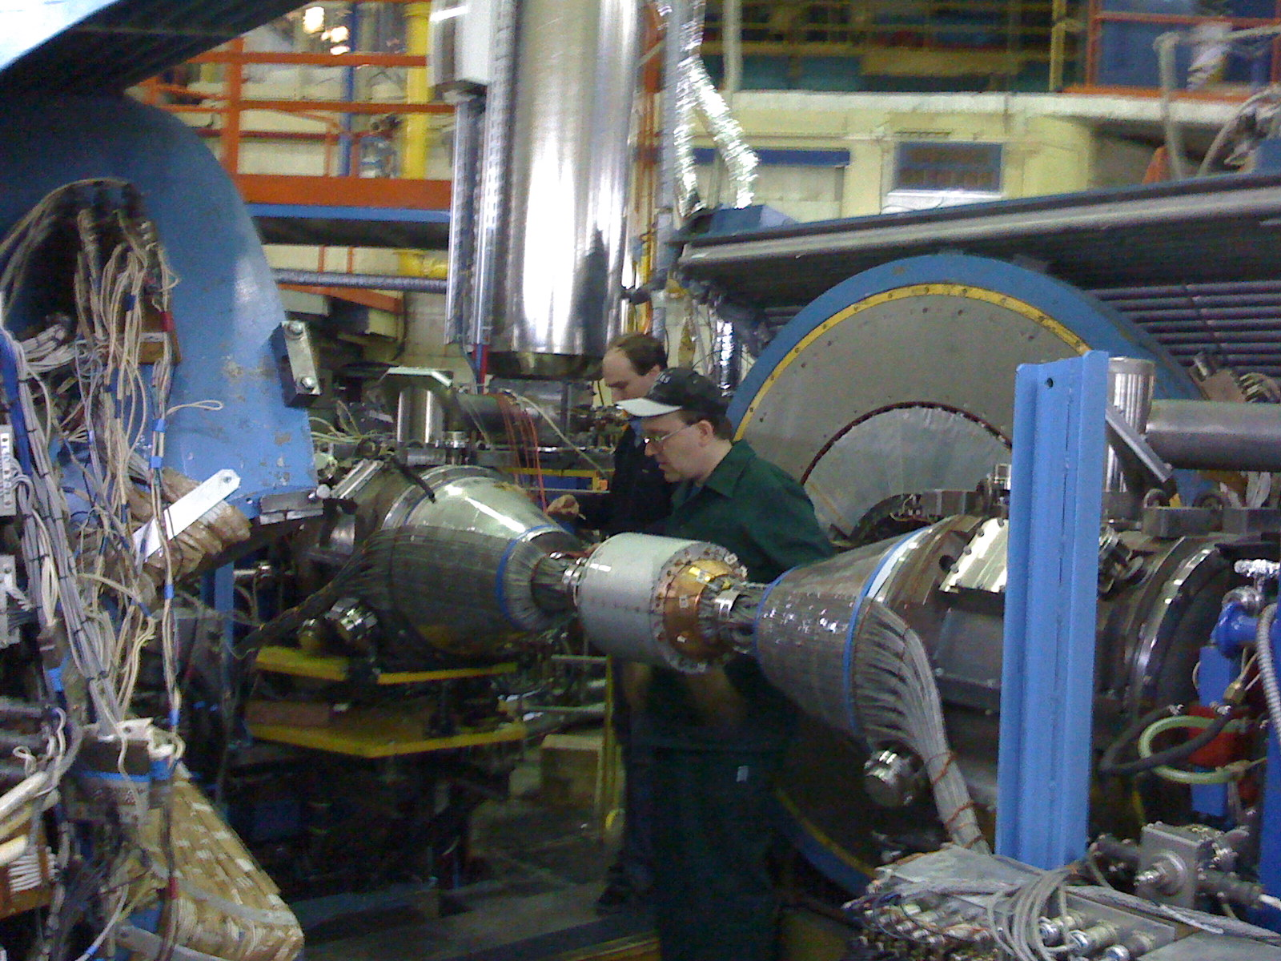
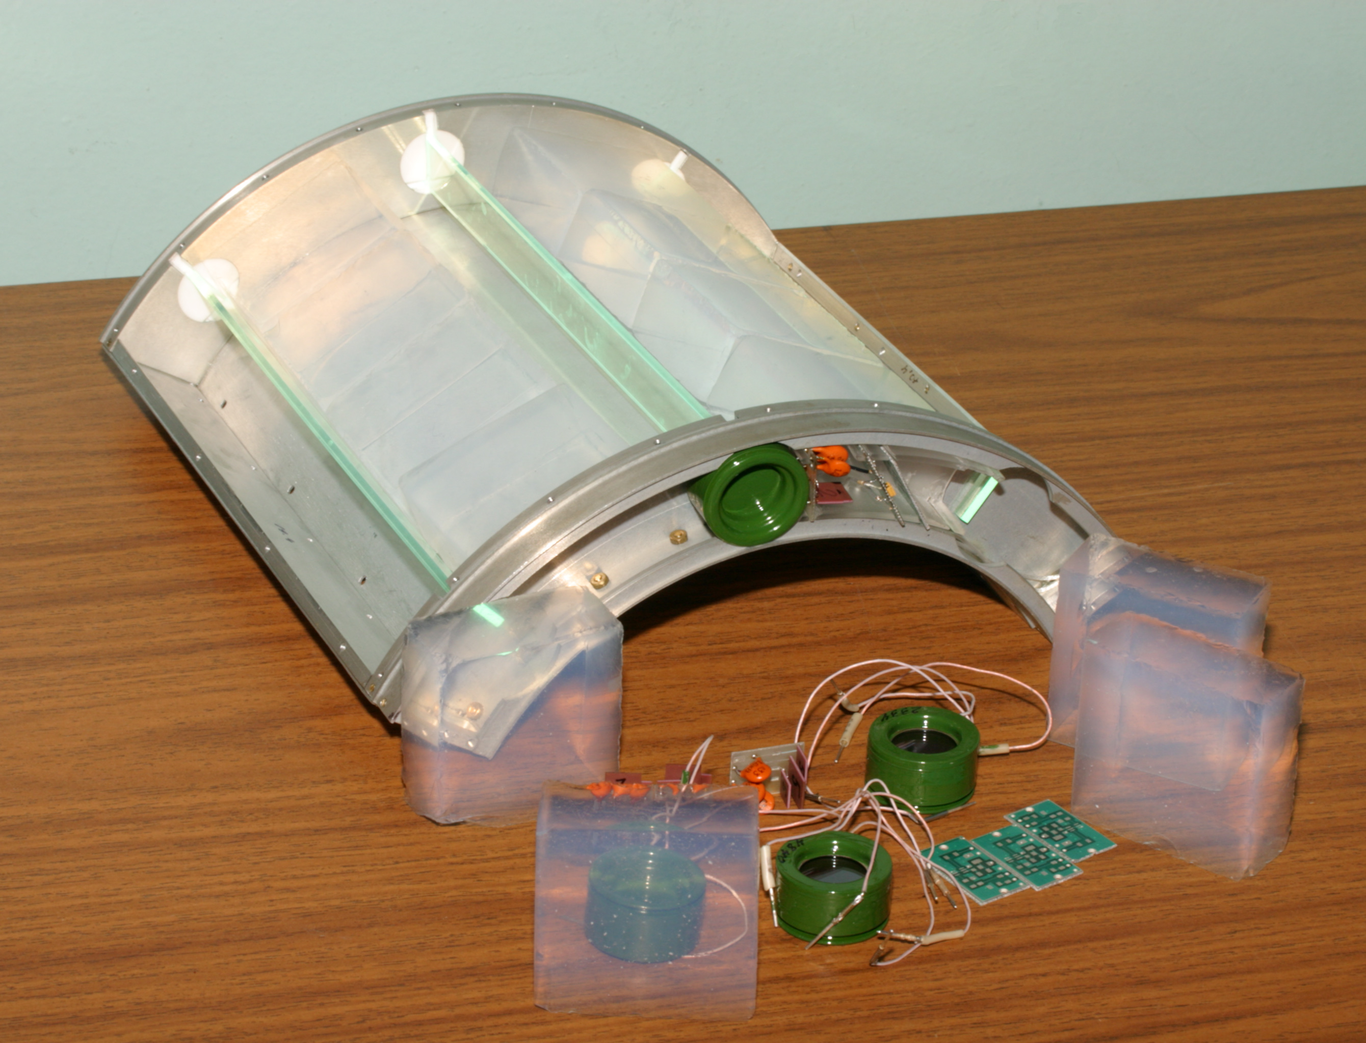
Particle ID Aerogel Counters
e/π, π/K separation
μ₀=10ph.e.
μ₀=5ph.e.
Prototype with
cosmic events
π
K
n
1,14
1,12
Counter efficiency
Aerogel + shifter + PMT
Aerogel thickness 31 mm
Shifter turned by 5˚
Teflon coverage (R=0.98)
Nucl.Instrum.Meth.A315:517-520,1992

Slide 21
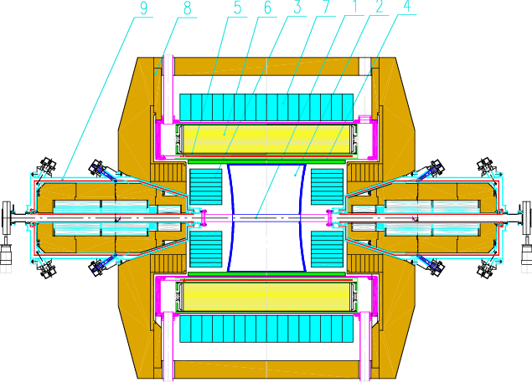
Cryogenic Magnetic Detector-3
1 – vacuum chamber
2 – drift chamber
3 – electromagnetic calorimeter BGO
4 – Z – chamber
5 – CMD SC solenoid
6 – electromagnetic calorimeter LXe
7 – electromagnetic calorimeter CsI
8 – yoke
9 – VEPP-2000 solenoid

Slide 22
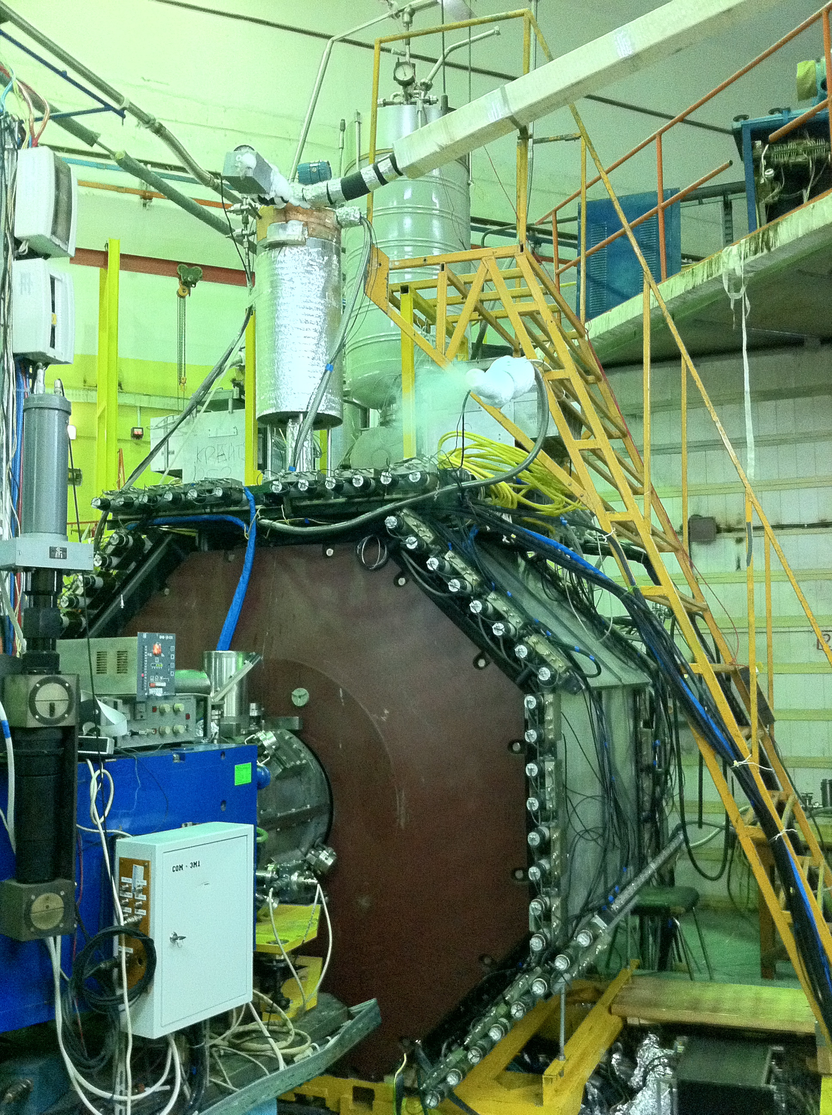
Cryogenic Magnetic Detector-3
1 – vacuum chamber
2 – drift chamber
3 – electromagnetic calorimeter BGO
4 – Z – chamber
5 – CMD SC solenoid
6 – electromagnetic calorimeter LXe
7 – electromagnetic calorimeter CsI
8 – yoke
9 – VEPP-2000 solenoid

Slide 23
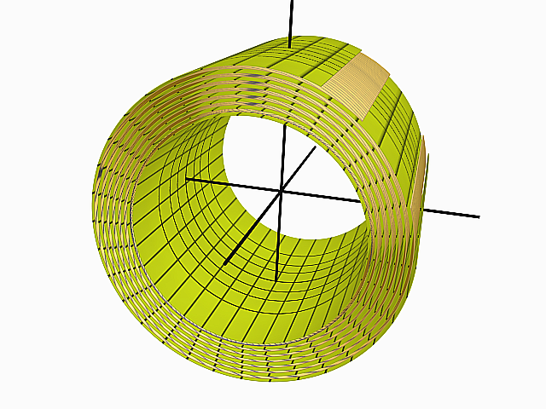
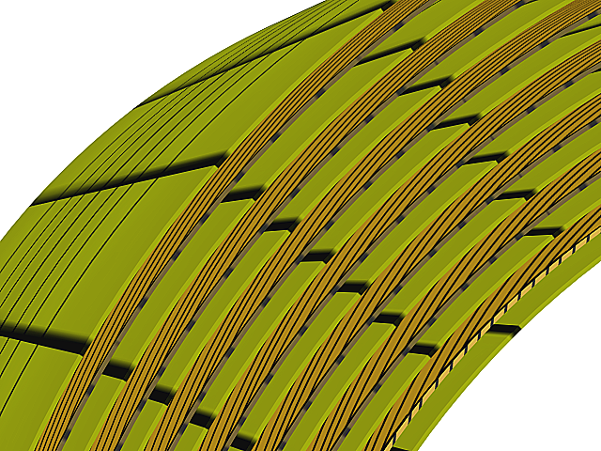
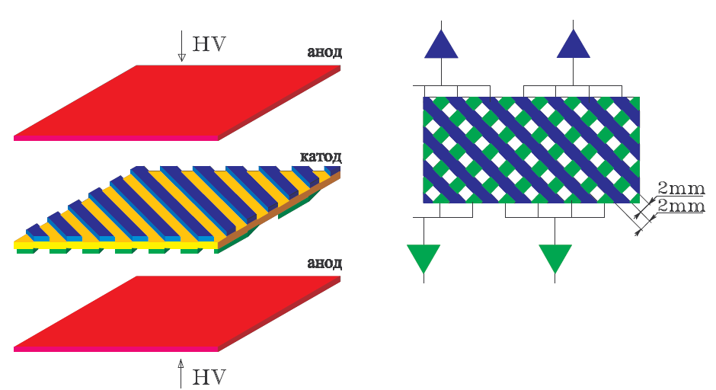
Calorimeter LXe
anode
5.7 X₀ of LXe (400 liters, 1.2 tons)
14 gaps by 10.2 mm
2124 coordinate strips
264 towers
cathode
anode

Slide 24
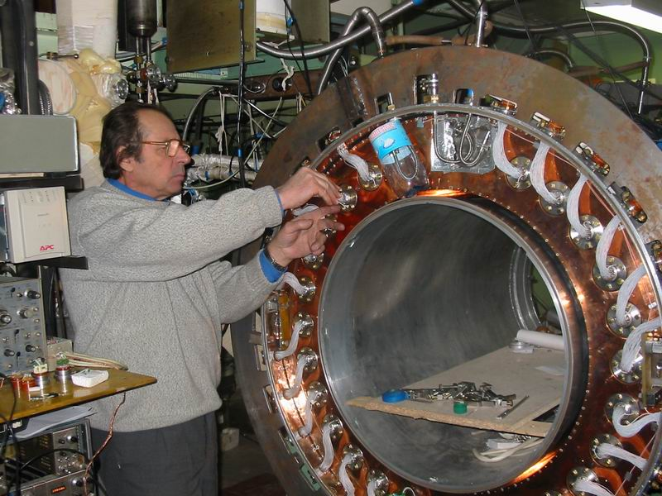
Calorimeter LXe
anode
5.7 X₀ of LXe (400 liters, 1.2 tons)
14 gaps by 10.2 mm
2124 coordinate strips
264 towers
cathode
anode

Slide 25
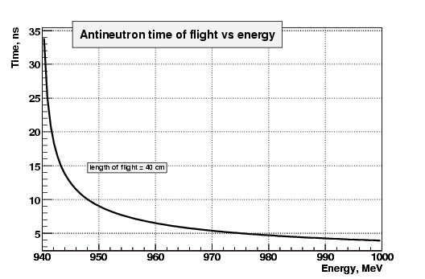
Particle ID: Timing Counter (SCiG)
Antineutron identification
in e⁺e⁻→n n bar

Slide 26
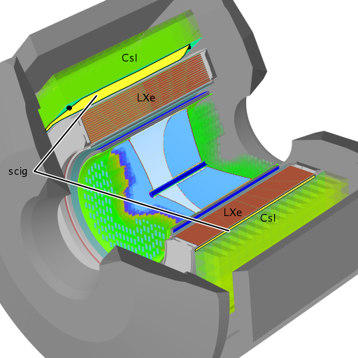
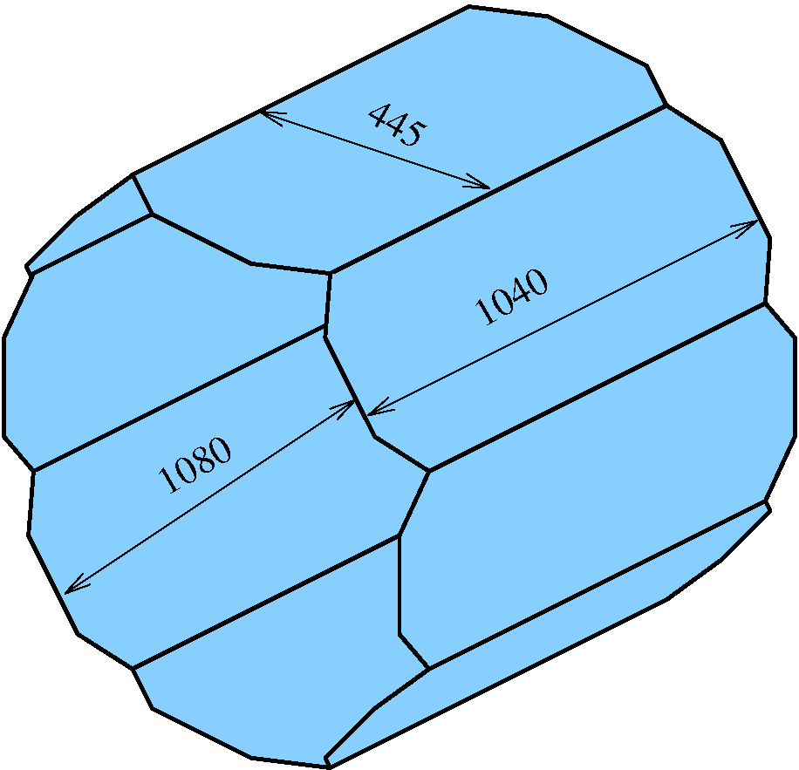
Particle ID: Timing Counter (SCiG)
Antineutron identification
in e⁺e⁻→n n bar

Slide 27
Particle ID: Timing Counter (SCiG)
Antineutron identification
in e⁺e⁻→n n bar
e⁺e⁻
σ = 0.75 ns
Ec.m. =1.925 GeV
PbarP

Slide 28
Successful physics run 2010/2011
CMD-3 data collection
Two scan (up and down) were performed from φ to 2 GeV energy range with 25 MeV step is and about 500 nb⁻¹ per point
We gather
~22 pb-1/detector
~x10 times to previous e⁺e⁻ experiments, and comparable to ISR data from B-factories.
First technical run last year

Slide 29
CMD-3 on-line monitor

Slide 30
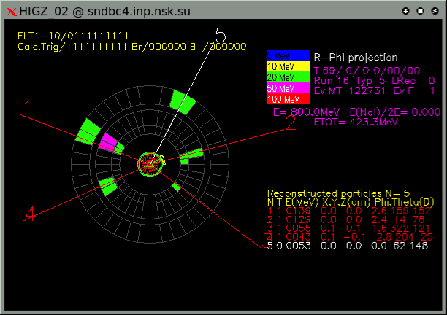
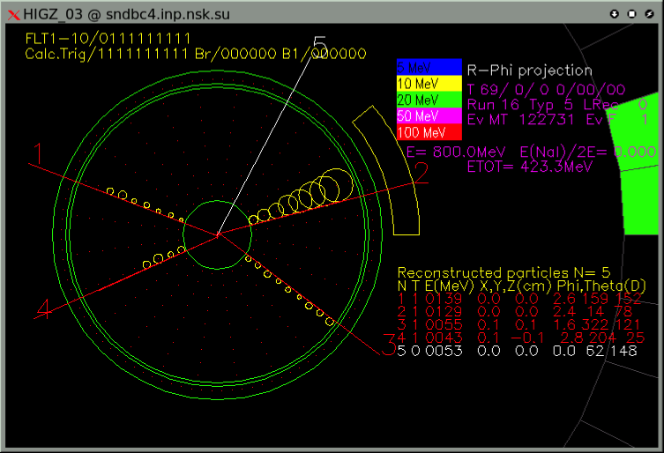
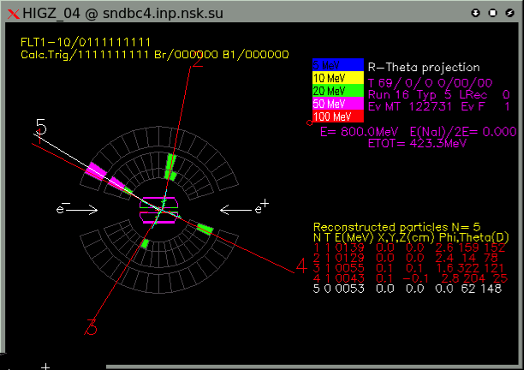
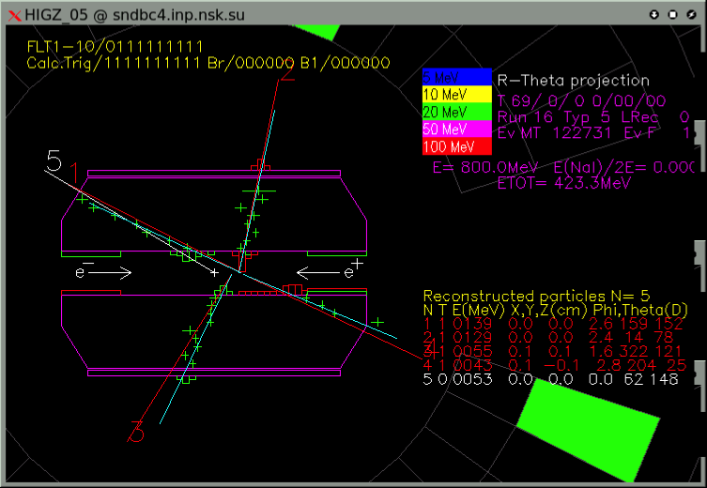
On-line events monitor for SND
e⁺e⁻ -> π⁺π⁻π⁺π⁻ candidate

Slide 31
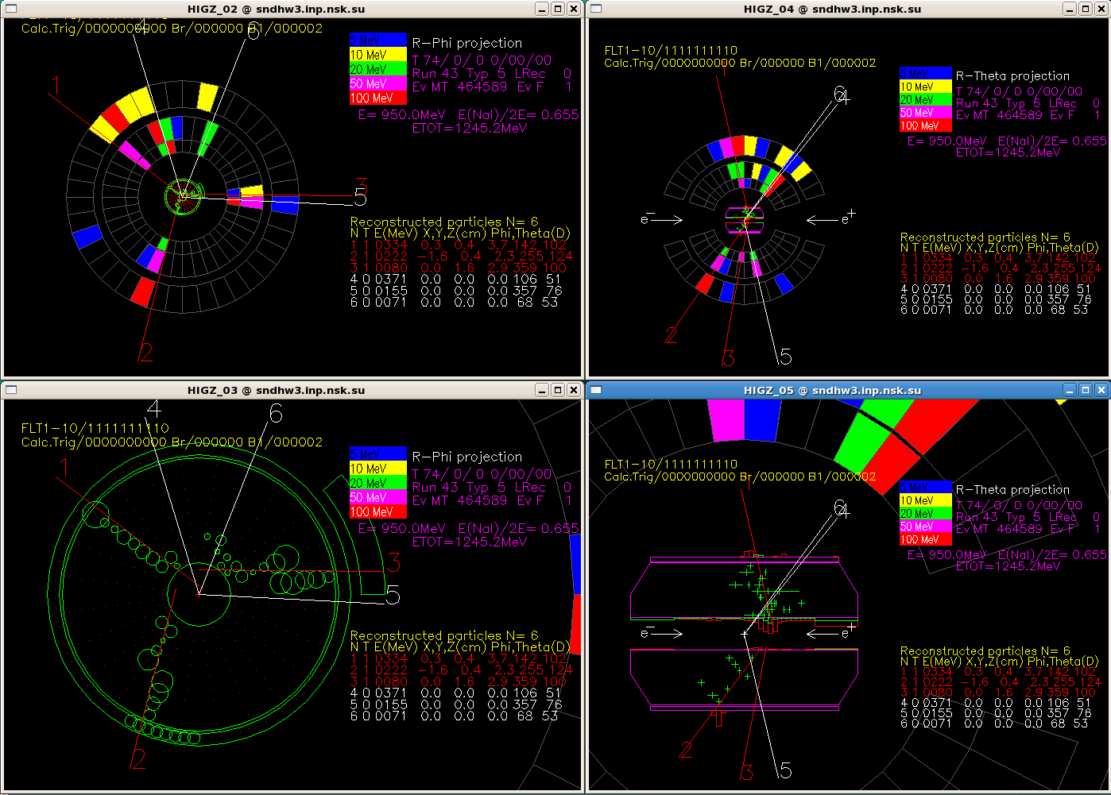
PbarP candidate
ON-LINE EVENTS MONITOR FOR SND
e⁺e⁻ -> π⁺π⁻π⁺π⁻ candidate

Slide 32
First preliminary result from SND
Poster by A. Obrazovsky
Data from 2010 technical run. (20% of available data)
Selecting events with 5 photons
Looking for 2 π⁰
Looking for ω -> π⁰γ
e⁺e⁻ -> ωπ⁰

Slide 33
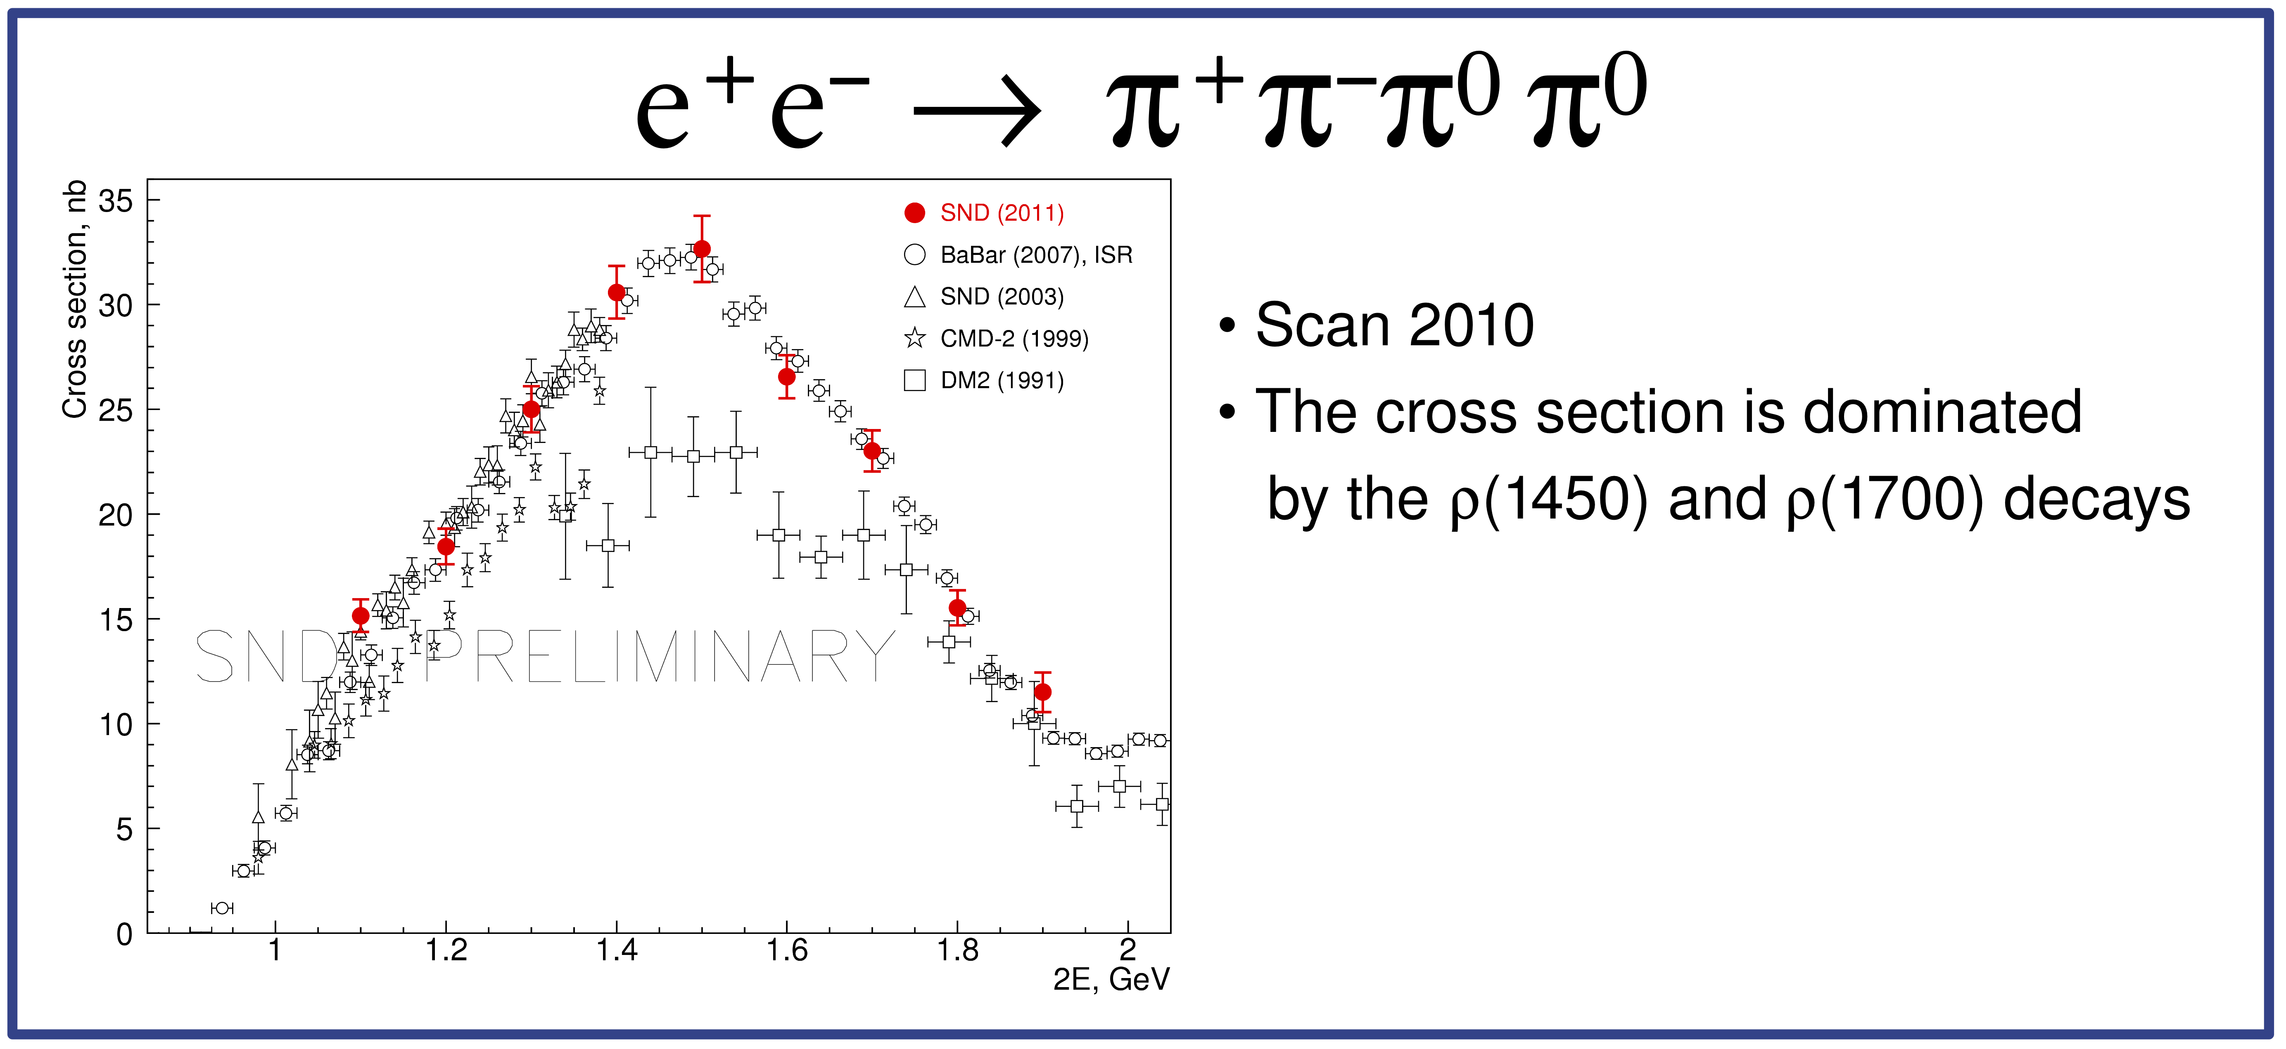
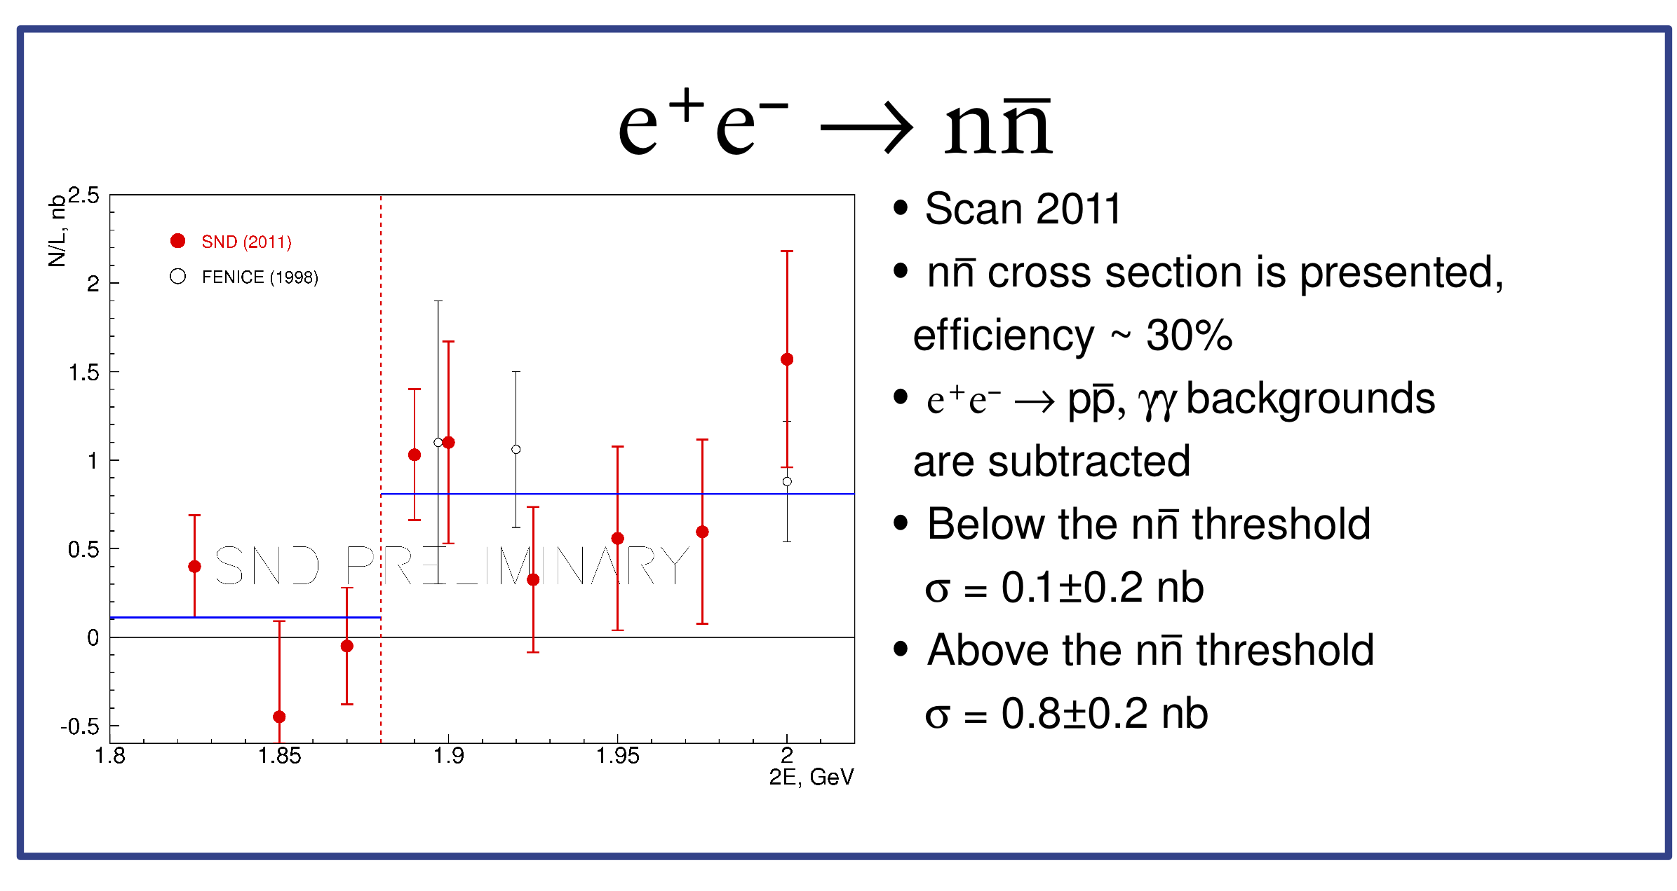
First preliminary result from SND
Poster by A. Obrazovsky

Slide 34
Collinear events in CMD-3 (E_{c.m.} = 1.95 GeV)
e⁺e⁻
e⁺e⁻
cosmic
μ+μ−
π⁺π⁻
P⁻P⁺
K⁺K⁻

Slide 35
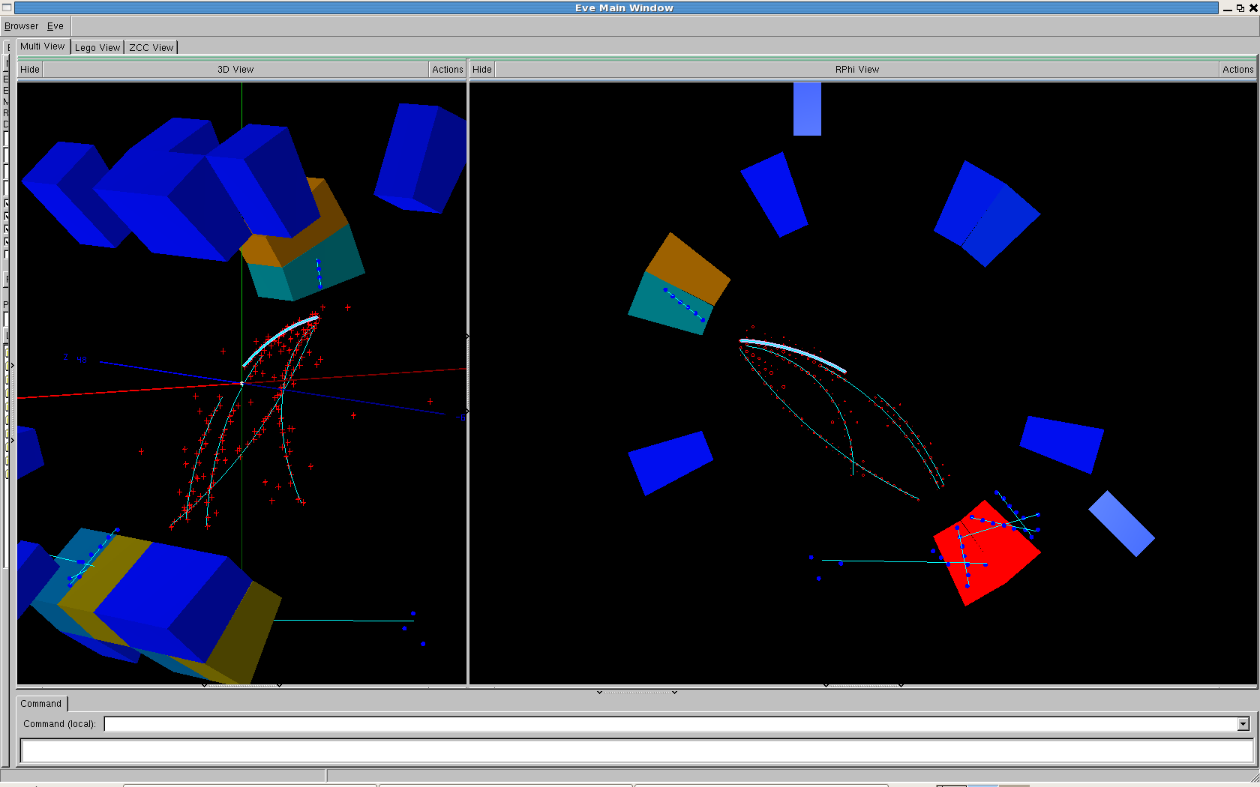
Preliminary results for the e⁺e⁻ -> PbarP study
Clear signature of the PbarP events

Slide 36
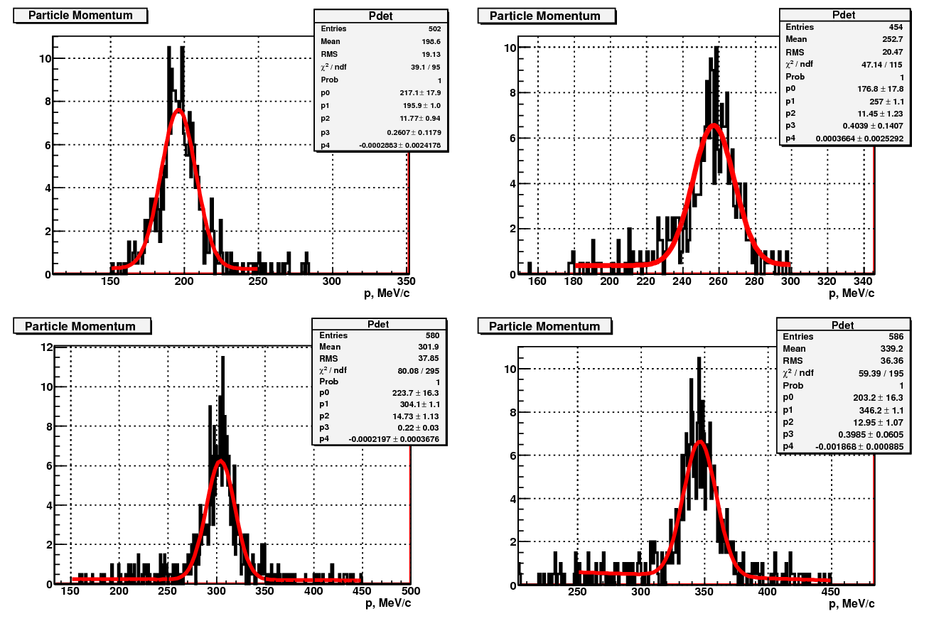
Preliminary results for the e⁺e⁻ -> PbarP study
Number of events from momentum distributions
Clear signature of the PbarP events
Ec.m.=1.95 GeV
Ec.m.=1.925 GeV
Ec.m.=1.975 GeV
Ec.m.=2.0 GeV

Slide 37
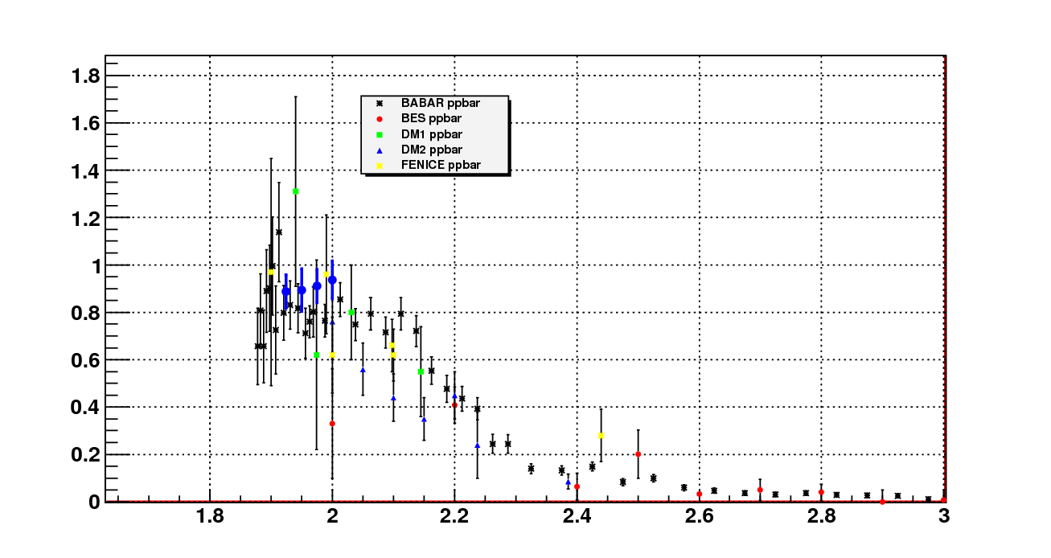
Preliminary results for the e⁺e⁻ -> PbarP study
Number of events from momentum distributions
Clear signature of the PbarP events
Ec.m.=1.95 GeV
Ec.m.=1.925 GeV
Ec.m.=1.975 GeV
Ec.m.=2.0 GeV
Cross section (nb)
- CMD3, preliminary
E_{c.m.} (GeV)

Slide 38
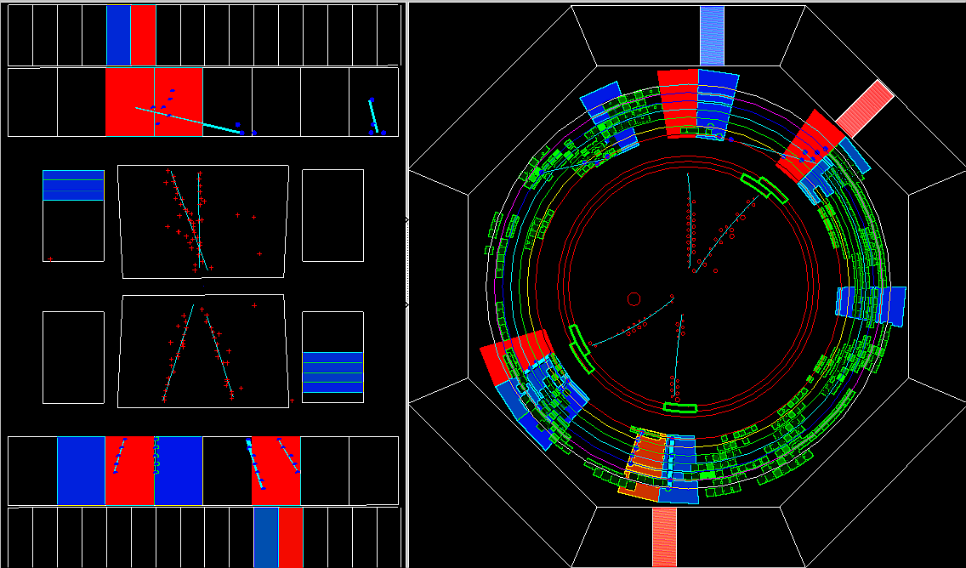
Example of e⁺e⁻ -> π⁺π⁻π⁺π⁻ from CMD-3

Slide 39
Example of e⁺e⁻ -> π⁺π⁻π⁺π⁻ from CMD-3
Ec.m. = 1.8 GeV
2(π⁺π⁻)(γ)
2(π⁺π⁻)π⁰
K⁺K⁻π⁺π⁻
2(π⁺π⁻)2π⁰

Slide 40
Example of e⁺e⁻ -> π⁺π⁻π⁺π⁻ from CMD-3
Ec.m. = 1.8 GeV
Ec.m. = 1.8 GeV
ρ(770)
2(π⁺π⁻)(γ)
f₀(980)
2(π⁺π⁻)π⁰
ρ(770)
K⁺K⁻π⁺π⁻
2(π⁺π⁻)2π⁰

Slide 41
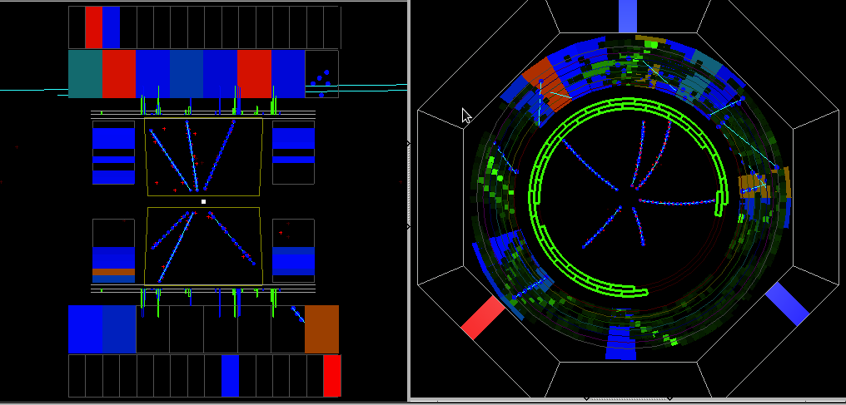
Example of e⁺e⁻ -> 3(π⁺π⁻) from CMD-3

Slide 42
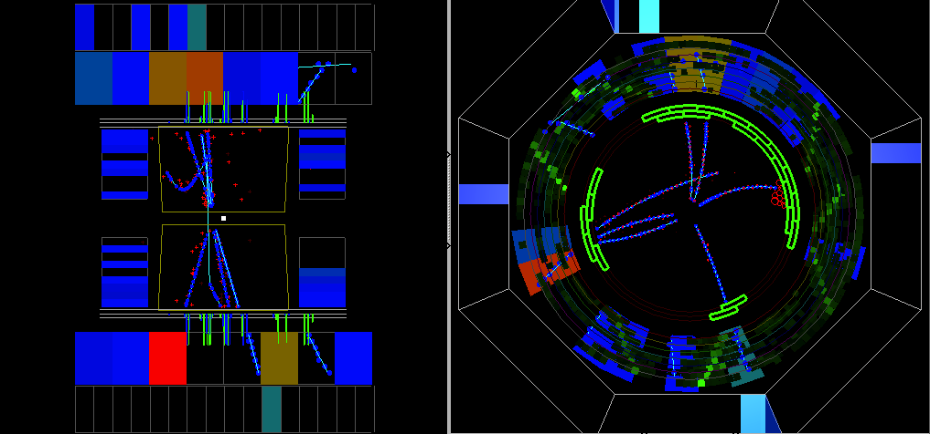
Example of e⁺e⁻ -> 3(π⁺π⁻) from CMD-3

Slide 43
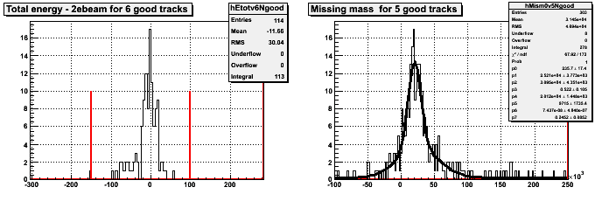
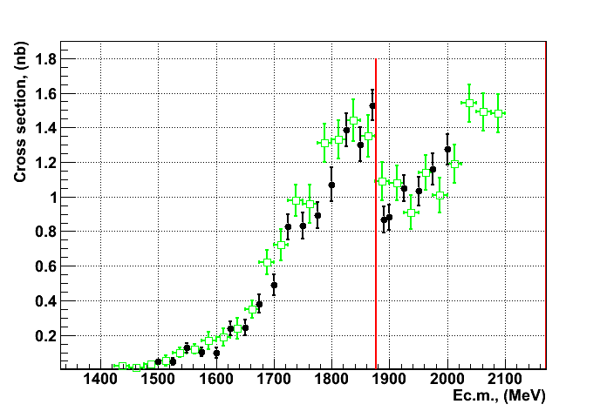
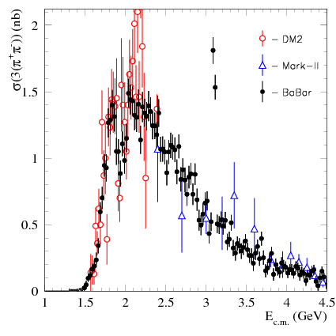
Preliminary results for the e⁺e⁻ -> 3(π⁺π⁻) study
We have very clean selection of 6 and 5 pions
E_{6tracks} -2*E_{beam}, (MeV)
m²(π)
Other data for e⁺e⁻ -> 3(π⁺π⁻)
BaBar
CMD-3
PbarP threshold

Slide 44
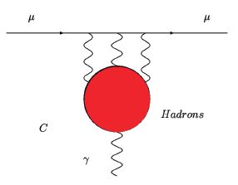
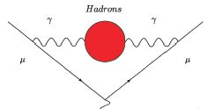

Anomalous magnetic moment of muon
Measured with highest precision at BNL-E821: a_{μ}^{exp} = (11659208.0±6.3)*10⁻¹⁰;
The theoretical calculations a_{μ}SM meet the problems with hadronic contribution of radiative corrections but calculations can be done using experimental data: e⁺e⁻ -> hadrons or τ-decays – optical theorem;
An high-order hadronic contribution “light-by-light” (LBL) stands apart – it can not be calculated with help of experimental data and could be achieved only from theoretic models;
The uncertainty in theoretic calculations determined by the uncertainty of hadronic contribution to a_{μ}SM.
e⁺e⁻ -> had diargam
Hadronic LO+HO diargams
LBL diagram

Slide 45
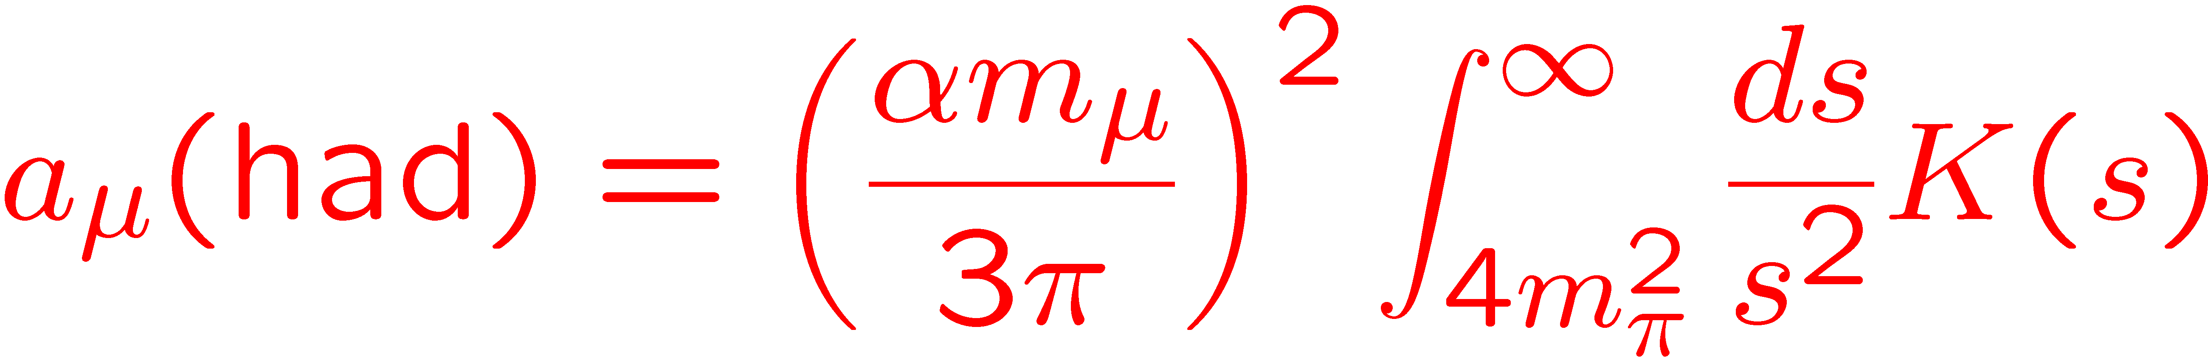
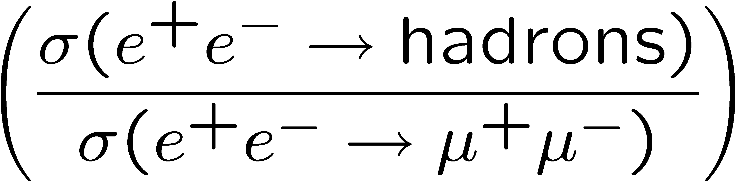
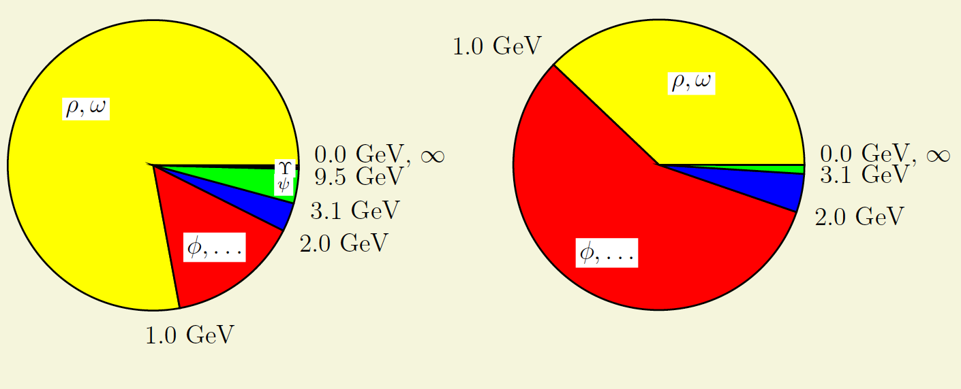
Hadronic contribution to a_{μ}
(from F. Jegerlehner)
error²
contribution
The contribution goes mainly from the small s, the contribution of √s > 2 GeV less than 10% of overall ;
The maximal contribution to the error now goes from 1 – 2 GeV region, the energy of VEPP-2000;
Hadronic contributions in terms of 10⁻¹⁰: LO VP: 694.91 ± 4.27 HO VP: -9.84 ± 0.07
LBL: 10.5 ± 2.6 – the recent result (K. Hagiwara et al., arxiv:1105.3149).

Slide 46
The current result and perspectives
The recent result has difference between a_{μ}SM and a_{μ}^{exp} in 3.3σ;
VEPP-2M, BaBar, KLOE significantly reduced errors.
More ISR analysis from KLOE, BaBar, Belle; better R below 4.3 from CLEO-c;
CMD-3, SND at VEPP2000, up to 2 GeV (next 5+ years) with goal < 1% of systematics for majority of the channels;
By 2014 LO error could reach 2×10⁻¹⁰ with LBL 2.6×10⁻¹⁰ .
New (g-2) experiment at FLAB with accuracy 3 times better, JPARC hopes for 4 times better accuracy. This corresponds to 0.2% of a_{μ}SM(had) – unreachable even for σ(e+e- -> hadrons)!
Progress in calculations of a_{μ}SM from 1st principles – QCD, Lattice ..
Δ ∼ 3.3σ

Slide 47
Summary
New generation of detectors perfectly matches the reach physics potential of VEPP-2000;
L~2x10³¹ cm⁻¹sec⁻² has been reached so far – positrons limited. “Unlimited” positron source is in preparation;
Both detectors are on the beams and are taking data. We start understanding their performance;
The integrated luminosity collected between 1 and 2 GeV already exceeds the one previously achieved in direct scans with precision close to BaBar;
In a few years we hope to measure σ(e⁺e⁻ -> had) with high accuracy and significantly improve the precision of a_{μ} SM(had, LO);
More results should come soon. Possibly in PhiPsi2011!

Slide 48
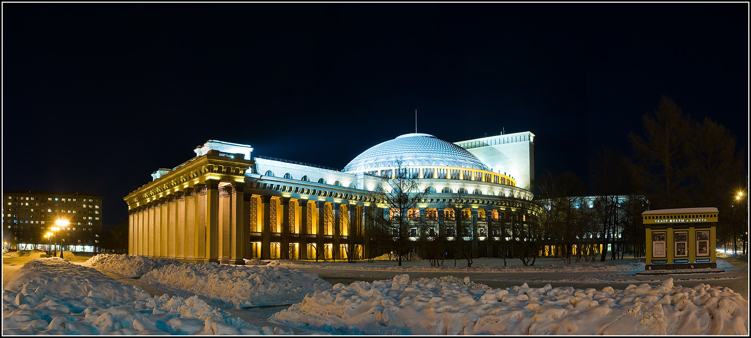
Thank you for your attention!

