Slide 1
DS-20k ID Engineering Forum • March 1st, 2024
Indico pages instructions +
ID to UAr vessel connection
Marco Carlini (LNGS – INFN)

Slide 2
OVERVIEW
ID to UAr vessel connection
Indico pages instructions
Concept for ID + UAr vessel support strategy (TDR recap)
ID to UAr vessel connection
ID to UAr vessel connection

Slide 3
Indico pages instructions

Slide 4
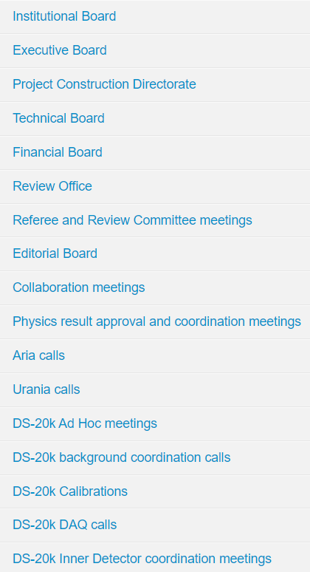
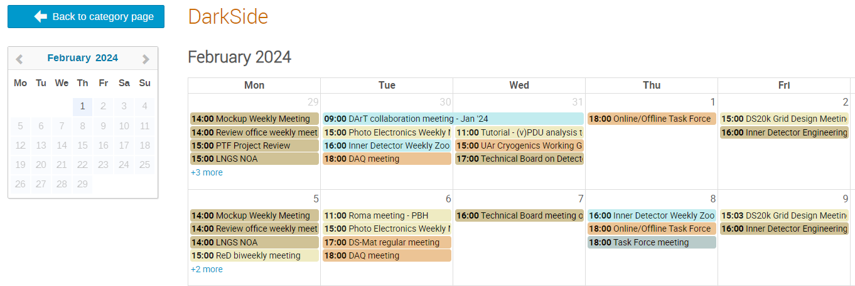
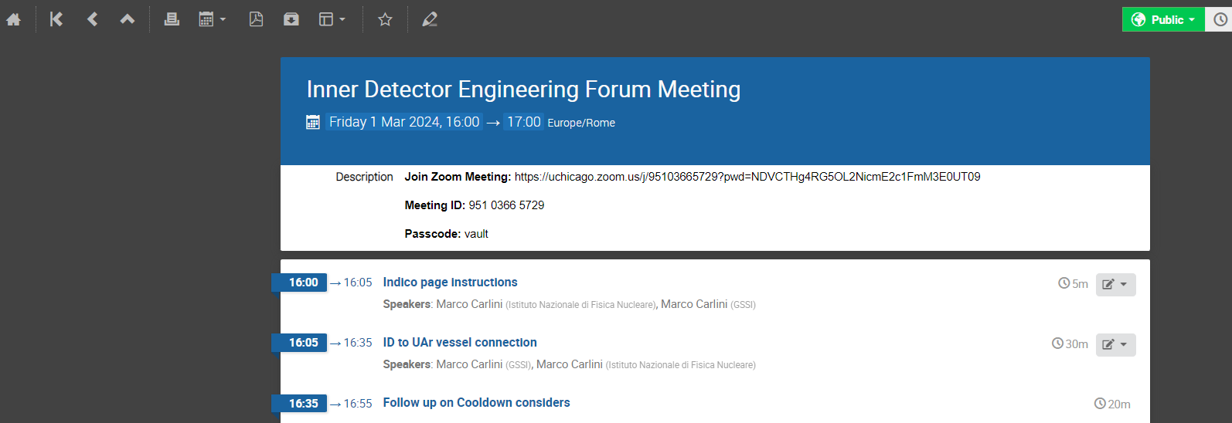
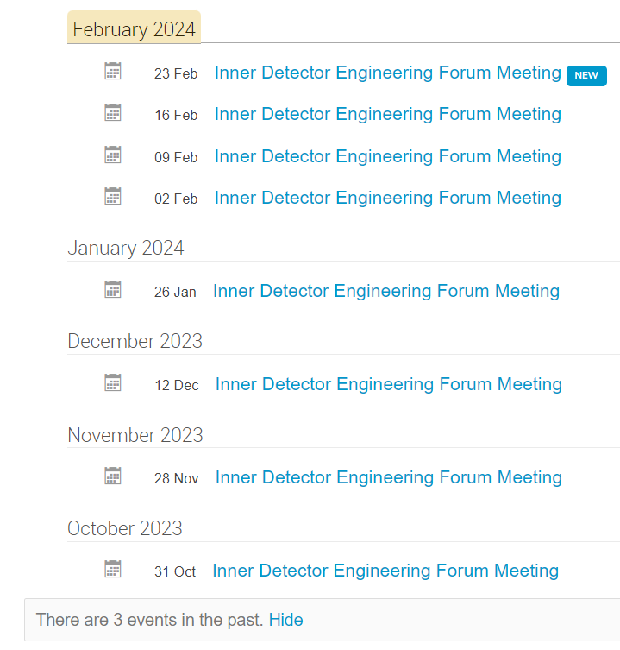
Indico pages instructions
The calendar of all the DS-20k meetings are accesible at this link (public access): DarkSide · Agenda (Indico) (infn.it)
Switch to management area of the event (I believe only for Luca G.)
Navigate through the events of the topic
Show all the events of the topic

Slide 5
Concept for ID + UAr vessel support strategy (TDR recap)

Slide 6
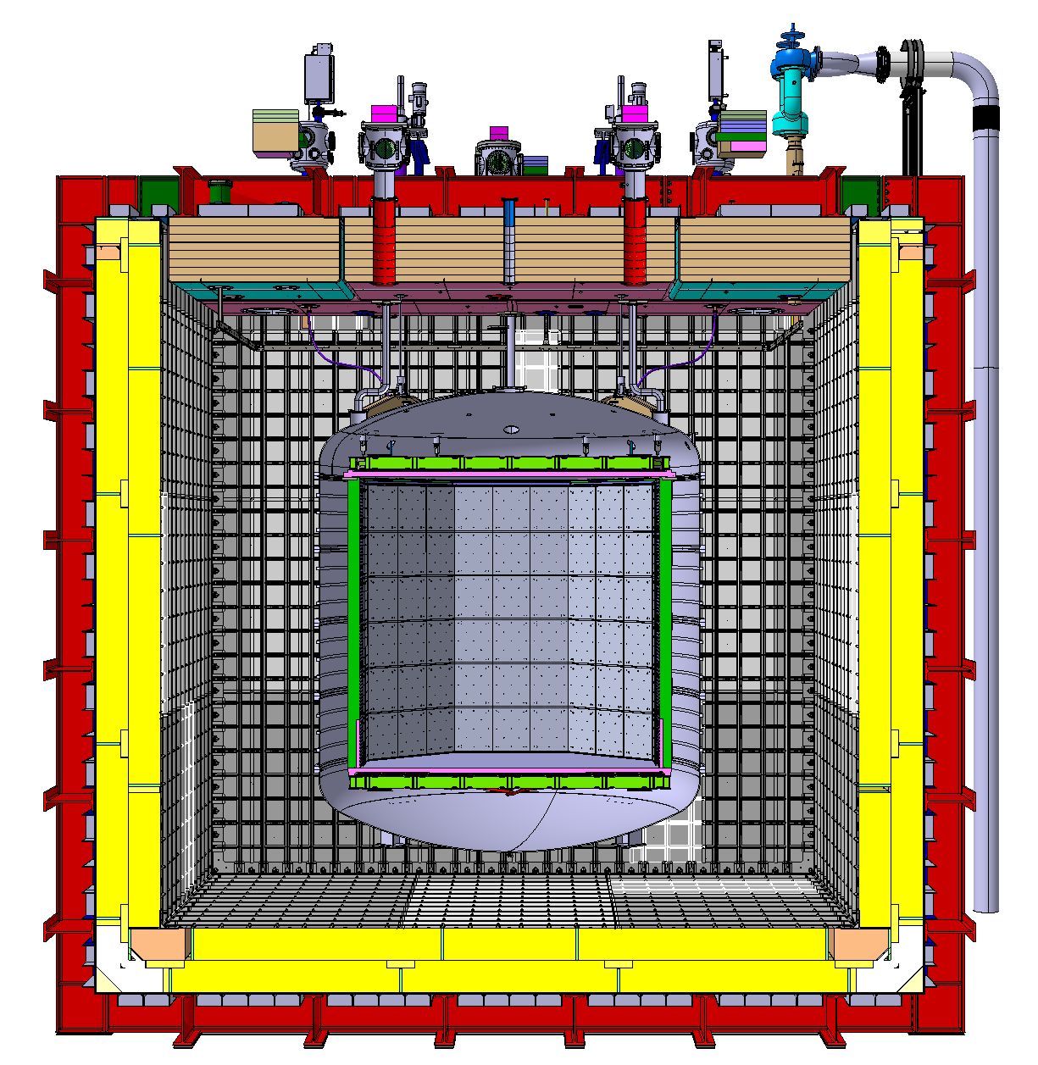
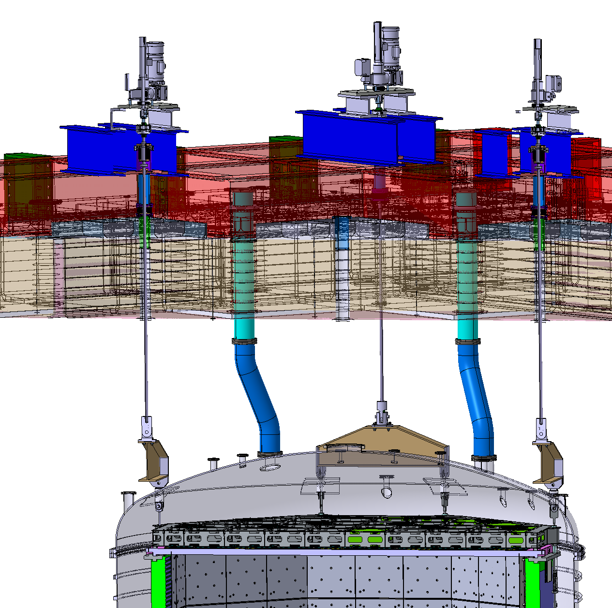
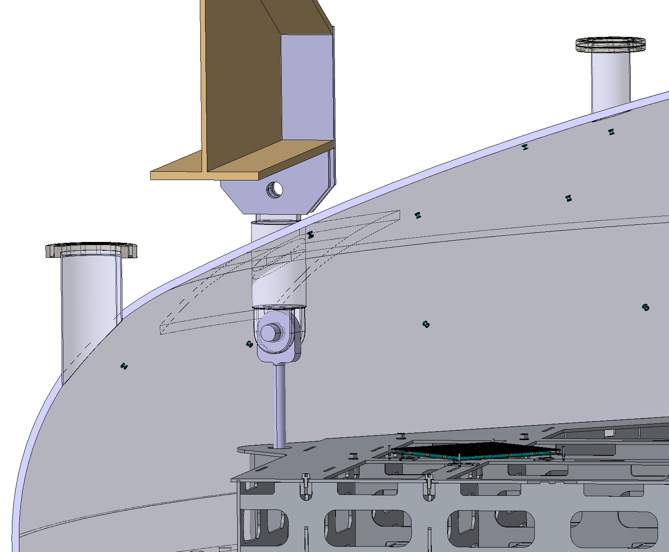
Concept for ID + UAr vessel support strategy (TDR recap)
ID hangs on 8 anchor points on the UAr vessel through 8 SS support rods
ID + UAr vessel + HDPE panels (?) weight is transferred though 4 SS beams to the 4 Detector Leveling System (DLS) SS rods
Pinned connections are planned on these 2 interfaces
4 x DN100CF (ID = 97 mm) penetrations for the DLS rods, included in the cryostat central top cap design. Location matching the ID support rods

Slide 7
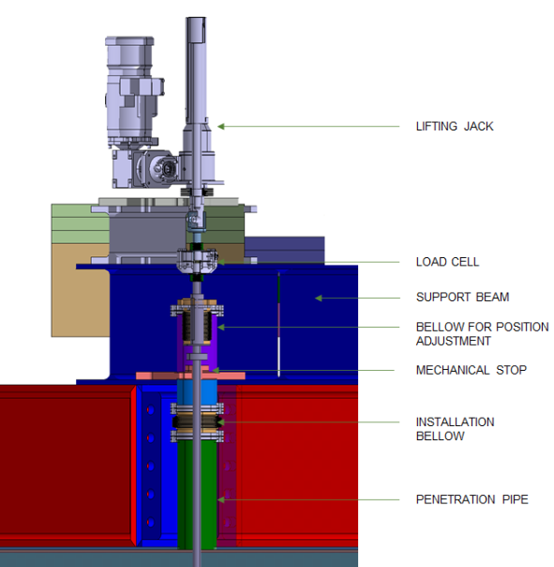
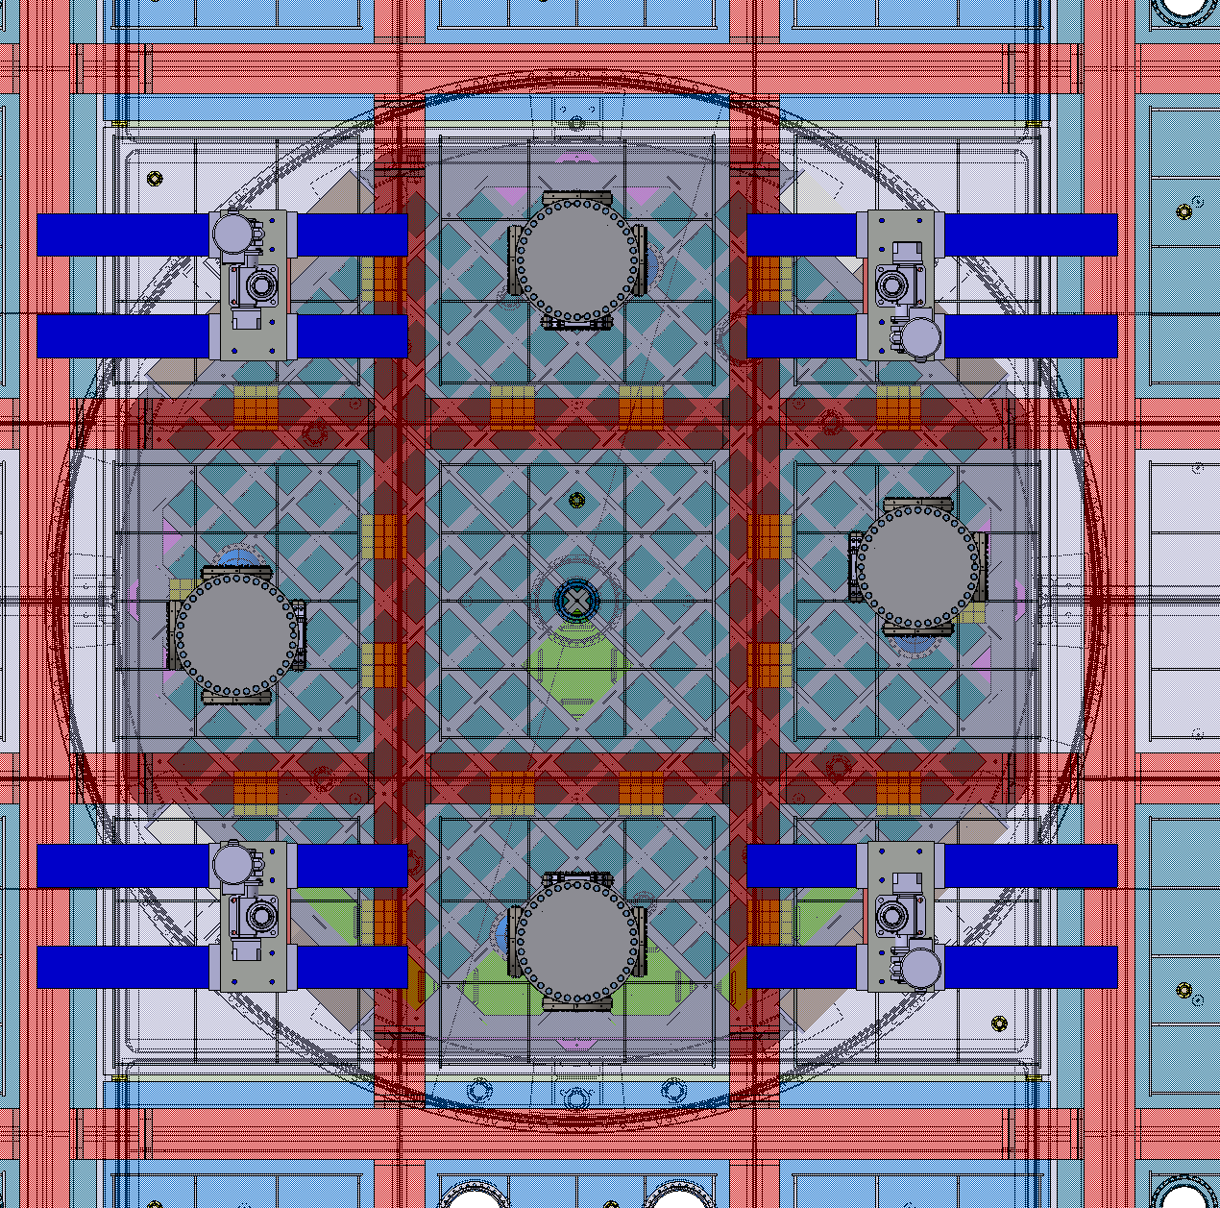
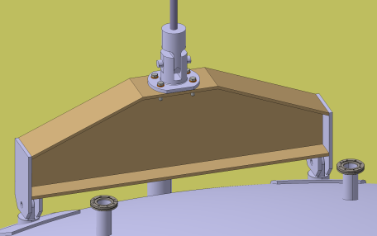
Concept for ID + UAr vessel support strategy (TDR recap) - DLS
WARM ASSEMBLY
COLD ASSEMBLY
Source: DS-20k TDR, Dec 2021
AAr volume
Source: DS-20k TDR, Dec 2021

Slide 8
ID to UAr vessel connection

Slide 9
ID to UAr vessel connection
DLS beam
UAr vessel to DLS pinned connection
ID to UAr vessel pinned connection
ID support rod
DS-20k SS Vessel mechanical design and structural analyses

Slide 10
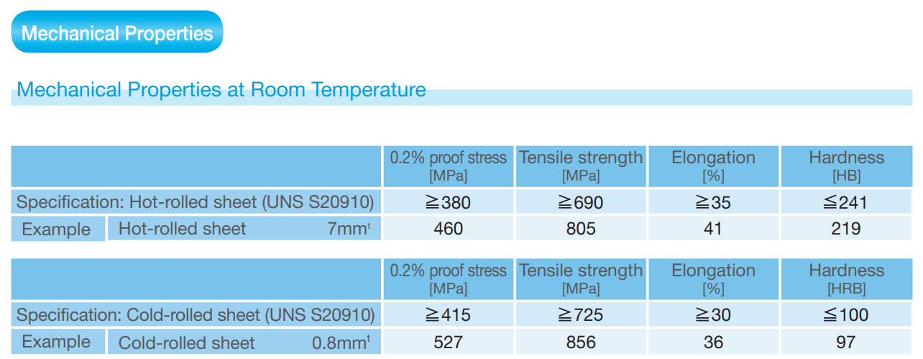
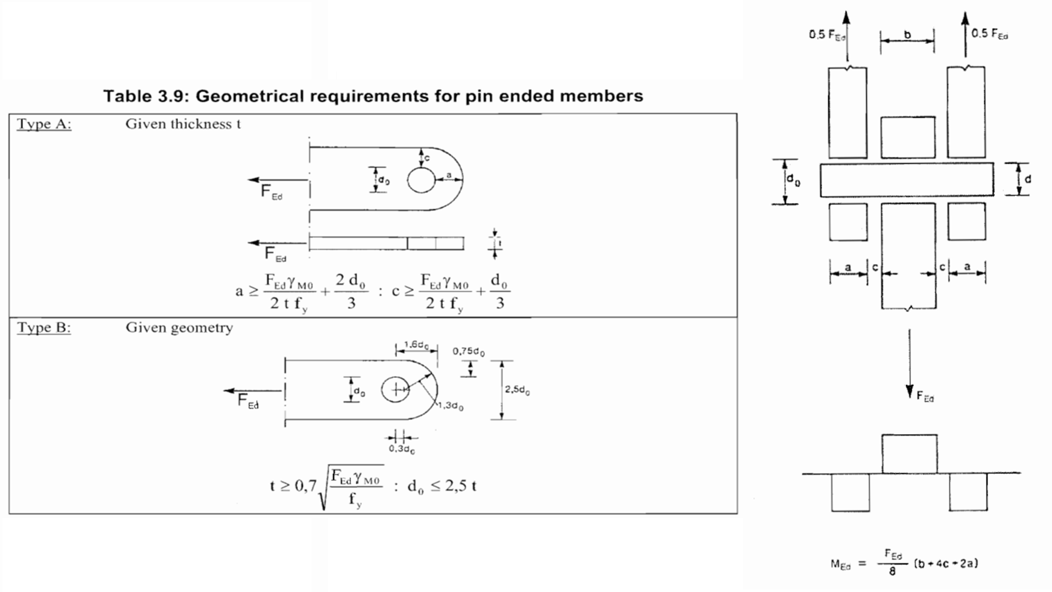
Verification of pinned connections, according to EN1993 - Part 1-8 §3.13
Static load case
hp: ID weight spread on 3 anchor points
Partial coefficient for permanent non structural loads
phi 25 mm, XM-19 SS pin
XM-19 is a nitrogen-strengthened austenitic stainless steel. In comparison with Type 316L, XM-19 provides higher corrosion resistance and higher strength. Suitable for cryogenic applications.

Slide 11
Verification of pinned connections, according to EN1993 - Part 1-8 §3.13
ID lifting load case
hp: ID weight spread on 3 anchor points?
Safety factor as per EN13155
phi 25 mm, XM-19 SS pin
XM-19 is a nitrogen-strengthened austenitic stainless steel. In comparison with Type 316L, XM-19 provides higher corrosion resistance and higher strength. Suitable for cryogenic applications.

Slide 12
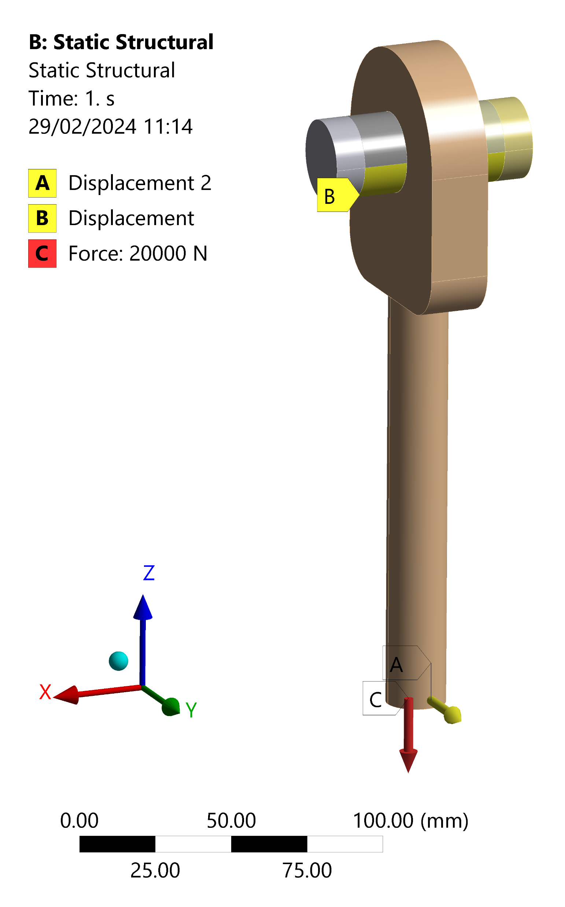
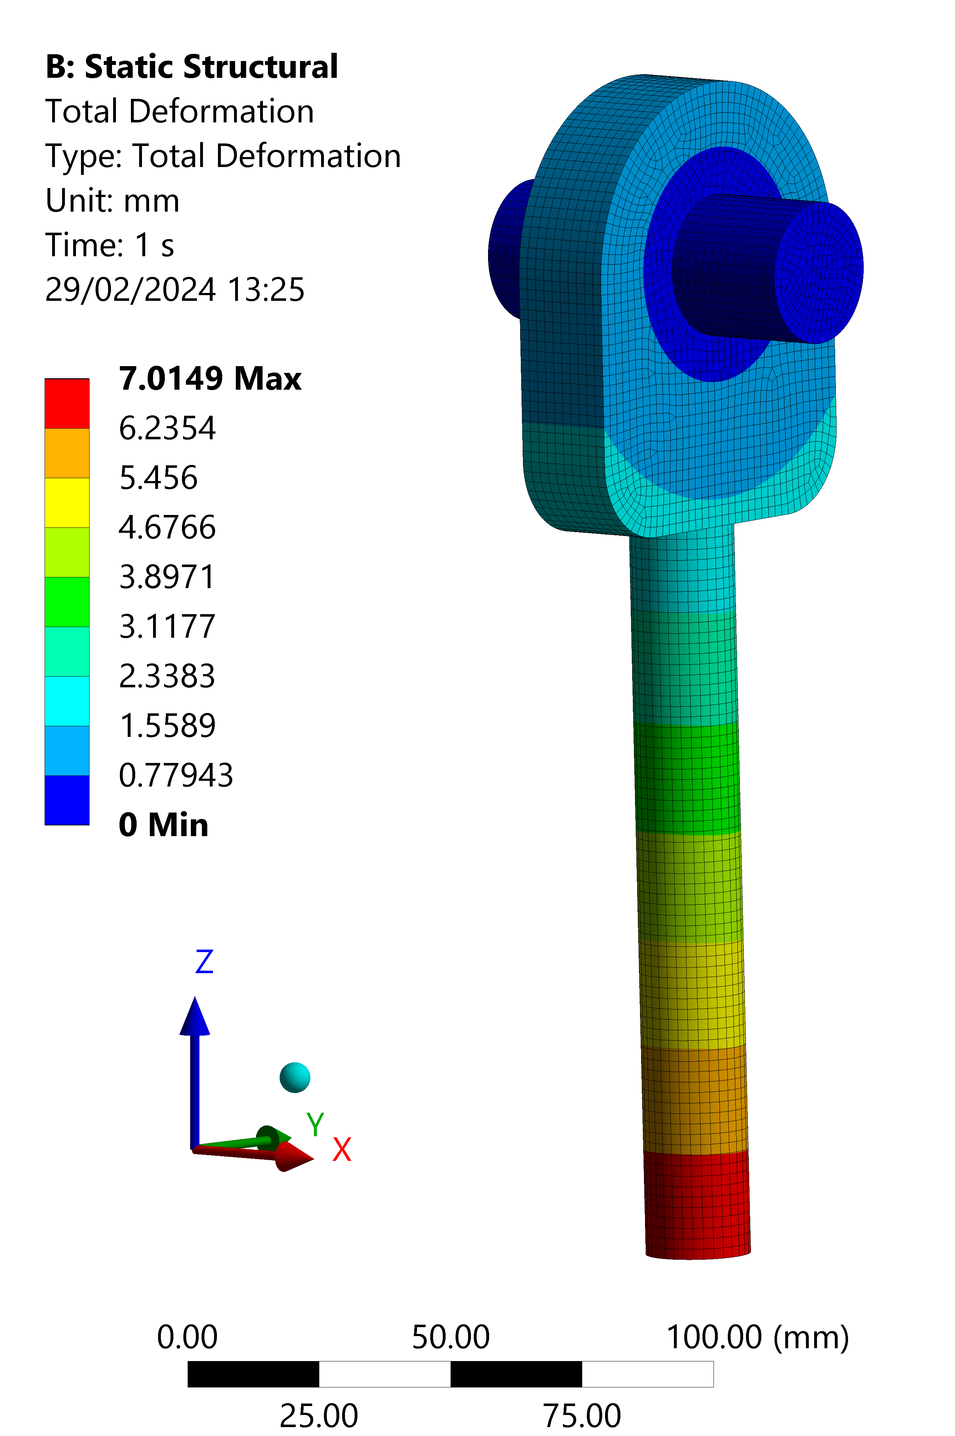
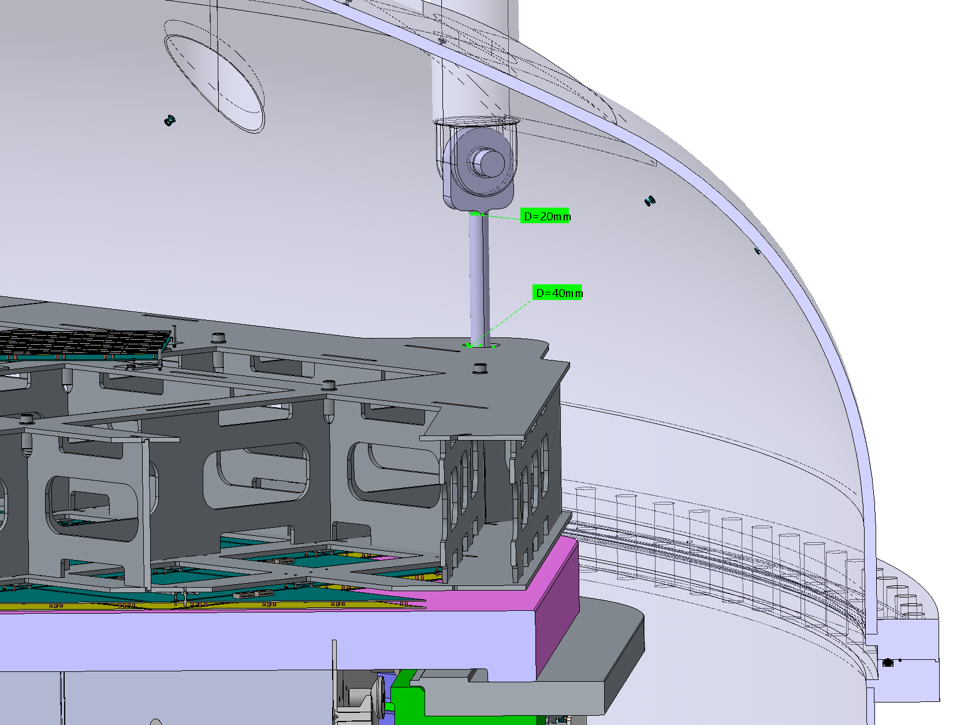
Verification of pinned connections during filling through FEA
FEAs have been run in order to calculate thermal stress arising on the TPC support rods induced by shrinking of the TOP during filling
Boundary conditions:
extreme hp of TOP al LAr temperature and UAr vessel dome at ambiente temperature → differential shrinking of 7 mm [A]
contemporaneity of the load of the ID weight acting on the rod [C]
fixed support on the surfaces in contact with the load bearing plates [B]
frictional contact between pin and rod (friction coefficient 0.2; 0.3)

Slide 13
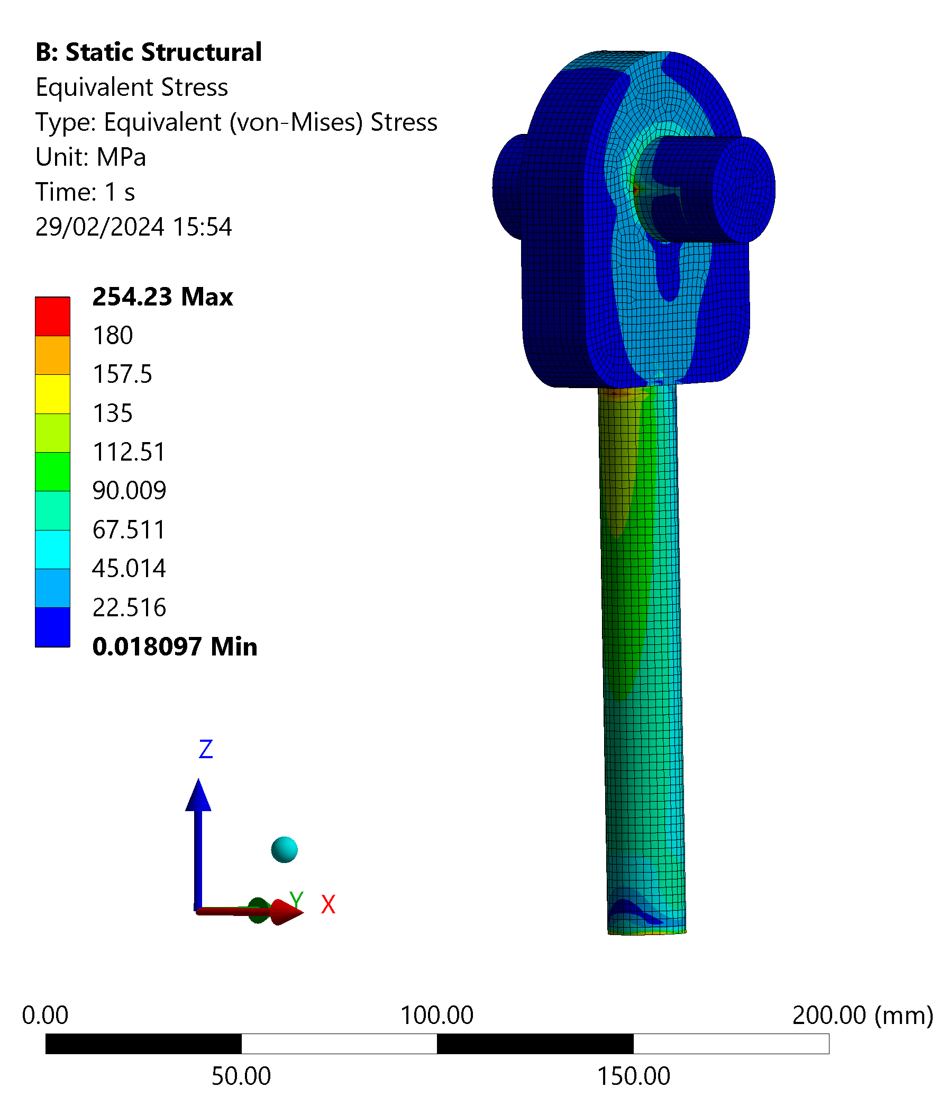
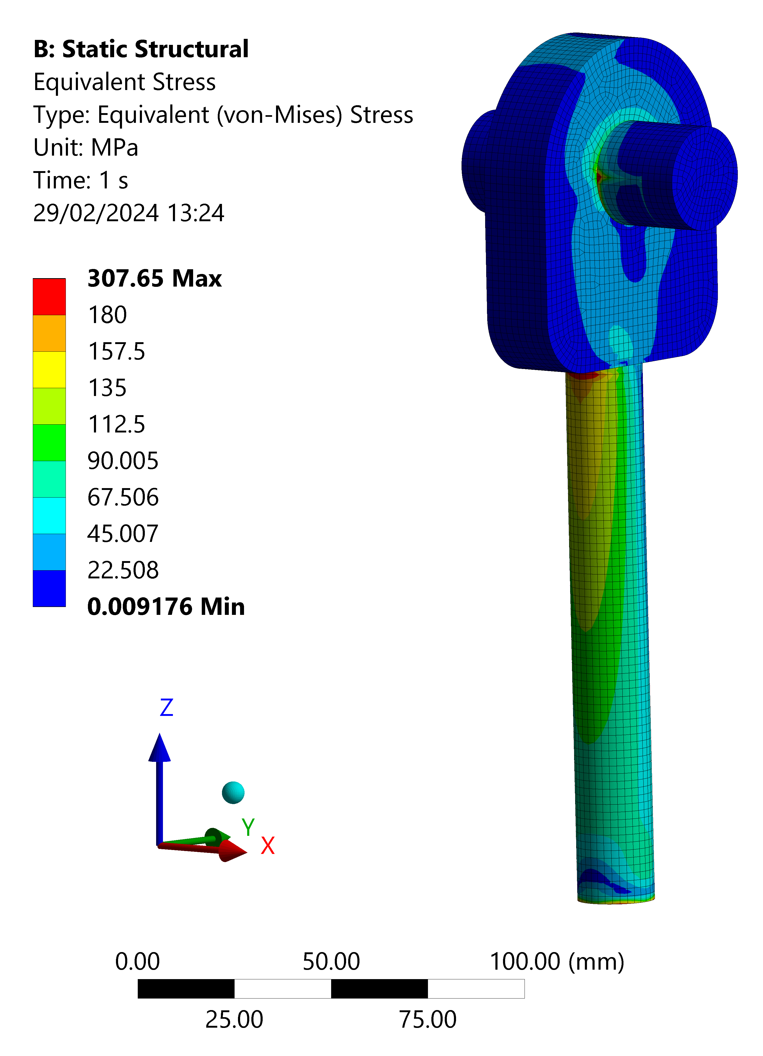
Verification of pinned connections during filling through FEA
FEAs have been run in order to calculate thermal stress arising on the TPC support rods induced by shrinking of the TOP during filling
Friction coefficient: 0.2
Friction coefficient: 0.3

Slide 14
ID to UAr vessel connection – open questions
For the lifting load case, is it realistic to consider that the load is spread on the 8 anchor points? If not, what is a realistic assumption? If it is three, design should be updated to comply with Eurocode.
Which other load case should be studied? How do we handle seismic load?

Slide 15
Backup

Slide 16
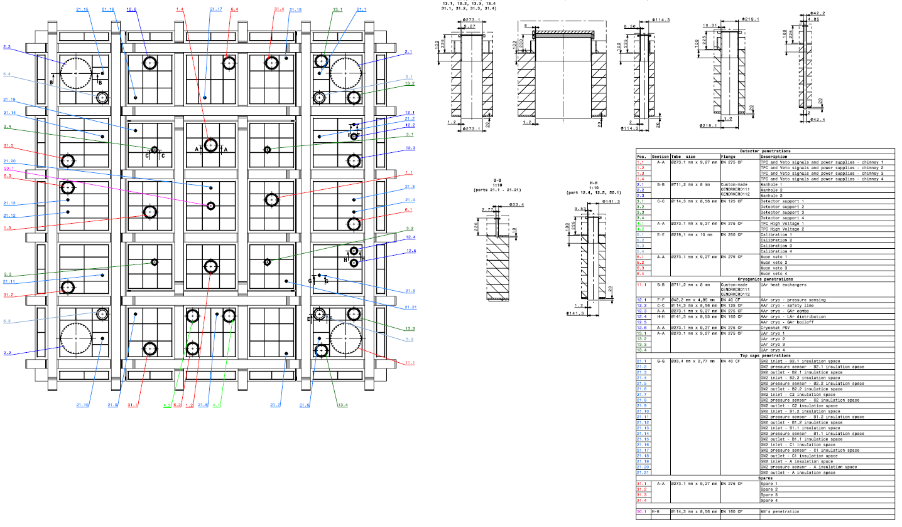

Slide 17
