Slide 1
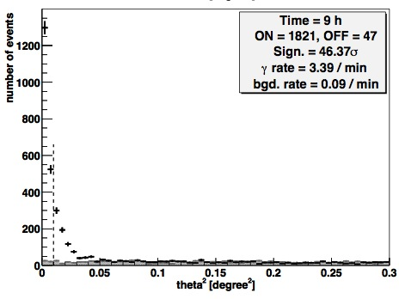

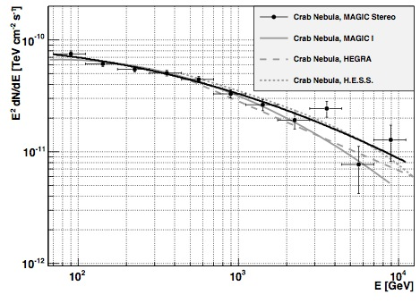
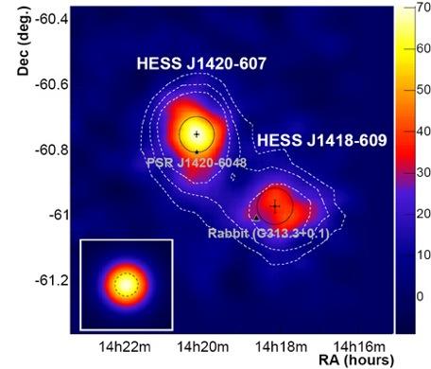
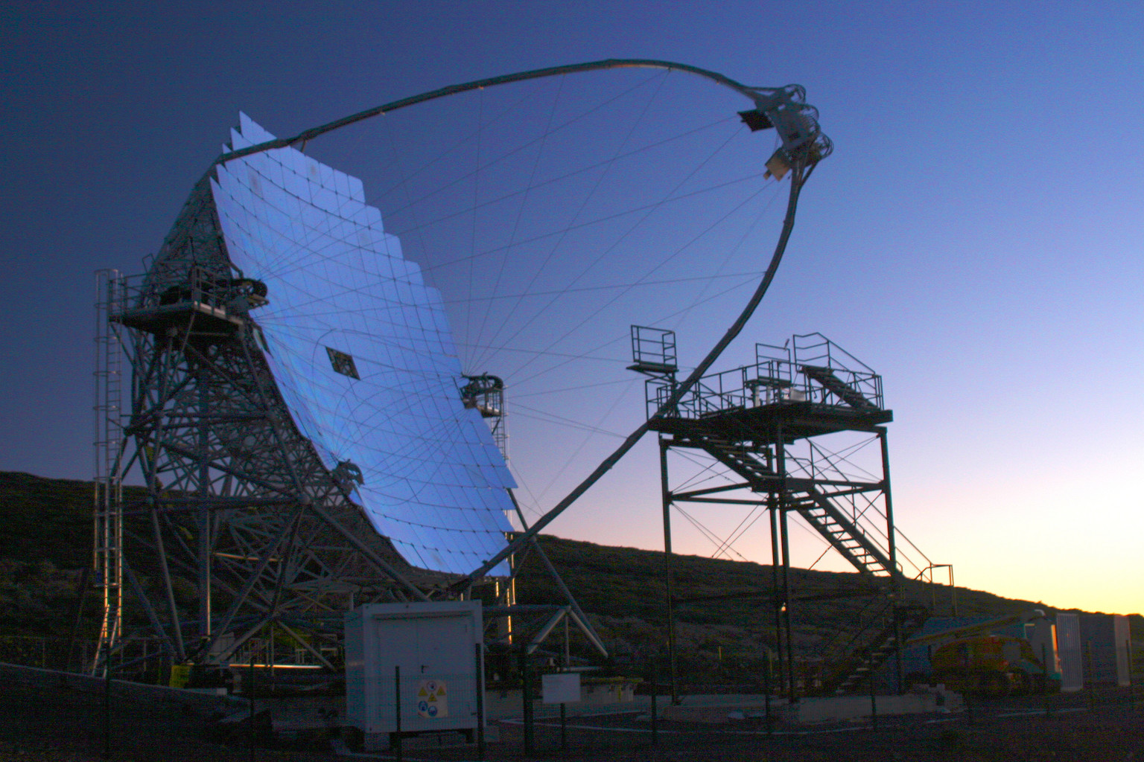
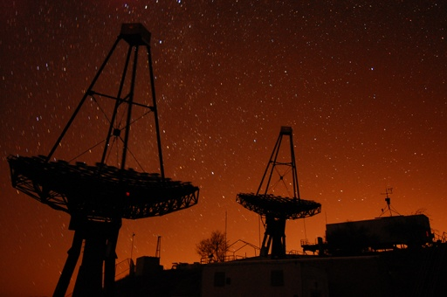
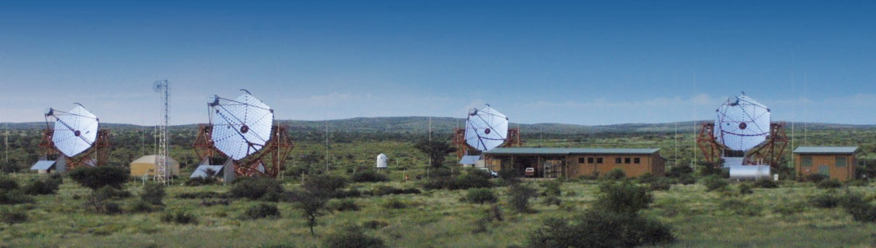
It’s a kind of MAGIC
Come i raggi gamma ad altissima energia diventano segnale
PART 1
Elisa Prandini
Padova University
MAPSES – Lecce
23 November 2011

Slide 2
Summary
Intro: VHE γ-rays Astrophysics
Observation Technique
Instruments and data taking
From raw data to shower images
Background Rejection and Signal extraction
Physics results:
  Sky Maps
  Integral and differential fluxes
Many thanks to Marcos Lopez and Francesco Dazzi

Slide 3
Intro: VHE γ-rays Astrophysics

Slide 4
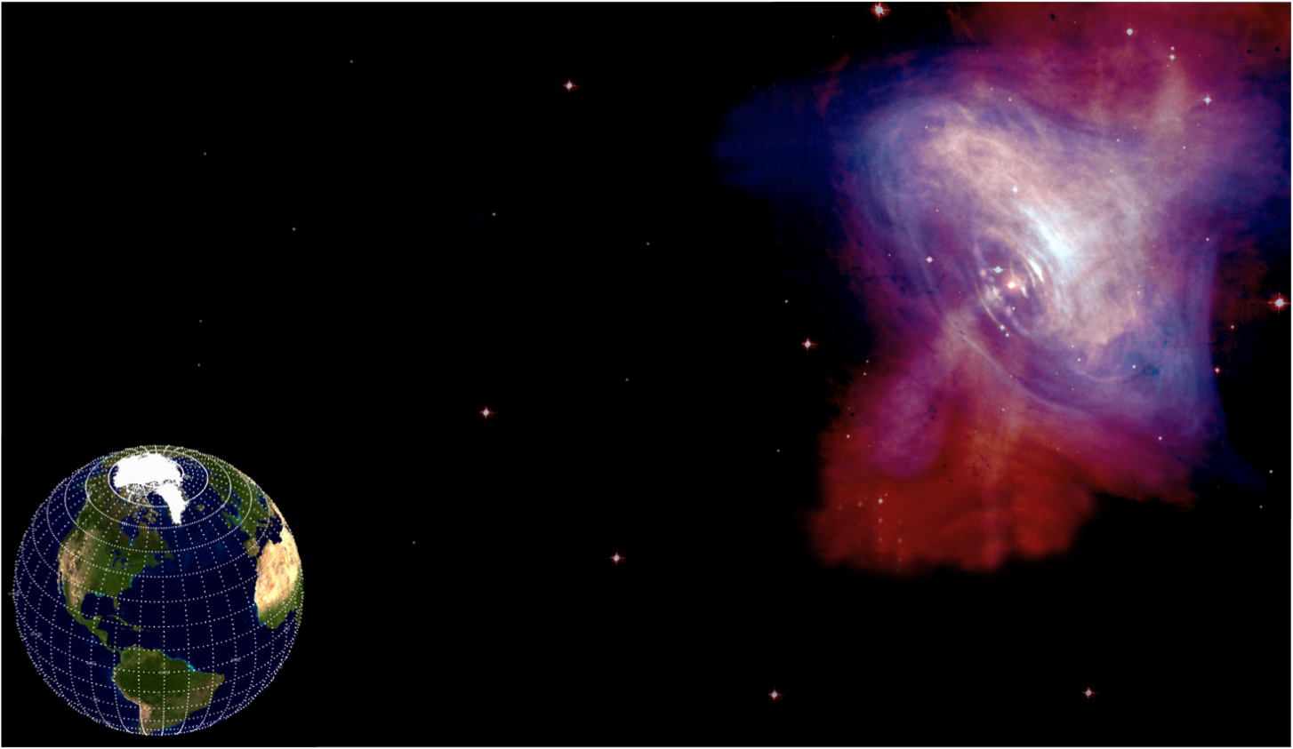

VHE photons: the ideal messengers
Charged particle
γ-ray
Crab
Image combines optical data from Hubble (in red) and X-ray images from Chandra (in blue).

Slide 5
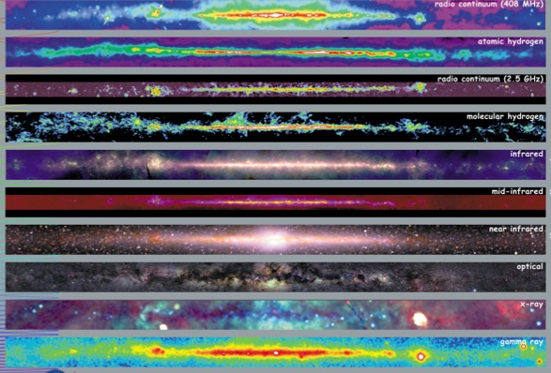
The Milky Way emission
The VHE regime is here: ~100 GeV to 30 TeV

Slide 6
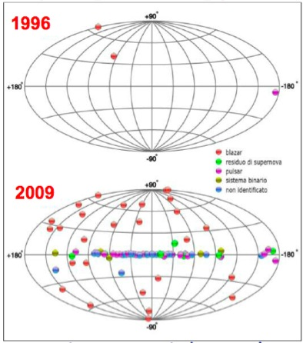
The VHE gamma-ray sky

Slide 7
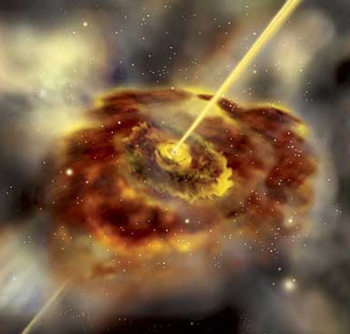
VHE γ-rays Astrophysics
Source detection and monitoring
Cosmology and fundamental physics

Slide 8
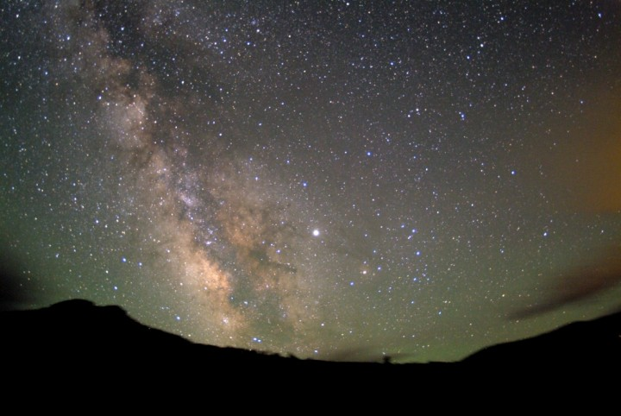
Sources
pulsar
Supernova
Remnants
X-ray binaries

Slide 9
Sources
FSRQs
pulsar
Supernova
Remnants
blazars
X-ray binaries
starburst galaxies
radio galaxies

Slide 10
Sources
FSRQs
pulsar
GRBs
Supernova
Remnants
Dwarf Galaxies
blazars
X-ray binaries
Galaxy Clusters
starburst galaxies
Unidentified objects
radio galaxies

Slide 11
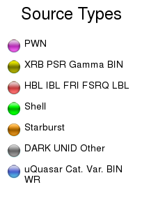
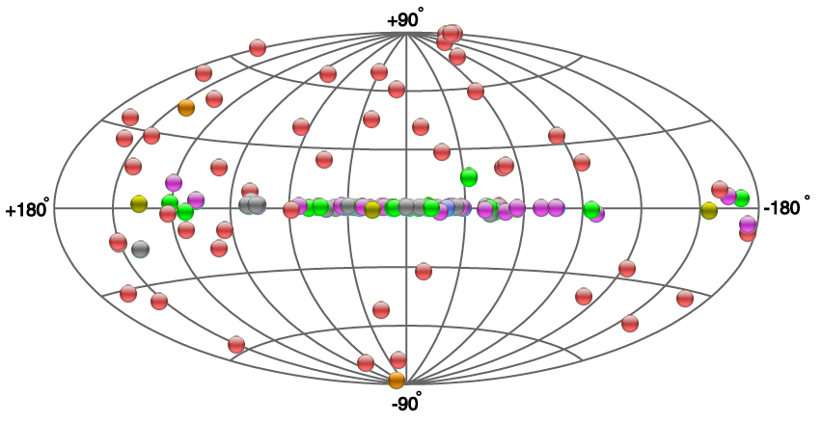
The TeV Sky
From: TeVCat http://tevcat.uchicago.edu/
49 extragalactic objects
61 galactic objects

Slide 12
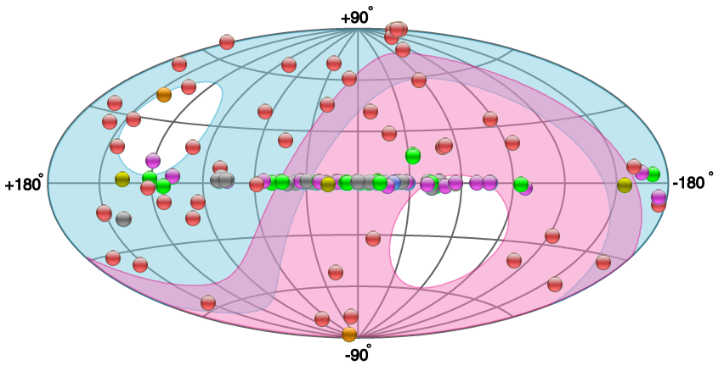
The TeV Sky
Nothern Telescopes
Southern Telescopes
From: TeVCat http://tevcat.uchicago.edu/
49 extragalactic objects
61 galactic objects

Slide 13
Observation Technique

Slide 14
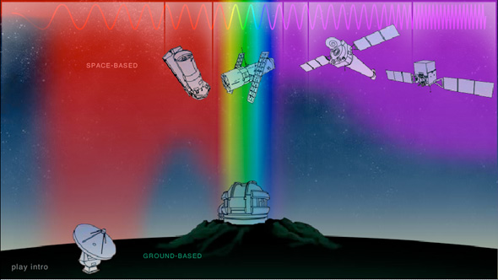
How do we study the sky?
We are here ☺

Slide 15

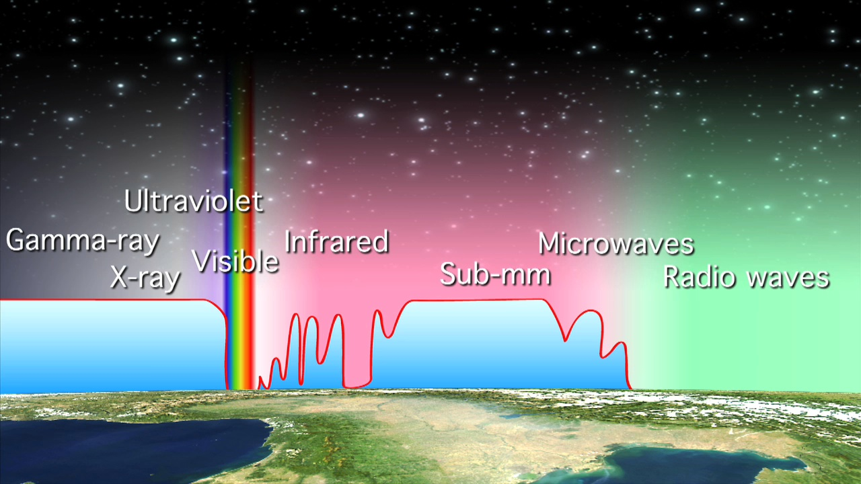

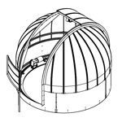
Atmospheric Extinction
100%
opacity
wavelength

Slide 16
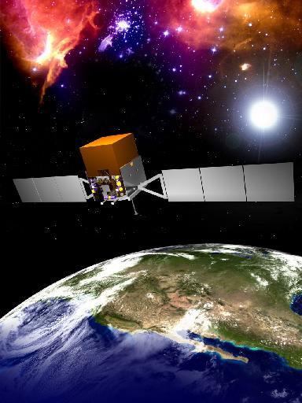
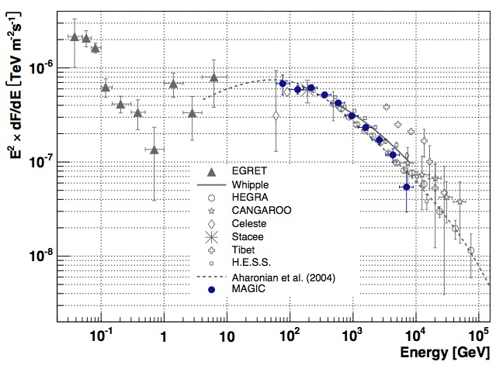
The case of γ-rays
They cannot be detected directly from Earth
Satellite experiments: like Fermi
  has an upper energy threshold of ~ 100 GeV → the VHE range!
  The threshold is due to the reduced surface of the detector related to the low flux of gammas at these energies!
Example: Fermi can detect 1 photon per year @ 1 TeV from the Crab Nebula

Slide 17
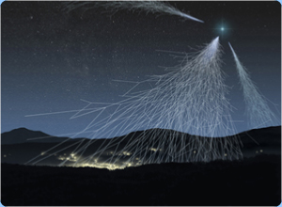
Alternative: indirect detection
What does it happen to a gamma-ray when enters the Earth atmosphere?
  Induces a shower of particles
  We have found a possible method to study gamma rays!
Problems: which is our possible background?

Slide 18
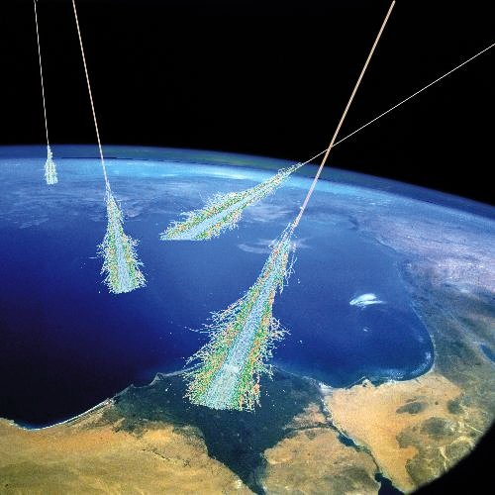
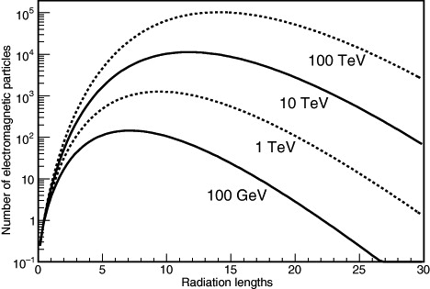
Detection of showers
The “easiest” solution is to look directly the particles which compose a shower
High altitudes required to reach sub-TeV region!!!
2600 m
sea level
4300 m

Slide 19
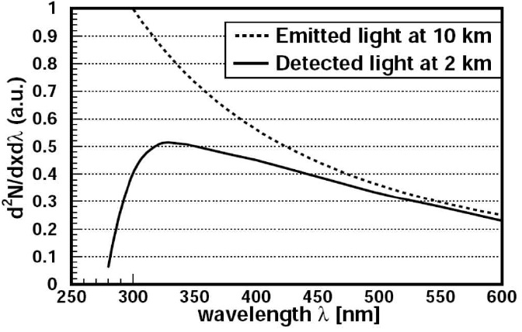
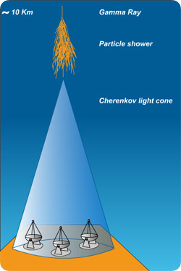
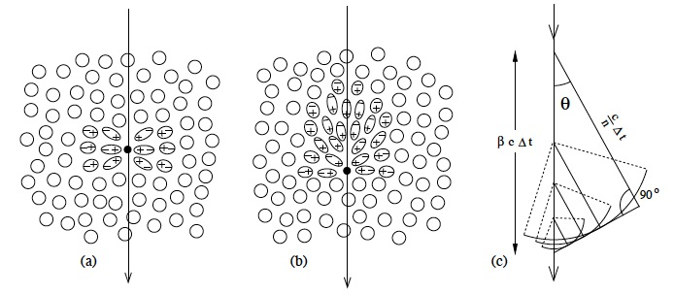
Light emitted by showers
Another solution is to look for light emission produced by particle showers induced by gamma-rays...
... such as the Cherenkov light!
  based on the Cherenkov effect: particles travelling faster than light in a medium polarize the medium and a visible light is emitted
  This light is peaked in the optical window
  It distributes on a light pool of ~ hundreds meters of radius → large effective area!

Slide 20

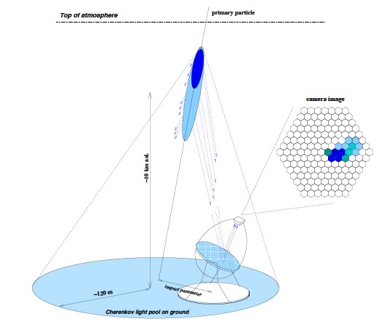
The principle
Imaging
Atmospheric
Cherenkov
Telescopes

Slide 21


Observables
We want to see:
  Cherenkov light (optical)
  flashes (last few ns)
  on a large surface
  when focused form an image

Slide 22
Instruments and data taking

Slide 23
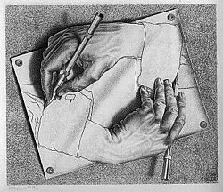
Detector features
Very low photons flux
(e.g. Φ(E_{CRAB} > 1TeV) = ~ 2•10⁻¹¹ cm⁻²s⁻¹)
  Large effective collection area (> 3•10⁴ m², dependency with altitude)
Small wavelength range detectable for Cherenkov light (300 ÷ 400 nm)
  Optimization of the reflective surface and light sensors efficiency in that range
Very brief Cherenkov flashes (few ns)
  Fast electronics (GHz domain)
Very high background
  Implementation of nice algorithms in the trigger and in the software cleaning to guarantee high rejection rate of noise and bad events

Slide 24
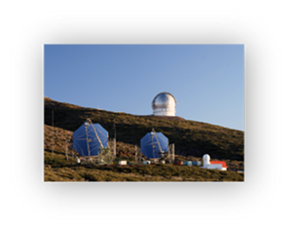

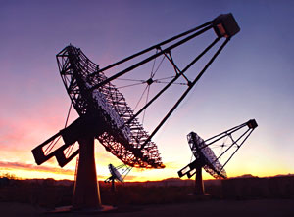
IACTs in the world
MAGIC
VERITAS
H.E.S.S.

Slide 25

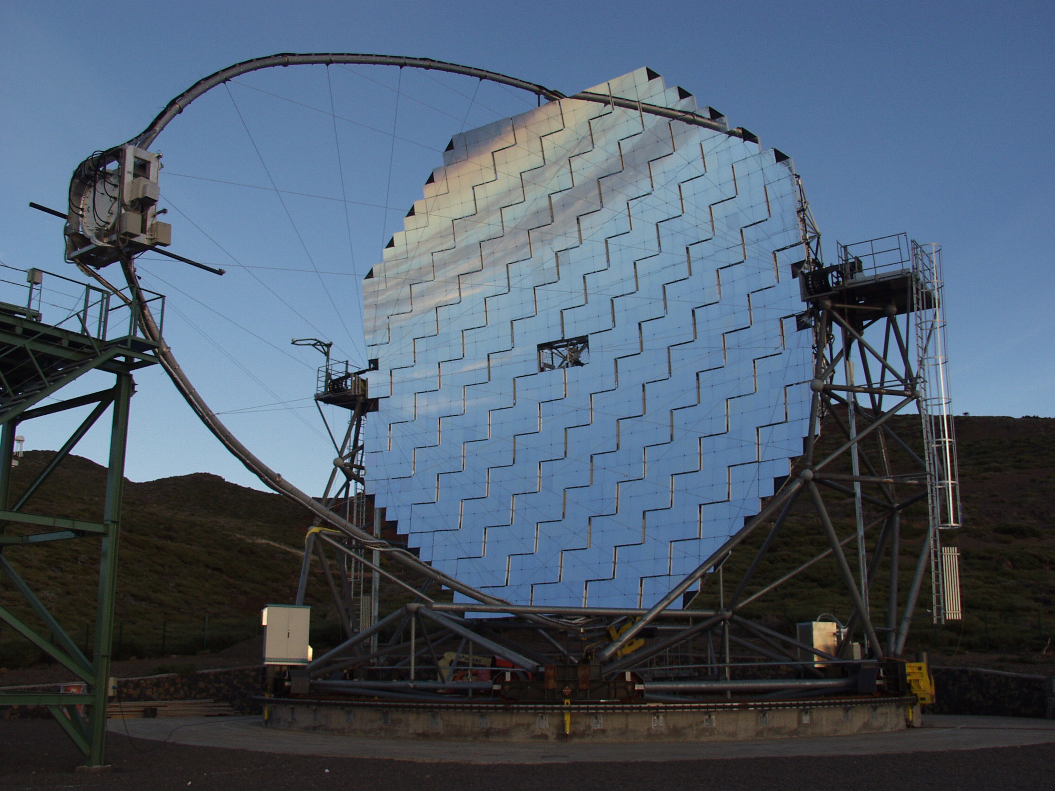
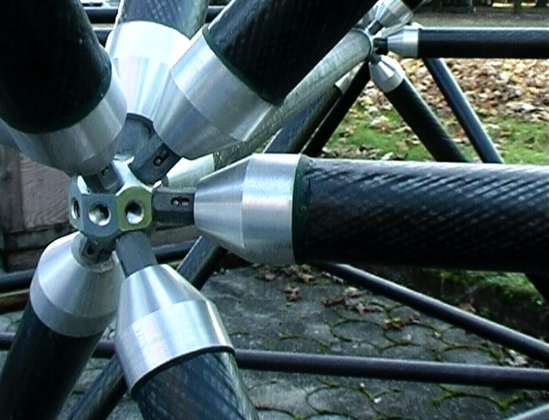
Key technological elements for MAGIC
MIRRORS
STRUCTURE
CAMERA
SIGNAL TRANSPORT
IPE
ACQUISITION SYSTEM
IPE
IPE
NET
CE

Slide 26
Reflective Surface
17 m diameter parabolic reflecting surface (240 m² )
high reflective diamond milled aluminum mirrors
parabolic shape
Active mirror control
(PSF: 90% of light in
0.1º inner pixel)

Slide 27
Key technological elements for MAGIC
STRUCTURE: very light!

Slide 28
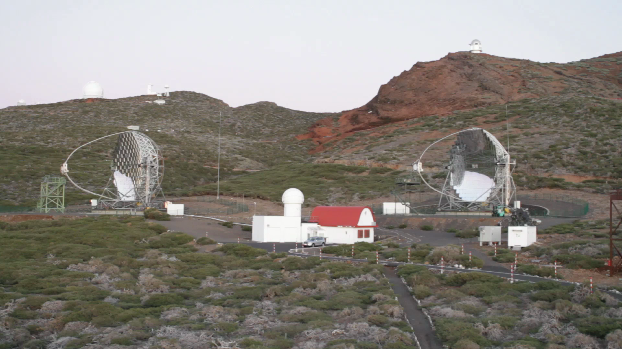

Slide 29
Key technological elements for MAGIC
- 3.5º FOV camera

Slide 30
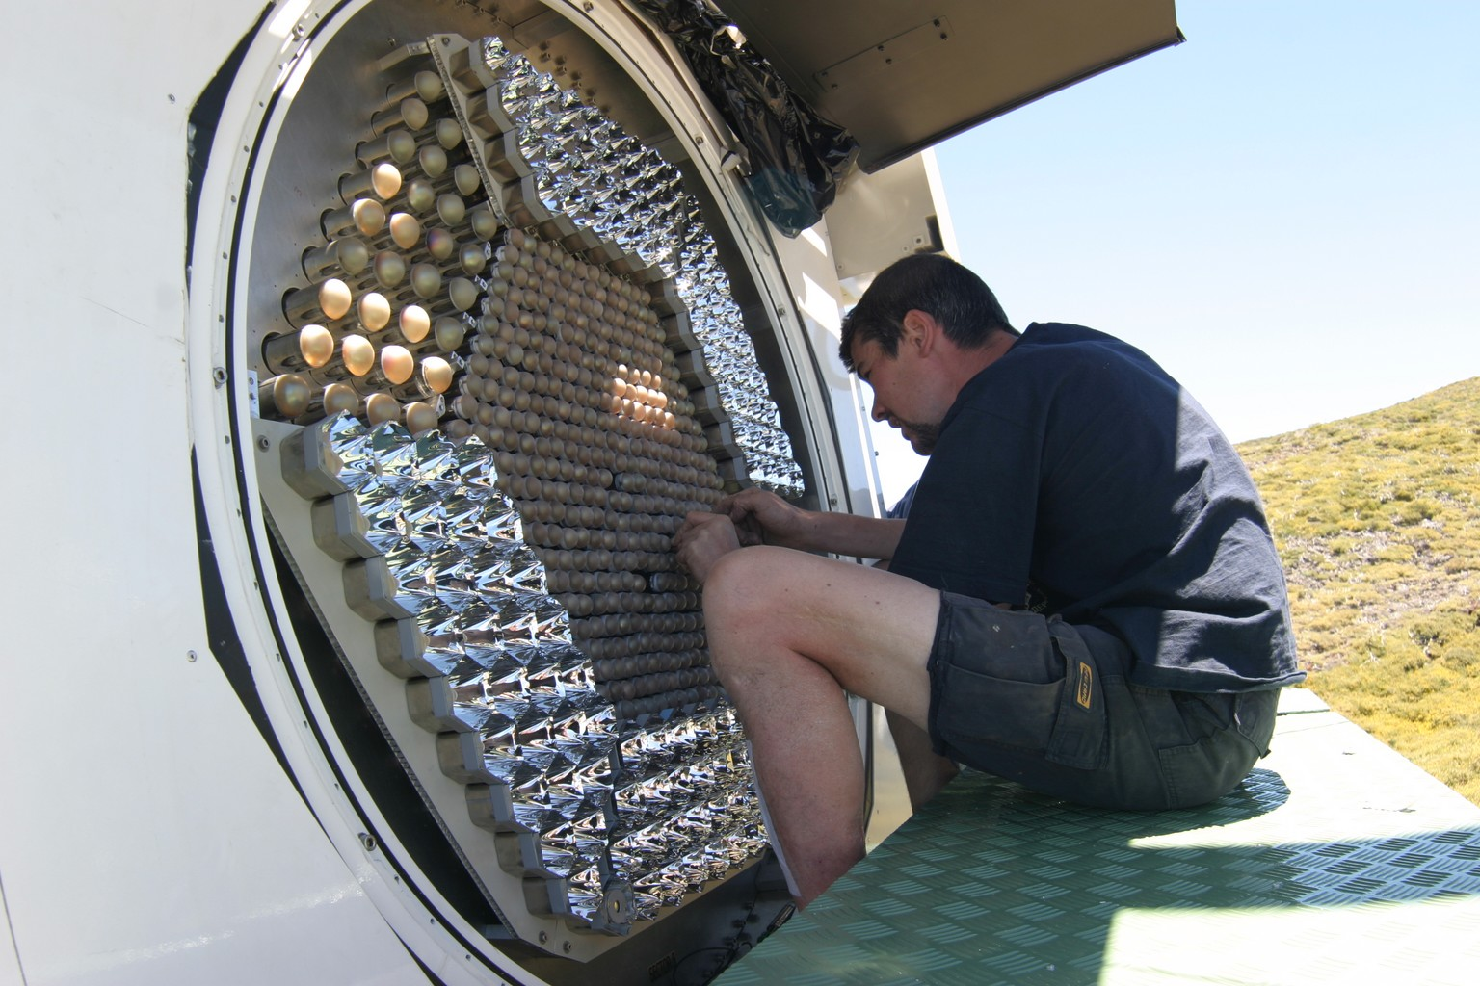
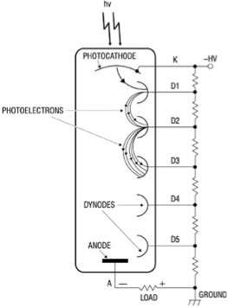
Light sensors
Cherenkov light is focused into each telescope camera
  MAGIC I: 576 pixels (PMT)
  MAGIC II: 1039 pixels (x 0.1 deg)
Light sensors type:
  Traditional PMTs selected by the three main IACT collaborations.
    It’s a well-known technology at relative low cost.
    Unfortunately it is mature and so only small improvements are possible.
    Low PDE between 20÷30%.
  New photo sensors are progressing: HPD & SiPM

Slide 31

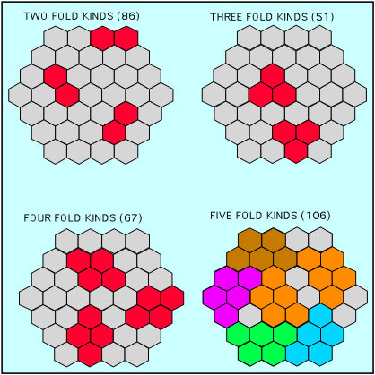
Trigger
An on fly hardware trigger is mandatory, because the maximum DAQ rate is ~ 1KHz!
General trigger concept for IACT Telescopes:
  Detect close compact images produced by few photons and reject noise (NSB & PMT afterpulses), preventing DAQ saturation.
  Based on different levels.
For instance MAGIC standard trigger:
  Level 0: accept signals higher then an adjustable thresholds.
  Level 1: fast coincidence (some nanoseconds) between neighbour PMTs (2-3-4-5 NN logic).
  [L2: enhanced topologic selection made with tree structured lookup table system and apply a prescaler factor.]
  Level 3: stereoscopic coincidence (100ns) between telescopes.
V
TH
OK
NO
t

Slide 32
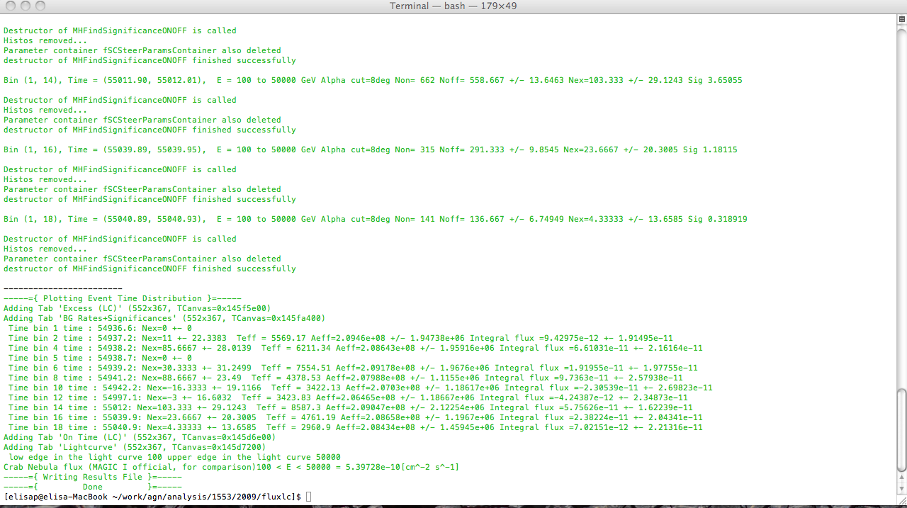

Then each event is recorded and then registered in computers or tapes, waiting for being analyzed

Slide 33
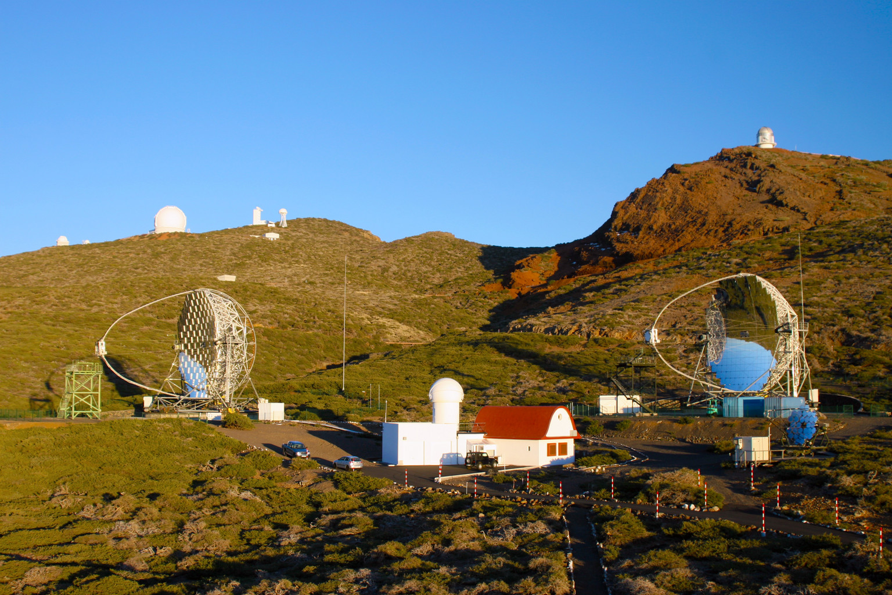

The site
Observatorio Roque de Los Muchachos (ORM)
counting house

Slide 34
The site
Observatorio Roque de Los Muchachos (ORM)
counting house

Slide 35
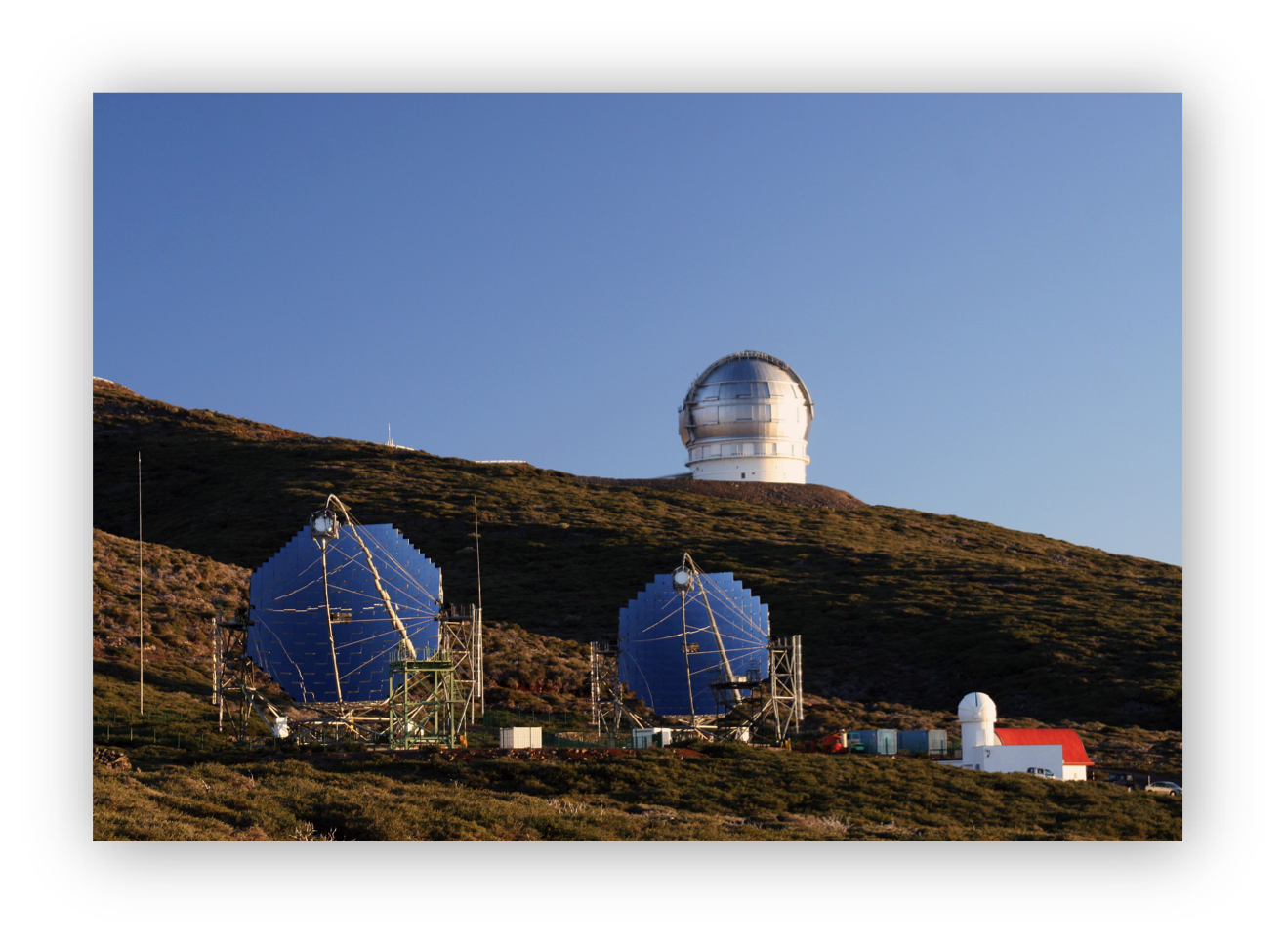
Numbers:
Energy threshold 60 GeV
Energy Resolution ~20%
FOV 3.5º
Angular Resolution ~0.1º
Sensitivity (5 σ in 50 hours) ~1% Crab Nebula flux (> 100 GeV)
MAGIC I (2004)
MAGIC II (2009)
MAGIC I (2004)

Slide 36
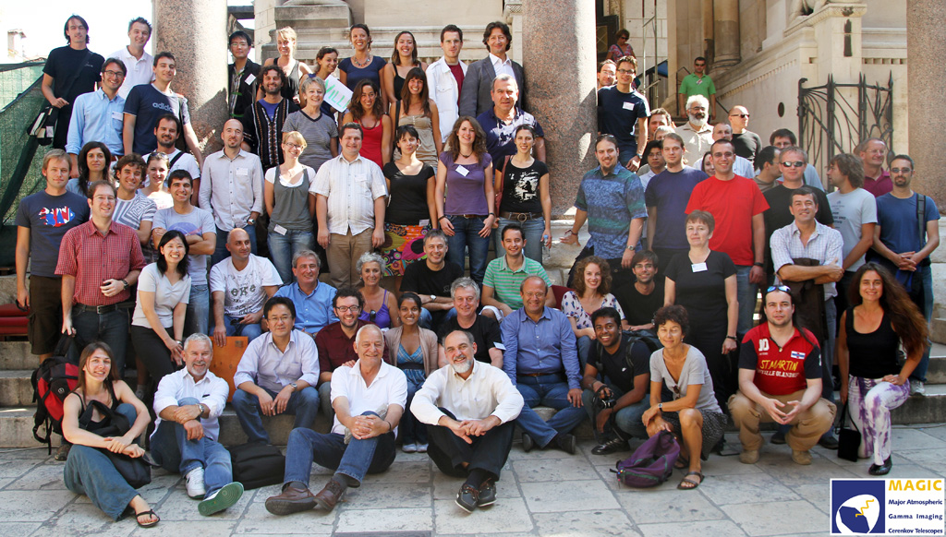
And of course… this is MAGIC:

Slide 37
From raw data to shower images

Slide 38

The Data Taking
Schedule → according to proposals
Observe only during the night
Possible problems:
  Bad weather
  Clouds
  Wind
  Desert sand (Calima)
Duty Cycle: ~ 50-80% [MAGIC]

Slide 39
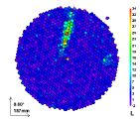
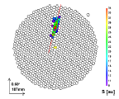
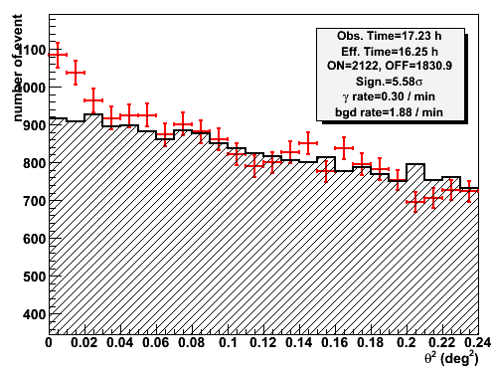
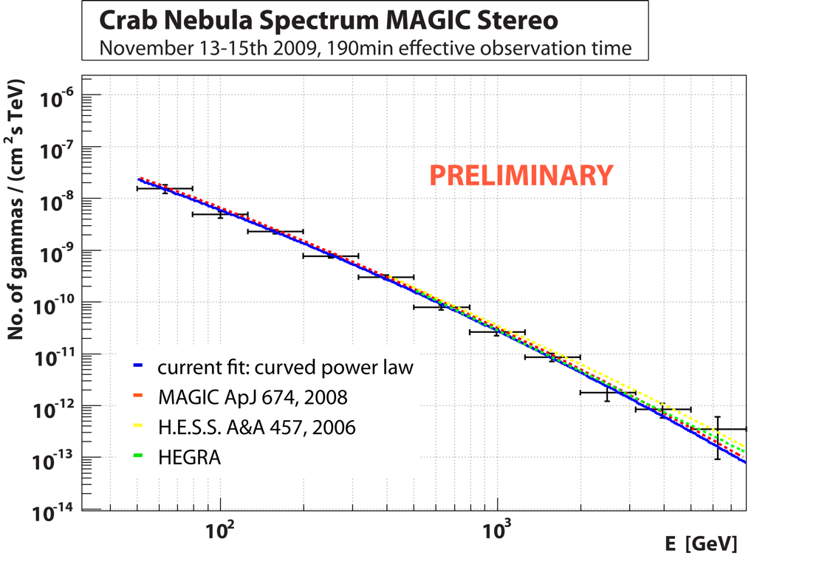
Steps of the Analysis of CT data
Pixel signal extraction
Raw signal
Image cleaning
Cleaned signal
Image parameterization
Stereo- reconstruction
Event parameter reconst
Background rejection
Background estimation
Detection
Source detection
Sky maps
Spectrum
Spectrum / light curve
Spectrum Unfolding

Slide 40
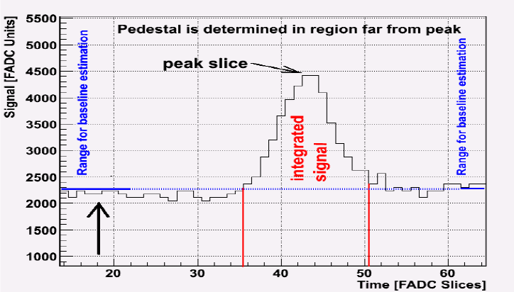
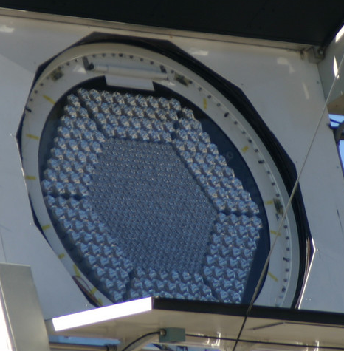

Pixel signal extraction
γ
Timing
For each pixel we get:
  integrated charge Q (FADC counts)
  arrival time T (ns)

Slide 41
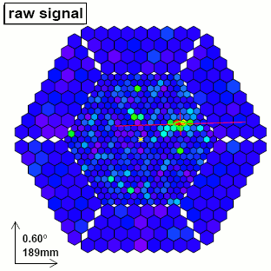
Pixel signal extraction
For each pixel we get:
  integrated charge Q (FADC counts)
  arrival time T (ns)
Then we get a raw image of the shower.

Slide 42

Calibration
Needed to:
Convert charges from FADC counts to ph.e. (or photons)
Correct for the differences between pixels:
  Different Photo Detection Efficiency & gains -> calibrate Q
  Different cable lenghts and transit time in pmt’s -> calibrete T
Method:
  - Take calibration runs. Camera illuminated with uniform light flashes (Flat fielding)
  - Muons signal

Slide 43
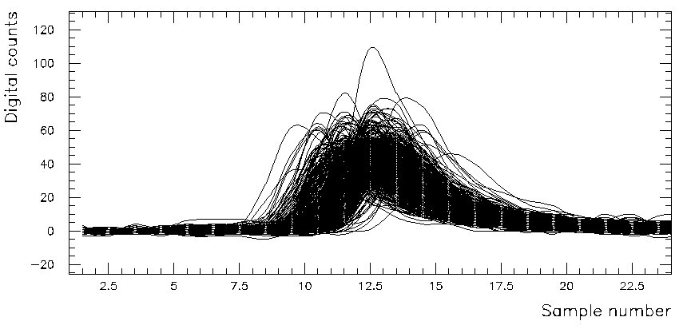
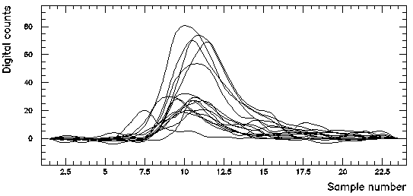
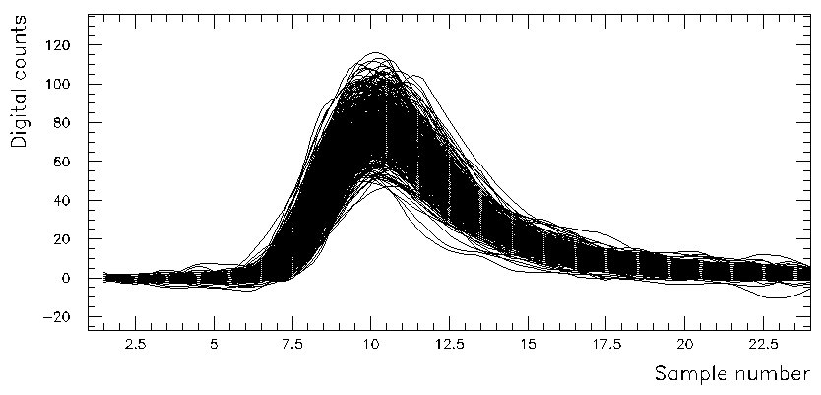
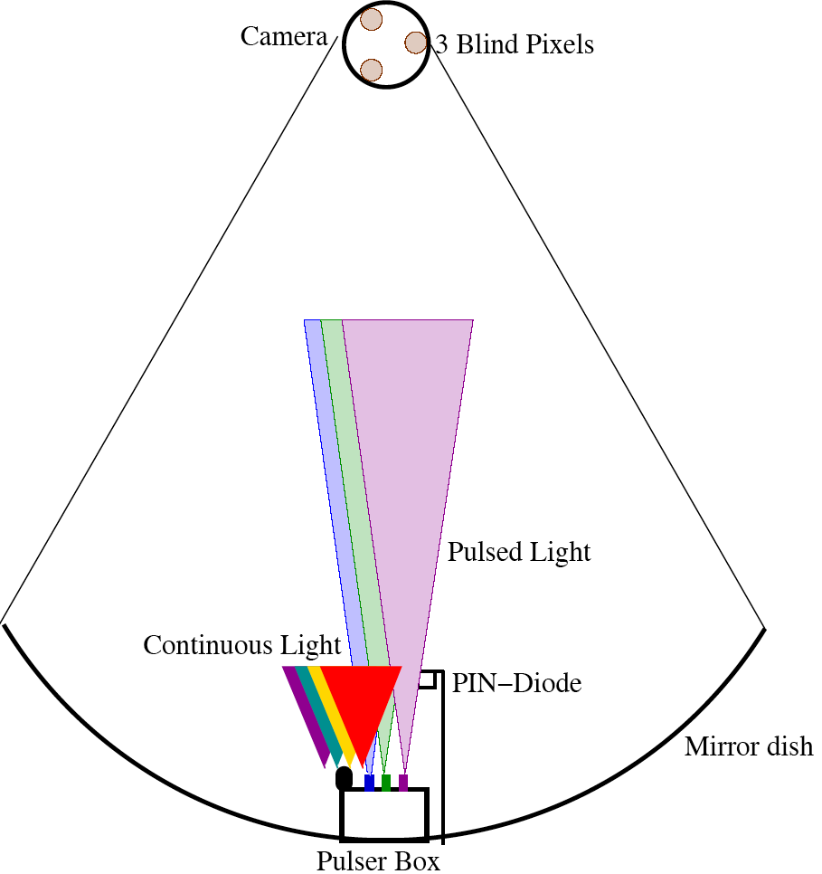

Calibration
Raw data
Response to calibration pulses of different pixels
Time and gain corrected data

Slide 44


Image Cleaning
Goal: Keep only pixels iluminated by the shower, i.e. remove pixels due to NSB
Method: The classical 2 thresholds method
Define 2 cleaning levels:
  keep pixels above first threshold (core pixel)
  keep pixels above 2nd level & neighbor of a core pixel
Depending on the Cleaning Levels more or less pixels survive.
A compromise is needed to retain as many shower pixels as possible but as less as possible NSB pixels
Light from the shower
Light from NSB

Slide 45
Image Parameterization
Input
List of used pixels (after cleaning)
Signal in each pixel
Pulse time of each pixel
Output
List of parameters which characterize each image
for each event and each telescope
extract only the important info!

Slide 46


Hillas parameters
Idea: Images of gamma showers have an oval shape. They can be described by an ellipse, defined by:
Size (or Sum): Σ pixel signal
Centroid: Coordinate of the center of gravity (x,y)
Main Axis (δ angle):
  - Line minimizing signal-weighed
  sum of squared pixel distance.
  - Angle of the 2nd moment matrix
  diagonalization.
Length: Signal RMS along main axis
Width: Signal RMS perpendicular to the main axis

Slide 47

Image quality parameters
Number of island
  Number of separated groups of pixel
  Can characterize the quality of the cleaning
Leakage
  Fraction of signal in the last pixel ring of the camera.
  Characterize how the image leaks outside of the camera
Number of pixels
  Number of core pixels
  Number of inner pixels
?
Leakage
Islands

Slide 48
Source dependent parameters
Mainly used only for single telescope analysis
ALPHA:
  Angle between the main axis
  and the centroid-source line.
DIST (DISP):
  Distance between the centroid
  and source position
MISS
  Distance between the main axis
  and the source position
Azimuthal-Width:
  Image width relative to the axis
  source-centroid
Source position

Slide 49
Extra Hillas parameters
Concentration (x):
  Fraction of the signal in x largest pixels
Asymmetry:
  Distance between centroid and highest pixel
  3rd moments of the signal distribution
Hillas parameters of the main island
And many others…

Slide 50


Image cleaning: Timing information
To decrease the cleaning levels, can additionally use the arrival time of photons in the camera
Arrival time distribution
of Cherenkov photons
for gamma-ray shower
For each Pixel we can get:
pulse time
pulse width
Image information:
RMS of pixel time
Time grad along main axis

Slide 51


Stereo observations: 3D param.
gamma ray
Stereo observations allows allows to reconstruct:
  Height of shower maximum
  Shower impact point on ground
  Impact parameter
3D-Length
Height of the shower max
3D-width
Shower-core
Impact point
Impact
parameter

Slide 52

Multi-telescope parameters
Hillas parameters
- Mean Scale Width
- Mean Scale Length
- etc.
Event quality
- No. of triggering tel.
- No. of clean images.
Time parameters
- time tel trigger RMS

Slide 53

Characterization of the events
Once we have obtained the shower images, the next step is to obtain the characteristics of the primary particle which originated the shower (using the parameters!)
Nature of the particle (Background rejection)
Primary Direction
Primary Energy

Slide 54
Background rejection
Gamma/hadron separation

Slide 55




Nature of background
Only air showers produce so rapid light flashes. But not only gamma-rays produce air showers !
Background
Gamma-like
~10⁴ times more frequent!

Slide 56




Gamma/hadron separation
gamma
proton
300 GeV gamma
1 TeV proton

Slide 57




Gamma/hadron separation
Gamma shower
( narrow, points to source )
h (m)
100 GeV proton
Proton shower
( wide, points anywhere )
m

Slide 58



The Background
gamma
Signal
Different images:
distributions of Hillas parameters
hadron
timing
main background
muon

Slide 59

Gamma/hadron separation
Width

Slide 60

Gamma/hadron separation
Length

Slide 61

Gamma/hadron separation
Height of Shower maximum

Slide 62


Gamma/hadron separation
Width
Length
Methods:
Super Cuts:
Cuts on image or/and
shower parameters
Random Forest:
Optimized decision trees
cut
cut
Hadronness
cut

Slide 63

Random Forests
A random forest is a numerical tool aimed to assign a numerical parameter to each event related to the probability of being gamma or hadron-like (“hadronness”)
Ingredients:
  MC Train samples of both species (Gammas & hadrons)
  Parameters to be used
  Statistical settings: #trees, #trials, final nodesize
Advantages:
  Fast calculation (compared to other classification methods)
  Very good separation
  Offers energy dependent cuts
The method implemented by MAGIC

Slide 64

Random Forests
How it works: The growing of a tree
Space parameter divided into hypercubes
Each division done choosing randomly an Image parameter
Algorithm ends when in each final node there is only one kind of event (gamma or hadron)

Slide 65
Random Forests
How it works: The growing of a tree
Space parameter divided into hypercubes
Each division done choosing randomly an Image parameter
Algorithm ends when in each final node there is only one kind of event (gamma or hadron)

Slide 66

The hadronness parameter
Finally, one applies a cut in the HADRONNESS.
Cut depends on the desired gamma purity of the sample
and changes with energy

Slide 67

Therefore:
Cherenkov Telescopes successfully observe the gamma-ray sky at energies above ~100 GeV;
The technique consists of looking at Cherenkov light flashes emitted by showers particles induced by primary gammas;
The signal, for these telescopes, is an optical flash (lasts few ns) that is reflected by large mirrors and focused on a multi-pixel camera;
The registered signal is characterized by a specific ellipsoidal shape;
First step of the data analysis is to extract the signal (i.e. gamma-ray):
  Calibration
  Image Cleaning
  Image parameters calculation
Characterization of the events:
  The hadronness
tomorrow @ 6.30 p.m.

Slide 68
Backup

Slide 69

Satellite Experiments

Slide 70

The MAGIC AMC System

Slide 71

The MAGIC AMC Principle

Slide 72



The MAGIC PSF without AMC
zen = 8º
AMC = 60º
zen = 22º
AMC = 93º
zen = 81º
AMC = 8º

Slide 73


The MAGIC Point Spread Function
zen = 8º
zen = 22º

Slide 74


Slide 75
First aim: signal detection
Our case: we have to discriminate the signal from the background… but what is our signal?
Background
Gamma-like

Slide 76
The analysis
Data acquisition
Calibration
Image cleaning and Hillas Parameters calculation
Hadronness and energy reconstruction
Former steps
File → Set of Events
Event → Set of Parameters characterizing the shower
Remember: event → is a shower (induced by a CR)

Slide 77

The incoming direction

Slide 78

Characteristics of a γ-like event
The ellipse major axis points to the center of the camera
With many telescopes:
The intersection of the axes is related to the incoming direction
Helpful to “detect the signal”

Slide 79
IACT telescopes
Technical features | H.E.S.S. | MAGIC | VERITAS
Altitude | 1800 m | 2225 m | 1275 m
Telescope number | 4 | 2 | 2
Reflector diameter | 12 m | 17 m | 10 m
Reflector genre | Davies-Cotton | Parabolic | Davies-Cotton
Focal distance | 15 m | 17 m | 12 m
Reflective area | 107 m² | 236 m² | 106 m²
Mirrors technology | Glass | Al & glass | Glass
Number pixels | 960 | 576 - 1039 | 499
Camera FoV | 5° | 3.5° | 3.5°
Light sensors kind | PMT | PMT | PMT
Light sensors QE | 15% | 20-30% | 15-20%
Complete rotation | 3 min | 40 s | 3-4 min
Readout | 1 GS/s | 2 GS/s | 0.5 GS/s
20m
0.10°
Low energy threshold & calibration with satellites
Low energy threshold and high angular resolution
10m
0.15°
DISH DIAMETER
PIXEL SIZE
Cost limitation & potential upgrade with high QE sensors
Cost limitation & reduction of the channels number
5m
0.25°
5.0°
f/1.5
Reduction images truncation and nice observation of extended sources
Reduction aberrations
f/1.2
Performances | H.E.S.S. | MAGIC | VERITAS
Sensitivity | 0.7% 50h | 0.9% 50h | 0.7% 50h
Trigger threshold | 100 GeV | 25 GeV | 75 GeV
Energy resolution | 15% | 15% | 10-15%
Angular resolution | 0.06° | 0.09° | 0.09°
FoV
OPTICAL SYSTEM
3.5°
Cost limitation & potential use of heavy camera
Cost limitation & potential use of smaller pixels
2.5°
f/0.7

