Slide 1


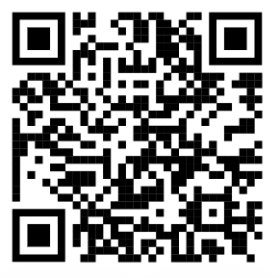

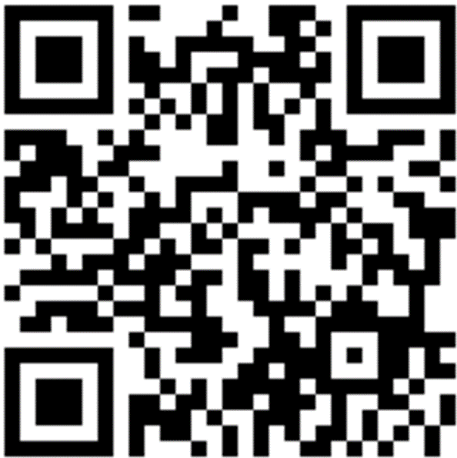
CH4rLiE
Associate Professor. Dr. Daniele Dondi
Director in Laboratory of Radiation Chemistry and EPR Spectroscopy
Department of Chemistry, University of Pavia, 27100, Italy.
Thursday, June 06th, 2024

Slide 2
TGA of Z-10 25-1000°C @ 20 °C/MIN

Slide 3
TGA Overlay of Z-10and Z-5 25-1000°C @ 20 °C/MIN

Slide 4
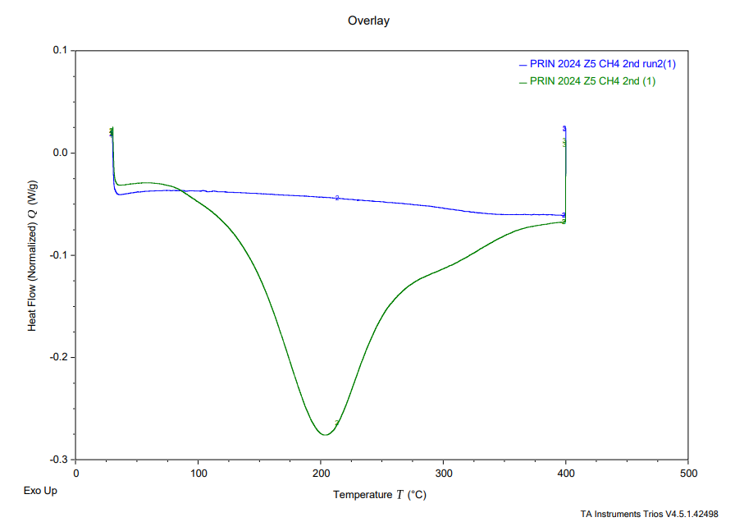
DSC of Z-5 sample at 40-400°C @10°C/min

Slide 5
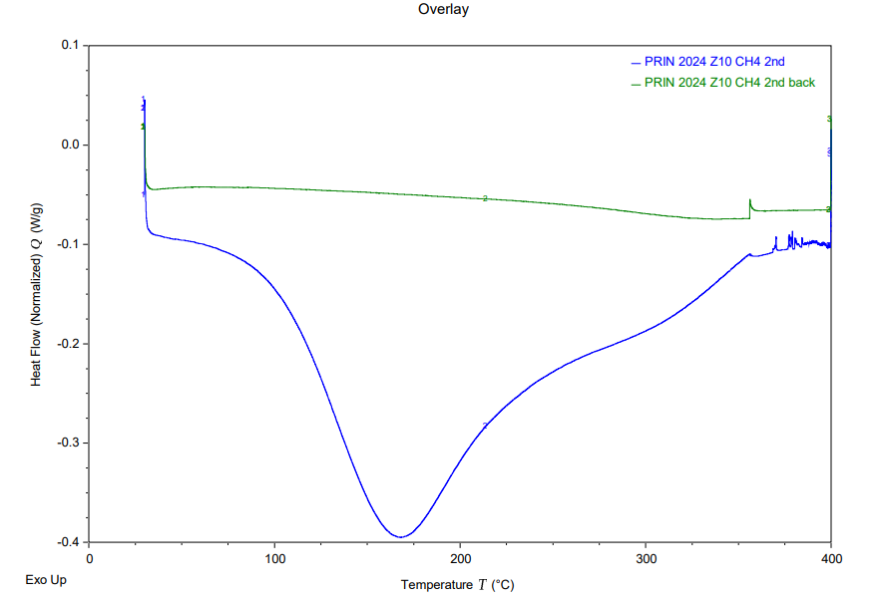
DSC of Z-10 sample at 40-400°C @5 °C/min

Slide 6
Further Experiments
The Amount of sample obtained from Tubes
Z-5-211.5g
Z-10-201.6g
These samples are transferred from the tubes to pouch, stored and utilized for further testing
The experiments planned with these samples
1.The adsorption of carbon materials in zeolite pores and pyrolysis of zeolite to obtain porous carbon material for the purpose of gas adsorption.
2. To find out the extent of CH₄ adsorption of Zeolites(Z5,Z10). The Process is to dry the Zeolites under vacuum and freshly adsorbing CH₄ and analyzing the samples is bound to reveal the extent of CH₄ adsorption on zeolite pores

Slide 7
Further experiments Cont.;
1.The candidates are Urea and melamine.
The procedure is to dissolve the compounds in water and add zeolite and sonicate the mixture and to distill out water.
The Samples prepared under these conditions were and they are stored for further analysis
Urea-Zeolite(Z-10)(20%-80%)
Urea-Zeolite(Z-10)(10%-90%)
Urea-Zeolite(Z-5) (20%-80%)
Urea-Zeolite(Z-5) (10%-90%)
The Samples under preparation are
Melamine-Zeolite(Z-10)(20%-80%)
Melamine-Zeolite(Z-10)(10%-90%)
Melamine-Zeolite(Z-5) (20%-80%)
Melamine-Zeolite(Z-5) (10%-90%)

Slide 8
Acknowledgement
Thank you

