Slide 1
Plasma sources design for plasma-based accelerators
Angelo Biagioni
Lucio Crincoli
Laboratori Nazionali di Frascati INFN, 6 Aprile 2024
Angelo.Biagioni@lnf.infn.it

Slide 2
Contents
What is a plasma?
Principles of accelerator physics
Plasma-based particle acceleration
SPARC_LAB test facility
Gas-filled capillary plasma source
Plasma module to confine and characterize plasmas
How is the capillary characterized?
Stark broadening technique
Outside the capillary

Slide 3
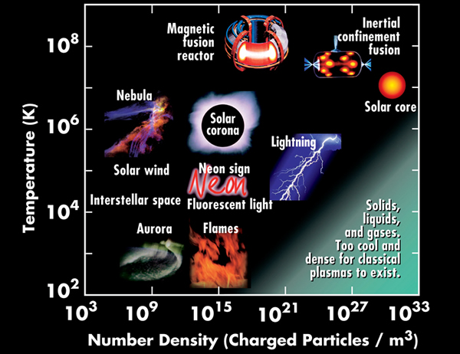
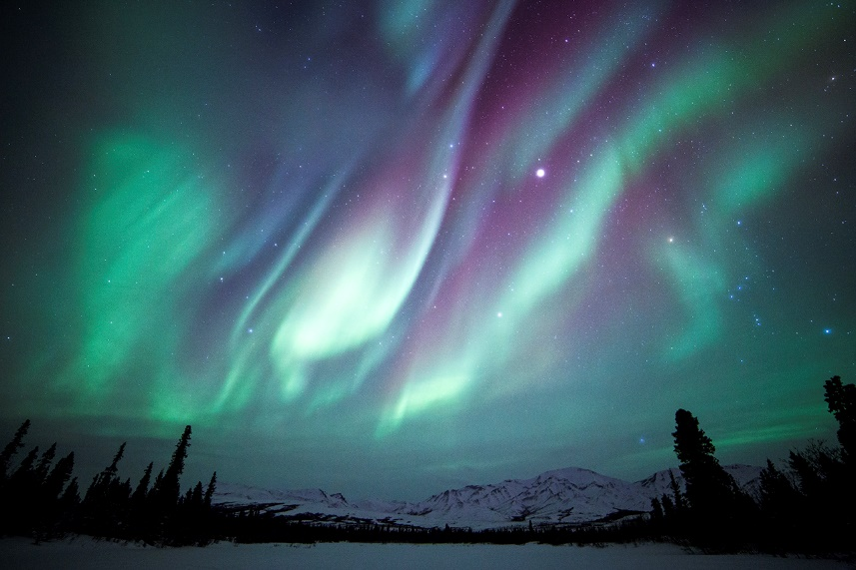
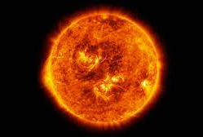
What is a plasma?
The plasma approximation: Charged particles must be close enough together that each particle influences many nearby charged interacting with the closest particle (these collective effects are a distinguishing feature of a plasma). The plasma approximation is valid when the number of electrons within the sphere of influence (called the Debye sphere whose radius is the Debye (screening) length) of a particular particle is large.
Cold or non-thermal plasma is less well ionized:
although the electrons are high temperature, the positive ions and neutral particles are at a lower temperature. When a fluorescent lighting tube is switched on, cold plasma (at room temperature) is set up within the tube.
Examples of plasma:
Aurora
Sun

Slide 4
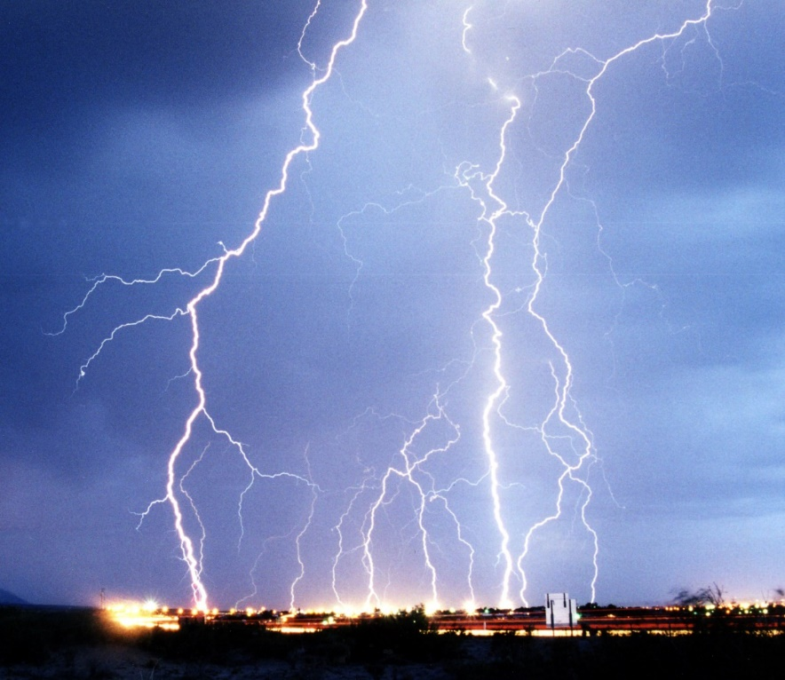
What is a plasma?
Natural plasmas
Artificial plasmas
Natural plasma:
Ip = 10-200 kA
Tp ~ 4-5 eV
Vp =10⁶ kV
Artificial plasmas:
Ip = 0.3 – 1 kA
Tp ~ 2-10 eV
Vp = 5-20 kV
Bulk interactions: The Debye length is much smaller than the physical size of the plasma. This criterion means that interactions in the bulk of the plasma are more important than those at its edges, where boundary effects may take place. When this criterion is satisfied, the plasma is quasineutral.
Collisionessless: The electron plasma frequency (measuring plasma oscillations of the electrons) is much larger than the electron–neutral collision frequency. When this condition is valid, electrostatic interactions dominate over the processes of ordinary gas kinetics. Such plasmas are called collisionless.

Slide 5
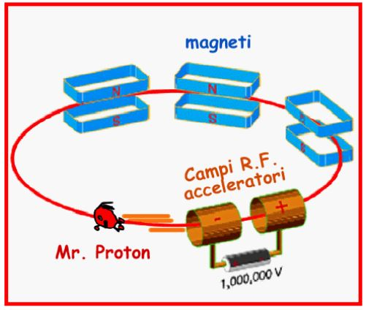
Principles of accelerator physics
Magnet
Main components of an accelerator:
Particle source
Thermoionic gun
Photocatode
Accelerating RF structure
Magnets for beam guiding
Vacuum system
S
N
N
S
RF structures
Particle source

Slide 6
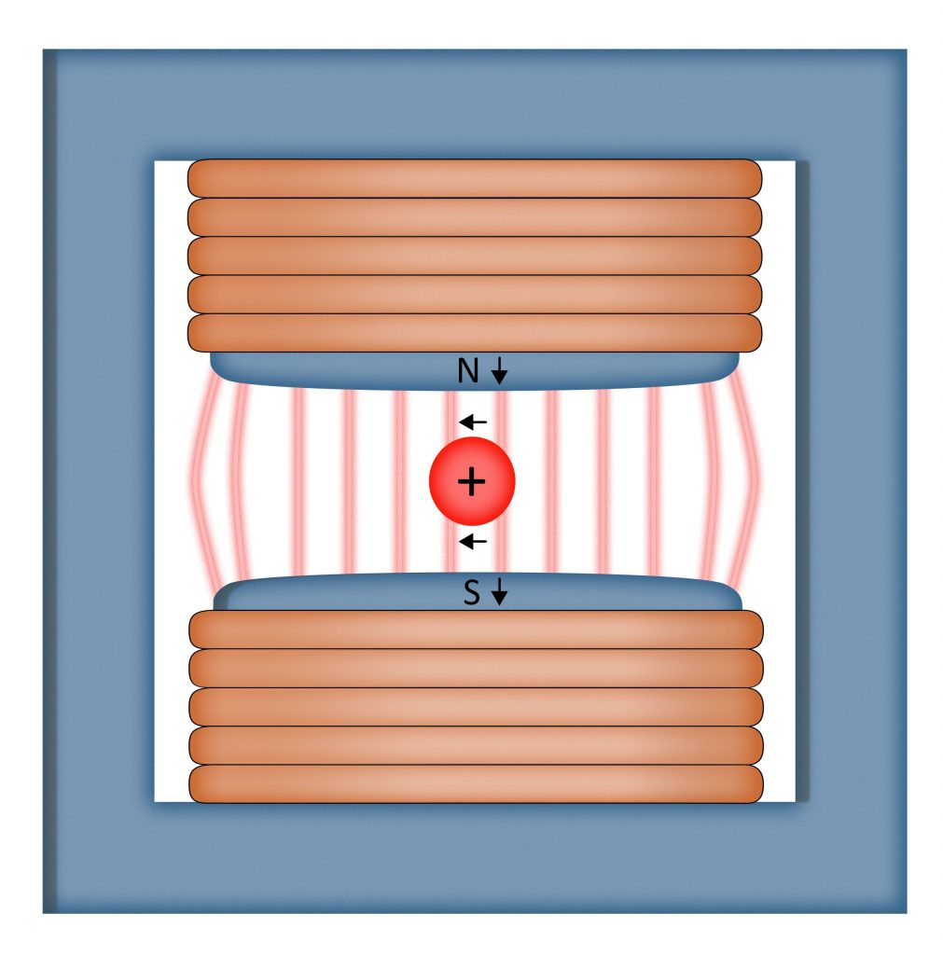
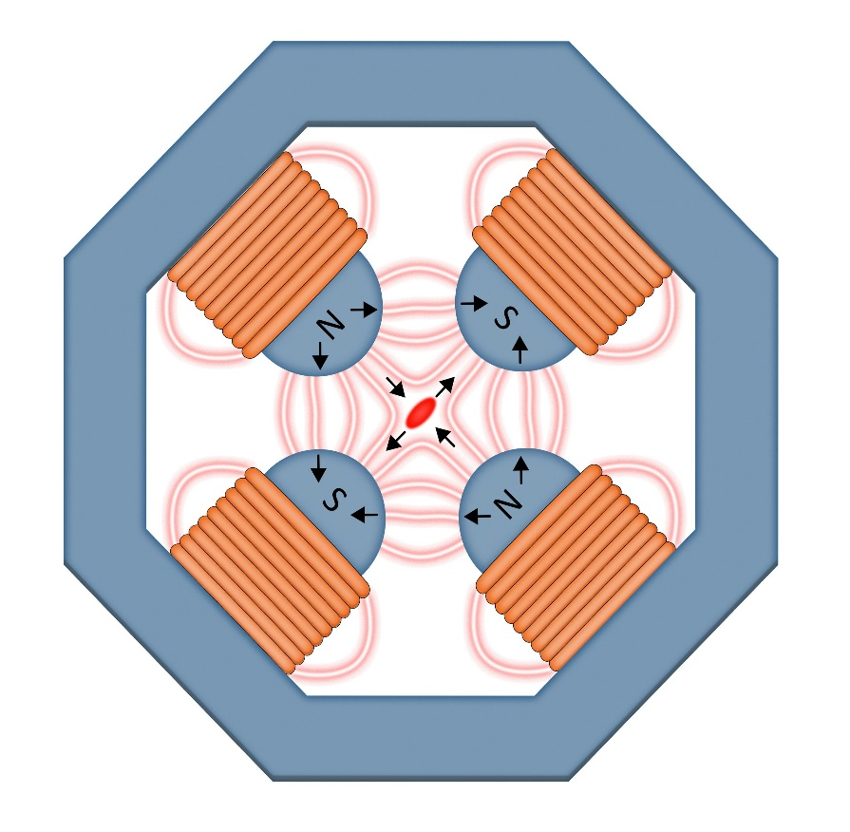
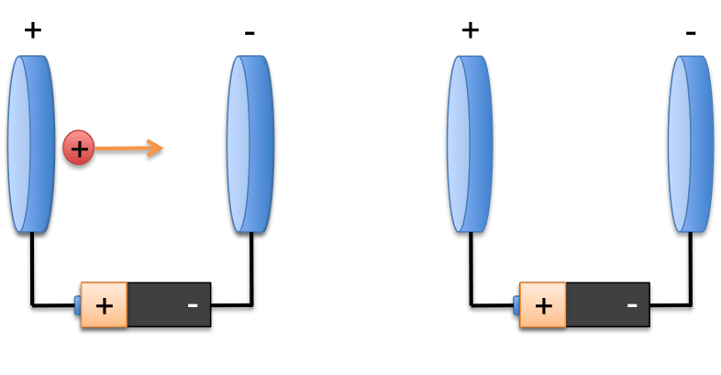
Principles of accelerator physics
A particle accelerator is a device that uses electromagnetic fields to propel charged particles to high speeds and to contain them in well-defined beams.
$$\vec{F}=q\left[\vec{E}+\vec{v} ×\vec{B}\right]$$
ELECTRIC FORCE:
Used to accelerate the particles
MAGNETIC FORCE:
Used to bend and focus the beam
-
Dipole
Quadrupole

Slide 7
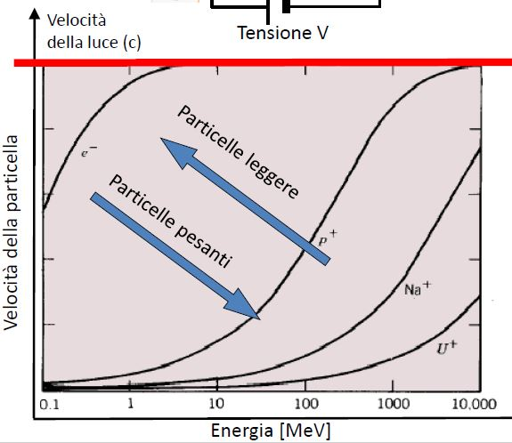
Principles of accelerator physics
Speed of light (c)
Energy gain:
One electron is accelerated with 1V gain an energy of 1eV
Accelerating a particle does NOT necessarily signify increasing the velocity. What increases is p=mv
One electron becomes relativistic (velocity close to c) when his energy E>5MeV
One proton needs an energy 1000 more than an electron to become relativistic.
Light particles
Velocity
Heavy particles
Energy

Slide 8
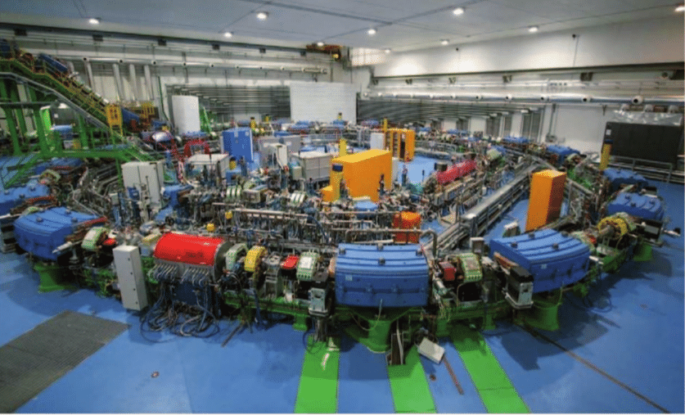
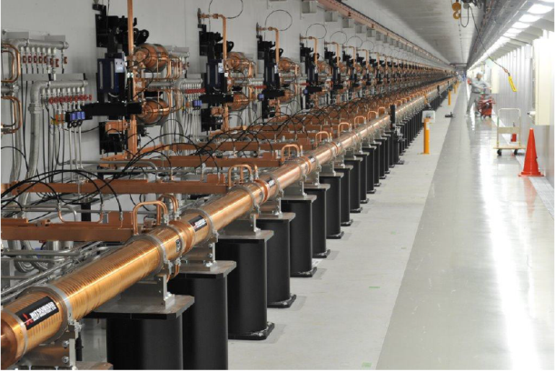
Principles of accelerator physics
Main limitations
Circular accelerators:
Heavy particles , strong magnetic fields are required
$$E∝p=q∗R∗B[T]$$
Light particles -> Synchrotron radiation
$$U∝\frac{E^{4}}{m_{0}^{4}}$$
Linear accelerators:
Limited gradient to avoid discharges
$$E=L∗G[{eV}/m]$$

Slide 9
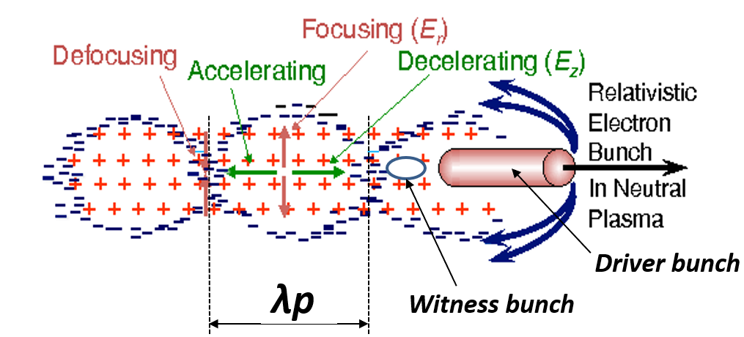
Plasma Wakefield acceleration
$$E_{acc}$$
Plasma density measurement represents a crucial point to implement plasma-based devices.
$$ω_{p}=\sqrt{\frac{n_{p}e^{2}}{m_{e}ε_{0}}}$$
$$λ_{p}=\frac{2πc}{ω_{p}}→λ_{p}∝\frac{1}{\sqrt{n_{p}}}$$

Slide 10
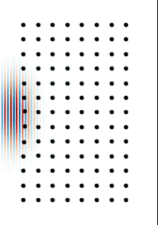
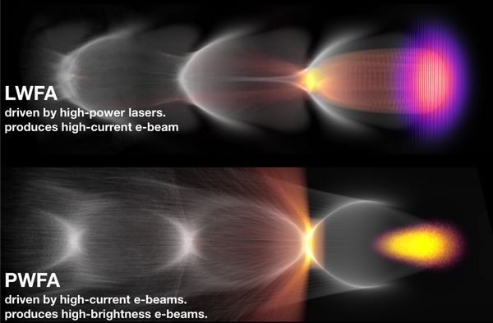
Plasma Wakefield acceleration
An intense laser beam is used to drive a relativistic plasma wave, within which are formed strong longitudinal electric fields able to accelerate beams of charged particles.
e⁻
Plasma
DRIVER
A driver bunch of ultra-relativistic electrons or protons are sent through a stationary plasma

Slide 11
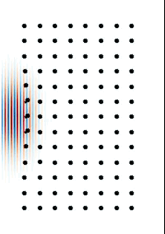
Plasma Wakefield acceleration
Linear regime (α < 1)
Weakly NL regime (α = 1)
Non-linear regime (α > 1)
Linear regime
Quasi-Linear regime
Non-Linear regime
1
2
4

Slide 12
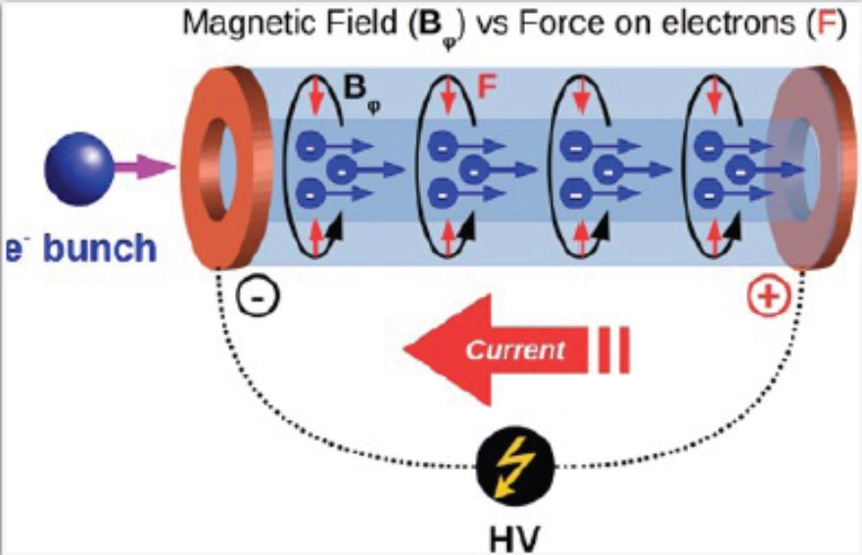
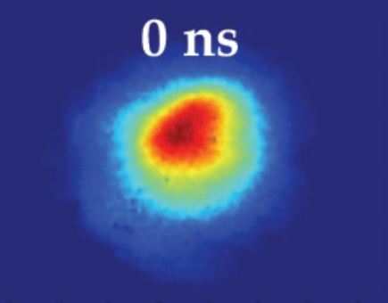
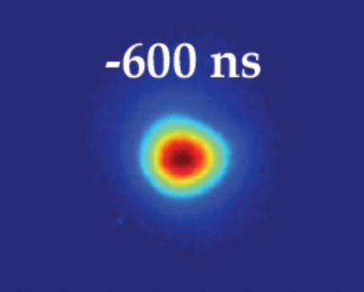
Plasma-based focusing
Active Plasma Lenses
Focusing (Compactness)
90 μm
25 μm
B_{φ} > 500 T/m

Slide 13
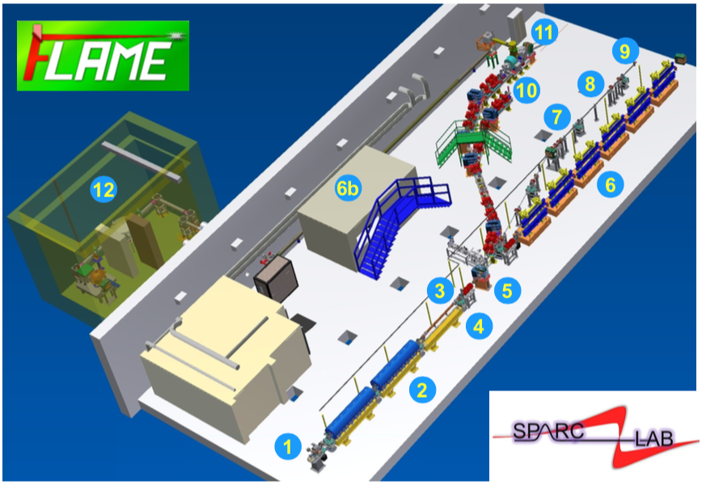
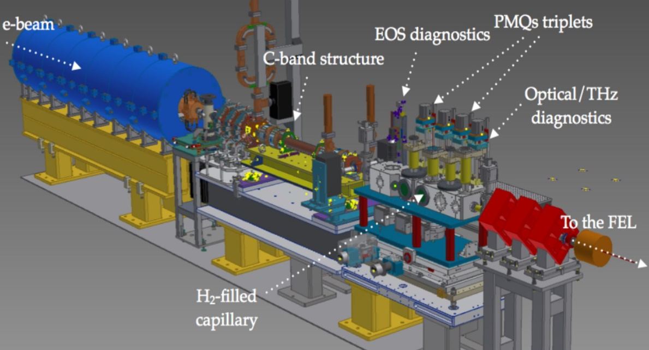
SPARC_LAB test facility
Advantages of plasma accelerators:
Compactness
Accelerating gradient
S-band accelerating structures(2): 20 MV/m
C-band accelerating structures(3): 35 MV/m
Up to 10-100 GV/m for Plasma-based
accelerating structures
Sparc_lab test facility

Slide 14
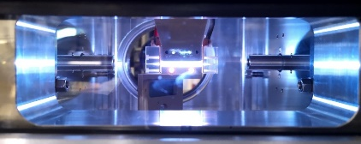
SPARC_LAB test facility
Plasma module
RF-Gun
RF-band
FEL
Users
Energy increasing up to several GV/m:
PWFA
LWFA
e-beams have to be produced and prepared for plasma modules (hundreds of MV/m)
At EuPRAXIA@SPARC_LAB user facility

Slide 15
SPARC_LAB test facility
COMB Chamber

Slide 16
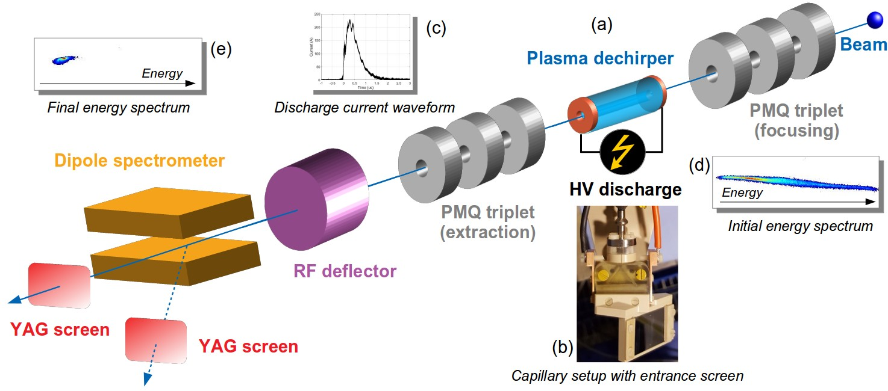
Integrated capillary for stage focusing and acceleration
Active plasma
lens
Acelerating
section
Integrated plasma module
Focusing
lens
Plasma capillary
Plasma capillary
Extraction
lens
Quadrupoles are essential
to achieve plasma acceleration
Alinegment issues
Compactness (20 cm)
No motors to move PMQs
Strong current-modulated magnetic field (1 kT/m)
Plasma formation
Lens ON Acc ON Lens ON
Current pulses
Acc-200A
3 us
Lens-500A

Slide 17
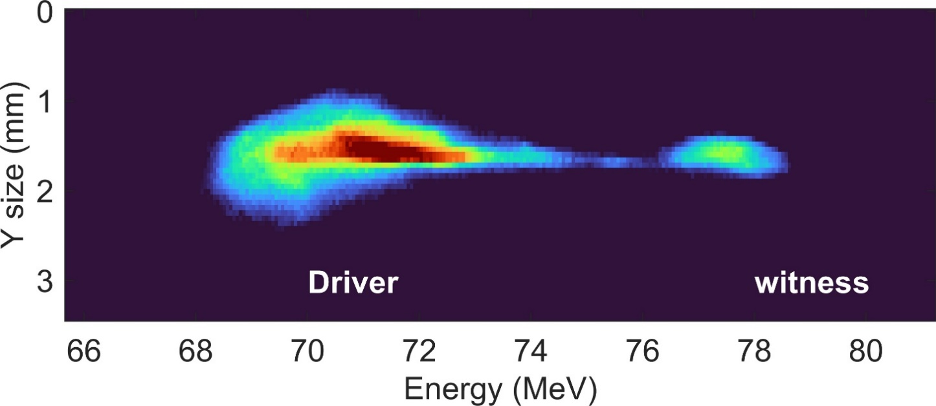
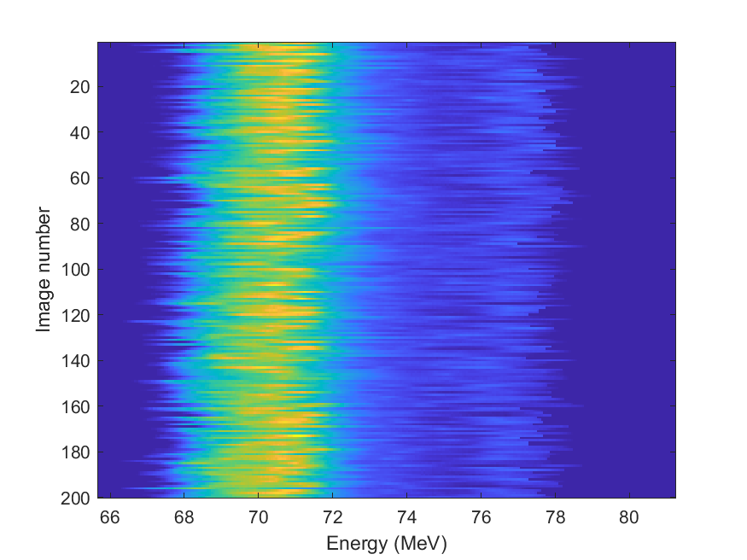
Integrated capillary for stage focusing and acceleration
Driver
Witness
5 MeV/3cm acceleration in 19 cm long integrated plasma module with 200 pC driver/50 pC witness
3 cm long accelerator with 200 A ionization current
3 cm long plasma lenses with 500 A ionization current
Plasma density inside the accelerator set to 2x10¹⁵ cm⁻³
~150 MV/m accelerating gradient
Stability of the accelerated beam

Slide 18
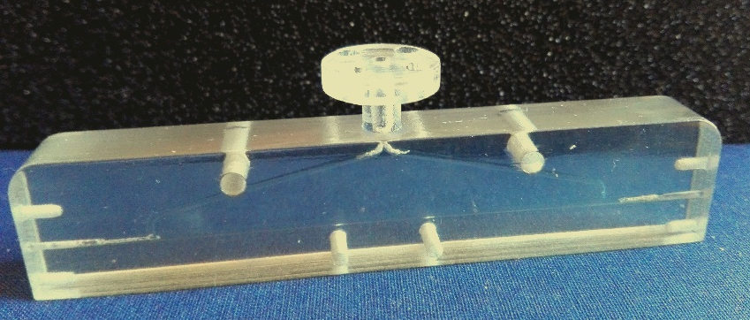
Gas-filled capillary plasma source
3cmx1mm
two inlets
10cmx1mm
single inlet

Slide 19
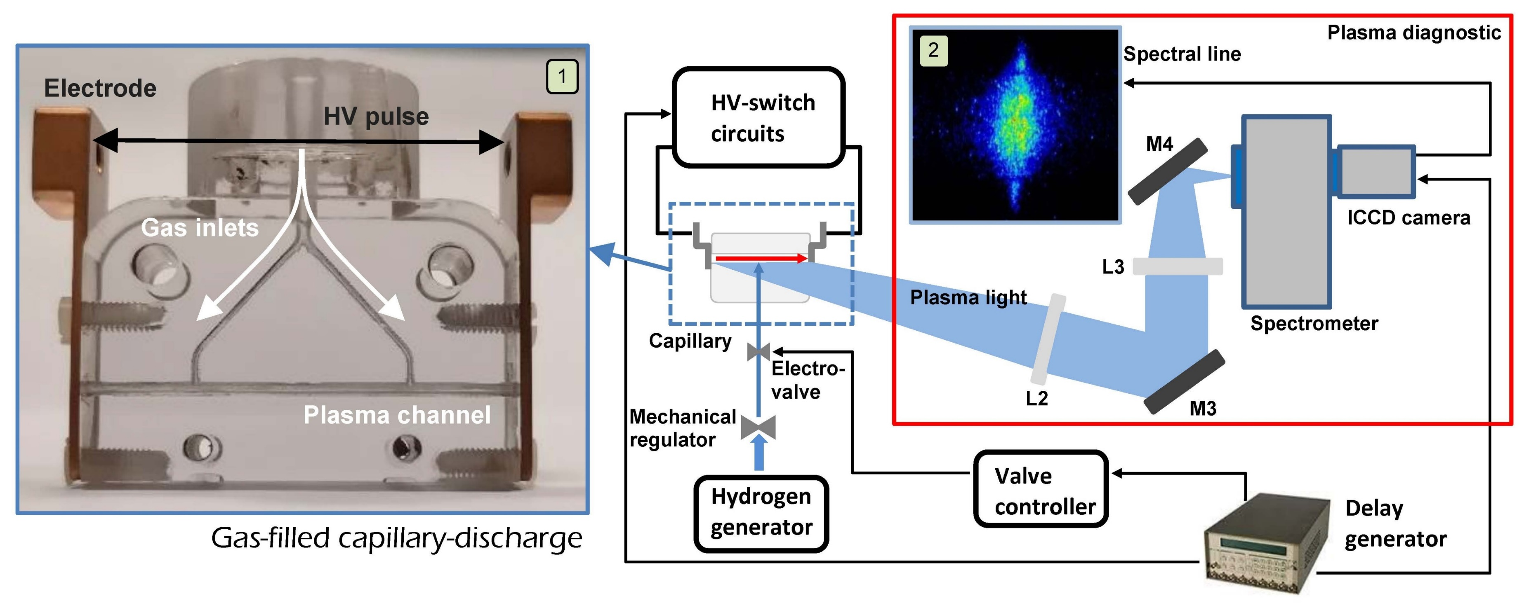
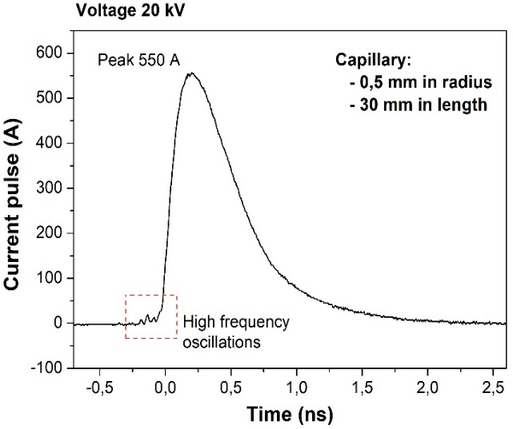
Plasma module to confine and characterize plasmas
Capillary shapes:
Length (Energy)
Radius (Density)
Timing:
Valve opening time
Voltage delay time
Trigger of ICCD camera
Spectrometer:
Grating
Optical alignment
Camera timing:
Delay time
Gate time

Slide 20
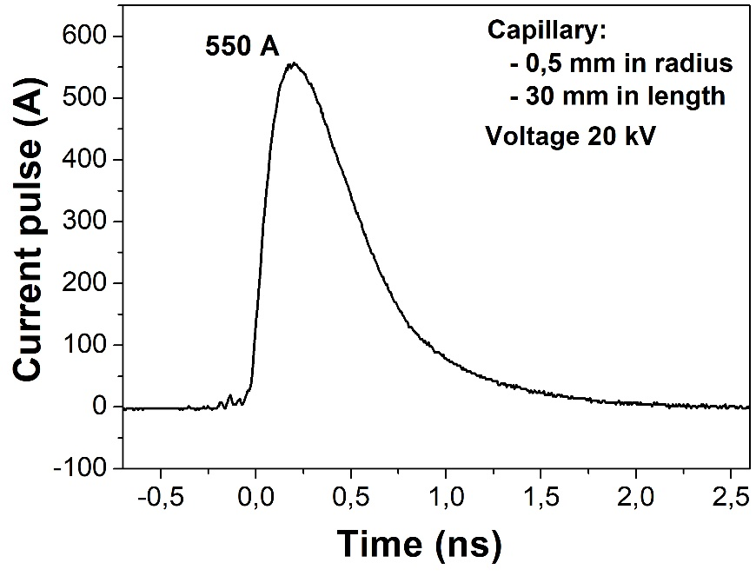
Plasma module to confine and characterize plasmas
Plasma Diagnostic
ICCD
camera
Vacuum
Discharge circuit – 550 A
Spectrometer
Parameters: 10 Hz/3 ms
Duration | Vacuum (mbar)
Starting values | 1.3x10⁻⁹
t₀ | 4.3x10⁻⁸
60 min | 6.4x10⁻⁸
Capillary
Vacuum
10⁻⁷ mbar
Current pulse
Gas injection system – 3 ms
Gas injection
Our chamber is an experimental chamber that is a little bit different from the real COMB chamber used on the accelerator machine
Capillary shape | 3 cm 1mm | 10 cm 1mm | 40 cm 1mm
Opening time | 5 ms | 14 ms | 48 ms
Voltage | 6 kV | 11 kV | 60 kV

Slide 21
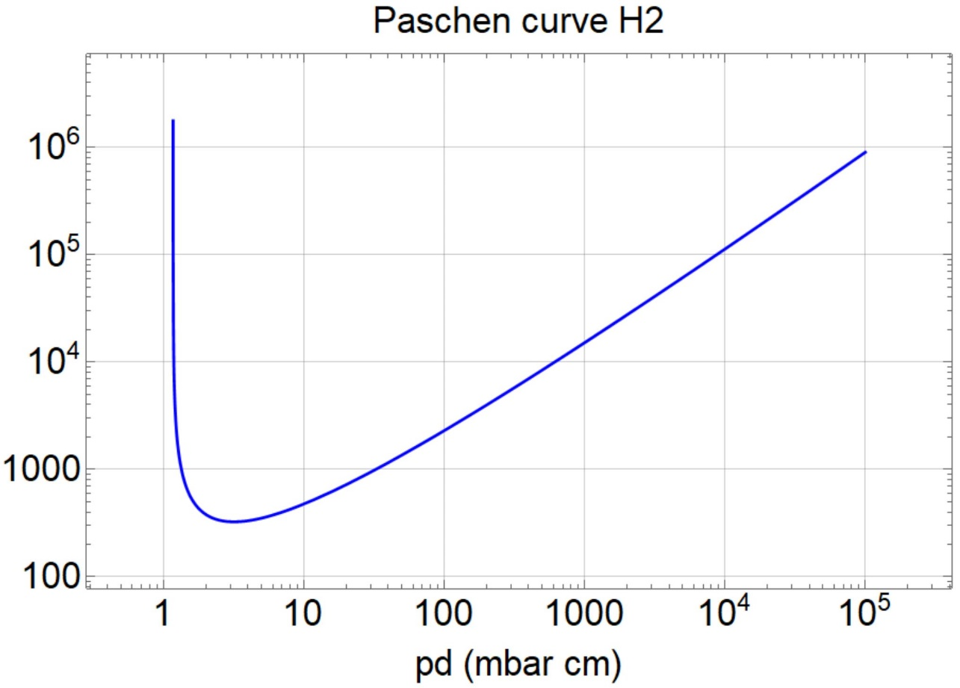
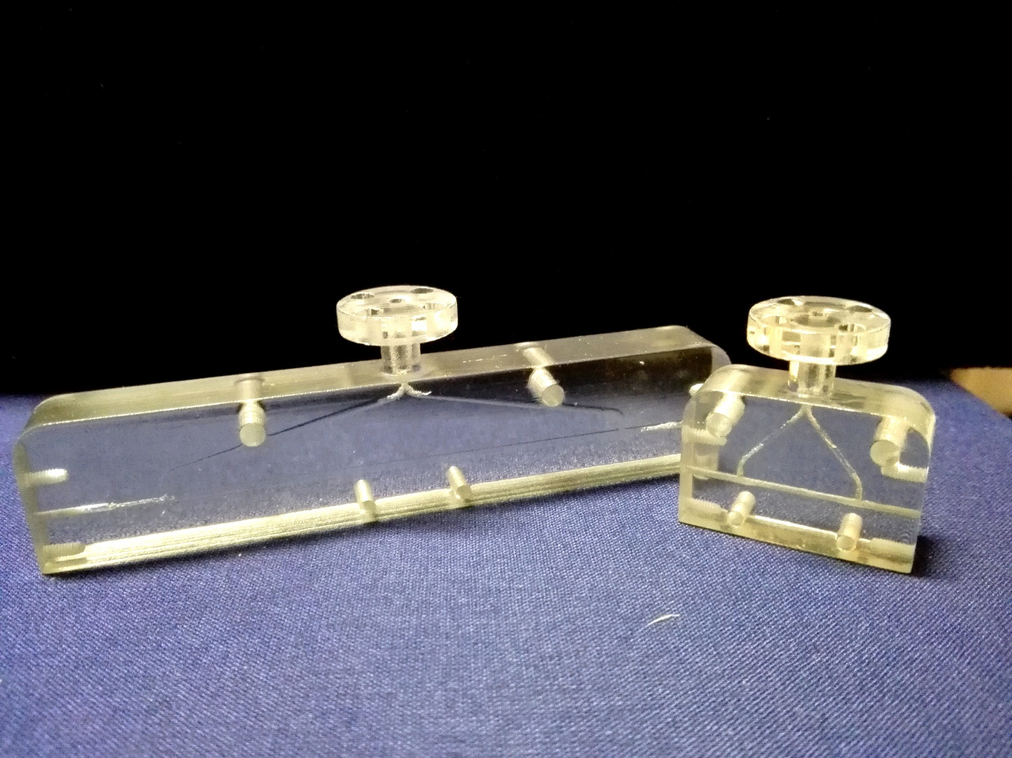
Plasma module to confine and characterize plasmas
First step: producing the plasma
V_{b} (V)
3 cm - 1 mm
10 cm - 1 mm
PRESSURE LENGTH | 600mbar | 800mbar | 1000mbar
1cm | 600 | 800 | 1000
3cm | 1800 | 2400 | 3000
10cm | 6000 | 8000 | 10 000
3 cm - 1 mm
3 cm - 2 mm
1 cm - 1 mm
2 cm - 1 mm
Using Paschen curves it is possible to determine the minimum HV to apply for producing plasma

Slide 22
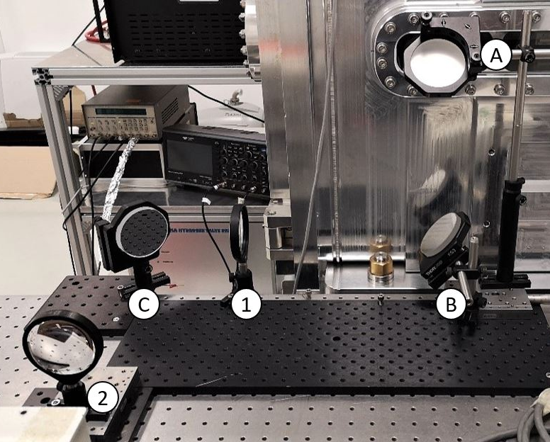
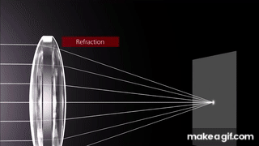
Plasma discharge capillary characterization
f
p
q
LENSMAKER’S EQUATION:
$$\frac{1}{f}=\frac{1}{p}+\frac{1}{q}$$
MAGNIFICATION FACTOR:
$$M=\frac{q}{p}$$
Mirror 1
Mirror 2
Mirror 3
Lens 1
Lens 2
In case of two lenses, there will be p1 and p2, q1 and q2, f1 and f2

Slide 23
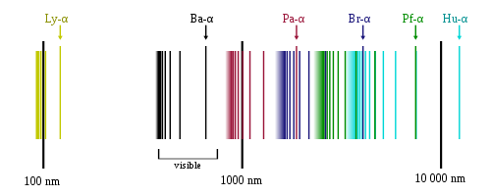
Stark broadening technique
Lyman Series:
91-121 nm -> UV region
Balmer Series:
364.6- 656 nm -> visible region
Paschen Series:
1458-4051 nm -> IR region
Hydrogen Balmer series spectral lines of emission
434nm
488nm
656nm

Slide 24
Stark broadening technique
434nm
488nm
656nm
wavelength
Stark broadening effect

Slide 25
Stark broadening technique
By using the Stark broadening method to measure the plasma density, we obtain the following results:
the larger is the Balmer line (Δλ), the higher is the electron density of plasma
Tabulated α values
Broadening of
the spectral line
$$∆λ$$

Slide 26
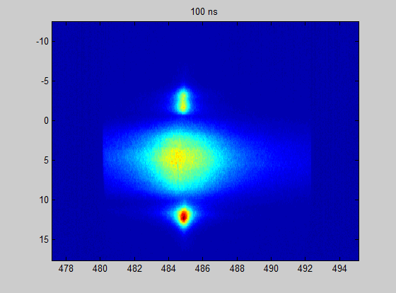
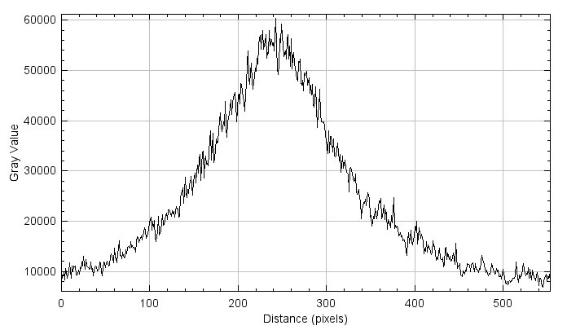
Stark broadening technique
Position (mm)
Balmer β line
Δλ
Capillary
Electrode
shadow
Plasma
channel
$$∆λ$$
Plasma plume
λ (nm)
Images acquired by using an ICCD camera:
Gate: 100 ns
Delay: 500-2500 ns
Area: 1024 x 255 pixel

Slide 27
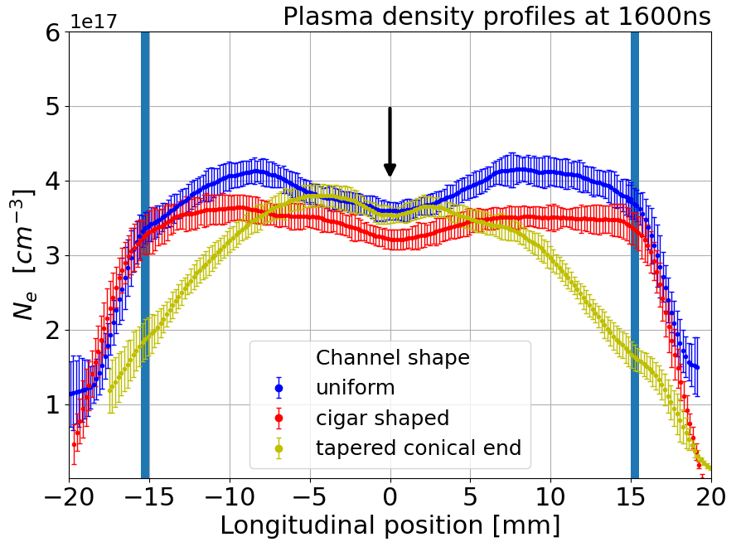
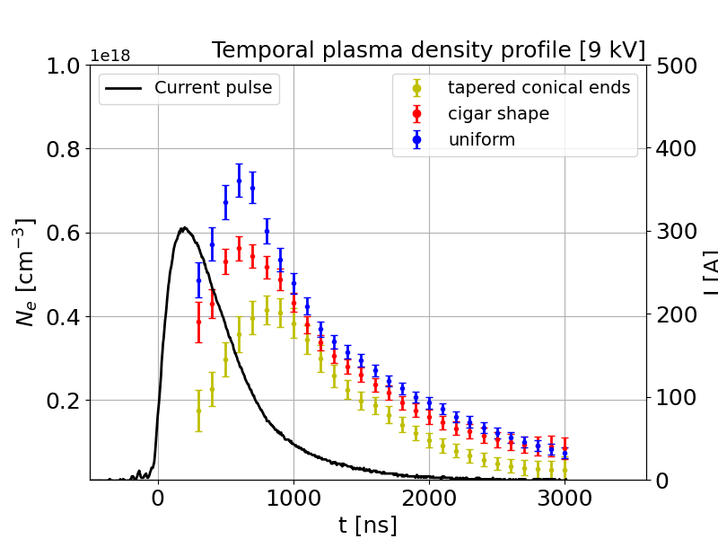
Stark broadening technique
Longitudinal characterization
Temporal characterization

Slide 28
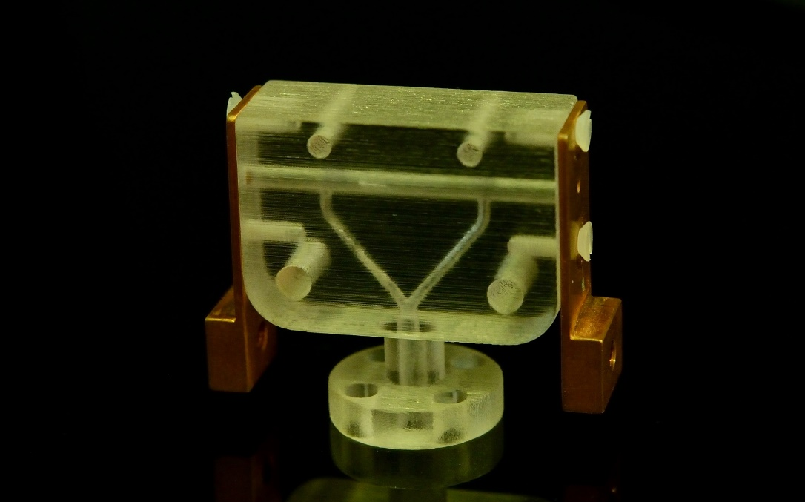
Outside the capillary
Dielectric capillary
In order to understand what happens to the electron beam outside of the capillary we have studied the plasma parameters in such areas:
Plasma density
Velocity of plasma
Electrode shadows
Outside capillary:
Plasma plumes
L = 30 mm
+V
-V
e⁻
H2 inlets
Ø = 1 mm
Electrode
Plasma discharge

Slide 29
Outside the capillary
L = 30 mm
e⁻
H2 inlets
Ø = 1 mm
Electrode
Plasma
plume
Plasma plumes depend on different conditions of pressure, temperature and density between inside and outside (vacuum) of the capillary
The expansion velocity and so the plume lengths depends on several terms as the dicharge voltage and the geometric properties of the capillary
Plasma
discharge

Slide 30
Outside the capillary
Undulator side: NEGATIVE
Delay: 20 images separated by 100 ns = 2 µs
Gate: 10 ns
Area: 1000 x 500 pixel
Photocathode side: POSITIVE

Slide 31
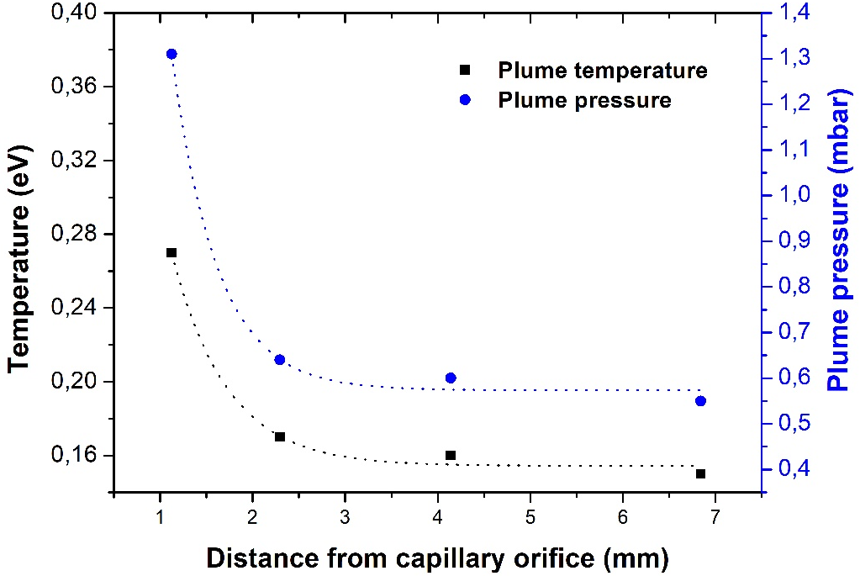
Outside the capillary
Vacuum
Discharge voltage 18 kV
Capillary
20 mm/2 μs
Plasma channel
Electrode
Plasma density ramps at the ends of the capillary can reach a total expansion length around 40 mm (20 mm each one) that is comparable with the channel length of 30 mm, so they can strongly affect the beam properties that passes through the capillary
Biagioni et al. (2019), DOI: 10.1088/1748-0221/14/03/C03002

Slide 32
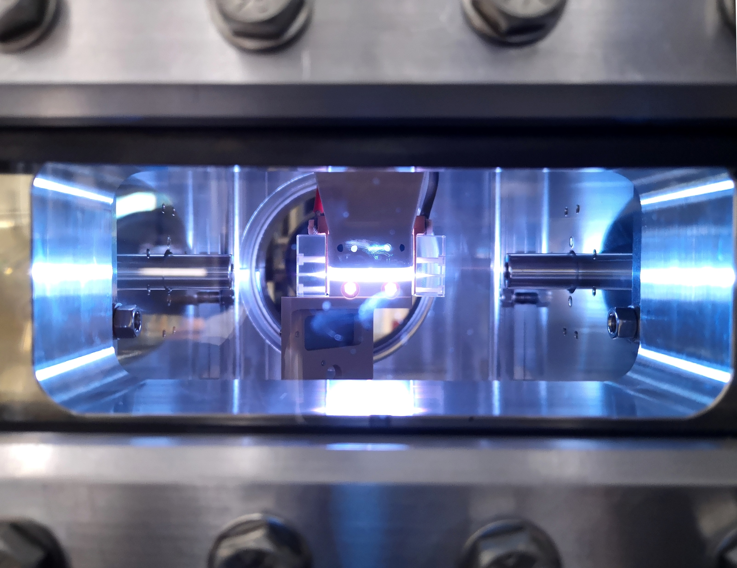
Thank for your attention

