Slide 1
Multi-bunch longitudinal beam-dynamics code for the DAFNE rings
D. Quartullo, G. Franzini, M. Migliorati
Acknowledgements:
D. Pellegrini, A. Stella

Slide 2
Introduction
The beam currents are high in DAFNE.
The HOMs of the accelerating cavity lead to strong longitudinal coupled-bunch instabilities.
A longitudinal feedback has been operational since the 90s to damp these instabilities.
In the 90s, a macroparticle code written in Fortran was developed by M. Migliorati for his PhD studies on the DAFNE longitudinal beam-dynamics with HOMs and feedback.
Main features of the code:
Just one macroparticle per bunch -> fast code, but only dipole oscillations are considered.
Able to simulate: synchrotron radiation losses, HOMs induced voltage, feedback corrections, etc.
The code can provide useful indications for stable machine operation, e.g. expected grow rates of instabilities and optimal feedback parameters.
It also allows to better understand why and how the feedback is able to damp the HOMs.
In 2021, the major part of the original Fortran code was rewritten in Python for better usability.
For the Accelerators Laboratory 2024, the most important Python routines were rewritten in Matlab.
In the Matlab version, we neglect for instance that the cavity kicker is itself a resonator with a certain filling time.

Slide 3
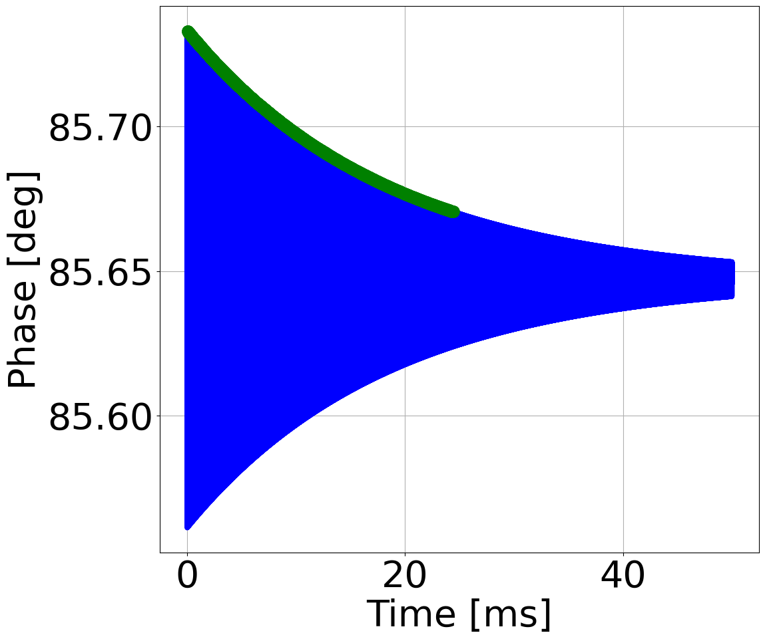
Equations of motion in the code (RF+SR)
Assuming $β=1$, the longitudinal equations of motion with synchrotron radiation (SR) are
$${∆φ}^{(n+1)}={∆φ}^{\left(n\right)}+2πhα_{0}δ^{(n)}$$
$$δ=\frac{∆E}{E_{0}}$$
$n:$ turn number
$h:$ harmonic number
$α_{0}:$ momentum compaction
${\hat{V}}_{rf}:$ peak RF voltage
$U_{0}:$ average energy lost per turn due to SR
$T_{0}:$ revolution period
$ω_{rf}:$ angular RF frequency
Accelerating
cavity
$$δ^{(n+1)}=δ^{(n)}+\frac{e{\hat{V}}_{rf}\cos{{∆φ}^{(n+1)}}}{E_{0}}−\frac{U_{0}}{E_{0}}\left(1+{2δ}^{(n)}\right)$$
Drift + synchrotron radiation
RF
Synchrotron radiation
The synchronous phase is
Simulation with SR
$${∆φ}_{SR}=\arccos{\frac{U_{0}}{e{\hat{V}}_{rf}}}$$
For small amplitude of oscillations, the damping rate and synchrotron frequency are
$$α_{r,SR}=−\frac{U_{0}}{E_{0}T_{0}}$$
$$ω_{s,SR}=\sqrt{\frac{e{\hat{V}}_{rf}ω_{rf}α_{0}}{E_{0}T_{0}}\sin{{∆φ}_{SR}}−α_{r,SR}^{2}}$$
$$α_{r,SR}=−54 s^{−1}$$
$$α_{r,SR}=−54 s^{−1}$$
Example: same $α_{r,SR}$ from simulated data (green) and from the analytical formula (pink).

Slide 4
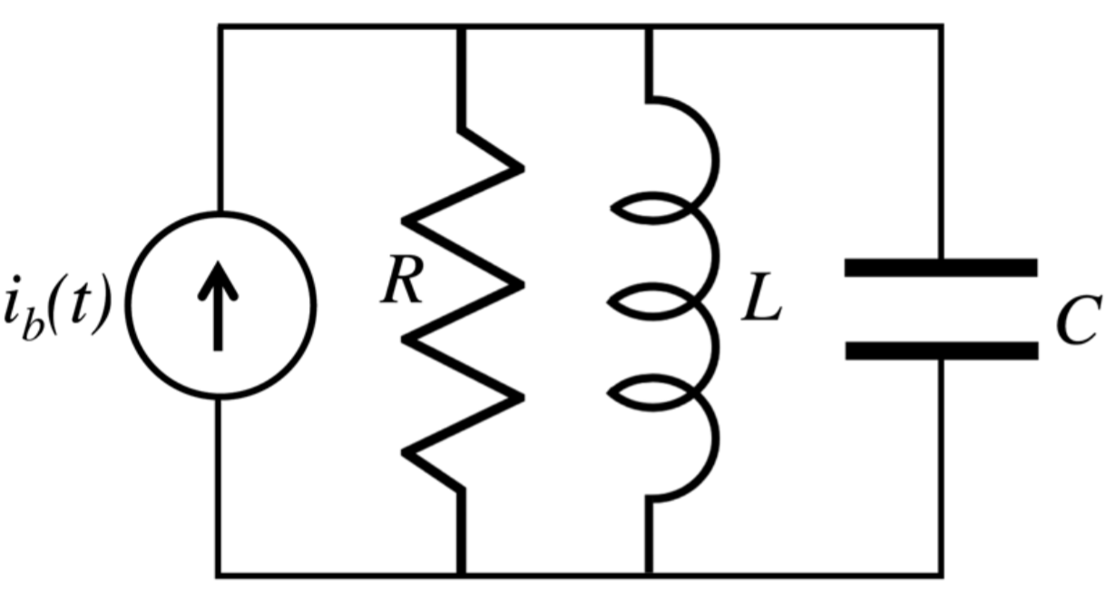
Beam-induced voltage due to an HOM
If $β$=1, each HOM of the accelerating cavity can be treated as a parallel RLC circuit driven by a point-charge current.
$i_{b}\left(t\right)=Q_{b}$ $\sum_{k}{δ(t−kT_{rf})}$
$δ\left(t\right):$ Dirac delta function
$Q_{b}$: bunch charge
$R_{s}$: shunt impedance
$L$: inductance
$C$: capacitance
$ω_{r}=1/{\sqrt{CL}}:$ angular resonance frequency
$Q=R_{s}\sqrt{C/L}:$ quality factor
$ω_{n}=\sqrt{ω_{r}^{2}−{\left(ω_{r}/2Q\right)}^{2}}$: natural frequency
$V(t)$: voltage across the capacitance at time t
$i(t)$: current in the inductance at time t
$$R_{s}$$
$$i(t)$$
$i_{b}(t)$
$$C$$
$$V(t)$$
$$L$$
$V\left(0^{−}\right)=i\left(0^{−}\right)=0$. The first charge passes at $t=0$, the voltage induced on the HOM is
By the beam-loading theorem, the first charge sees $∆V/2$ at $t=0$.
The second charge passes at $t_{1}$, when the voltage and current in the HOM are
$$∆V=−\frac{Q_{b}}{C}=−\frac{R_{s}ω_{r}}{Q}Q_{b}$$
$$\left({V\left(t_{1}\right) \atop i\left(t_{1}\right)}\right)=e^{−\frac{ω_{r}}{2Q}t_{1}}\left(\begin{matrix}\cos\left(ω_{n}t_{1}\right)−\frac{ω_{r}}{2Qω_{n}}\sin\left(ω_{n}t_{1}\right) & −\frac{R_{s}ω_{r}}{Qω_{n}}\sin\left(ω_{n}t_{1}\right) \\ \frac{ω_{r}Q}{R_{s}ω_{n}}\sin\left(ω_{n}t_{1}\right) & \cos\left(ω_{n}t_{1}\right)+\frac{ω_{r}}{2Qω_{n}}\sin\left(ω_{n}t_{1}\right)\end{matrix}\right)\left({∆V \atop 0}\right)=W\left(t_{1}\right)\left({∆V \atop 0}\right)$$
The second charge sees $V\left(t_{1}\right)+∆V/2$ at $t_{1}$.

Slide 5
Equations of motion in the code (RF+SR+HOMs)
The residual voltage and current in the HOM can be propagated from bunch to bunch (and from turn to turn) through simple matrix multiplications.
$V_{k,j,RES}^{\left(n\right)}$: (residual) voltage in the HOM $j$ at turn $n$ for bunch $k$.
${\overline{t}}_{k−1,k}^{(n)}=\frac{\left({∆φ}_{k}^{(n)}−{∆φ}_{k−1}^{(n)}\right)}{ω_{rf}}+T_{rf}d_{k−1,k}$: distance between bunches $k−1$ and $k$.
$d_{k−1,k}:$ distance in buckets between bunches $k−1$ and $k$.
${∆V}_{k,j}=−\frac{R_{s,j}ω_{r,j}}{Q_{j}}Q_{b,k}$: voltage induced by the charge $k$ on the HOM $j$.
$$\left({V_{k,j,RES}^{\left(n\right)} \atop i_{k,j,RES}^{\left(n\right)}}\right)=W_{j}\left({\overline{t}}_{k−1,k}^{(n)}\right)\left({V_{k−1,j,RES}^{\left(n\right)}+{∆V}_{k−1,j} \atop i_{k−1,j,RES}^{\left(n\right)}}\right)$$
The energy equation of motion become
Residual voltage in the HOM
Beam loading theorem
$$δ_{k}^{(n+1)}=δ_{k}^{(n)}+\frac{e{\hat{V}}_{rf}\cos{{∆φ}_{k}^{(n+1)}}}{E_{0}}−\frac{U_{0}}{E_{0}}\left(1+{2δ}_{k}^{(n)}\right)+\frac{e}{E_{0}}\sum_{j=1}^{N_{HOM}}{\left[V_{k,j,RES}^{\left(n+1\right)}+\frac{{∆V}_{k,j}}{2}\right]}$$
$N_{HOM}$: number of HOMs

Slide 6
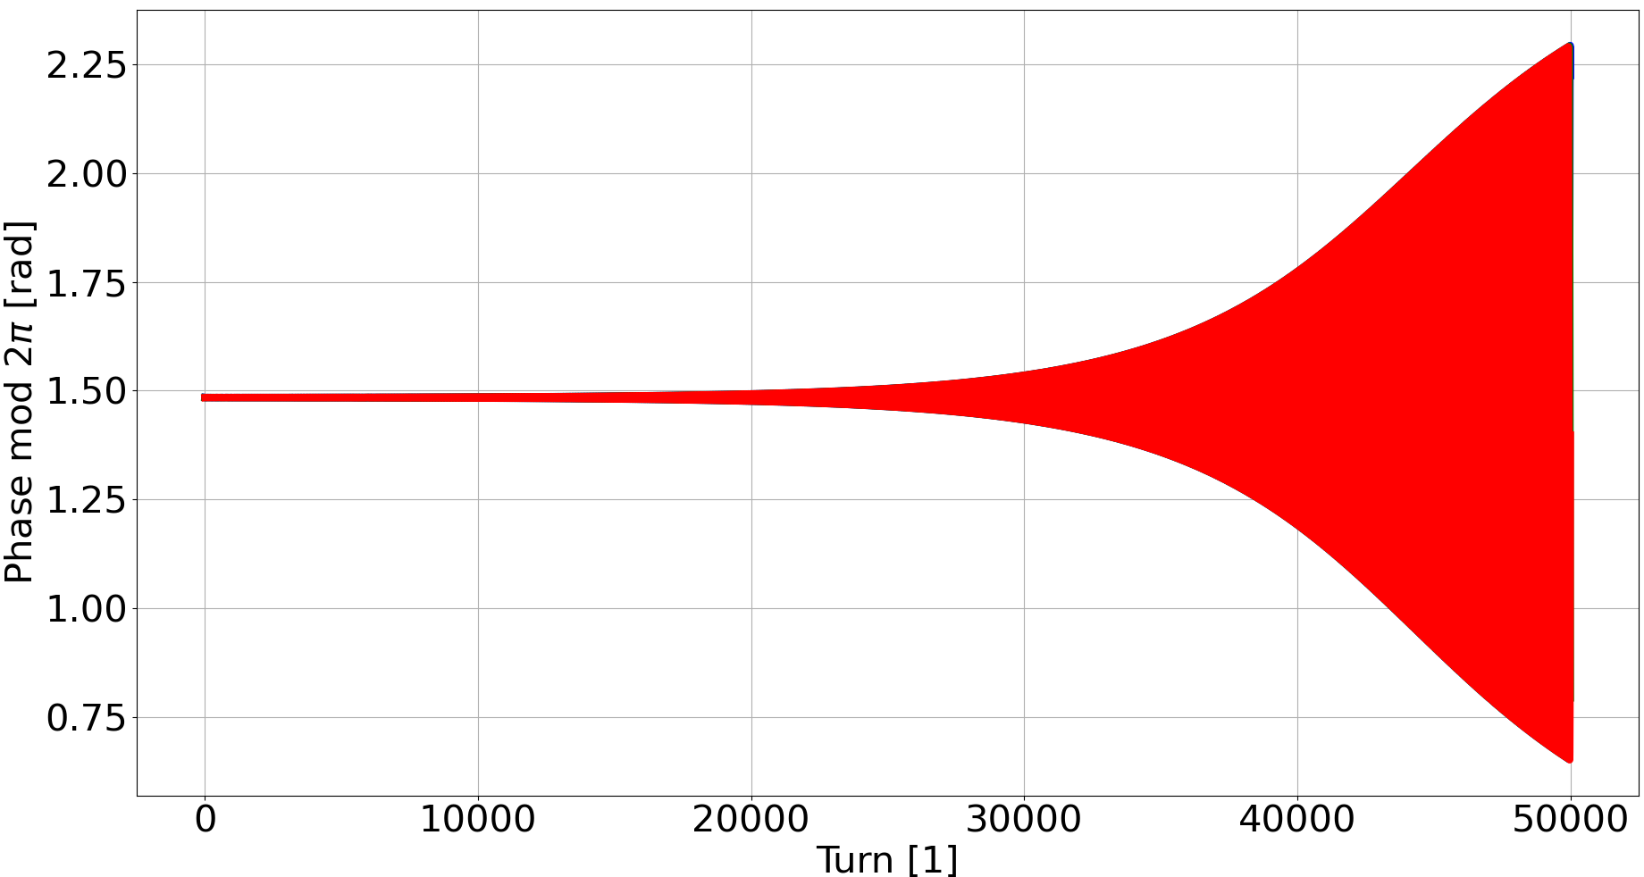
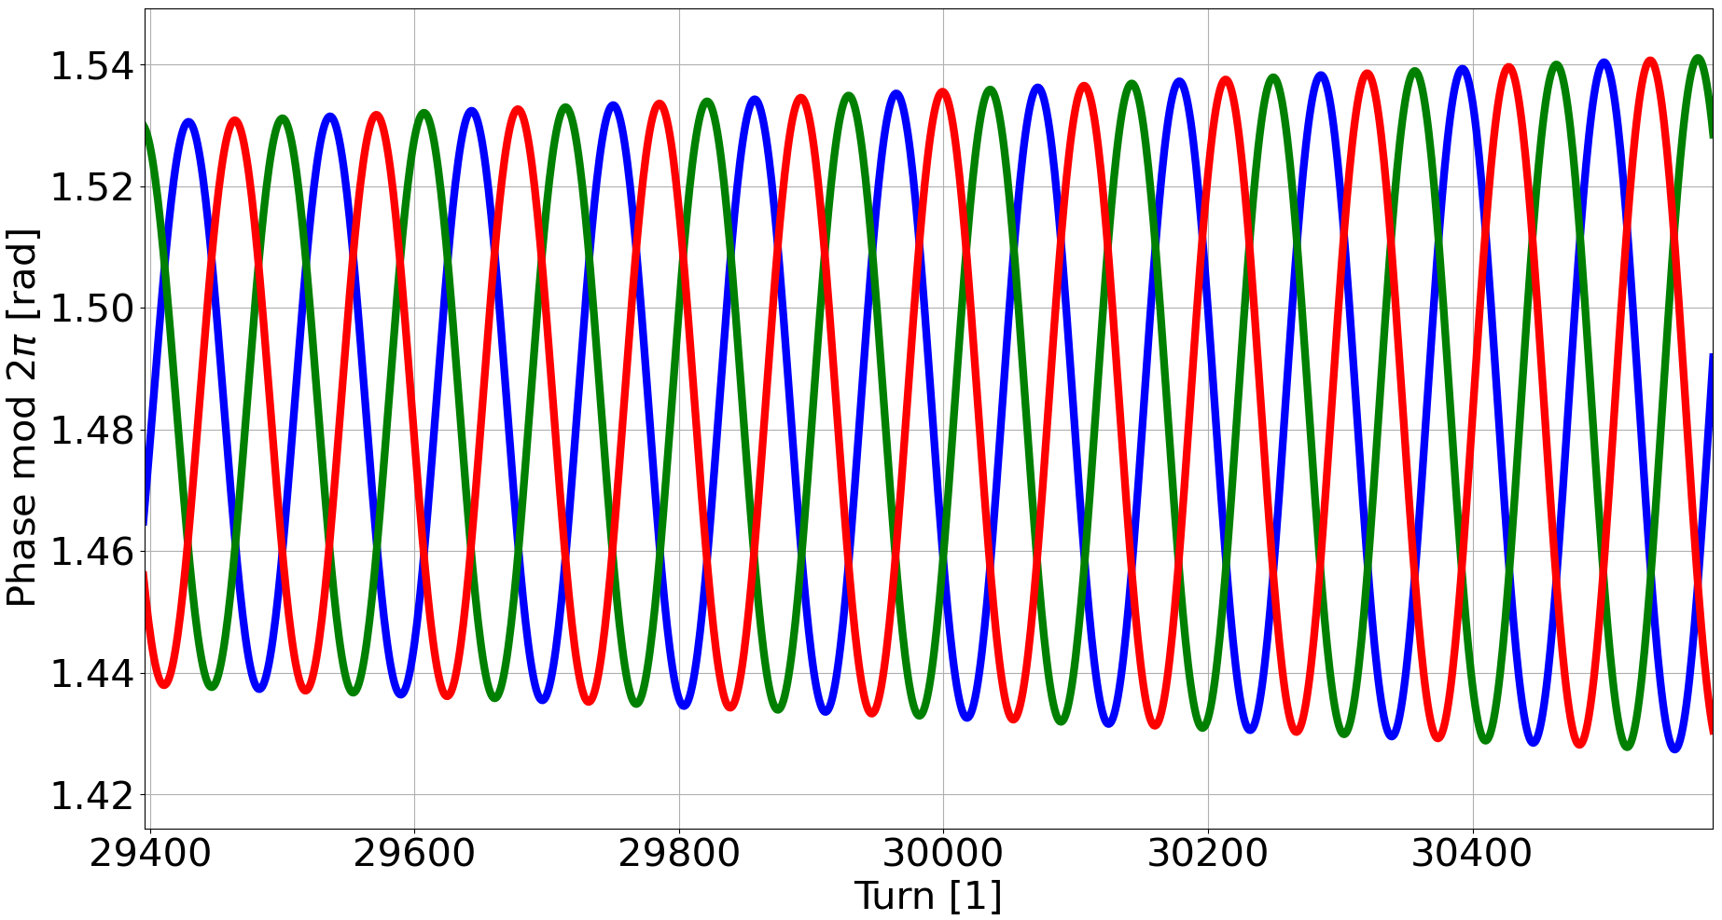
Coupled bunch instabilities (1/2)
Let’s suppose that we have $N_{b}$ equally-spaced bunches.
The possible coupled-bunch modes are $μ=0, 1,…,N_{b}−1$.
The phase between consecutive bunches is $∆φ_{μ}=\frac{2π}{N_{b}}μ$.
To excite the mode $μ$, the resonant frequency $f_{r}$ of the HOM should be $f_{l,μ}=\left(μ−N_{b}l\right)f_{0}+f_{s}$, with $l$ a negative integer.
Simulation with 3 bunches and one HOM, $f_{r}$ chosen to excite $μ=1$, $∆φ_{μ}=120°$.
Zoom
Bunch 1
Bunch 41
Bunch 81

Slide 7
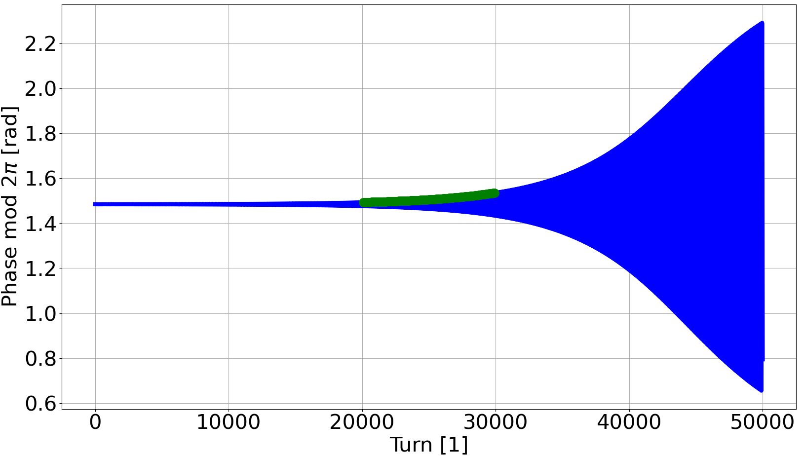
Coupled bunch instabilities (2/2)
We can perform an exponential fit of the envelope of the oscillations, from which we obtain the grow rate.
Defining the longitudinal impedance of a resonator as
we can evaluate the grow rate also analytically as
Bunch 1
Bunch 1
$$α_{r}=551\frac{1}{s}$$
$$Z_{∥}\left(f\right)=\frac{R_{s}}{1+jQ\left(\frac{f}{f_{r}}−\frac{f_{r}}{f}\right)}$$
$$α_{r}=−\frac{U_{0}}{E_{0}T_{0}}−\frac{α_{0}eN_{b}Q_{b}}{2E_{0}T_{0}^{2}ω_{s}}\sum_{l=−∞}^{+∞}{\left[\left(lN_{b}−μ\right)ω_{0}−ω_{s }\right]}Re\left\{Z_{∥}\left[\left(lN_{b}−μ\right)ω_{0}−ω_{s }\right]\right\}=546\frac{1}{s}$$
$α_{r,SR}$: SR damping rate
$α_{r,HOM}$: HOM grow rate
Usually the disagreements between numerical and analytical estimations are within few percent.

Slide 8
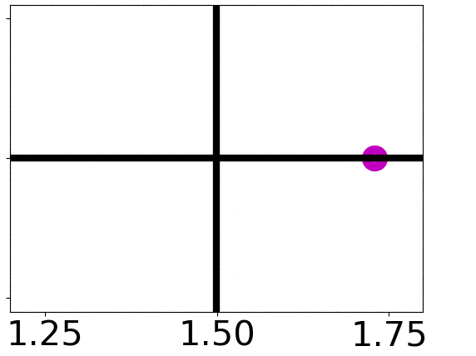
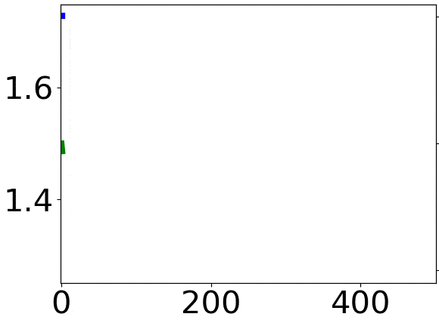
Block diagram of the longitudinal feedback
The feedback acts on a bunch-by-bunch basis.
The energy correction applied to the bunch should be $Δφ$ shifted by -$π/2$ (or $δ$ shifted by $π$).
The code starts directly from the output of the low-pass filter, since $Δφ$ is known from tracking.
0.1
0.1
$Δφ$ [rad]
$δ$ [%]
$δ$ [%]
0.0
0.0
-0.1
-0.1
$Δφ$ [rad]
Turn [1]

Slide 9
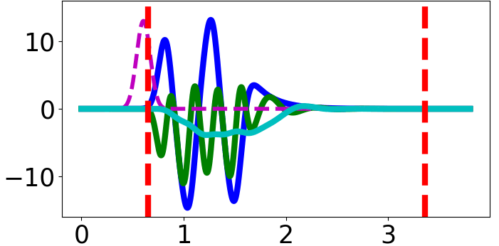
Signal out of the low-pass filter
The signal from the two-burst comb generator at 4$f_{rf}$ is approximately
where the synchrotron oscillations of the bunch are
The signal out of the mixer is
where
$${∆t}_{s}$$
ADC clock
$${∆t}_{s}+t_{rf}$$
$$V_{comb}\left(t\right)∝\sin\left[4ω_{rf}\left(t−∆t_{s}−τ(t)\right)\right]$$
$λ$, $V_{comb}$, $V_{mix}$, $V_{lpf}$ [a.u.]
$τ(t)$= $A$cos($ω_{s}t)$
$${∆t}_{s}+\frac{t_{rf}}{2}$$
$$V_{mix}\left(t\right)=V_{comb}(t) V_{lo}(t)$$
$$V_{lo}\left(t\right)=−cos\left[4ω_{rf}\left(t−∆t_{s}\right)\right]$$
$∆t$ [ns]
The signal out of the low-pass filter is
For small-amplitude oscillations $A$, $V_{lpf}$is essentially the phase signal $τ$.
$$V_{lpf}\left(t\right)∝\sin\left[4ω_{rf}τ(t)\right]$$

Slide 10
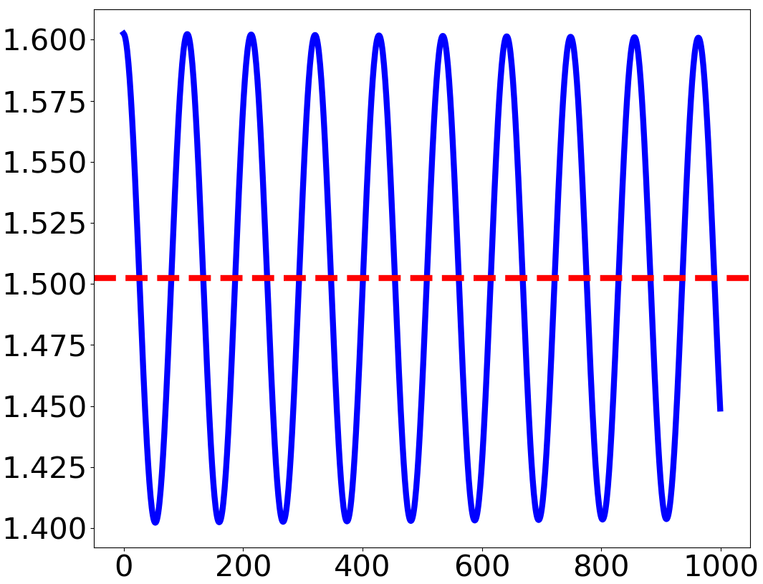
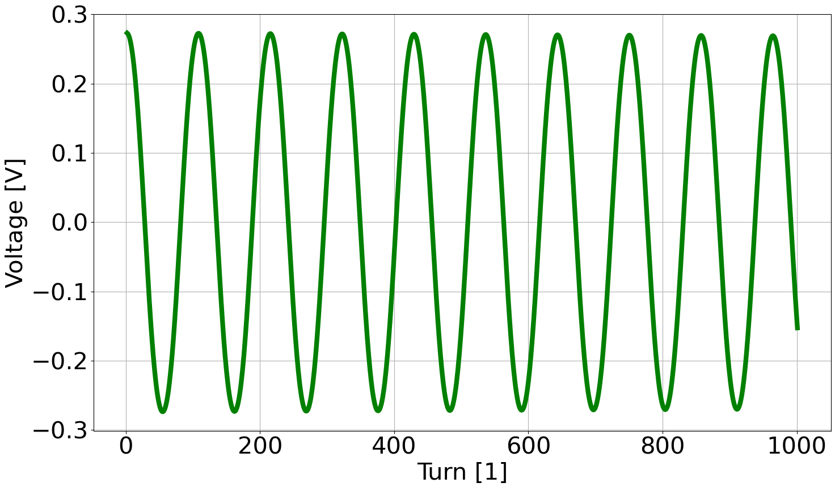
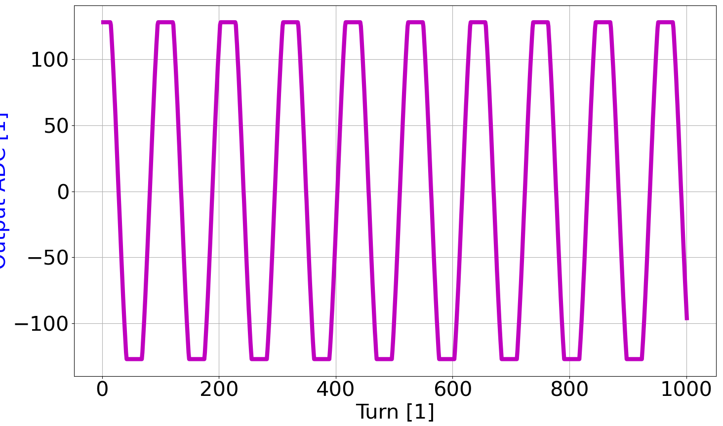
Signal through the ADC
In the code we directly compute
known from tracking
$$V_{lpf,k}^{(n)}=\frac{Q_{b}}{T_{0}}g_{mix}\sin\left(4∆φ_{k}^{(n)}\right)$$
$${Δφ}_{k}^{(n)}=φ_{k}^{(n)}−φ_{s}$$
With $n_{bit,ADC}=8$ bits available in the ADC and a maximum input voltage of $V_{max,ADC}=$ 200 mV, the digitized signal is
$$n_{ADC}=int\left(\frac{2^{n_{bit,ADC}}−1}{2}\frac{V_{lpf}}{V_{max,ADC}}+0.5\right)$$
with saturation outside [-127, 128].
Simulated phase oscillations
ADC input with too large values
Saturated ADC output
$$V_{max,ADC}$$
$$128$$
$${∆φ}_{SR}$$
$n_{oADC}$ [1]
$∆φ$ [rad]
$V_{ADC}$ [V]
Turn [1]
Turn [1]
Turn [1]

Slide 11
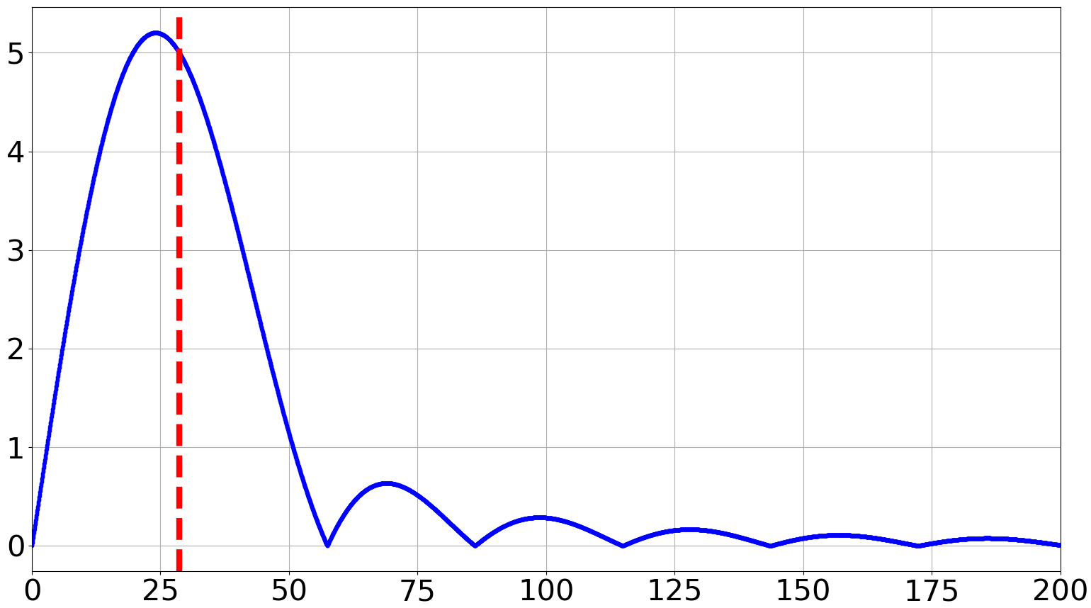
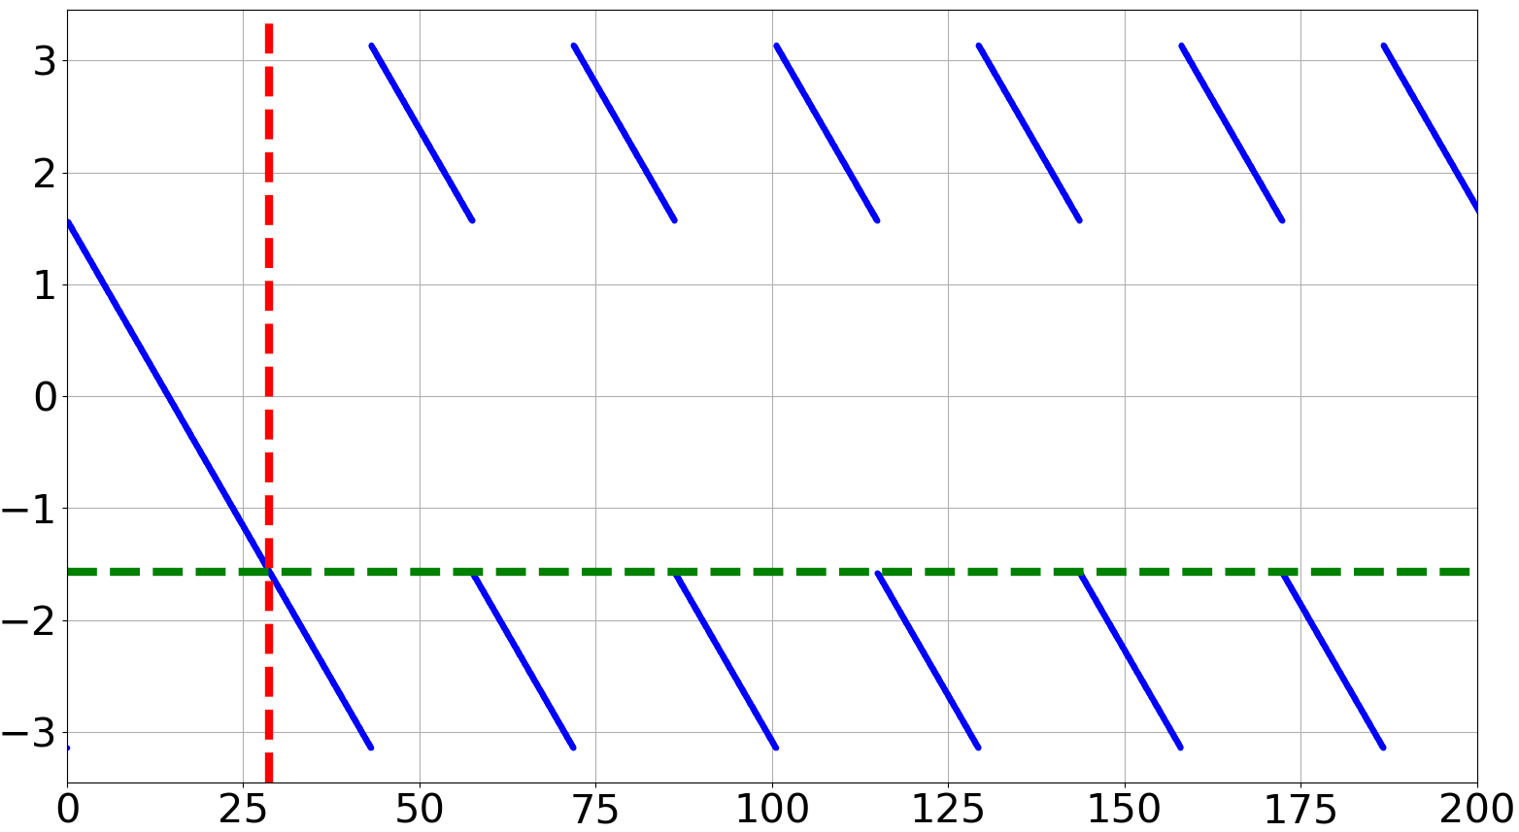
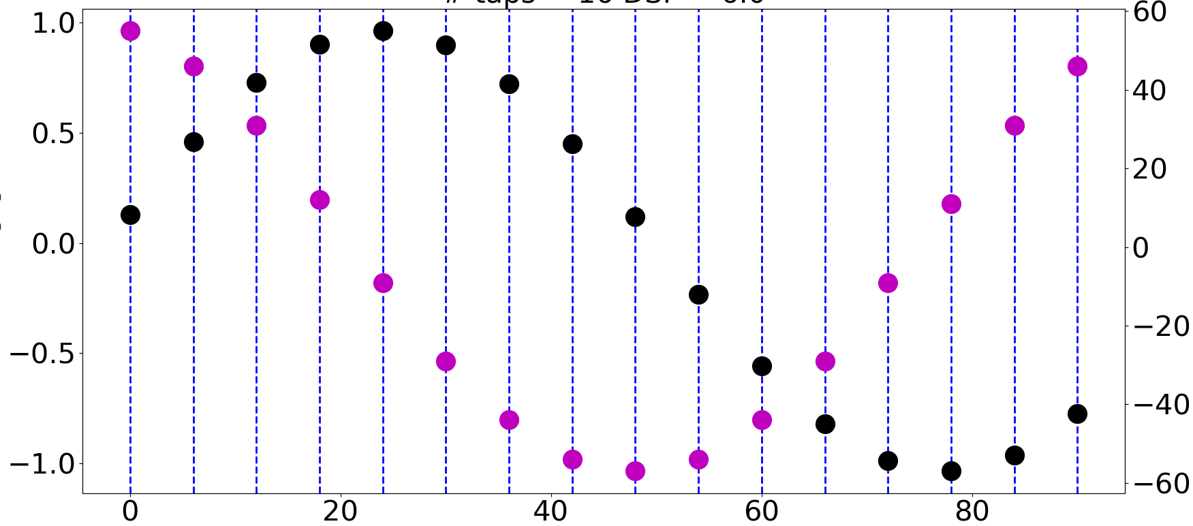
Signal through the FPGA
The FPGA shifts the $n_{ADC}$ (phase) signal by $−π/2$.
The shift is performed in time domain, by convolving $n_{ADC}$ with a sinusoidal filter.
$$n_{FPGA}\left(t_{k}\right)=g_{FPGA}n_{ADC}∗f_{FIR}=g_{FPGA}\sum_{i=0}^{N_{tap}−1}{n_{ADC}\left[t_{k−i}\right]\sin\left(ω_{s}d_{DSF}T_{0}i\right)}$$
$N_{tap}$: number of filter taps, such that
$n_{ADC}(t_{k})≈n_{ADC}(t_{k−N_{tap}})$.
$d_{DSF}:$ down-sampling factor, i.e. number
of turns between two new corrections.
Example of $f_{FIR}$ with
$N_{tap}=16$ and $d_{DSF}=6$
Frequency response of $f_{FIR}$
$$f_{s0}$$
$f_{FIR}$ [1]
$n_{ADC}$ [1]
$\left|ℱ\left(f_{FIR}\right)\right|$ [a.u.]
Phase of $ℱ\left(f_{FIR}\right)$ [rad]
$$f_{s0}$$
- $π/2$
Frequency [kHz]
Frequency [kHz]
Turn [1]

Slide 12
Signal through the DAC and equations of motion
The output from the DAC is a piecewise-constant function, with discontinuities occurring when the feedback computes a new correction.
$$0$$
$$t_{rf}$$
2$t_{rf}$
3$t_{rf}$
4$t_{rf}$
$$n_{DAC}=\frac{int(n_{FPGA})}{2^{n_{bit,DAC}−1}}$$
$n_{bit,DAC}$: number of bits for the DAC
$V_{FBkick}$ [1]
If $V_{max,kick}$ is the maximum voltage which the kicker can provide, the feedback correction is
The energy equation of motion becomes
Time [ns]
$$V_{FB,kick}=n_{DAC}V_{max,kick}$$
(saturation for $\left|n_{DAC}\right|>1$)
$$δ_{k}^{(n+1)}=δ_{k}^{(n)}−\frac{U_{0}}{E_{0}}\left(1+{2δ}_{k}^{\left(n\right)}\right)+\frac{e{\hat{V}}_{rf}\cos{{∆φ}_{k}^{(n+1)}}}{E_{0}}+\frac{e}{E_{0}}\sum_{j=1}^{N_{HOM}}{\left[V_{k,j,RES}^{\left(n+1\right)}+V_{k,j,IND}\right]}+\frac{eV_{FBkick,k}^{\left(n\right)}}{E_{0}}$$
$V_{FBkick}$ is the ideal voltage correction.

Slide 13
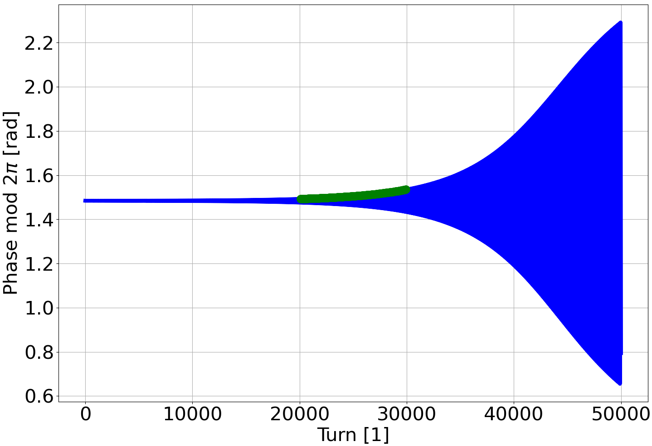
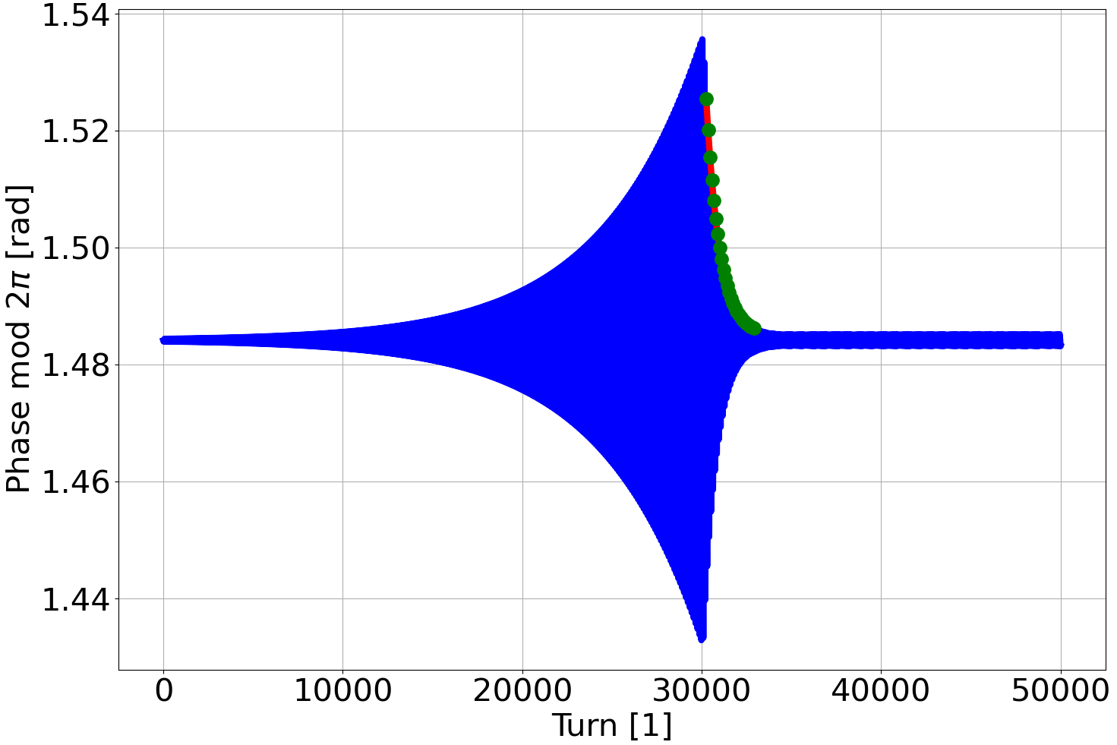
Simulations of grow-damp dynamics
The analytical damping rate due to the ideal feedback corrections is
$$α_{r,FB}=−\frac{hf_{0}^{2}α_{0}eg_{FB,tot}}{2E_{0}f_{s}}$$
$g_{FB,tot}=\frac{4Q_{b}}{T_{0}}g_{mix}\frac{2^{n_{bit,ADC}}−1}{2V_{max,ADC}}\frac{g_{FPGA}T_{s}}{2T_{0}d_{DSF}}\frac{1}{2^{n_{bit,DAC}−1}}V_{max,kick}$: total feedback gain
In the presence of synchrotron radiation, HOM induced voltage and feedback, the total grow rate is
$$α_{r}=α_{r,SR}+α_{r,HOM}+α_{r,FB}$$
Same example as before, but this time we activate the feedback at turn 30000 (grow-damp).
Also in this case, the disagreements between numerical and analytical estimations are within just few percent.
Bunch 1, without feedback
Bunch 1, grow-damp
$$α_{r}=552 s^{−1}$$
$$α_{r}=546 s^{−1}$$
$$α_{r}=−4058 s^{−1}$$
$$α_{r}=−3990 s^{−1}$$
Feedback activated at turn 30000

Slide 14
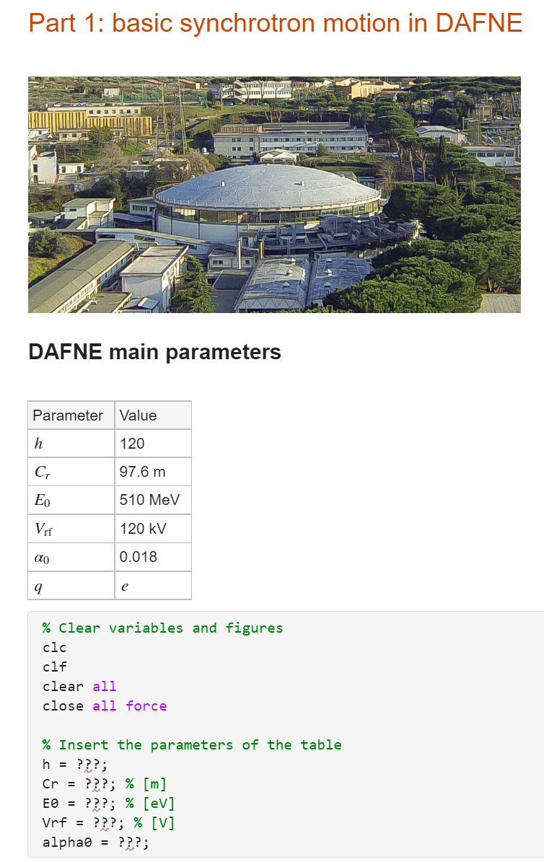
Instructions to get started with the code
Go to https://agenda.infn.it/event/40135/
Download and open the Matlab scripts Part_1.mlx, …, Part_4.mlx.
These are scripts prepared with Matlab Live Editor, i.e. they are notebook-style scripts which you should execute section by section.
The characters ??? should be replaced with proper code to be able to proceed to the following section.
Go through the scripts in order of number, since each script builds on top of the previous ones.
Have fun and ask questions if something is not clear!

