Slide 1
Laboratori Nazionali di Legnaro – INFN
Pre clinical biodistribution analysis of ¹¹¹Ag ions
L. Fogarolo
March 15th, 2024

Slide 2
Outline
Detector calibration and geometrical efficiency analysis
CAPiR (Catania) experiment
MOBY
Conclusions
Notes:
2

Slide 3
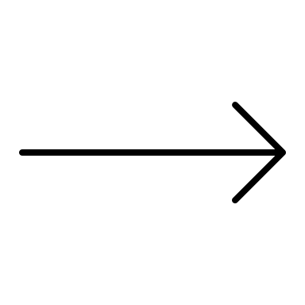
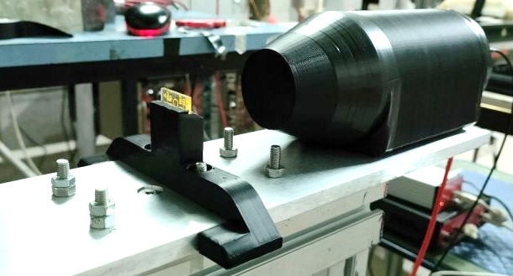
Detector calibration and efficiency
EFFICIENCY
Using:
¹³⁷Cs
²⁴¹Am
²²Na
LBC DETECTOR
for γ-rays
CALIBRATION
Notes:
3

Slide 4
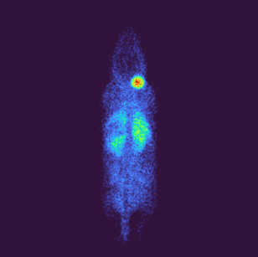
CAPiR (Catania) experiment
CAPiR
Biodistribution experiment with ¹¹¹Ag
Mice injected with part of the silver-based radiopharmaceutical
In-vivo imaging
Ex-vivo measurements of each organ's activity
Notes:
4

Slide 5
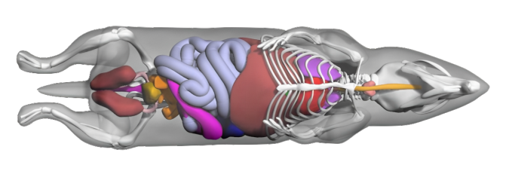
MOBY
MOBY (MOuse whole BodY)
Simulation tool based on GEANT4
Allows to evaluate dose local's release according to measured activity
Creates a 4D whole body digital phantom
Notes:
5

Slide 6
Conclusions
My thesis' structure:
detector calibration and geometrical efficiency analysis
simulations with GEANT4 and MOBY
data analysis of the CAPiR experiment
comparize simulations and data and draw conclusions

