Slide 1
Laboratori Nazionali di Legnaro – INFN
Work Package 2
Status of beta-imaging detector
J. Delgado
March 15th, 2024

Slide 2
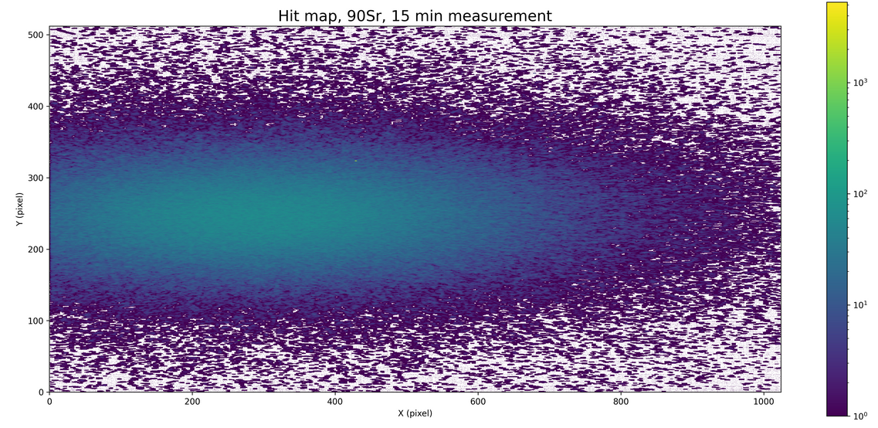
Testing the current board+ALPIDE chip
Installation of the OS and programs on the new notebook acquired (AlmaLinux9, OpenFPGALoader, Python)
Setup ready for the measurements in April at Pavia
Measurement performed with a ⁹⁰Sr source, activity 1799 KBq (on 26/09/23)
90Sr β−→ 90Y (End point 545.9 keV)
90Y β−→ 90Zr (End point 2278.5 keV)
The distance between the chip and source 5mm.
Notes:
2

Slide 3
Preliminary test
With the current board+ALPIDE chip there is no direct contact with the ALPIDE chip.
To facilitate better communication and understanding of the chip, an embedded board will be utilized.
Incorporating two ALPIDE chips as well as the mezzanine board.
PCB for chip mounting
mezzanine board
FPGA board
Idea proposed by Michele Giorato
Notes:
3

Slide 4
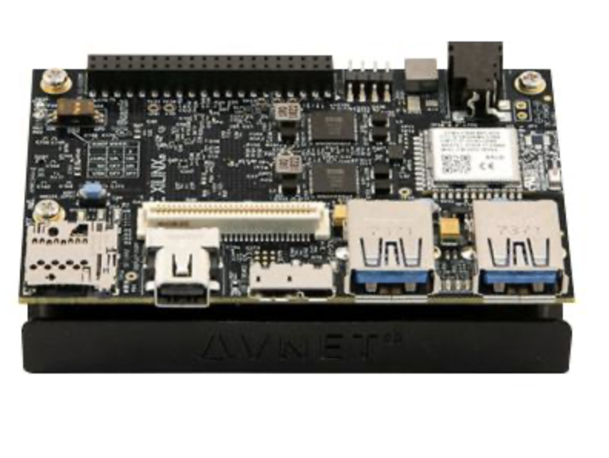
Final version of the FPGA board
High performance, low-cost and compact size PCB (dimensions approximately 85 mm x 55 mm) has been already ordered.
Additionally, USB to JTAG/UART Adapter Module have also been ordered. The interface facilitates program testing and enables communication with the board.
AVNET AES-ULTRA96-V2-G
Connection pins
(high speed)
PCB for chip mounting
mezzanine board
FPGA board
Notes:
4

Slide 5
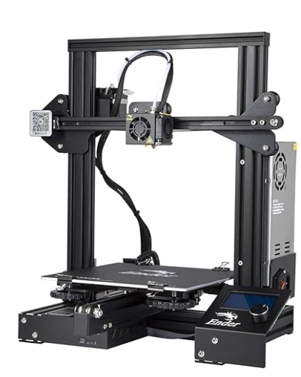
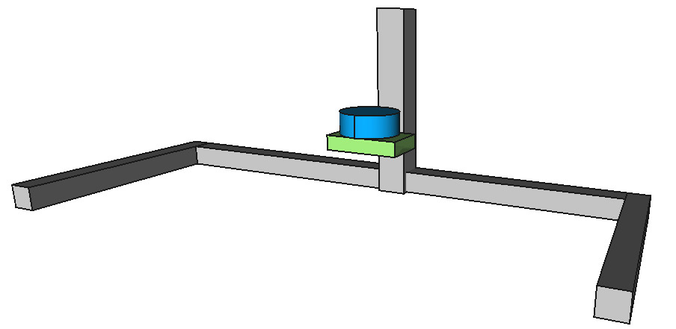
Mechanical Design
Sealed box: detector+Electronic card, only exposes the sensitive part of the chips, the power supply and data I/O connectors
Option to set up upside down the sensitive part
Movements along vertical and horizontal axes (exploiting the geometry in scanner mode).
The movement will be automated, with micrometric adjustments.
Convenient idea
Preliminary proposal
To use the frame of a 3D printer.
Idea proposed by Rubens Raffagnato
Notes:
Sia rivolta faccia verso l'alto verso il basso, asse verticale e orizzontale
5

Slide 6
Conclusions
Current setup ready for the measurements in April at Pavia
Preliminary test using an embedded board, for better communication
Final version of the FPGA board already ordered
Mechanical design using a 3D printer frame.
Notes:
6

Slide 7
Thank you ..!!
Notes:
7

