Slide 1
Laboratori Nazionali di Legnaro – INFN
ISOLPHARM 111Ag Production and Separation at L.E.N.A
Steps for the development of a separation and recycling protocol
G. Grosso
March 15th, 2024

Slide 2
Outline
Up-to-date protocol
Possible improvements
Conclusions
Notes:
2

Slide 3
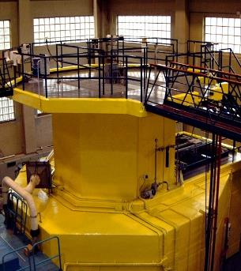
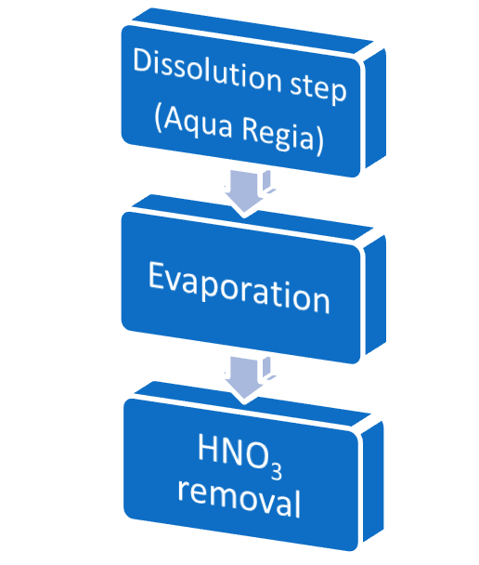
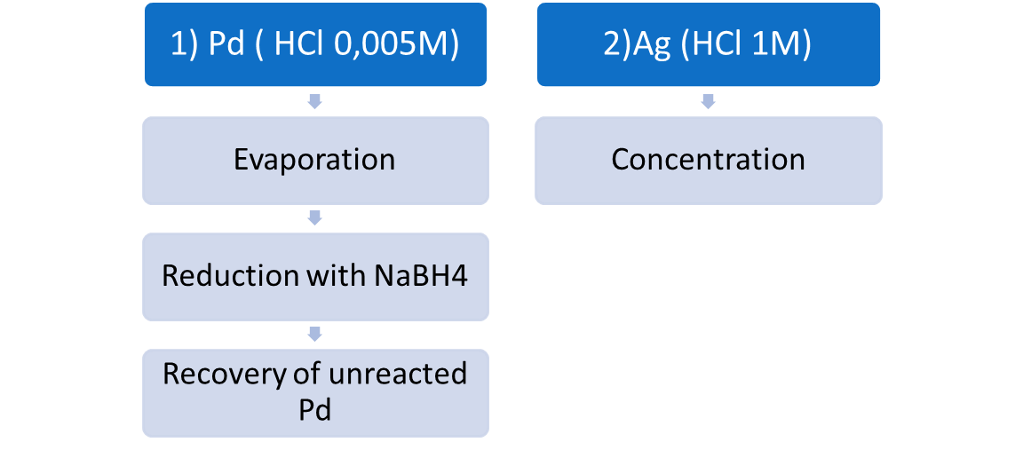
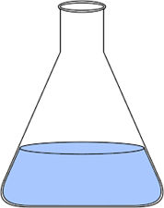
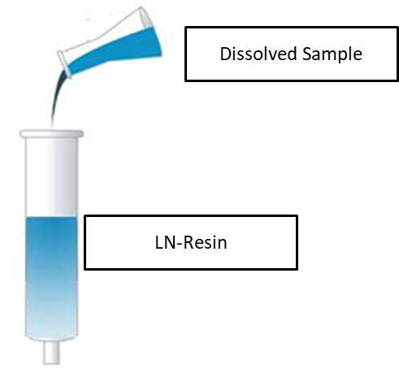
Up-to-date protocol
Notes:
3

Slide 4
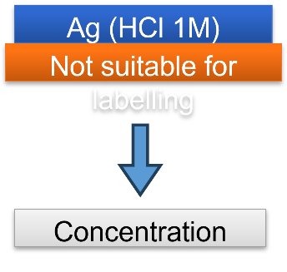
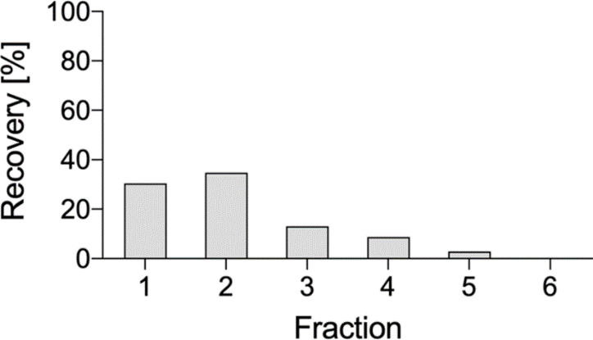
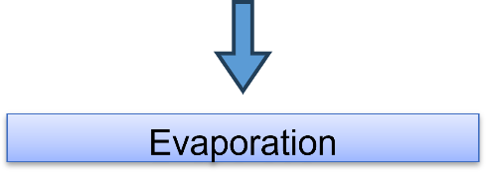
Possible improvements
Ag polish on TK200
Procedure
Precondition 2 mL TK200 cartridges with 5 mL 0.5M HCl
Load Ag fraction obtained on the LN Resin cartridge through the TK200 cartridge => Ag will remain retained.
Rinse cartridge with 5 mL HCl 0.5M=> this will remove last traces of Cu => waste
Elute Ag with 6 mL water.
Recovery Ag:
80% in 6 ml
Notes:
4

Slide 5
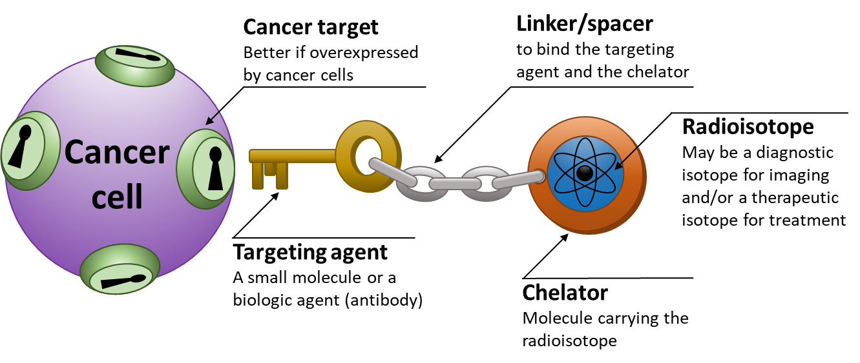
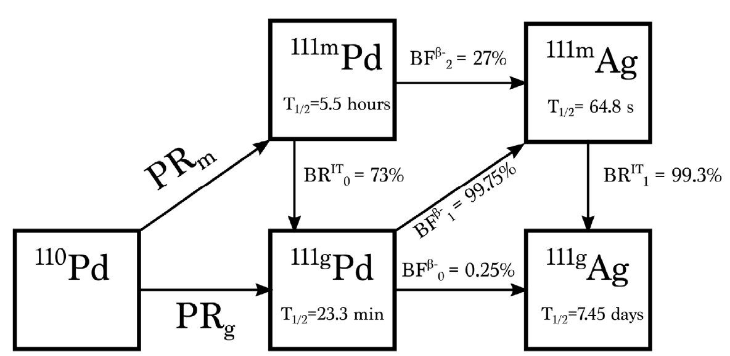
Conclusions
To move beyond the main objectives of the ISOLPHARM project and to promote studies and interest in 111Ag-based radiopharmaceuticals, the first batches of this nuclide were carried out at LENA
Production of 111Ag via neutron activation
Development of a separation and recycling protocol
Radiopharmaceutical design and synthesis
Radiolabeling
Testing in-vitro and in-vivo labeled compound
Notes:
5

