Slide 1



Laboratori Nazionali di Legnaro – INFN
Implantation substrates for the efficient recovery of radionuclides
F. Nicente
March 15th, 2024

Slide 2
Outline
Implantation substrates
Innovative targets
Characterization and metal recovery
Notes:
2

Slide 3
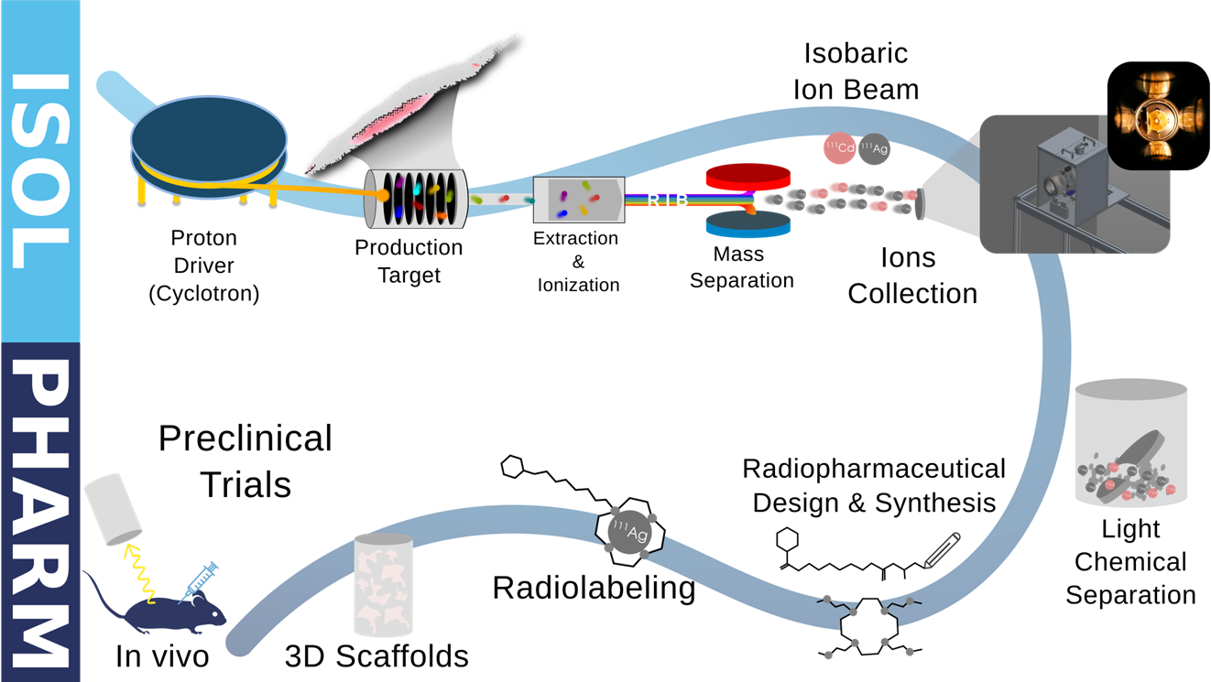
Implantation substrates
Mechanical properties
Technological properties
Vacuum resistance
Handling and falling resistance
Appropriate size for IRIS fitting
Low porosity to ensure superficial deposition of radionuclides
Contaminants-free materials
Highly flowing and compacting pow-ders, forming resistant disks
High radionuclides release
Compatibility with a wide panel of radionuclides
Size
Morphology
Porosity
Breaking load
Flowability of the powders
Disaggregation time/behavior
Metals uptake and release
Notes:
3

Slide 4
State of the art
Soluble targets (e.g. salts, sugars) prepared by powder compaction
→ Good metal recovery, but contaminants potentially interfering with separation processes
Notes:
4

Slide 5
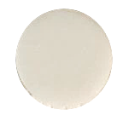
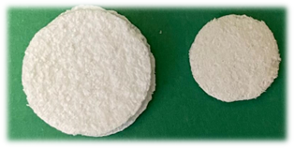
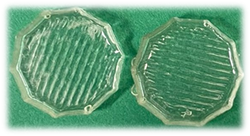
Innovative targets
Targets produced with traditional methods
Targets produced with innovative methods
Direct compression:
Polyols
Freeze-thaw:
Cellulose
Solution casting:
Polyvinylpyrrolydone (PVP)
HP: PVP 50%, HPMC 1%
HPS: PVP 50%, HPMC 1%, sorbitol 0,4%
SPS: sorbitol, PVP 1%(w/w), stearic acid 1%(w/w)
S100: sorbitol 100%
Cellulose and PVA 25:75 w/w crosslinked
Notes:
5

Slide 6
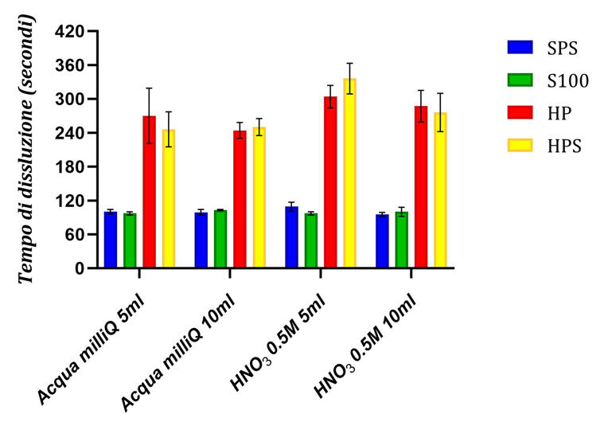
Characterization and metal recovery
Dimensional analysis
Weight loss in vacuum
Diameter (mm)
Thickness (mm)
After 24 h (%)
After 7 days (%)
SPS
12,99 ± 0,01
1,32 ± 0,02
≈0
7,86±0,23
S100
13,01 ± 0,01
1,32 ± 0,02
≈0
≈0
HP
12,78 ± 0,15
1,55 ± 0,05
9,78±0,09
20,03±0,14
HPS
13,86 ± 0,15
1,51 ± 0,07
7,02±0,17
9,78±0,09
Dimensioni appropriate per l’utilizzo in IRIS
Massa >100mg
Spessore tra 1,15 e 1,56mm
Superficie liscia e omogenea
Forma regolare
Rigidità
Notes:
6

Slide 7
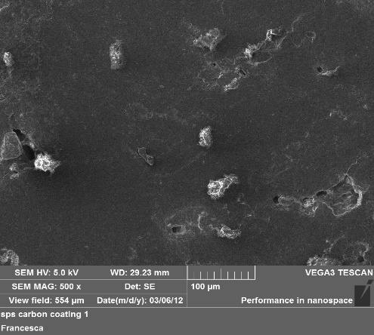
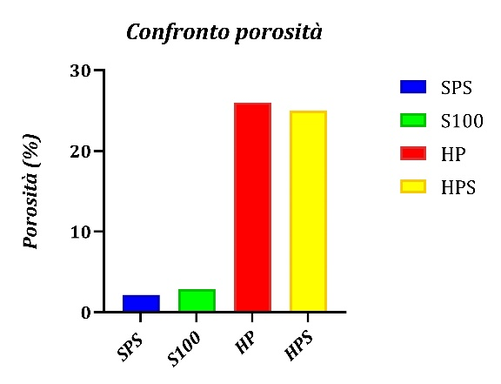
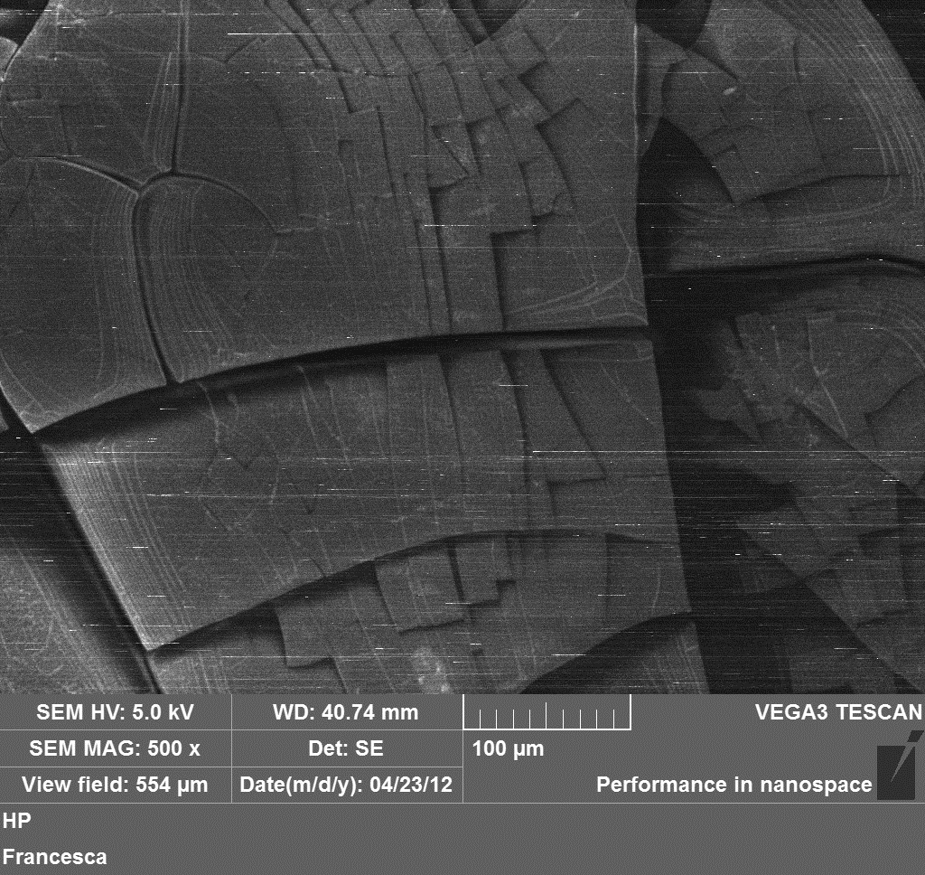
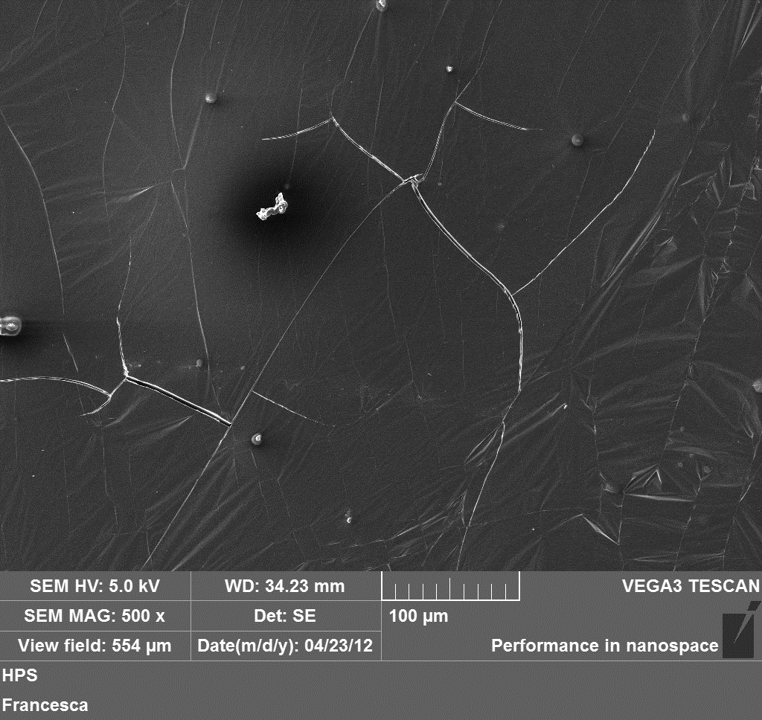
Characterization and metal recovery
SPS
S100
SPS: 2,16%
S100:2,85%
HP:26%
HPS:25%
HP
HPS
Higher degree of fissures
Notes:
7

Slide 8
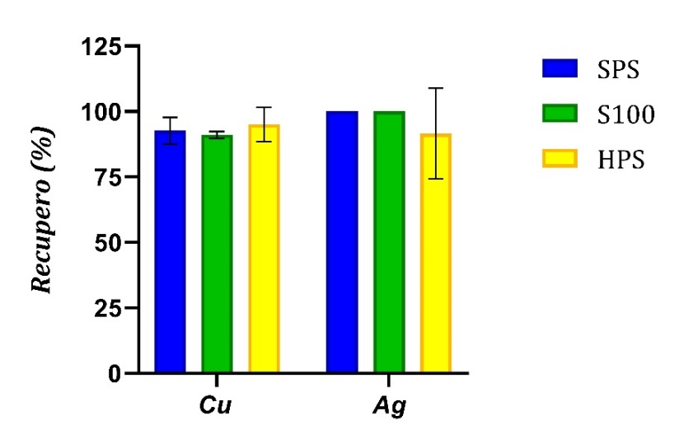
Characterization and metal recovery
Recovery (%)
Cu²⁺
Ag⁺
Bulk solution
100
100
SPS
92,68 ± 5,11
≈100
S100
91,06±1,30
≈100
HPS
95,09±6,55
91,53±17,36
High recovery of both metal ions
Notes:
8

Slide 9
Conclusions
Notes:
9

