Slide 2
Quite some advancements since 2007 in Patras regarding axions:
there is an axion TV station now!

Slide 3
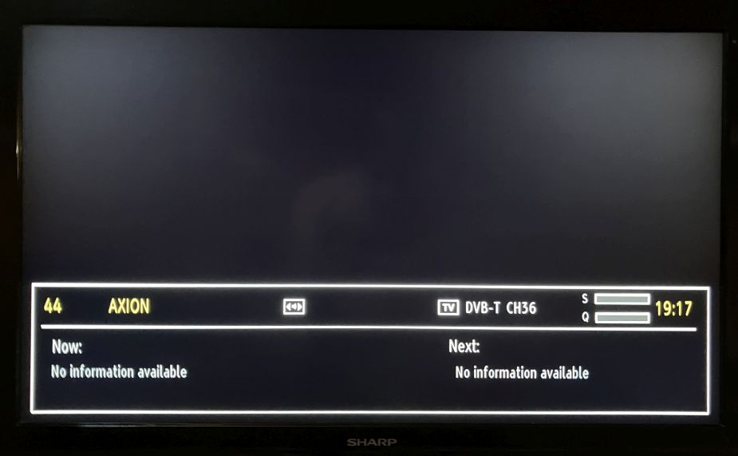
Quite some advancements since 2007 in Patras regarding axions:
there is an axion TV station now!
However, no signal. As usual.

Slide 4
Some personal recollections

Slide 5
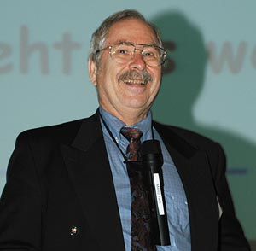
Hermann Friedrich Wagner (German ministry for research)
around 2004

Slide 6
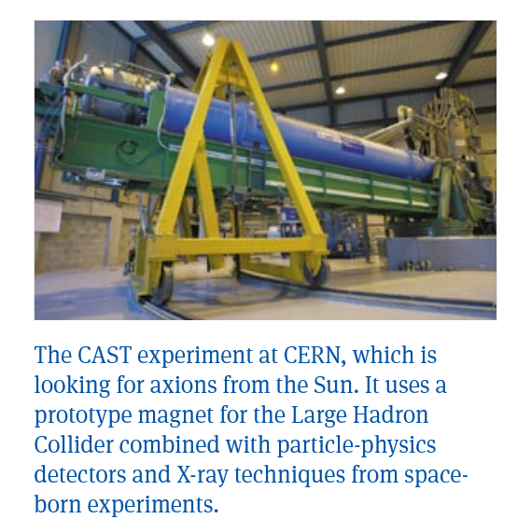
CERN Courier March 2004

Slide 7
First personal encounter with Konstantin
… near miss …

Slide 8
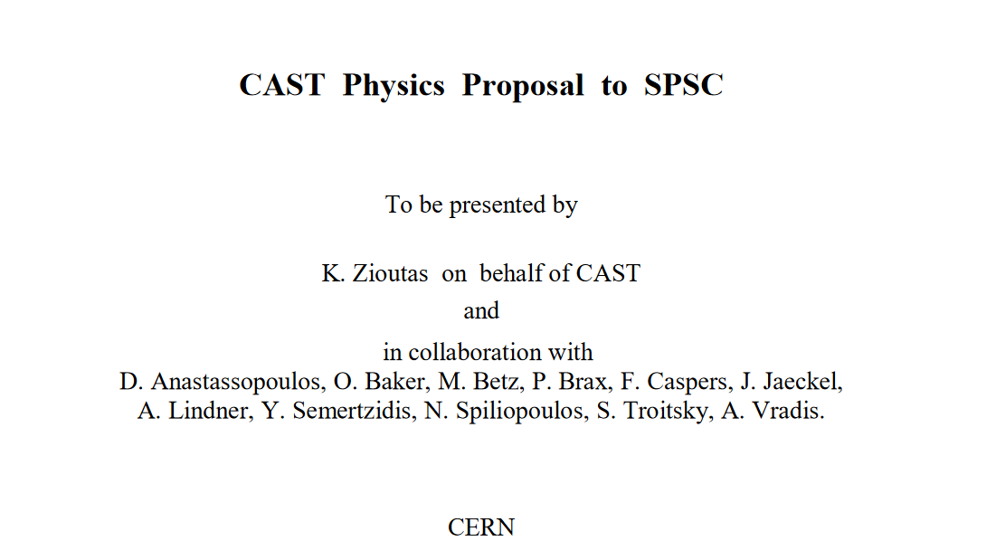
One of my personal highlights (March 2011)

Slide 9
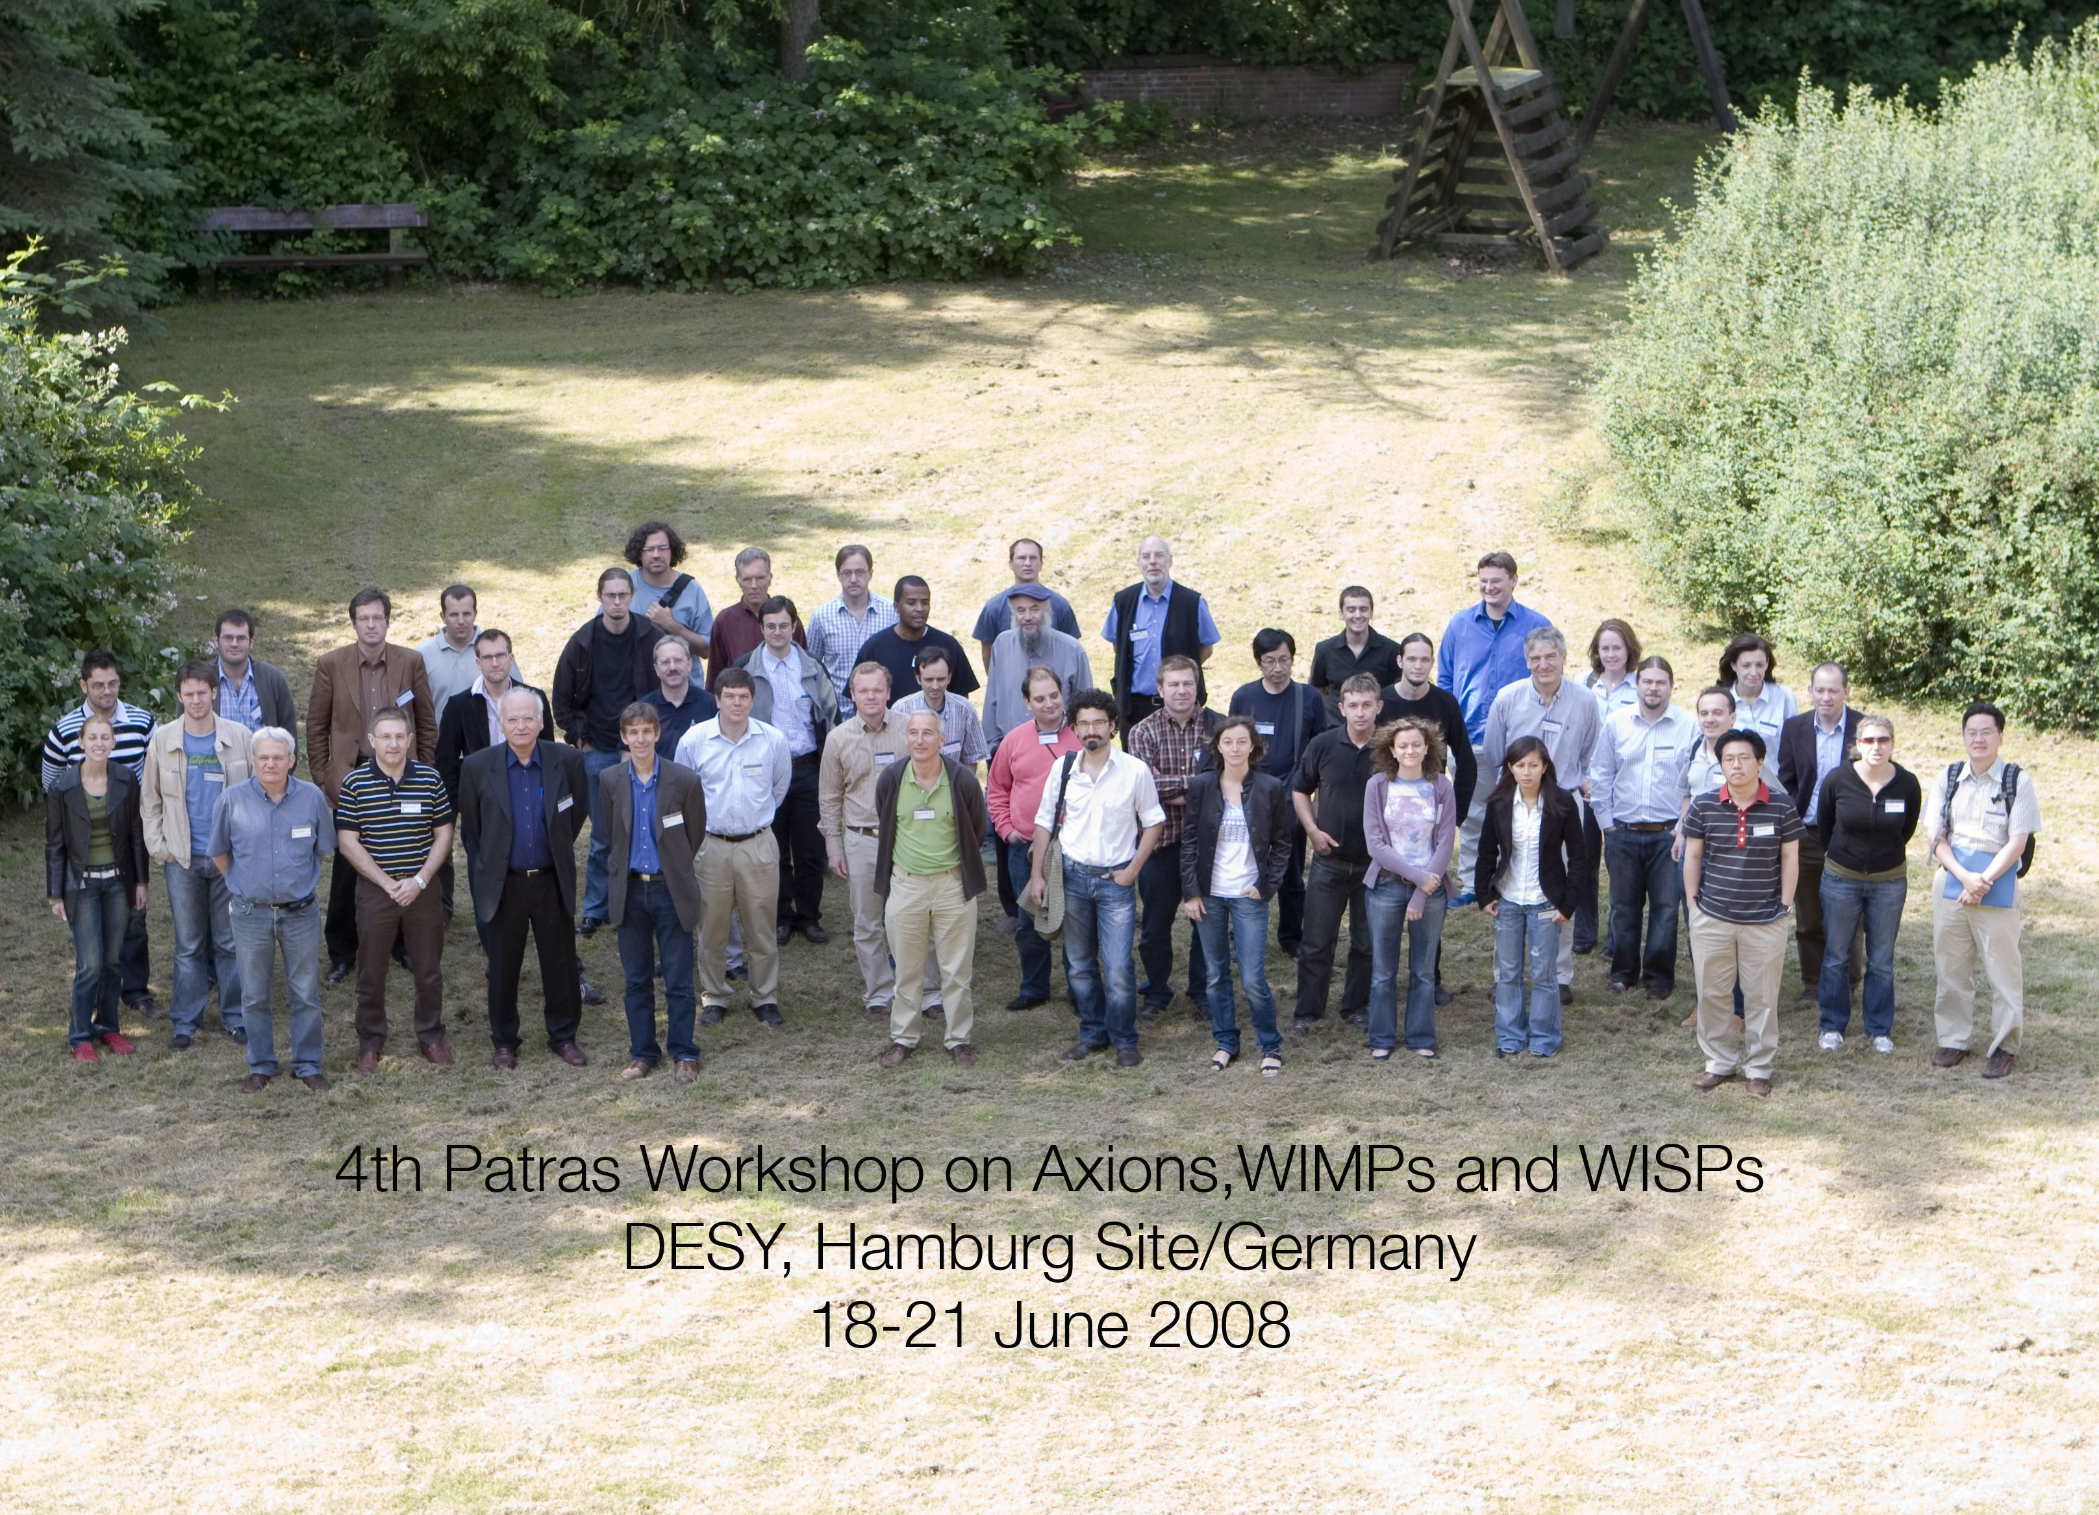
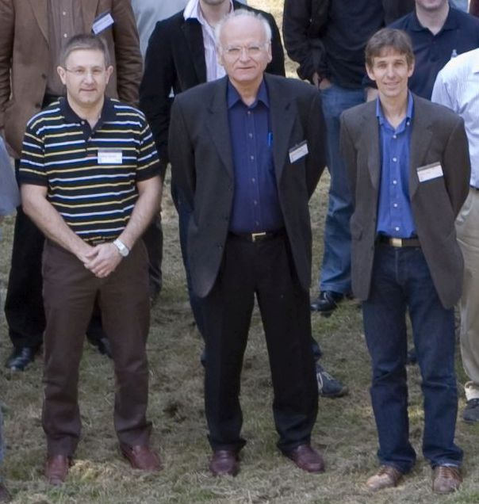
The first PATRAS workshop in 2008: at DESY!

Slide 10
My personal thanks to Konstantin!
You've helped starting my fun-time in physics.
Well, it is fun at least for most of the time.
Many thanks also on behalf of the collaborations
ALPS II, MADMAX and IAXO!

Slide 11
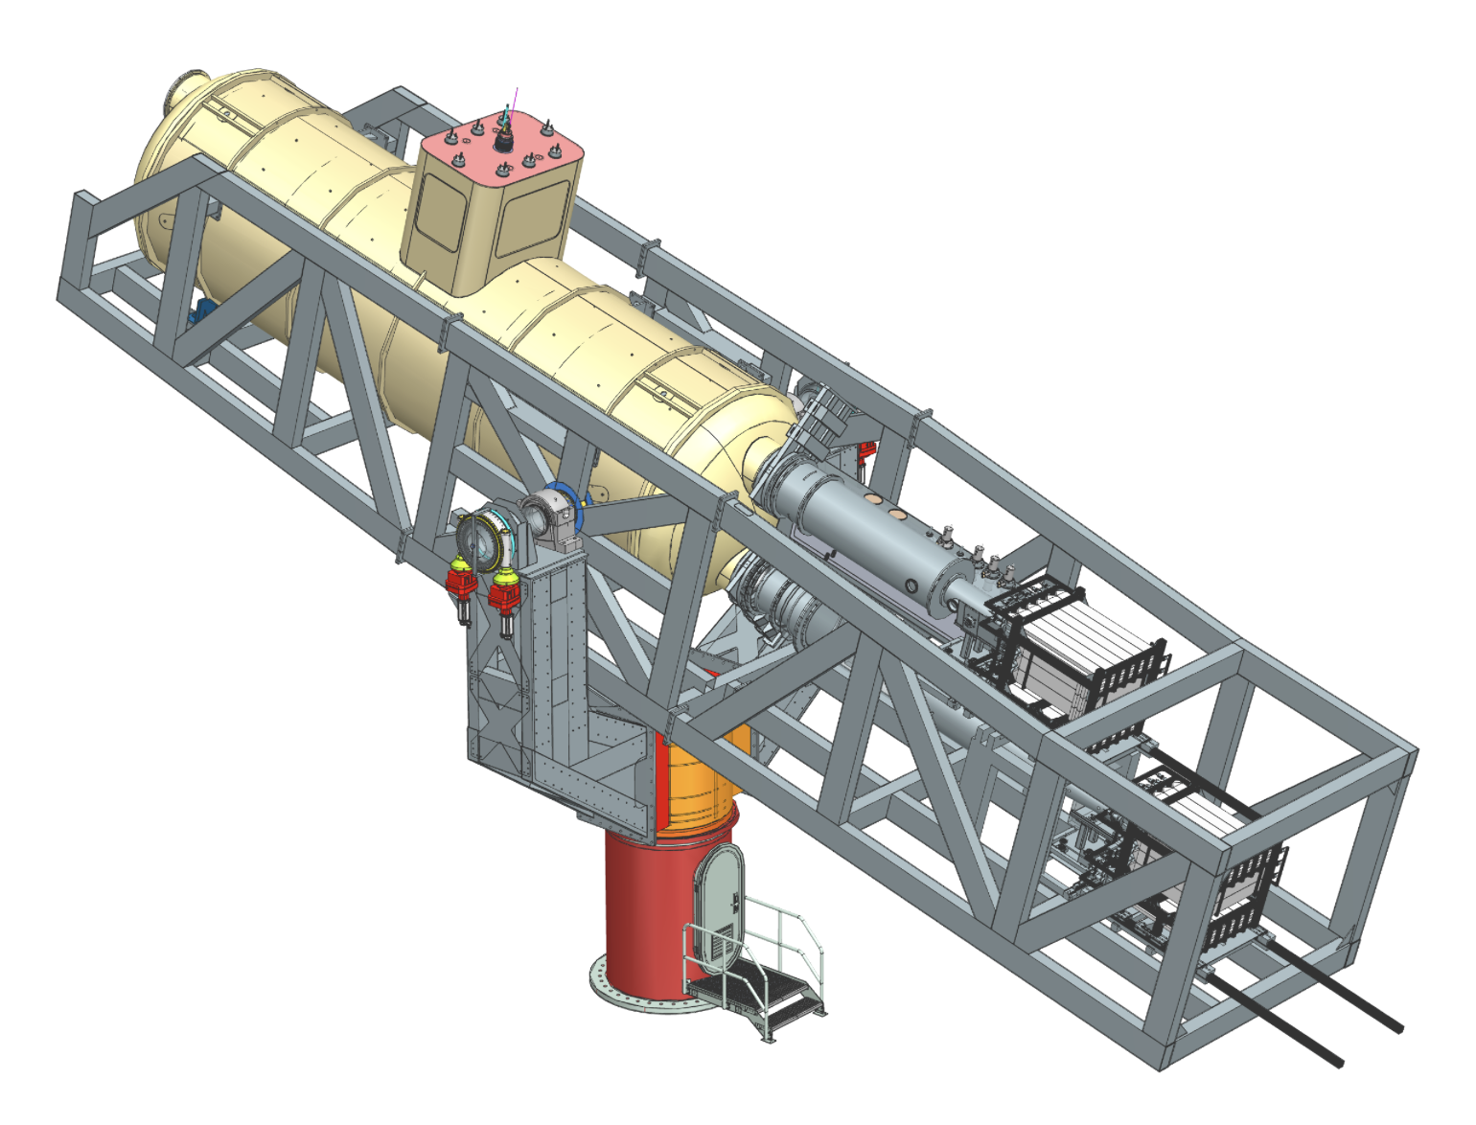
Now: the future!

Slide 12
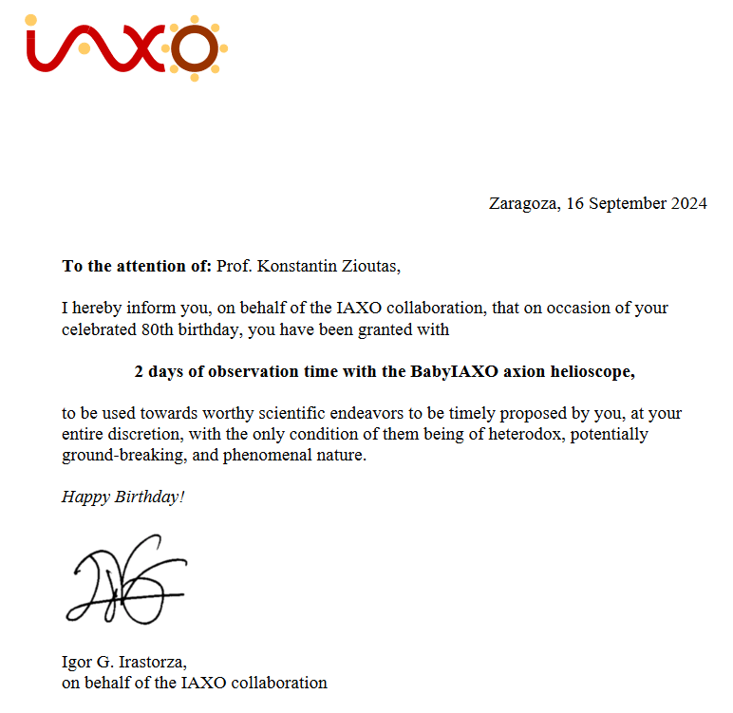
Now: the future!

