Slide 1
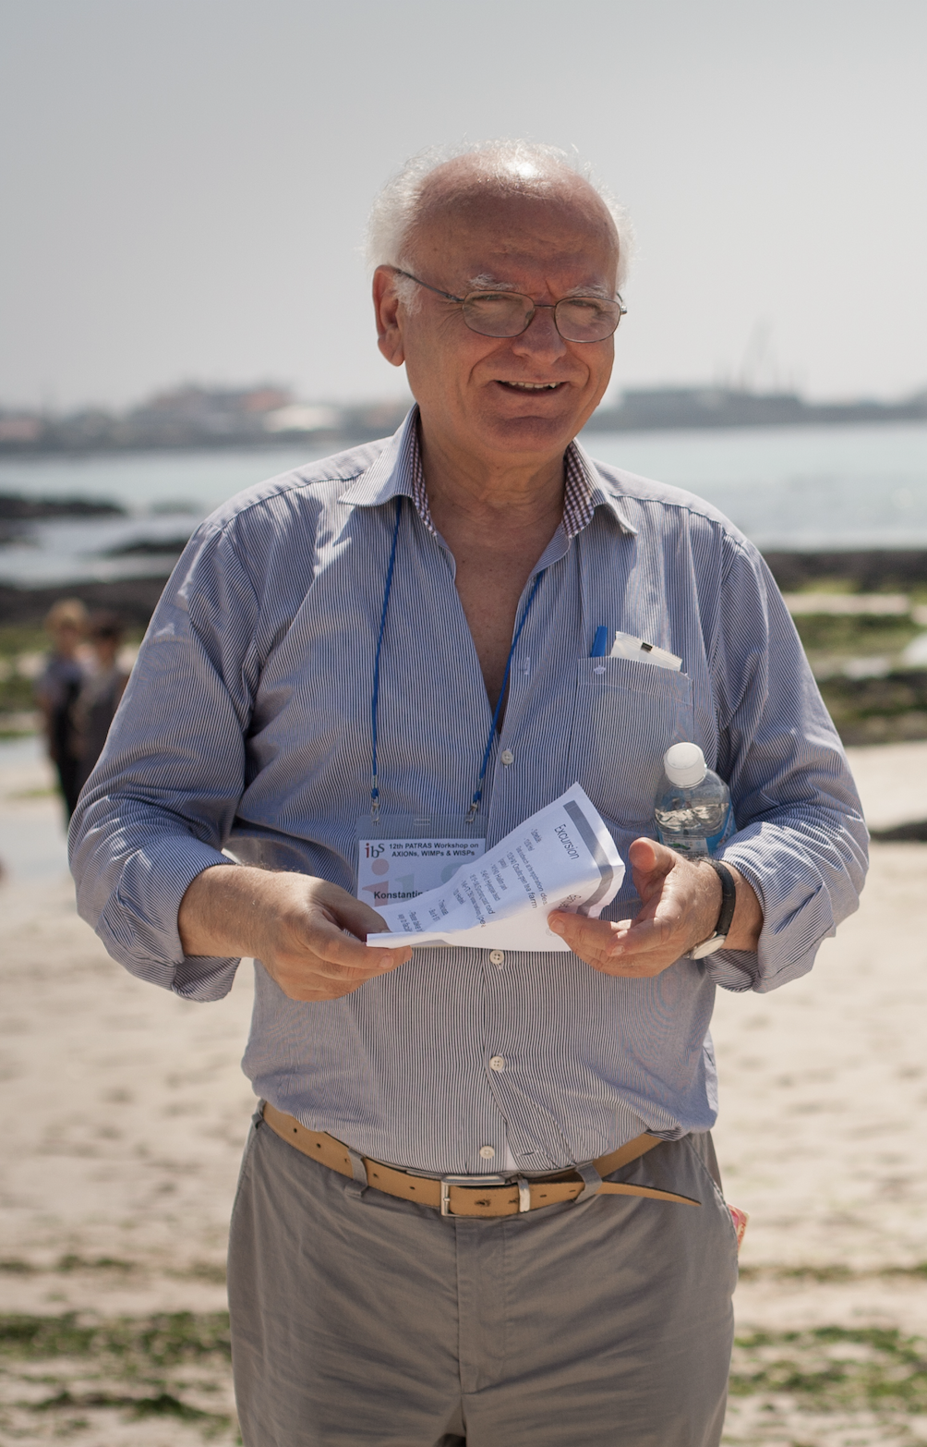
Konstantin Zioutas
80th Birthday celebration
Patras, September 17, 2024

Slide 2
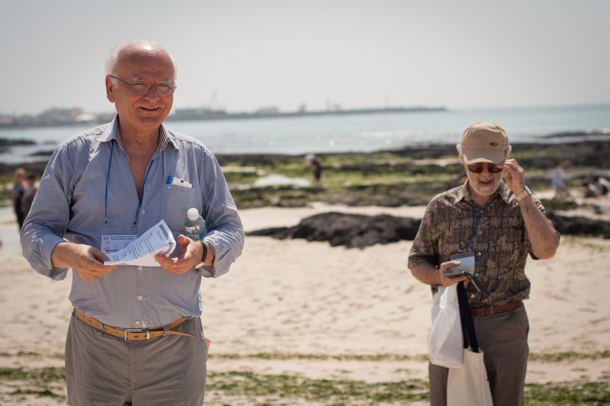
Konstantin Zioutas
I know Konstantin since the
fall, ’81,
That’s 1981!

Slide 3
Konstantin Zioutas
I learned from Konstantin never to give up!
“In the end, everything will be OK.
If it’s not OK, it’s not the end.”
Some attribute this quote to John Lenon and Paulo Coelho (The Alchemist, Author), but Konstantin practices it!
You need to do what it takes, no matter the difficulty of the task!

Slide 4
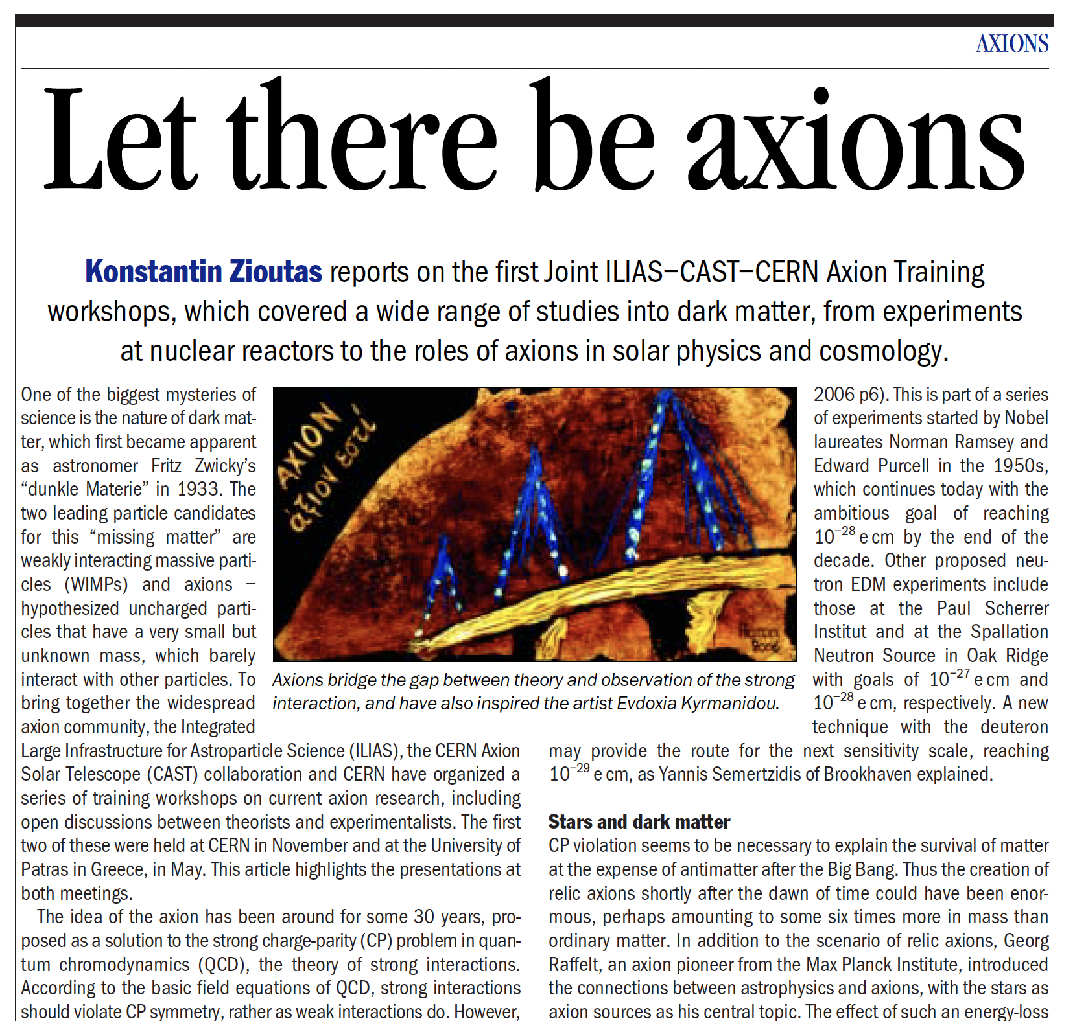
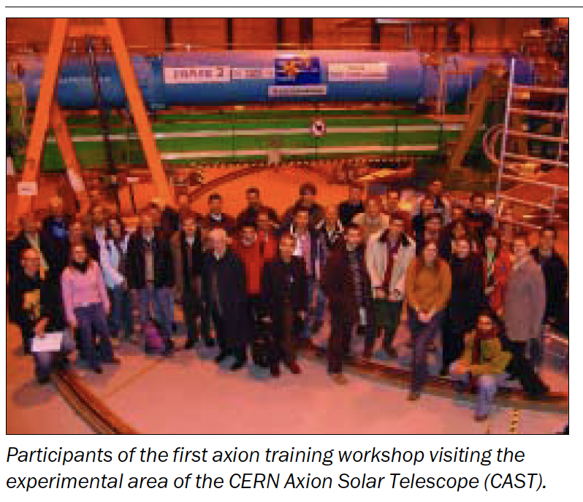
Konstantin Zioutas and the Patras Workshops CERN, November 2005 Patras, May 2006

Slide 5
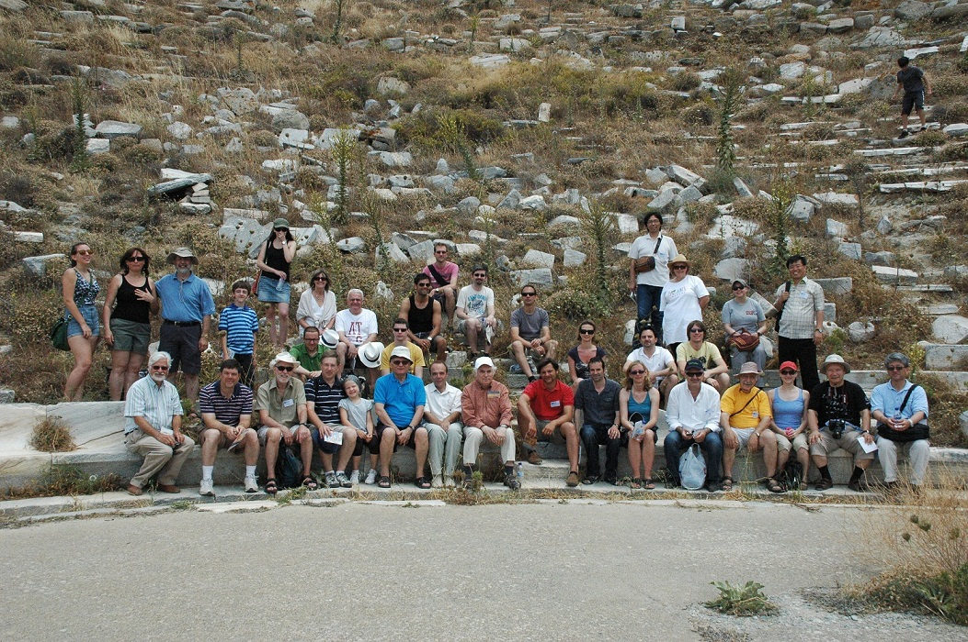
Konstantin Zioutas and the Patras Workshops Mykonos 2011

Slide 6
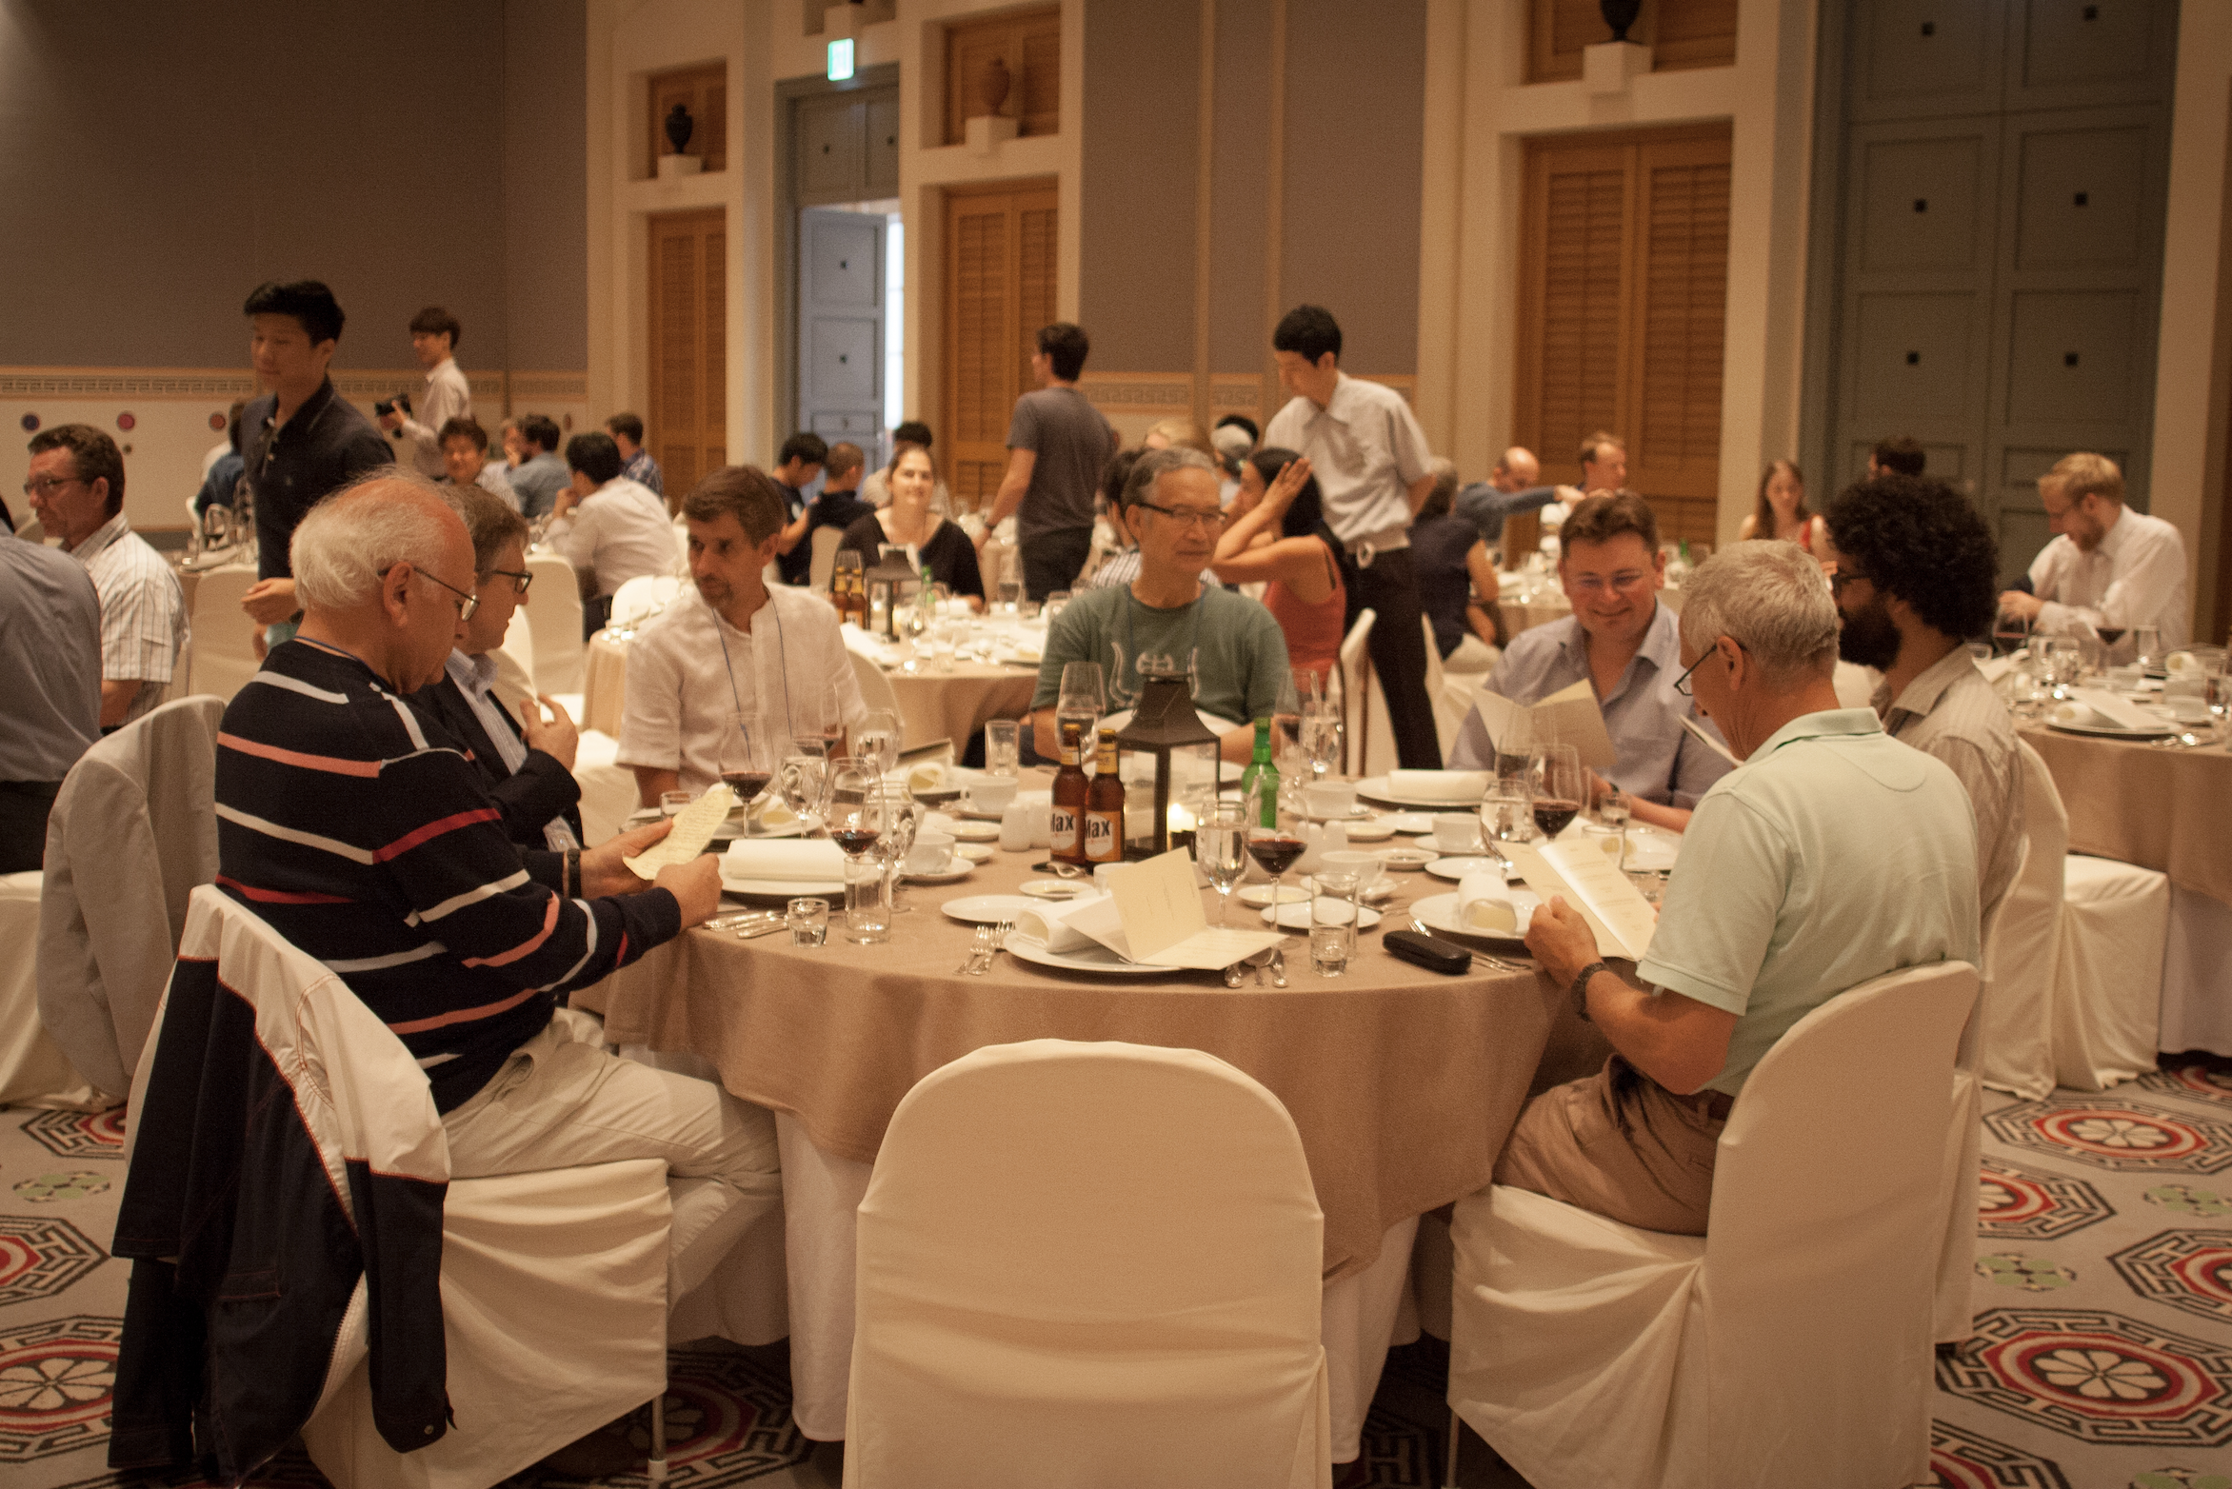
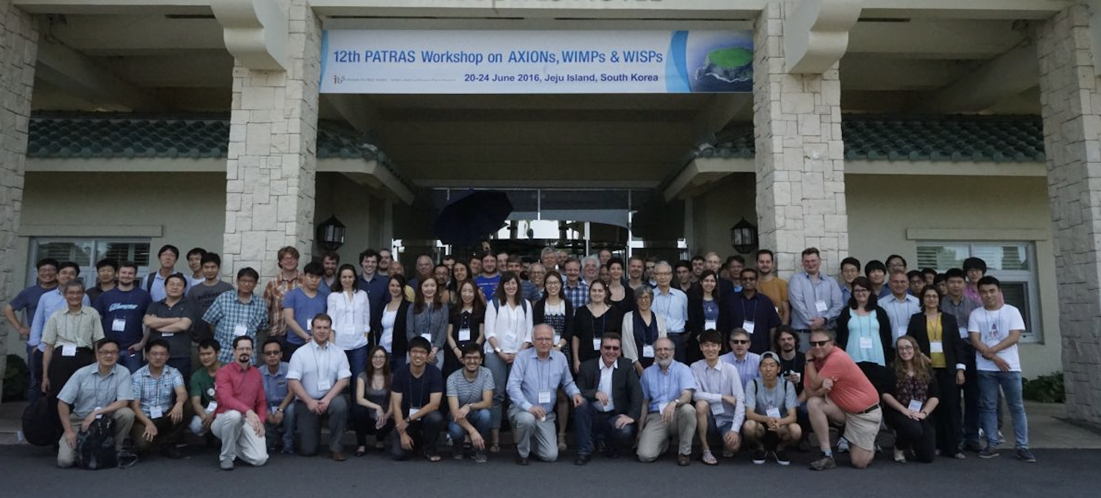
Konstantin Zioutas and the Patras Workshops Jeju Island, South Korea, 2016

Slide 7
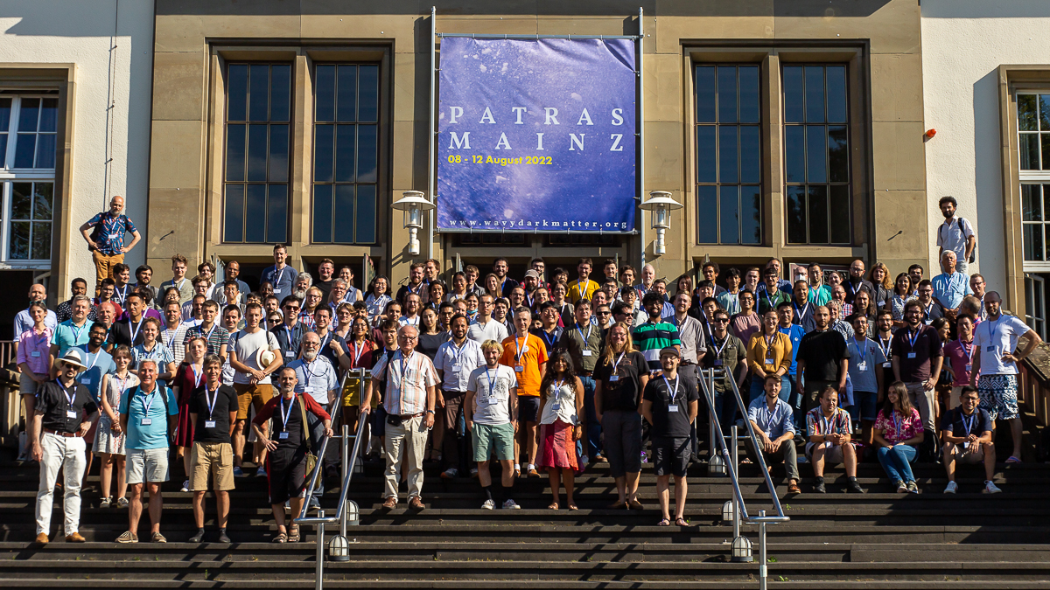
Konstantin Zioutas and the Patras Workshops Mainz, 2022

Slide 8
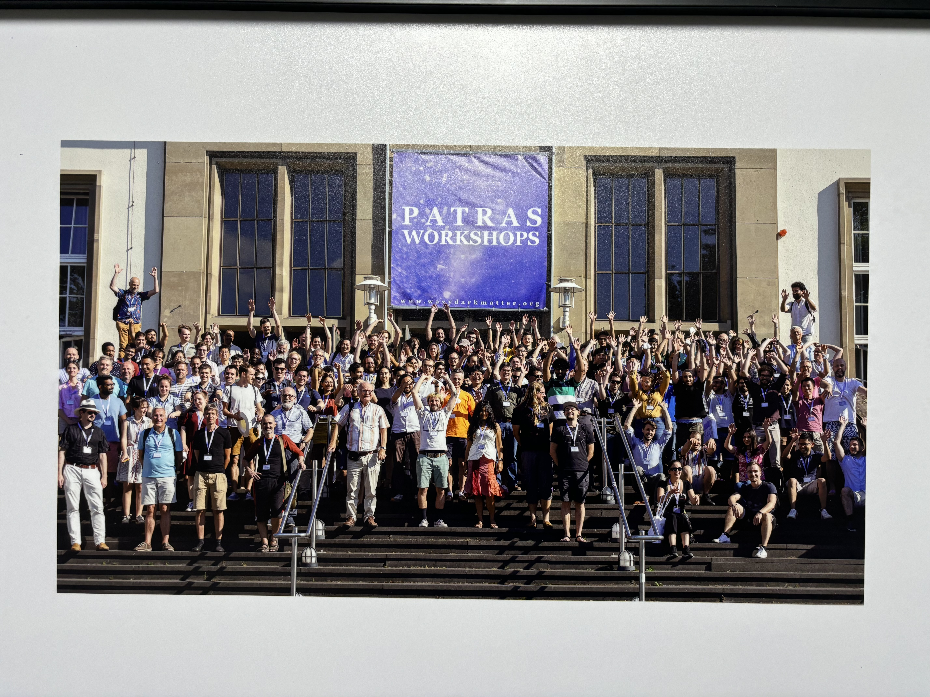
Happy 80th Birthday, Konstantin Zioutas, from all the people of the Patras Workshops! September 17, 2024
During the break, please come up
to wish Happy Birthday and
sign the photo (white area only,
Please) using the special markers.

Slide 9
In Recognition of Prof. Konstantin Zioutas For Pioneering Leadership in Dark Matter Research Spokesman of the CAST Experiment at CERN Celebrating His 80th Birthday, Patras Workshop 2024.

Slide 10
In Recognition of Prof. Konstantin Zioutas For Pioneering Leadership in Dark Matter Research Spokesman of the CAST Experiment at CERN Celebrating His 80th Birthday, Patras Workshop 2024.
To Konstantin:
Happy Birthday and many happy returns!
…and to keep coming up with
breakthrough ideas!

