Slide 1
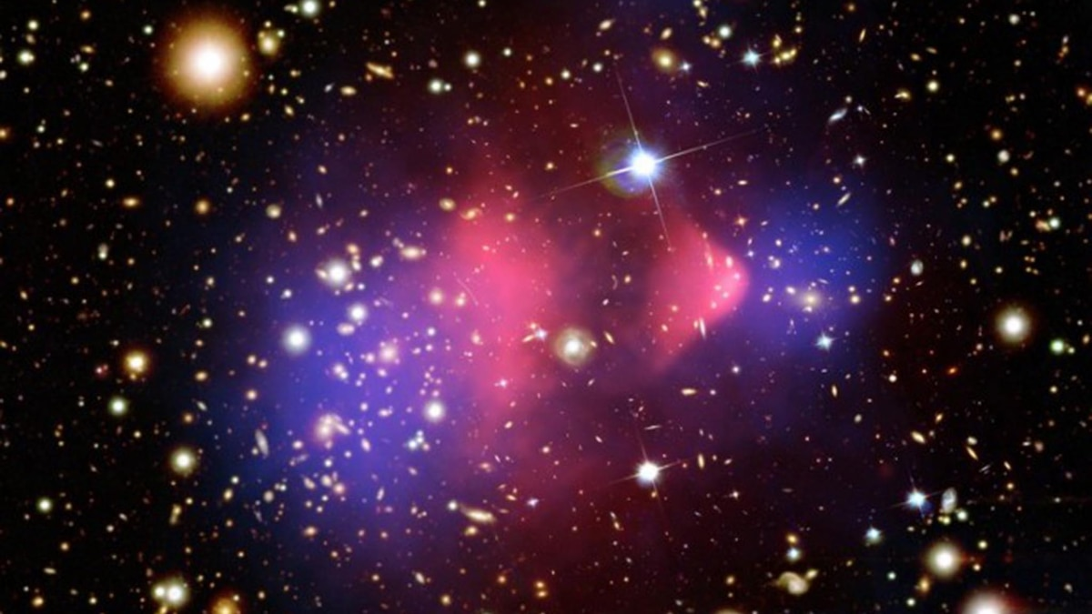
A search for axionlike Dark Matter
using nuclear magnetic resonance
at CASPEr-Gradient low-field
Julian Walter
on behalf of the CASPEr collaboration
Johannes Gutenberg-Universität Mainz / Helmholtz Institut Mainz, Germany
PATRAS 2024

Slide 2
Outline
CASPEr-gradient low-field
First Axion search test run
Data analysis & preliminary results
Setup status & future plans

Slide 3
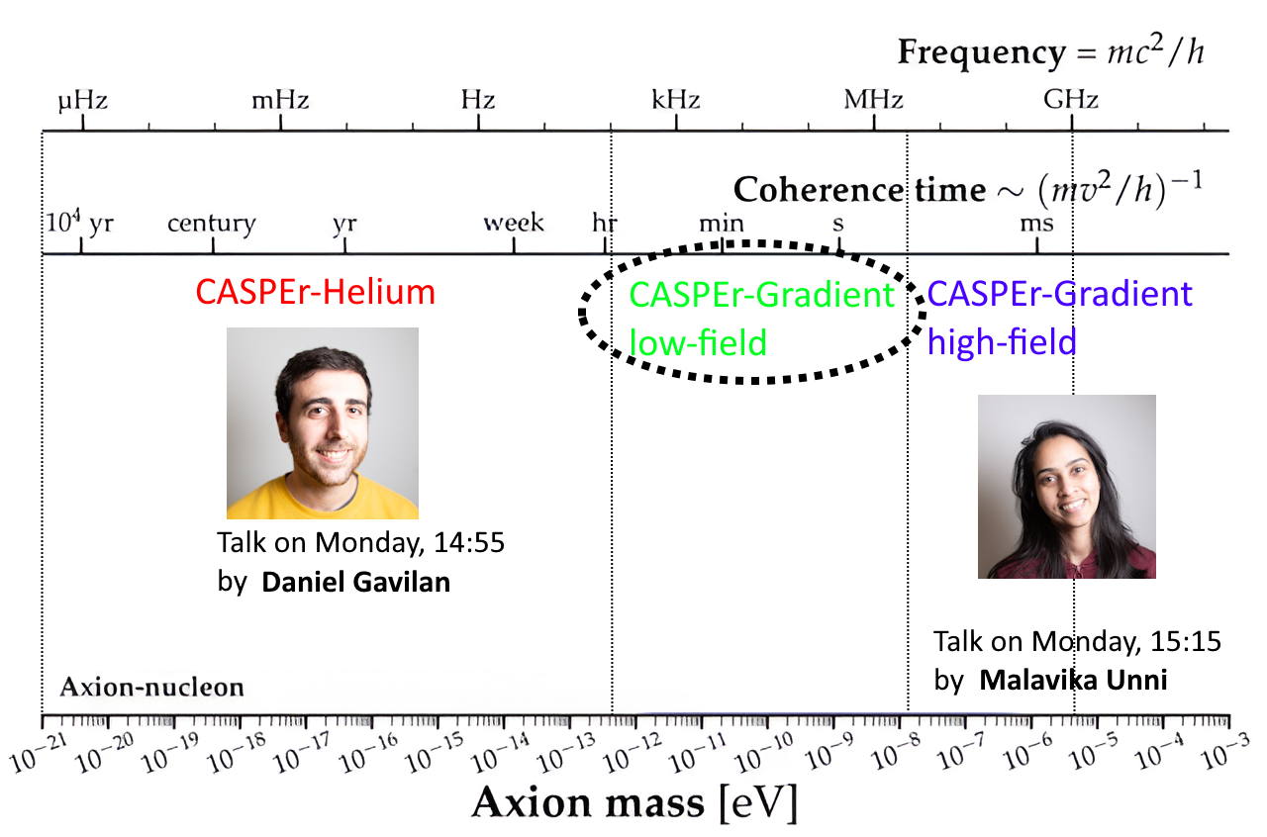
Testing the gradient coupling with CASPEr
this talk
A search for axionlike Dark Matter at CASPEr-Gradient low-field Julian Walter for the CASPEr collaboration 1/15

Slide 4
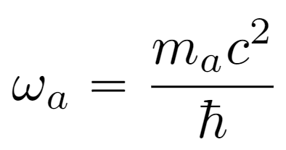
Possible Axion couplings
Axion coupling to: | Probed by:
Photon | many experiments: cavities, lumped element, …
Gluon | CASPEr-electric, …
Fermion | NMR and magnetometer experiments CASPEr-gradient (formerly CASPEr-wind), CASPEr-helium, ...
Magnetic field - Nuclear spin
Graham, P. W. and S. Rajendran, Phys. Rev. D 88, 035023 (2013)
ALP field gradient - Nuclear spin
ALP field gradient
≈ pseudo-magnetic field
A search for axionlike Dark Matter at CASPEr-Gradient low-field Julian Walter for the CASPEr collaboration 2/15

Slide 5
CASPEr-gradient detection scheme
Faraday cage
CASPEr is similar to (cw-) NMR⁽¹⁾
High-f noise
Sample
Nb shield
SQUID
Pickup
& Excitation
Low-f noise
continuous-wave Nuclear Magnetic Resonance
Axion
field
B_{a}(t, ⍵_{a} , g_{aNN})
If ⍵_{exc}= ⍵₀ → Resonant “tipping”
of magnetization due to ALP field
We can do pulsed-NMR for diagnostics…
… or let the ALP gradient perpendicular to B₀ do the pulsing!
A search for axionlike Dark Matter at CASPEr-Gradient low-field Julian Walter for the CASPEr collaboration 3/15

Slide 6
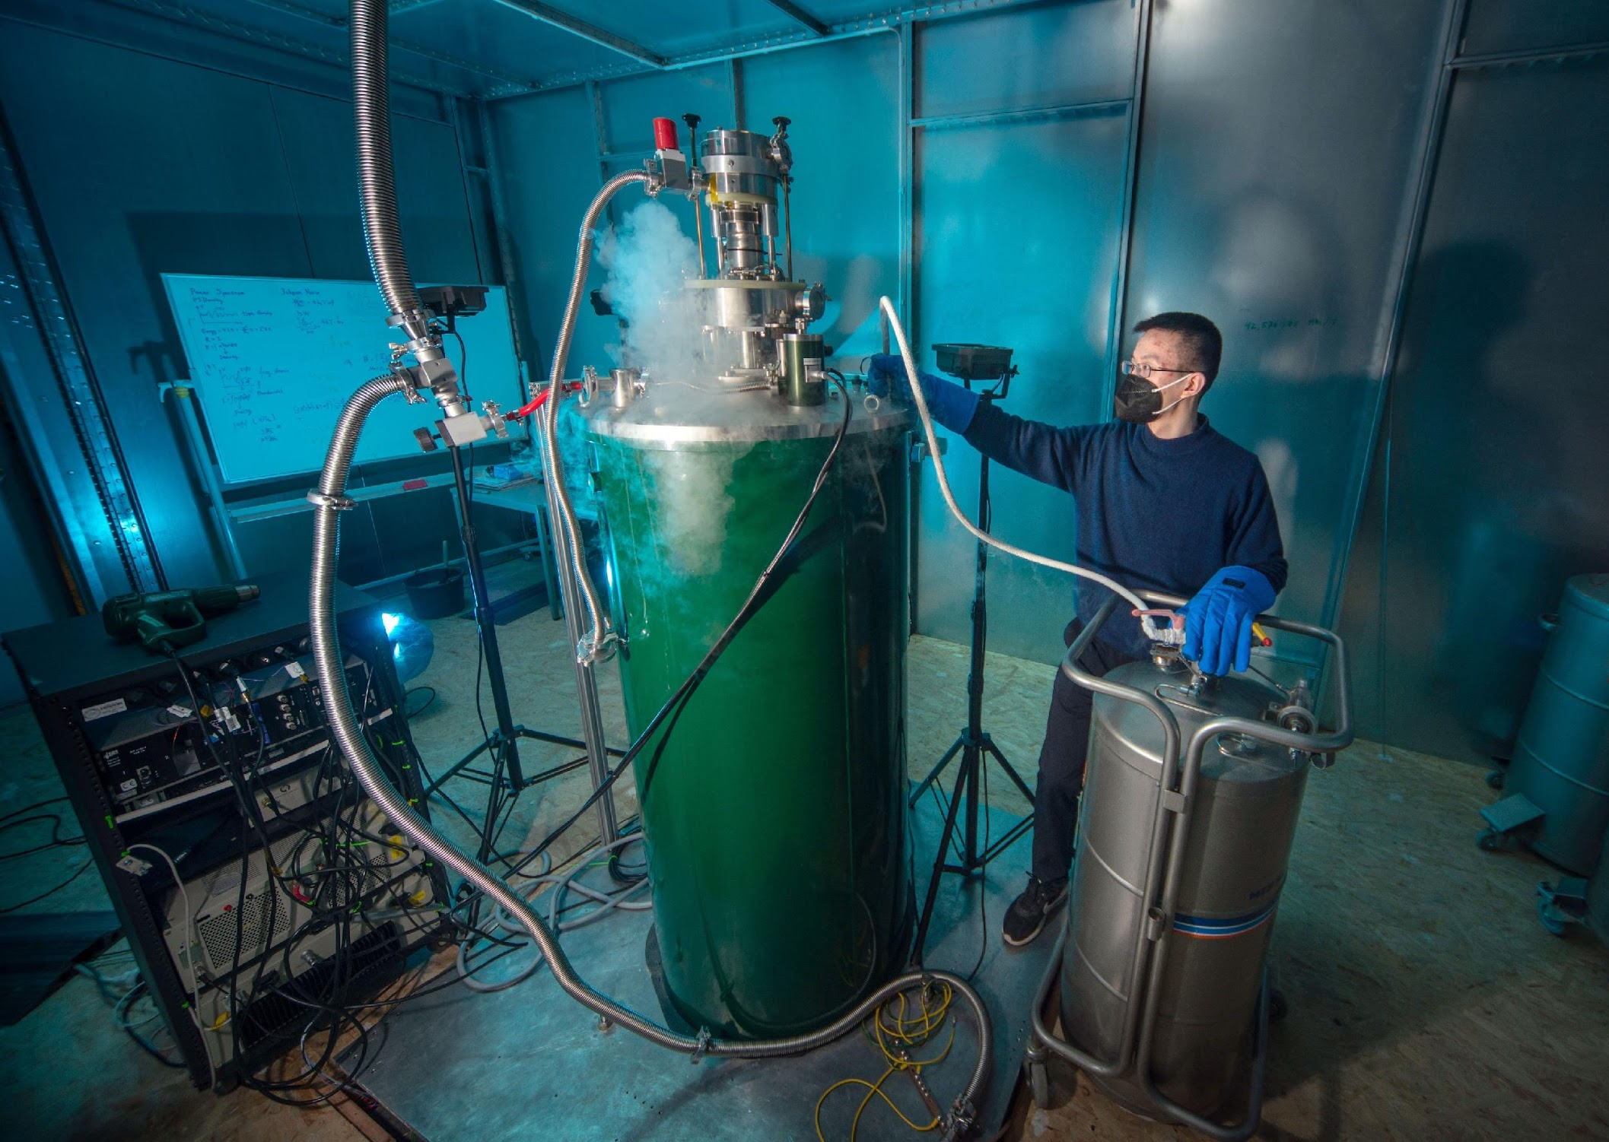
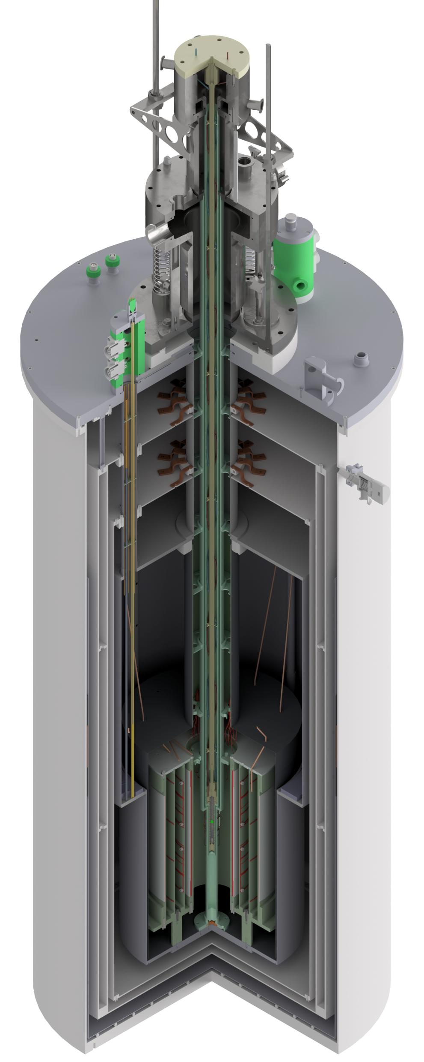
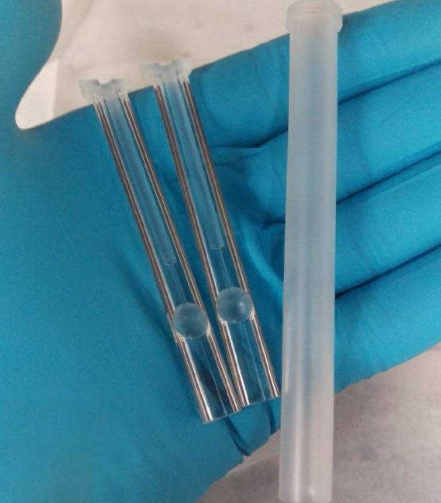
The CASPEr-gradient low-field setup
SQUIDs (T≈4K)
Nb shield
Faraday room
1.5 m
pickup coil
Working sample:
liquid methanol (CH₃OH),
thermally polarized
Tunable SC coil
(0 to 0.1T)
A search for axionlike Dark Matter at CASPEr-Gradient low-field Julian Walter for the CASPEr collaboration 4/15
Notes:
test

Slide 7
The Axion field and its gradient
random phase
field amplitude ~
local DM density
Compton frequency ~ axion mass m_{a}
A search for axionlike Dark Matter at CASPEr-Gradient low-field Julian Walter for the CASPEr collaboration 5/15

Slide 8
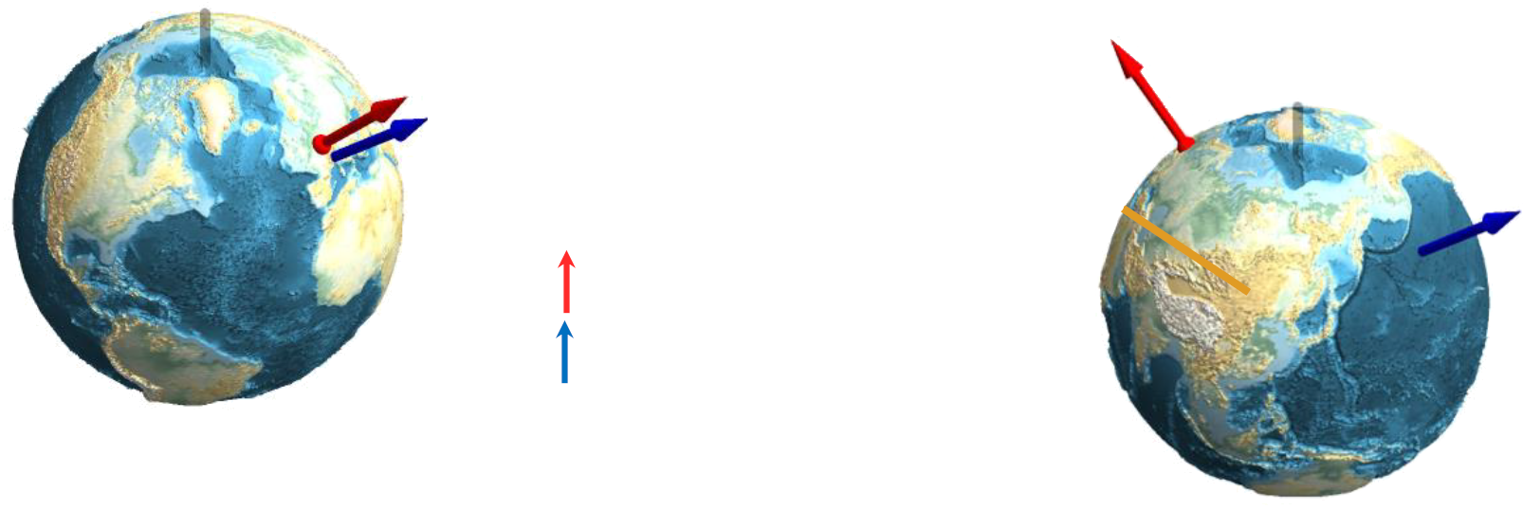
The Axion field and its gradient
random phase
Axion velocity
Compton frequency ~ axion mass m_{a}
CASPEr B₀ axis
Earth velocity
Coherence time τ_{a}:
ALP field can be approx. considered in-phase over this duration
Axion velocity is boosted by Earth’s motion through the halo
=> modulation of Axion signal strength
over time
Gramolin et al: “Spectral Signatures of Axionlike Dark Matter.”
PhysRev D 105, no. 3 (February 24, 2022): 035029
A search for axionlike Dark Matter at CASPEr-Gradient low-field Julian Walter for the CASPEr collaboration 5/15

Slide 9
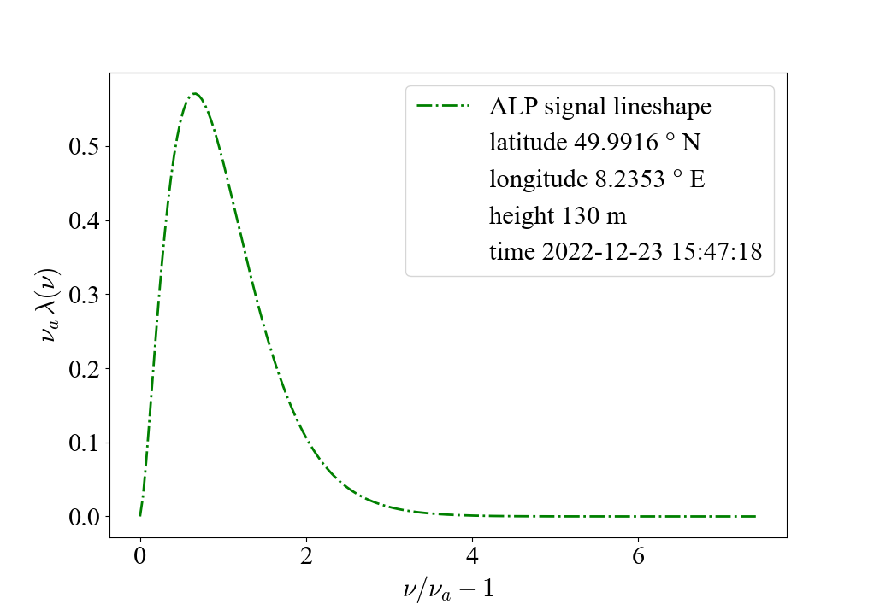
The Axion signal @CASPEr-gradient
⍵_{a}: Axion frequency v_{a}: Axion velocity α: “wind angle” between v_{a} and B₀ τ_{a}: Axion coherence time g_{aNN}: Axion-nucleon coupling strength ρ_{DM}: local DM density (≈ 0.4 GeV/cm³)
p: Sample polarization (≈10⁻⁷ for thermal) n_{s}: Spin density (99 mmol/cm³) V: sample volume (22mm x 8mm) u: spectral factor
T₂: transverse relaxation time, (≈ 0.02s, B₀ field inhomogeneity < 10ppm)
T_{S}: Spin projection noise (~ 10⁻¹⁹ Φ₀²/Hz) + thermal noise + RF chain noise
Effective SQUID noise level ~ 10⁻¹² Φ₀²/Hz => expected sensitivity ~ 10⁻² GeV⁻¹
Axion properties
Sample properties
System Noise
field inhomogeneity
Yuzhe Zhang et al., “Frequency-scanning considerations in axionlike dark matter spin-precession experiments” (2023)
Dongok Kim et al JCAP03(2020)066,” Revisiting the detection rate for axion haloscopes
A search for axionlike Dark Matter at CASPEr-Gradient low-field Julian Walter for the CASPEr collaboration 6/15

Slide 10
Outline
CASPEr-gradient low-field setup
First Axion search test run
Data analysis & preliminary results
Setup status & future plans

Slide 11
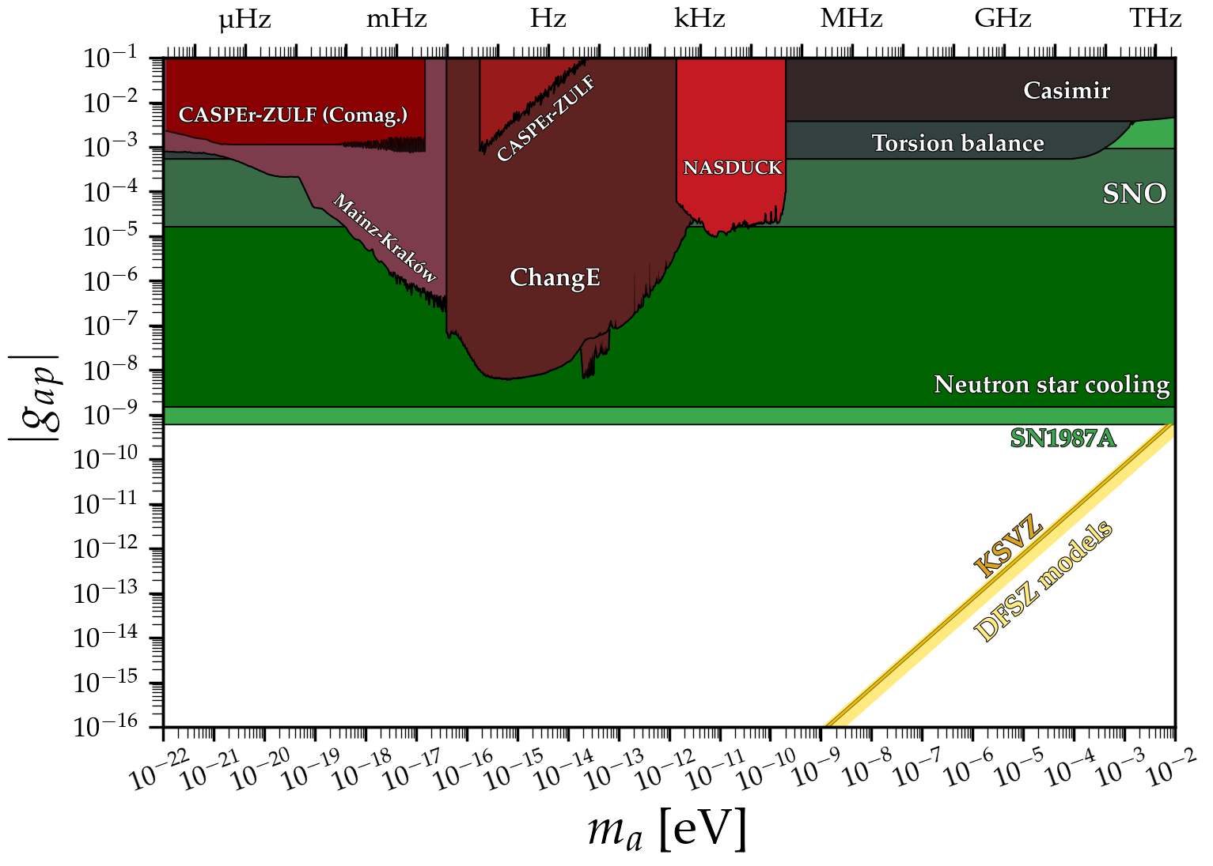
A preliminary axion search with CASPEr-thermal
HF
LF
CASPEr-g
test runs
CASPEr-gradient
“thermal” test runs:
3 x scan of 240Hz
from 1.3485 MHz (B₀=317G)
in steps of 6 Hz
https://cajohare.github.io/AxionLimits/
A search for axionlike Dark Matter at CASPEr-Gradient low-field Julian Walter for the CASPEr collaboration 7/15

Slide 12
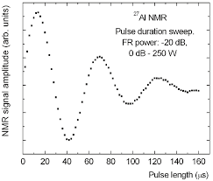
A preliminary Axion search with CASPEr-thermal
Experimental
preparations
Prepare sample
liquid methanol
thermal
polarization
Shimming (*)
≤10 ppm field
inhomogeneity
Pulse
duration
sweep
(*) Julian Walter et al., “Fast Shimming Algorithm Based on Bayesian Optimization for Magnetic Resonance Based Dark Matter Search” (2023)
(25s)
(25s)
downtime
(5s)
(100s)
Ramp B₀, increase Larmor frequency by 6 Hz (15s)
Repeat N times
A search for axionlike Dark Matter at CASPEr-Gradient low-field Julian Walter for the CASPEr collaboration 8/15

Slide 13
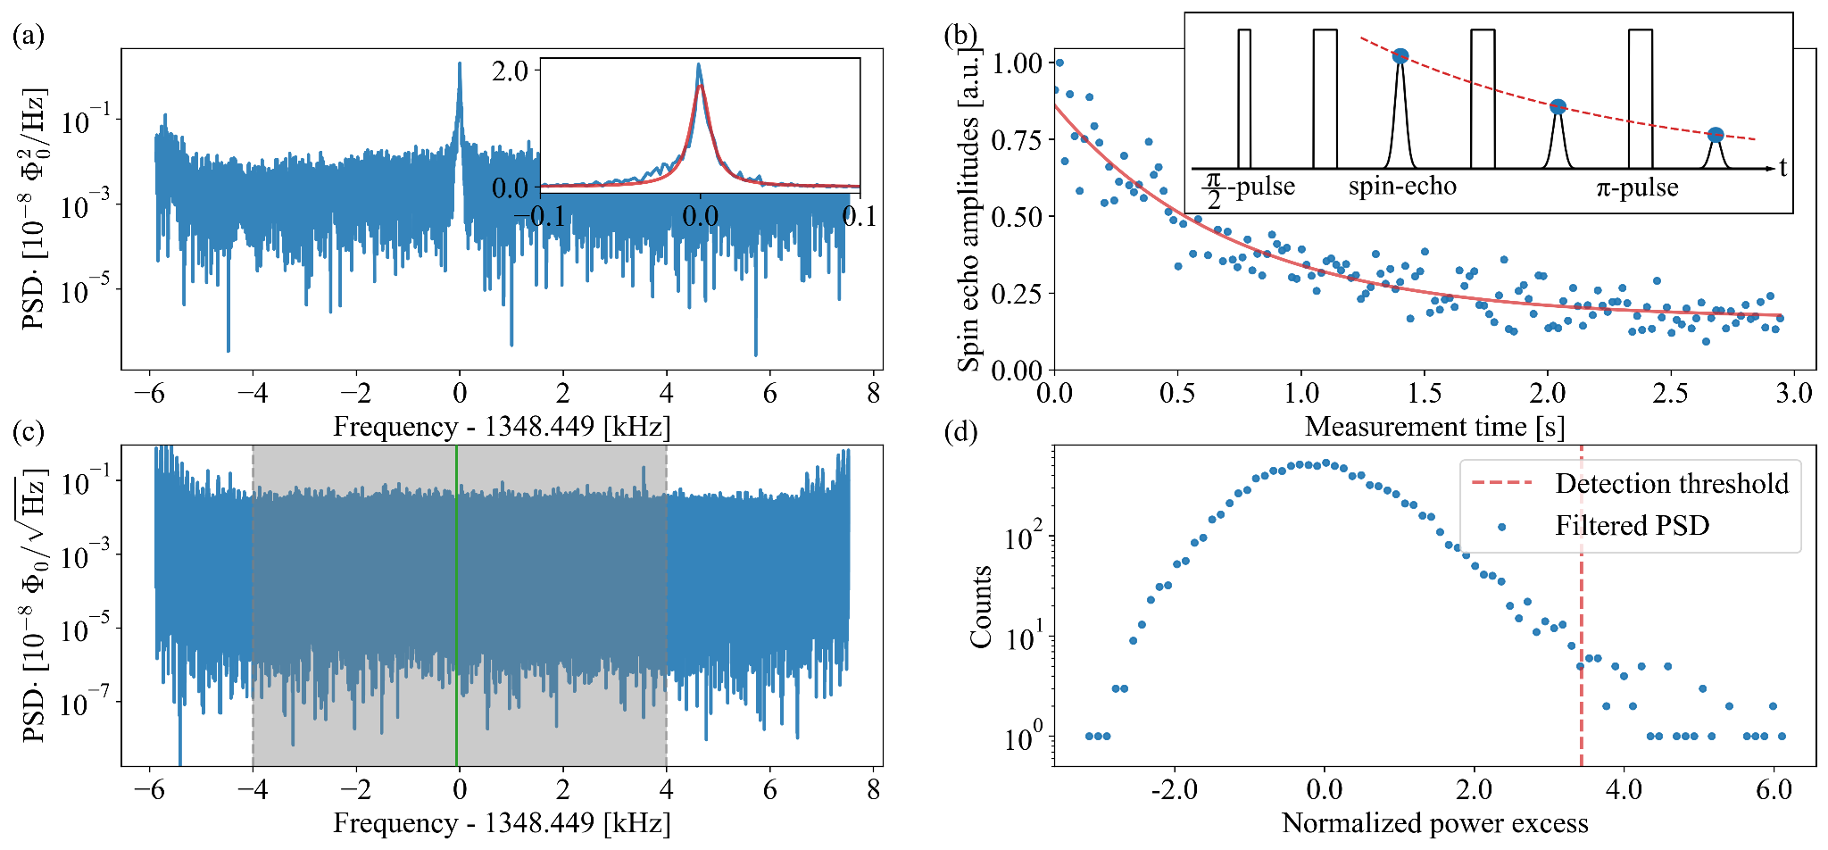
A single Axion scanning step
Scienca data Diagnostics
A search for axionlike Dark Matter at CASPEr-Gradient low-field Julian Walter for the CASPEr collaboration 9/15

Slide 14
Outline
CASPEr-gradient low-field setup
First Axion search test run
Data analysis & preliminary results
Setup status & future plans

Slide 15
Data analysis procedure
Axion signal
candidate evaluation
or rescan
Narrow-spike and Baseline removal
(Savitzky-Golay)
Matched filtering
with
A search for axionlike Dark Matter at CASPEr-Gradient low-field Julian Walter for the CASPEr collaboration 10/15

Slide 16
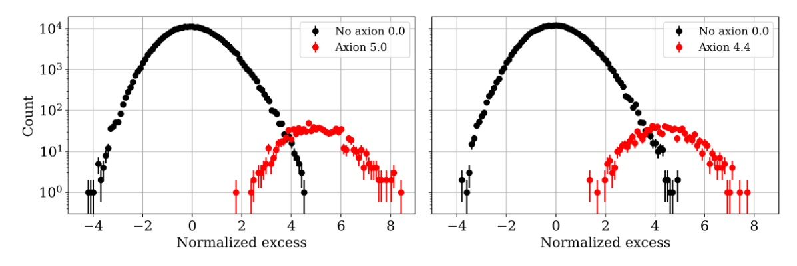
Monte Carlo simulation of power distribution
flat baseline with baseline & SG filtered
SG-filtered, convolved & normalized PSD
=> Histogram power excess
inject “fake Axion” signal peak at the 5σ-level
find 95% confidence level for detection
filter efficiency: 88.2 ± 4.6 %
A search for axionlike Dark Matter at CASPEr-Gradient low-field Julian Walter for the CASPEr collaboration 11/15

Slide 17
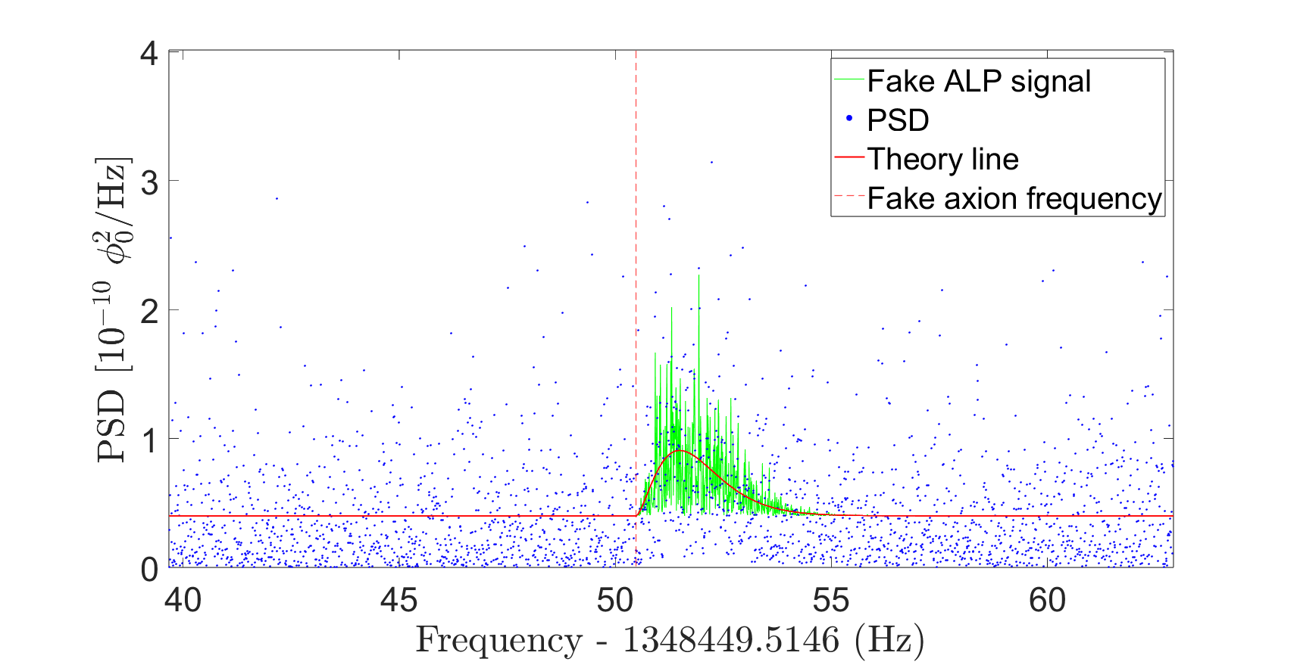
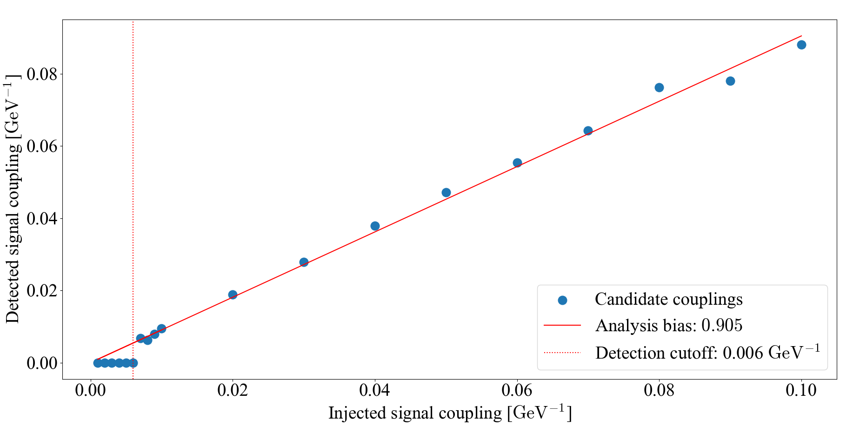
Signal recovery test
Inject “fake” ALP signals into PSD at random frequencies, with varying coupling strengths g_{aNN}
Compare with recovered couplings for ALP signal candidates detected at input frequencies
Our results are corrected for the analysis bias
A search for axionlike Dark Matter at CASPEr-Gradient low-field Julian Walter for the CASPEr collaboration 12/15

Slide 18
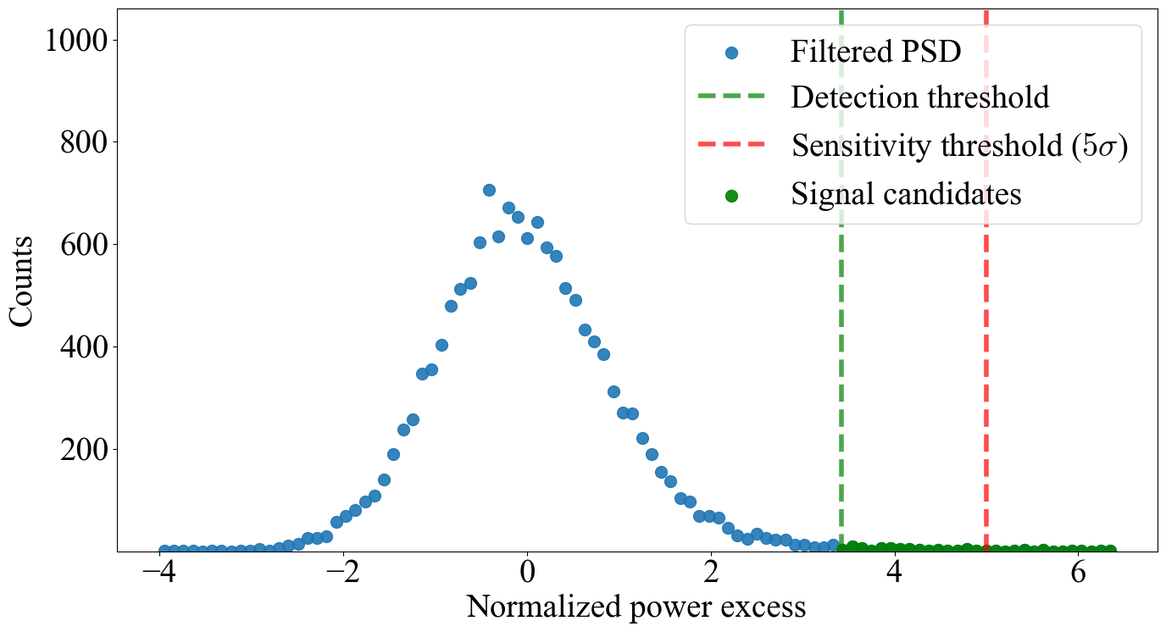
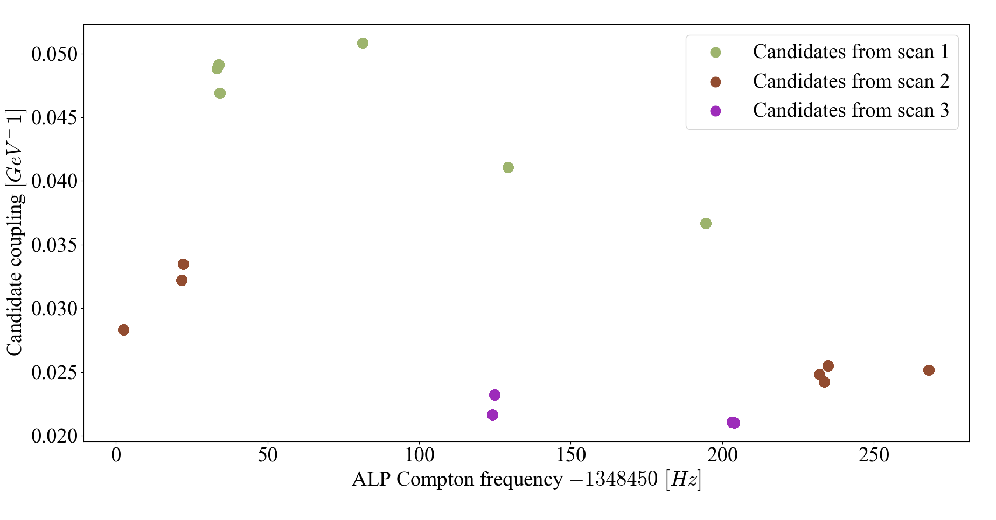
Signal candidate verification
Reject outliers that appear off-resonance
Merge candidates closer than 1 ALP linewidth
Rescan check A: is candidate consistent within the rescans?
Rescan check B: reject candidates that appear off-resonance within 1 Hz as noise in more than one other spectrum
Overlap check: does it appear within neighboring scanning steps?
Our analysis rejects all signal candidates - No ALP DM detection
“On-resonance” signal candidates
(out of ≈ 100 outliers found per spectrum)
A search for axionlike Dark Matter at CASPEr-Gradient low-field Julian Walter for the CASPEr collaboration 13/15

Slide 19
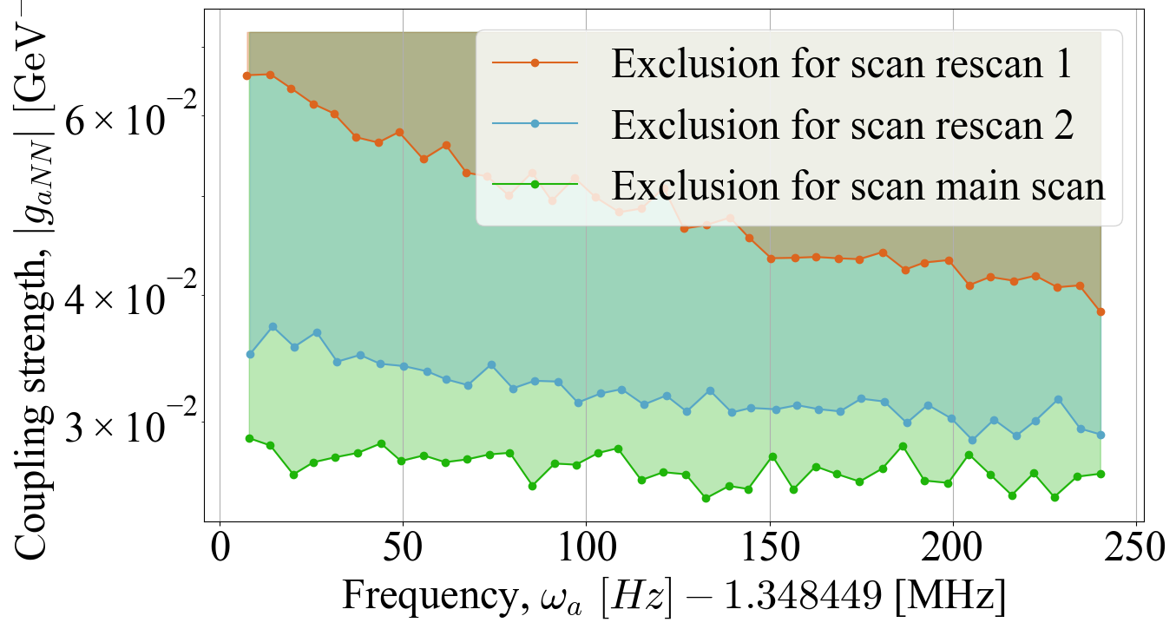
Exclusion with thermal test sample
¹]
At frequencies where
candidates were found in the main scan:
quote the rescan sensitivity instead
A search for axionlike Dark Matter at CASPEr-Gradient low-field Julian Walter for the CASPEr collaboration 14/15

Slide 20
Outline
CASPEr-gradient low-field setup
First Axion search test run
Data analysis & preliminary results
Setup status & future plans

Slide 21
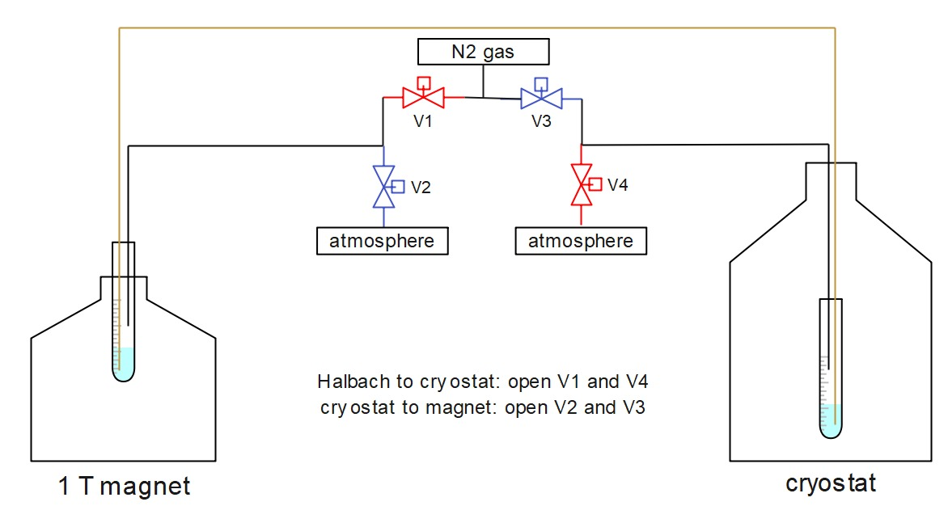
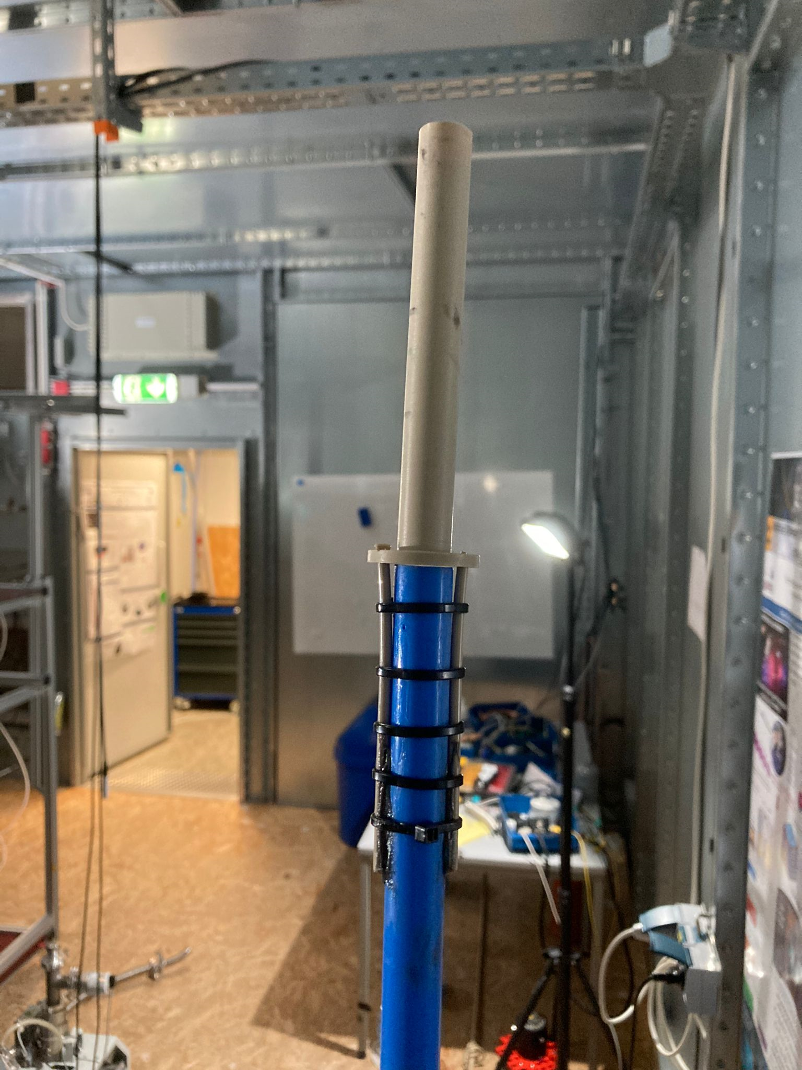
Next steps: Pre-polarizer & sample shuttling
SNR enhancement for thermal sample ∝ 1T /B₀
A search for axionlike Dark Matter at CASPEr-Gradient low-field Julian Walter for the CASPEr collaboration 15/15

Slide 22
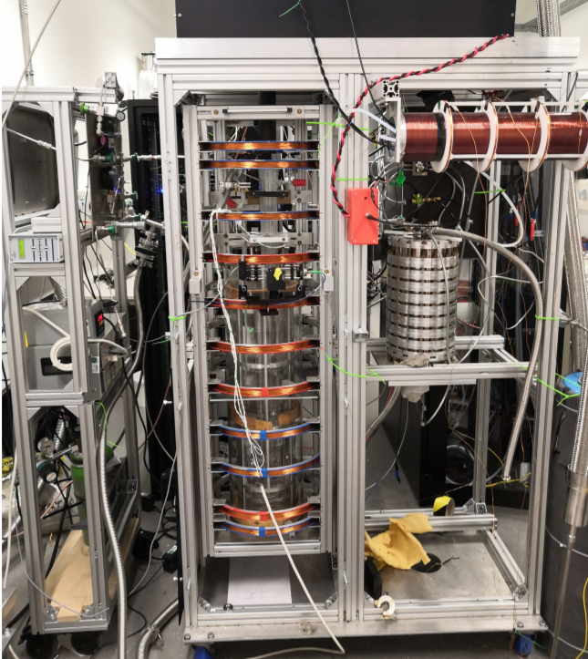
Next steps: Hyper-polarized sample
Spin Exchange Optical Pumping (SEOP)
hyperpolarized, liquid Xe sample: P ~ 70%
T₁ time ~ 1000 s
SNR enhancement for HP sample: at least x 10⁶
A search for axionlike Dark Matter at CASPEr-Gradient low-field Julian Walter for the CASPEr collaboration 15/15

Slide 23
Conclusion & Outlook
Preliminary runs: CASPEr-gradient is prepared for Axion-DM searches
On the way towards surpassing astrophysical exclusion limits
Many improvements are planned:
pre-polarization of methanol sample
Hyperpolarized xenon sample
revise data analysis
setup / electronics optimization
A wider scan between 0 and 1 MHz (variable step size & dwell time?)
Expand search range with CASPEr-gradient high field (up to 600 MHz)

Slide 24
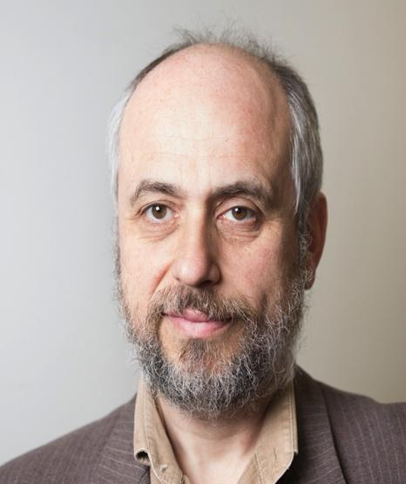
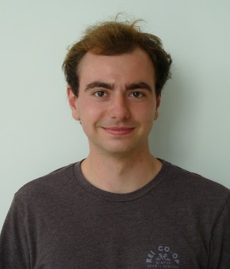
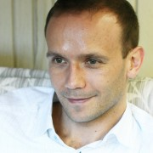
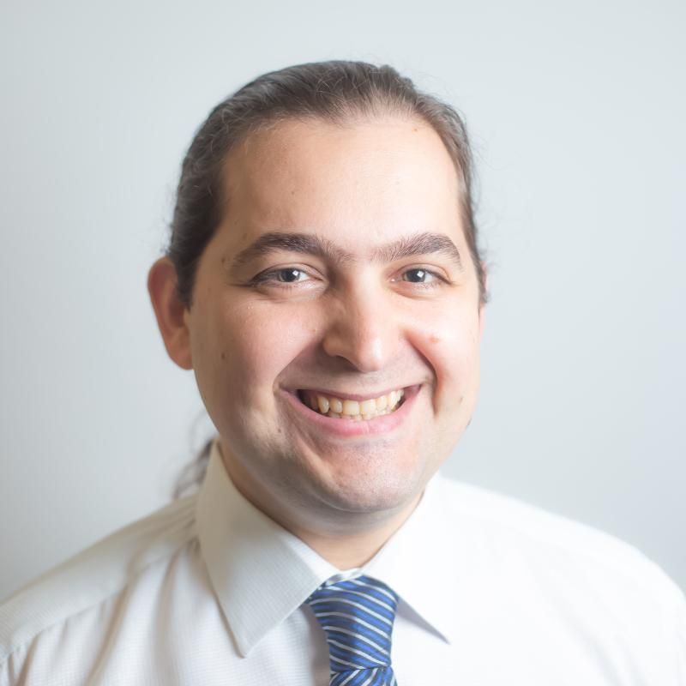
The CASPEr-gradient Mainz team
… and some of many international collaborators
Prof. Dmitry Budker
Dr. Hendrik Bekker
Prof. Derek J. Kimball
Dr. Arne Wickenbrock
Olympia Maliaka
Arian Dogan
Yuzhe Zhang
Malavika Unni
Declan W. Smith
Prof. Alexander O. Sushkov
Julian Walter
Ophir Ruimi
Dr. Younggeun Kim
Dr. Jonathan Agil
Vivian Gao

Slide 25
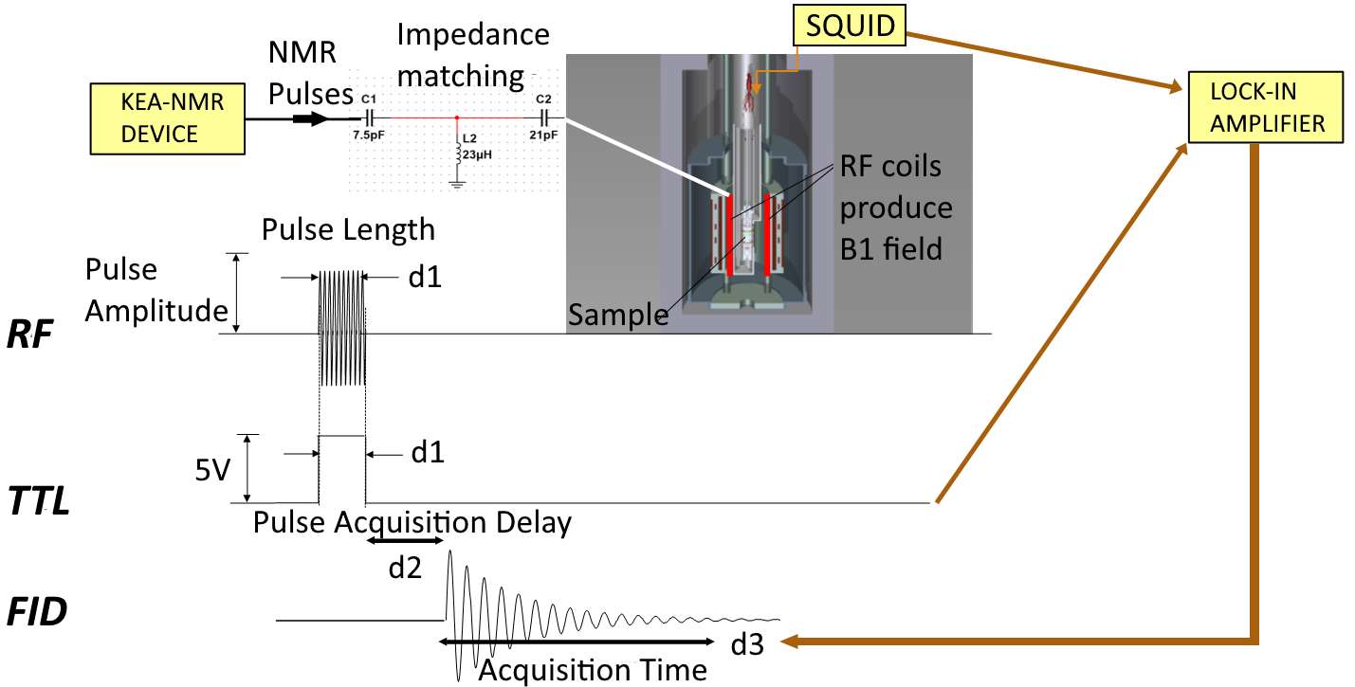
CASPEr-g pulsed NMR & signal acquisition

Slide 26
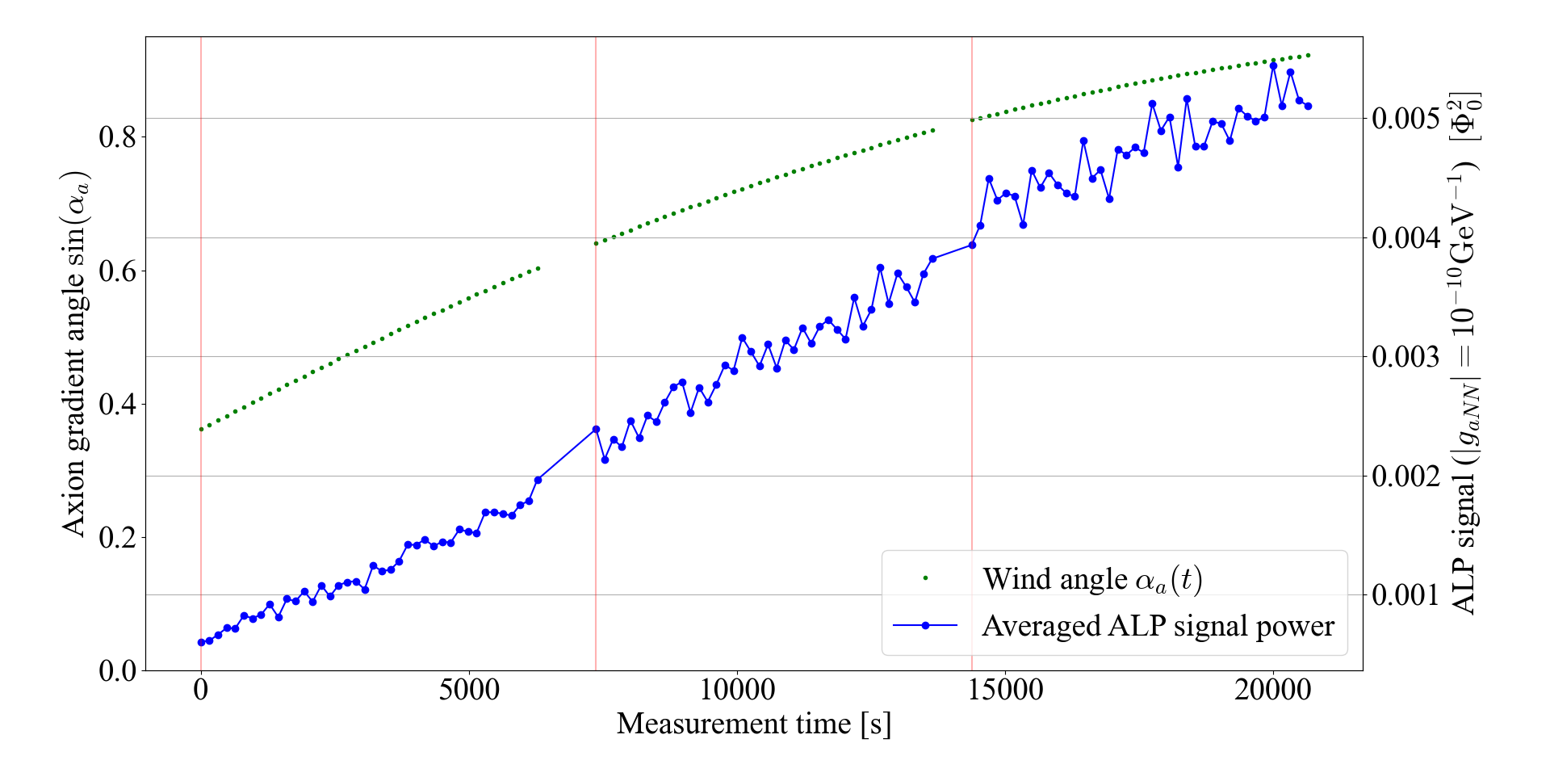
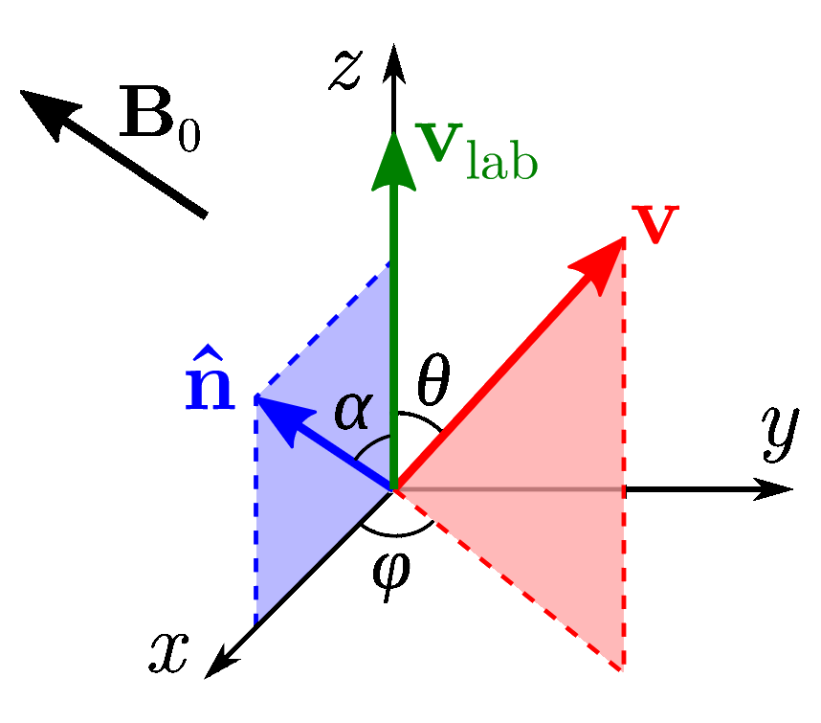
The ALP signal @CASPEr-gradient (2)
v_{a} is boosted by Earth’s
motion through the halo
=> annual & daily
amplitude modulation
ALP linewidth:

Slide 27
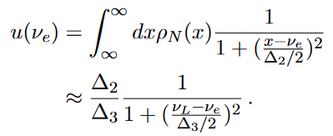
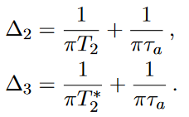
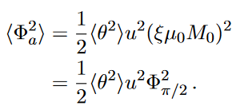
The ALP signal @CASPEr-gradient (3)
RMS Rabi frequency of ALP drive
Decay signal of pulsed-NMR
Spectral factor
RMS tipping angle from ALP drive
Flux from transverse magnetization
RMS ALP signal amplitude in PSD

Slide 28
Resonant Axion signal

Slide 29
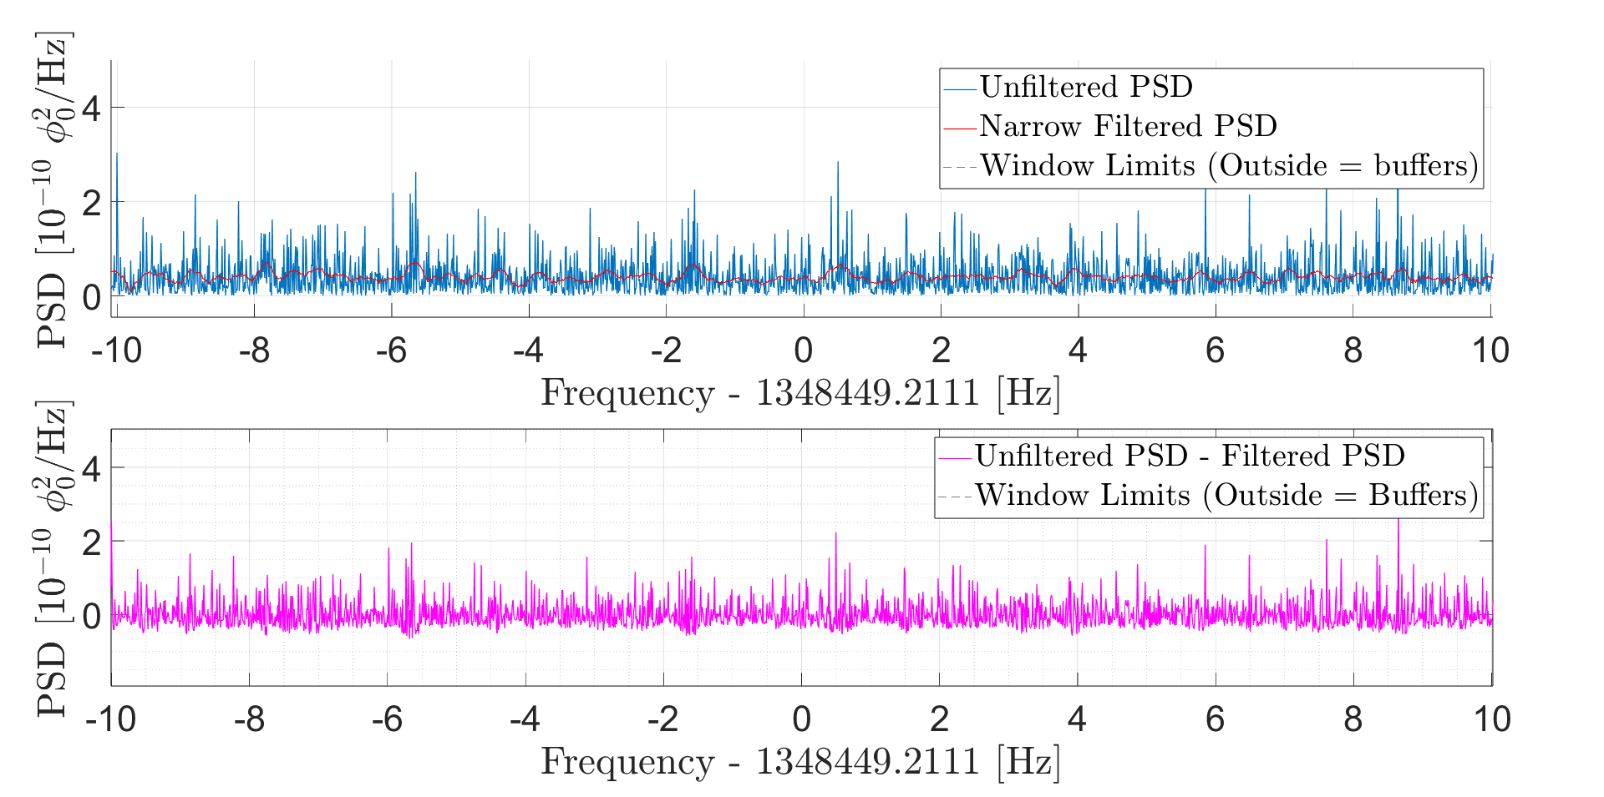
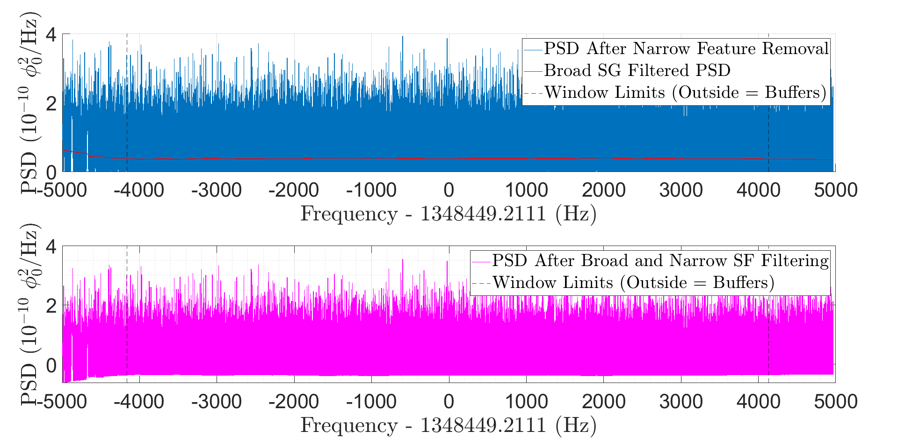
Savitzky-Golay (SG) filtering
Filter out noise spikes that are narrower or broader than the signal
“Narrow”: filter length = ½ ALP signal width
“Broad”: filter length = 100 ALP signal width
Identify RFI peaks narrower than the ALP signal linewidth
& selectively smooth them out
(on average ~3% of points per spectrum)
Baseline subtraction:
Set noise floor to zero / normalize spectrum

Slide 30
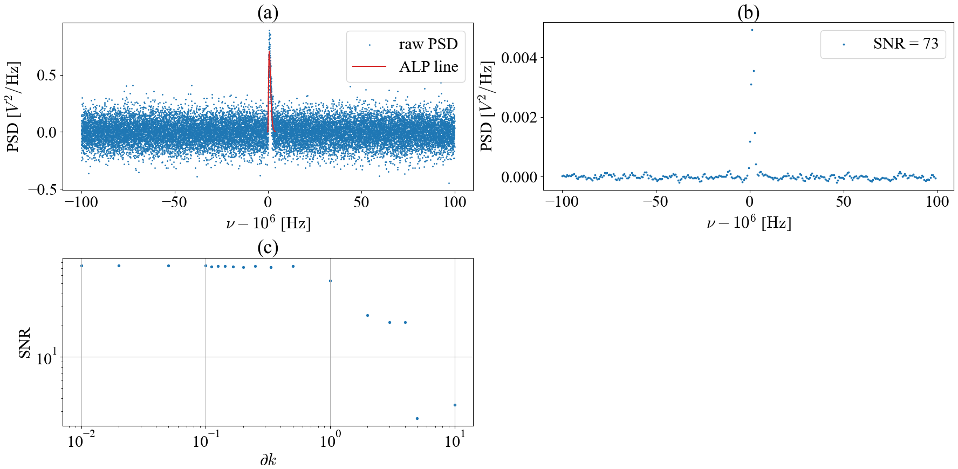
Optimal filter: convolution with known signal
https://www.gunthard-kraus.de/DSP/Dsp_CD/Matched_Filter/Bores/11_mat.htm
A noisy square wave… … is improved by filtering with a single band pass filter… …but the best SNR comes from a matched filter
steps too wide → miss ALP signal
steps too small → over-correlation
Optimize step size to give best SNR in convolved spectrum with injected synthetic ALP signals

Slide 31
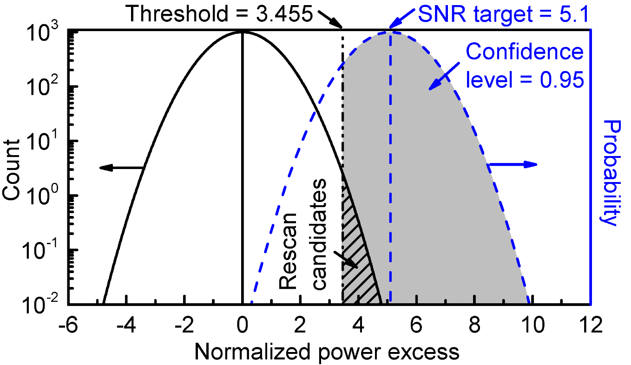
Hypothesis testing
We define the scenario of a 5σ-Axion signal being present as our Null Hypothesis H₀
The just-noise scenario is our alternative hypothesis, H₁
If we discard all rescan candidates (which live within the 95% CL of H₀) as statistical fluctuations, we will have to reject the Null Hypothesis - there is no 5σ signal in our data
Brubaker et al: The HAYSTAC Axion Search Analysis Procedure (2017)

