Slide 1


Detection of Axion Quark Nuggets via their interactions in kt liquid detectors
Mihaela Parvu, Ionel Lazanu
Faculty of Physics, University of Bucharest, RO
19th Patras Workshop on Axions, WIMPs and WISPs
16-20 September 2024

Slide 2
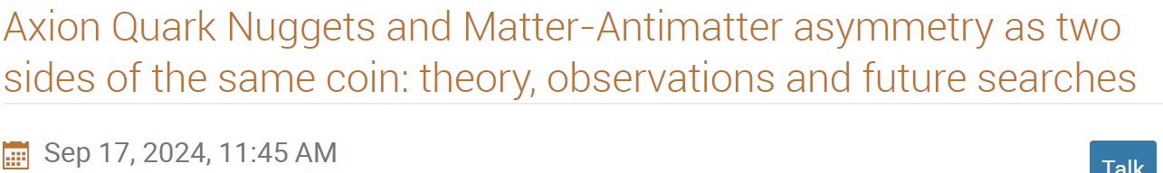

History of $A\overline{Q}N$𝑠
In the Big Bang model, the Universe began as a symmetric state with zero global baryonic charge. Later this evolved into a state with a net positive baryon number.
Current explanation: 1. violation of baryon number; 2. violation of charge conjugation-parity symmetry (CP); 3. the process must not be in thermal equilibrium.
1984 E. Witten (PRD, 30, 272): Cosmic Separation of Phases: Nuggets
1984 A. R. De Rujula and S. L. Glashow (Nature 312, 734): Nuclearites
2003 Ariel Zhitnitsky (JCAP, 10, 010): Dark matter as baryonic colour superconductor: Axion Quark/anti-Quark Nuggets

Slide 3
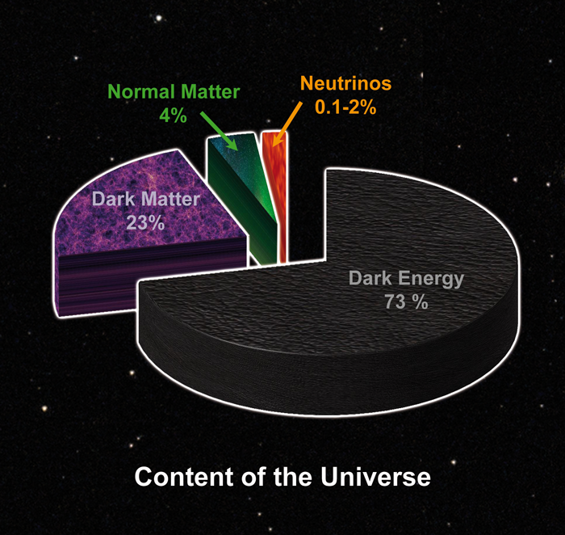
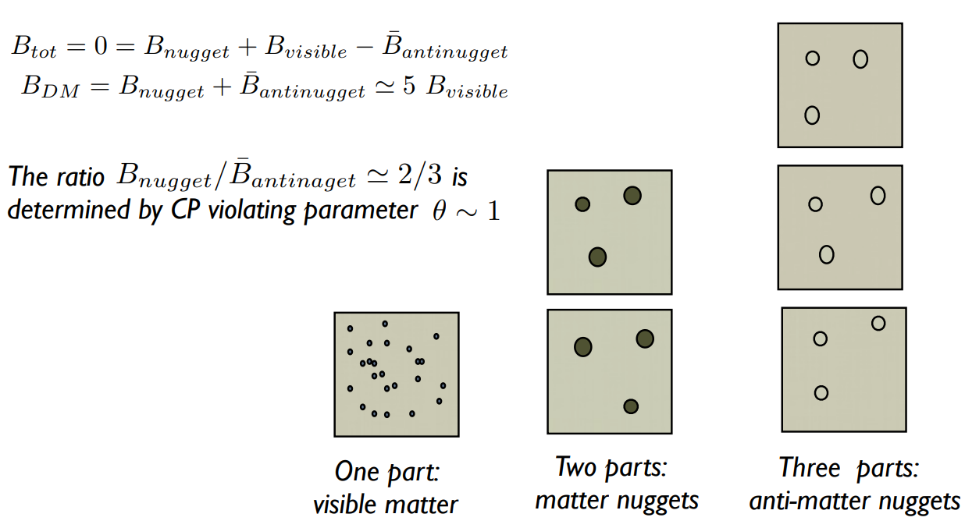
Dark Matter and Baryogenesis as two sides of the same coin
Ariel Zhitnitsky's AQNs idea restores matter-antimatter symmetry but only a fraction of 20% is observable!

Slide 4
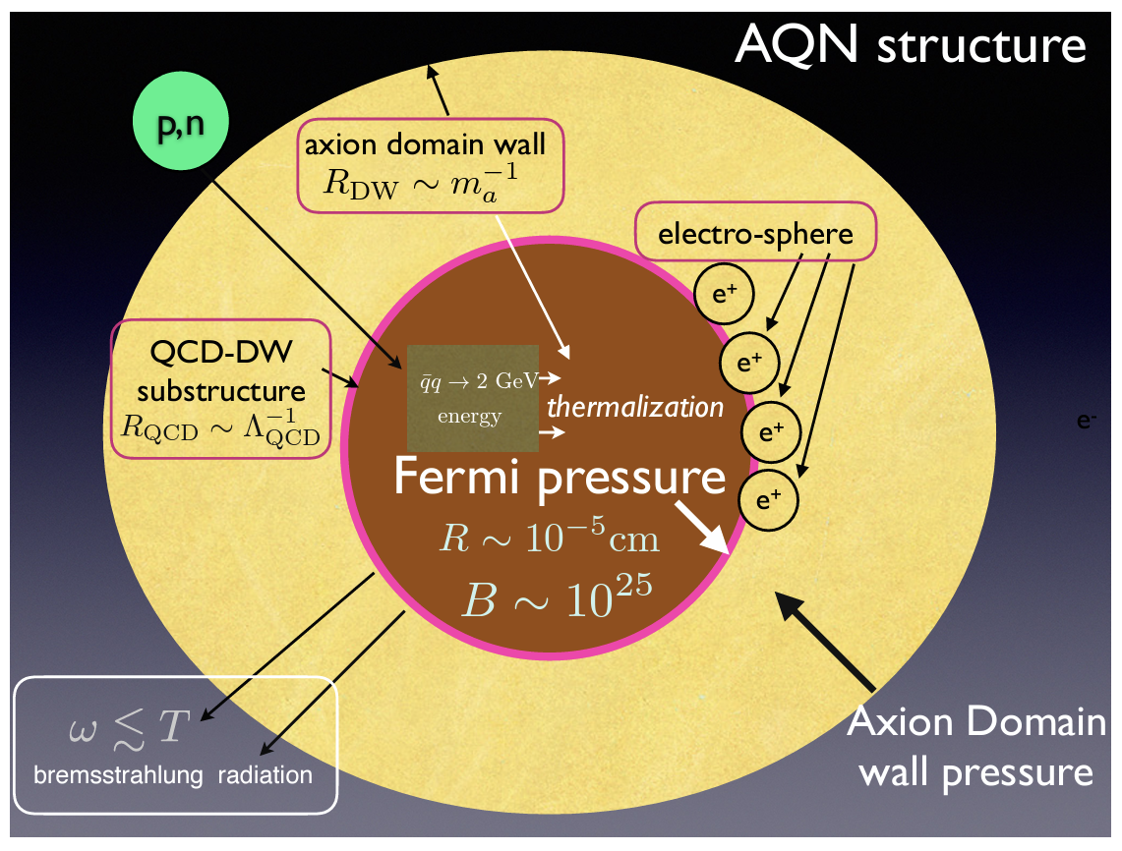

Structure of $A\overline{Q}N$𝑠
Core: antiquarks in the color-superconducting phase, color–flavor locking (CFL) phase or phase 2CS.
Electrosphere: electrons (AQN) / positrons (𝐀$\overline{Q}$𝐍𝑠)
Domain wall: a theoretical two-dimensional surface that separates regions with different properties. DW were formed during phase transitions in the early universe. The formation of DW is a consequence of the symmetry breaking that occurs during phase transitions.
Ariel Zhitnitsky, Physics of the Dark Universe, 40(2023), 101217

Slide 5
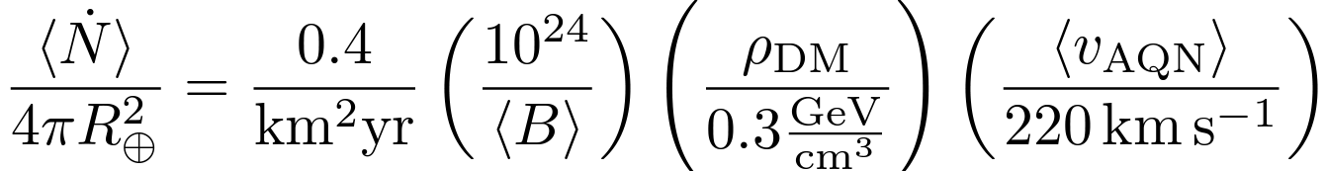
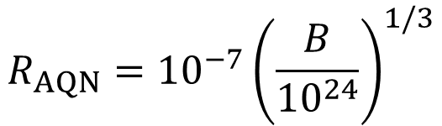


Characteristics of $A\overline{Q}N$𝑠
$A\overline{Q}N$ flux hitting the Earth:
Interaction cross section:
$$σ_{AQN}=πR_{AQN}^{2}$$
$$R_{AQN}={10}^{−7}{\left(\frac{B}{{10}^{24}}\right)}^{1/3}$$
Ariel Zhitnitsky, Modern Physics Letters A 2021 36:18
Notes:
k - theoretical uncertainties in the annihilation process

Slide 6
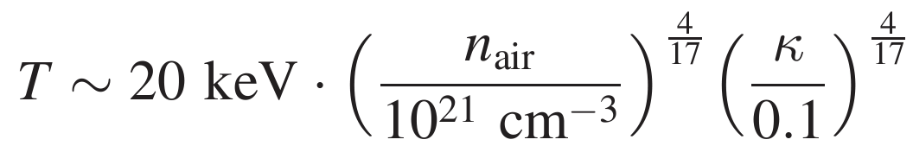
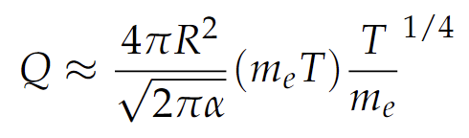
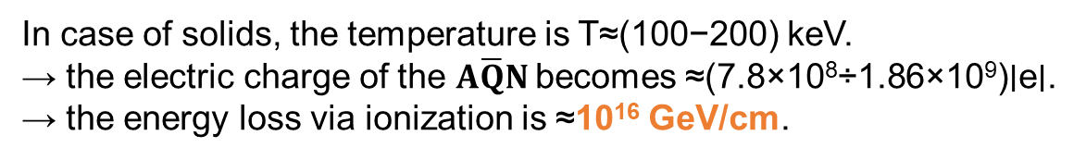
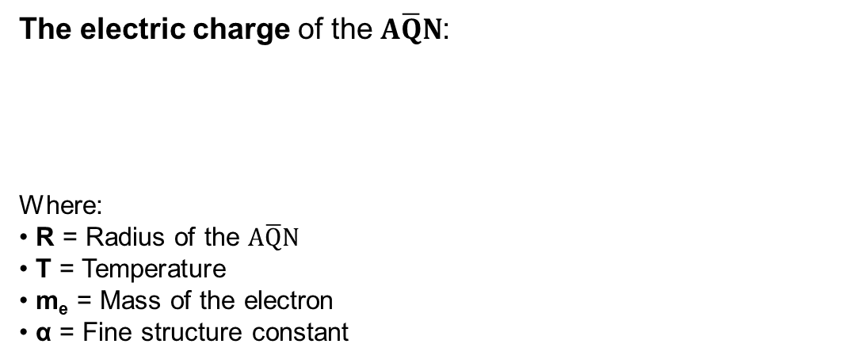
Characteristics of $A\overline{Q}N$𝑠
The internal temperature of the $A\overline{Q}N$:
The electric charge of the $A\overline{Q}N$:
Where:
R = Radius of the $A\overline{Q}N$
T = Temperature
m_{e} = Mass of the electron
α = Fine structure constant
In case of solids, the temperature is T≈(100−200) keV.
→ the electric charge of the $A\overline{Q}N$becomes ≈(7.8×10⁸÷1.86×10⁹)∣e∣.
→ the energy loss via ionization is ≈10¹⁶ GeV/cm.
Ariel Zhitnitsky, Modern Physics Letters A 2021 36:18
Notes:
k - theoretical uncertainties in the annihilation process

Slide 7
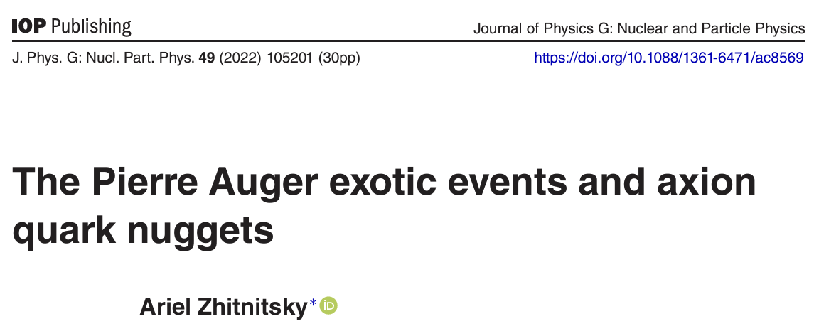
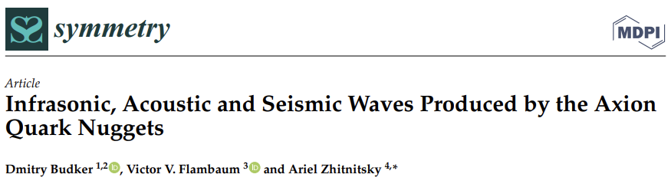
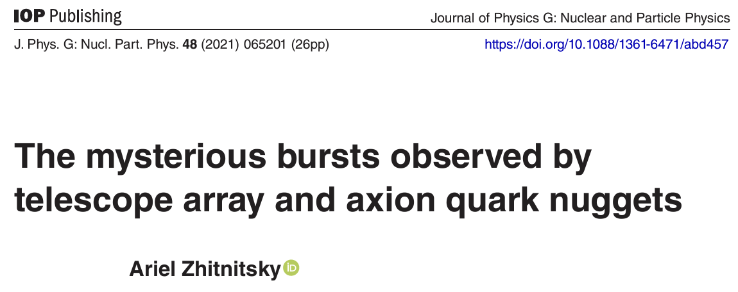
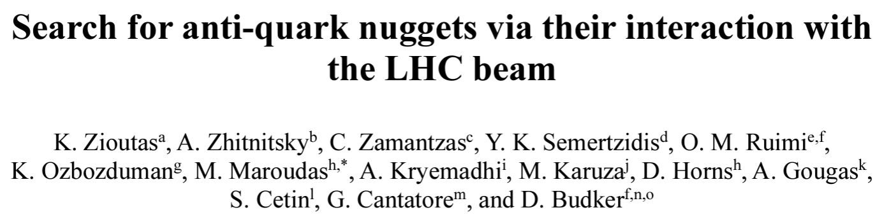
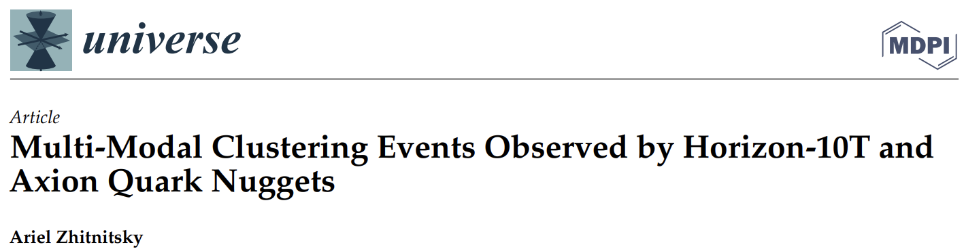

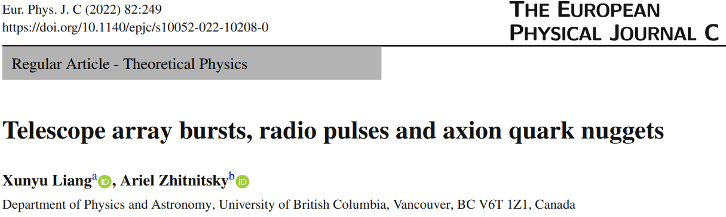
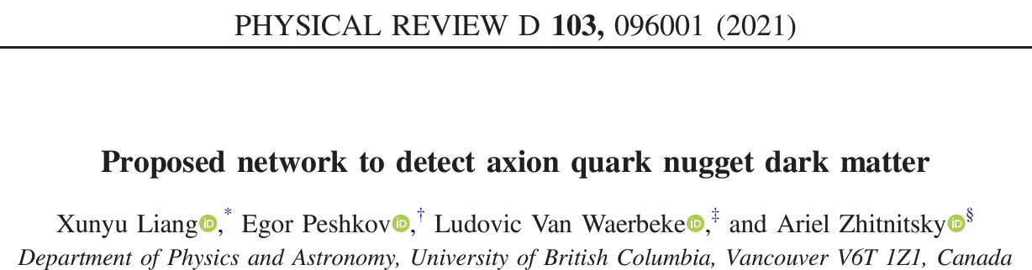
Detection mechanism
arXiv:2403.05608
See the poster of Ophir Ruimi

Slide 8
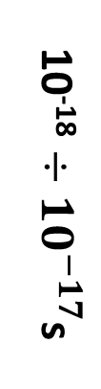
Detection mechanism
Capture of antimatter structure into high-n atomic orbit.
Capture of antimatter structure into high-n atomic orbit.
Production of mesons: K, η, ρ, ω, π (ranging from 2 to 8 mesons) with energies between 20 to 600 MeV/π.
Direct emission of kaons and pions from the annihilation process.
Multi-pion induced intranuclear cascade (INC) of $π N$, $π NN$, $NN$.
Multi-pion induced intranuclear cascade (INC) of 𝜋 𝑁, 𝜋 𝑁𝑁, 𝑁𝑁.
Emission of energetic n, p from INC coalescence.
Emission of d, t, ³He, ⁴He from pre-equilibrium, multifragmentation, and other related processes.
10⁻¹⁸ $÷$ ${10}^{−17}$s
H S Plendl et al 1993 Phys. Scr. 48 160

Slide 9
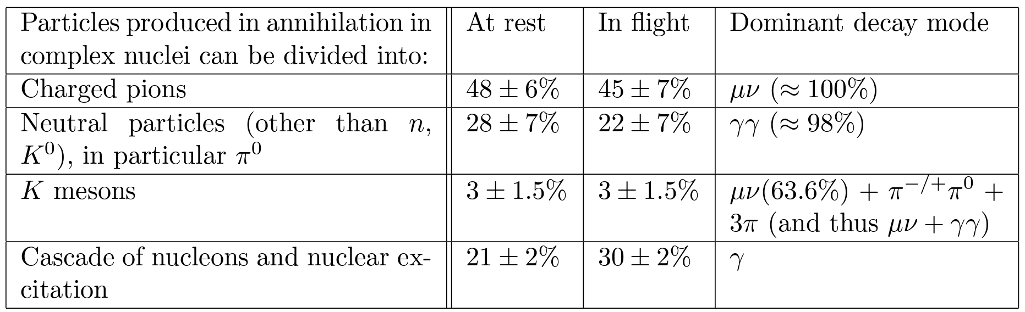
Detection mechanism
Chamberlain et al., Phys. Rev. 113, 1615

Slide 10
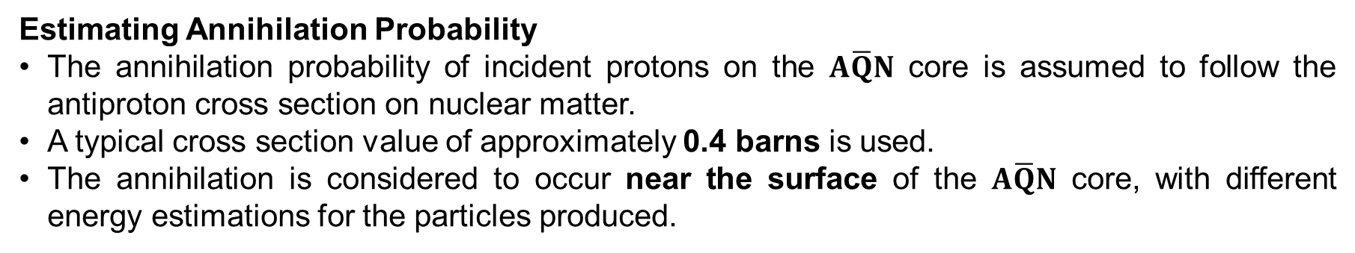
Experimental characteristics of the particles in the final state
Estimating Annihilation Probability
The annihilation probability of incident protons on the $A\overline{Q}N$ core is assumed to follow the antiproton cross section on nuclear matter.
A typical cross section value of approximately 0.4 barns is used.
The annihilation is considered to occur near the surface of the $A\overline{Q}N$ core, with different energy estimations for the particles produced.
Constraints on Annihilation Processes
In a recent paper, Flambaum et al. (2024) introduced constraints on energy absorption during annihilation.
They considered that strong and electromagnetic interactions absorb energy, suppressing weak disintegrations and neutrino emission.
A suppression factor of less than 3.3 x 10⁻⁴ for the emitted mesons.
V. V. Flambaum and I. B. Samsonov, Phys. Rev. D 104, 063042
V. V. Flambaum and I. B. Samsonov, Phys. Rev. D 105, 123011
V. V. Flambaum and I. B. Samsonov, Phys. Rev. D 106, 023006
V. V. Flambaum et al., arXiv:2405.17775 (2024)

Slide 11
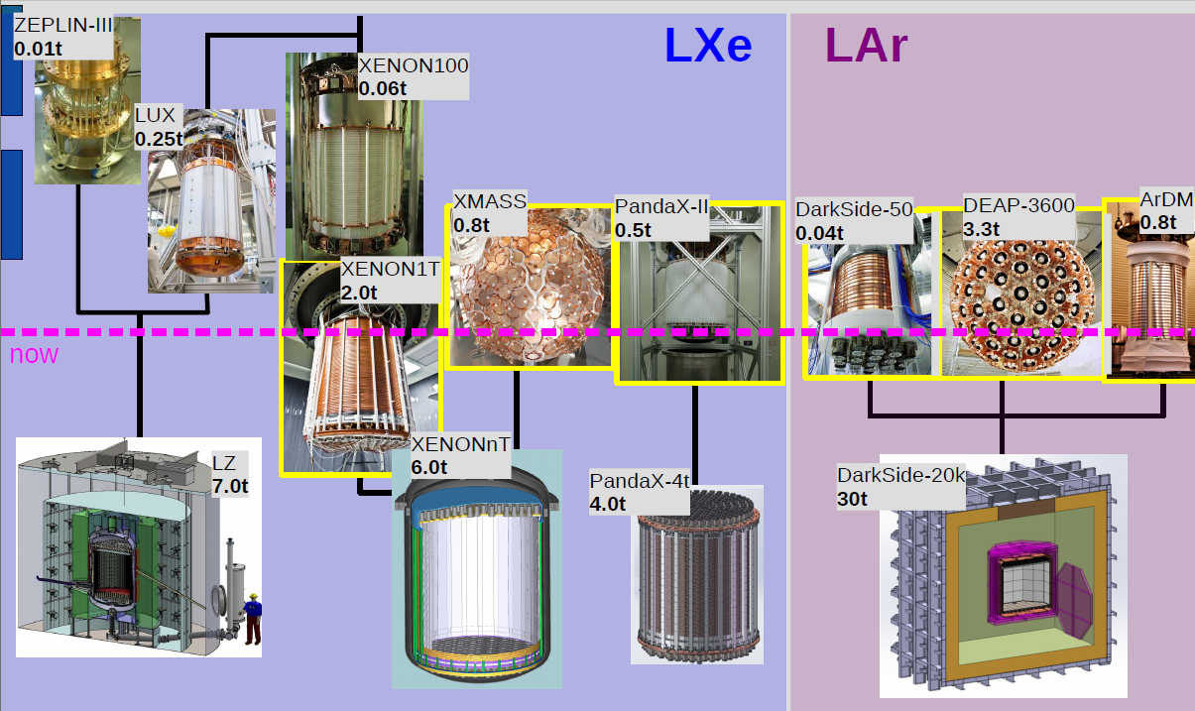
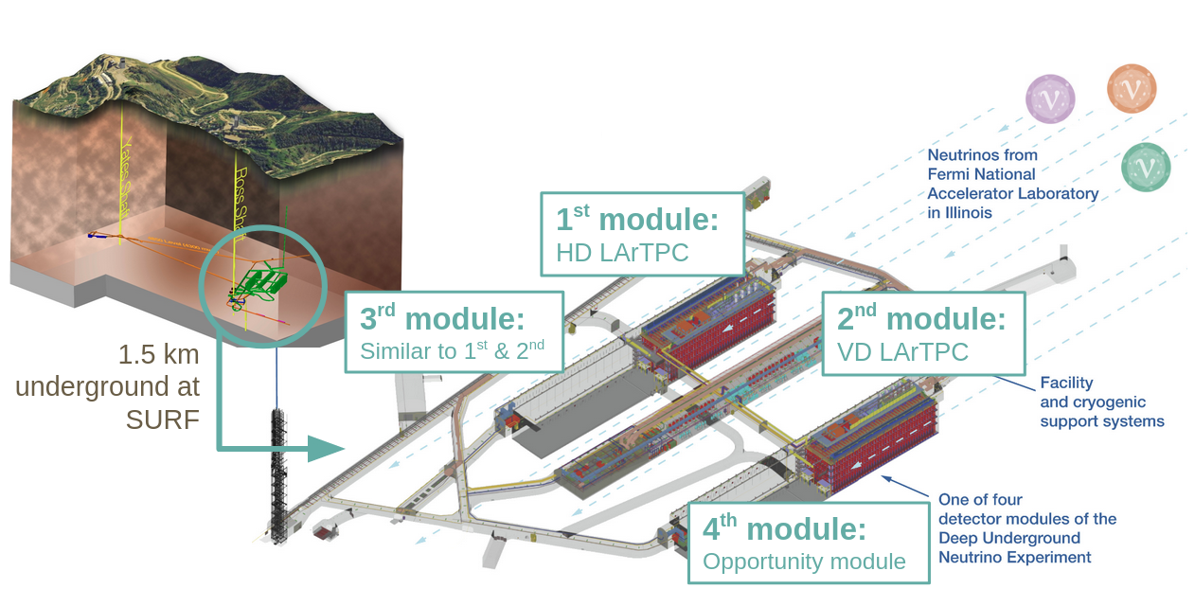
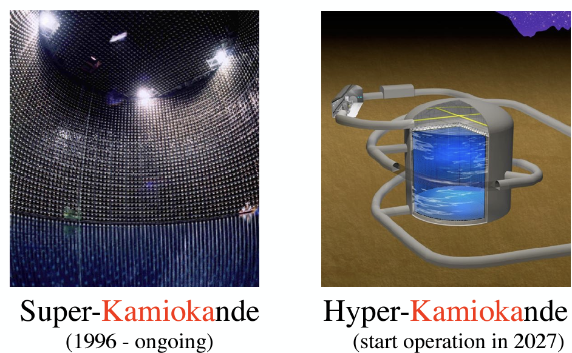
Experimental signatures
Liquified noble gases and Water Cherenkov detectors
Taken from M. Schumann
Notes:
Big active volumes
Suppressed background

Slide 12
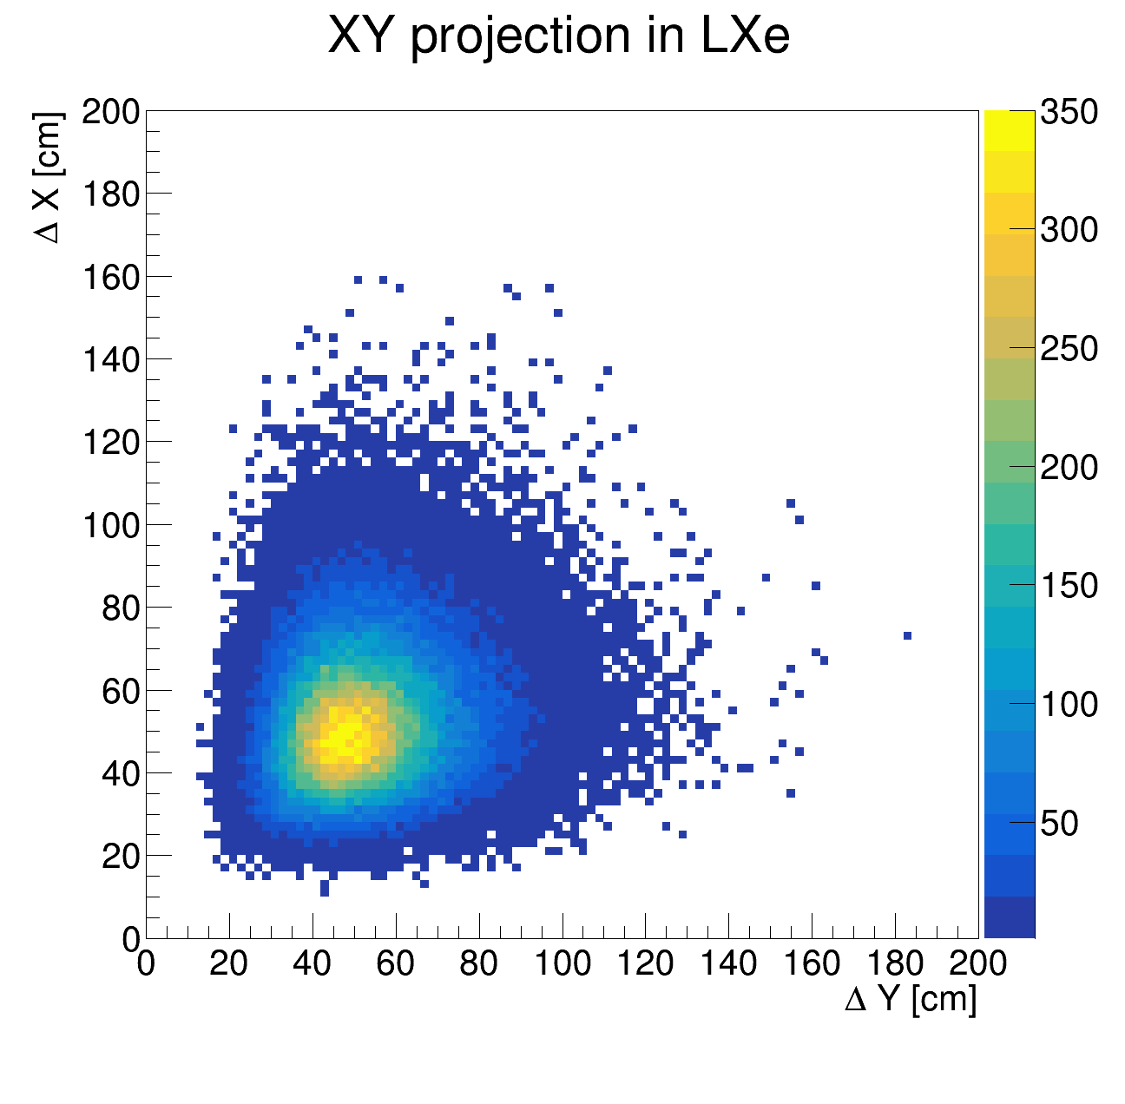
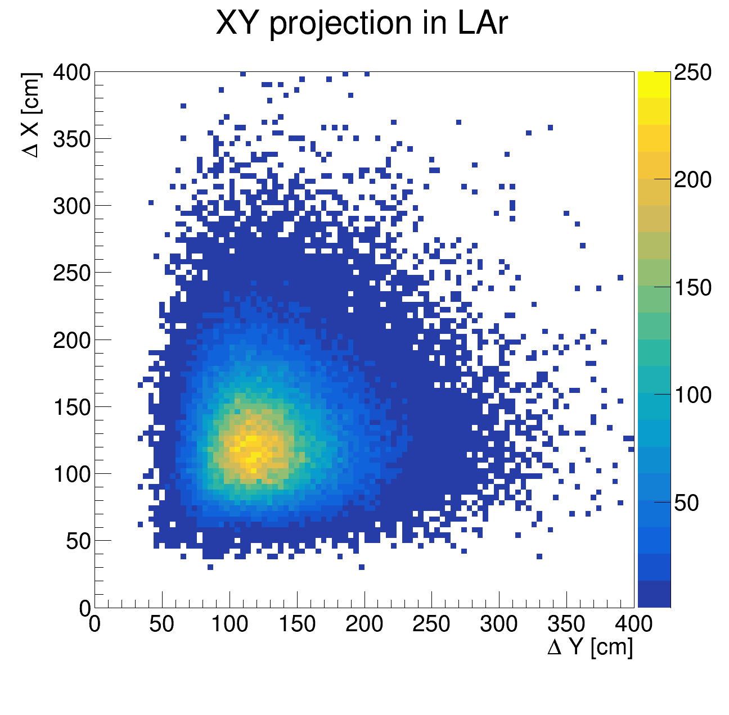
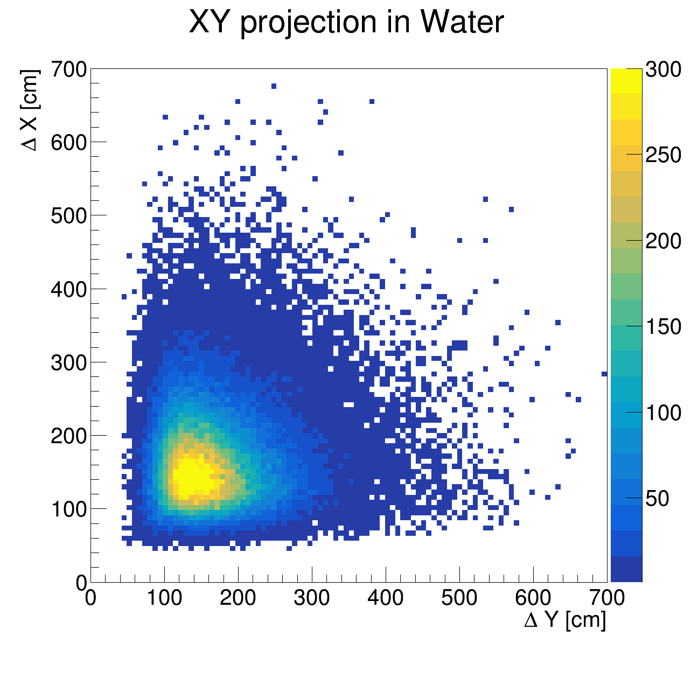
Experimental signatures
The spatial evolution of the electromagnetic cascade generated by π⁰ decay in LXe, LAr and water considering an uniform energy distribution up to 500 MeV for the decaying π⁰.
*simulations done with FLUKA
I. Lazanu and M. Parvu JCAP05(2024)014

Slide 13
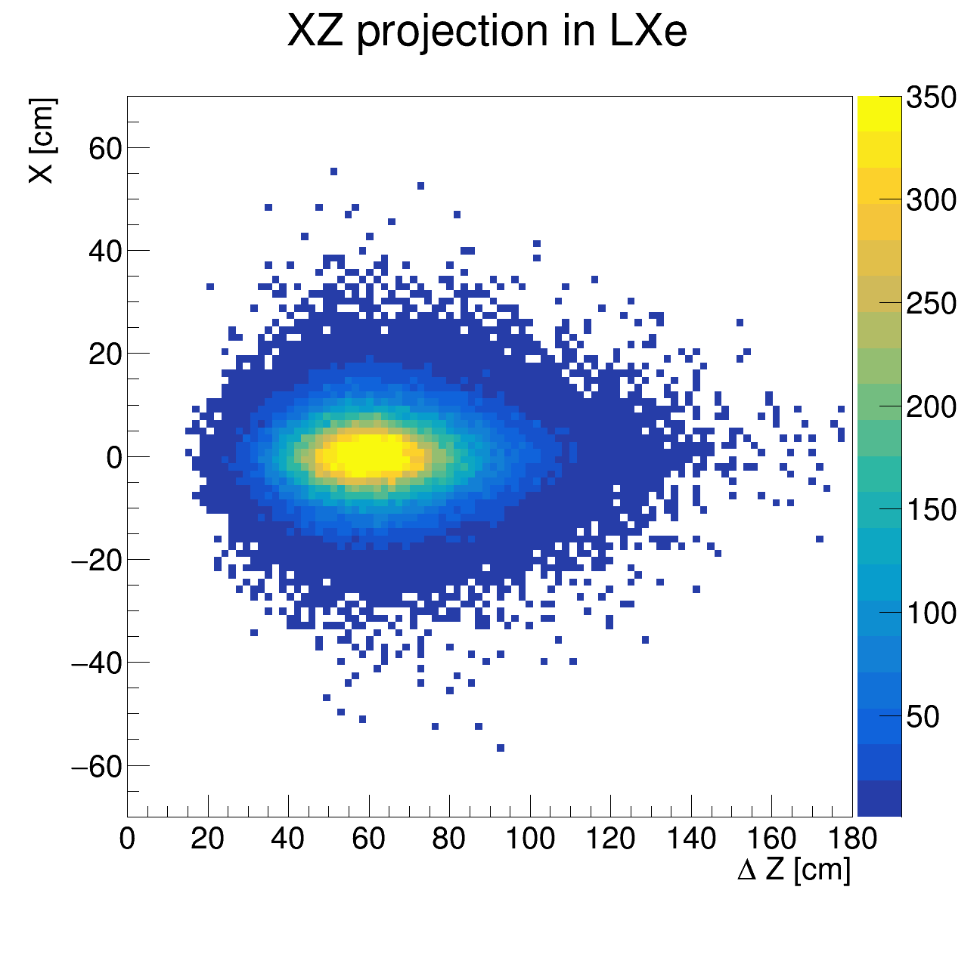
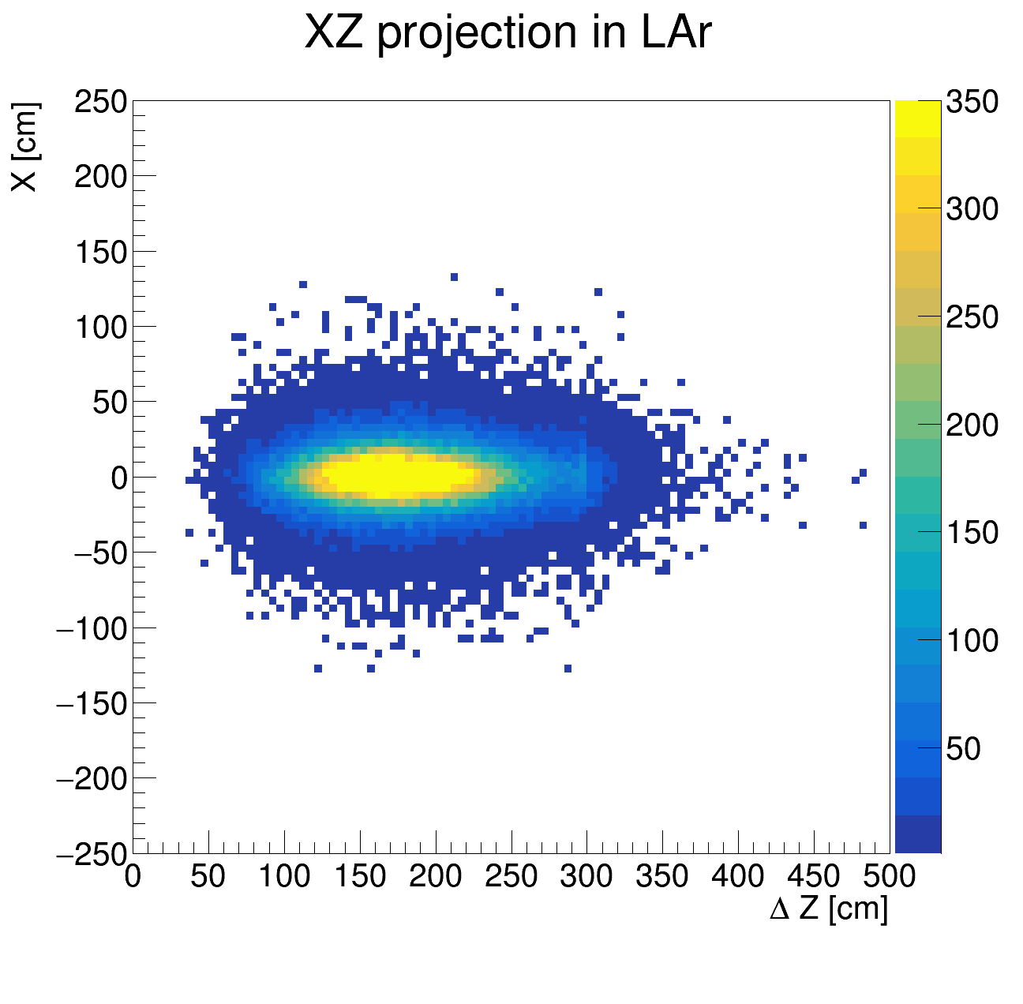
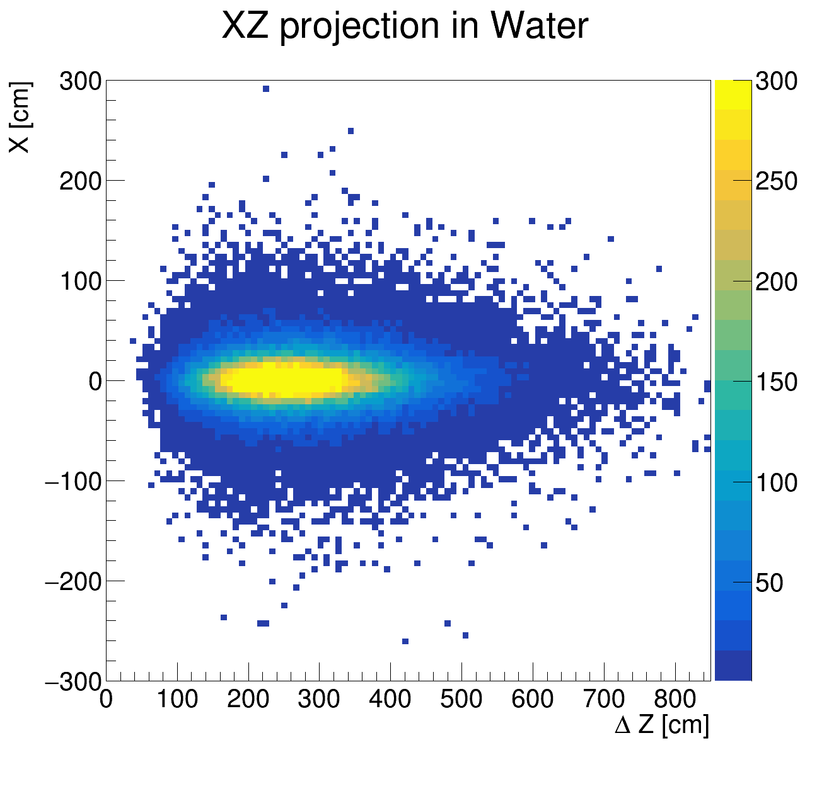
Experimental signatures
The spatial evolution of the electromagnetic cascade generated by π⁰ decay in LXe, LAr and water considering an uniform energy distribution up to 500 MeV for the decaying π⁰.
*simulations done with FLUKA
I. Lazanu and M. Parvu JCAP05(2024)014

Slide 14
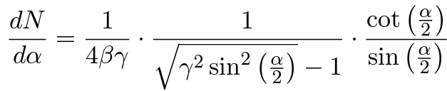
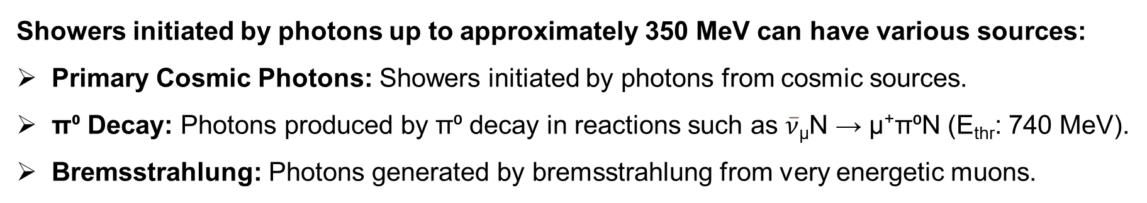
Experimental signatures
In the laboratory system, the opening angle between the primary photons is:
Backgrounds
Showers initiated by photons up to approximately 350 MeV can have various sources:
Primary Cosmic Photons: Showers initiated by photons from cosmic sources.
π⁰ Decay: Photons produced by π⁰ decay in reactions such as $\overline{ν}$_{µ}N → µ⁺π⁰N (E_{thr}: 740 MeV).
Bremsstrahlung: Photons generated by bremsstrahlung from very energetic muons.

Slide 15
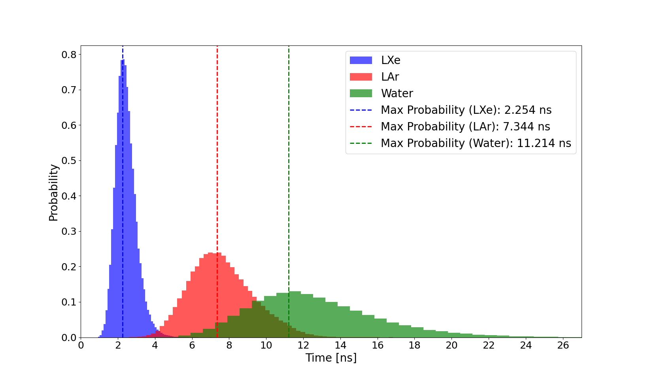
Experimental signatures
Time necessary to develop the complete electromagnetic shower in LAr, LXe and water considering an uniform energy distribution up to 500 MeV for the decaying π⁰.
I. Lazanu and M. Parvu JCAP05(2024)014

Slide 16
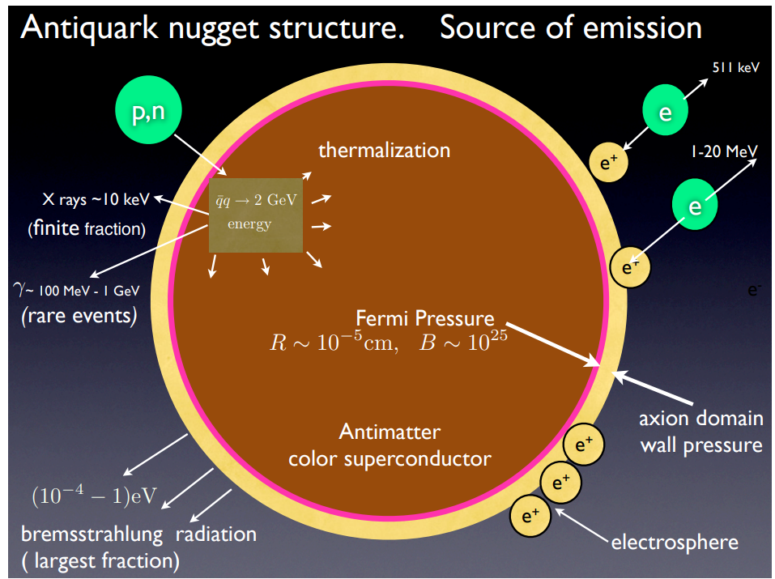
Detection mechanism
What about axion detection?
The AQNs are in equilibrium when the DW contributes about 1/3 of its total mass and does not emit axions.
When the annihilation processes start, the equilibrium breaks because the mass of the AQN decreases, thus reducing its size. The domain wall starts to oscillate, generating excitation modes and emitting axions with a typical velocity of axion ≈ 0.6c.
A. Zhitnitski, Physics of the Dark Universe, 40 (2023), 101217

Slide 17
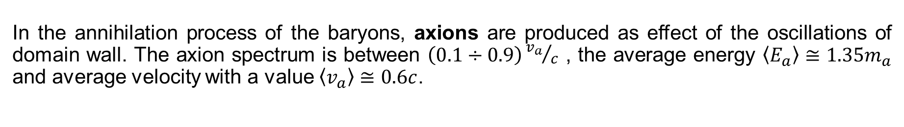
Detection mechanism
What about axion detection?
In the annihilation process of the baryons, axions are produced as effect of the oscillations of domain wall. The axion spectrum is between $\left(0.1÷0.9\right){v_{a}}/c$ , the average energy $〈E_{a}〉≅1.35m_{a}$ and average velocity with a value $〈v_{a}〉≅0.6c$.
Can axions emitted from AQN be observed?
Axions can be converted into photons in the presence of an external magnetic field, or interact in ways that produce observable signals.

Slide 18
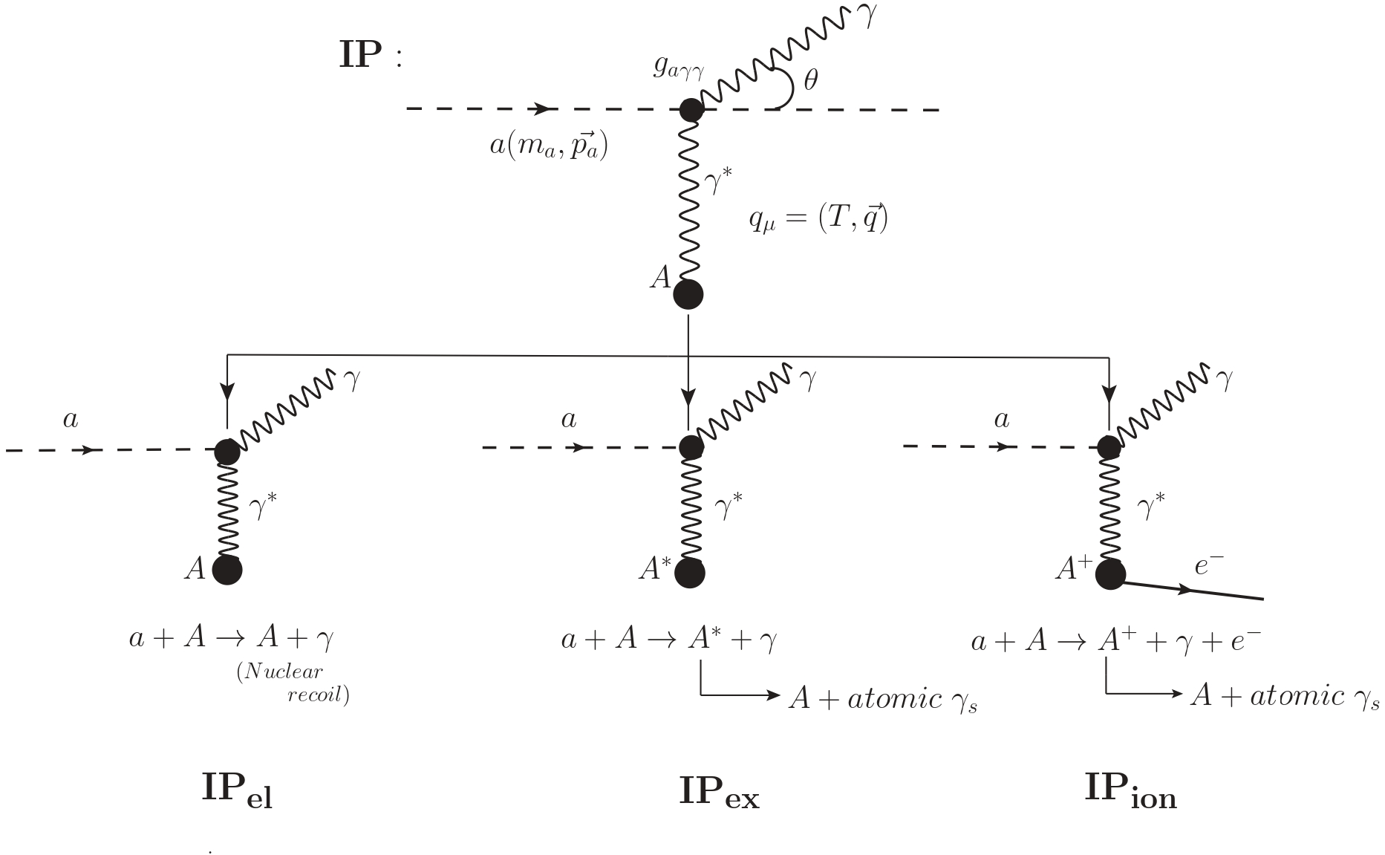
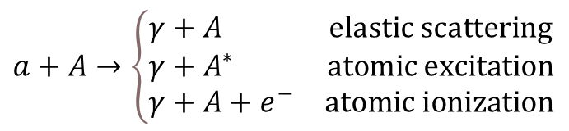
Can we detect these axions?
$$a+A→\left\{\begin{aligned}&\begin{matrix}γ+A & elastic scattering\end{matrix} \\ &\begin{matrix}γ+A^{∗} & atomic excitation\end{matrix} \\ &\begin{matrix}γ+A+e^{−} & atomic ionization\end{matrix}\end{aligned}\right.$$
C.-P. W et al., Phys. Rev. D 108, 043029

Slide 19
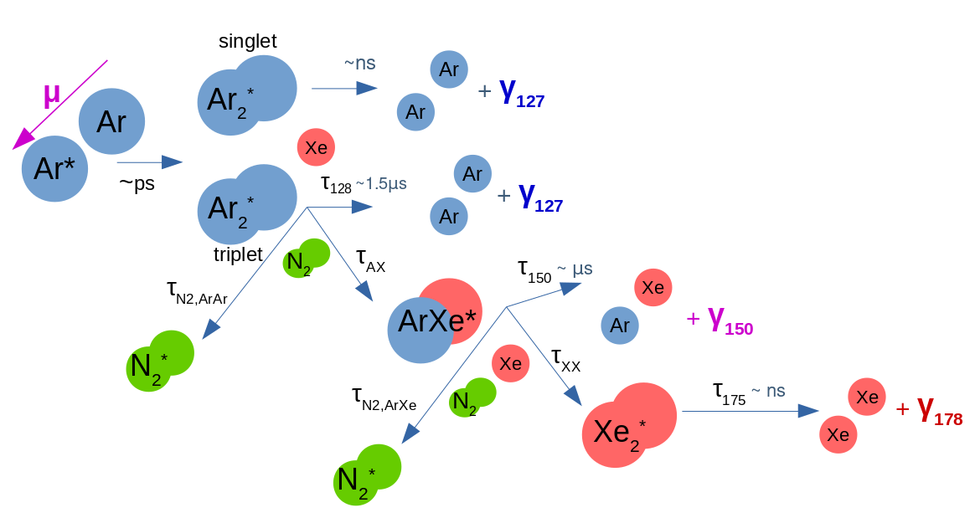
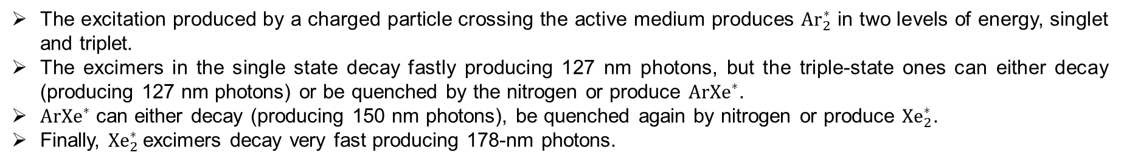
Detection mechanism
Charged particle
The excitation produced by a charged particle crossing the active medium produces ${Ar}_{2}^{∗}$ in two levels of energy, singlet and triplet.
The excimers in the single state decay fastly producing 127 nm photons, but the triple-state ones can either decay (producing 127 nm photons) or be quenched by the nitrogen or produce ${ArXe}^{∗}$.
${ArXe}^{∗}$ can either decay (producing 150 nm photons), be quenched again by nitrogen or produce ${Xe}_{2}^{∗}$.
Finally, ${Xe}_{2}^{∗}$ excimers decay very fast producing 178-nm photons.
J. Soto-Oton and on behalf of the DUNE Collaboration 2022 J. Phys.: Conf. Ser. 2374 012164

Slide 20
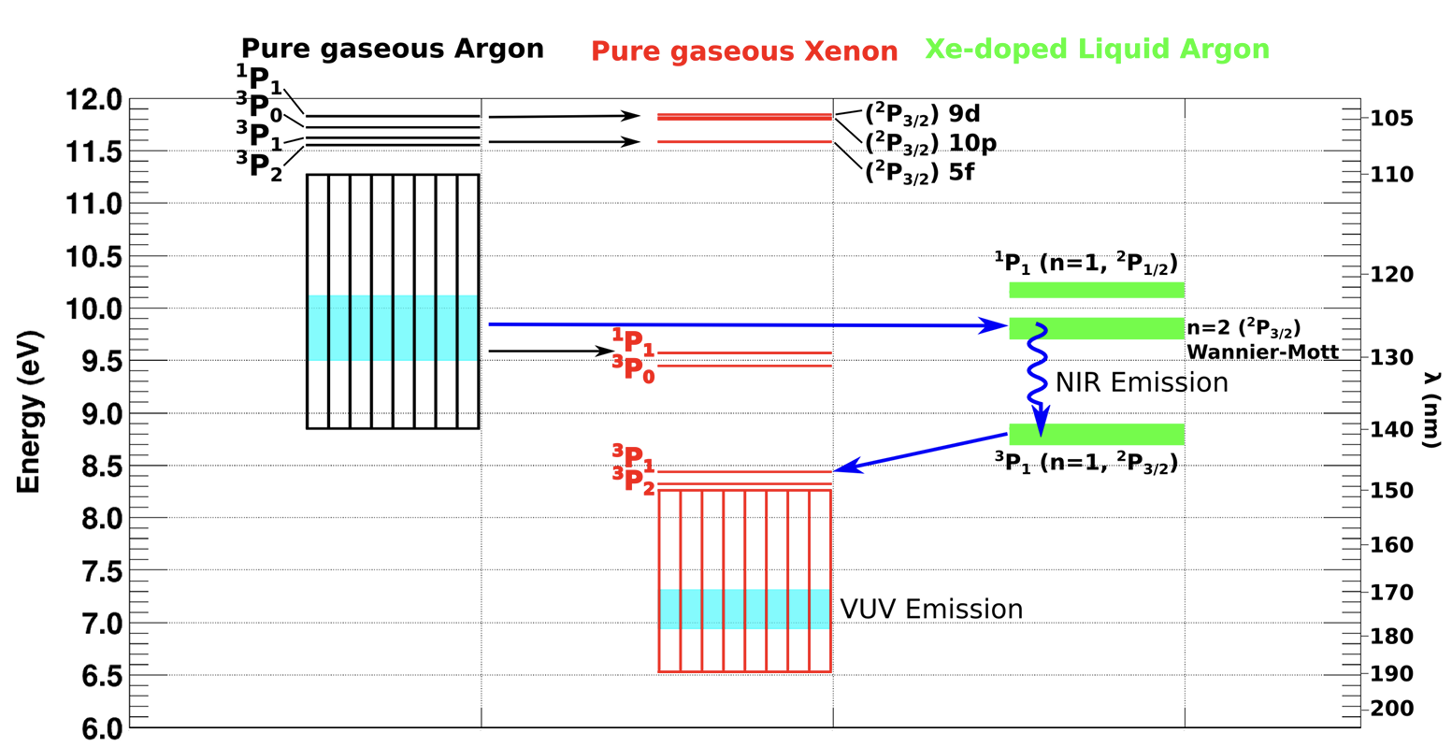
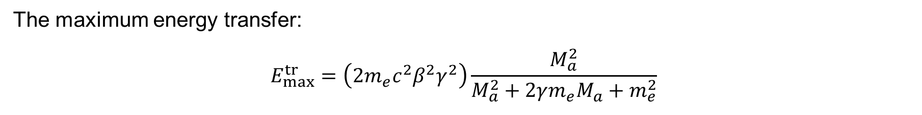
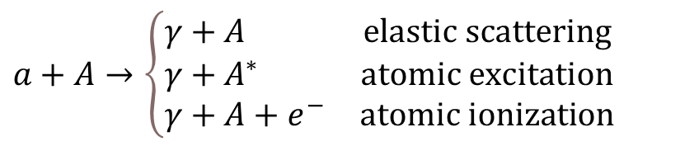
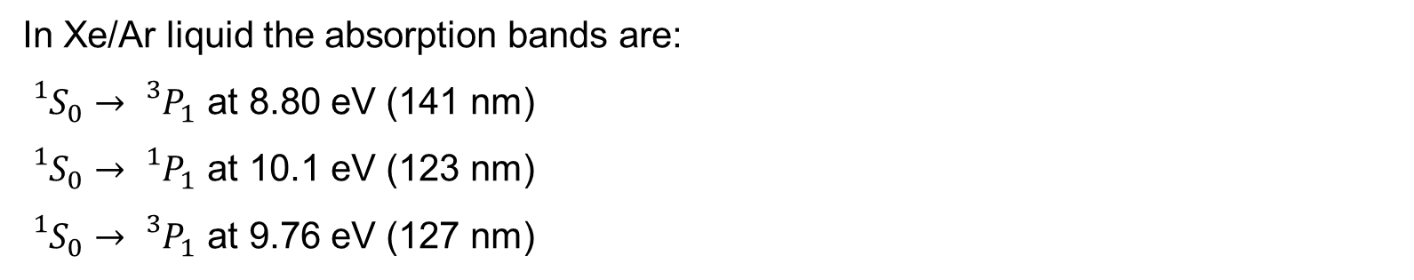
Detection mechanism
$$a+A→\left\{\begin{aligned}&\begin{matrix}γ+A & elastic scattering\end{matrix} \\ &\begin{matrix}γ+A^{∗} & atomic excitation\end{matrix} \\ &\begin{matrix}γ+A+e^{−} & atomic ionization\end{matrix}\end{aligned}\right.$$
In Xe/Ar liquid the absorption bands are:
${}_{}^{1}{S_{0}→}{}_{}^{3}{P_{1}}$ at 8.80 eV (141 nm)
${}_{}^{1}{S_{0}→}{}_{}^{1}{P_{1}}$ at 10.1 eV (123 nm)
${}_{}^{1}{S_{0}→}{}_{}^{3}{P_{1}}$ at 9.76 eV (127 nm)
The maximum energy transfer:
$$E_{max}^{tr}=\left(2m_{e}c^{2}β^{2}γ^{2}\right)\frac{M_{a}^{2}}{M_{a}^{2}+2γm_{e}M_{a}+m_{e}^{2}}$$
C.-P. Wu et al., Phys. Rev. D 108, 043029
A. Neumeier et al 2015 EPL 111 12001
Raz and Jortner, Proc. R. Soc. Lond. A317113–131

Slide 21
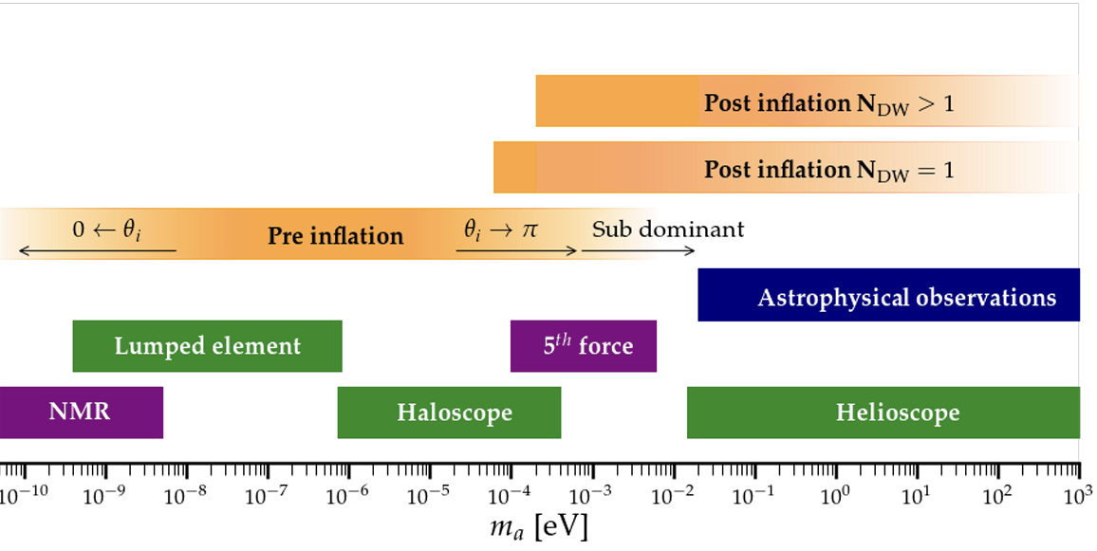

Can we detect these axions?
→ LAr doped with LXe${ E}_{max}^{tr}≥0.2 eV$,$β≅0.6$, $γ≅1.25$
$$m_{a}≥300 eV$$
Y.K. Semertzidis, S. Youn, arXiv:2104.14831
Notes:
0.1 – 1000 ppm

Slide 22
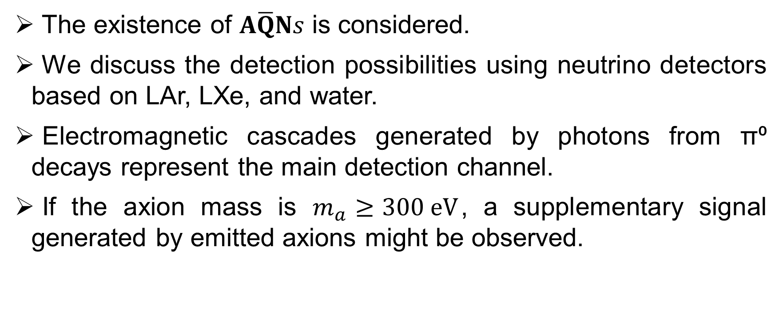
Summary
The existence of 𝐀$\overline{Q}$𝐍𝑠 is considered.
We discuss the detection possibilities using neutrino detectors based on LAr, LXe, and water.
Electromagnetic cascades generated by photons from π⁰ decays represent the main detection channel.
If the axion mass is $m_{a}≥300 eV$, a supplementary signal generated by emitted axions might be observed.

Slide 23
Thank you for your attention!

