Slide 1
Observing axions from supernovae through their many (loop-induced) couplings
(“artist’s” impression of axions leaving SN 1987A)
$$a$$
$$a$$
$$a$$
Eike Ravensburg (prev. Müller), Postdoc @ University of Southern Denmark (SDU) Odense
Based on work with David Marsh, Ricardo Z. Ferreira, Pierluca Carenza, Alessandro Lella
19th Patras Workshop, September 2024

Slide 2
Axionlike particles
ALPs are naturally light, weakly interacting pseudoscalar particles that appear in many BSM theories
At low energies $E≪Λ$, all these models are described by the same effective field theory (EFT):
$$ℒ⊃−\frac{1}{2}a\left(◻+m_{a}^{2}\right)a+\frac{1}{4}g_{aγ}a F_{μν}{\tilde{F}}^{μν}+\sum_{𝓁}{{\hat{g}}_{a𝓁}\left(∂^{μ}a\right)\overline{𝓁}γ_{5}γ_{μ}𝓁}+\sum_{N}{g_{aN}}\frac{∂_{μ}a}{2m_{N}}\overline{N}γ^{μ}γ_{5}N$$
Are all these couplings independent? No, Quantum effects mix them!
For collider phenomenology, see, e.g., Bauer et al.: 1708.00443, 2012.12272
Here, study ${\hat{g}}_{a𝓁}→$ $g_{aγ}$ and $g_{aN}→$ $g_{aγ}$, since photon coupling is very important for phenomenology
Mass (free parameter, not related to couplings)
Photon coupling
Lepton couplings
Non-relativistic nucleon couplings

Slide 3
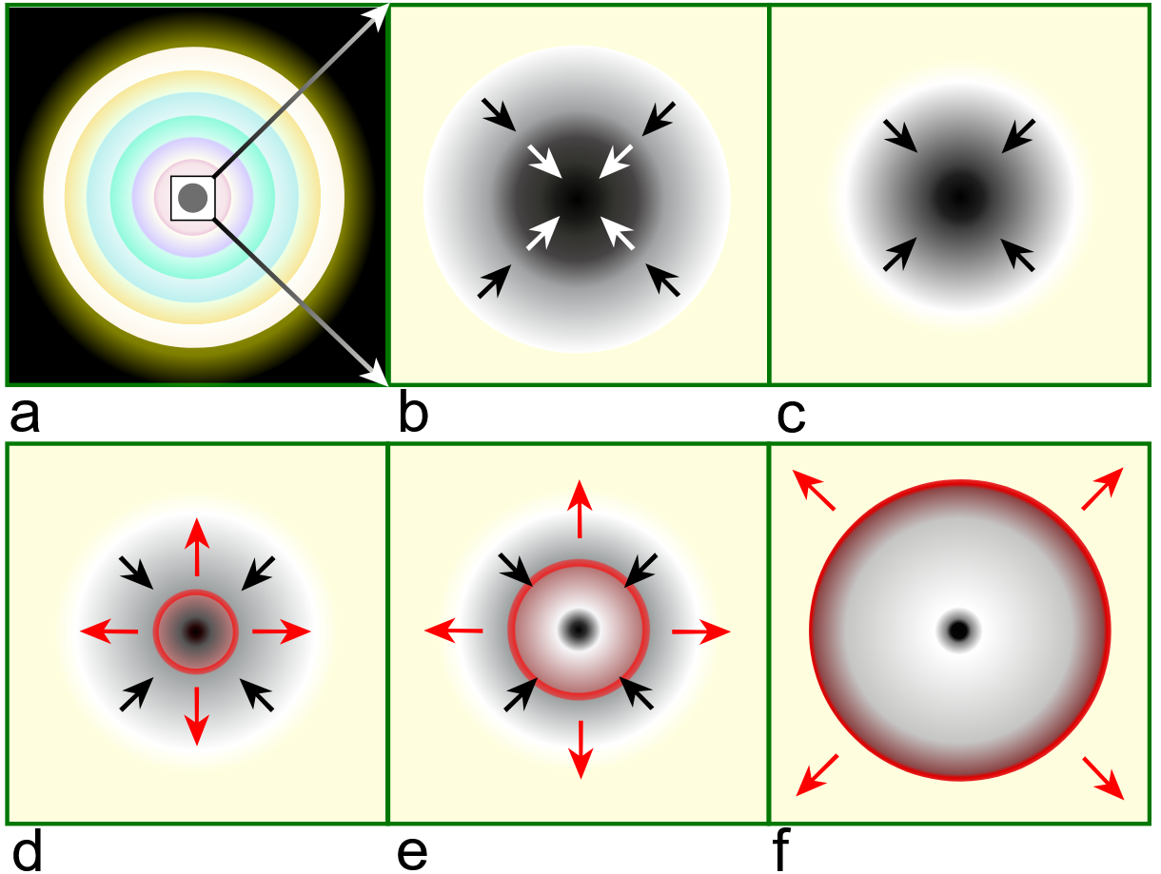
Supernovae – a great lab for new physics
SN 1987A remnant as seen by the Hubble telescope
Illustration by R.J. Hall taken from Wikipedia, based on Janka et al., Physics Reports. 442 (1–6): 38–74

Slide 4
Supernovae – a great lab for new physics
Blue line: “Agile-Boltztran” SN simulation, Fischer et al., PRD 104 (2021) 103012
Green and orange lines: models of the “Garching SN Archive”, R. Bollig et al., Phys. Rev. Lett. 125 (2020) 051104
Hot and dense plasma
→ even weakly interacting particles are produced
… and they can escape!

Slide 5
Axionlike particles
ALPs are naturally light, weakly interacting pseudoscalar particles that appear in many BSM theories
At low energies $E≪Λ$, all these models are described by the same effective field theory (EFT):
$$ℒ⊃−\frac{1}{2}a\left(◻+m_{a}^{2}\right)a+\frac{1}{4}g_{aγ}a F_{μν}{\tilde{F}}^{μν}+\sum_{𝓁}{{\hat{g}}_{a𝓁}\left(∂^{μ}a\right)\overline{𝓁}γ_{5}γ_{μ}𝓁}+\sum_{N}{g_{aN}}\frac{∂_{μ}a}{2m_{N}}\overline{N}γ^{μ}γ_{5}N$$
Are all these couplings independent? No, Quantum effects mix them!
For collider phenomenology, see, e.g., Bauer et al.: 1708.00443, 2012.12272
Here, study ${\hat{g}}_{a𝓁}→$ $g_{aγ}$ and $g_{aN}→$ $g_{aγ}$, since photon coupling is very important for phenomenology
Mass (free parameter, not related to couplings)
Photon coupling
Lepton couplings
Non-relativistic nucleon couplings
Leptonic ALPs

Slide 6
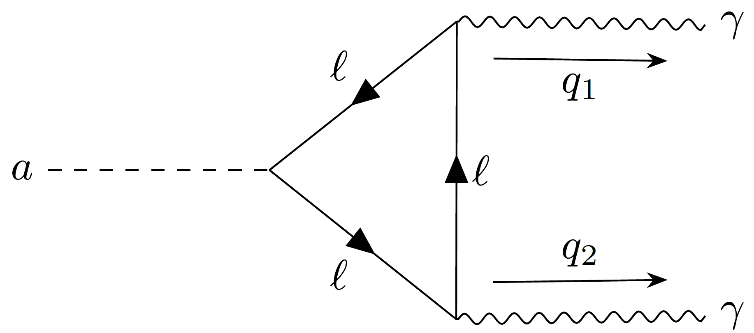
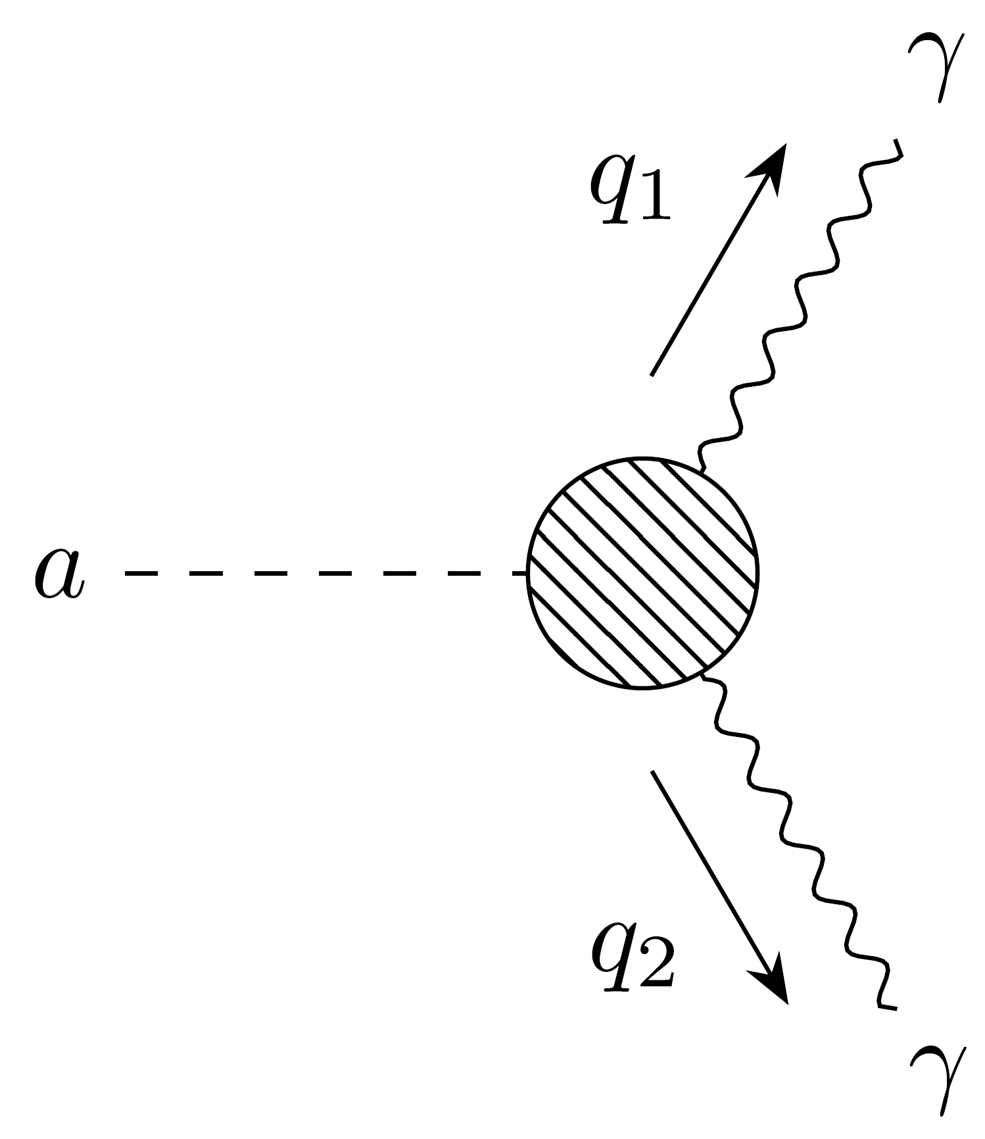
Leptonic ALPs
$$⊃−\frac{1}{2}a\left(◻+m_{a}^{2}\right)a+\sum_{𝓁}{{\hat{g}}_{a𝓁}\left(∂^{μ}a\right)\overline{𝓁}γ_{5}γ_{μ}𝓁}+\frac{1}{4}g_{aγ}^{\text{eff}}a F_{μν}{\tilde{F}}^{μν}$$
$$ℒ_{\text{1}\text{−}\text{loop}}$$
$$ℒ$$
ALP that is only interacting with electrons or muons (taus are too heavy, not interesting for SNe(?))
R. Ferreira, D. Marsh, EM, JCAP 11 (2022) 057

Slide 7
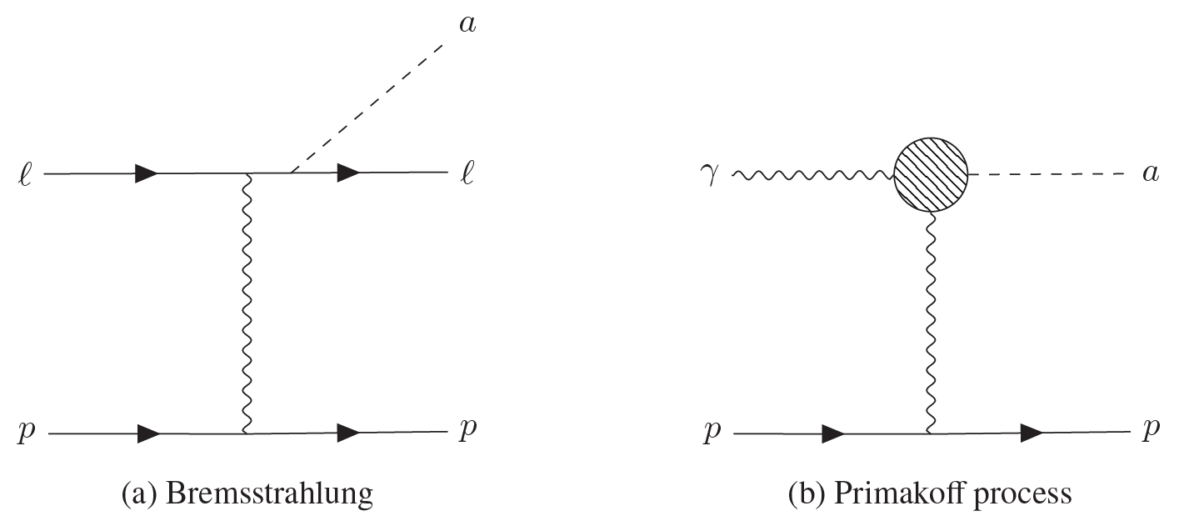
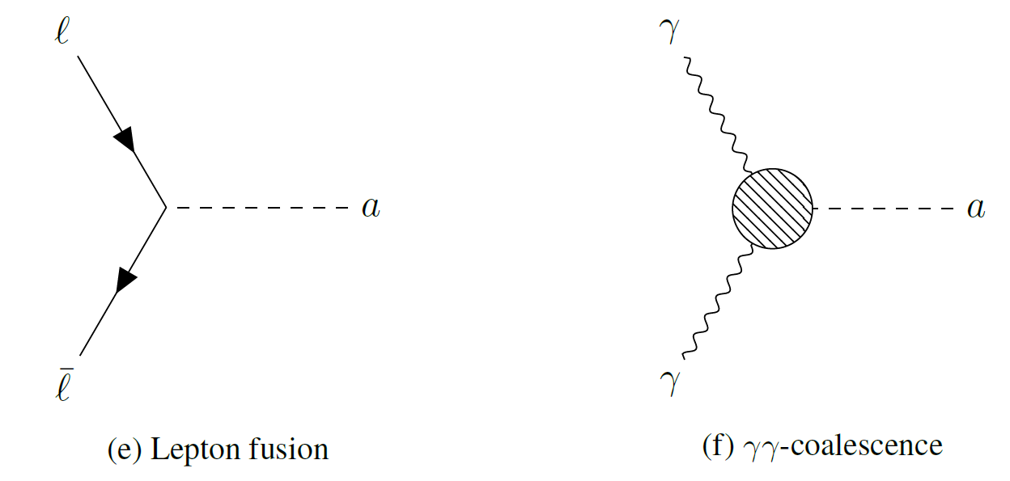
Leptonic ALPs produced in SNe
R. Ferreira, D. Marsh, EM, JCAP 11 (2022) 057
& soon to be published work
production
absorption

Slide 8
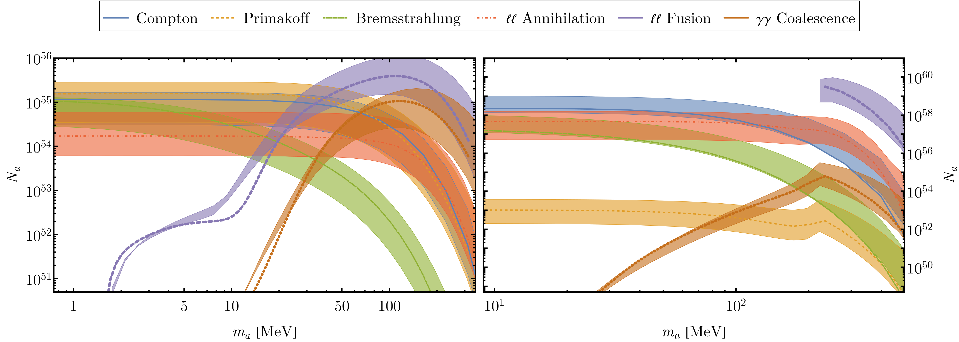
Leptonic ALPs produced in SNe
$${\hat{g}}_{ae}={10}^{−10}{\text{MeV}}^{−1}$$
$${\hat{g}}_{aμ}={10}^{−10}{\text{MeV}}^{−1}$$

Slide 9
ALPs from SNe: Observables
$R_{ν}$: ALP cools the ν-sphere
$R_{\text{gal}}$: decay inside the Milky Way
${c/H}_{0}$: decay during the age of the Universe
1 kpc
14 Glyrs
20 km
//
Distance to SN core
${10}^{7}$ km
50 kpc
$r=0$: production of ALP in SN core
$R_{∗}$: ALP escapes into the ISM
$R_{\text{SN}}$: decay before reaching earth
Anomalous cooling
Explosion energy of the mantle
Gamma-ray burst from nearby SNe
Diffuse gamma rays from all past SNe
Galactic positrons

Slide 10
ALPs from SNe: Observables
See also Lucente & Carenza, Phys.Rev.D 104 (2021) 10, 103007
Cooling bound, from the duration of the neutrino burst of SN 1987A
Decay bound, from the non-observation of gamma-rays following core-collapse SNe
Explosion energy bound, from the observed kinetic energy of the SN explosion
See also Jaeckel et al., Phys.Rev.D 98 (2018) 5, 055032; Hoof & Schulz, JCAP 03 (2023) 054; EM et al., JCAP 07 (2023) 056
See also Caputo et al., Phys.Rev.Lett. 128 (2022) 22, 221103

Slide 11
ALPs from SNe: Observables
511 keV-line bound, from Galactic positrons annihilating into X-rays
Diffuse gamma-ray bound, from all past SNe
See also Calore et al., Phys. Rev. D 104 (2021) 043016; De La Torre Luque et al. Phys.Rev.D 109 (2024) 10, 103028
See also Calore et al., Phys.Rev.D 102 (2020) 12, 123005; Caputo et al., Phys.Rev.D 105 (2022) 3, 035022
(preliminary)
Notes:
f_D : fraction of bosons that has decayed between the epoch of emission at redshift z and today

Slide 12
Leptonic ALPs from SNe: Results (electrons)
(preliminary)

Slide 13
Leptonic ALPs from SNe: Results (muons)
(preliminary)

Slide 14
Axionlike particles
ALPs are naturally light, weakly interacting pseudoscalar particles that appear in many BSM theories
At low energies $E≪Λ$, all these models are described by the same effective field theory (EFT):
$$ℒ⊃−\frac{1}{2}a\left(◻+m_{a}^{2}\right)a+\frac{1}{4}g_{aγ}a F_{μν}{\tilde{F}}^{μν}+\sum_{𝓁}{{\hat{g}}_{a𝓁}\left(∂^{μ}a\right)\overline{𝓁}γ_{5}γ_{μ}𝓁}+\sum_{N}{g_{aN}}\frac{∂_{μ}a}{2m_{N}}\overline{N}γ^{μ}γ_{5}N$$
Are all these couplings independent? No, Quantum effects mix them!
For collider phenomenology, see, e.g., Bauer et al.: 1708.00443, 2012.12272
Here, study ${\hat{g}}_{a𝓁}→$ $g_{aγ}$ and $g_{aN}→$ $g_{aγ}$, since photon coupling is very important for phenomenology
Mass (free parameter, not related to couplings)
Photon coupling
Lepton couplings
Non-relativistic nucleon couplings
“QCD ALPs”

Slide 15
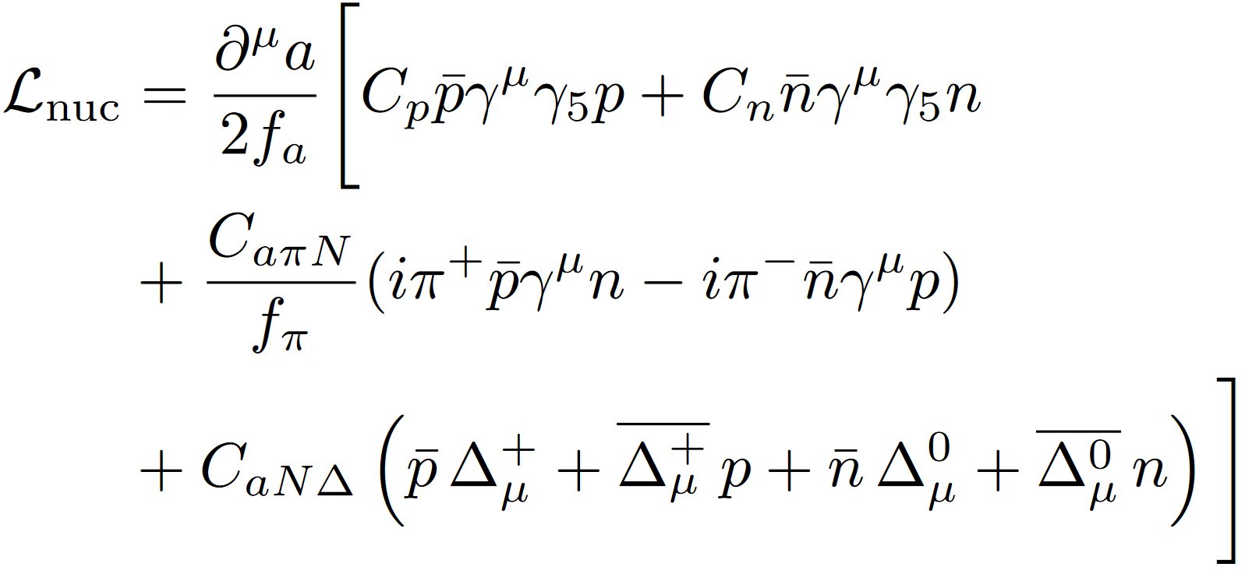
“QCD ALPs”
Lella, ER, et al., Phys.Rev.D 110 (2024) 4, 043019
ALPs that interact with gluons and/or quarks (but are not the QCD axion!)
Interesting for phenomenology: low-energy couplings to nucleons and pions are very efficient in SNe
Fundamentally
determined by
Couplings to quarks and gluons: $c_{u},c_{d},c_{g}$
$$g_{aγ}=\frac{α}{2π f_{a}}\left\{−1.92 c_{g}−\frac{m_{a}^{2}}{m_{π}^{2}−m_{a}^{2}}\left[c_{g}\frac{m_{d}−m_{u}}{m_{d}+m_{u}}+\left(c_{u}−c_{d}\right)\right]\right\}$$
In general, there is an “irreducible” photon coupling as well!

Slide 16
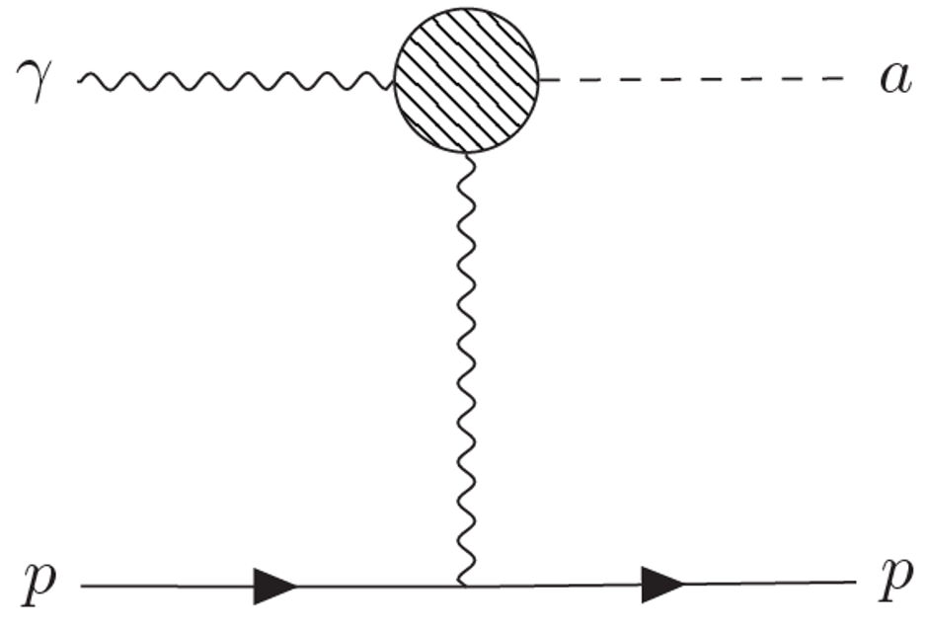
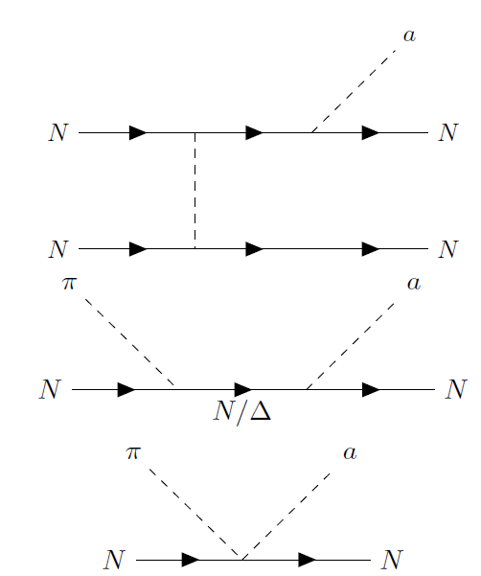
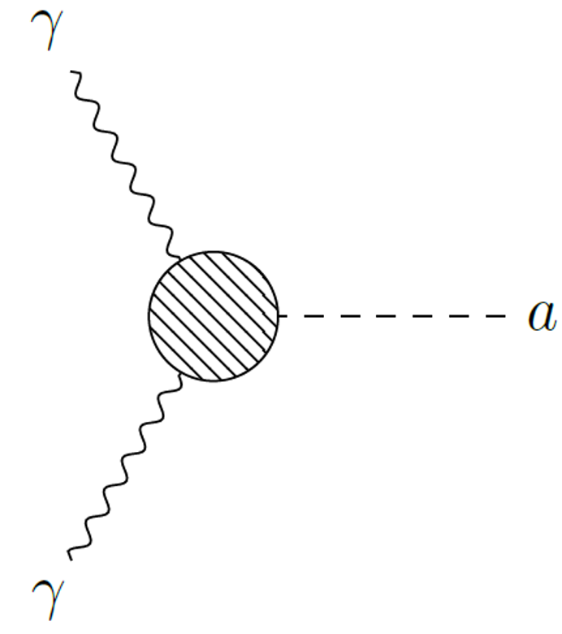
“QCD ALPs” produced in SNe
Nucleon-nucleon Bremsstrahlung
Production via “irreducible” photon interaction is negligible here
Pion-axion conversion

Slide 17
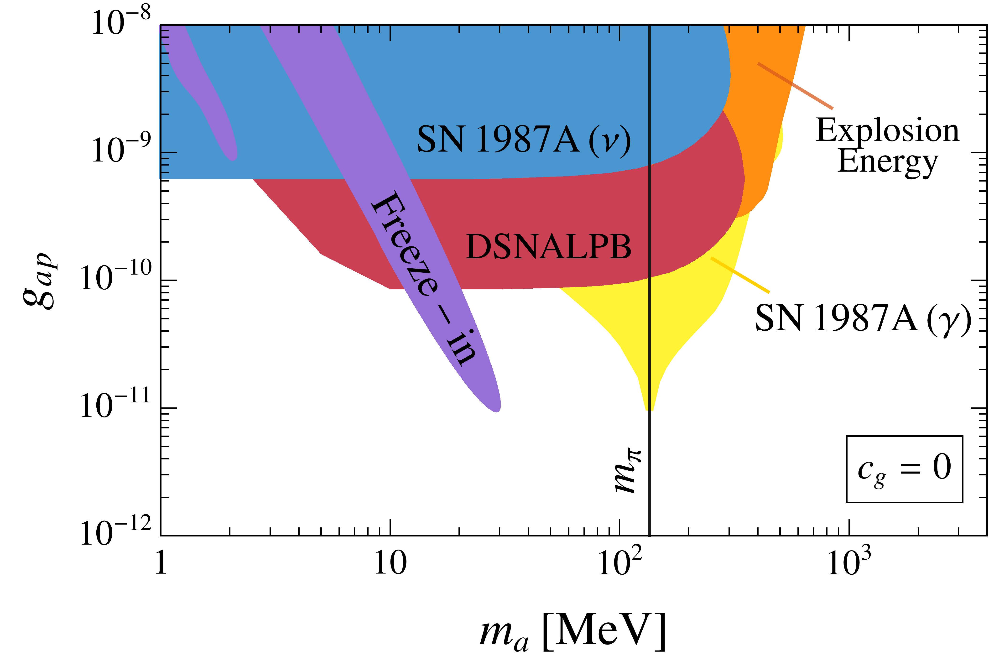
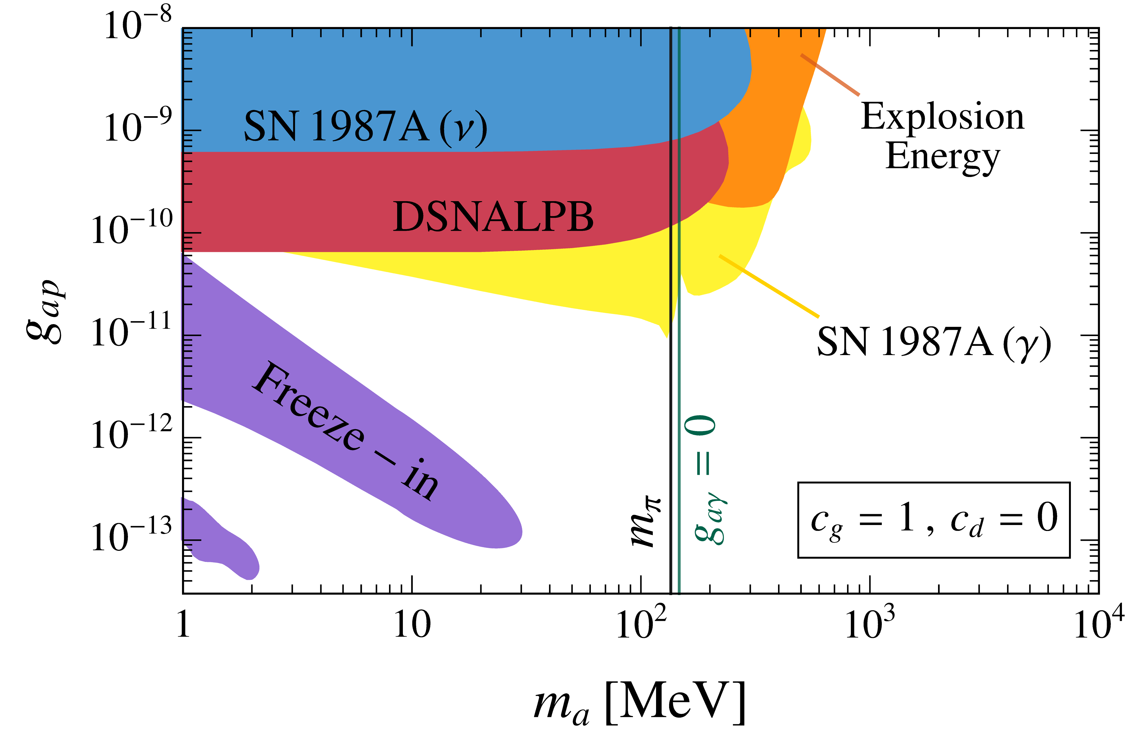
“QCD ALPs” from SNe: Results
Lella, ER, et al., Phys.Rev.D 110 (2024) 4, 043019

Slide 18
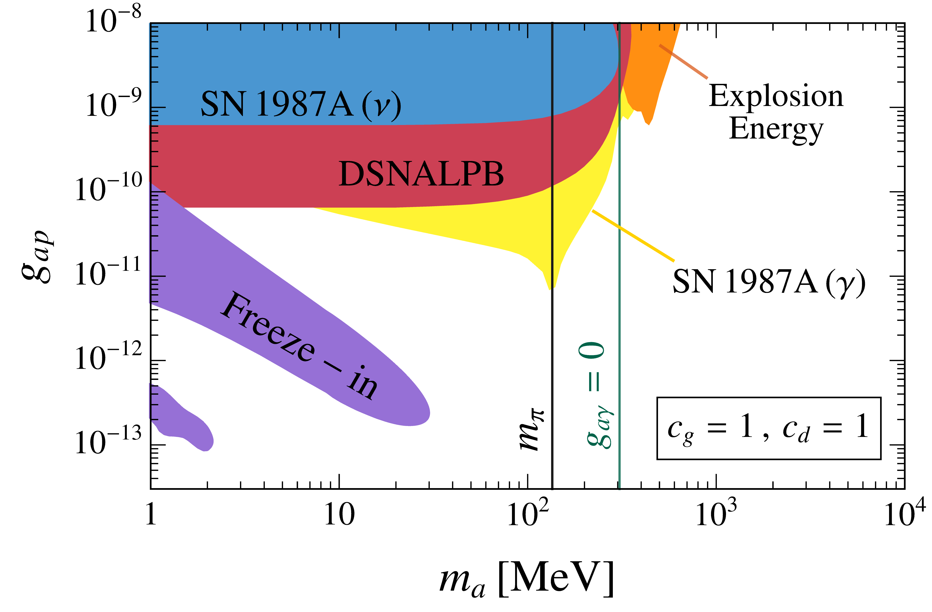
“QCD ALPs” from SNe: Results
Lella, ER, et al., Phys.Rev.D 110 (2024) 4, 043019

Slide 19
Conclusion & Outlook
Supernovae are great laboratories to search for axionlike particles
There are many observables to look for, and predicting them is numerically quite costly
Even in phenomenological EFT models, higher-order QFT effects play an important role
Effective ALP couplings are not independent! And corrections are important in SNe
Stay tuned for our comprehensive results for leptonic ALPs and technical improvements
Upcoming: search for the time signature of ALP-induced gamma-ray bursts from nearby SNe (following first steps in EM, P. Carenza, C: Eckner, A. Goobar, Phys.Rev.D 109 (2024) 2, 2)
Thanks for your attention!

Slide 20
Back-up slides

Slide 21
ALPs from SNe: Observables
Among the technical advances in our recent work: anisotropic ALP-absorption probability
In the Cooling bound and Explosion energy bound, the transmissivity is given as an angular average
with the optical depth
$$a$$
Following Caputo et al., JCAP 08 (2022) 08, 045

Slide 22
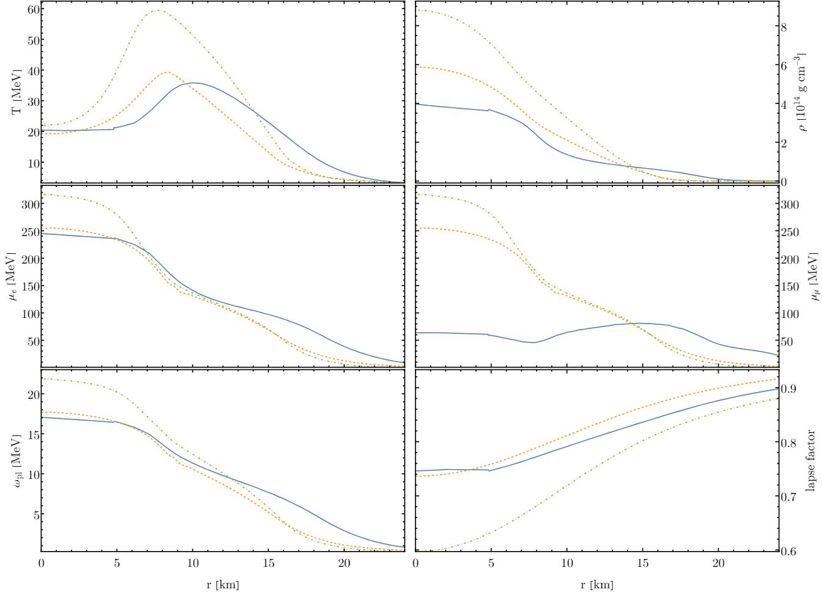
Supernovae – a great lab for new physics

Slide 23
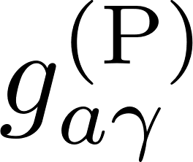
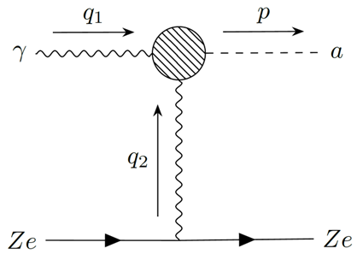
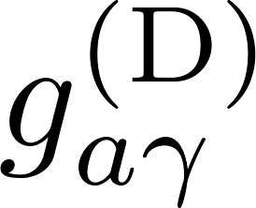
The effective ALP-photon coupling

Slide 24
ALPs decay into photons
Photophobic ALPs decay at one-loop level with a lifetime of
This is a bound from a loop effect!
Ricardo Z. Ferreira, M. C. David Marsh, and EM
Phys. Rev. Lett. 128, 221302
See also Pospelov et al. 2008, Arias et al. 2012 for earlier work on this
Direct detection limits are superseded here
Direct detection limits do not apply here
Notes:
ALPs cannot be dark matter in the dark grey region → makes some parameter space of direct detection experiments inconsistent
Especially GERDA: in 97% of the mass range can ALPs not be DM
Indirect constraints rule direct detection parameter space out for m>6keV
Loophole: by including additional & (very) finetuned couplings, the loop contribution can be cancelled

Slide 25
ALPs from a SN plasma
The spectral rate of change in the number density of ALPs (“production spectrum”) can be calculated using the Boltzmann equation:
for every relevant production process.
Notes:
Section 3

