Slide 1
First results from a cavity haloscope experiment with a novel frequency tuning system using a qubit
19th Patras Workshop on Axions, WIMPs and WISPs,
University of Tokyo
Kan Nakazono
Notes:
Thank you for giving me a great opportunity to have a presentation!
I'm a graduate school student at the university of Tokyo.
Today I will talk about a novel frequency tuning system using a qubit.

Slide 2
Introduction
Today’s talk
In the context of cavity haloscope experiments, Introducing a novel frequency tuning system, using interaction between cavity and qubit.
Report preliminary Dark photon (DP) exclusion limit using this new system around 36.1 μeV.
(~8.73GHz)
Notes:
There are today's talk. I will talk about a tuning system using interaction between cavity and qubit.
I will talk about the principle of this system, method ,and the first result of Dark photon search around 36.1 ueV

Slide 3
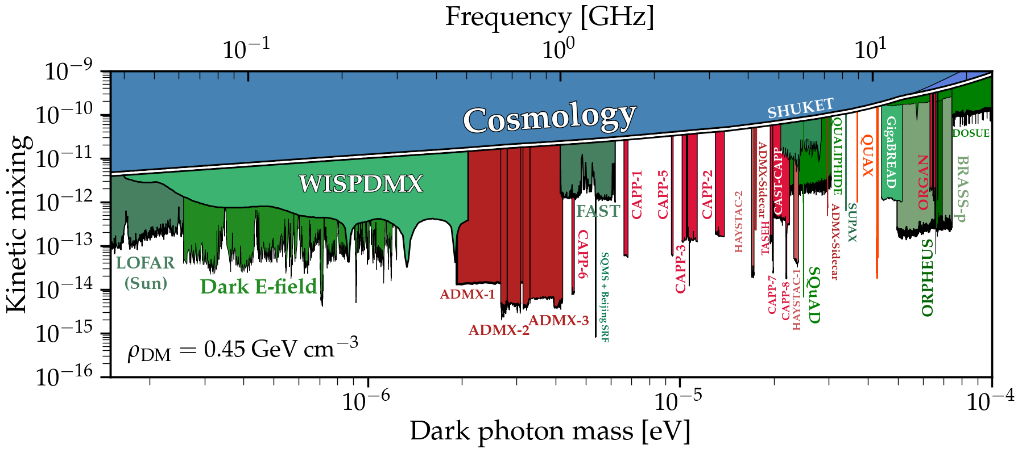
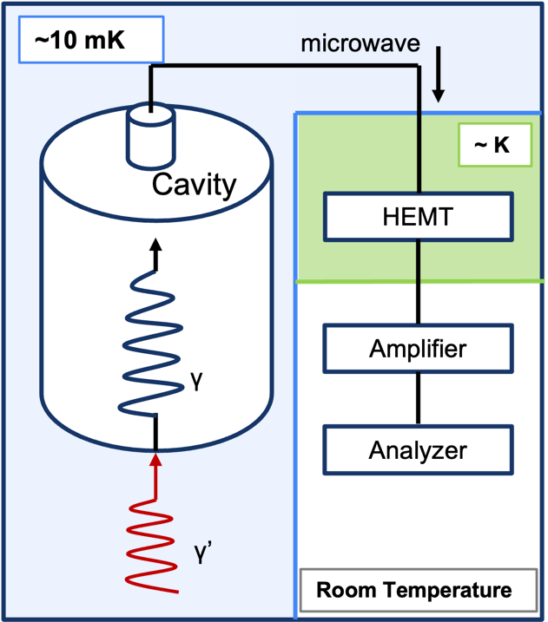
Dark photon
・One of the candidates of DM
・Mixed with photon in kinetic mixing parameter χ
・Conversion photon can be measured.
cavity haloscope
Caputo et al. 2021
Notes:
Probably you have already known, I would like to skip the detail of dark photon.
The left hand-side shows a very nice parameter space plot and the right-hand side shows a concept of a cavity haloscope

Slide 4
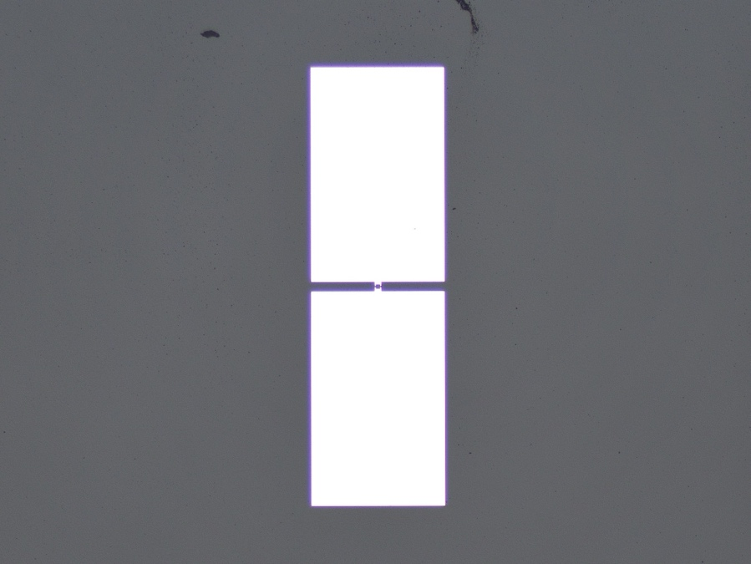
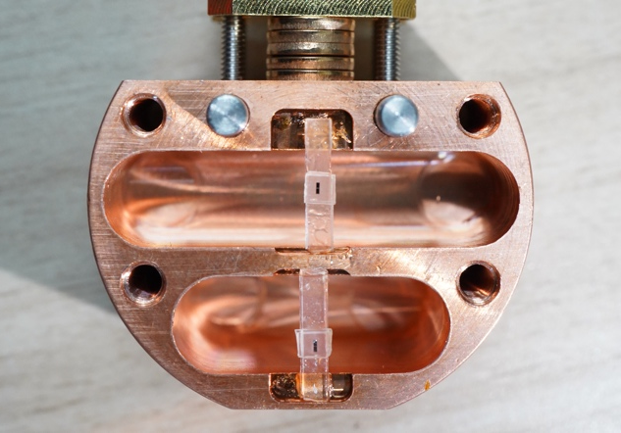
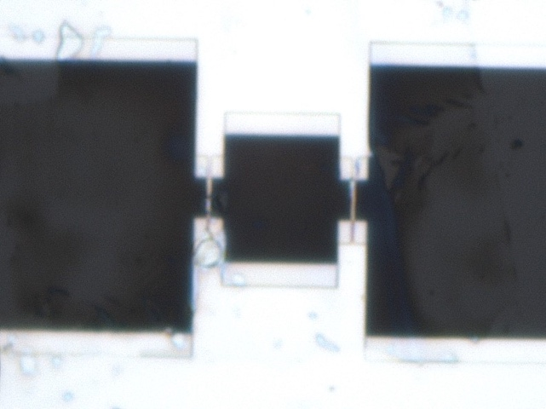
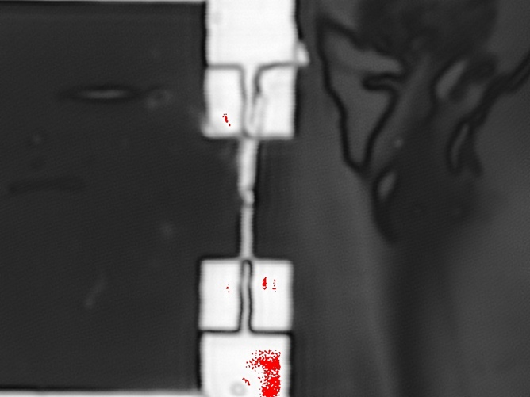
What is “qubit”?
Transmon qubit
Superconducting charge qubit
Josephson Junctions (~100nm) between two large islands (~100μm).
Equal to non-linear LC circuit
Tunable qubit(SQUID-based qubit)
Tunable qubit has one loop with two JJs.
→Enable to change energy gaps
(= qubit’s resonant frequency)
by varying magnetic flux penetrating the qubit.
Al
7 mm
400 μm
2 mm
250 μm
10 μm
Sapphire
width
250 nm
Al
Sapphire
2 mm
250 μm
1 loop with 2 JJs
single JJ (Dolan bridge)
(Koch et al., 2007)
Notes:
First of all, I would like to talk about what is qubit. In this presentation, I will use a word "qubit" as superconducting charge qubit, or transmon qubit
transmon qubit has Josephson junction between two large scale islands. Generally, qubit is equal to non-linear LC circuit.
Also, for tuning system, In addition to the transmon qubit feature, we use tunable qubit, Tunable qubit has 1loop and 2JJs. Tunable qubit can change their resonant frequency by changing magnetic flux penetrating the qubit.
These 4 photos are cavity and qubit.

Slide 5
Interaction between cavity and qubit
Jaynes-Cummings model
qubit
cavity
…Pauli spin Z
Important point
frequency’s shift ∝
…Detuning
…Coupling constant
Notes:
Next, I will introduce the interaction between cavity and qubit. The model is Jaynes cummings model which is the simplest model described cavity and qubit.
Hamiltonian can be written as below. We can write the terms of qubit, cavity, and interaction explicitly. wq and wc is the original frequencies of cavity and qubit, and, g square over delta is interaction. the important thing is that frequency shift is the proportional to this g squared over delta.

Slide 6
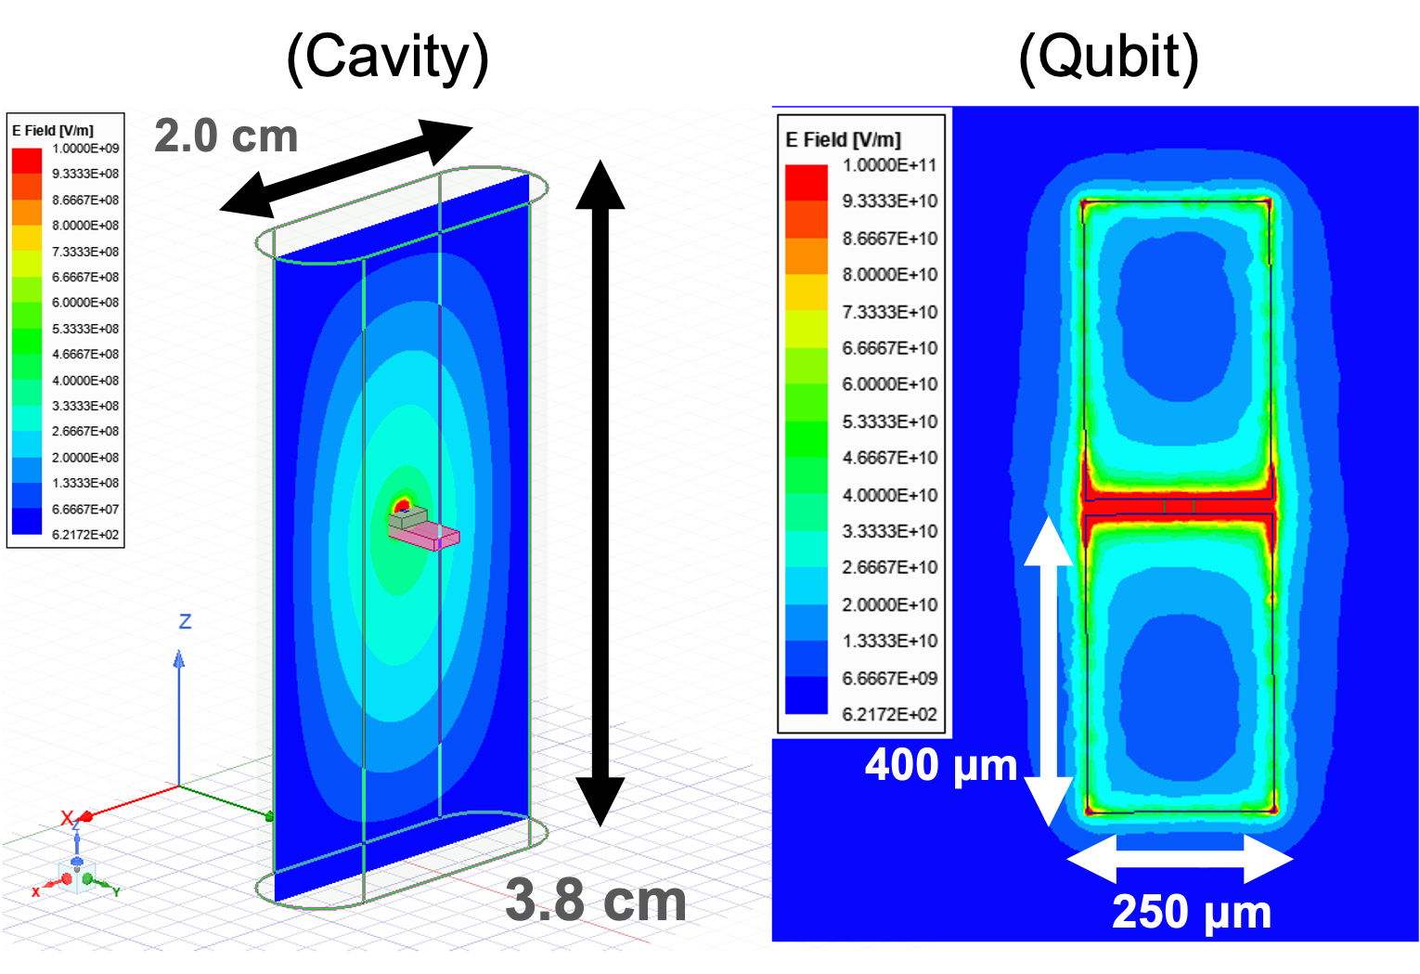
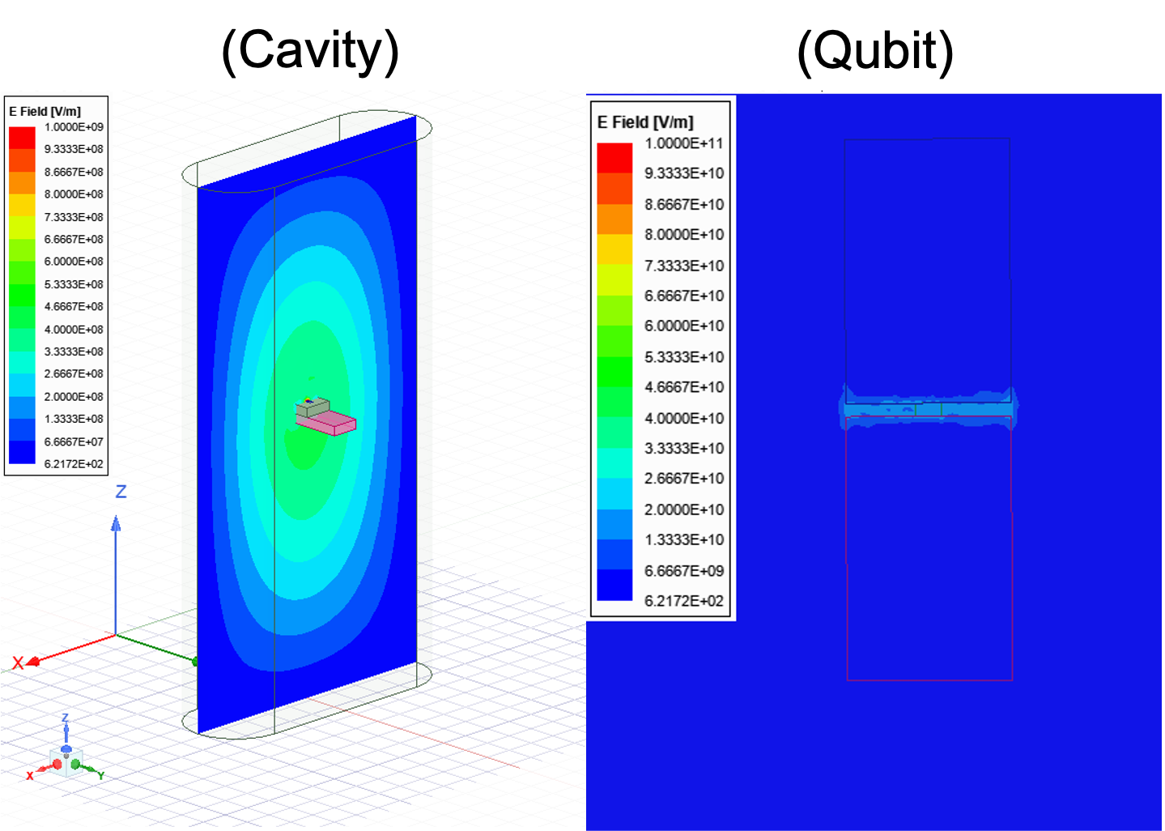
TE101 mode simulation
The same design and material of the actual cavity and qubit
here!
Interaction Maximum
Interaction Minimum
Cavity frequency ≒ Qubit frequency → Mode crossing is maximum.
Notes:
This figures show TE101 mode simulation. Itis the same design and materialas the actual one. The left hand sideis the interaction is maximum. the right hand side is mimnimum.The picturess show

Slide 7
TE101 mode simulation
The same design and material of the actual cavity and qubit
Form factor is merely dropped in 7%
(Interaction min:0.4837→max:0.4485)
Cavity frequency ≒ Qubit frequency → Mode crossing is maximum.
Notes:
Surprisingly, Form factor is maintained 93% between two situation between the interraction is maxmum and minimum

Slide 8
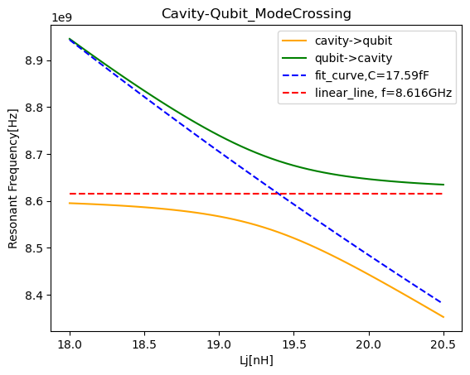
Mode crossing simulation
Blue dashed line
estimated qubit frequency without interaction
Red dashed line
estimated cavity’s frequency without the interaction
Yellow line
Cavity→(mode crossing)→Qubit
Green line
Qubit→(mode crossing)→cavity
Notes:
Also, we have attempted to simulate mode crossing. dashed line are both frequencies estimated without interaction. and Yellow and green line is actual.

Slide 9
Mode crossing simulation
Blue dashed line
estimated qubit frequency without interaction
Red dashed line
estimated cavity’s frequency without the interaction
Maximum frequency shift
when ω_{c}~ω_{q}
※Black dots... points of cavity frequency
Notes:
As I mentioned before, when wc is nearly equal to wq, frequency shift is maximum

Slide 10
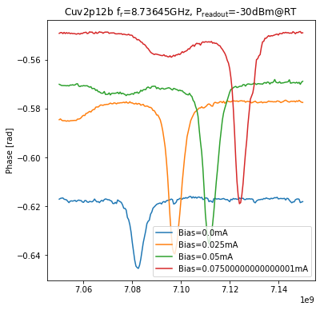
Test for Tuning qubit’s frequency by DC current
Tunable qubit frequency
Phase
Qubit Frequency
Notes:
I have talked the principle of tuning system. nextI will talk the performance check in actual our setup. First we have done the test for qubit's frequency tunig.

Slide 11
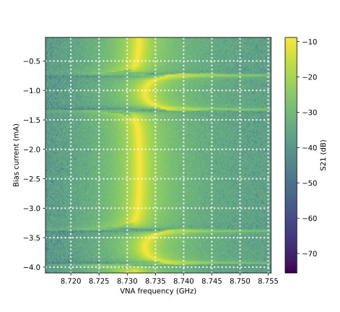
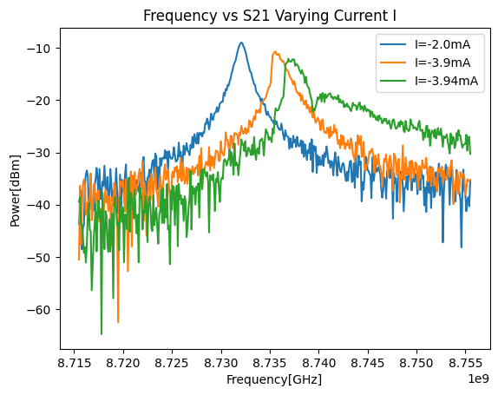
Performance Check and Calibrations for cavity tuning
Measuring S21(transmission wave) while varying DC current through the coil.
Frequency vs Current (height :S21)
O(10MHz)
Power
Cavity frequency
Cavity frequency
We want to use this regime
Notes:
Also we have done performance check and calibrated for cavity tuning.
Cavity frequency is also shifted in the left-hand figure.
on the right-hand side, we have measured S21 continuously cavity center frequency versus current.
To use tuning system,
we would like to use the regime of frequency shift widely. in this experiment the tuning range is order10MHz

Slide 12
Why is “qubit”?
In this experiment, we assume some features that...
Easy implementation
only with coils and qubits
without physical restriction
No need to be worry about electromagnetic wave leakage
the risk caused by physical gaps of a cavity
Fast scanning because of no thermal noise from the friction.
Notes:
I have talked about What is qubit, I will talk about why is qubit? what is the motivation we use qubit as tuning system.
We assume mainly three features in this experiment that,...
1.easy implementation
2. No need to be worry about elecromagnetic wave leakage
3.Fast scannig because of no thermal noise from friction
These features are because we do not need physical mechanism or manipulation but only electromagnetic interaction

Slide 13
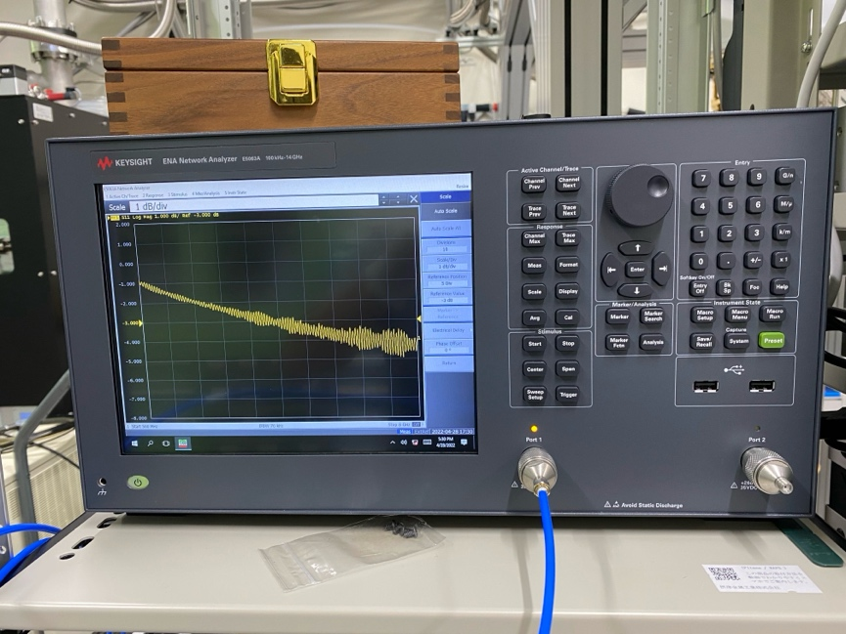
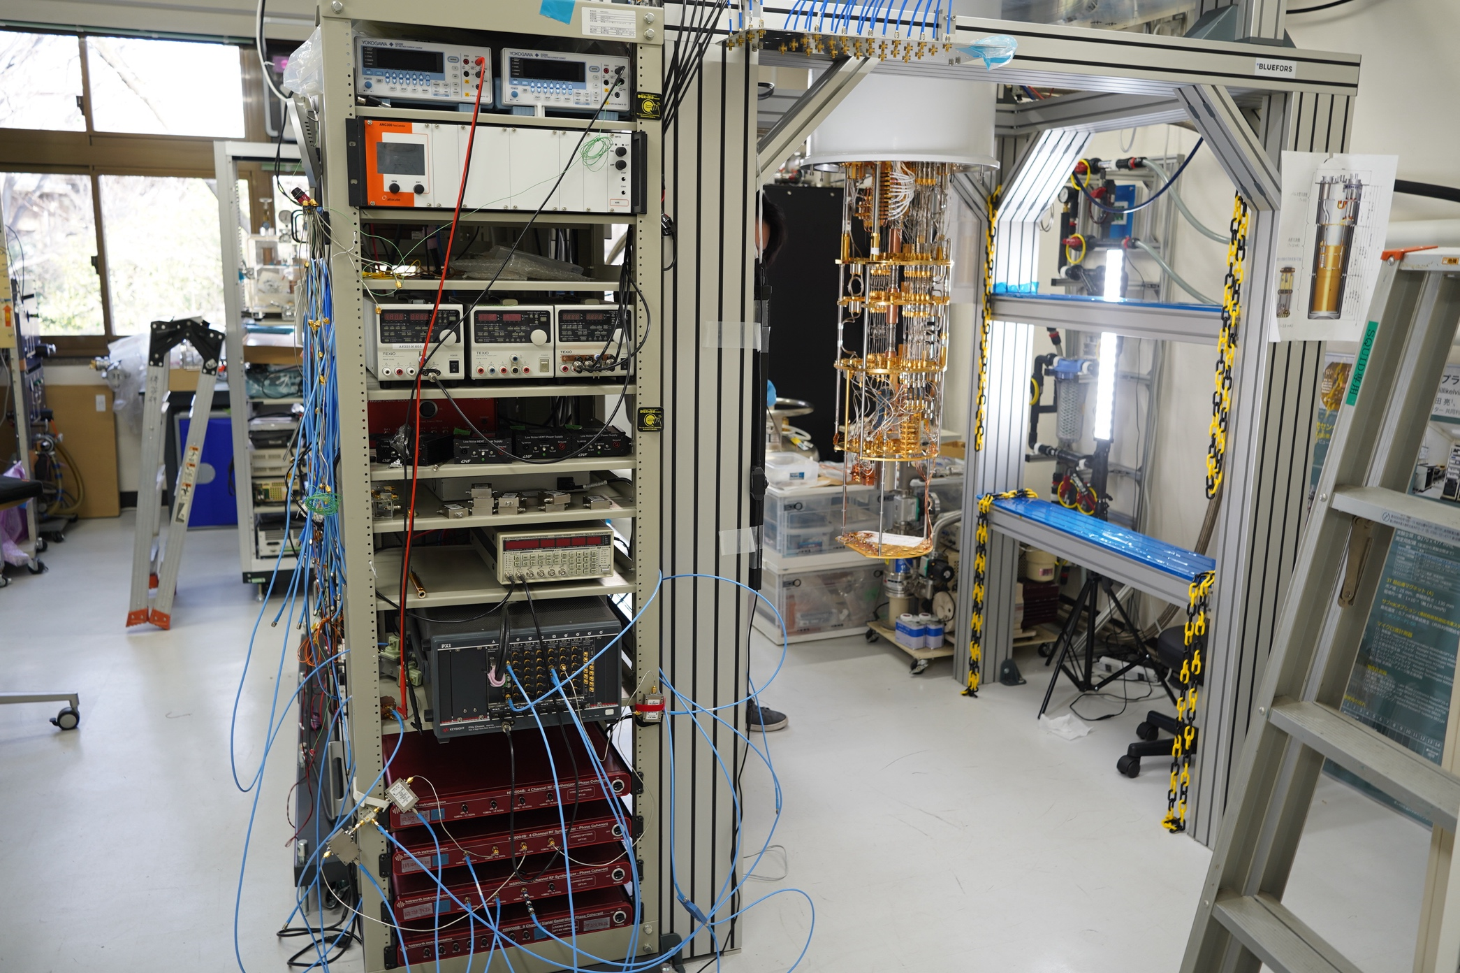
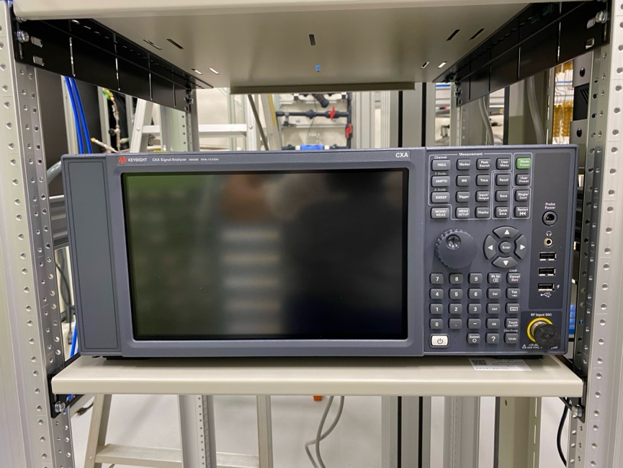
The setup and equipment
The dilution refrigerator cool down to 10mK
VNA
Spectrum analyzer
Cryogenic Research Center, The University of Tokyo
Notes:
There are our setup pictures. we use dilution refregdereator in order to cool down to 10mK, And VNA and SA.

Slide 14
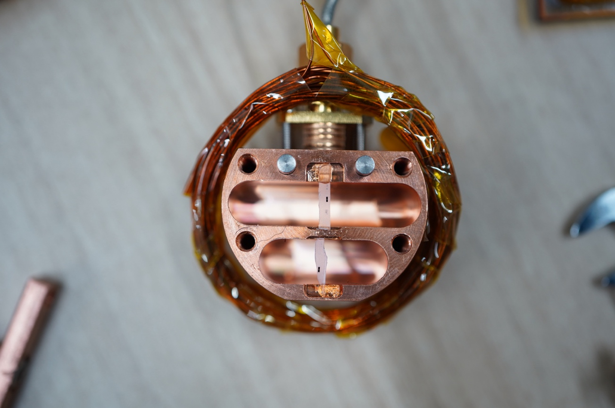
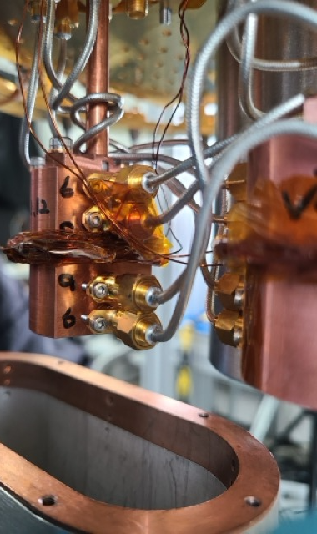
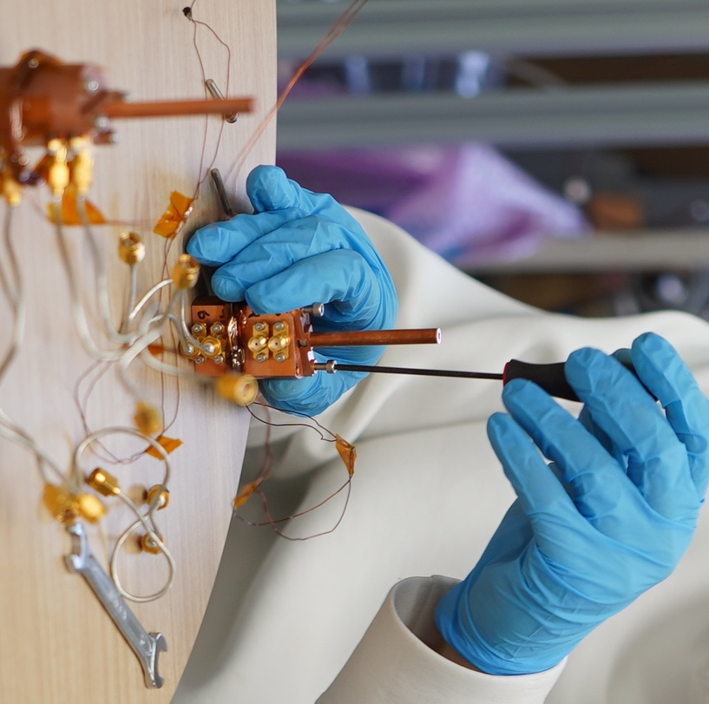
The setup of cavity and qubit
A coil for Magnetic flux (NbTi)
10mk stage
3.2 cm
width: 2 mm
Cavity(Cu)
DC line for magnetic flux
A Shield for
external EM noise
4 cm
Notes:
Next, I also introduce cavity and qubit setup.
There is a copper cavity, coil for magnetic flux ,and sapphire qubit.
construct it.
and then load it on the 10mK stage.

Slide 15
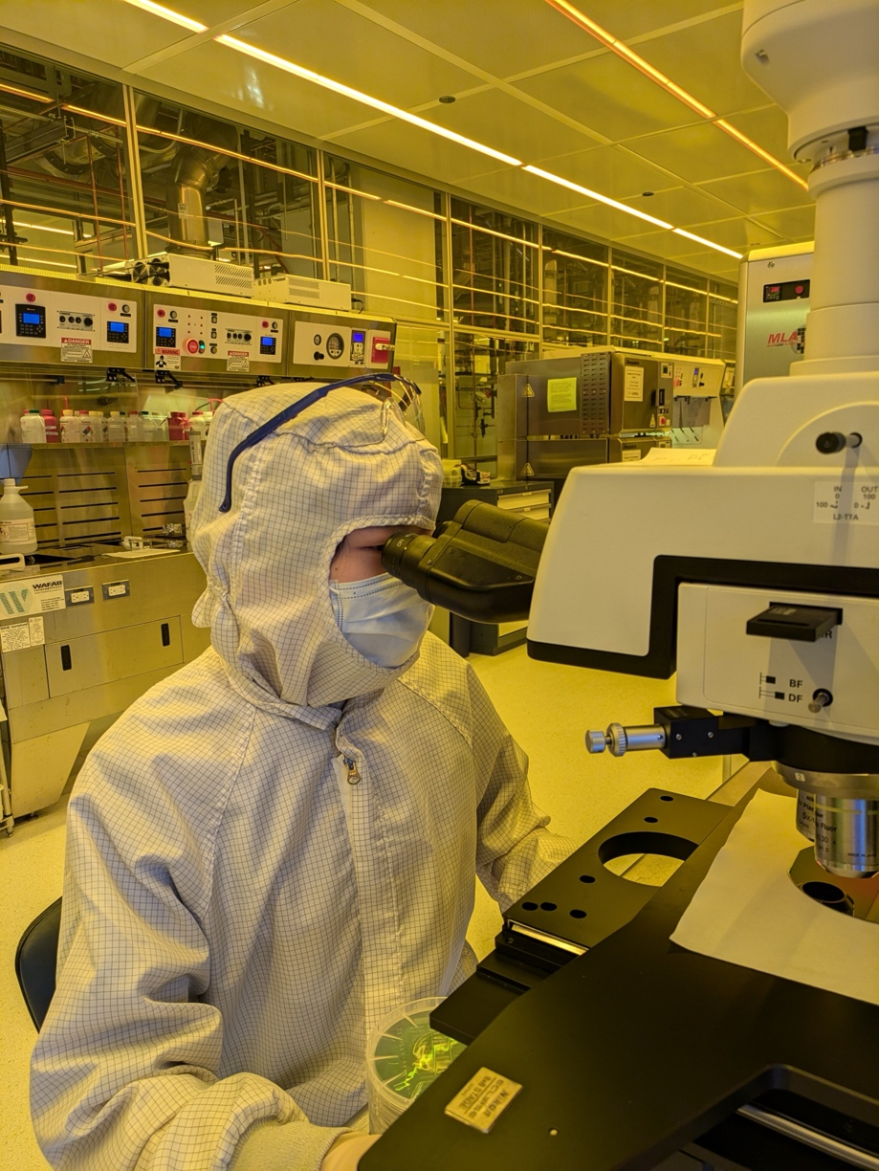
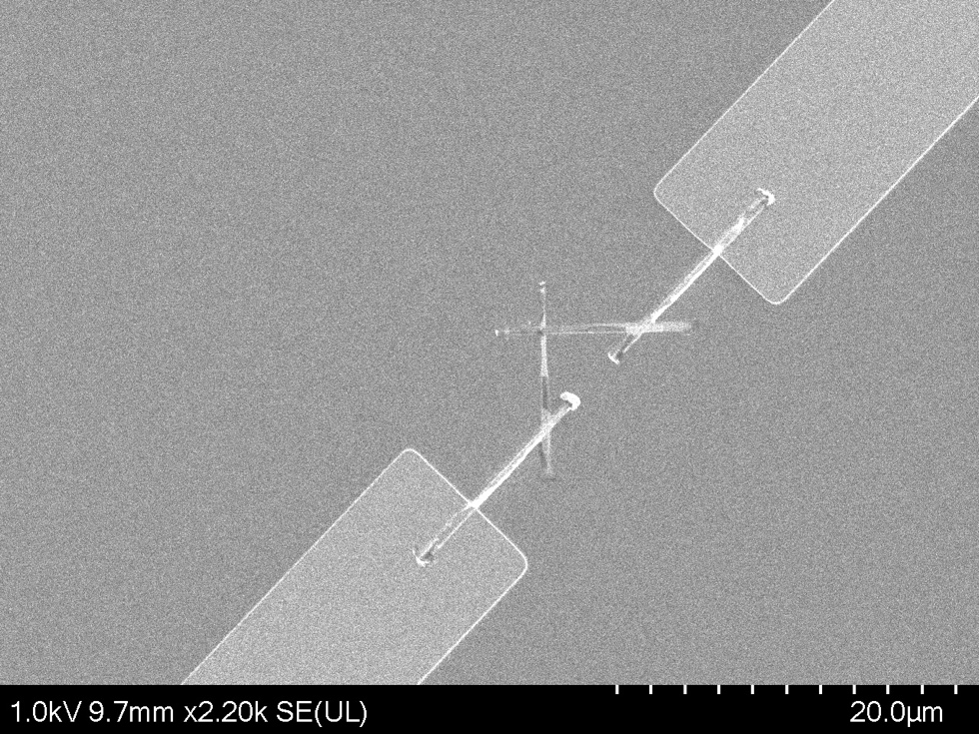
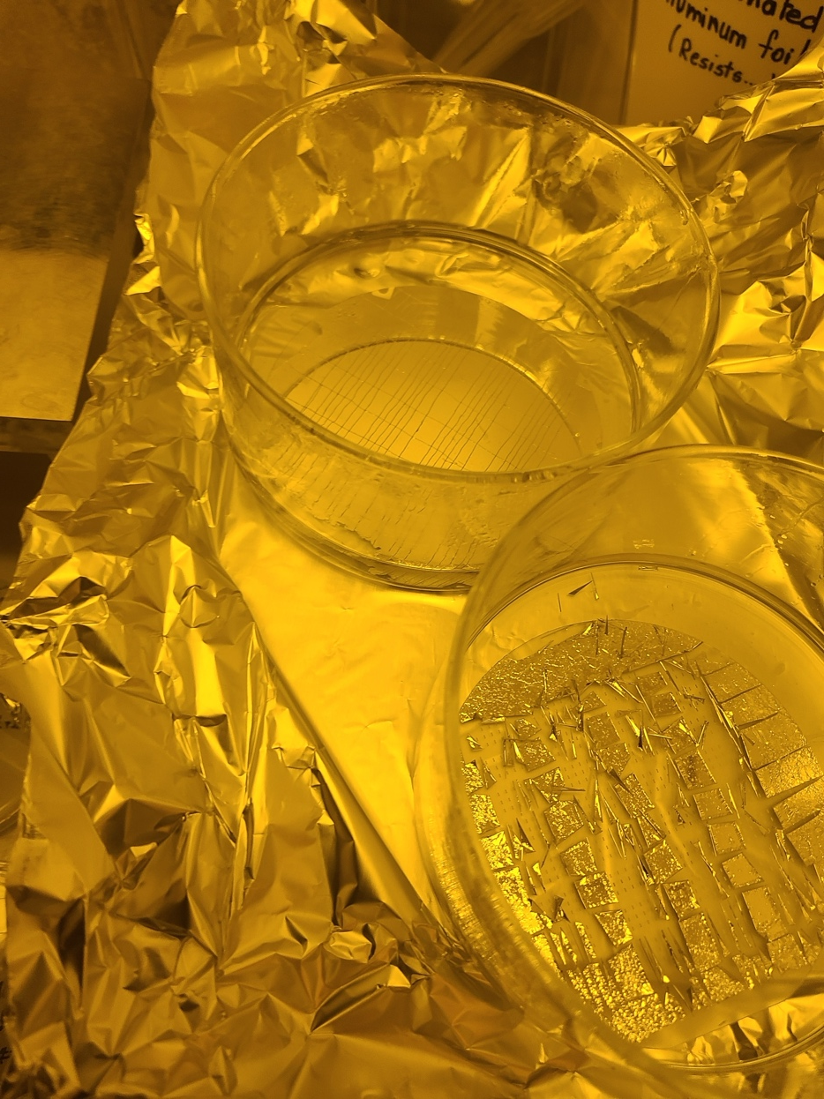
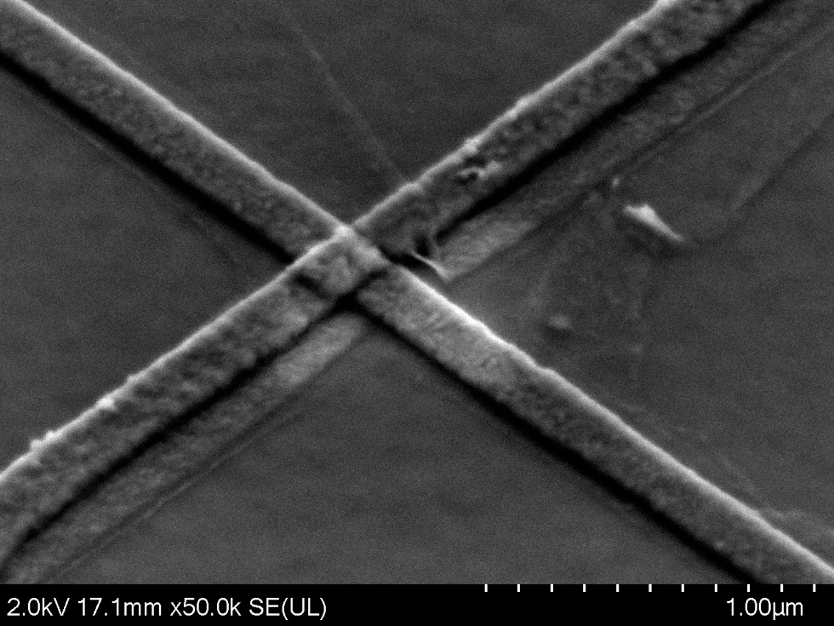
Qubit fabrication
We made our qubits by our selves
Thank you for much help!
U-Tokyo
OIST
EPFL
U-Chicago
We make at...
Manhattan style JJ
Notes:
Our team made our qubits by our selves. The two microscope photos are another Josephson Junction style, Manhattan style. We make at several creanrooms in several university. Thank you for much help!

Slide 16
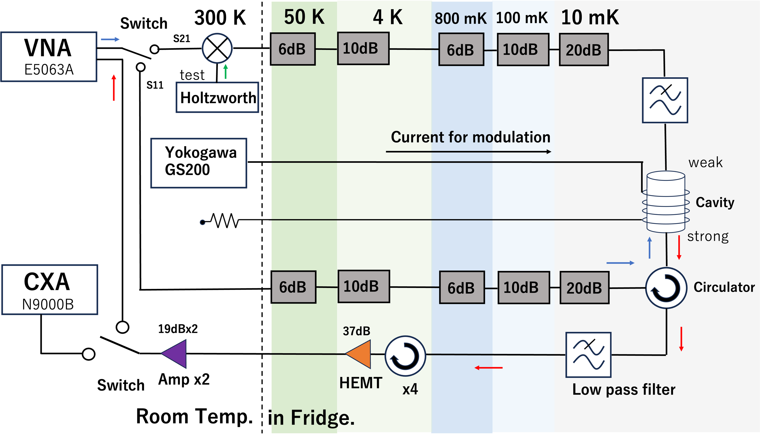
Measurement methods
Well-established measurement methods in haloscope experiments
Notes:
Then, I will introduce our measurement method. It is based on the well established method in haloscope experiments.

Slide 17
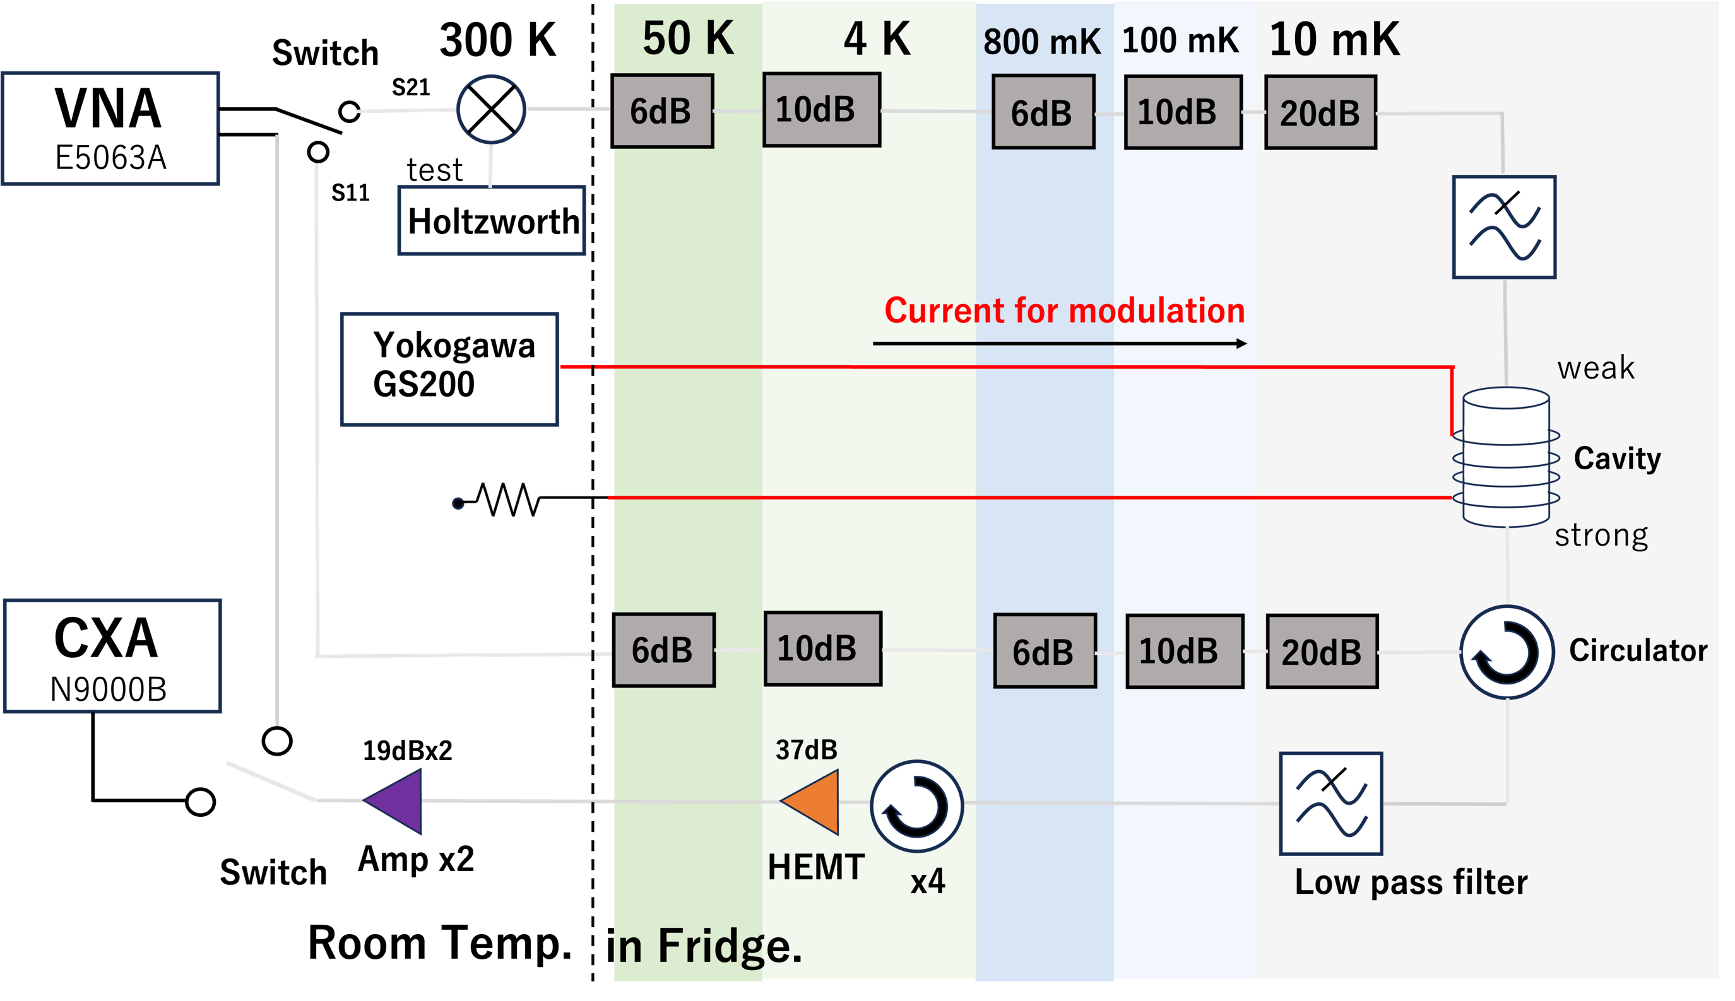
Methods step by step part0
0.Varying DC current suitably (considering the performance check)
Notes:
At the beginning, we changed DC current suitably.

Slide 18
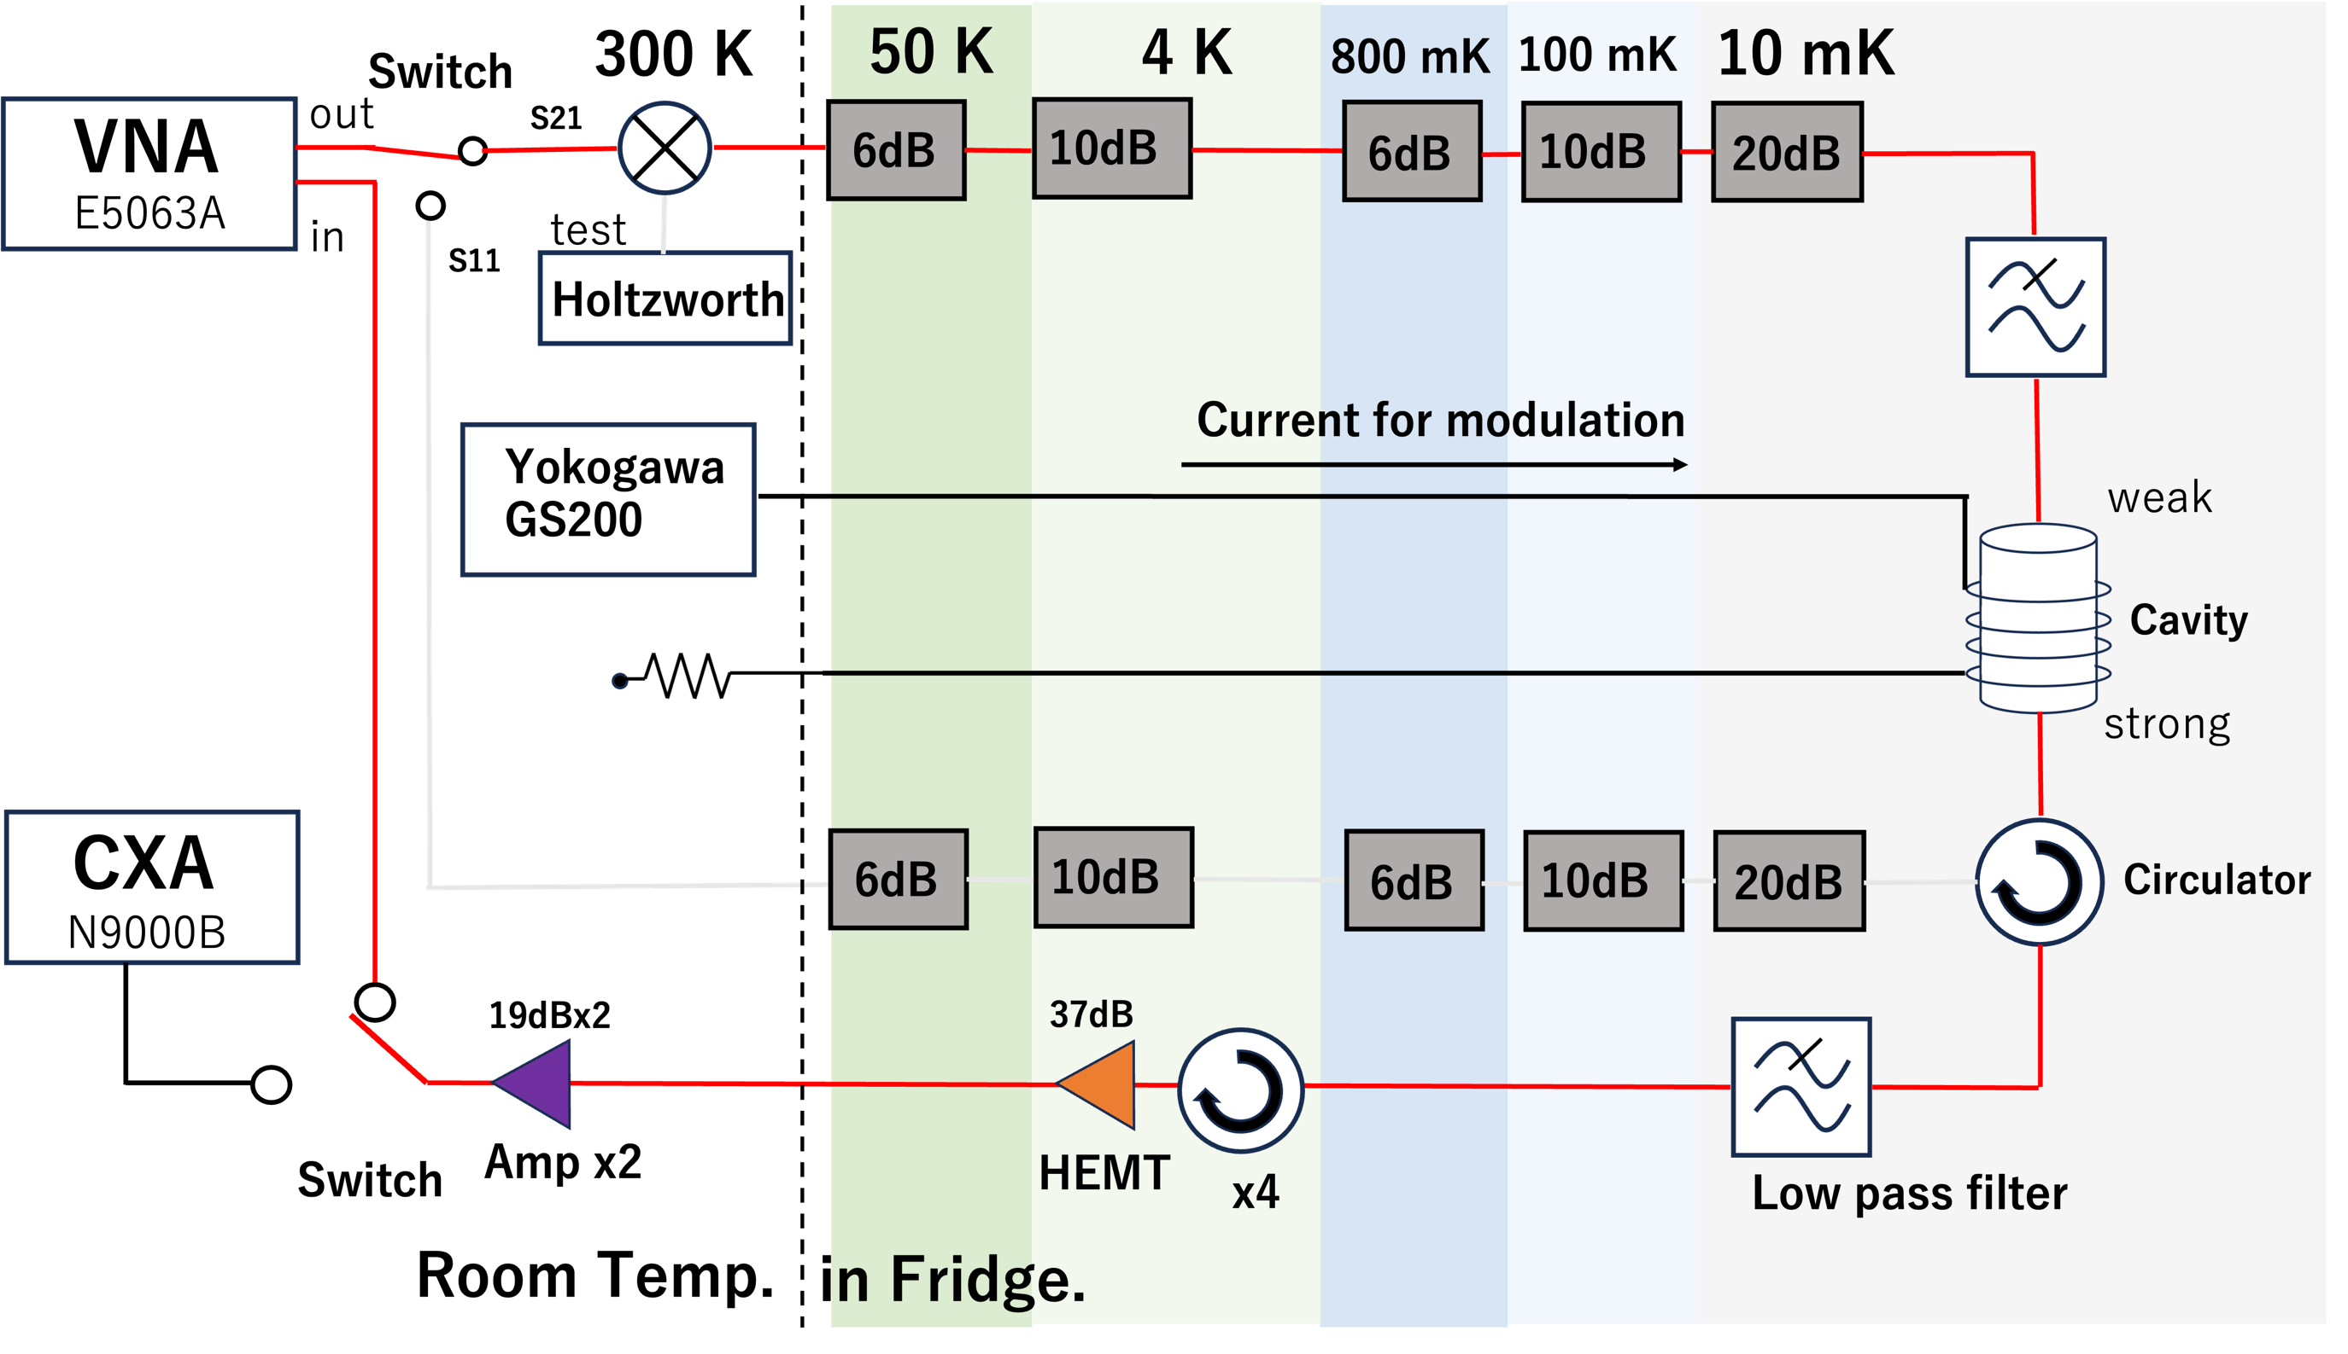
Method step by step part1
1.Measure S21 by VNA
for Q and center frequency
Notes:
Next, measure S21 for Quality value and center frequency.

Slide 19
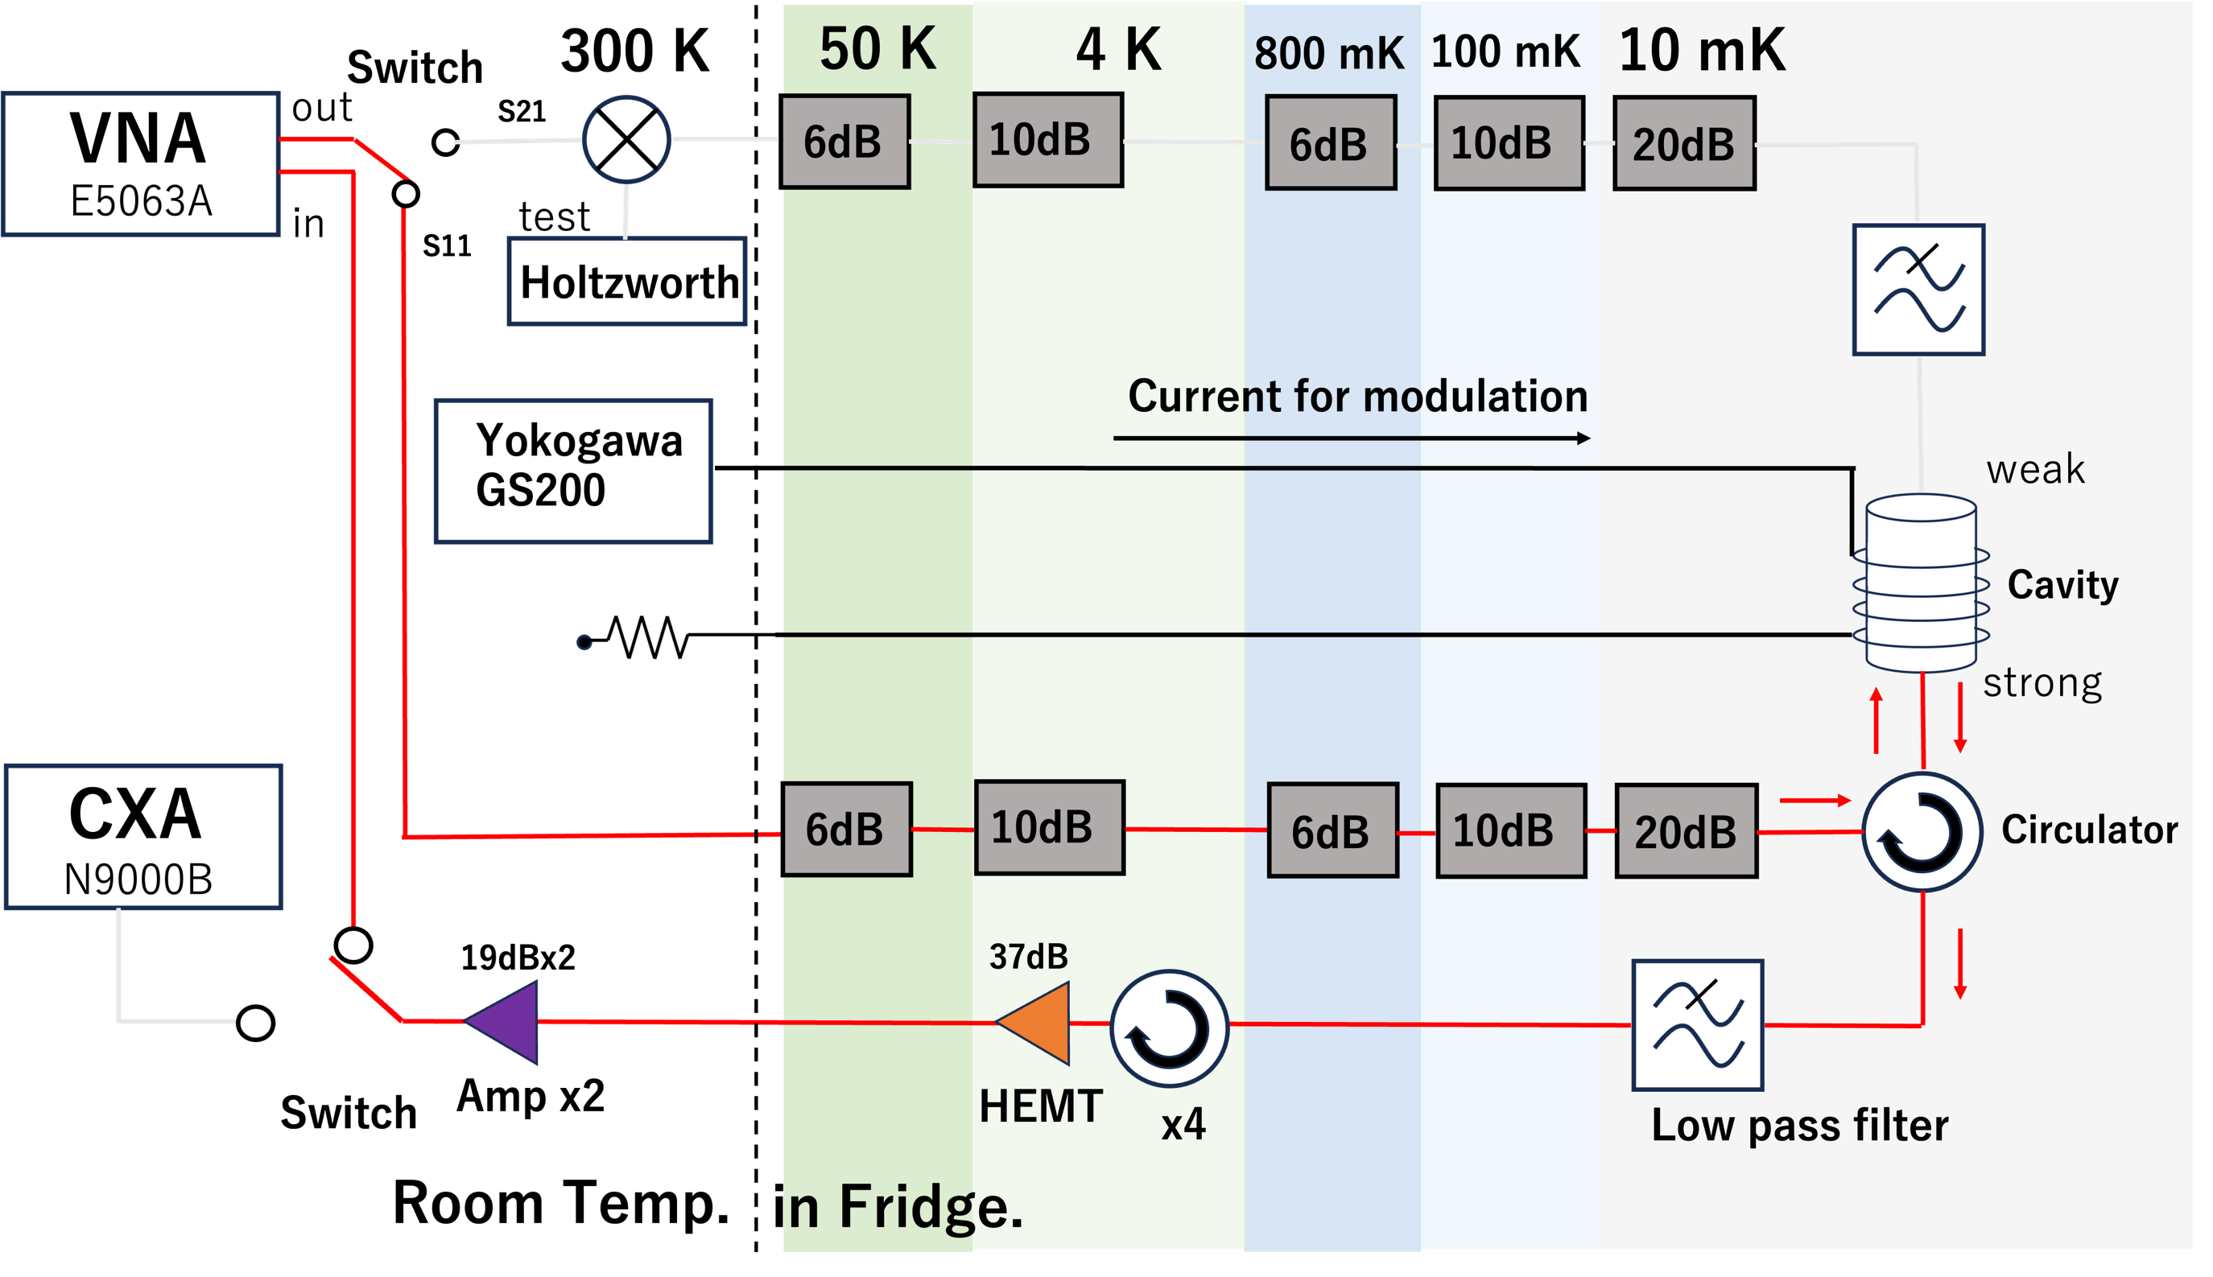
Method step by step part2
2.Measure S11 by VNA
for β
Notes:
Next, measure S11 for coupling coefficient beta

Slide 20
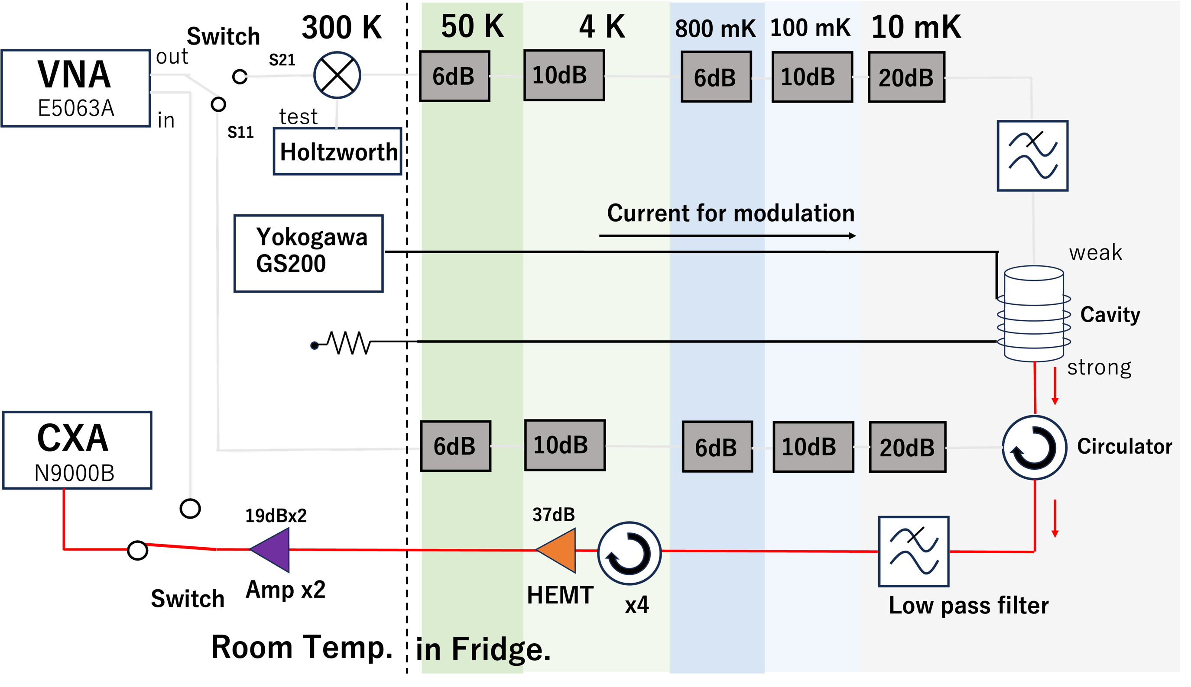
Method step by step part3
3.Data-taking by spectrum analyzer
SA
Notes:
Finally, we took DM data by SA.

Slide 21
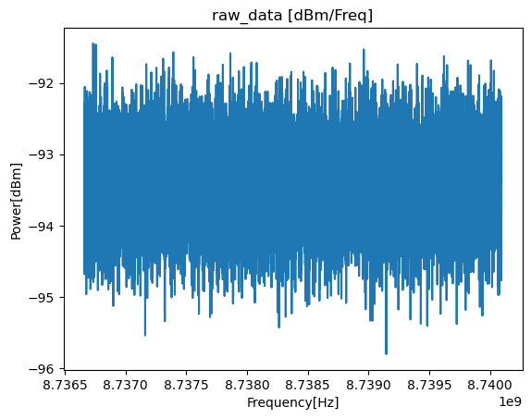
Data taking & Analysis
Data taking:
・Data was taken on July 24th, July 30th, and Aug 1st in 2024.
・About 1600 Spectra is totally taken.
・one Measurement of data-taking 1 spectrum took 1 min.
A sample of raw data
Data selection and filters:
・Exclude data in which cavity’s line shape collapsed
・2-order Savitzky-Golay filter
・Maxwell-Boltzmann filter
judged by β, Q, χ²
All filtered spectra are finally combined.
Notes:
Before talking the results of this study, I have to talk about data taking and analysis.
Data-taking has been done during three days in 2024.
about 16 thousand spectra was taken.
・1 spectra took 1min.
Data selection and filter is as below:
exclude poor lineshape data
2orderS-G filter
Maxwell boltzmann filter
Then finally all spectra are combined

Slide 22
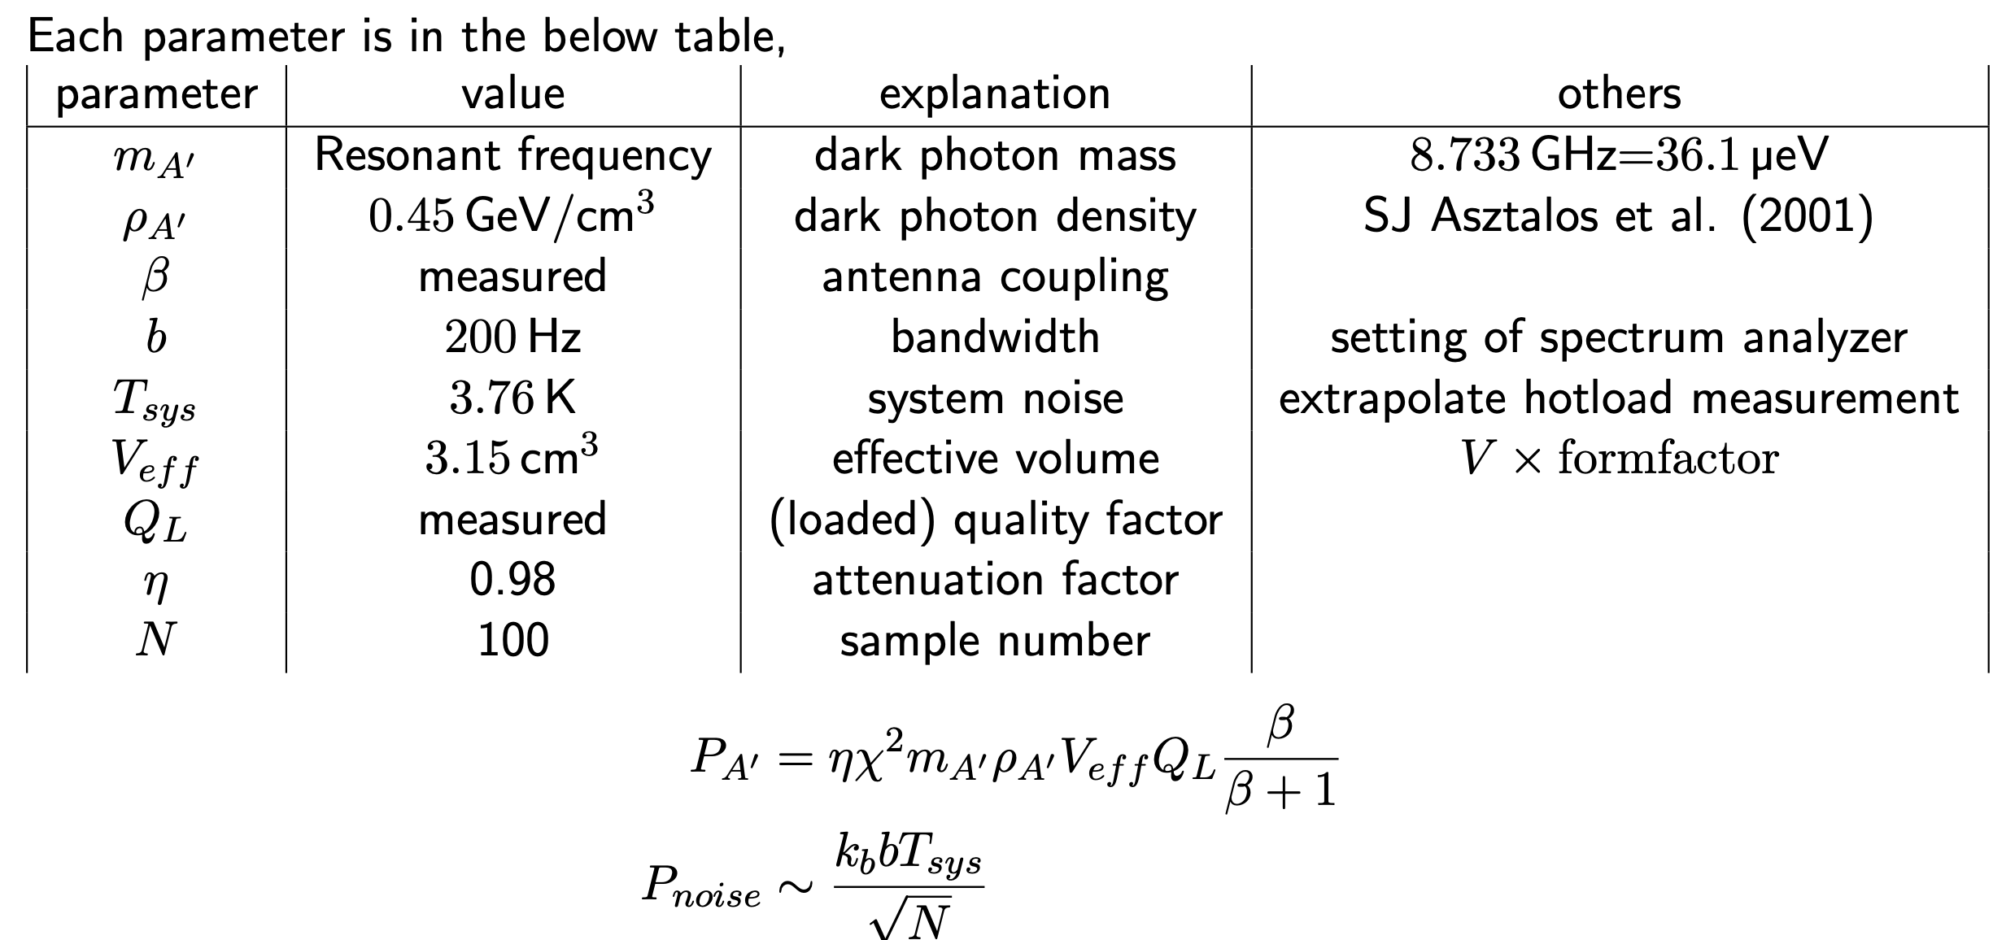
The Parameters in this experiment
The parameters of our setup
Notes:
they are the parameters in our setup

Slide 23
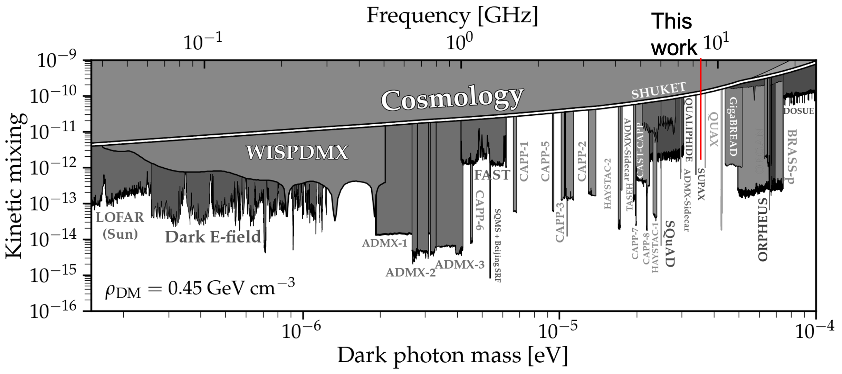
Results
90% exclusion limit of kinetic mixing χ
No significant excess
Preliminary
Notes:
this is our results in this experiment.
the red line is our exclusion limit of chi_p.olarlised

Slide 24
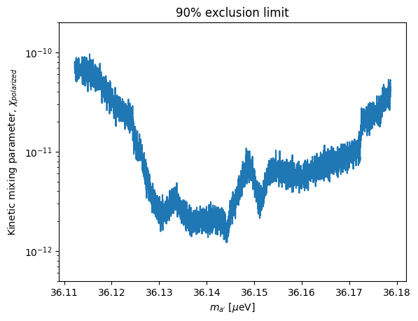
Results
90% exclusion limit of kinetic mixing χ
No statistical significance
Preliminary
Preliminary
χ_{polarized}~10⁻¹²
Notes:
the detailed is in this figure. chi is reach to 10 to -12.
the scan range is about 10MHz.

Slide 25
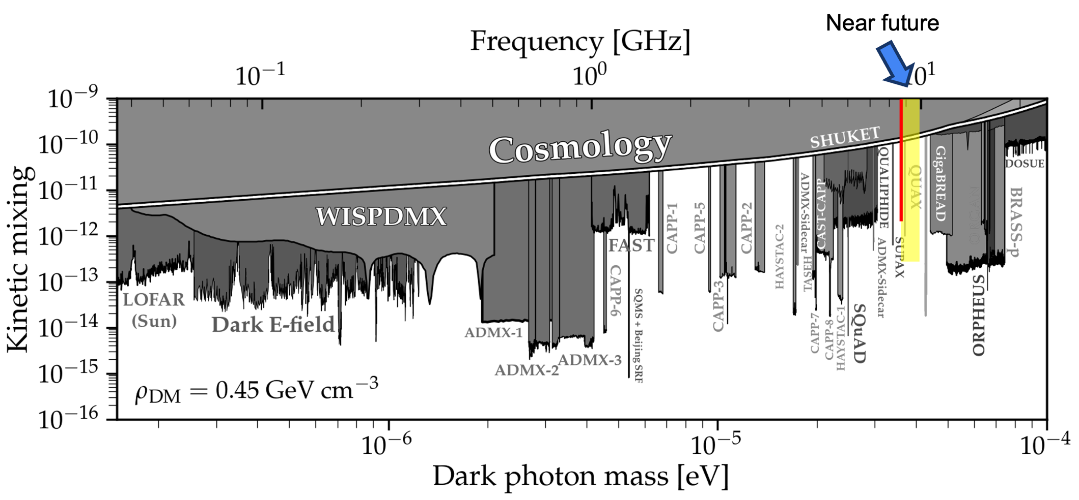
Future prospect
Expand search regime (sensitivity, wide scan range)
Sensitivity→ high Q cavity (now: Cu cavity, Q=10^4), low system noise
scan range→ high Q, strongly coupled qubit
Now trying
Both cavity and qubit (Long lifetime)
e.g.)Change islands distance d...(shift~1GHz)
Notes:
in the last of the presentation I will talk about the future experiments.
to be honest, we can improve this experiment in terms of both of sensitivity and scan frequency range.
the previous study shows that cavity's frequency shift was measured at maximum 1GHz with so strongly coupled qubit.
This is the near future scan range below the figure.
in the future study, it is interesting to combine with qubit measurement. first, single photon counting, of course, we can use it for direct excitation enhancement .(related poster is made by Karin Watanabe)
Too further study, It can be use for Axion detection. It still has some gaps to introduce strong B field, but it is very interesting.

Slide 26
Future prospect
Expand search regime (sensitivity, wide scan range)
Sensitivity→ high Q cavity (now: Cu cavity, Q=10^4), low system noise
scan range→ high Q, strongly coupled qubit
Now trying
Both cavity and qubit (Long lifetime)
e.g.)Change islands distance d...(shift~1GHz)
Combine with a qubit measurement
Single photon counting
Direct excitation enhancement (related poster by Karin Watanabe)
For Axion detection (to introduce strong B field)
Notes:
in the last of the presentation I will talk about the future experiments.
to be honest, we can improve this experiment in terms of both of sensitivity and scan frequency range.
the previous study shows that cavity's frequency shift was measured at maximum 1GHz with so strongly coupled qubit.
in the future study, it is interesting to combine with qubit measurement. first, single photon counting, of course, we can use it for direct excitation enhancement .(related poster is made by Karin Watanabe)
Too further study, It can be use for Axion detection. It still has some gaps to introduce strong B field, but it is very interesting.

Slide 27
Thank you for your attention!

Slide 28
APPENDIX

Slide 29
How to calculate the 90% exclusion limit

Slide 30
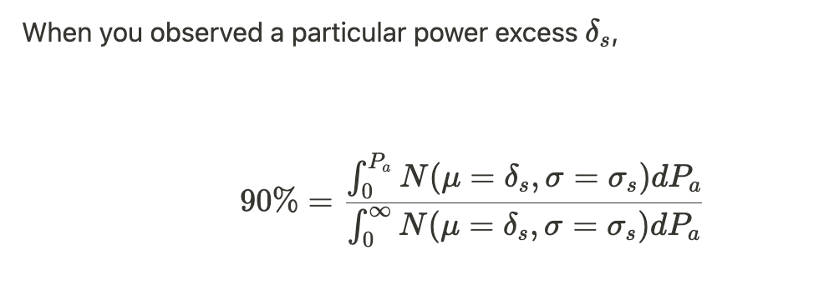
Truncated gaussian distribution
P>0 is imposed on Dark photon signal power
P_{a}...Dark matter signal power

Slide 31
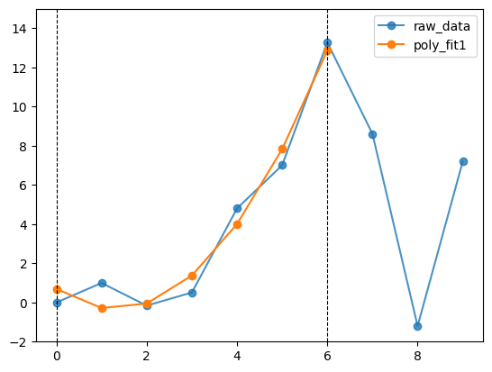
Savitzky-Golay filter 1/4
A kind of moving average to ignore sharp peaks and smooth the signal.
Set window.
Approximate n-order polynomial equation
Pick up the center point of the fit curve
e.g.) When you set window=7, you should pickup 4th point of the curve.
Window
↑ 2nd order approximation

Slide 32
Savitzky-Golay filter 2/4
A kind of moving average to ignore sharp peaks and smooth the signal.
Set window.
Approximate n-order polynomial equation
Pick up the center point of the fit curve
e.g.) When you set window=7, you should pickup 4th point of the curve.
Window
pick up
↑ 2nd order approximation

Slide 33
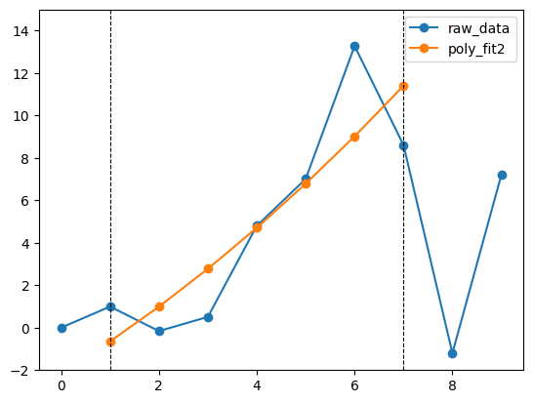
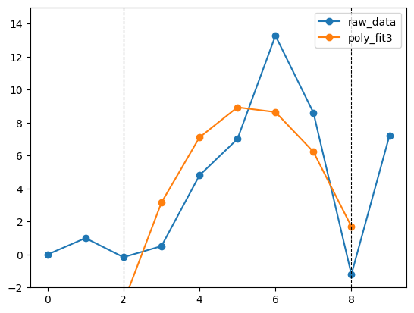
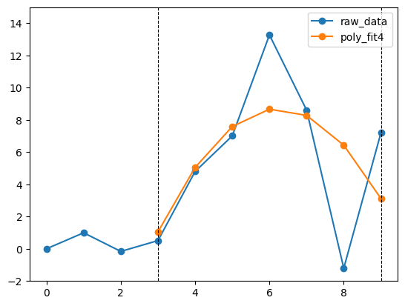
Savitzky-Golay filter 3/4
Then you move the window in parallel, fit, and pick up each center point...
window moving
pick up
window moving
pick up
pick up

Slide 34
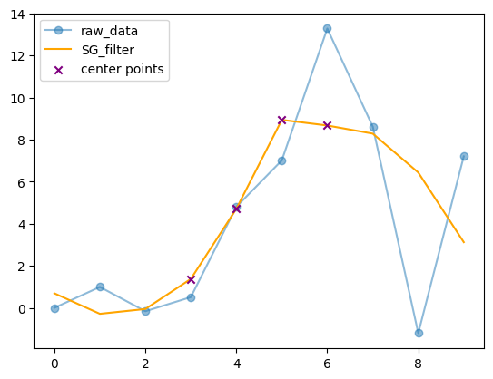
Savitzky-Golay filter 4/4
Finally, the picked-up center points are filtered spectrum.

Slide 35
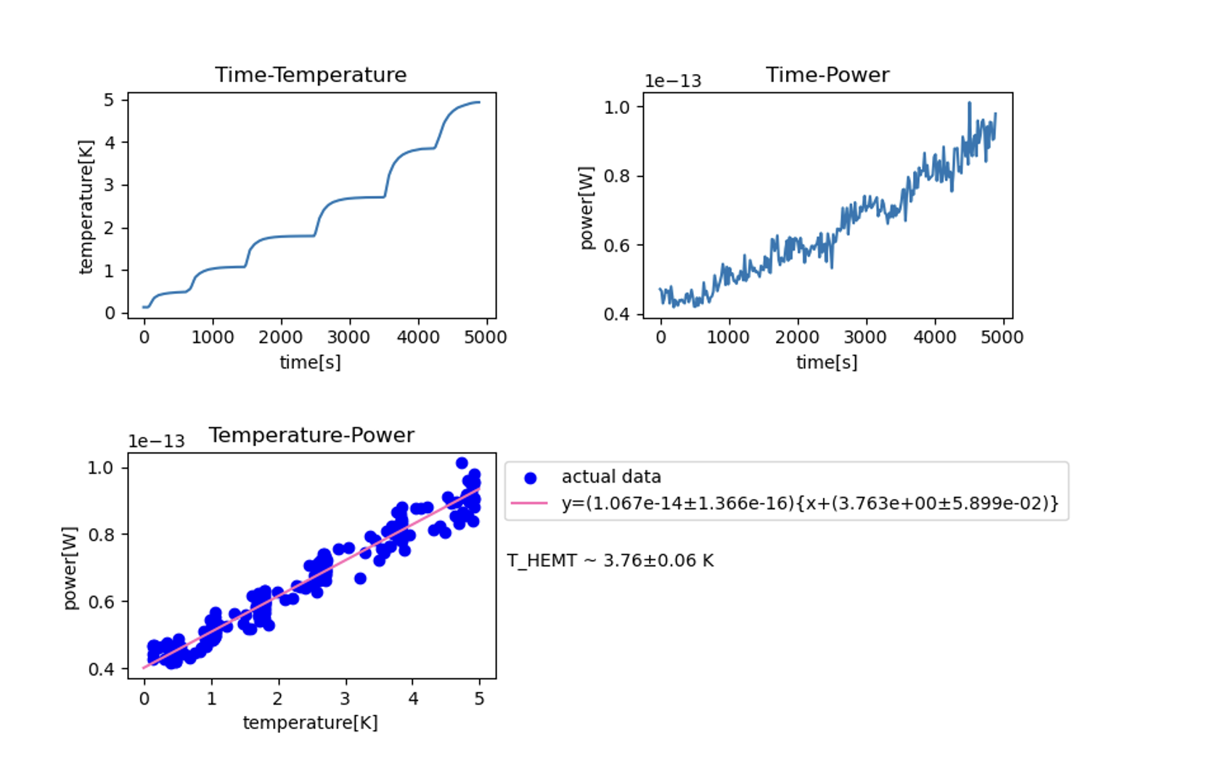
Tsys estimation

