Slide 1



Search for axion quark nugget at CAPP
09/18/2024
Jinsu Kim and CAPP-AQN team
IBS-CAPP

Slide 2
Table of Contents
Axion Quark Nugget
Haloscope experiment
Data processing
Summary

Slide 3
Axion quark nugget

Slide 4
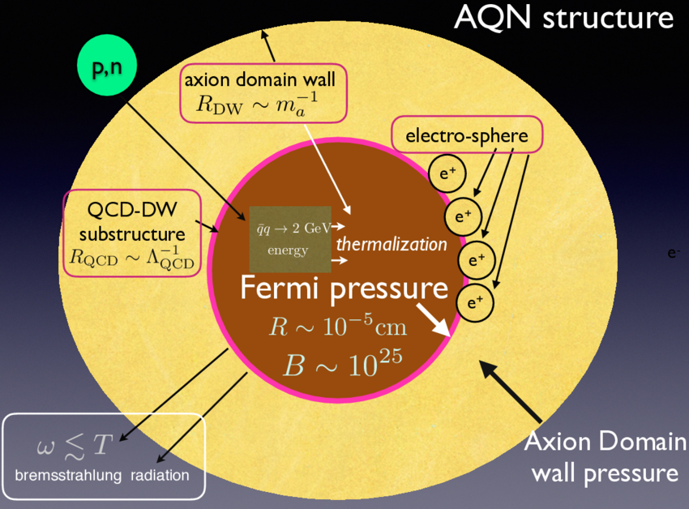
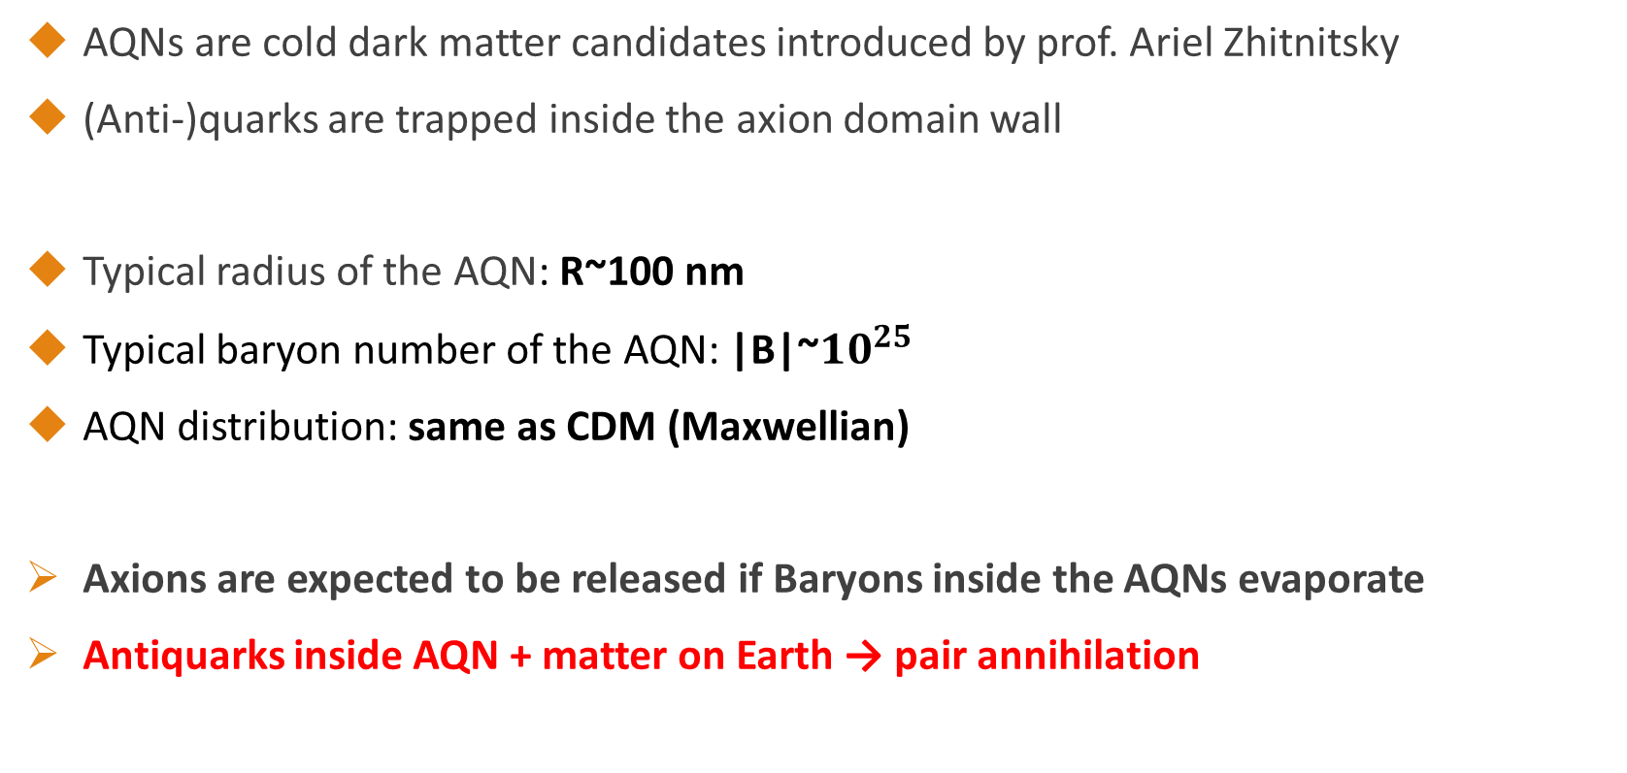
Axion quark nuggets
AQNs are cold dark matter candidates introduced by prof. Ariel Zhitnitsky
(Anti-)quarks are trapped inside the axion domain wall
Typical radius of the AQN: R~100 nm
Typical baryon number of the AQN: |B|~$10^{25}$
AQN distribution: same as CDM (Maxwellian)
Axions are expected to be released if Baryons inside the AQNs evaporate
Antiquarks inside AQN + matter on Earth → pair annihilation
Zhitnitsky, Ariel. "Structure Formation Paradigm and Axion Quark Nugget dark matter model." arXiv preprint arXiv:2302.00010 (2023).

Slide 5
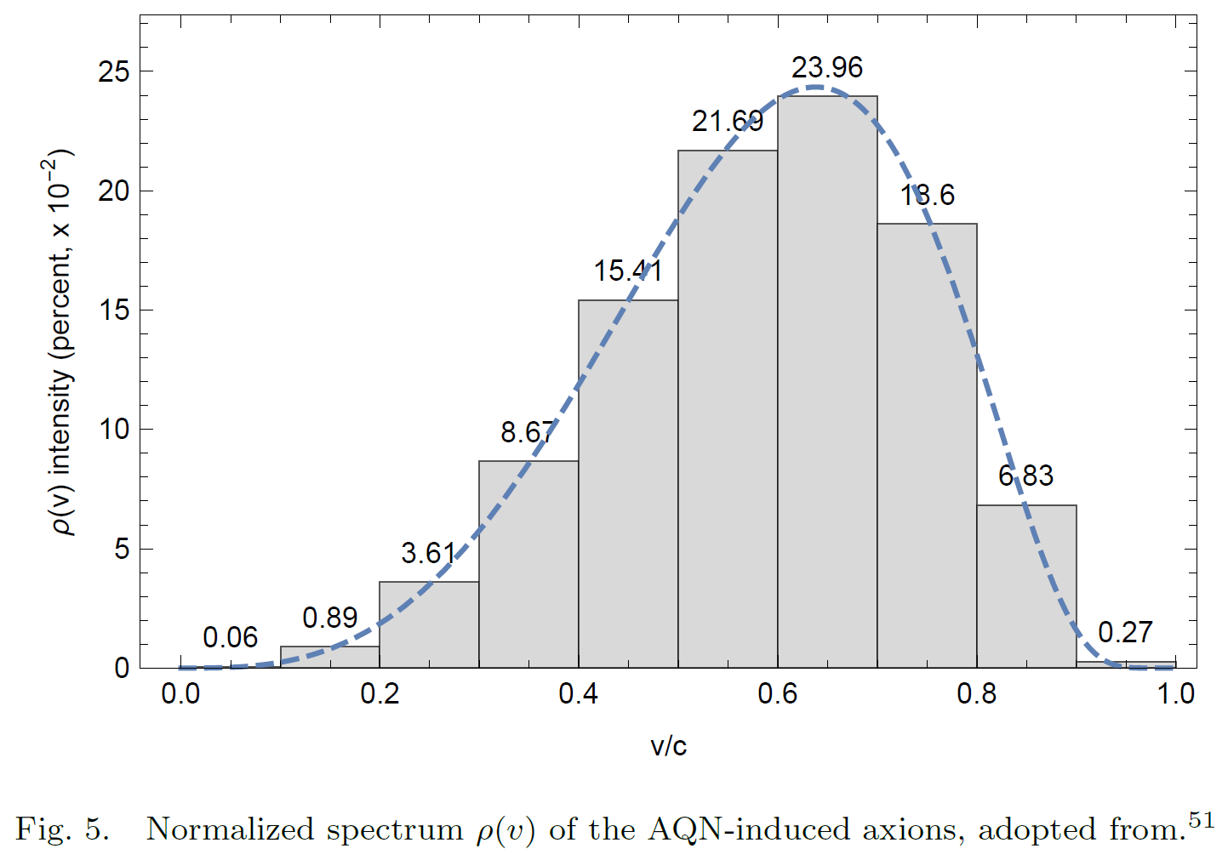
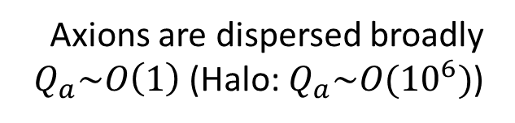
AQN as a broadband axion source
AQN itself should be cold according to the CDM model
However, AQN-induced axions will have different energy distribution
  The potential energy of the AQN structure can be added to axion kinetic energy
Broadband search is possible (ex: 1 ~ 2 GHz can be swept with cavity @ 2 GHz)
Axions are dispersed broadly $Q_{a}\sim O\left(1\right)$ (Halo: $Q_{a}\sim O({10}^{6})$)
Zhitnitsky, Ariel. "Axion quark nuggets. Dark matter and matter–antimatter asymmetry: Theory, observations and future experiments." Modern Physics Letters A 36.18 (2021): 2130017.

Slide 6
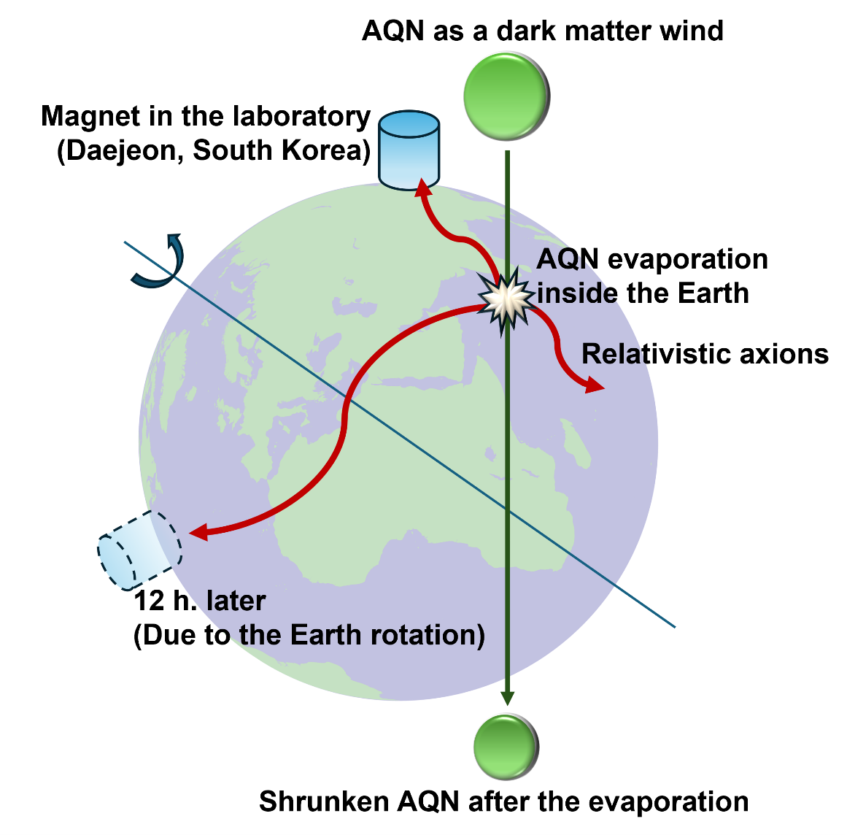

Another difference: Daily modulation
Liang, Xunyu, et al. "Axion quark nugget dark matter: Time modulations and amplifications." Physical Review D 101.4 (2020): 043512.
DM wind (AQN flux) blows in Earth frame
Daily modulation exists due to Earth rotation
South Korea has $δP_{a}≈0.06×P_{a}$
Phase determined (related to the Earth motion)
We can search for the daily-modulating AQN signal
peak-peak amplitude

Slide 7
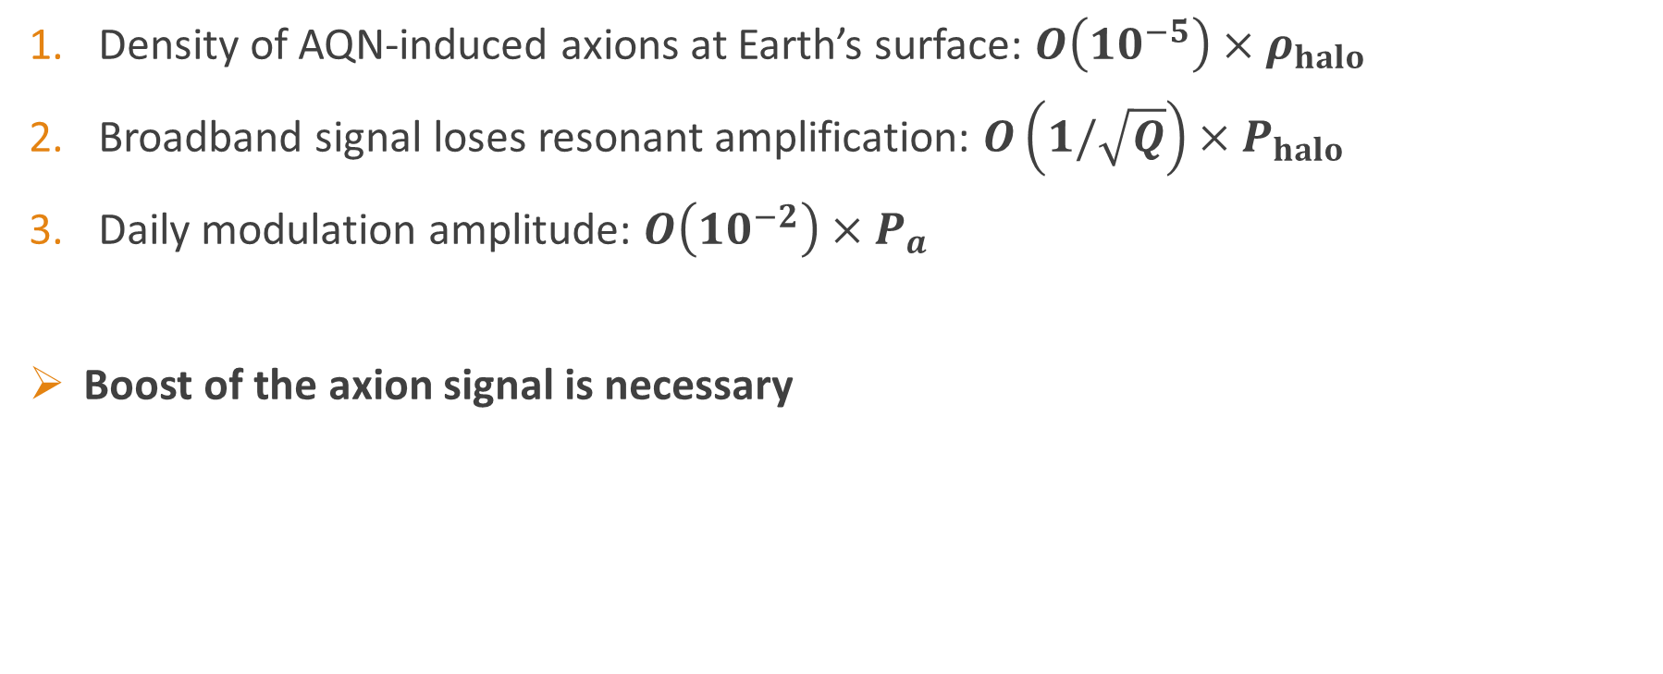
Challenges to AQN experiments
Density of AQN-induced axions at Earth’s surface: $O\left({10}^{−5}\right)×ρ_{halo}$
Broadband signal loses resonant amplification: $O\left(1/\sqrt{Q}\right)×P_{halo}$
Daily modulation amplitude: $O\left({10}^{−2}\right)×P_{a}$
Boost of the axion signal is necessary

Slide 8
Haloscope experiment

Slide 9
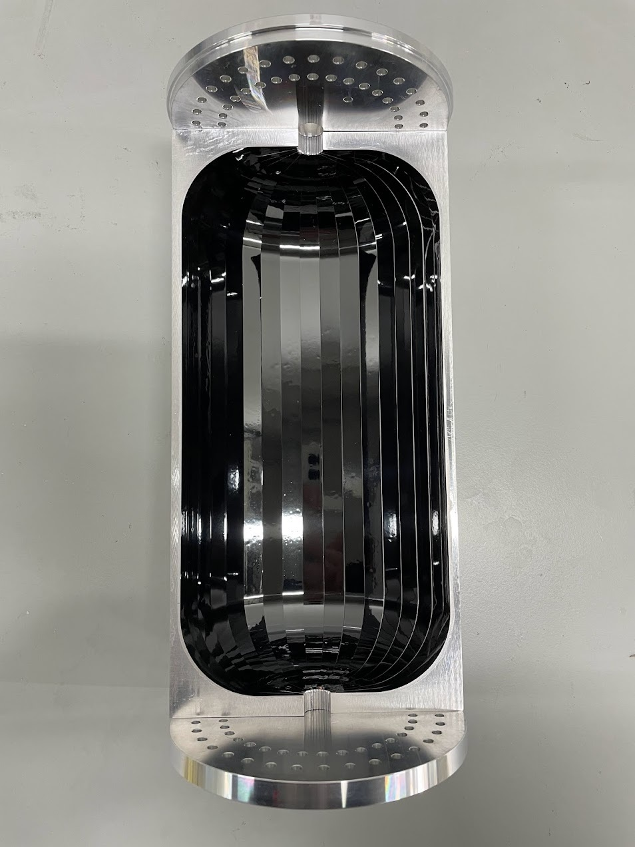
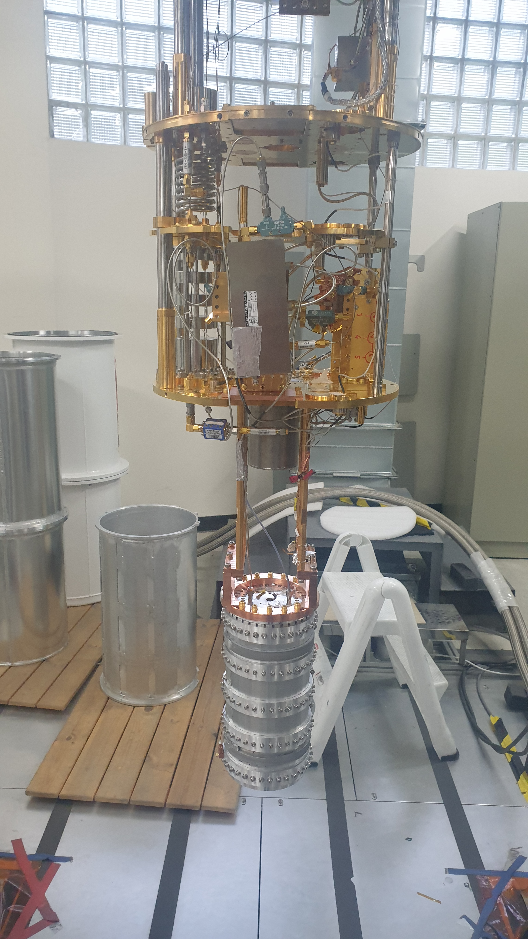
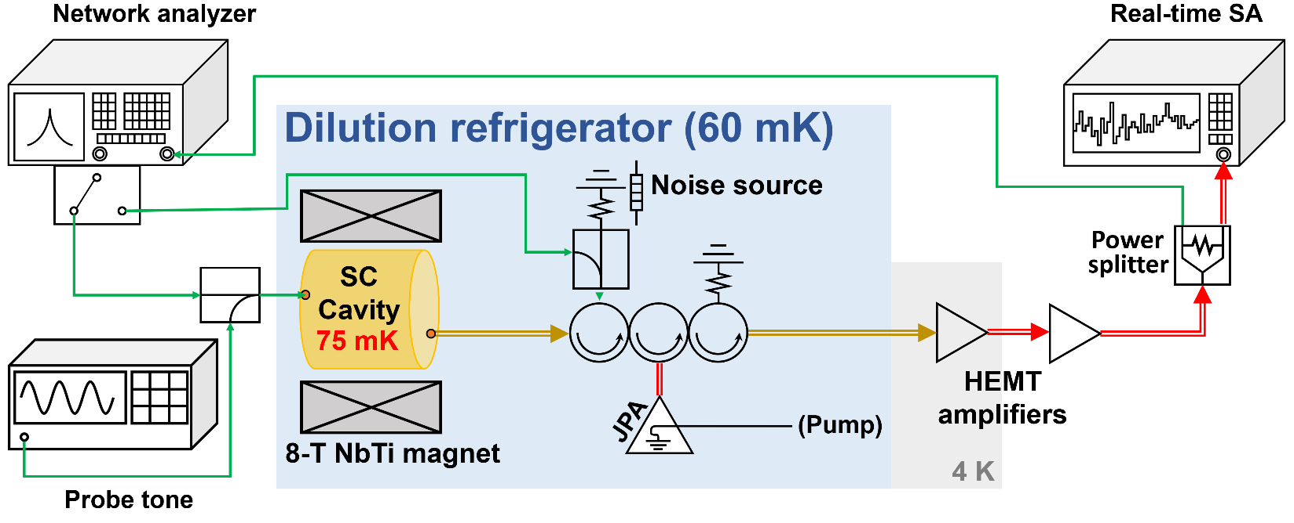

Experimental setup
SC cavity installed ($Q_{0}∼1.5×{10}^{6}$)
  $R≈50$ mm, $H≈200$ mm → 1.66 L
JPA installed: $T_{sys}\sim 240$ mK (2.2 SQL)
Kim, Jinsu, et al. "Near-quantum-noise axion dark matter search at CAPP around 9.5 μ eV." Physical Review Letters 130.9 (2023): 091602.

Slide 10
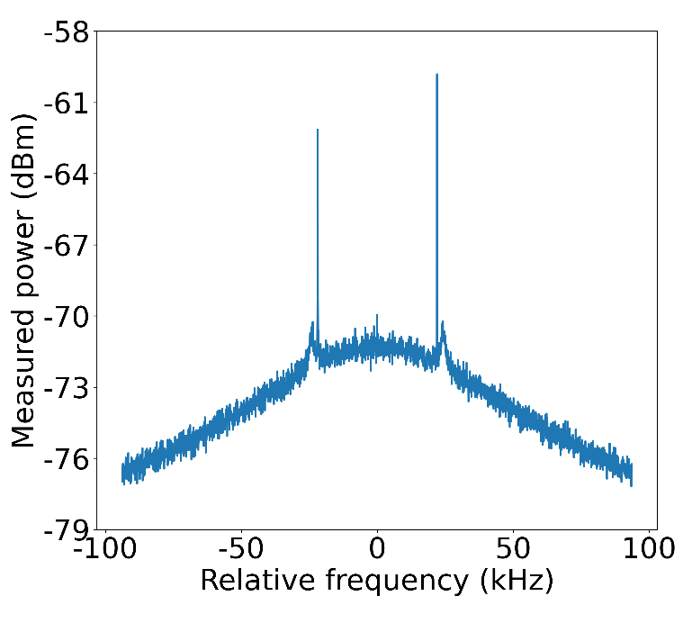
Experimental parameters
Data collected: June 8th ~ July 11th , 2023
  Digitizer used: 62.5 Hz resolution bandwidth
  Several maintenances in between to stabilize the JPA → 10.5 days of real DAQ
Frequency | Loaded Q | Coupling | Volume | B-field | MXC | Cavity | JPA gain | Tsys average
2.269 GHz | 1,051,000 | 0.43 | 1.66 L | 8 T | 60 mK | 75 mK | 20 dB | 240 mK (2.2 SQL)
Reference
tone
Idler
Hot cavity + Impedance mismatch
Shape of JPA gain
Artifact

Slide 11
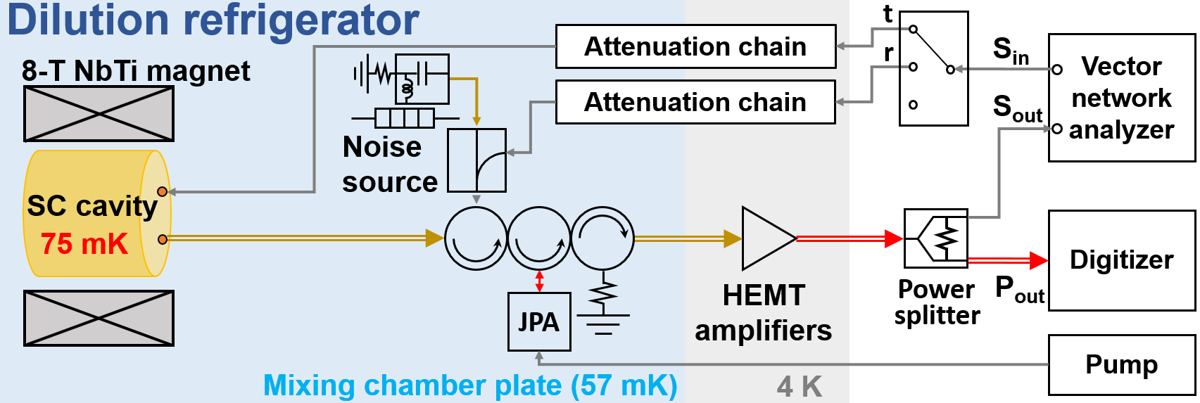
Building a noise model
$$Noise=\left({\left|r\right|}^{2}T_{ns}+{\left|t\right|}^{2}T_{cav}\right)+\left(T_{ns}/A\right)+\left(T_{d.s.}/G_{pre}\right)$$
Noise spectra were reconstructed from the data for calibrating the spectrum
Signal-contained data were NEVER used (T-sensor, VNA, off-resonant power values)
Based on spectrum comparison noise analysis
Kutlu, Çağlar, et al. "Characterization of a flux-driven Josephson parametric amplifier with near quantum-limited added noise for axion search experiments." Superconductor Science and Technology (2021).
$$Total noise=Thermal noise+JPA noise+Downstream noise$$

Slide 12
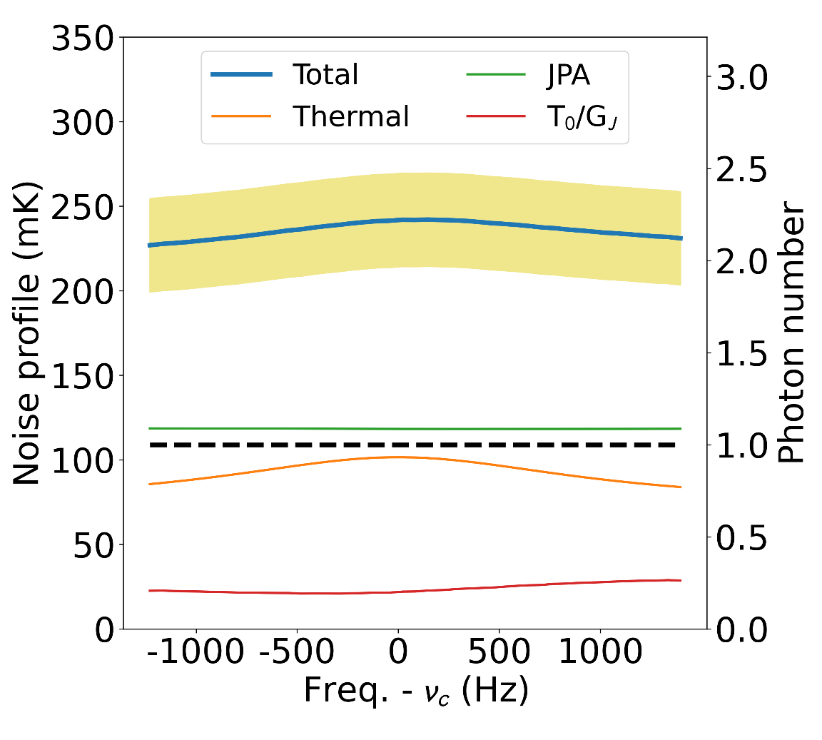

Noise analysis (single spectrum)
Noise spectra were obtained at each power spectrum
$ν_{c}=$ Cavity frequency
JPA: Idler + Cav-to-JPA attenuation
$T_{0}=$ JPA-off Y-factor noise, $G_{J}=$ JPA gain

Slide 13
Data processing

Slide 14
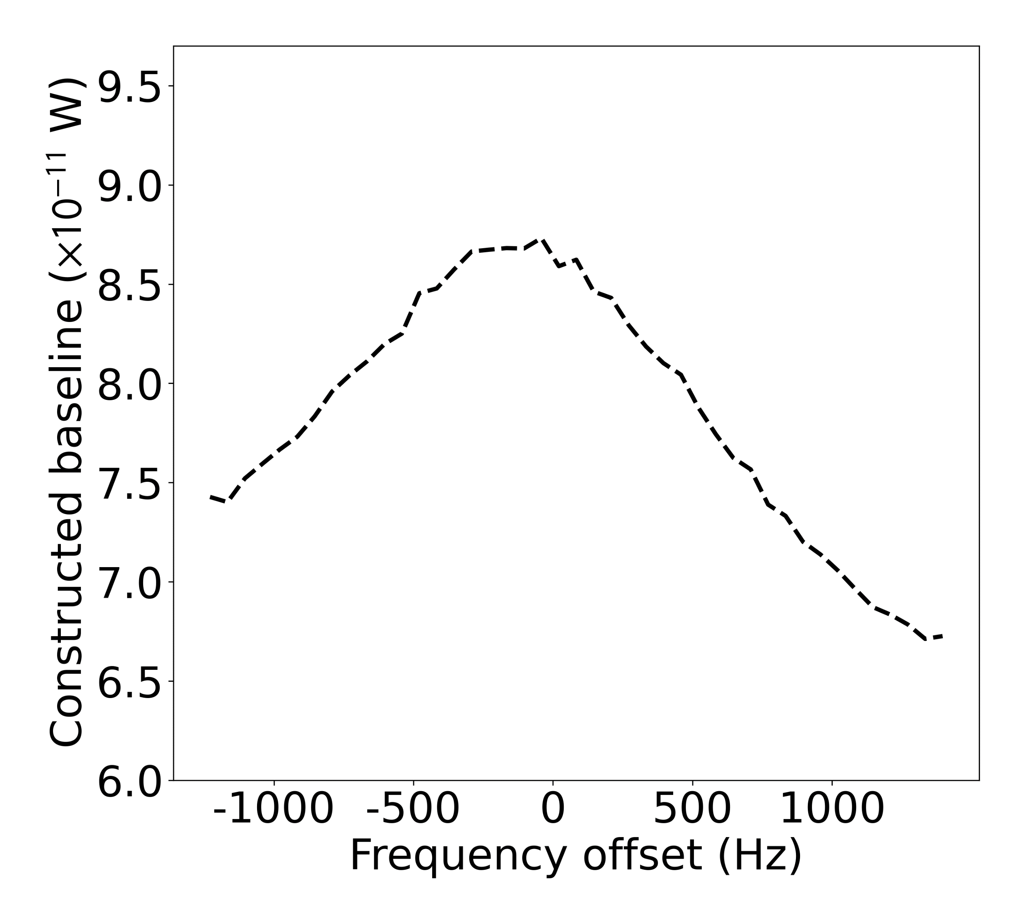
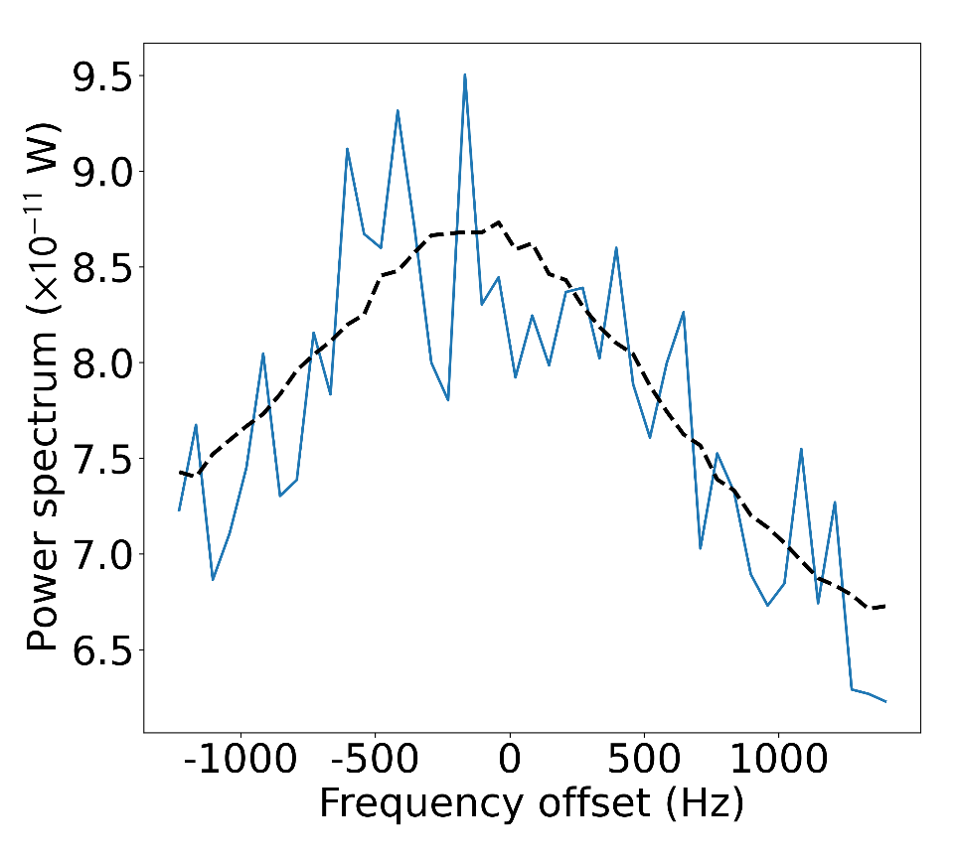
Baseline removal
Baseline = Noise spectrum x Gain spectrum (identified simultaneously)
Received power in this range is NOT USED
→ T-sensor, VNA used
Real data overlapped

Slide 15
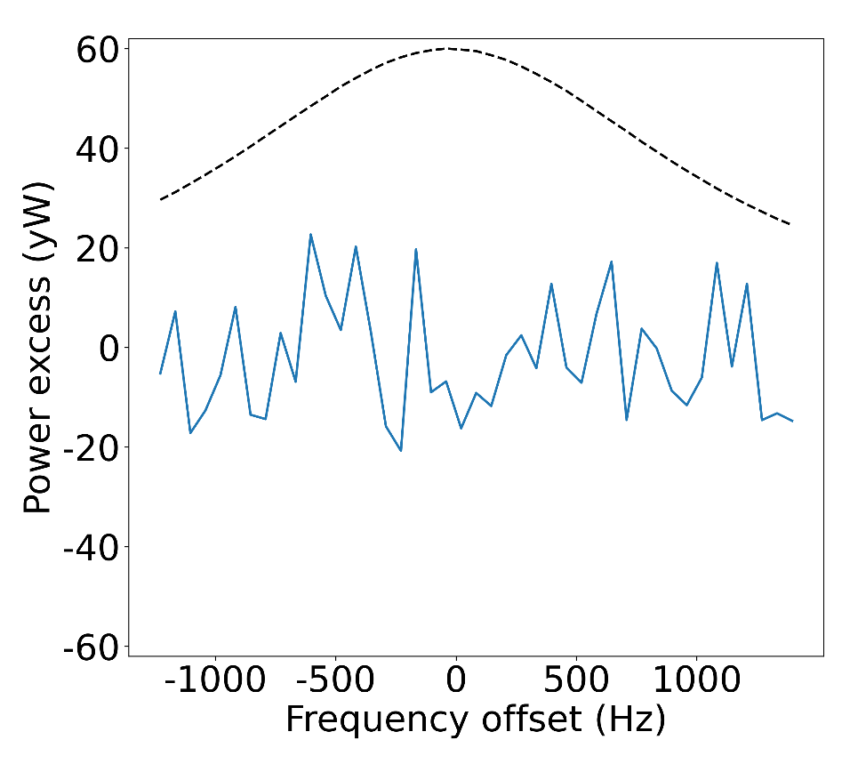
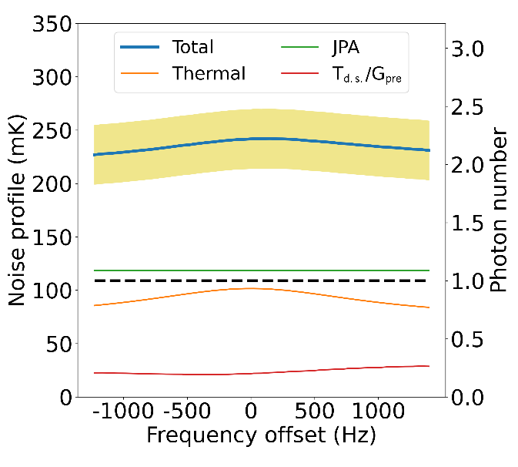




Baseline removal
The reconstructed baselines were used to remove the background envelop
AQN signal shape
$$P_{bs}=\frac{\left(P−B_{a}\right)}{\left(B_{a}/T_{sys}\right)}$$
$$P$$
$$B_{a}$$
$$T_{sys}$$

Slide 16
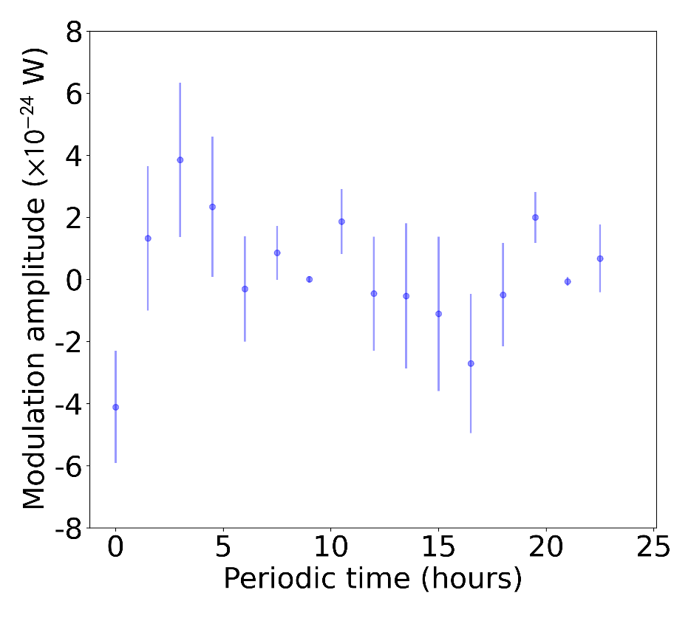
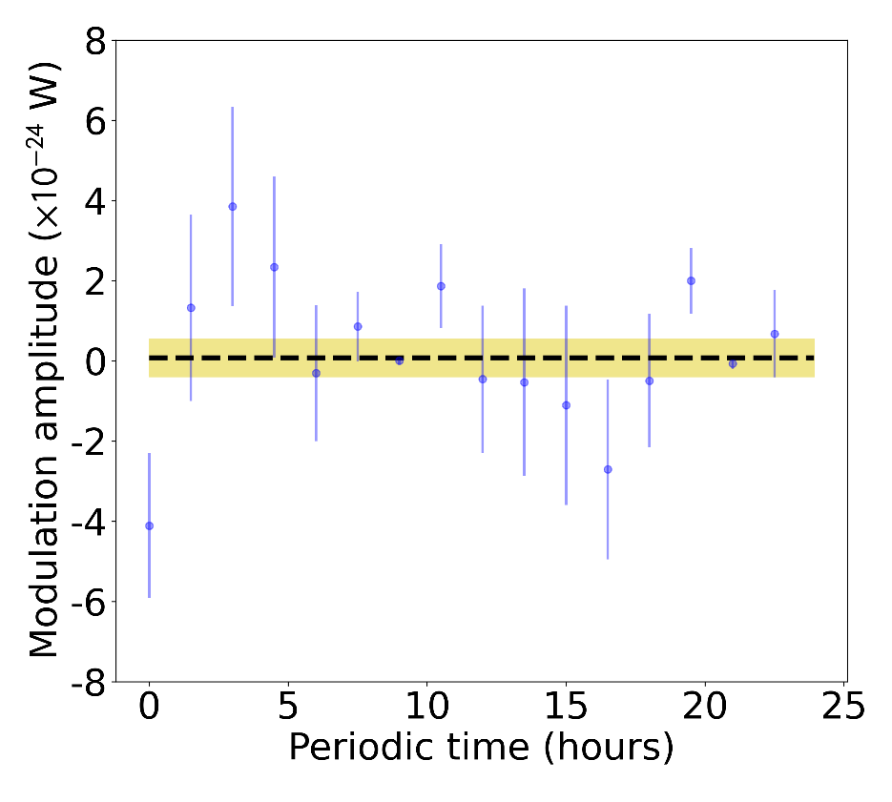
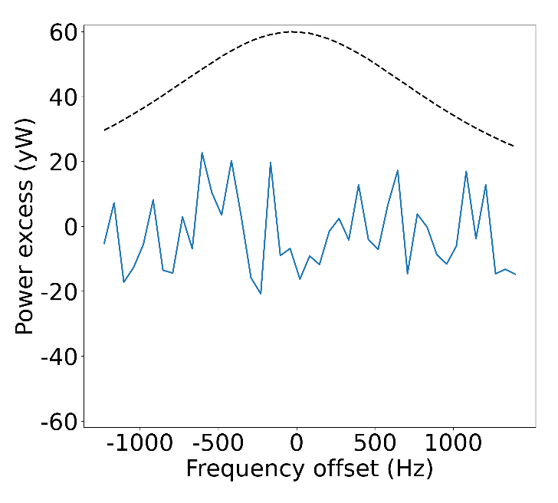
Bin merging & overlapping
Basically, weighted discrete Fourier transform
Merge bins with Lorentzian weight (signal shape) ← Horizontal combination
Power excesses were piled-up and averaged modulo 23:56:04 (sidereal day)
Modulation period & phase are known → Likelihood fitting (black dashed level)
Single-point grand excess
→ Repeat this over time
(10.5 days data)

Slide 17
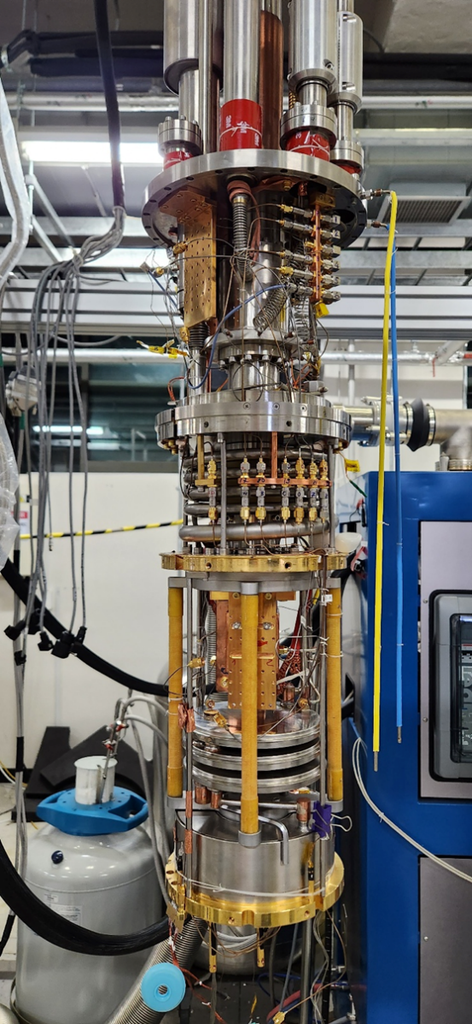
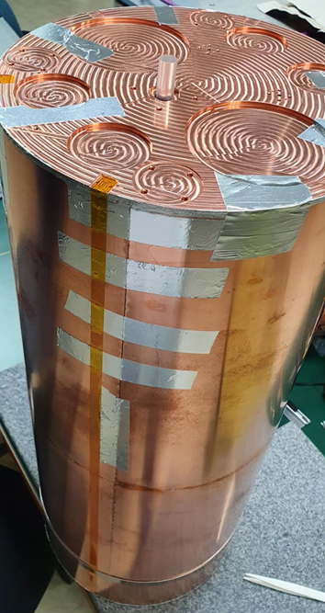
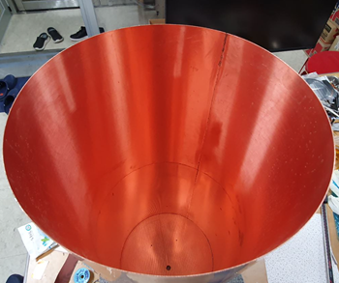
2nd experiment: Ultra-Light Cavity (ULC) run
Ahn, Saebyeok, et al. "Extensive search for axion dark matter over 1 GHz with CAPP’s Main Axion eXperiment." Physical Review X 14.3 (2024): 031023.
Upcoming CAPP-MAX experiment was in preparation
  Large-volume cavity in wet-type dilution refrigerator
  Superconducting cavity
As an intermediate experiment we conducted another AQN experiment using CAPP-MAX system with copper cavity
14:35 Thur. “Advancements in Axion Haloscope Sensitivity: CAPP-MAX with High-Temperature Superconducting Cavities” KWON, Ohjoon

Slide 18
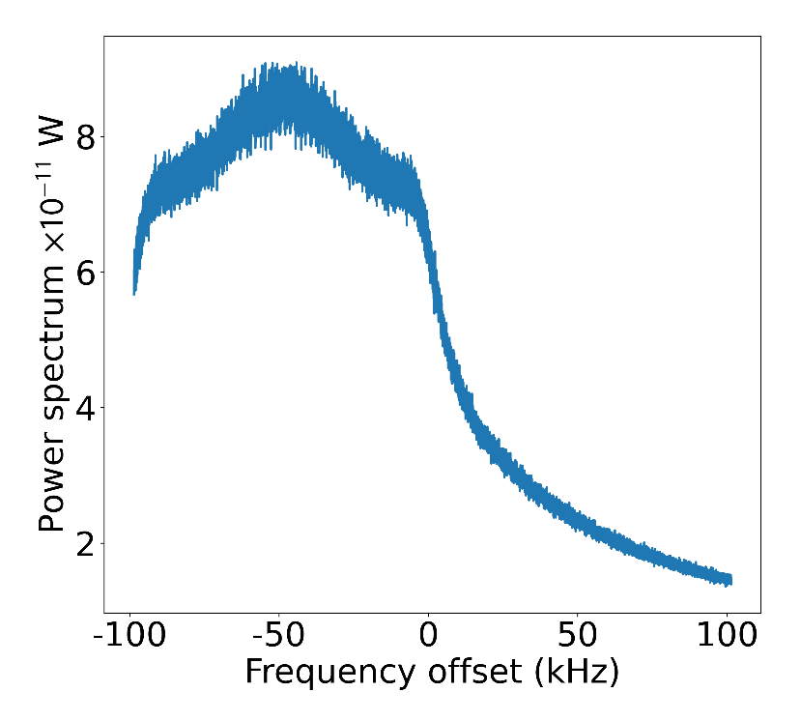
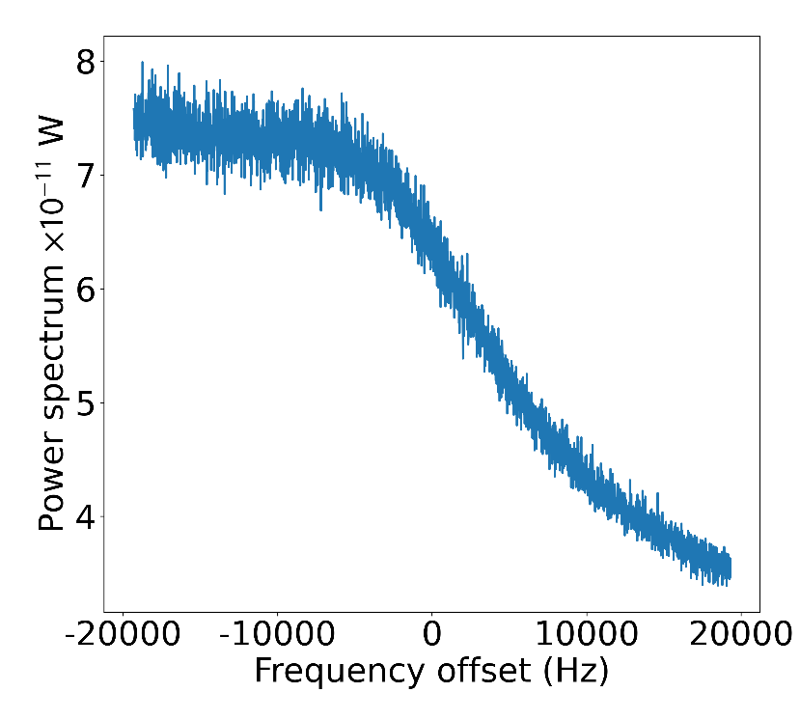
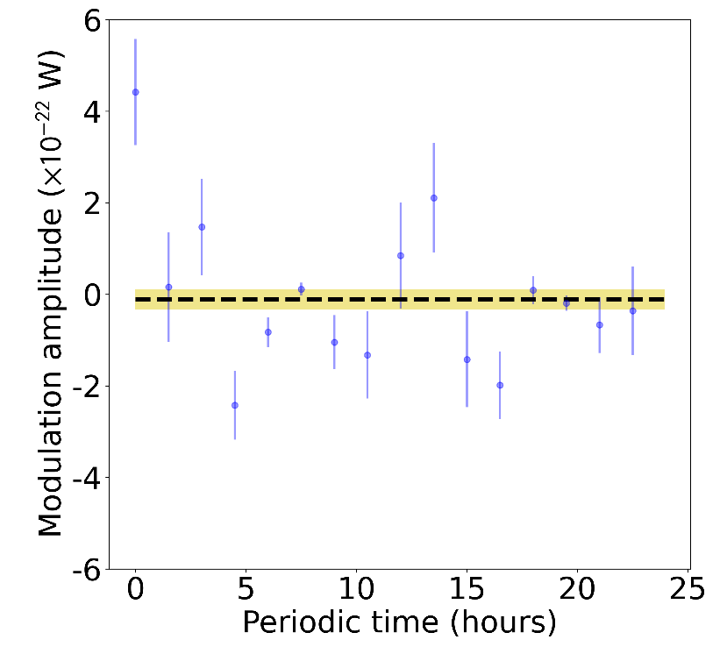
ULC run’s DAQ & analysis
Most of the processes were like the superconducting cavity (SCC) run
Data collected: May 30th ~ June 11th (6.2 days of real DAQ)
Frequency | Loaded Q | Coupling | Volume | B-field | MXC | Cavity | JPA gain | Tsys average
1.036 GHz | 58,500 | 1.0 | 37 L | 12 T | 30 mK | 27 mK | 20 dB | 230 mK (4.6 SQL)
Hot cavity + Impedance mismatch
Dominantly from the unrelated frequency components
Mostly the JPA gain shape

Slide 19
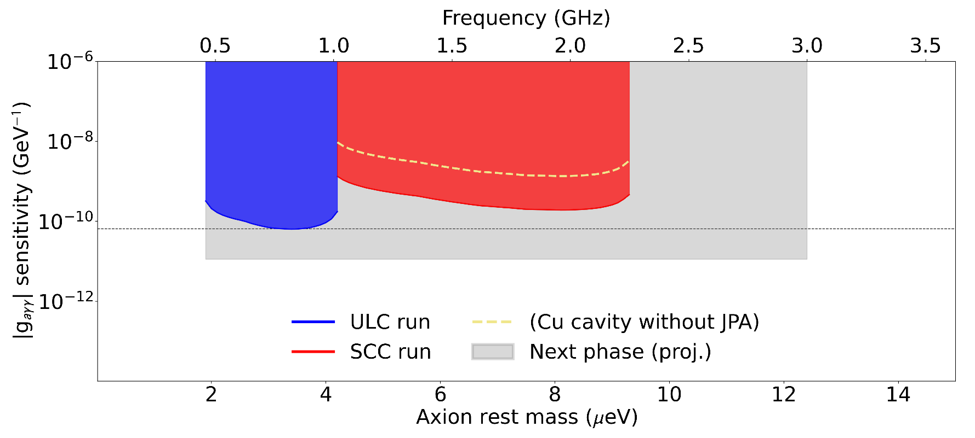

Parameter exclusion
Using the fitted modulation amplitude and its error, $(g_{aγγ},m_{a})$ sets that predict strong amplitudes are excluded with 95% confident level
x50 difference in SNR
Preliminary
CAST (2017)
COMBINED technology

Slide 20
Summary

Slide 21
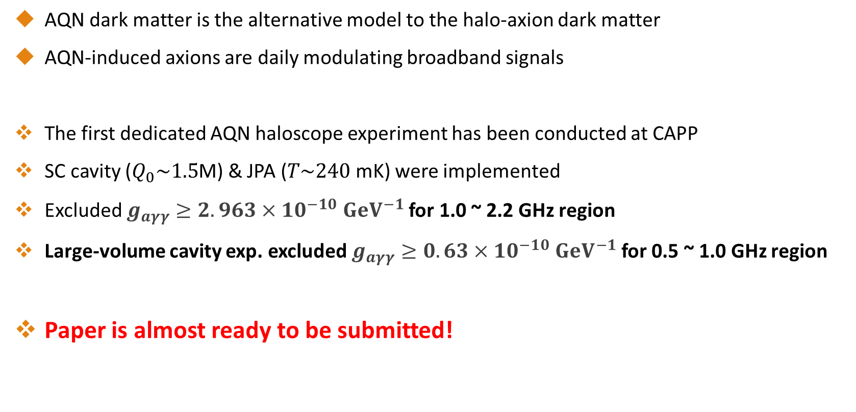
Summary
AQN dark matter is the alternative model to the halo-axion dark matter
AQN-induced axions are daily modulating broadband signals
The first dedicated AQN haloscope experiment has been conducted at CAPP
SC cavity ($Q_{0}\sim 1.5$M) & JPA ($T\sim 240$ mK) were implemented
Excluded $g_{aγγ}≥2.963×{10}^{−10}$ $GeV^{−1}$ for 1.0 ~ 2.2 GHz region
Large-volume cavity exp. excluded $g_{aγγ}≥0.63×{10}^{−10}$ $GeV^{−1}$ for 0.5 ~ 1.0 GHz region
Paper is almost ready to be submitted!
Thank you for your attention!

