Slide 1
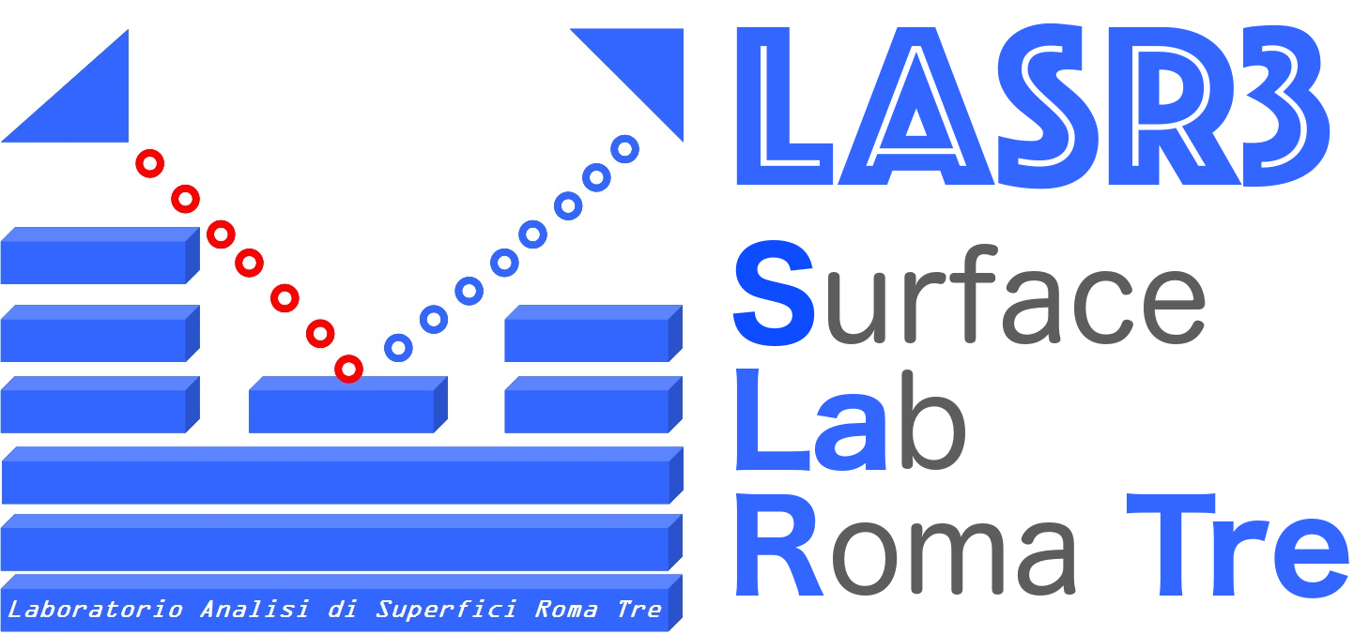

LASR3 for MU-COL
Luca Tortora
LASR3 Surface Laboratory Roma Tre
Department of Sciences Roma Tre University
National Institute for Nuclear Physics-Roma Tre

Slide 2
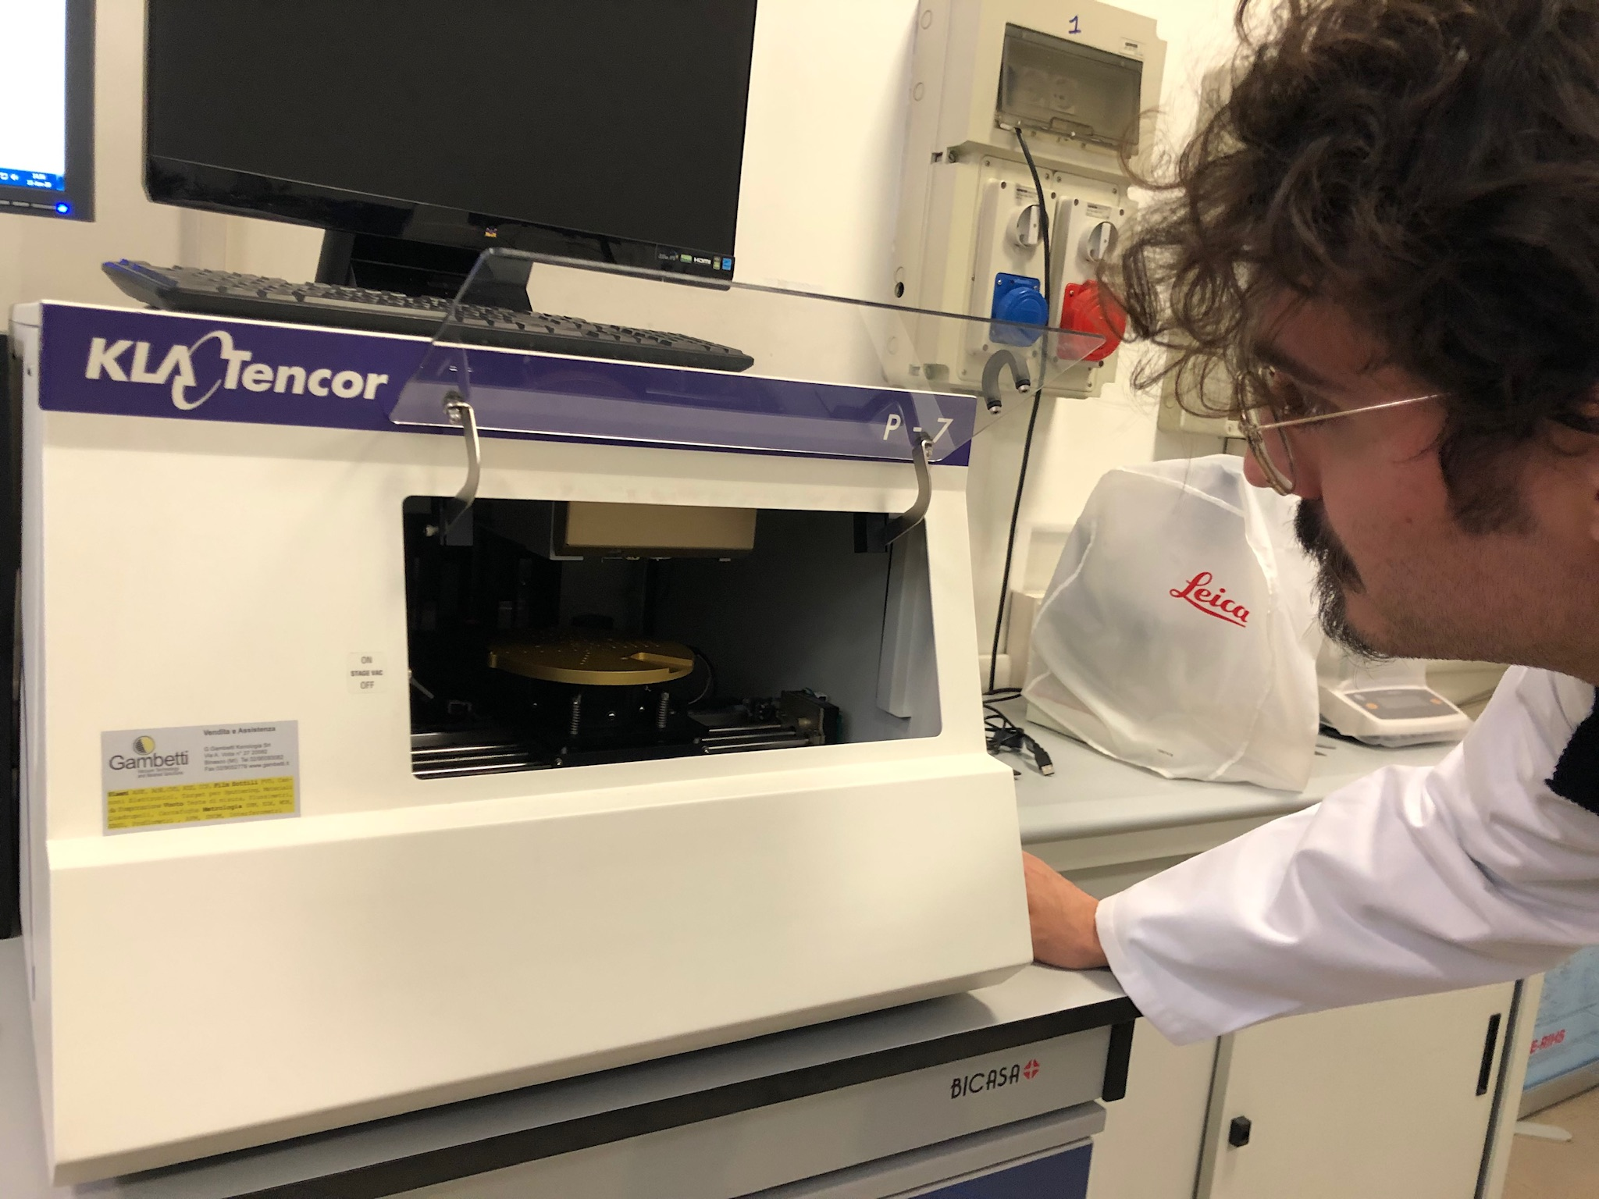
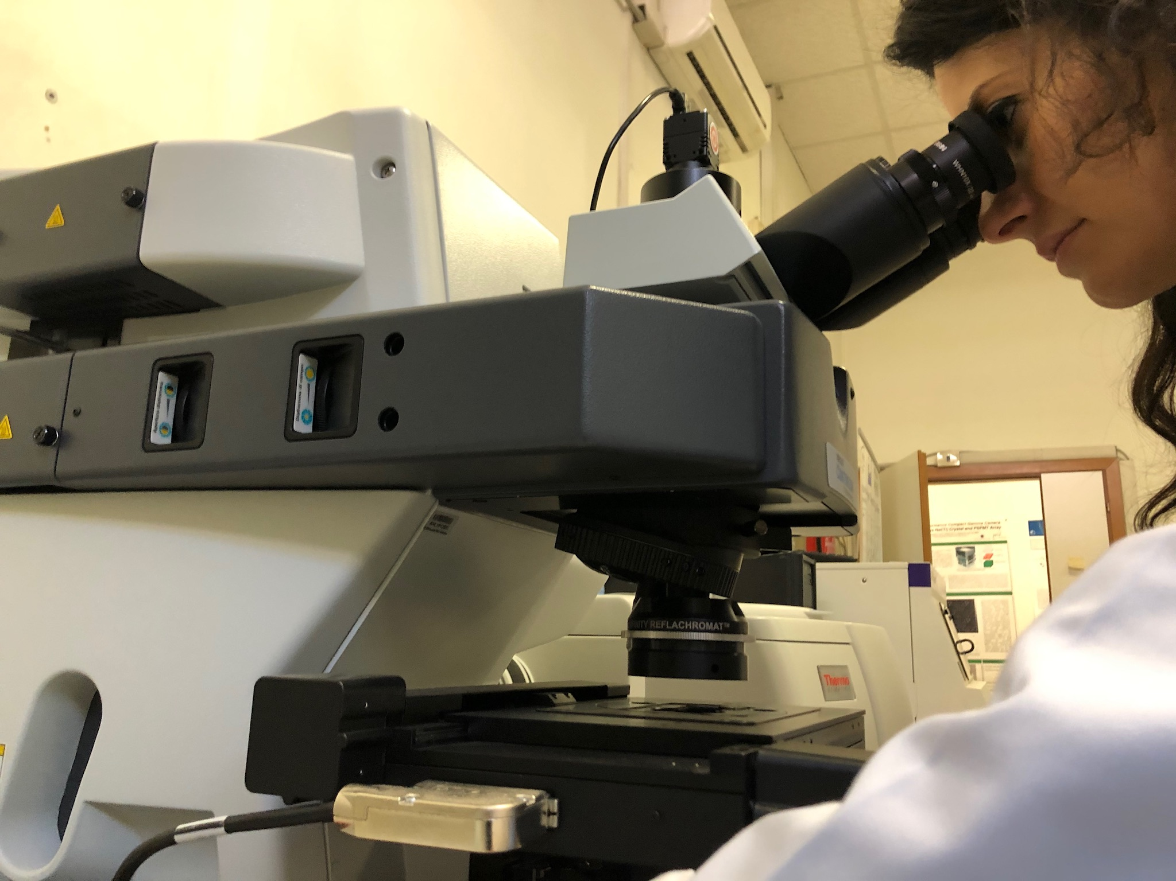
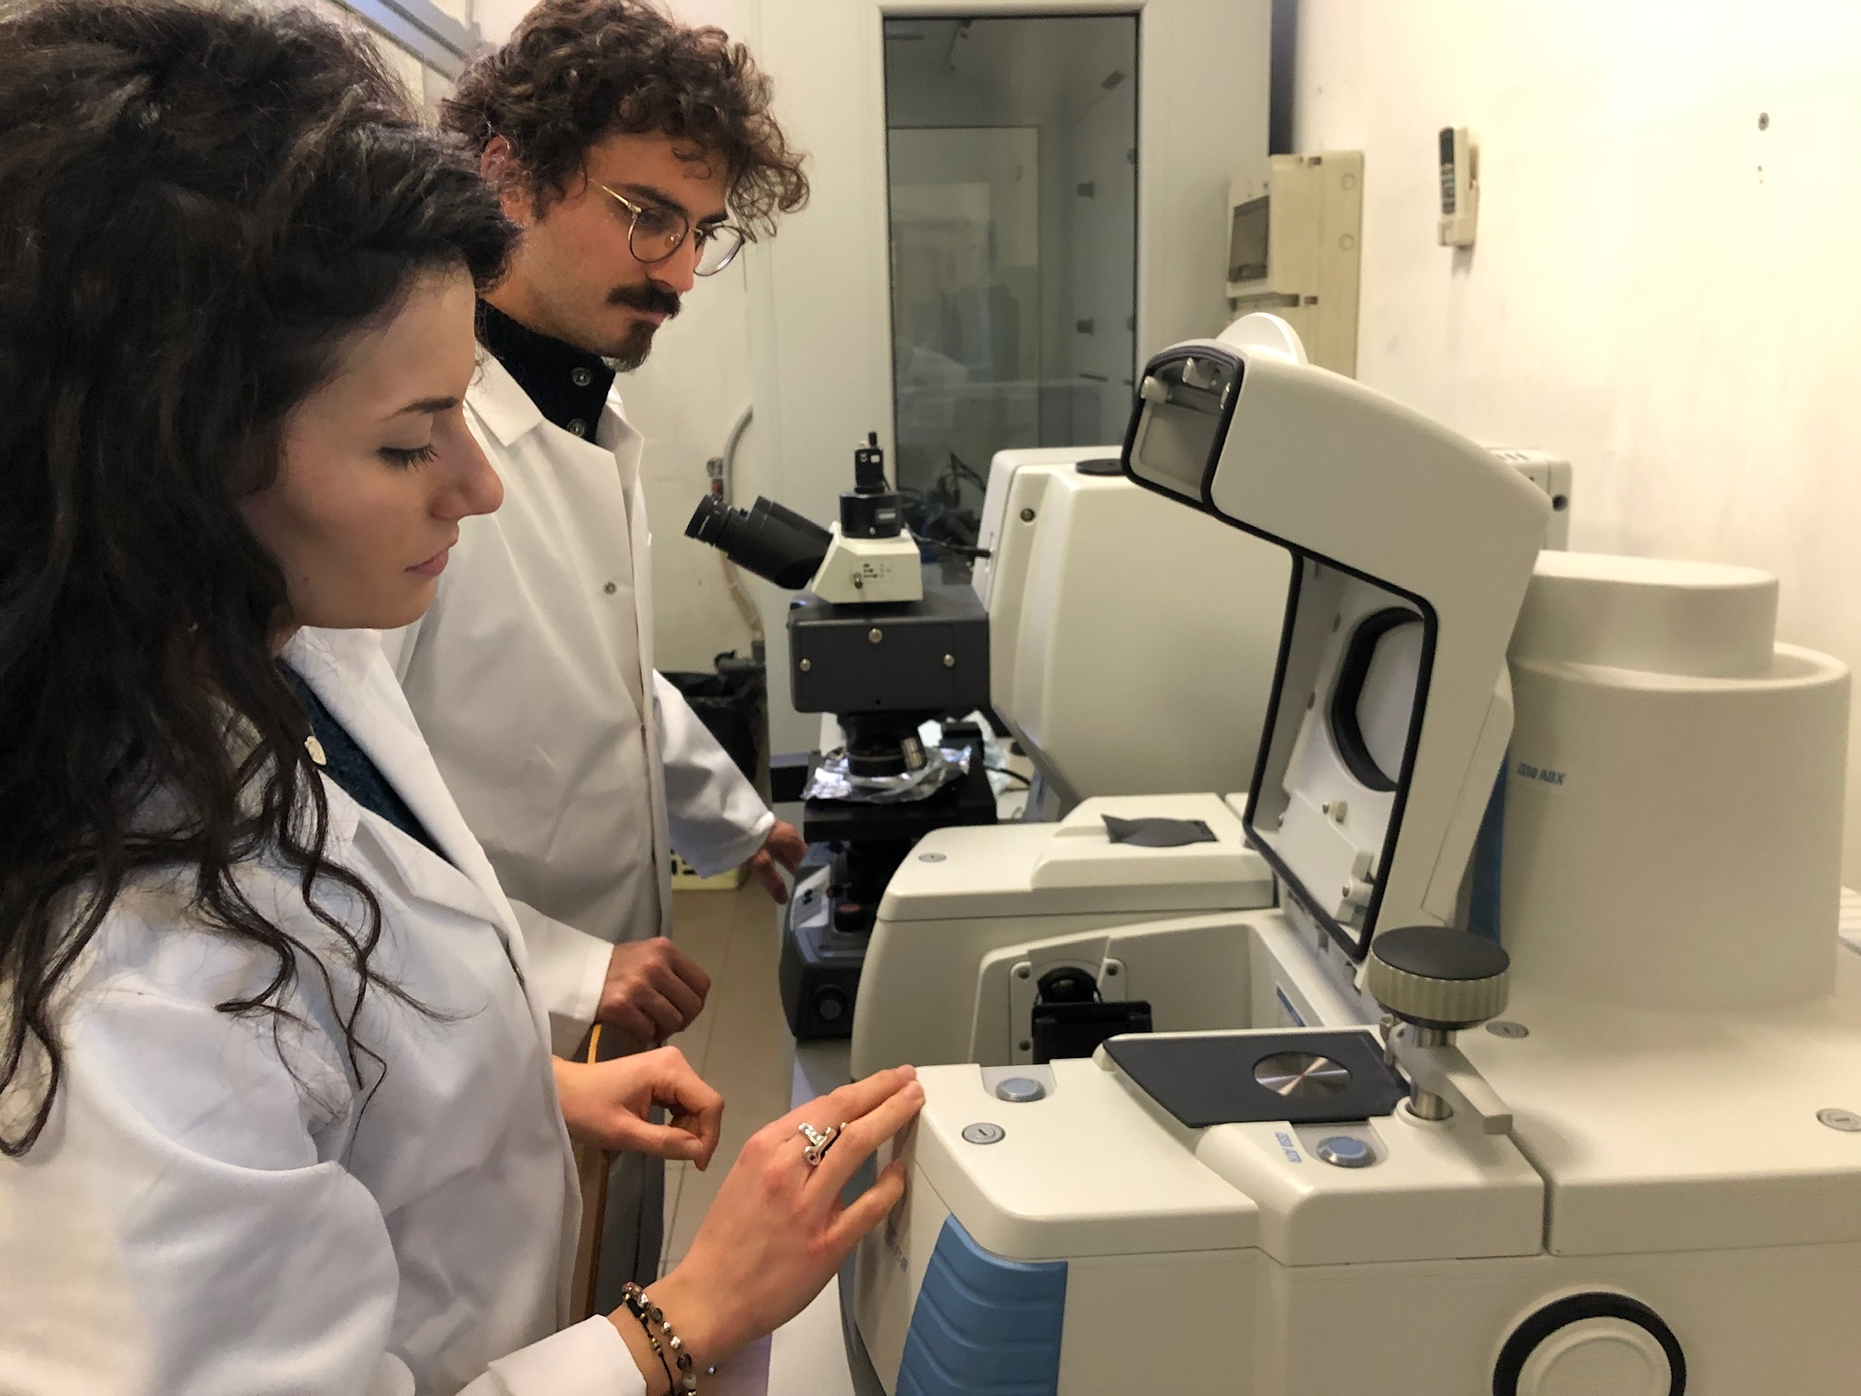
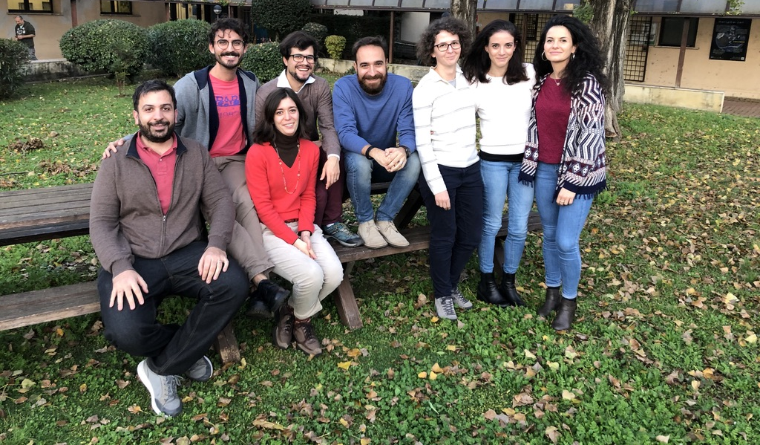
People at LASR3
Luca Tortora (Chemist)
Hussam Boumlaat (Theoriretical Physics)
Elisabetta Colantoni(Solid state Physics)
Eleonora Marconi (Material Science)
Valerio Graziani (Material Science)
Agnese De Carlo(Physicist)
Nadia Ismail (Material Science)
Payel Aich (Physicist)
Ajahr Jabkiro (Material Science)

Slide 3
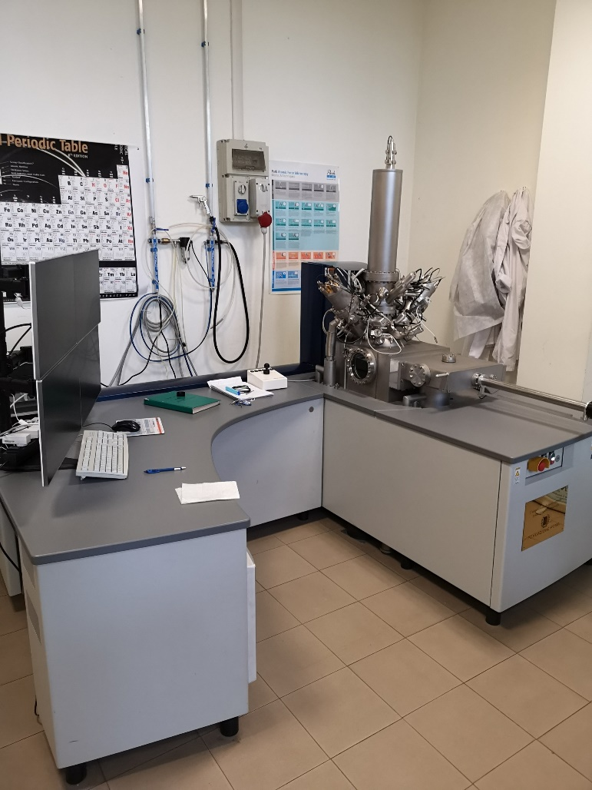
Instruments at LASR3
Low-energy ion beam analysis (ToF-SIMS)
Gun 1: Bi⁺ 30keV
Gun 2: Cs⁺ 0.2-11 keV
Gun 3: Electron floodgun (20 V)
Mapping risoluzione laterale < 100 nm
Profiling risoluzione profondita in z < 1 nm)
Spectrometry from 1 a.m.u. to 15000 a.m.u.
Detector ToF

Slide 4
Instruments at LASR3
Materials | Task | Applications
Semiconductors | Failure Analysis | Contamination
Polymers | Quality Control | Adhesion
Paint + Coatings | Development | Friction
Biomaterials | Reverse Engineering | Wettability
Pharmaceuticals | Research | Diffusion
Glass | etc. | Corrosion
Paper |  | Segregation
Metals |  | Cell Chemistry
Ceramics |  | Biocompatibility
etc. |  | etc.

Slide 5
Instruments at LASR3
Customized with aluminum optical coatings Nicolet™ iS50 FTIR Spectrometer, fully-automated multi-spectral range system (15 – 27,000cm-¹).THERMO FISHER
+
iS50 ATR built-in multi-range module with diamond sampling station.
+
Nicolet™ Continuum™ Infrared Microscope

Slide 6
Instruments at LASR3
Recommended for the characterization of micro samples in:
Failure analysis
Product consistency verification
Reverse engineering
Research and development
Measurement of bulk, surface and composite structures in material science applications

Slide 7
Instruments at LASR3
Thermo Scientific™ Evolution™ 350 UV-Vis Spectrophotometer

Slide 8
Instruments at LASR3
FLS1000 Photoluminescence Edinburgh Instruments Spectrometer
STEADY STATE FLUORESCENCE SPECTROMETER WITH SINGLE EXCITATION AND DOUBLE EMISSION MONOCHROMATORS
+
TIME RESOLVED FLUORESCENCE AND PHOSPHORESCENCE UPGRADE

Slide 9
LASR3 for RDMUCOL (LEMMA target)

Slide 10
LASR3 for RDMUCOL

Slide 11
LASR3 for RDMUCOL

Slide 12
LASR3 for RDMUCOL

