Slide 1
Institute Board Meeting Report
Napoli, 26 Jun 2024

Slide 2
Agenda
Communications
- Personnel to acquire
Next data takings; next requests
Request of new members
Rotation of charges
Next meeting location
AoB

Slide 3
- Recruiting personnel
1. Comunications
Currently hiring 3 persons (NA, TO, BA) within the MAECI project. Others have been recruited within the PRIN 2022 fundings
Still one position needed in LNF (electronic/hardware)
Many PhD calls are open or will be opened soon.

Slide 4
2. Next data takings; next requests
We have acquired several samples:
GSI 2020, GSI 2021, HIT 2022, CNAO 2022, CNAO 2023
The first have not yet fully published; the last ones have not yet fully analysed..
CSN3:
2024 Measurements with electronic set-up & emulsions
2025 CNAO 2025 (p, C), GSI 2025 (O) → several improvements expected (VTX, TW, NIT emulsions)
Proposals:
- CNAO 2024 detuned to be a detector data taking only (CALO, VTX&IT, ….)
Proposal for 2025:
- Main measurement at GSI 2025 with Oxygen (feb-jun)
- Possible measurement at CNAO with carbon (oct-nov)
Waiting to be confirmed …

Slide 5
3. New institutes joining FOOT
3.a LNGS – a lab at LNSG working on nuclear emulsions is actually used by FOOT since quite some time. The proposal is to make an official acknowledgement of the LNGS people involved in producing/processing the emulsions.
Decision to welcome the LNSG as a new member of the FOOT collaboration

Slide 6
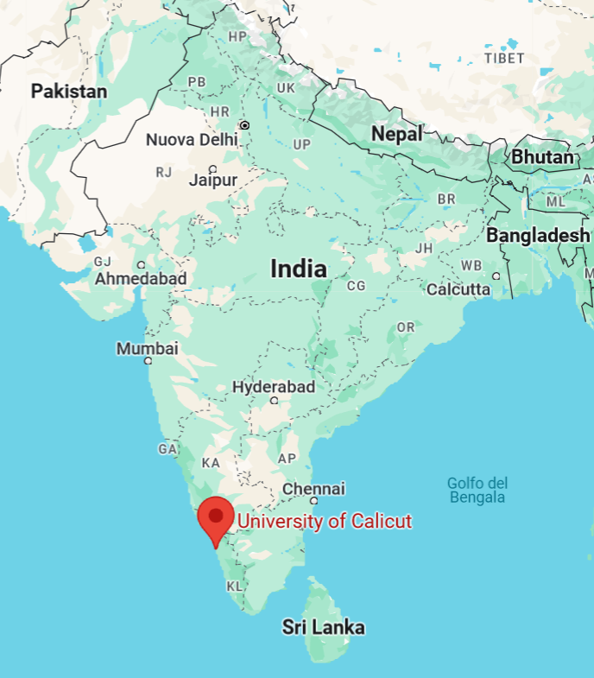
3.B New institute asking to join FOOT – Calicut University, India
They show competence in nuclear physics, hadron therapies, dosimetry, nuclear reactions @ PT energies, «theoretical analysis»
Discussions not so easy….
We offered them authorship up to 3 people after 1 year of working of a FTE researcher on our data.
Not received a clear answer. We’ll still have to pin them
Proposal: lets see them at work. We can give a well defined goal (cross section measurement) on «secondary» sample (Heidelberg 2022? CNAO 2022?) and we judge by the results the get or by the effort they put in the analysis.

Slide 7
4. Rotation of charges
Physics Coordinator:
M. Toppi (jun 25)
Software coordination:
C. Finck (dec 25), Y. Dong (deputy, jun 25)
New! Technical coordinator:
M. Morrocchi (jun 26)
Editorial Board:
A. Kraan (EB chair, jun 25), A. Lauria (jun 24), G. Traini (jun 25)
Spokesperson:
M. Villa (dec 24), P. Cerello (deputy)
(jun 26)
(dec 27)

Slide 8
5. Next Meetings locations
2024: Napoli, ?
2023: Bergamo, Trento
2022: Strasbourg, Perugia
2021: online, CNAO
2020: online, online
2019: CNAO, Rome
2018: Elba, Borgomale (CN)
2017: Napoli, Bologna
2016: Milano
2024:
2025:
Torino or surroundings
Bologna or surroundings, Bari

Slide 9
8. AoB
No AoB, No discussion

Slide 10
That’s all from IB!

Slide 11
Thanks to the Napoli group for the kind and nice hospitality

