Slide 1
EB report
Giacomo Traini, Aafke Kraan, Adele Lauria
FOOT general meeting, Napoli 26th June 2024

Slide 2
Conferences 2024
Contributions at today
Expected in next months
Oral
Poster
60th International Winter Meeting on Nuclear Physics 22-26.01.2024 (Bormio) | Bormio | Silvia Muraro | Status of the FOOT experiment: the measurement of fragmentation of light ions in the 200-700 MeV/u energy range
PTCOG | Singapore | Vincenzo Boccia | Charge identification of fragments produced in 1616O beam interactions at 200 MeV/n and 400 MeV/n on C and C22​H44​ targets
Sesto Incontro Nazionale di Fisica Nucleare | Trento | Yunsheng Dong | Nuclear fragmentation cross sections measurements: the FOOT experiment
International Conference on Calorimetry in Particle Physics CALOR2024 | Tsukuba (Japan) | Alessandro valetti | Equalizing the response of the FOOT calorimeter as a function of the ion energy and charge
16th Pisa Meeting on Advanced Detectors in La Biodola, Isola d’Elba (Italy) | Isola d'Elba | Vincenzo Boccia
" |  | Vincenzo boccia | Study of hadron beam fragmentation with the foot experiment
XX th International Conference on the use of Computers in Radiation therapy (ICCR) | Lyon | Christian Fink | New Global Reconstruction for Charged Particles With the FOOT Experiment
SIF 2024 | Bologna | 9-13/9/2024 | Alice Caglioni
" |  |  | Mauro Villa
" |  |  | Riccardo Ridolfi
 |  |  | Benedetto Spadavecchia
5th Jagiellonian Symposium | Cracovia (Polonia) | 29/6-7/7/2024 | Ilaria Mattei
ANP 2024 | Thessaloniki, Greece |  | Alice Manna
ANP 2024 | Thessaloniki, Greece |  | Roberto Zarrella

Slide 3
Papers and proceedings 2024
Papers
Charge identification of fragments produced in 16O beam interactions at 200 MeV/n and 400 MeV/n on C and C_2H_4 targets | Galati, Boccia et al
The FLUKA Monte Carlo Simulation of the magnetic spectrometer of the FOOT experiment | Yunsheng Dong et Al.
Development and Performance Assessment of the Calorimeter Module for the FOOT experiment | Turin group
A new photon calibration method for silicon microstrip sensors | Perugia group
Cross Section (Emulsions) | Galati et Al.
Cross Section GSI2021 (electronic setup) | Ridolfi et al
FOOT detetector performance (2025) | Yun & Giuliana
Proceedings
Characterization of the FOOT neutron detectors for nuclear fragmentation measurements at the n_TOF facility | JINST | Zarrella et Al
Equalizing the response of the FOOT calorimeter as a function of the ion energy and charge | TIPP23 | Alessandro valletti
Charge measurement with nuclear emulsions spectrometers for hadron therapy fragmentation cross section measurements with the FOOT experiment | Pisa meeting | Vincenzo Boccia
Published
Accepted for publication
Submitted
Revised by EB
Draft

Slide 4
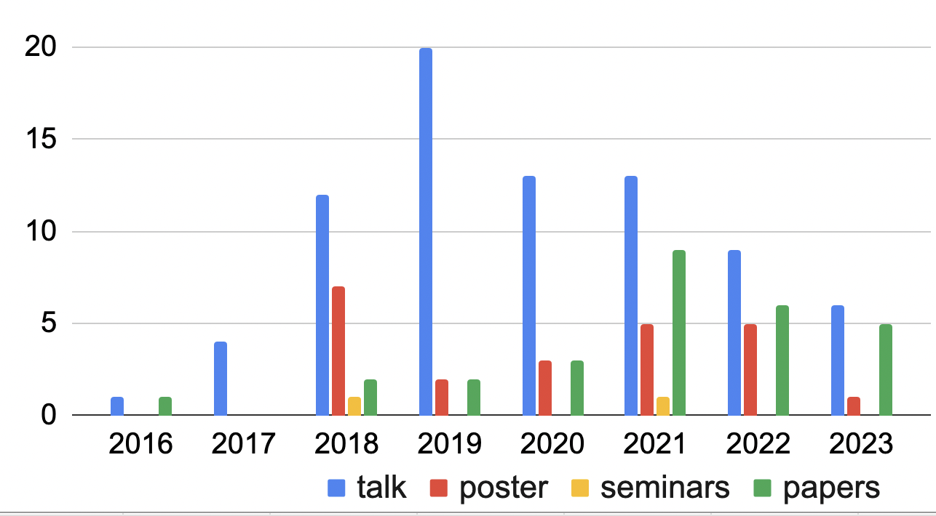
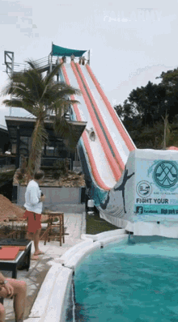
Summary in December 2023
2024

Slide 5
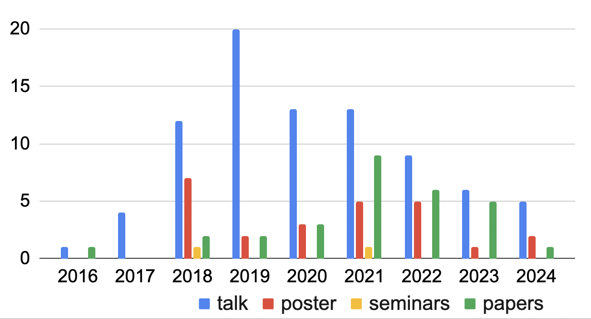
Summary

Slide 6
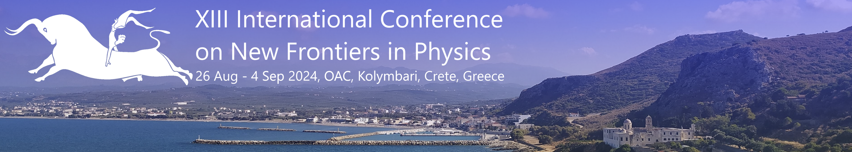

Opportunity for 2024
13rd International Conference on New Frontiers in Physics (ICFNP)

