Slide 1
Update on the Analysis of
GSI ¹⁶O@200MeV/n Data Taking
A. Alexandrov, V. Boccia, A. Di Crescenzo, G. De Lellis, G. Galati, A. Iuliano, A. Lauria, M. C. Montesi, V. Tioukov
Università di Napoli “Federico II”, INFN Napoli
Università di Bari “Aldo Moro”, INFN Bari
25/6/2024, XVI General FOOT Meeting Napoli, Accademia Pontiniana

Slide 2
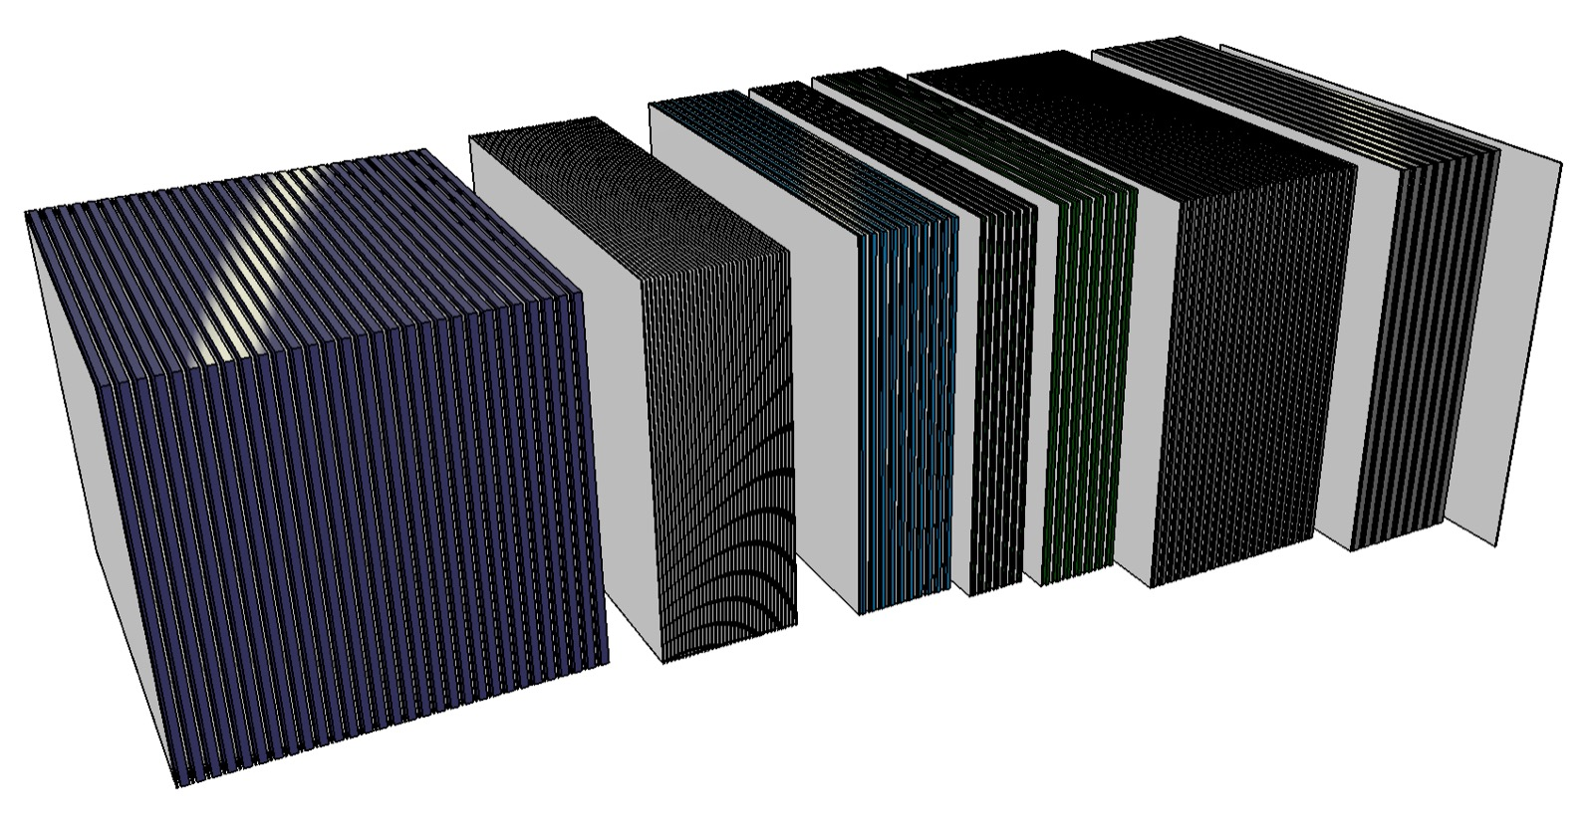
Summary
2019 (GSI1, GSI2, GSI3, GSI4):
scanning: 100%
alignment: 100%
tracking: GSI1: S1-S7: completed GSI2: S1-S7: completed GSI3: S1-S2: completed
2020 (GSI5, GSI6):
scanning: 328/328 (100%)
 | 2019
 | Oxygen 200 MeV/n | Oxygen 400 MeV/n
Carbon | GSI1 | GSI3
Polyethylene | GSI2 | GSI4
Beam
Target
S3
S1: vertexing
S2: charge
Reconstruction of vertices from Oxygen interactions in Section 1 (S1)
Charge measurement in Section 2 (S2)
Momentum measurement in Section 3 (S3) [see G. Lorusso’s talk]
 | 2019 |  | 2020
 | Oxygen 200 MeV/n | Oxygen 400 MeV/n | Carbon 700MeV/n
Carbon | GSI1 | GSI3 | GSI5
Polyethylene | GSI2 | GSI4 | GSI6
Beam
Target

Slide 3
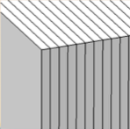
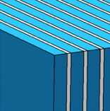
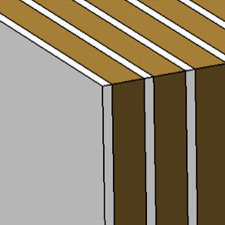
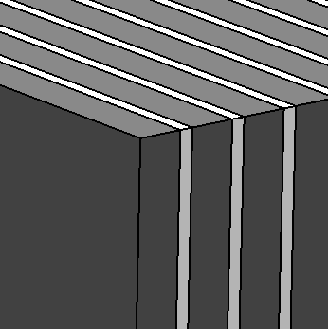
The nuclear emulsion setup
Emulsion film
300 μm
Lexan
1000 μm
Tungsten
500 μm
Tungsten
900 μm
C (C2H4) layer
1000 (2000) μm
Lead
1000/2000 μm
Beam
10 cm
12.5 cm
S3: Momentum - range measurement
and isotope identification
S2: Charge identification
S1: Vertexing
Notes:
Nuclear emulsion films are a type of photographic plate, used to record and investigate charged particles. After exposing and developing the emulsion film, particle tracks can be observed and measured using an optical microscope

Slide 4
Reconstruction improvements

Slide 5
Improvements of detector response in MC description (“MC Reco”)
Efficiencies for cross section measurement is obtained comparing True and Reconstructed Monte Carlo
Reconstructed Monte Carlo has to reproduce detector response
Effects considered:
angles and positions smearing
data-driven inefficiencies
data-driven random background (Optimized)
data-driven long cosmic rays background (Optimized)
data-driven misalignments
NEW: MC True and MC Reco statistics improved: $∼80$k Oxygen ions ($=×4$ previous stat.)
Notes:
to checking if the efficiencies found with MC are trustable

Slide 6
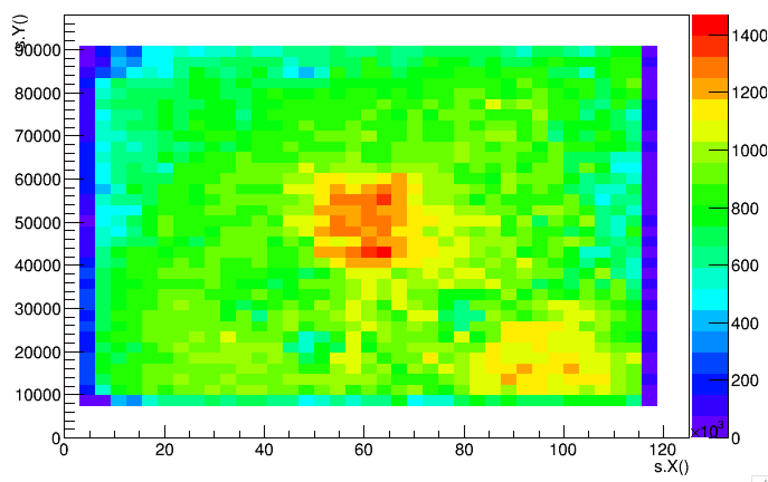
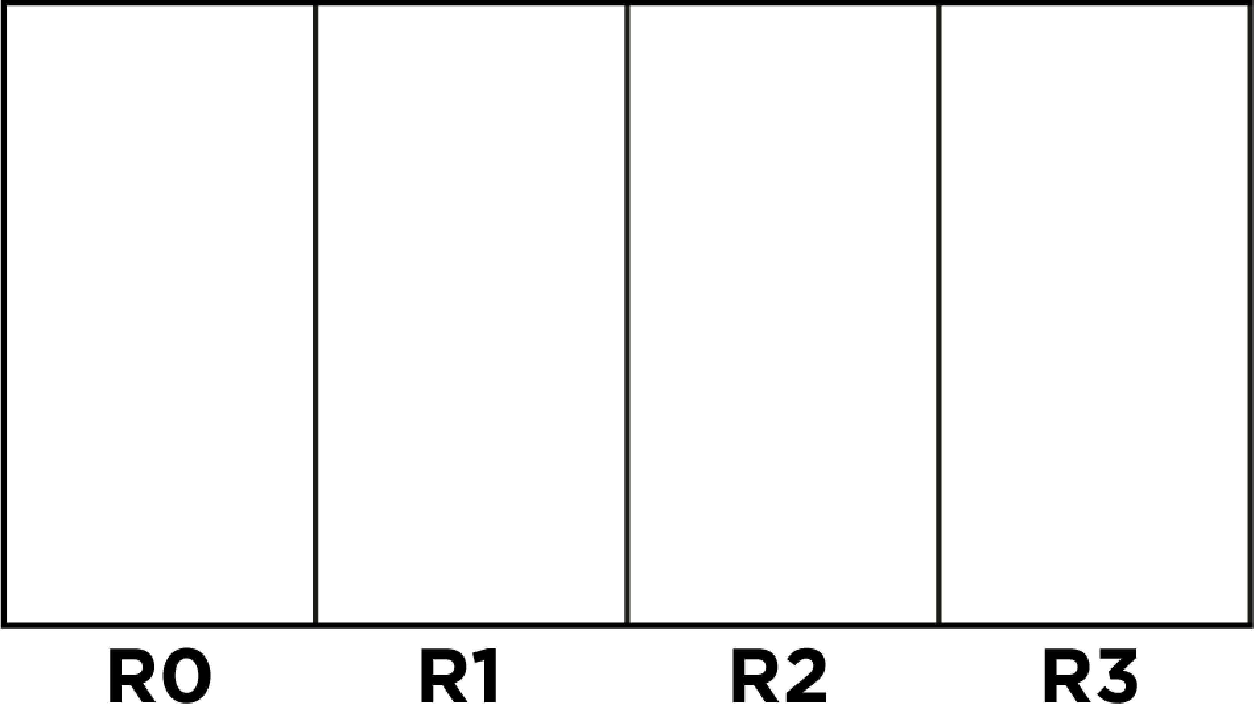
Background in Monte Carlo Simulation
data
Nuclear emulsions integrate cosmic rays since their production up to their development
Bkg
Signal
Bkg
Basetracks belonging to cosmic rays tagged from Section2 Charge identification analysis in DATA
Basetracks due to the cosmic rays integrated when brick is not assembled
Not added because it is not tagged as Cosmic Ray in S2
Beam
Passive material not to scale

Slide 7
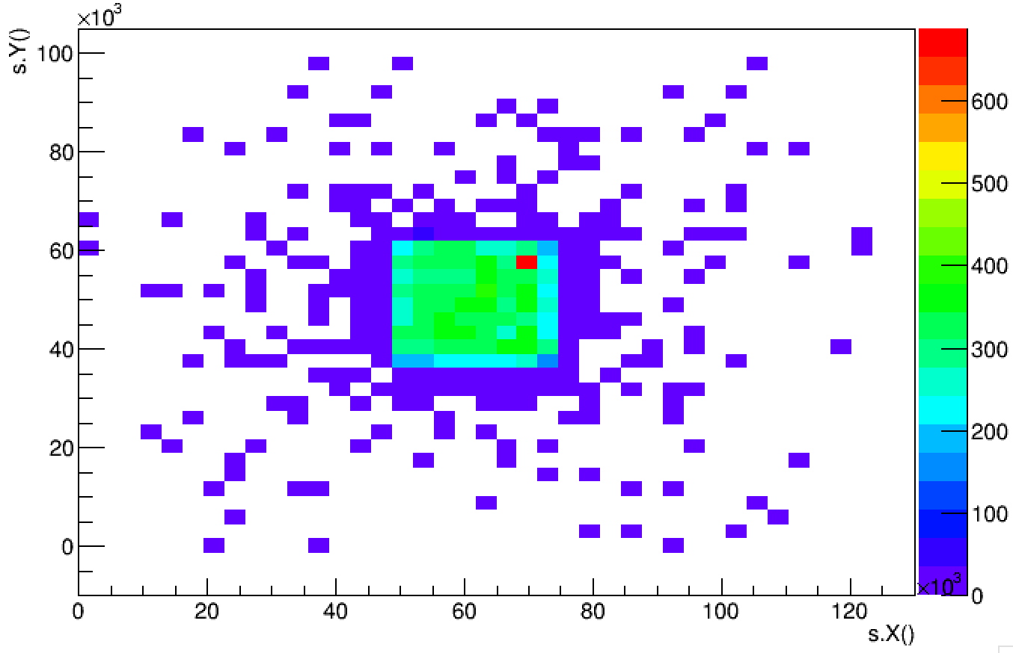
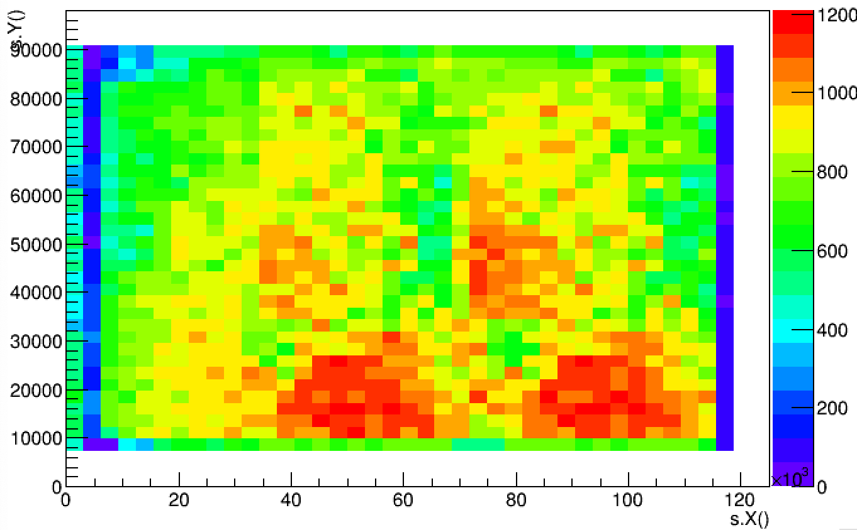
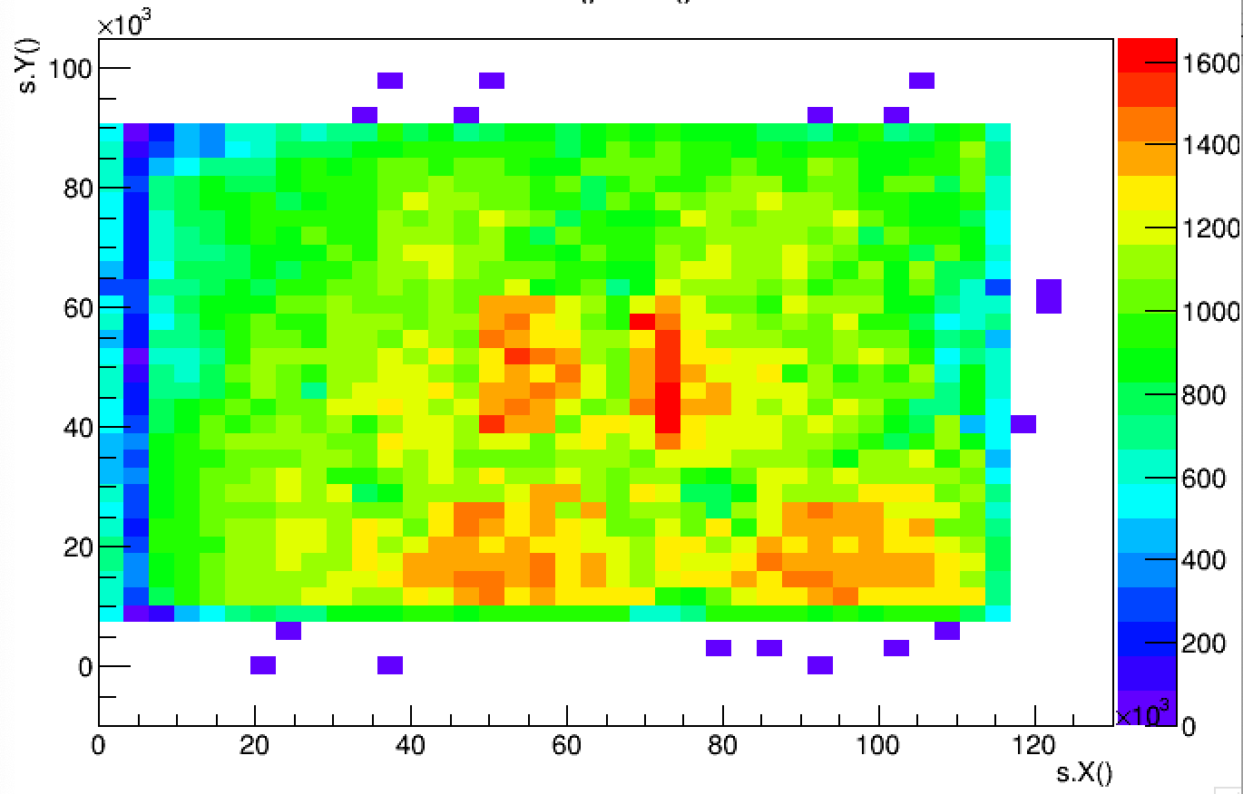
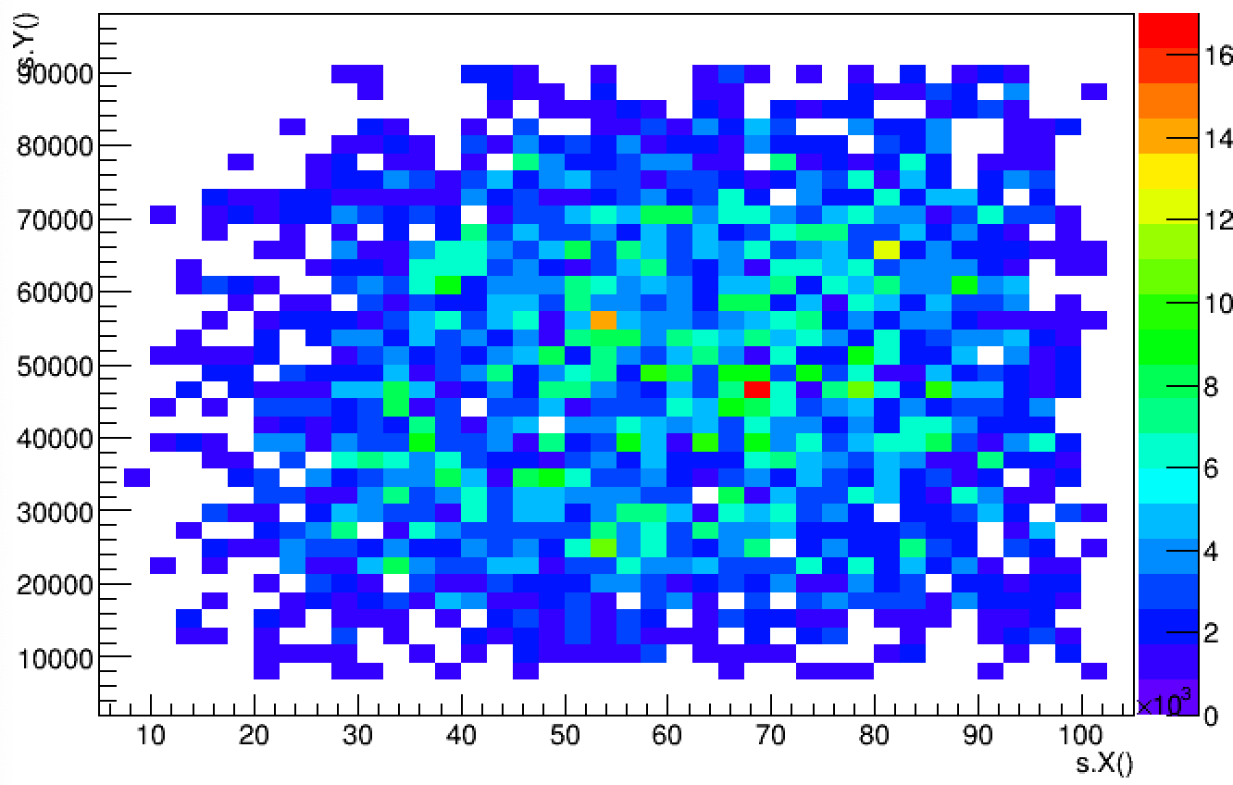
Background in Monte Carlo Simulation
1023915 basetracks from data (region with no signal)
+
22523 MC Basetracks
+
=
3068 basetracks from data tagged as cosmic rays
1049506 Basetracks
Notes:
1023915+22523+3068

Slide 8
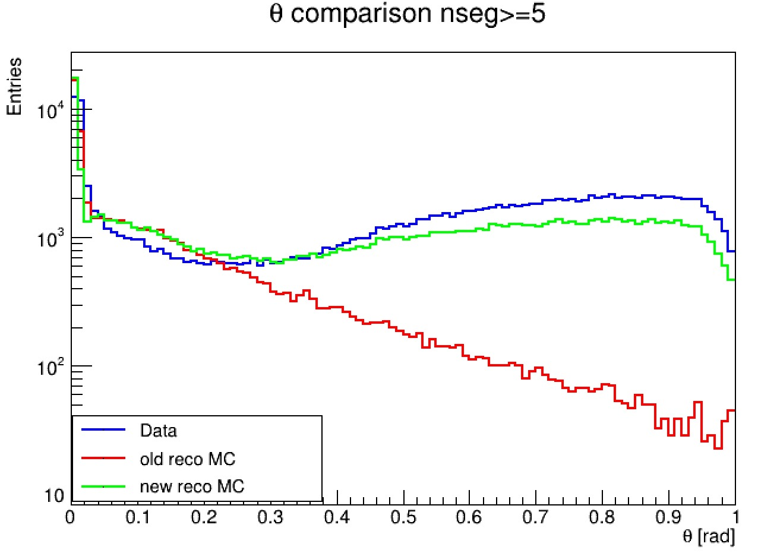
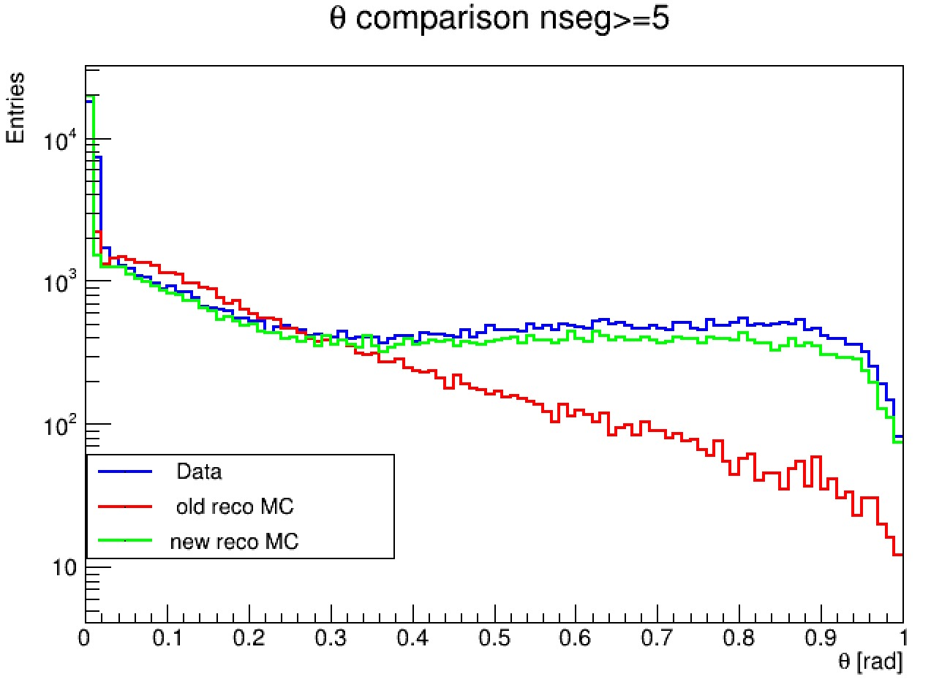
Background in Monte Carlo Simulation
Correction of affine trasformation applied to bkg base tracks taken from DATA
Smearing on coordinates applied to random background
C Target
C2H4 Target
Signal
Signal
Background
Background

Slide 9
Nuclear emulsion films misalignments in MC Reco
Misalignments were simulated applying a small smearing on XYZ positions $→$ being the smearing random, we had a decrease in tracking efficiency, but we were not really simulating what happens in Data!
Rototranslation matrix taken from DATA (same brick-same film)
Matrix applied to MC Reco basetracks
Alignment procedure applied to MC Reco as in Data (three steps, same parameters)
Notes:
## 2023-12-08 17:18:36
ZLAYER 0 1325.423462 0.000000 0.000000
AFFXY 0 0.999879 0.00444336 -0.00374883 1.00063 52.1279 -164.947
AFFTXTY 0 0.999979 -0.00645702 0.00645702 0.999979 -0.00127066 0.000533638
SHRINK 0 1.000000
## 2023-05-20 16:00:35
ZLAYER 0 1423.410034 0.000000 0.000000
AFFXY 0 0.999659 -0.00461033 0.00393115 0.998851 -15.1847 177.306
AFFTXTY 0 1 -0.000752976 0.000752976 1 -0.0119892 0.016414
SHRINK 0 1.000000
Copy tracks identified as cosmic rays from S2 DATA (long cosmics)
Perform tracking with re-alignment enabled
The following step will be to introduce systematic shifts between plates and simulate the alignments as well

Slide 10
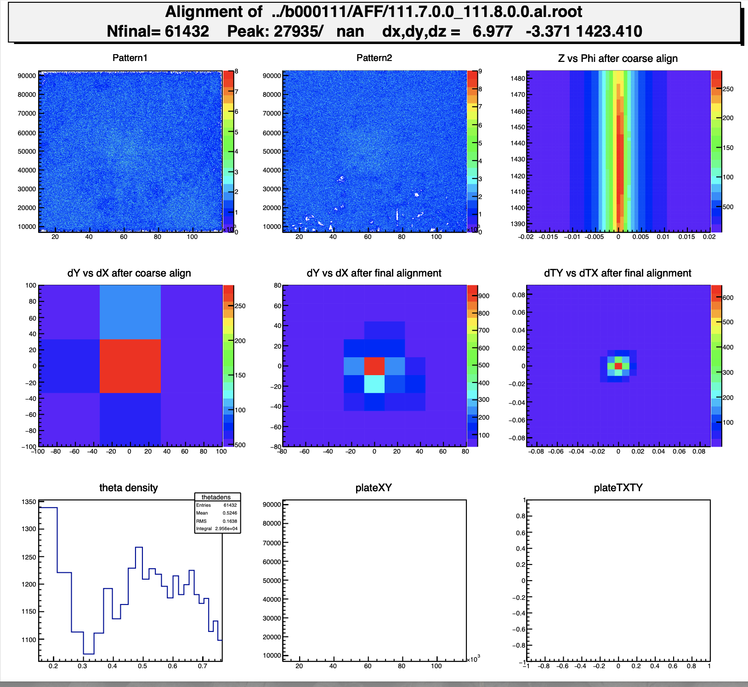
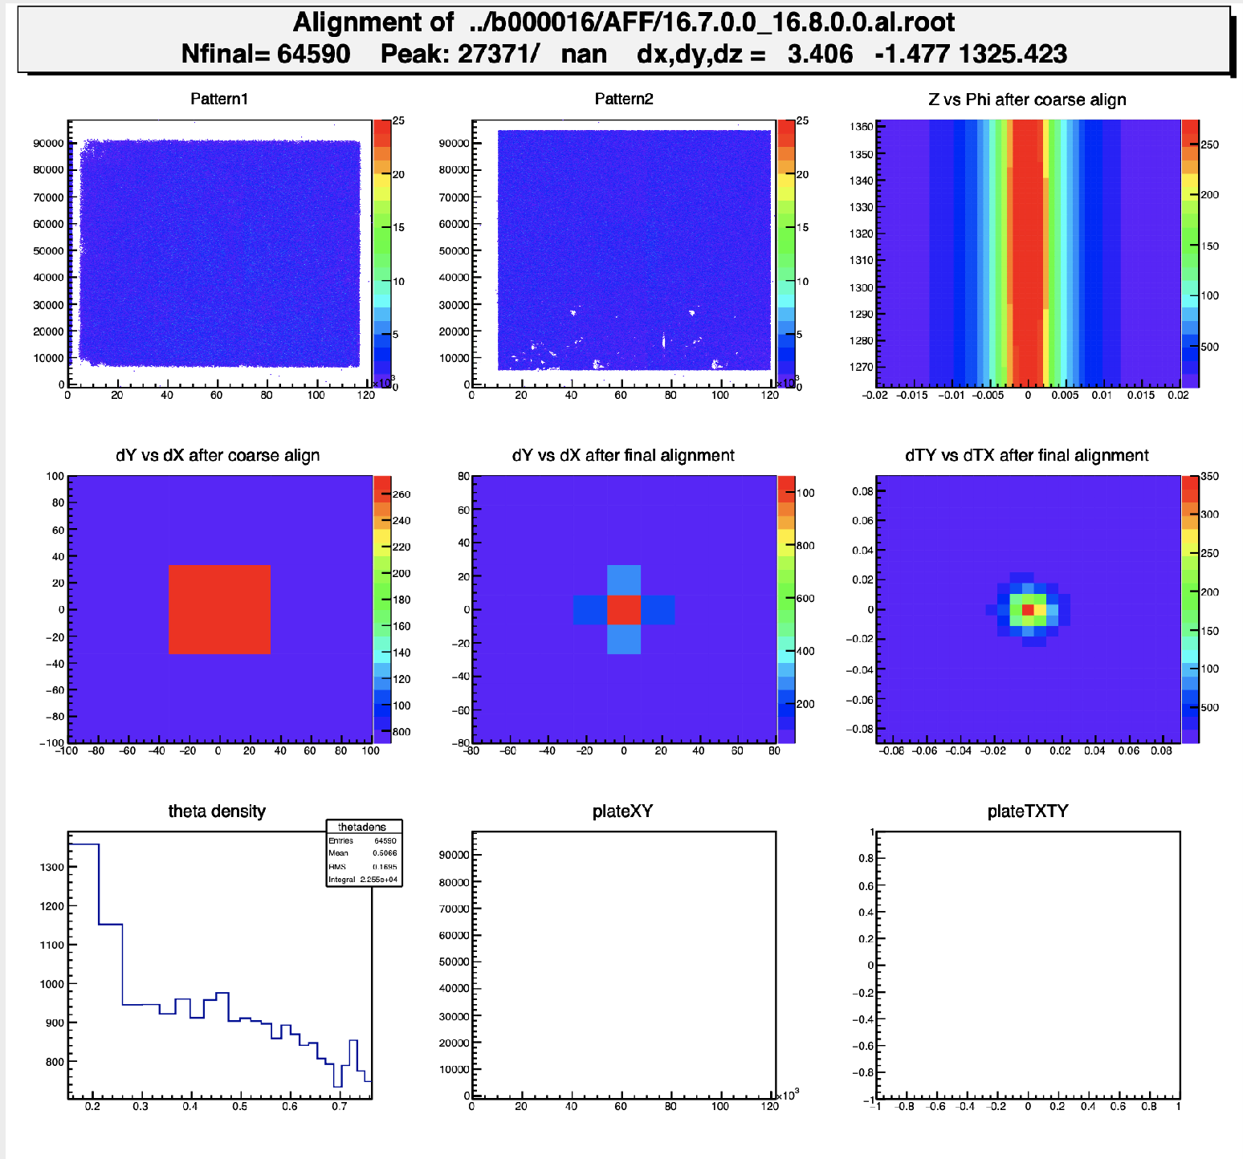
Nuclear emulsion films misalignments in MC Reco
DATA
MC RECO
Notes:
## 2023-12-08 17:18:36
ZLAYER 0 1325.423462 0.000000 0.000000
AFFXY 0 0.999879 0.00444336 -0.00374883 1.00063 52.1279 -164.947
AFFTXTY 0 0.999979 -0.00645702 0.00645702 0.999979 -0.00127066 0.000533638
SHRINK 0 1.000000
## 2023-05-20 16:00:35
ZLAYER 0 1423.410034 0.000000 0.000000
AFFXY 0 0.999659 -0.00461033 0.00393115 0.998851 -15.1847 177.306
AFFTXTY 0 1 -0.000752976 0.000752976 1 -0.0119892 0.016414
SHRINK 0 1.000000
Copy tracks identified as cosmic rays from S2 DATA (long cosmics)
Perform tracking with re-alignment enabled
The following step will be to introduce systematic shifts between plates and simulate the alignments as well

Slide 11
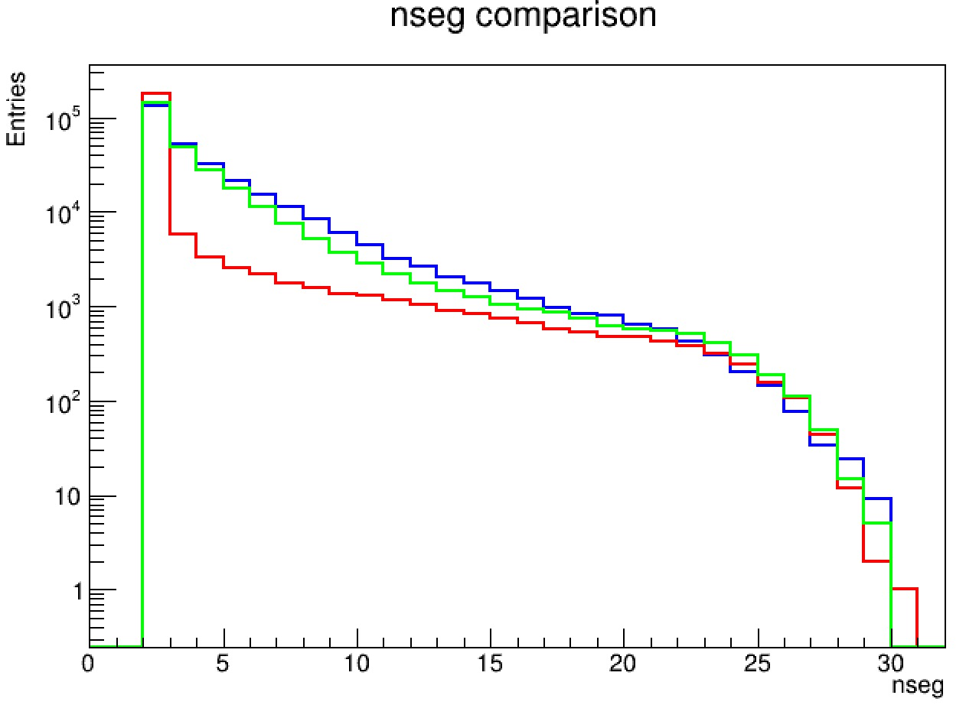
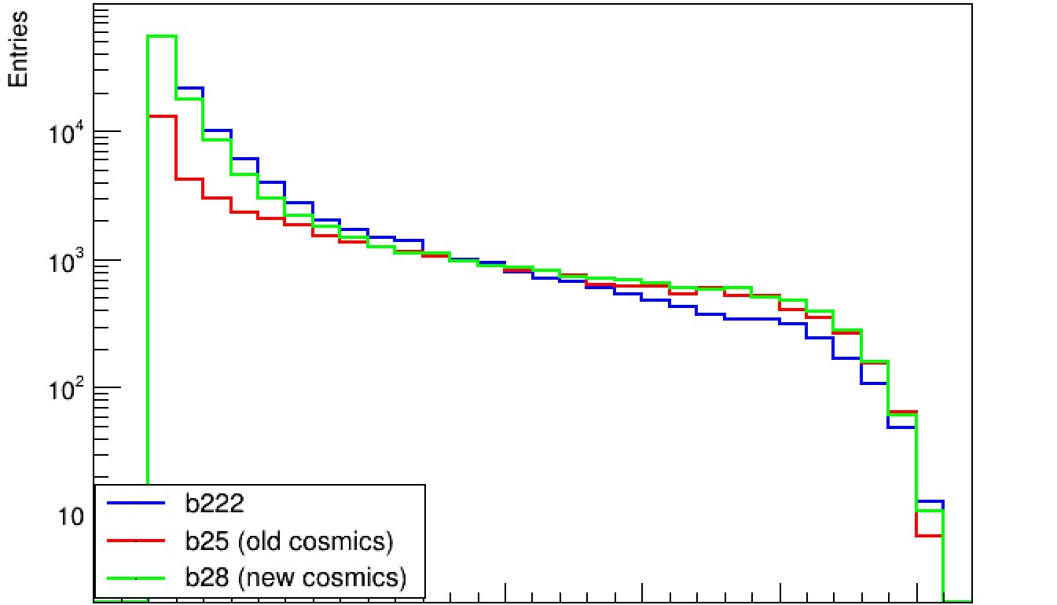
Number of segments for fragments in S1
C Target
C2H4 Target

Slide 12
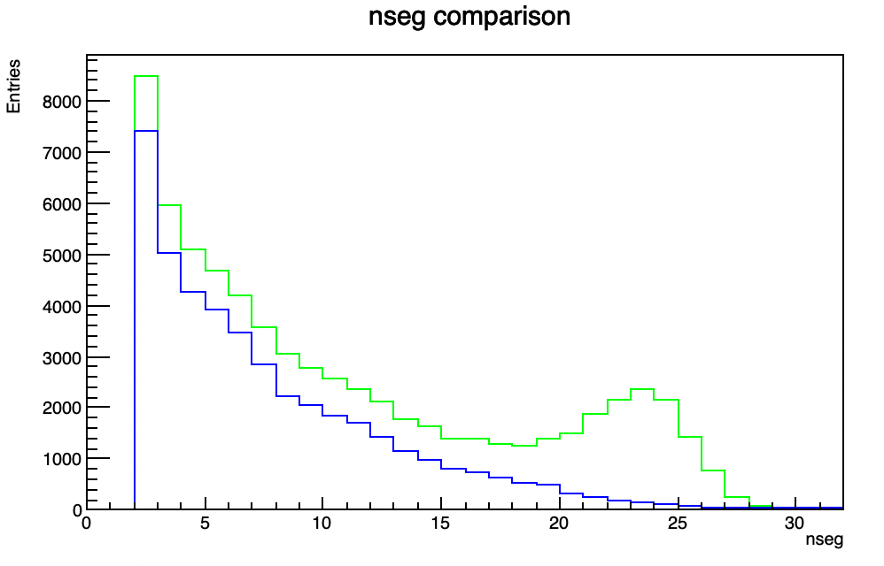
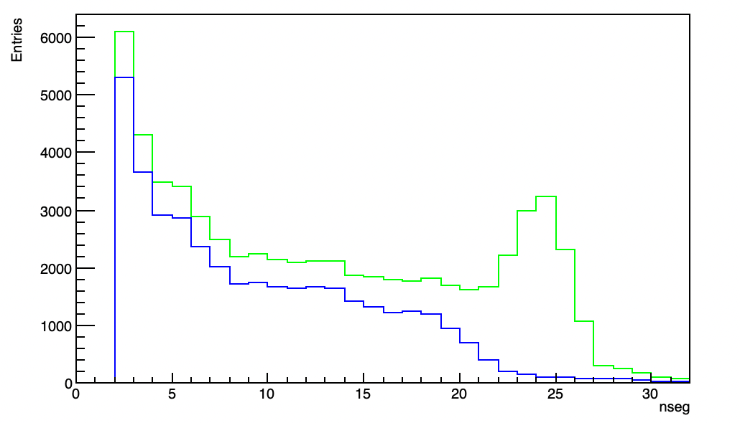
Number of segments for Oxygens
C Target
C2H4 Target
Data
MC Reco
Data
MC Reco

Slide 13
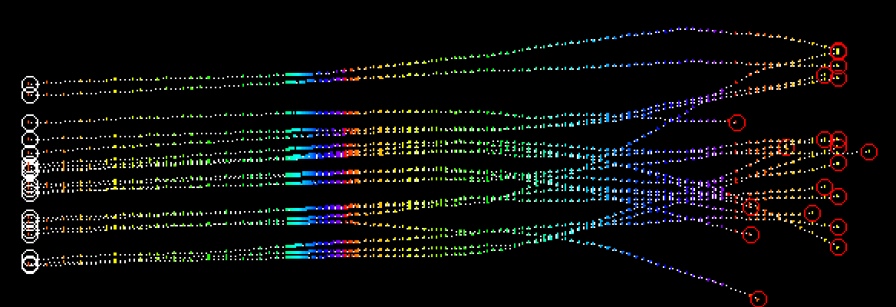
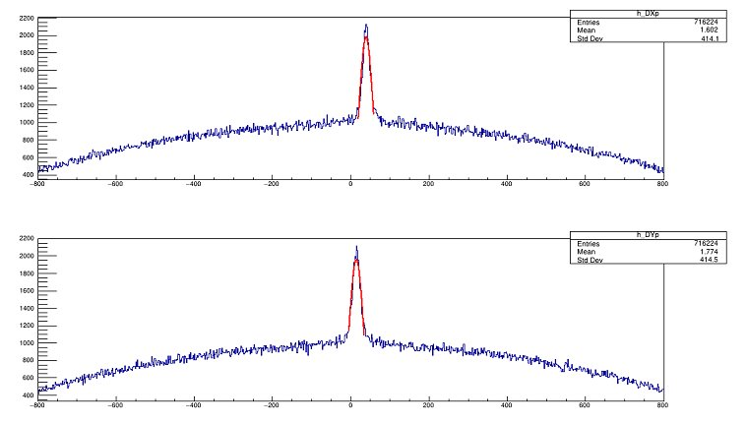
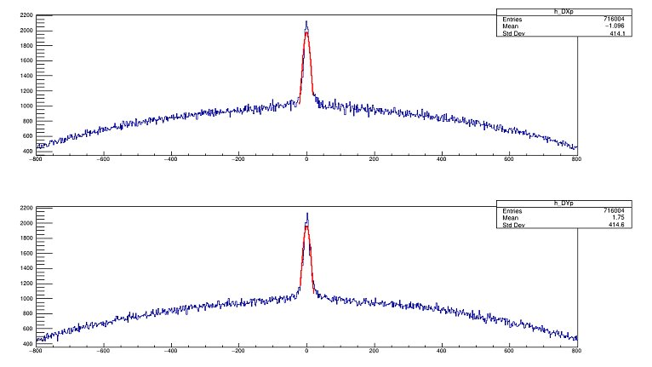
Tracking between different sections
Each section is characterised by its own parameters (material density, thickness…): tracking algorithm applied to each section separately $→$ Different reference systems for each section
XY shift + rotation to correct the offsets
Before corrections
After corrections
Example taken from C2H4 Target MC Reco (S1→S2)

Slide 14
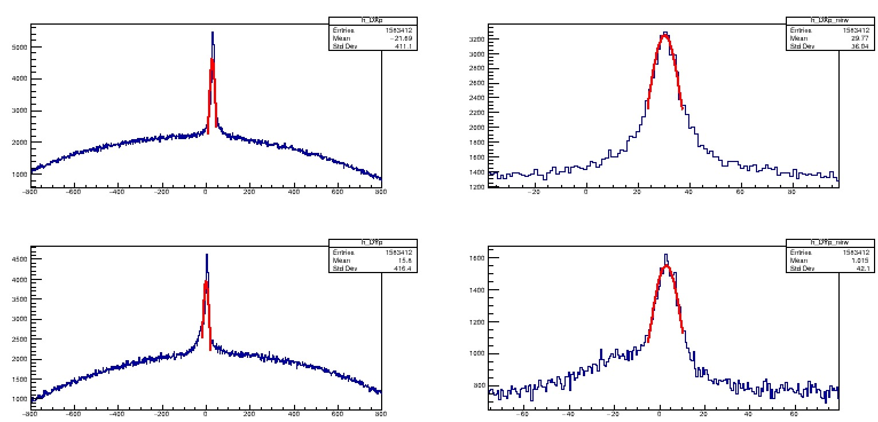
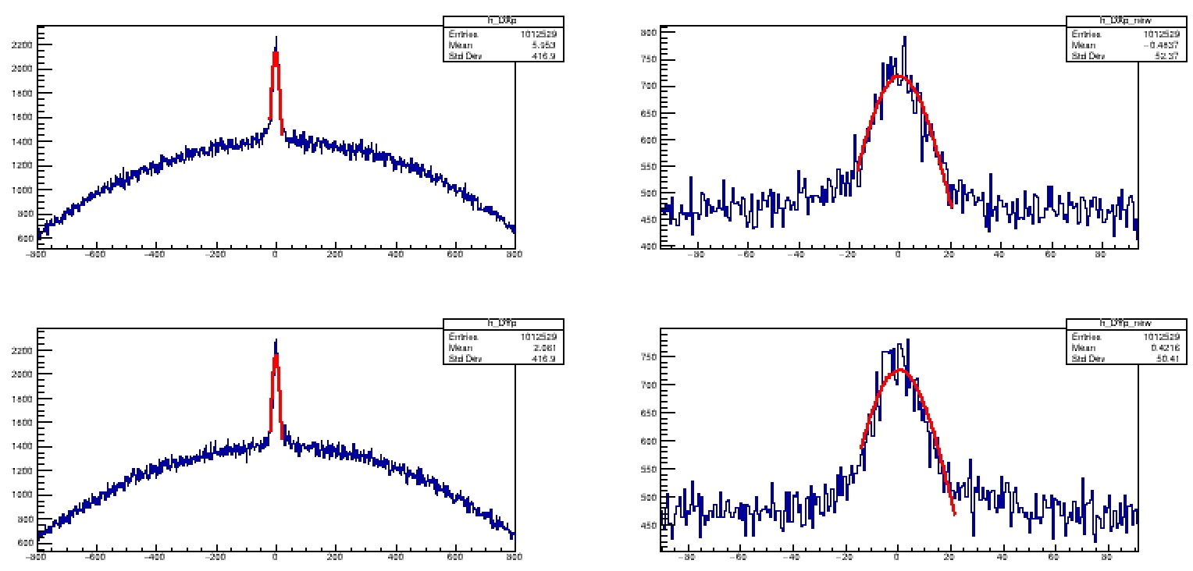
Tracking between different sections
Each section is characterised by its own parameters (material density, thickness…): tracking algorithm applied to each section separately $→$ Different reference systems for each section
XY shift + rotation to correct the offsets
Before corrections
After corrections
Example taken from C Target DATA (S1→S2)

Slide 15
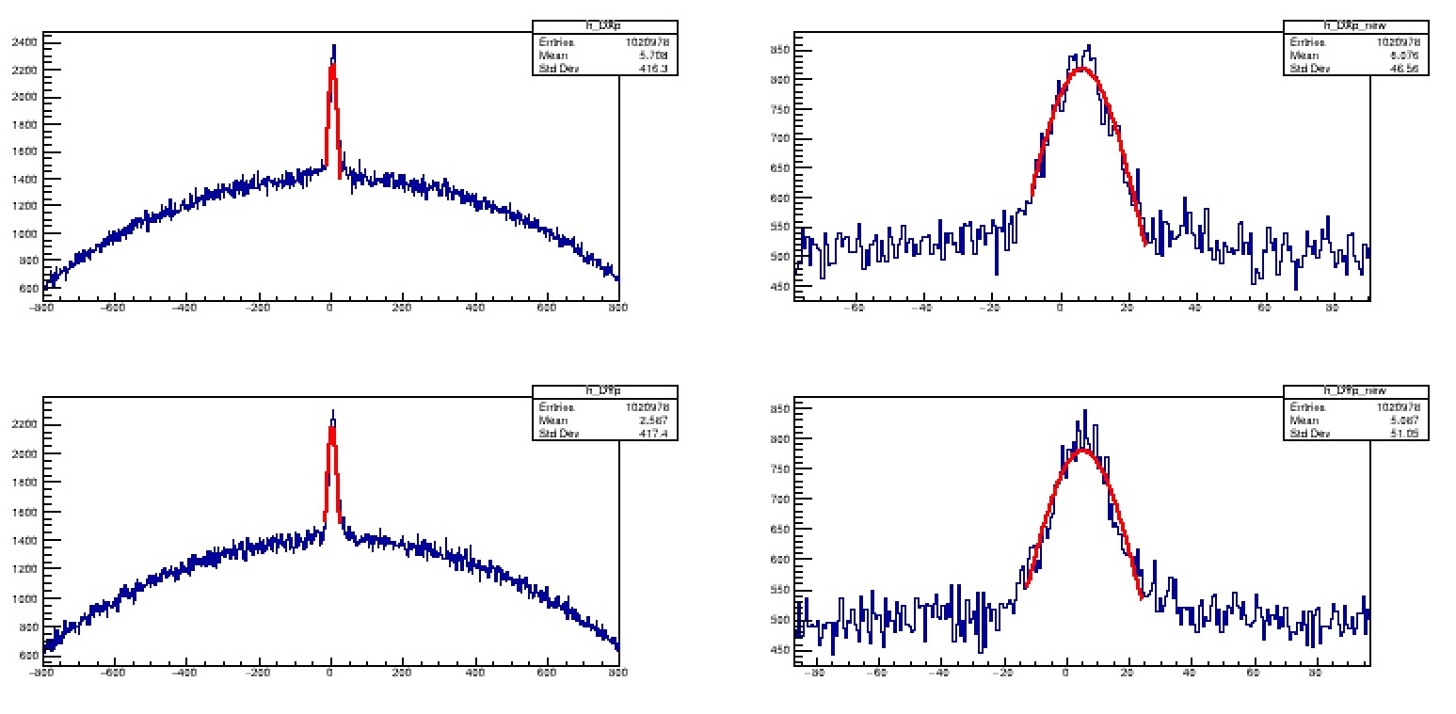
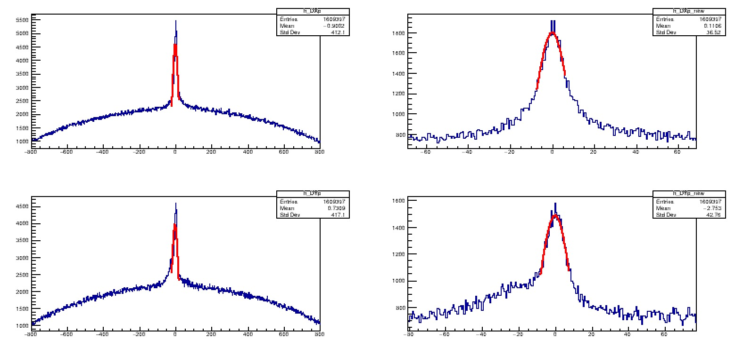
Tracking between different sections
Each section is characterised by its own parameters (material density, thickness…): tracking algorithm applied to each section separately $→$ Different reference systems for each section
XY shift + rotation to correct the offsets
Before corrections
After corrections
Example taken from C Target MC Reco (S1→S2)

Slide 16
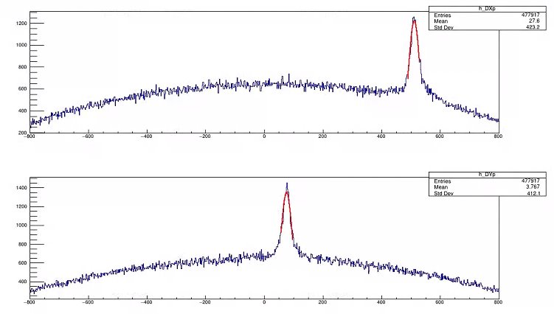
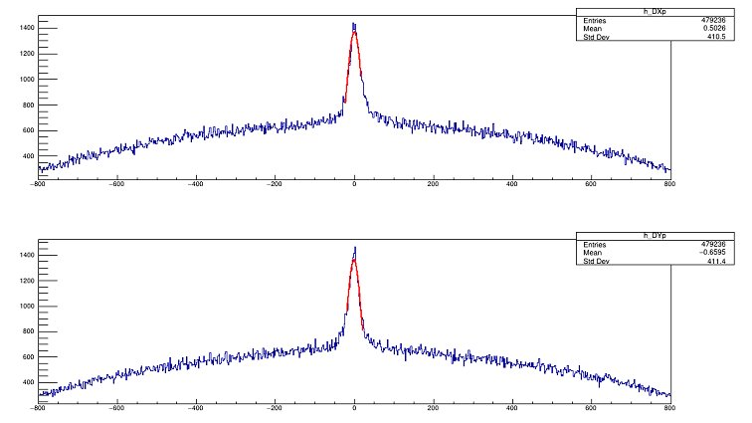
Tracking between different sections
Each section is characterised by its own parameters (material density, thickness…): tracking algorithm applied to each section separately $→$ Different reference systems for each section
XY shift + rotation to correct the offsets
Before corrections
After corrections
Example taken from C2H4 Target DATA (S1→S2)

Slide 17
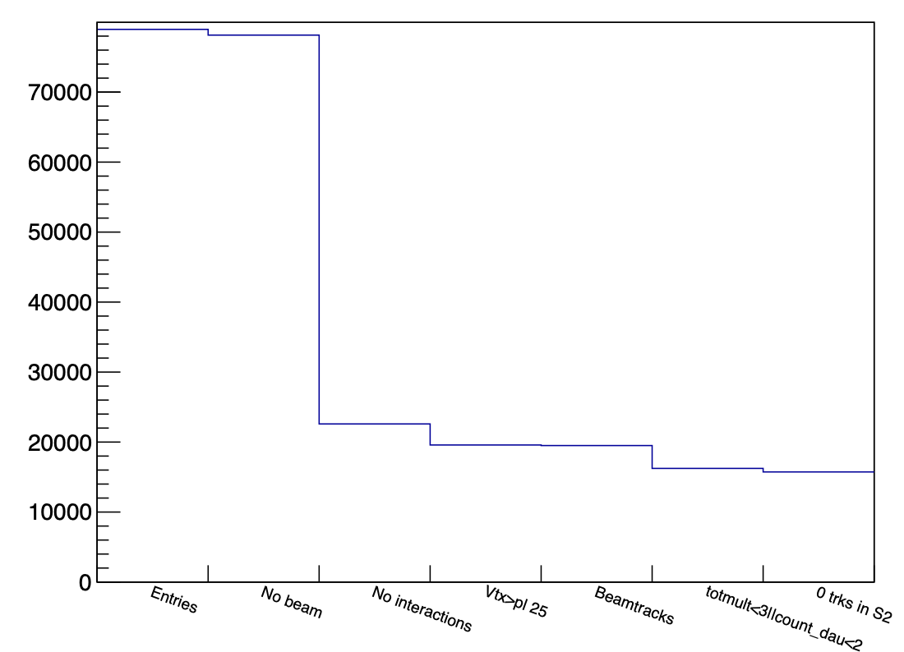
Cuts for vertices selection and bkg rejection
C Target
Events: 78965
Events without beam Oxygen: 821
Events with no interactions: 55554
Interactions after plate 25: 3008
The number of tracks with $θ≤0.03$ mrad can’t be $≥2$ if the remaining number of tracks is $≤2$: 81
at least 3 tracks and at least 2 daughters with more than 3 base tracks: 3265
At least one track arriving in S2: 505
MCT
MC Cut

Slide 18
Example of fake vertices from Oxygens

Slide 19
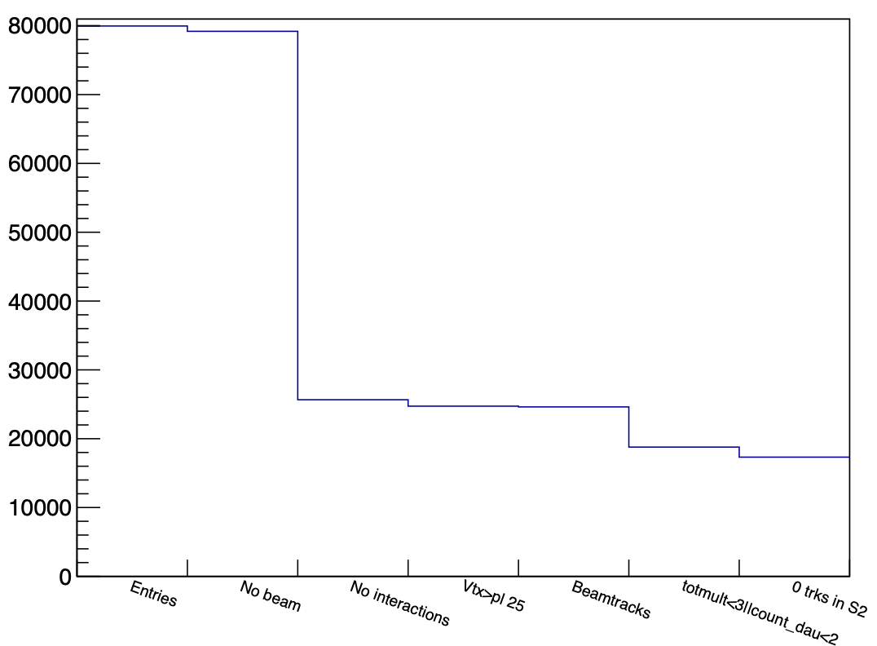
Cuts for vertices selection and bkg rejection
C2H4 Target
Events: 79965
Events without beam Oxygen: 773
Events with no interactions: 53415
Interactions after plate 25: 936
The number of tracks with $θ≤0.03$ mrad can’t be $≥2$ if the remaining number of tracks is $≤2$: 108
at least 3 tracks and at least 2 daughters with more than 3 base tracks: 5837
At least one track arriving in S2: 1459
MCT
MC Cut
Notes:
entries 78965
COUNT_NO_BEAM 821
TOT_beam_MCT 78142 79191
COUNT_evt1 55433
COUNT_evtBP 2308 278
N_VTX_MCT 20429 25833
COUNT_START 78965 79965
COUNT_evt1bis 55554 53530
COUNT_ELASTICBEAM 0 0
COUNT_notinrange 3008
EXCLUDED_daubeam 81
COUNT_checkmult 3265
COUNT_atleastoneS2 505

Slide 20
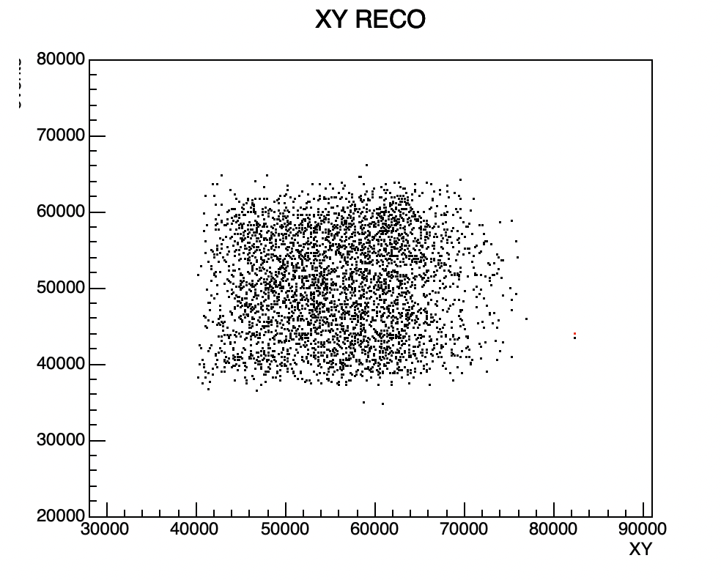
Check vertices out of signal region
Counting the number of vertices in the region out of signal due to background added from data (after new cuts)
C Target = 2
C2H4 Target = 1
C2H4 Target example

Slide 21
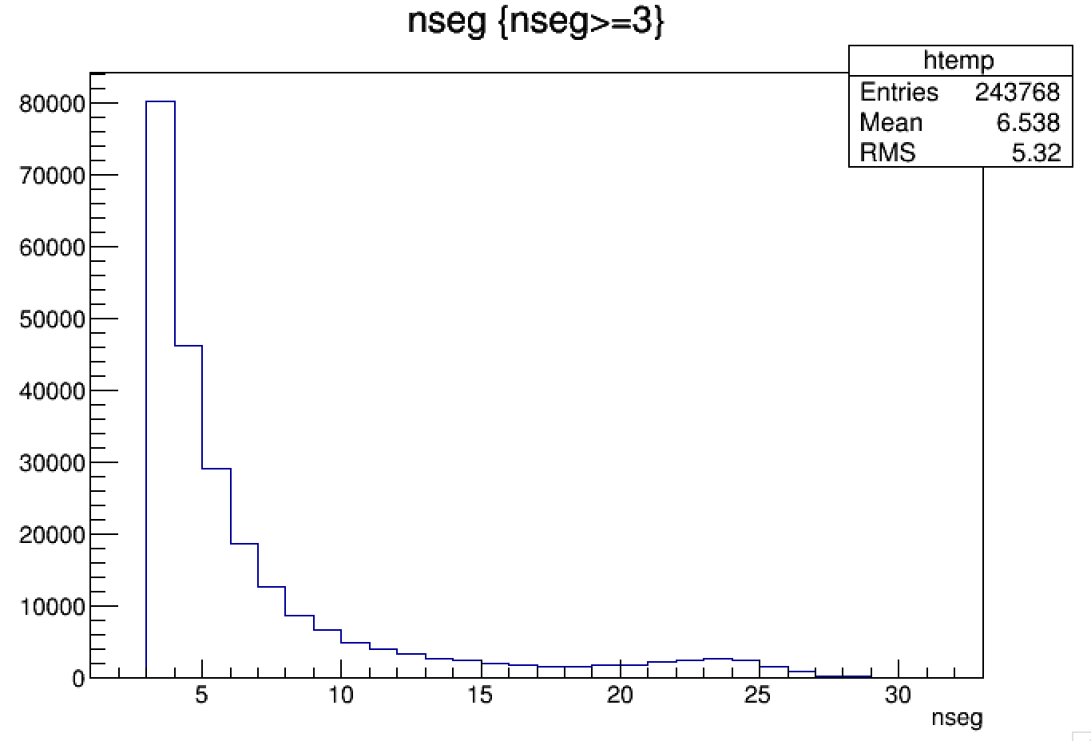
C Target MC Reco - Purity of Tracks
Checking MC id of segments belonging to a track
Mean purity: 99.7% evaluated on 517991 tracks
nseg | purity
3-4 | 99.95% evaluated on 126657 tracks
5-9 | 99.88% evaluated on 76052 tracks
10-14 | 99.48% evaluated on 17563 tracks
15-19 | 98.69% evaluated on 8700 tracks
20-24 | 97.41% evaluated on 11704 tracks
25-29 | 95.44% evaluated on 3075 tracks
30-34 | 99.61% evaluated on 17 tracks
35-66 | 0 tracks
Notes:
b26

Slide 22
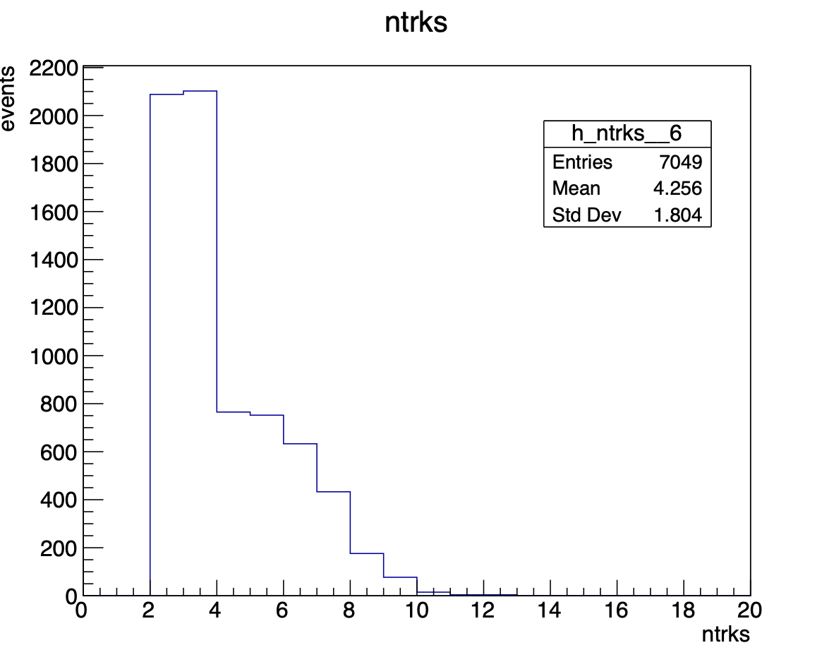
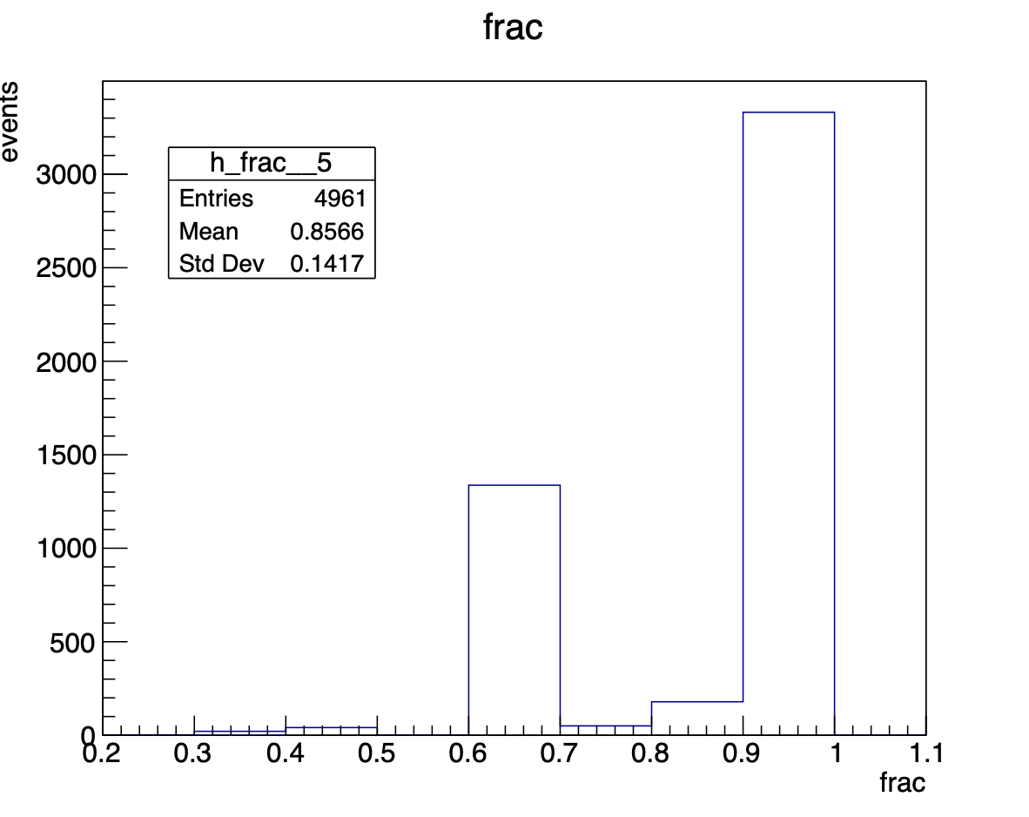
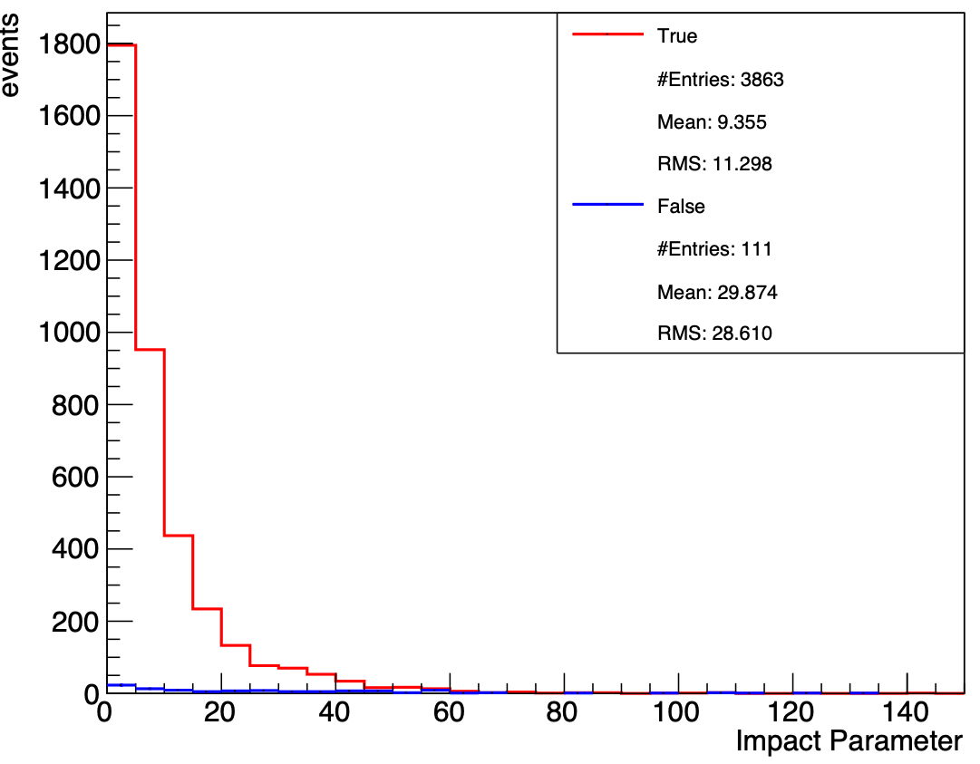
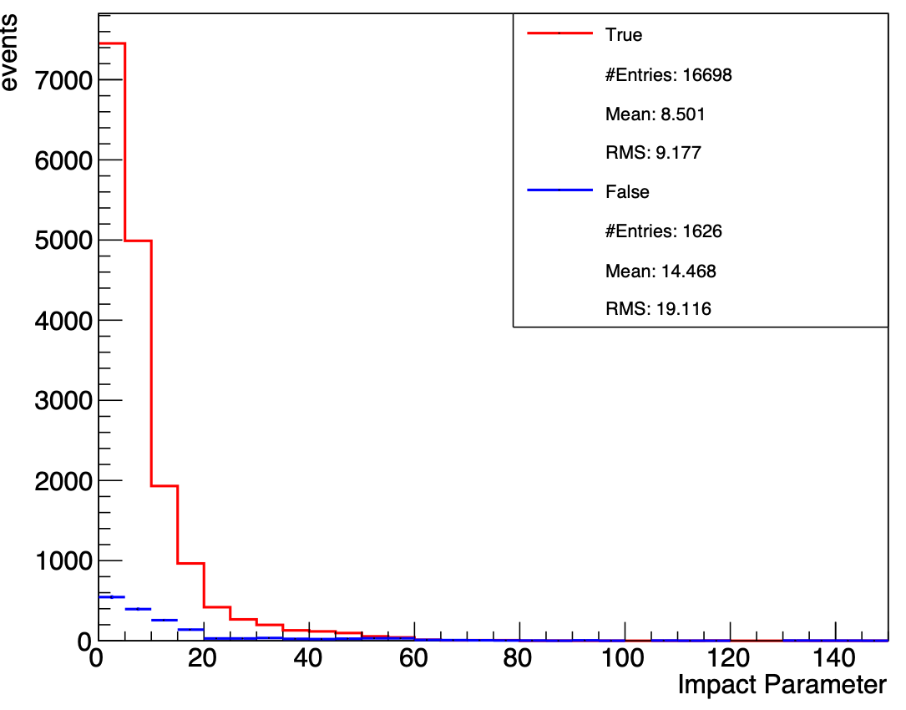
C Target MC Reco - Vertex purity test
N tracks
Fraction of events with correct MC id
IP beam
IP daughters
Notes:
b26

Slide 23
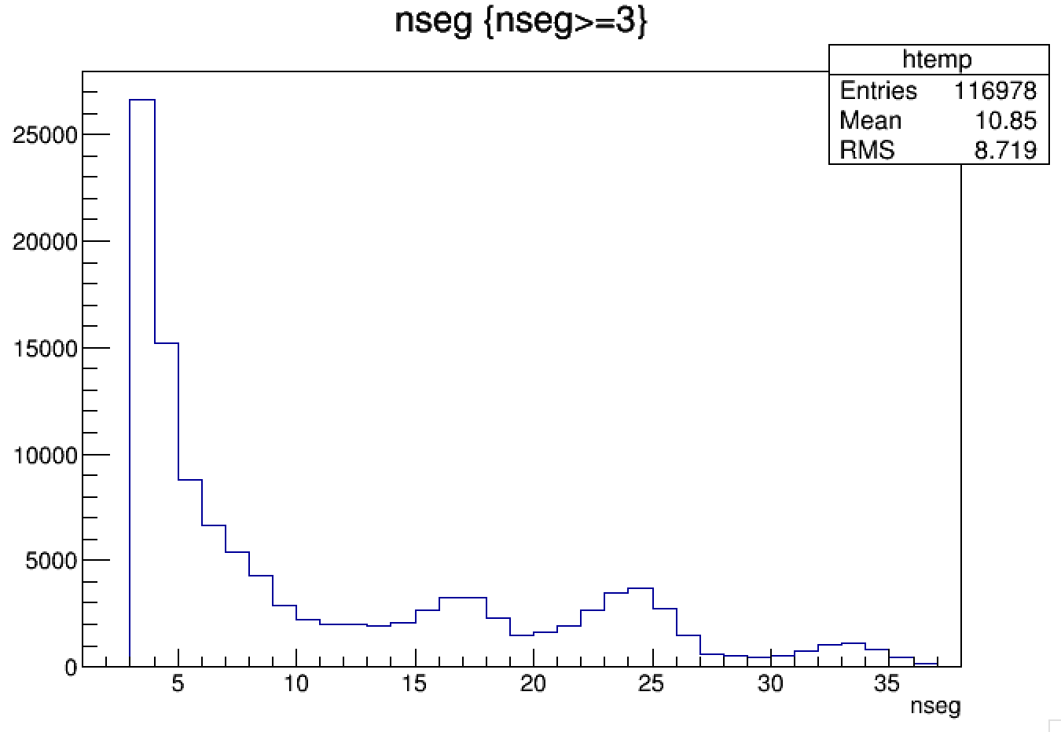
C2H4 Target MC Reco - Purity of Tracks
Checking MC id of segments belonging to a track
Mean purity: 99.3% evaluated on 207860 tracks
nseg | purity
3-4 | 99.92% evaluated on 41825 tracks
5-9 | 99.79% evaluated on 28011 tracks
10-14 | 99.29% evaluated on 10156 tracks
15-19 | 99.21% evaluated on 12976 tracks
20-24 | 97.57% evaluated on 13410 tracks
25-29 | 95.34% evaluated on 5752 tracks
30-34 | 99.8% evaluated on 4295 tracks
35-39 | 100% evaluated on 553 tracks
40-66 | 0 tracks
Notes:
b26

Slide 24
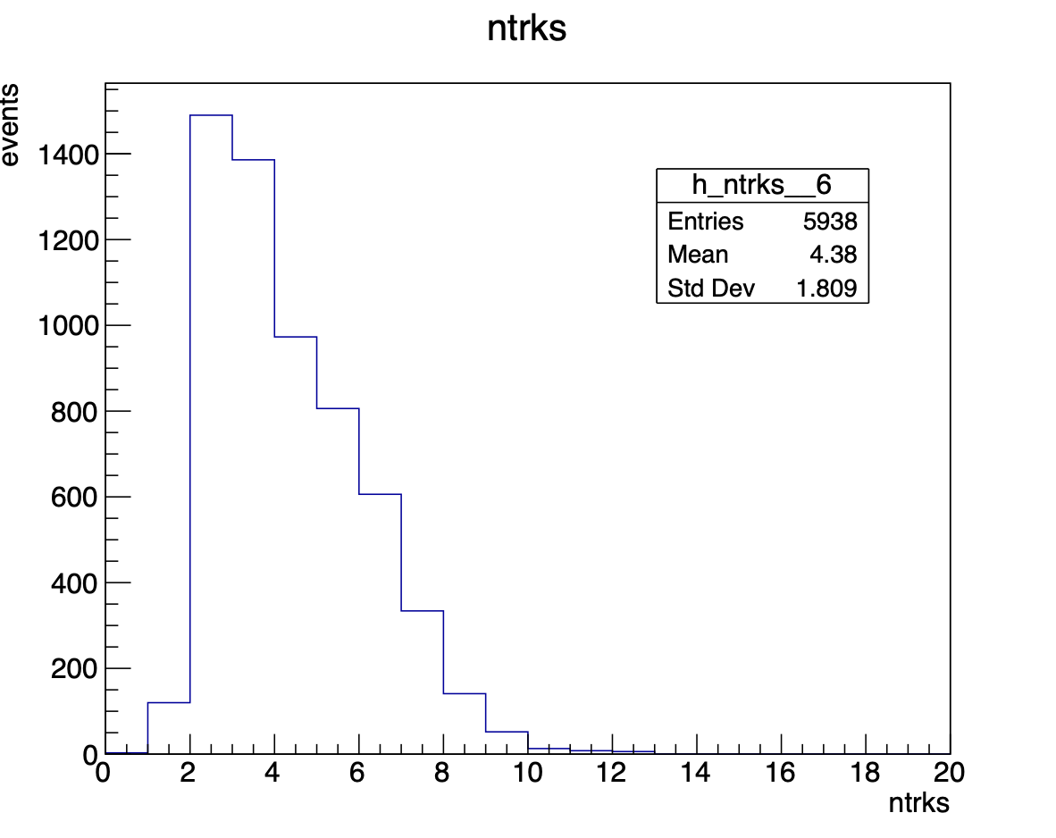
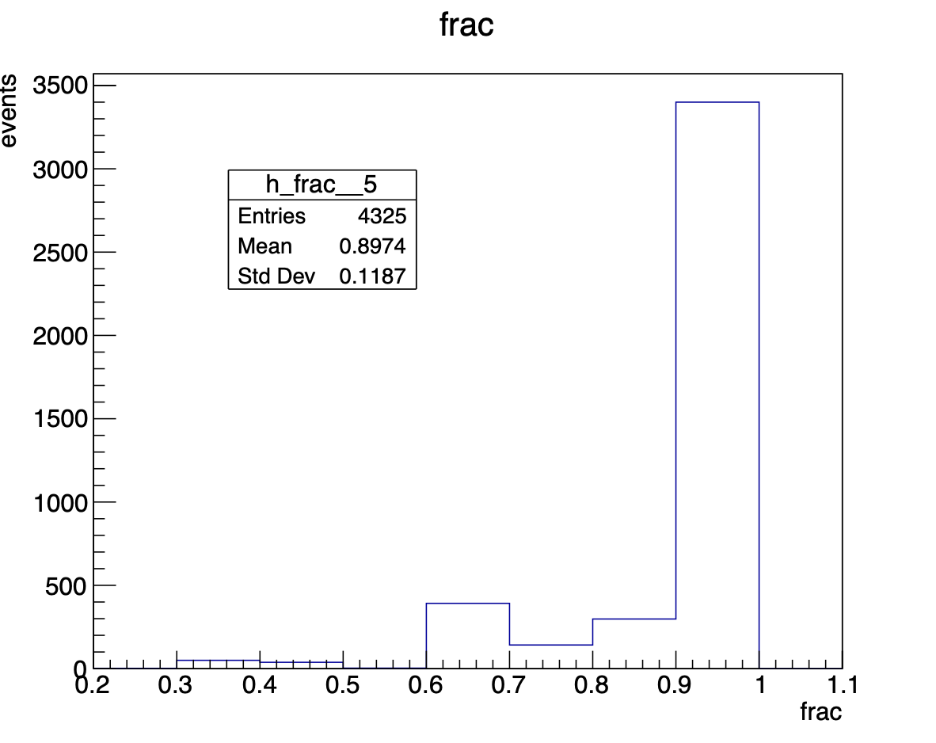
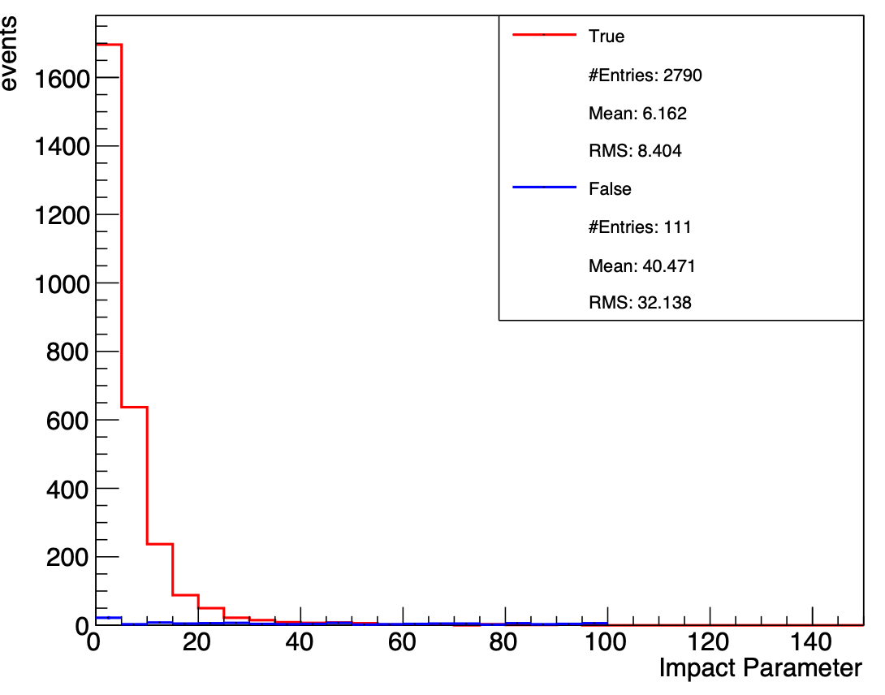
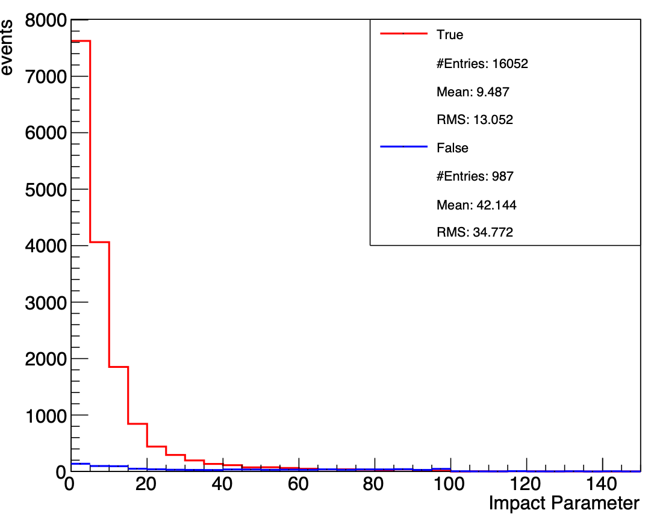
C2H4 Target MC Reco - Vertex purity test
N tracks
Fraction of events with correct MC id
IP beam
IP daughters
Notes:
b26

Slide 26
Cross section evaluation

Slide 27
Cross Section Measurement
$Y_{i}=$# of fragments in the interval $Δx$
$N_{B}=$# of ions colliding on the target
$N_{TG}=$# of particles in the target: $\frac{ρdN_{A}}{A}$, with:
$ρ=$target density: $ρ_{C}=2.26g/cm^{3}$ $ρ_{C_{2}H_{4}}=0.94g/cm^{3}$ $ρ_{H}=0.0708g/cm^{3}$
$d=$target thickness: $d_{C}=0.1cm$ per layer $d_{C_{2}H_{4}}=0.2cm$ per layer
$$N_{A}=6.022⋅{10}^{23}/mol$$
$A=$molar mass: $A_{C}=12g/mol$ $A_{C2H4}=28g/mol$ $A_{H}=1g/mol$
$Δx=$$x$ bin
$ϵ_{reco}^{i}$ = reconstruction efficiency
$$\frac{dσ(x)}{dx}|_{CorC_{2}H_{4}}=\frac{Y_{i}(x)}{N_{B}N_{TG}Δxϵ_{reco}^{i}(x)}$$
$$\frac{dσ(x)}{dx}|_{H}=\frac{1}{4}\left(\frac{dσ(x)}{dx}|_{C_{2}H_{4}}-2\frac{dσ(x)}{dx}|_{C}\right)$$

Slide 28
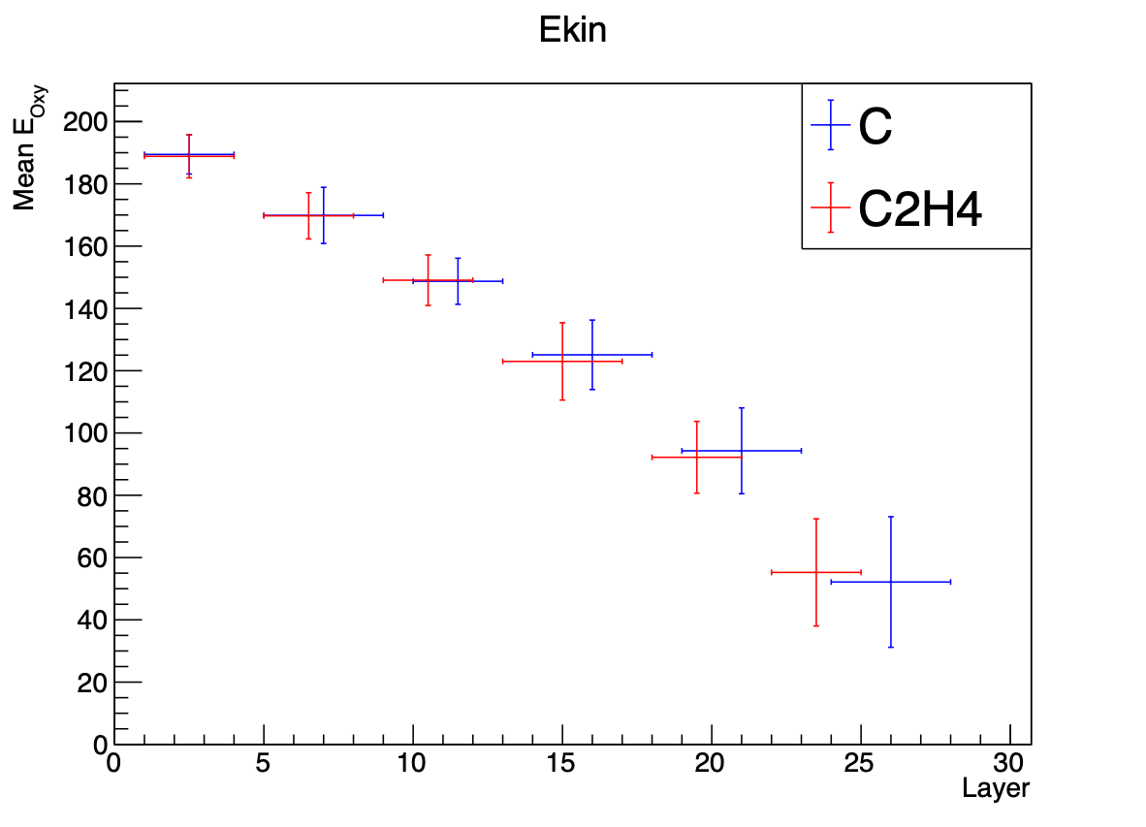
One detector… many measurements!
$$\frac{dσ(x)}{dx}|_{CorC_{2}H_{4}}=\frac{Y_{i}(x)}{N_{B}N_{TG}Δxϵ_{reco}^{i}(x)}$$
The energy loss within S1 is not negligible
We divide S1 into sub-sections
C:
(189 ± 6) MeV/n
(170 ± 9) MeV/n
(149 ± 7) MeV/n
(125 ± 11) MeV/n
(94 ± 14) MeV/n
(52 ± 21) MeV/n
C2H4:
(189 ± 7) MeV/n
(170 ± 7) MeV/n
(149 ± 8) MeV/n
(123 ± 12) MeV/n
(92 ± 12) MeV/n
(55 ± 17) MeV/n
H:
(189 ± 7) MeV/n
(170 ± 9) MeV/n
(149 ± 8) MeV/n
(124 ± 12) MeV/n
(93 ± 14) MeV/n
(54 ± 21) MeV/n

Slide 29
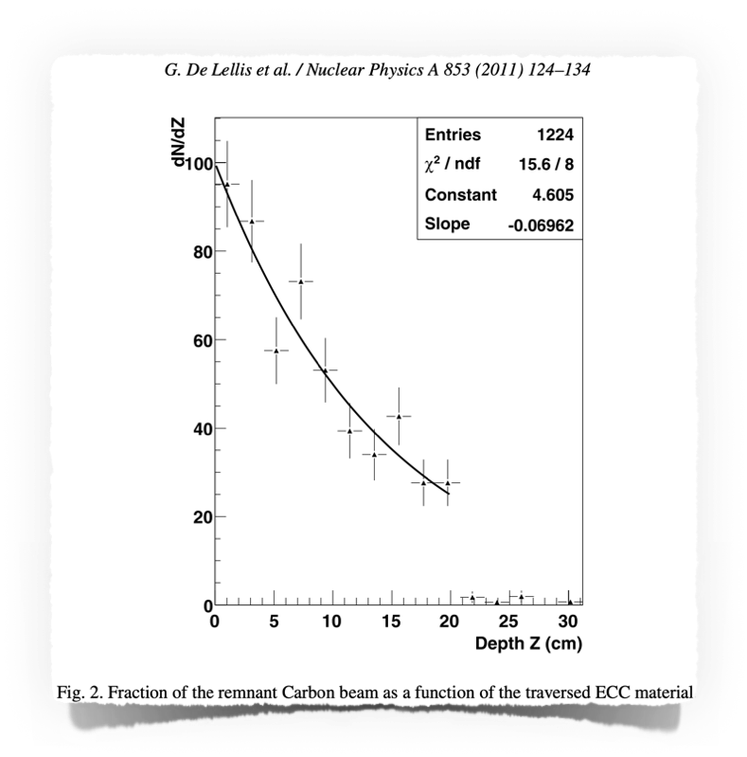
The problem of $N_{B}$ evaluation
$$\frac{dσ(x)}{dx}|_{CorC_{2}H_{4}}=\frac{Y_{i}(x)}{N_{B}N_{TG}Δxϵ_{reco}^{i}(x)}$$
$$N_{B_{1}}$$
$$N_{B_{2}}$$
$$N_{B_{3}}$$
Each passive material layer can be considered a “new measurement”
The number of incident beam particle on each layer has to be evaluated and is affected by its efficiency
New approach: estimation from oxygen tracks

Slide 30
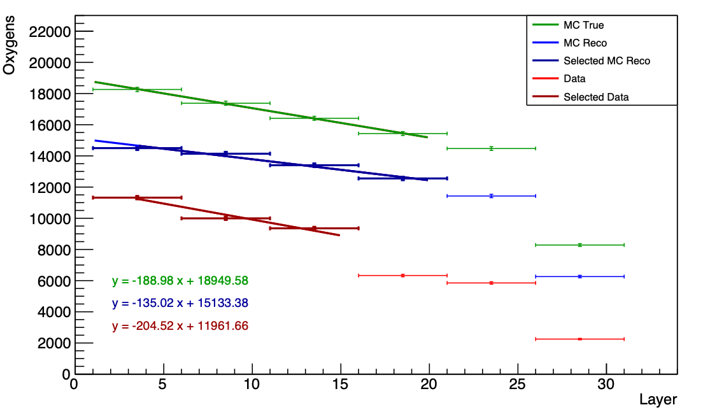
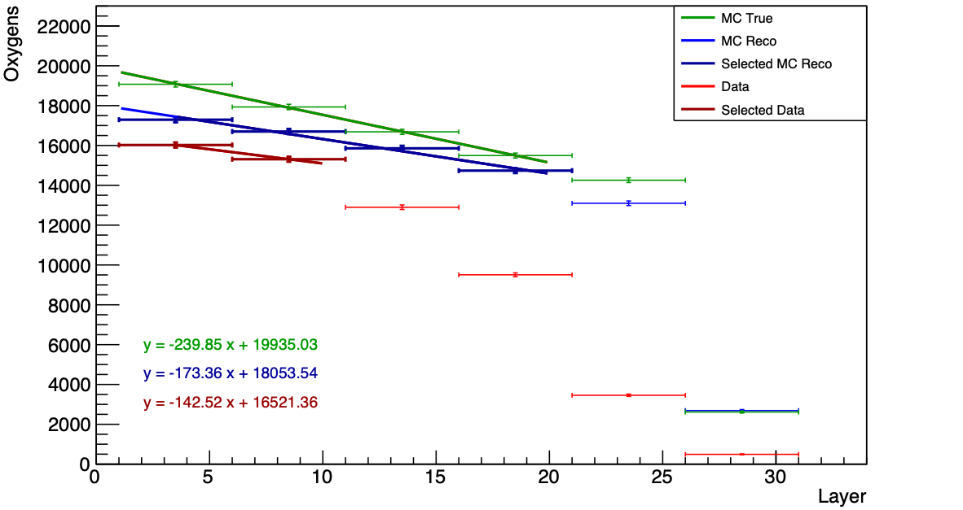
The problem of $N_{B}$ evaluation
Oxygen: tracks with $tanθ≤0.02$ rad
Bin grouped (size 5) to reduce efficiency problems in single layers
For fit only layers in bold have been considered (larger inefficiencies for data after)
$N_{B}$ of a specific film evaluated from the fit and corrected for efficiency (${N_{BMCReco}}/{N_{BMCTrue}}$)
C Target
C2H4 Target

Slide 31
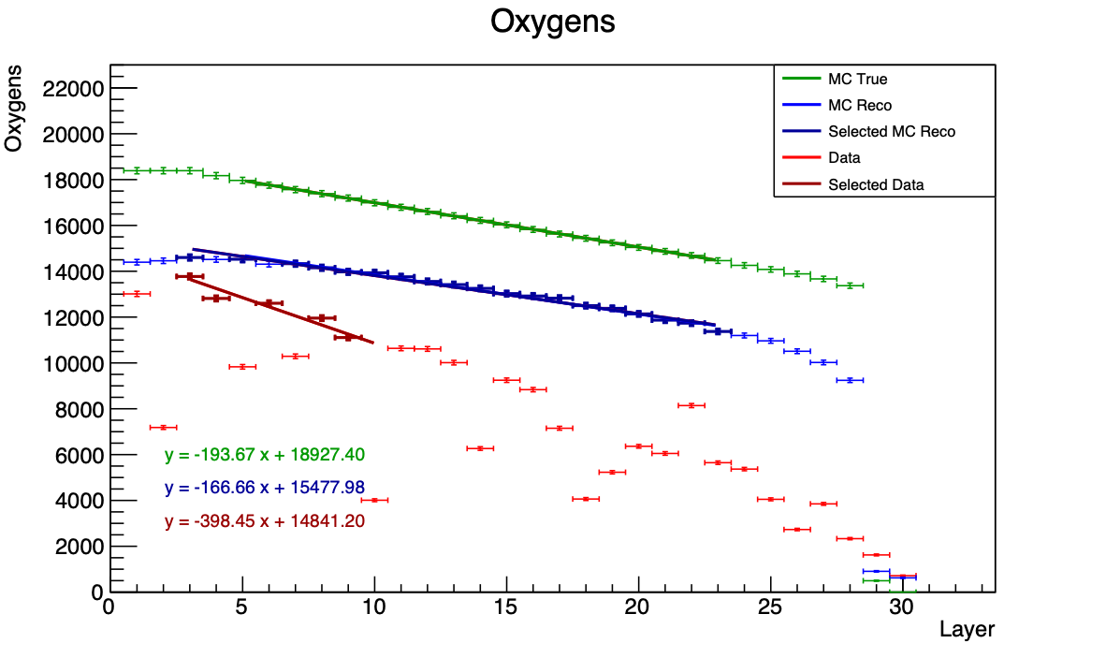
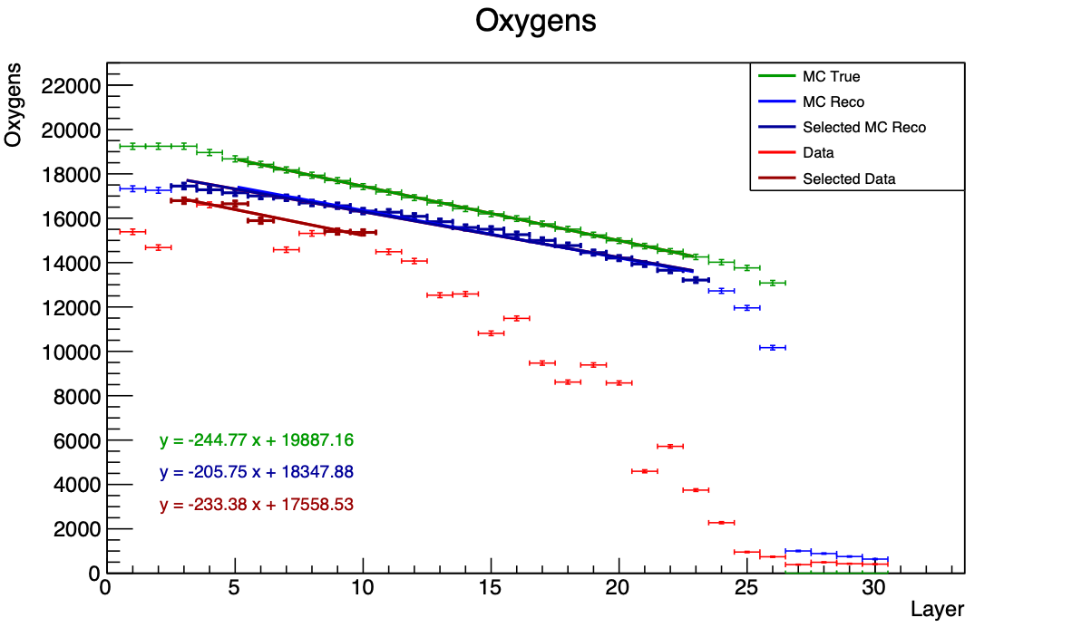
The problem of $N_{B}$ evaluation
Cross section measurement sensitive to $N_{B}$
New attempts on-going for improving (only) oxygen reconstruction
If successful, it will be a double check for cross section evaluation!
C Target
C2H4 Target

Slide 32
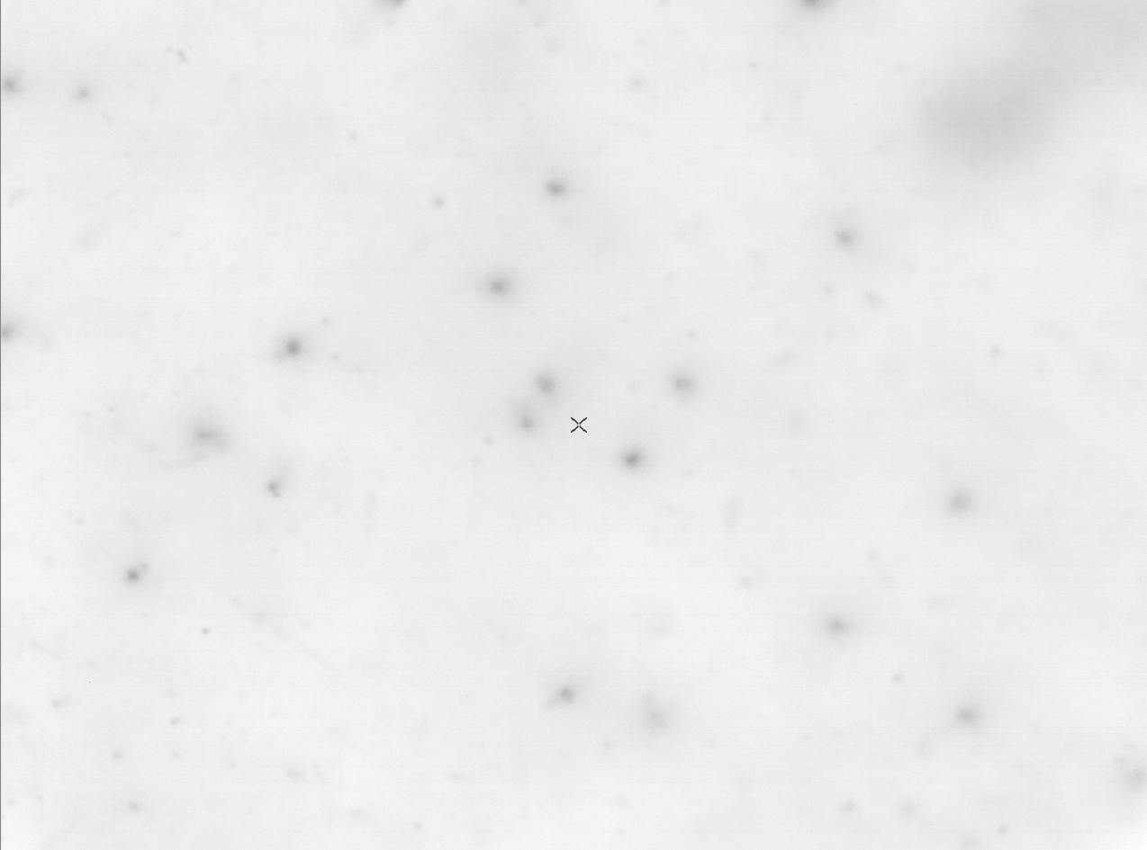
590 μm
797 μm

Slide 33
Closure test?
$$\frac{dσ(x)}{dx}|_{CorC_{2}H_{4}}=\frac{Y_{i}(x)}{N_{B}N_{TG}Δxϵ_{reco}^{i}(x)}$$
How to evaluate efficiencies? At the moment: $ϵ=\frac{Y_{i_{MCReco}}}{Y_{i_{MCTrue}}}$
We cannot evaluate efficiency from MC event by event (no trigger, no time stamp for emulsions…)
Comparison of integrated cross section at Z=3 and $θ<{10}^{∘}$ with electronic detector setup
Comparison with literature
Other ideas?

Slide 34
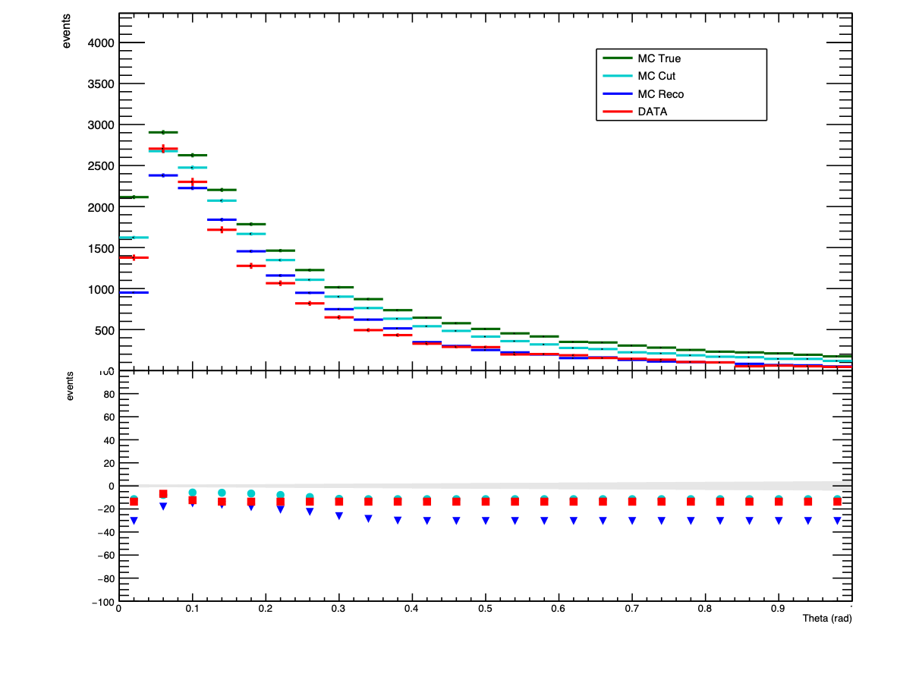
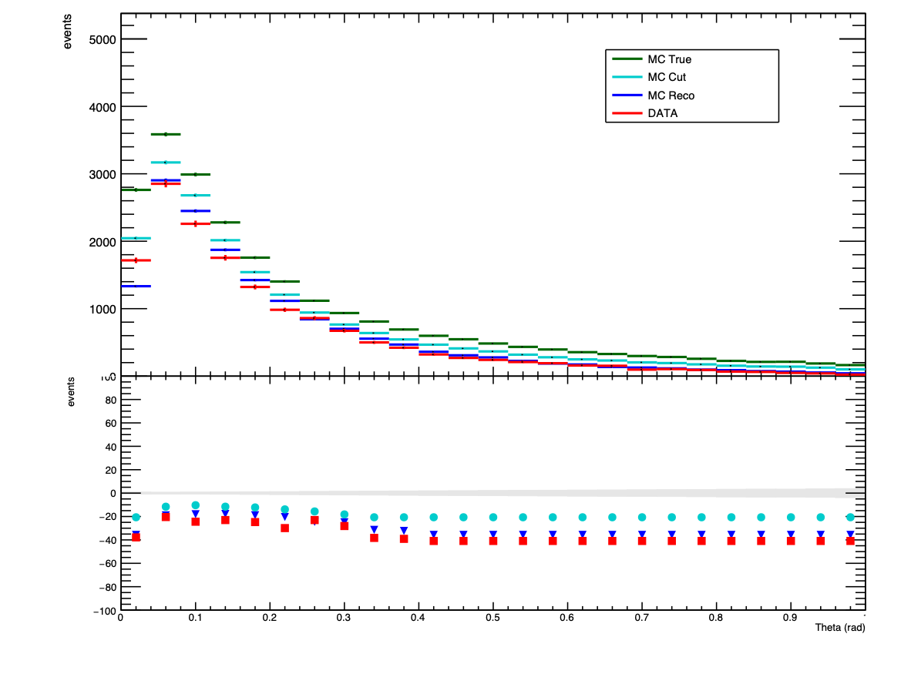
Angle distributions
C Target
C2H4 Target
% [(X - MCT)/MCT]*100
% [(X - MCT)/MCT]*100
Thanks Riccardo!

Slide 35
Vertices multiplicity distributions
C Target
C2H4 Target

Slide 36
Number of vertices per layer
C Target
C2H4 Target
% [(X - MCT)/MCT]*100
% [(X - MCT)/MCT]*100

Slide 37
Number of fragments per layer
C Target
C2H4 Target
% [(X - MCT)/MCT]*100
% [(X - MCT)/MCT]*100

Slide 38
Total reaction cross section on C
PRELIMINARY
 | Projectile Ekin (MeV/n) | Cross section
Yamaguchi 2011 | 288 | 852 ±17
Zeitlin 2011 | 290 | 863 ±20
Zeitlin 2011 | 400 | 842 ±22
$Y_{i}=$# of vertices

Slide 39
Total production cross section on C
PRELIMINARY
$Y_{i}=$# of fragments

Slide 40
Total reaction cross section on C2H4
PRELIMINARY
Plate 2-3 excess under investigation!
 | Projectile Ekin (MeV/n) | Cross section on CH2
Webber 1990 | 441 | 1260 ±13
Webber 1990 | 591 | 1316 ±13
Webber 1990 | 669 | 1328 ±13
$Y_{i}=$# of vertices

Slide 41
Total production cross section on C2H4
PRELIMINARY
$Y_{i}=$# of fragments

Slide 42
Integrated cross section H
Total reaction cross section
Total production cross section
PRELIMINARY
PRELIMINARY
$Y_{i}=$# of vertices
$Y_{i}=$# of fragments

Slide 43
New article in preparation!
Possible Journals:
Nuclear Physics A (IF 1.4)
Physical Review Letters C

Slide 44
Conclusions
Improvements:
MC description of detector response (“MC Reco”): background + misalignments
Oxygen @ 200 MeV/n on C and C2H4
Comparison between MC True, MC Reco and DATA improved
Estimation of the number of incoming oxygens in each S1 “sub-section”
Integrated Cross section evaluation at different energies
To do:
Closure test?
Systematics evaluation
Final checks and new publication soon
New paper on charge measurement PUBLISHED!

Slide 45
Notes:
© Copyright Showeet.com – Creative & Free PowerPoint Templates

Slide 46
BACK UP SLIDES
Notes:
© Copyright Showeet.com – Creative & Free PowerPoint Templates

Slide 47
Number of reconstructed vertices
 |  | GSI1 C target | GSI2 C2H4 target | GSI3 C target
 | Beam particles | 18990 | 19988 | 14375
MC | True vertices | 3547 | 5403 | 5860
 | Reco vertices | 3140 | 4624 | 3591
DATA | Beam particles | 19375 | 20625 | 14375
 | Data vertices | 3519 | 4686 | 3462
Cuts for vertices selection:
n≥3, n = number of tracks (parent + daughters)
At least 2 daughters with at least 3 segments
Notes:
----------------
nvtx MC: 4798 5567
nvtx MC RECO: 4031 4753
nvtx DATA: 4086 5136

Slide 48
GSI1: Oxy@200 MeV/n on C target
Fragments’ Multiplicity
MC TRUE vs MC RECO
MC RECO vs DATA
Distributions normalised to beam particles

Slide 49
GSI1: Oxy@200 MeV/n on C target
N vertices per layer
MC TRUE vs MC RECO
MC RECO vs DATA
Distributions normalised to beam particles

Slide 50
GSI1: Oxy@200 MeV/n on C2H4 target
N vertices per layer
MC TRUE vs MC RECO
MC RECO vs DATA
Distributions normalised to beam particles

Slide 51
GSI1: Oxy@200 MeV/n on C target
N fragments per layer
MC TRUE vs MC RECO
MC RECO vs DATA
Distributions normalised to beam particles
Notes:
aggiungere display mult 1

Slide 52
GSI2: Oxy@200 MeV/n on C2H4 target
N vertices per layer
MC TRUE vs MC RECO
MC RECO vs DATA
Distributions normalised to beam particles

Slide 53
GSI2: Oxy@200 MeV/n on C2H4 target
Fragments’ Multiplicity
MC TRUE vs MC RECO
MC RECO vs DATA
Distributions normalised to beam particles

Slide 54
GSI3: Oxy@400 MeV/n on C target
Fragments’ Multiplicity
MC TRUE vs MC RECO
MC RECO vs DATA
Distributions normalised to beam particles

Slide 55
Vertexing improvements
2-prongs back-to-back vertices, formed due to more stringent tracking parameters, are reattached in the same track
D
C
v3
B
v2
A
v1

Slide 56
Vertexing improvements
2-prongs fake vertices made of one or two short tracks (n$≤$3)
3-prongs fake vertices made of a short (n$≤$3) large angle track attached to an oxygen track which was split into two pieces. Short track discarded and long track becomes a a single track

Slide 57
Vertexing improvements
Vertices made of two oxygen tracks discarded
Two oxygens entering the same vertex: the one with largest impact parameter is removed

Slide 58
Vertexing - improvements
Vertices without oxygen track: beam track is reconstructed as penetrating due to very similar angle of a daughter track. The correct topology is restored
Search for extra daughters
Before
After
800 microns
Notes:
METTERE UNITA’ Di misura
DATA Found candidates beam tracks: 324
MCFound candidates beam tracks: 644 true MC 453 -> 70%
vertices formed: 783
vertices corrected: 160

Slide 59
Vertexing - improvements
Oxygen going into nitrogen with the emission of a proton. Due to very similar angle Oxygen and Nitrogen are reconstructed as one track. Search for protons with small impact parameter to the beam track which go beyond the Bragg Peak.
Before
After
Proton
Oxygen
Nitrogen

Slide 60
Cross Section Measurement
$Y_{i}=$# of fragments in the interval $Δθ$
$N_{B}=$# of ions colliding on the target
$N_{TG}=$# of particles in the target: $\frac{ρdN_{A}}{A}$, with:
$ρ=$target density: $ρ_{C}=2.26g/cm^{3}$ $ρ_{C_{2}H_{4}}=0.94g/cm^{3}$ $ρ_{H}=0.0708g/cm^{3}$
$d=$target thickness: $d_{C}=0.1cm$ per layer $d_{C_{2}H_{4}}=0.2cm$ per layer
$$N_{A}=6.022⋅{10}^{23}/mol$$
$A=$molar mass: $A_{C}=12g/mol$ $A_{C2H4}=28g/mol$ $A_{H}=1g/mol$
$Δθ=$$θ$ bin
$ϵ_{reco}^{i}$ = reconstruction efficiency
Starting from kinematic distributions it's possible to evaluate the differential cross section:
$$\frac{dσ(θ)}{dθ}|_{CorC_{2}H_{4}}=\frac{Y_{i}(θ)}{N_{B}N_{TG}Δθϵ_{reco}^{i}(θ)}$$
$$\frac{dσ(θ)}{dθ}|_{H}=\frac{1}{4}\left(\frac{dσ(θ)}{dθ}|_{C_{2}H_{4}}-2\frac{dσ(θ)}{dθ}|_{C}\right)$$

