Slide 1
XVI FOOT Meeting
Clustering in Light Nuclei
University of Naples "Federico II" & INFN-Naples
Daniele Dell’Aquila^{1,2}
¹Dipartimento di Fisica "Ettore Pancini", University of Naples "Federico II", Naples, Italy
²INFN-Sezione di Napoli, Naples, Italy
daniele.dellaquila@unina.it
Daniele Dell’Aquila (daniele.dellaquila@unina.it) – June, 24th 2024

Slide 2
Clusters in nuclei
Complexity of nuclear force → deviation from the sphericity: axial deformation (collective behaviours), spatial re-organization of nucleons in bounded sub-units (cluster model).
¹²O
¹³O
¹⁴O
¹⁵O
¹⁶O
¹⁷O
¹⁸O
¹⁹O
²⁰O
²¹O
²²O
¹¹N
¹²N
¹³N
¹⁴N
¹⁵N
¹⁶N
¹⁷N
¹⁸N
¹⁹N
²⁰N
²¹N
C
⁸C
⁹C
¹⁰C
¹¹C
¹²C
¹³C
¹⁴C
¹⁵C
¹⁶C
¹⁷C
¹⁸C
¹⁹C
²⁰C
α
B
⁸B
⁹B
¹⁰B
¹¹B
¹²B
¹³B
¹⁴B
¹⁵B
¹⁷B
¹⁹B
α
University of Naples "Federico II" & INFN-Naples
Be
⁷Be
⁸Be
⁹Be
¹⁰Be
¹¹Be
¹²Be
¹⁴Be
α
Li
⁶Li
⁷Li
⁸Li
⁹Li
¹¹Li
linear chain
¹⁰Be,¹³⁻¹⁴C,¹⁶C(?),…
He
³He
⁴He
⁶He
⁸He
¹H
²H
³H
α
α
n
core
α
α
α
core
neutron skin
⁸He,C
α-cluster
⁸Be
neutron halo
⁶He,¹¹Li,¹¹Be
dilute gas
¹²C 0⁺,¹⁶O,²⁰Ne(?)
Daniele Dell’Aquila (daniele.dellaquila@unina.it) – June, 24th 2024

Slide 3
Clusters in nuclei
Liquid drop model → historically the first model to describe the systematic properties of nuclei. It originates from Bohr’s basic concept of compound nucleus reaction. In a compound nucleus reaction, an incident particle captured by a target nucleus rapidly shares its energy with all the nucleons in the target (short and strong interactions, colletive behaviours → saturation of the binding energy). In addition → nuclei have low compressibility and well-defined surface effect → analogy with a liquid drop.
University of Naples "Federico II" & INFN-Naples
$$B=B_{V}+B_{S}+B_{C}$$
$$B=a_{V}A−a_{S}A^{\frac{2}{3}}−a_{C}Z\left(Z−1\right)A^{−\frac{1}{3}}$$
Volume term: to account for the saturation due to the short range of nuclear forces
Coulomb term: to account for the repulsion due to the Coulomb force
Surface term: to account for the lack of binding of nucleons on the surface
Daniele Dell’Aquila (daniele.dellaquila@unina.it) – June, 24th 2024

Slide 4
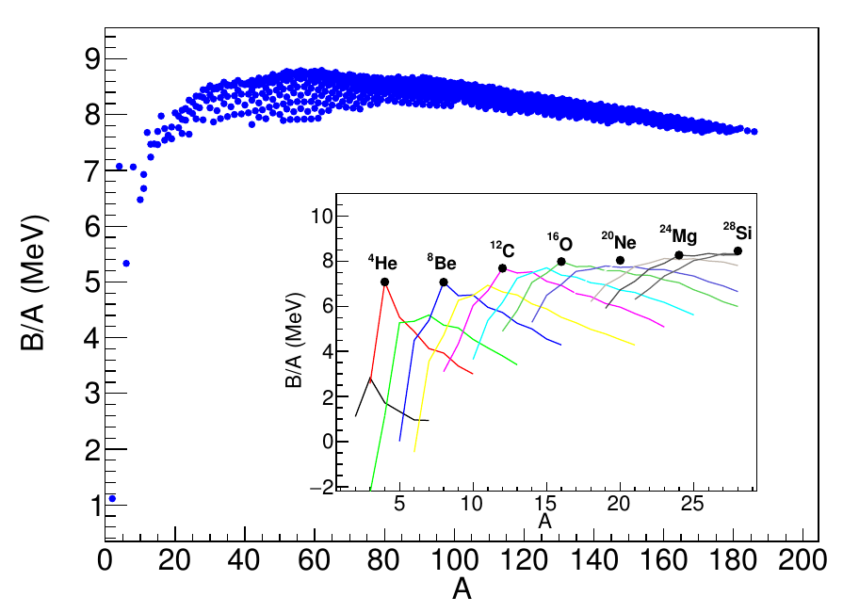
Clusters in nuclei
Hafstad and Teller and Wefelmeir’s experiments → local maxima in the binding energies per nucleon of self-conjugate isotopes.
University of Naples "Federico II" & INFN-Naples
However → the liquid drop model is inadeguate to describe the binding energy of self-conjugate nuclei → self-conjugate nuclei are exceptionally bound → long range correlations → clustering phenomena in self-conjugate systems.
(Self-conjugate nuclei: even-even nuclei with equal number of protons and neutrons → Nα)
Daniele Dell’Aquila (daniele.dellaquila@unina.it) – June, 24th 2024

Slide 5
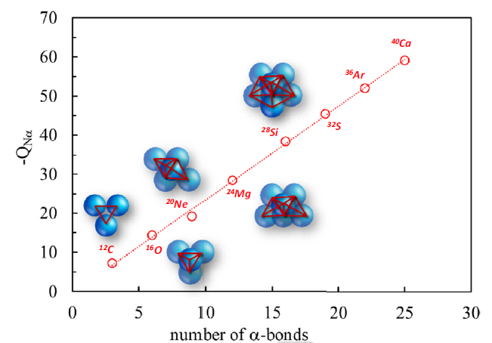
Clusters in nuclei: the alpha-particle model
1899 → Rutherford experiment → use of alpha-radiation to carry out an experiment.
1928 → Gamow and, independently, Gurney and Condon → alpha-decay made possible by quantum-mechanlical tunneling of an alpha-particle from inside the decaying nucleus → alpha-particle preformed in the nucleus.
1938 → Hafstad and Teller found out that the binding energy for self-conjugate systems was linearly correlated with the number of α-α bonds in the nucleus → geometrical model for the descrition of the nucleus:
University of Naples "Federico II" & INFN-Naples
$$−Q_{Nα}=N_{bonds}⋅B_{0}$$
Daniele Dell’Aquila (daniele.dellaquila@unina.it) – June, 24th 2024

Slide 6
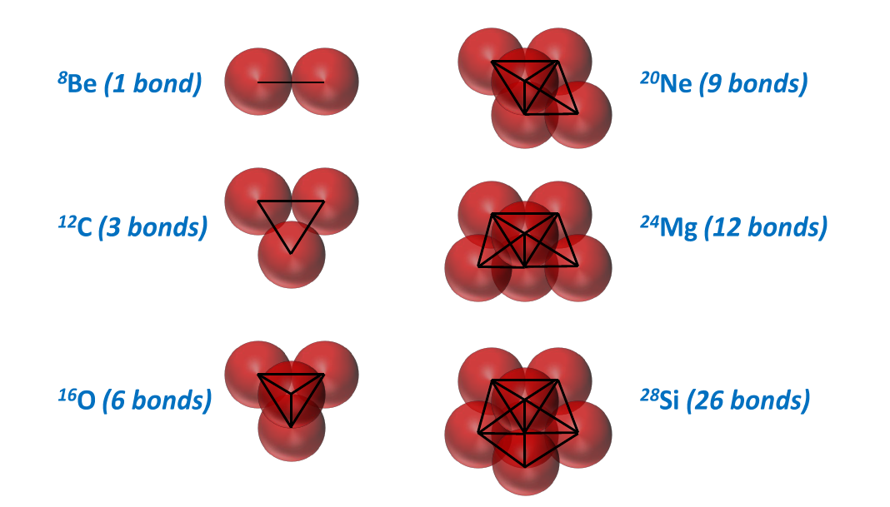
Clusters in nuclei: the alpha-particle model
Experimentally → the α-binding energy per number of bonds is surprisingly constant for each system (about 2.130 MeV) → apparently constant α-α interaction → resilience of the α-particle consituents in the ground state of light self-conjugate nuclei.
The begining of the α-cluster model → L. Hafstad and E. Teller, Phys. Rev. 54, 681 (1938)
University of Naples "Federico II" & INFN-Naples
The model is based on the interaction between α-particles proposed by Wheeler (1937) → application of the Hartree-Fock variational method to the system of eight nucleons (two interacting α-particles).
Daniele Dell’Aquila (daniele.dellaquila@unina.it) – June, 24th 2024

Slide 7
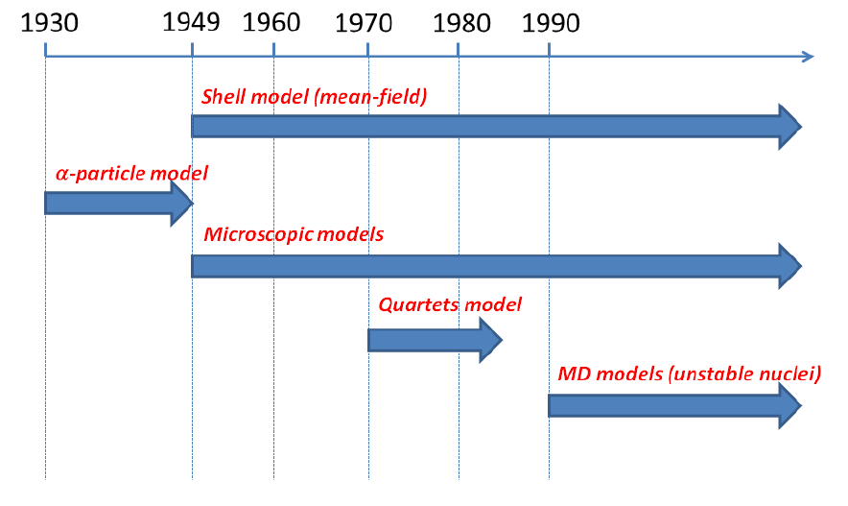
Clusters in nuclei: models
University of Naples "Federico II" & INFN-Naples
Shell model: mean-field and residual interaction → clusters emerge;
α-particle model: spatial disposition of clusters in self-conjugated systems and rotational/vibrational excitations (sensitive to the α-α intearction);
Microscopic models (RGM, GCM, OCM): detailed treatment of the Pauli principle and inter-cluster motion;
Quartet models: excitation of quartets of nucleons and their mutual interaction;
MD models (AMD, FMD): resolution of the Schrödinger equation by using gaussian wave packets.
Daniele Dell’Aquila (daniele.dellaquila@unina.it) – June, 24th 2024

Slide 8
Clusters in nuclei: correlation operator
Cluster models → nuclear models capable to describe clustering aspects in nuclei → study of the formation and spatial distributions of clusters in nuclei.
A key aspect → why do clusters spontaneously form in the nucleus?
Correlation operator: the probability to find two nucleons, respectively, with momenta $Q^{(1)}$ and $Q^{(2)}$, located at ${\vec{x}}^{\left(1\right)}$ and ${\vec{x}}^{\left(2\right)}$, when the nucleus is in the ground state $Ψ$:
University of Naples "Federico II" & INFN-Naples
the integral is extended to the whole momentum space and i and f represent two different sets of spin $σ$ and isospin $τ$ coordinates. The diagonal terms of this operator give the probability for two nucleons to be at a distance $r=\left|\vec{x}\right|=\left|{\vec{x}}^{\left(1\right)}−{\vec{x}}^{\left(2\right)}\right|$. The spatial correlation of a pair of nucleons gives:
$P_{σ}$ and $P_{τ}$ are the spin and isospin projectors, $ρ(\vec{x})$ is the ordinary density and $ρ\left({\vec{x}}^{\left(1\right)},{\vec{x}}^{\left(2\right)}\right)=\frac{A}{V}G\left(r\right)$ is the “mixed-density”. One obtains:
Daniele Dell’Aquila (daniele.dellaquila@unina.it) – June, 24th 2024

Slide 9
Clusters in nuclei: correlation operator
This leads to:
Non-Congruent nucleons, i.e. nucleons which differ either for spin or isosospin or both (12 states).
Congruent nucleons, i.e. nucleons with same spin and isospin (4 states).
University of Naples "Federico II" & INFN-Naples
Including a simplified nuclear interaction → next approximation to the spatial correlation for congruent and non-congruent nucleons (see C.F.v. Weizsacker, Naturwiss 26 (1938) 209):
Daniele Dell’Aquila (daniele.dellaquila@unina.it) – June, 24th 2024

Slide 10
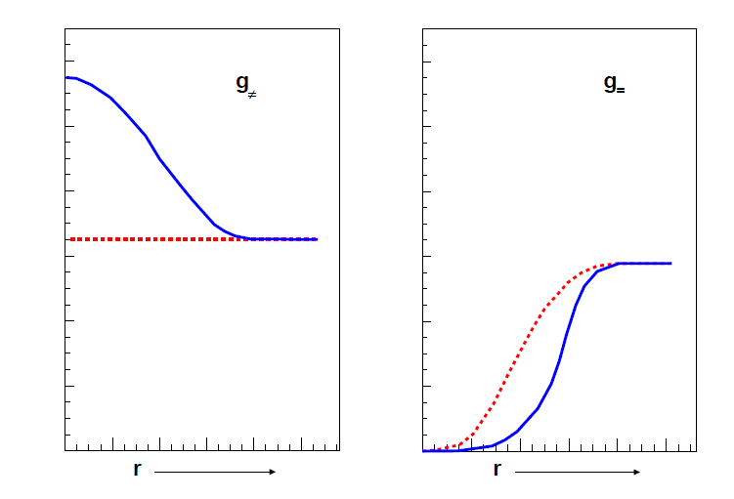
Clusters in nuclei: correlation operator
zero-order approximation → no nuclear interaction
first-order approximation → simplified nuclear interaction
University of Naples "Federico II" & INFN-Naples
Daniele Dell’Aquila (daniele.dellaquila@unina.it) – June, 24th 2024

Slide 11
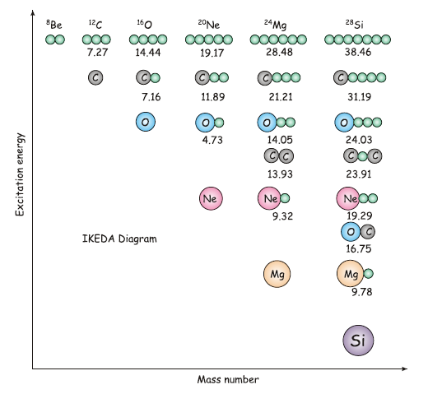
Energetics: Ikeda diagrams
Energetics are crucial in driving the system towards a particular cluster configuration
→ Ikeda diagrams (1968) → clusters are expected to emerge close or slightly below the cluster separation energy.
University of Naples "Federico II" & INFN-Naples
Daniele Dell’Aquila (daniele.dellaquila@unina.it) – June, 24th 2024

Slide 12
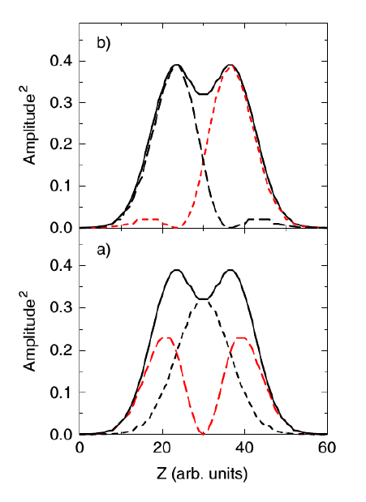
Clusters and deformation
Another key aspect → how do symmetries affect the appearance of clusters in nuclei?
Symmetries have an impact on the collective excitation of the nucleus, but via their influence on the mean-field of light systems, they guide the formation of the clusters themselves → interaction between the mean-field and the cluster degree of freedom.
If one solves the Shroedinger equation usign a simple axially deformed harmonic oscillator potential, one finds that the eigenstates can be expressed expressed in terms of the linear combination of independent states $φ_{i}$:
University of Naples "Federico II" & INFN-Naples
Density corresponding to the HO configurations for ⁸Be → The density distribution generated by particles moving in an axially deformed potential generates a clustered density. →
Daniele Dell’Aquila (daniele.dellaquila@unina.it) – June, 24th 2024

Slide 13
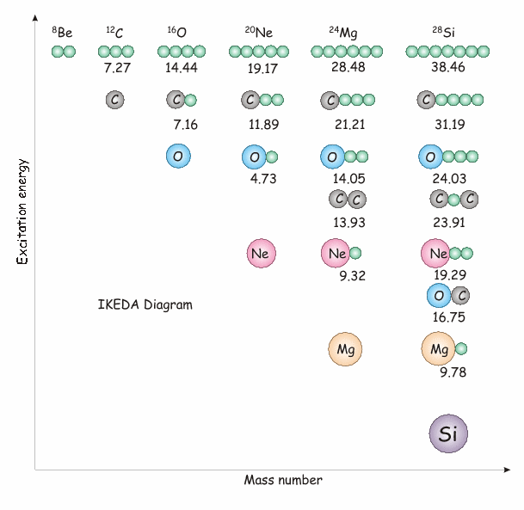
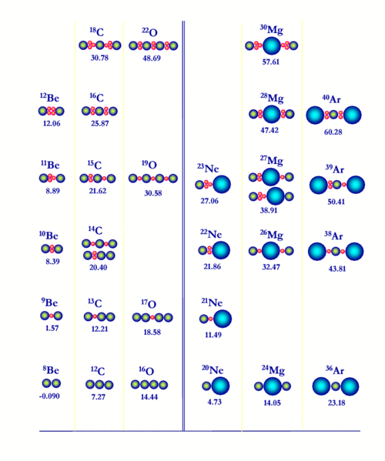
How to study clustering phenomena
Cluster structures appear with larger probability near the corresponding decay threshold → Ikeda diagram, modified Ikeda diagram (neutron-rich nuclei).
Univ. di Napoli Federico II & Université Paris-Saclay
H. Horiuchi K. Ikeda, N. Tagikawa, Prog. Theo. Phys. Suppl. Extra number, 464: 881–884, 1968.
To investigate on the possible presence of clustering phenomena → nuclear reactions to populate resonant states characterized by clustering → if they are above threshold the cluster decay dominates → invariant mass reconstruction of the emitting state by detecting and tracking all the emitted particles: particle-particle or multi-particle correlations.
N*
N_{gs}
$$E_{x}=\sqrt{q^{μ}q_{μ}}−E_{thr}$$
Daniele Dell’Aquila (daniele.dellaquila@unina.it) – June, 24th 2024

Slide 14
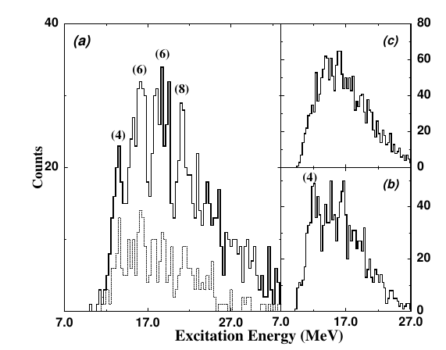
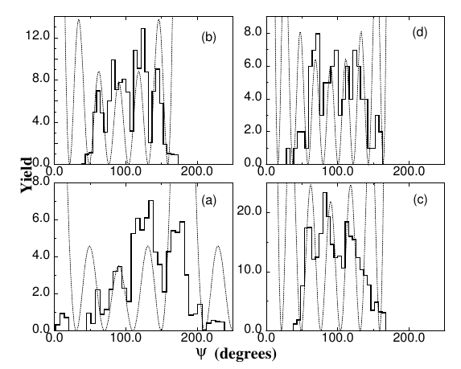
Particle-particle and multi-particle correlations
M. Freer et al., Phys. Rev. Lett. 82 (1999) 1383
¹²B studied via helium correlations → invariant mass spectra of correlated particles to evidence possible cluster configurations.
Angular correlation studies suggest spin and parity (J^{π}) assignments of the populated resonances → periodicity of the $ψ$ angle spectra (angle of the relative velocity vector with the beam axis):
$$\frac{dσ}{dΩ}∝{\left|P_{l}\left(cosψ\right)\right|}^{2}$$
Legendre polynomial of l-th order → relative angolar momentum → spin of the resonance.
Univ. di Napoli Federico II & Université Paris-Saclay
Daniele Dell’Aquila (daniele.dellaquila@unina.it) – June, 24th 2024

Slide 15
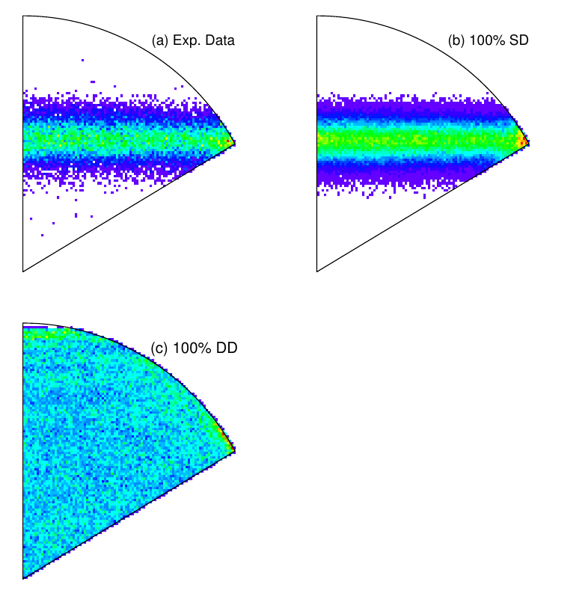
Particle-particle and multi-particle correlations
D. Dell’Aquila et al., Phys. Rev. Lett. 119 (2017) 132501
Using invariant-mass techniques to probe the cluster decay mechanism of clustered states in ¹²C (focus on the famous Hoyle state) → outstanding astrophysical relevance.
Using invariant-mass techniques to probe the cluster decay mechanism of clustered states in ¹²C (focus on the famous Hoyle state) → outstanding astrophysical relevance.
Two alpha-emitting decay modes are possible: direct and sequential (through the ground state of ⁸Be) → topological studies of the alpha-emission events are required to disentangle.
Univ. di Napoli Federico II & Université Paris-Saclay
⁸Be
α
$$Γ_{α_{0}}$$
α
¹²C*
sequential
α
α
α
α
direct
α
$$Γ_{3α}$$
α
α
Daniele Dell’Aquila (daniele.dellaquila@unina.it) – June, 24th 2024

Slide 16
Particle-particle and multi-particle correlations: HICs
In collisions involving heavy ions (Heavy Ion Collisions, HICs) → large number of particles → more complicated case.
Hot and dilute in-medium sources
Organization of nucleons in finite clusters, bound and unbound states, exotic isotopes, …
Resonance decays: Invariant mass spectroscopy → clustering and nuclear structure properties
¹⁰B
Univ. di Napoli Federico II & Université Paris-Saclay
p
¹¹C
t=10 fm/c
t=100 fm/c
t=200 fm/c
t=400 fm/c
Central Xe+Sn E/A=56 MeV, b=0 fm
Daniele Dell’Aquila (daniele.dellaquila@unina.it) – June, 24th 2024

Slide 17
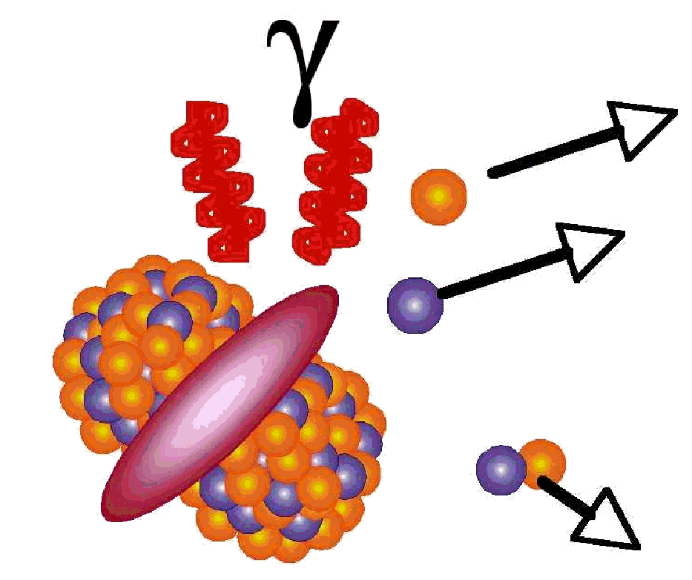
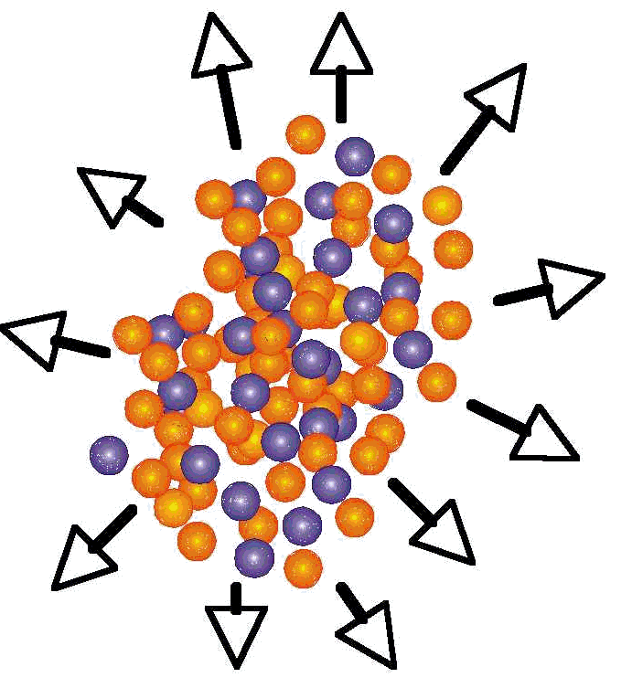
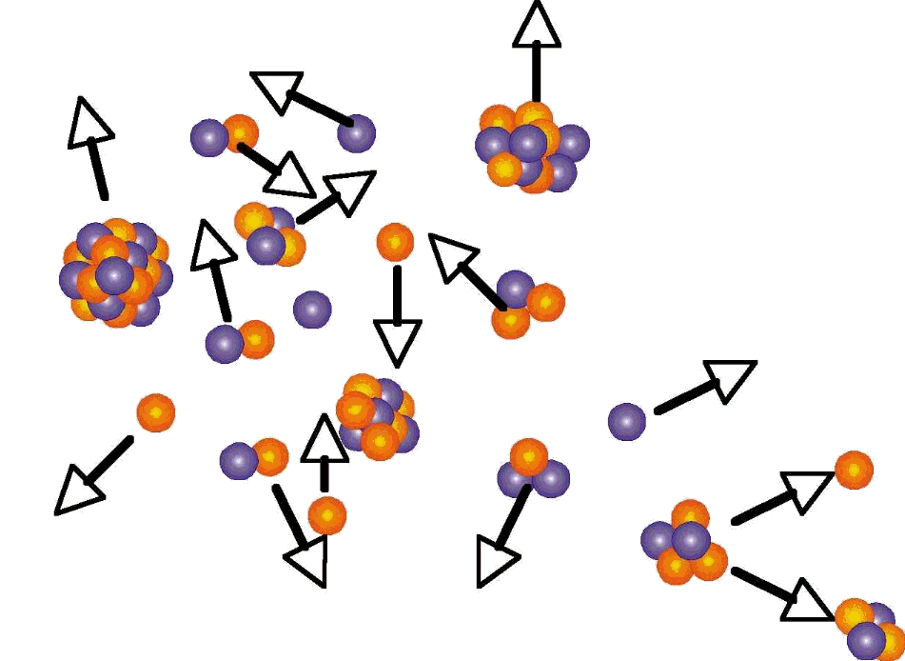
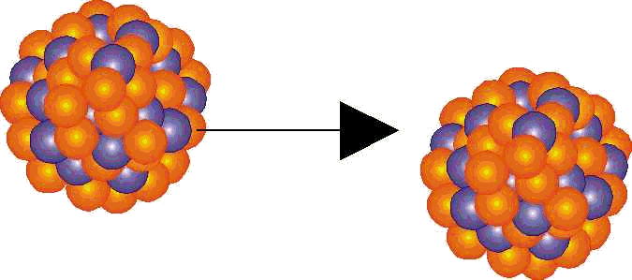
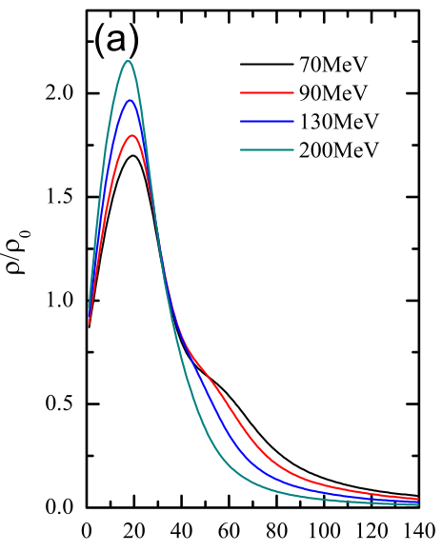
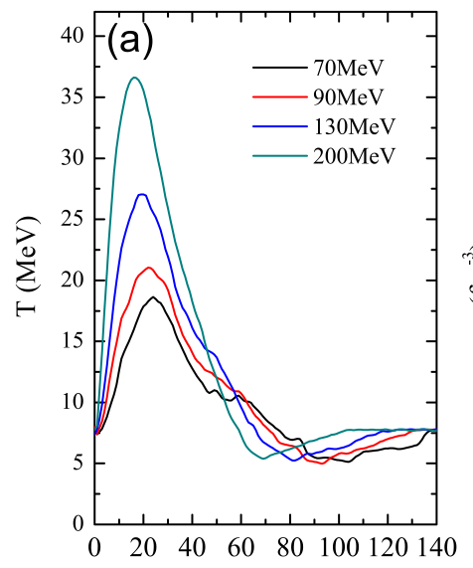
Particle-particle and multi-particle correlations: HICs
Heavy Ion Collisions (HICs) at intermediate energies (20-200 MeV/u) with central impact parameters → sub-saturation density region (ρ<ρ₀) created in the collision.
Projectile
Target
Secondary decays
Pre-equilibrium, stopping, compression
Fragmentation
Flow, expansion
Univ. di Napoli Federico II & Université Paris-Saclay
ρ/ρ₀
Temperature
time (fm/c)
time (fm/c)
Quantum Molecular Dynamics (QMD) model calculations
Daniele Dell’Aquila (daniele.dellaquila@unina.it) – June, 24th 2024

Slide 18
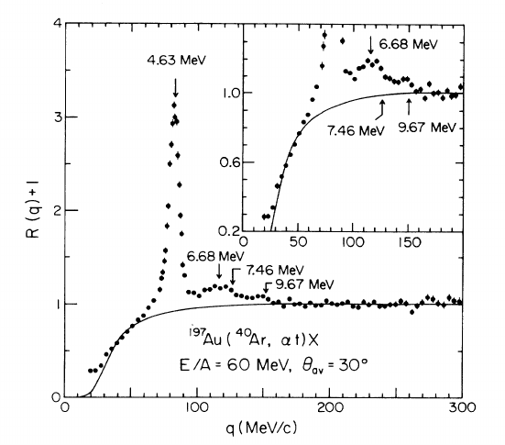
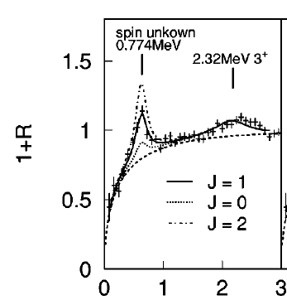
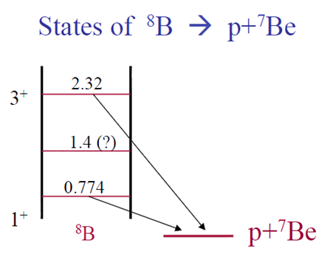
Particle-particle and multi-particle correlations: HICs
Correlation functions R(q) → to evidence nuclear resonant states produced in-medium.
⁷Li->t-α from J. Pochodzalla et al., Phys. Rev. C 35 (1987) 1695
2-particle correlation function R(q) produced in ⁴⁰Ar+¹⁹⁷Au at 60 AMeV → structure of 7Li (t-α correlations).
Univ. di Napoli Federico II & Université Paris-Saclay
⁸B->p-⁷Be from W.P. Tan et al. Phys. Rev. C69, 061304 (2004)
Resonance decays in dilute and hot expanding nuclear systems
Thermal Model
Relative populations depend on T and structure properties
Daniele Dell’Aquila (daniele.dellaquila@unina.it) – June, 24th 2024

Slide 19
Clusters in nuclei
Thank you for your attention
University of Naples "Federico II" & INFN-Naples
Daniele Dell’Aquila (daniele.dellaquila@unina.it) – June, 24th 2024

