Slide 1
FRPC – FATIC2 status

Slide 2
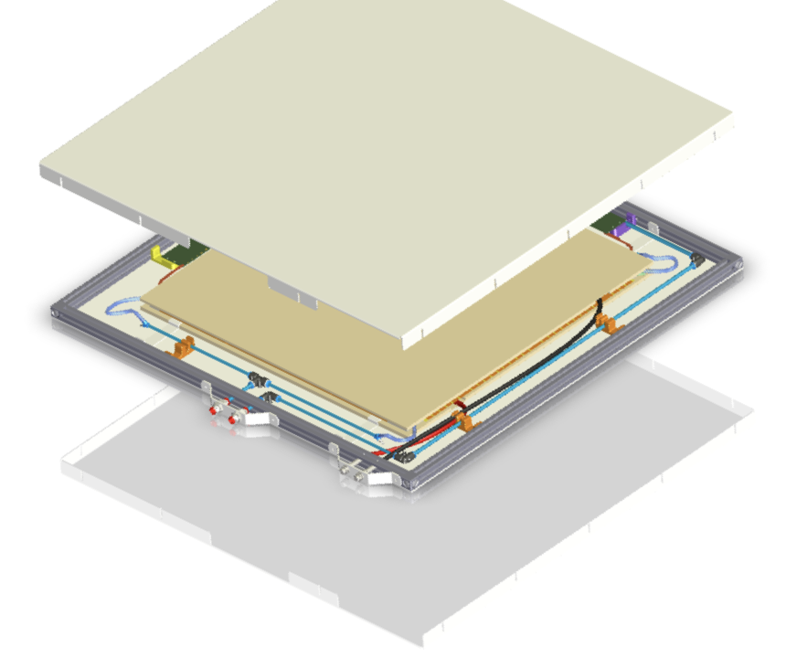
RPC - FATIC2
RPC double gap
  Electrode material/thickness: soda lime glass/1.1 mm
  Gas thickness: 1.43 mm
  1 plane - 32 strips
FATIC2 - 2 discriminators
  ARM discriminator → charge estimation
  Fast discriminator → time of arrival
Signal-noise study on FD

Slide 3
Only strips-FATIC (Electronic office)

Slide 4
Full chamber (RPC lab) – No connected (flying chamber)

Slide 5
Full chamber (RPC lab) – No connected (flying chamber), 1wk after (totally same conditions)

Slide 6
Connecting only HV cables

Slide 7
RPC ON (around WP 7.2 kV)

Slide 8
RPC ON, detector grounded, no calibration

Slide 9
RPC ON, detector grounded, calibration at 20 fC

Slide 10
RPC ON, detector grounded, calibration at 10 fC

Slide 11
RPC ON, detector grounded, calibration at 15 fC

Slide 12
Actions to take place
Chamber layout grounding to be analyzed
External ground??

