Slide 1


3D image reconstruction for Boron Dose distribution in BNCT with CZT-based Compton camera
February 26-28, 2024 @Trento Institute
Sesto Congresso TIFPA
nicola.ferrara@ba.infn.it
dayron.ramos@ba.infn,it

Slide 2
INDEX
BNCT bases and dosimetry
Sensor for dose imaging
Image reconstruction method and simulations
Results using the iterative method
Alternative method of source reconstruction using image processing
First SPECT set-up for dose tomography

Slide 3
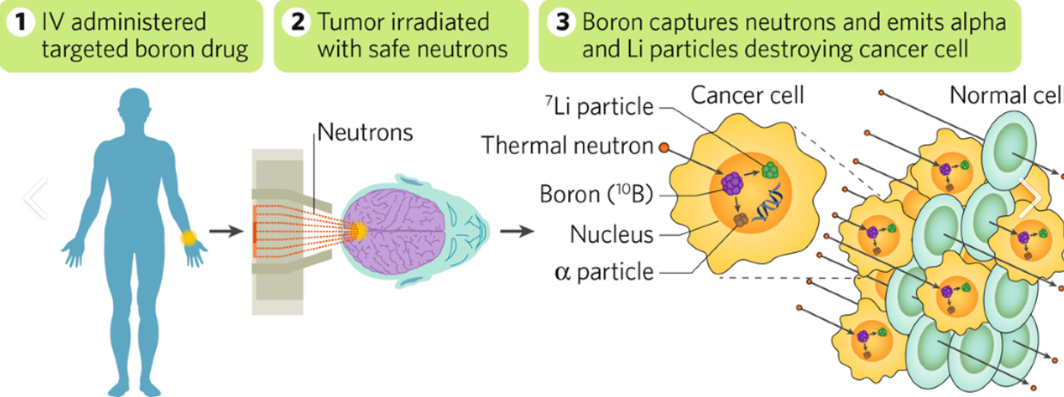
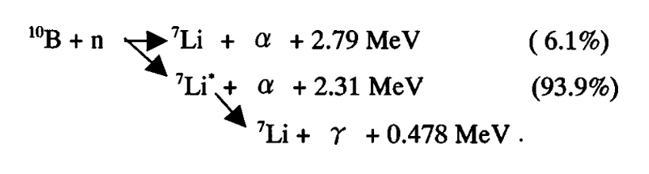
Boron neutron capture therapy
Capture reaction: ¹⁰B(n,α)⁷Li
dD(x,y,z) ≈ n_{B10}(x,y,z) Φ(x,y,z) dV
HADRON THERAPY INSIDE THE
SINGLE CELL

Slide 4
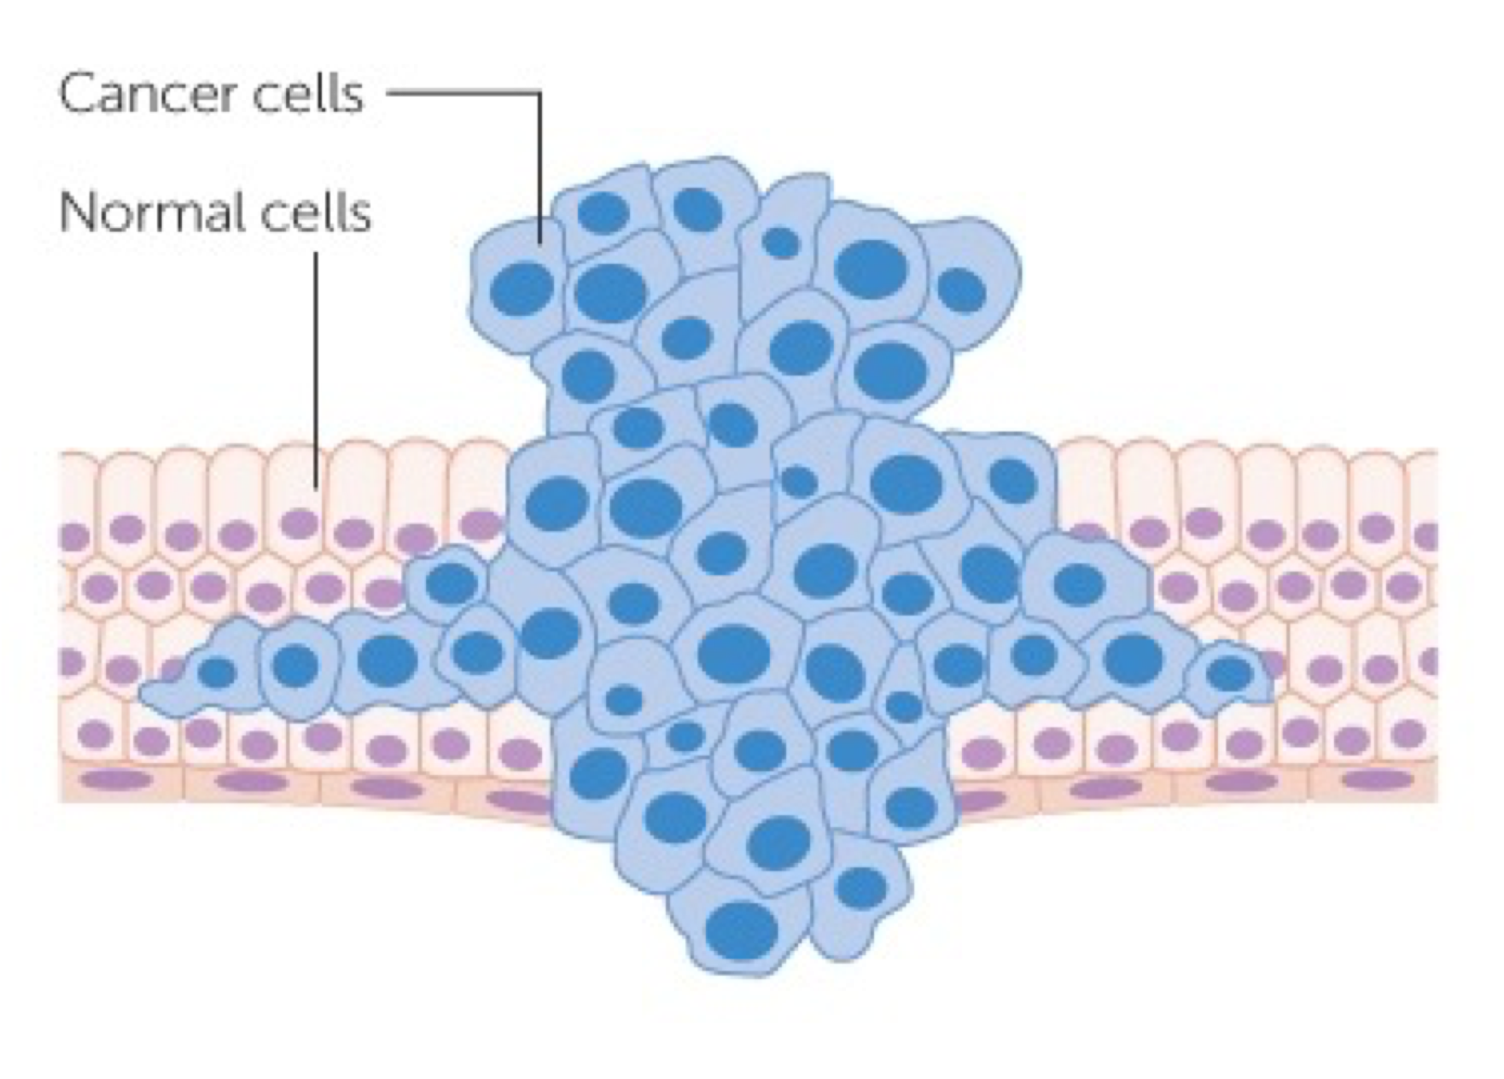
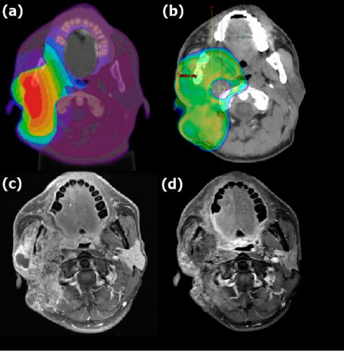

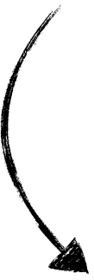

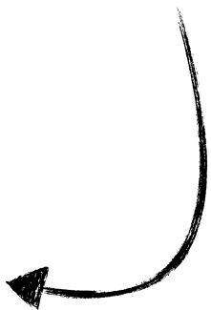
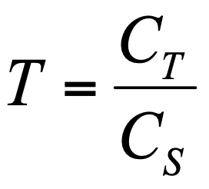
Boron neutron capture therapy
SELECTIVITY
at single cell level
DISTRIBUTION of ¹⁰B

Slide 5
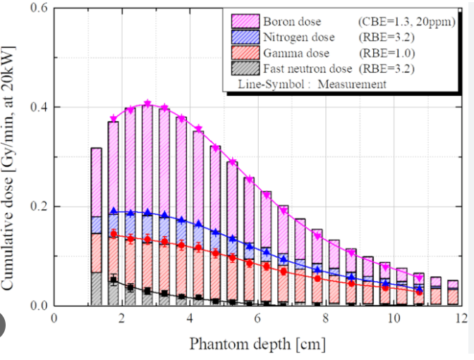
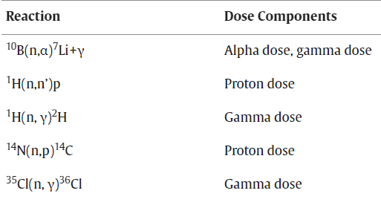
Dosimetry on BNCT
In BNCT we must correctly account for four separate radiation components
Dtotal =
DB +
Dp +
Dn +
D𝛄
Therapeutic dose from ¹⁰B(n,⍺)⁷Li (𝛔=3837 b)
From ¹⁴N(n,p)¹⁴C reactions (Ep=630 keV, 𝛔=1.9 b) due to thermal neutron
Due to epithermal and fast neutron elastic scattering daily with H nuclei
From ¹H(n,𝛄)²H (E=2.2 MeV, 𝛔=0.33 b) & reactor background

Slide 6

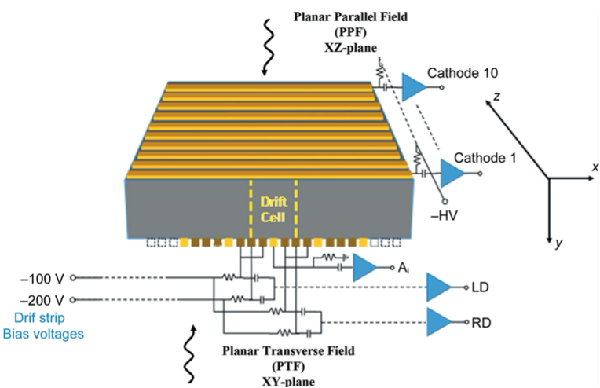
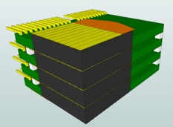
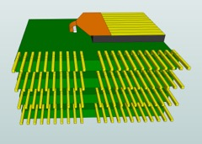
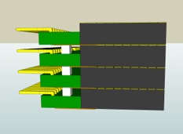
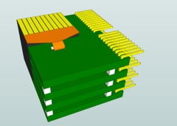
CZT sensors for dose imaging on BNCT
Room-temperature gamma-ray spectroscopic
Sub-millimetre spatial resolution and excellent energy resolution (<1% FWHM at 661.7 keV)
drift strip detector
drift cell: a collecting anode strip + 2 drift strips on the right
side (RD) + 2 on the left side (LD) + 10 cathode strips
CZT single unit: 20x20x5 mm³,
planar transversal field (PTF),
orthogonal drift strip electrodes

Slide 7
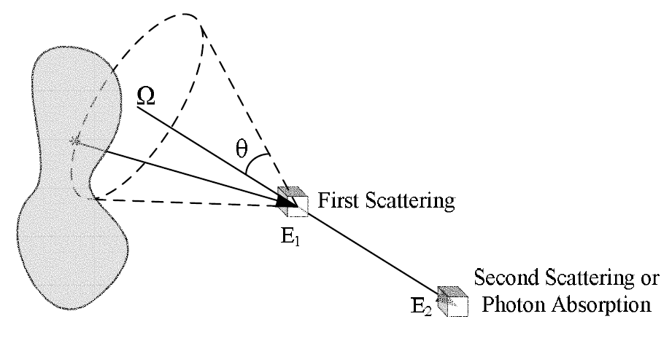
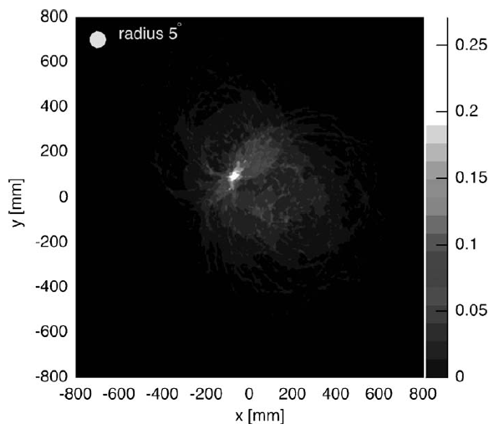
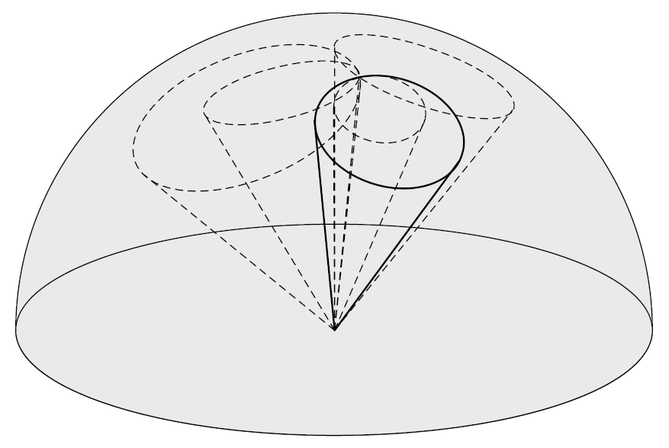
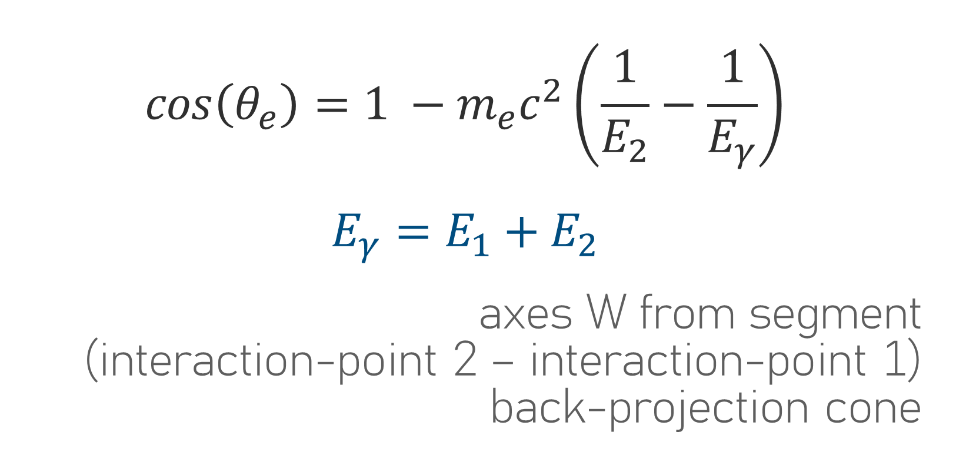
Compton imaging: single stage detector
front plane SCATTER detector
Back plane ABSORBER detector
$$cos\left(θ_{e}\right)=1 −m_{e}c^{2}\left(\frac{1}{E_{2}}−\frac{1}{E_{γ}}\right)$$
$$E_{γ}=E_{1}+E_{2}$$
axes W from segment
(interaction-point 2 – interaction-point 1)
back-projection cone

Slide 8

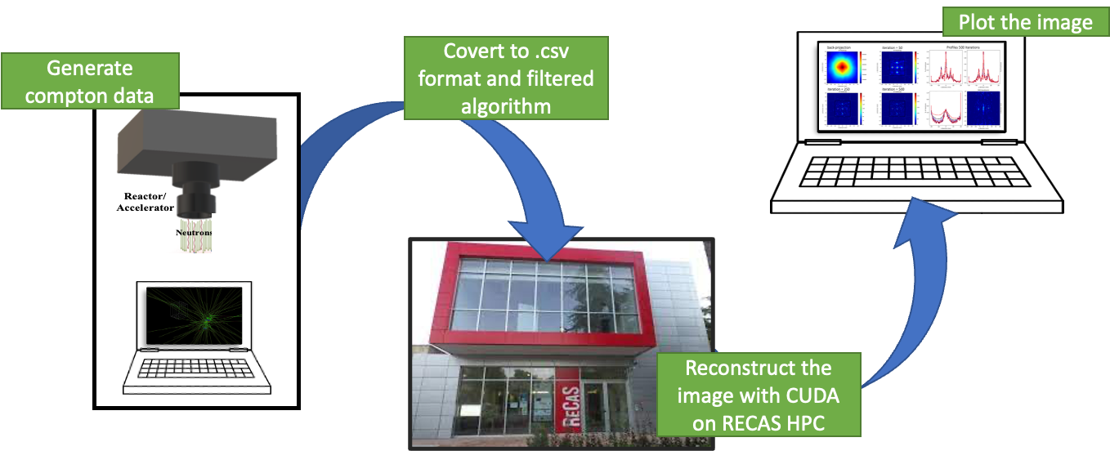
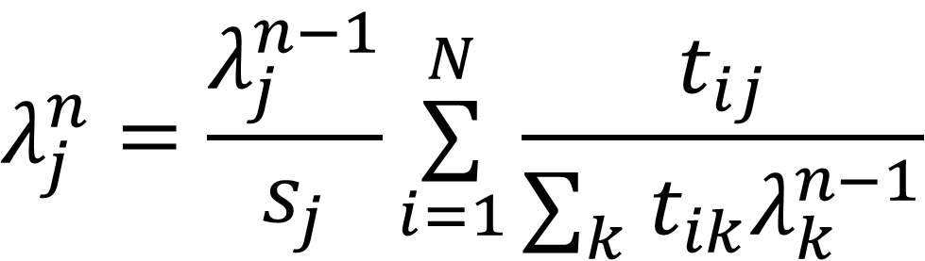
Image reconstruction method
most probable source distribution
Iterative method
Maximum Likelihood Expectation Maximisation (MLEM)
UCT_MLEM – CUDA Compton Camera Image Reconstruction Code
https://github.com/mattcleigh/Compton_MLEM
$$λ_{j}^{n}=\frac{λ_{j}^{n−1}}{s_{j}}\overset{N}{\underset{i=1}{∑}}\frac{t_{ij}}{∑_{k}^{}t_{ik}λ_{k}^{n−1}}$$
λ^{n}j = calculated amplitude of pixel j at the nth iteration
sj = sensitivity, i.e. the probability that a gamma ray originating from pixel j is detected anywhere
Tij = imaging response matrix, i.e. the transition probabilities generated by the measured events(first estimation: based on back-projection, λ0)

Slide 9
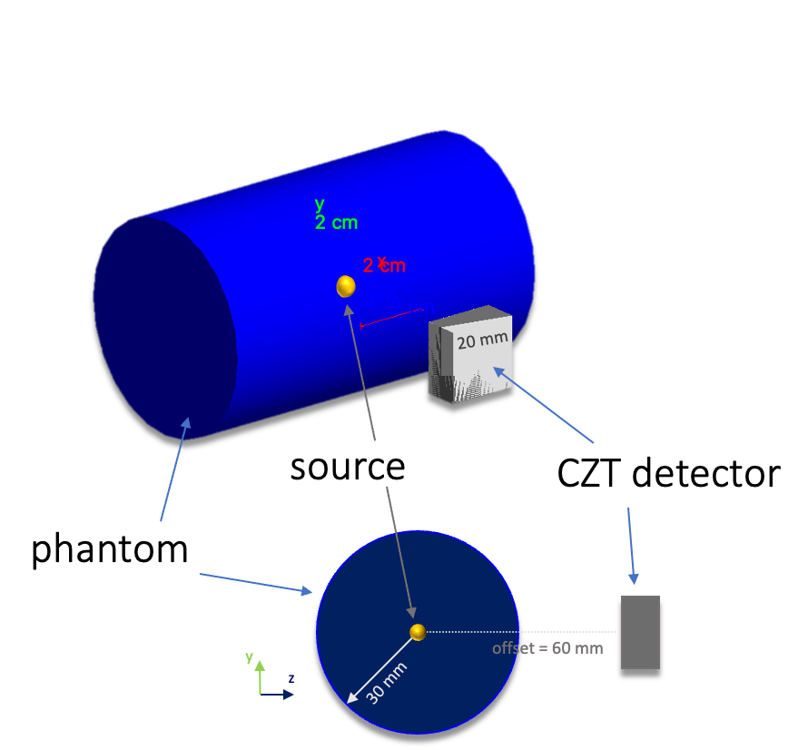
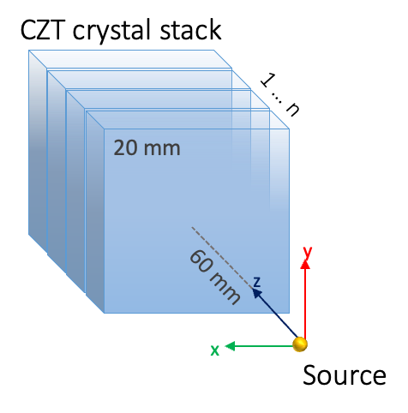
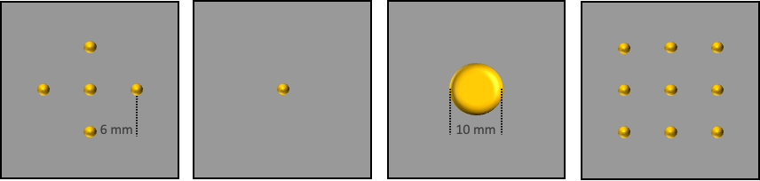
Simulation set-up
Detector
CZT crystal stack (5mm thickness each)
Phantom material
Air, soft tissue
Data
Hits positions, energies dep, replica number

Slide 10
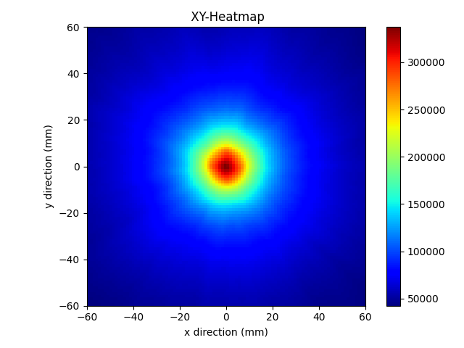
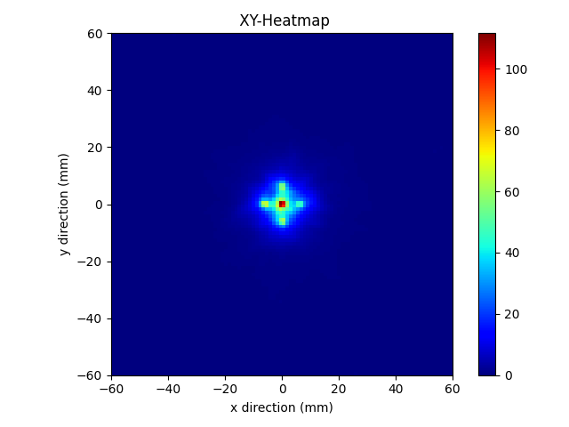
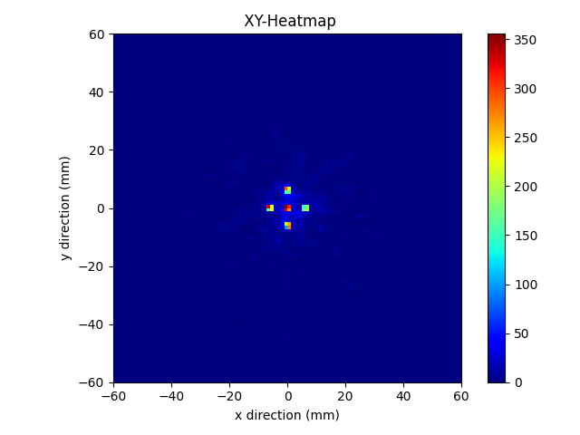
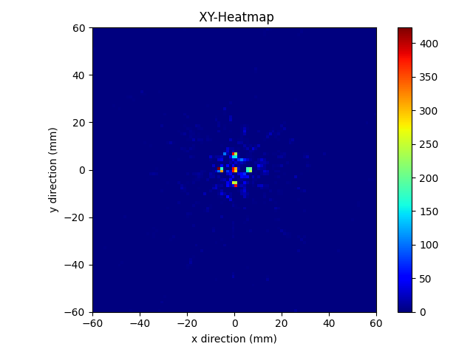
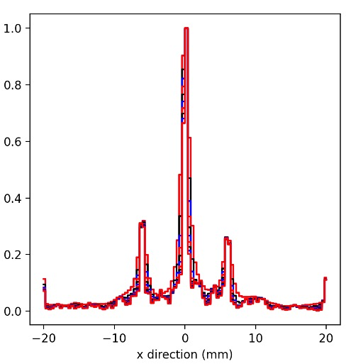
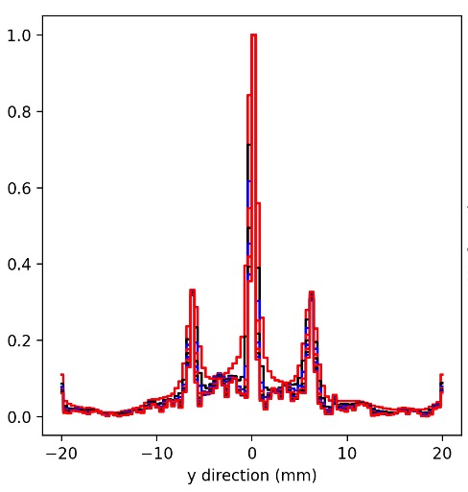
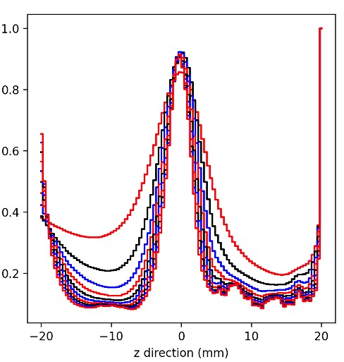
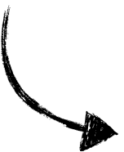

Algorithm commissioning
On Air phantom
Back-projection
I = 10
I = 50
I = 250
On Tissue phantom
I = 50

Slide 11
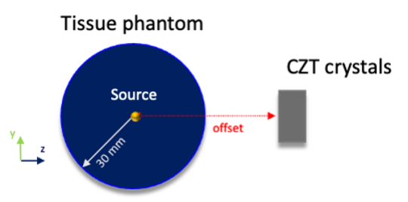
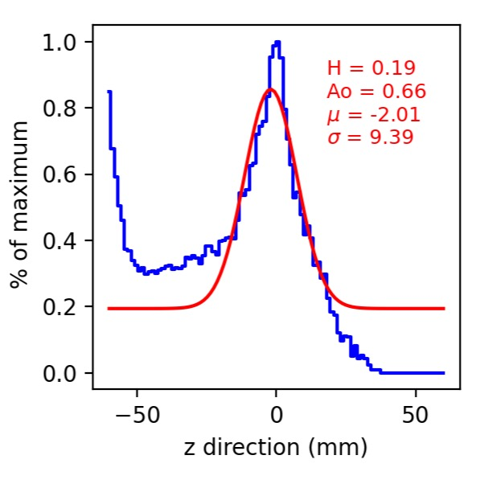
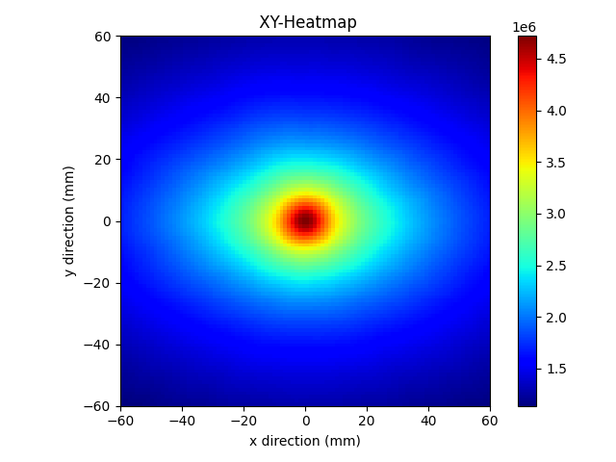
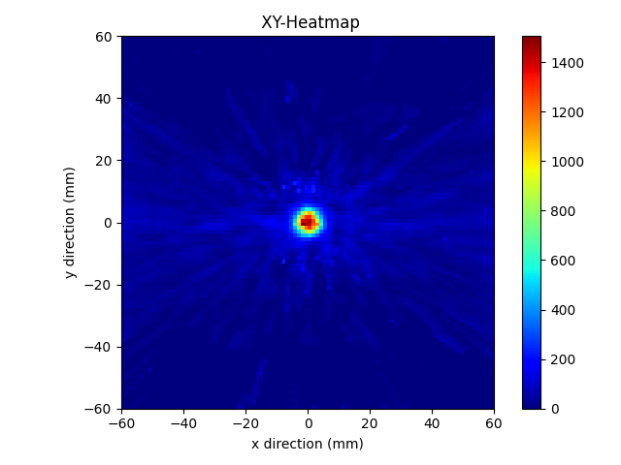
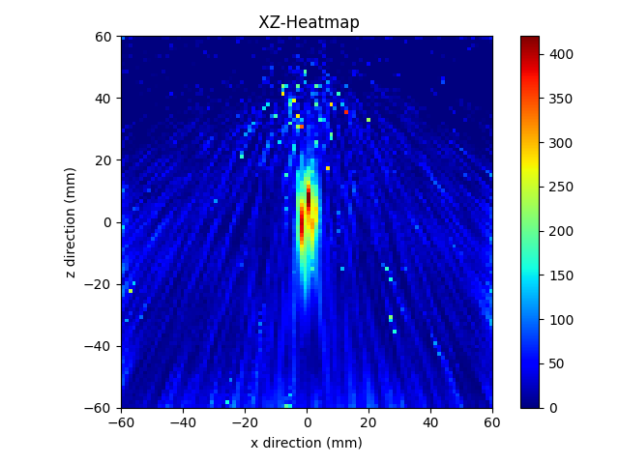
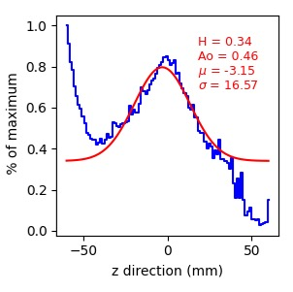
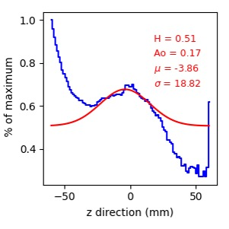
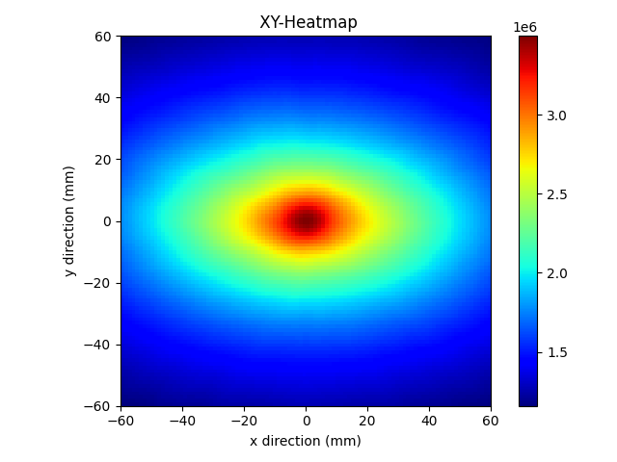
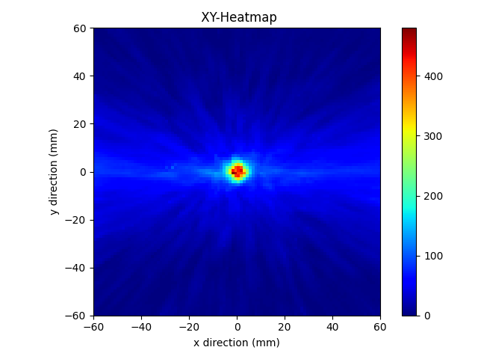
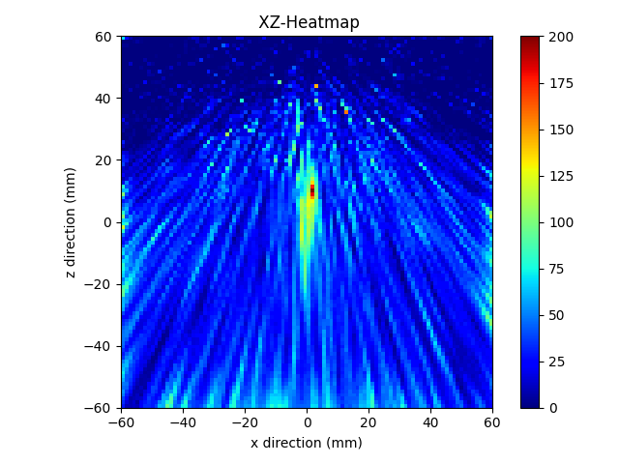
Spheric source reconstruction
Z-axis stretching
On Tissue phantom, 60 mm Offset, T = 5.0
offset = 30 mm
Back-projection
I = 50
I = 250
offset = 60 mm
On Tissue phantom, 60 mm Offset, T = 2.0
offset = 100 mm
Back-projection
I = 50
I = 250

Slide 12
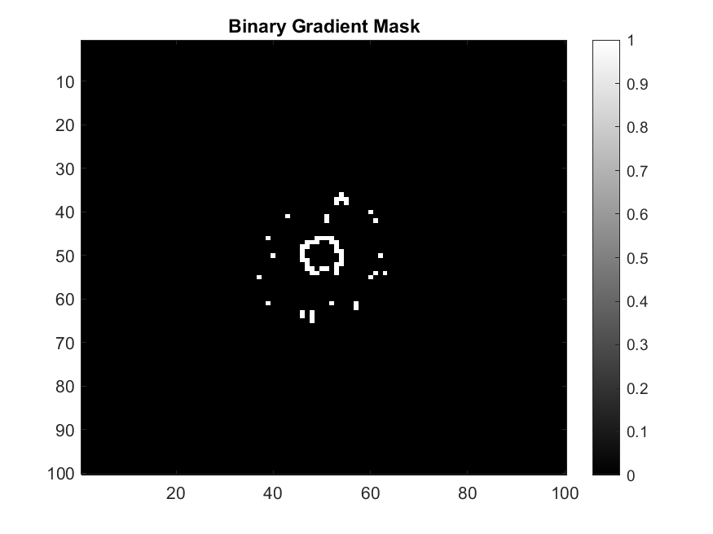
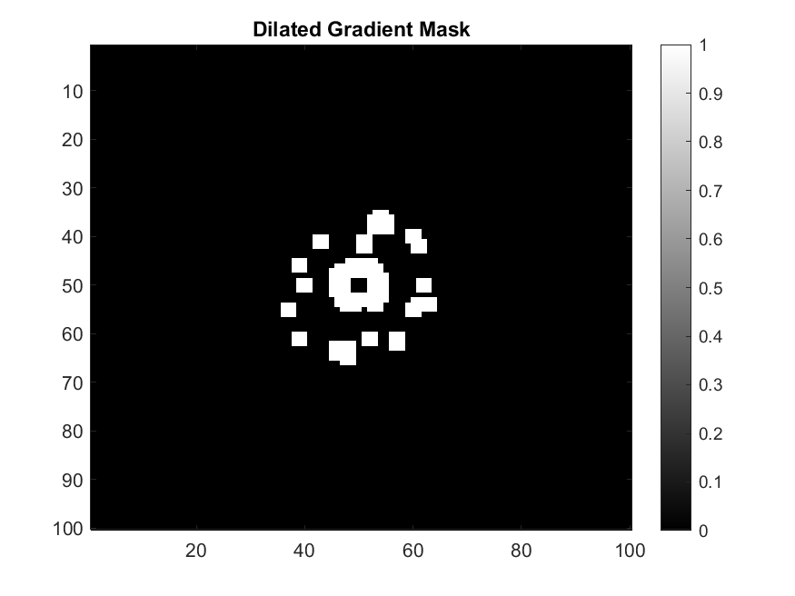

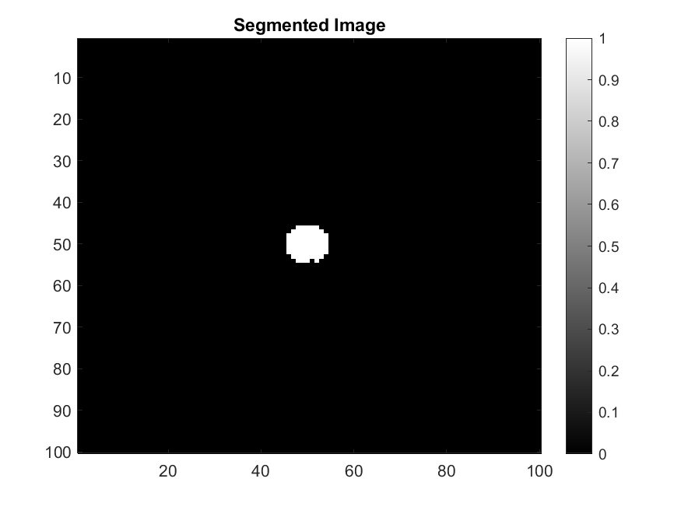
Alternative source reconstruction method
Morphological filters
Erosion and dilation filters
to back-projection image
Dilation
Spur pixel deleted
Hole filling
Erosion and dilation cycles
First limits approximation of the source
Source reconstruction

Slide 13
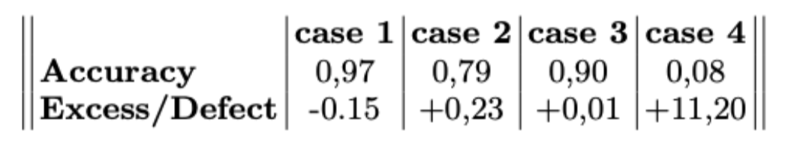
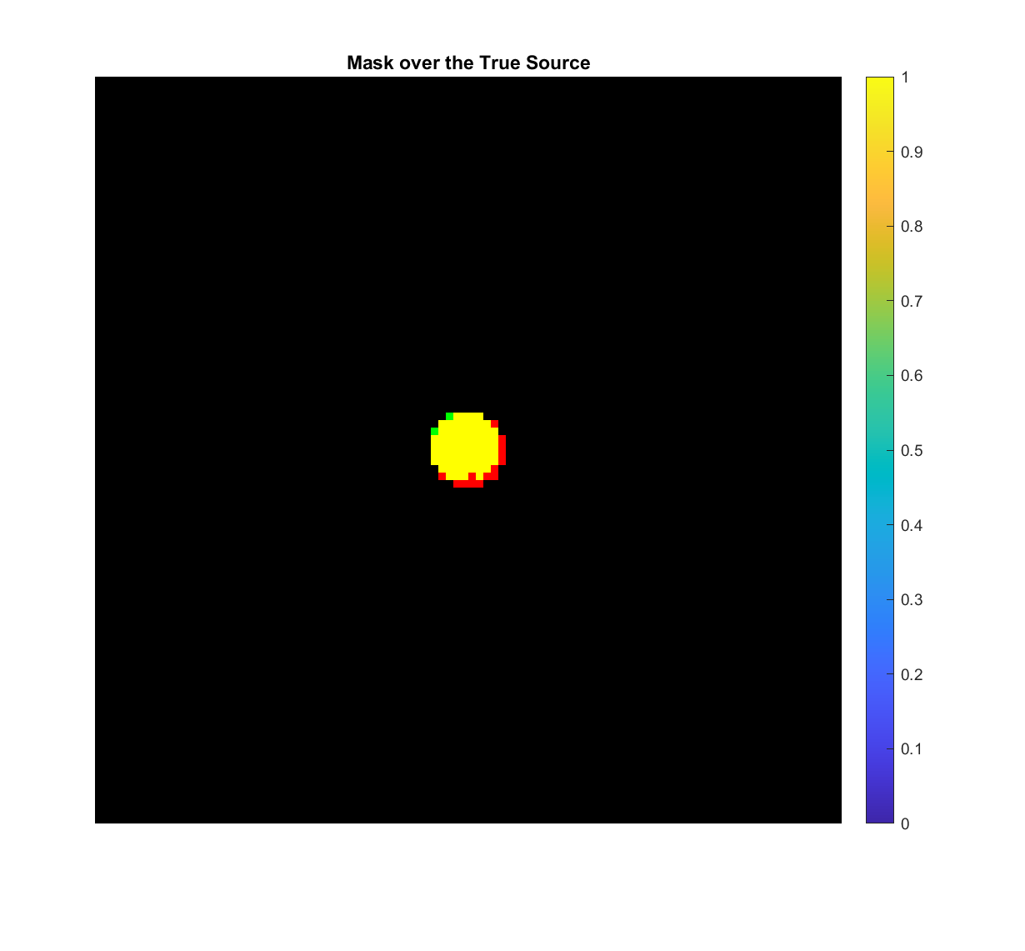
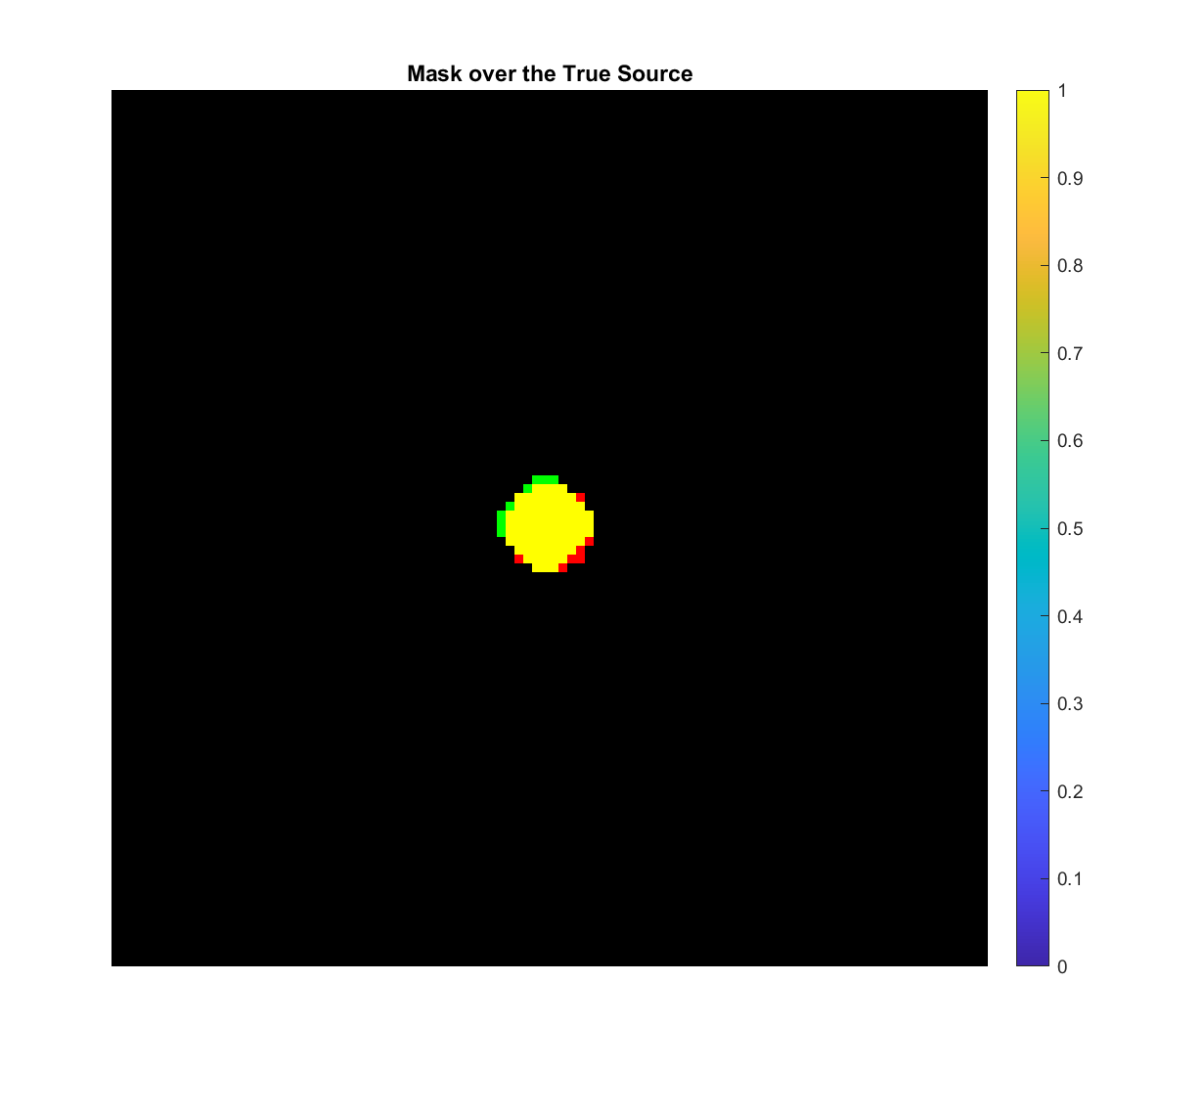

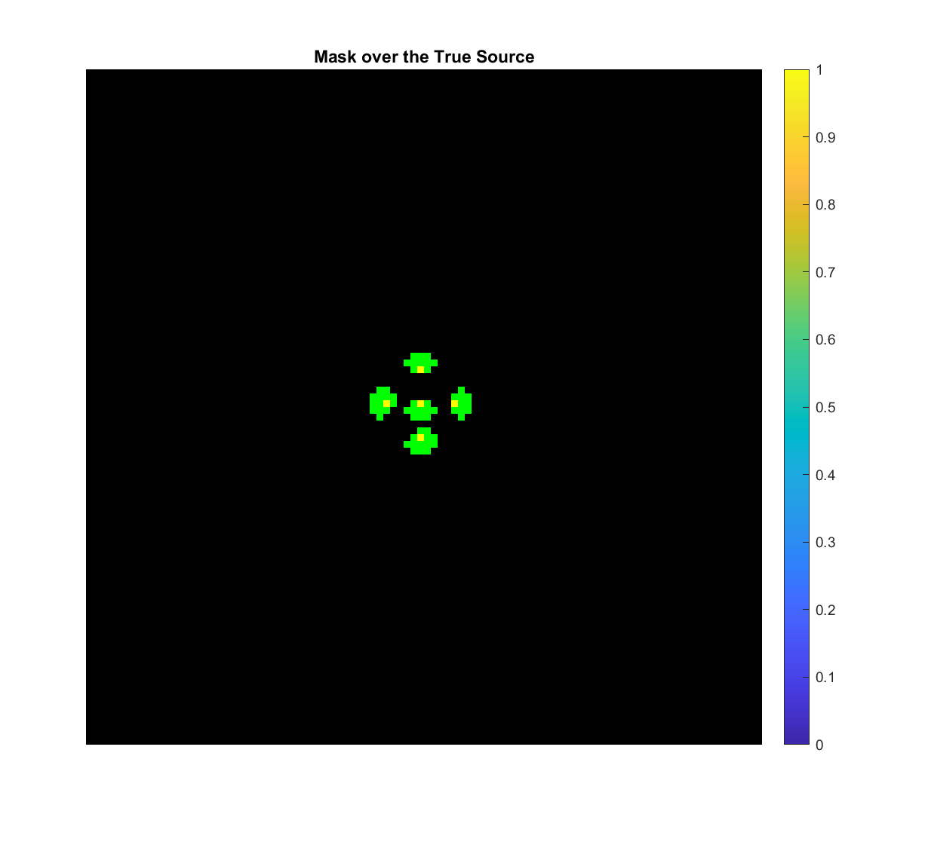
Alternative source reconstruction method
Morphological filters
Reconstructed sources examples
Spheric source on
Tissue (T=2)
Spheric source on
Tissue (T=5)
Spheric source on Air
5 point-like source on Air
Real source
Source reconstructed
Overlap

Slide 14
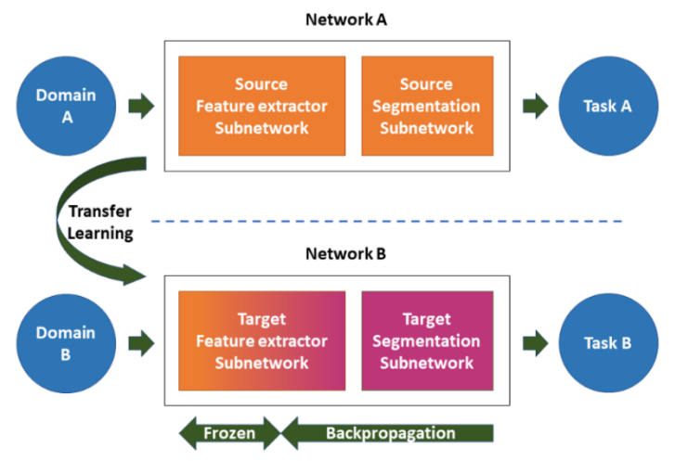
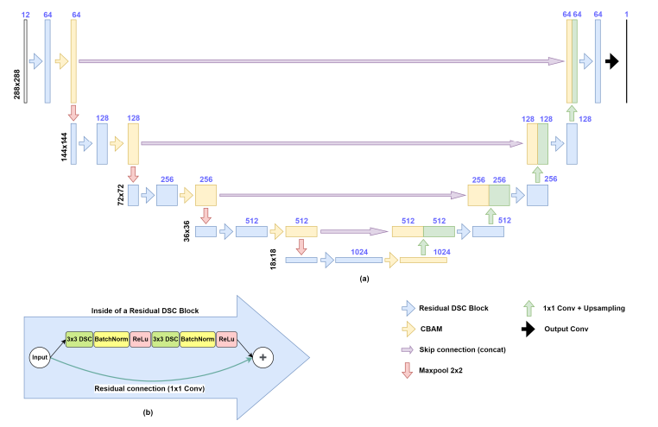

Deep learning reconstruction
U-net architecture:
Directed Acyclic Graph
U-net Convolutional neural network: layer of convolution, pooling and upsampling
Residual: take difference between input and output

Slide 15








Deep learning reconstruction
U-net architecture
Spheric source on
Tissue (T=2)
Spheric source on
Tissue (T=5)
5 point-like source on Air

Slide 16



Outlook
Tomography reconstruction:
Set 4 module CZT
Collimator pin-hole
OSEM reconstruction
$${λ(new)}_{j}=\frac{λ{(old)}_{j}}{\sum_{i}{C_{ij}}}\sum_{i}{C_{ij}\frac{Y_{i}}{\sum_{k}{C_{ik}{λ(old)}_{k}}}}$$

Slide 17
Conclusions
                Sensor CZT good in reconstruction of boron dose
                Test of three reconstruction methods
                What’s next?
                Measure with detector at BNCT facility
                Build of a tomography reconstruction of dose

Slide 18
THANKS!
nicola.ferrara@ba.infn.it
dayron.ramos@ba.infn.it

