Slide 1




Simulation of the Radiation Field in GIF++
Nicola Ferrara, Gabriella Pugliese,
Giuseppe Iaselli, Dayron Ramos
INFN and Polytecnic of Bari
GMM, 26/02/2023

Slide 2
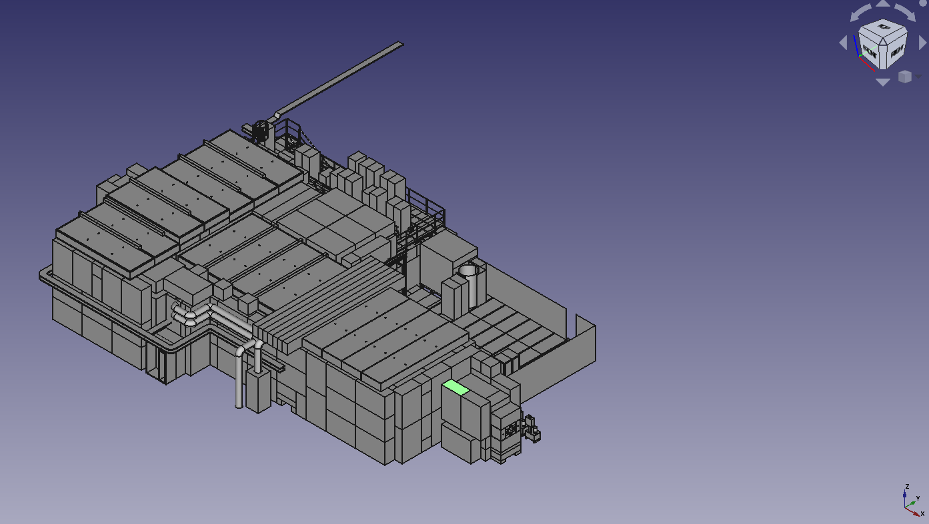
State of Art
Since 2014, test at Gamma Irradiation Facility at CERN has been extensively performed for Eco-gas, longevity, and R&D detector studies involving various detector technologies such as DT, MDT, CSC, RPC, iRPC, GEM, and more.
A simulation study was developed by Pfeiffer Dorothea and published (“The radiation field in the Gamma Irradiation Facility GIF++ at CERN” [1]). It used GEANT4-10.0 to model the radiation background at GIF++ and it was performed without the detectors installed.
Moreover, a new bunker geometry was implemented in 2018
New simulation work is needed….
[1] http://dx.doi.org/10.1016/j.nima.2017.05.045

Slide 3
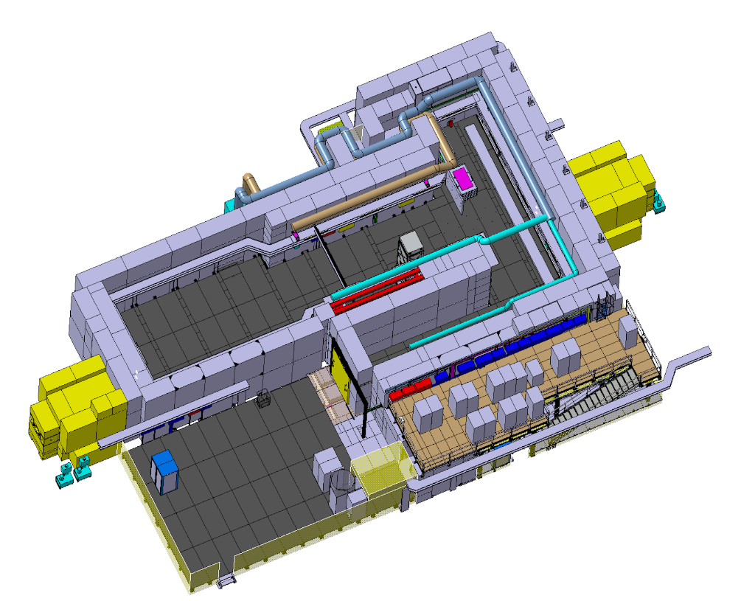
The GIF++ facility @ CERN
12.5 TBq souce of ¹³⁷Cs emitting 662 keV photons
Beam from SPS (muons)
Radiation intensity controlled by a combination of attenuation filters, that shapes the radiation field from point-like to planar
Gas and electronics infrastructures
Unified control/monitoring system
Setups for beam & cosmic trigger, radiation monitoring, environmental monitoring, DAQ,…

Slide 4
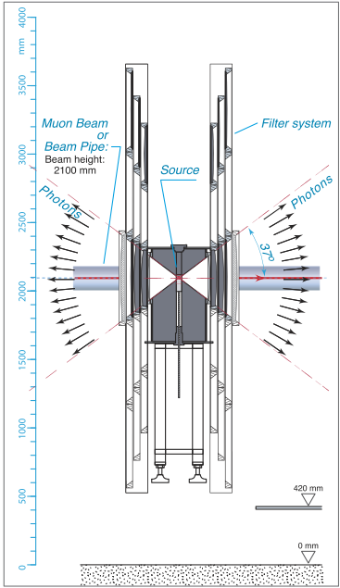
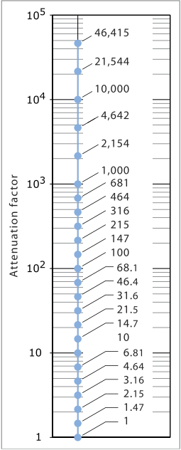
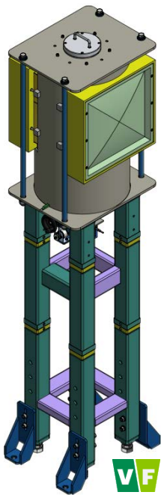
Gamma Filters
Array of 3 × 3 convex lead attenuation filters, to fine tune the photon flux for each irradiation field individually, upstream (UP) and downstream field (DOWN)
Systems of movable lead attenuators for large irradiation zone that allows attenuation factors (ABS) between 1 and 46000 in several steps

Slide 5
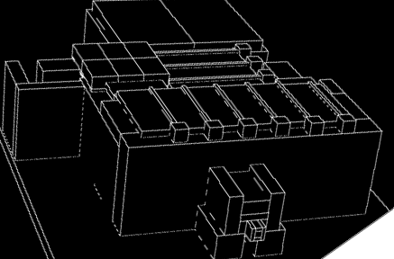
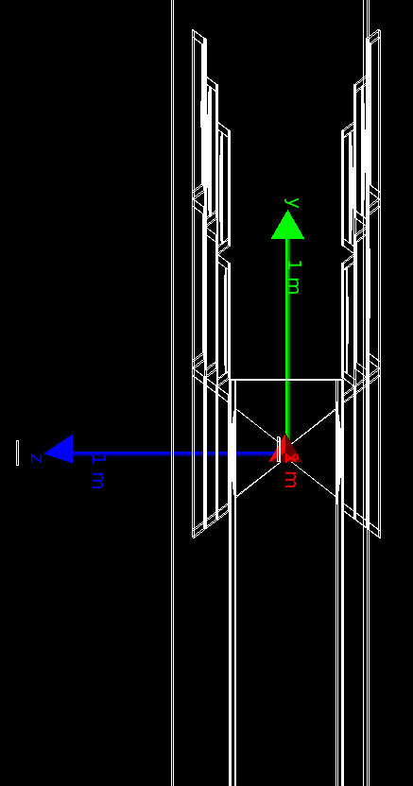
New simulation
New GDML Gif++ layout implemented for Geant4
Bunker Geometry updated
Geant4 updated the version to 11.0
Physics List- G4EmLivermorePhysics
Filter implementation: mounted on aluminum support plates, the filters are positioned inside steel frames, as collimators.

Slide 6
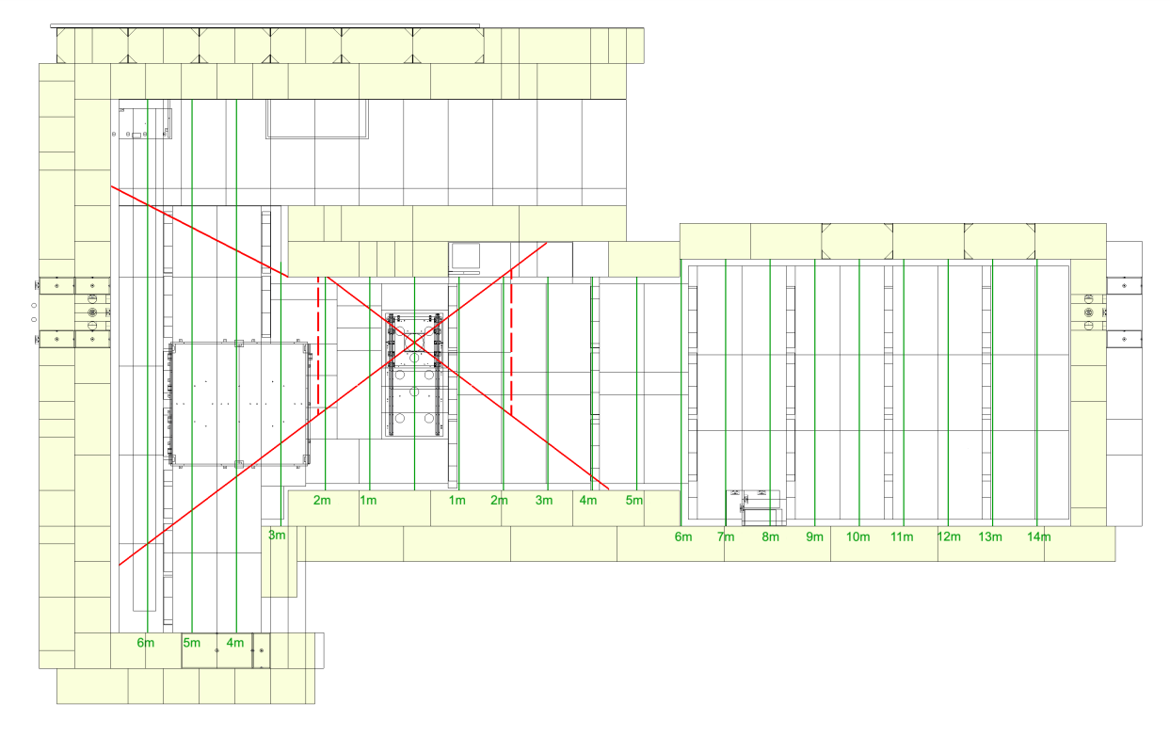
Simulation analysis
4 points were chosen (in the Upstream region) to study the dose and flux vs. the distance from the source
In each point, a sensitive volume of human tissue was considered for ambient dose equivalent rate estimation
12.5 TBq source ¹³⁷Cs of was considered
Detectors and mechanical supports were not yet simulated
Ua
Ub
Uc
Ud
Box of 10 cm of size

Slide 7
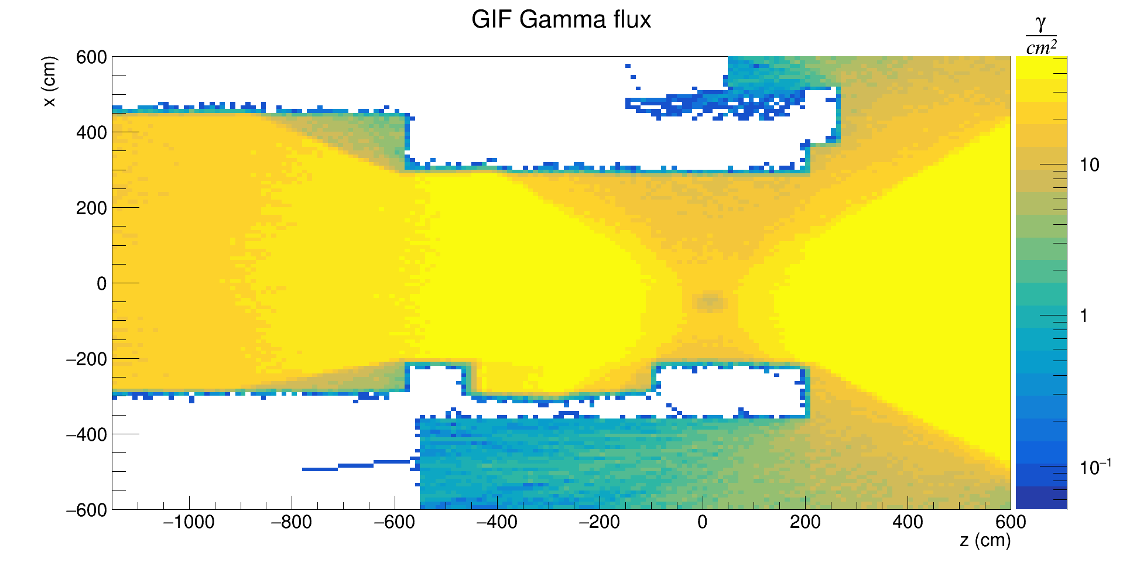
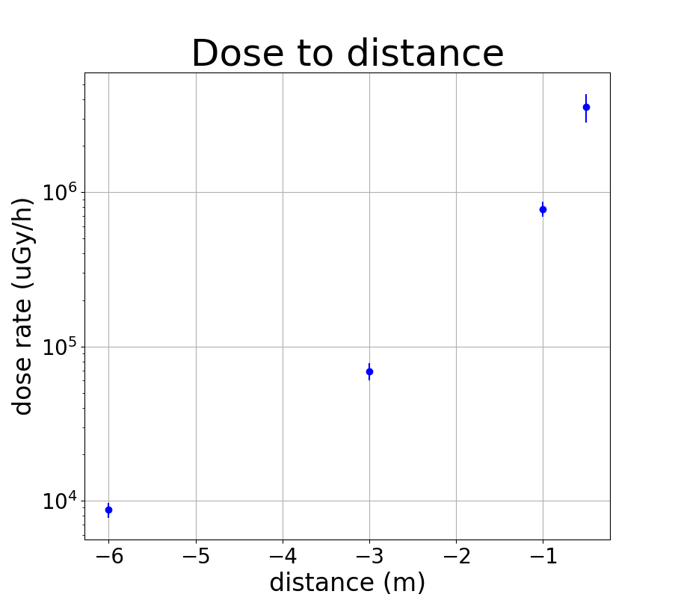
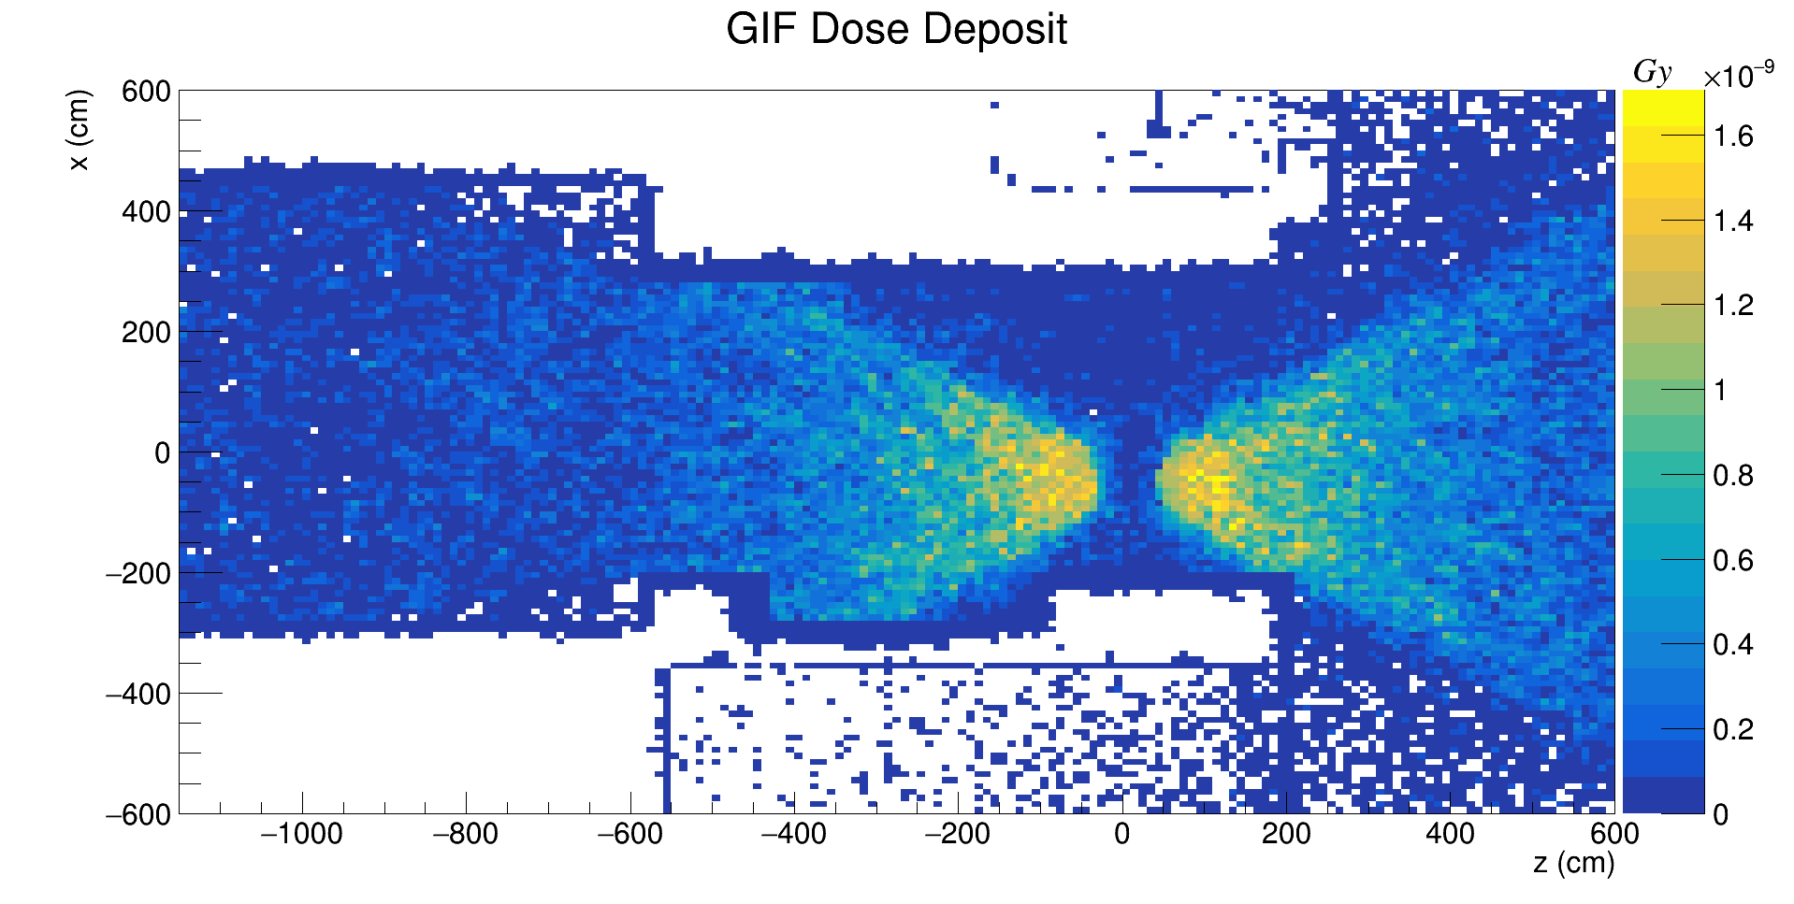
Gamma flux and dose simulation (@ABS 1)
ABS1 UPSTREAM

Slide 8
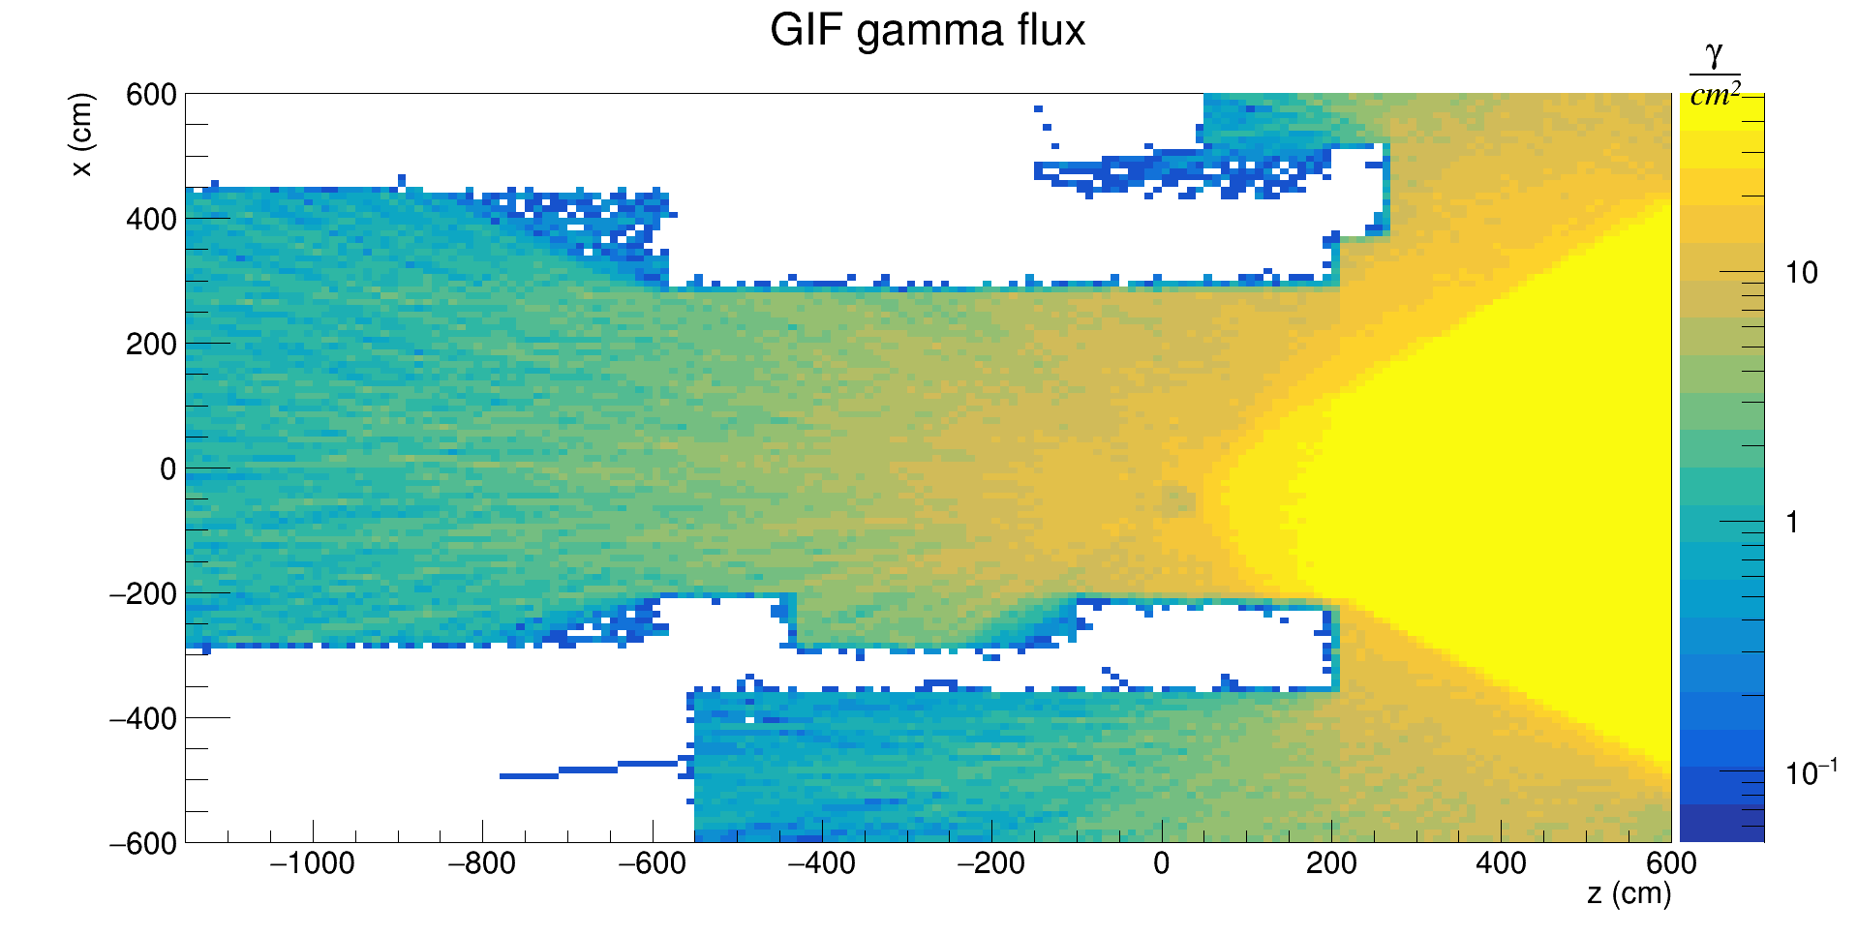
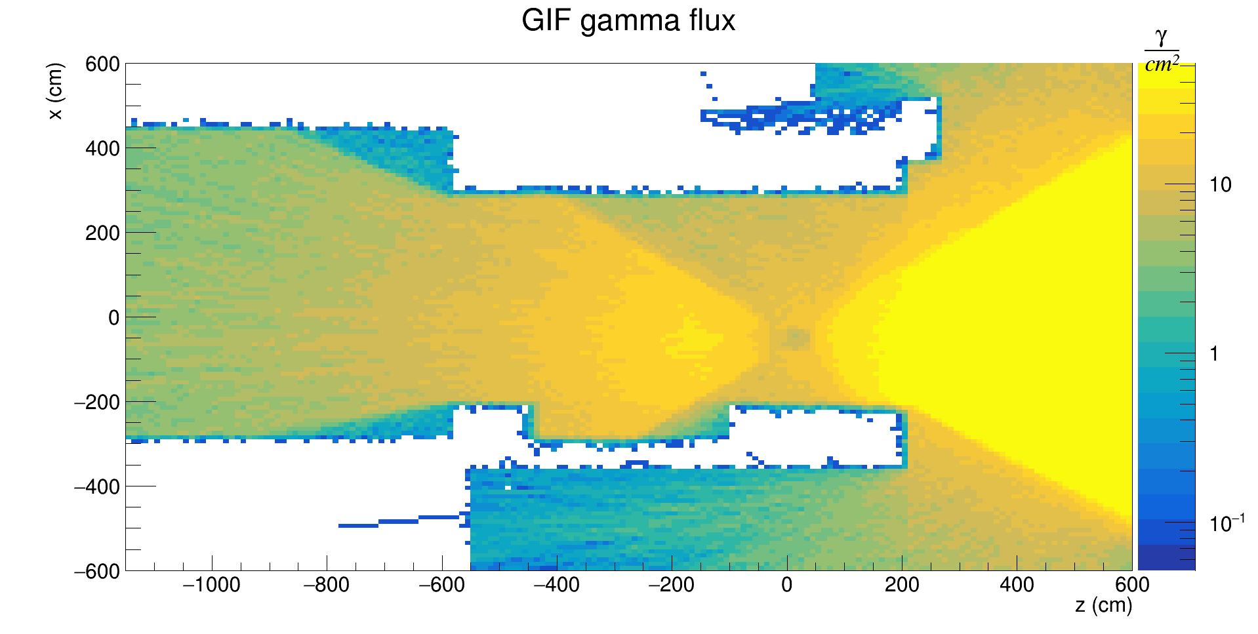
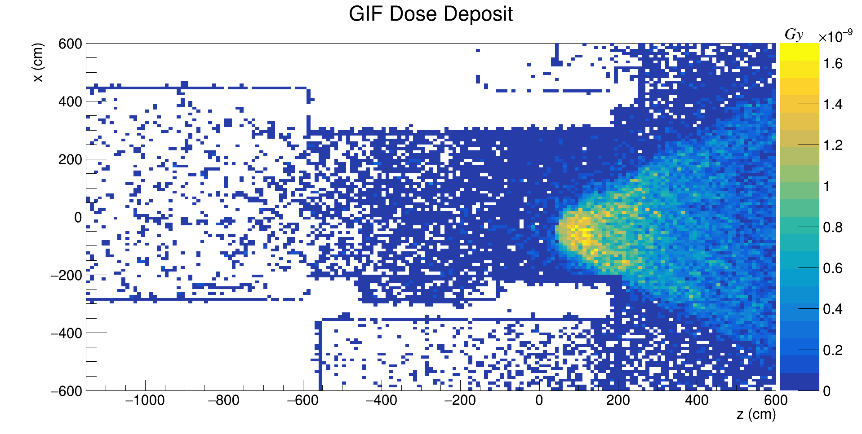
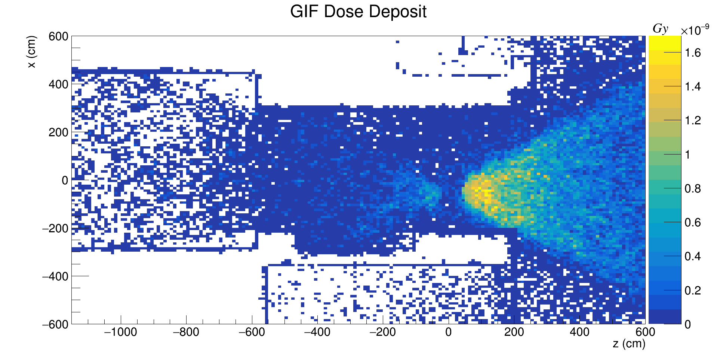
Gamma flux and dose simulation (ABS 100 and 10) UP stream region
ABS100
ABS10

Slide 9
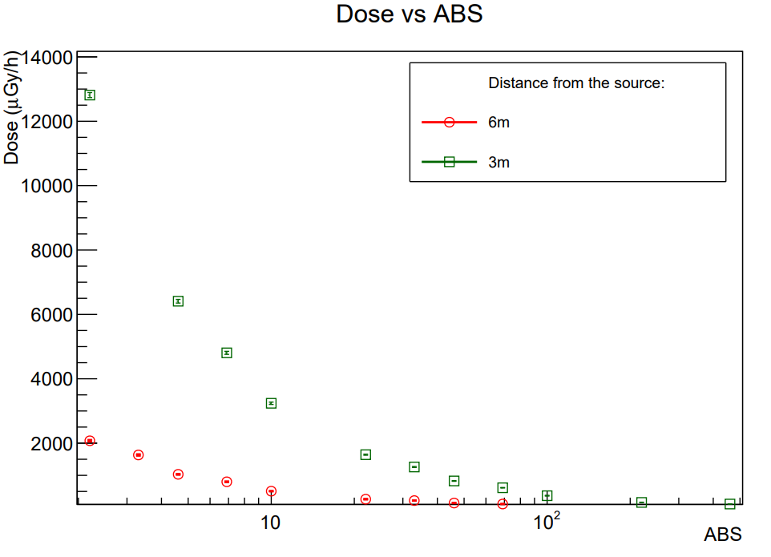
Dose rate measurements by ECOgas@GIF++ Collaboration in 2021
To validate the simulation, we used some dose campaign measurements performed in 2021 by the ECOgas@GIF++ collaboration and published [2].
Two postions and several ABS were considered
[2]High-rate tests on Resistive Plate Chambers operated with eco-friendly gas mixtures, RPC ECOGas@GIF++ collaboration,2023, https://doi.org/10.48550/arXiv.2311.08259

Slide 10
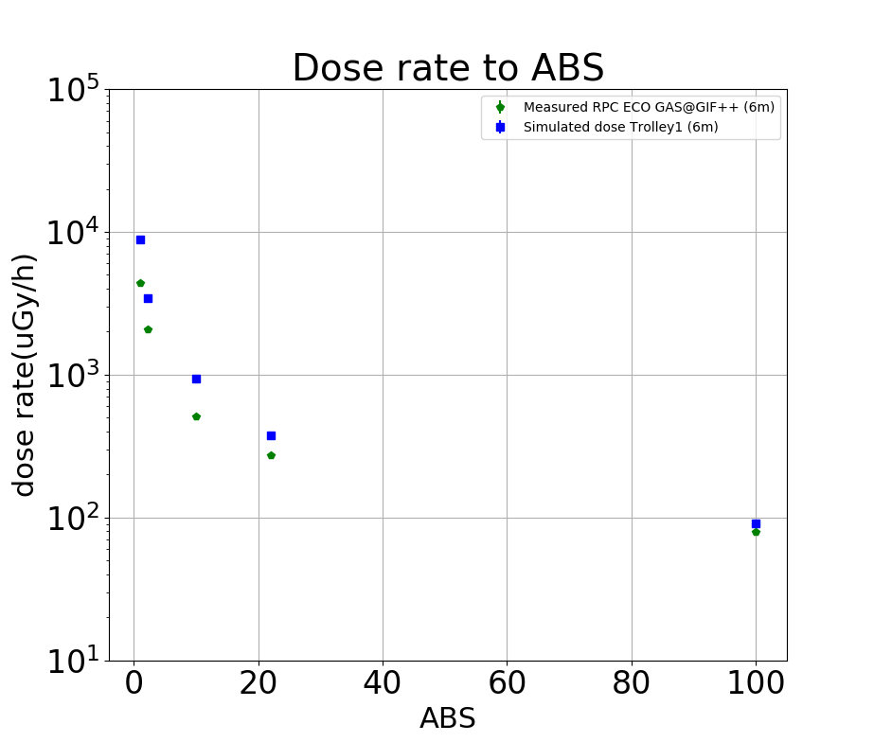
Simulation validation with data
For the validation the position at 6 m from source was considered
Slightly discrepancies at lower ABS probably due to simulation setup
Note: the simulation is done without detectors inside GIF++ bunker

Slide 11
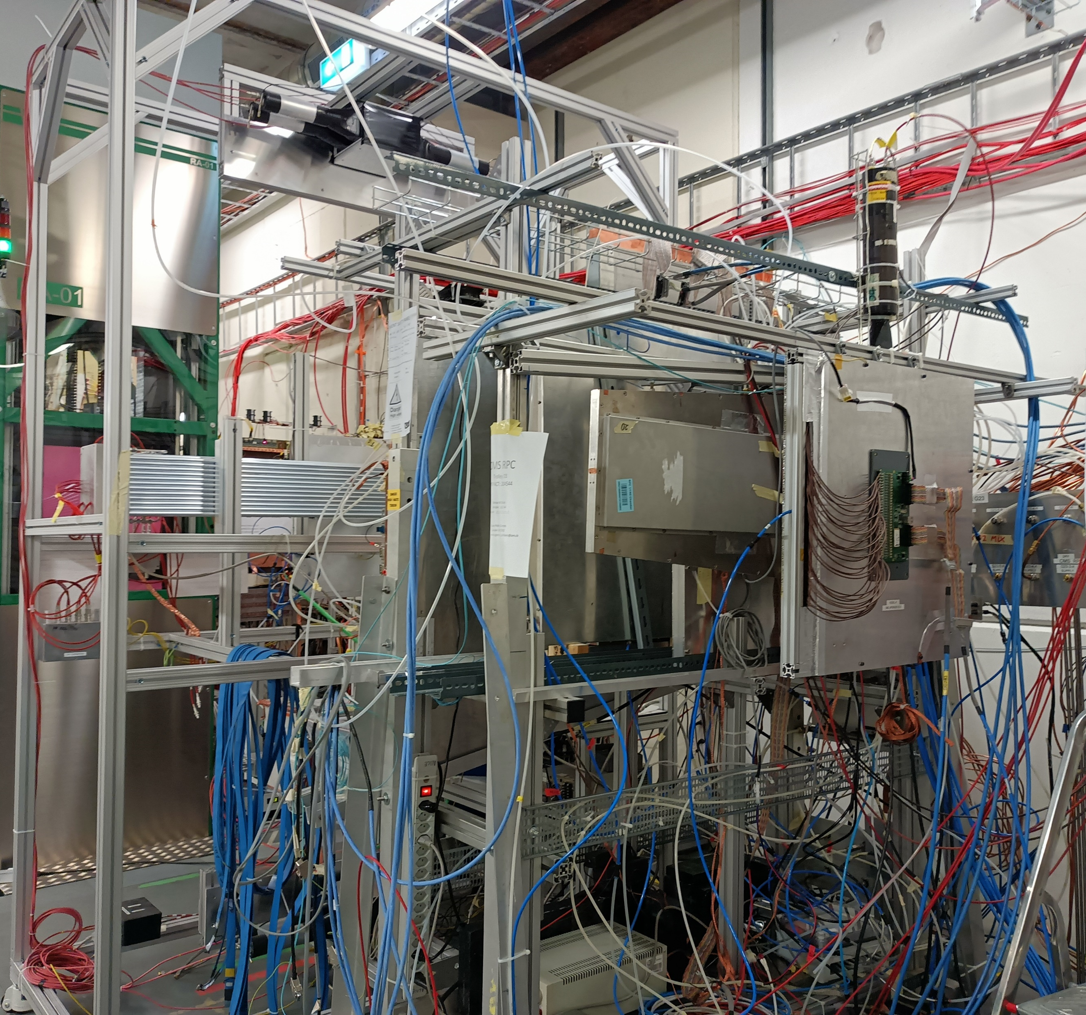
Next steps
Simulation of different detectors installed inside the GIF
Extensive dose campaign of measurements for further validation
Deeply study with different ABS upstream and downstream and analysis of influence of backscattering between Up stream and Down stream regions

Slide 12
THANKS

Slide 13
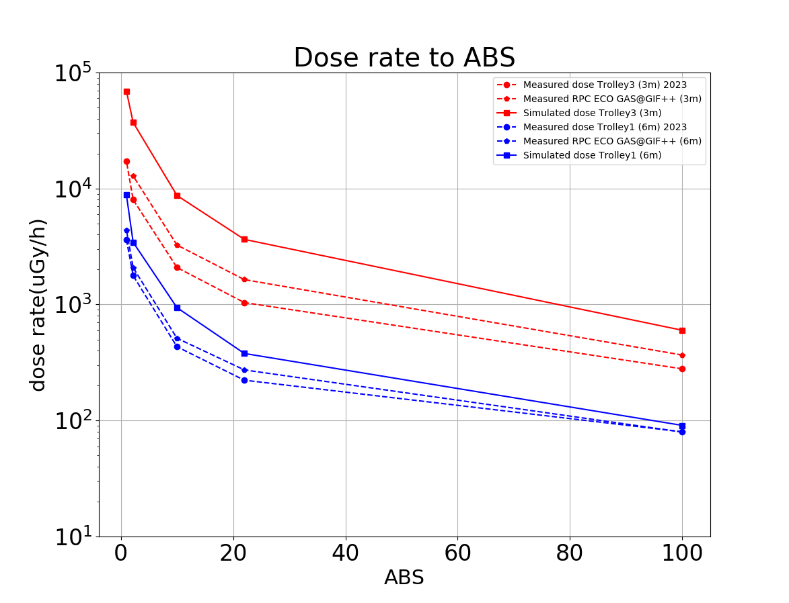
BACKUP
For the validation: data taking in 2021 and 2023
Slightly discrepancies at lower ABS probably due to simulation setup
Note: the simulation is done without detectors inside GIF++ bunker

