Slide 1
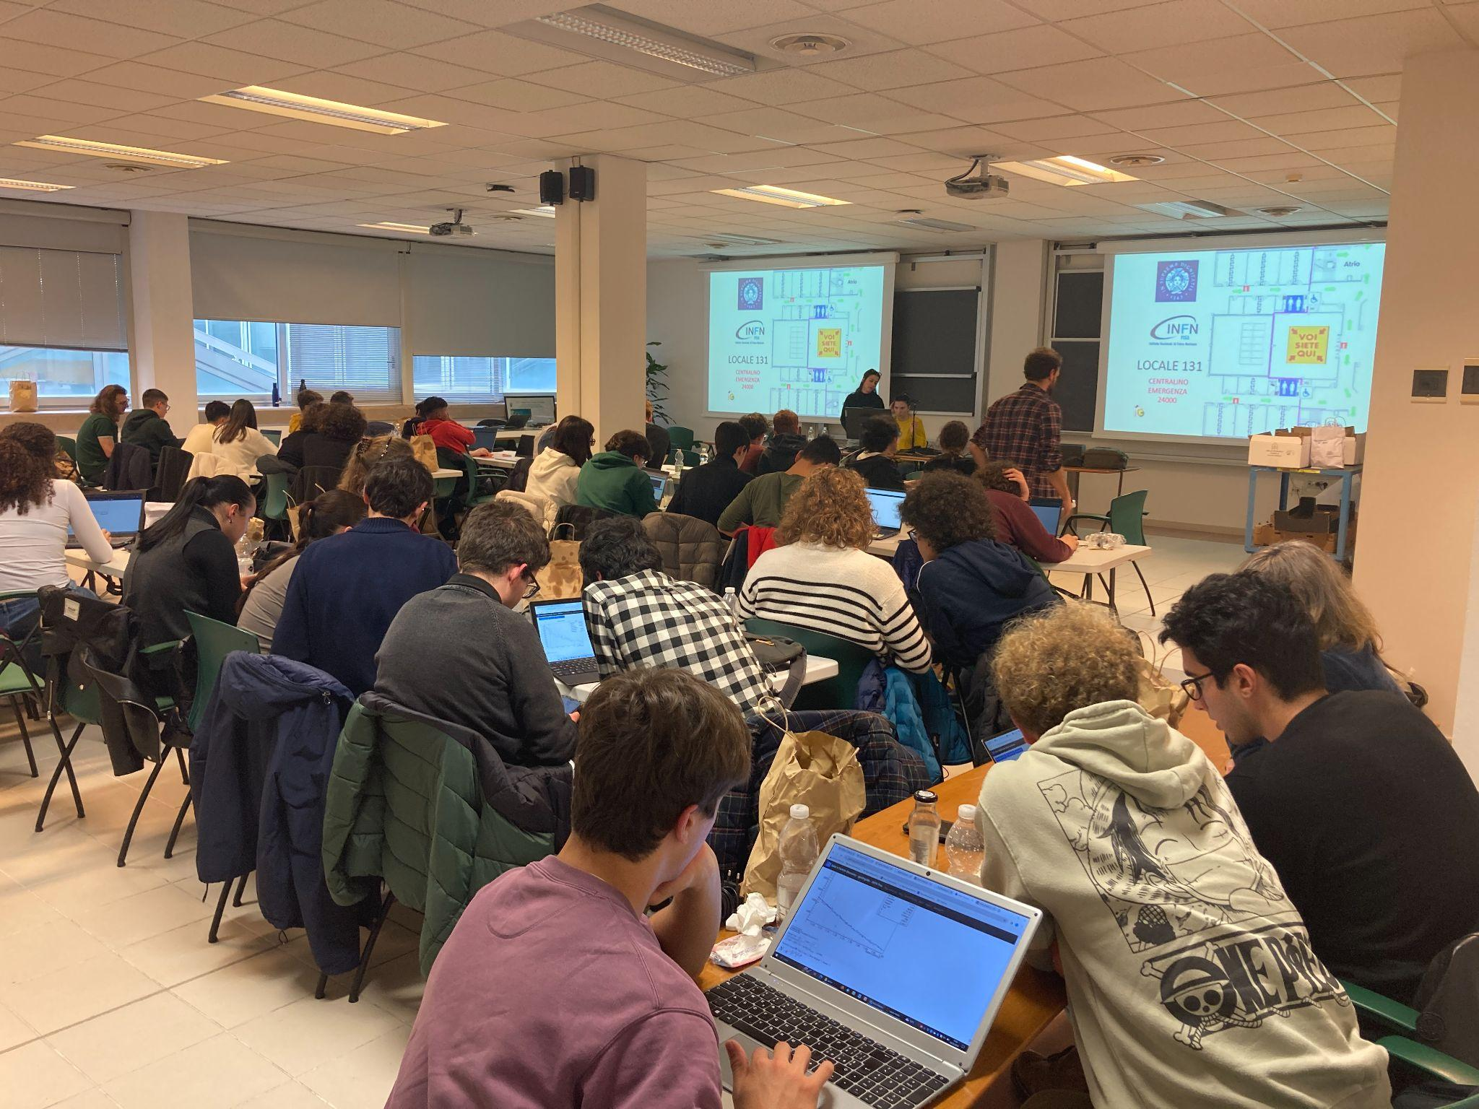
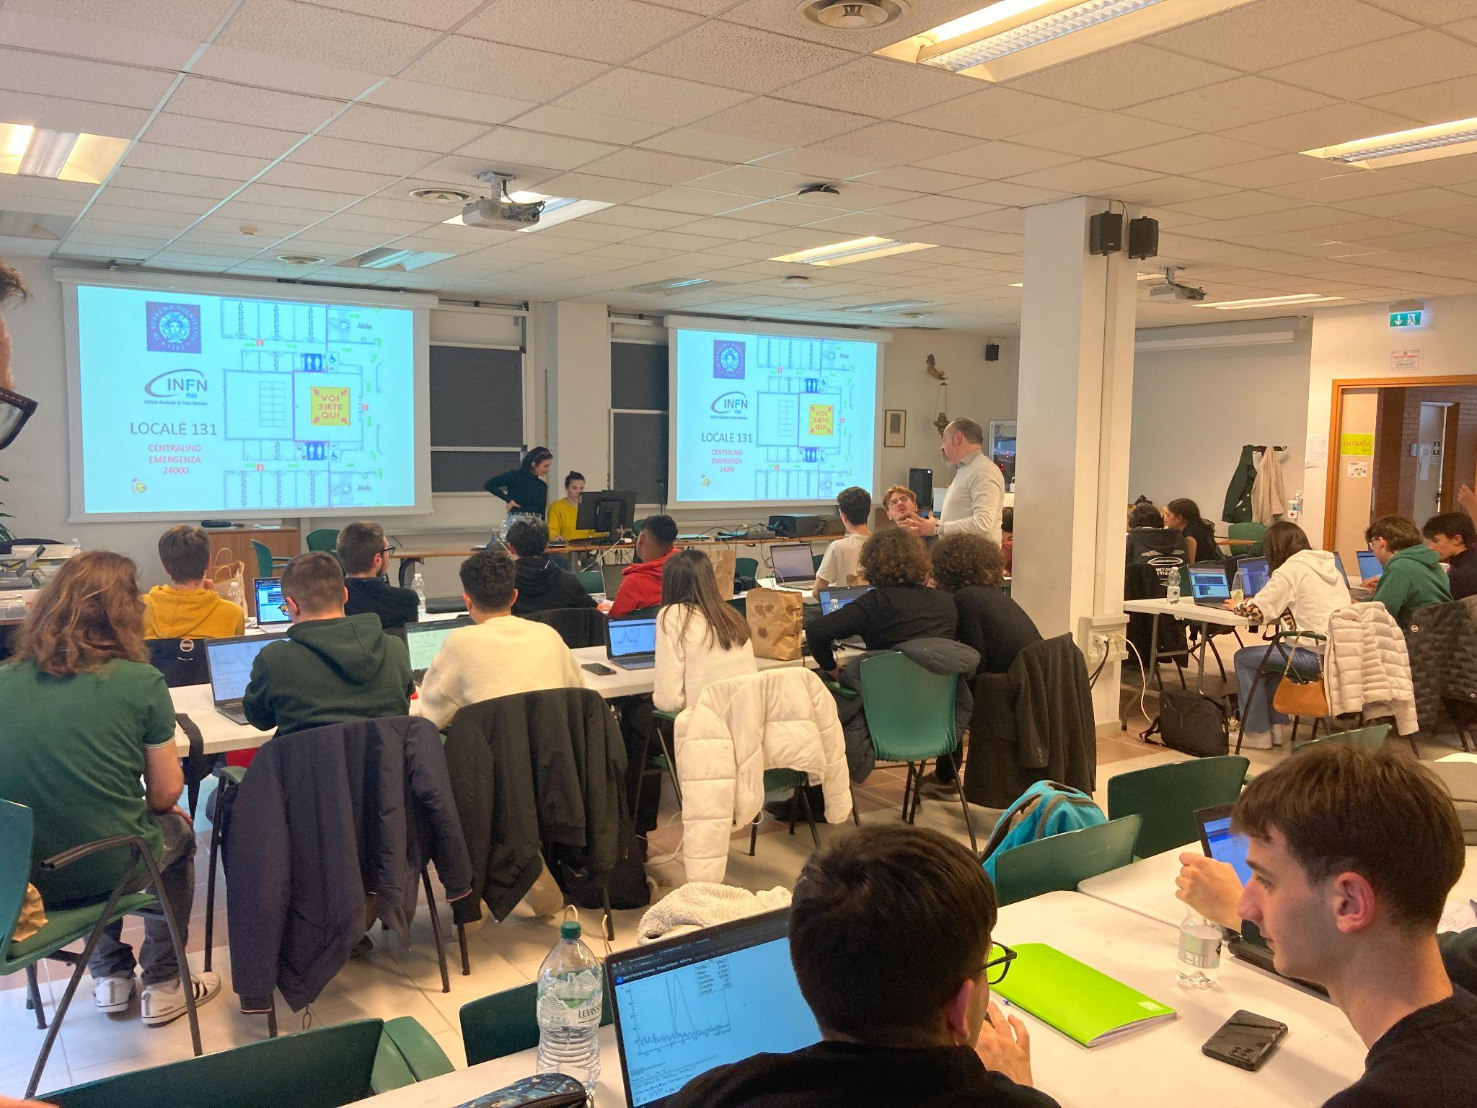
International Belle II Masterclass
2024 March 26th - Pisa

Slide 2
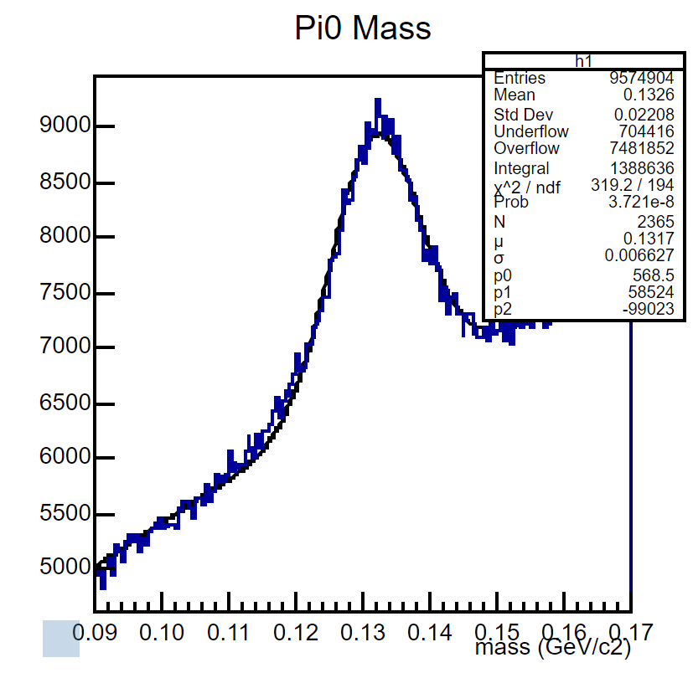
Mission 3 - π⁰→𝛾𝛾
Reconstructed π⁰ combining two photons.
The reconstructed mass of the π⁰ is 0.132 GeV/c²
and the width is 6.6 MeV/c² .
The background was fitted with a second order polynomial function.

Slide 3
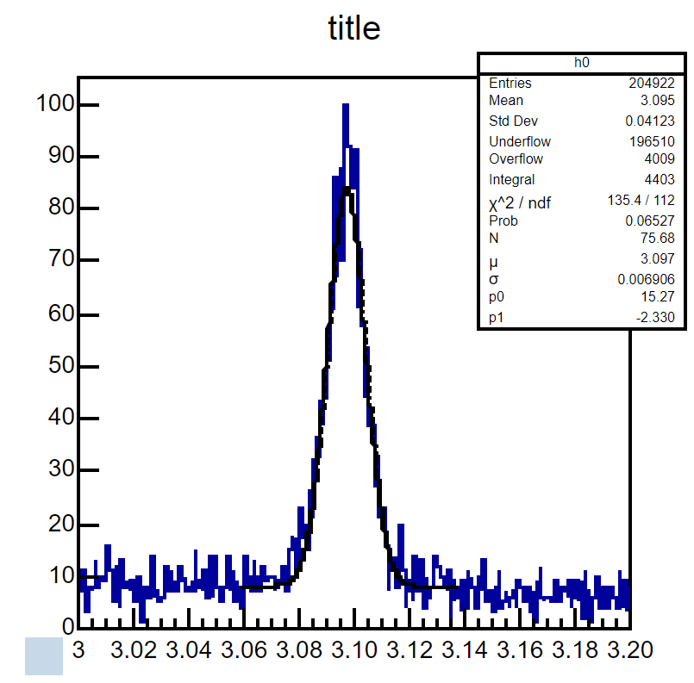
Mission 6 - J/psi→𝜇⁺𝜇⁻
The reconstructed mass of the J/psi is 3.097 GeV/c²
and the width is 6.9 MeV/c² .
The background was fitted with a first order polynomial function.

Slide 4
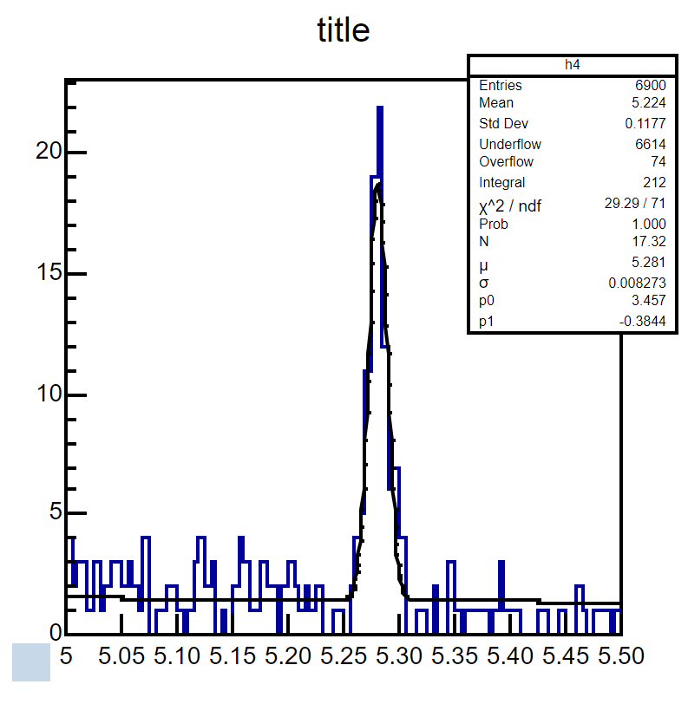
Mission 8 - B±→J/psi K±, J/psi→𝜇⁺𝜇⁻
We reconstruct B+ to J/psi and charged Kaon
The reconstructed mass of the B is 5.281 GeV/c²
and the width is 8.2 MeV/c² .

Slide 5
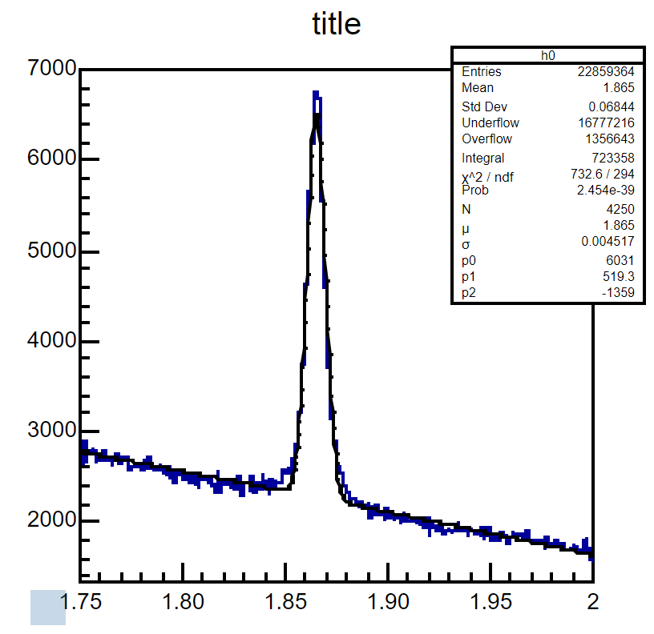
Mission 7 - D⁰→K⁻π⁺
We reconstruct D0 to K- and π+
The reconstructed mass of the D is 1.865 GeV/c²
and the width is 4.5 MeV/c² .

Slide 6
Back-up

Slide 7
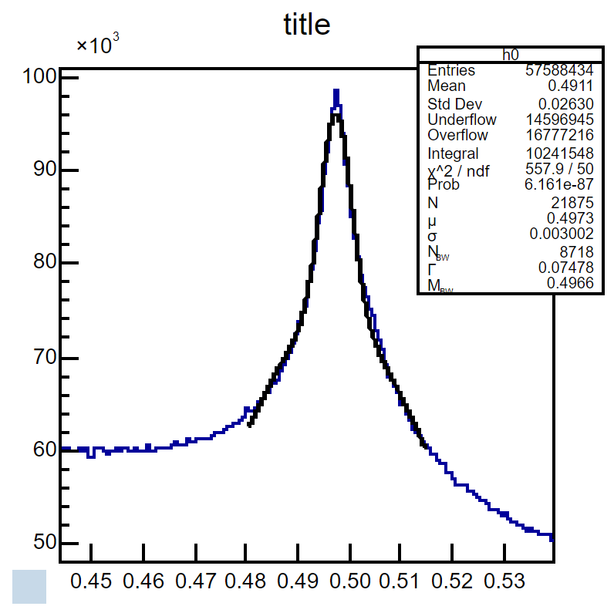
Mission 4 - K_{S}⁰→π⁺π⁻

Slide 8
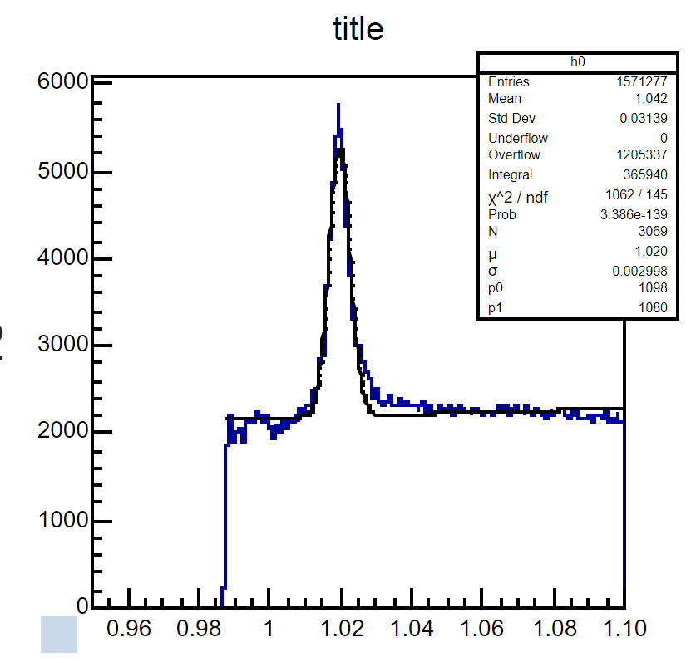
Mission 5 - ɸ→K⁺K⁻

Slide 9
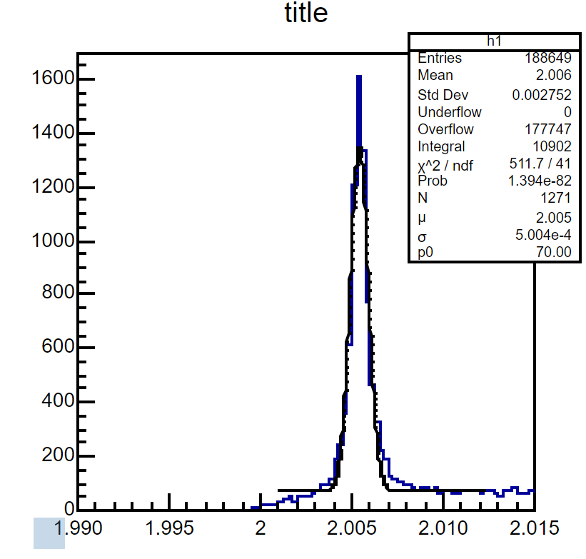
Mission 9 - D*→D⁰π⁺, D⁰→K⁻π⁺

