Slide 1
WP 4:Quality Control on Water, Soil and Crops and Fertilizer characterization
SWIRPS Tunisian group
First SWRIPS General Meeting
Catania 13 February 2024, on-line

Slide 2
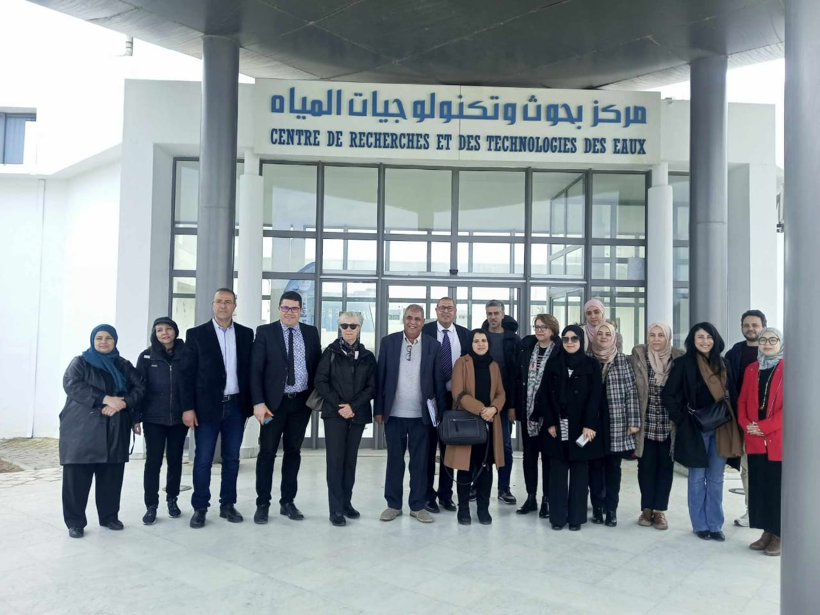
WP4 aims
SWIRIPS project aims to reduce the risk of water pollution and soil salinization saving fresh water and minimizing the external use of resources for field crops fertilization, avoiding further contamination of land and water

Slide 3
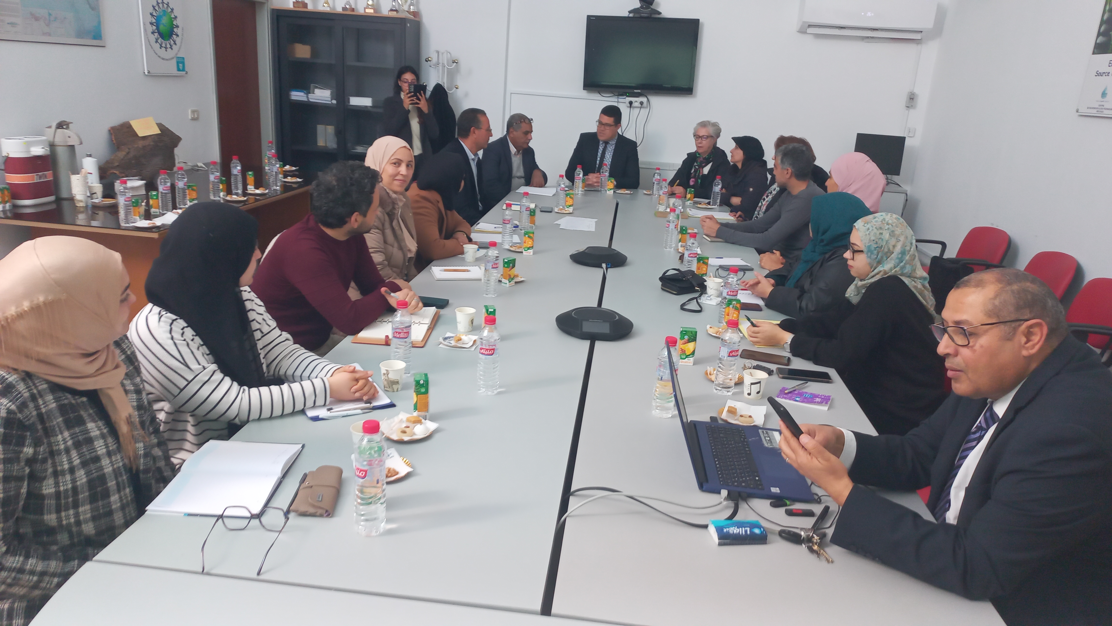
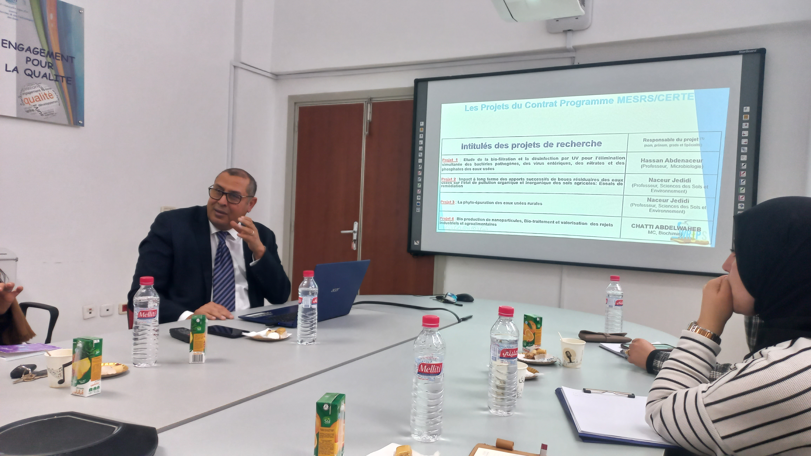
WP4 Activities carried out by the Tunisian group
Organization of the meeting of the tunisian group
Meeting: 12 February 2024 in CERTE (Prof. Ismail TRABELSI)

Slide 4
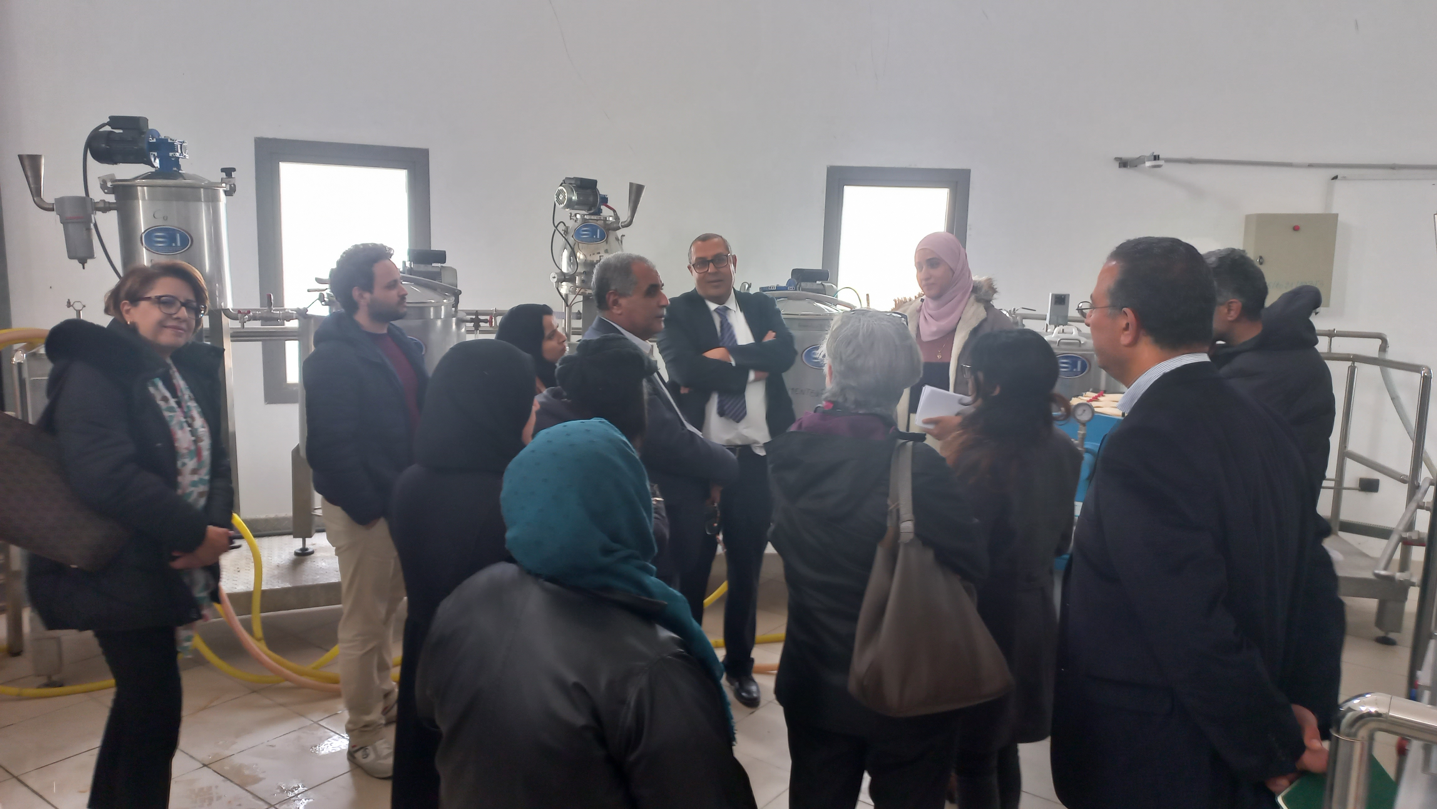
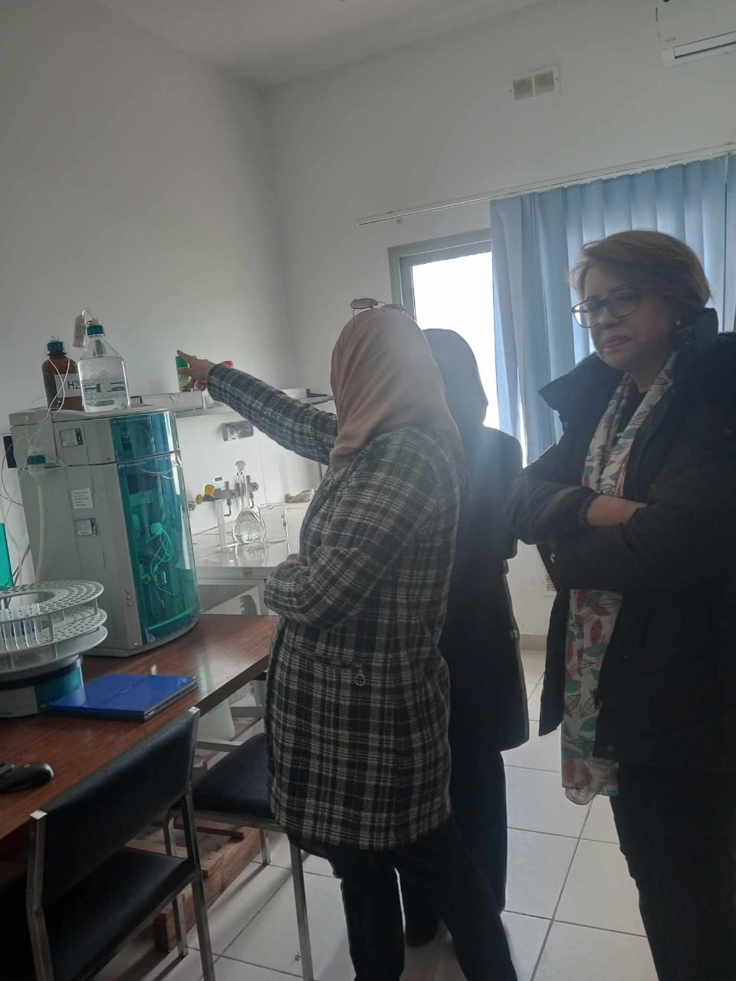
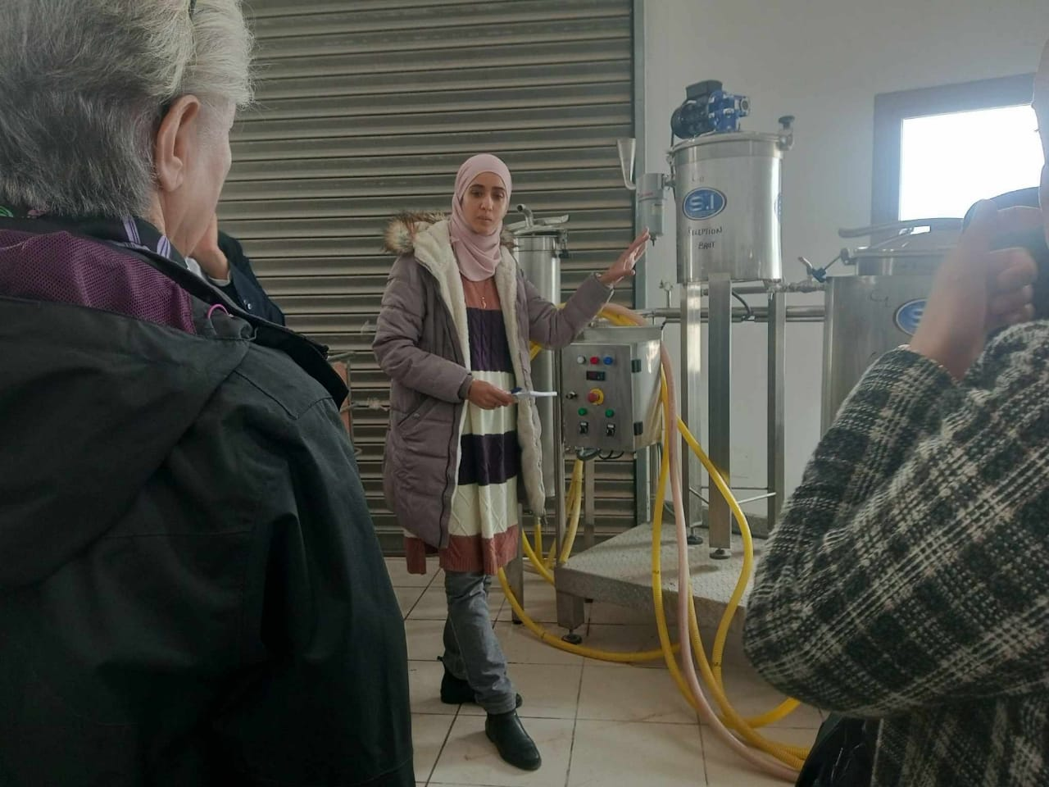
WP4 Activities carried out by the Tunisian group
Organization of three meetings in Tunisia
Laboratory visit: CERTE Lab (Prof. Ismail TRABELSI)

Slide 5
WP4 Activities carried out by the Tunisian group
CERTE Director's speech and description of Center for Water Research and Technology (CERTE)and it’s involvement in the SWRIPS project.
Presentation by CERTE Laboratory Director Ismail TRABELSI and description of his team's involvement in WP2 and WP4 of the SWRIPS project.
Discussion of the various COMOCAP water sampling protocols during July.
Proposal to visit COMOCAP industry in April.

Slide 6
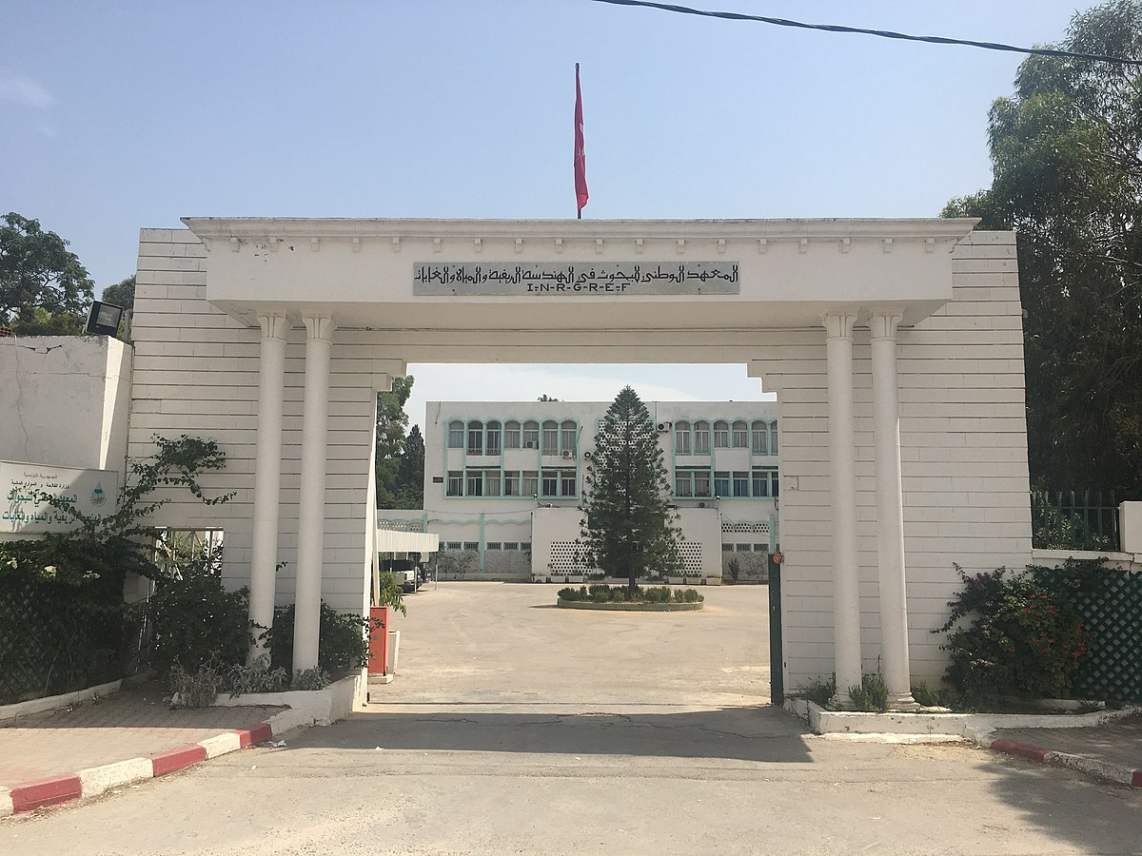
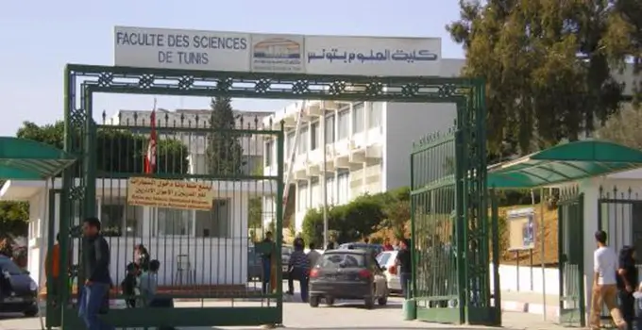
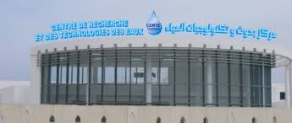
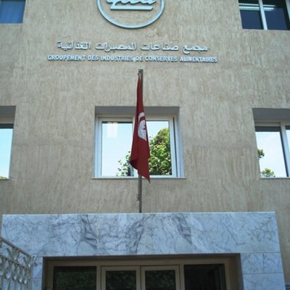
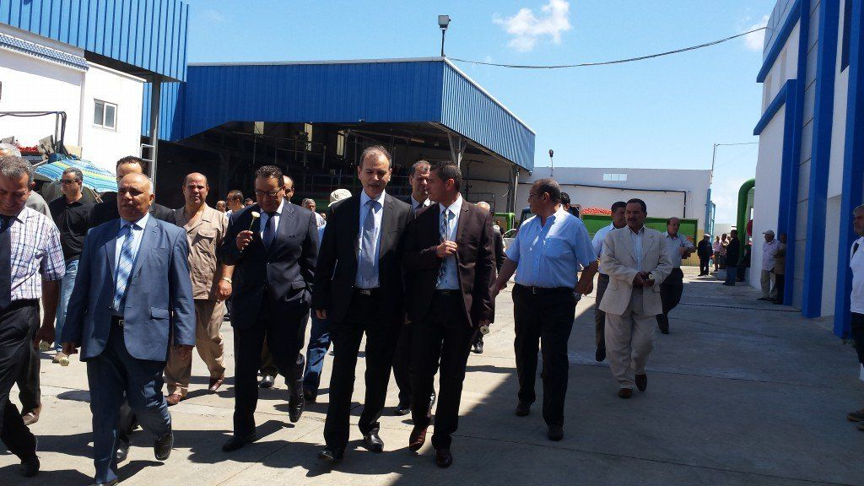
On going activities
Planning of next meetings:
Visit of COMOCAP industry (Mr Mohamed OBAY)

