Slide 1
ESRF-EBS: a low emittance lattice
for high brilliance X-ray production

Slide 2
outline
Synchrotron light sources:
beam emittance and brilliance
a brief history
lattice evolution
The ESRF EBS
design
commissioning
operation
Applications

Slide 3
History of synchrotron radiation
X-rays were discovered in the late XIX century.
X-ray tubes are still used a lot, but they produce low brilliance beam.
The first synchrotron radiation (SR) was observed in 1947.
We talk about 4 generations of synchrotron light sources: from 1961 to 2020.
10²⁴
10²³
10²²
10²¹
10²⁰
10¹⁹
10¹⁸
10¹⁷
10¹⁶
10¹⁵
10¹⁴
10¹³
10¹²
10¹¹
10¹⁰
10⁹
10⁸
10⁷
10⁶
ESRF-EBS (2020)
ESRF (2014)
Third
generation
ESRF (1994)
Synchrotron Radiation
Second generation
Brilliance (photons/s/mm²/mrad²/0.1%BW)
First generation
X-ray tubes
1900 1920 1940 1960 1980 2000 2020

Slide 4
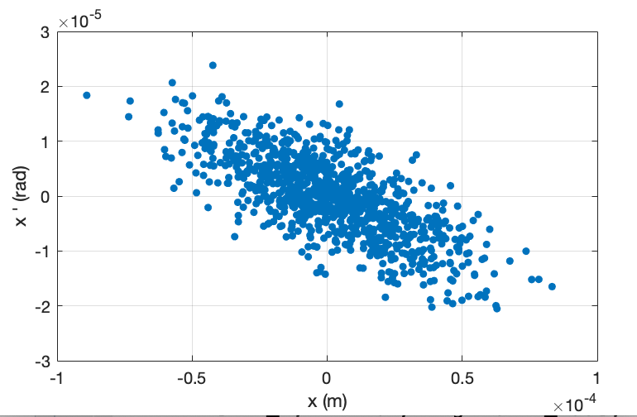

Beam emittance and Brilliance of synchrotron radiation
The brilliance is the main figure of merit for a synchrotron light source.
The brilliance is the number of photons in a small bandwidth per unit of time, area and solid angle. [#photons / (mm² mrad² 0.1% bandwidth)]
The emittance is the area in the phase space of the electron or the photon beam. [pm rad] or [nm rad]
The emittance of the photon beam is the convolution of the emittance of the electron beam and the photon emittance from a single electron.
Photon emittance from a single electron depends on the photon wavelength
1 nm rad for 100 eV
100 pm rad for 1 keV
10 pm rad for 10 keV
The reduction of the electron beam emittance is a way to increase the X-ray brilliance until we reach the diffraction limit.

Slide 5
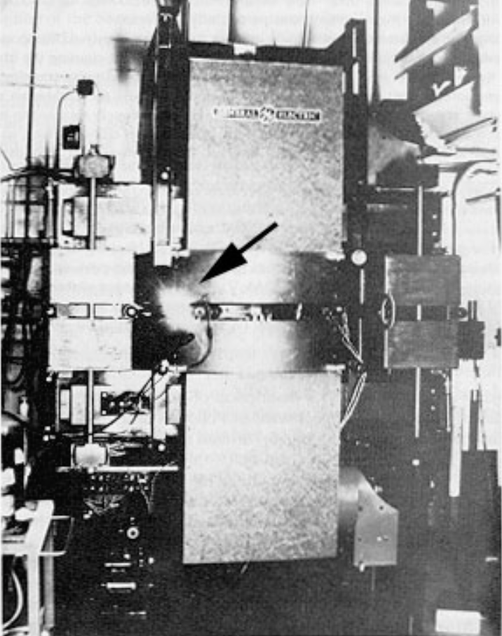
First generation synchrotron light sources (1960-1970)
First synchrotron radiation (SR) seen in 1947 from a 70 MeV synchrotron in the General Electric Laboratories
The first synchrotron light source is considered to be the 180 MeV synchrotron of the US national institute of standards and technology, where in 1961 a tangent section was added to extract the SR.
SR has been used in parasitic mode in many particle physics accelerators for decades.

Slide 6
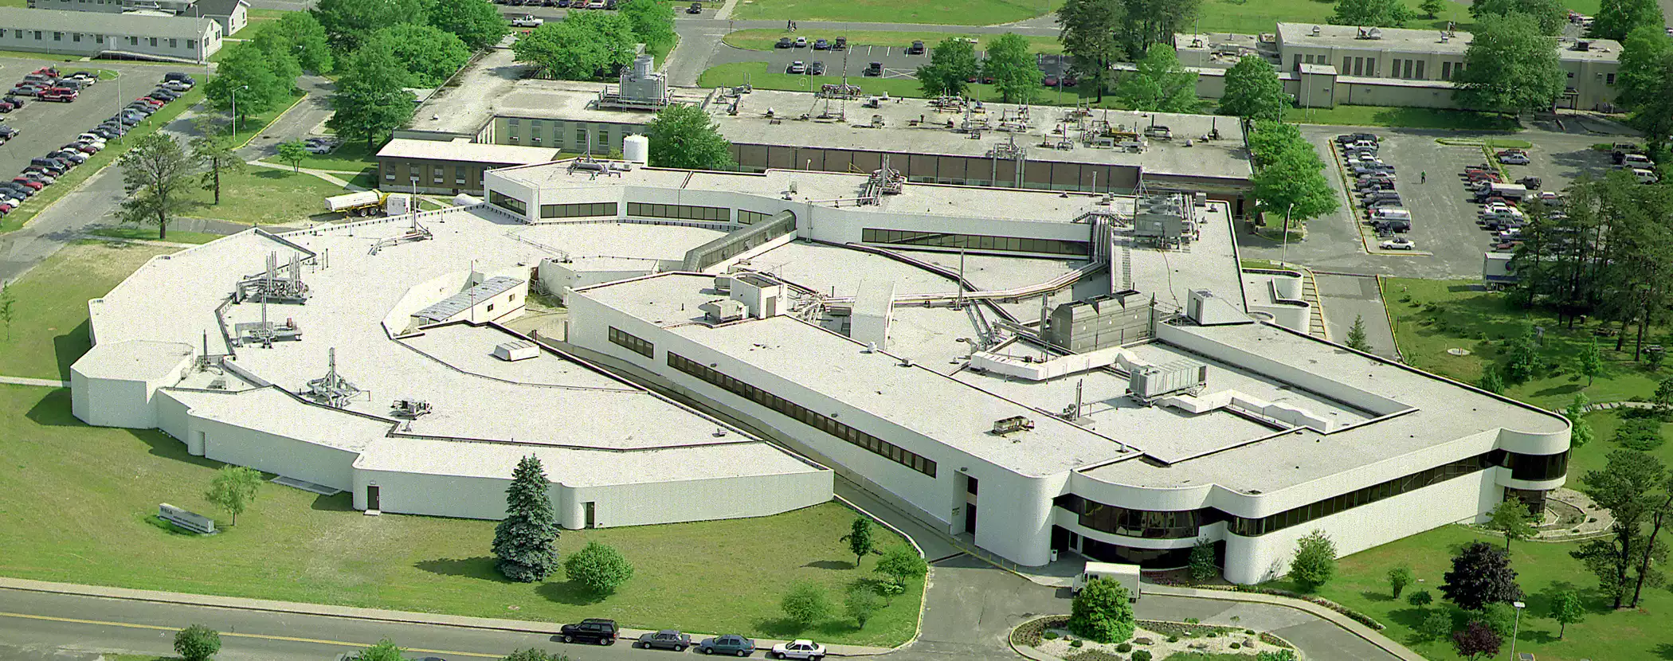
Second generation light sources (1980)
Second generation light sources were dedicated to Synchrotron Radiation. Mostly based on Chaseman-Green Double Bend Achromat (DBA) lattice cells.
1981: University of Wisconsin Synchrotron Radiation Center 1 GeV storage Ring
1982: National Synchrotron Light Source (NSLS at Brookhaven National Laboratory) 700 MeV and 2.5 GeV storage rings
1982 – Tsukuba KEK Laboratory 2.5 GeV storage Ring – Photon Factory
1982 – Berlin 0.8 GeV storage Ring – Bessy I
France: 1987 – Orsay – Lure Laboratory 0.8 GeV storage Ring – Super-ACO
Then SSRL in Stanford, HasyLab at Dasy, SRS at Daresbury.

Slide 7
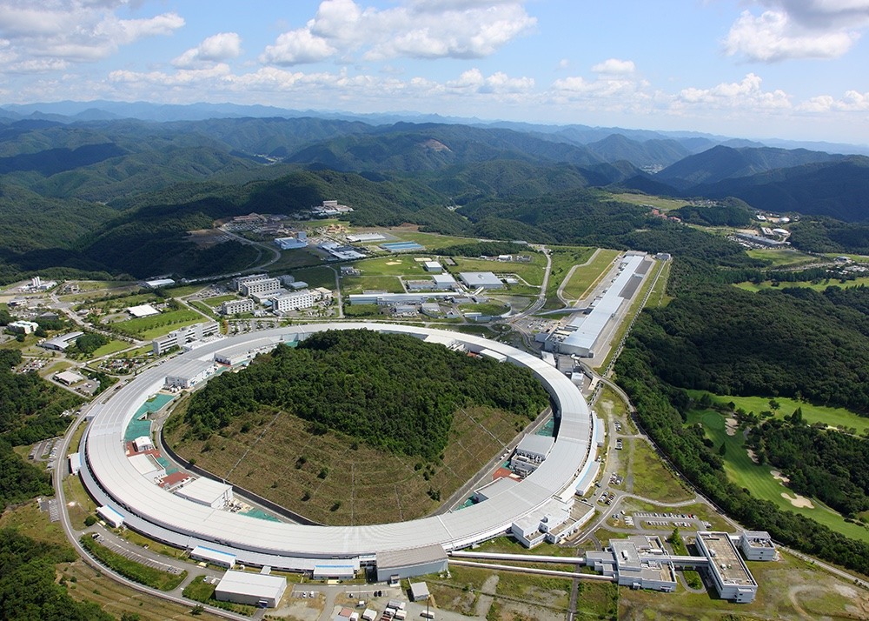
3rd generation from the (1990-2000-2010)
From third generation, the SR is regularly produced by undulator magnets.
Spring8
A few high energy machines:
1994: ESRF in Grenoble (France) 6 GeV, 844 m
1995: APS in Argonne (USA) 7 GeV, 1100 m
1997: Spring8 in Japan 8 GeV, 1500 m
2009: Petra III in Hamburg (Germany) 6 GeV, 2300 m
And a lot of 1.5 to 3.5 GeV small machines
Elettra (1993), ALS (1993), Bessy2 (1998), Anka (2000), Diamond (2001), Soleil (2006), Alba (2012), NSLSII (2015), Solaris (2016), …

Slide 8
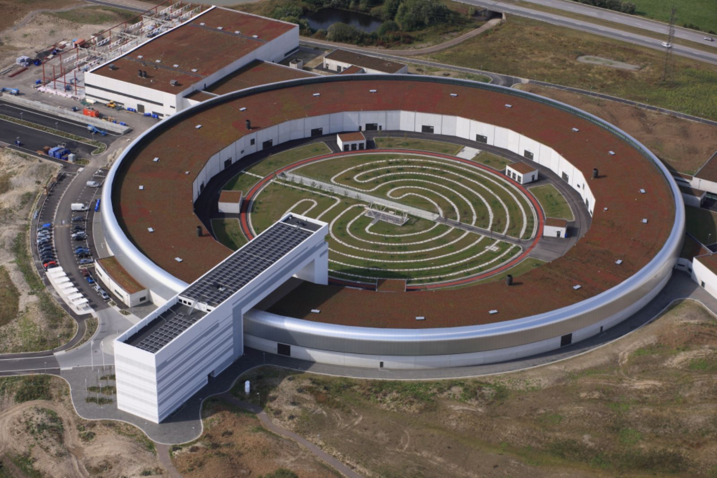
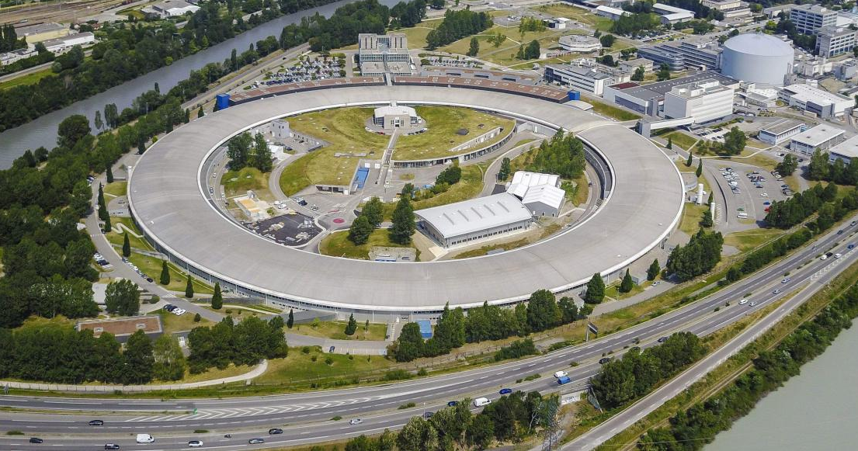
Fourth generation (2015-2020)
Fourth generation synchrotron light sources are based on Multi-Bend achromat lattices, with more than 1 order of magnitude emittance reduction.
Max-IV (3 GeV) and ESRF-Extremely brilliant source (EBS) (6 GeV) are the first two of them.
Max-IV
ESRF-EBS

Slide 9
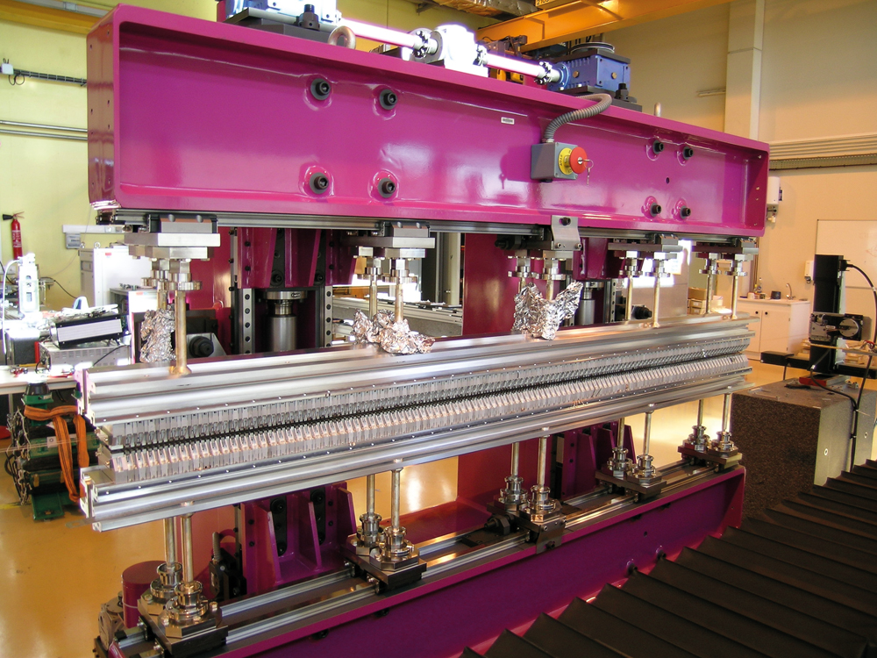
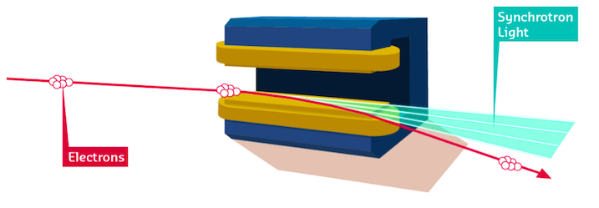
Sources of radiation
There are two possible sources of radiation in synchrotron light sources: the bending magnets and the undulators.
Undulator
Bending magnet

Slide 10
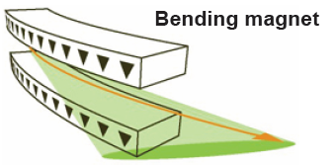
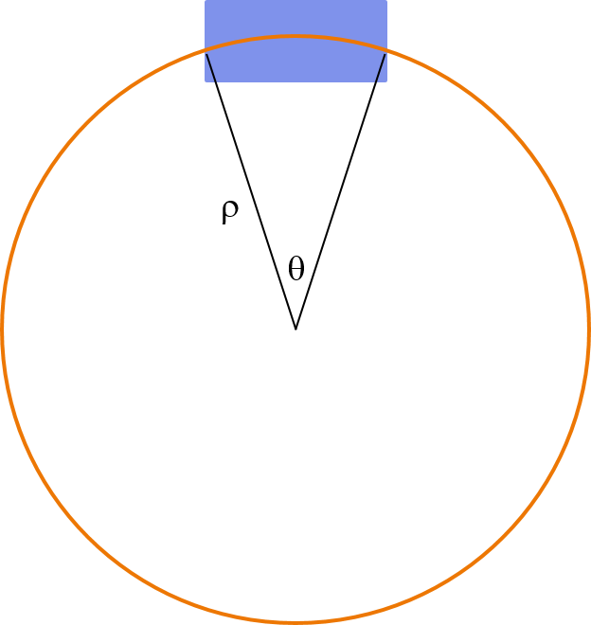
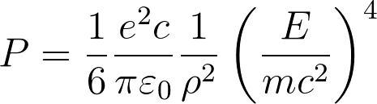
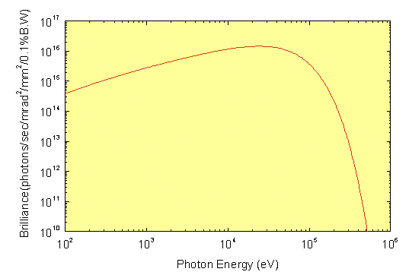
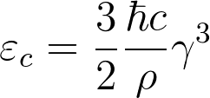
Bending magnets radiation
First and second generation synchrotron light sources were taking the radiation from the bending magnets.
Power emitted by an ultra-relativistic
particle in a bending magnet
ρ is the radius of curvature
Bending magnet
Electrons
Photons
Critical photon energy: half of the power is radiated at larger energy and half at lower
Spectrum from a 0.679 T bending magnet with a 8 GeV beam (Spring8).
Critical energy 28.9 keV.

Slide 11
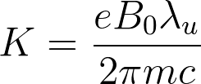
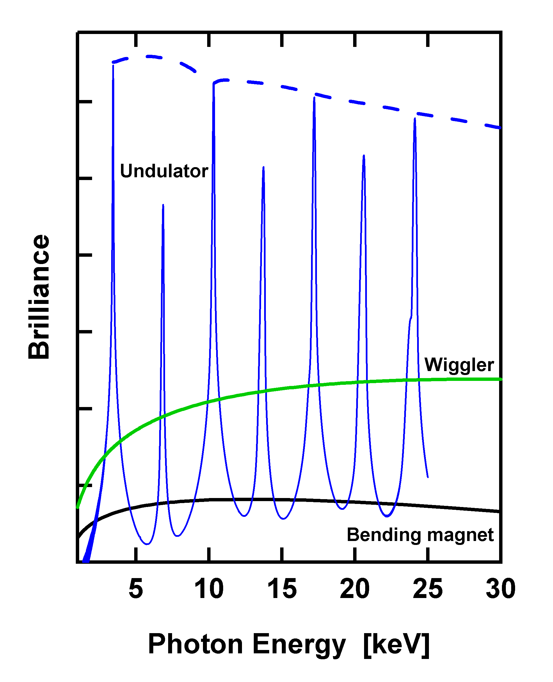
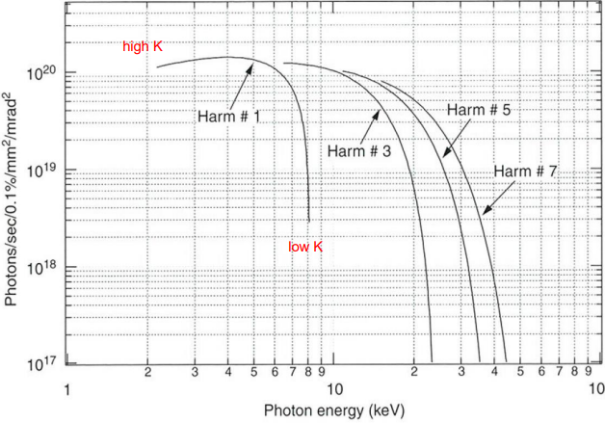

Undulator radiation
Undulators and wigglers magnets were first proposed in the ‘40s, then the first undulator was installed in a Linac at Stanford in 1953.
Third and fourth generation synchrotron light sources produce the radiation mostly from undulators.
The undulator parameter K<1 can be changed by varying the magnetic gap.
$$K ∝ e^{−\frac{π gap}{λ}}$$
Fundamental undulator wavelength λ₁

Slide 12
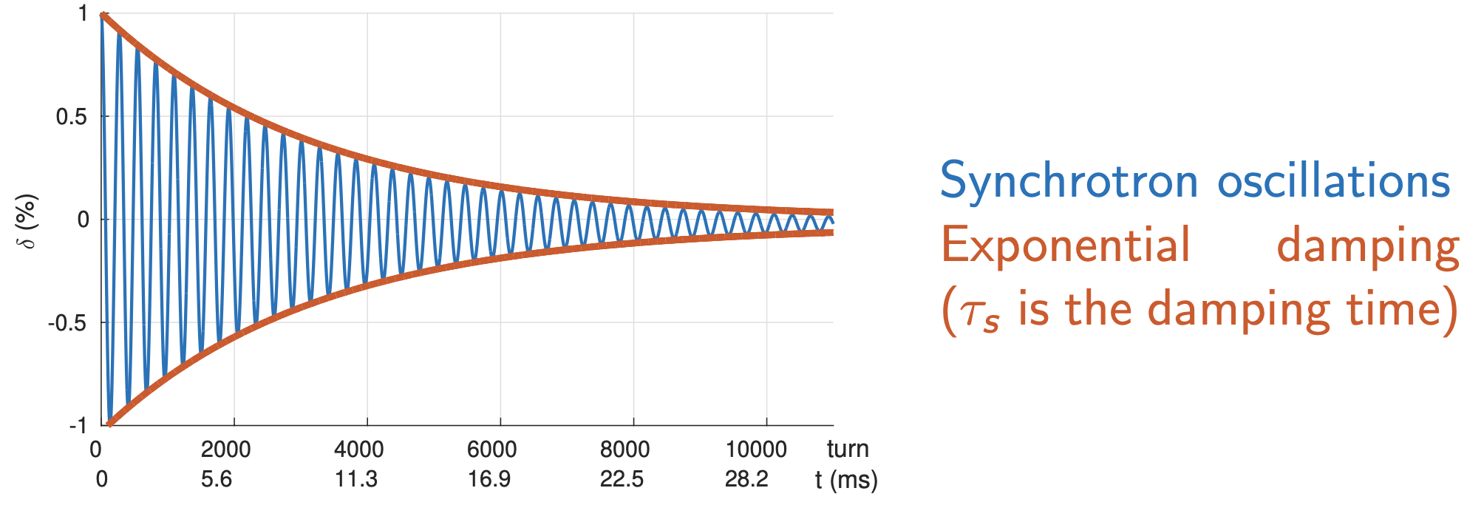
How emittance is generated: damping + diffusion
High energy particles emit more SR than low energy ones. RF cavities give back the same amount of energy to all the electrons. The energy oscillates and damps to the nominal value. This would send the energy spread to zero.
In the old ESRF:
τs = 3.5 ms, fs = 2.1 kHz
In the EBS:
τs = 9.1 ms, fs = 1.3 kHz
The graininess of the photon emission cause a fluctuation of the residual electron energy.
Many weak dipoles would reduce the average energy of the radiated photons and decrease the quantum fluctuation.

Slide 13
Distribution of the stored electrons
Only radiation damping
Radiation damping and quantum diffusion
Dipoles bend more the low energy electrons: energy spread becomes horizontal position spread.
The emittance is the equilibrium between radiation damping and quantum diffusion.

Slide 14
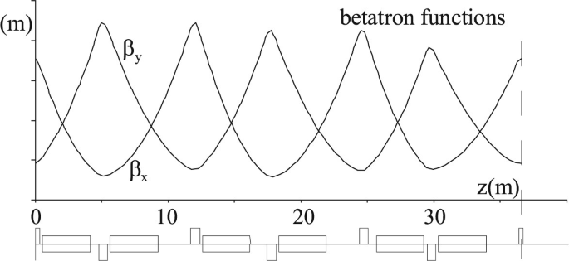
Lattice evolution: FODO
Most of the colliders have long arcs with periodic FODO lattices:
QF - dipole - QD - dipole
β functions (envelope of transverse oscillations) are oscillating
FODO lattices are not designed for low emittance.
QF
QD
Bending magnets

Slide 15
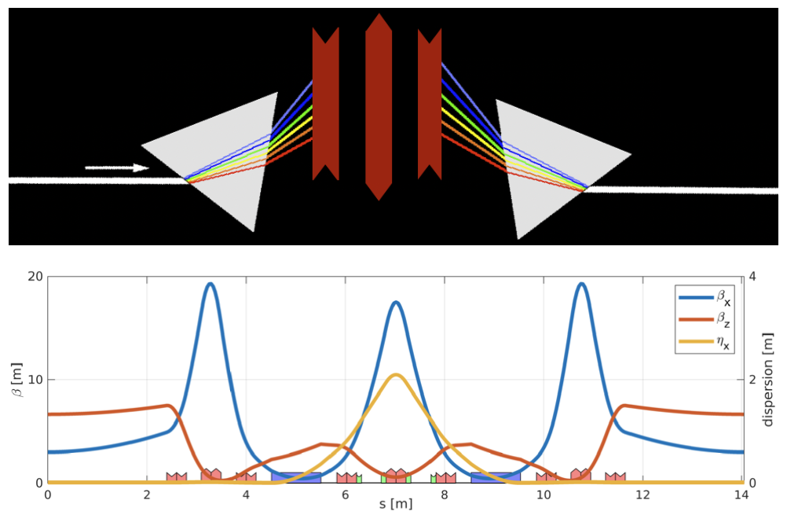
Lattice evolution: Double bend achromat
An achromat is a lattice that starts and ends with zero dispersion.
Most of 2nd and 3rd generation synchrotron light sources use the Chaseman-Green Double Bend Achromat (DBA) lattice cells proposed in the ‘70s and used for about 40 years.

Slide 16
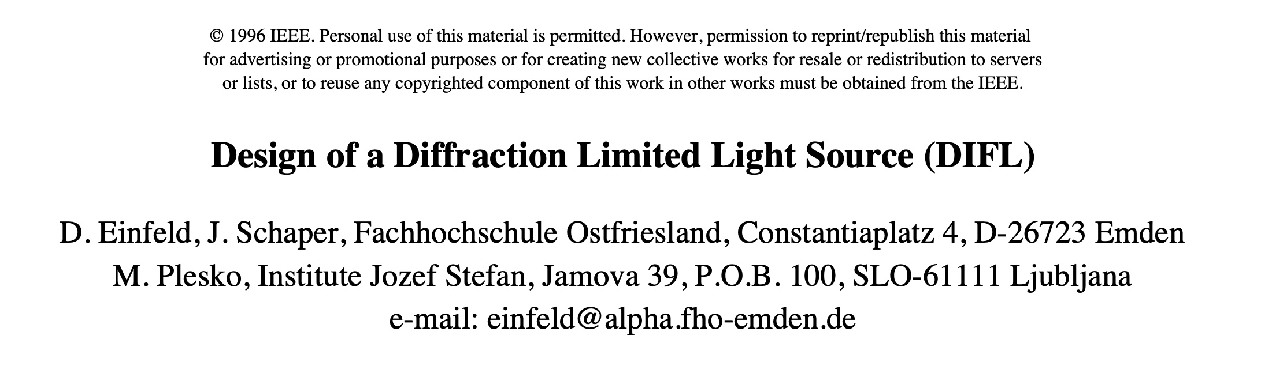
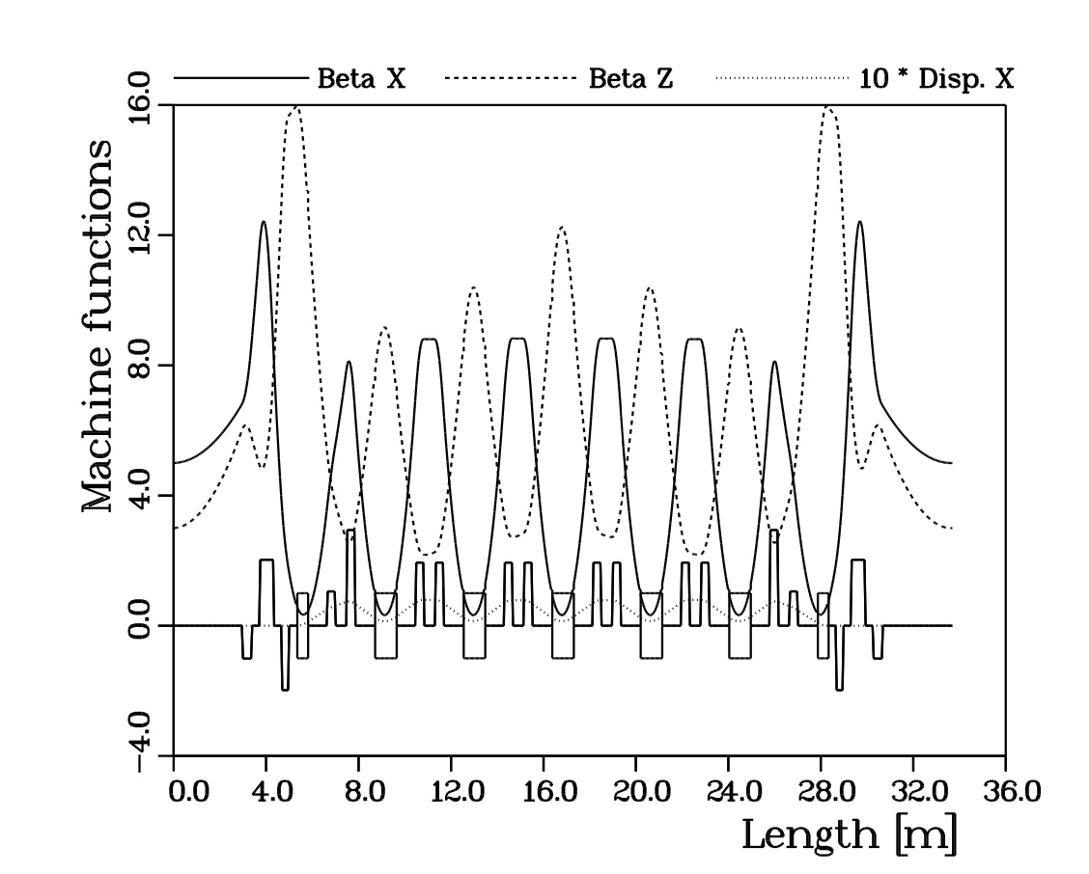
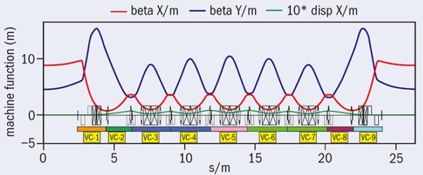
First proposal of Multi-Bend Achromat lattice
1995: D. Einfeld and J. Schaper propose the Multi Bend Achromat low-emittance lattice.
Many weak dipoles in each cell, to reduce the energy of the emitted photons.
DIFL, proposed in 1995:
7 bend achromat, 3 GeV, 500 pm
Max IV, built in 2016:
7 bend achromat, 3 GeV, 350 pm

Slide 17
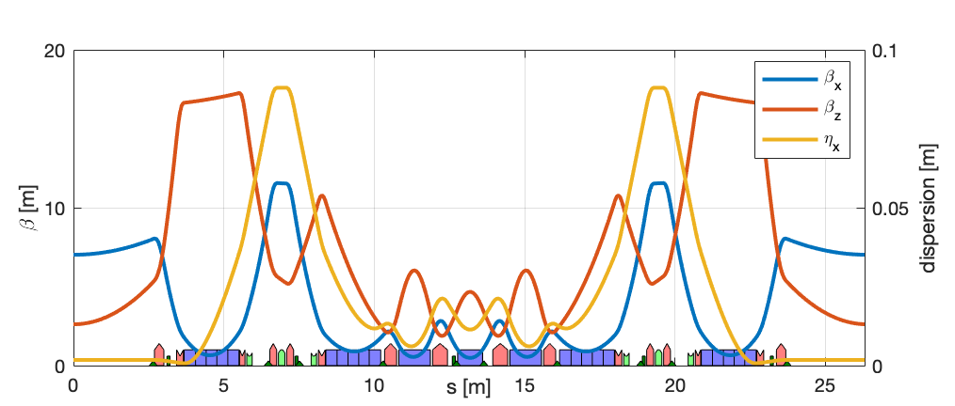
challenges of Multi-bend achromats
Many weak dipoles and small beta-functions => strong quadrupoles and large chromaticities
Many weak dipoles => small energy dispersion => strong sextupoles => bad nonlinear dynamics
Still the Max IV ring works, but a new design has been proposed in 2012 by Pantaleo Raimondi.
Multi-Bend Achromat cell (Max-IV)
The Hybrid Multi Bend Achromat:
two dispersion bumps at –I phase advance, inspired by the Super-B factory lattice.
Nonlinear resonances are canceled thanks to the –I phase advance between the sextupoles.
Less and weaker sextupoles than standard MBA.
Hybrid Multi-Bend Achromat lattice (ESRF-EBS)

Slide 18
outline
Synchrotron light sources:
beam emittance and brilliance
a brief history
lattice evolution
The ESRF EBS
design
commissioning
operation
Applications

Slide 19
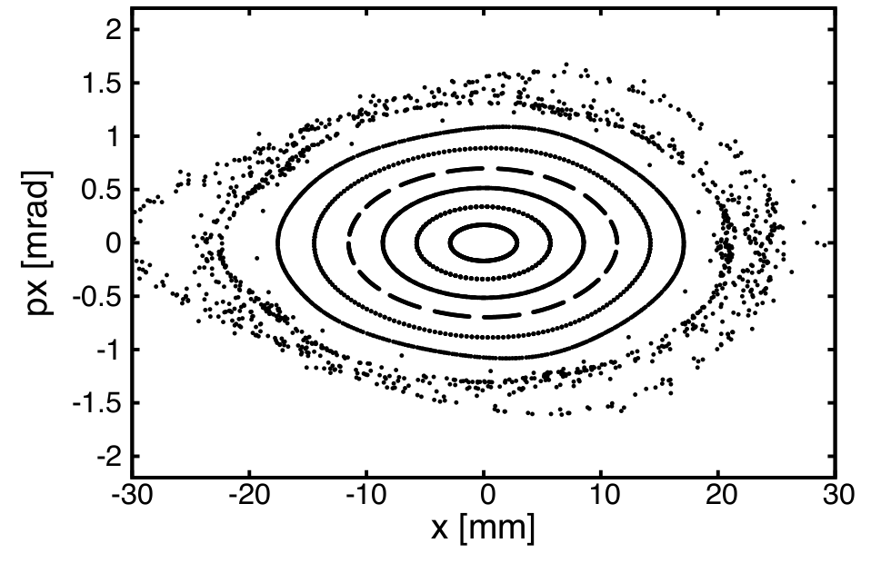
Nonlinear dynamics: Dynamic aperture
The dynamic aperture is the area of the stable region in the 6D phase space coordinates.
In a linear machine it would be infinite. Sextupoles are needed for chromaticity correction, but they create chaotic motion at large amplitudes.

Slide 20
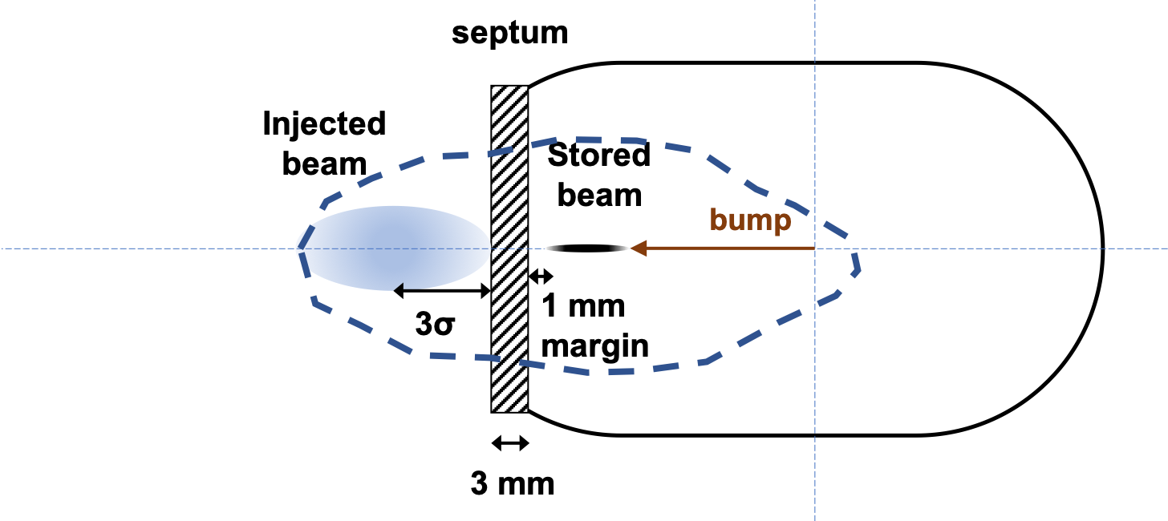
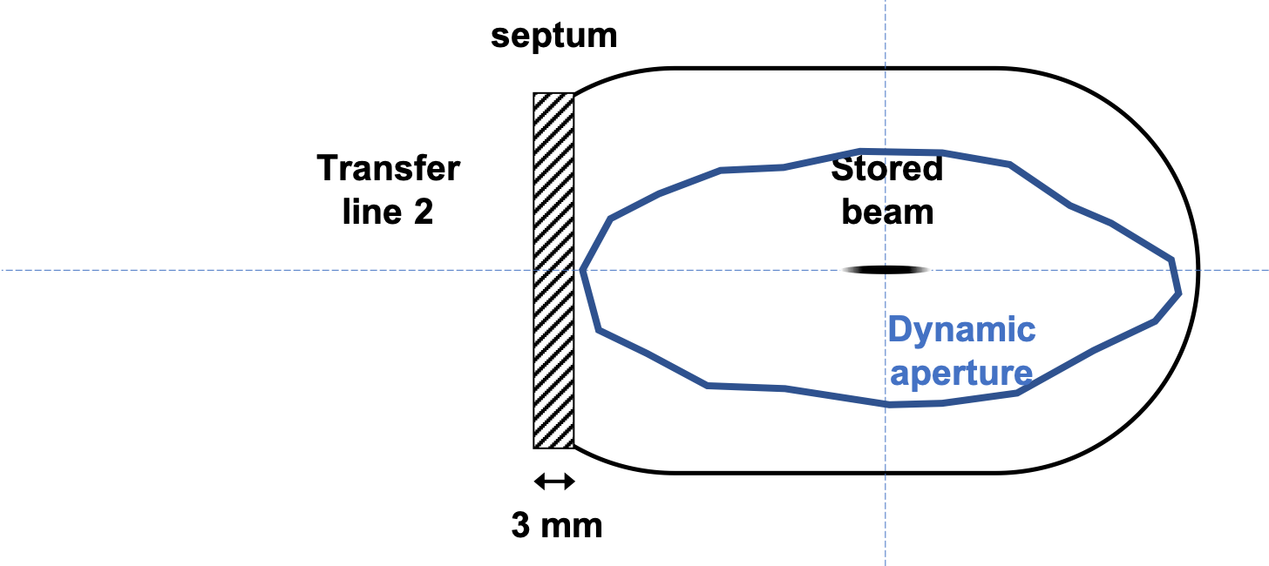
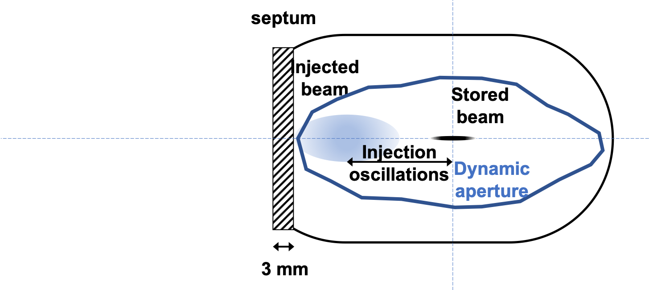
Nonlinear dynamics: Dynamic aperture
Injection is performed off-axis. So the dynamic aperture has to be large enough to accommodate the injected beam and the thickness of the septum blade.

Slide 21
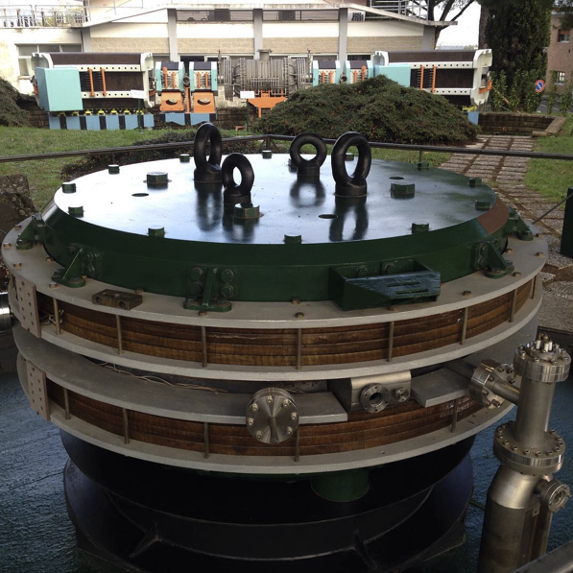
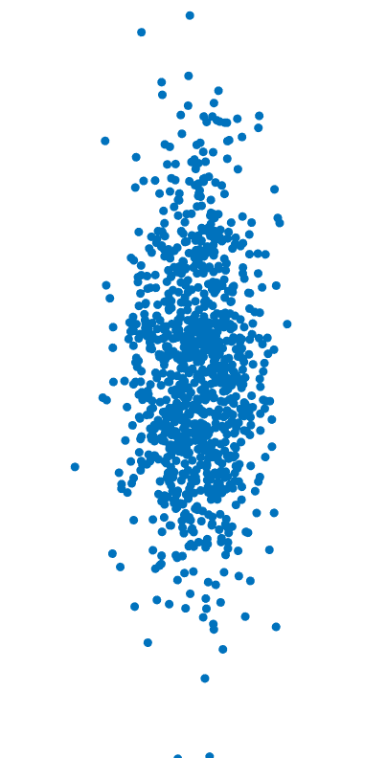
Nonlinear dynamics: Touschek lifetime
Touschek effect is a large angle electron electron scattering inside a bunch.
It has been first observed at AdA.
x
Horizontal momentum is transferred to longitudinal, exceeding the momentum acceptance.
The 2 electrons are lost!
z
The Touschek effect is the main lifetime limitation in the electron storage rings.

Slide 22
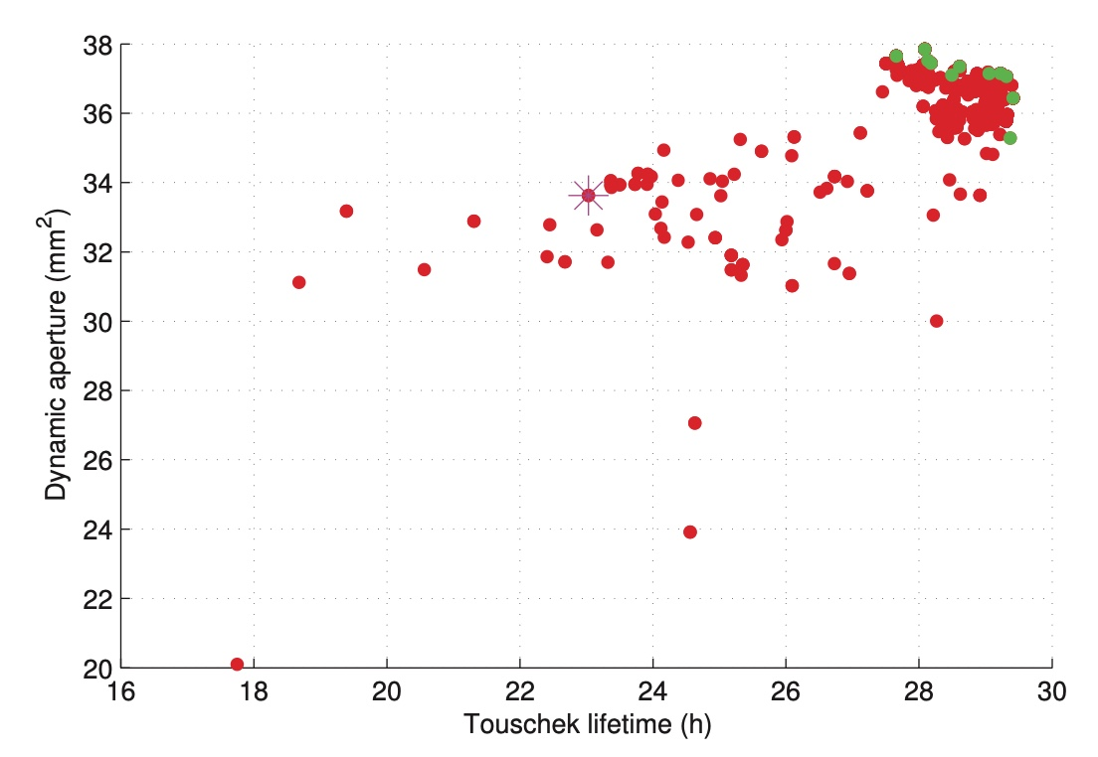
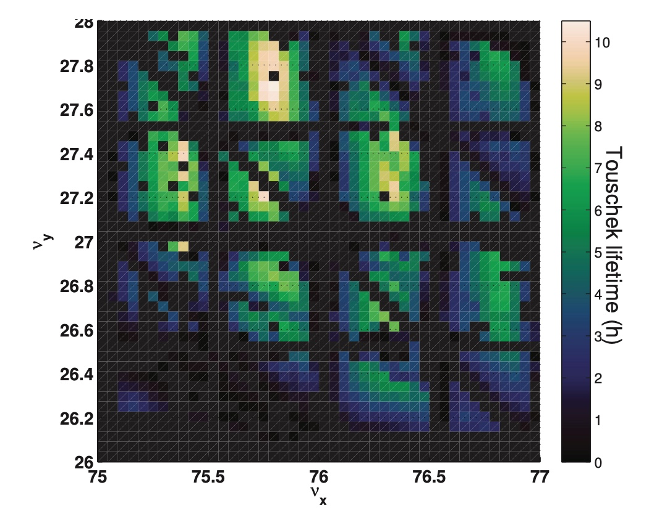
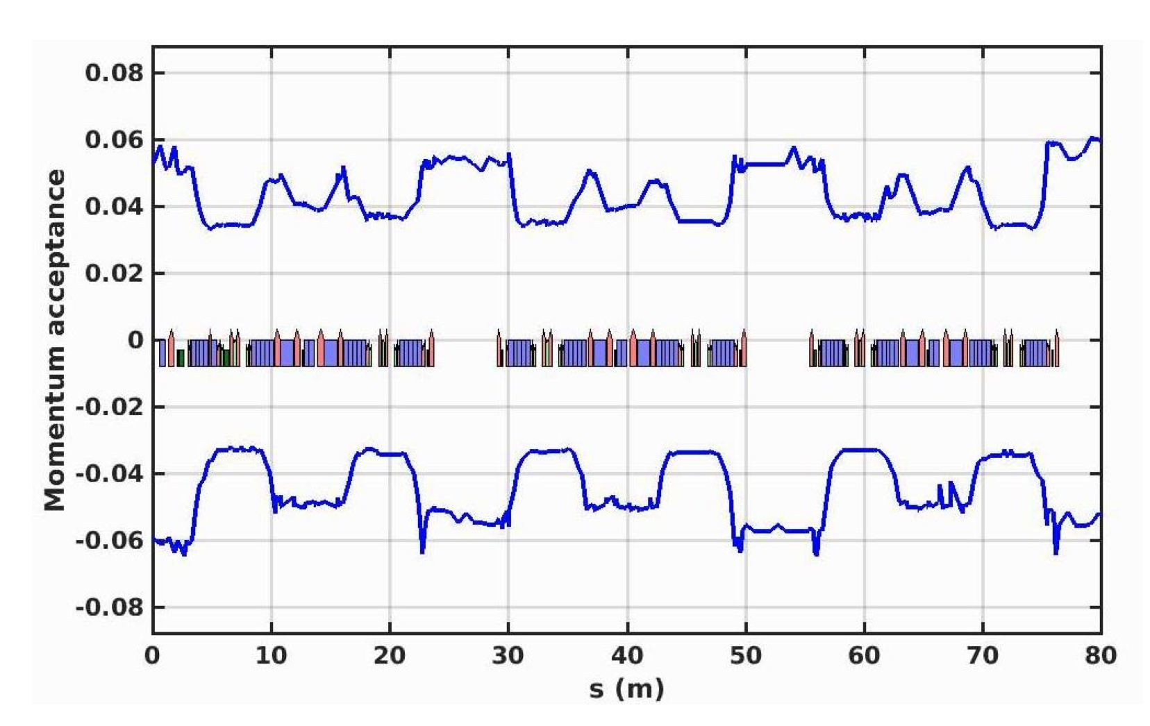
Nonlinear dynamics Optimizations
Nonlinear dynamics optimizations are strongly based on multi-objective evolutionary algorithms (NSGA2, MOPSO, …) or parameter scans.
Big computer cluster are needed to design new storage rings.
The Touschek lifetime simulations require to find the momentum acceptance by particle tracking

Slide 23
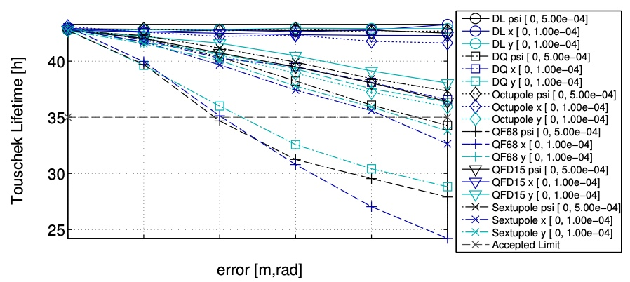
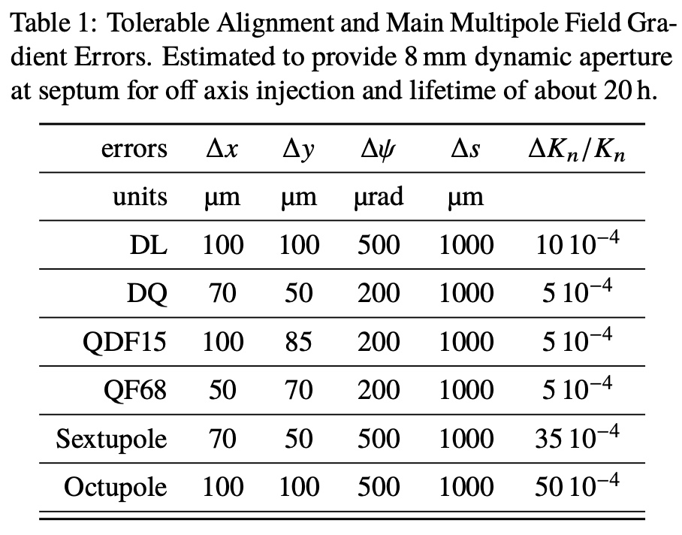
error studies
Source of errors:
Alignment x,y,z
Tilts
Power supplies
Multipole components
Each error source has been studied to find the tolerable value, giving a small reduction of dynamic aperture and Touschek lifetime.

Slide 24
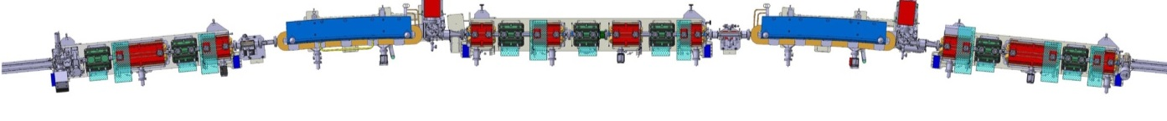
the ebs upgrade at esrf
Sextupoles
Dipole
Dipole
Quadrupoles
Octupole
Octupole
Sextupoles
Quadrupoles
Quadrupoles
Sextupoles
Dipole
Dipole
Dipole
Dipole
Dipole-quadrupoles
Quadrupoles
Quadrupoles
Magnet type | ESRF | ESRF EBS
Dipoles | 64 | 128
Dipole-Quadrupoles | 0 | 96
Quadrupoles | 256 | 512
Sextupoles | 224 | 192
Octupoles | 0 | 64
Correctors | 0 | 96
The ESRF Extremely Brilliant Source (EBS) has 31 magnets per cell instead of 17 of the old machine.
Free space between magnets (for one cell): 3.4 m instead of 8 m.
Dipoles cover 38% of the total length instead of 18%.

Slide 25
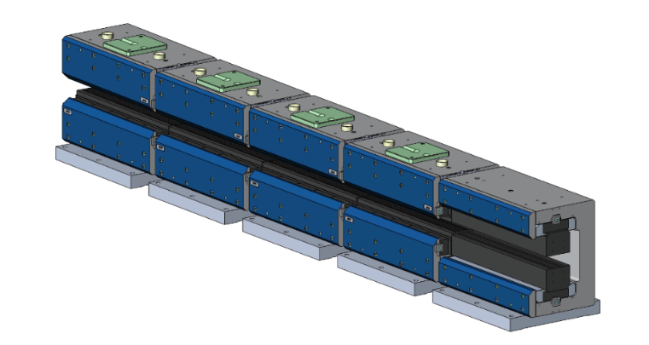
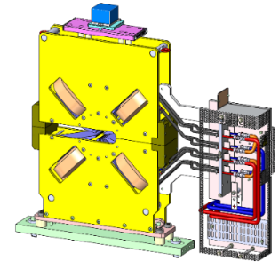
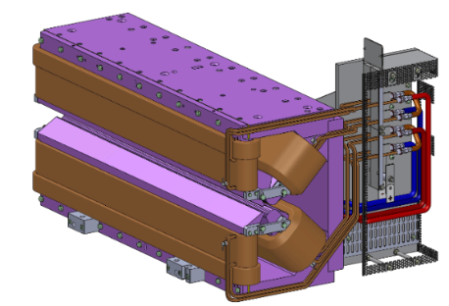
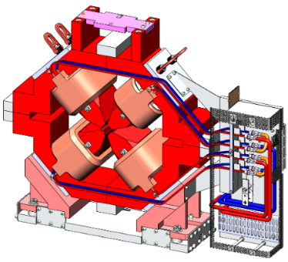
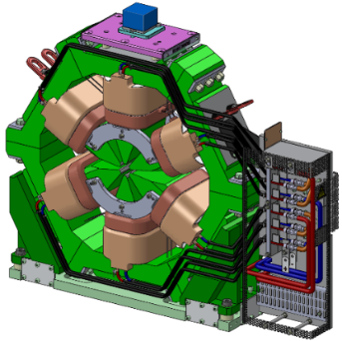
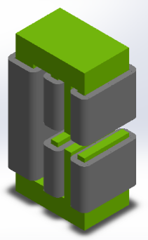
EBS components: magnets
96 [100] Dipole-quadrupoles
64 [66] Octupoles
Assembled in house
BINP
128 [132] Permanent Magnet Dipoles
TESLA
More than 1000 Magnets
96 [98] Correctors
192 [196] Sextupoles
512 Quadrupoles
(128 [132] HG, 384 [392] MG)
TESLA (MG)
DANFYSIK
SEF
DANFYSIK (HG)

Slide 26
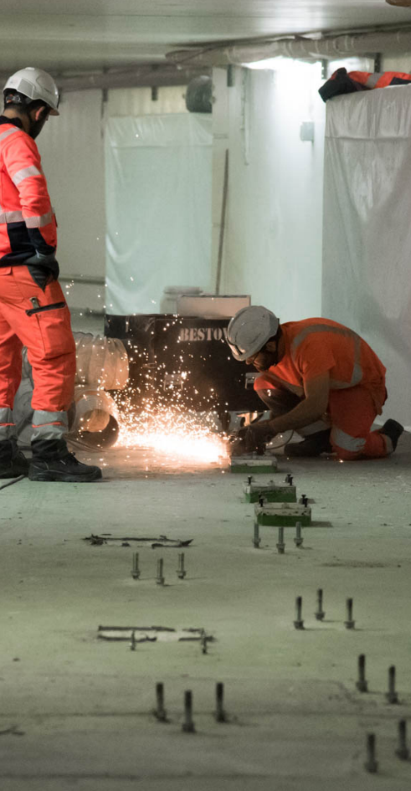
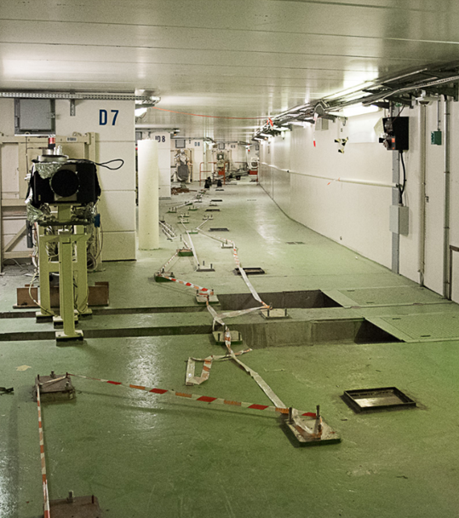
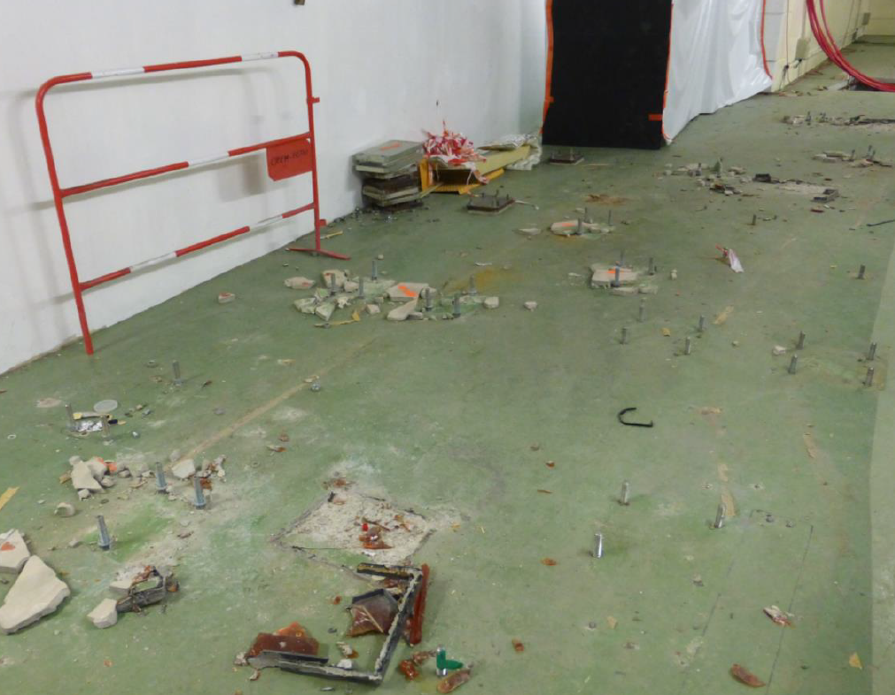
Preparation of the tunnel
The EBS has been installed in the tunnel of the old machine.
Storage ring tunnel during the 2019 shutdown.

Slide 27
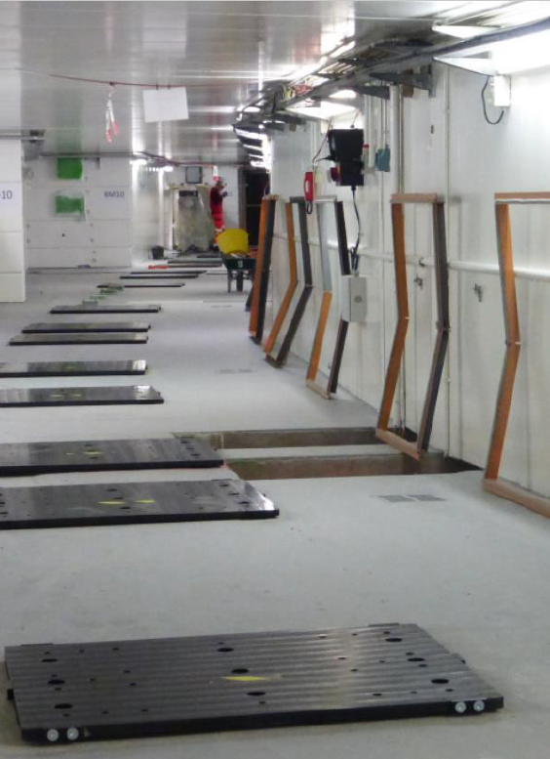
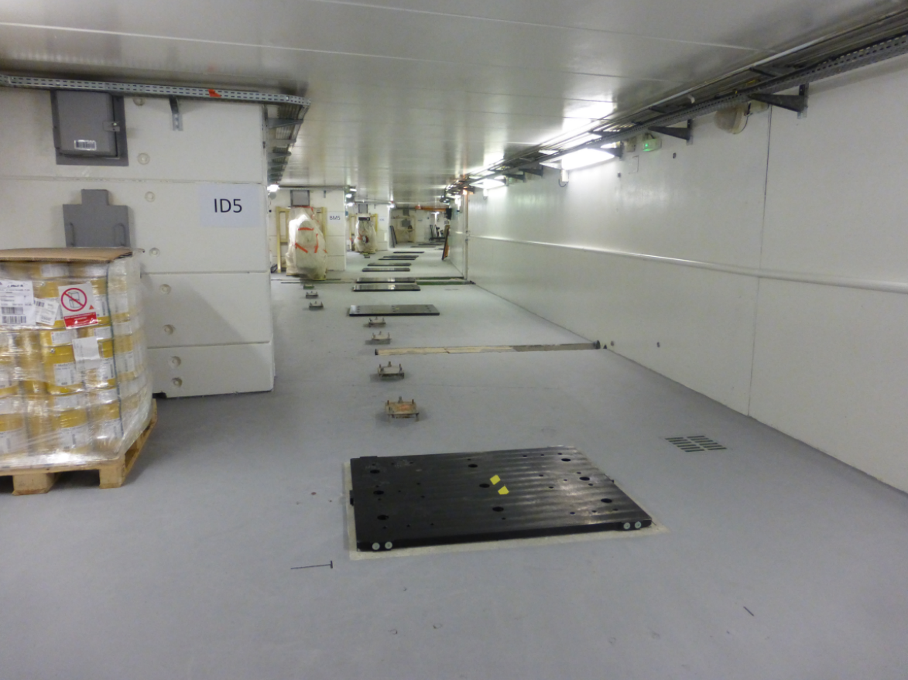
Preparation of the tunnel

Slide 28
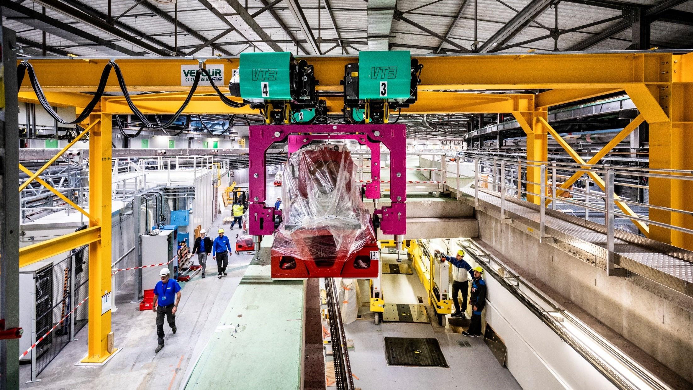
Installation of the EBS
Preassembled girders lifted from the roof.

Slide 29
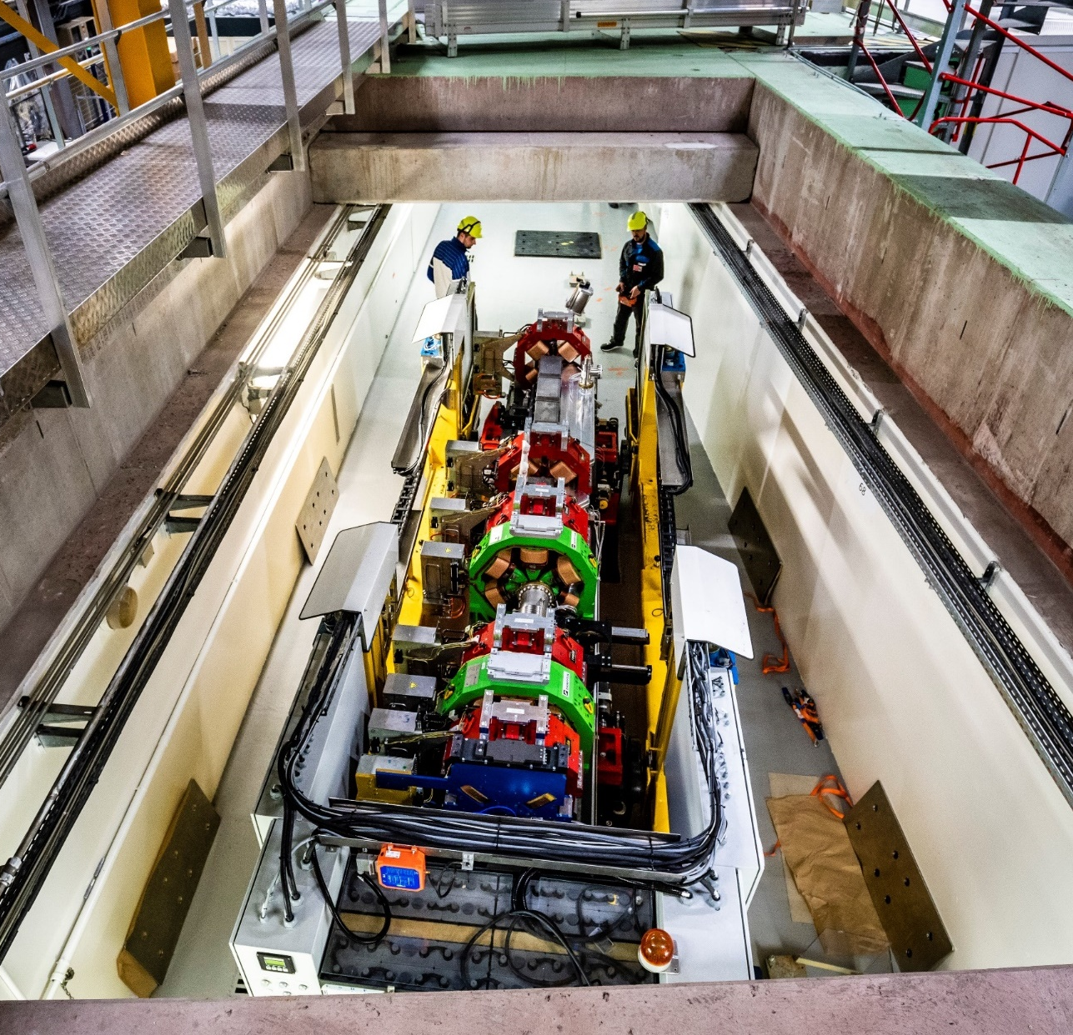
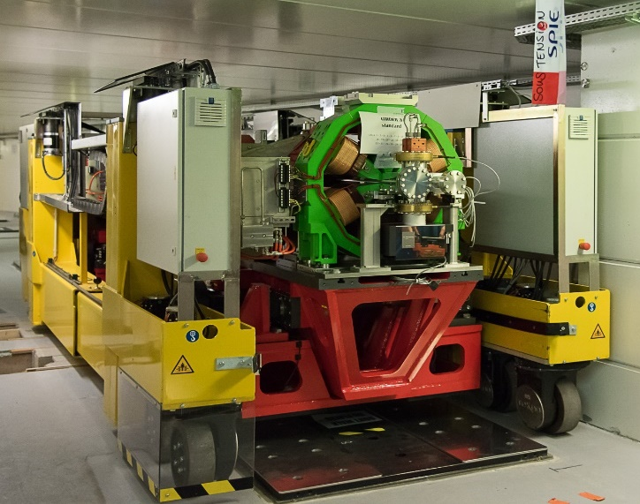
Installation of the EBS
The girders have been driven to their location in the tunnel with a special vehicle.

Slide 30
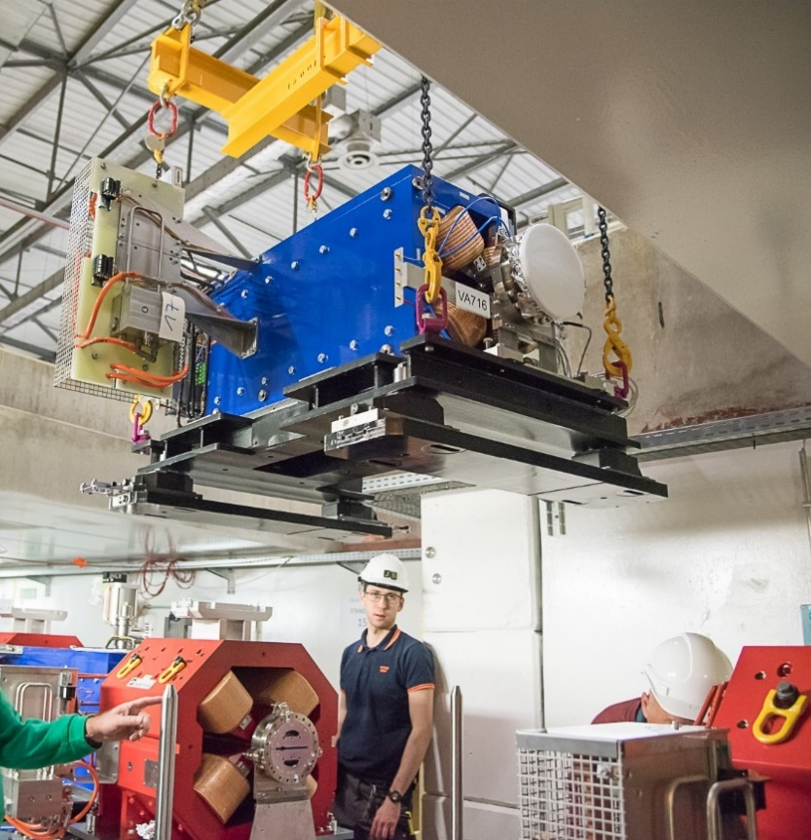

DQ2 installation
DQ2 magnets in between two girders installed from the roof.

Slide 31
ESRF Booster adaptations
TL1
The ESRF booster has a FODO lattice with three arcs and three straight sections: injection, extraction, RF.
Only two quadrupole families and two sextupole families.
Off-energy operation:
ε_{x} = 120 nm => 85 nm.
Gun
Linac
SI
KI
CTRM
B1
KE
SE1
B2
B3
TL2
RF

Slide 32

Hardware modifications: Booster CIRCUMFERENCE reduction
Length of old ESRF: 844.391 m (f_{RF} = 352.1997 MHz)
Length of EBS: 843.977 m (f_{RF} = 352.3722 MHz)
RF frequency of EBS is 172 kHz higher than for ESRF.
The booster had to share the same RF source, so it had to be realigned to reduce its circumference, but it runs off-energy with 40 kHz mismatch.
Length of the booster with EBS: $\frac{c h}{fRF EBS−40 kHz}$ = 299.51 m, instead of 299.62 m
All the girders have to be moved by 17.5 mm, perpendicularly to the beam trajectory.
Off-energy operation: electrons are bent by dipoles and quadrupoles
=> more damping, smaller emittance: 120 nm => 85 nm.

Slide 33


Booster realignment
The 17.5 mm displacement of the main girders of the arcs is within the range of adjustment capability.
Distance between two dipoles is reduced by 1.5 mm and bellows can handle the reduction.

Slide 34


Booster emittance exchange
Emittance exchange in the booster done by crossing the tunes changing the vertical quickly
Time from injection (ms)
Vertical tune
The vertical tune is changed by 0.1 at extraction time
With emittance exchange in the booster, the injection efficiency improved by 5-10%

Slide 35










ESRF-EBS: beam Commissioning
November 28th
First turns
December 6th
Beam stored
December 15th
Accumulation
January 30th
First Beam on 26 Beamlines
February 28th
200 mA achieved
3 physical obstacles on the beam path and poor vacuum in a few ID NEG coated chambers slowed down the overall commissioning.

Slide 36




ESRF-EBS: beam Commissioning – physical obstacles found
Obstacle in Cell-5 Ch7
AL piece fall during installation of DQ2
3 physical obstacles on the beam path found during commissioning.
Piece of wire accidently into SS-23
ID chamber
Installation error
in cell8
Detected, get around, resolved by:
Very useful beam loss and turn by turn BPM diagnostics
Bumps, non-closed injection bump, off-energy operation, distorted close orbit,,…
Intervention to remove the obstacles one by one
Largely beneficial to injection efficiency, lifetime, optics tuning
Nominal position
Installation mistake Cell8-Bellow 9-11

Slide 37











ESRF-EBS: beam Commissioning – cross talk between magnets
G.Le Bec, J.Chavanne
Magnetic simulations show a cross-talk effect among neighboring magnets.
Gradient recomputed + calibration scaling
Thin lens fix field multipole
+1.3% *QF4B
-0.8%*QD2A
model tunes: 76.2100 27.3400
+ Cross Talks: 76.6973 26.0038
-1.3 Q_{y}

Slide 38
Da studies: dA vs orbit correctioN
Orbit correction is performed with an SVD pseudo-inversion of the orbit response matrix (ORM).
ORM has 288 lines and 320 columns. During the design phase we were using only 64 eigenvectors to limit the correctors strengths.
64 eigenvectors
Decided from these simulations to go to 162
→ Smaller closed orbit residual →
→ Smaller closed orbit residual →
Better orbit correction gives a smaller beta-beating and larger dynamic aperture

Slide 39

ESRF-EBS: Commissioning from 28/11 to 01/04
200 mA
SR current ramping
Injection efficiency
90 %
75%
Beamline commissioning
55%
30%
20%
0.1%
5%
Winter shutdown
28/11/2019
01/04/2020

Slide 40
Reliability of EBS very high
User mode of EBS started in mid 2020.
Statistics of beam availability are improving and are now at the level of the old machine.
 | 2017 | 2018 | 2020 | 2021 | 2022 | 2023(07)
 |  |  | EBS | EBS | EBS | EBS
Availability (%) | 98.3 | 98.5 | 96.1 | 96.4 | 99.1 | 99.3
Mean time between failures (h) | 64.3 | 104.3 | 46.0 | 66.4 | 88.5 | 121.7
Mean duration of a failure (h) | 1.11 | 1.60 | 1.80 | 2.42 | 0.83 | 0.8

Slide 41



Further improvements of the EBS: vertical halo reduction
The EBS is operated with low vertical emittance: ε_{y}=10 pm
σ_{y} about 10 μm,
but a small fraction at hundreds of sigmas: the beam halo
Beam halo does not allow to close more the undulator gaps
From simulation, we see that off-energy particles can cross a resonance and start to have large vertical oscillations.
$$σ_{y}≈few mm$$
Brilliance of an invacuum undulator
Different low halo optics have been tested and will allow low-gap operations. Results will be published soon.

Slide 42

Further improvements of the EBS: off-energy operation
Operating the EBS with a 1% lower energy (RF frequency 300 Hz higher) the horizontal emittance is 20 % smaller.
Electrons pass off-axis in the quadrupoles and emit some more radiation, reducing the equilibrium emittance.
For some undulators harmonics, the gain in brilliance by operating off-energy can be about 10 %.
The off-energy operation mode is under study. Results will be published soon.

Slide 43


Further improvements of the EBS: harmonic cavity
A fourth harmonic RF cavity at the correct amplitude and phase => bunch length increase by a factor 3 to 5.
Touschek lifetime is increased by the same factor.
The beam is more stable and less affected by collective effects.
A design of an active copper cavity has been done and a prototype should be produced.

Slide 44
outline
Synchrotron light sources:
beam emittance and brilliance
a brief history
lattice evolution
The ESRF EBS
design
commissioning
operation and future improvements
Applications

Slide 45





BM 18, a new beamline designed for the EBS
BM 18 is a very long new beamline taking the light from a 1.56 T 3 poles wiggler.
Specialized in high resolution imaging of large samples
Lung of a covid patient
Hominid skull
fossil of arthropod in an amber block
High value objects

Slide 46


9 ERC grant currently at the ESRF
The ESRF EBS has 40 beamlines with very wide research topics.
Currently, there are 9 European Research Council grants on different topics and in different beamlines.

Slide 47

Many thanks for you attention

