Slide 1
Dark matter signatures
Konstantin Zioutas
University of Patras / Greece
Zwicky: 1st cosmic DM signal ➔ locally?
From Collaboration work with: A. Argiriou, G. Cantatore, S.A. Cetin, E. Georgiopoulou, D.H.H. Hoffmann, S. Hofmann, M. Karuza, A. Kryemadhi, M. Maroudas, A. Mastronikolis, E.L. Matteson, K. Ozbozduman, T. Papaevangelou, M. Perryman, Y.K. Semertzidis,
I. Tsagris, M. Tsagri, G. Tsiledakis, E.L. Valachovic, A. Zhitnitski
https://agenda.infn.it/event/39939/timetable/#20240903
1

Slide 2
1st DM signal
More matter
ZWICKY
1933
Cosmic observations in tension with expectation
➔ “dunkle Materie” (DM)
F. ZWICK first postulated DM in 1933; he analyzed the kinematics of galaxies and was thus able to indirectly deduce the total mass of the system, which was much larger than the visible mass.
Can we utilize his reasoning also now?
2

Slide 3
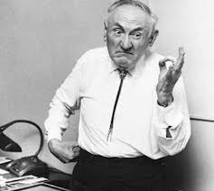
Fritz ZWICKY
IF long lasting striking…
strong
➔
Q. …local observations are in tension with expectation ➔
Due to DM ?
2
NO remote planetary force; An:
UNexpected planetary dependency
“It is the main common DM argument
following Zwicky’s paradigm “
this work
➔
following observations
THIS WORK
J. JAVARAIAH, Solar Physics 212 (2003) 23
3

Slide 4
Tidal forces:
REMOTE ✓ but extremely feeble!
6

Slide 5
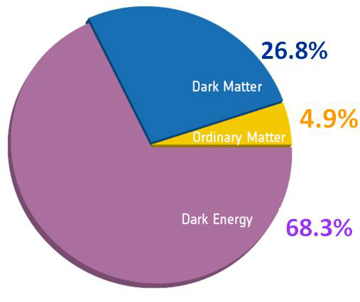
“All we know is dark matter is well hidden”_{=>“dark”}
misleading
16thFebruary 2021: http://spaceref.com/astronomy/the-smallest-galaxies-in-our-universe-bbring-more-about-dark-matter-to-light.html
Our universe is dominated by a mysterious matter known as DM. Its name comes from the fact that
DM does not absorb, reflect or emit electromagnetic radiation, making it difficult to detect.
Overlooked counter examples =>this work
4

Slide 6
⬅ Frank Wilczek (CERN seminar):
“~focus on anomalies / mysteries”
NOBEL 2004
Sun’s dynamical behaviour
=> a multifaceted mystery <=
5

Slide 7
In this work ➔
local tensions
w. known physics?
several
Striking examples
p.t.o. ➔
Local => - solar system
- exo-solar system (M. Perryman, K.Z.,
https://www.mdpi.com/2073-8994/14/4/721 )
7

Slide 8
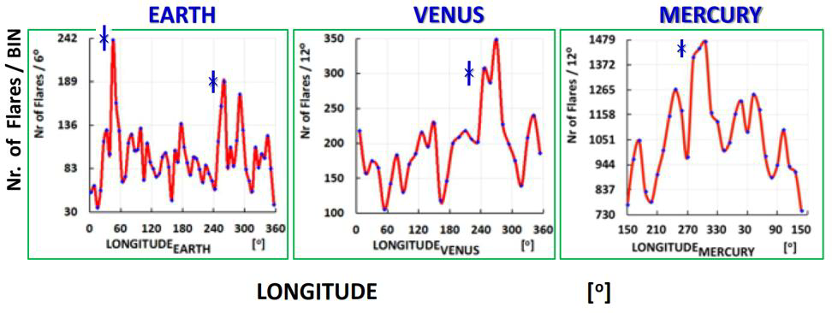
1)
Solar Flares
Peaking planetary relationship,
Biggest +unpredictable sol system “explosions”
excludes remote planetary interaction, like: tidal forces
extrem feeble
Data from MJ Aschwanden
See in Phys. Dark Universe 2017: https://doi.org/10.1016/j.dark.2017.06.001
8

Slide 9
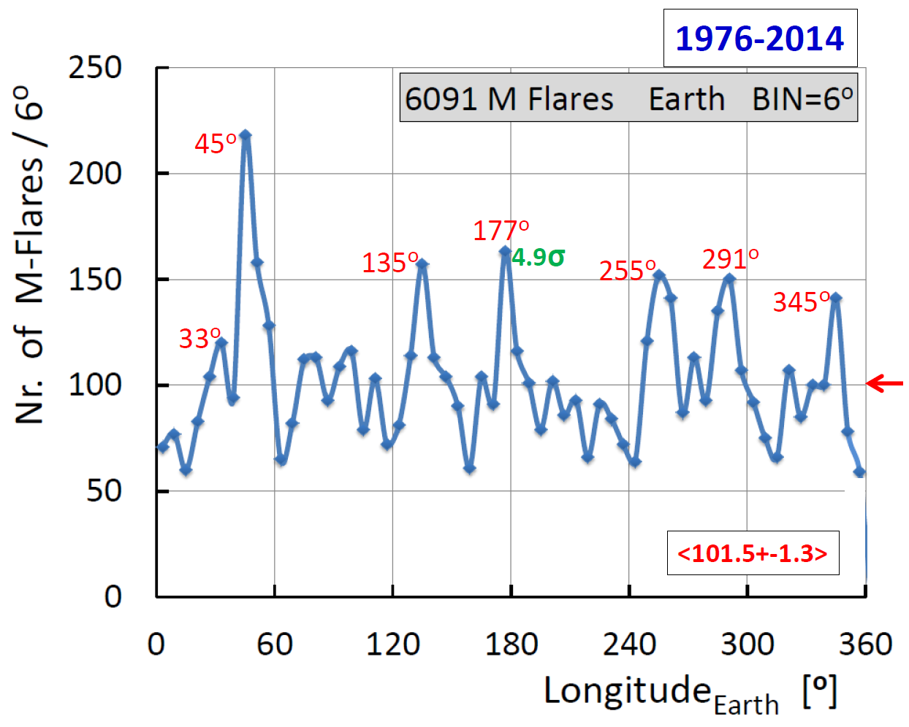
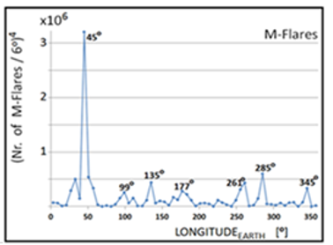
EARTH
EARTH
9

Slide 10
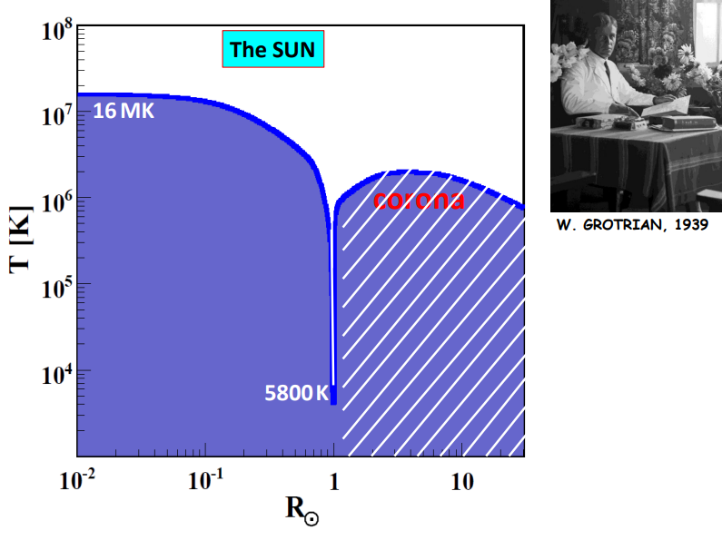
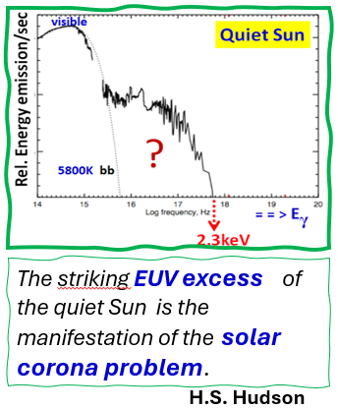
2)
A mysterious solar observation: T_{SUN} = ƒ(R)
W. Grotrian 1939
WHY the Sun has not relaxed
thermodynamically after 4-5 Gyears?
Surface
10

Slide 11
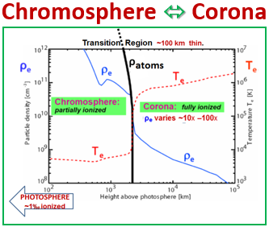
corona mystery
Why…
Temp inversion?,
=> by factor ≥ 100 within ≤100km
1939- NO explanation
within known physics!
11

Slide 12
“Spacecraft Makes Progress on
Solar Heating Mystery”
October 2022• Physics 15, 157 Parker Solar Probe confirms a long-suspected heat source for the Sun’s … Experts are not sure why the solar corona and the solar wind are hundreds of times hotter than the surface of the Sun, but they have
several theories. Researchers have now confirmed one suspected source of heating.
surprisingly hot corona, but there may be others. https://physics.aps.org/articles/v15/157
See also https://journals.aps.org/prl/abstract/10.1103/PhysRevLett.129.165101?utm_source=email&utm_medium=email&utm_campaign=prl-alert
A long lasting mystery
It is extremely difficult to simulate the details of coronal heating …Thus
testing realistic models with observations is
a major challenge.
JA. Klimchuk et al., ApJ (2022) accepted 2nd Nov. 2022
12

Slide 13
On the Intermittency of Hot Plasma Loops in the Solar Corona
PG Judge, NPM Kuin, ApJ 970 (25th JULY 2024) 130; https://doi.org/10.3847/1538-4357/ad5202
Sometimes in a mature research field, there is a need to step back and reassess some fundamental facts. A recent analysis ➔ the heating of the solar corona depends ….
also on processes yet to be identified…
findings claim …
unobserved physical processes … govern the heating…
... the solar X-ray corona above ARs … heated somehow through B
➔ something missing … in the way the corona is heated..⬅
Is there an unseen corona between the visible coronal loops?...
Could the coronal heating be a secondary result of such processes?
https://arxiv.org/abs/2408.07824
Before this work ➔ p.t.o.
13

Slide 14
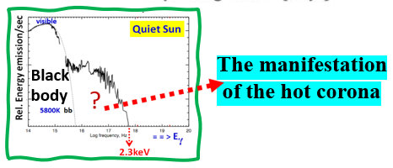
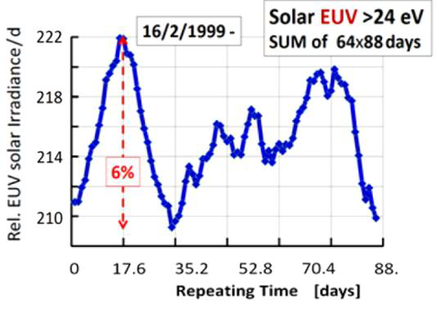
Follow-up ➔
The solar corona paradox.
2017
2002
[10]
NOT
EXPECTED
Solar EUV / d
NOT EXPECTED
[H. Hudson]
Repeating time 88 d
[L. Di Lella, K. Z., AP 19 (2003) 145];
https://arxiv.org/abs/astro-ph/0207073
=Mercury orbit
Planetary relationship
➔ Paradox²
14

Slide 15
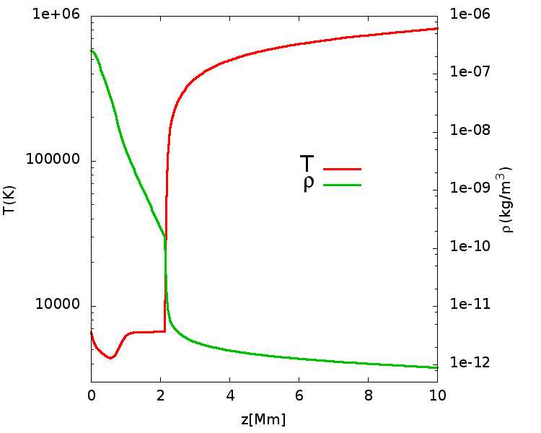
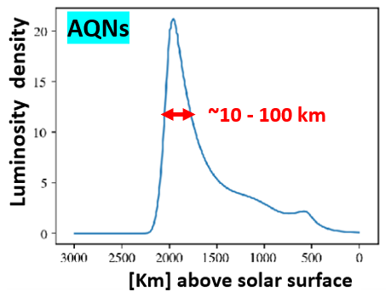
The AQN model➔ the only explaining the TR
chromosphere ⬄ Corona
Temp.
TR
Density
~2000 km
planetary dependence of the flaring Sun
more unexplained obs’?!
N. Raza, L. van Waerbeke, A. Zhitnitsky, Solar Corona
Heating by the AQN DM, arXiv:1805.01897(2018)
15

Slide 16
3)
The 11-years cycle:
A ~ ubiquitous solar mystery!
16

Slide 17
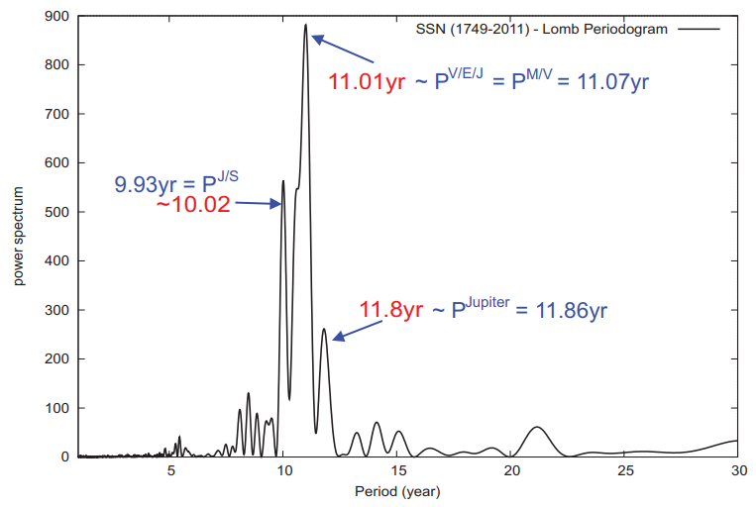
The first suspicion-suggestion: solar-cycle ✗ dark-Universe
https://doi.org/10.1142/S0217732314400082
At the beginning around 2012:
We suspected& - suggested Planetary gravitational lensing of invisible streams are at the origin of the mysterious solar cycle.
154 years earlier:
R. Wolf, M.N.R.A.S. 19 (1859) 85 ⬅ 1st suspicion of planet. involvement, somehow. Missing ingradients to complete the process(es) behind 11yrs:
Gravitational planetary lensing of DM streams
5 10 15 20
Period [years]
Fig. 1. (color online) The monthly average sunspot number reveals the existence of three peaks around 11 years (red),16 which are all associated to planetary tides (blue). Tidal periods (P) of single and combined planets by Jupiter, Saturn, Venus, Earth, Mercury fit to planetary frequencies around 11 years. Note, in this work tidal timing reflects also gravitational lensing by the same planet(s).
17

Slide 18
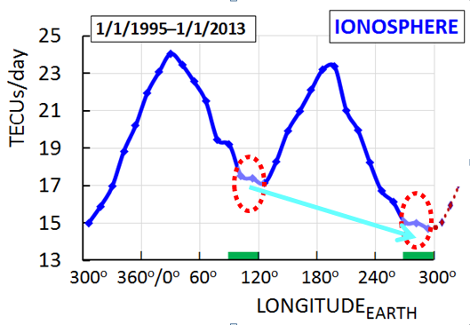
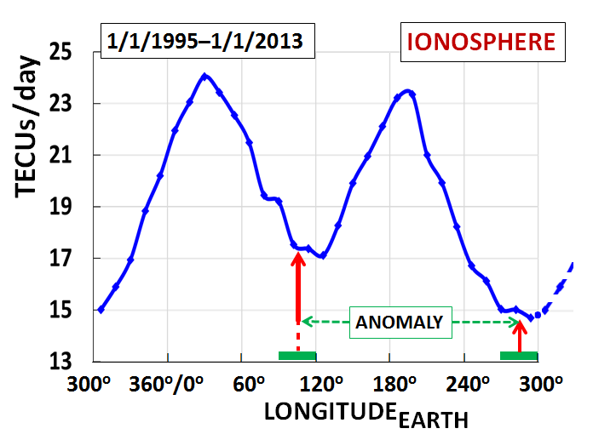
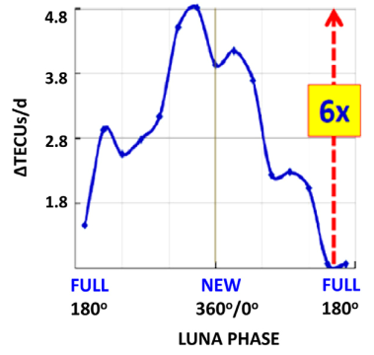
4)
IONOSPHERE’s
ANOMALY 1937-
2017
Moon as gravitational lens !?
June
Dec.
Atmospheric anomaly!?
https://doi.org/10.1016/j.dark.2017.06.001
18

Slide 19
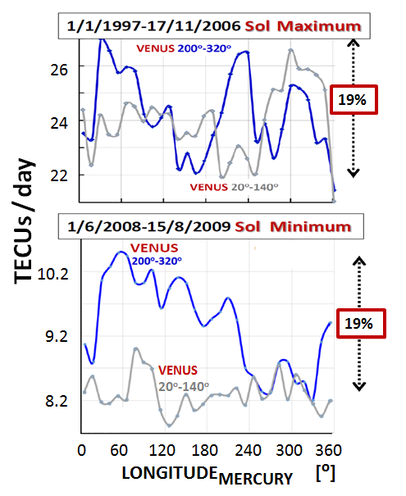
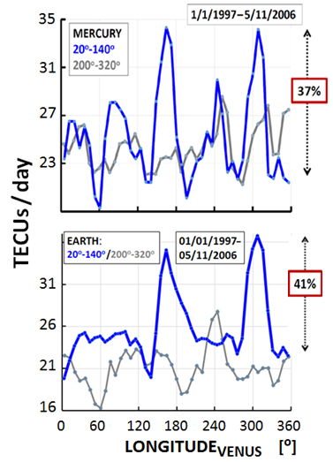
MERCURY
⊗
VENUS
⊗
EARTH
Planetary dependency of ionosphere’s TEC
Max / Min
PLASMA @ IONOSPHERE:
➔ Planetary dependency
✓
19

Slide 20
The 27-day variations of plasma densities and temperatures in the topside ionosphere
other factors that affect TEC more strongly than F_{10.7} and mask the effects of daily solar EUV variations. TEC=TotalElectronContent
https://agupubs.onlinelibrary.wiley.com/doi/full/10.1029/2002JA009731
“…when they did not see a correlation 2003
they even did NOT publish it,..”
?
?
20

Slide 21
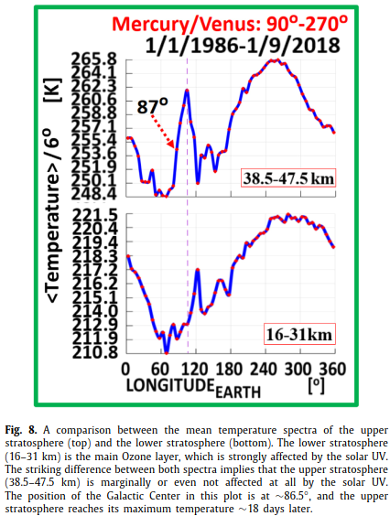
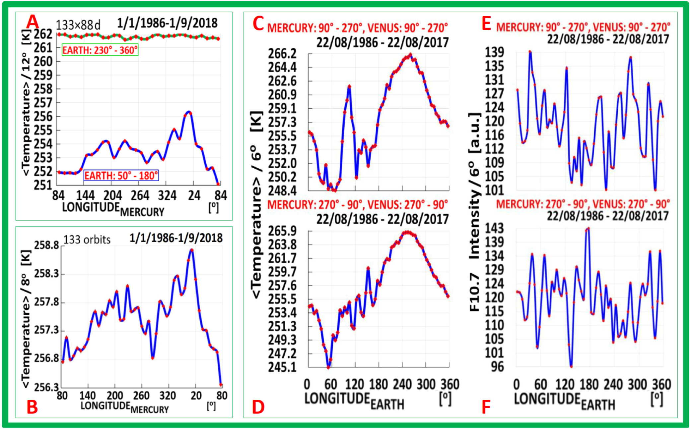
5)
Stratosphere:
…planetary temperature dependencies
2020
X
X
The peaking planetary dependence of the temperature in (38.5-47.5) km, is not present in the layer underneath [(16 – 31) km of altitude]. Also, the solar activity proxy (E,F) dissimilar with all stratosphere’s T-distributions.
➔ No correlation atmosphere ⬄ F10.7 ⬅
21
https://doi.org/10.1016/j.dark.2020.100497¹²

Slide 22
6)
New constraint / information!?
HOW to reconcile w known Phys.?
A_{corona}/A_{photosph.}
K.Z. et al, The dark Univere is not invisible, Phys.
Sciences Forum, 2 (#1) (2021)
10.3390/ECU2021-09313 &
[PDF] The Dark Universe Is Not Invisible | Semantic Scholar
22

Slide 23
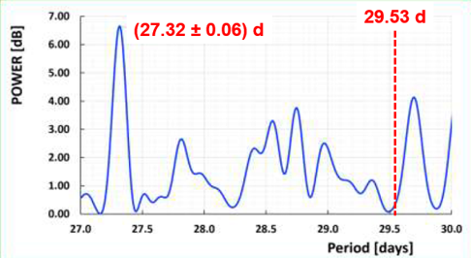
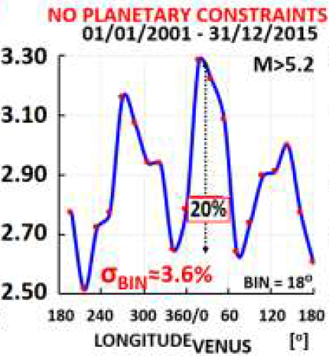
7)
Earthquakes
Moon month
Moon sidereal
Planetary relationships for EQs with Magnitude M > 5.2 (> 5σ). Total number of EQs =15696, and it is normalized to daily rates compensating for eccentricity related effects
Fourier periodogram on the number of EARTHQUAKES (EQs) with
M > 5.2 and by selecting only days with maximum 25 EQs / day
(1/1/2001 to 31/12/2015). Total Nr. of EQs = 15696 with M > 5.2
and maximum 25 EQs/day worldwide. Of note, the appearance only
of the sidereal lunar periodicity at (27.32 ± 0.06) days, while the
synodic one at 29.53 days is absent.
[ Marios Maroudas, PhD thesis, University of Patras, Signals for invisible matter from
solar-terrestrial observations. 2022 https://arxiv.org/abs/2404.02290 ]
24

Slide 24
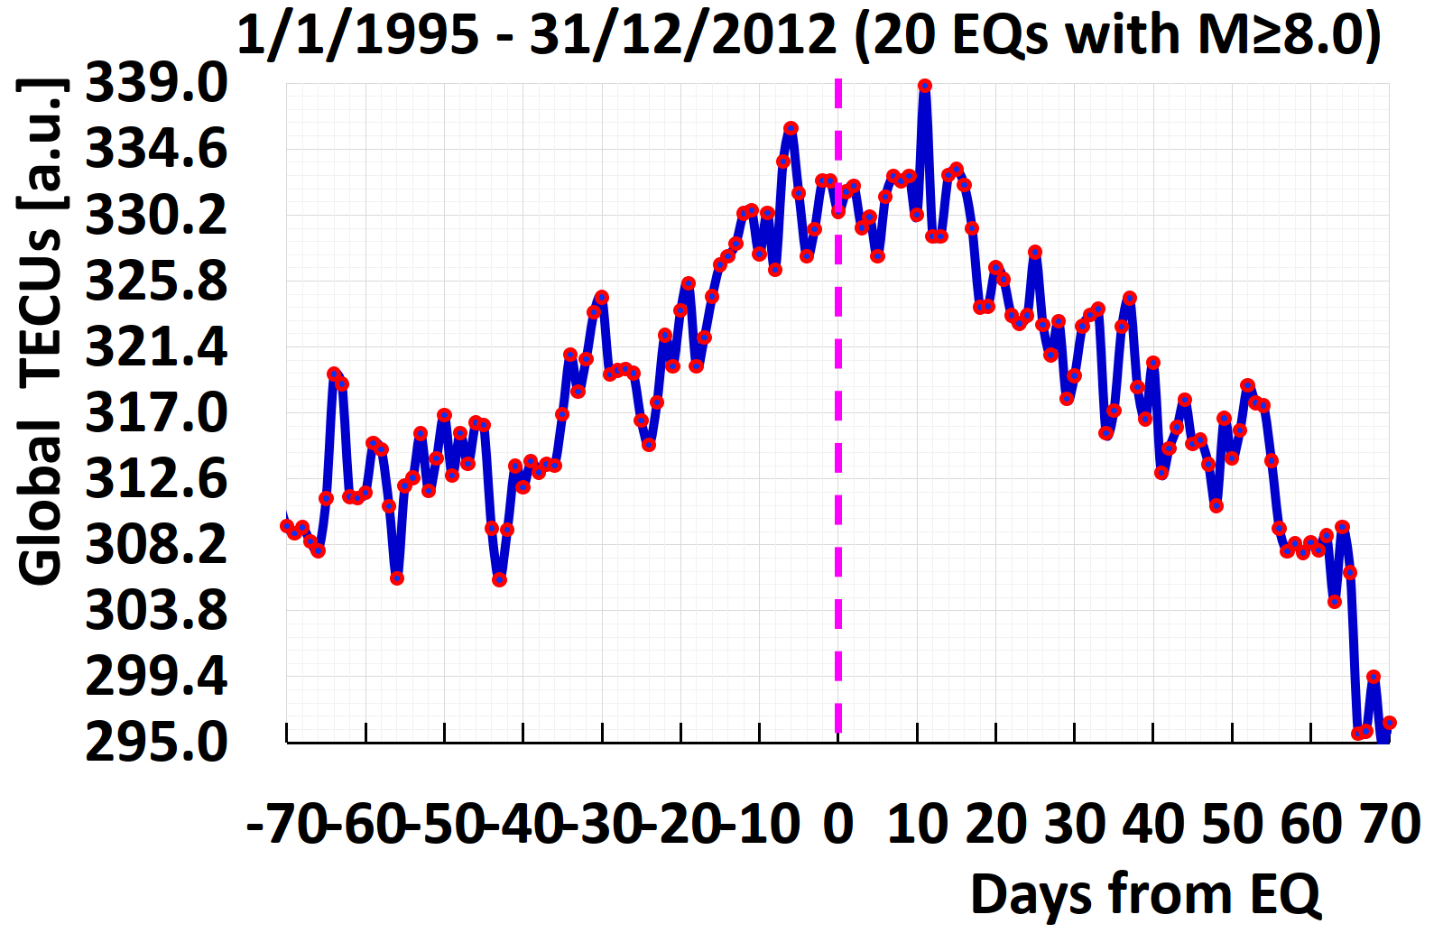
Correlation between
Ionosphere’s + inner Earth’s activity
The streaming DM scenario was the driving idea of this and previous work. Here we have searched for possible correlations between the global activity of the ionosphere and the actually unpredictable activity of the inner Earth.
➔ compare data from the global ionosphere and the inner Earth, concentrating on large Earthquakes. Figure below shows the daily derived value of the total electron content of the ionosphere (TECUs) for a large period around the zero time, as it is defined by the time of occurring the strong Earthquakes (EQs). ➔ apparent correlation
The degree of ionization of the entire Earth’s ionosphere with reference to the observed
20 largest Earthquakes (EQs) of magnitude M ≥ 8. [M. Maroudas, PhD thesis 2021].
8)
2021
Precursor
for large EQs ?
Evidence for streaming
DM with huge impact.
See paper by
Budker, Flambaum, Zhitnitsky p.t.o.
23
31

Slide 25
https://arxiv.org/abs/2003.07363
25

Slide 26
... outside physics
+
@ Earth surface
26

Slide 27
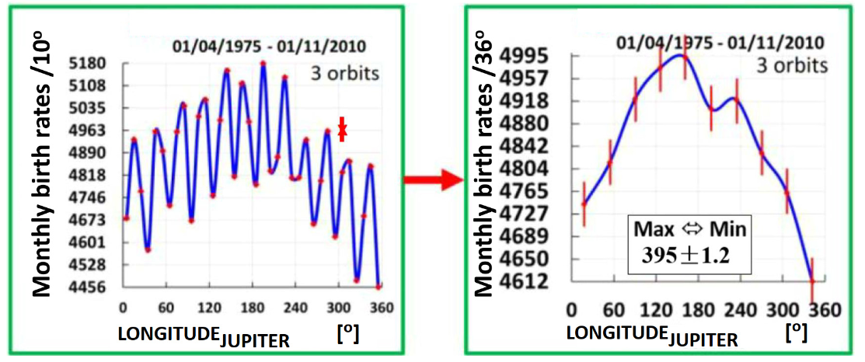
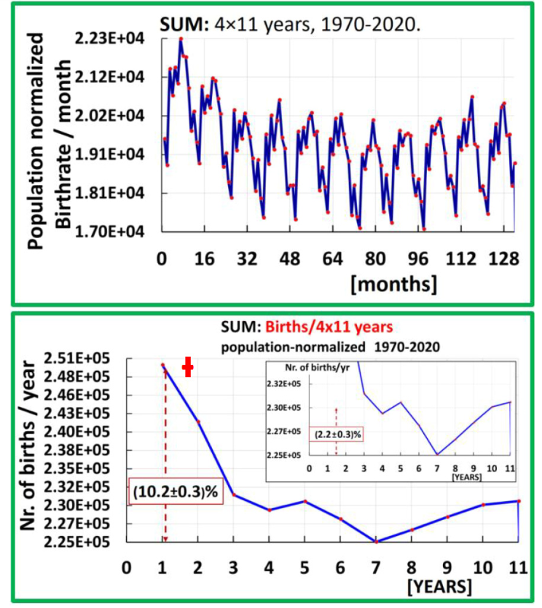
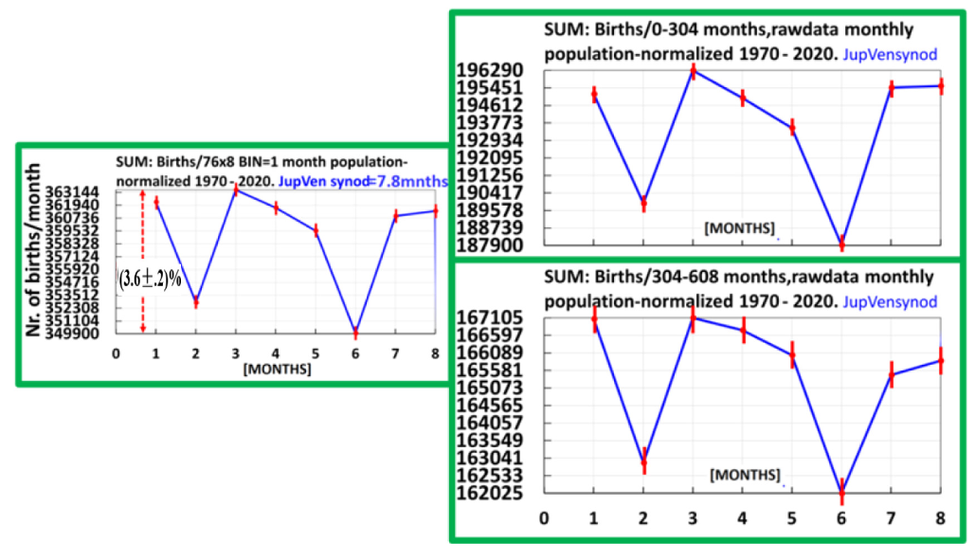
10)
Conception rates ➔ >3 PLANETARY DEPENDENCIES
In vivo✓
>3M conceptions
11 years
11.8 yrs
11.8 yrs
⬅ JUPITER – Venus synod 7.8 months
E. Georgiopoulou, S. Hofmann, M. Maroudas, A. Mastronikolis, E. L. Matteson, M. Tsagri, K. Z. BRL 18 (2023) 107; https://doi.org/10.1142/S1793048023500029
30

Slide 28
How planets can be involved since no remote planetary force?
➔ DM STREAMS and/or DM clusters ⛒ solar,…, atmosphere
Gravitational focusing =/= at low speeds
>>> pretends … <<< ➔ p.t.o.
31

Slide 29
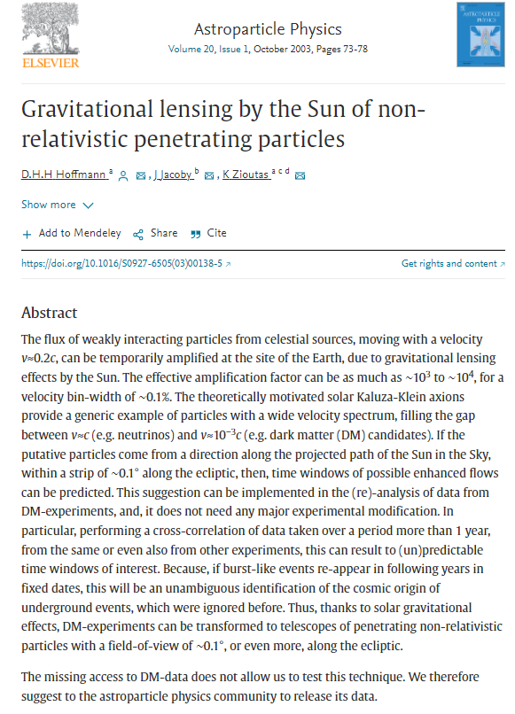
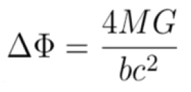
Gravitational lensing ⬄ c
⬄ 0.001c
2003
DM
a ”first”
Need ..
STREAMS
32

Slide 30
DM ➔
Clusters & Streams
Predicted by cosmology!
33

Slide 31
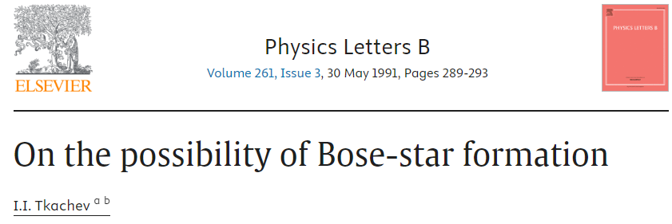
1991
Igor Tkachev et al.
1993
Assumptions fit-in present work!
Tkachev, On the possibility of Bose-star formation, Phys. Lett. 261, 289 (1991),
https://www.sciencedirect.com/science/article/abs/pii/037026939190330S?via%3Dihub
E. W. Kolb, I. Tkachev, Axion miniclusters and bose stars, Phys. Rev. Lett. 71, 3051(1993),
https://doi.org/10.1103/PhysRevLett.71.3051
34

Slide 32
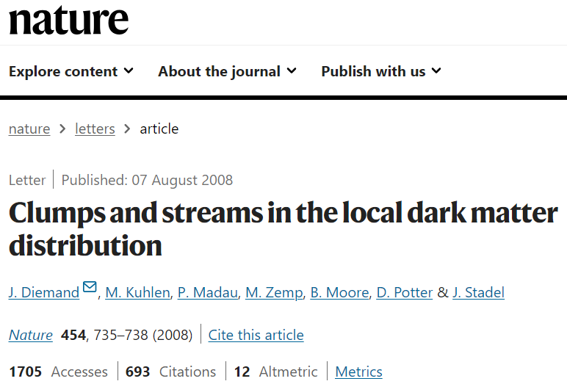
2008
Assumptions fit-in present work!
https://www.nature.com/articles/nature07153
35

Slide 33
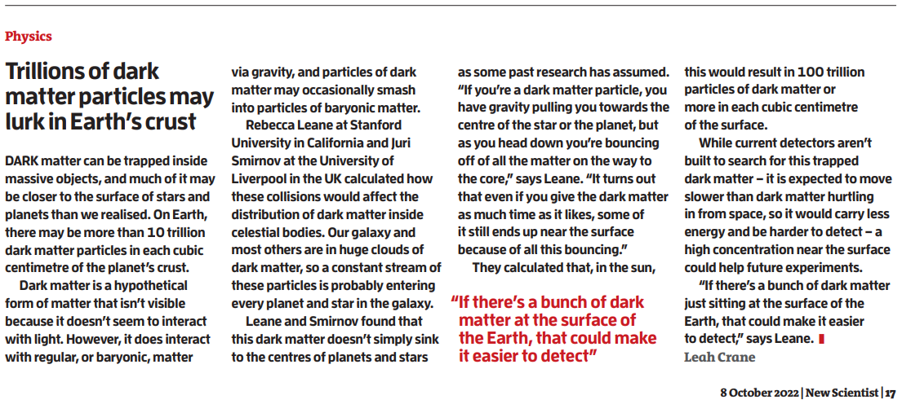
Floating DM in celestial bodies RebeccaK.Leane+JuriSmirnovhttps://iopscience.iop.org/article/10.1088/1475-7516/2023/10/057 …DM can thermalize + sit at the celestial-body surface
ρ_{surface}~ X10¹³ ρ₀
➔
➔
36

Slide 34
Large scale
Locally fluctuations!
<ρ_{DM}> ≈ 0.45 GeV/cm³
37

Slide 35
arXiv:2108.11647 [pdf]
The Dark Universe is not invisible
Phys. Sci. Forum 2021, 2(1), 10 Febr. 2021
Trillions of DM particles may lurk in Earth’s crust
https://doi-org.ezproxy.cern.ch/10.1016/S0262-4079(22)01808-5 Oct. 2022
Dunkle Materie weniger dunkel?
= Is DM less dark?
https://www.scinexx.de/news/kosmos/dunkle-materie-wer-enigdunkel/ Febr. 2023
Seminar at CERN 28/3/2023, M. Hostert. Semi-Visible Dark Photons
https://arxiv.org/abs/2302.05410 self-interacting DM? Febr. 2023
Next 2024
p.t.o.
38

Slide 36
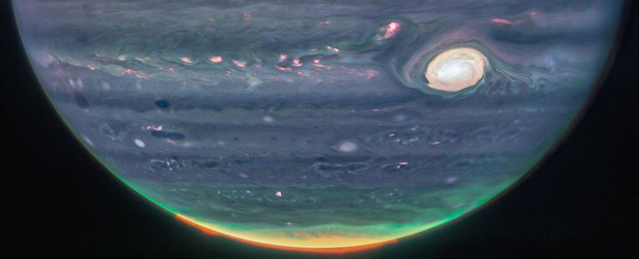
A Glow in Jupiter's Night Could Be The smoking gun Signal For DM
Provided by ScienceAlert A Glow in Jupiter's Night Could Be The Gun Signal
For Dark Matter (msn.com) (Blanco & Leane, PRL, 1st July 2024)
https://journals.aps.org/prl/pdf/10.1103/PhysRevLett.132.261002
In Earth’s atmosphere + inner
Earth a Nr of observations✓
➔Welcomed planetary
coincidence ⬅
39

Slide 37
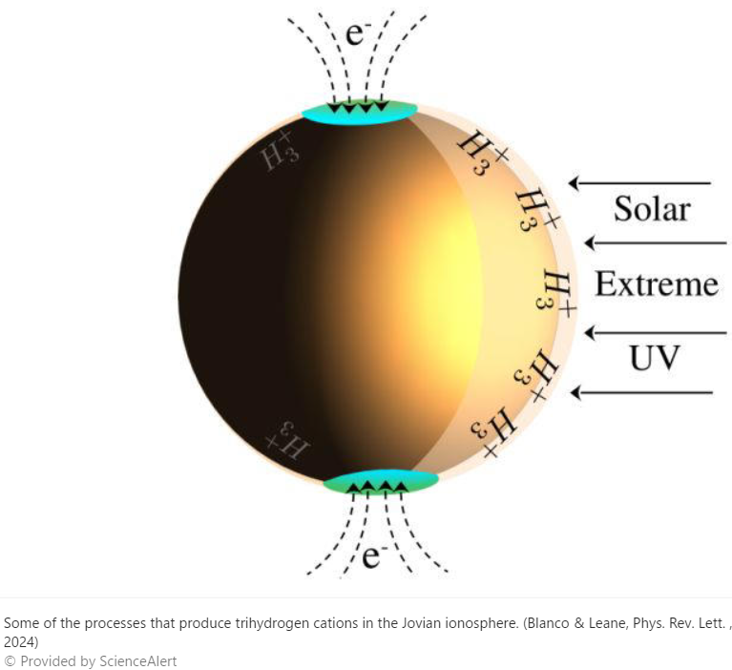
On the night side of Jupiter, an infrared glow high up in the atmosphere could be produced by an interaction with this shadowy material.
There, charged hydrogen ions called trihydrogen cations (H₃⁺) can be found in abundance. And, while there are several cosmic processes that can produce H₃⁺ in the Jovian atmosphere, an interaction with dark matter could produce an excess beyond what we'd expect to find.
"We point out that DM can produce an additional source of H₃⁺ in planetary atmospheres,"This will be produced if DM scatters + is captured by planets, and consequently annihilates, producing ionizing radiation."
Grav. focused DM streams ✗ atmosphere / Sun, Earth
40
https://www.msn.com/en-us/news/technology/a-glow-in-jupiter-s-night-could-be-the-smoking-gun-signal-for-dark-matter/ar-BB1oXqRO?ocid=entnewsntp&pc=U531&cvid=125ca349093640aa88d3cd77a52735cb&ei=81

Slide 38
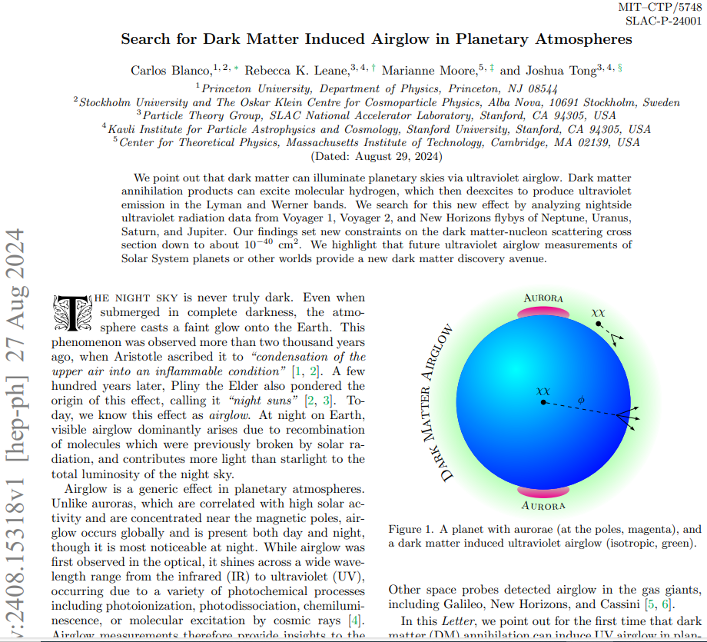
Aristotle ascribed it to “condensation of the upper air into an inflammable condition” [1, 2]. A few hundred years later, Pliny the Elder also pondered the origin of this effect, calling it “night suns”
Search for Dark Matter Induced Airglow in Planetary Atmospheres
-5 days
https://arxiv.org/abs/2408.15318

Slide 39
THANKS for your attention
41

Slide 40
Additional slides

Slide 41
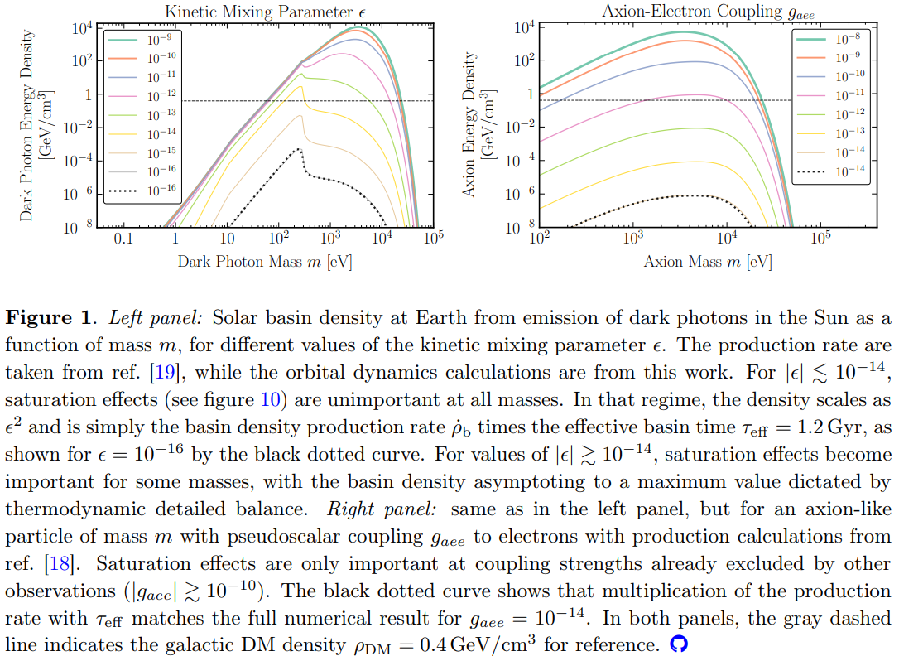
Orbital Dynamics of the Solar Basin
solar basin—the accu-mulated population of weakly-interacting parti-cles on bound orbits in the Solar System
https://arxiv.org/abs/2408.16041

Slide 42
References:
https://doi.org/10.3390/ECU2021-09313 , The dark Universe is not invisible;
References therein:3-6,8-10,14,16,17
Marios Maroudas, PhD thesis, University of Patras, Signals for invisible matter from
solar-terrestrial observations. 2022 https://arxiv.org/abs/2404.02290

Slide 43
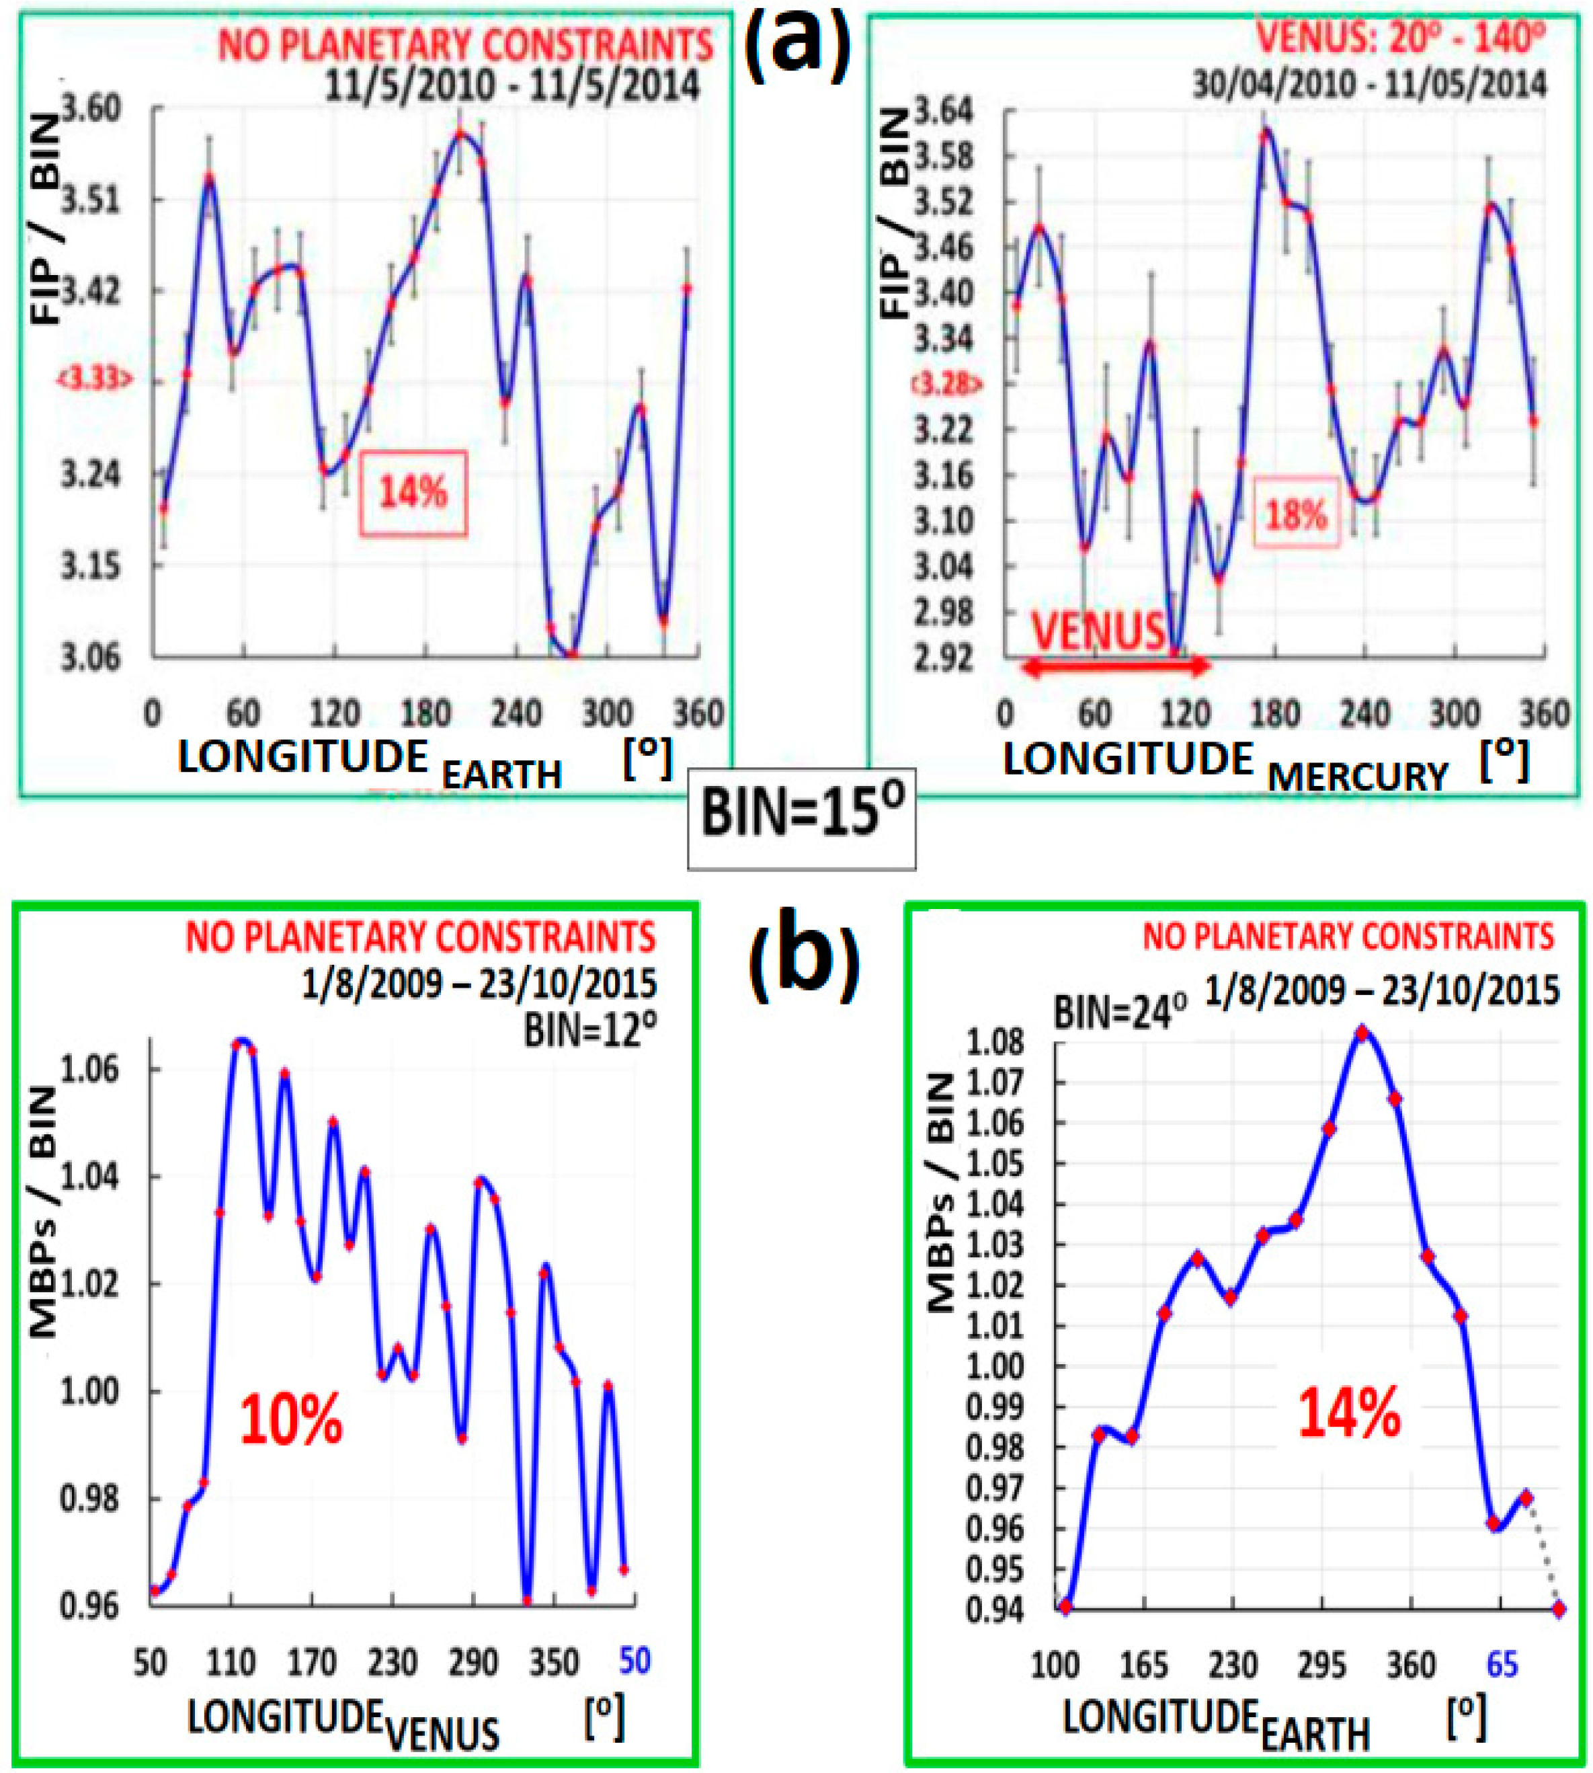
6)
K.Z. et al, The dark Univere is not invisible, Phys. Sciences Forum, 2 (#1) (2021)
10.3390/ECU2021-09313 & [PDF] The Dark Universe Is Not Invisible | Semantic Scholar
Planetary relations:
how to reconcile
existing anomaly w.
conventional picture?
Elemental
Composition
A_{corona}/A_{photosph.}
Magnetic
MBPs
Bright points
(a)https://www.nature.com/articles/s41467-017-00328-7NATURE Comm. 2017
(b) https://arxiv.org/abs/1710.01678 PASJ 2017
22
M. Maroudas and D. Utz, work in preparation

Slide 44
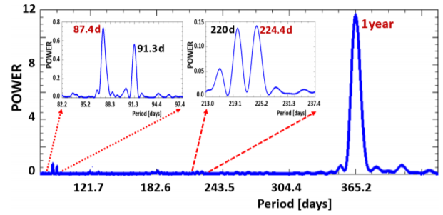
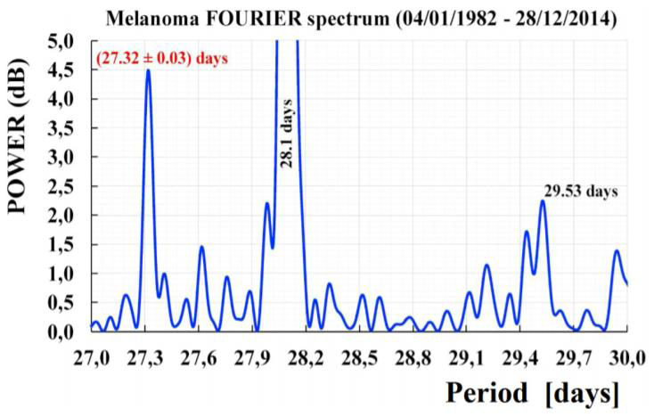
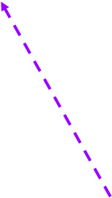
Melanoma
9)
2018⬅ ➔ 2020
..a 27 Days Periodicity in Melanoma Diagnosis
Planetary Dependence of Melanoma
http://dx.doi.org/10.1142/S179304801850008X
NORTH
https://doi.org/10.1142/S1793048020500083
AUSTRALIA daily data 1982-2015
USA <monthly> data 1973-2011
±0.76d
SOUTH
87.97 days
@Mercury’sorbit @Moon’sorbit 27.32 days (sidereal)
=>fixed to remote stars
Confirmed independently
Origin: exo-solar!
+ p.t.o.
➔ overlooked!
https://doi.org/10.1142/S1793048019200029
27

Slide 45
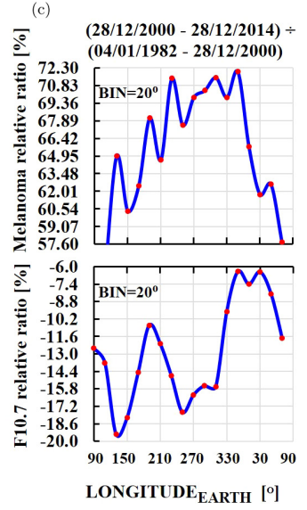
The origin of the 27.3 d line?
NOT SOLAR
two arguments against solar origin!
1) NO line at 29.32 days & 2) this dissimilarity
28

Slide 46
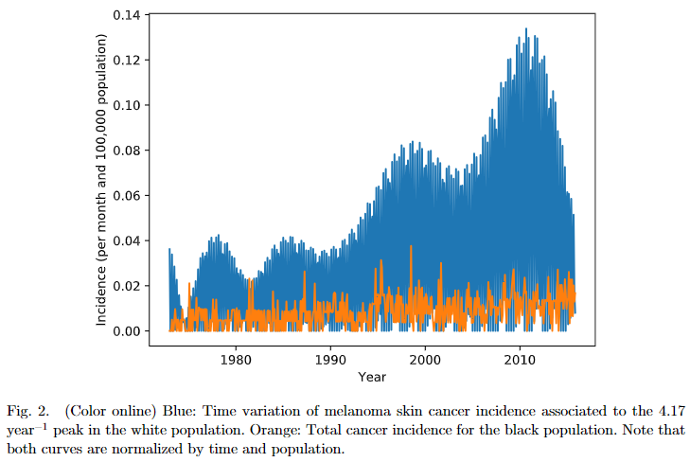
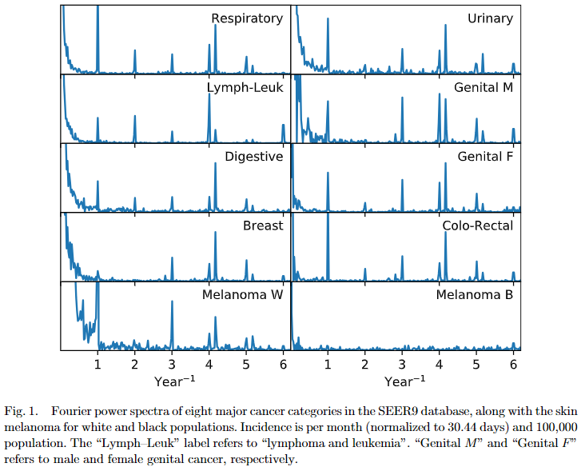
Socas-Navarro’s BRL 14 #1 (2019) 1
29

