Slide 1
Polarimetry for Vacuum Magnetic Birefringence
Laura (Lo) Roberts
Max Planck Institute for Gravitational Physics/ Leibniz Universität
2nd General Meeting of COST Action COSMIC WISPers (CA21106)
Istanbul, Turkey

Slide 2
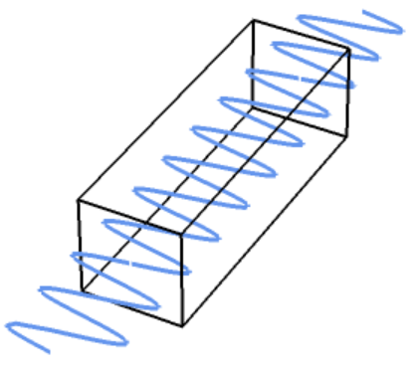
The classical vacuum
$$\vec{∇}∙\vec{E}=0$$
$$\vec{∇} × \vec{E}=−\frac{∂\vec{B}}{∂t}$$
$$\vec{∇}∙\vec{B}=0$$
$$\vec{∇} × \vec{B}=ε_{0}μ_{0}\frac{∂\vec{E}}{∂t}$$
$$ℒ= \frac{1}{2μ_{0}}\left[\frac{{\vec{E}}^{2}}{c^{2}} − {\vec{B}}^{2}\right]$$
$$\vec{P}= \frac{∂ℒ}{∂\vec{E}}− ε_{0}\vec{E }=0$$
$$\vec{M}= \frac{∂ℒ}{∂\vec{B}}− \frac{\vec{B}}{μ_{0}}=0$$
Light in vacuum propagates:
Because:
$$n_{∥,⊥}= \sqrt{ε_{r}μ_{r}}=1$$
$$c= \frac{1}{\sqrt{ε_{0}μ_{0}}}=299782458 m/s$$
At speed:
2nd General Meeting COST Action COSMIC WISPers

Slide 3
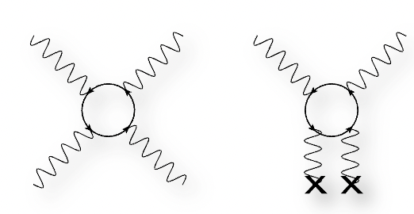
Nonlinear effects in vacuum
2nd General Meeting COST Action COSMIC WISPers

Slide 4
The non-classical vacuum
$$\vec{P}= \frac{∂ℒ}{∂\vec{E}}− ε_{0}\vec{E} ≠0$$
$$ℒ= \frac{1}{2μ_{0}}\left[\frac{{\vec{E}}^{2}}{c^{2}} − {\vec{B}}^{2}\right]+\frac{A_{e}}{μ_{0}}\left[{\left(\frac{E^{2}}{c^{2}} − B^{2}\right)}^{2}+7{\left(\frac{\vec{E}}{c}∙ \vec{B}\right)}^{2}\right]$$
$$\vec{M}= \frac{∂ℒ}{∂\vec{B}}− \frac{\vec{B}}{μ_{0}}≠0$$
2nd General Meeting COST Action COSMIC WISPers

Slide 5
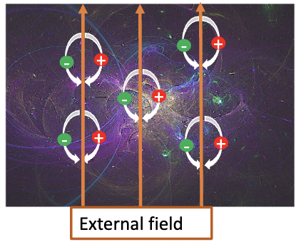
The non-classical vacuum
$$\vec{P}= \frac{∂ℒ}{∂\vec{E}}− ε_{0}\vec{E} ≠0$$
$$ℒ= \frac{1}{2μ_{0}}\left[\frac{{\vec{E}}^{2}}{c^{2}} − {\vec{B}}^{2}\right]+\frac{A_{e}}{μ_{0}}\left[{\left(\frac{E^{2}}{c^{2}} − B^{2}\right)}^{2}+7{\left(\frac{\vec{E}}{c}∙ \vec{B}\right)}^{2}\right]$$
$$\vec{M}= \frac{∂ℒ}{∂\vec{B}}− \frac{\vec{B}}{μ_{0}}≠0$$
Velocity of light now depends on presence of external fields!
$$n_{∥,⊥}= \sqrt{ε_{r}μ_{r}}≠1$$
$$Δn= n_{∥}− n_{⊥}≈4×{10}^{−24}[T^{−2}]$$
2nd General Meeting COST Action COSMIC WISPers

Slide 6
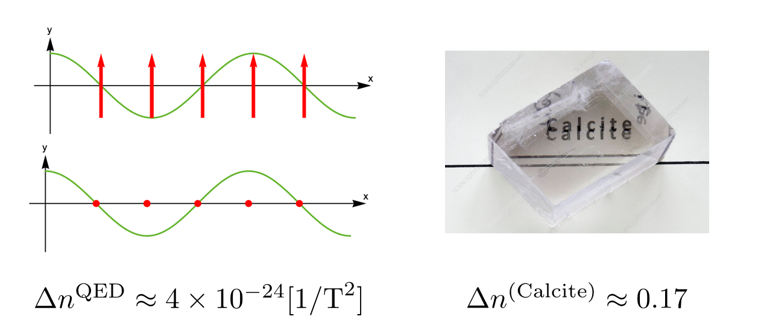
2nd General Meeting COST Action COSMIC WISPers

Slide 7
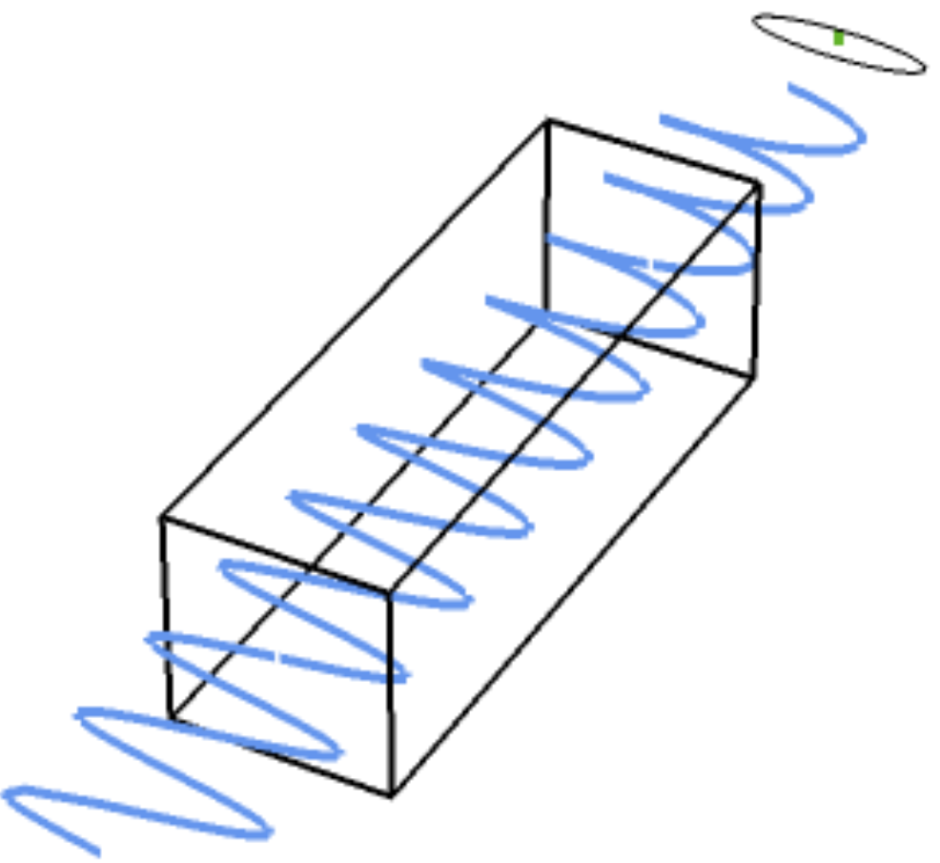
Measuring VMB:
$$\vec{E_{0}}= E_{0}\left(\begin{matrix}1 \\ 0\end{matrix}\right) ⇒ \vec{E_{γ}} ≅ E_{0}\left(\begin{matrix}1 \\ i\frac{φ}{2}sin\left(2θ\right)\end{matrix}\right)$$
External B-field
2nd General Meeting COST Action COSMIC WISPers

Slide 8
Measuring VMB:
$$\vec{E_{0}}= E_{0}\left(\begin{matrix}1 \\ 0\end{matrix}\right) ⇒ \vec{E_{γ}} ≅ E_{0}\left(\begin{matrix}1 \\ i\frac{φ}{2}sin\left(2θ\right)\end{matrix}\right)$$
$$φ= \frac{2π}{λ}\left(n_{∥}− n_{⊥}\right)L$$
External B-field
2nd General Meeting COST Action COSMIC WISPers

Slide 9
Measuring VMB:
$$\vec{E_{0}}= E_{0}\left(\begin{matrix}1 \\ 0\end{matrix}\right) ⇒ \vec{E_{γ}} ≅ E_{0}\left(\begin{matrix}1 \\ i\frac{φ}{2}sin\left(2θ\right)\end{matrix}\right)$$
$$φ= \frac{2π}{λ}\left(n_{∥}− n_{⊥}\right)L$$
What we measure: Ellipticity $ψ$
$$ψ= \frac{φ}{2}\sin\left(2θ\right)= \frac{πΔnL}{λ}sin⁡(2θ)$$
External B-field
2nd General Meeting COST Action COSMIC WISPers

Slide 10
Measuring VMB:
$$\vec{E_{0}}= E_{0}\left(\begin{matrix}1 \\ 0\end{matrix}\right) ⇒ \vec{E_{γ}} ≅ E_{0}\left(\begin{matrix}1 \\ i\frac{φ}{2}sin\left(2θ\right)\end{matrix}\right)$$
$$φ= \frac{2π}{λ}\left(n_{∥}− n_{⊥}\right)L$$
What we measure: Ellipticity $ψ$
External B-field
$$ψ≈{10}^{−17}$$
For a magnetic field strength B=1T and L = 1m
2nd General Meeting COST Action COSMIC WISPers

Slide 11
The PVLAS Experiment
2nd General Meeting COST Action COSMIC WISPers

Slide 12
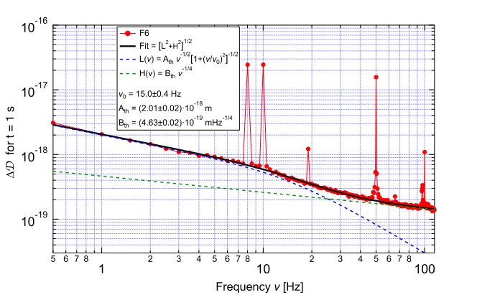
Birefringence Noise Limit – Thermal?
Investigating optical path length difference sensitivity:
$$S_{Δ}=\frac{λ}{Nπ}$$
2nd General Meeting COST Action COSMIC WISPers

Slide 13
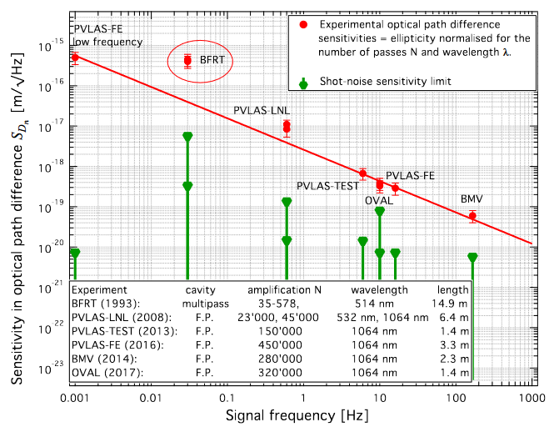
Learning from the past:
Birefringence Noise $∝ f^{0.8}$
Parameters to maximize:
$${SNR ∝B}^{2}Lf^{0.8}$$
2nd General Meeting COST Action COSMIC WISPers

Slide 14
VMB@CERN
VMB with ALPS ll
$B_{max}$ | $$9 T$$
$$L$$ | $$15 m$$
$$B^{2}L$$ | $$1200$$
$$f$$ | $$1 mHz$$
$$SNR∝$$ | $$4.8$$
$B_{max}$ | $$5 T$$
$$L$$ | $$212 m$$
$$B^{2}L$$ | $$6000$$
$$f$$ | $$1 mHz$$
$$SNR∝$$ | $$23$$
LHC Dipole magnet – CERN, Geneva Switzerland
ALPSll magnet string – DESY, Hamburg Germany

Slide 15
Learning from the past:
Birefringence Noise $∝ f^{0.8}$
Parameters to maximize:
$${SNR ∝B}^{2}Lf^{0.8}$$
How can we maximize this?
2nd General Meeting COST Action COSMIC WISPers

Slide 16
New proposed VMB experiment
2nd General Meeting COST Action COSMIC WISPers

Slide 17
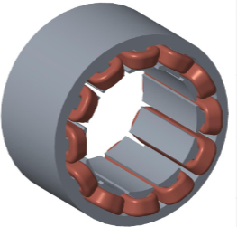
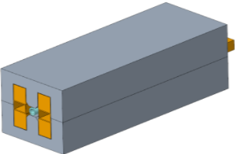
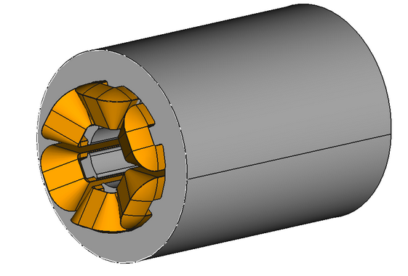
The magnet system:
Working with Linz Center of Mechatronics (LCM), Austria for design and manufacturing
The goal:
Roughly 1m in length, 1Tesla field (min) and kHz rotation frequency
Minimize mechanical noise induced by magnet
Long operation time – can be used continuously
2nd General Meeting COST Action COSMIC WISPers

Slide 18
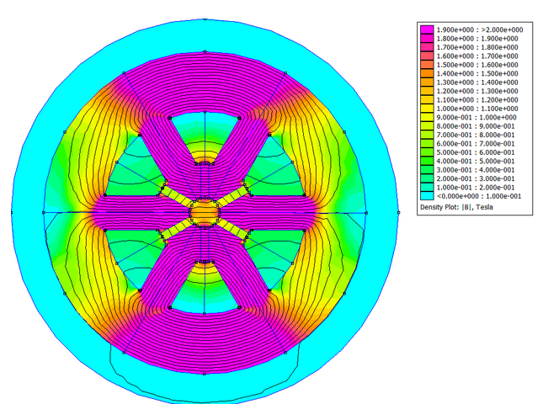
The Toroid magnet:
Consists of two 40cm Toroid magnets
1.3 Tesla homogeneous dipole field
7mm bore diameter
Rotates electromagnetically at a tunable frequency up to kHz
6 sets of winded copper wires with alternating current
$$SNR∝ B^{2}Lf^{0.8}→340$$
2nd General Meeting COST Action COSMIC WISPers

Slide 19
The Toroid magnet:
Consists of two 40cm Toroid magnets
1.3 Tesla homogeneous dipole field
7mm bore diameter
Rotates electromagnetically at a tunable frequency up to kHz
6 sets of winded copper wires with alternating current
Con:
Cooling of coils is difficult – temperature rise is ~5 Kelvin a second
2nd General Meeting COST Action COSMIC WISPers

Slide 20
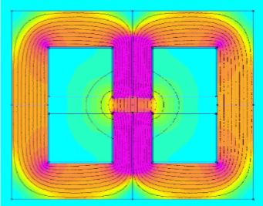
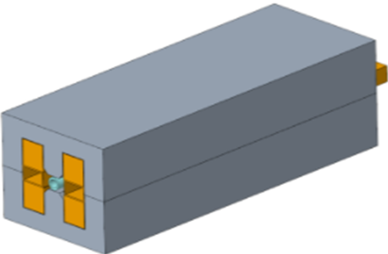
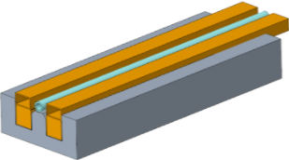
Alternatively:
Magnetic field modulation in one axis
Higher magnetic field strength: 1.7T
8mm bore diameter:
More room for equipment
Easier cooling – more room for pipes
Simpler electronics -> higher freq
$$SNR∝ B^{2}Lf^{0.8}→290$$
2nd General Meeting COST Action COSMIC WISPers

Slide 21
Alternatively:
Magnetic field modulation in one axis
Higher magnetic field strength: 1.7T
8mm bore diameter:
More room for equipment
Easier cooling – more room for pipes
Simpler electronics -> higher freq
Note:
Sinus wave form: $B=B_{0}sinθ$ meaning in signal $B^{2}→DC+\frac{B_{0}^{2}}{2}cos2θ$
2nd General Meeting COST Action COSMIC WISPers

Slide 22
VMB@CERN
VMB w/ALPS ll
AEI VMB
$B_{max}$ | $$9 T$$
$$L$$ | $$15 m$$
$$B^{2}L$$ | $$1200$$
$$f$$ | $$1 mHz$$
$$SNR∝$$ | $$4.84$$
$B_{max}$ | $$5 T$$
$$L$$ | $$212 m$$
$$B^{2}L$$ | $$6000$$
$$f$$ | $$1 mHz$$
$$SNR∝$$ | $$23$$
$B_{max}$ | $$1.2−1.7 T$$
$$L$$ | $$0.8 m$$
$$B^{2}L$$ | $$\sim 1.8$$
$$f$$ | $$1 kHz$$
$$SNR∝$$ | $$200−300$$
LHC Dipole magnet – CERN, Geneva Switzerland
ALPSll magnet string – DESY, Hamburg Germany
AEI electro-magnet – Hannover Germany
2nd General Meeting COST Action COSMIC WISPers

Slide 23
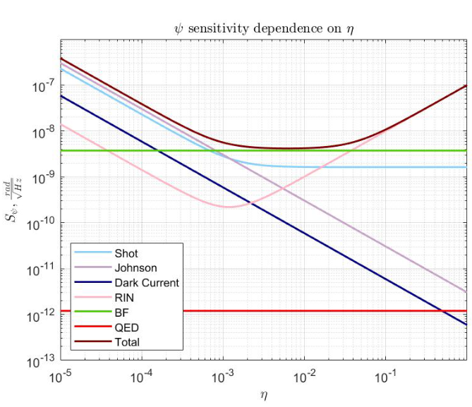
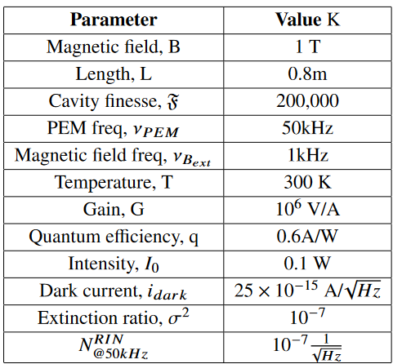
Intrinsic noise sensitivity
Integration time to reach QED: $\sim 140 days$
Note: $η_{0}$is modulation depth of the pem
2nd General Meeting COST Action COSMIC WISPers

Slide 24
Prospects
2nd General Meeting COST Action COSMIC WISPers

Slide 25
Prospects
1st generation: 0.8m, two 40cm magnets
$SNR 1 →140 days$
$SNR 5 →9.6 years$
$SNR 10 →38.3 years$
Next gen: 5m, 10 electro-magnets
$SNR 1 →5.5 days$
$SNR 5 →140 days$
$SNR 10 →1.5 years$
Next gen 2 : 10 m, 20 electro-magnetc
$SNR 1 →1.4 days$
$SNR 5 →35 days$
$SNR 10 →140 days$
2nd General Meeting COST Action COSMIC WISPers

Slide 26
Thank you!

Slide 27
1kHz
50kHz
analyzer
polarizer
magnet
pem
cavity finesse: 200,000

Slide 28
BFRT- 1993 – USA
BMV – 2007 – France
Polarimetry experiment for ‘invisible’ axion search
Modulated B_0 = 3.25 T with ampl B_mod = 0.62 T at 20mHz, Leff = 14.9 m
Pulsed B_0 = 6.5T with repetition rate 1.7 mHz, Leff = 0.137 m
Fabry- Perot cavity – Finesse 450,000
OVAL – 2017 – Japan
PVLAS – 2020 – Italy
Pulsed B_0 = 9 T with repetition rate 0.17 Hz, L= 0.17 m
Fabry- Perot cavity- Finesse 320,000
Rotating permanent B_0 = 2.5T with repetition rate 8 Hz, L= 1.6 m
Fabry- Perot cavity- Finesse 450,000

