Slide 1
Compton Back-Scattering Sources ;Emerging Physics and Technology
G. Dattoli
In collaboration with
A. Curcio and E. Di Palma

Slide 2
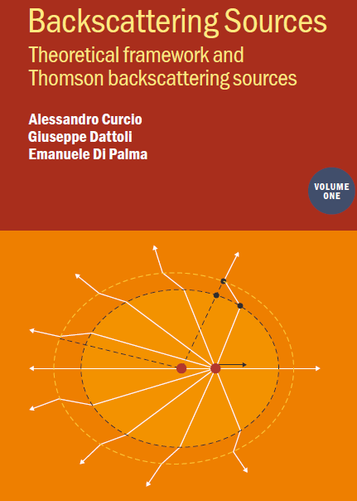
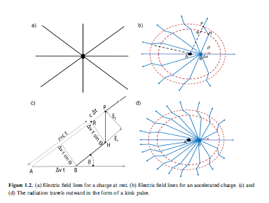
Research activity on CBS and on the relevant applications
Commercials Thomson-Longhair

Slide 3
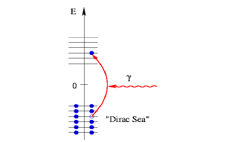
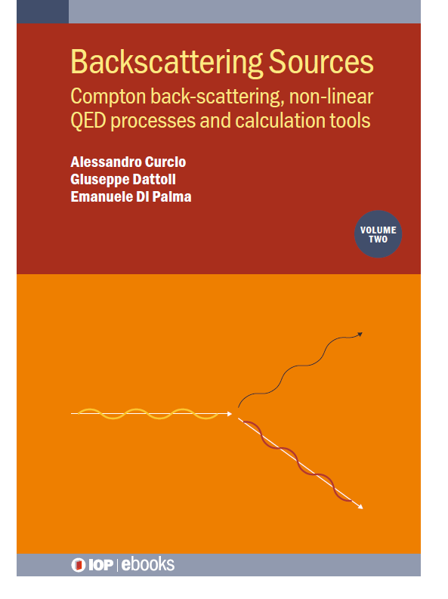
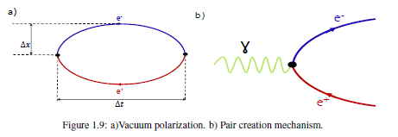
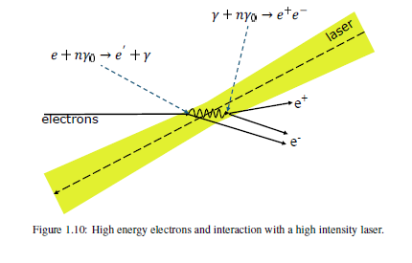
...Commercials 2… Hard QED effects, dressed states…
.

Slide 4
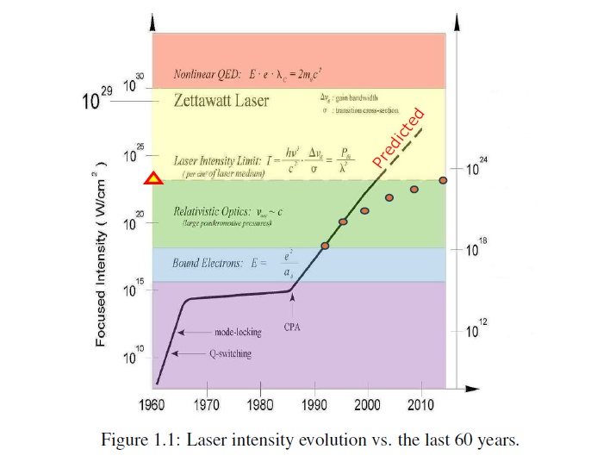
Laser Intensity evolution Chart
.

Slide 5
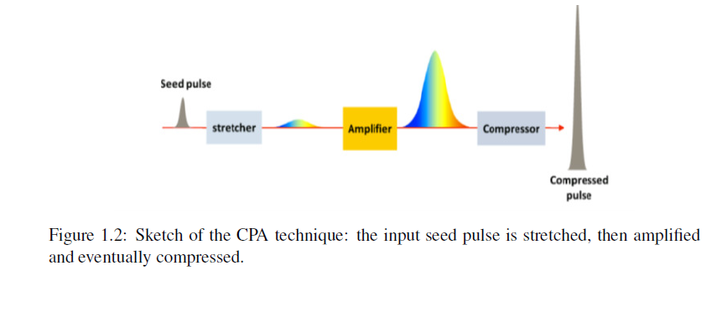
CPA –Technique the turning point
.

Slide 6
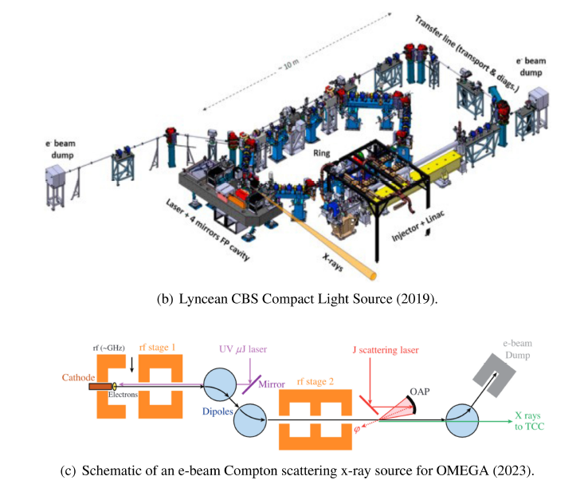
New architectures of low energy accelerators and conceptions of experimental stations
.

Slide 7
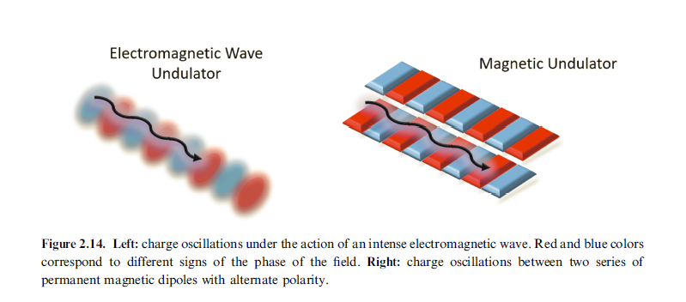
Wave vs. Magnetic Undulators
.

Slide 8
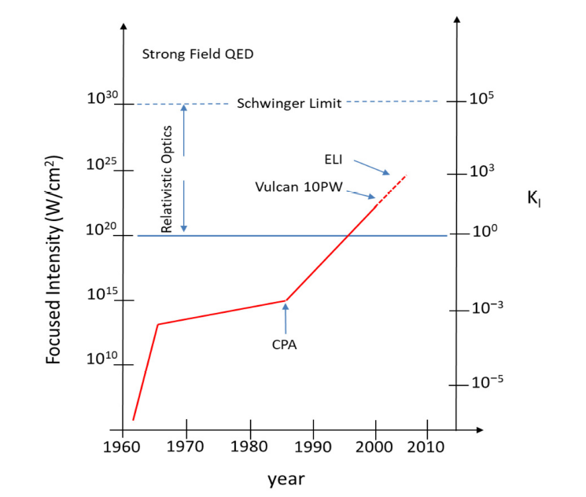
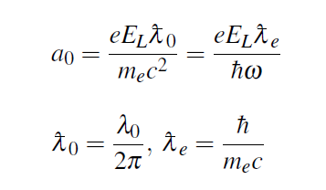
CBS Reference parameters
Classical
MAX LASER INTENSITY
Co Re LS (KOREA)

Slide 9
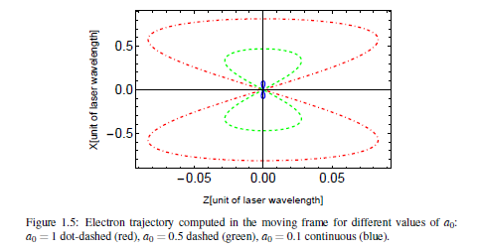
…CBS vs. Undulator Radiation…
.

Slide 10
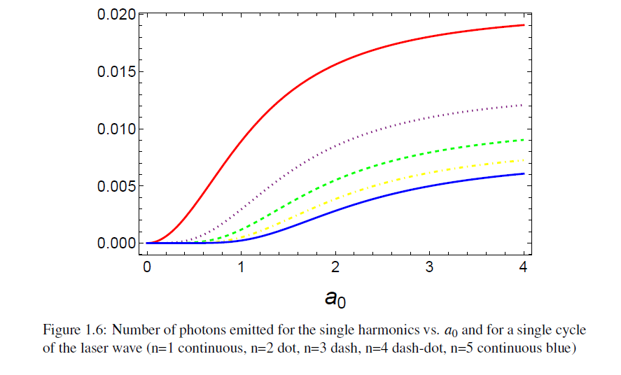
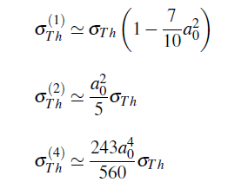
CBS and Laser Intensity
.

Slide 11
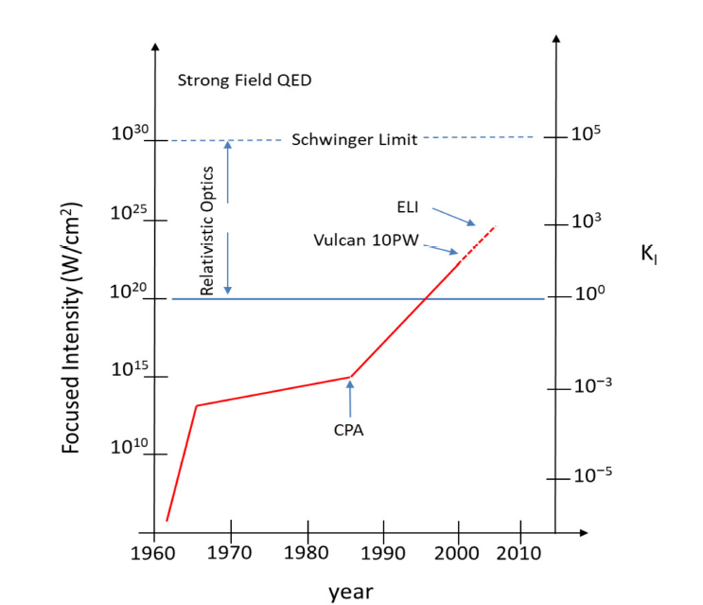
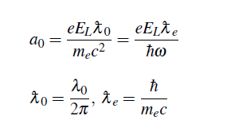
STRONG -FIELD and hard QED
.

Slide 12
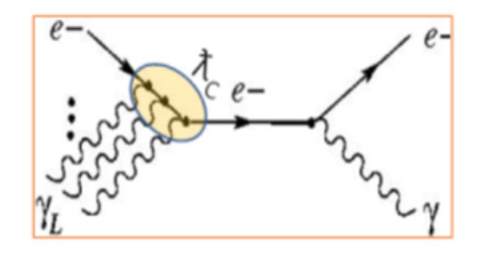
Quantum and multiphoton effetcs
.

Slide 13
Schwinger-Sauter field
.VACUUM engeneering

Slide 14
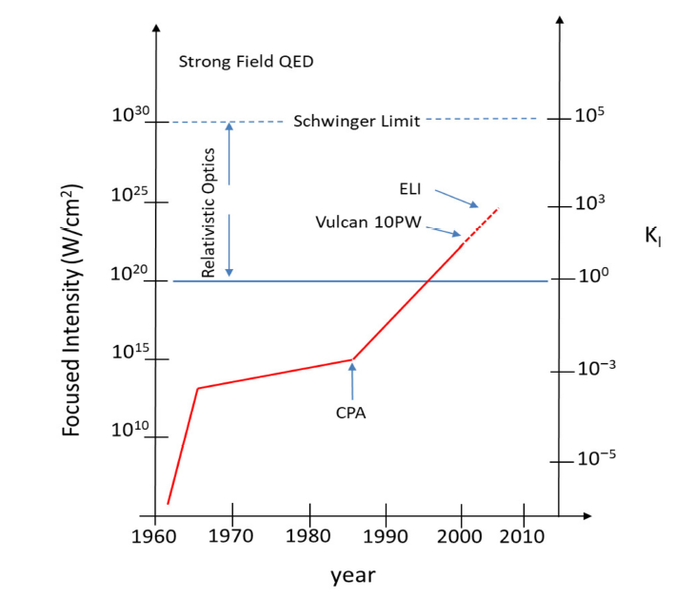
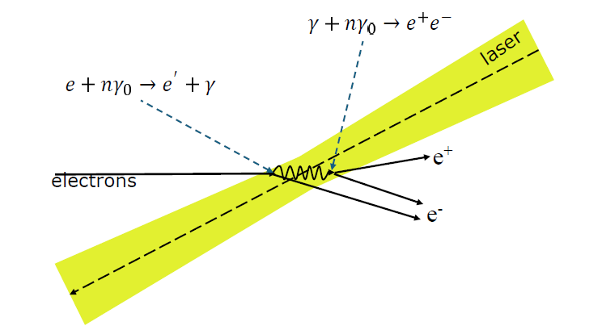
Where are we on FEL Intensity Chart?
.

Slide 15
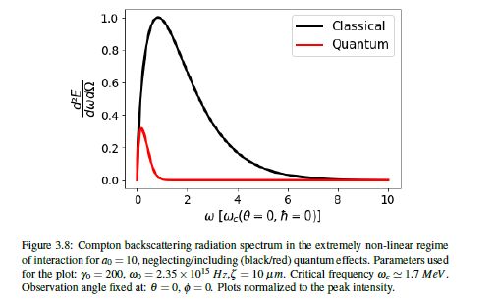
Quantum-Strong Field-Phenomenology
For any question Ask the Chairman (dr. Curcio)

Slide 16
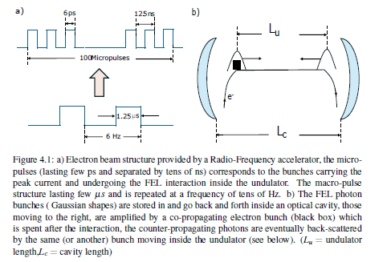
.FEL BASED CBS Sources
.Intracavity FEL photons CBS

Slide 17
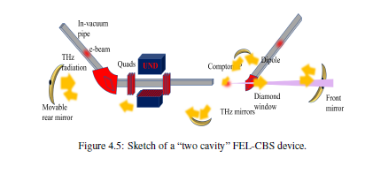
…
.»Two Cavities» ….New design Challenges

Slide 18
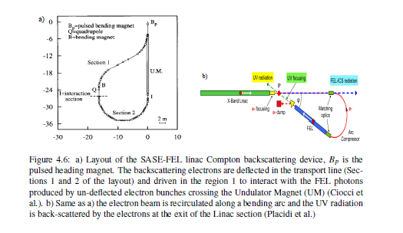
..SASE and CBS…
…

Slide 19
Towards Single QED electron dynamics ….Statistical properties of emitted radiation
Integrable-Test Accelerator (IOTA) storage ring at Fermilab
In the second experiment, a single electron was stored in the ring, emitting a photon only once per several hundred turns. In this regime, any classical interference-related collective effects were eliminated, and the quantum fluctuations could be studied in detail to search for possible deviations from the expected Poissonian photon statistics

Slide 20
An old dream…
Deviation from Poisson Statistics due to Quantum effects…
Further Theoretical and Experimental studies in Compton Back-Scattering will be able to shine light…

