Slide 1
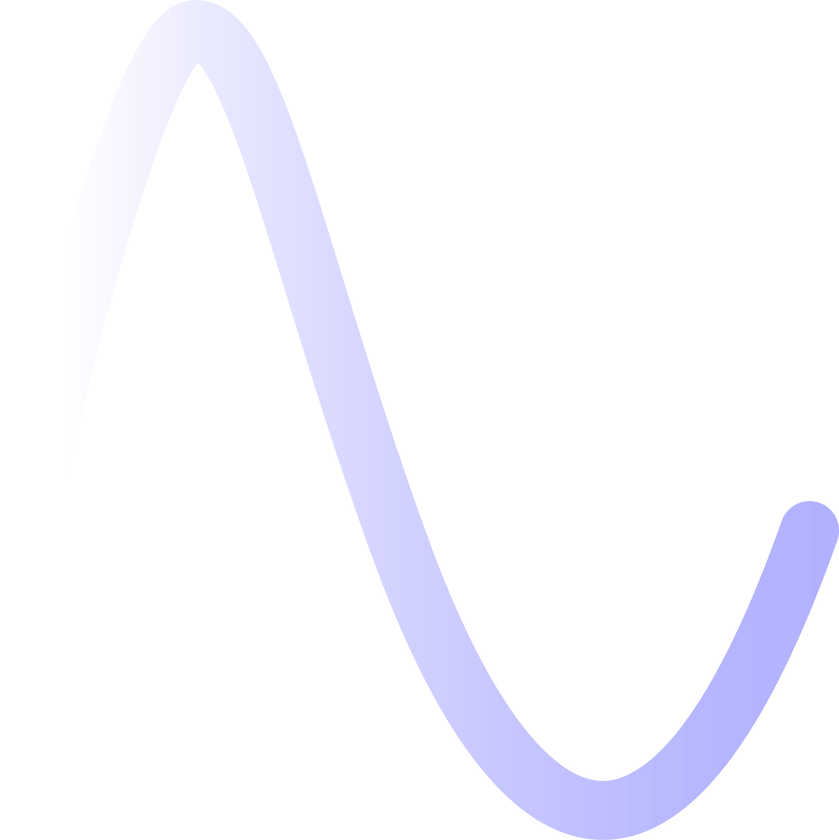
First studies of crystal collimation for the FCC-ee
G. Broggi^{1,2,3}, A. Abramov², M. Boscolo³, R. Bruce², D. Mirarchi², S. Redaelli²
¹ Sapienza University of Rome, Italy
³ INFN-LNF, Frascati, Italy
² CERN, Meyrin, Switzerland
Channeling 2024 – Riccione, Italy, 09/09/2024
Many thanks to:
L. Bandiera, B. Lindstrom, L. Nevay, F. Zimmermann

Slide 2
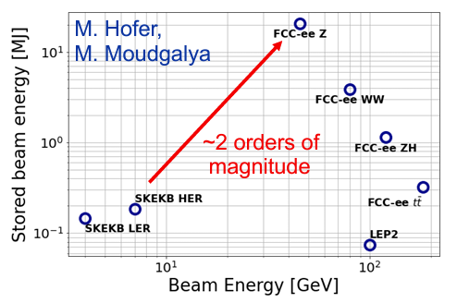
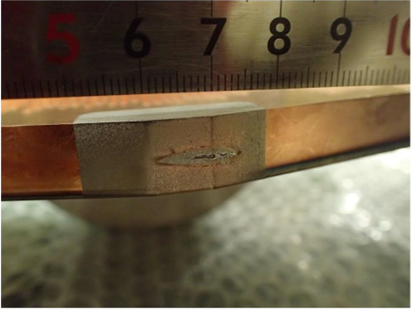
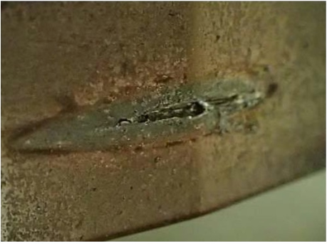
Collimation for the FCC-ee
Comparison of lepton colliders
FCC-ee is the FCC first stage e⁺e⁻ collider
90.7 km circumference, tunnel compatible with FCC-hh
4 beam operation modes, optimized for production of different particles:
Z (45.6 GeV), W (80 GeV), H (120 GeV), ttbar (182.5 GeV)
FCC-ee presents unique challenges
Unprecedented stored beam energy for a lepton collider: up to 17.5 MJ in the Z operation mode (45.6 GeV)
Highly destructive beams: collimation system indispensable
The main roles of the collimation system are:
Reduce background in the experiments
Protect the machine from unavoidable losses
Two types of collimation currently foreseen for the FCC-ee:
Beam halo (global) collimation
Synchrotron Radiation (SR) collimation – around the IPs
Tertiary collimators for local protection and particle shower absorbers under study
Damage to coated collimator jaw due to accidental beam loss in the SuperKEKB – T. Ishibashi (talk)
09/09/2024
G. Broggi | First studies of crystal collimation for the FCC-ee

Slide 3
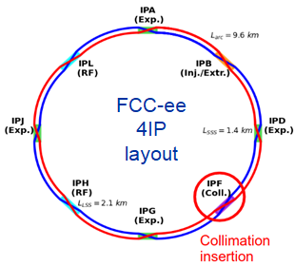
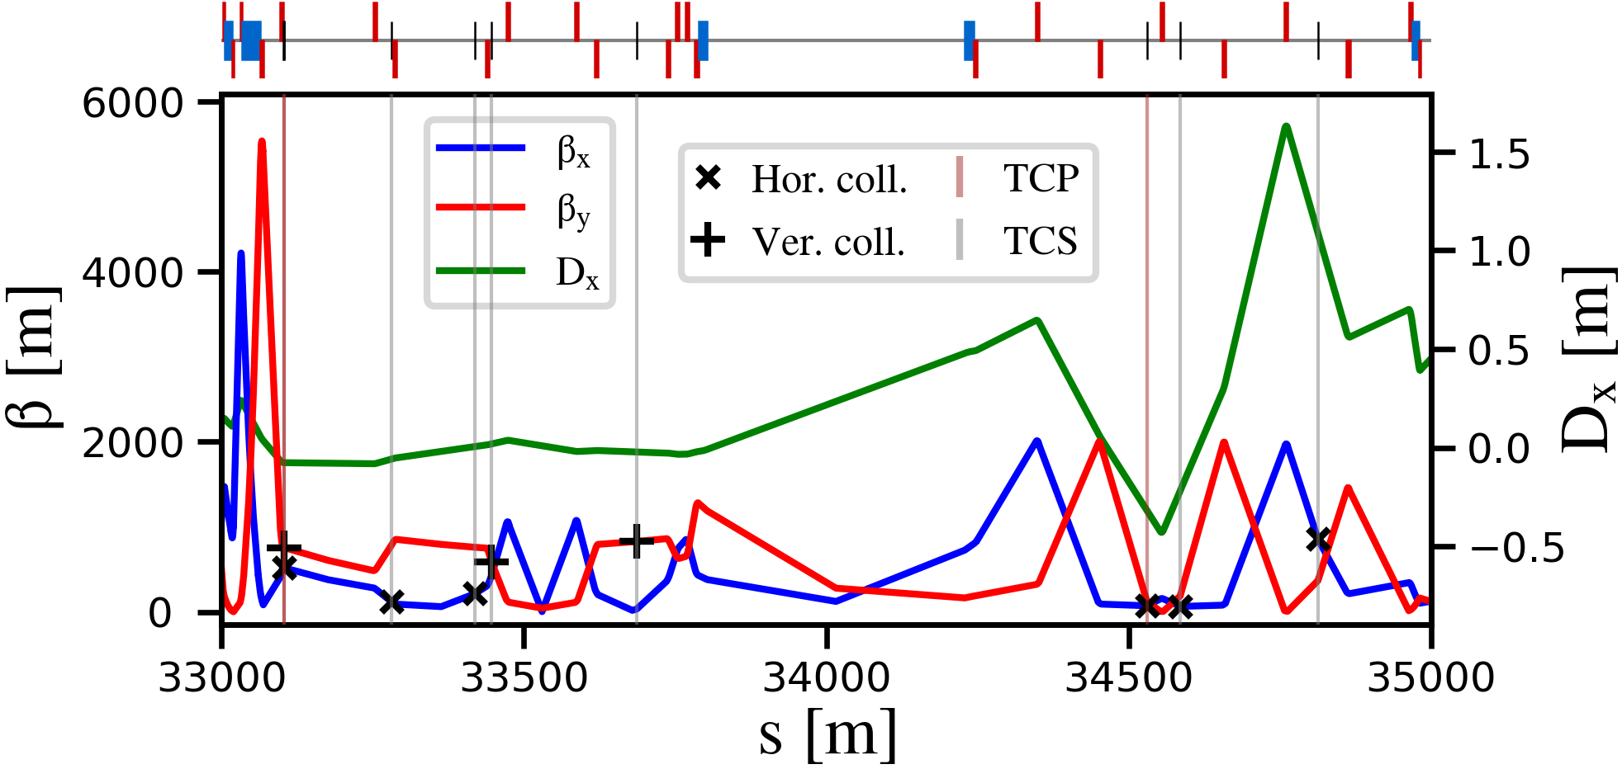
M. Hofer
FCC-ee halo collimation system
Dedicated halo collimation system in PF
Dedicated collimation optics (M. Hofer)
Two-stage betatron and off-momentum collimation system in one insertion
Ensure protection of the aperture bottlenecks in different conditions
Aperture bottleneck at Z: 14.6σ (H plane), 84.2σ (V plane)
First collimator design for cleaning performance – relies on amorphous collimators
Ongoing studies for optimizing the collimator design (G. Broggi – IPAC’24 paper)
betatron
off-momentum
FCC-ee beam halo collimator parameters and settings (Z mode)
Name | Plane | Material | Length [cm] | Gap [σ] | Gap [mm] | δ_{cut} [%]
TCP.H.B1 | H | MoGr | 25 | 11 | 6.7 | 8.9
TCP.V.B1 | V | MoGr | 25 | 65 | 2.4 | -
TCS.H1.B1 | H | Mo | 30 | 13 | 3.8 | 6.7
TCS.V1.B1 | V | Mo | 30 | 75 | 2.5 | -
TCS.H2.B1 | H | Mo | 30 | 13 | 5.1 | 90.6
TCS.V2.B1 | V | Mo | 30 | 75 | 3.0 | -
TCP.HP.B1 | H | MoGr | 25 | 18.5 | 4.2 | 1.3
TCS.HP1.B1 | H | Mo | 30 | 21.5 | 4.6 | 2.1
TCS.HP2.B1 | H | Mo | 30 | 21.5 | 16.8 | 1.6
FCC-ee Z V23, tridodo_572 collimation optics
Further materials will be studied in the future
09/09/2024
G. Broggi | First studies of crystal collimation for the FCC-ee

Slide 4
Crystal collimation for the FCC-ee: motivation
As an alternative to the baseline design relying on amorphous collimators, crystal collimation is also being explored:
Impedance
Short (sub-mm) bent crystals in place of tens of cm long amorphous primary collimators
Potentially larger absorber (secondary collimator) mechanical gaps
Power deposition on collimators
Short (sub-mm) bent crystals in place of tens of cm long amorphous primary collimators
Potentially increase beam halo spot size at the absorbers employing bent crystals
Power deposition on absorber could still be challenging
Cleaning efficiency
Angular deflection by bent crystals increases the impact parameter of beam halo particles on the absorbers (secondary collimators)
Working principle of a crystal collimation system
D. Mirarchi, PhD thesis
09/09/2024
G. Broggi | First studies of crystal collimation for the FCC-ee

Slide 5
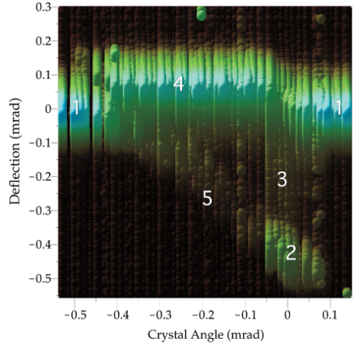
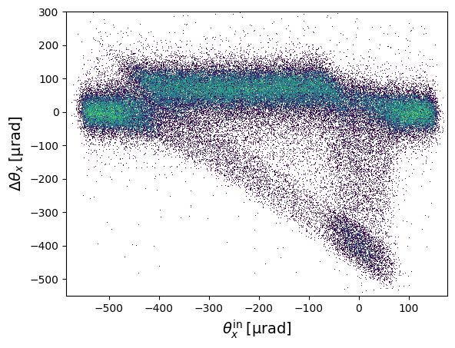
Crystal collimation for the FCC-ee: first considerations
Particle steering exploiting channeling in bent crystals more challenging for q<0
First focus on e- crystal collimation exploiting planar channeling in Si (111) plane
Studies extended to e+ crystal collimation
First checks to identify possible show-stoppers
Beam divergence at crystal candidate location in the FCC-ee vs. critical angle
Crystal bending angle needed to deeply impact an absorber downstream
Crystal bending radius vs. critical bending radius
First bent crystal parameters based on optimization of channeling efficiency through channeling simulations:
Geant4 (10.4.03) crystal channeling routine through the BDSIM simulation toolkit
Crystal data from E. Bagli, G4_MC_CHANNELING Git repository
Good agreement with exp. results – efficiencies agreement within few % (e.g., U. Wienands et al., Observation of Deflection of a Beam of Multi-GeV Electrons by a Thin Crystal)
First collimation tracking simulations with selected bent crystal parameters
experiment
simulation (BDSIM)
09/09/2024
G. Broggi | First studies of crystal collimation for the FCC-ee

Slide 6
Crystal candidate location: FCC-ee Z mode
Current locations of FCC-ee primary betatron collimators (TCPs) chosen as crystal candidate locations
At such locations:
TCP.H.B1 and TCP.V.B1 might be replaced by bent crystals
Absorber candidate locations are the same as secondary collimators (TCSs): phase advance is optimal
relatively high β-functions ↔ large beam sizes ↔ large collimator half-gaps
small Twiss α-functions ↔ small beam divergence
betatron
off-momentum
FCC-ee beam halo collimator parameters and settings
Name | Plane | Material | Length [cm] | Gap [σ] | Gap [mm] | δ_{cut} [%]
TCP.H.B1 | H | MoGr | 25 | 11 | 6.7 | 8.9
TCP.V.B1 | V | MoGr | 25 | 65 | 2.4 | -
TCS.H1.B1 | H | Mo | 30 | 13 | 3.8 | 6.7
TCS.V1.B1 | V | Mo | 30 | 75 | 2.5 | -
TCS.H2.B1 | H | Mo | 30 | 13 | 5.1 | 90.6
TCS.V2.B1 | V | Mo | 30 | 75 | 3.0 | -
TCP.HP.B1 | H | MoGr | 25 | 18.5 | 4.2 | 1.3
TCS.HP1.B1 | H | Mo | 30 | 21.5 | 4.6 | 2.1
TCS.HP2.B1 | H | Mo | 30 | 21.5 | 16.8 | 1.6
FCC-ee Z V23, tridodo_572 collimation optics
09/09/2024
G. Broggi | First studies of crystal collimation for the FCC-ee

Slide 7
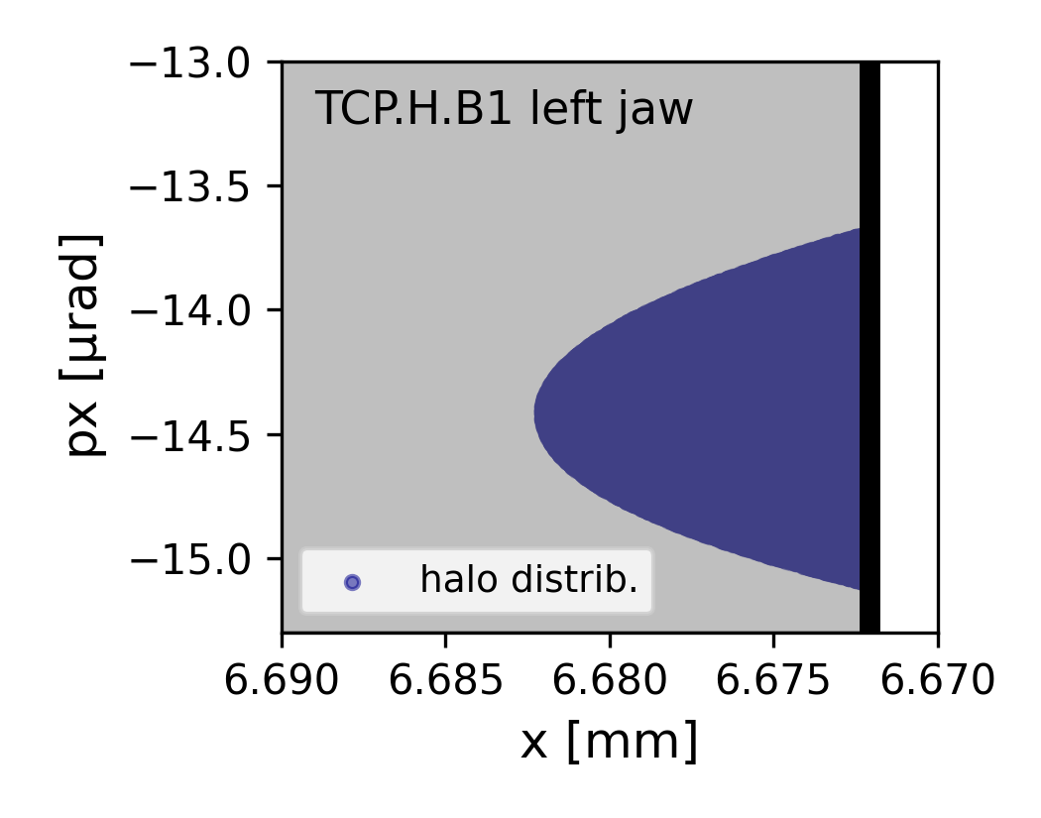
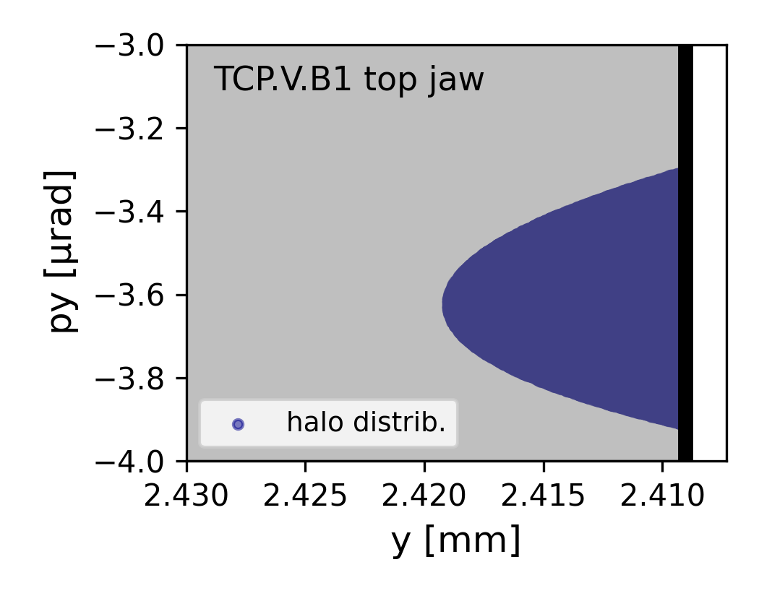
Divergence at crystal location and critical angle
$θ_{c}=\sqrt{\frac{2U_{0}}{pv}}≈\sqrt{\frac{2U_{0}}{E}}$
Angular spread of a beam halo distributions with impact parameter b=10 μm at crystal candidate locations:
U₀: potential well depth of the planar/axial channel [eV]
E: particle energy [eV]
H plane
V plane
FCC-ee Z mode (E = 45.6 GeV)
Si planar channel | U₀ [eV] | $θ_{c}$ [μrad]
(111) | 25.6 | 33.5
(110) | 22.8 | 31.6
(100) | 12.9 | 23.8
b
b
14.4 ± 0.7 μrad
3.6 ± 0.3 μrad
NOTE: At the highest FCC-ee beam energy of 182.5 GeV (ttbar mode) the critical angles reduce by about a factor 2 w.r.t FCC-ee Z beam energy
NO show stoppers identified
09/09/2024
G. Broggi | First studies of crystal collimation for the FCC-ee

Slide 8
Crystal bending angle, bending radius and length
First focus on H plane – the study will then be extended to the V plane
Different bending angles scanned (50 μrad, 100 μrad, 150 μrad)
Bending radius R: to ensure smooth particle steering and enhance channeling efficiency
maximize impact parameter on absorber
safety margin w.r.t mechanical aperture (30 mm)
$$R=\frac{l}{θ}>3R_{c}=0.3 m$$
Critical bending radius (Si, E = 45.6 GeV)
$R_{c}=\frac{pv}{U^{′}(x_{max})}≈\frac{E}{U^{′}\left(x_{max}\right)}≈9 cm$
U’(x_{max}): maximum potential gradient [eV/cm]
09/09/2024
G. Broggi | First studies of crystal collimation for the FCC-ee

Slide 9
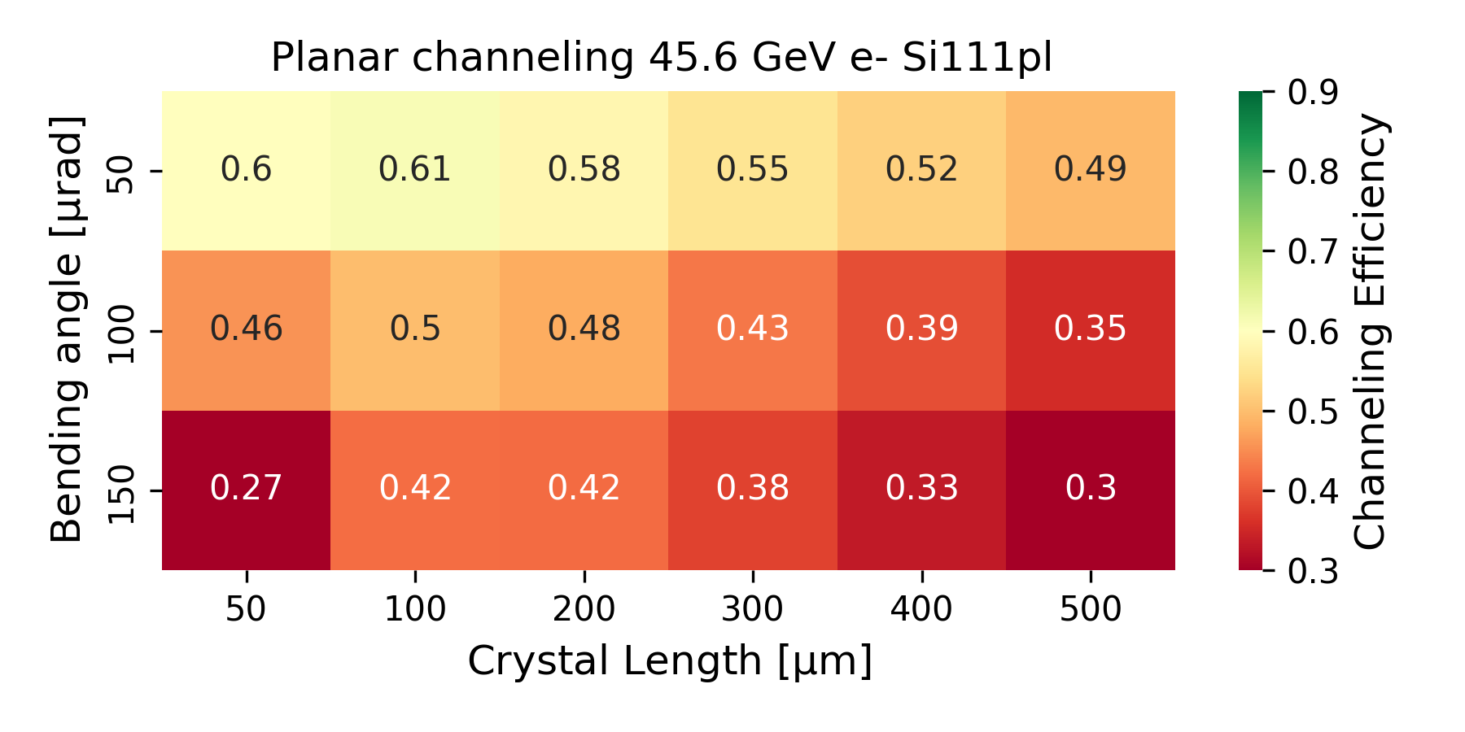
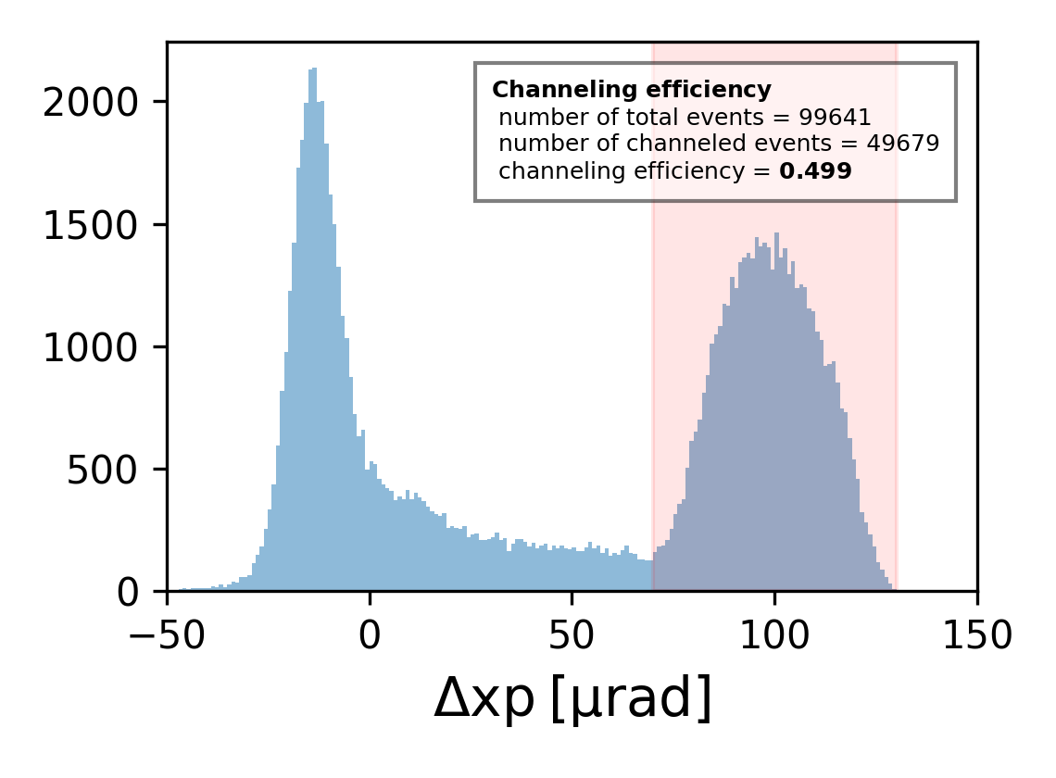
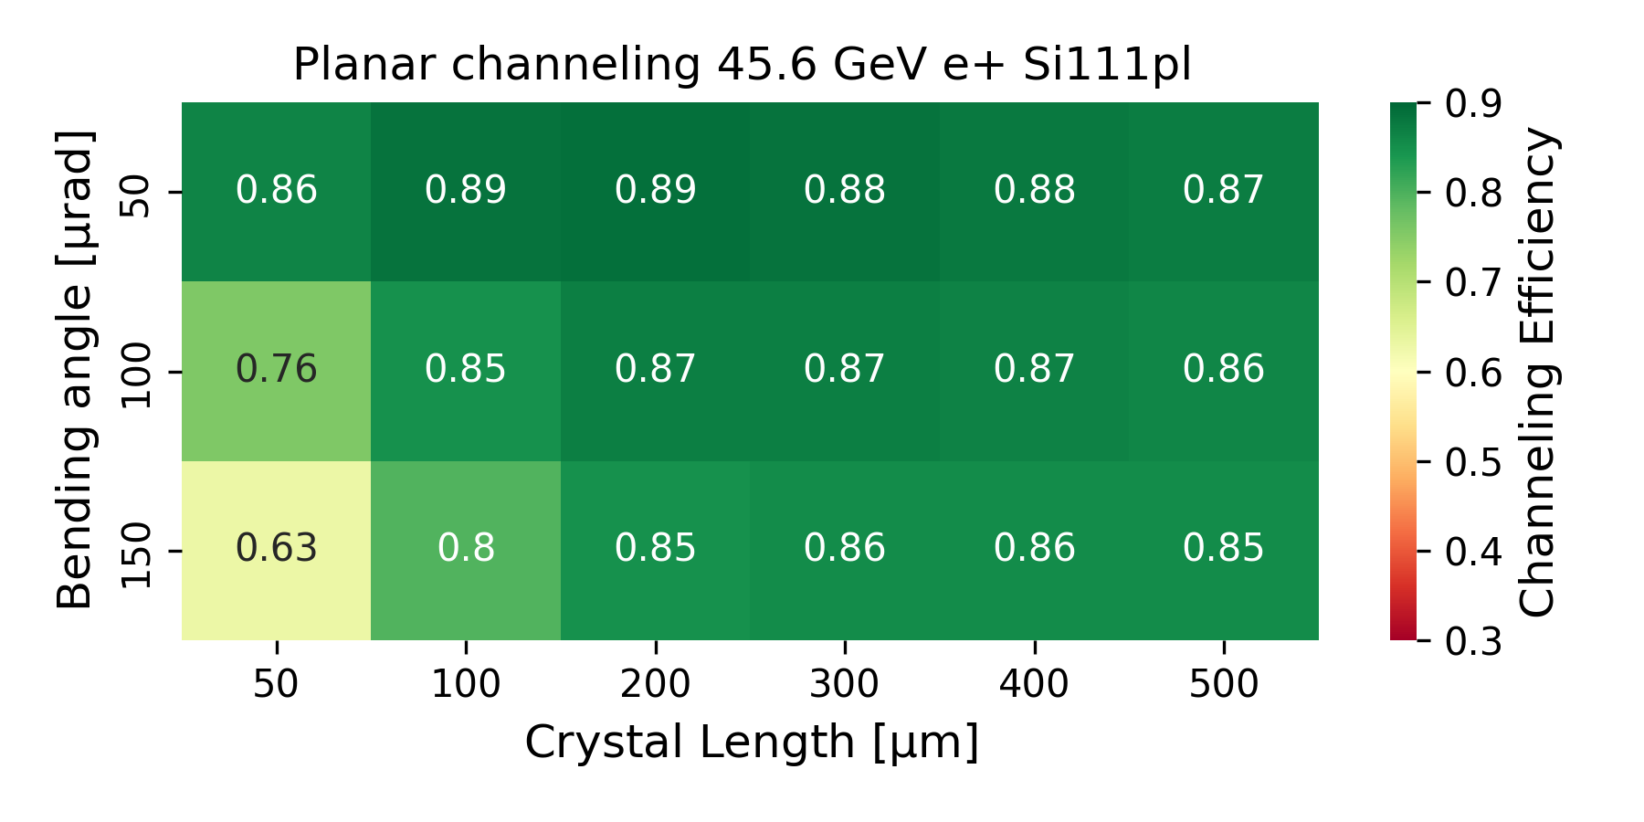
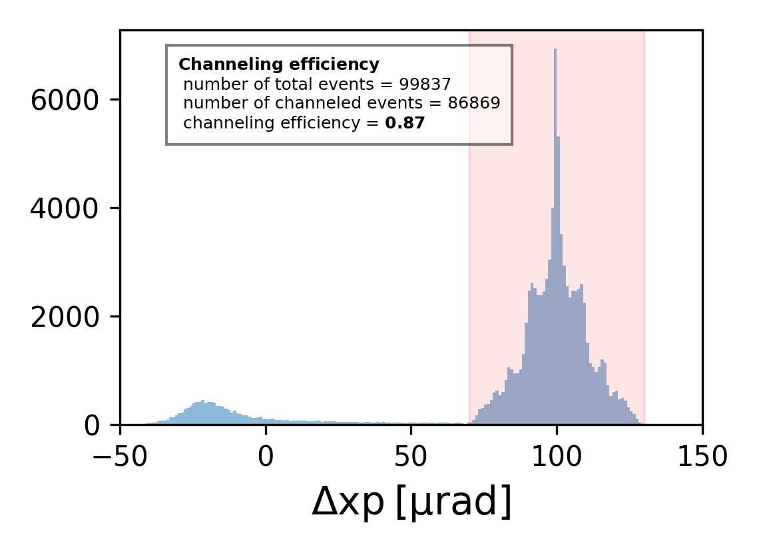
Particles are considered channeled if:
$$∆x_{p}∈\left[θ_{b}−θ_{c},{ θ}_{b}+θ_{c}\right]$$
Channeling efficiency
$θ_{b}$: bending angle
$θ_{c}$: critical angle
Deflection of 100 μrad of 45.6 GeV e- using the Si (111) planar potential of a 100 μm long Si crystal.
Deflection of 100 μrad of 45.6 GeV e+ using the Si (111) planar potential of a 200 μm long Si crystal.
NOTE: safety margin w.r.t mechanical aperture for 150 urad angular kick is tight.
09/09/2024
G. Broggi | First studies of crystal collimation for the FCC-ee

Slide 10
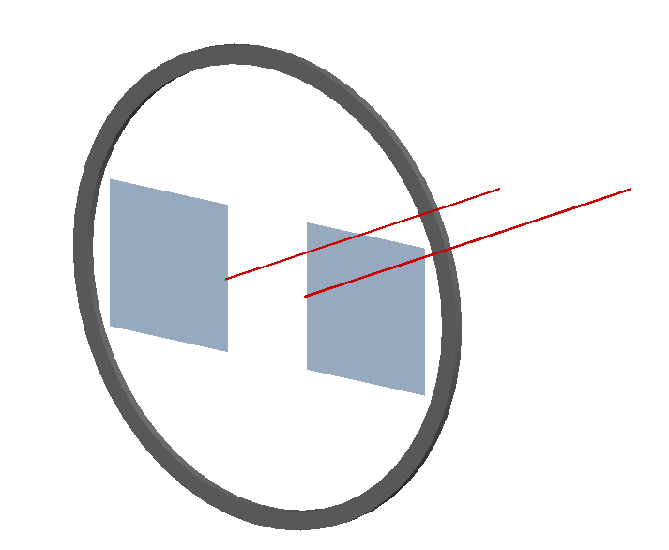
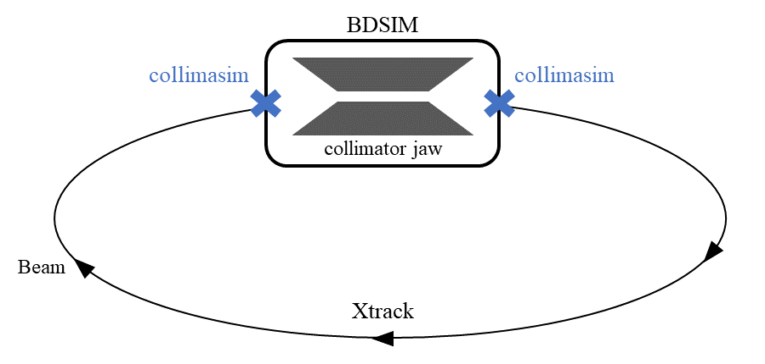
Collimation tracking simulations
beam pipe aperture
bent crystals
Simulation workflow:
Stand-alone BDSIM simulation for FCC-ee (Z) beam halo interacting with bent crystal
Channelled halo distributions used as input for Xsuite-BDSIM
5x10⁶ macroparticles (45.6 GeV) tracked through the FCC-ee lattice - including:
Nonlinearities
Synchrotron Radiation (mean model)
RF cavities
magnet tapering
detailed aperture model
halo and SR collimators
For 1 machine turn.
Results compared with standard (amorphous) collimation system one-turn cleaning
beam halo
BDSIM geometry
09/09/2024
G. Broggi | First studies of crystal collimation for the FCC-ee

Slide 11
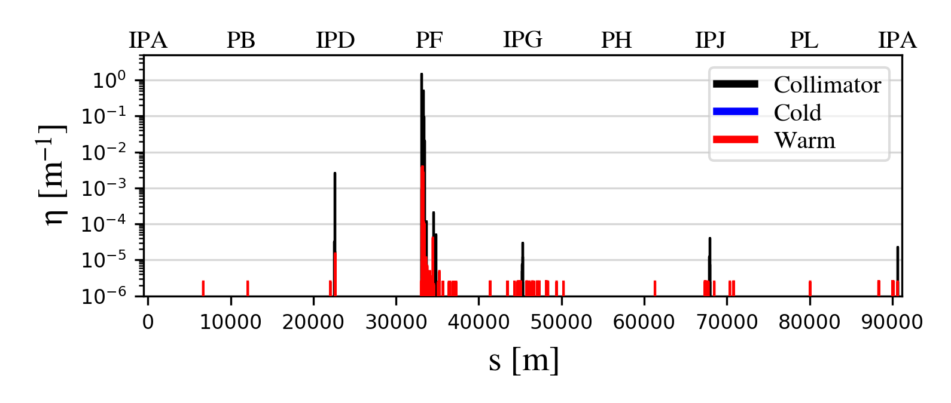
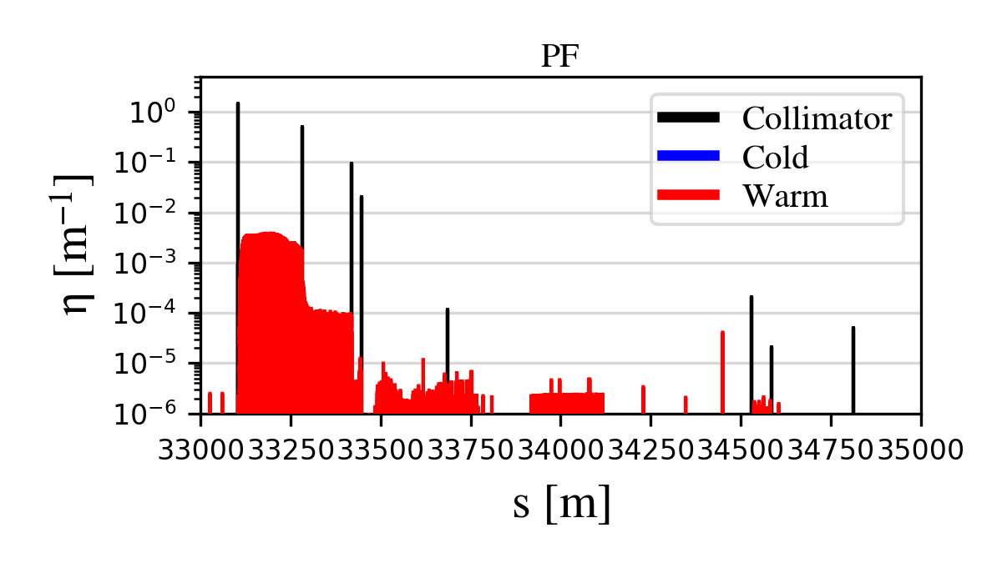
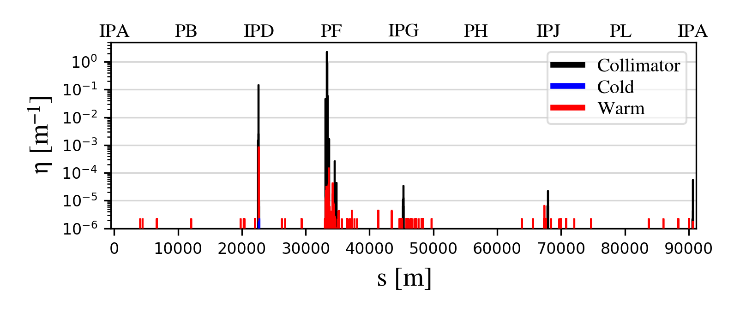
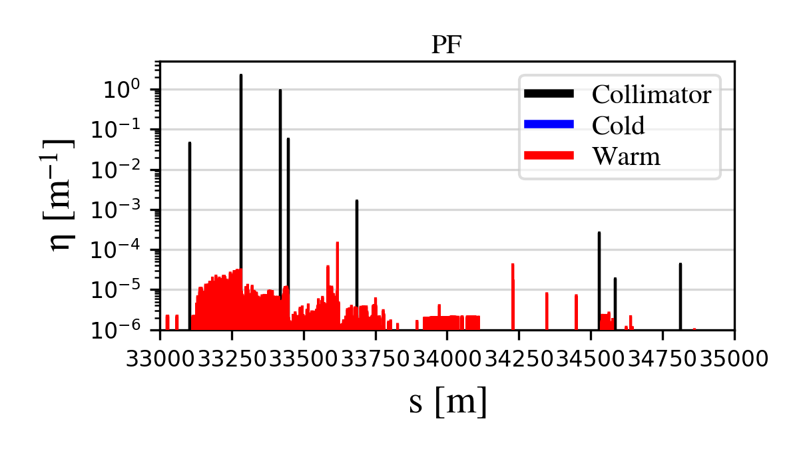
One-turn cleaning of the e- beam
Replacement of primary collimators with 100 μm bent Si crystals (100 μrad bending angle)
Standard collimation
Crystal collimation
One-turn cleaning is comparable
In the crystal collimation case:
Most beam halo losses end up on the absorbers – as expected
Significant reduction (up to a factor >100) of local losses in PF
Increase of losses on a vertical SR collimator upstream IPD – to be investigated
09/09/2024
G. Broggi | First studies of crystal collimation for the FCC-ee

Slide 12
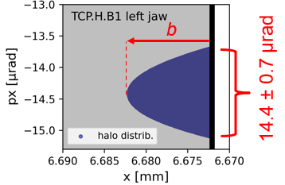
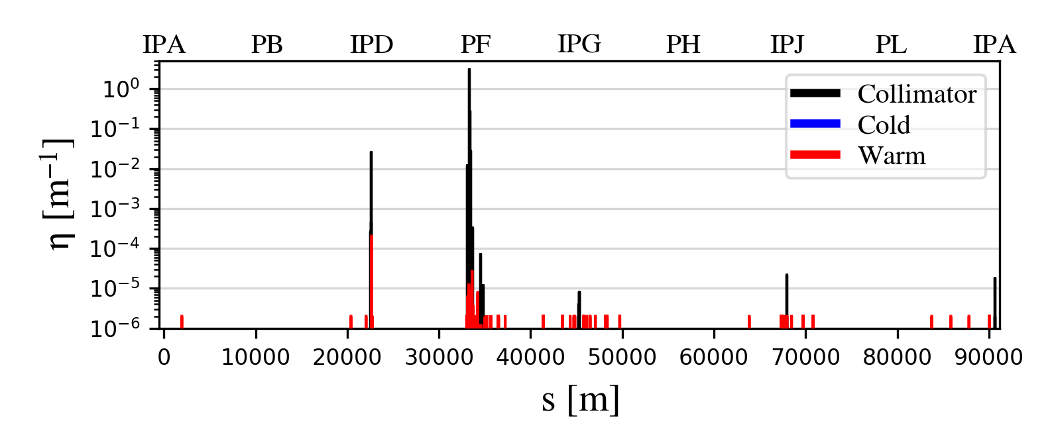
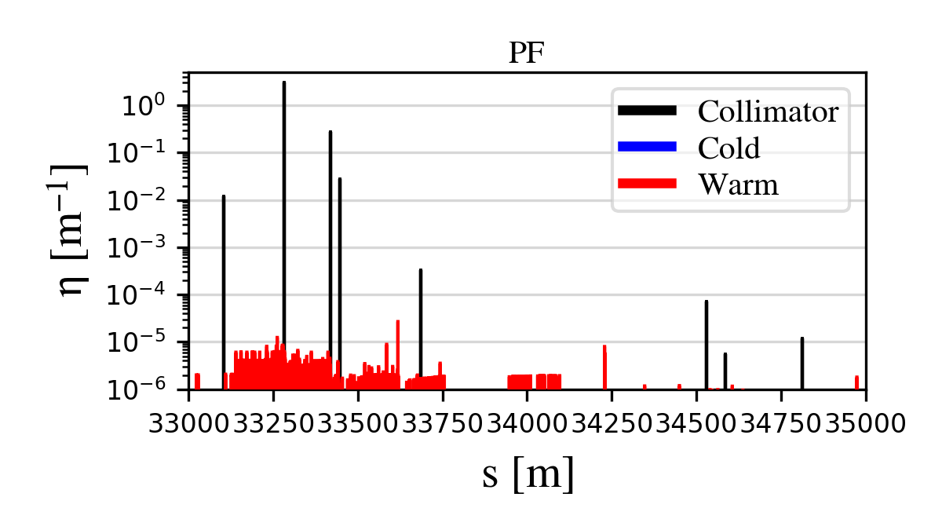
One-turn cleaning of the e+ beam
Replacement of primary collimators with 200 μm bent Si crystals (100 μrad bending angle)
Standard collimation
Crystal collimation
One-turn cleaning is comparable – compare again the performance considering smaller impact parameters b
In the crystal collimation case:
Most beam halo losses end up on the absorbers – as expected
Significant reduction (up to a factor >100) of local losses in PF
Increase of losses on a vertical SR collimator upstream IPD – to be investigated
09/09/2024
G. Broggi | First studies of crystal collimation for the FCC-ee

Slide 13
Summary
Crystal collimation might be an interesting solution for FCC-ee collimation
Feasibility studies have started: no show-stoppers identified
First crystal parameter optimization studies performed
Planar channeling of e- and e+ in Si (111)
100/200 μm Si crystals with 100 μrad bending angle
First collimation tracking simulations with crystals performed: performance gain over standard collimation cannot be demonstrated yet – further studies are needed (e.g., considering smaller impact parameters)
Next steps
radiation emission
strong field effects
Extend the analysis using more complete channeling routines including
Extend the analysis for studying crystal collimation in the V plane
Possibly extend the current analysis to:
Axial channeling – potentially more promising for the e- beam
(Multiple) volume reflection
Optimize absorber parameters (materials, length, retraction, etc.)
Extend the capabilities of the Xsuite-BDSIM simulation tool to allow for multi-turn collimation tracking with crystals
09/09/2024
G. Broggi | First studies of crystal collimation for the FCC-ee

Slide 14
Thank you!
09/09/2024
G. Broggi | First studies of crystal collimation for the FCC-ee

Slide 15
Oscillation period
Si crystal
$λ=πd_{p}\sqrt{\frac{pv}{2U_{max}}}≈πd_{p}\sqrt{\frac{E}{2U_{max}}}$
dp: interplanar distance [Ang]
Umax: maximum potential well depth [eV]
E: particle energy [eV]
Z mode (E=45.6 GeV)
ttbar mode (E=182.5 GeV)
Planar channel | dp [A] | Umax [eV] | $λ$ [um]
(111) | 2.35 (0.78) | 25.6 | 22.0
(110) | 1.92 | 22.8 | 19.1
(100) | 1.36 | 12.9 | 18.0
Planar channel | dp [A] | Umax [eV] | $λ$ [um]
(111) | 2.35 (0.78) | 25.6 | 44.1
(110) | 1.92 | 22.8 | 38.2
(100) | 1.36 | 12.9 | 36.0

Slide 16
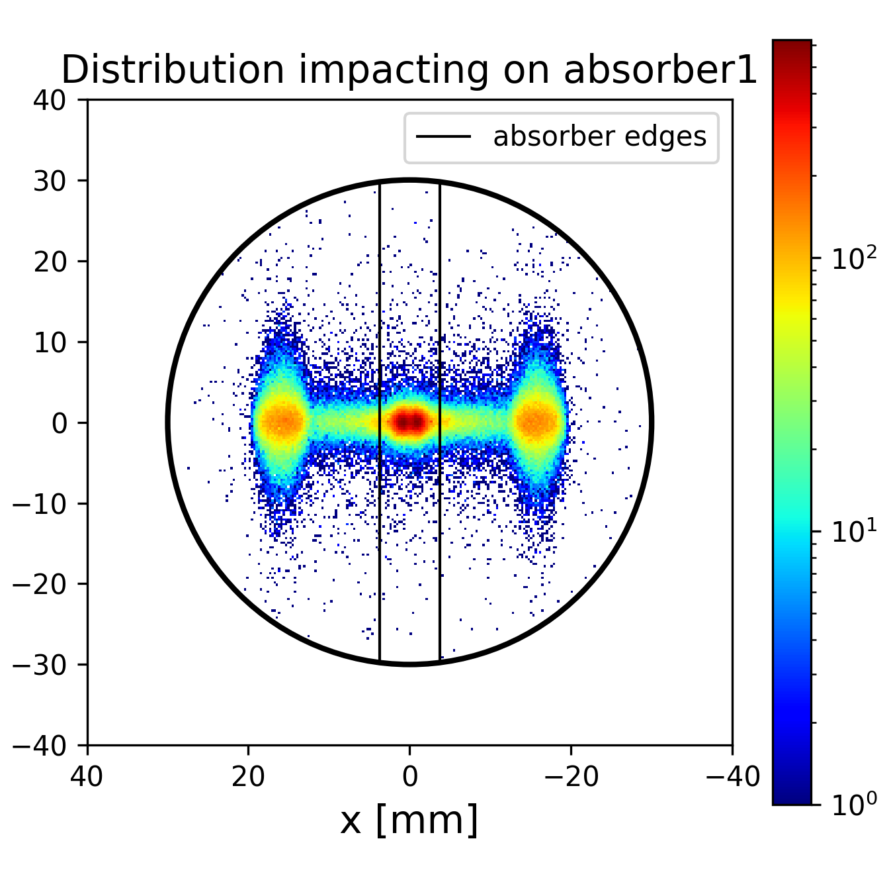
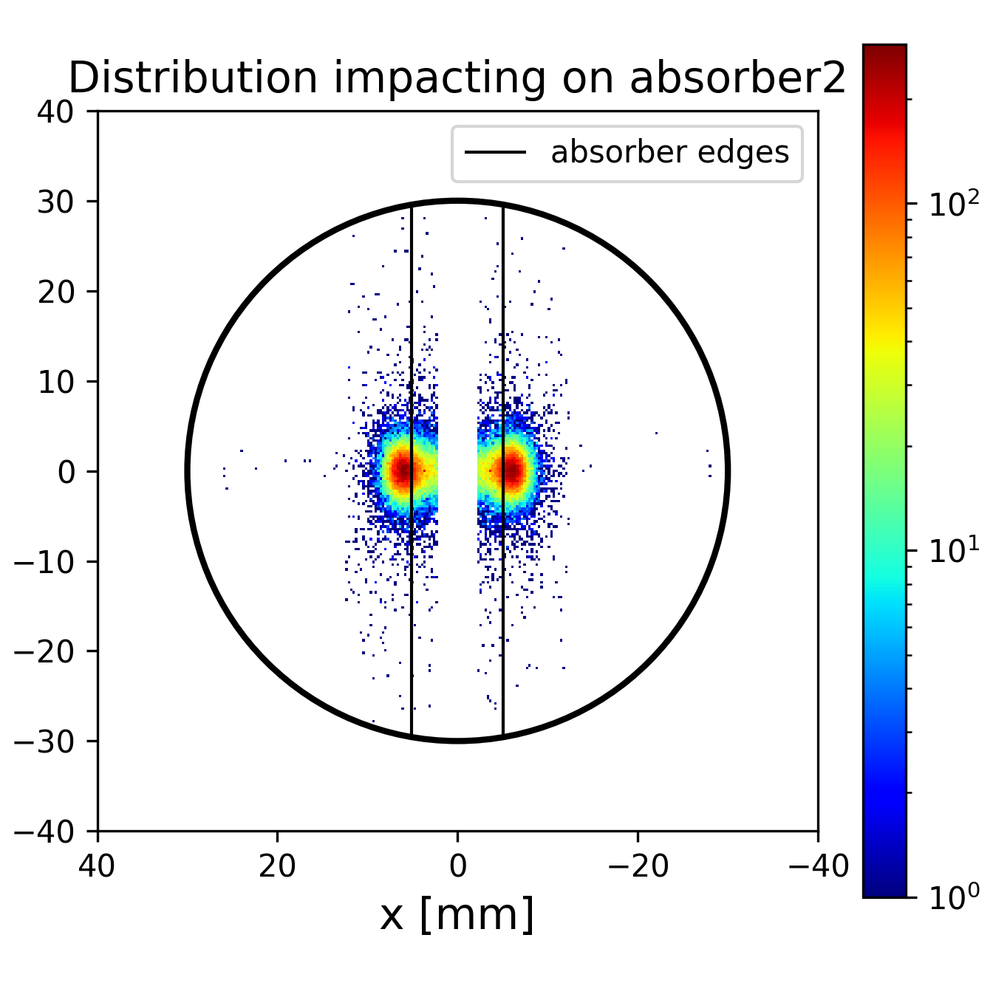
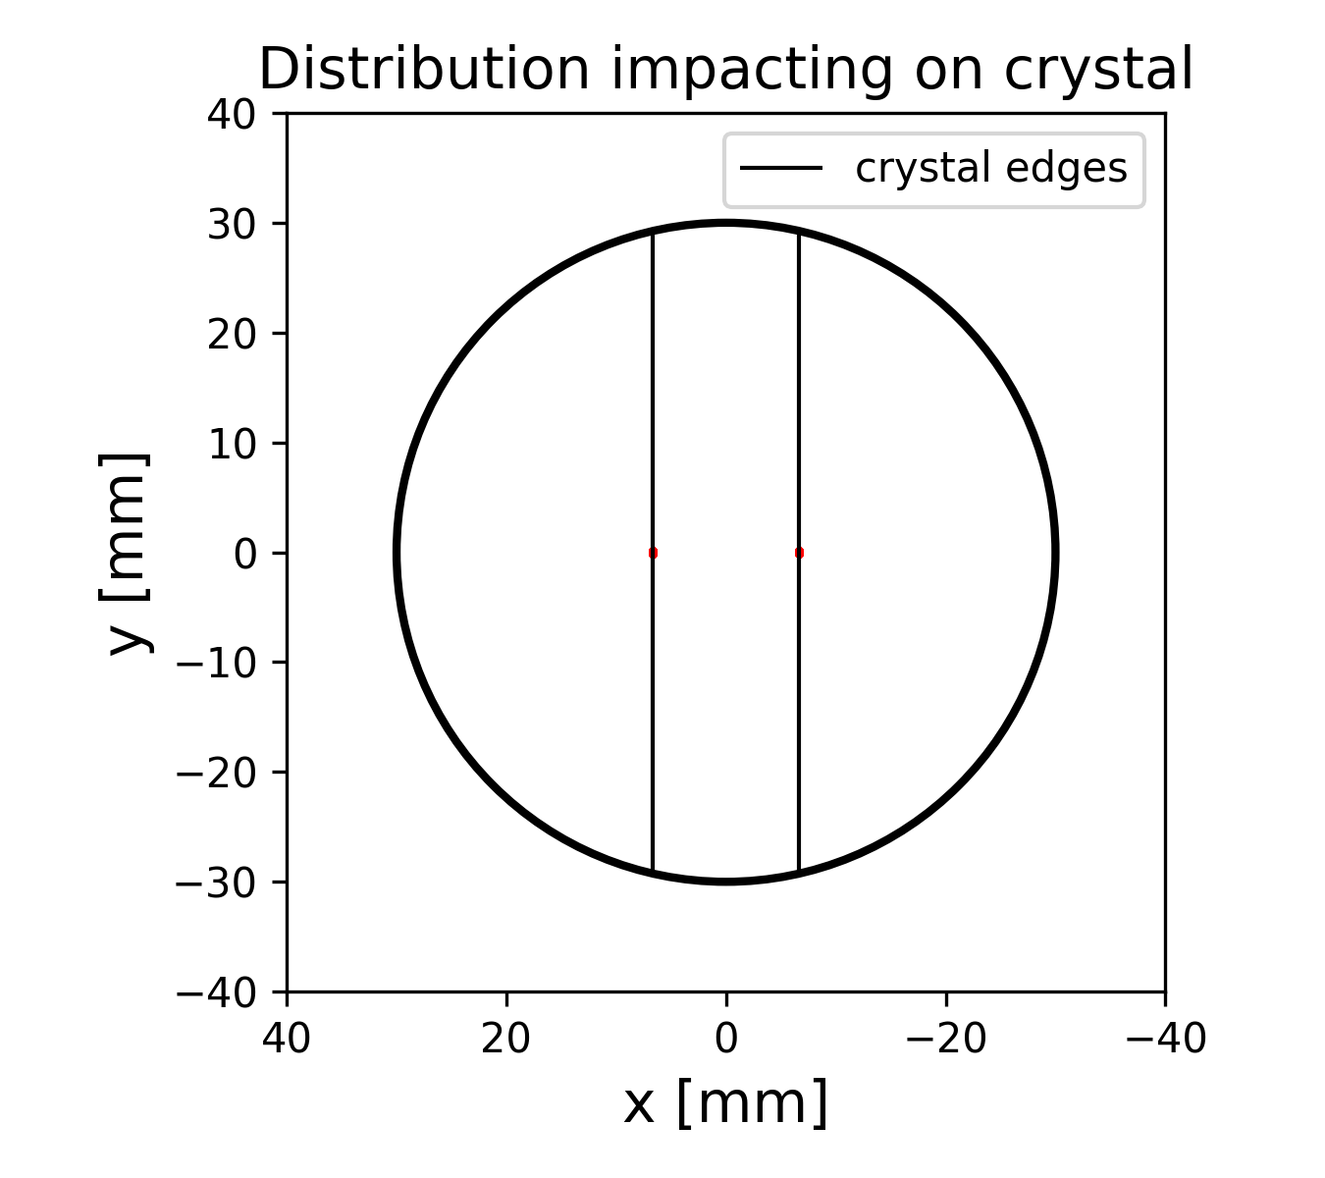
Electron beam distribution impacting absorbers

