Slide 1
Radiation pressure driven ion acceleration at BNL - Focus on Laser Channeling
Ginevra Casati, Nicholas Dover, Oliver Ettlinger, Nuo Xu, Sanjith Chandran, Mikhail Polyanskiy, Igor Pogorelsky, William Li, Charlotte Palmer and Zulfikar Najmudin

Slide 2
Overview
Laser driven ion sources – applications
Laser driven ion sources – main acceleration mechanisms
Characteristics of our setup at BNL
Shock acceleration results – then (2012) and now (2024)
Focus on laser channeling
Channeling PIC simulations vs experimental results
Further work and Conclusions
2

Slide 3
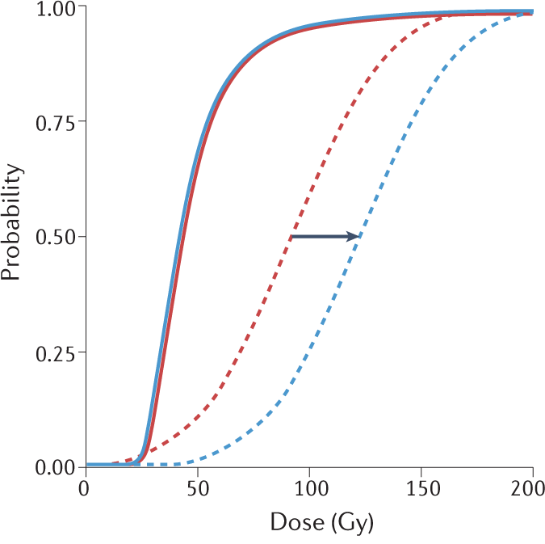
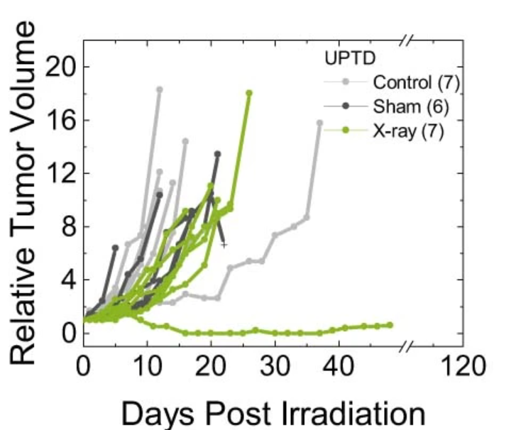
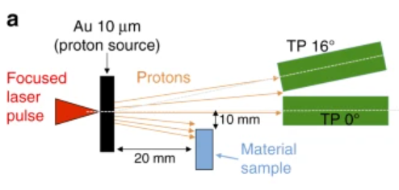
Why laser driven ion acceleration ?
Laser driven ion sources:
compact sources
high energy ions – above 100MeV
high peak currents
Low emittance
Short ion beams - ps to ns
high divergence beams ~${10}^{°}−$ ${20}^{°}$
Desirable characteristics for Radiobiological and material sciences applications
Flash Irradiation therapy [1]
Stress testing of materials [2]
NTCP
w or w/ FLASH
3

Slide 4
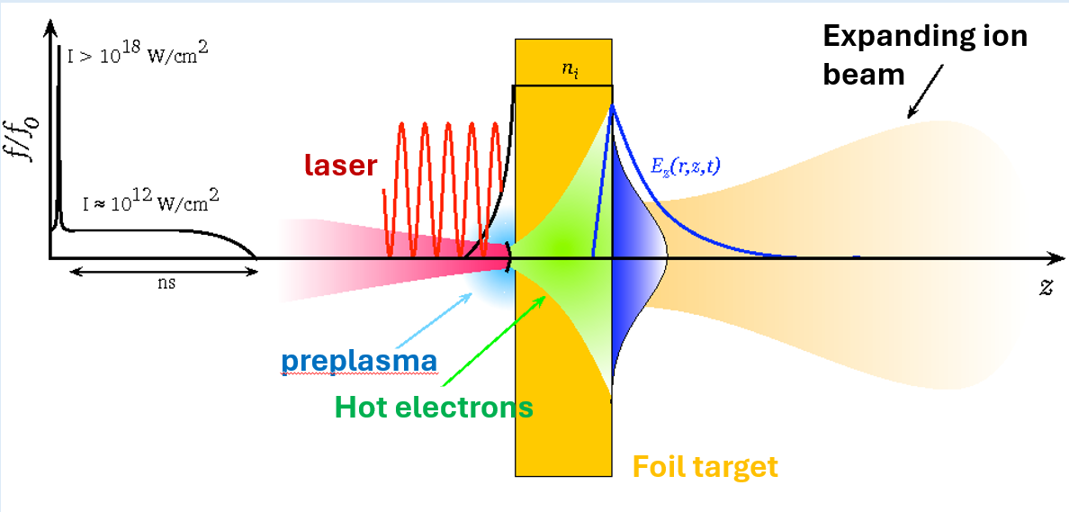
Laser-Plasma ion acceleration
Several mechanisms exist, the two most common are:
Sheath Acceleration
Radiation Pressure Acc. (RPA)
Very high intensities and very thin targets are required. Gas targets are suitable for front surface acceleration configurations.
Implementing this method is challenging when using gas targets.
4

Slide 5
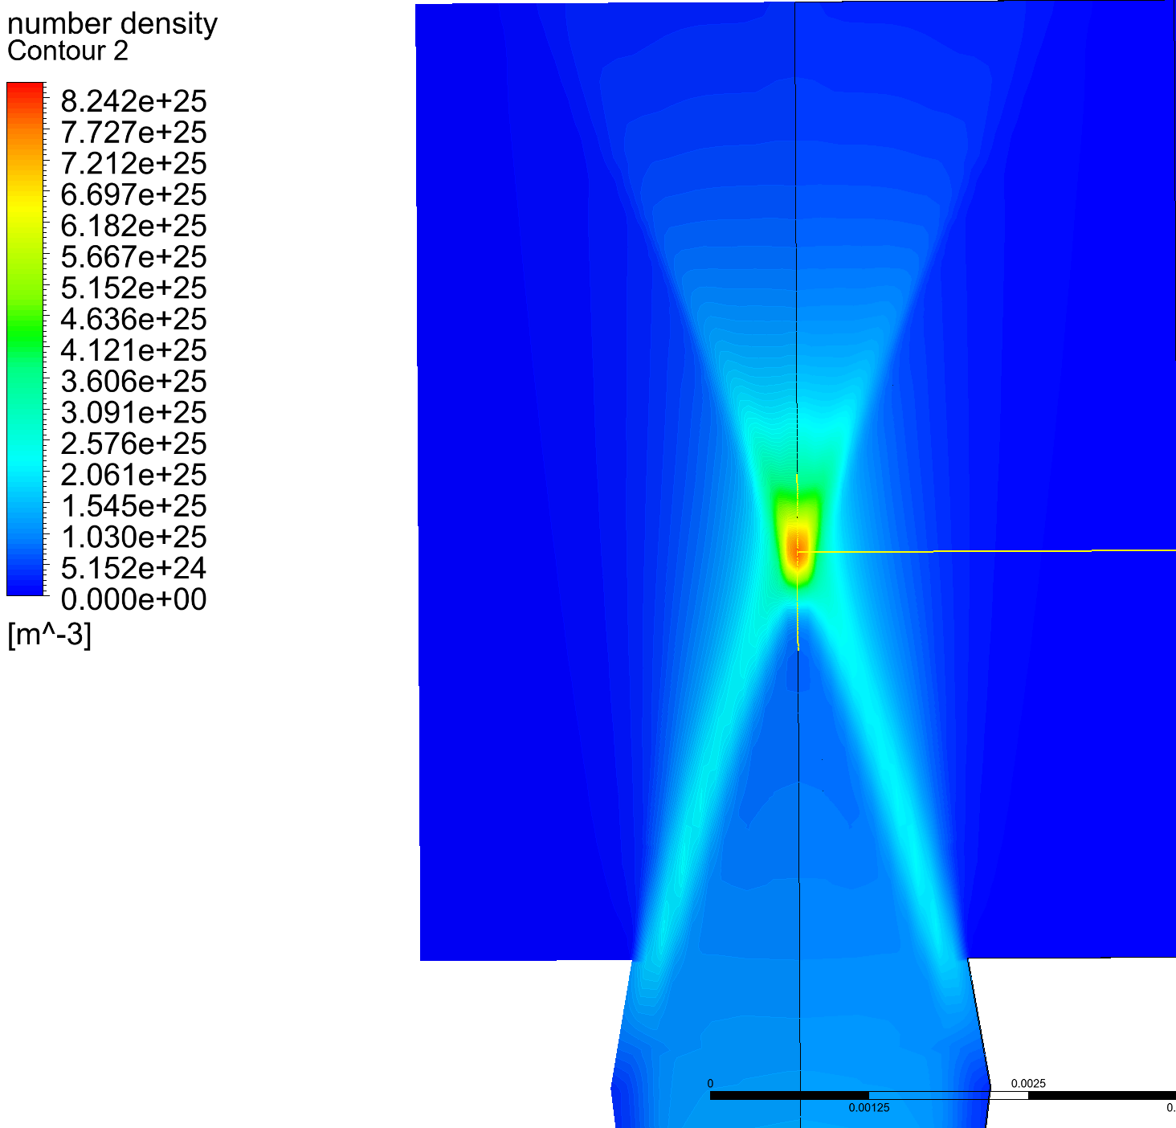
Why we chose the BNL facility
The main reasons why we chose BNL:
It is a ${CO}_{2}$ laser Very long wavelength ~ 9.2 $μm$
This has several implications:
the a0 of the laser scales favorably as: ${ a}_{0}=\frac{E_{0}e \text{λ}}{m_{e}c}$
the critical density is 100 times lower than for Ti-sapph lasers: ${ n}_{c}=\frac{m_{e}ε_{0}}{e^{2}{\text{λ}}^{2}}$
Hence gas targets can be used and still be in the critical density regime !
Gas targets are important because:
they can produce pure beams, in particular the medical field wants pure He beams,
they don’t generate debris,
And they can operate at high rep rates
5

Slide 6
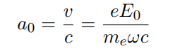
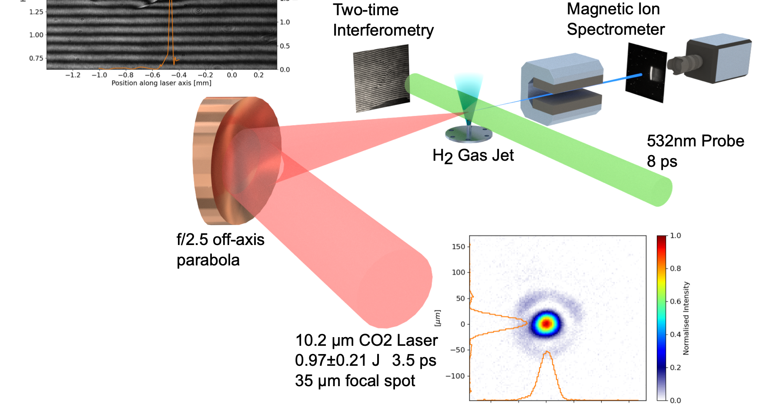
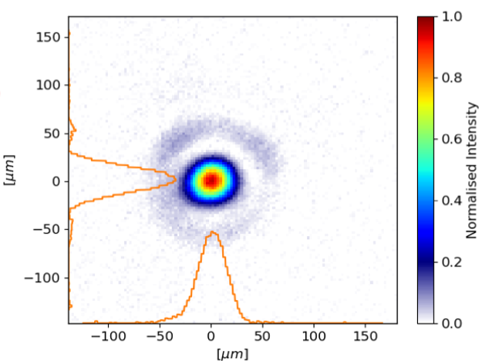
BNL CO2 laser facility
Favorable scaling:
CO2 laser:
~ 9.2 μm wavelength
~ 3 ps pulse length
~ 5J Energy on target
~ 25 μm focal spot size
~ 9E+21 W/$m^{2}$
~ 5.4 $a_{0}$
Ti:Sapph
100fs
Ideal for Medical applications
f/1
Proton Spatial
Scintillator
Credits to Nicholas Dover
6

Slide 7
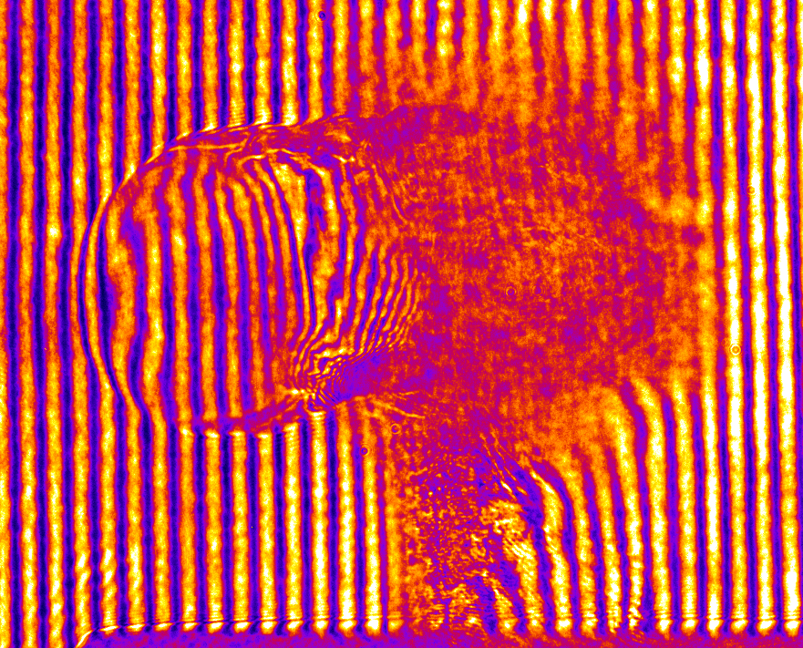
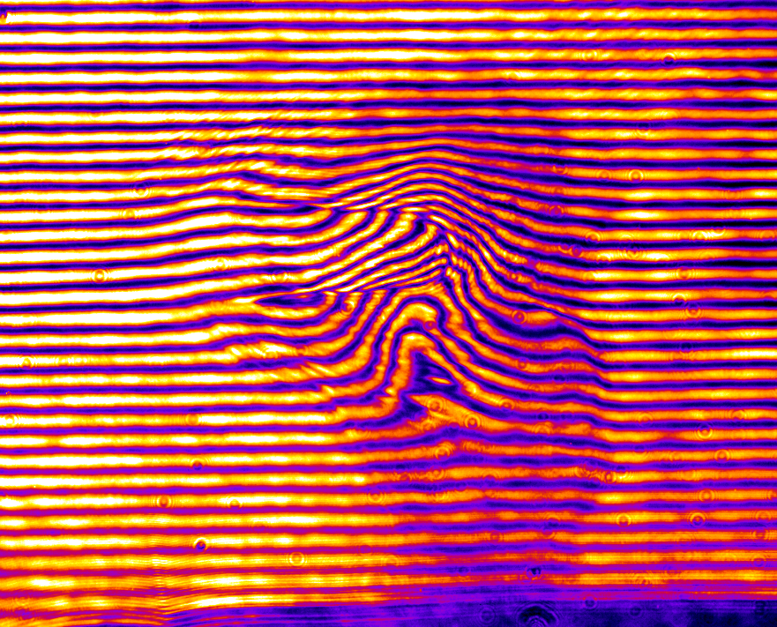
Femtosecond probe - measuring intrapulse dynamics
Previously: 8 ps ND:YAG, results in significant image blur
Recently implemented <100 fs Ti:Sapphire probe, allowing measurement of intrapulse dynamics
Previously: blur due to ionisation and plasma dynamics
8 ps
Old ND:YAG probe
2 ps
Now: clean images when overlapping drive and probe
CO2 drive
100 fs
New Ti:Sapph probe
7
Notes:
A serious limitation of the filamentation study was the pulse length of the optical probe. We were using an ND:YAG probe with 8 ps pulse length. This resulted in significant blurring of the plasma dynamcis during the drive pulse where there was significant plasma formation during the probe itself. However, recently the ATF has installed a new sub 100 fs Ti:S probe, which allows us to measure the plasma dynamics *during* the drive pulse

Slide 8
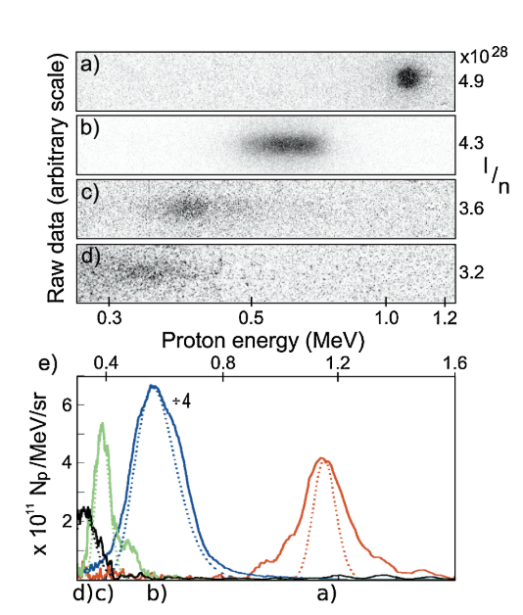
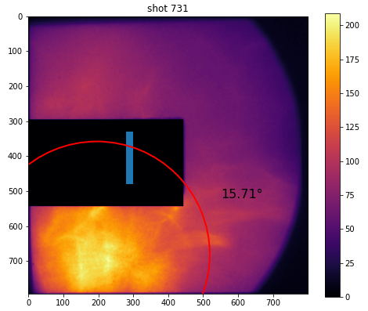
Work on radiation pressure driven acceleration
Palmer+, Phys. Rev. Lett. 106, 014801 (2011)
Recent experimental run exemplary shot:
Proton spatial screen
Thompson Spectrometer
8

Slide 9
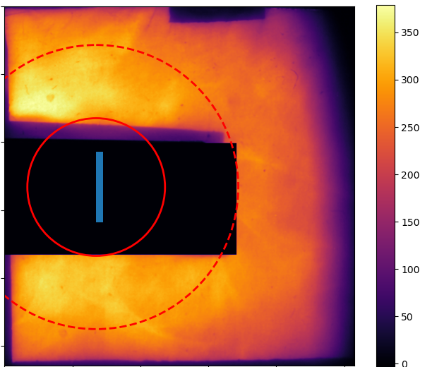
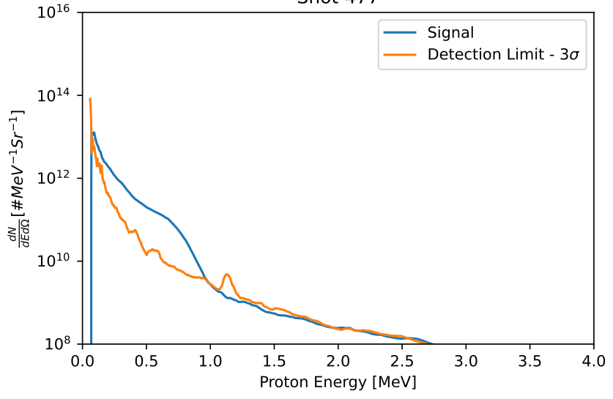
Scenario where shock acceleration failed
x
Thermal ion beams
Divergence higher than 20º
20º
10º
Deconvolved spectrum
9

Slide 10
Channeling in near critical density plasma
Shadowgraphy at two times from the same shot:
t = 2 ps
t = 7.8 ps
500 μm
~1 nc hydrogen plasma
Generation of a clear laser-driven channel
10
Notes:
We exploited this new probing system in a recent study to measure the channeling of a high power laser pulse in a critical density plasma. Here we see two images from the same plot. A clear channel is seen to form over a few ps along the laser propagation direction, together with filamentary structures to the side of the channel. It is important to stress that the plama density is 1 nc – normally we cannot probe such interactions with a NIR drive. This is a highly non-linear LPI

Slide 11
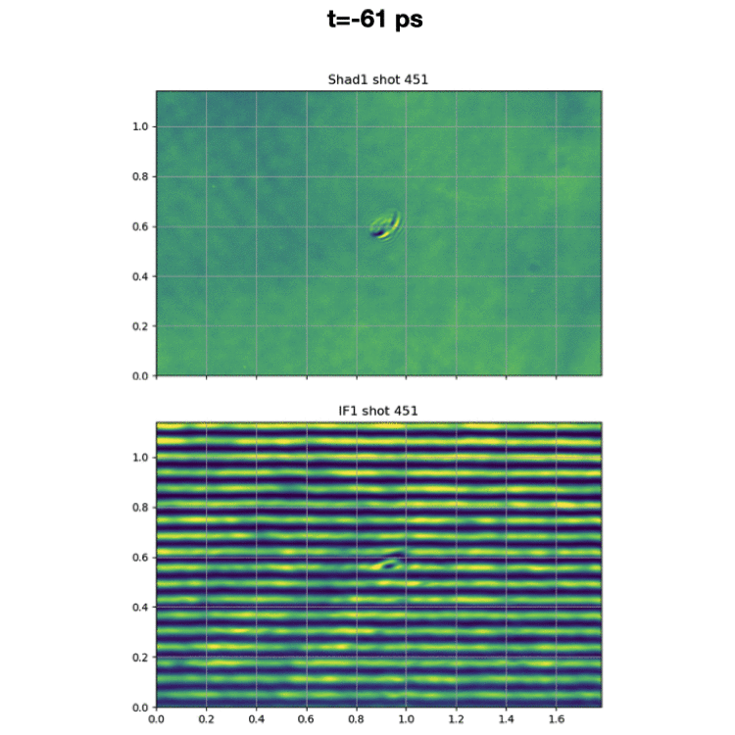
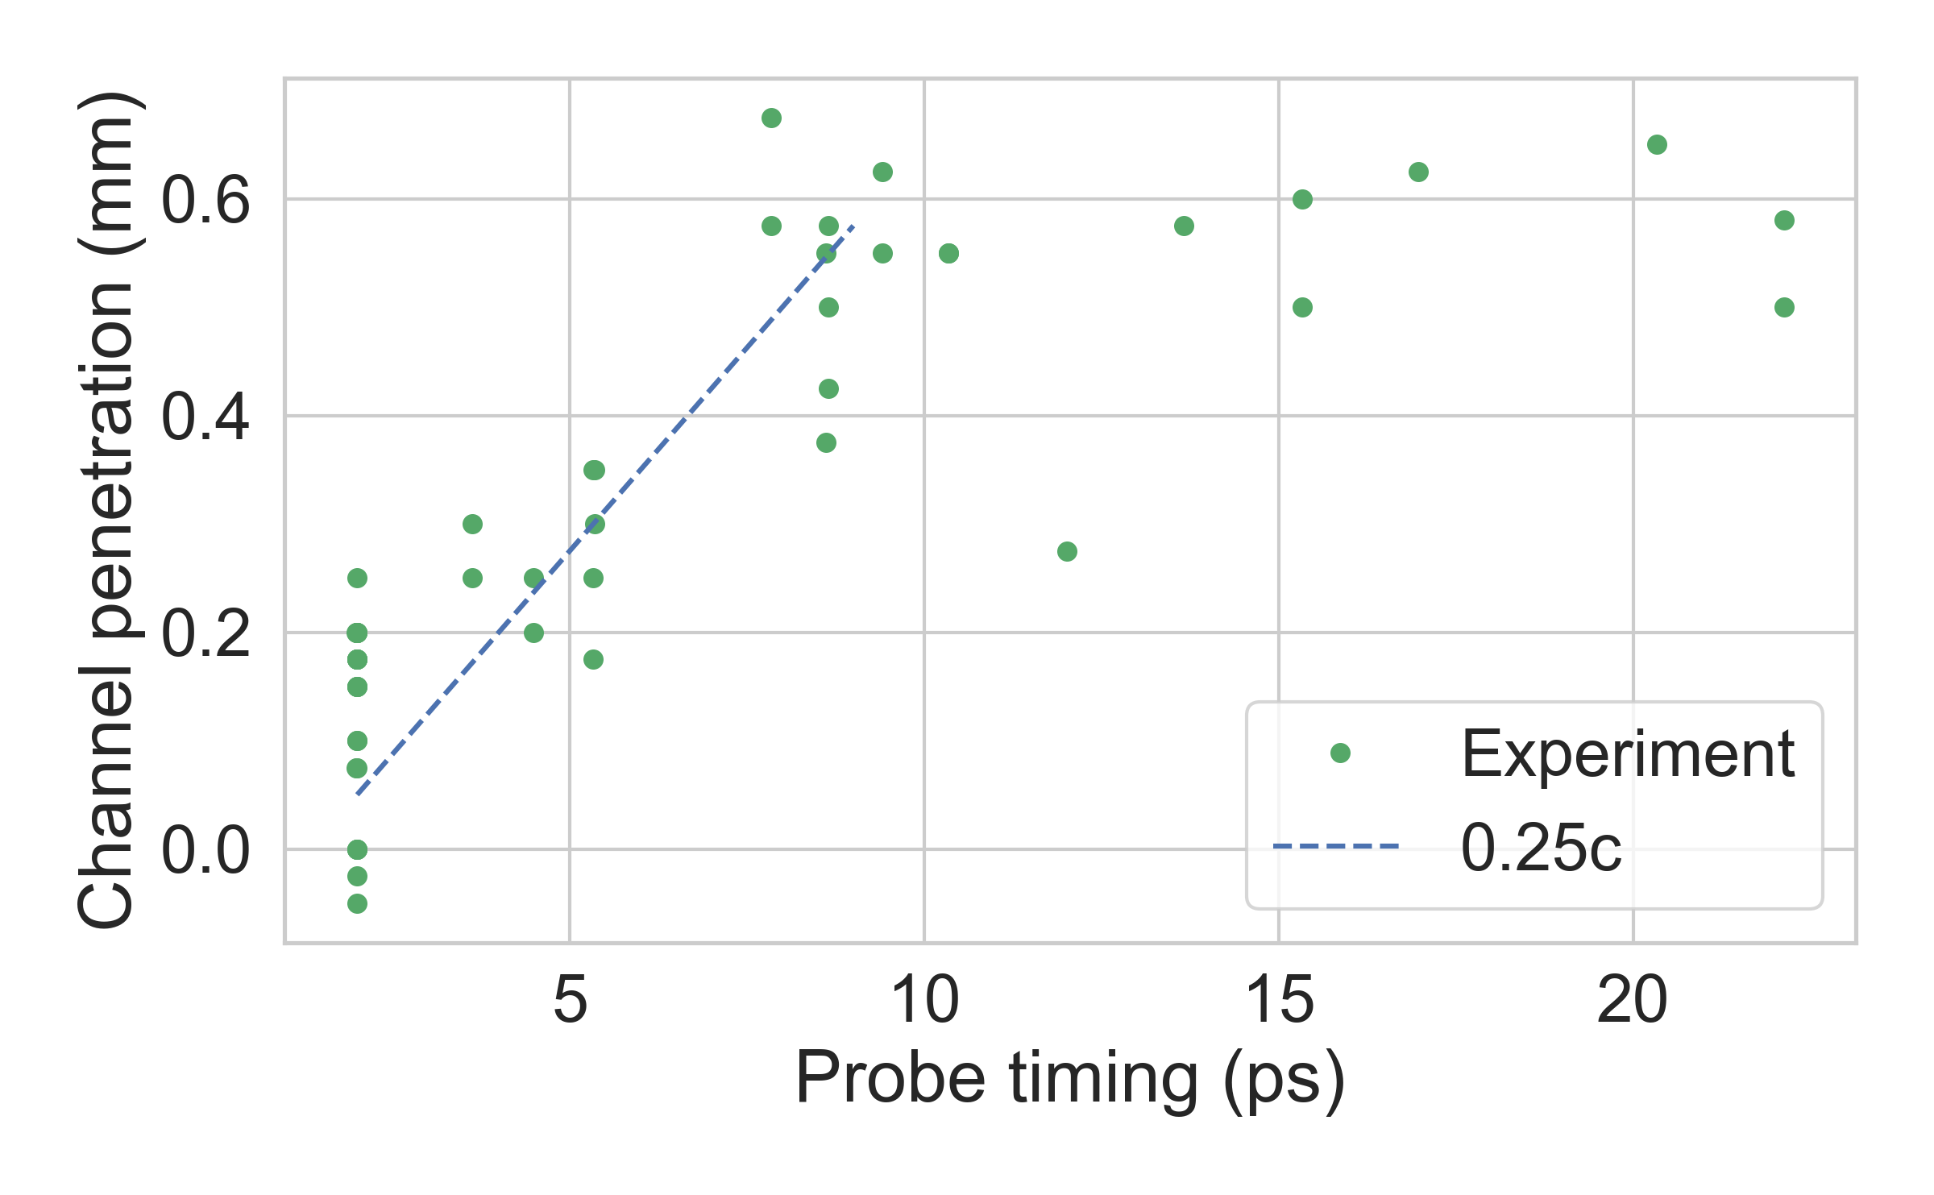
Laser channeling and thermal ions
500 μm
11
Notes:
By stacking together mulple shots we can stitch together the channel formation process. We see the channel forming over ~7 ps and extending in length, after which the laser is evidently depleted. After this point only transverse expansion of the channel is observed. The speed of the channel formation is approximately c/4. This highlights the fact that this is a critical density plasma, as this is well under the speed of light. The speed of propagation is determined by a reduced group velocity and pulse etching at the front of the pulse.

Slide 12
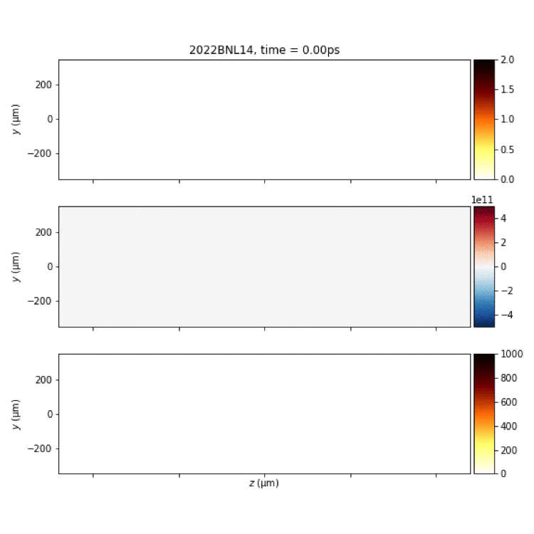
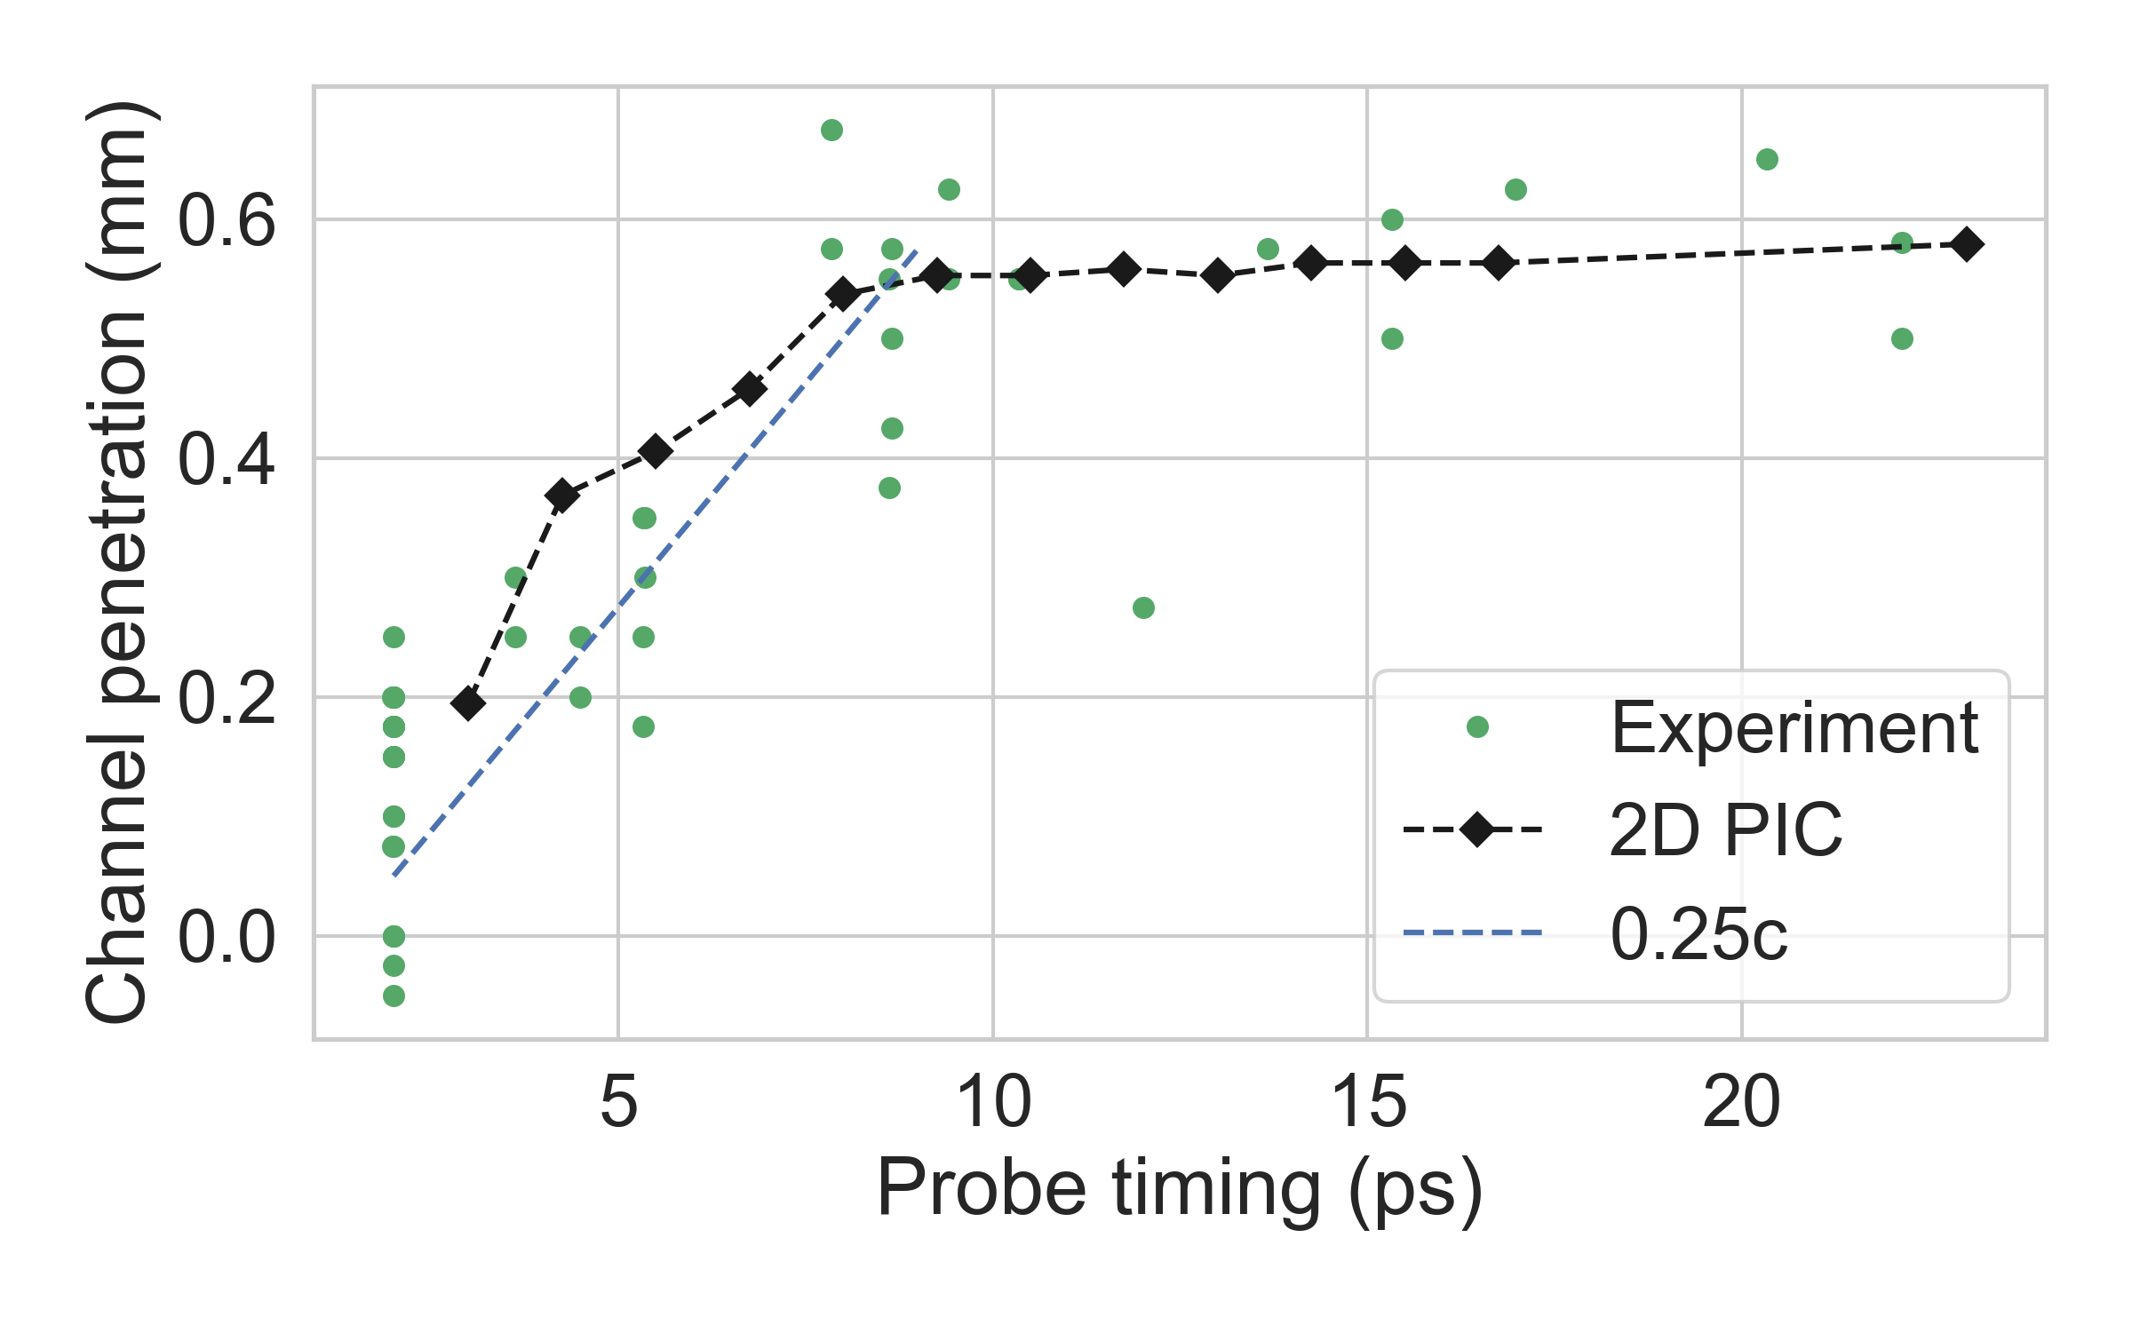
Laser channeling and thermal ions
~1 nc hydrogen plasma
ne (nc)
500 μm
500 μm
Ey (V/m)
KEp (keV)
11
Notes:
Such a behavior is reproduced in 2D PIC (with ionization turned on). The channel formation and filamentation is clearly seen, and the speed of channel formation agrees well with the experiment. We also observe hosing in both the experiment and simulation; this again is typical of near critical density LPI

Slide 13
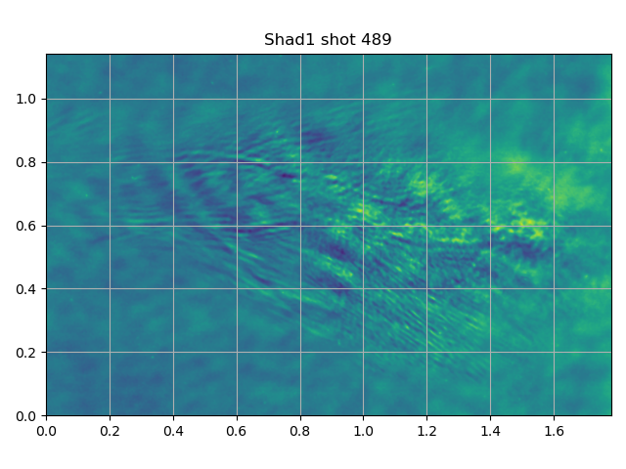
Experimental shadowgraphy and 2D PIC
12

Slide 14
Summary & Outlook
Developing a testbed for laser driven ion source and fundamental LPI driven by longwave-IR laser
Recent results include:
Investigation of shock ion acceleration with production of up to 5MeV monoenergetic ion beams
Channeling near critical-density plasma with production of ~1MeV thermal ions
Exciting possibilities to exploit setup to look at many facets of critical density LPI

