Slide 1


1
Possible Crystal Applications for FCC and Beyond
Frank Zimmermann
Channeling 2024, Riccione, 9 September 2024
Many thanks to
Michael Benedikt, Sara Casalbuoni, Iryna Chaikovska, Sultan Dabagov, Massimo Giovannozzi, Sakura Pascarelli, Stefano Redaelli, Walter Scandale
This project has received funding from the European Union’s Horizon 2020 Research and Innovation programme under GA No 101004730.

Slide 2
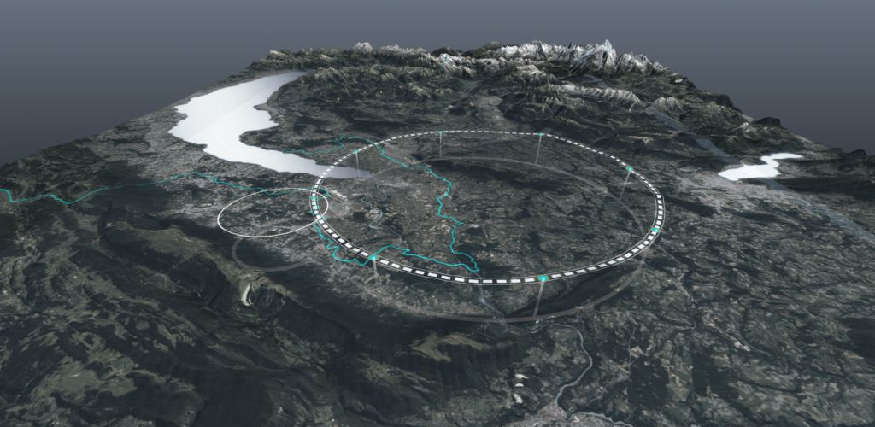
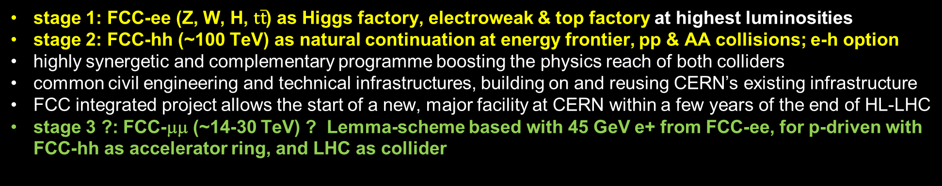
Future Circular Collider - long-term program maximizing physics opportunities
r
stage 1: FCC-ee (Z, W, H, $\text{t}\overline{\text{t}}$) as Higgs factory, electroweak & top factory at highest luminosities
stage 2: FCC-hh (~100 TeV) as natural continuation at energy frontier, pp & AA collisions; e-h option
highly synergetic and complementary programme boosting the physics reach of both colliders
common civil engineering and technical infrastructures, building on and reusing CERN’s existing infrastructure
FCC integrated project allows the start of a new, major facility at CERN within a few years of the end of HL-LHC
stage 3 ?: FCC-μμ (~14-30 TeV) ? Lemma-scheme based with 45 GeV e+ from FCC-ee, for p-driven with FCC-hh as accelerator ring, and LHC as collider
Documented in M. Benedikt, F. Zimmermann, M. Doser, S. Casalbuoni, 10.5281/zenodo.7675663

Slide 3

FCC-ee Main Machine Parameters
Parameter | Z | WW | H (ZH) | ttbar
beam energy [GeV] | 45.6 | 80 | 120 | 182.5
beam current [mA] | 1270 | 137 | 26.7 | 4.9
number bunches/beam | 11200 | 1780 | 440 | 60
bunch intensity [10¹¹] | 2.14 | 1.45 | 1.15 | 1.55
SR energy loss / turn [GeV] | 0.0394 | 0.374 | 1.89 | 10.4
total RF voltage 400/800 MHz [GV] | 0.120/0 | 1.0/0 | 2.1/0 | 2.1/9.4
long. damping time [turns] | 1158 | 215 | 64 | 18
horizontal beta* [m] | 0.11 | 0.2 | 0.24 | 1.0
vertical beta* [mm] | 0.7 | 1.0 | 1.0 | 1.6
horizontal geometric emittance [nm] | 0.71 | 2.17 | 0.71 | 1.59
vertical geom. emittance [pm] | 1.9 | 2.2 | 1.4 | 1.6
horizontal rms IP spot size [μm] | 9 | 21 | 13 | 40
vertical rms IP spot size [nm] | 36 | 47 | 40 | 51
beam-beam parameter ξ_{x} / ξ_{y} | 0.002/0.0973 | 0.013/0.128 | 0.010/0.088 | 0.073/0.134
rms bunch length with SR / BS [mm] | 5.6 / 15.5 | 3.5 / 5.4 | 3.4 / 4.7 | 1.8 / 2.2
luminosity per IP [10³⁴ cm⁻²s⁻¹] | 140 | 20 | ≥5.0 | 1.25
total integrated luminosity / IP / year [ab⁻¹/yr] | 17 | 2.4 | 0.6 | 0.15
beam lifetime rad Bhabha + BS [min] | 15 | 12 | 12 | 11
Design and parameters
dominated by the
choice to allow for
50 MW synchrotron
radiation per beam.
4 years
5 x 10¹² Z
LEP x 10⁵
2 years
> 10⁸ WW
LEP x 10⁴
3 years
2 x 10⁶ H
5 years
2 x 10⁶ tt pairs
x 10-50 improvements on all EW observables
up to x 10 improvement on Higgs coupling (model-indep.) measurements over HL-LHC
x10 Belle II statistics for b, c, τ
indirect discovery potential up to ~ 70 TeV
direct discovery potential for feebly-interacting particles over 5-100 GeV mass range
Up to 4 interaction points → robustness,
statistics, possibility of specialised detectors
to maximise physics output
F. Gianotti

Slide 4
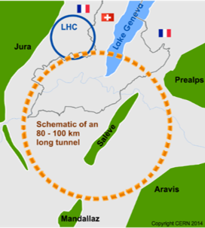
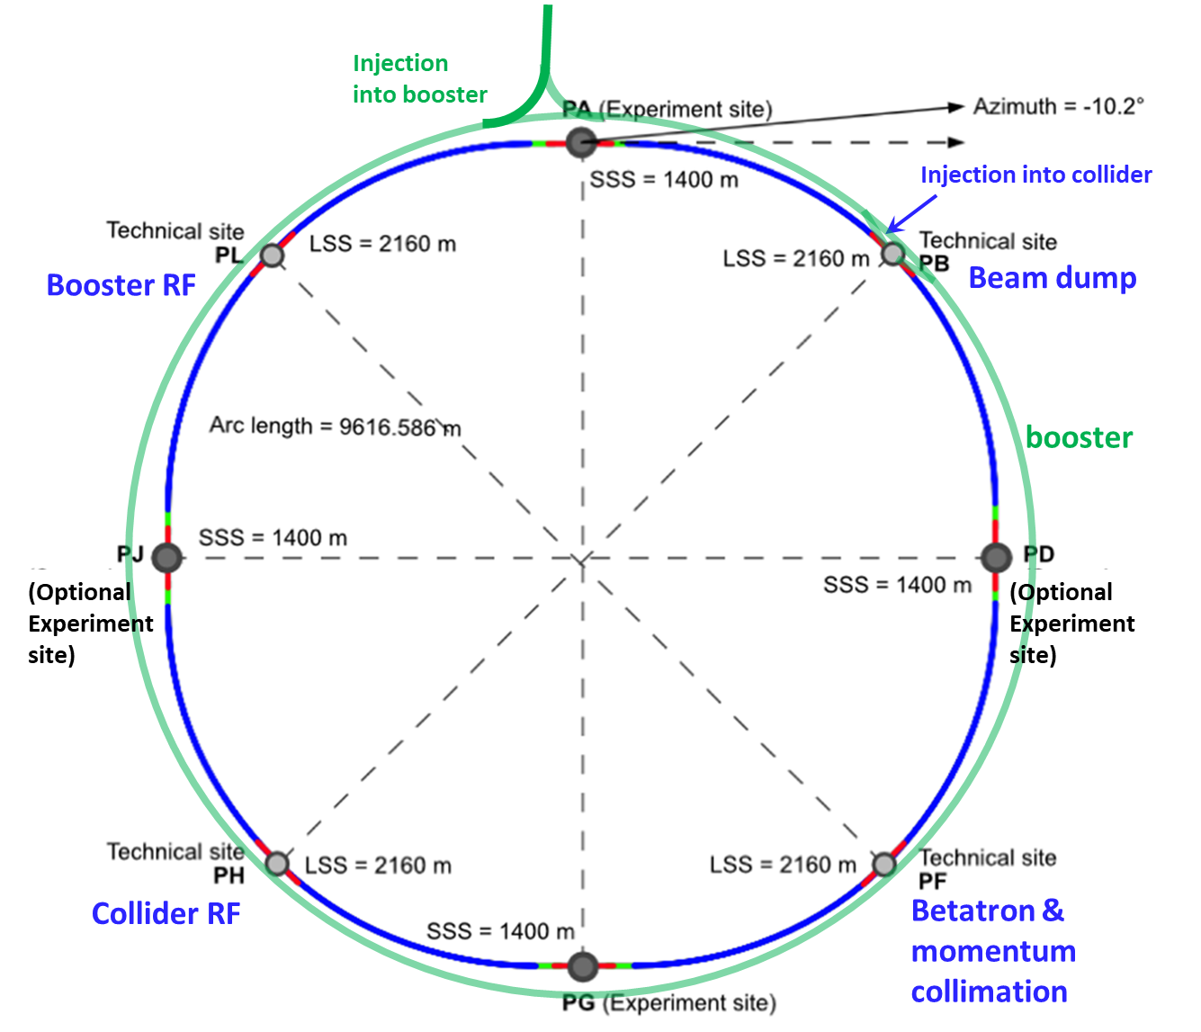
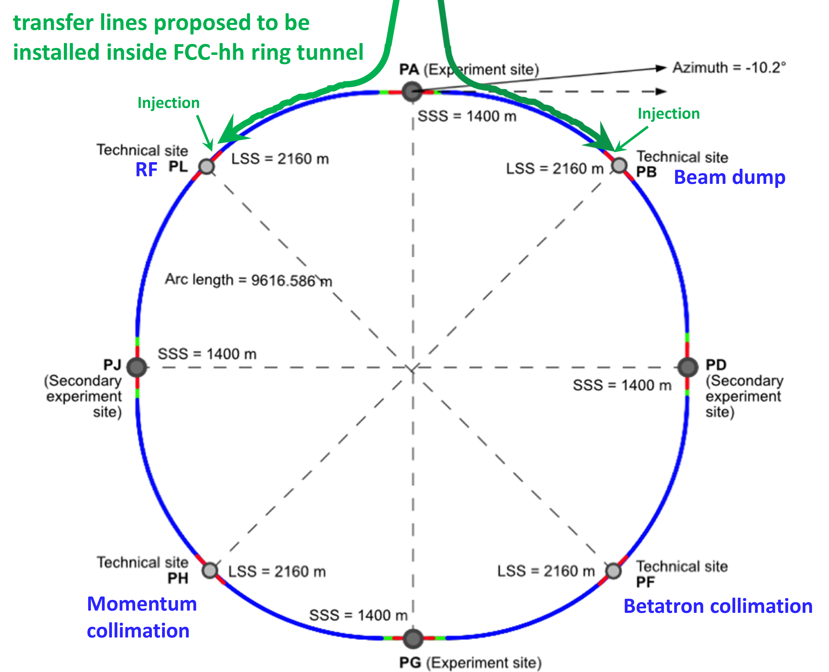

FCC-ee Integrated Programme & possible extension
FCC-ee
FCC-hh
2020 - 2046
2048 - 2063
2074 - 2099
FCC-μμ??
FCC-μμ not (yet) part of FCC baseline
various options !
2110-2200 ?

Slide 5
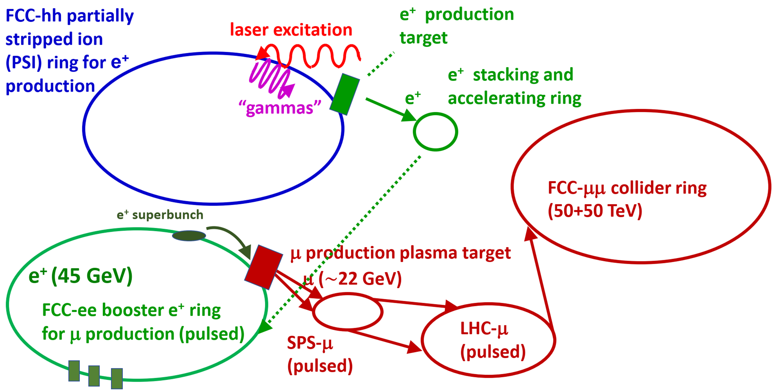
FCC based LEMMA-type muon collider
Farmer et al., Muon Collider based on Gamma Factory, FCC-ee and Plasma Target, IPAC’22
FCC-ee would already allow many important proof-of-principle tests, e.g. 45 GeV positrons extracted from the booster would be optimum for demonstration experiments and beam tests for the LEMMA low-emittance muon-beam production scheme. Various targets and accumulation schemes could be studied. The emittance of the generated muons could be characterized.

Slide 6
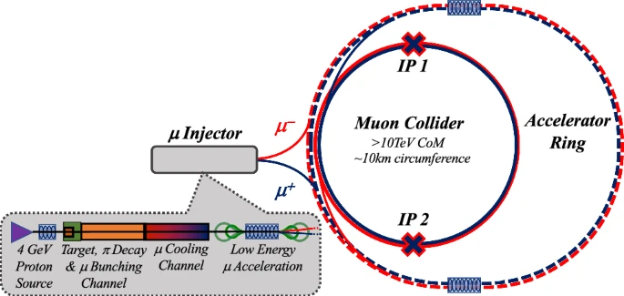
FCC as muon accelerator ring to feed muon collider in LHC tunnel
FCC-ee tunnel could
host muon accelerator
ring
LHC tunnel can host
~30 TeV CoM muon collider
C. Accettura et al.
EPJC, vol 83, 864 (2023)

Slide 7
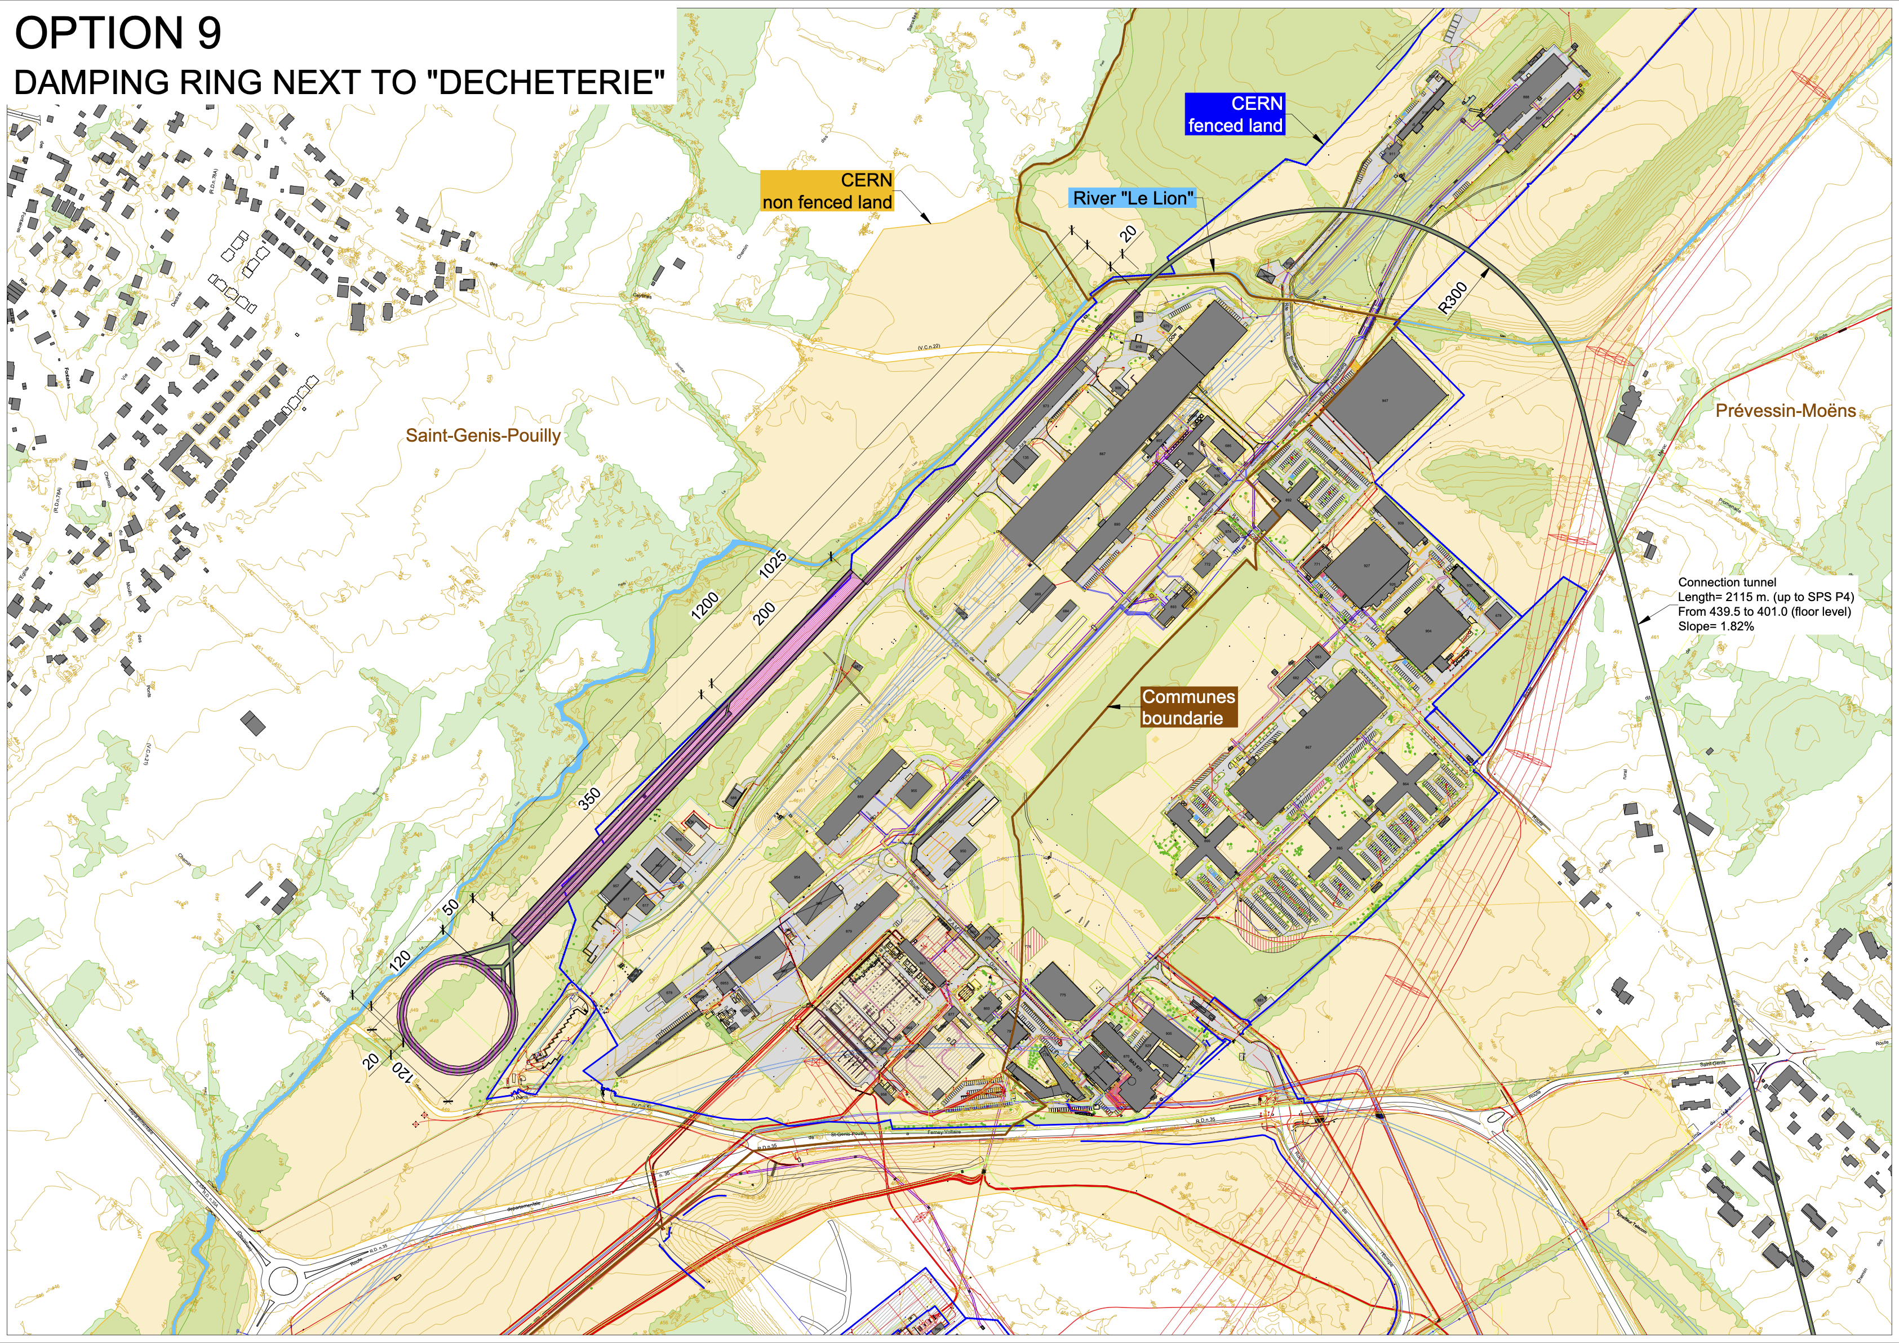
FCC-ee injector complex – offering many possibilities
Latest proposal: injector complex on the Prévessin site with damping ring next to the “decheterie”
High energy linac next to North Area and Beam Dump Facility
Connection tunnel (2.1 km) to reach BA4 of the SPS, for transfer to the booster
Injector complex up to 20 GeV (booster injection energy)
Electron linac up to 2.86 GeV
Positron target at 2.86 GeV and positron linac to reach again 2.86 GeV
Damping ring for both e+ and e- at 2.86 GeV
High energy linac to reach 20 GeV
H. Bartosik, T. Watson, P. Craievich

Slide 8
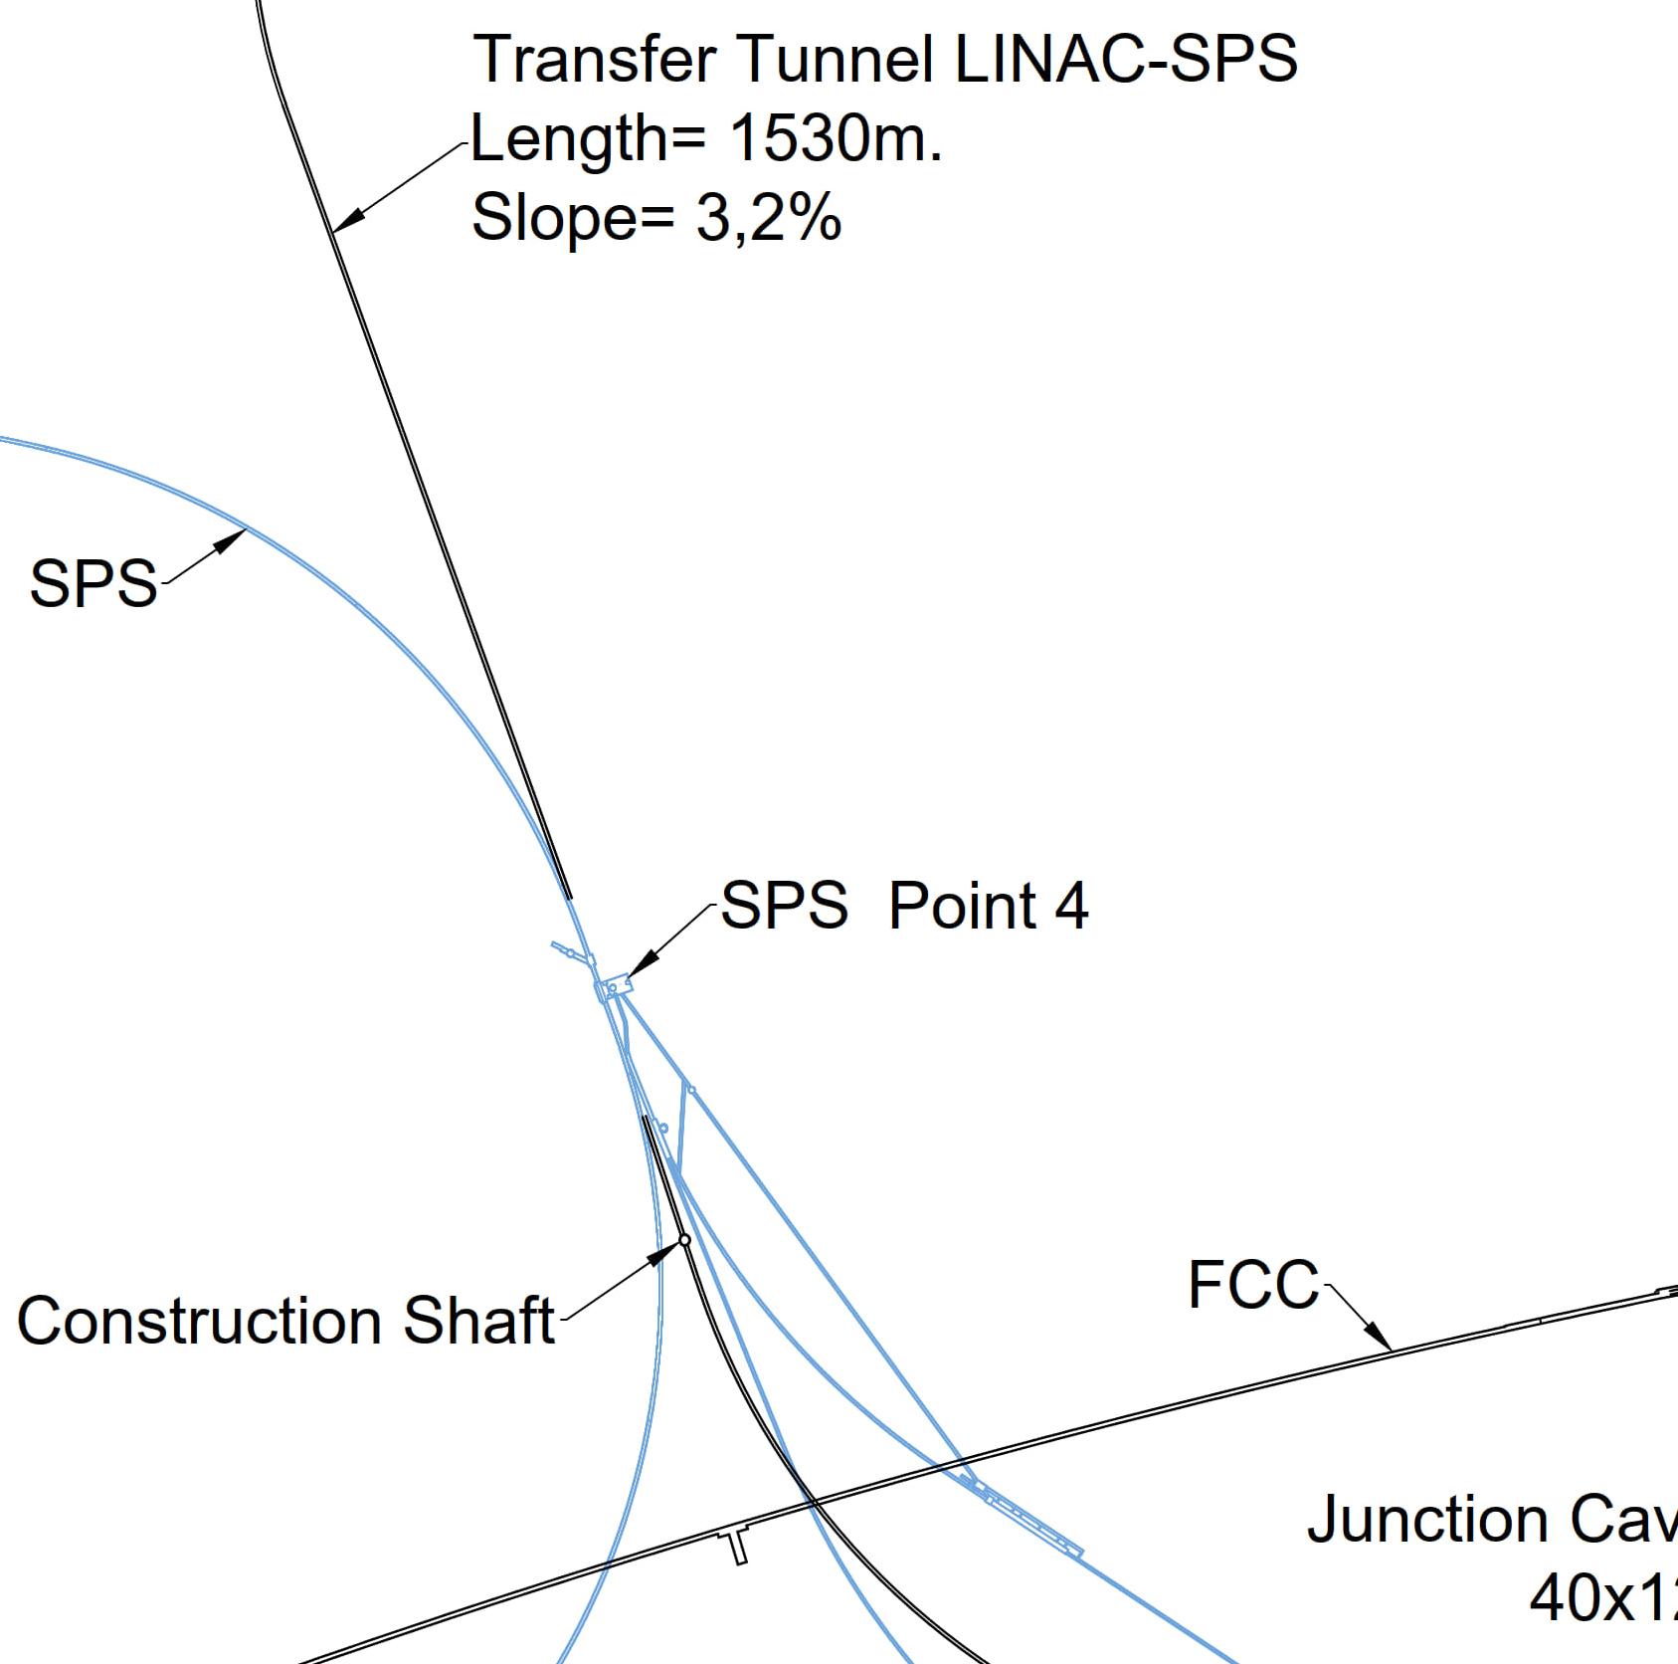
Other applications of FCC-ee injectors
H. Bartosik
FCC-ee injector beams (including also the damping ring) could be used for:
  R&D for accelerator components and beam diagnostics for FCC-ee or the injector itself
  Irradiation facility (e.g. for testing electronics components)
  Medical research
  Use synchrotron light from damping ring at 2.86 GeV to test coatings, photon desorption
  Plasma & nanotube/crystal wakefield acceleration test facilities
  X-ray photon source, e.g. with crystalline undulators
  Neutron source with e- beam from injector linac
FCC-ee injector complex of interest for AWAKE! FCC-ee beam line passes through SPS BA4, i.e. the SPS extraction point of protons for the plasma wakefield acceleration experiment AWAKE. Unique opportunity to perform proton driven plasma wakefield acceleration of 20 GeV electrons and positrons
  Lepton beam parameters fit extremely well
  Also electron driven plasma etc. wakefield acceleration experiments
  Unique possibility of positron acceleration
Proton beam line, experimental facility as well as lepton injection area and tunnel to the experiment exists. Would only require ~800 m transfer line for e+/e- in TT40/41 tunnel
M. Calviani
AWAKE

Slide 9
FCC-hh Main Machine Parameters
parameter | FCC-hh | HL-LHC | LHC
collision energy cms [TeV] | 84 - 120 | 14 | 14
dipole field [T] | 14 - 20 | 8.33 | 8.33
circumference [km] | 90.7 | 26.7 | 26.7
arc length [km] | 76.9 | 22.5
beam current [A] | 0.5 | 1.1 | 0.58
bunch intensity [10¹¹] | 1 | 2.2 | 1.15
bunch spacing [ns] | 25 | 25 | 25
synchr. rad. power / ring [kW] | 1100 - 4570 | 7.3 | 3.6
SR power / length [W/m/ap.] | 14 - 58 | 0.33 | 0.17
long. emit. damping time [h] | 0.77 – 0.26 | 12.9 | 12.9
peak luminosity [10³⁴ cm⁻²s⁻¹] | ~30 | 5 (lev.) | 1
events/bunch crossing | ~1000 | 132 | 27
stored energy/beam [GJ] | 6.3 – 9.2 | 0.7 | 0.36
Integrated luminosity/main IP [fb⁻¹] | 20000 | 3000 | 300
With FCC-hh after FCC-ee: significantly
more time for high-field magnet R&D
aiming at highest possible energies
Formidable challenges:
high-field superconducting magnets: 14 - 20 T
power load in arcs from synchrotron radiation: 4 MW → cryogenics, vacuum
stored beam energy: ~ 9 GJ → machine protection
pile-up in the detectors: ~1000 events/xing
energy consumption: 4 TWh/year → R&D on cryo, HTS, beam current, …
Formidable physics reach, including:
Direct discovery potential up to ~ 40 TeV
Measurement of Higgs self to ~ 5% and ttH to ~ 1%
High-precision and model-indep (with FCC-ee input)
measurements of rare Higgs decays (𝛄𝛄, Z𝛄, µµ)
Final word about WIMP dark matter
F. Gianotti

Slide 10
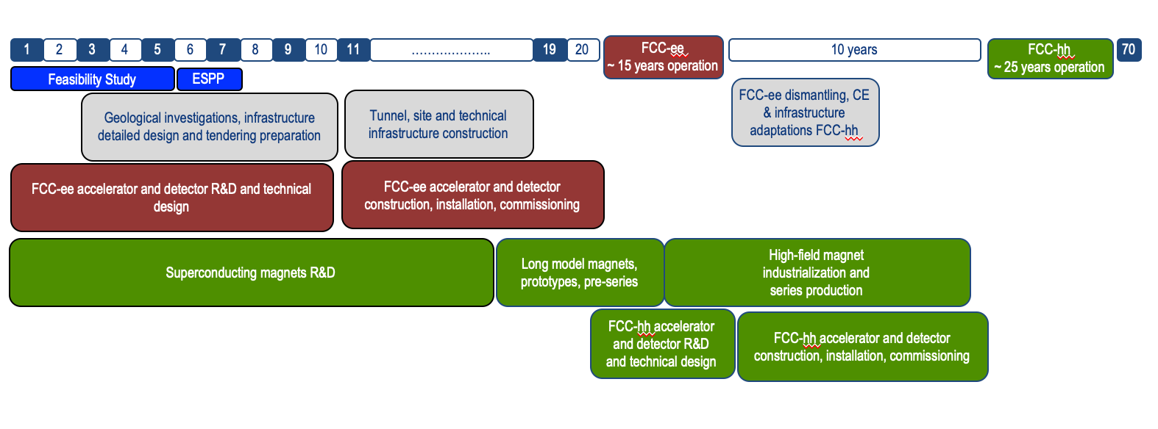
FCC integrated program – “accelerated” schedule
FCC Conceptual Design Study started in 2014 leading to CDR in 2018
2021- 25:
Feasibility Study
2027/2028:
Project Approval by CERN Council
2032:
Start of construction
2041:
HL-LHC ends
2045:
Operation of FCC-ee
2070:
Operation of FCC-hh
“Realistic” schedule taking into account:
past experience in building colliders at CERN
approval timeline: ESPP, Council decision
that HL-LHC will run until 2041
Can be further accelerated if more resources become available

Slide 11




Timeline till start of construction
2024
2025
2026
2027
2028
2029
2030
2031
2032
2033
Feasibility Study
Pre-TDR Phase
TDR Phase
Construction →→→
FS Report
cost update
ESPPU
2025/26
pre TDR
cost update
TDR
cost update
Project
Decision
accelerator design, technical infrastructure design, R&D, towards TDR
engineering design →
Environmental Impact study & Authorization Process
Phase 1 Site Investigations
Phase 2 Site Investigations
CE Concept Design update
CE Tender Design
Construction Design
Start construction
Detector EOI submissions
FC³ formation, call for CDRs
Detector CDRs submitted to FC³

Slide 12
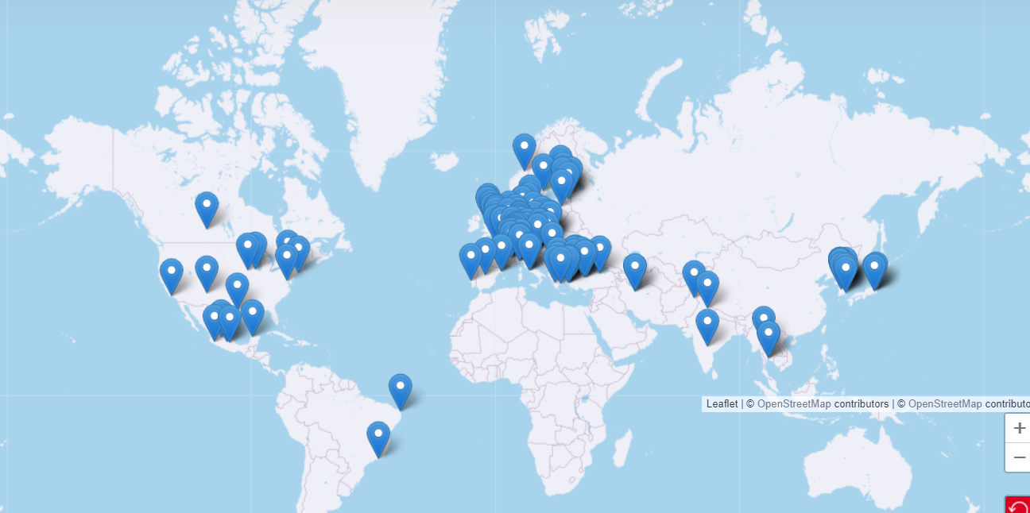


Status of FCC global collaboration
Increasing international collaboration as a prerequisite for success:
→links with science, research & development and high-tech industry will be essential to further advance and prepare the implementation of FCC
141 Institutes
32 countries
+
CERN
FCC Feasibility Study:
Aim is to further increase the collaboration,
on all aspects, in particular on
Accelerator and Particle/Experiments/Detectors

Slide 13

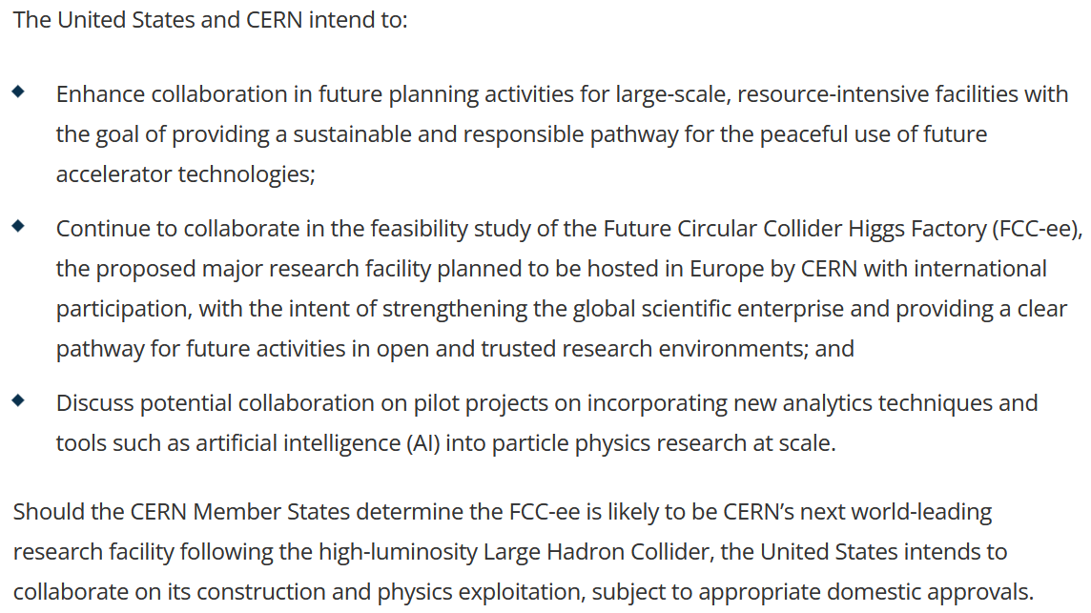
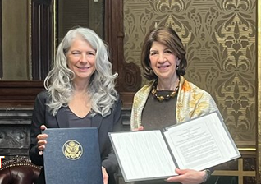
Progress on international collaboration
26 April 2024
White House Office of Science and Technology Policy Principal Deputy U.S. Chief Technology Officer Deirdre Mulligan signed for the United States while Director-General Fabiola Gianotti signed for CERN.

Slide 14
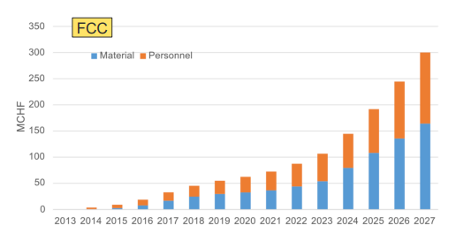
Recent decisions by CERN Council
February 2024: special Council meeting: successful Mid-Term Review; all objectives met, lots of praise & positive feedback, recommendations & guidance
March 2024: ESPPU schedule 2025/2026 approved with input by March 2025, conclusions mid 2026; compatible with “accelerated” FCC schedule
June 2024: approval of modified CERN Medium Term Plan (MTP), including more resources for FCC-FS completion and for FCC pre-TDR phase
Additional expenses in June 2024 MTP to prepare for CERN’s future
Future Circular Collider (FCC)
Additional resources for the Feasibility Study → 13 MCHF (until March 2025, when final report will be submitted)
Funding for “pre-TDR phase” → 82 MCHF (April 2025-end 2027)
Superconducting radiofrequency technology (SRF)
Ramp up R&D for future accelerators (until now 2.3 MCHF/year) → 9.7 MCHF (2025-2027)
cumulative FCC funding up to
end pre-TDR phase
w/o HFM & SRF

Slide 15
Crystal Applications for FCC
crystal-based positron production
  - for FCC-ee (and FCC-μμ) and other e⁺ science applications
crystalline undulators
  - for FCC-ee
crystal collimation
  for FCC-ee and FCC-hh
crystal extraction
  - for FCC-hh
crystal steering
  - for FCC-μμ

Slide 16
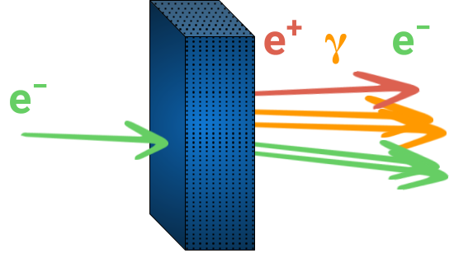
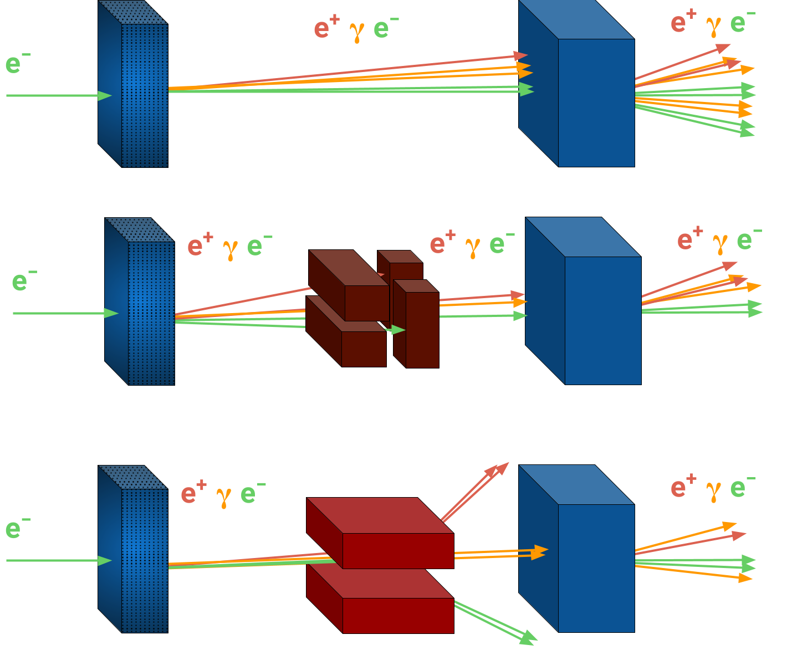
Crystal-based positron production
Iryna Chaikovska
Originally proposed by R. Chehab, A. Variola, V. Strakhovenko and X. Artru
R. Chehab et al., in Proc. of the 1989 IEEE Particle Accelerator Conf., 1989, pp. 283–285
lattice coherent effects in oriented crystals : channeling and over barrier motion
→ typical angular range ∼a few mrad at 6 GeV for <111> axis in W
oriented crystalline
target
Novel production scheme for positron sources
Enhancement of photon generation in oriented crystals → enhanced pair production / e+ charge
Lower energy deposition and PEDD in target
→ lower heating and thermo-mechanical stress
Towards a crystal-based positron source for FCC-ee
L. Bandiera et al., Eur. Phys. J. C (2022) 82:699
→ talks by F. Alharthi, A. Sytov, and G. Paterno

Slide 17
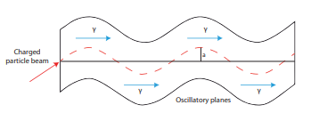
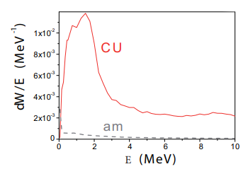
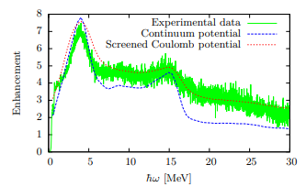
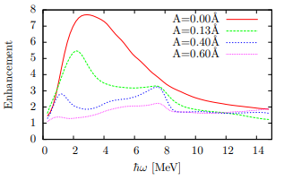
Crystalline undulators
Simulated radiation emission probability for a 10-GeV positron beam interacting with sample 1 (solid line) and the Bethe-Heitler amorphous emission probability for a Si sample of the same thickness (dashed line). The radiation collimation half-angle is 0.5/γ, γ being the Lorentz factor.
Schematic of a Crystalline Undulator (CU). The red dashed line represents the channeled trajectory. The bending amplitude a refers to the deformation of the oscillatory planes.
Riccardo Camattari, Laura Bandiera,Viktor Tikhomirov et al., Phys. Rev. Accel. Beams 22, 044701 (2019)
W. G. A.V. Korol, A.V. Solov’yov, Channeling and Radiation in Periodically Bent Crystals (Springer, 2013)
V. Baryshevsky and V. Tikhomirov, Nucl. Instr. Meth. B 30 (2013)
A. Kostyuk, Phys. Rev. Lett. 110, 115503 (2013)
A. Kostyuk, Nucl. Inst Meth. B 410 (2017) 215-221
Comparison of theoretical and experimental radiation yield for a 855 MeV beam and a=0.12 Å
Calculated radiation spectra for different a at 600 MeV e- energy and screened Coulomb potential.
Tobias N. Wistisen et al., Phys. Rev. Lett. 112, 254801 (2014)

Slide 18
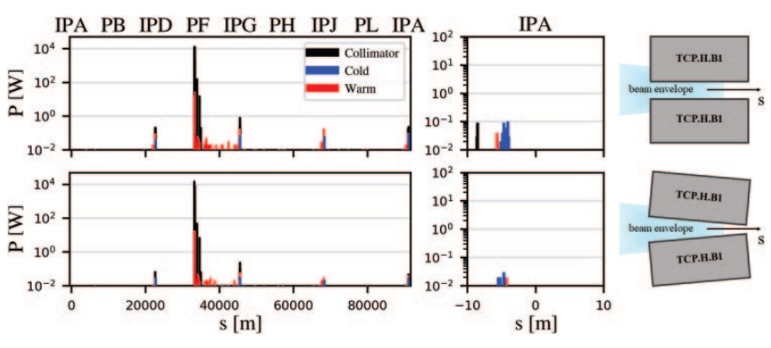
Crystal collimation for FCC-ee
FCC-ee machine protection and collimation challenge
Possible scheme: bent crystal-assisted collimation
G,. Broggi,
IL NUOVO CIMENTO
47 C (2024) 273
Loss maps showing the power load distributions without any crystals in the FCC-ee (Z mode) for the case with the horizontal TCP parallel to the closed orbit (top) and parallel to beam envelope (bottom). The figure also shows the power load distributions around the most exposed interaction point, IPA.
→ talk by G. Broggi

Slide 19
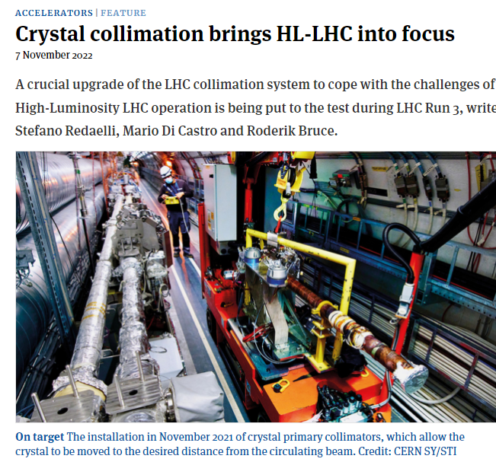
Crystal collimation for FCC-hh
CERN Courier 62, 6 (2022)
FCC-hh machine protection and collimation challenge
Directly learn from (HL-)LHC experience !
→ talk by D. Mirarchi

Slide 20
Crystal based fixed-target experiment
two bent crystals (double-crystal setup)
a first crystal deflects beam-halo particles onto an in-vacuum target
2. a 2nd crystal deflects short-lived particles created in the target, thus inducing spin precession
set up is sensitive to electric & magnetic dipole moments of these short-lived particles
→ proof-of-principle experiment at the LHC in 2025,
later deployment at the FCC-hh ?
D. Chen et al., First observation of magnetic moment precession of channeled particles in bent crystals, Phys. Rev. Lett. 69, 3286 (1992)
→ talk by S. Redaelli
Status and prospects for the Mu2e experiment at Fermilab
→ talk by S. Miscetti

Slide 21
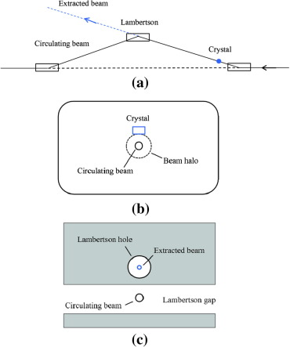
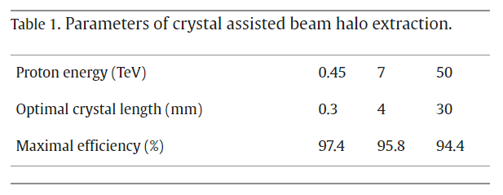
Crystal extraction for FCC-hh
Possible scheme of beam halo extraction from the FCC with a bent crystal.
(a) The horizontal dogleg with a bent crystal upstream the Lambertson septum.
(b) The cross-sectional view at the position of the crystal. A vertical beam halo intercepts crystal.
(c) The cross-sectional view in the Lambertson septum.
Similar to earlier scheme proposed for the SSC.
“Extraction of a natural beam halo from a collider of 50 TeV protons using a bent crystal is possible and may be efficient if a precise goniometer with the angular accuracy of 0.1 μrad can be realized.”
A.D. Kovalenko, W. Scandale, A.M. Taratin, Bent crystal extraction from a 100 TeV proton collider, Nucl. Instrum. Meth. Phys. Res., B 355 (2015) 390-394

Slide 22


Crystal extraction with resonance islands
I am curious to learn about this method
→ talk by D. Veres
Crystal assisted μ steering
using silicon and germanium bent crystals for steering high-energy muons
assessment and optimization of crystal-deflection efficiency
→ talk by M. Romagnoni

Slide 23
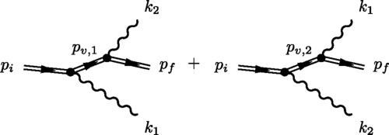
Strong field QED in crystals
Strong crystalline field + ultrarelativistic electrons
→ Schwinger field in the electron rest frame
example: sending 180 GeV electrons
(available at FCC-ee !) through a thin silicon crystal
easier to observe “one-step” contribution (where two photons are emitted “simultaneously”) in a crystal experiment than in a laser experiment
Feynman diagrams, where the double fermion lines correspond to positron solutions of the Dirac equation in the background field of the interplanar crystal potential.
Tobias N. Wistisen
Phys. Rev. D 100, 03600 (2019)

Slide 24
Other FCC(-ee) Science
14 May 2013 brainstorming meeting on LHC as a light source organized by Herman Winick of SLAC. Followed by discussion on HE-LHC, VHE-LHC (FCC-hh) & TLEP (FCC-ee) as light sources.
Brainstorming in July 2020 on R1 outside terrasse (covid!): Michael Benedikt, Sara Casalbuoni (EU-XFEL, remote), Michael Doser, Frank Zimmermann; identified 7 exciting applications. 10.5281/zenodo.7675663
«Other FCC Science» Initiative (also in view of ESU), kick off brainstorm 23 August 2024. https://indico.cern.ch/event/1442918/

Slide 25
FCC-ee booster as Diffraction Limited Storage Ring
With respect to PETRA IV, planned diffraction limited storage ring with smallest emittance, the FCC-ee booster has the potential to produce
  a fraction of coherent X-rays larger by one order of magnitude at 50-100 keV
  an average brilliance larger by up to two orders of magnitude at 50-100 keV
  a peak brilliance larger by up to four orders of magnitudes
high average brilliance flux hungry experiments
high peak brilliance time resolved experiments
S. Casalbuoni

Slide 26
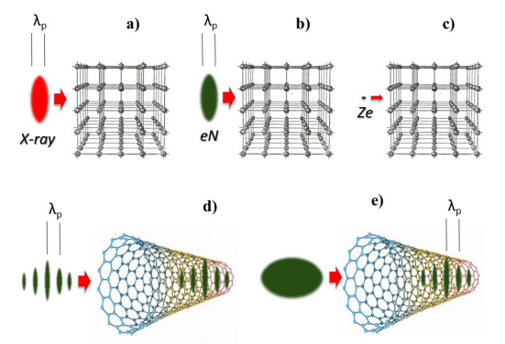
Acceleration in crystals
V.Shiltsev, Ultimate colliders for particle physics: Limits and possibilities, International Journal of Modern Physics A, 34, 1943002 (2019).
Possible ways to excite plasma wakefields in crystals or/and nanostructures: a) by short X-ray laser pulses; b) by short high-density bunches of charged particles; c) by heavy high-𝑍 ions; d) by modulated high current beams; e) by longer bunches experiencing self-modulation instability in the media.
Max F. Gilljohann, .. L. Bandiera, et al., Channeling Acceleration in Crystals and Nanostructures and Studies of Solid Plasmas: New Opportunities, arXiv 2203.07459 (2024)
Also see: Radiation pressure driven collisionless shock ion acceleration at BNL
→ talk by G. Casati

Slide 27

Working Groups & next steps for Other FCC Science
photon science (light source, CBS, crystalline undulators? )
- S. Casalbuoni, F. Zimmermann, +
HEP applications (QED, dark sector, strong field QED in crystals)
- G. Arduini + ?
e⁺ applications (surface science, Ps BEC, 511 keV X-ray laser )
- B. Rienäcker, M. Doser
neutron science (based on e⁻ linac) & radionuclide production
(based on the beamstrahlung photons)
- M. Calviani – tbc
accelerator R&D (plasma acceleration, e.g. of e⁺, muon collider, acceleration of e⁻ and e⁺ in solid targets…)
- F. Zimmermann, ? +
can crystals/channeling play a role?
can crystals/channeling play a role?
in person status & wrap-up meeting at CERN, 28+29 Nov. 2024
https://indico.cern.ch/event/1454873

Slide 28
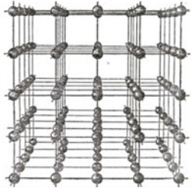
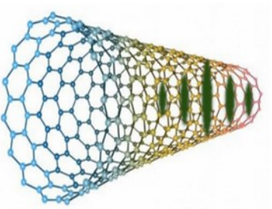



Suppression of synchrotron radiation in crystals
Synchrotron radiation emission is suppressed at wavelengths larger than
with d signifying the pipe diameter (Warnock, SLAC-PUB-5375, 1990).
Therefore, miniature accelerators with extremely small beam pipe on the micron or nanometre scale, combined with a large bending radius ρ [FCC tunnel!] could suppress almost all radiation. An extreme case would be the use of nanotubes or bent-crystals,
where d becomes comparable to the inter-atom distance in the crystal lattice.
$$λ_{sh}=2\sqrt{{d^{3}}/ρ}$$
$$d\sim 1 Å$$
$$d\sim 10 Å$$
pictures from
Ariniello et al., arXiv 2203.07459, 2022

Slide 29
Future circular crystal pp collider ?
circular crystal (or nanotube) storage ring?
cryogenic
crystal
bending
stage
cryogenic
crystal
bending
stage
bending fields of
~1000’s of Tesla
proton beam
10 PeV pp collider (100x FCC-hh)
energy ramp using induction acceleration

Slide 30
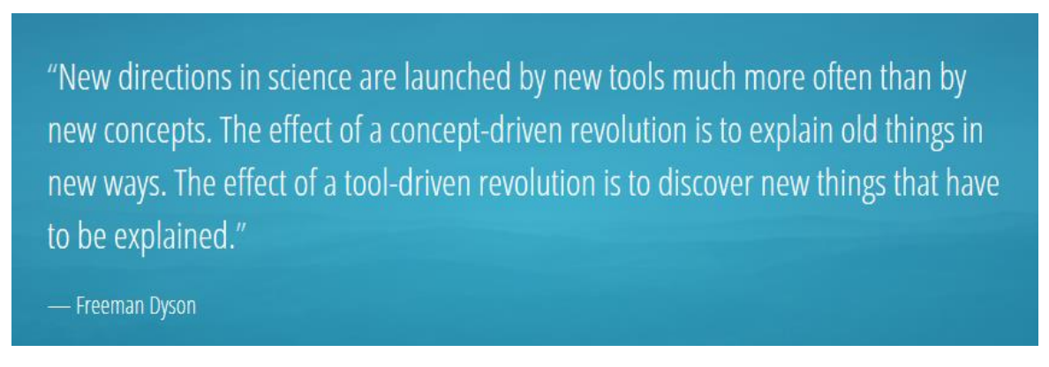
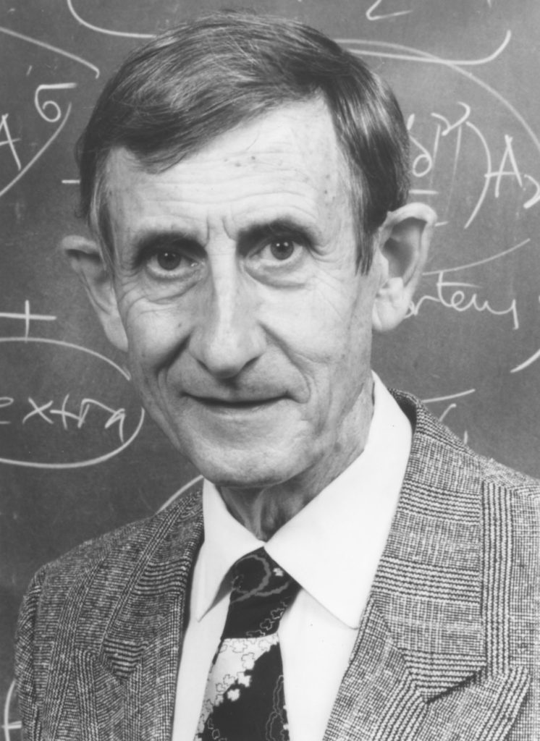
Tool-driven revolutions
S. Pascarelli

