Slide 1
Institute of Applied Problems of Physics (IAPP)
Thermodynamic parameters of the electron gas in CdSe nanoplatelets
H.T. Ghaltaghchyan, L.A. Tadevosyan, Y.S. Mamasakhlisov, H.A. Sarkisyan
Riccione 2024

Slide 2
Outline:
Nanoplatelets
Dimensional quantization
Thermodynamics features
Bolztmann statistics
FD statistics
Conclusions

Slide 3
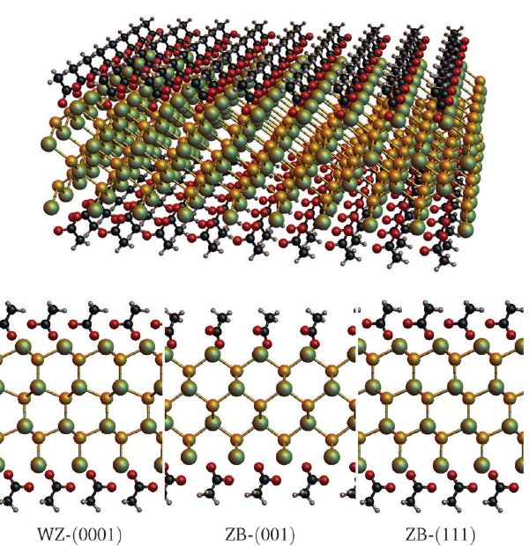
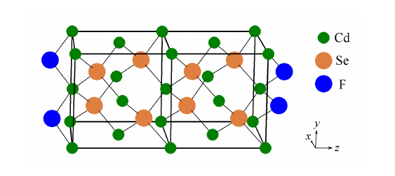
CdSe nanoplatelets

Slide 4
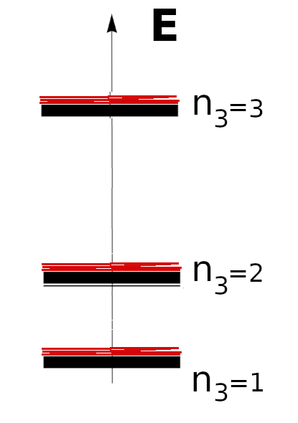
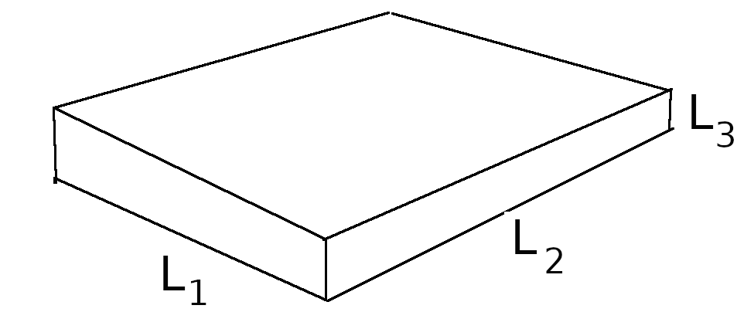
One-electron energy spectrum: 2D system

Slide 5
Ideal electronic gas: Boltzmann statistics

Slide 6
Heat capacity

Slide 7
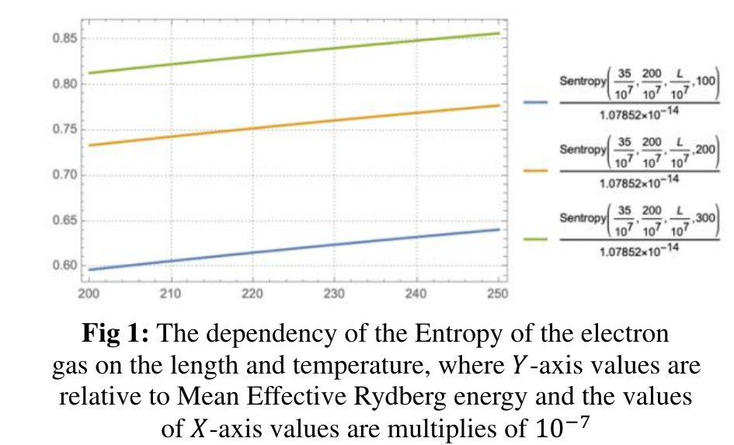
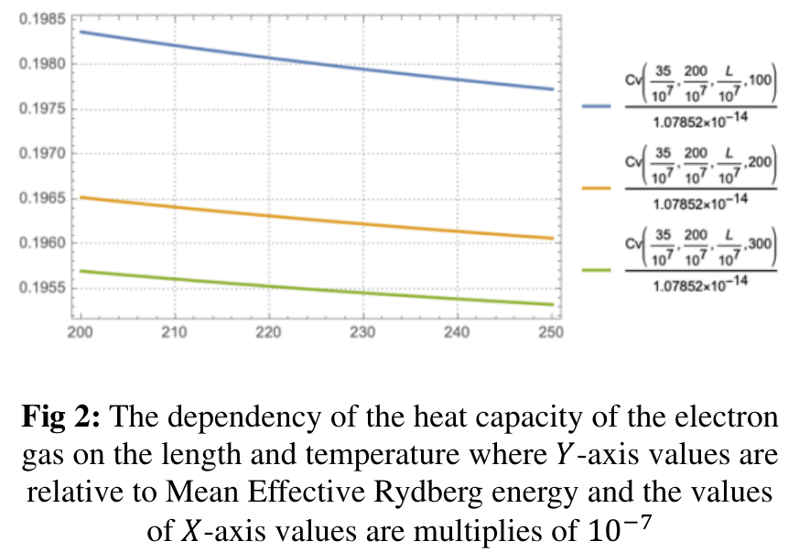
Thermodynamic characteristics

Slide 8
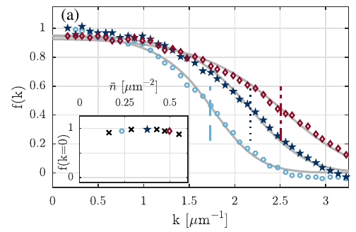
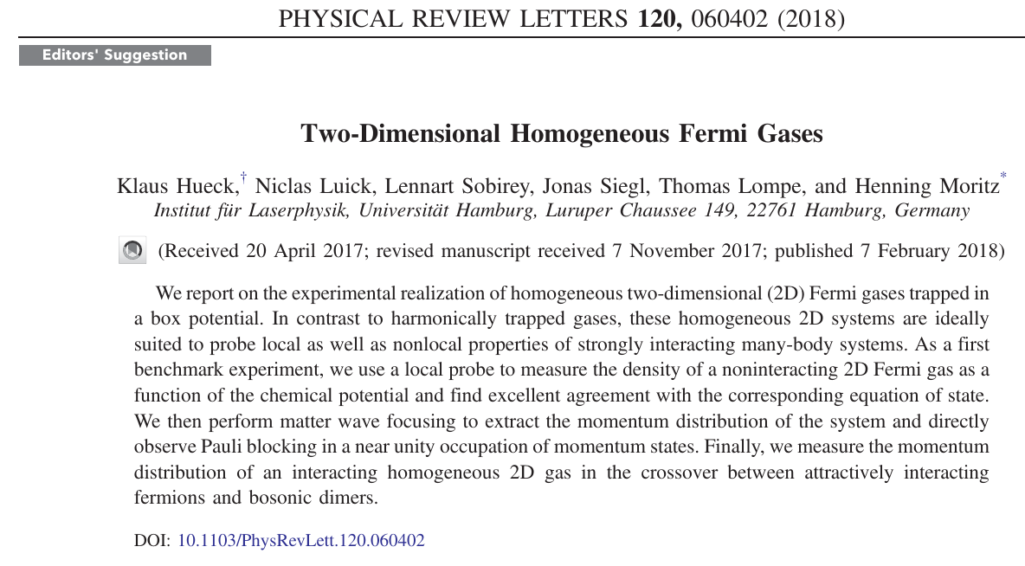
2D Ideal Fermi – gas: experimental

Slide 9
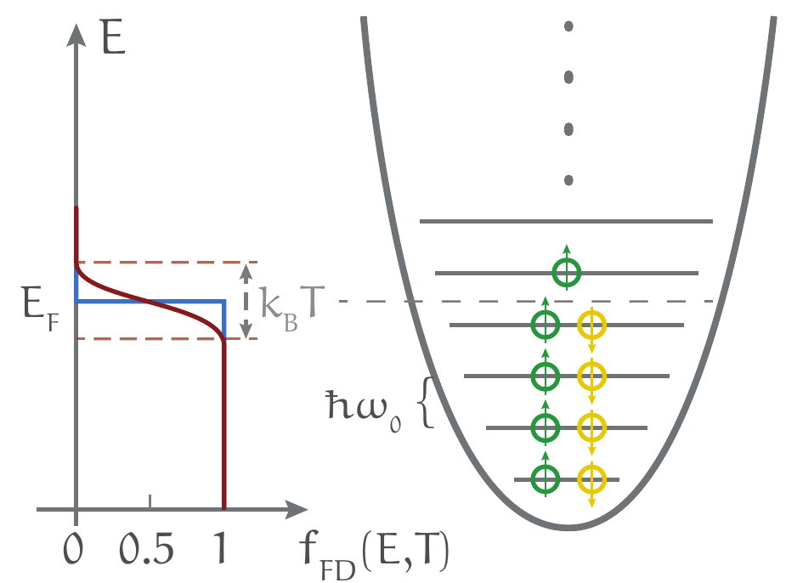
2D Ideal Fermi – gas (in NPL)

Slide 10
2D (Homogeneous)Fermi – gas: DOS

Slide 11
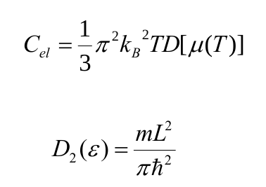
Heat capacity: FD vs. Boltzmann

Slide 12
Conclusions:
The electronic heat capacity of the CdSe NPL decreases with the linear size of NPL in
the high–temperature (Boltzmann) limit because of decreased inter-level distances
The electronic heat capacity of the CdSe NPL decreases with temperature in
the high–temperature (Boltzmann) limit because of localization of energetic levels in the
vicinity of n3=1
The electronic heat capacity exhibits the usual linear temperature behaviour in the
low-temperature (Fermi-Dirac) limit

Slide 13
THANK YOU FOR ATTENTION

