Slide 1

Institute of Applied Problems of Physics (IAPP)
Few-particle intraband dipole transitions in strongly oblate asymmetric ellipsoid QD
Yevgeni Mamasakhlisov
In collaboration with Aram Nahapetyan, Mher Mkrtchyan, Hayk Sarkisyan
Riccione 2024

Slide 2
Outline:
Ion – channeling and QDs
QD and one – particle problem
Few – particle problem and Moshinsky model
Kohn’s theorem and QD
The effect of external electric field
Results

Slide 3
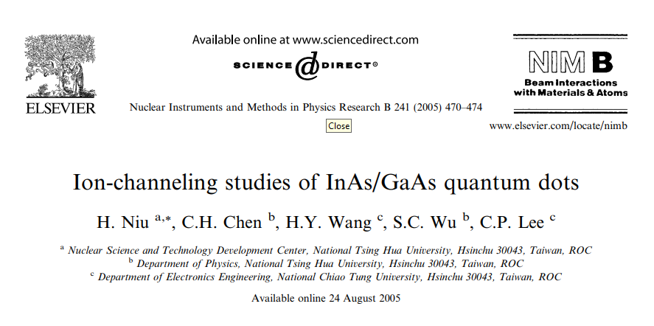
Channeling through QDs

Slide 4
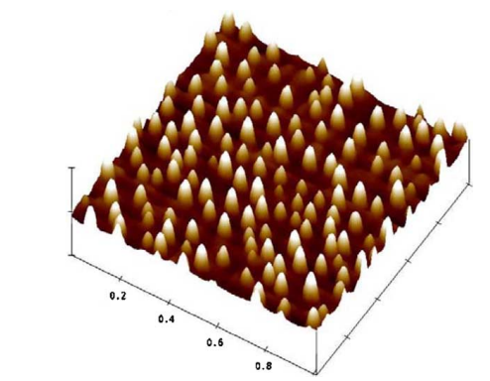
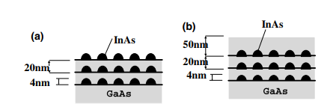
Channeling through QDs
Atomic force microscope (AFM) photograph of the uncapped sample Schematic view of (a) the uncapped and (b) the capped QDs samples
RBS/w channeling measurement was performed with 4 MeV ¹²C²⁺ beam provided by the 9SDH-2 Tandem accelerator. The obtained results show the existence of strains in and around the synthesized QDs.

Slide 5
Ellipsoidal Quantum Dot
Z
O
Y
X

Slide 6
One particle problem

Slide 7
One particle problem

Slide 8
One particle problem: 2D Schrodinger equation

Slide 9
One particle Wave function and Energy Spectrum

Slide 10
Few particle problem

Slide 11
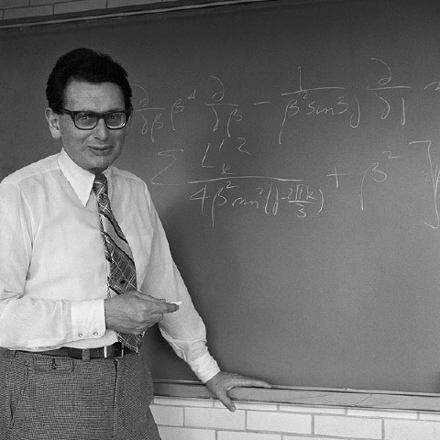
Marcos Moshinsky (1921-2009)

Slide 12
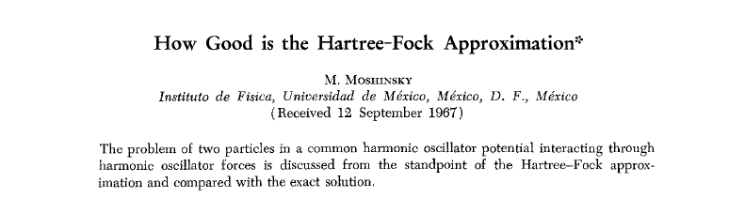




Moshinsky Atom

Slide 13
Moshinsky Model

Slide 14
Two Schrodinger equations along the axes OX and OY

Slide 15
Transition to new variables and dimensionless Schrodinger equations for X and Y

Slide 16
Jacobi coordinates and Schrodinger equations

Slide 17
System energy spectrum and wave functions

Slide 18
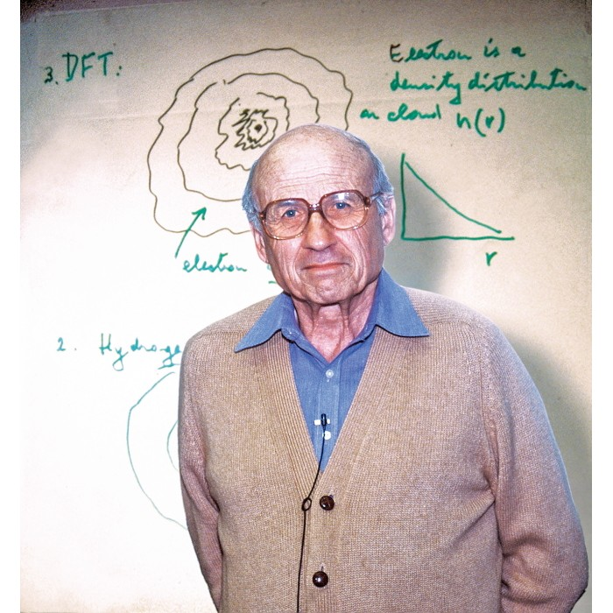
Walter Kohn (1923-2016)
Generalized Kohn theorem: The frequency of resonant absorption of long-wave radiation from a pair-interacting electron gas localized in a parabolic QD doesn't depend on the number of particles. In other words, single-particle transitions are realized in a multiparticle system.

Slide 19
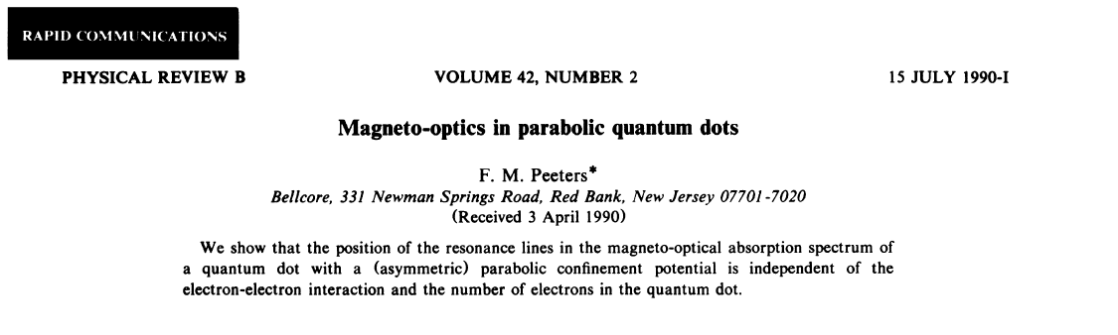
Kohn’s theorem in the case of asymmetric parabolic QD

Slide 20
Hamiltonian for N noninteracting electrons in an asymmetric QD, its diagonalization and energy spectrum

Slide 21
Hamiltonian of the interacting system, electron-electron interaction
and commutation relations

Slide 22
System in an electric field, commutation relation

Slide 23
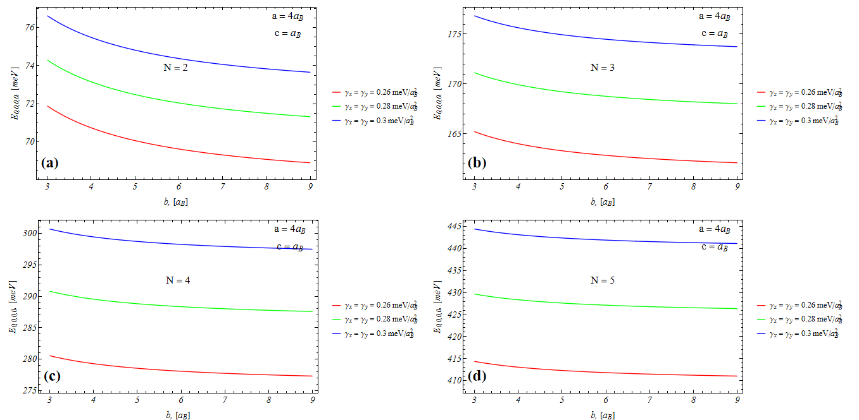
Obtained results
.
Electron gas total energy dependency from QD semiaxis b for different interaction parameter

Slide 24
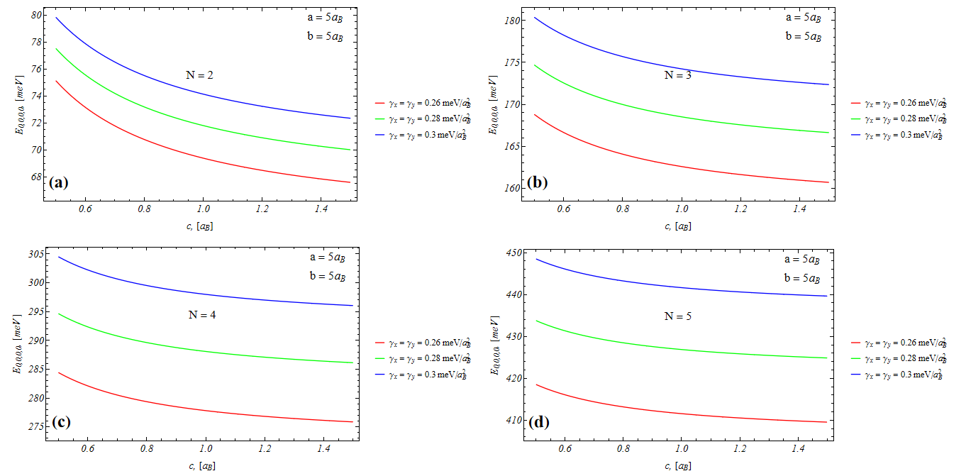
Obtained results
Electron gas total energy dependency from QD semiaxis c for different interaction parameter

Slide 25
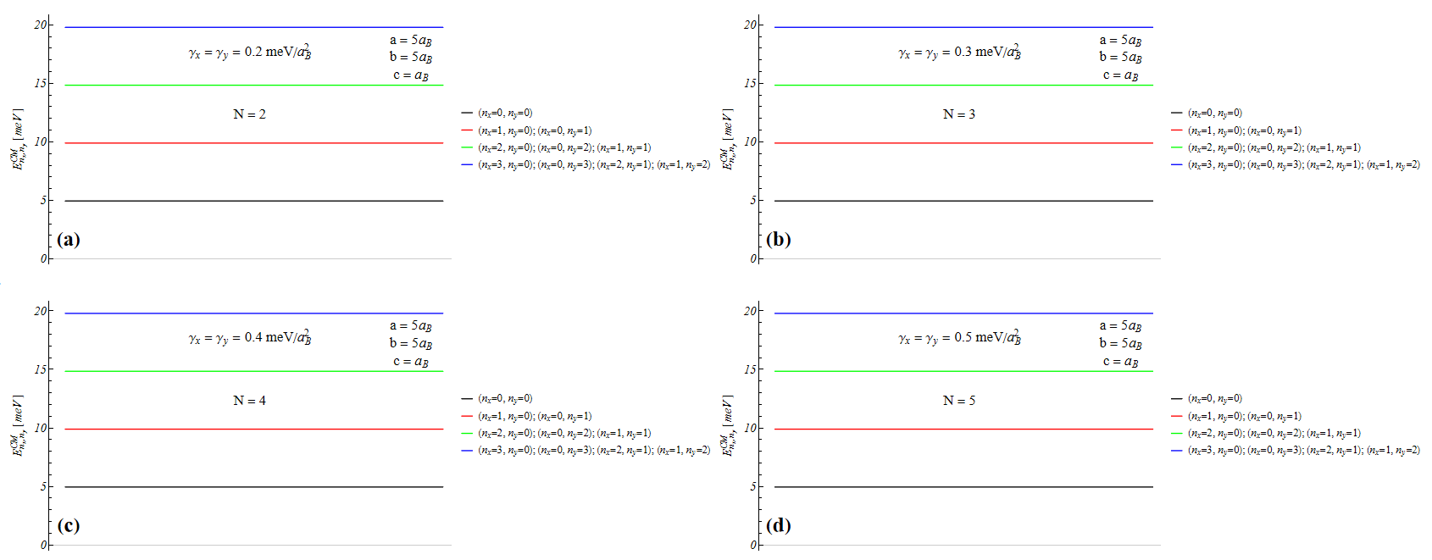
Obtained results
Electron gas center of mass energy diagram

Slide 26
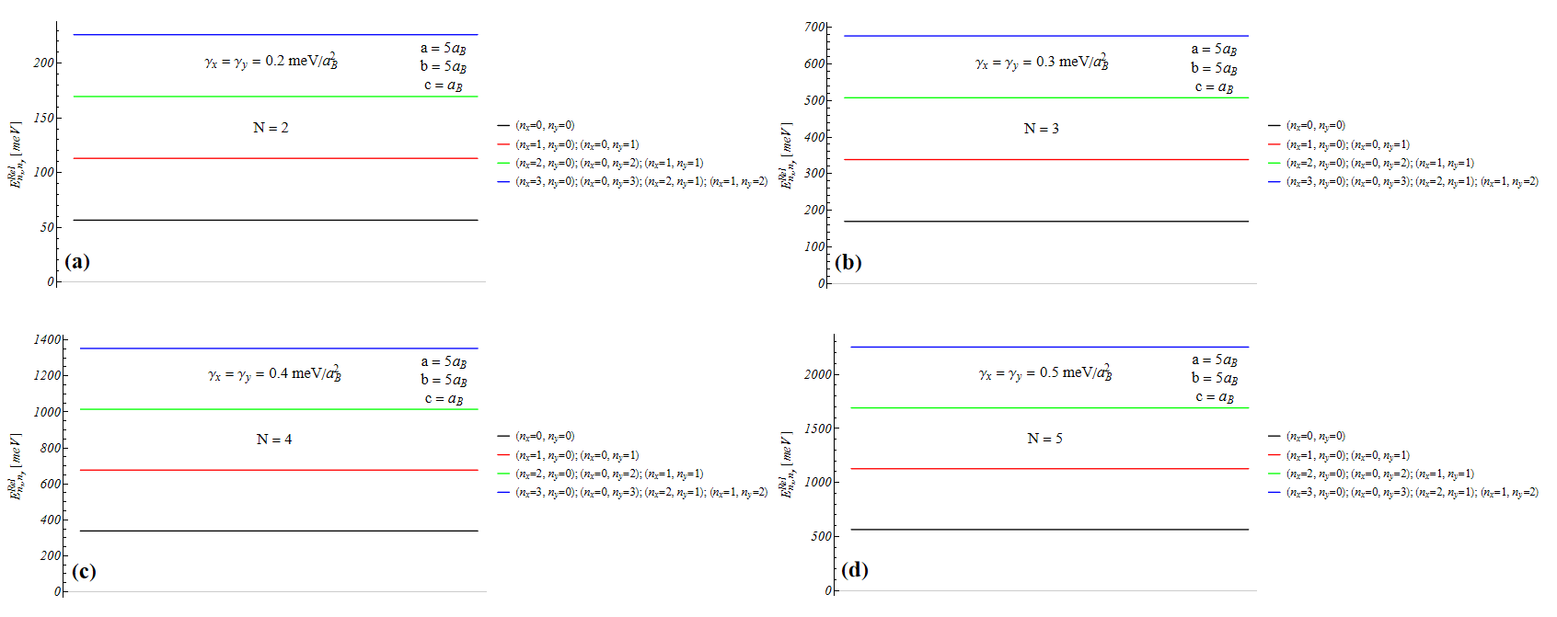
Obtained results
Electron gas relative energy diagram

Slide 27
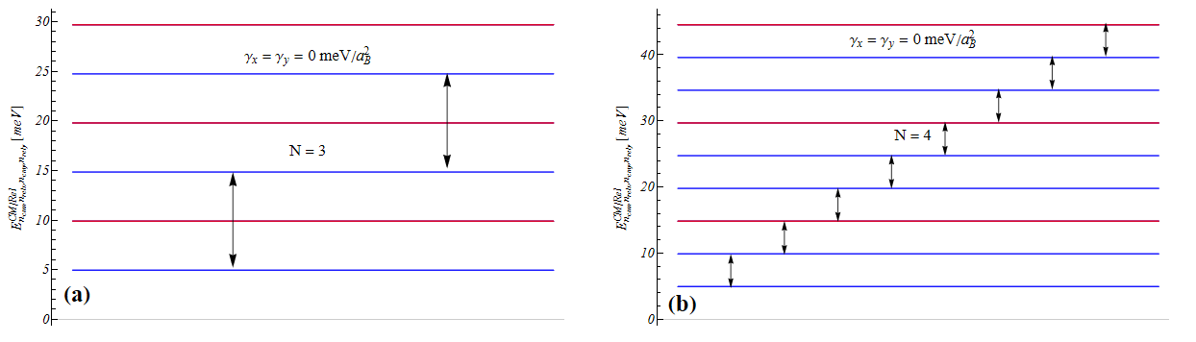
Obtained results
Electron gas total energy diagram

Slide 28
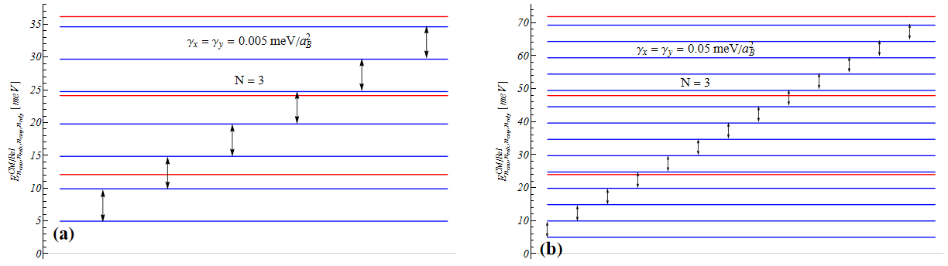
Obtained results
Electron gas total energy diagram

Slide 29
Main Results:
1. In the case of a strongly oblate asymmetric ellipsoidal quantum dot, the confining potential of the slow subsystem is described within the framework of a two-dimensional asymmetric parabolic well.
2. In the quantum dot under consideration, for the case of a pair-interacting electron gas, the conditions for fulfilling the generalized Kohn theorem are realized.
3. The resonance frequencies of the transitions described by the generalized Kohn theorem depend on the geometric parameters of the ellipsoidal quantum dot and can be controlled by changing these parameters.

Slide 30
Thank You!

