Slide 1
Cherenkov Diffraction Radiation Studies at Diamond Light Source using a One Dimensional Beam Position Monitor
A. Clapp, P. Karataev, L. Bobb

Slide 2
Contents
Diamond Light Source
Introduction to Cherenkov Diffraction Radiation
Beam Position Monitor Assembly
Impact Parameter Dependence
Rotational Dependence
Vertical Dependence
Beam Position Studies
Current Plans

Slide 3
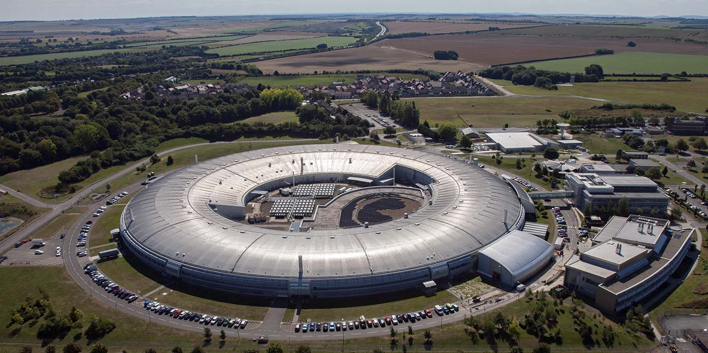
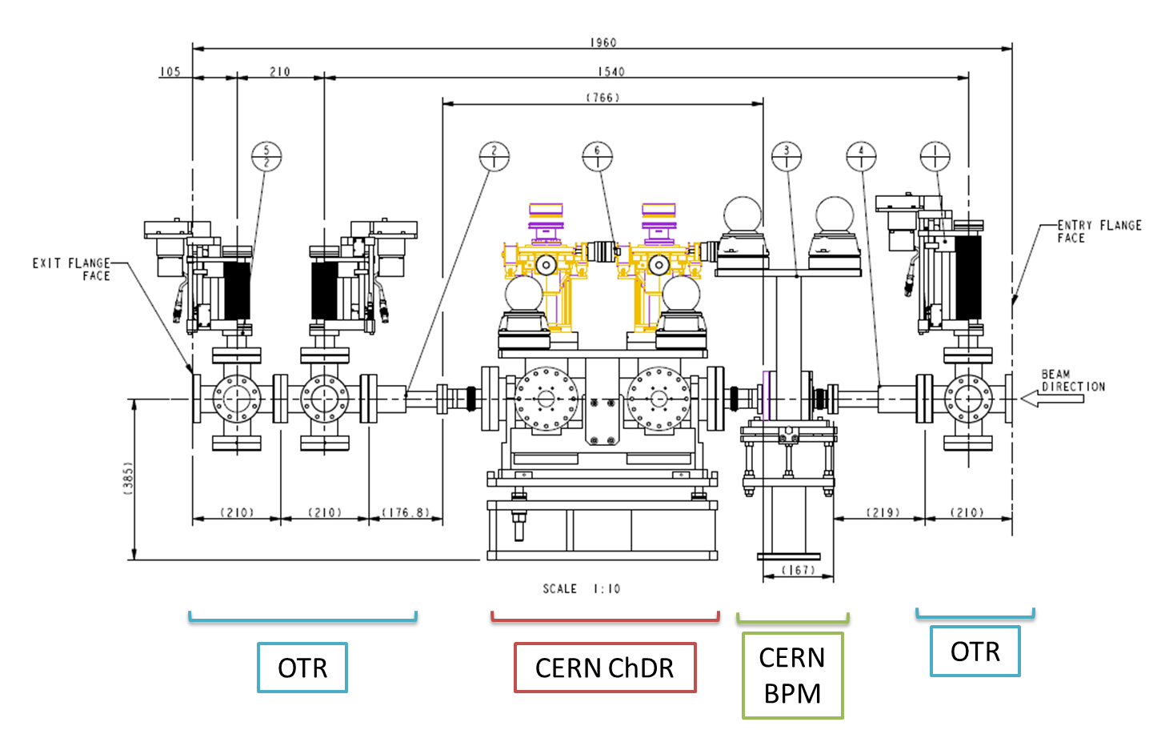
Diamond Light Source
3
2
1
Diamond Light Source (DLS) is a 3 GeV electron synchrotron in the UK
Specifically, our experiment is positioned in the Booster To Storage (BTS) transfer line in a test stand, part of which was given to us by CERN after the closing of CTF3
The BTS test stand consists of three Optical Transition Radiation (OTR) and Yttrium Aluminium Garnet (YAG) monitors, along with one Inductive Beam Position Monitor (IBPM)
Schematic taken from: Bobb, L, et al. 2018. BTS Test Stand: ChDR Installation [PowerPoint presentation]. Diamond Light Source.

Slide 4
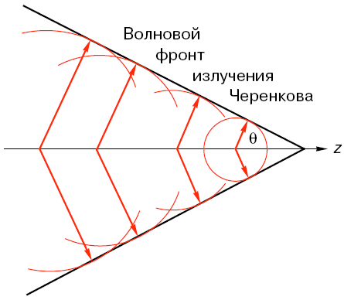
Introduction to Cherenkov Diffraction Radiation
R(t)
O
z(t)
Classical Cherenkov Radiation (CR)
CR requiring an incident particle to travel through a dielectric medium with $v> c_{med}$
Classical Diffraction Radiation (DR)
DR requiring an incident particle to travel close to a medium within a distance h
Single effect Vs separate phenomenon?
Images taken from: Karataev, P. 2021. Cherenkov Diffraction Radiation in Particle Accelerators [PowerPoint presentation]. Royal Holloway University of London.

Slide 5
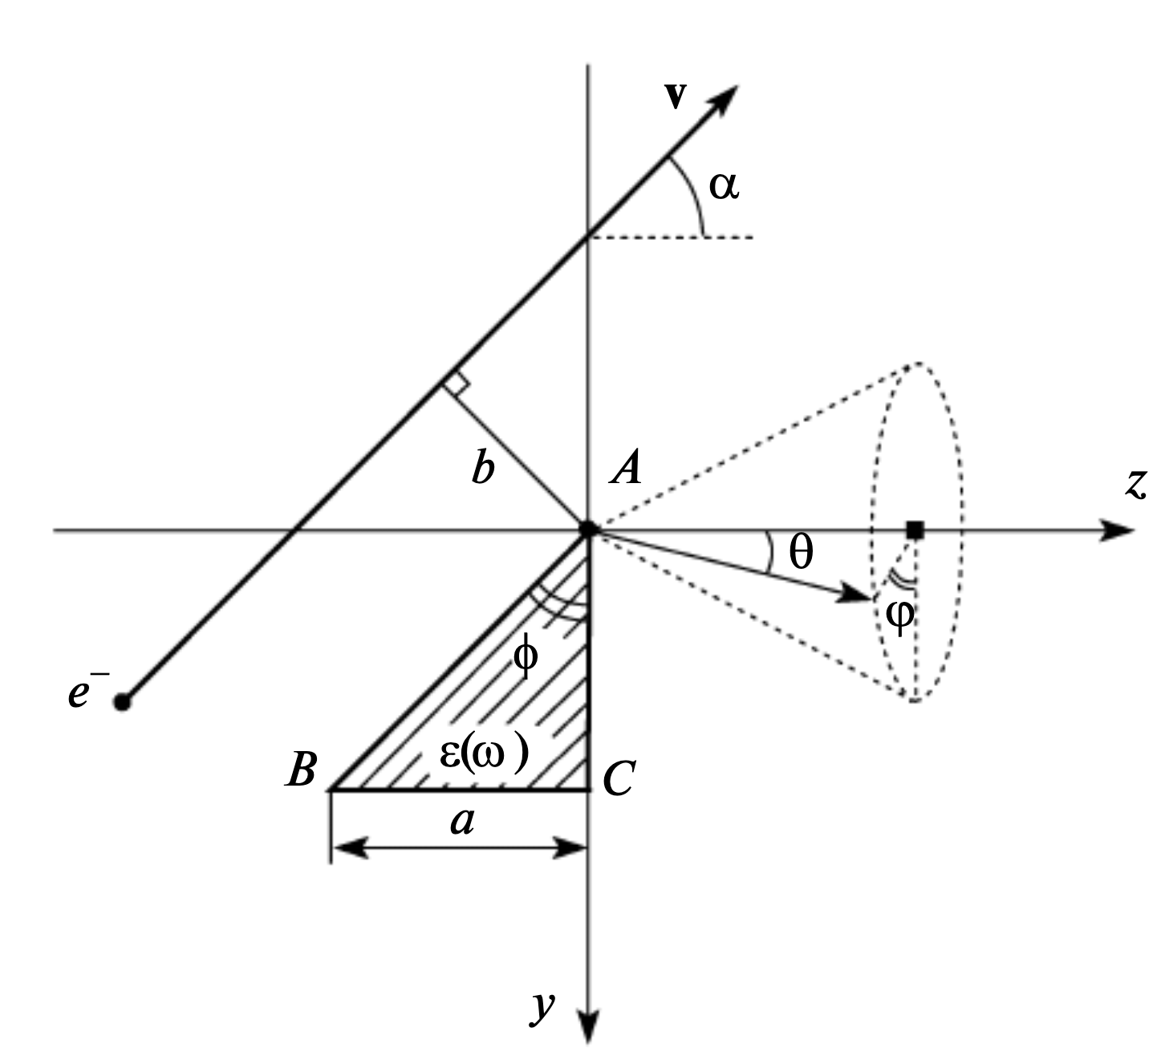
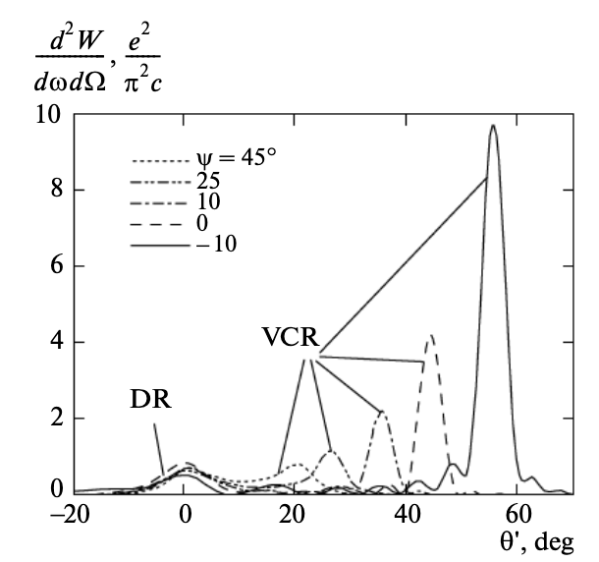
Introduction to Cherenkov Diffraction Radiation
Consider an electron travelling nearby to a dielectric target but not directly through it
As we can see, we do not only just get the classical DR but there is also a simultaneous contribution from CR
If we have an incident charged particle travelling at $v> c_{med}$ whilst also fulfilling the condition of $h ≤γλ$ we can generate Cherenkov Diffraction Radiation (ChDR)
Images taken from: M. Shevelev and A. S. Konkov, “Peculiarities of the generation of Vavilov-Cherenkov radiation induced by a charged particle moving past a dielectric target,” Journal of Experimental and Theoretical Physics, vol. 118, no. 4, pp. 501–511, Apr. 2014, doi: https://doi.org/10.1134/s1063776114030182.

Slide 6
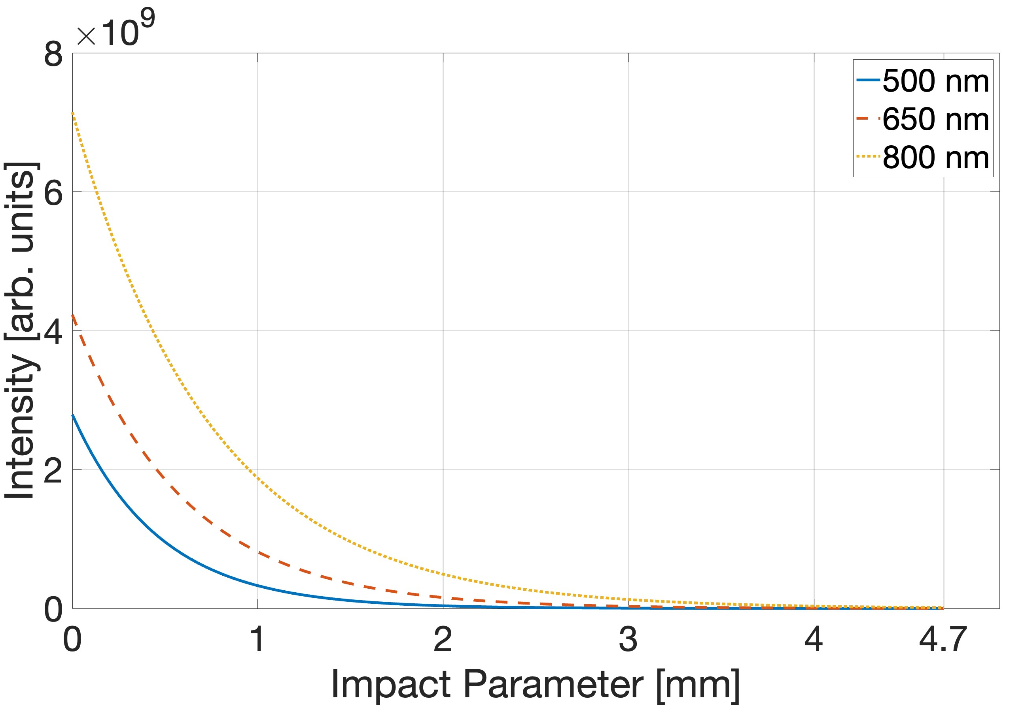
Introduction to Cherenkov Diffraction Radiation
$$I= I_{0}e^{\frac{−2 πh}{γλ}}$$
ChDR exhibits an exponential dependence on impact parameter given by the equation to the right
The example graph demonstrates how, for a single incident particle, the signal should drop to zero when an impact parameter of $\sim γλ$ is reached
This aligns with the condition for the generation of classical DR

Slide 7
Beam Position Monitor Assembly
Assembly = two UV grade fused Silica prisms, positioned parallel either side of the electron beam to form a 1D Beam Position Monitor (BPM)
Emission optimization of 500 nm ChDR light is achieved by angling the back face at ${\sim 90 − θ}_{Ch}$ along with the front face being angled at $\sim θ_{Ch}$
Based on previous tests at DLS, the vertical height of the target was seen to be a dominating factor
If the target size was comparable or smaller than $γλ$ then significant suppression of the signal occurred
To combat this, this new setup is comprised of prisms $\sim 32$ mm tall, which when considering 500 nm emission, is $\sim 11γλ$ allows consideration of an infinite target
$${90}^{°}$$
L
$${46.8}^{°}$$
$$θ_{Ch}$$
$${43.2}^{°}$$
$$h_{1}$$
e- 3GeV
$$h_{2}$$
43.9 mm
$${46.8}^{°}$$
$$θ_{Ch}$$
$${43.2}^{°}$$
R
30.05 mm
$${90}^{°}$$
32 mm

Slide 8
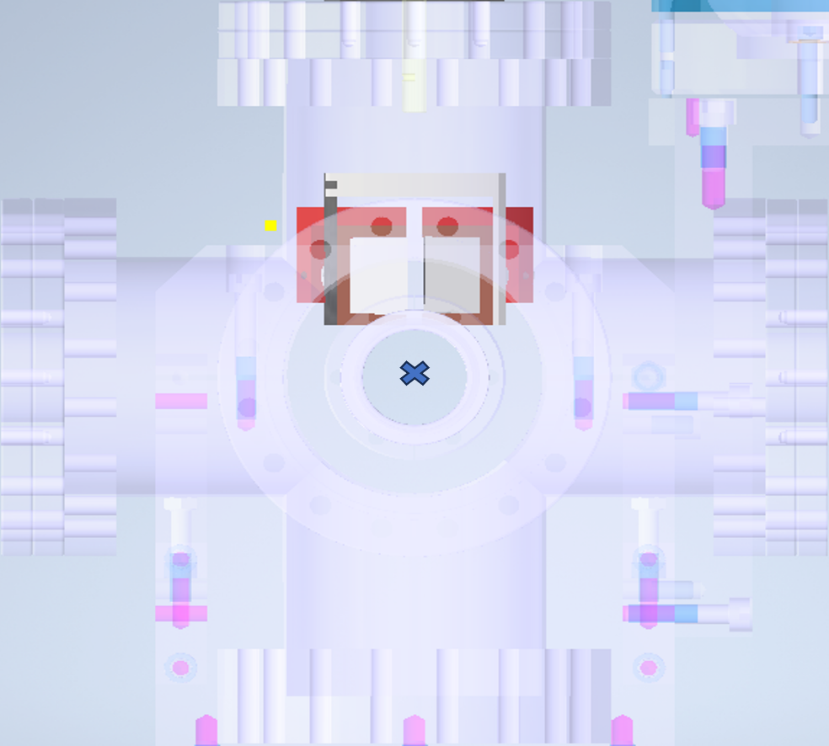
Beam Position Monitor Assembly
Collimators connect light generated in each prism to a fibre optic system and are angled such that the lens is parallel to the output face of the prisms
Using spacers the prisms can have a gap of $1.1→6.1$mm, or have the left side as shown in the figure completely removed
The whole assembly can be retracted from or lowered into the path of the beam via a central actuator
The actuator allows for the system to be rotated about the y-axis, and each prism to be rotated towards or away from the path of the beam
y
x

Slide 9
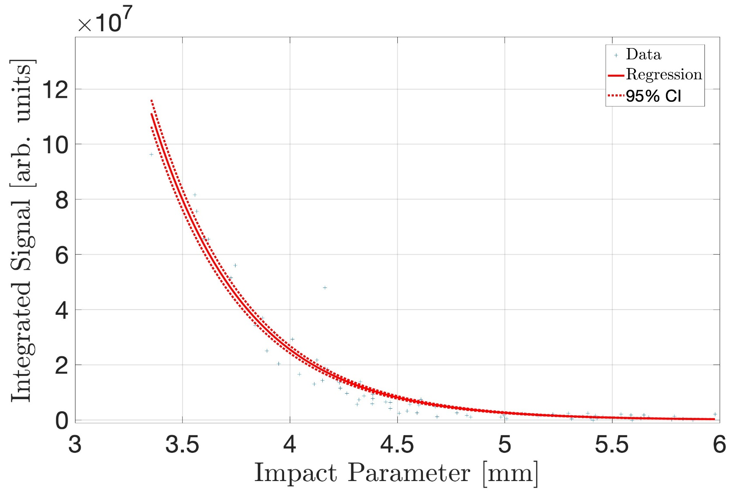
Impact Parameter Dependence
Utilising the assembly with only a single target the dependence on impact parameter has been characterized for broadband emission
Both pick-ups exhibit an exponential dependence as desired, along with a very significant signal
Data has been fitted using $Ae^{Bx}$
Fit parameters:
$$A=2.33e+11 ±7.65e−15,$$
$$B=−2.28 ±0.00657$$

Slide 10
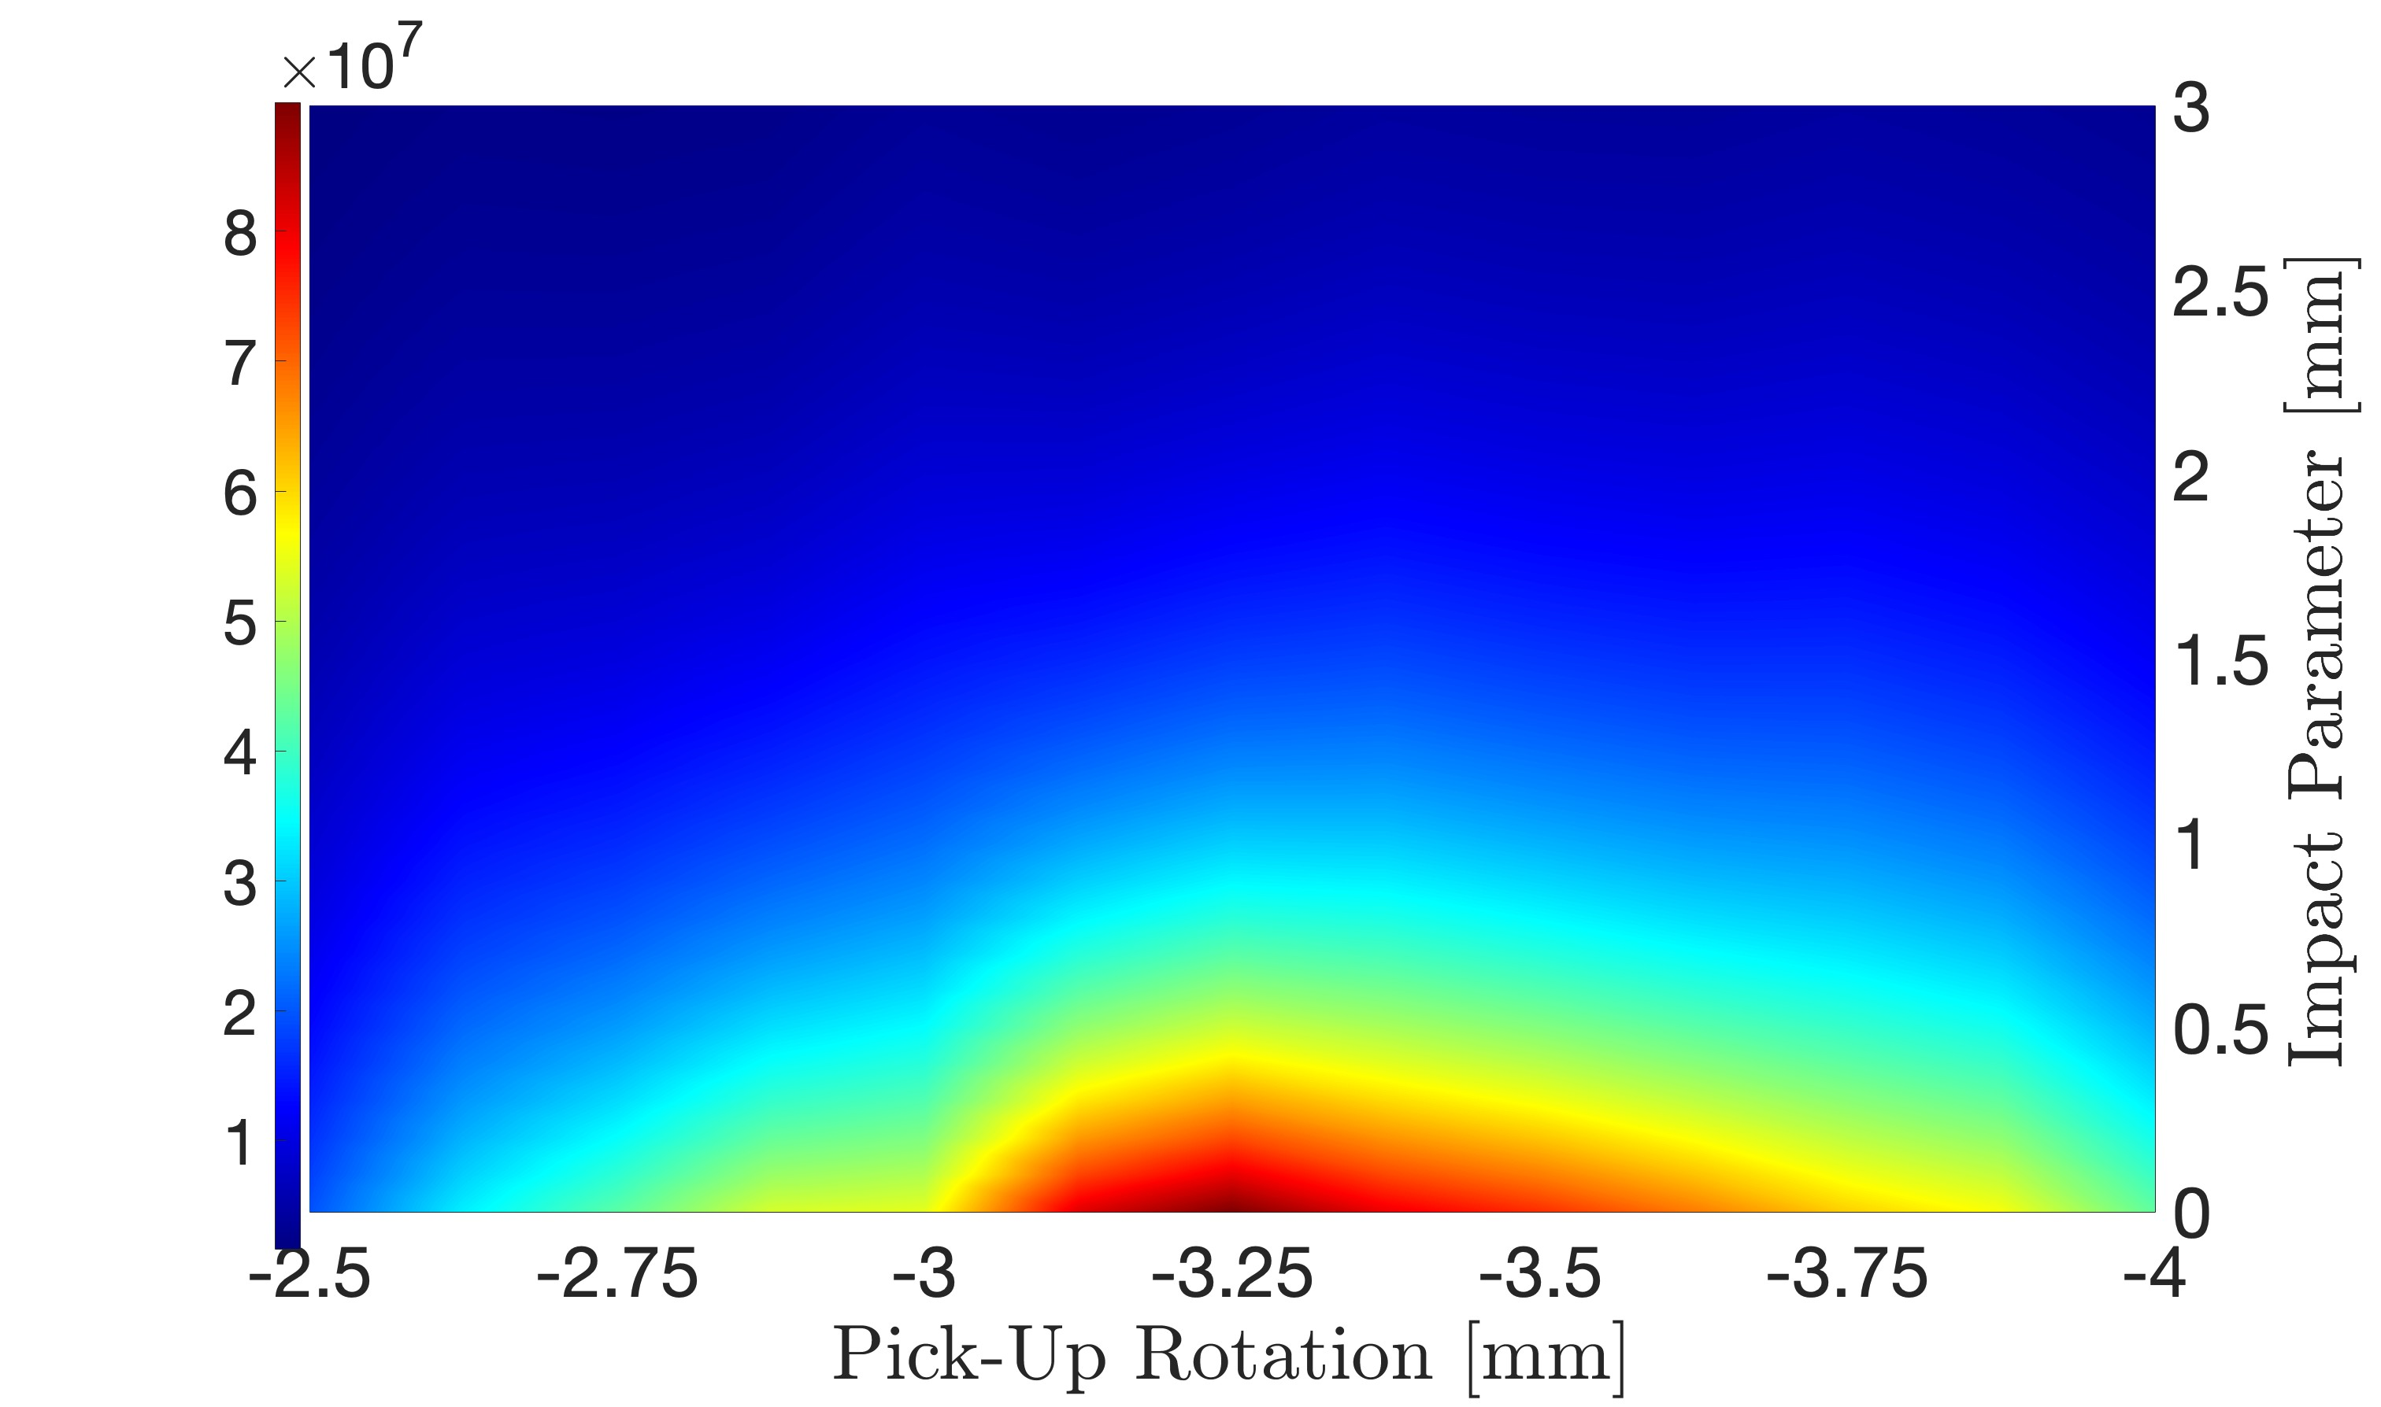
Rotational Dependence
Depicted is the rotational dependence of the single target system for broadband emission
$\sim −3.25°$ is the dominant angle of the system
This being the angle at which the face of the prism that sees the beam is at its most parallel
When considering this in terms of the BPM experiment this translates to us having a very limited operational arc

Slide 11
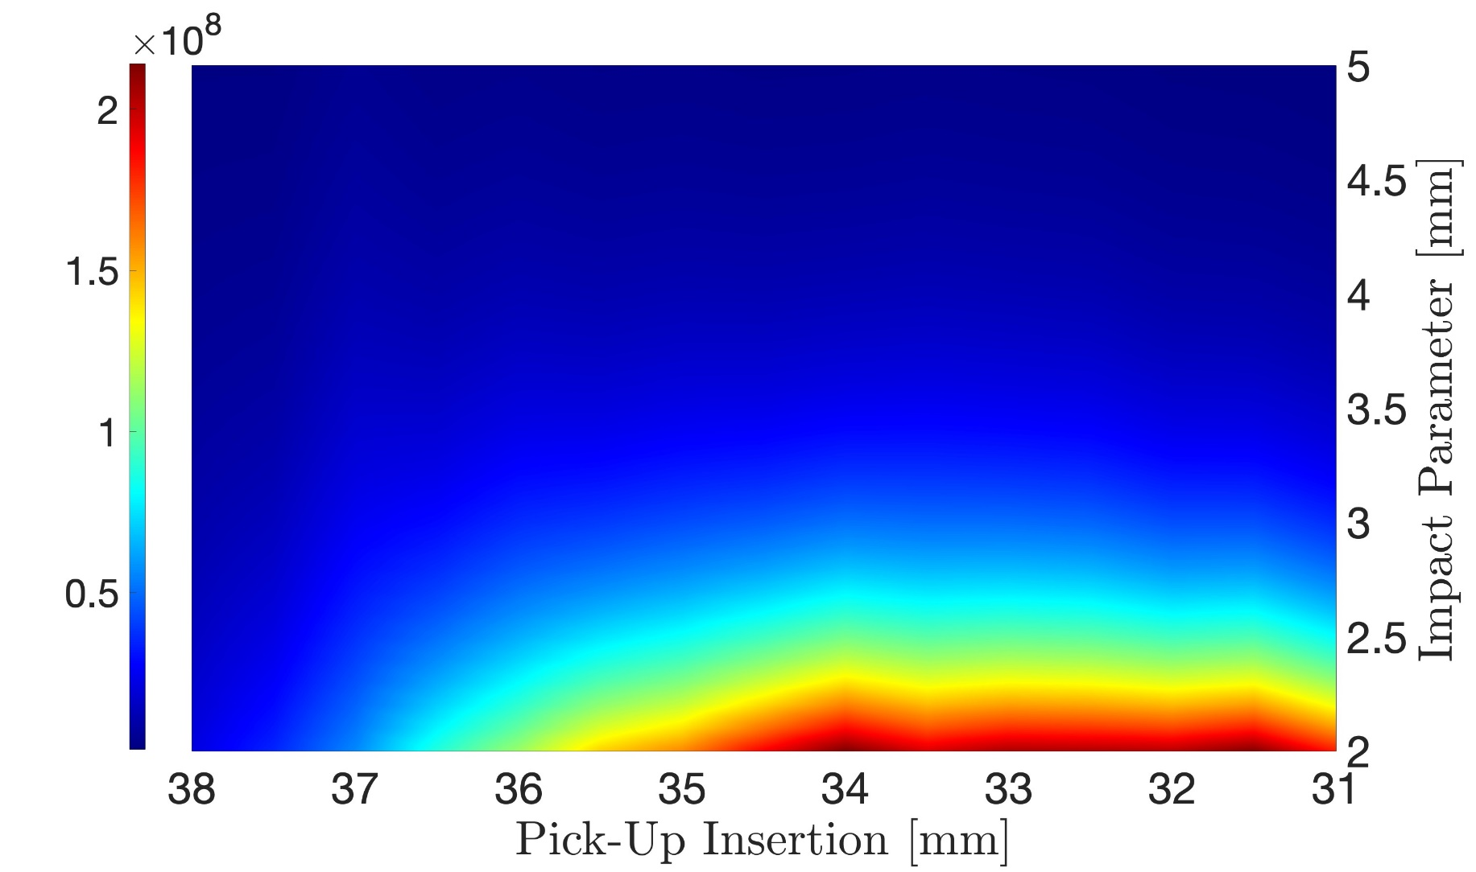
Vertical Dependence
Depicted is the vertical dependence of the system for broadband emission
It was originally predicted that nearly the whole height of the target would be utilised
Only losing signal at the either the top or bottom edge
We found we have a set range we can reasonably access
This will then limit the vertical range the BPM can operate

Slide 12
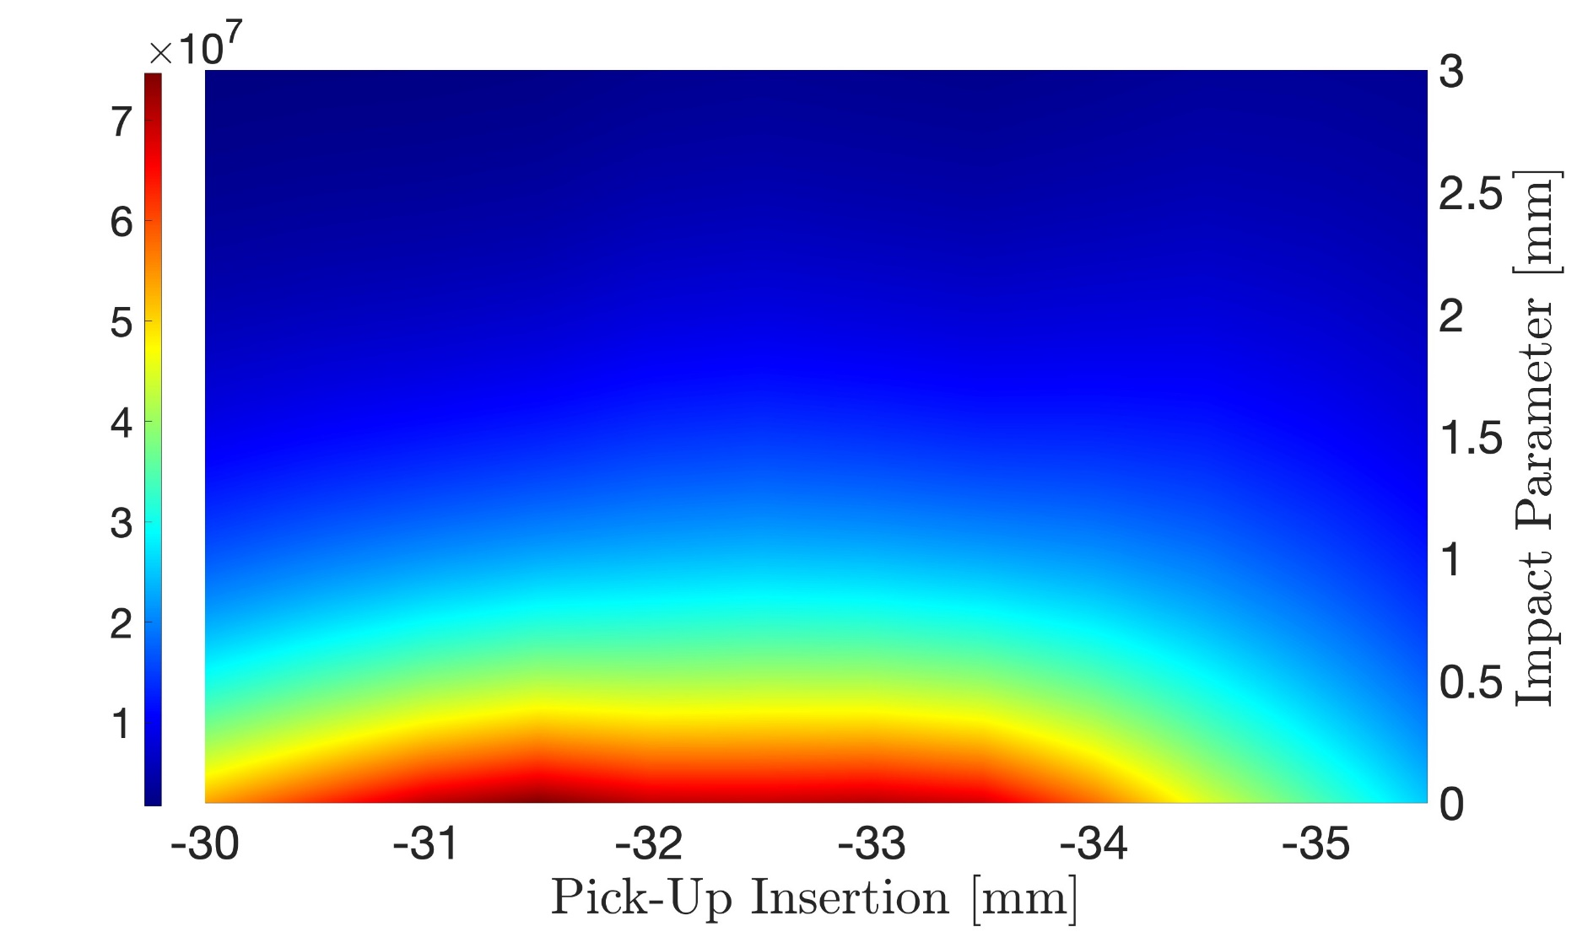
Vertical Dependence
Depicted is the vertical dependence of the system for 500 nm emission
For the ability to test isolated wavelengths and fight saturation, optical filters have been introduced to the system
The range is smaller for isolated 500 nm emission, along with the max intensity being noticeably smaller
Goes back to the dependence of ChDR generation on the factor $γλ$

Slide 13
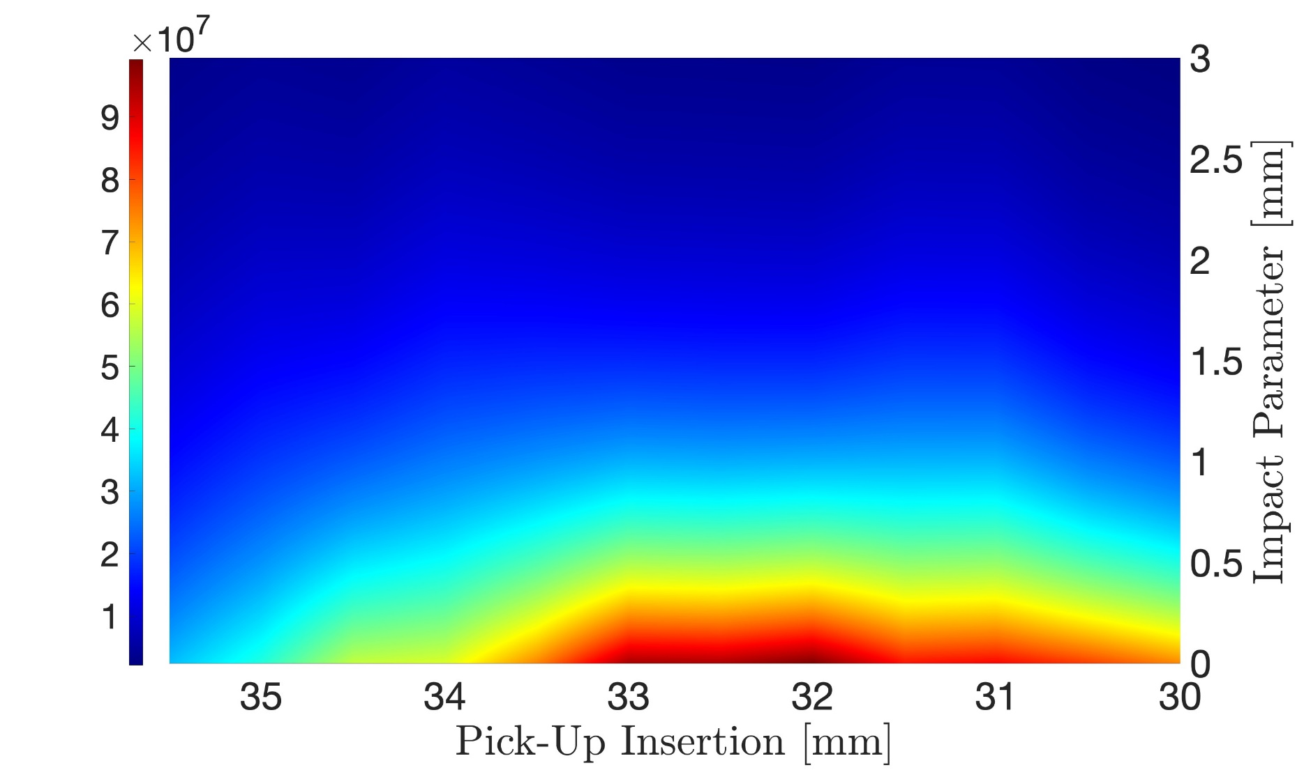
Vertical Dependence
Shown is the vertical dependence of the system for 650 nm emission
Upon increasing the measured wavelength some of the lost intensity and operational range is regained
Whilst still worse for operational purposes when compared to broadband, it is a marked improvement over 500 nm emission

Slide 14
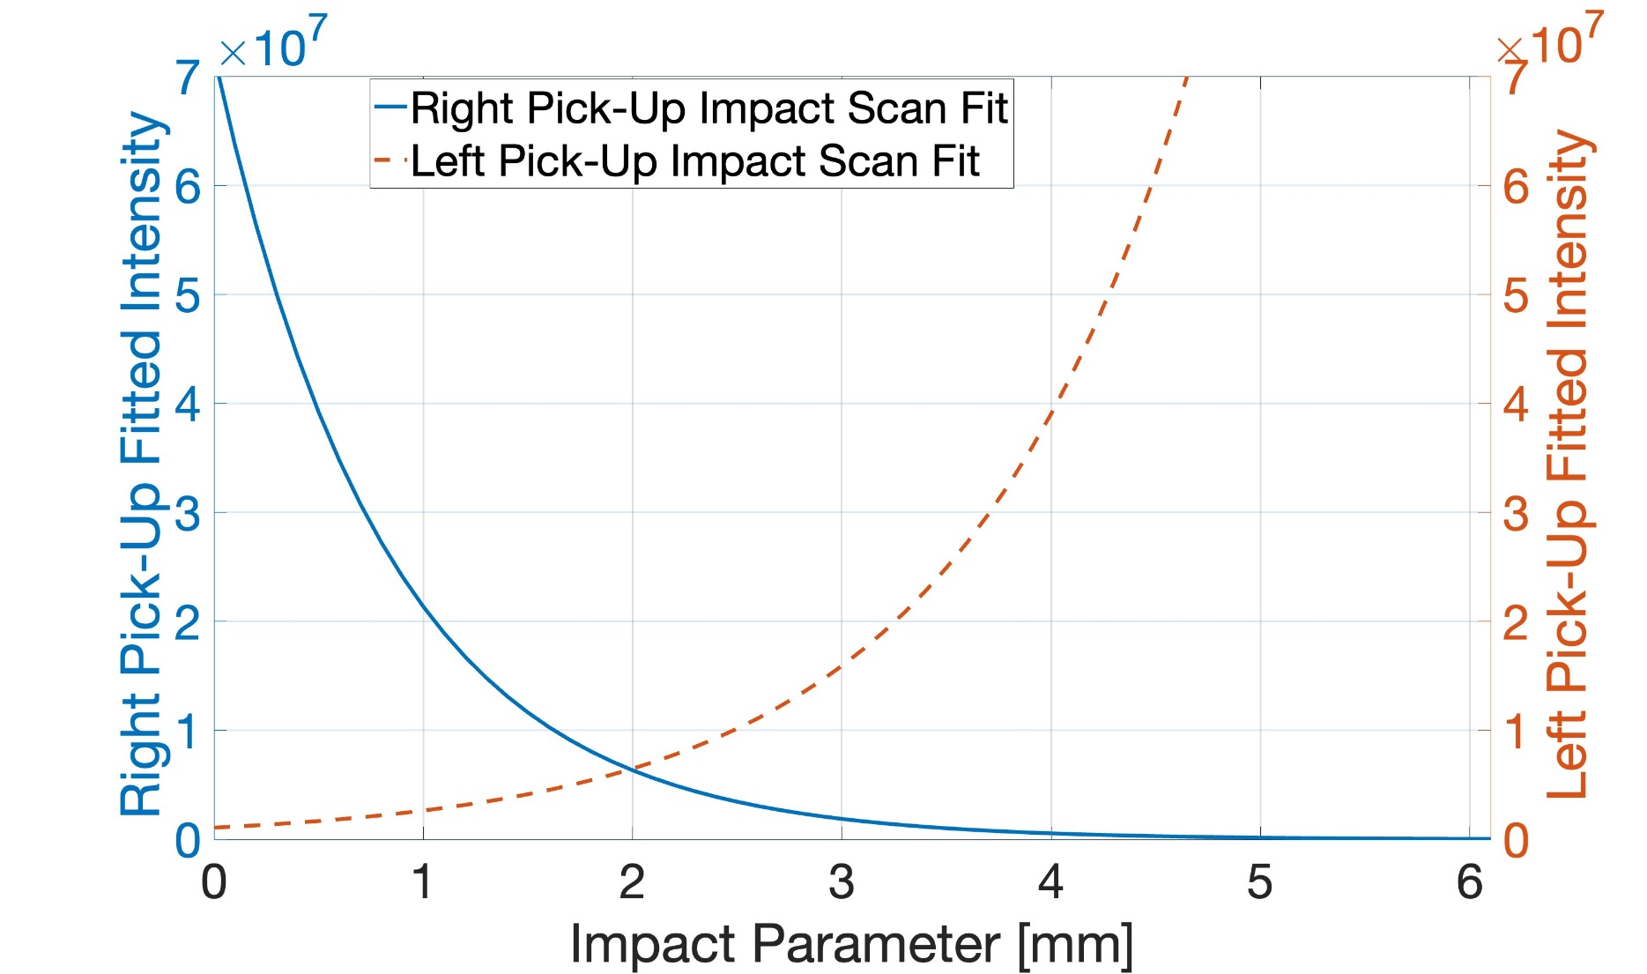
Beam Position Studies
At the time of this presentation, the ChDR BPM has been characterized for: 500; 650 and; 800 nm emission
We have found that the EM centre of the device is offset by close to 1mm
Currently it is presumed to be a discrepancy caused inside the vacuum chamber
The detectors used have been swapped and the EM centre stayed the same

Slide 15
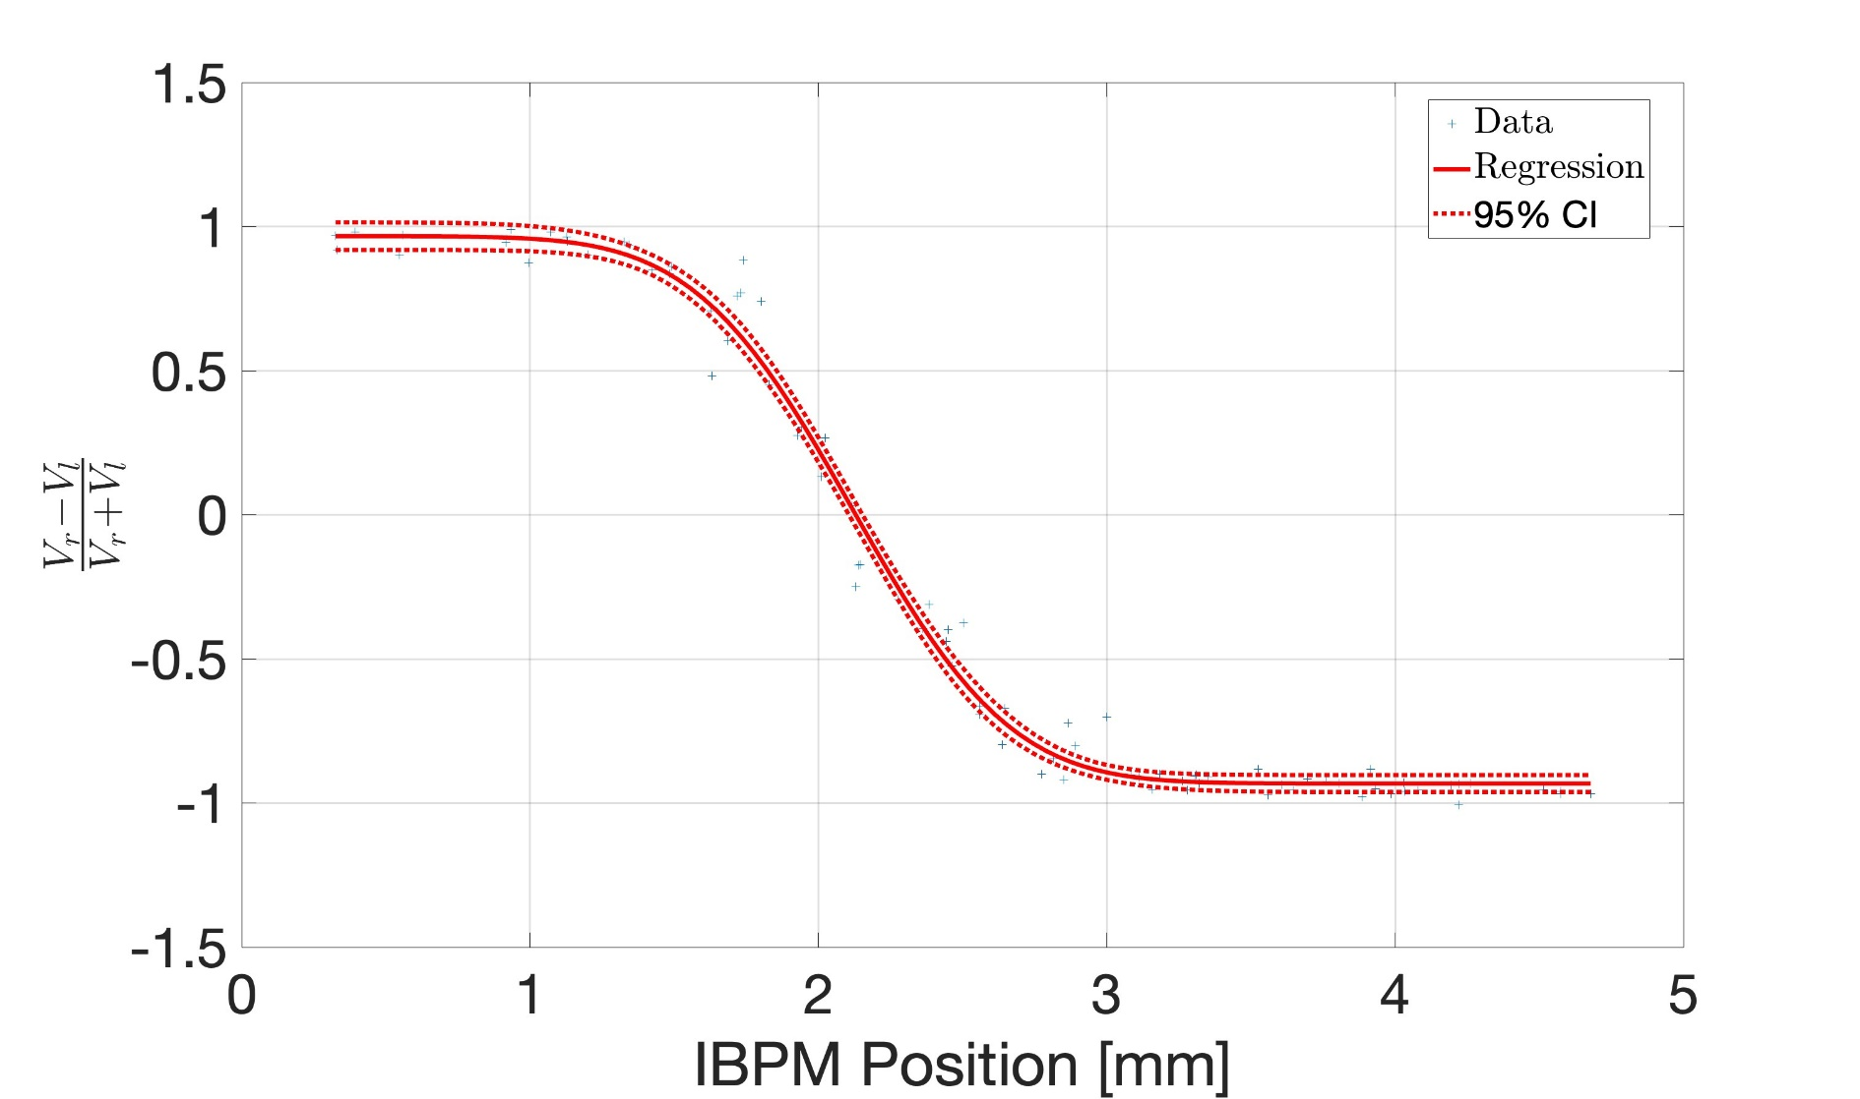
Beam Position Studies
Graph shown is the difference over sum of the ChDR BPM compared to the absolute beam position from the IBPM
For each wavelength tested, clear linearity and plateau regions and fit erf functions to the data have been observed
The range of linearity increasing with the wavelength
Graph plateaus when the impact parameter to a particular pick-up goes towards zero and the detector approaches saturation

Slide 16
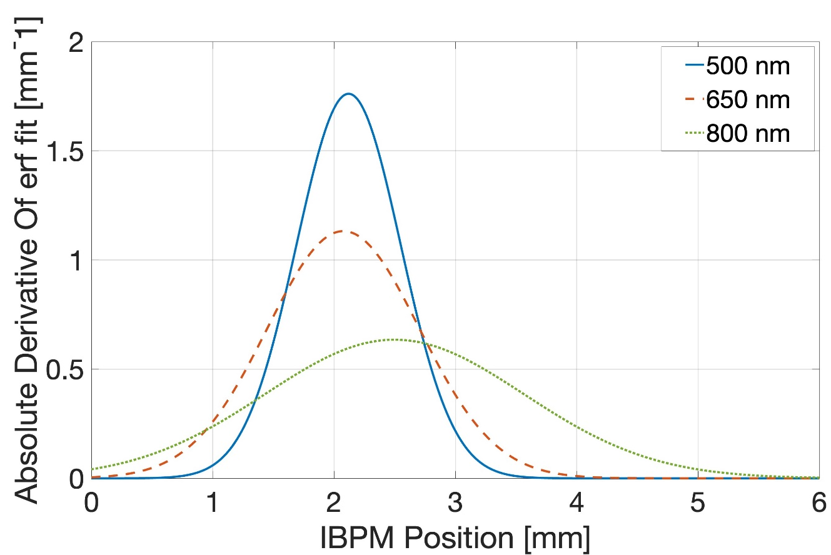
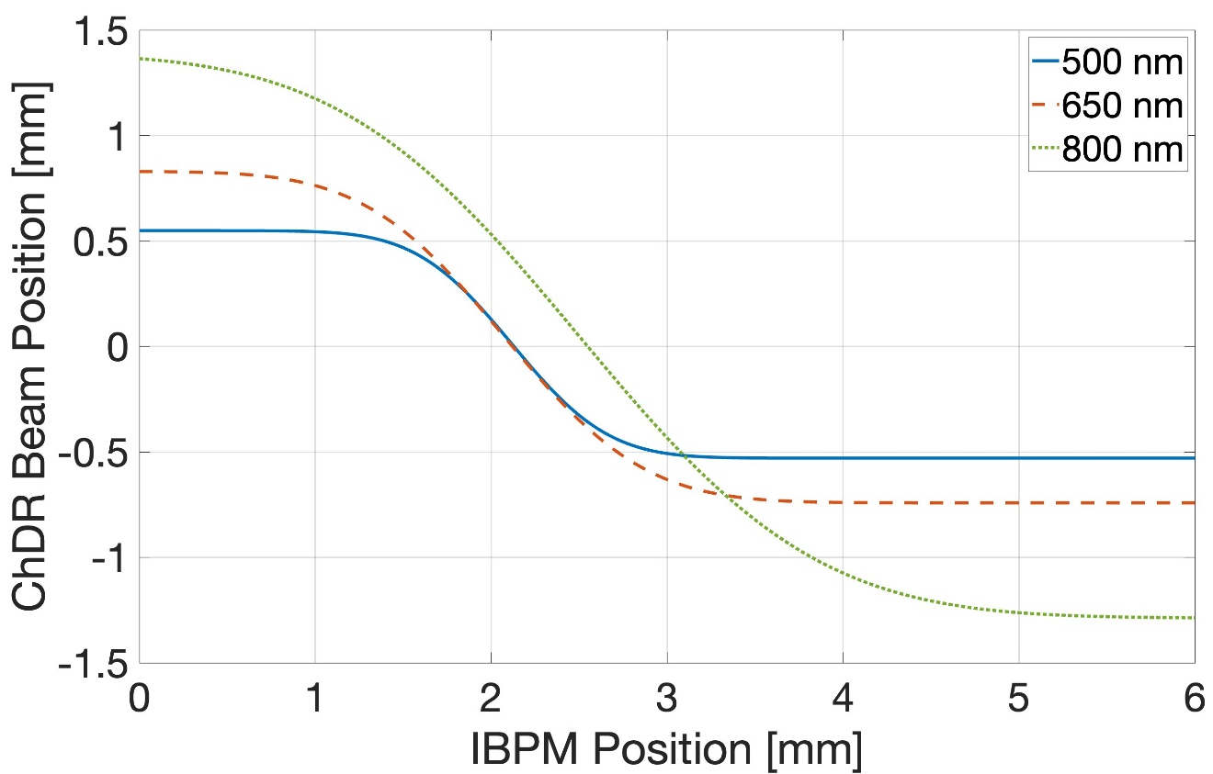
Beam Position Studies
Finally, if we take the derivative of the fitted erf functions, we can find the factor necessary to convert difference over sum into beam position
Upon doing this the dynamic range of the system is obtained
This range increases along with the wavelength at the cost of sensitivity to beam position
Note: the EM centre should be identical regardless of wavelength, the disparity for 800 nm is due to more data spread in that particular set of results

Slide 17
Current Plans
Calibrate the ChDR BPM against the IBPM using broadband emission
Find the resolution of the ChDR BPM using the IBPM and the downstream YAG screens

Slide 18
End of Presentation
Thank you for listening, are there any questions?
Contact details: alec.clapp@diamond.ac.uk

