Slide 1
Application of PXR-based
X-ray source using a Si(400) radiator in the 40-keV region
LEBRA: Laboratory for Electron Beam Research & Application
Nihon University
Yasushi HAYAKAWA

Slide 2
Collaborators
Y. Hayakawa¹, K. Hayakawa¹, S. Kurumi²,
K. Nogami¹, T. Sakai¹, Y. Takahashi¹,
T. Tanaka¹, M. Yoshukawa²
¹Laboratory for Electron Beam Research and Application (LEBRA), Institute of Quantum Science, Nihon University
²College of Science and Technology, Nihon University
Notes:
2
2
2

Slide 3
Outline
Introduction of the LEBRA facility
Status of the LEBRA-PXR source
Production of X-ray in 40-keV region by Si(400) crystal
X-ray imaging using PXR beam in 40-keV region
Summary

Slide 4
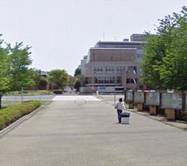
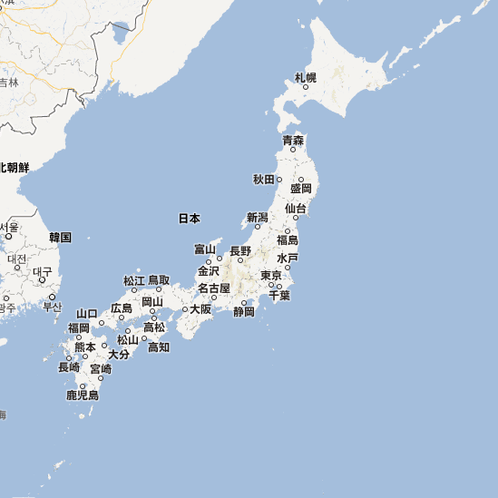
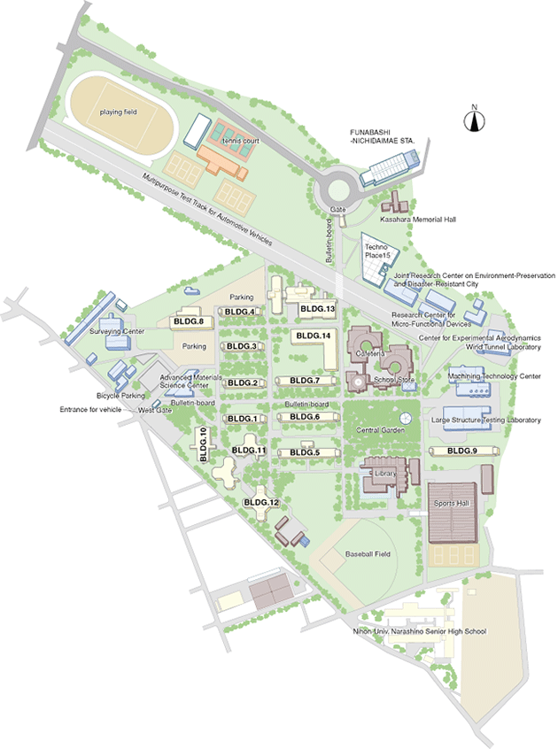
Nihon University
Funabashi, Chiba

Slide 5
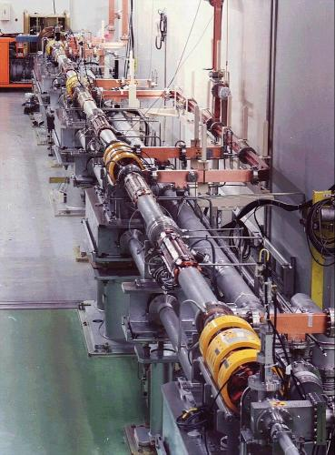
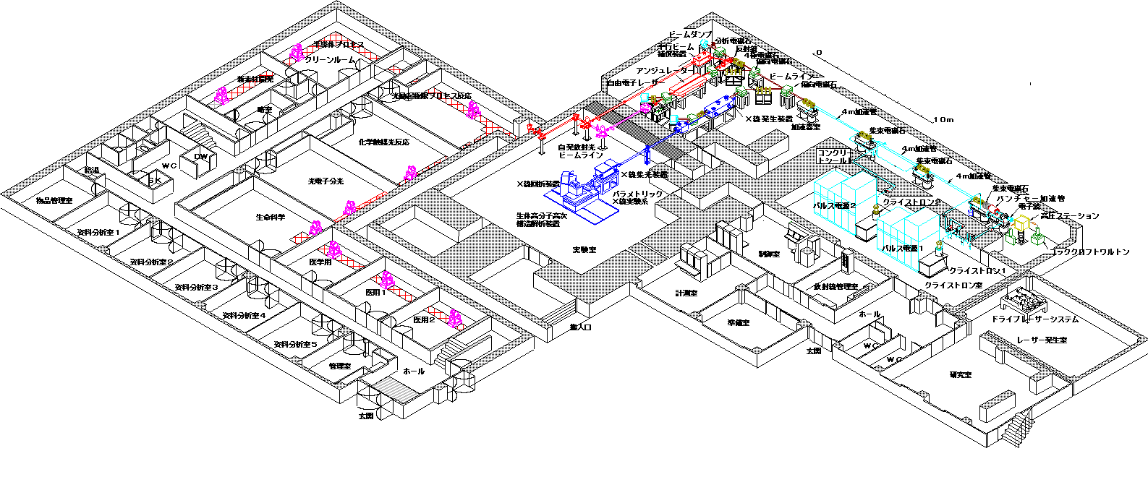
LEBRA facility
LEBRA: Laboratory for Electron Beam Research & Application
Coherent light-source facility based on
a conventional S-band electron linac
elctron energy: 100MeV(max.)
average current : 8μA (max.)‏

Slide 6
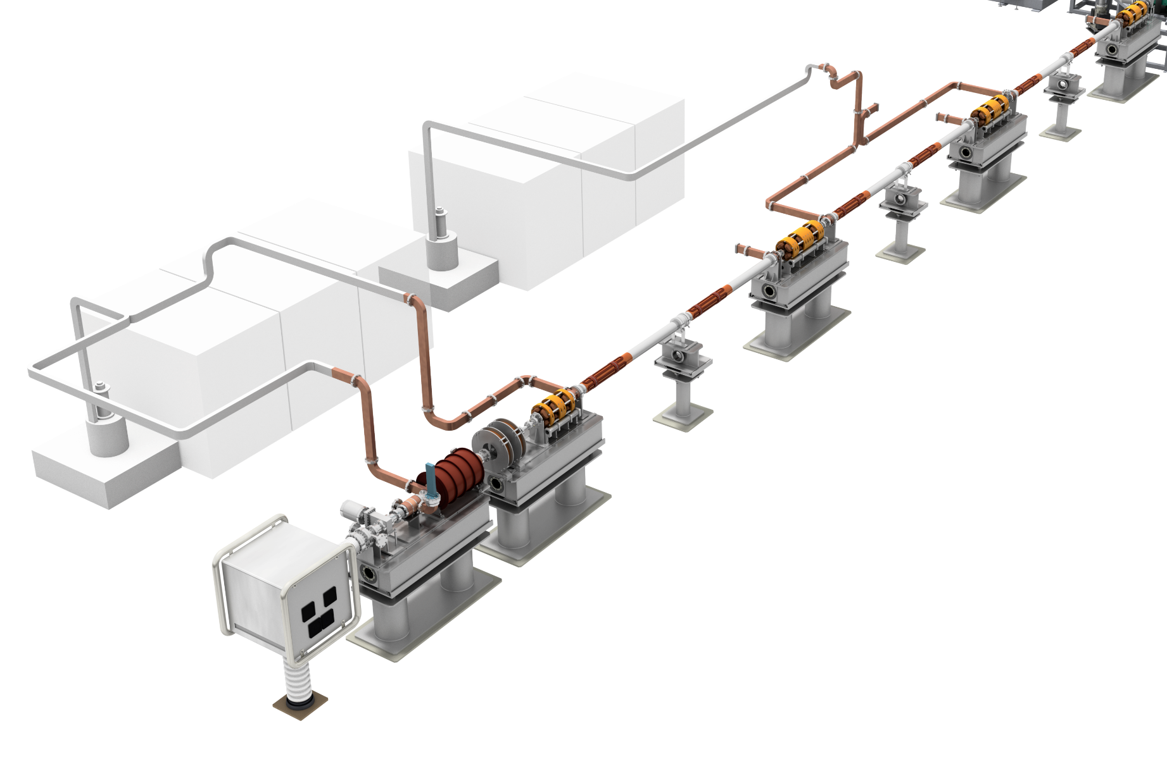
LEBRA electron linac
Electron energy | 100 MeV
Accelerating frequency | 2856 MHz
Klystron power | 30 MW × 2
Macropulse duration | ≦ 20 µs
Macropulse current | ≦ 200 mA
Repetition rate | ≦ 5 pps
Maximum beam power | 0.8 kW
Normalized emittance | ＜ 15 π mm mrad
S-band klystron（PV3030） X 2
©Rey.Hori
pre-buncher + buncher system
4m traveling-wave tube X 3
Electron gun：thermal cathode（EIMAC Y646B）
DC Voltage： -100 kV

Slide 7
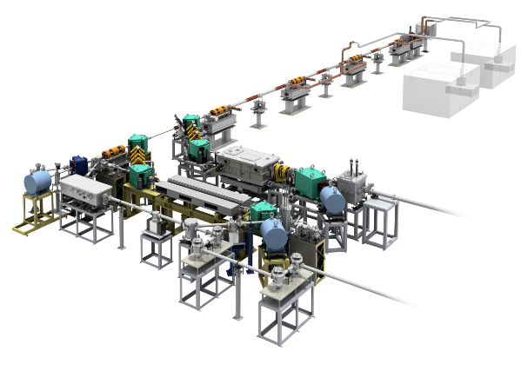
２beamlines and 3 types of light sources
©Rey.Hori
Parametric X-ray radiation (PXR) source
5 – 47 keV
user application
THz-wave source
・coherent transition radiation (CTR)
・coherent edge radiation (CER)
・coherent Cherenkov radiation (CCR)
Infrared FEL
(free eletron laser)
1 – 6.7µm
user application

Slide 8
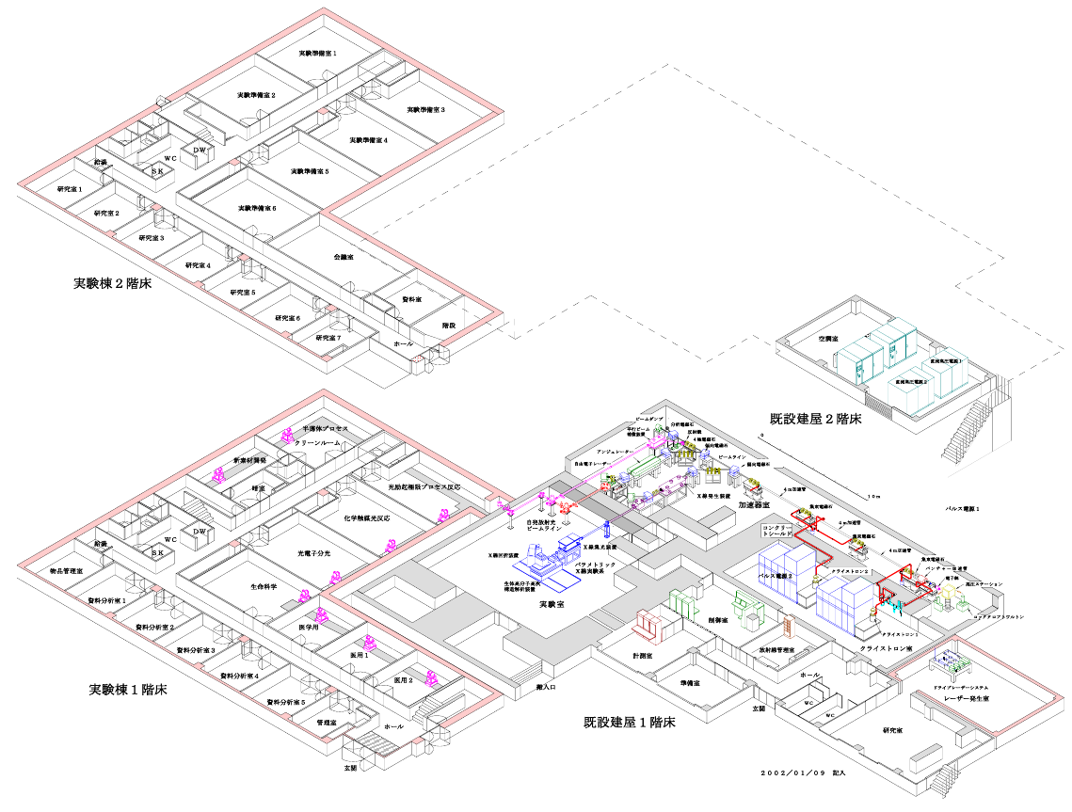
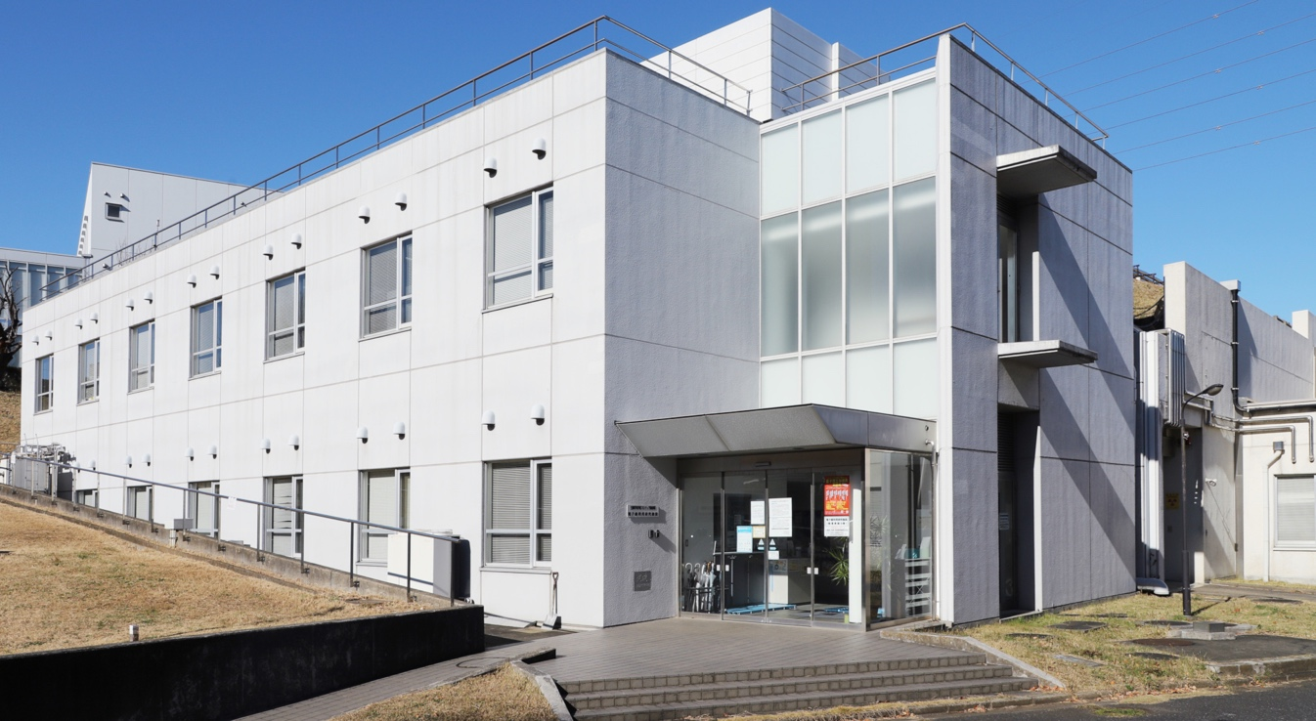
Experiment rooms for user applications
Accelerator building
Users building
Experiment rooms for FEL users: 8 in the users building
Experiment hall for PXR & THz applications in the accelerator building

Slide 9
History of the LEBRA facility
1957: Establishment of Institute of Quantum Science, Nihon University
1975: Project of π-meson cancer therapy started
1989: Construction of 35MeV double-sided microtron
1992: Project of FEL-based light source started
1997: Construction of 100MeV-class S-band electron linac
1998: Successful acceleration of 100 MeV electron beam
2001: FEL first lasing＠1.5µm, PXR source development
2003: User applications using light sources started
2004: First X-ray beam from LEBRA-PXR source
2011: Adoption system for research proposals from users (chargeable)
2012: Study on THz-wave source started

Slide 10
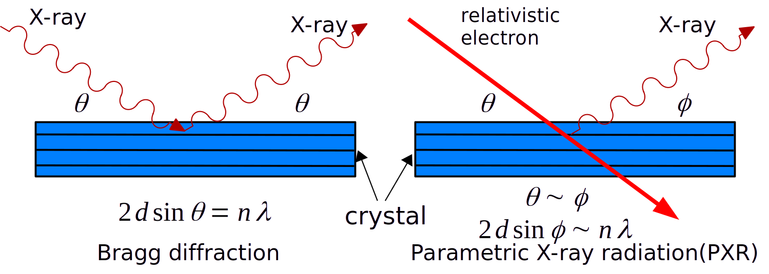
Parametric X-ray radiation（PXR）
PXR is apparently similar to X-ray Bragg diffraction.
The X-ray energy is tunable depending on the Bragg angle.
Notes:
PXR is a kind of monochromatic X-ray radiation phenomena caused by interaction between a high energy electron and a crystal material.
It is similar to X-ray Bragg scattering and the energy of emitted X-rays is continuously controlled by Bragg angle.

Slide 11
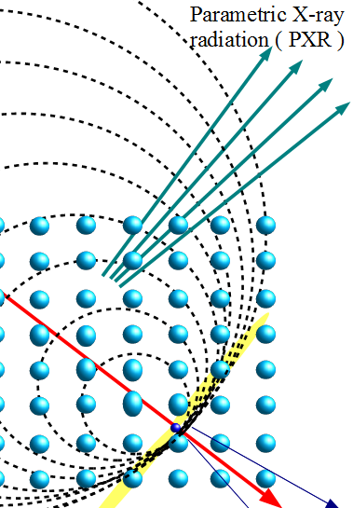
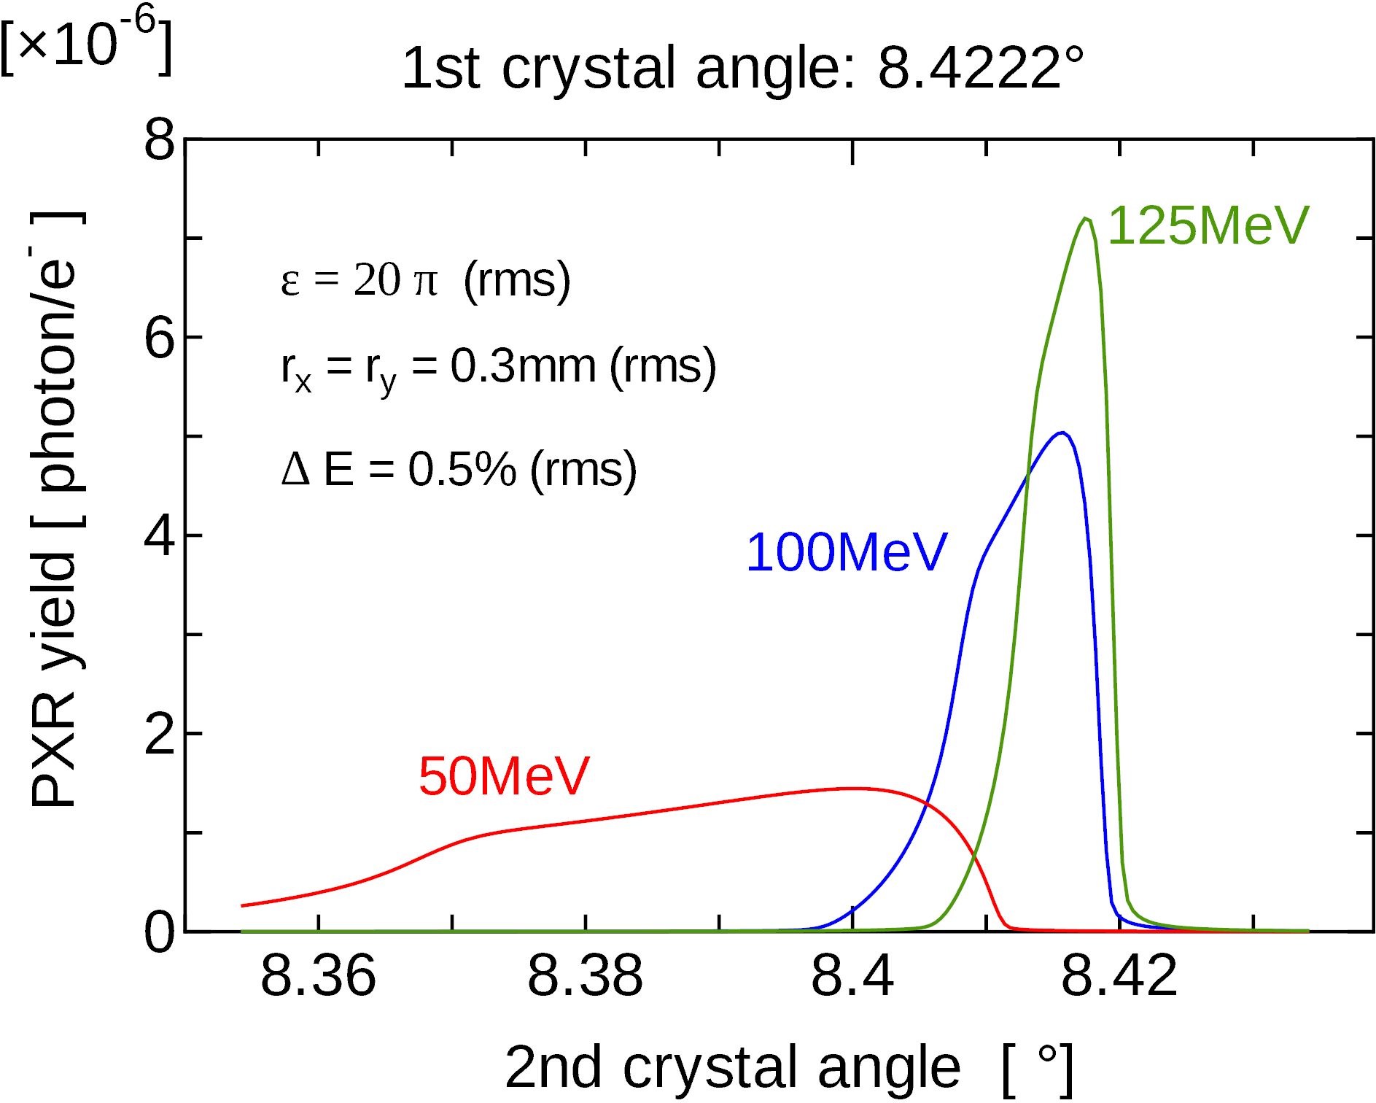
PXR beam transport by double-crystal system
electron
2nd crystal
1st crystal
parallel move
PXR beam has linear energy dispersion (spatial chirp) along the horizontal
lower X-ray energies hit with larger Bragg angles
hgher X-ray energies hit with smaller Bragg angles on the 2nd crystal planes.
→ the whole PXR beam can be diffracted simultaneously

Slide 12
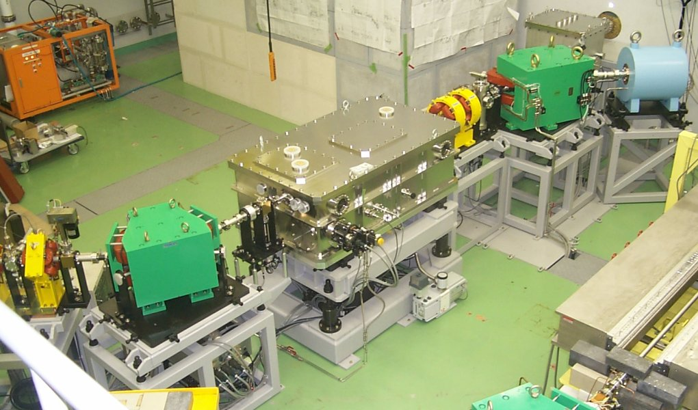
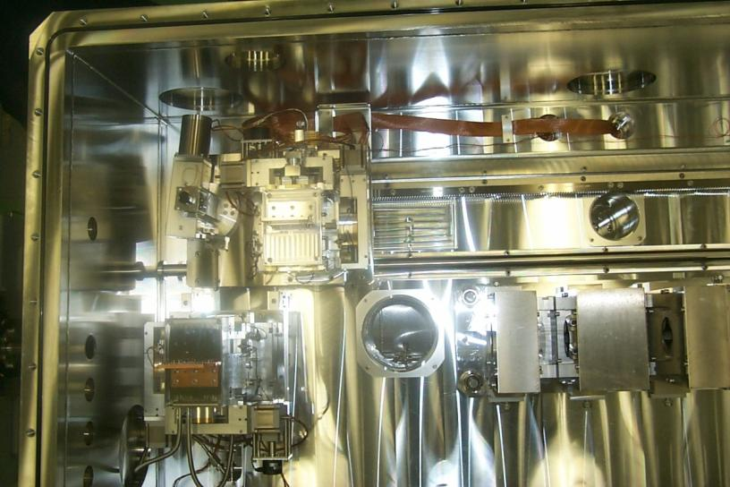
PXR beamline
2nd crystal
e-beam
permanent
Q-magnet
1st crystal
Parametric X-ray radiation (PXR): double-crystal system
X-ray beam is extracted using a (+, -) crystal optics
Notes:
12
12

Slide 13
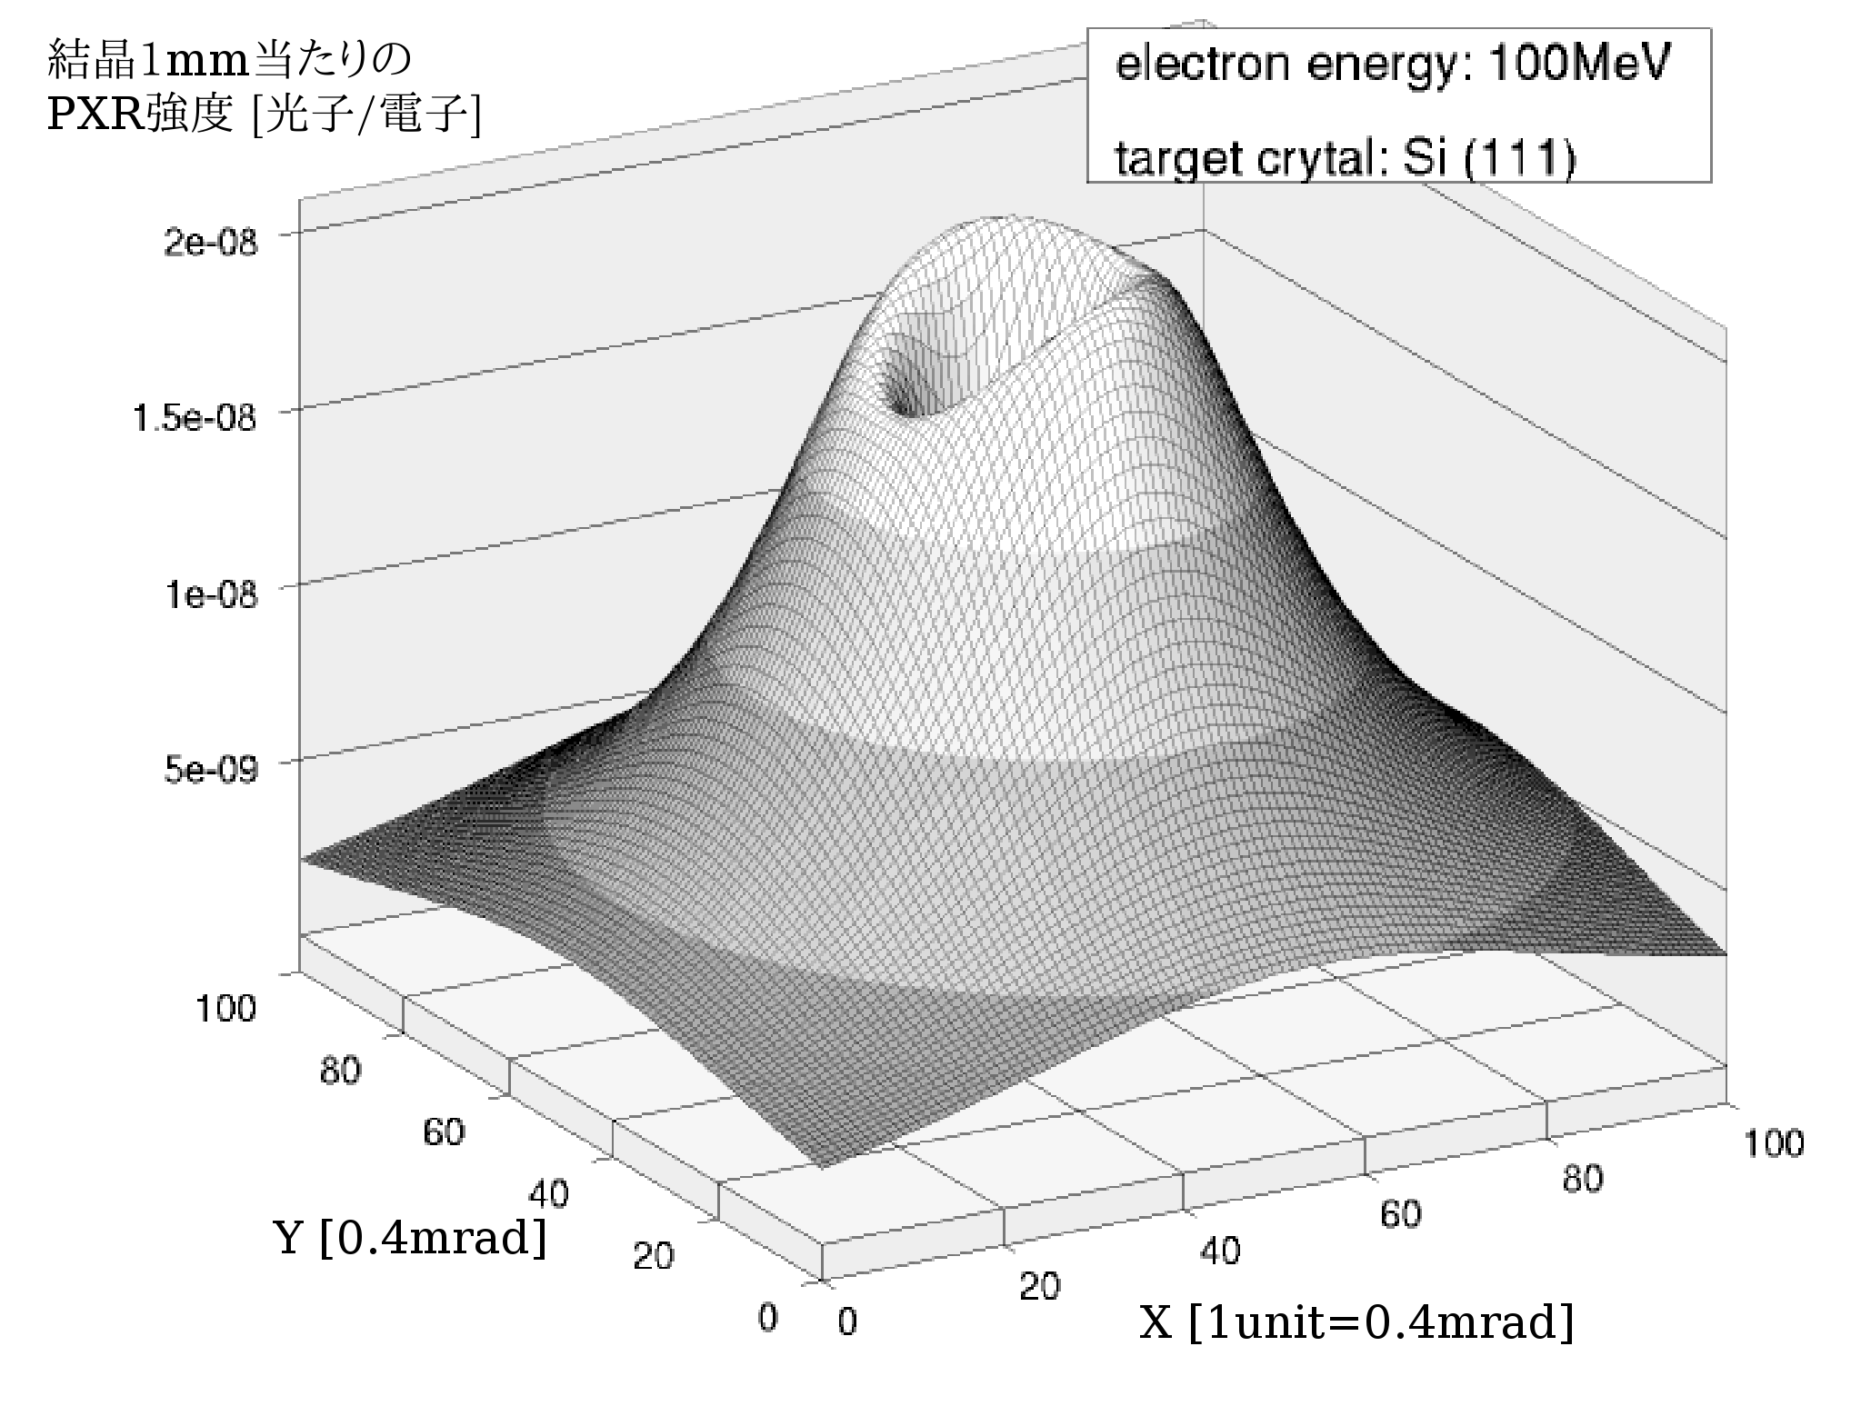
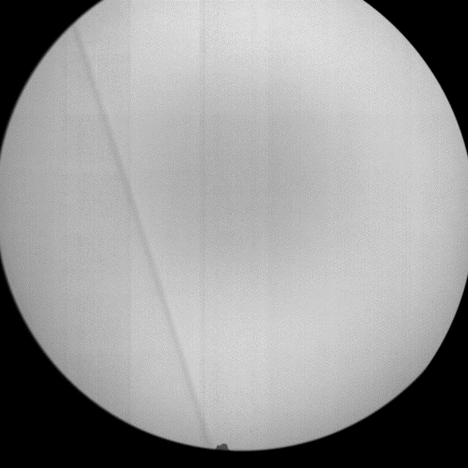
Characteristics of the LEBRA-PXR source
Monochromaticity
linear energy dispersion (spatial chirp) ～10%
local narrow bandwidth less than 0.1% (a few eV)
Continuous energy selection
X-ray energy can be controlled by “Bragg angle”
Wide and flat irradiation-field
cone-shaped beam depending on 1/γ
100mm in diameter ＠ X-ray exit window
Spatial coherence
sensitive to X-ray refraction on the order ofμrad
Stability
LEBRA-linac is old and conventional but stable.
long measurement can compensate for low X-ray flux
Notes:
13

Slide 14
Specification of LEBRA-PXR source
Electron energy 100 MeV
PXR radiator Si mono-crystal
Electron beam size 0.5 – 1mm （rms diameter）
X-ray energy range Si(111): 4 – 20 keV
Si(220): 6.5 – 34 keV
Si(400): 9.1 – 47.4 keV
Irradiation field size
（X-ray window＠experiment hall） 100 mm in dia.
X-ray photon rate ～ 10⁷ /s @17.5keV (Si(111))

Slide 15
Applications of the PXR source（Imaging）
Monochromatic X-ray imaging
CT （computed tomography） is possible
X-ray absorption fine structure (XAFS)
dispersive-type method
Diffraction-enhanced imaging (DEI)
detection of X-ray refraction/scattering on the order of μrad
phase-contrast/SAXS-contrast
Element imaging based on K-edge subtraction (KES)
3D distribution of a specific element
Notes:
15

Slide 16
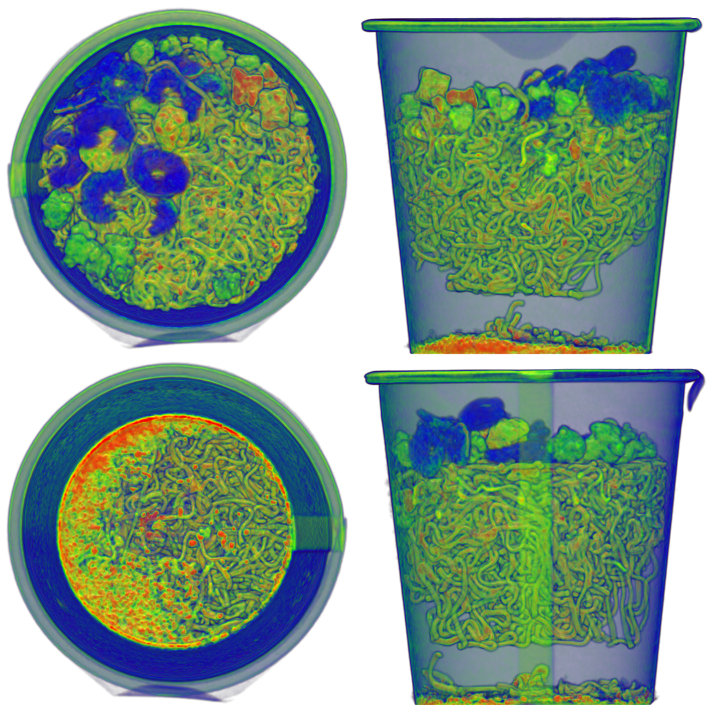

Computed tomography (CT)
PXR energy: 22keV
sample: cup noodle
projection images: 500
net measurement time : 3.5 hr

Slide 17
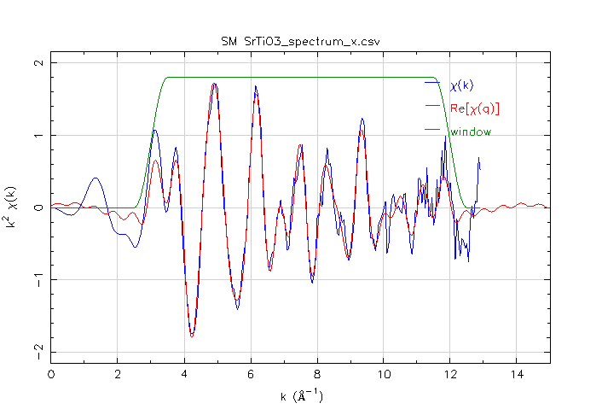
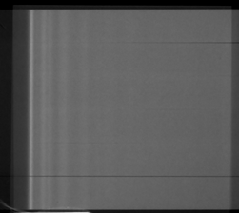
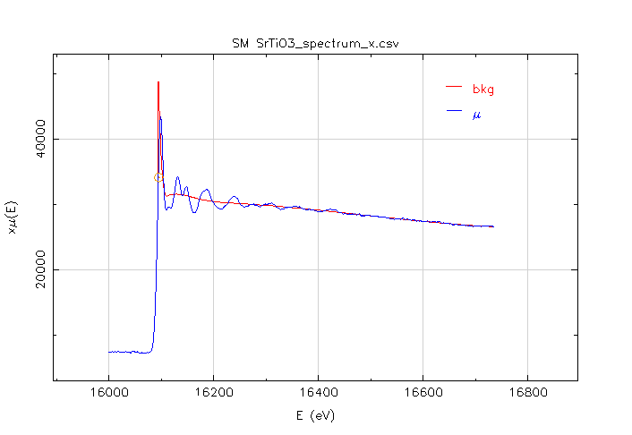
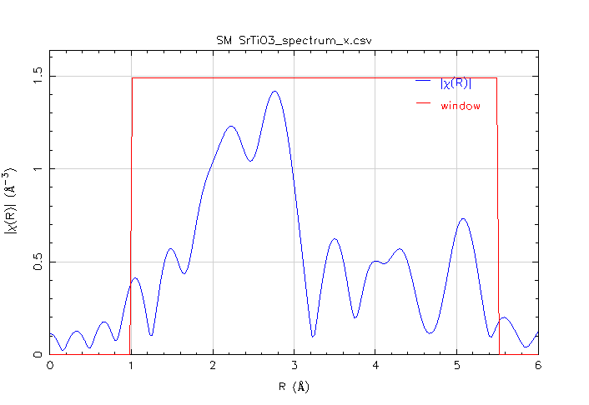
Dispersive-XAFS analysis
sample
SrTiO₃ (white pigment)
measurement: 30min
detector: Imaging plate
EXAFS oscillation
radial distribution function
absorption spectrum
XAFS: X-ray absorption fine structure

Slide 18
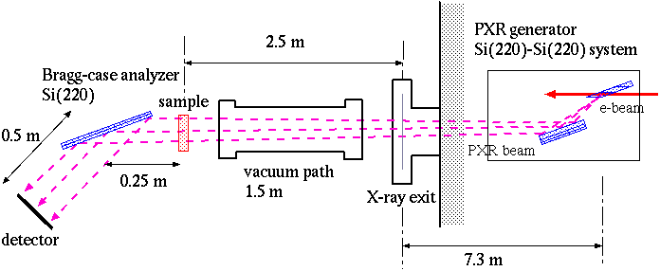
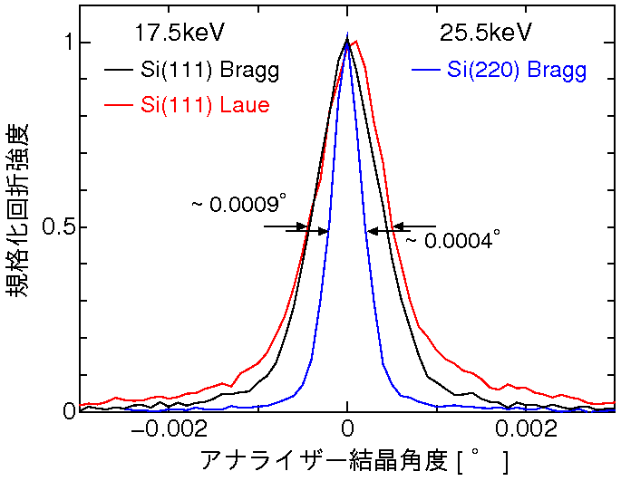
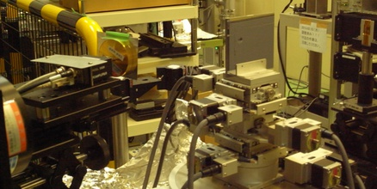
Diffraction-enhanced imaging（DEI）
top view
Using a 3rd analyzer crystal in the (+,-,+) arrangement, the whole of a PXR beam can be diffracted with a narrow angular width despite the cone-beam.
The method is sensitive to the refraction and the scattering of X-rays due to the sample material.
Notes:
This is actual DEI setup using PXR beam. Due to~
This measurement system is possible to detect X-ray refraction or scattering due to the sample material with high angular resolution.

Slide 19
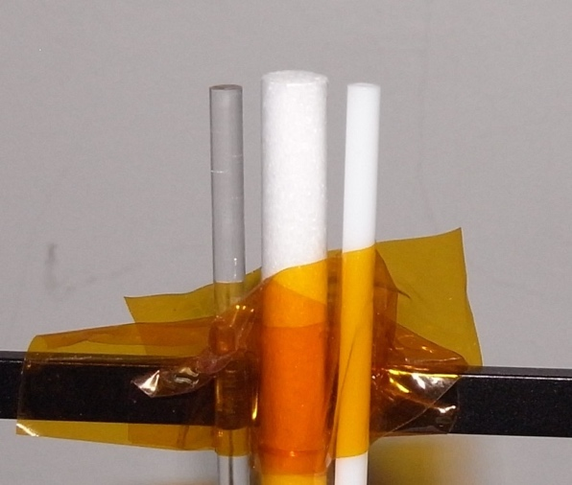

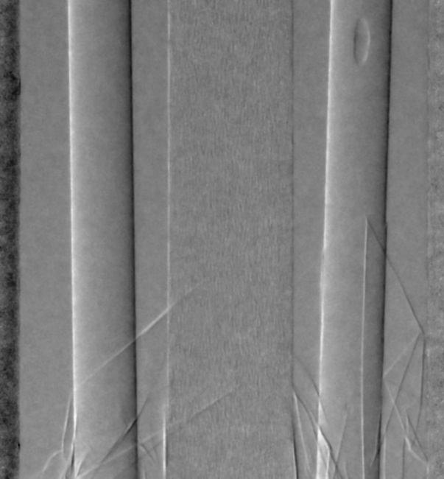
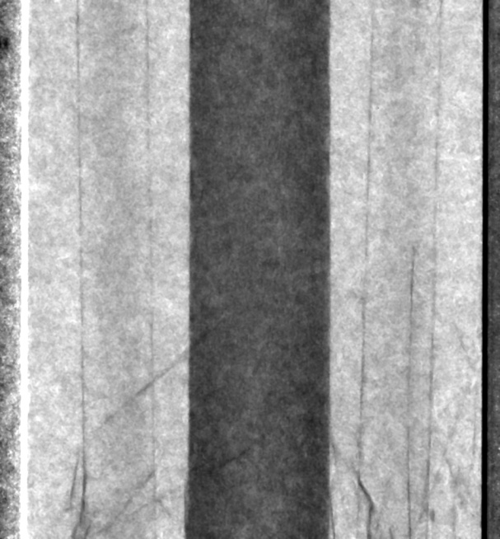
Absorption, Refraction, Scattering Images
PXR energy: 25.5 keV
crystal system: Si(220)
left to right:
acrylic rod
1.17 g/cm³
styrene-foam rod
0.16 g/cm³
polystyrene rod
0.986 g/cm³
absorption contrast
phase-contrast
SAXS contrast
(small angle X-ray scattering)
Notes:
19

Slide 20
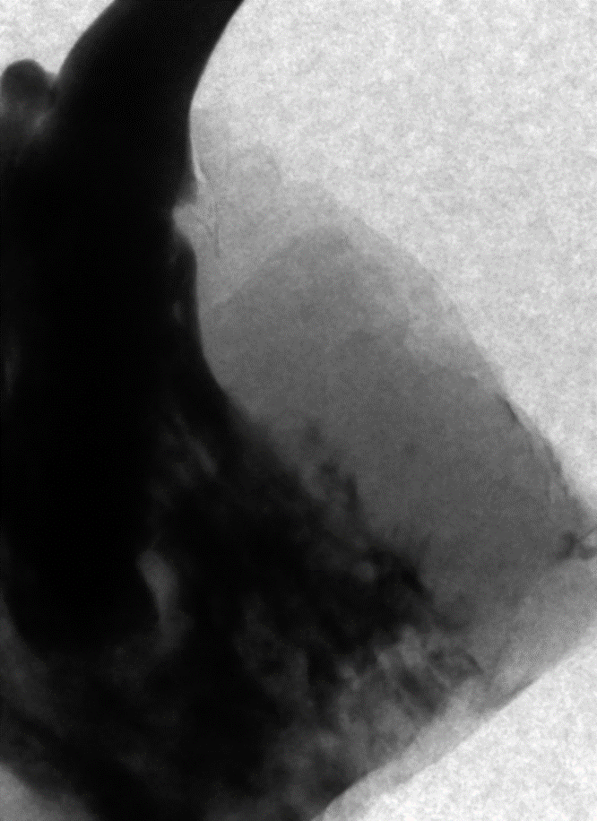
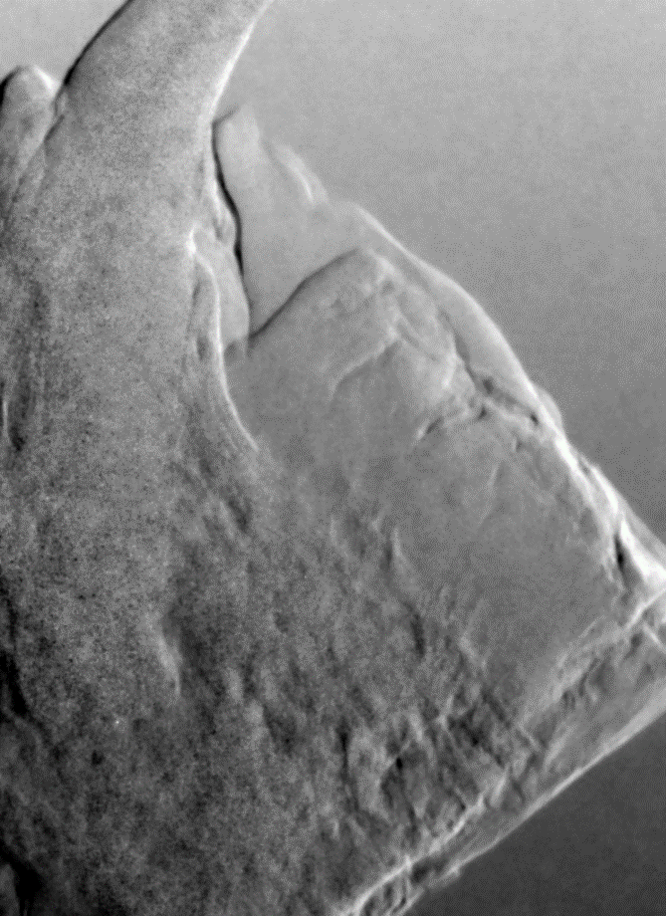
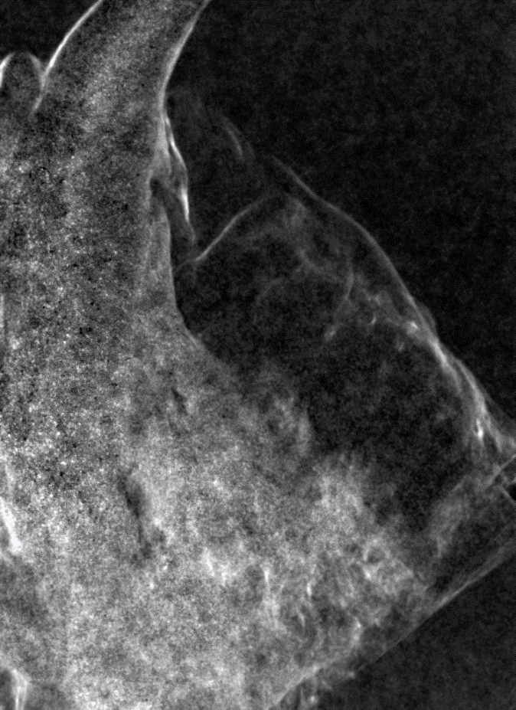
Typical result of DEI for a biological sample
sample: squamous cell carcinoma at jawbone of japanese cat （T. Kaneda Lab.）
PXR energy: 20 keV (DEI image: 15min x 5 + background image)
absorption contrast
phase-contrast
SAXS contrast

Slide 21
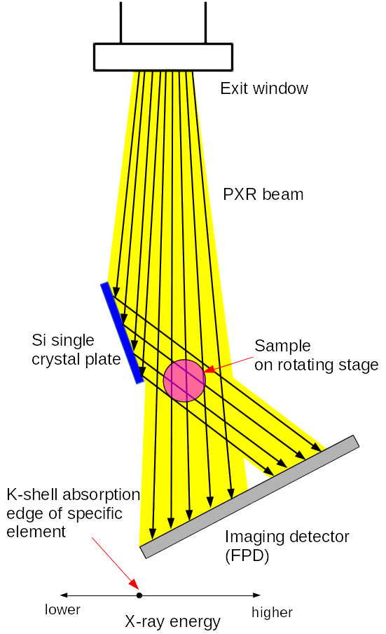
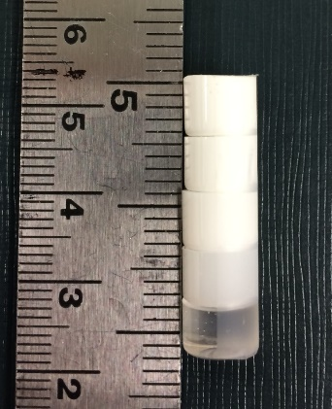
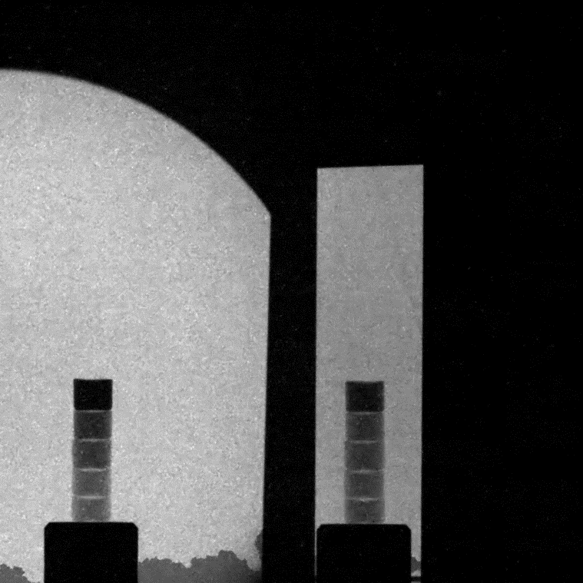
3D element imaging by simultaneous-KES
Using the DEI setup, only lower-energy PXR can be reflected by a Si crystal.
Simultaneous-KES measurement is possible
using the crossing X-ray beams.
sample: epoxy resin colored with SrTiO₃ (STO)
Sr concentration: 5%, 1%, 0.5%, 0.1%, 0%
X-ray energy
< Sr-K
PXR energy: 16.105keV
projection images: 360
each expusure: 20s
measurement time : 2 hr
X-ray energy
> Sr-K
Notes:
21
21

Slide 22
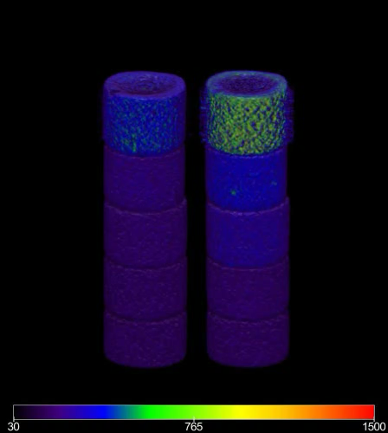
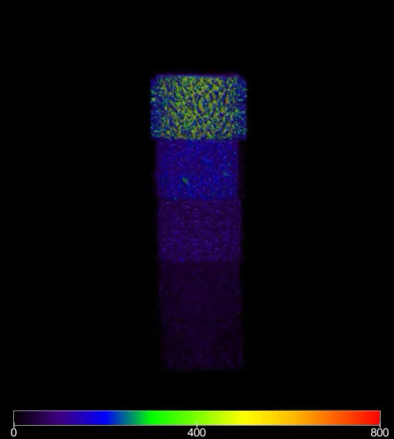
Result of simultaneous KES-CT
(left) low enerdy
(~ 16.0 keV)
(right) high energy
(~ 16.2 keV)
Sr concentration as the subtraction of the 2 images

Slide 23
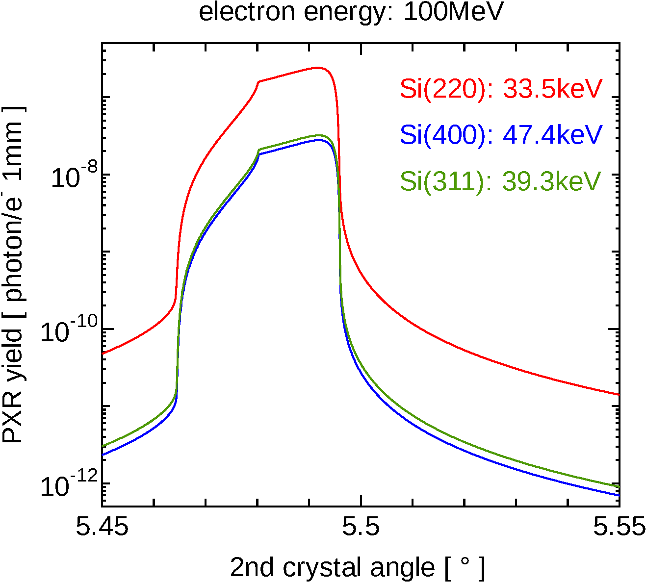
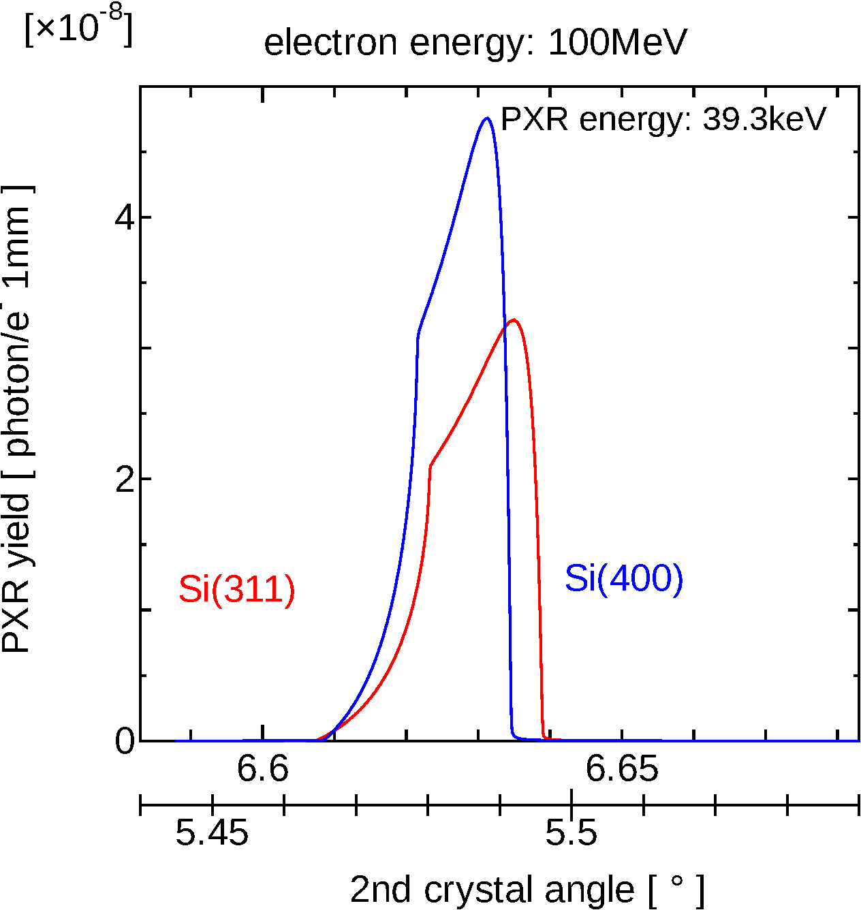
Generation high energy X-rays using LEBRA-PXR source
PASJ2018 第15回年会（長岡市）会場
Bragg angle range of LEBRA-PXR source | 5.5° - 30°
PXR energy range
Si (220) | 6.5 keV - 33.5 keV
Si (311) | 7.6 keV - 39.3 keV
Si (400) | 9.1 keV - 47.4 keV
To generate 40-keV X-rays, it is necessary to use Si crystals with higher order planes.
Si(311) and Si(400) are possible candidates.
We chose Si(400) for the project.
←
Comparison of diffraction curves at the 2nd crystal in the case of Si(220), Si(311) and Si(400), when the Bragg angle of the radiator is 5.5°
→
Si(400) is superior to Si(311)
in generating 40-keV X-rays
※ calculations without emittance growth of e-beam in the crystal medium

Slide 24
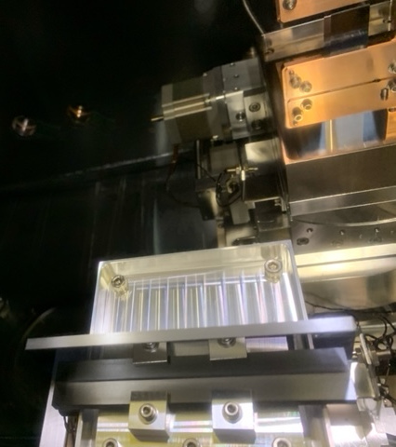
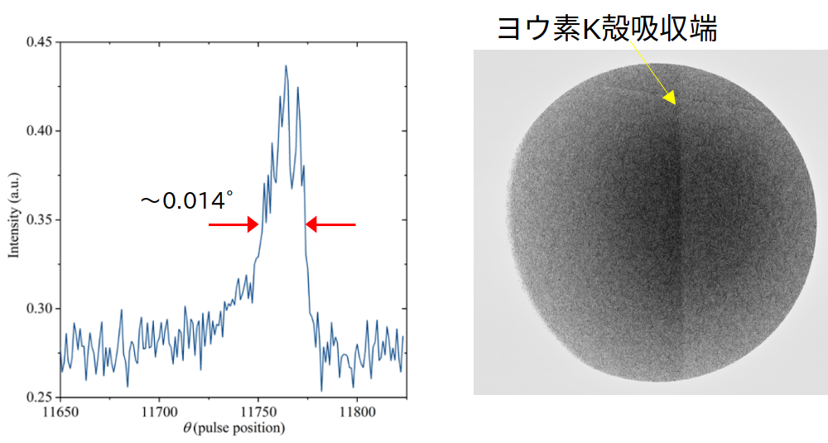
Installation of Si(400) crystals to the PXR source
LEBRA-PXR source: double crystal system
iodine K-edge
10mm
diffraction curve at 2nd crystal@33keV
beam profile of 33-keV PXR
(detector: IP)
1st and 2nd crystal plates have to be installed
as the PXR source.
(Both plates should be polished without disturbance.)
K-edge of Iodine contained in IP itself was observed around the Bragg angle correspond to 33keV

Slide 25
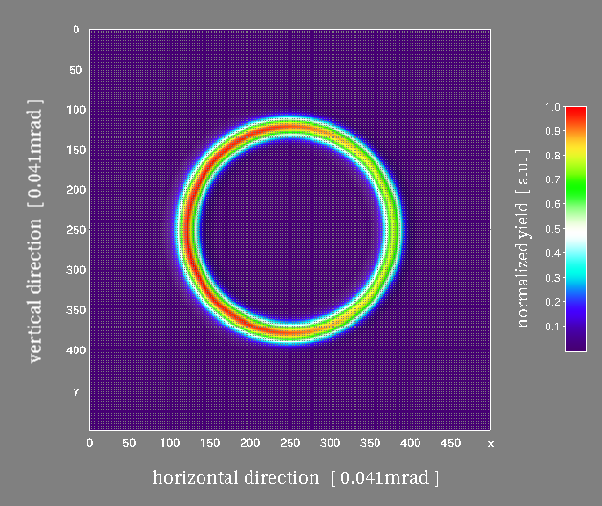
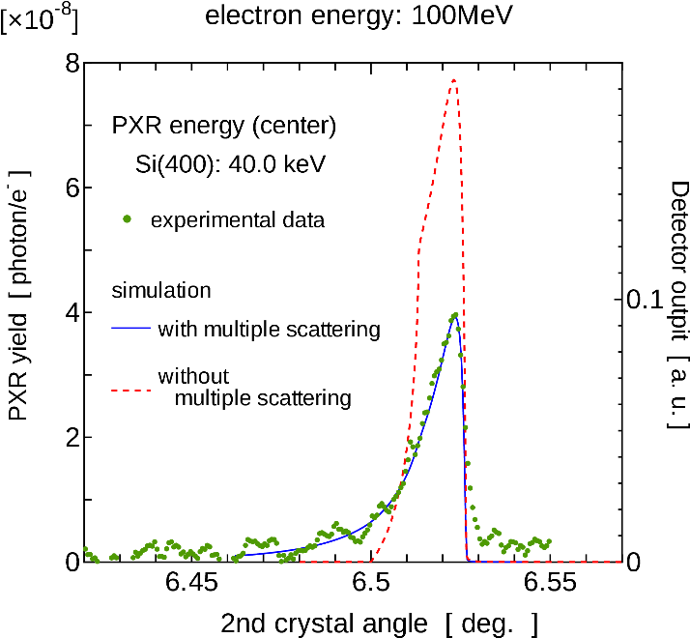
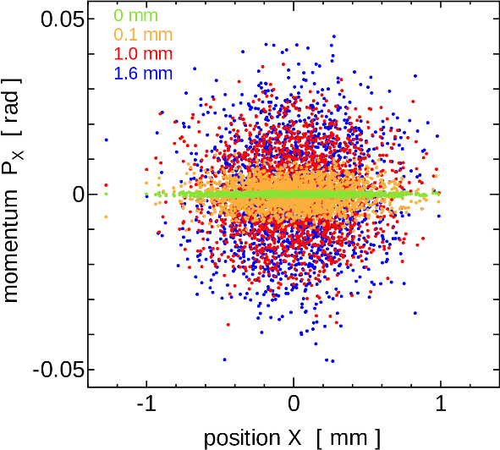
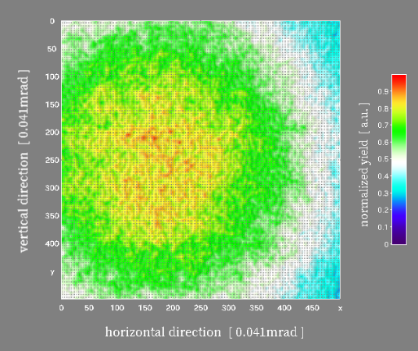
Property of 40-keV PXR from Si(400)
The emittance of 100-MeV electron beam grows from 20π to 660π mm mrad due to multiple scattering after penetrating 1-mm thick Si crystal.
The experimental result of the diffraction curve at the 2nd crystal has good agreement with the calculation including the effect of multiple-scattering.
The X-ray profile are also flattened.
The calculation suggests slight shift of the PXR beam center.

Slide 26
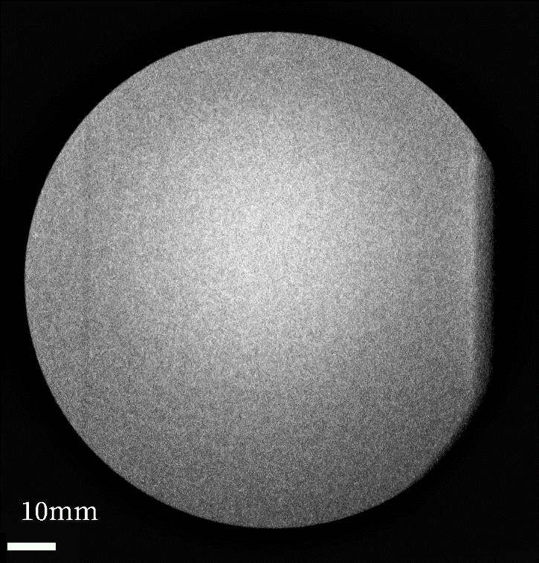
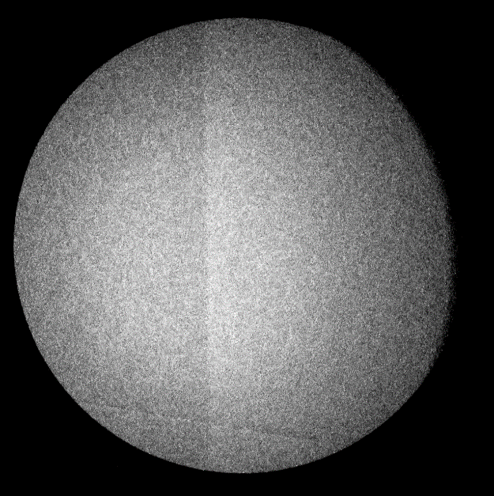
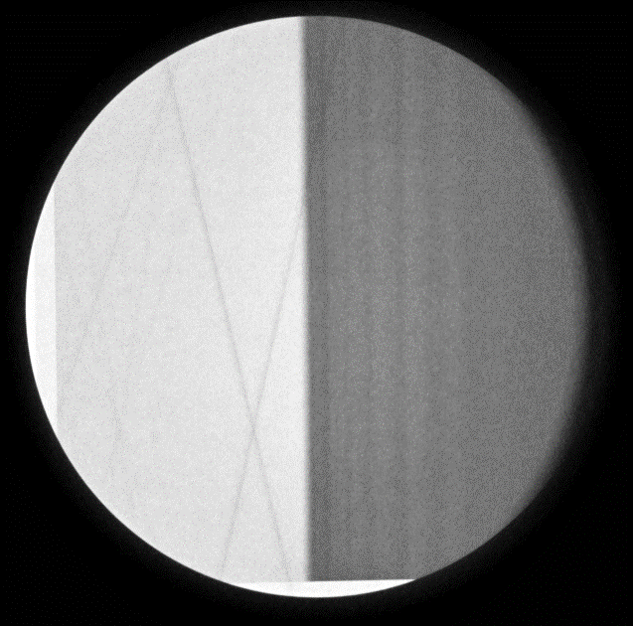
40-keV PXR profile and energy calibration
PXR energy is tuned by the Bragg angle of the radiator crystal. The angle can be calibrated using the K-shell edge energies of several elements.
left) The profile of PXR adjusted at 33.3keV
The K-edge of iodine (33.17keV) can be observed.
right) The image of Mo thin foil (Mo K-edge: 20.0 keV )
The profile of 40-keV PXR beam from Si(400)
electron energy： 100 MeV
average beam current： 1.3µA
detector： imaging plate (IP)
measurement time： 600 s
The flatness is inferior to Si(220).

Slide 27
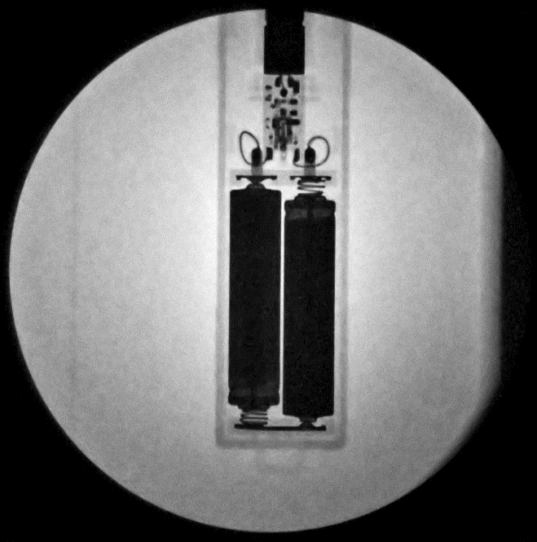
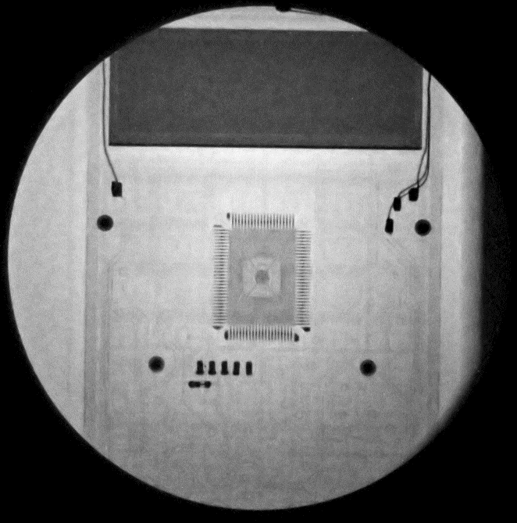
X-ray imaging using 40-keV PXR
PXR energy: 40 keV
detector: IP
(1pixel: 87µm)
measurement time:
1200s
(electron beam current was limited because of the linac trouble )
laser pointer device
calculator

Slide 28
Summary
Research project of non-destructive inspection for PCFC using the LEBRA X-ray source started.
To achieve the project, X-rays higher than 30 keV are required and it is necessary to use Si crystal with higher order planes.
Si(400) system was installed to the LEBRA-PXR source, and the 40-keV PXR beam has a capability of imaging experiments.
Preliminary PBI experiment was performed for non-destructive inspection of PCFC.
Imaging detector with high-sensitivity and low dark-noise is required to improve imaging quality with weak X-ray intensity.
Notes:
28
28

Slide 29
Acknowledgement
The study on fuel-cells is supported by a project,
JPNP20003, commissioned by the New Energy and Industrial Technology Development Organization (NEDO)
Thank you for your kind attention !!

