Slide 1

Gravitational waves and GRBs
Andrew Levan

Slide 2
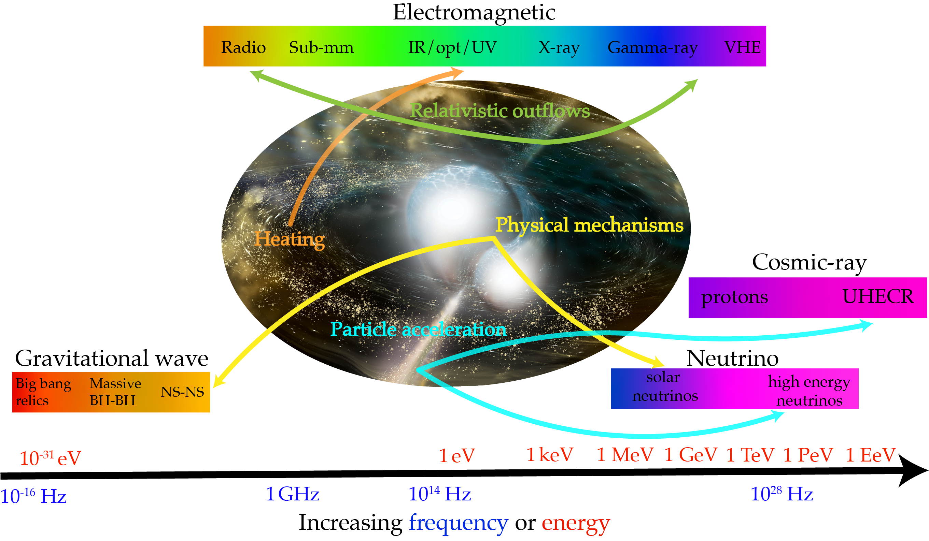

Slide 3
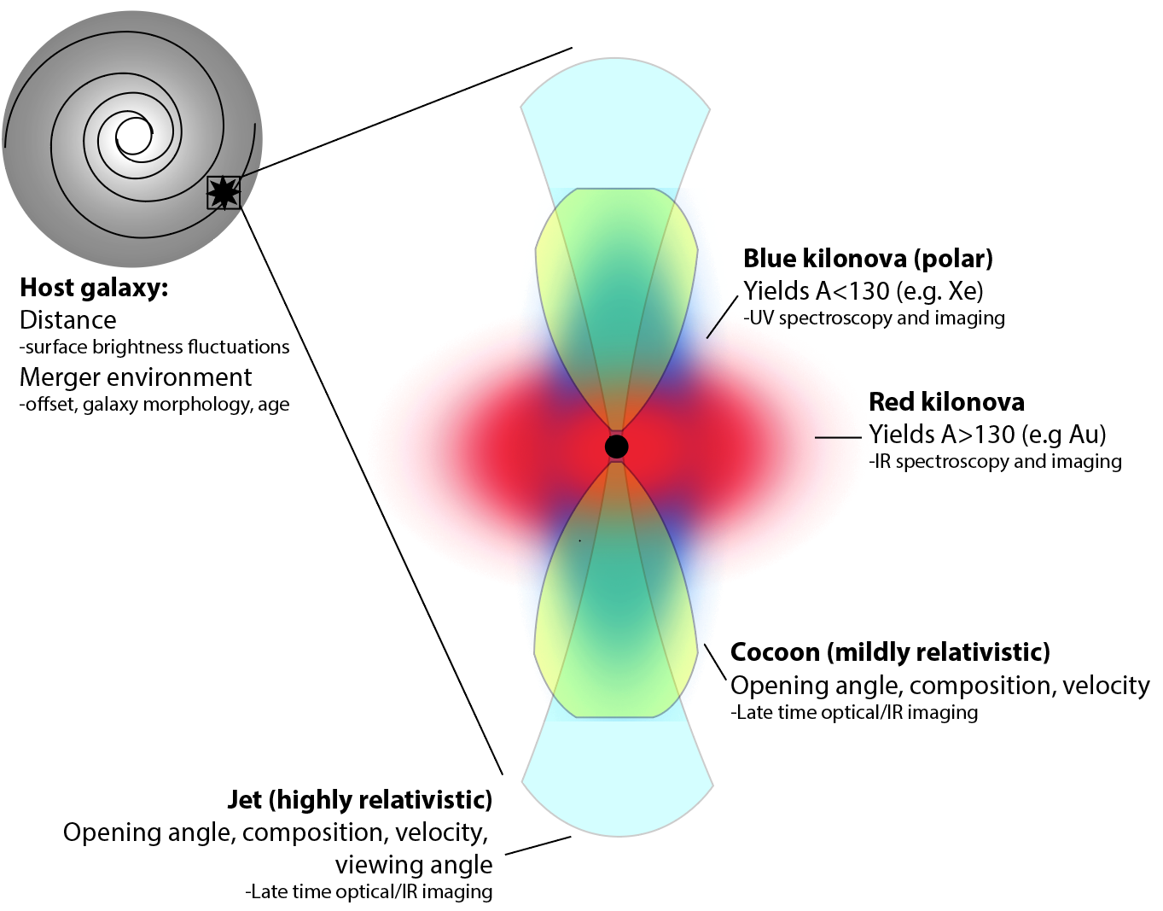
Possible multi-messenger and GRB signals
Adapted from Metzger 2017

Slide 4
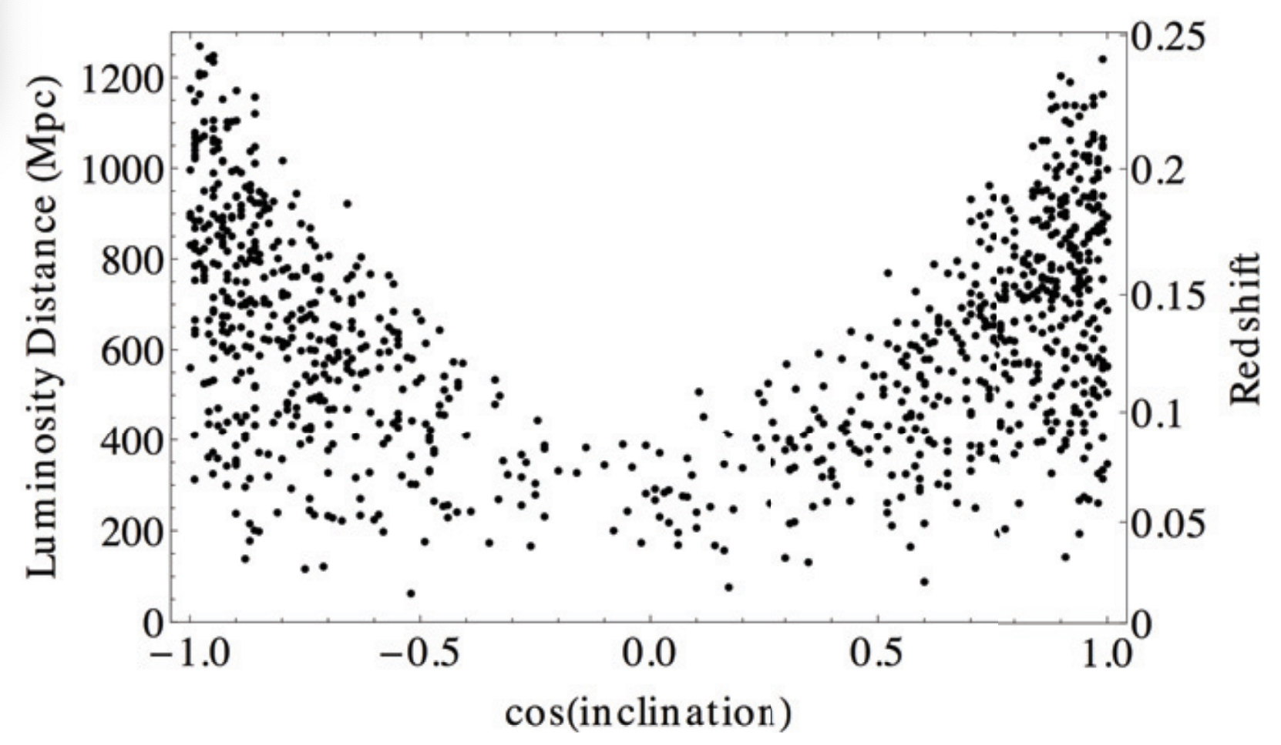
GRB detectability in a compact object merger
Top hat jet
Nissanke et al. 2011

Slide 5
GRB detectability in a compact object merger
Structured jet
Nissanke et al. 2011

Slide 6
GRB detectability in a compact object merger
Cocoon? Magnetar? Isotropic X-rays?
Nissanke et al. 2011

Slide 7
Sky localisation
Do all compact object mergers (with mass outside innermost stable orbit) produce a GRB?
What is the luminosity function of the associated GRBs? What parts of this are intrinsic or viewing angle dependent?
What is the duration of the GRBs?

Slide 8
Which progenitors produce which GRBs?
Do all compact object mergers (with mass outside innermost stable orbit) produce a GRB?
What is the luminosity function of the associated GRBs? What parts of this are intrinsic or viewing angle dependent?
What is the duration of the GRBs?

Slide 9
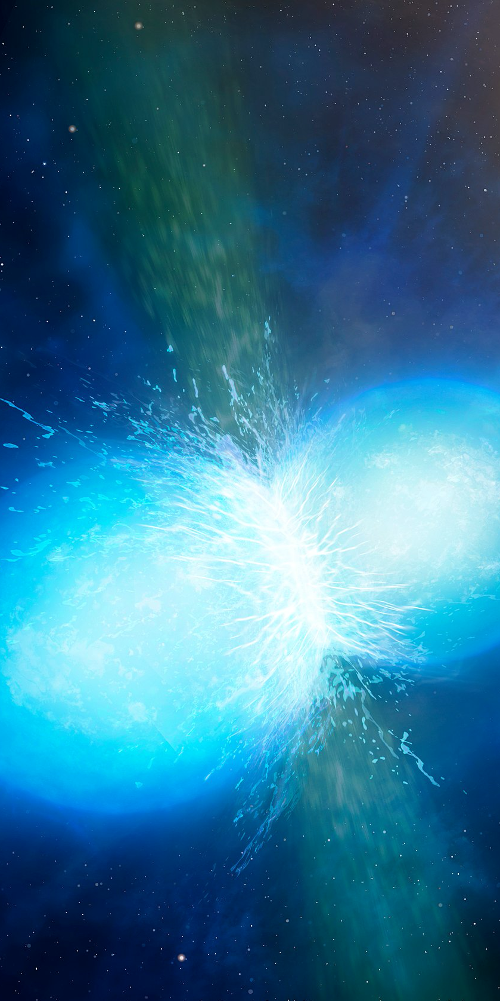
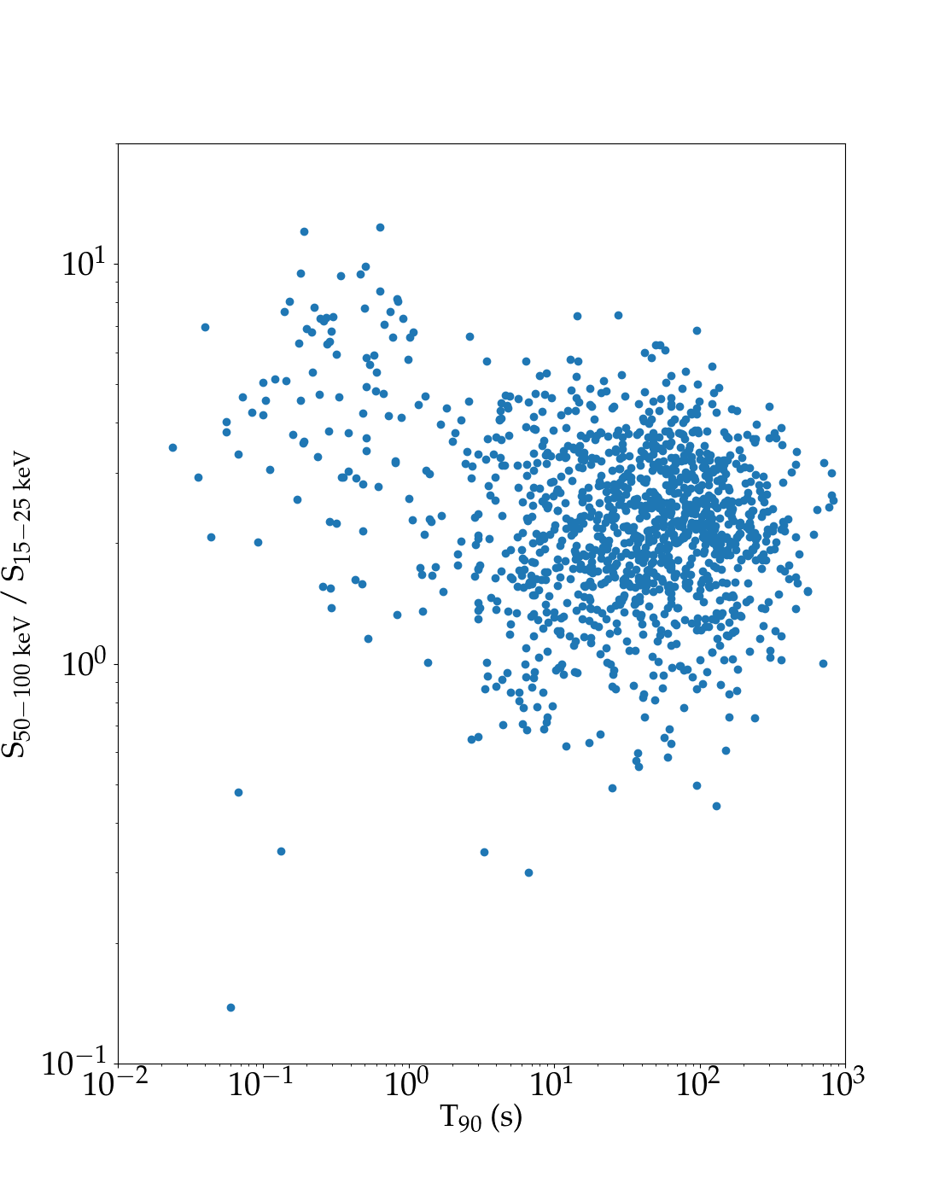
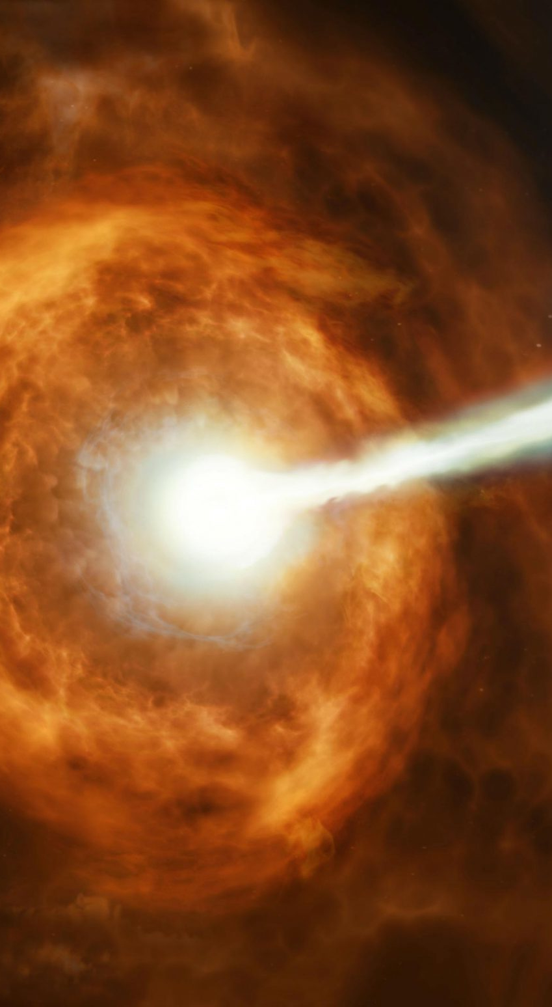
The classical GRB progenitor paradigm
Short GRBs
Compact object mergers
Kilonovae
Long GRBs
Collapsing Massive stars
Supernovae

Slide 10
Short GRB progenitors – kilonovae
Tanvir et al. 2013

Slide 11
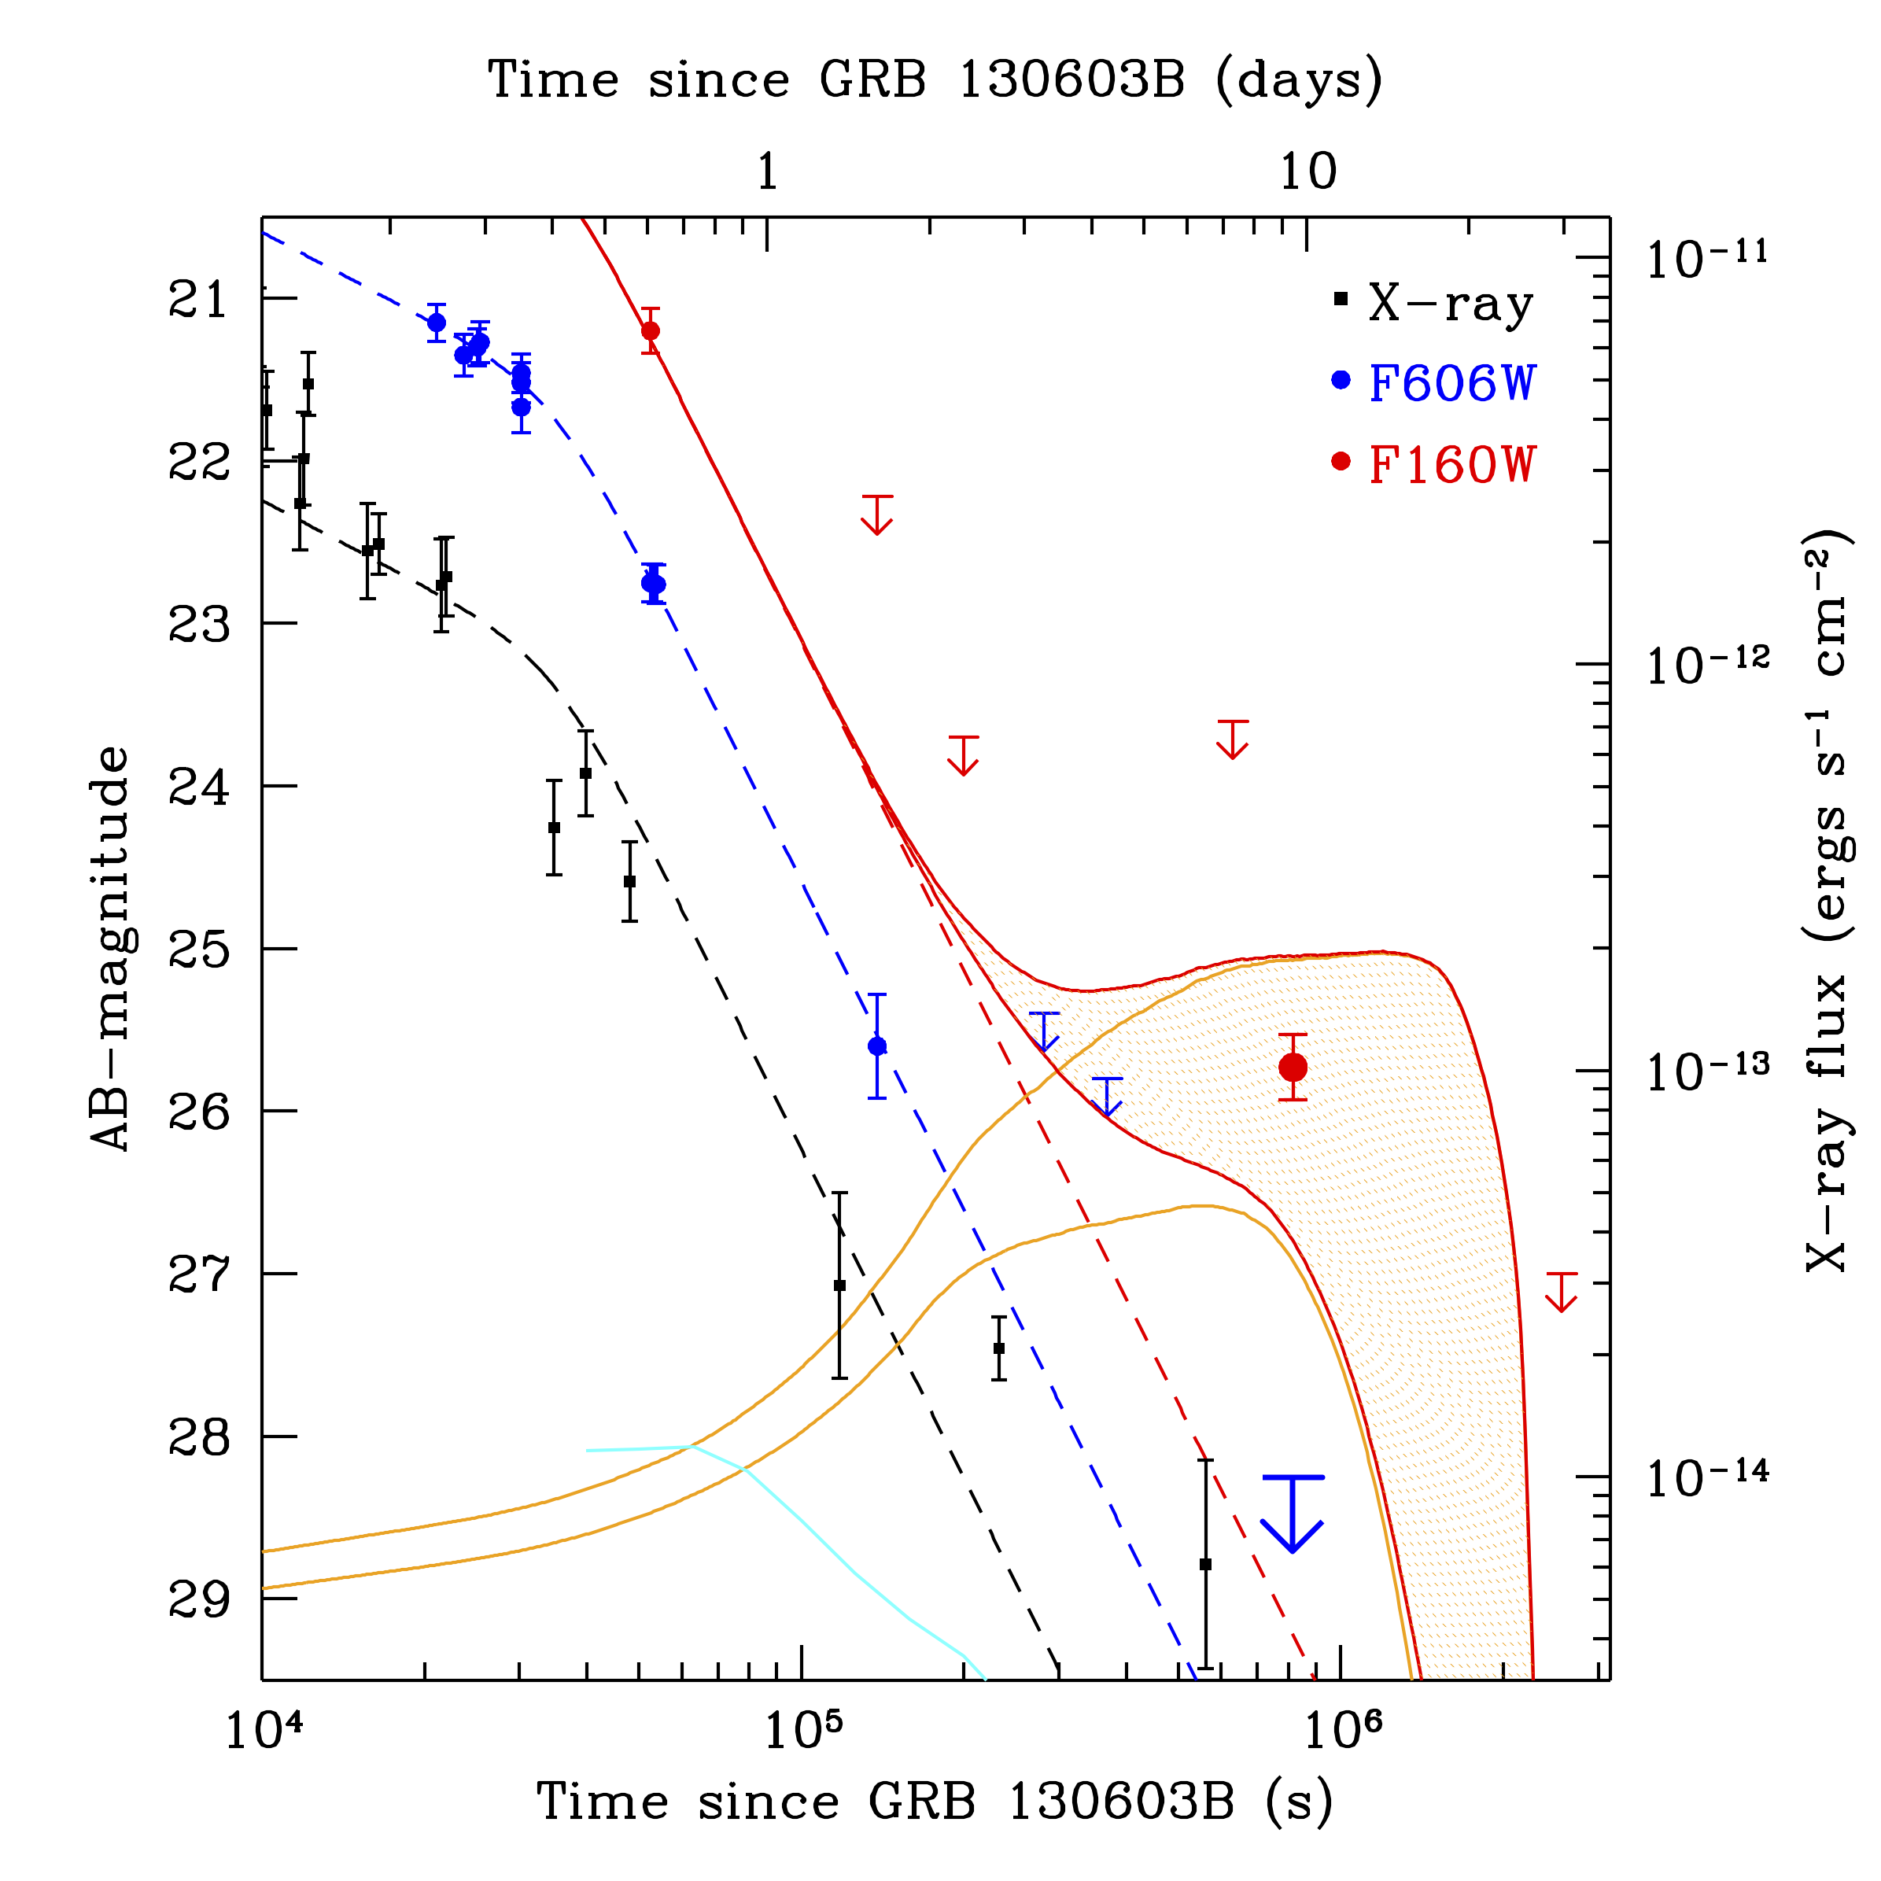
Short GRB progenitors – kilonovae
Tanvir et al. 2013

Slide 12
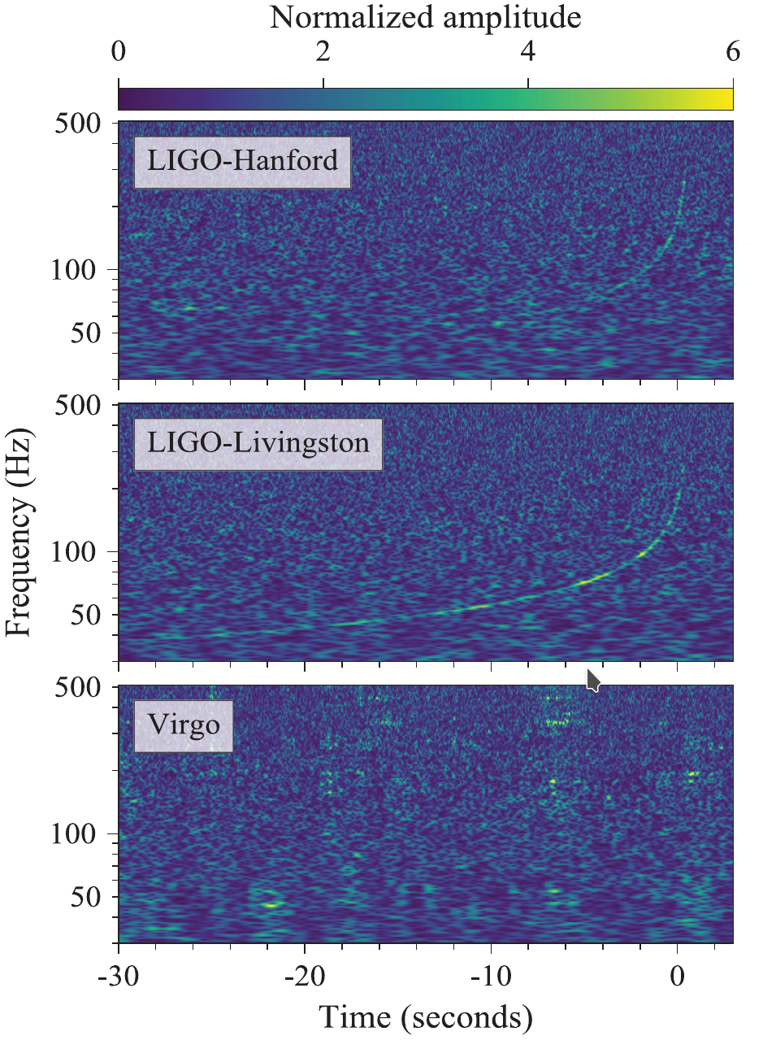
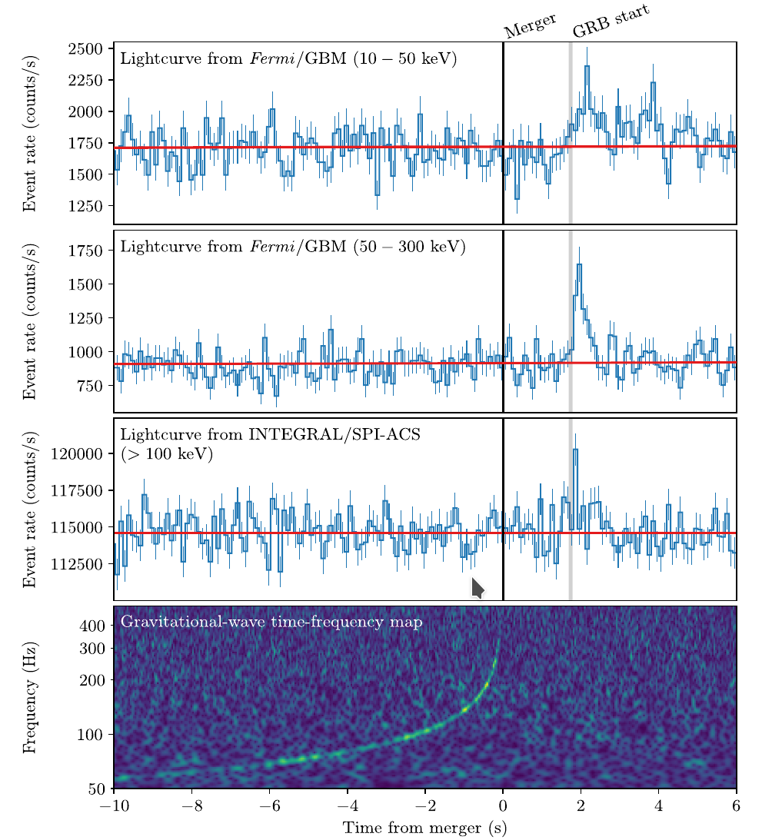
Short GRB progenitors secured
Levan et al. 2017, Tanvir et al. 2017
Abbott et al. 2017

Slide 13
Short GRB progenitors secured
LVC et al. 2017 ApJL
See also:
Arcavi et al. 2017, Cowperthwaite et al. 2017, Chornock et al. 2017, Drout et al. 2017 Nicholl et al. 2017, Haggard et al. 2017, Hallinan et al. 2017, Kasliwal et al. 2017, Levan et al. 2017, Lipunov et al. 2017, Margutti et al. 2017, Smartt et al. 2017, Soares-Santos et al. 2017, Tanvir et al. 2017, Troja et al. 2017, Valenti et al. 2017

Slide 14
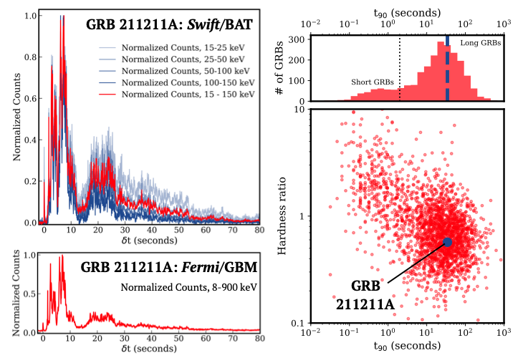
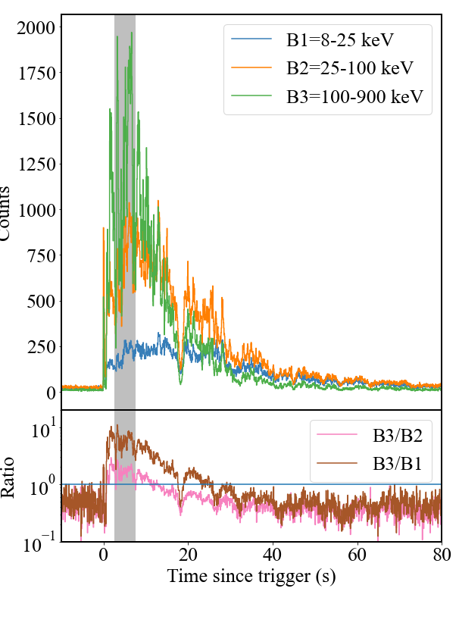
“Normal” long GRBs?
GRB 230307A
GRB 230307A
Rastinejad et al. 2022 Nature 612 223, Troja et al. 2022 Nature 612 228, Yang et al. 2022 Nature 612 232, Levan et al. 2024 Nature 626 737 Yang et al. 2024 Nature 626 742 Sun et al. 2023 arXiv:2307.05689, Gillanders et al. 2023 arXiv: 2308.00633

Slide 15
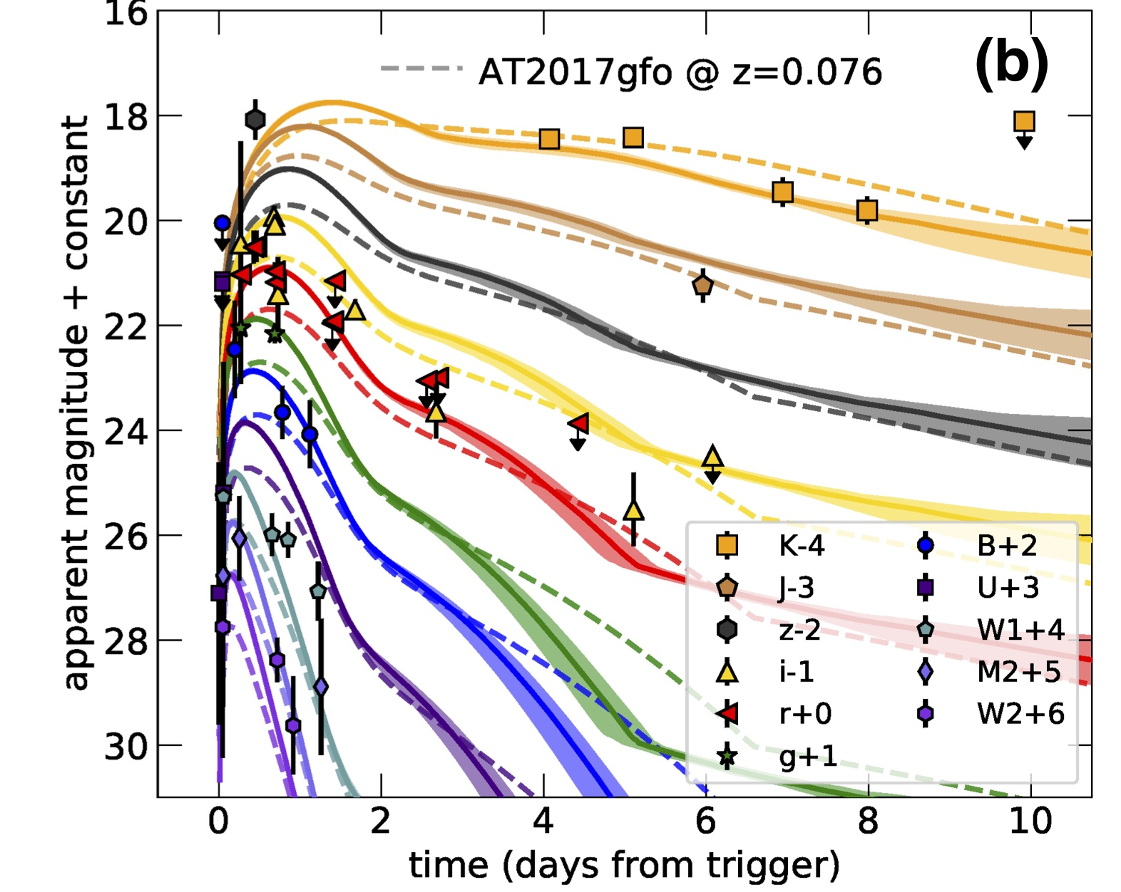
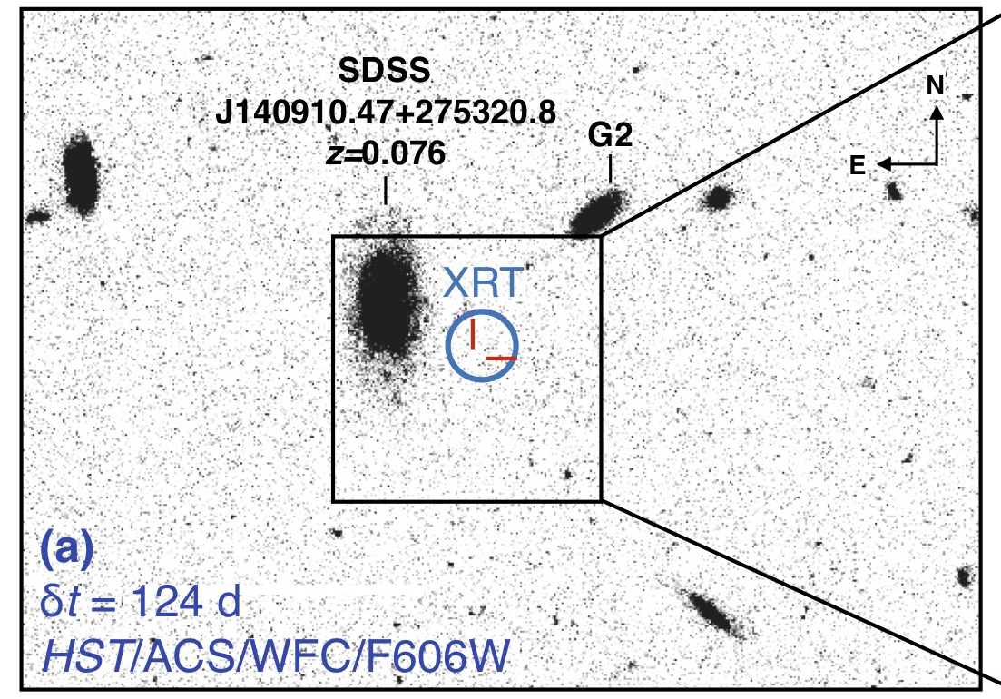
GRB 211211A
Long duration gamma-ray bursts can form kilonovae ➔ merging compact objects
Rastinejad et al. 2022 Nature 612 223, Troja et al. 2022 Nature 612 228, Yang et al. 2022 Nature 612 232

Slide 16
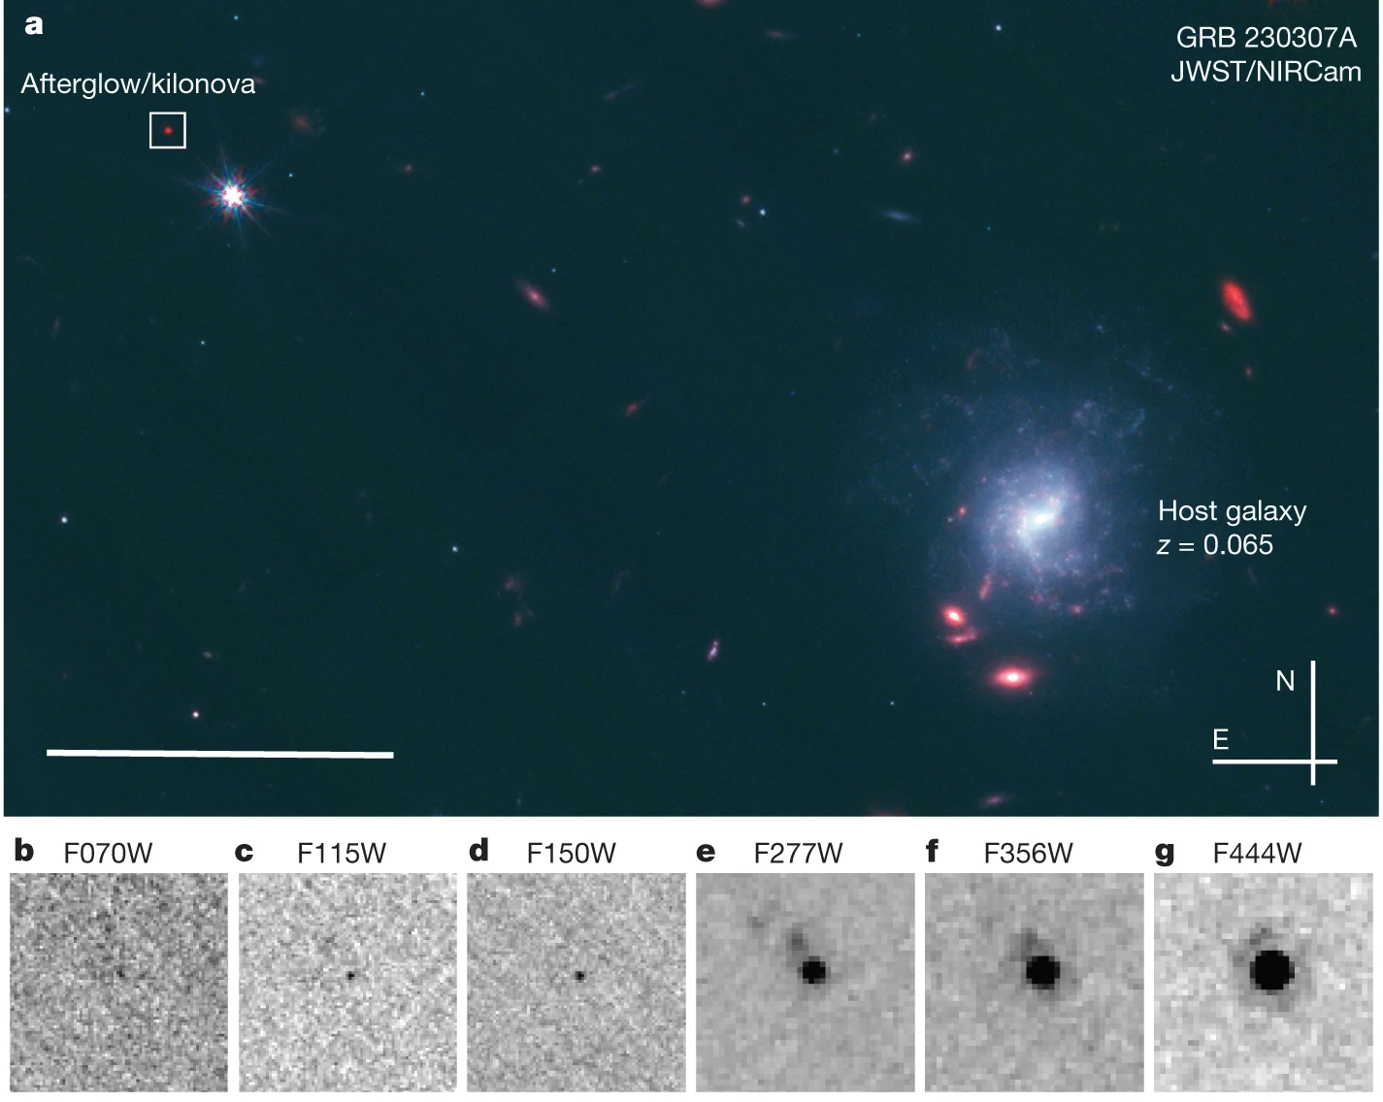
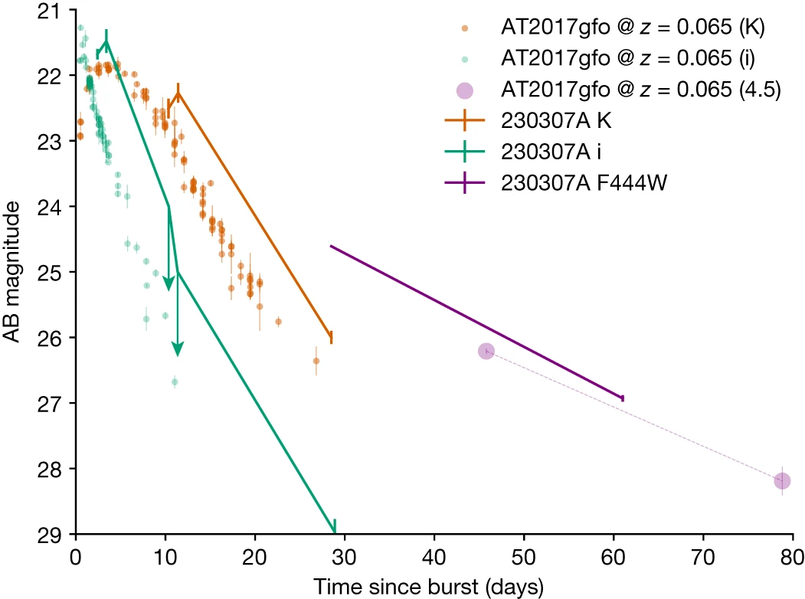
GRB 230307A
second brightest GRB of all time
Levan et al. 2024 Nature 626 737

Slide 17
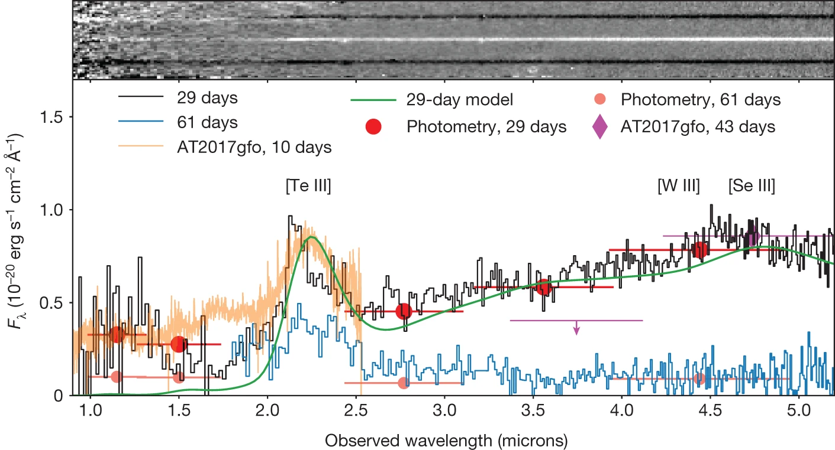
GRB 230307A
second brightest GRB of all time
Levan et al. 2024 Nature 626 737, Gillanders et al. arXiv: 2308.00633

Slide 18
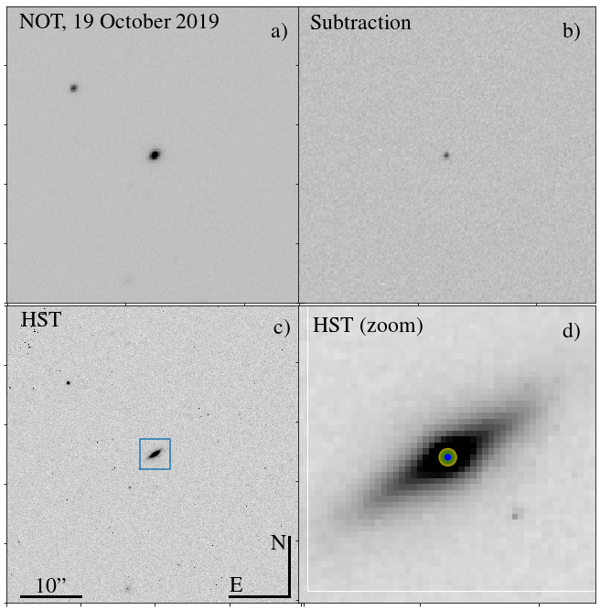
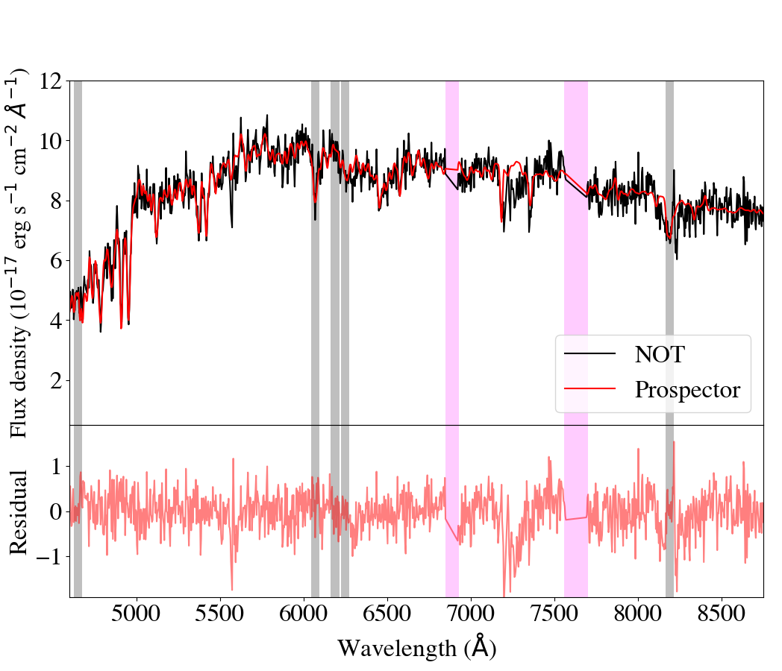
GRB 19109A
(T₉₀ = 65s, no short spike, no supernova (<0.05 SN 1998bw)
Is GRB 191019A the first example of dynamical merger? Is it in an AGN disc?
Levan et al. 2023 Nature Astronomy, 7, 976,Lazzati et al. 2023 ApJ 950 20

Slide 19
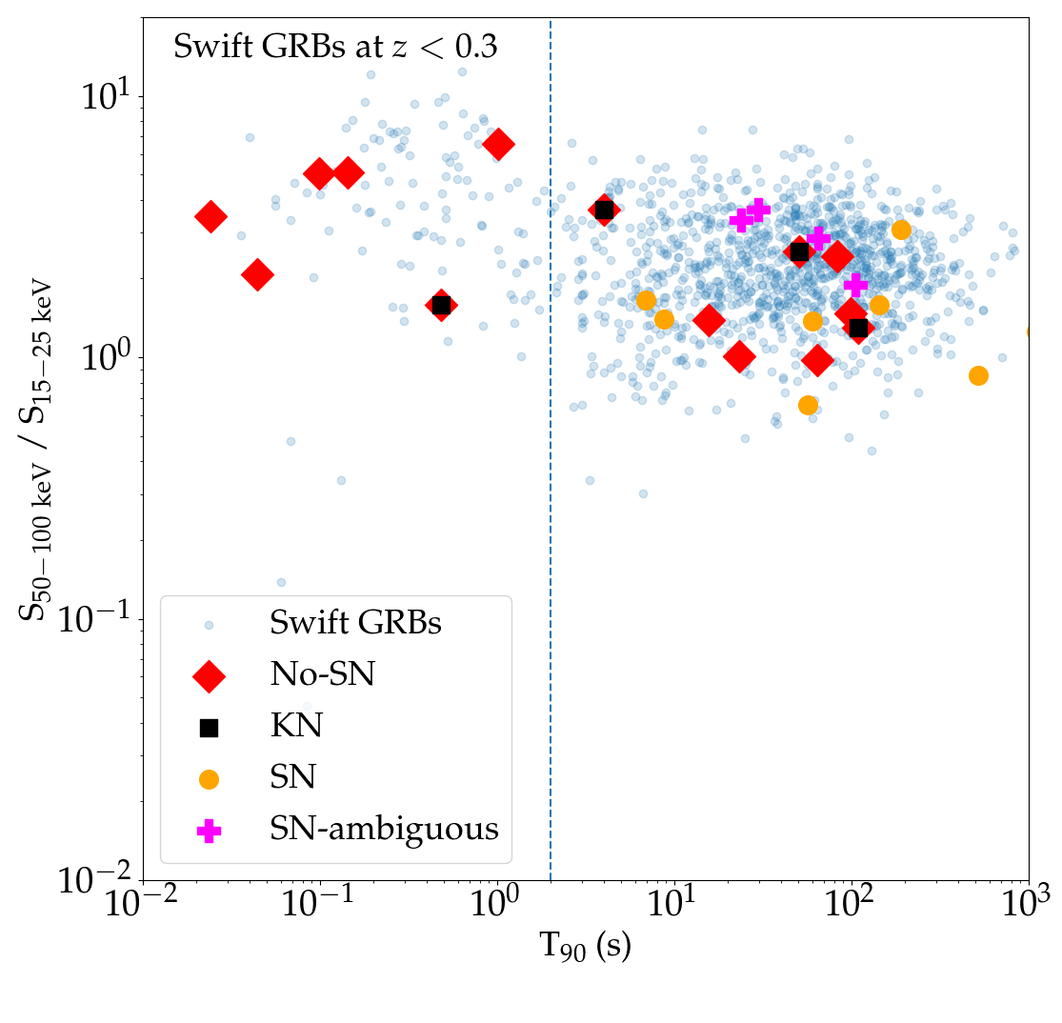
Long GRBs from mergers?

Slide 20
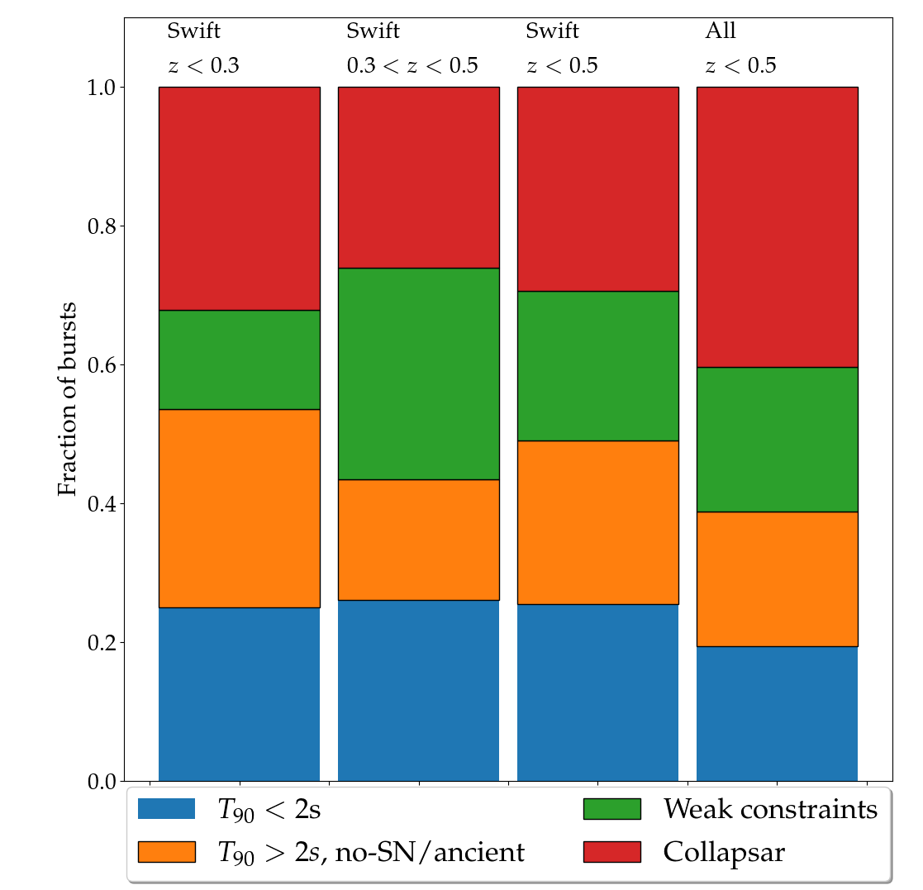
There can be a substantial contribution from compact object mergers to long GRBs
Mergers?

Slide 21
The population of mergers at relevant distances for GW detectors
400 Mpc – on-axis, BNS, LVK
800 Mpc – on-axis, BH-NS, LVK
GRB 170817A
GRB 111005A
GRB 230307A
GRB 211211A
GRB 051109B
GRB 060505
GRB 080905A
GRB 150101B
GRB 050709
GRB 060614
GRB 160821B
Mostly detected by Swift, 1/6th of sky at any moment, 30% redshift complete. All sky rate likely 10-20 times higher.
Is the best route to getting more GW-EM events narrower deeper, further down luminosity function, or wider shallower but getting all events?
800 Mpc is also close to the limit where we might reliably find kilonova without precise positions, even with VRO/LSST.
Claimed kilonova
Long
In the local Universe, there are more long GRBs possibly from mergers than short GRBs.
But rates start to become problematic with the non-detection of BNS mergers in O4

Slide 22
Summary
GRBs were the first seen GW-EM signal (even if only by a few hours) and remain a prime route to identify multi-messenger signals
While a GRB time co-incidence alone is enough to claim association, the big gains come if GRBs can also provide precise localization => multi-wavelength counterparts, host galaxies, redshifts, energetics, cosmology etc etc.
Surprisingly, recent evidence suggests that long GRBs can also form via compact object mergers, and in the local Universe may contribute equally (or even more) than short GRBs to the volumetric rate.
Given beaming, it is likely that only a modest fraction of GRBs will be associated with GW events unless there is some broad or isotropic component. In the LVK era wide-field surveys for counterparts and kilonovae may be more important (but may also not be).
In the longer term future for Einstein Telescope/Cosmic Explorer GRBs are likely to be the tool of choice.

