Slide 1
TWO-PHONON PAIRING DOES NOT EXPLAIN SUPERCONDUCTIVITY IN STRONTIUM TITANATE
Antonio Santacesaria

Slide 2
1
STRONTIUM TITANATE
Connection between FE and SC transition, two-phonon mechanism
3
EFFECTIVE TWO-PHONON INTERACTION
5
CONCLUSIONS AND OUTLOOKS
2
ELIASHBERG THEORY
Eliashberg equations
4
RESULTS
Critical temperature and dimensionless parameters

Slide 3
INTRODUCTION TO (CONVENTIONAL)
SUPERCONDUCTIVITY

Slide 4
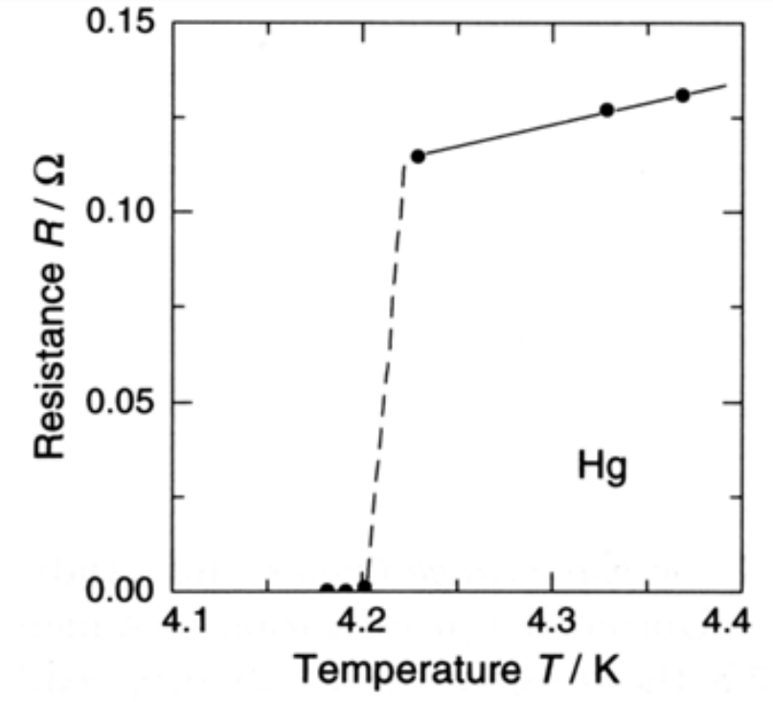
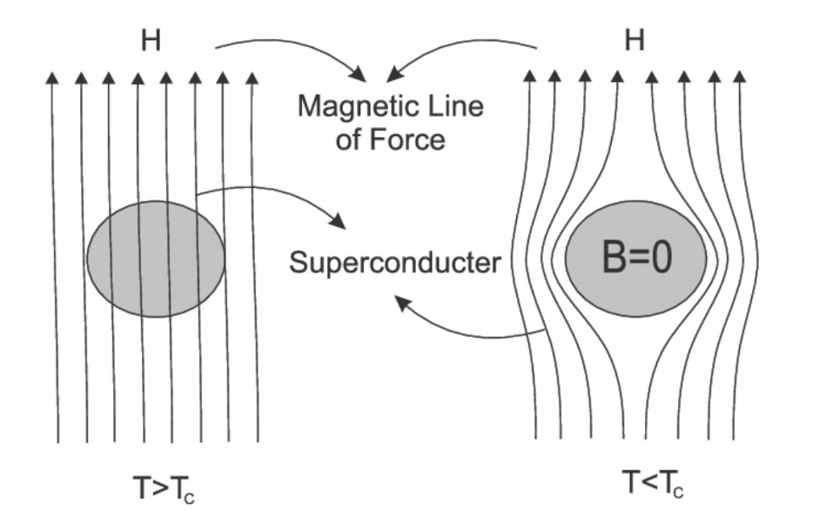
DISCOVERY & MEISSNER EFFECT
Mercury (Hg)
$$T_{C}=4.2K$$
Kamerlingh Onnes (1911)
Meissner effect (1933)
Normal state
SC state
Magnetic flux completely expelled

Slide 5
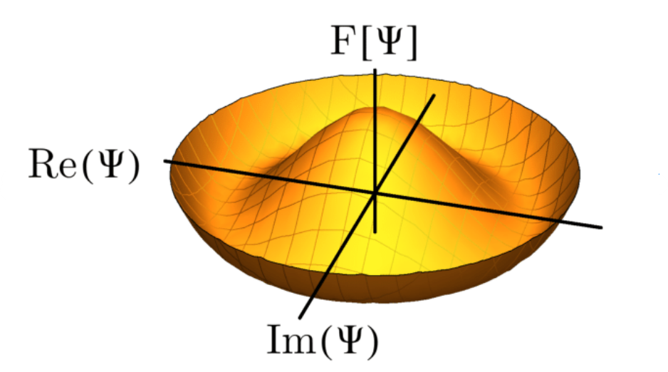
ORDER PARAMETER
Landau-Ginzburg theory (1957)
Complex order parameter
Gap function: Δ
Spontaneous symmetry breaking (SSB)

Slide 6
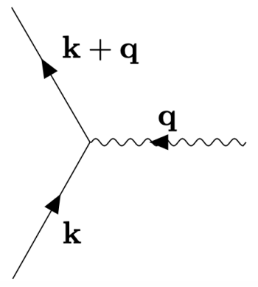
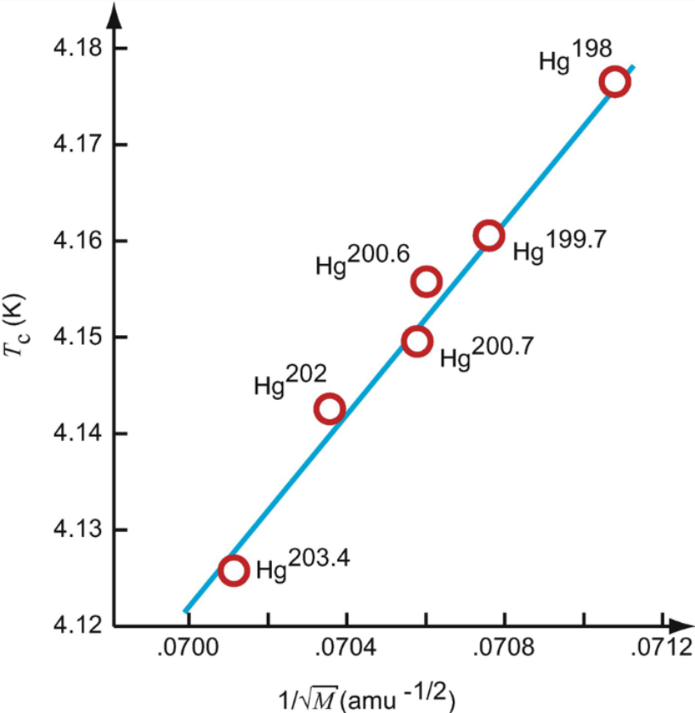
ISOTOPE EFFECT & PHONONS
Isotope effect (1953)
$$T_{C}∝1/√M$$
Pairing mechanism: longitudinal optical (LO) phonon

Slide 7
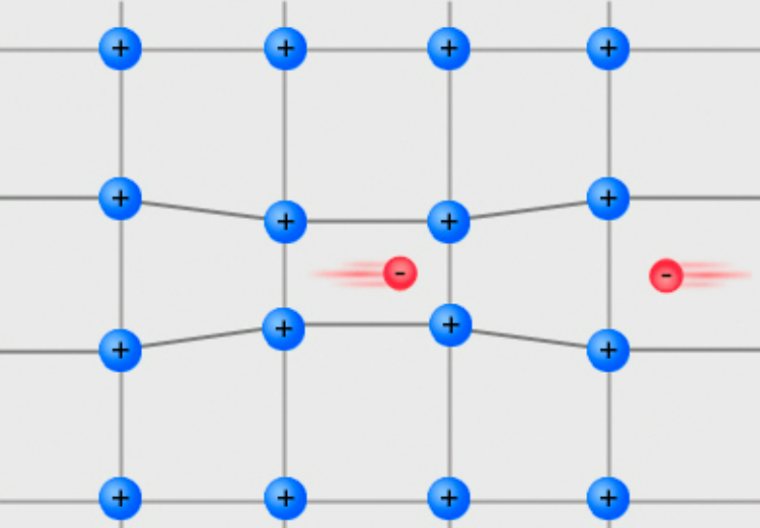
COOPER PAIRS
Attractive interaction between electrons: Cooper pairs
Coulomb interaction negligible (screening)

Slide 8
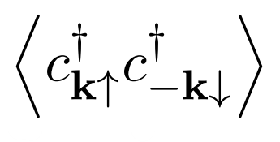
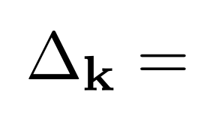
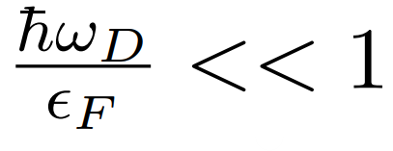
BCS THEORY (1957)
Order parameter: GAP function
Mean potential
Assumption:
Electron-phonon coupling
DOS at the Fermi level
Adiabatic regime
Pairing mediated by one LO phonon
No dynamics

Slide 9
STRONTIUM TITANATE
(STO)

Slide 10
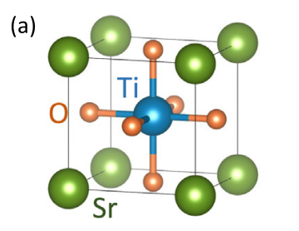
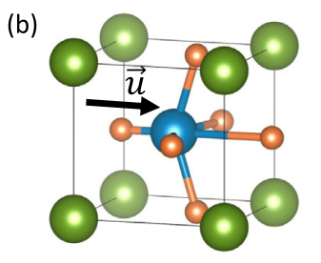
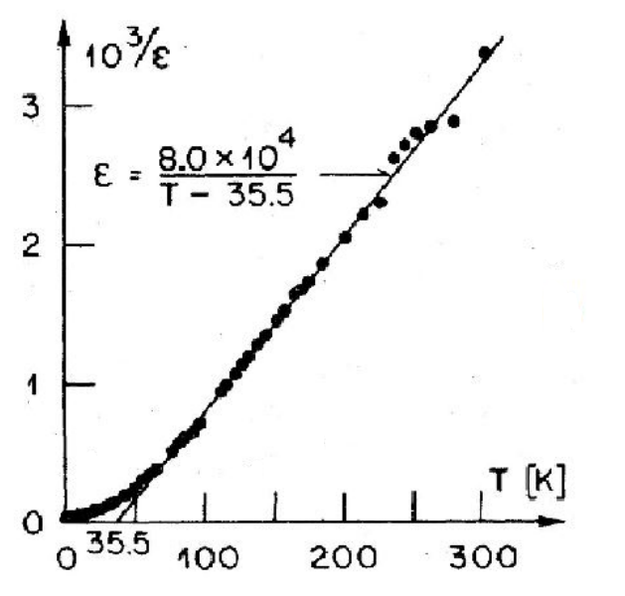
STO
Pure $SrTiO_{3}$ is an insulator with 5 atoms per unit cell: $1 Sr^{2+}$, $1 Ti^{4+}$ and $3 O^{2−}$
Centrosymmetric cubic structure
Maria N. Gastiasoro et al. Annals of Physics 2020
Incipient ferroelectric transition
Curie-Weiss behavior
QUANTUM FLUCTUATIONS DESTROY FE ORDER
(Quantum paraelectric)
K. A. Müller and H. Burkard PRB 1979

Slide 11
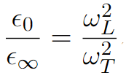
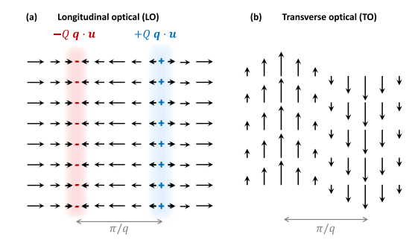
INSULATING STO
Optical polar mode splitted at the $Γ$ into
1 longitudinal optical (LO) mode
2 degenerate transverse optical (TO) modes
SOFTENING
L.S.T. relation
(Not complete
due to quantum fluctuations)
$$ω_{L}>ω_{T}$$
Maria N. Gastiasoro et al. Annals of Physics 2020

Slide 12
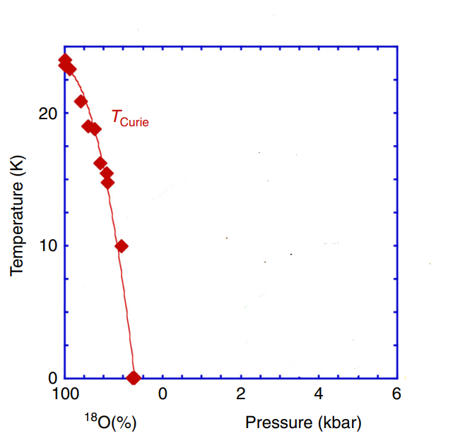
INSULATING STO
FE ORDER
Disorder
Pure STO
FE
Complete softening
QCP
Enderlein et al. Nature Communication 2020.

Slide 13
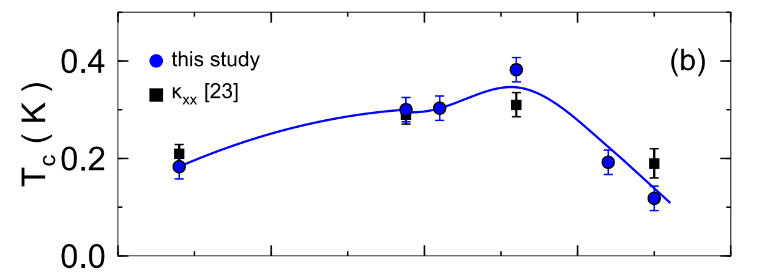
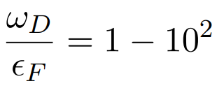
DOPED PHASE
BCS THEORY (conventional SC)
Mean potential
Coupling
DOS at the Fermi level
Collignon et al. PRB 2017
Debye Frequency
$$n={10}^{17}−{10}^{21}{cm}^{−3}$$
Small density of states (DOS) ${ N}_{0}\sim \sqrt{ε_{F}}$
BCS framework questionable
Fermi Energy
Dynamical effects

Slide 14
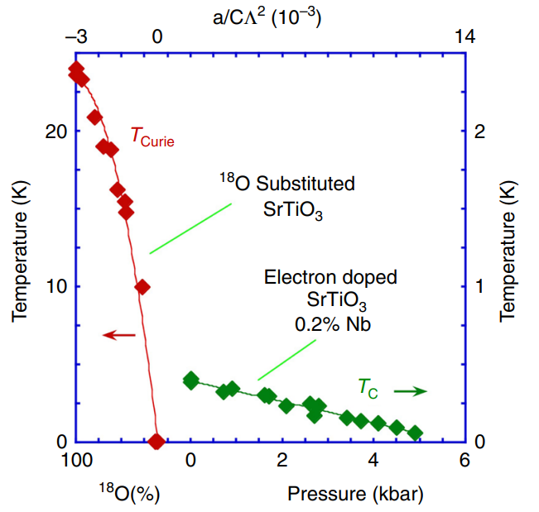
FE, SC & PAIRING MECHANISM
This suggests a mechanism involving the SOFT TO phonon
(FE)
(SC)
Conventional SC
Pairing with a LO phonon (high energy)
Enderlein et al. Nature Communication 2020.
QCP
Two-phonon coupling
$T_{C}$ enhanced
14

Slide 15
TOY MODELS
LINEAR COUPLING
QUADRATIC COUPLING
$$M$$
$$u$$
$$M$$
$$u$$
$$k_{0}$$
$$k_{0}$$
$$d$$
$$d$$
$$ε$$
$$ε$$
Classical and quantum results coincide:
Purely quantum effect
${ T}_{C}$ enhanced (?)

Slide 16
ELIASHBERG THEORY

Slide 17
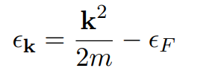
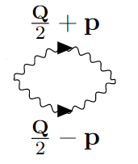
ELIASHBERG EQUATION
ISOTROPIC SYSTEM
Dynamical effects
GAP

Slide 18
EFFECTIVE TWO-PHONON INTERACTION

Slide 19
EFFECTIVE INTERACTION
Cut-off ‘‘Debye’’ frequency
Phonon dispersion
Eliashberg function
*Mathematics*
Isotropic effective interaction
Logarithmic enhancement

Slide 20
RESULTS

Slide 21
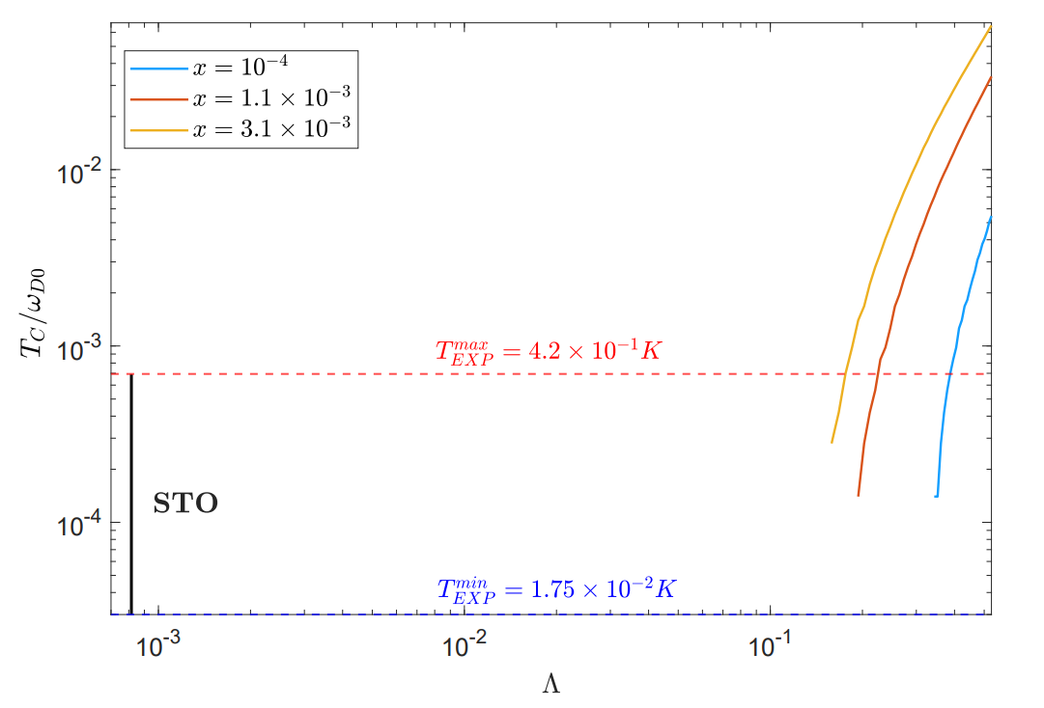
RESULTS
ACOUSTIC PHONON DISPERSION ($ω_{T}=0$ meV )
DIMENSIONLESS PARAMETERS
Coupling
BCS
STO

Slide 22
RESULTS
ACOUSTIC PHONON DISPERSION ($ω_{T}=0$ meV )
DIMENSIONLESS PARAMETERS
Coupling
BCS
STO

Slide 23
CONCLUSIONS & OUTLOOKS

Slide 24
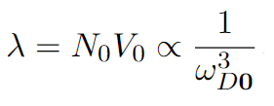
CONCLUSION & OUTLOOKS
CONCLUSION
OUTLOOKS
Dynamical two-phonon pairing mechanism may be important for other phenomena in STO (transport)
Explain superconductivity in materials with a soft phonon in all BZ
Rashba-like coupling
Effective two-phonon mediated electron-electron interaction is very strong at $Q=0$ but weak at the rest of the Brillouin zone.

Slide 25
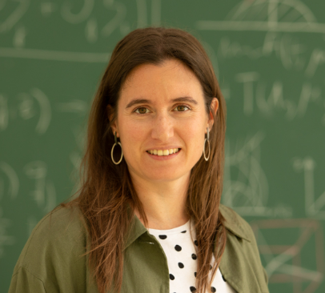
THANKS TO
José Lorenzana
Maria N. Gastiasoro
CNR-ISC
DIPC

Slide 26
THANKS FOR THE ATTENTION

Slide 28
APPENDIX

Slide 29
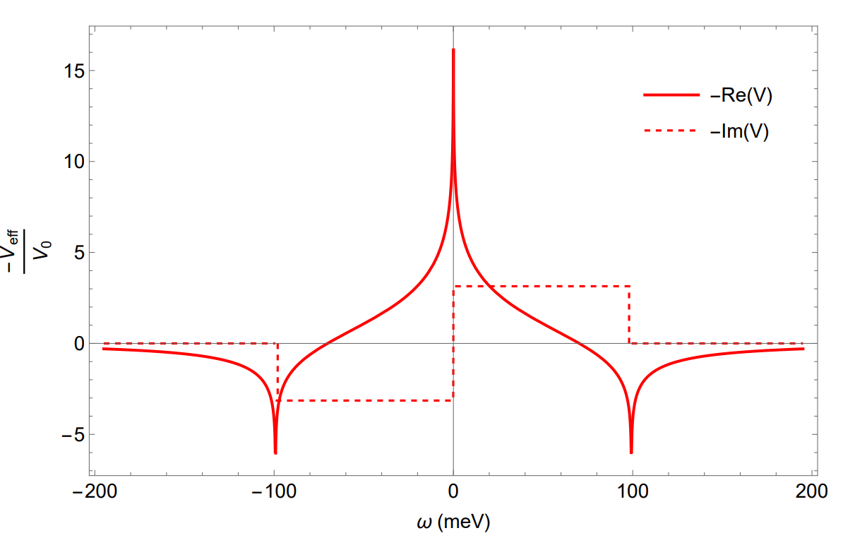
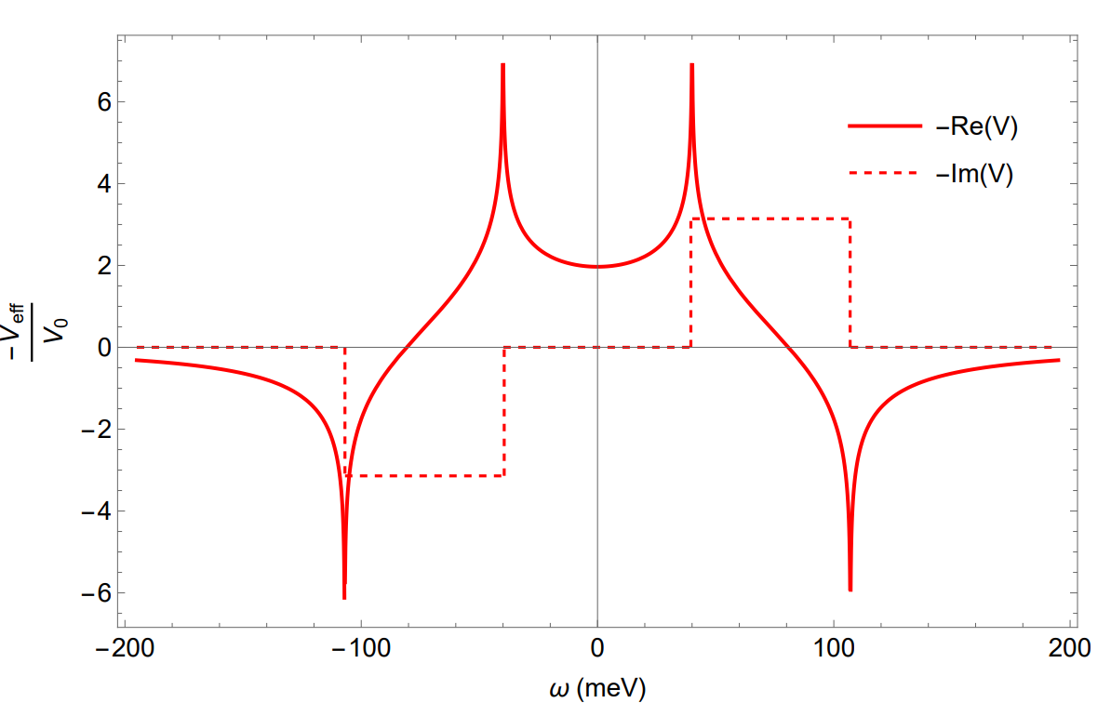
EFFECTIVE INTERACTION
ACOUSTIC PHONON DISPERSION ($ω_{T}=0$ meV )
$$Q=0$$
$Q≠0$
${Re(V}_{eff})<0$ for $ω <2ω_{D}(Q)$

Slide 30
ELIASHBERG EQUATION
ISOTROPIC SYSTEM
Dynamical effects
FS
$$k$$
$$Γ$$
GAP
$$k′$$
$$Q$$
$$\frac{Q}{2}+p$$
$$\frac{Q}{2}−p$$
$$FBZ$$

Slide 31
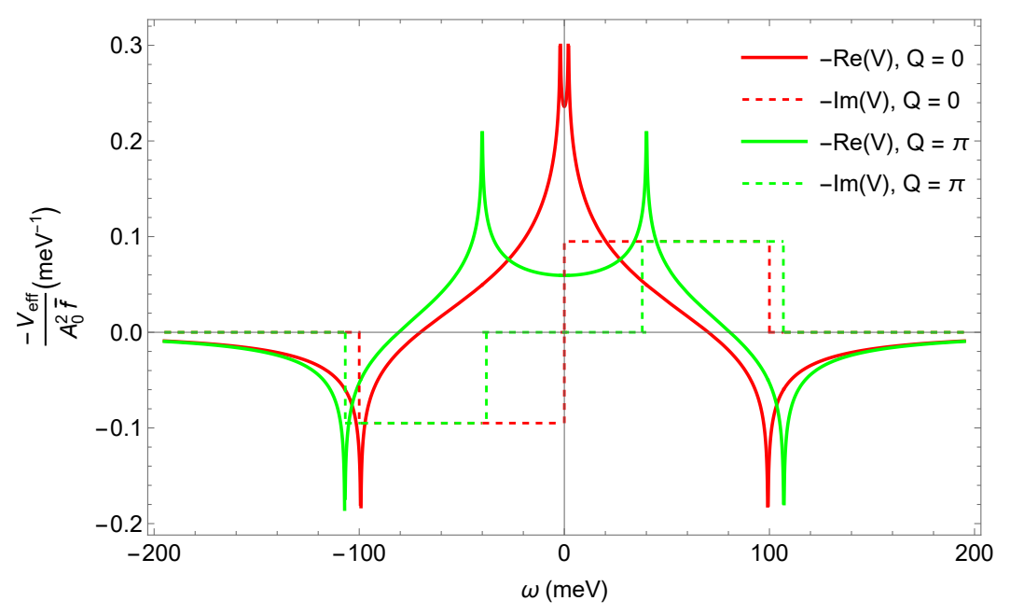
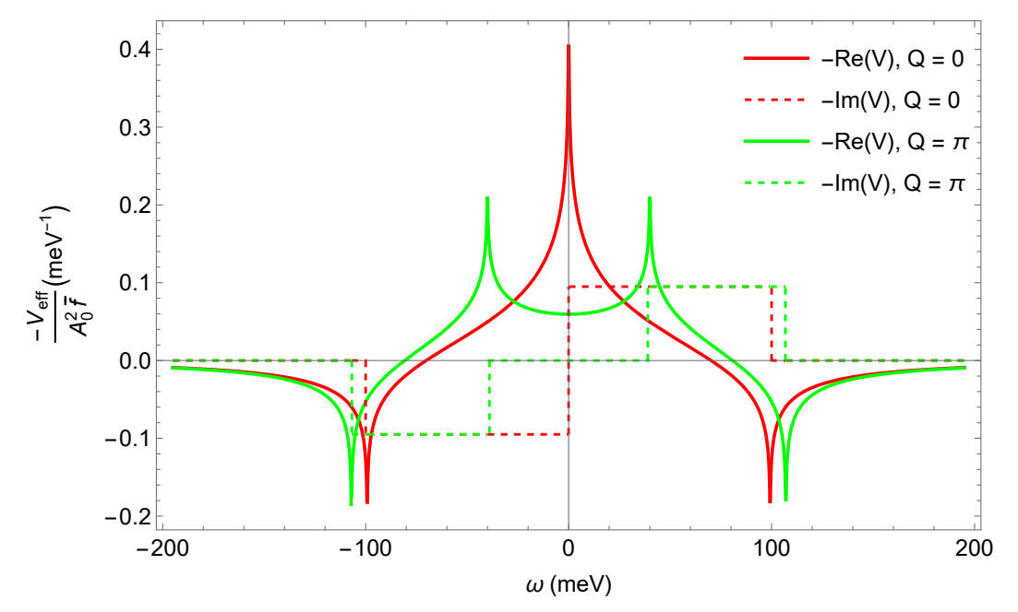
EFFECTIVE INTERACTION
Soft phonon dispersion ($ω_{T}=1$ meV )
Acoustic phonon dispersion ($ω_{T}=0$ meV)

Slide 32
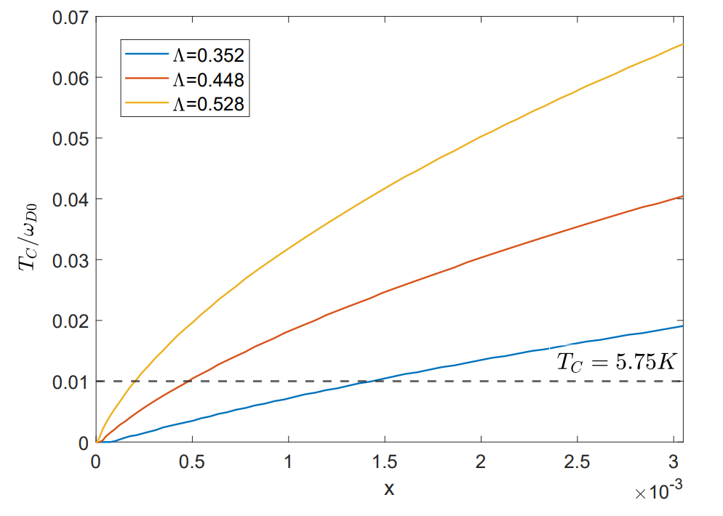
RESULTS
ACOUSTIC PHONON DISPERSION ($ω_{T}=0$ meV )
DIMENSIONLESS PARAMETERS
Coupling
BCS
Adiabaticity

Slide 33
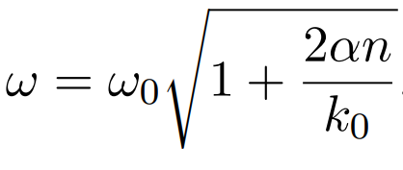
TOY MODELS
LINEAR COUPLING
QUADRATIC COUPLING
$$M$$
$$M$$
$$k_{0}$$
$$k_{0}$$
$$ε$$
$$ε$$
Purely quantum effect
Classical and quantum results coincide:
${ T}_{C}$ enhanced (?)

Slide 34
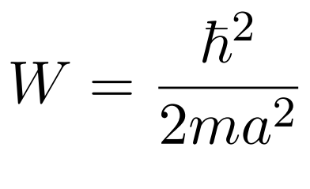
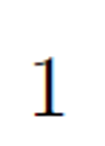
PARAMETERS
Parameters evaluated in STO

Slide 35
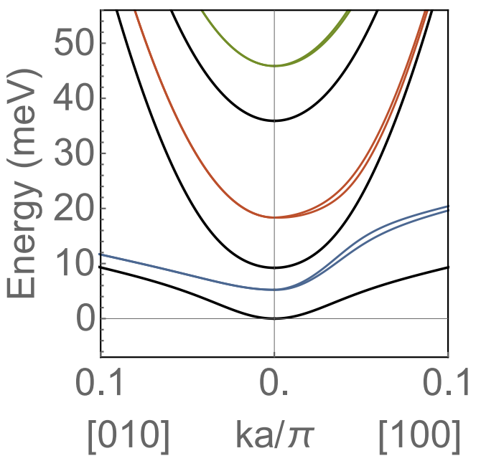
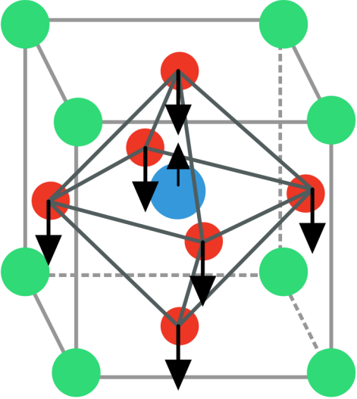
TWO-PHONON MEDIATED INTERACTION
Assumption
Slater mode
$\frac{1}{2}a_{n}u_{S}^{2}$
Cristiano Muzzi. Master thesis. 2020/2021.

Slide 36
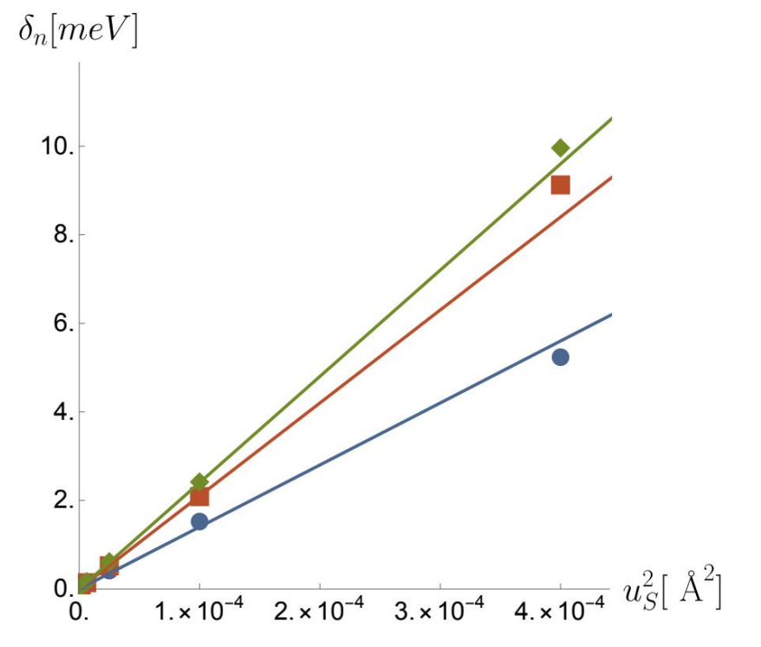
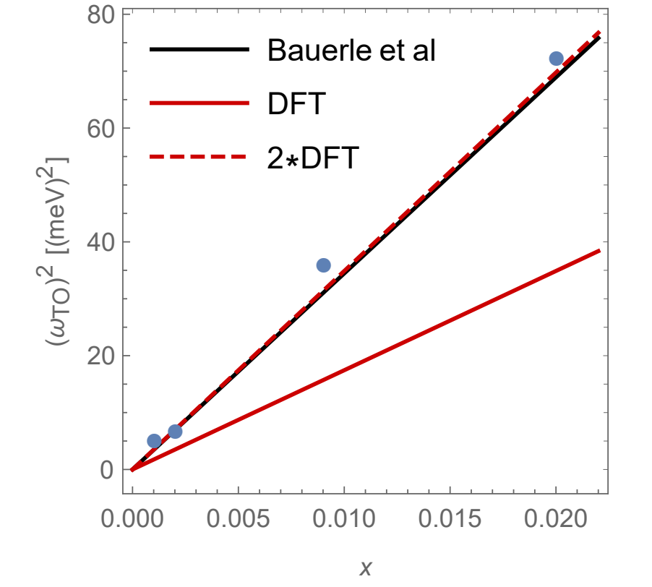
DOPED INDUCED HARDENING

Slide 37
ELIASHBERG EQUATIONS
ISOTROPIC SYSTEM
GAP
(Effects absorbed in $ε_{k}$)
Eliashberg function

Slide 38
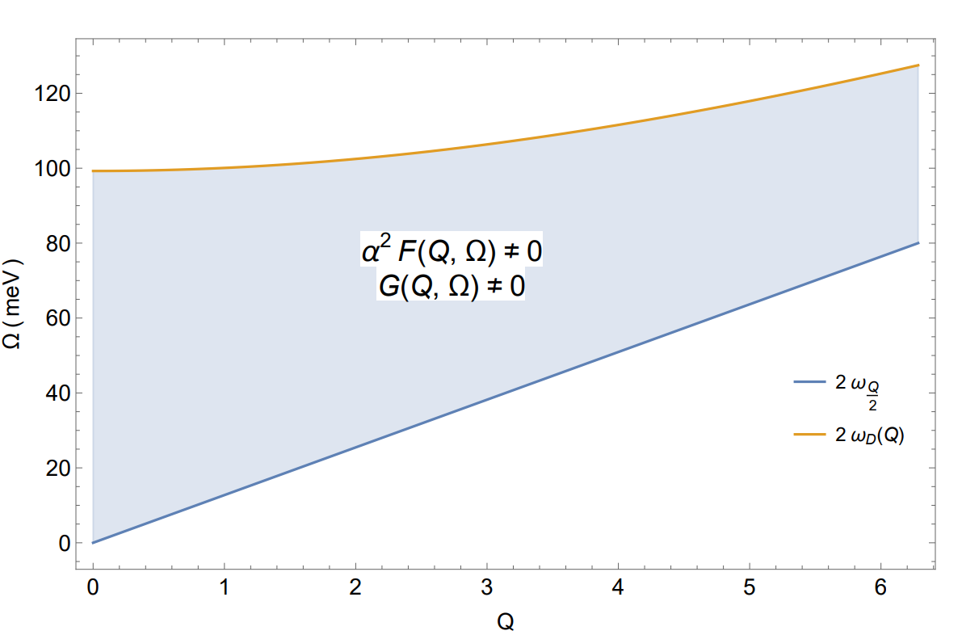
EFFECTIVE INTERACTION
Phonon dispersion
Normalized two-phonon DOS
Cut-off ‘‘Debye’’ frequency
Eliashberg function
Approximation
Isotropic effective interaction
Acoustic phonon dispersion ($ω_{T}=0$ meV )

Slide 39
LINEARIZED ELIASHBERG EQUATION
Definitions
Weakly dependent on |k|, |k’|
$$≈$$
ADIMENSIONAL PARAMETERS
Real and positive
Adiabaticity
Coupling
LINEARIZED ELIASHBERG EQUATION
BCS

Slide 40
PARAMETERS
$Ω_{n}=0$ (Statitic limit)
$Q→0$
Kiseliov and Feigelman, Arxiv.org, 2021

Slide 41
$$M$$
$$u$$
$$k_{0}$$
$$d$$
$$ε$$
$$M$$
$$u$$
$$k_{0}$$
$$d$$
$$ε$$

