Slide 1
© C. Grupe, KIT (2024)
Beta decay
and
neutrino mass:
KATRIN and beyond
Magnus Schlösser
Karlsruhe Institute of Techology
Institute for Astroparticle Physics
Tritium Laboratory Karlsruhe
Neutrino Oscillation Workshop
NOW 2024, Otranto, Italia

Slide 2
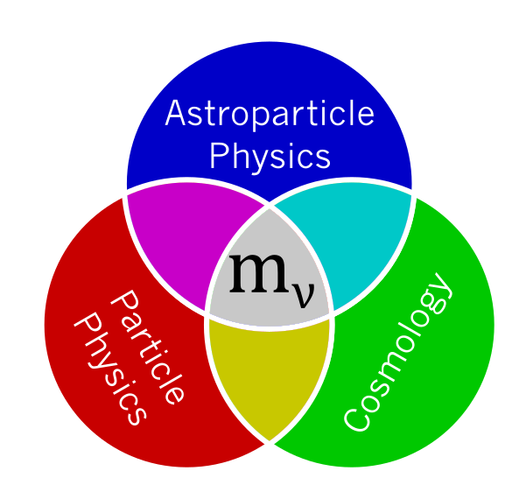
The role of massive neutrinos and motivations to measure it
Cosmology and the role
of neutrinos therein may
be more complex
(what is DE, …?)
Neutrino masses bring in a
fundamental energy scale
(besides Higgs scale)
0vββ observation not necessarily points to an neutrino mass
Model for mass
generation needs:
mixing matrix AND mass scale
Signal is „in reach“: Minimal mass scales exist!
“m(ν_{e})“ > 10 meV (normal mass ordering)
“m(ν_{e})“ > 50 meV (inverted mass ordering)

Slide 3
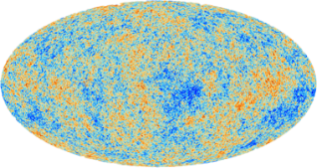

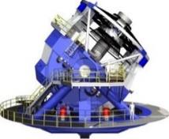
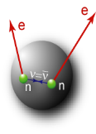
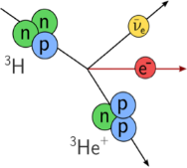
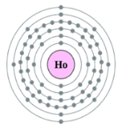




Ways to access the neutrino mass
 | Cosmology | Search for 0νββ | β-decay & electron capture
Observable
Present upper limit | 0.12 eV (0.072 eV) | 0.156 eV | 0.8 eV
Model dependence | Multi-parameter cosmological model | Majorana ν contributions other than m(ν)? nuclear matrix elements, g_{A} | Direct, only kinematics; no cancellations in incoherent sum
This talk

Slide 4
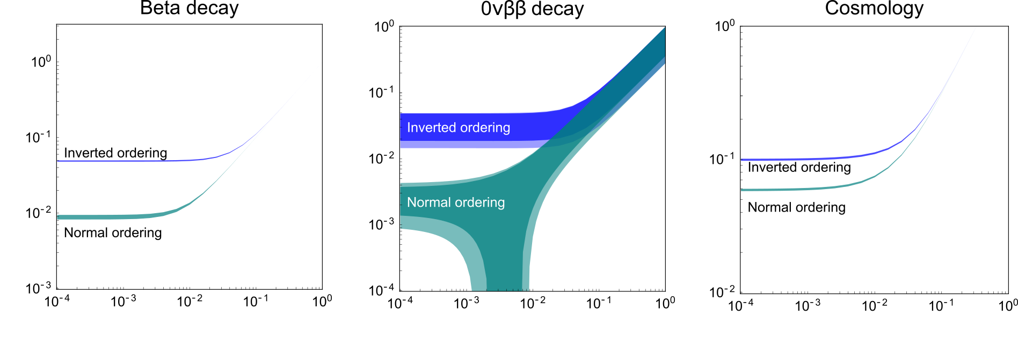



Complementarity and need for direct mass measurements
Standard neutrino picture: observations have to be found in colored regions
KATRIN(2022)
KamLAND-Zen (2023)
NuFit, J. High Energ. Phys. 2020, 178 (2020).
Planck (2020)
$m_{ββ}$ (eV)
Inspired by IUPAP neutrino panel white paper, www.iupapneutrinopanel.org
$m_{β}$ (eV)
${∑m}_{ν}$ (eV)
Planck (2020)
DESI (2024)
Planck (2020)
Planck (2020)
Lightest neutrino mass (eV)
Lightest neutrino mass (eV)
Lightest neutrino mass (eV)
Tie-breaker needed to exclude exotic models in neutrino nature or cosmology
KATRIN, Nat. Phys. 18 (2022) 160
KamLAND-Zen, PRL 130, 051801 (2023)
Planck, Astron. Astrophys. 641 (2020) A6
DESI, 2406.14554

Slide 5
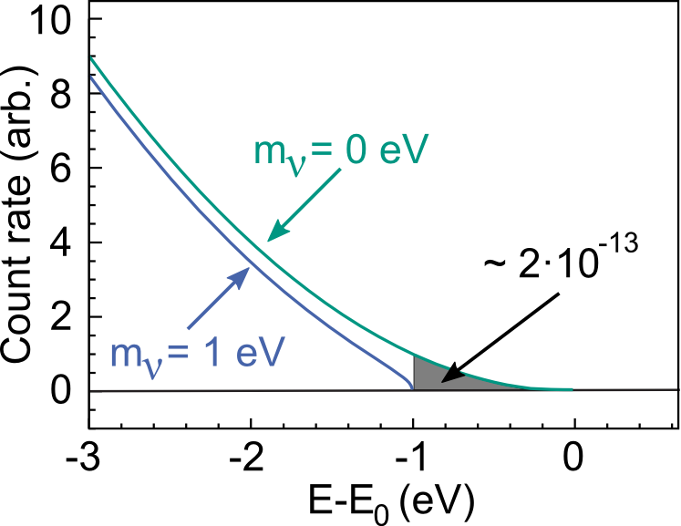




Direct mass experiments
Direct, model-independent access to neutrino mass
$β^{(−)}$ decay
$$X→Y+e^{−}+{\overline{ν}}_{e}$$
Measurement of kinetic energy of electron
Tiny
fraction
Electron capture
$$X+e^{−}\left(shell\right)→Y^{∗}+ν_{e}$$
$$Y^{∗}→Y+E_{C}$$
Measurement of internal excitation of daughter atom
(Anti-) neutrino mass determined from shape distortion near kinematic endpoint

Slide 6
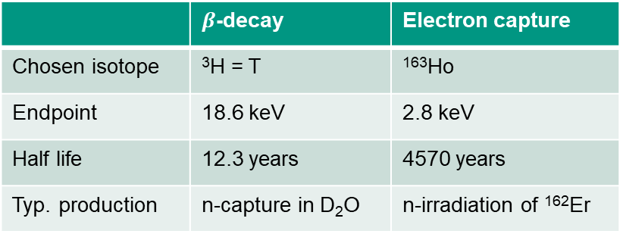
Challenges for achieving mass low sensitivity
  Low kinematic endpoint, high decay rate
 | $β$-decay | Electron capture
Chosen isotope | ³H = T | ¹⁶³Ho
Endpoint | 18.6 keV | 2.8 keV
Half life | 12.3 years | 4570 years
Typ. production | n-capture in D₂O | n-irradiation of ¹⁶²Er
Tiny
fraction
See Talk
06 Sep, 17:50
Elena Ferri
This talk
High signal (→ statistics)
Low background (→ statistics)
High energy resolution (→ sensitivity)
Low and quantified systematic effects

Slide 7
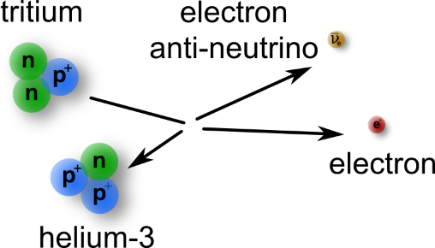
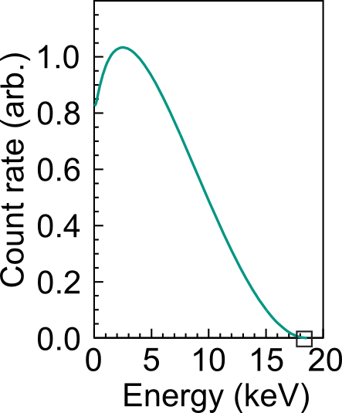
Tritium beta decay experiments
Direct, model-independent access to neutrino mass
E₀ = 18.6 keV
T_{1/2} = 12.3 y
KATRIN’s aim: Measurement of m_{ν} with a sensitivity of 0.2 eV/c²

Slide 8
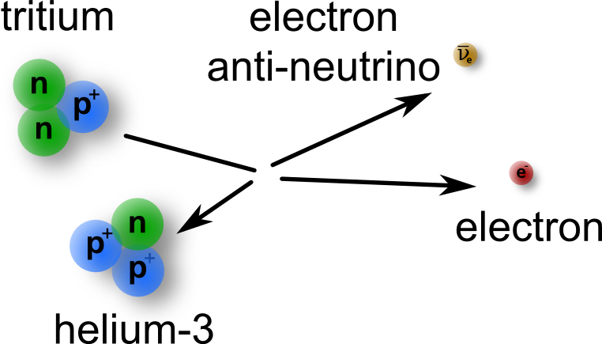
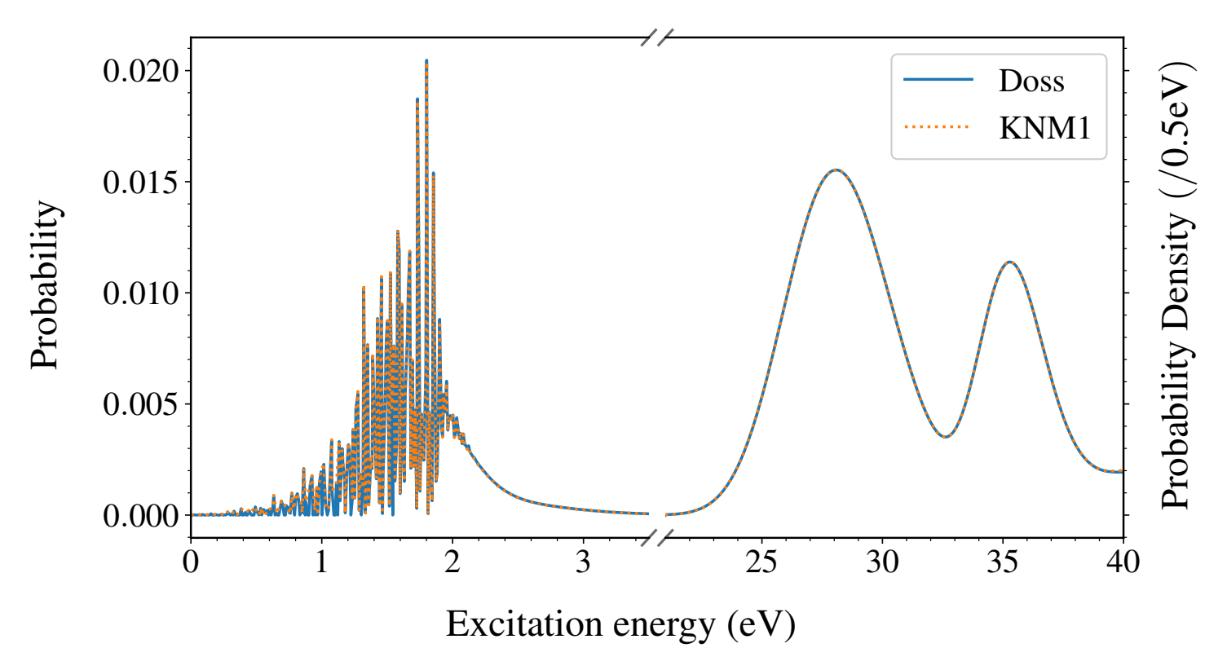
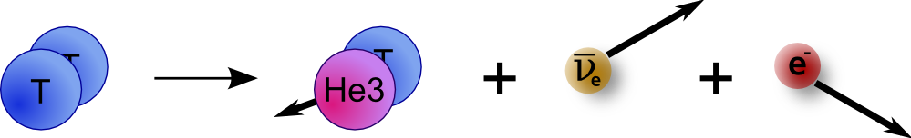
Molecular decay
Atomic decay
Final-state distribution
Decay from a molecule
Molecular effects need to be
taken into account in
neutrino mass analysis
+ further inner excitations (rotation / vibration)
„model-dependence“

Slide 9




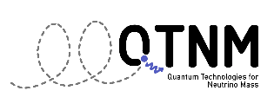
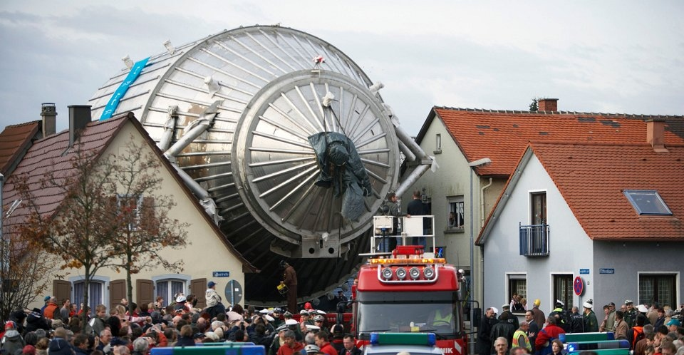
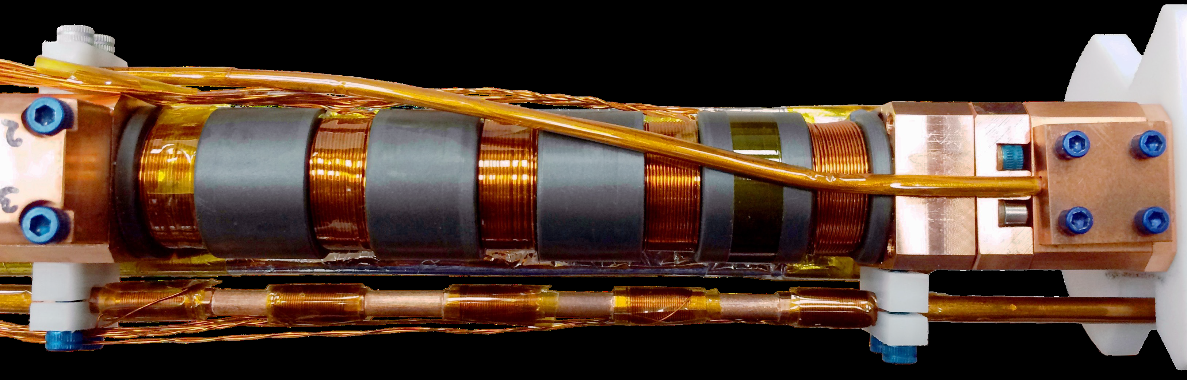


Established measurement principles
CRES
MAC-E filter
Calorimeters
Cyclotron Radiation Emission Spectroscopy
Measuring energy via frequency
Magnetic Adiabatic Collimation with an Electrostatic Filter
Measuring energy by applying a high-pass filter
Low-temperature
micro calorimeters
Measuring energy by temperature change
See Talk
06 Sep, 17:50
Elena Ferri

Slide 10
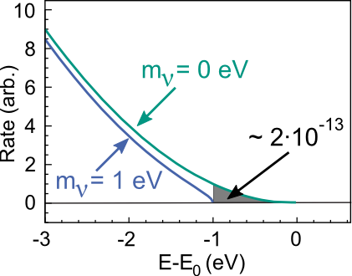
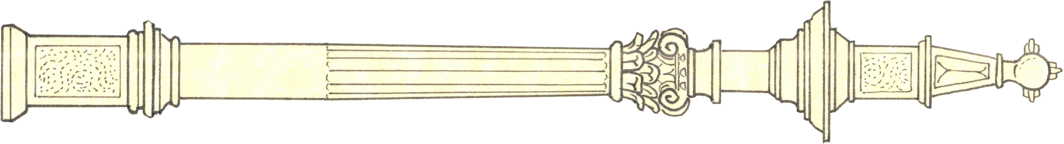
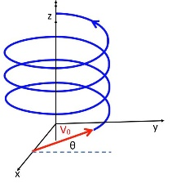
Basic principle of KATRIN-like experiment
Electron
transmission
if above filter
potential
T₂ out
T₂ in
Tritium
source
Electron
transport
along B-field lines
Tritium
reduction
Electron
Filter
Electron
detector
Calibration

Slide 11
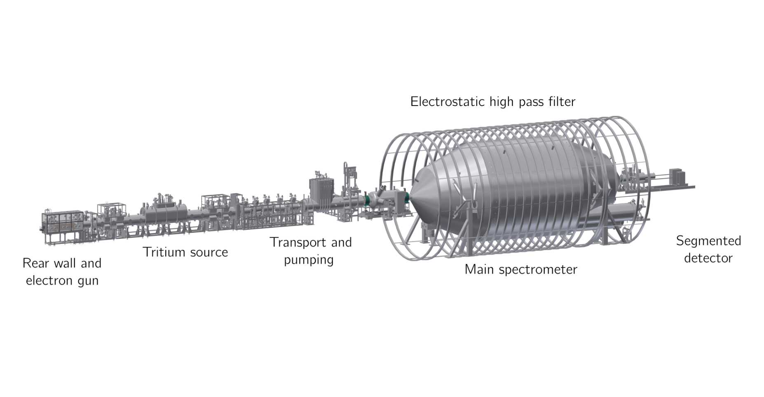
Karlsruhe Tritium Neutrino Experiment (KATRIN)
ultra-stable high-luminosity
windowless gaseous tritium
source (10¹¹ Bq)
70 m long setup
at KIT campus north
high-resolution MAC-E filter
with < 1 eV energy resolution
JINST 16 T08015 (2021)
KATRIN’s aim: Direct measurement of m_{ν} with a sensitivity of 0.2 eV/c²

Slide 12
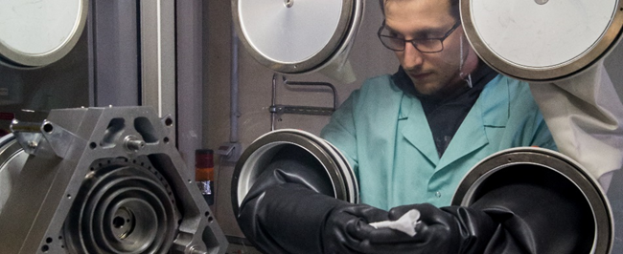
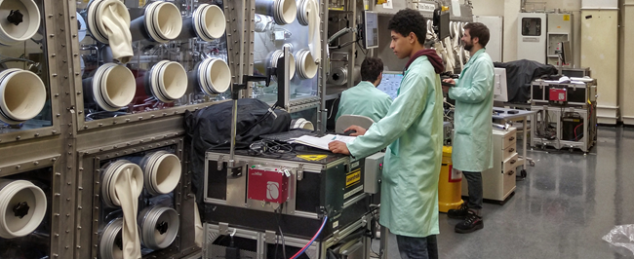

Tritium Laboratory Karlsruhe (TLK)
A facility for high activity tritium experiments
Licensed for 40 g Tritium
Closed tritium cycle for recycling and
purifying tritium in gram amounts
> 50 experience scientists, engineers and technicians
Two missions:
  Fuel cycle for fusion reactors
  KATRIN Experiment
We develop safe tritium technology and versatile tritium analytics since 1993
We are able to setup and operate a large variety of experiments with tritium

Slide 13
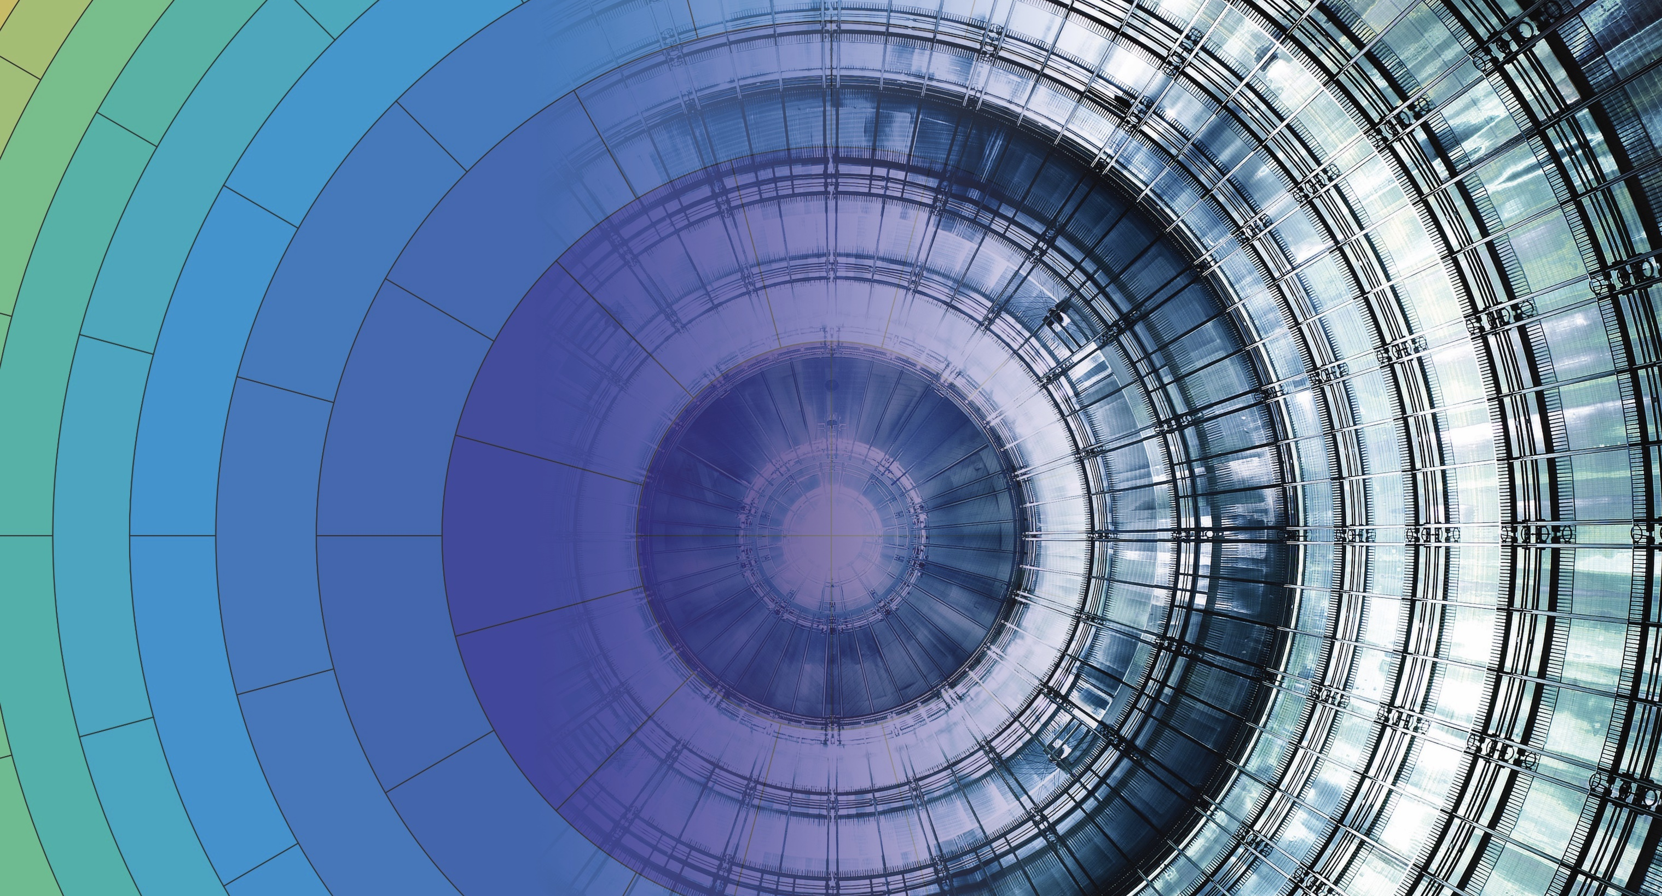
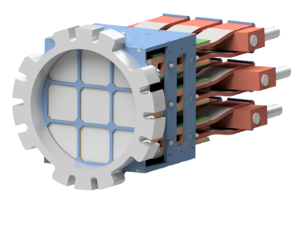

KATRIN timeline
2019-2025
2026-2027
2028-2034
Scientific goal
Phase 1 (Integral)
Neutrino mass
Phase 2 (Differential)
keV sterile $ν$
R&D Phase for KATRIN++
Neutrino mass
Atomic Tritium Demonstrator
Differential detection demonstrators
See Talk
06 Sep, 18:10
Richard Salomon
Details of the latest
KATRIN data analysis
See Talk
04 Sep, 18:50
Andrea Nava
KATRIN: keV sterile
neutrino search
This talk
This talk
TRISTAN
detector

Slide 14
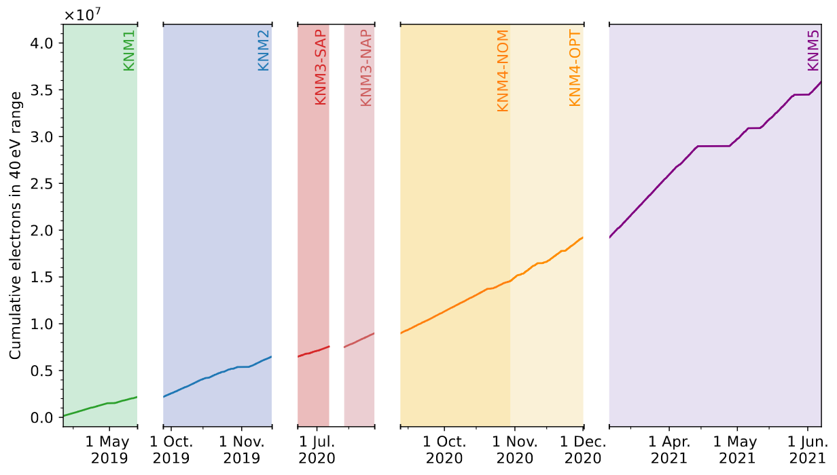


KATRIN data releases and neutrino mass results
First 5 campaigns:
taking data while finding optimal operation conditions
2019: m_{𝛎} < 1.1 eV (90% CL)
2022: m_{𝛎} < 0.8 eV (90% CL)
~6 Mio counts
Current data set
259 measurement days
1757 𝛽-scans
~36 Mio counts
Expected sensitivity < 0.5 eV
PRL 123 (2019) 221802
PRD 104 (2021) 012005
Nature Phys. 18 (2022) 160

Slide 15
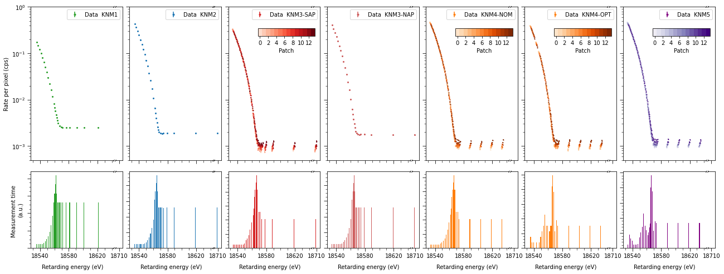
Data combination challenges
59 stacked spectra with
+ 28 + 14 x 28 + 28 + 14 x 28 + 14 x 25 + 14 x 28 =
1609 data points
Rate per pixel (cps)
Challenges arisen from KATRIN‘s learning curve
Combination of 7 sub-data sets with different settings
Source temperature
Tritium column density
Measurement time distribution
MAC-filter configuration
Operation modes
See Talk
06 Sep, 18:10
Richard Salomon
Details of the latest
KATRIN data analysis
Measurement time
Retarding energy (eV)

Slide 16
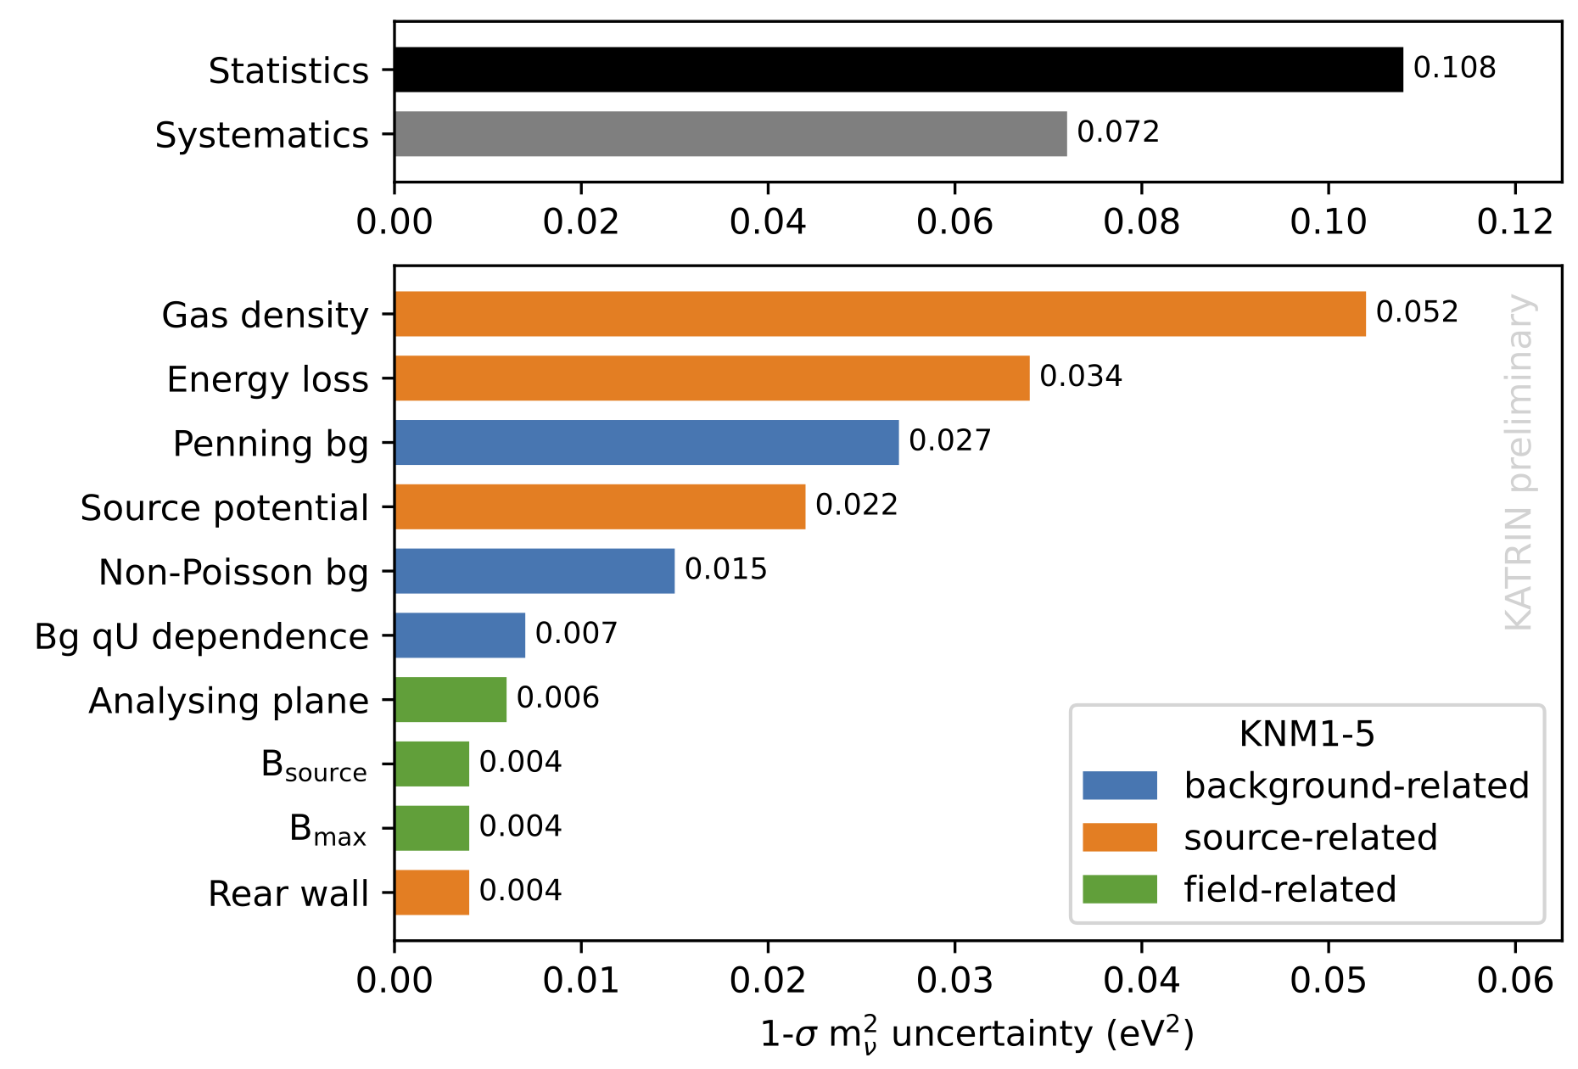
Systematic uncertainties
Statistical uncertainties dominate
Significant reduction of the background-related systematics
Better control over source scattering
Increased conservative uncertainties in
this release
  Reduced uncertainties in current data
  Reduction of the molecular final-states uncertainties
Forecast: individual systematics in final KATRIN analysis (post 2025)
expected to be > 0.01 eV² range

Slide 17
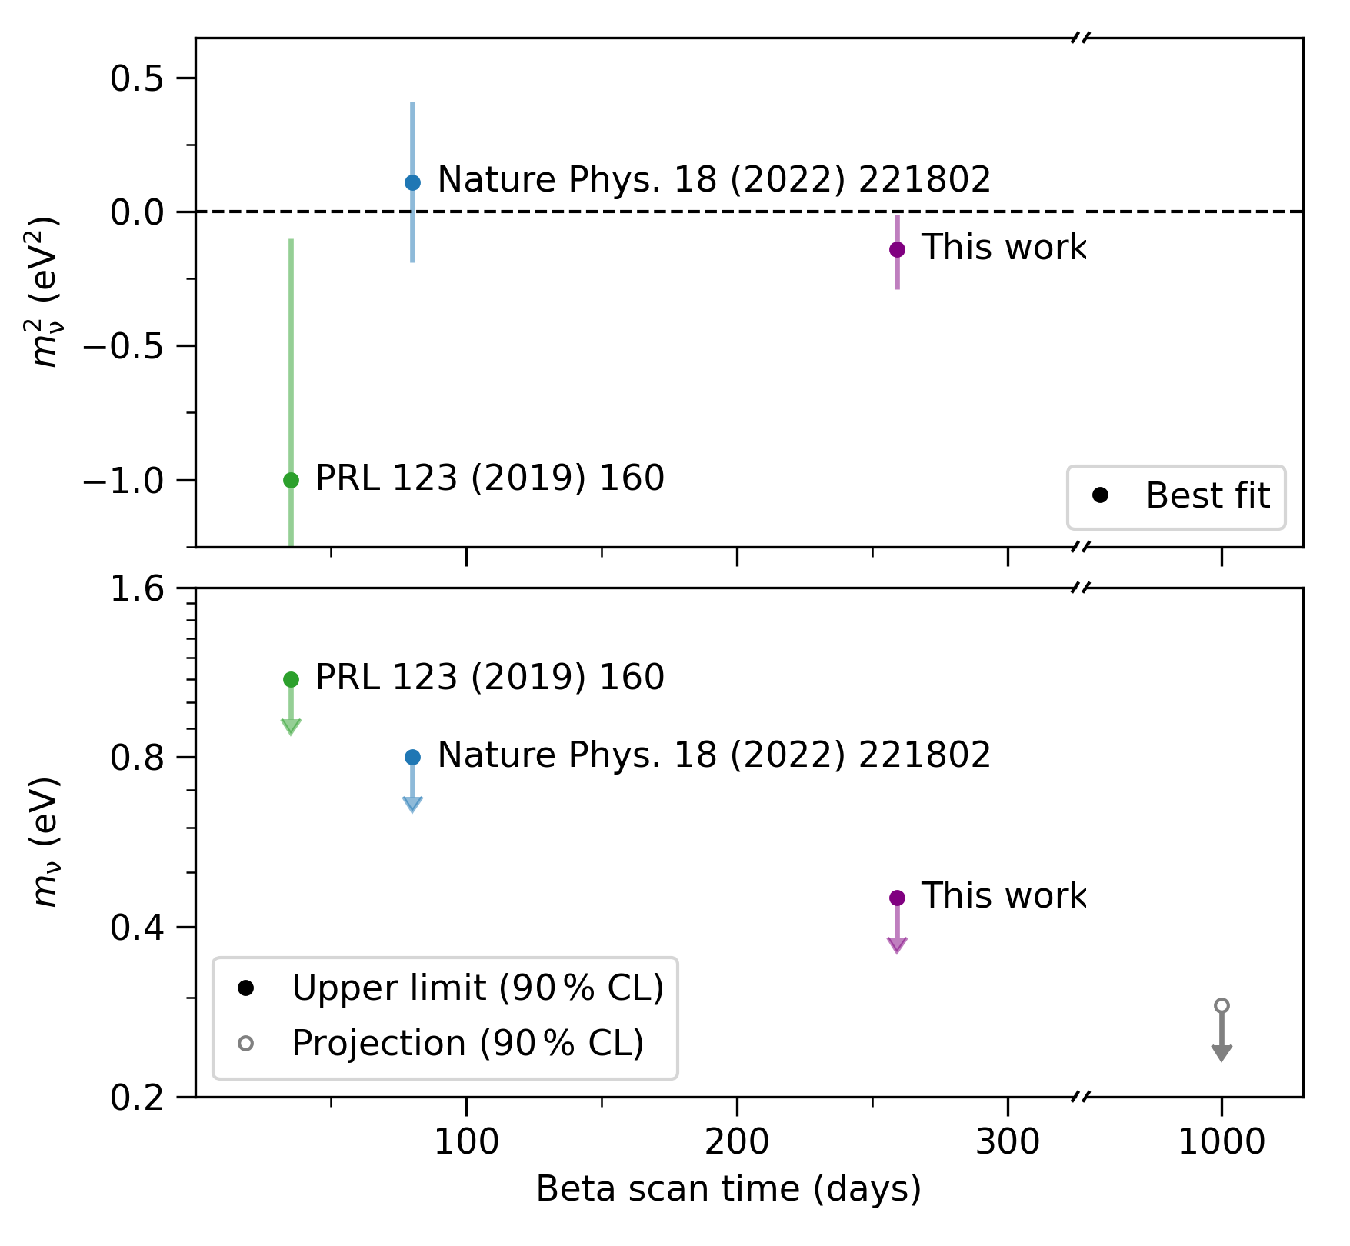
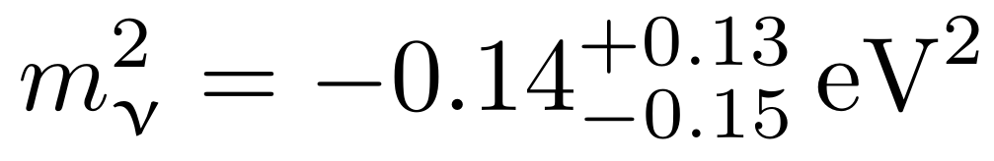

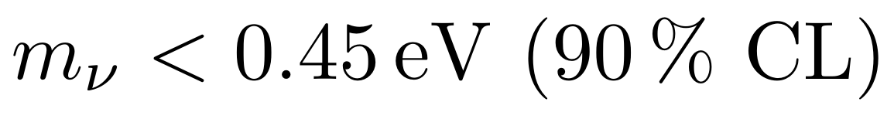
New best fit and upper limit
New best fit compatible with vanishing neutrino mass
This release
Resulting in an new upper limit
This release
New KATRIN release improves
direct neutrino-mass bound by a factor of 2
https://arxiv.org/abs/2406.13516

Slide 18
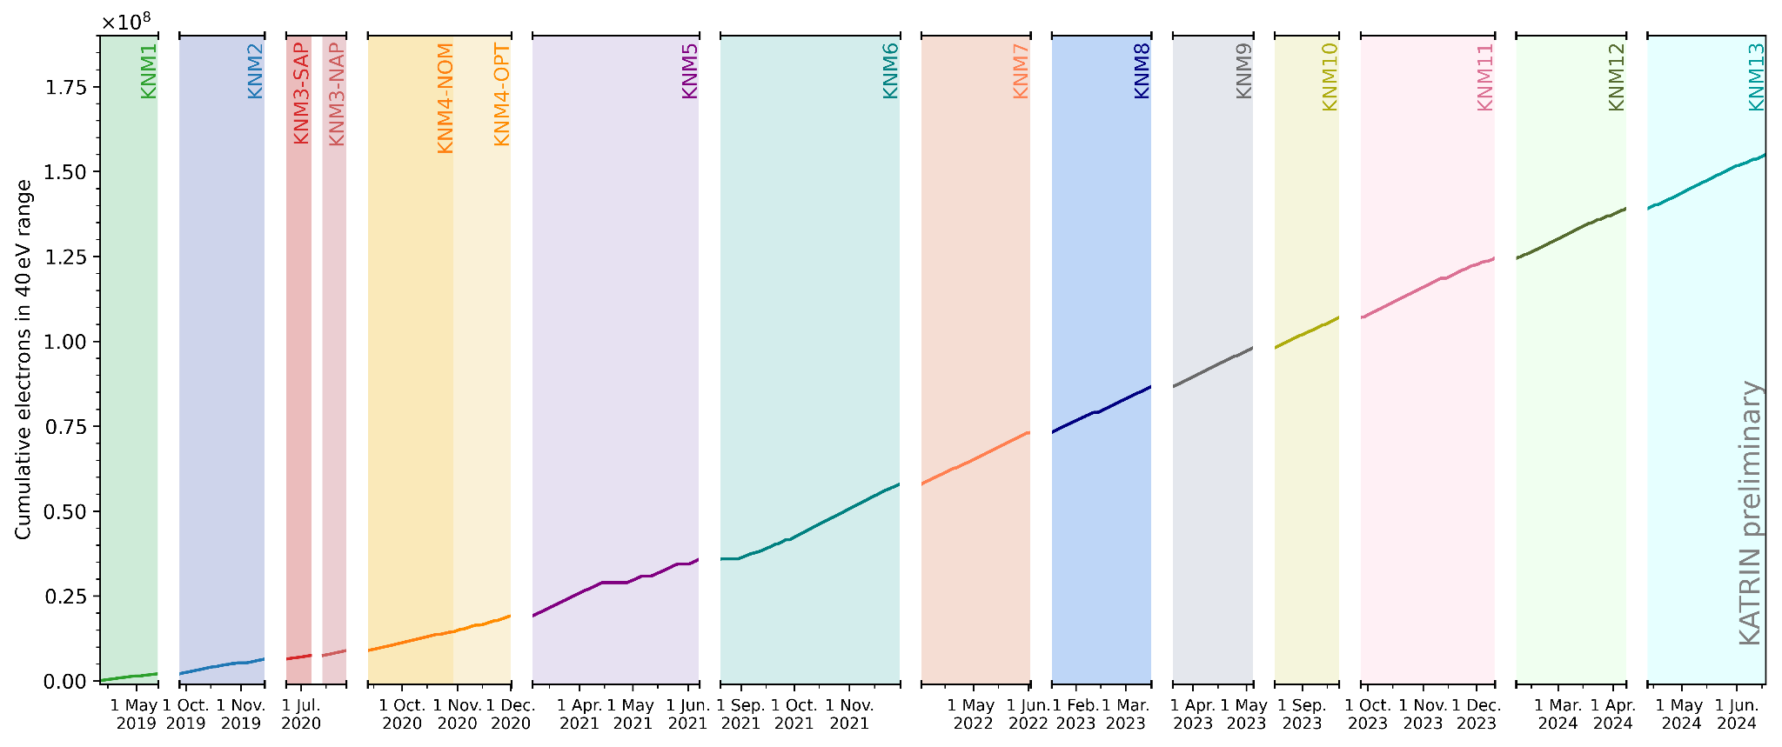
KATRIN data taking continues
Ongoing data taking through 2025 → 𝚺 1000 days
➔ target sensitivity below 0.3 eV
14 measurement campaigns completed
in the next week.
> 175 Mio counts recorded
– x4 of this release!
More data to come in 2024-2025 + calibration/systematics improvements
Cumulative counts
in 40 eV range

Slide 19
Established measurement principles
CRES
MAC-E filter
Calorimeters
Cyclotron Radiation Emission Spectroscopy
Measuring energy via frequency
Magnetic Adiabatic Collimation with an Electrostatic Filter
Measuring energy by applying a high-pass filter
Low-temperature
micro calorimeters
Measuring energy by temperature change
See Elena Ferri

Slide 20
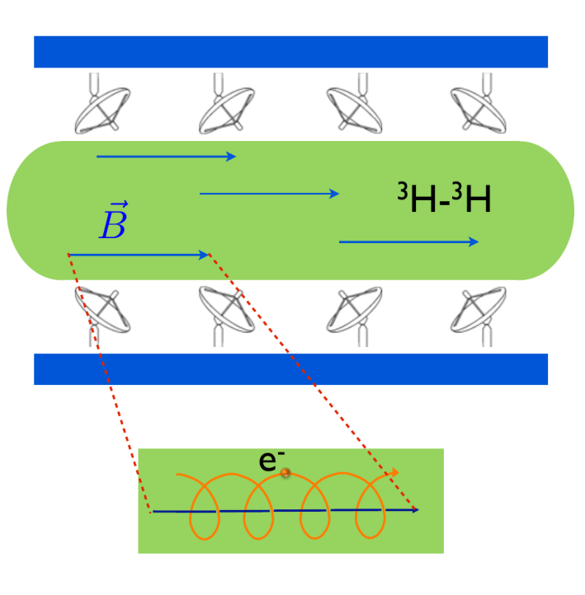
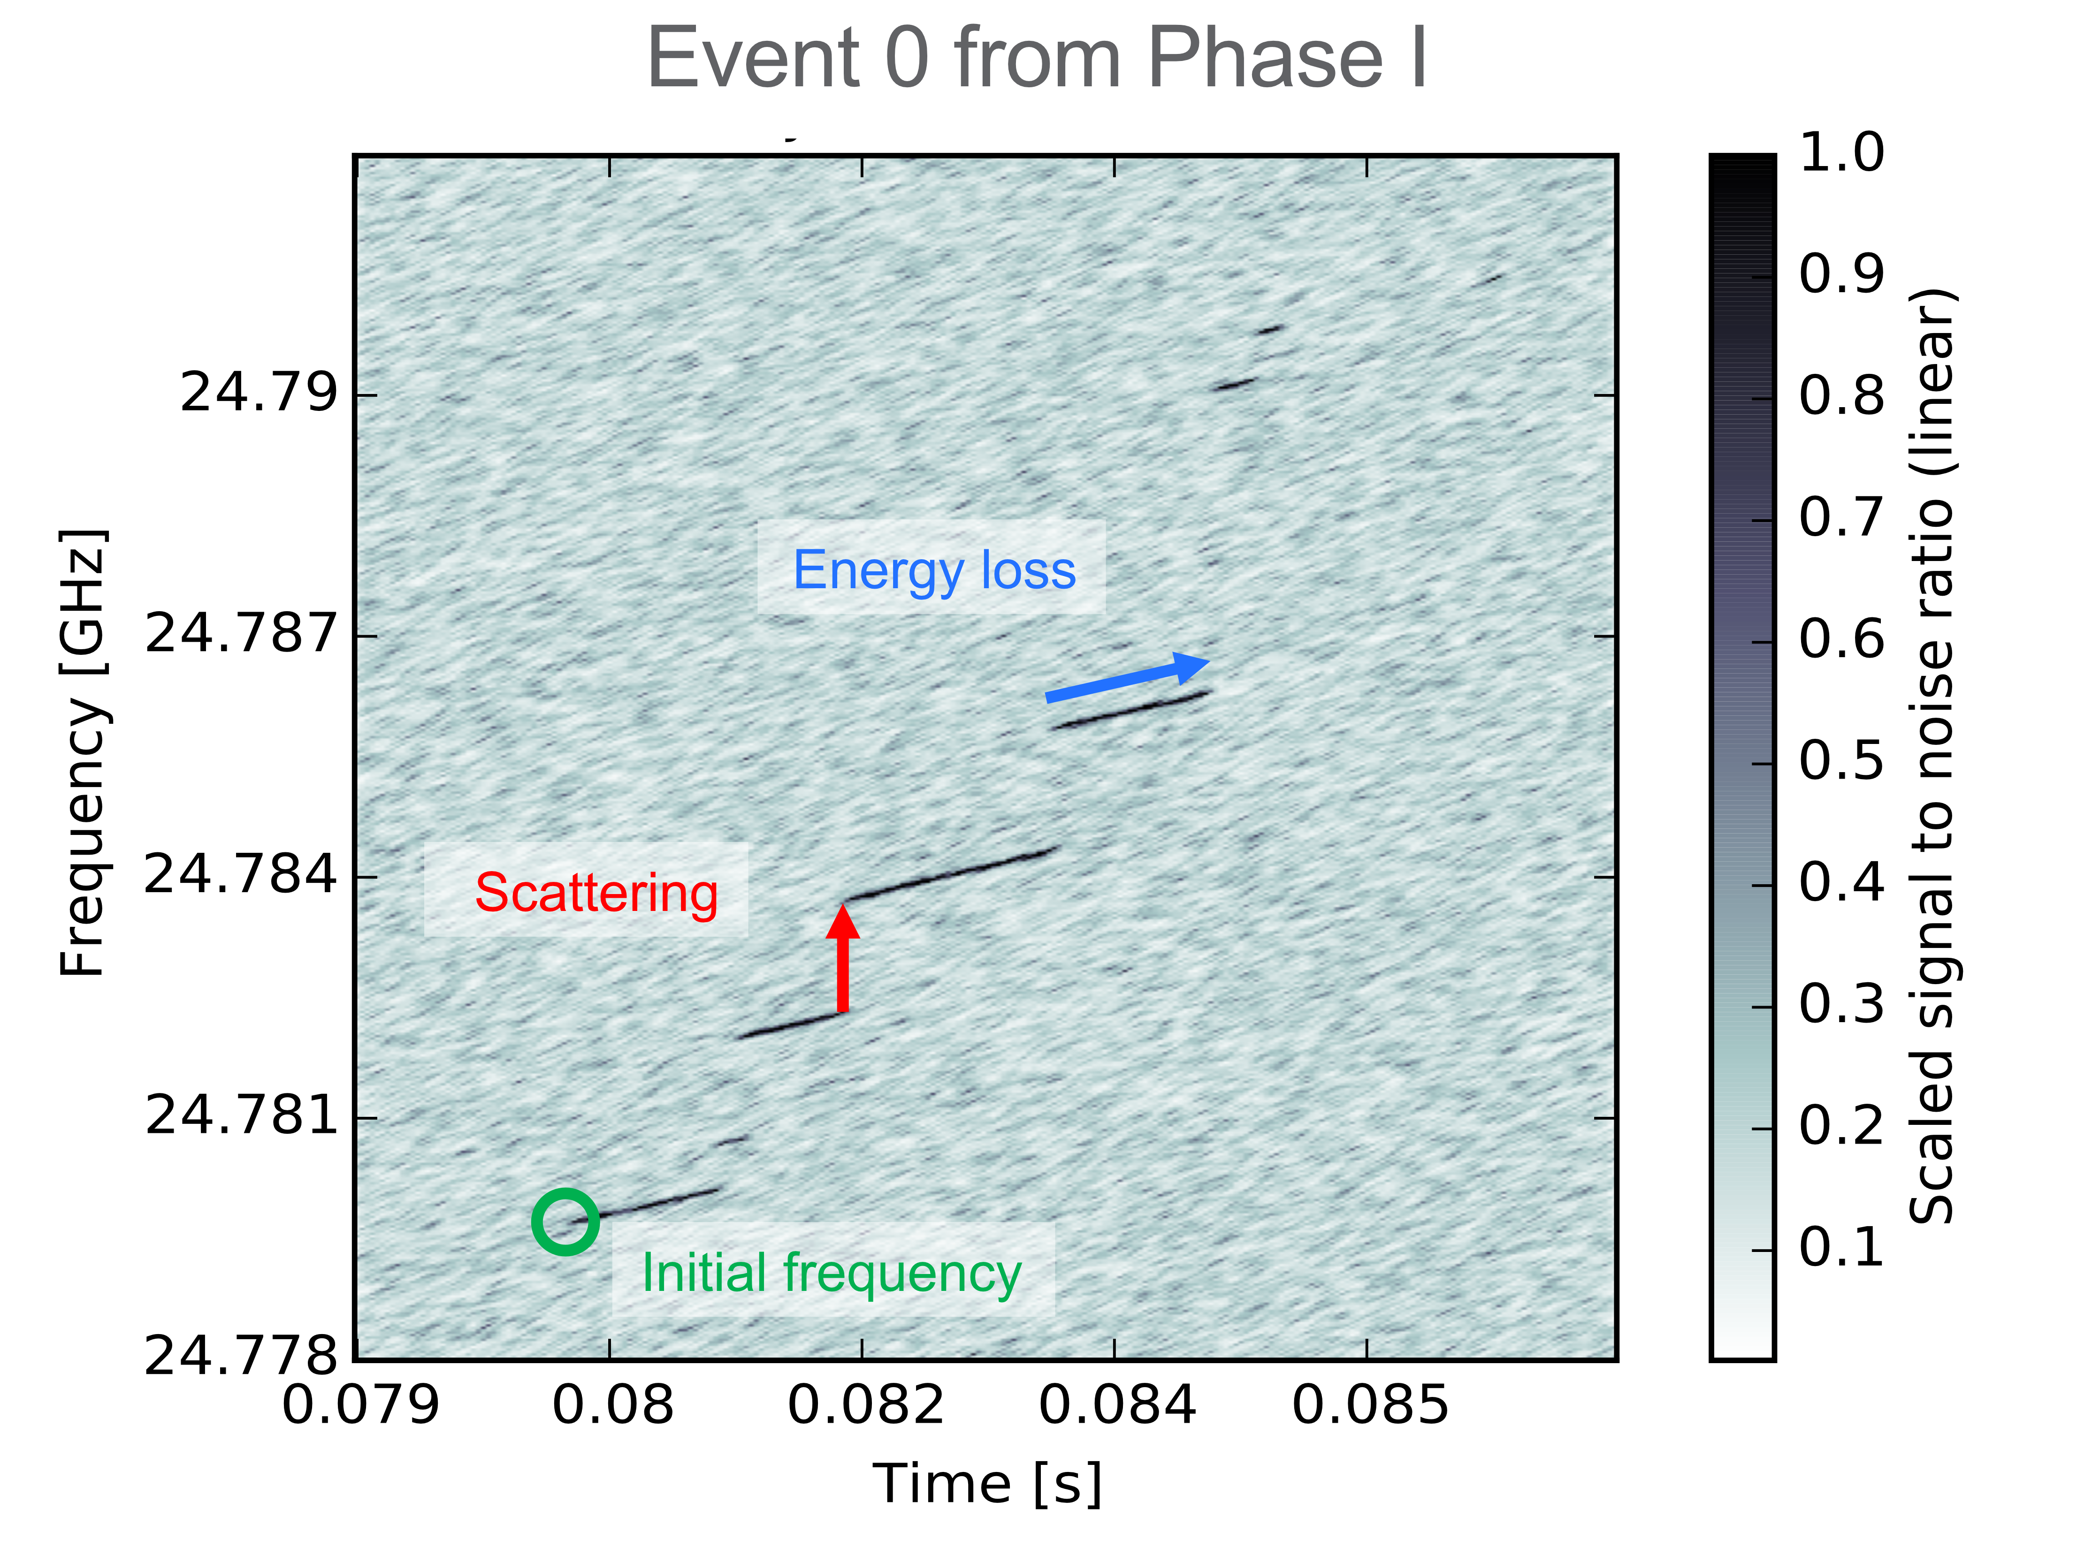

Cyclotron Radiation Emission Spectroscopy
$$f_{γ}=\frac{f_{c}}{γ}= \\ \frac{1}{2π}\frac{eB}{m_{e}+E_{kin}}$$
~fW
Differential measurement with antenna arrays
around a (atomic) tritium source
→ Frequency measurement

Slide 21

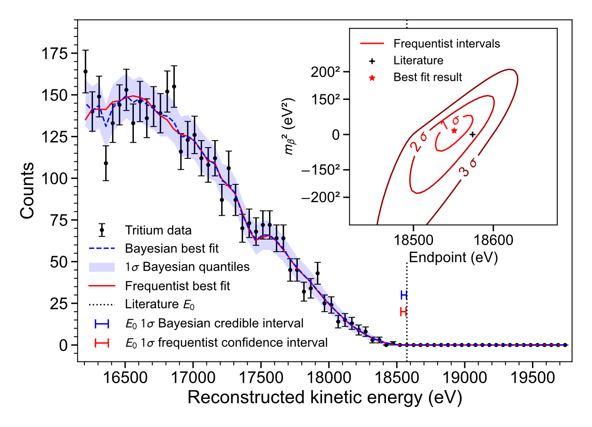
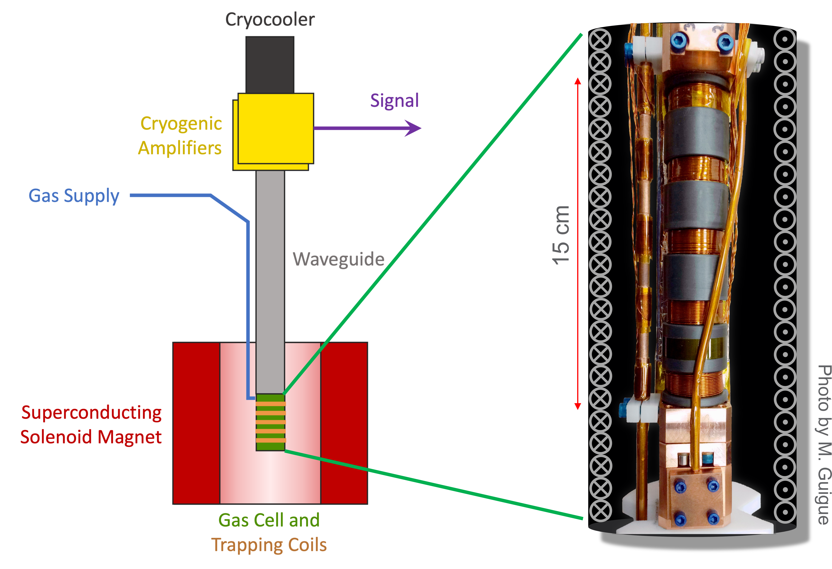

Project 8 – Results
Phase I: First use of CRES for
electron spectroscopy (^{83m}Kr)
Phase II: First use of CRES for tritium beta decay electron spectroscopy
→ Neutrino mass limit ($m_{β}<155 e$V)
Copied from presentation by N. S. Oblath TAUP 2023
D. M. Asner, et al., Phys. Rev. Lett. 114, 162501 (2015)
A. Ashtari Esfahani et al.Phys. Rev. Lett. 131, 102502 (2023)

Slide 22
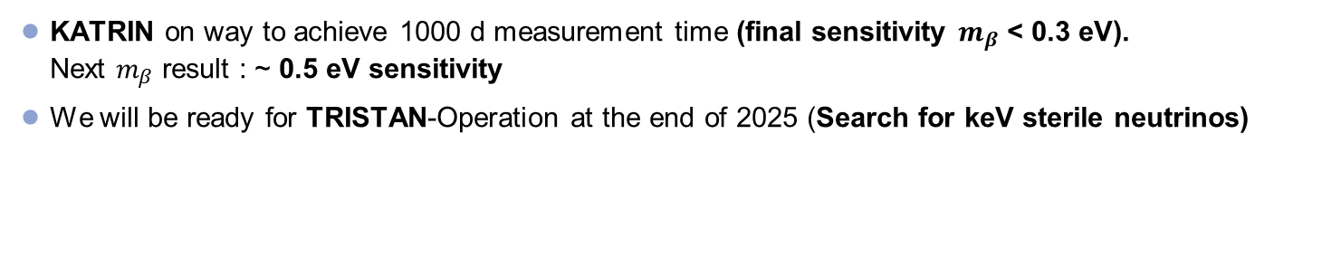
Outline
2019-2025
2026-2027
2028-2034
Scientific goal
Phase 1 (Integral)
Neutrino mass
Phase 2 (Differential)
keV sterile $ν$
R&D Phase for KATRIN ++
Neutrino mass
Atomic Tritium Demonstrator
Differential detection demonstrators
KATRIN on way to achieve 1000 d measurement time (final sensitivity $m_{β}$ < 0.3 eV).
Next $m_{β}$ result : ~ 0.5 eV sensitivity
We will be ready for TRISTAN-Operation at the end of 2025 (Search for keV sterile neutrinos)

Slide 23
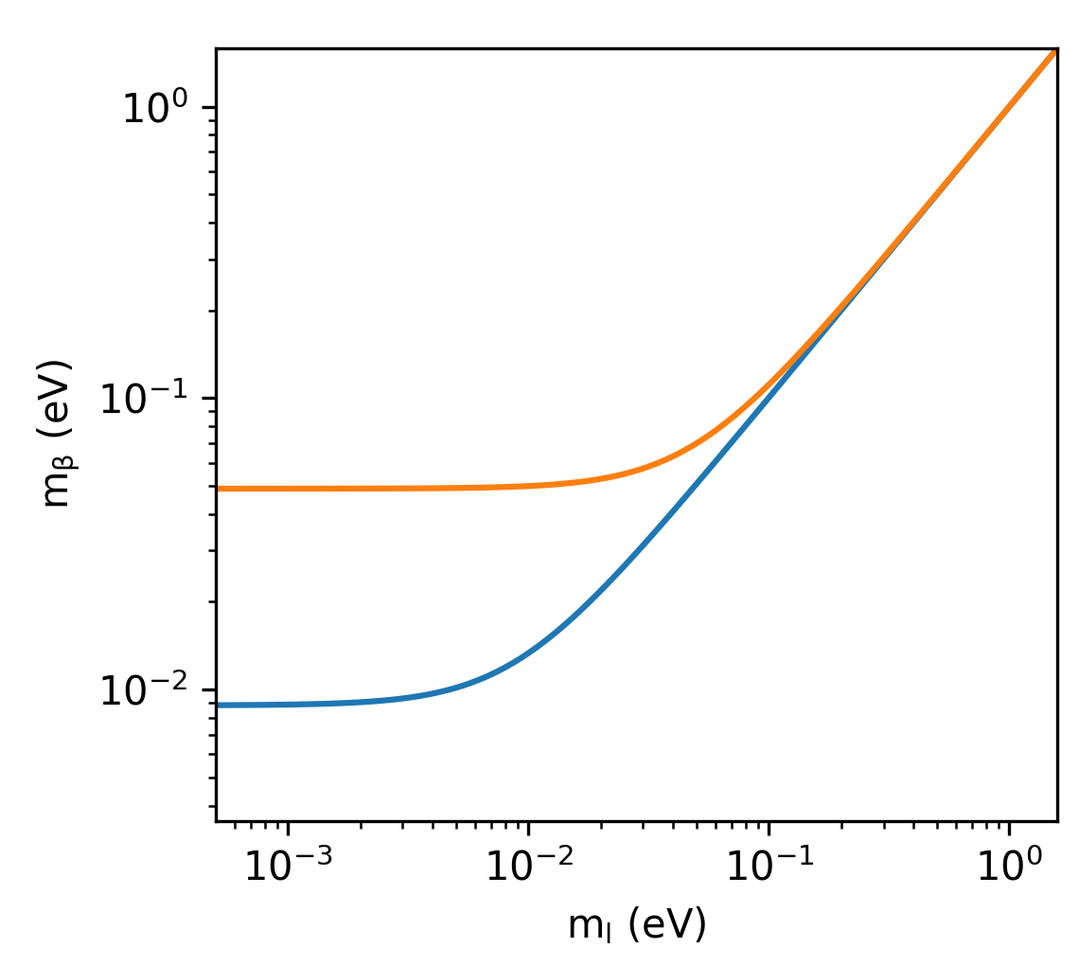

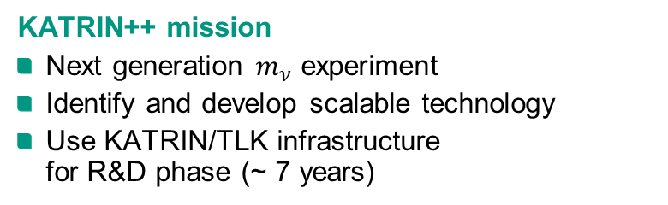
Going beyond KATRIN
KATRIN final: < 0.3 eV (90% CL)
Distinguish between degenerate and
hierarchical scenario
New technologies: < 0.05 eV
Cover inverted ordering
KATRIN
ν₂
ν₁
New
technologies
ν₃
IO
ν₃
KATRIN++ mission
Next generation $m_{ν}$ experiment
Identify and develop scalable technology
Use KATRIN/TLK infrastructure
for R&D phase (~ 7 years)
NO
ν₂
ν₁

Slide 24
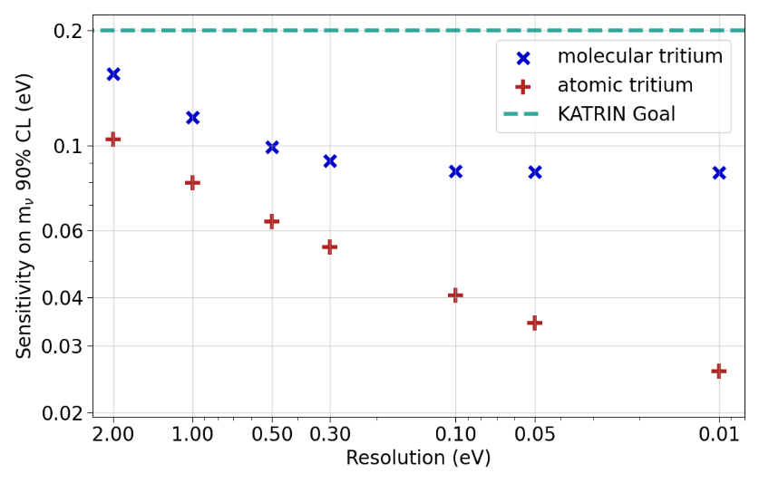
Going beyond KATRIN
Differential measurement (FWHM < 1 eV)
  Better use of statistics
  Lower background
Atomic tritium
  Avoid broadening (~ 1 eV)
  Avoid limiting systematics of T₂
Preliminary
Stat only
10 eV region
1000 days
T₂, integral (ΔE = 1 eV, bg = 0.01 cps)
IO
T₂, differential (FWHM = 0.2 eV, bg = 10⁻⁵ cps/eV)
T-atom, differential (FWHM = 0.2 eV, bg = 10⁻⁵ cps/eV)
NO
KATRIN source
S. Mertens
S. Heyns
Current KATRIN performance (integral, ΔE = 2.7 eV, bg = 0.1 cps)
Notes:
So what does it take to really go beyond KATRIN?
If we would continue with a KATRIN-like integral measurement mode, we would need much more tritium
The first key to boost the sensitivity is…
The second key to boost the sensitivity is…

Slide 25
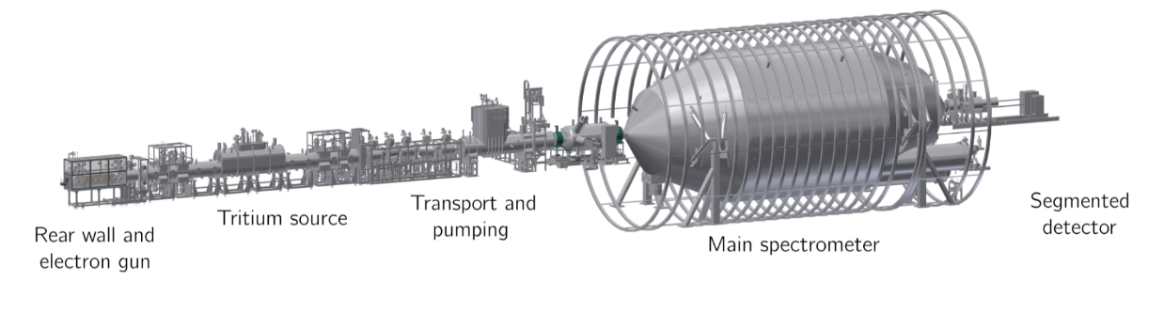
KATRIN and TLK as ideal R&D facilities
Differential detector
technology
Atomic source
technology
Notes:
Grüner Kasten weg → andere Frage
Ggf. 20 + 21 kombinieren

Slide 26
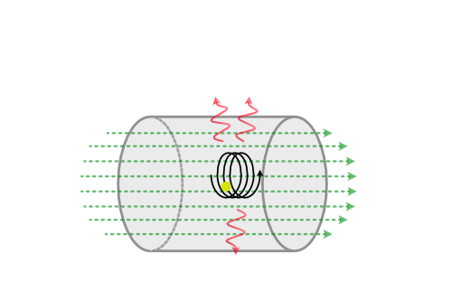
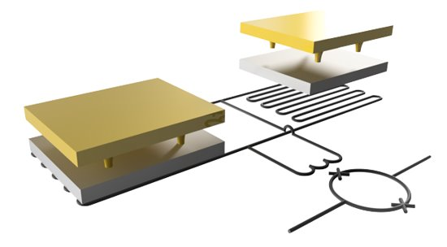
KATRIN and TLK as ideal R&D facilities
Further options?
Technologies by community?
Differential detector
technology
Option 2
Time-of-flight via
electron tagging
Option 1
Micro-calorimeters /
Quantum sensor
eV resolution for differential detection
immune to Rydberg-like backgrounds
Notes:
Grüner Kasten weg → andere Frage
Ggf. 20 + 21 kombinieren

Slide 27
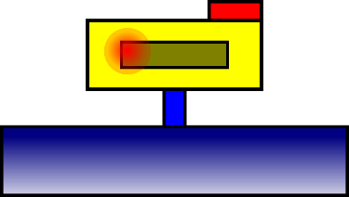
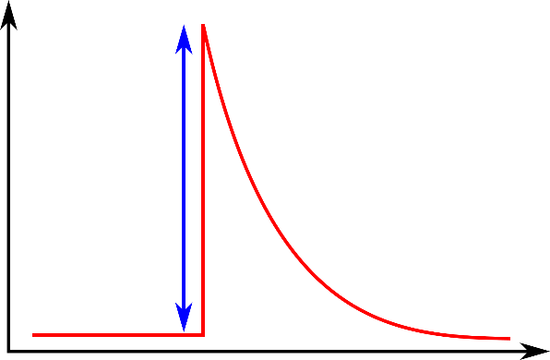
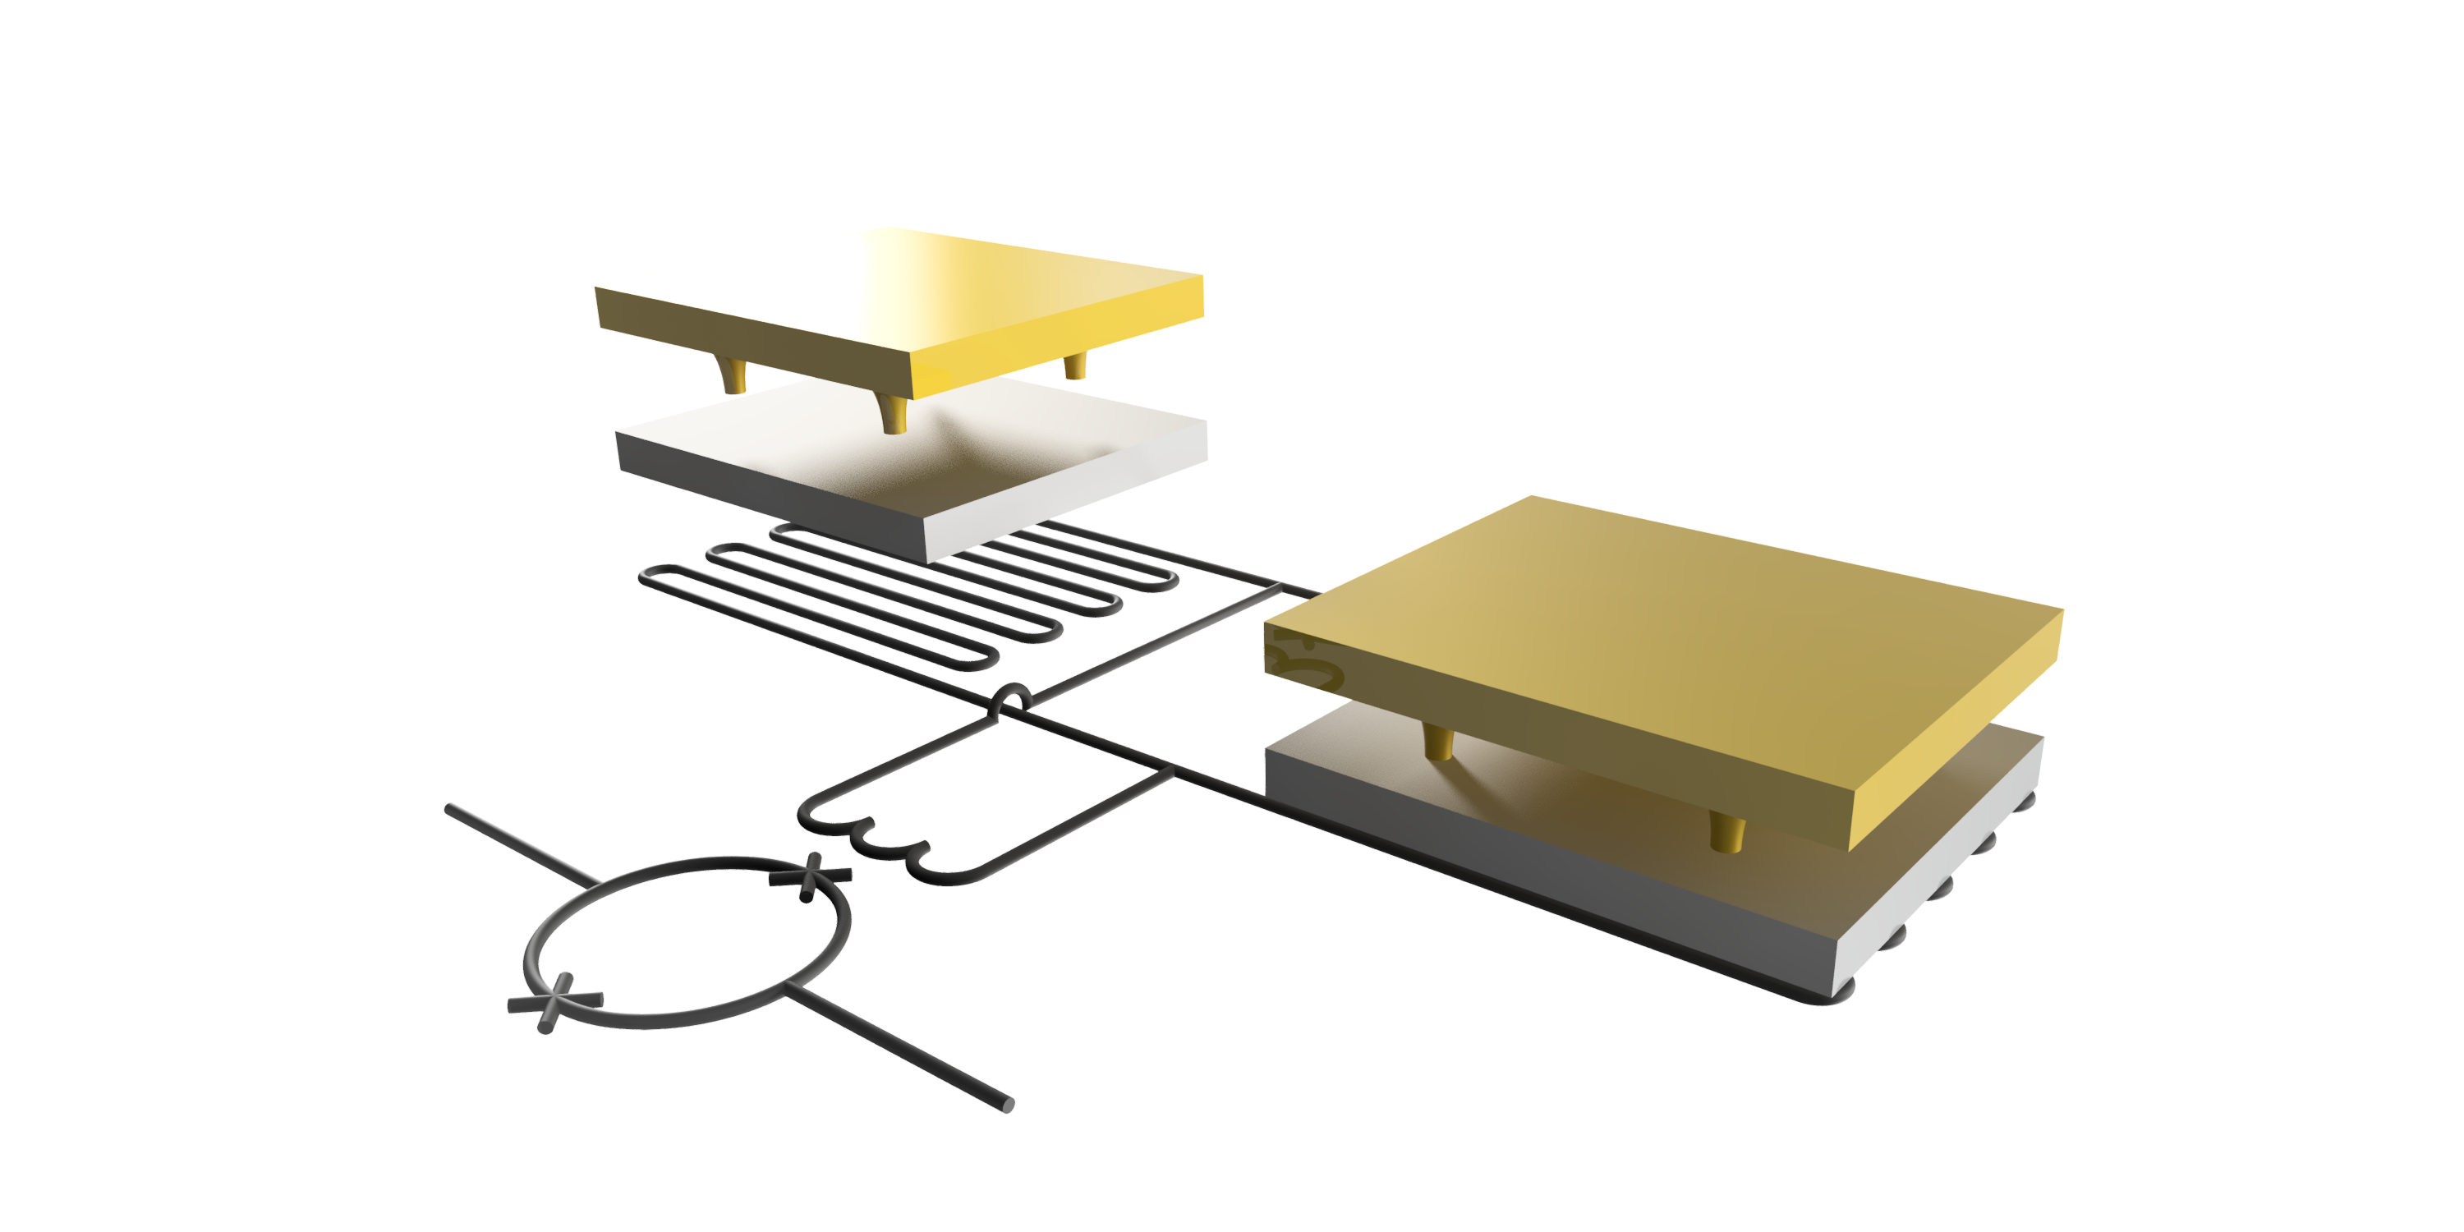




Quantum sensors as high resolution differential detectors
Advantages
Energy resolution O(eV) compared to conventional detectors O(100 eV)
Nearly 100% quantum efficiency
Broad spectrum of possible applications
Electron
Thermometer
incoming
particle
Absorber
Thermal bath
Weak thermal link
absorber
  e.g. Metallic Magnetic Calorimeters (MMC)
  Temperature-dependence in
  sensor magnetization
  Read-out by SQUID
  Energy resolution:
  - Current: $ΔE ≲ 2 eV$
  - Midterm: $ΔE ≲1 eV$
  - Future: $ΔE ∼100 meV$
sensor
$$τ=\frac{C_{tot}}{G}$$
Temperature
$$δT=\frac{E}{C_{tot}}$$
$$T_{bath}$$
$$1 ms$$
SQUID
Time
Not yet tested with external electrons
27.02.2024

Slide 28
Next R&D goal:
Demonstrate KATRIN with a quantum sensor array
Use existing / well-characterised
beamline
with Milano‘s
cryo expertise
+
10⁶ x
Preliminary
Stat only
10 eV region
1000 days
Challenges of coupling quantum sensor detector array
to KATRIN infrastructure
  Type of quantum sensor
  Operation in magnetic field (~10 mT)
  Coupling of mK cryo-platform with RT spectrometer
  Large area detector and multiplexing of ~1e6 channels
  Limits to energy resolution
T₂, integral
IO
T₂, differential
NO
KATRIN source

Slide 29





ELECTRON: e⁻ spectroscopy with quantum sensors
8 channel detector chips
& front-end SQUID chips
Metallic Magnetic Calorimeters (MMC)
FWHM ~ 25 eV
x-ray and
electron lines
Kr-83m
170 µm
Energy / keV
Calorim. Kr-83m spectrum @ highest resolution
Next: tritium spectroscopy
KIT-IMS (Kempf group)

Slide 30
Next R&D goal:
Demonstrate single electron tagging for ToF
Pre-spectrometer:
limit rate < 1 khz
Fast detector: stop
Main spectrometer:
delay line due to retardation pot.
KATRIN Source:
10¹¹ Bq
Tagger: start (~1000 Hz)
Single electron tagging is challenging
Strategy
„Single channel“ detector
→ less complex than
quantum sensor array (QSA)
Differential measurement
with ToF before QSA ready
Work on techniques to improve ToF resolution (U Münster)
Cyclotron radiation
emission detection (CRES)
Coreless cryogenic
current comparator
Tiny signals vs.
minimal noise floor
R&D ongoing at U North Carolina

Slide 31
KATRIN and TLK as ideal R&D facilities
Differential detector
technology
Atomic source
technology
Notes:
Grüner Kasten weg → andere Frage
Ggf. 20 + 21 kombinieren

Slide 32


KATRIN and TLK as ideal R&D facilities
Molecular effects → spectral broadening
Intrinsic broadening
to about 1 eV FWHM
Atomic source
technology
Atomic source cannot be adapted to
existing KATRIN beamline
Notes:
Grüner Kasten weg → andere Frage
Ggf. 20 + 21 kombinieren

Slide 33

Atomic Tritium Demonstrator at TLK
2022-2025
TLK
2025-2028
TLK+Mainz
2028…
TLK+P8?/…
Aim for investigation
  Develop atom cooling mechanism
  Trapping times / max. densities
  Interplay of beta-driven plasma (meV$−$eV) and ultra-cold
  trapped atoms (neV)
Molecular
tritium
Atomic
tritium
(hot, 2500 K)
Atomic
tritium
(cold)
Atomic
tritium
(trapped, injected)
Loss
Inline
reprocessing
Tritium atom throughput on
the order of 10 g/day (c.f. KATRIN: 40 g/day)
return T₂ + impurities
Impurity
processing
Essential for next generation neutrino mass experiment (e.g. KATRIN++) : Demonstrate the large scale generation and cooling (~10 mK) of atomic tritium

Slide 34



Atomic source R&D progress
Decontaminated
glove box
Source
Mass spectrometer
Non-tritium hydrogen cracker
being operated
Characterization measurements
for tritium beamline ongoing
Installation of first ever atomic tritium source
at TLK ongoing
First results expected in 2024

Slide 35

Atomic Tritium Demonstrator at TLK
2022-2025
TLK
2025-2028
TLK+Mainz
2028…
TLK+?/…
Molecular
tritium
Atomic
tritium
(hot, 2500 K)
Atomic
tritium
(cold)
Atomic
tritium
(trapped, injected)
Loss
~20 m
Inline
reprocessing
return T₂ + impurities
Impurity
processing
TLK is offering room and infrastructure
for extended atomic tritium experiments

Slide 36


CRES plans aiming at 40-50 meV sensitivity
https://www.project8.org/
https://www.hep.ucl.ac.uk/qtnm/
Staged approach:
- Proof-of-principle
- Demonstrators
- Final experiments in 2030s
Concept: CRES readout
in magneto-gravitational trap for atomic tritium
Concept: CRES readout
in race-track for atomic tritium

Slide 37



Future of direct neutrino mass detection
Aim: direct detection of big-bang neutrinos;
determination of neutrino mass is „by-product“
https://ptolemy.lngs.infn.it/
M.G. Betti et al JCAP07(2019)047
Content from „Nicola Rossi,
EPS-HEP July 2023 Hamburg“
Combine technologies (TES, CRES, novel drift filter) with large scale O(100g) tritiated graphene target
Start of technology demonstrator @LNGS soon

Slide 38




KATRIN++ and other next generation projects
Currently, no technology proven to reach ultimate sensitivity
Neutrino mass detection must be confirmed by independent technologies
Atomic tritium trap is key independently of detection techniques
CRES, bolometer and ToF complementary
B-field
CRES
antenna
Bolometer
array
CRES
Tagger
and ToF
measurement
Acceptance
wrt B-field
Bolometer array

Slide 39


Atomic source research
Atomic tritium trap is key independently of detection techniques
Mission: Realize (global) Atomic Tritium Demonstrator (at TLK)
KAMATE
Form joint working group
(kick-off meeting in September)
KATRIN++
ATD**
consortium
Possible partners:
Ubachs (VU Amsterdam), T₂, DT, HT
Schiller (U Düsseldorf) HT⁺
Pohl (U Mainz) T
….
Atom / molecular physics, .. communities
**placeholder name
* CRES-based

Slide 40
Final R&D goal
Atomic tritium with Quantum sensor array
Warm/cold
interfacing
Conceptual idea
Electron
filtering
Atomic T trap
Atomic T
flow in
Sensor array
Work started
- concept
- sensitivities
- R&D
Flow out

Slide 41


Beta decay and neutrino mass: KATRIN and beyond
2019-2025
2026-2027
2028-2034
Scientific goal
Phase 1 (integral)
neutrino mass
Phase 2 (differential)
keV-sterile $ν$
R&D phase for KATRIN++
Neutrino mass
Differential detection R&D
Differential detection demonstrators
Atomic tritium R&D
Atomic tritium demonstrator
KATRIN on way to achieve 1000 d measurement time (final sensitivity $m_{β}$ < 0.3 eV).
Next $m_{β}$ result : ~ 0.5 eV sensitivity
We will be ready for TRISTAN-Operation at the end of 2025 (Search for keV sterile neutrinos)
Ultimate neutrino mass experiment (Normal Ordering; sensitivity on $m_{β}$ < 40 meV) requires
differential detector principle und an atomic tritium source → R&D Plan for PoF-V
KATRIN++ invites research groups for tackling challenges together

Slide 42












KATRIN collaboration
Collaboration meeting, March 2024, TUM
Czech Republic:
https://www.linkedin.com/company/tritiumlab/

Slide 44



Atomic vs molecular tritium
Atomic FSD
~70% of decays to electronic GS
~ 8 eV shift of endpoint
Molecular FSD
Intrinsic broadening
to about 1 eV FWHM
~57% of decays to electronic GS

Slide 45

Going beyond KATRIN
Differential measurement (FWHM < 1 eV)
  Better use of statistics
  Lower background
Atomic tritium
  Avoid broadening (~ 1 eV)
  Avoid limiting systematics of T2
Preliminary
Stat only
10 eV region
1000 days
T₂, integral (ΔE = 1 eV, bg = 0.01 cps)
IO
T₂, differential (FWHM = 0.2 eV, bg = 10⁻⁵ cps/eV)
T-atom, differential (FWHM = 0.2 eV, bg = 10⁻⁵ cps/eV)
NO
KATRIN source
S. Mertens
S. Heyns
Current KATRIN performance (integral, ΔE = 2.7 eV, bg = 0.1 cps)
Notes:
So what does it take to really go beyond KATRIN?
If we would continue with a KATRIN-like integral measurement mode, we would need much more tritium
The first key to boost the sensitivity is…
The second key to boost the sensitivity is…

Slide 46




Improved measurement principle
Retarding voltage
(scanned!)
Integral measurement
(high pass filter)
Energy resolution
determined by filter
Detector „only“ counts
Reduced statistics
arXiv:1806.00369v2
All energies
at onces
Differential measurement
Energy resolution determined by
A) detector
or
B) time of flight
threshold
27.02.2024
More signal
Less background
Notes:
Integral spectrum
TRITIUM2019 Proceedings
Differential spectrum
arXiv:1806.00369v2 [physics.data-an] 28 Jun 2018

Slide 47

Next R&D goal:
Demonstrate single electron tagging for ToF
Pre-spectrometer:
limit rate < 1 khz
Fast detector: stop
Main spectrometer:
delay line due to retardation pot.
KATRIN Source:
10¹¹ Bq
Tagger: start (~1000 Hz)
Strategy
„Single channel“ detector
→ less complex than
quantum sensor array (QSA)
Differential measurement
with ToF before QSA is ready
Work on techniques to improve ToF resolution
(U Münster)
Single electron tagging is challenging
Cyclotron radiation
emission detection (CRES)
Coreless cryogenic
current comparator
Tiny signals
vs minimal
noise floor
T. Tanabe et al., Nucl. Instr. Meth. A 427 (1999) 455
See Project 8
R&D ongoing at U North Carolina

Slide 48



KAMATE –
Karlsruhe Mainz Atomic Tritium experiment
Scientific / technical goals
Atomic beam characterization
  Atomic fraction
  Maximal flow rates / pressure limits
  Isotopic effects
  Angular dispersion
  Time-of-flight (upgrade)
  Wire-detector
Cooling / accommodation (upgrade)
  Velocity measurement
  Recombination
Karlsruhe
Mainz
Sophisticated setup based on Mainz setup
Multi chamber / collimation design, tilting mechanism,
beam control, source parameter control, beam analytics
A. Lindman

Slide 49



KAMATE –
Karlsruhe Mainz Atomic Tritium experiment
2024
Karlsruhe
KAMATE 0.5 (at Mainz)
Identify best source at MATS with H/D
KAMATE 1.0 (at TLK)
Operate KAMATE 0.5 setup with T.
T(Beam) ~ 2500 K
KAMATE 2.0 (at TLK)
Add accommodator as first stage cooling.
T(Beam) ~ 150 K
KAMATE 3.0 (at TLK)
Add nozzle for second stage cooling and beam temperature measurement setup (time of flight).
T(Beam) ~ 4 K
KAMATE stages
Mainz
A. Lindman
2028

Slide 50

Preparing TLK for Atomic Tritium Demonstrator (ATD)
PETRA box
ALTEX Box
In process of disposal/repurposing of former experiment
Next step: decontamination
Decontamination completed
Installation ongoing
ATD Glove box infrastructure
Other systems
e.g. large tritium retention system (~500k€), tritium supplies, …
→ Acquisition on-going
e.g. former tritium retention system, gas bottles, control cabinets, …
→ Relocation in progress

Slide 51


Working principle of KATRIN
Artwork L. Köllenberger

