Slide 1
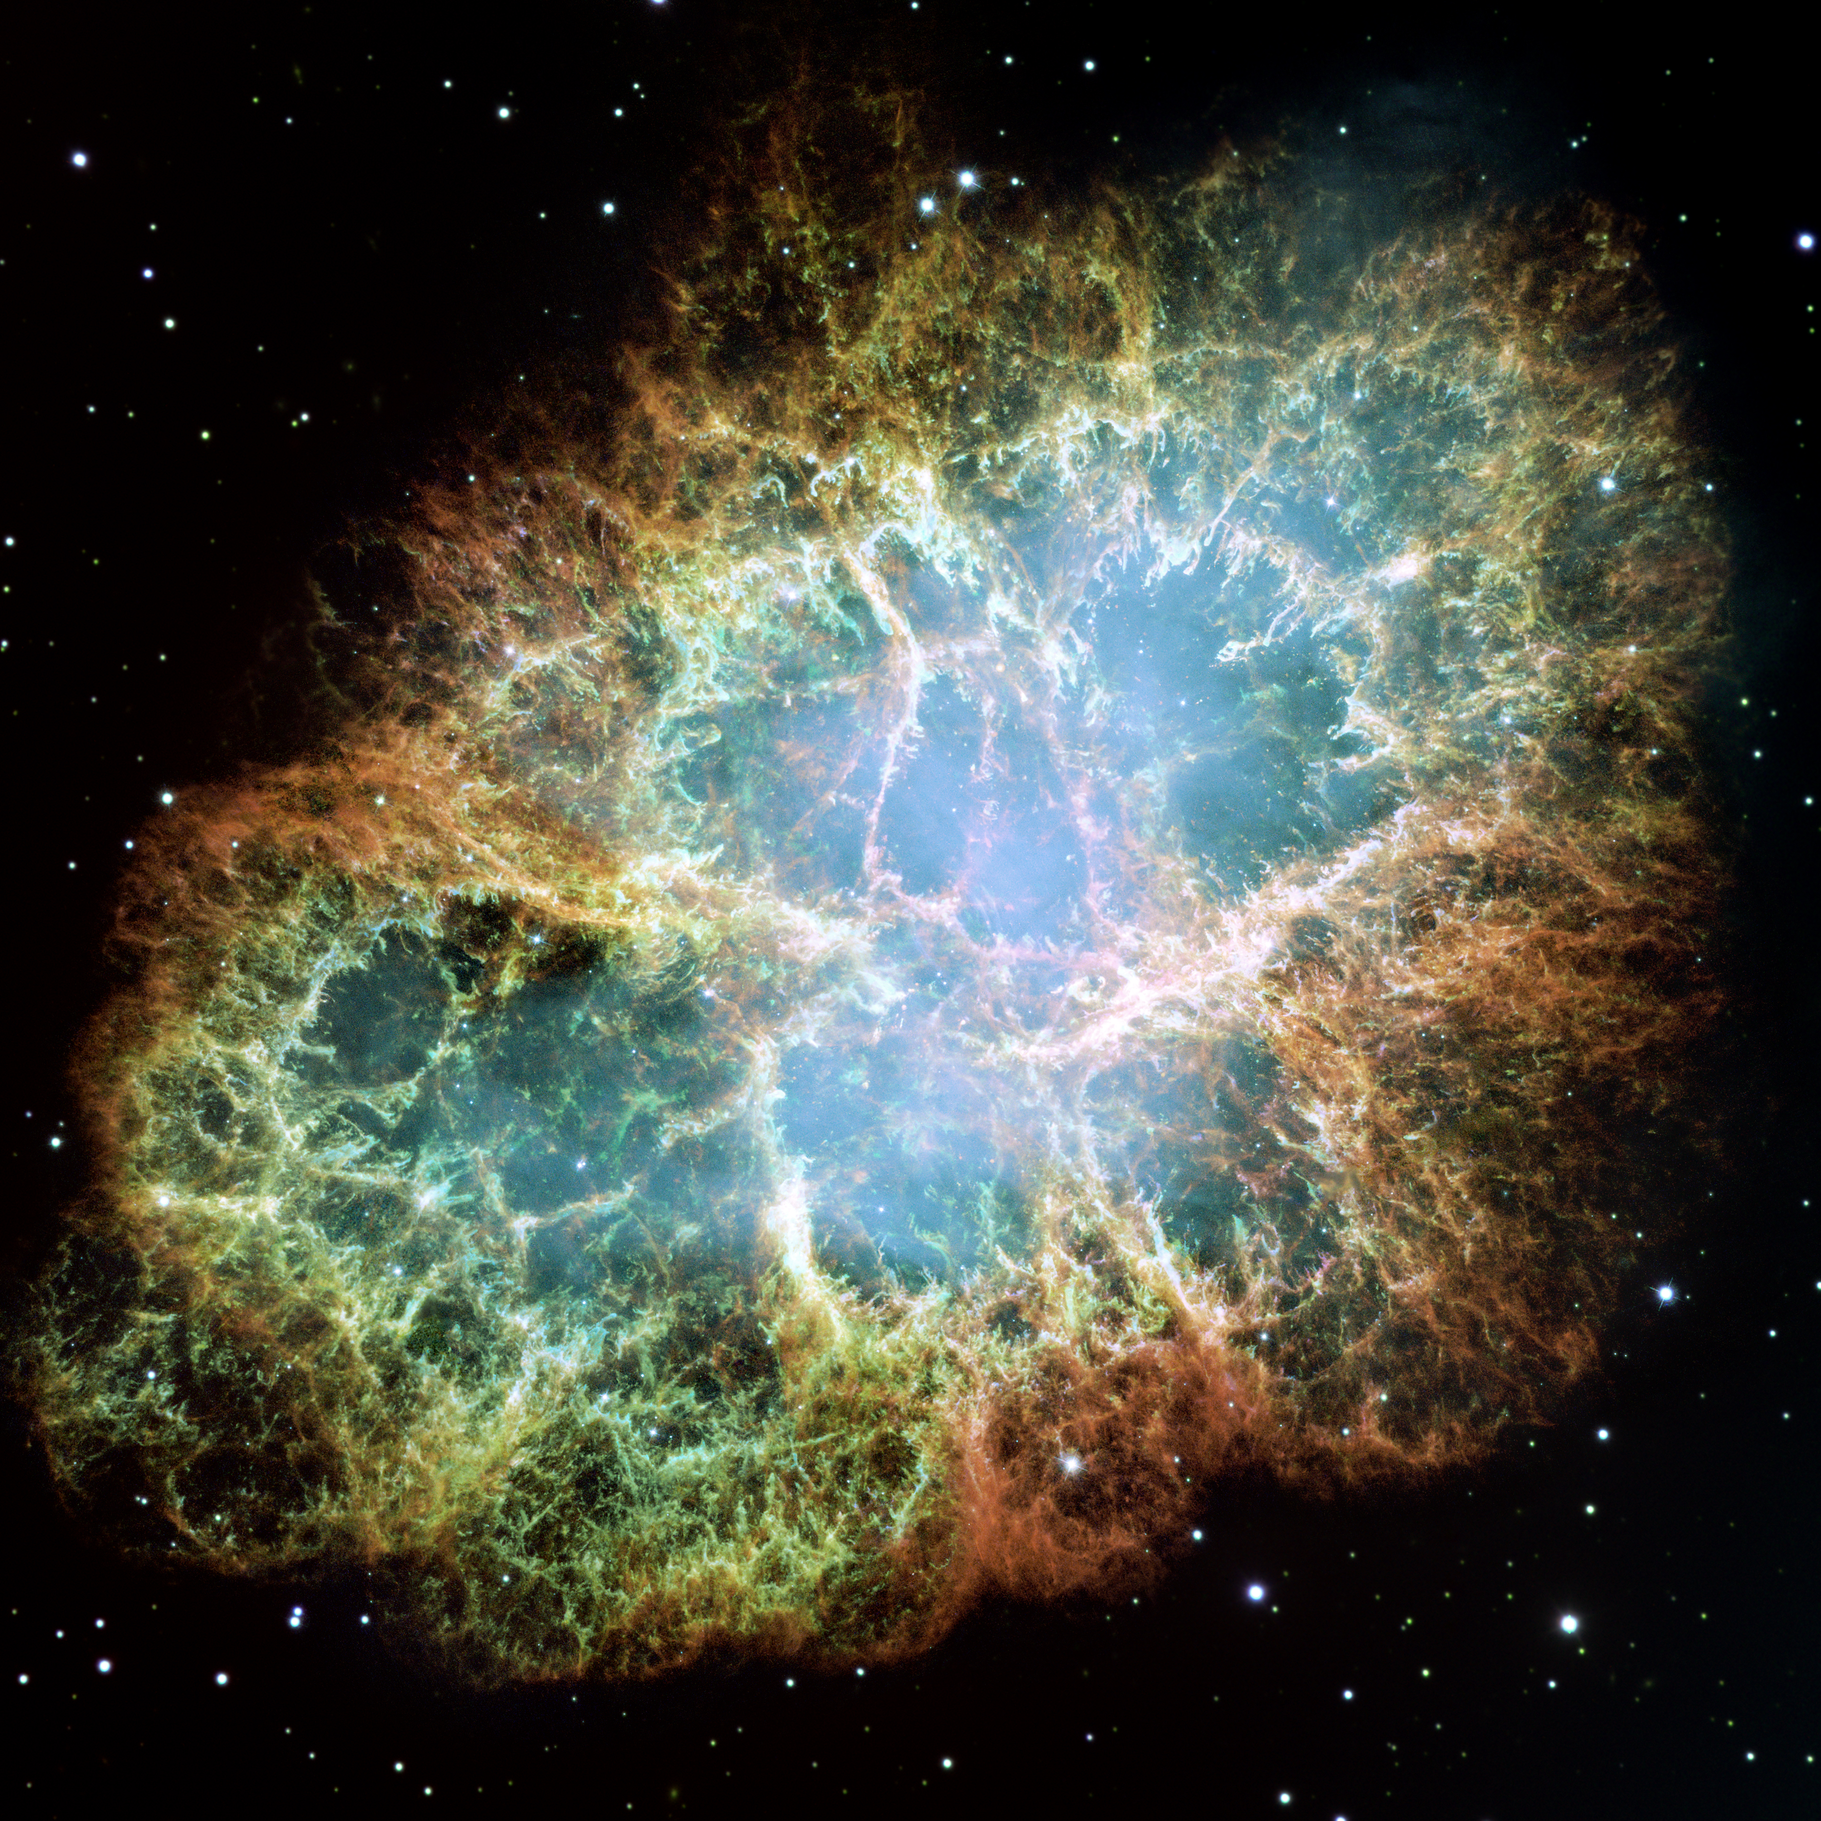
What SHALL We LEARN
From a FUTURE
CORE-COLLAPSE supernova?
Maria Cristina Volpe
CNRS, Astroparticle and Cosmology
Laboratory, Paris

Slide 2
OUTLINE
Core-collapse supernovae
Theoretical aspects of neutrinos
from dense environments
A future supernova
The diffuse supernova neutrino background
Conclusions

Slide 3
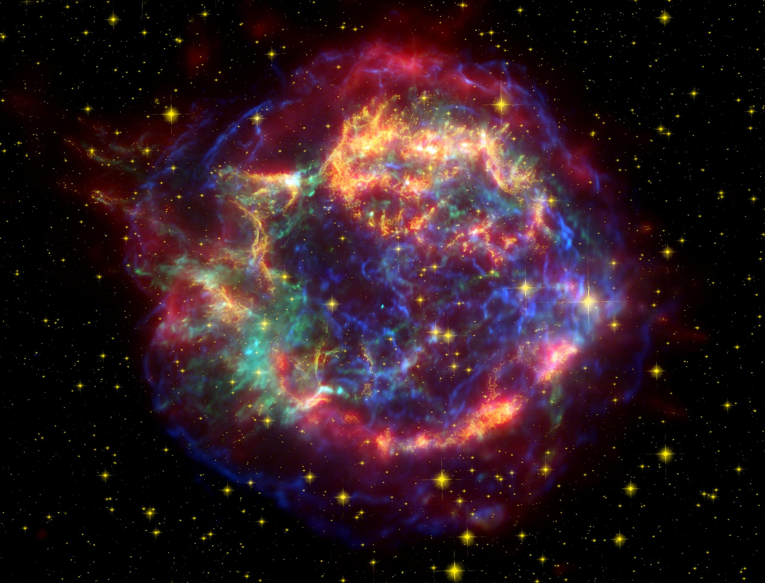
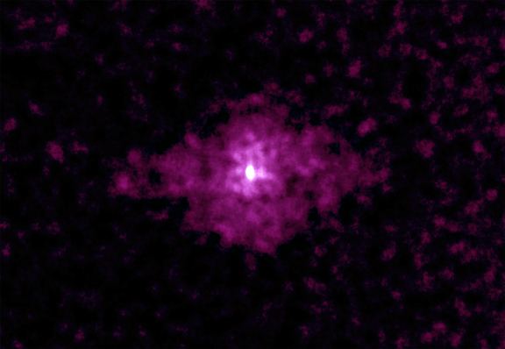
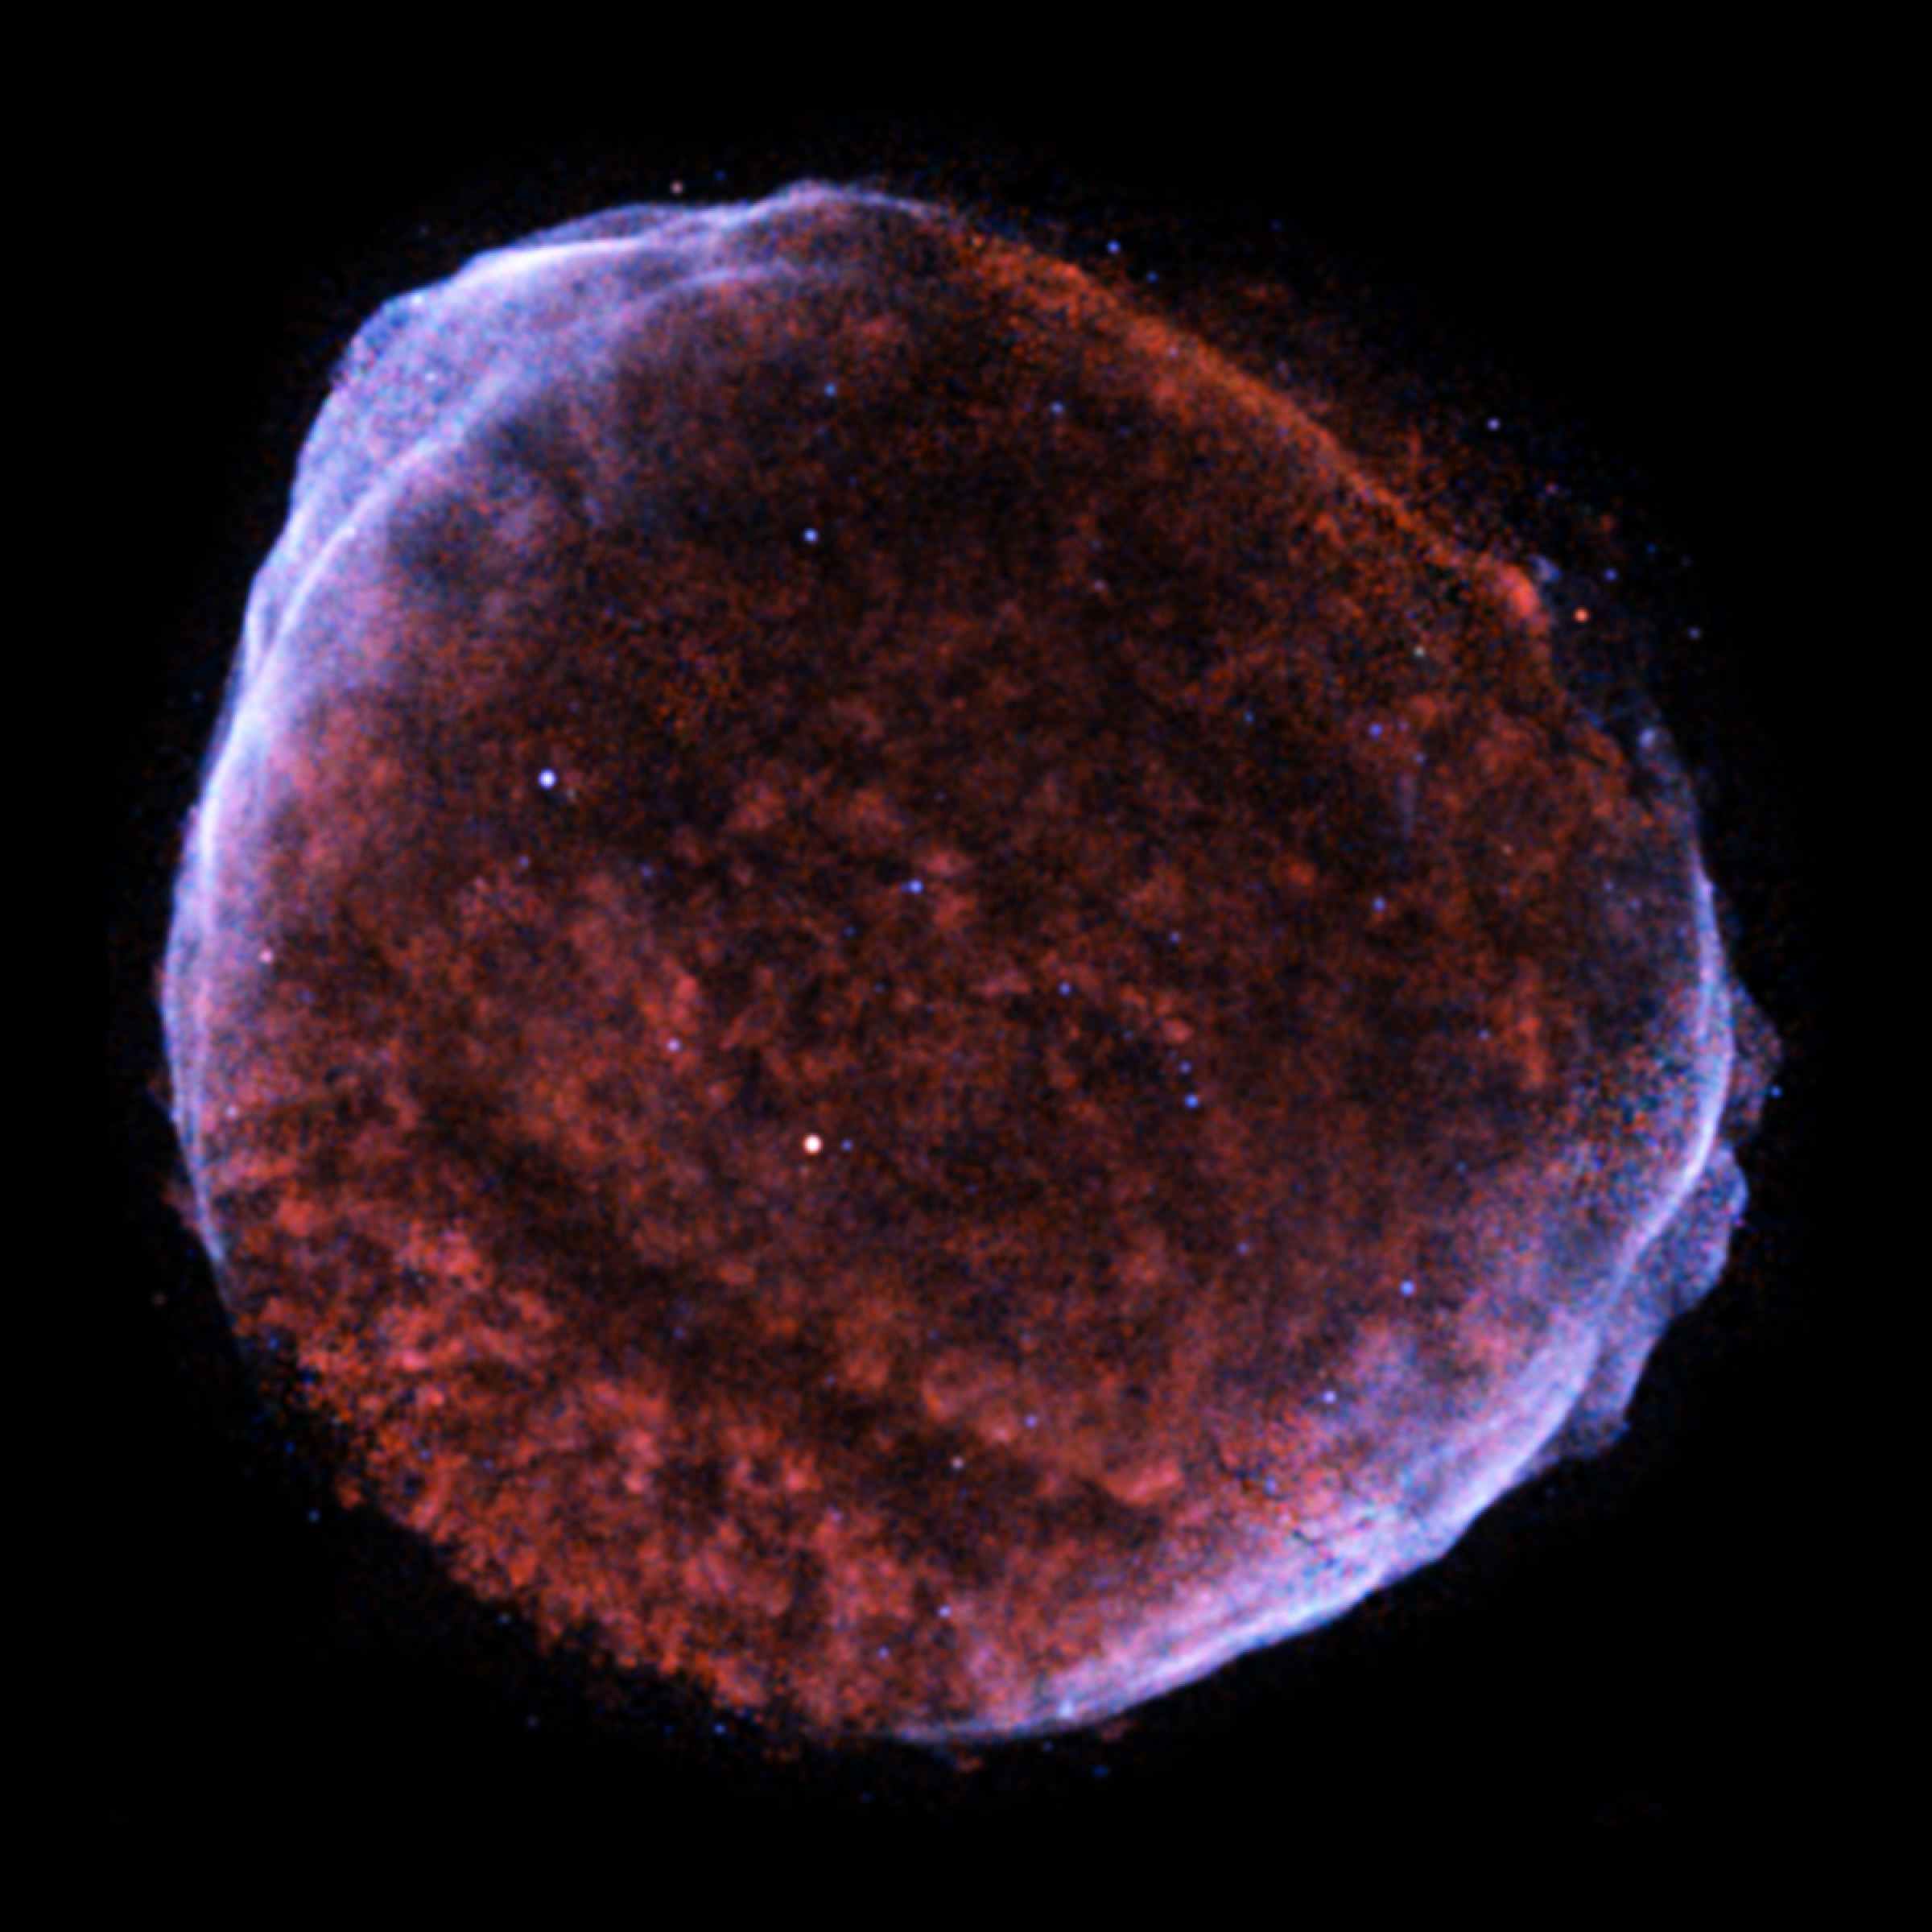
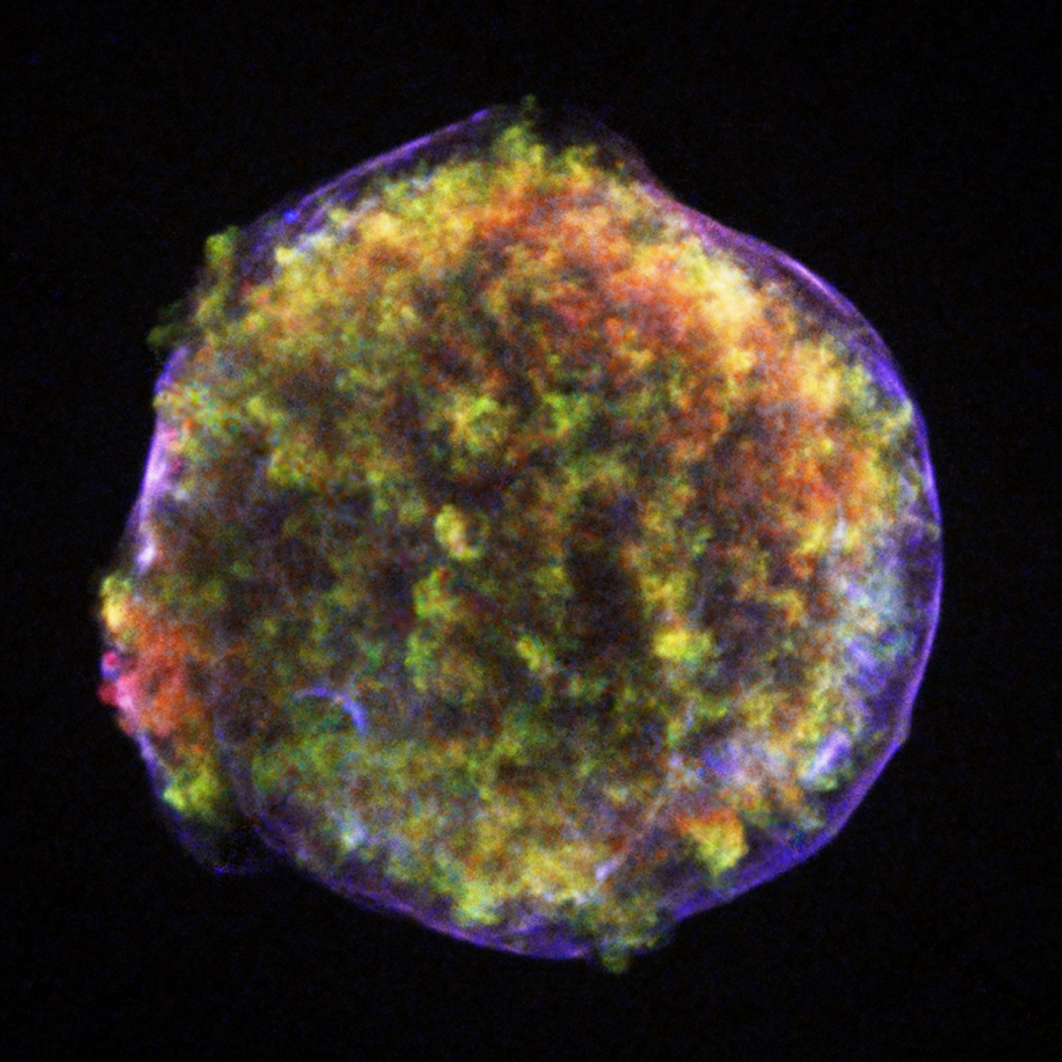
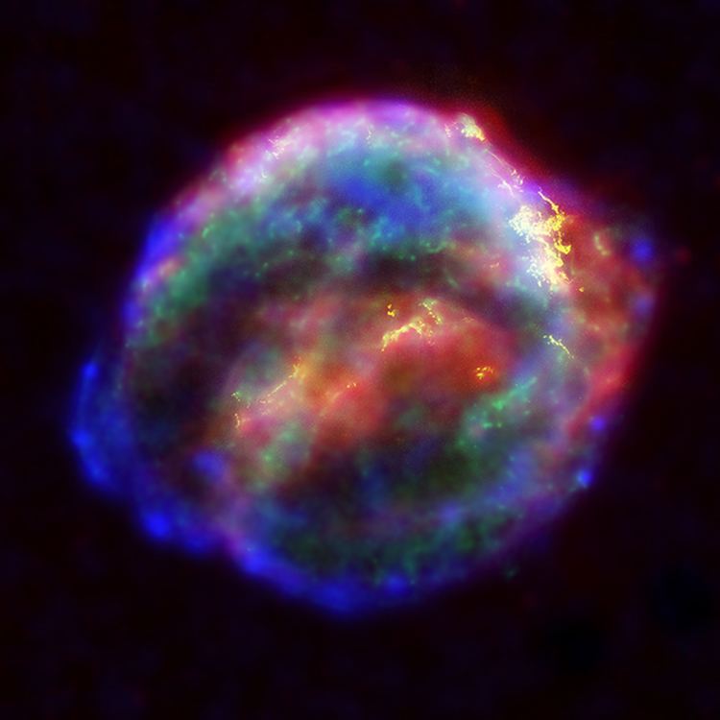
SUPERNOVAE IN THE MILKY WAY - since 1000 y
SN 1006
SN 1572
SN 1604
NASA/CXC/SAO/S.Murray et al.
Courtesy NASA/JPL-Caltech
NASA, ESA, J. Hester and A. Loll
SN 1054
Crab Nebula
SN 1181
SN 1667 (Cas A)
Smithsonian Institution
NASA/CXC/Rutgers/J.Warren & J.Hughes et al.
NASA/ESA/JHU/R.Sankrit & W.Blair
Neutrino Oscillation Workshop (NOW) 2024, Otranto

Slide 4
THE LOCAL GROUP
Largest galaxies : Small Magellanic Cloud (SMC), NGC 3109, Large Magellanic Cloud (LMC),
Triangulum Galaxy, Milky Way, Andromeda (M31).
In the last century, in the Local Group, SN1987A (LMC) and SN 1885 (Andromeda)
Supernovae are rare events. Evaluations of the Galactic core-collapse supernova rate include
$$CORE−COLLAPSESUPERNOVARATES(MilkyWay)(100y)^{−1}$$
²⁶Al in our Galaxy
$$1.9±1.1$$
Diehl et al, Nature, 2006
historical SNe
$${3.2}_{−2.6}^{+7.3}$$
Adams et al, Astr. Journ., 2013
observed SNe
$$1.7±0.74$$
Cappellaro et al 1993, Abrahim et, 2020
observed NS
Keane, Kramer, Mon. N. Roy. Ac., 2008
$$7.2±2.7$$
Rozwadowska et al, New Astr., 2021
1.5 kpc from Sun
$$1−2$$
Reed, Astr. J., 2005
$$1.63±0.46$$
combining some observations
Rozwadowska et al, New Astr., 2021
In the Milky Way, the core-collapse supernova rate is about 1-2 or 1-3 per century.
Neutrino Oscillation Workshop (NOW) 2024, Otranto

Slide 5
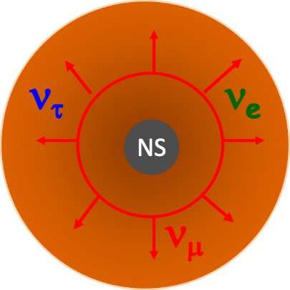
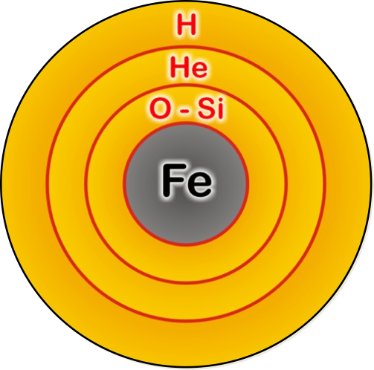
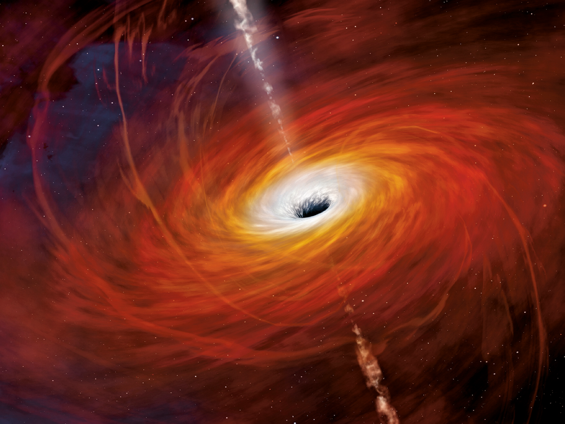
Spectral classification of supernovae
CORE-COLLAPSE SUPERNOVAE
Spectral classification
of supernovae
Schematic evolution of a massive star (25 Msun)
Energy : 99 % neutrinos, 0.01% photons
about 1% explosion kinetic energy
INITIAL STAGES
neutron star (NS)
formed
H
He
black-hole (BH)
Artist image Artist image
H burning
T= 0.09 10⁹ K
Burning time = 7 My
He burning
T= o.2 10⁹ K
Burning time = 5 10⁵ y
C (Si) burning
T= o.8 (3.5) 10⁹ K
Burning time = 600 y (1 d)
Supernova
(core-collapse and explosion)
+ FAILED
SUPERNOVAE
Weaver, Woosley (1980)
FINAL STAGES
Neutrino Oscillation Workshop (NOW) 2024, Otranto

Slide 6
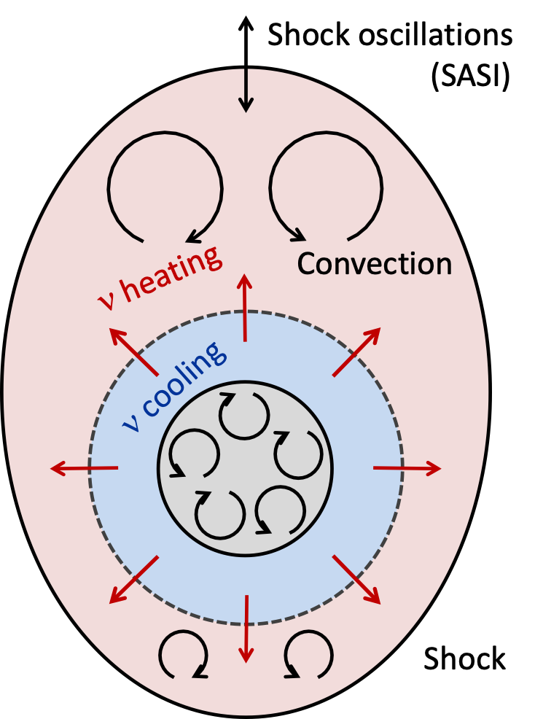
SUPERNOVA EXPLOSION MECHANISM
Elucidating the core-collapse supernova mechanism is
six-decade quest:
- Colgate and White (1966) neutrinos deposit energy behind
the shock triggering the explosion: prompt explosion mechanism.
Wilson (1982), Bethe and Wilson (1985) : neutrino heating render the accretion shock a dynamical shock.
Herant et al (1992) performed the first 2D-simulations.
Blondin et al (2003) : shock wave unstable to non-radial perturbations.
Murphy et al (2013) : turbulent ram pressure contributes pushing the shock outward.
the progenitor dependence, rotation (Summa et al, 2018),
and magnetic fields (Obergaulinger et al, 2015, Kuroda et al, 2020)
also important.
see Mezzacappa (2022), arXiv: 2205.13438,
T. Janka’s talk at « Neutrino Frontiers » (GGI, 2023)
A MAJOR STEP FORWARD EVERY DECADE
Neutrino Oscillation Workshop (NOW) 2024, Otranto

Slide 7
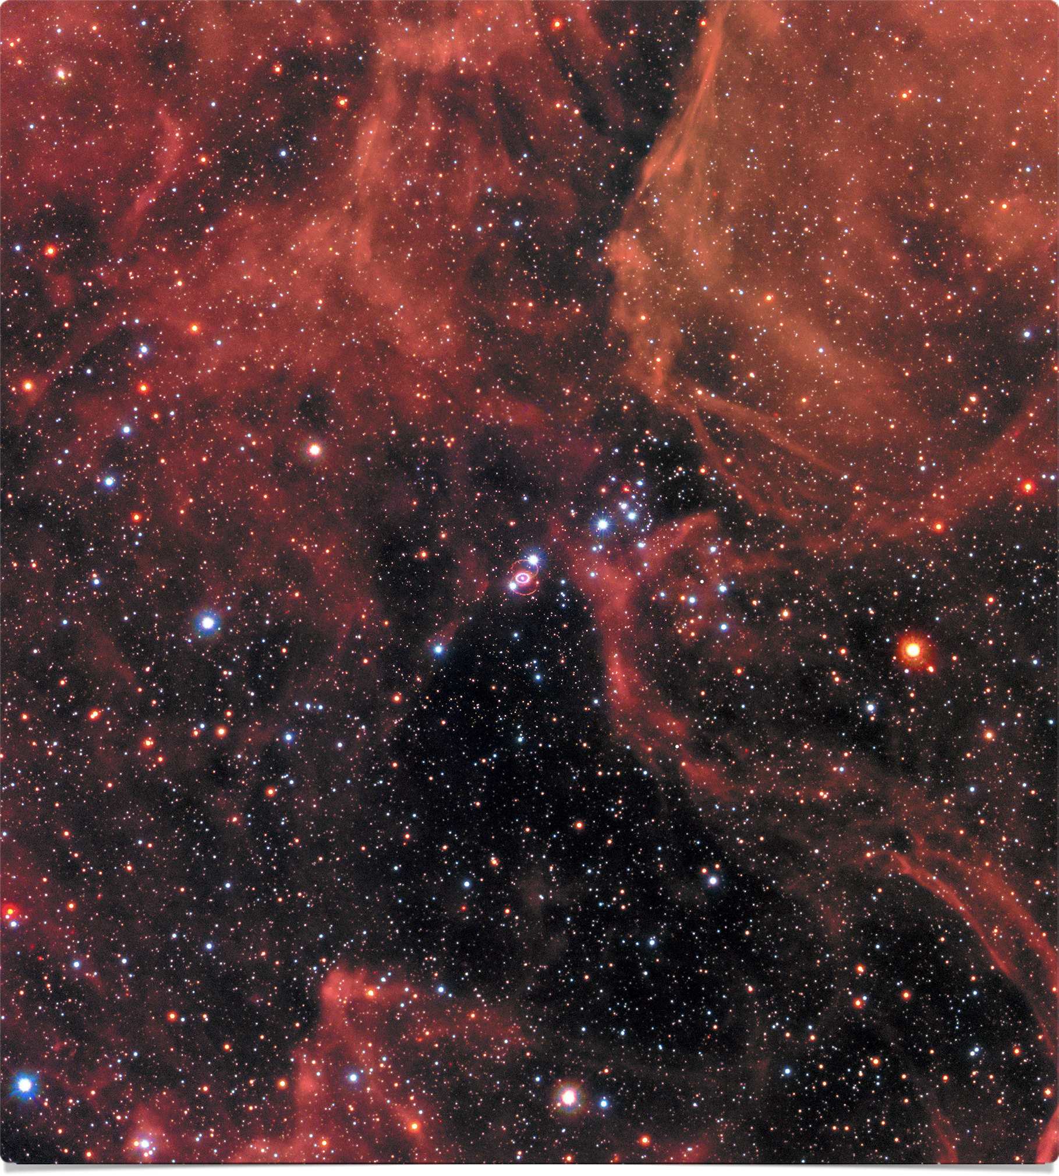
SN1987A today
On the 23rd February, Sanduleak 69⁰202
(blue supergiant) exploded, in the
Large Magellanic Cloud
kpc (163,000 light-years)
Schmidt et al, 1992
distance to LMC now known with 1% precision
49.59 ± 0.09 (stat) ± 0.54 (sys) kpc
Pietrzynski et al., 2019
Hubble Space Telescope
After 30 years, the remnant has been identified:
a dust-obscured thermally emitting neutron star.
Alp et al, 2018, Cigan et al, 2019,
Page et al., Astroph. Journ. 898, 2020
Hubble Space Telescope
Neutrino Oscillation Workshop (NOW) 2024, Otranto

Slide 8
SN1987A NEUTRINO EVENTS
First observation of neutrinos from the core of an exploding
massive star. Observed in all wavelengths.
24 events detected (+5 events in Mont Blanc debated).
Kamiokande
7 s
Bayesian analysis considering only cooling models
or accretion+cooling models.
Baksan
Suzuki, J. Phys. Conf. Ser. (2008)
«We find two-component models to be 100 more probable than single-model component. »
7 s
Loredo and Lamb, PLB 205 (1988)
IMB
Accretion+cooling SN model
favored, prompt model rejected
Mont Blanc
Consistent with predicted time window, average energies
Neutrino Oscillation Workshop (NOW) 2024, Otranto

Slide 9
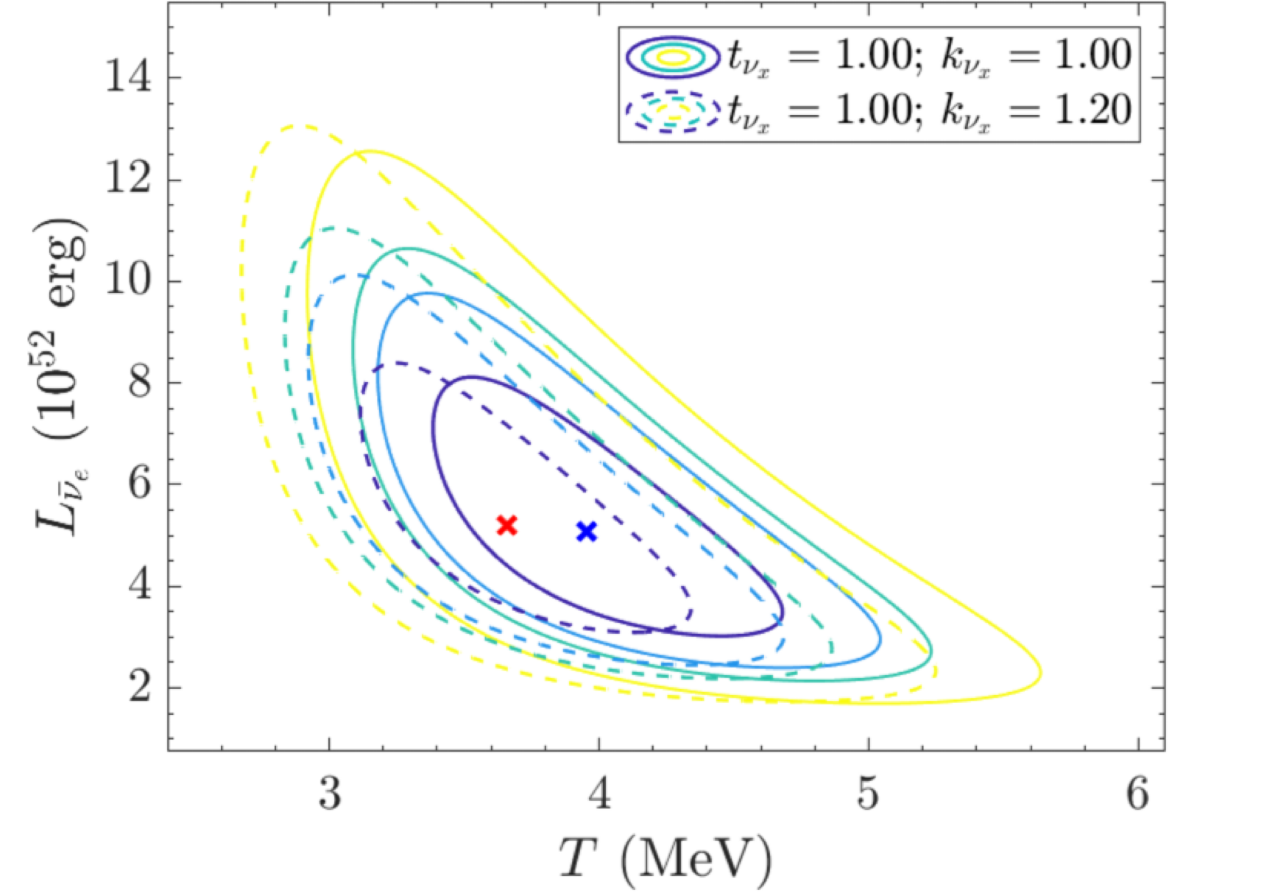
SN1987A and the Mikheev-Smirnov-Wolfenstein (MSW) effect
First analysis found strong sensitivity,
Lunardini and Smirnov , Astrop. Phys. 2004
or indicated a conflict with average
neutrino energies from simulations.
Jegerlherer, Neubig, Raffelt, PRD 54, 1996
More recent found sensitivity at the level of
10%, from the spectral analysis
Vissani, J.Phys.G 42, 2015
Ivanez-Ballesteros and Volpe, PLB 2023, 2307.03549
At the same level of several uncertainties
in the analysis (energy thresholds, efficiencies, …)
Neutrino Oscillation Workshop (NOW) 2024, Otranto

Slide 10
Neutrino Oscillation Workshop (NOW) 2024, Otranto

Slide 11
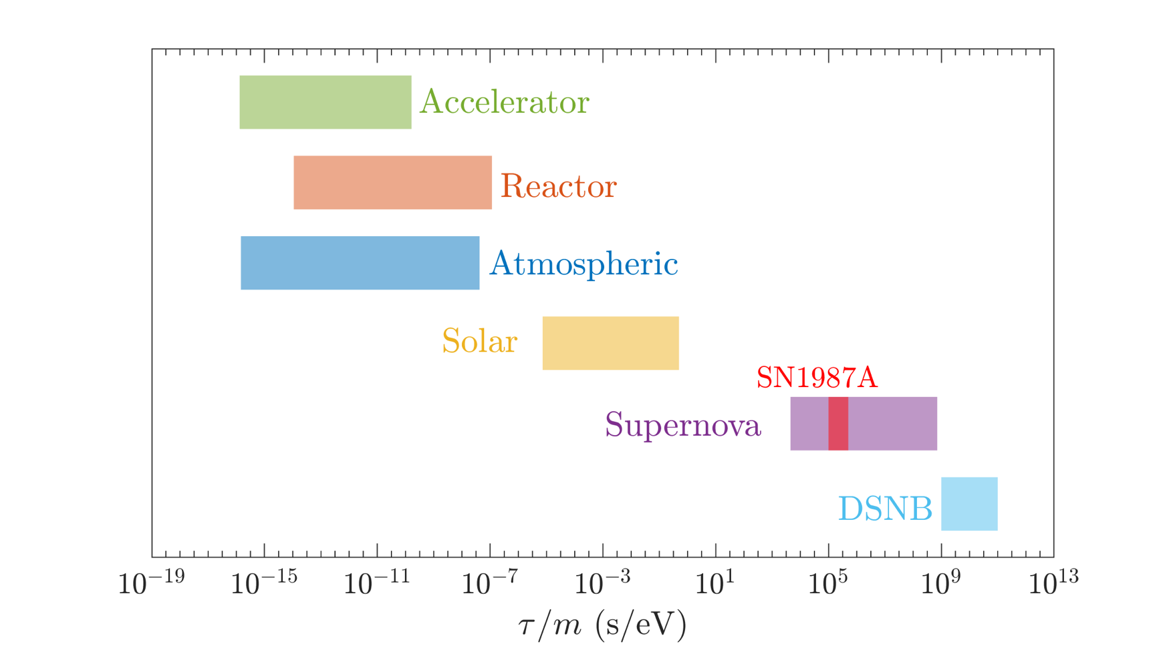
NEUTRINO NON-RADIATIVE DECAY
Since neutrinos are massive they can decay.
Neutrino non-radiative two-body decay:
Sensitivity from different neutrino sources
a massless (pseudo)scalar particle
due to tree-level (pseudo)scalar couplings.
The neutrino fluxes get suppressed by the factor
- souce-detector distance
$$exp(−\frac{L}{τ}×\frac{m}{E})$$
- neutrino energy
- neutrino mass
- lifetime
Ivanez-Ballesteros, Volpe, PLB 2023, 2307.03549
Unique sensitivity to tau/m from CCSNe and the diffuse supernova neutrino background
Neutrino Oscillation Workshop (NOW) 2024, Otranto

Slide 12
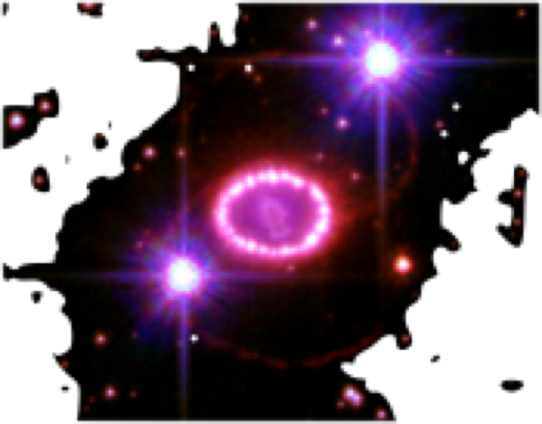
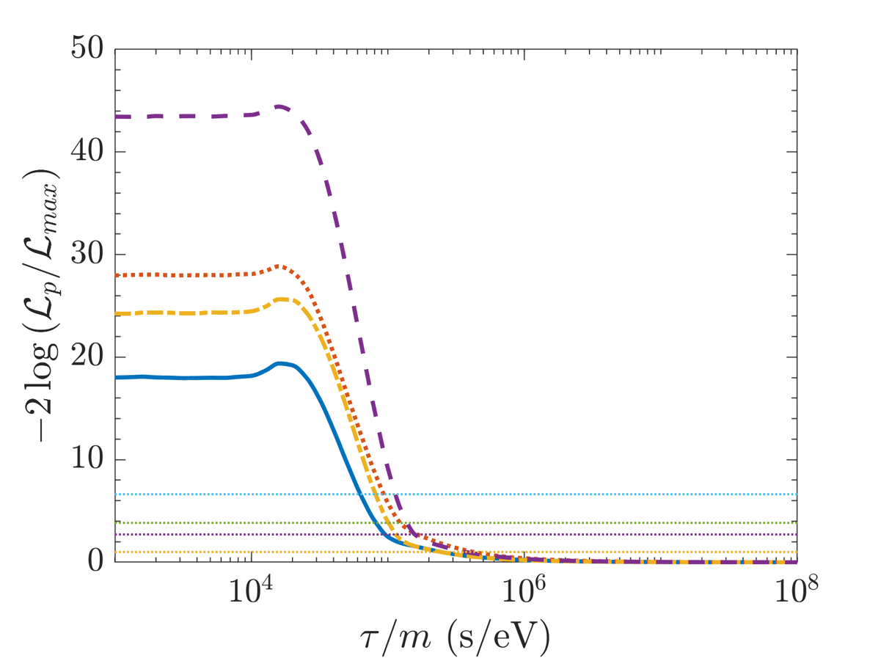
SN1987A and NEUTRINO NON-RADIATIVE DECAY
I
A likelihood analysis (7D) of the 24 SN1987 neutrino
events in Kamiokande, IMB and Baksan, with
non-radiative decay yields
inverted
mass
ordering
Full 3 neutrino framework, three possible decay
patterns (NO and SH or QD, IO) .
99 % CL
95%
90%
68%
Ivanez-Ballesteros, Volpe, PLB 2023, 2307.03549
$$τ/m>1.2×{10}^{5}(90\%C.L.)forν_{1}andν_{2}(IO)$$
Excludes previous bounds on tau/m (PDG),
competitive with cosmology
Neutrino Oscillation Workshop (NOW) 2024, Otranto

Slide 13
What ArE We LEARNING
WAITiNG FOR the next supernova?
see talks by Manibrata Sen (Wednesday), Nagakura (Wednesday), Johns (Wednesday),
Abbar (Saturday), Lella (Saturday), Beauchêne (Saturday)
See C. Volpe, «Neutrinos from dense: flavor mechanisms, theoretical approaches, observations, new directions »,
Review of Modern Physics . 96 (2024) 2, 025004, arXiv: 2301.11814
see also the reviews Duan et al 2010, Scholberg 2012, Volpe, 2015, Mirizzi et al 2016, Horiuchi and Kneller 2018,
Tamborra and Shalgar 2021, Kato et el 2020, Manibrata Sen 2024, Volpe, 2024, …
Neutrino Oscillation Workshop (NOW) 2024, Otranto

Slide 14
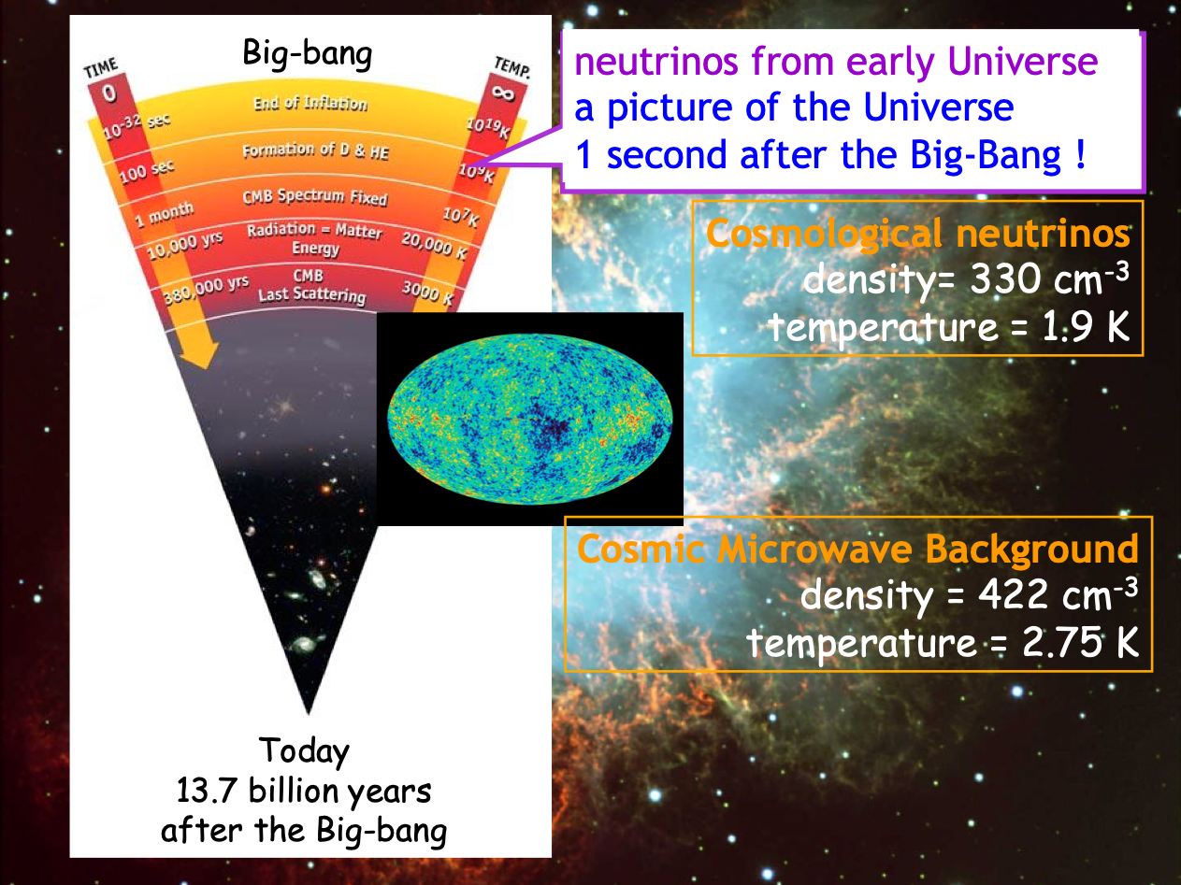
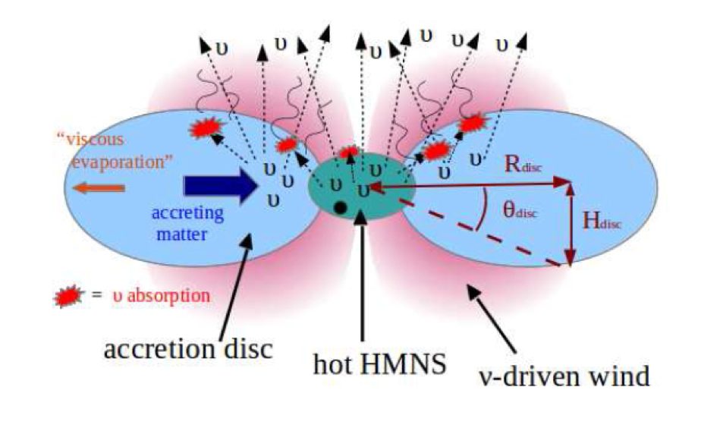
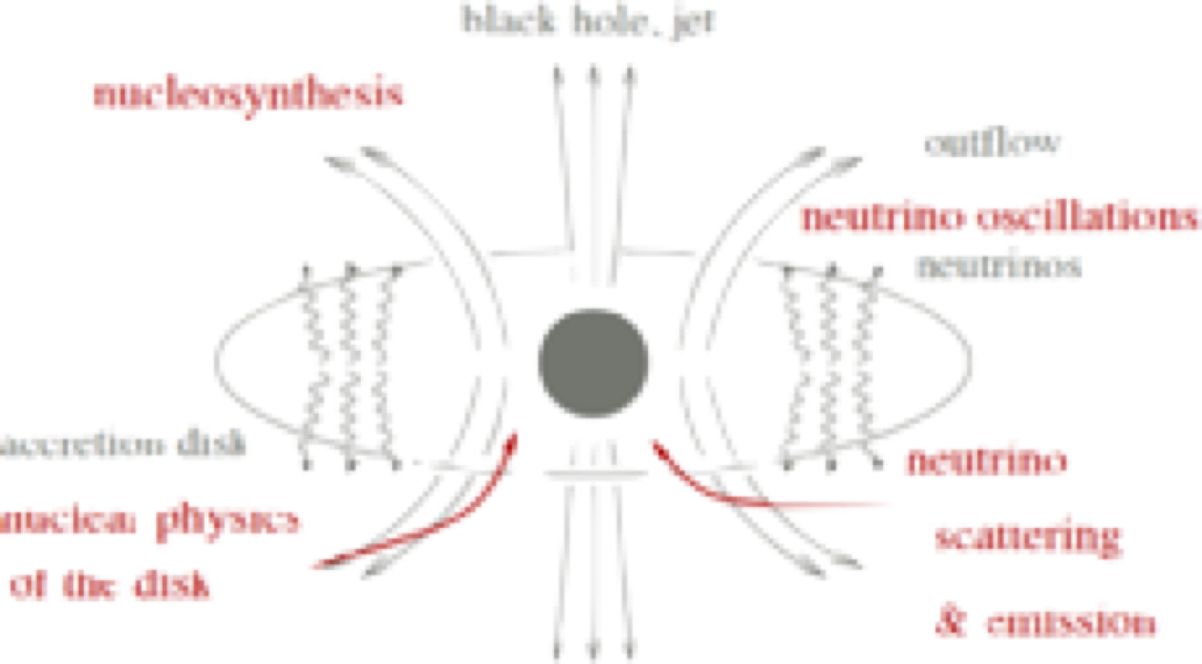
BINARY NEUTRON STAR MERGERS
NEUTRINOS FROM
DENSE
ENVIRONMENTS
GW170817
ACCRETION DISKS AROUND BLACK HOLES
CORE-COLLAPSE SUPERNOVAE
SN1987A
Neutrino Oscillation Workshop (NOW) 2024, Otranto

Slide 15
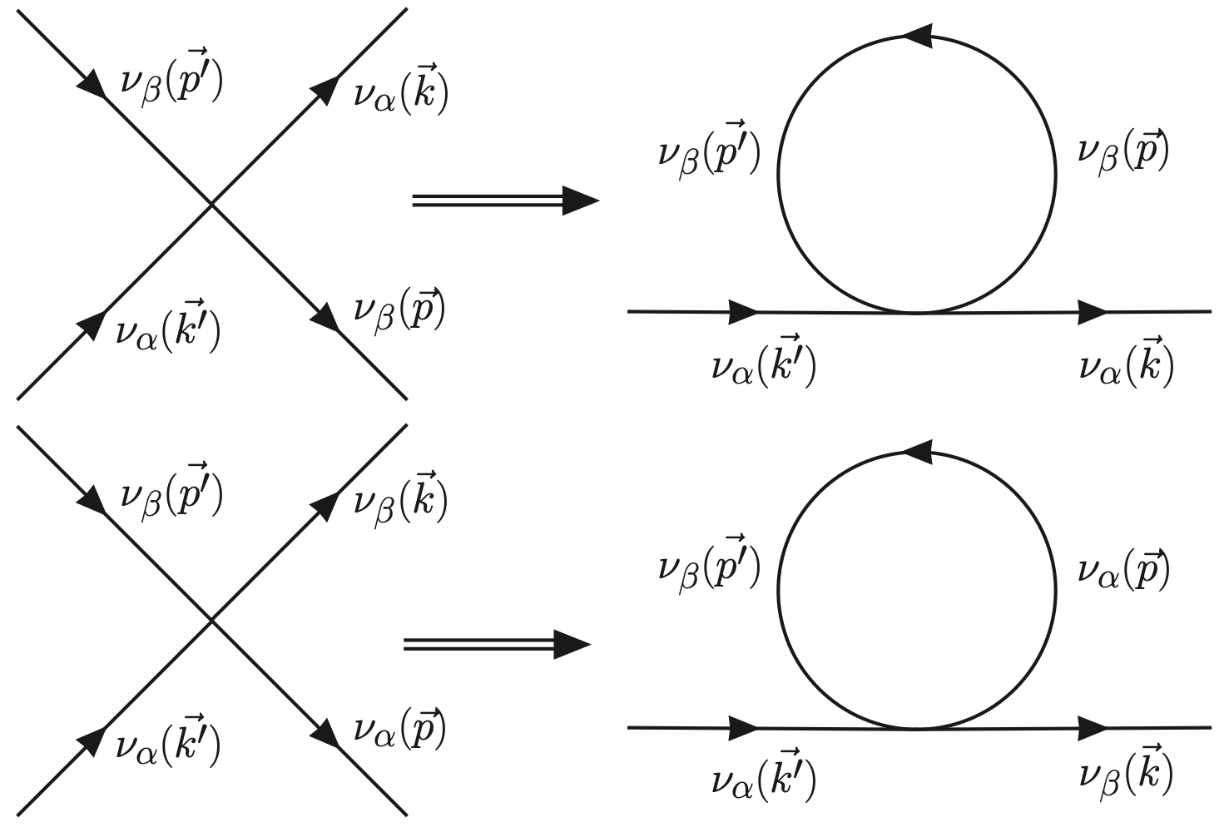
DENSE ENVIRONMENTS
« Dense» = a medium that can reach 10¹⁰ g/cm³ and more,
10¹⁵ ⁻ 10¹⁶ g/cm³ (limits of matter compressibility),.
But « dense » also means in neutrinos. In a supernova explosion
about 10⁵⁸ neutrinos with an average energy of 10 MeV produced.
Raffelt, 2001
Dense in matter and neutrinos
« Neutrino propagation in supernovae is a
non-linear many-body problem due to a
sizeable neutrino-neutrino interaction. »
Pantaleone, PLB 1992
Neutrino Oscillation Workshop (NOW) 2024, Otranto

Slide 16
NEUTRINO EVOLUTION EQUATIONS IN DENSE MEDIA
In astrophysical and cosmological environments, neutrinos interact with the particles in the medium.
One-body density matrix in 2nu framework :
The full description employs the neutrino quantum
kinetic equations:
Necessary for the early Universe -
primordial nucleosynthesis (10 MeV - 0.1 MeV,
neutrinos set n/p ratio key for the
build up to He4, D, He3, Li7).
$$i(∂_{t}+v⋅∇_{x}+F⋅∇_{p})ρ_{x,p}=[h_{x,p},ρ_{x,p}]+iC[ρ,\overline{ρ}],$$
Diagonal elements are the expectation value of
the number operator :
The full Liouville operator is 7-dimensional.
Non-diagonal elements account for the mixings
(flavor modification)
Solved in the early Universe (isotropy, homogeneity).
A precise value for Neff = 3.0440 (BBN epoch)
Froustey, Pitrou, Volpe, JCAP 12, 2020; Bennet et al, JCAP 04, 2021
Neutrino Oscillation Workshop (NOW) 2024, Otranto

Slide 17
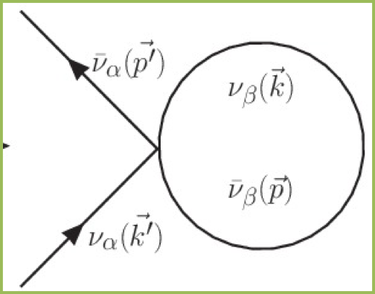
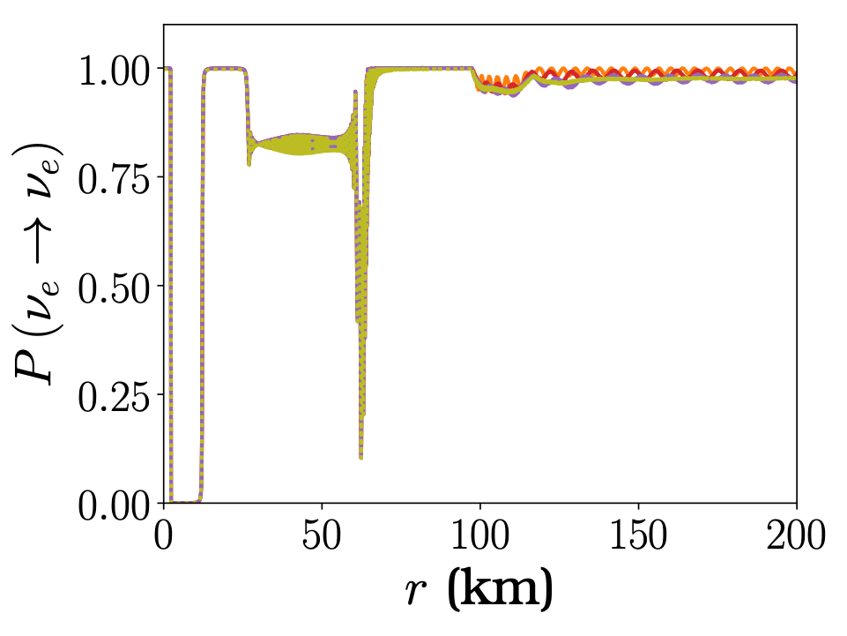
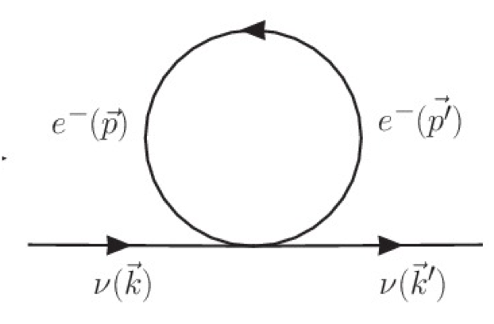
NEUTRINO HAMILTONIAN (MEAN-FIELD)
Neutrinos propagating in a dense astrophysical environments :
A weakly interacting many-body problem.
Non-standard interactions
responsible for vacuum
oscillations
limits for neutral solar-like matter
Neutrino-neutrino interactions
Matter term, MSW effect
NSI in BNS
MNR
I
I
Chatelain, Volpe, PRD97, 2018.
Neutrinos
Neutrino Oscillation Workshop (NOW) 2024, Otranto

Slide 18
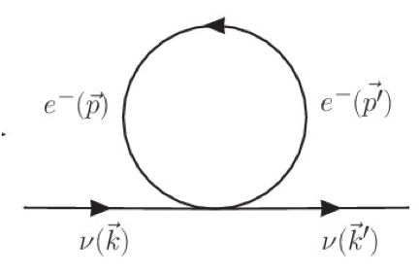
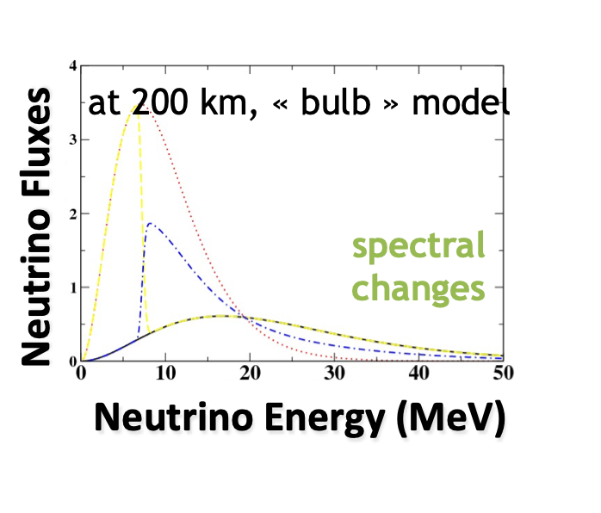
FLAVOR CONVERSION IN DENSE ENVIRONMENTS
MSW effect
MSW
region
neutrinospheres
Neutrino-neutrino interactions
NS
shock wave
Pantaleone, PLB287 (1992).
Duan et al, PRD, 2006
slow modes
fast modes (m scale or less)
Shock wave effects (multiple MSW)
MSW effect
Schirato and Fuller,
hep-ph/0205390
Sawyer PRD 2005, PRL 2016.
Turbulence effects
Loreti et al, PRD 52 (1995)
Collisional instabilities
Johns, PRL 19 (2023)
Neutrino-neutrino interactions
Neutrino Oscillation Workshop (NOW) 2024, Otranto

Slide 19
« It doesn’t matter how beautiful your theory is, it doesn’t matter how smart you are.
If it doesn’t agree with experiment, it’s wrong. »
R. Feynman
From C. Giunti and C. W. Kim, « Fundamentals of neutrino physics and astrophysics », Oxford U Press

Slide 20
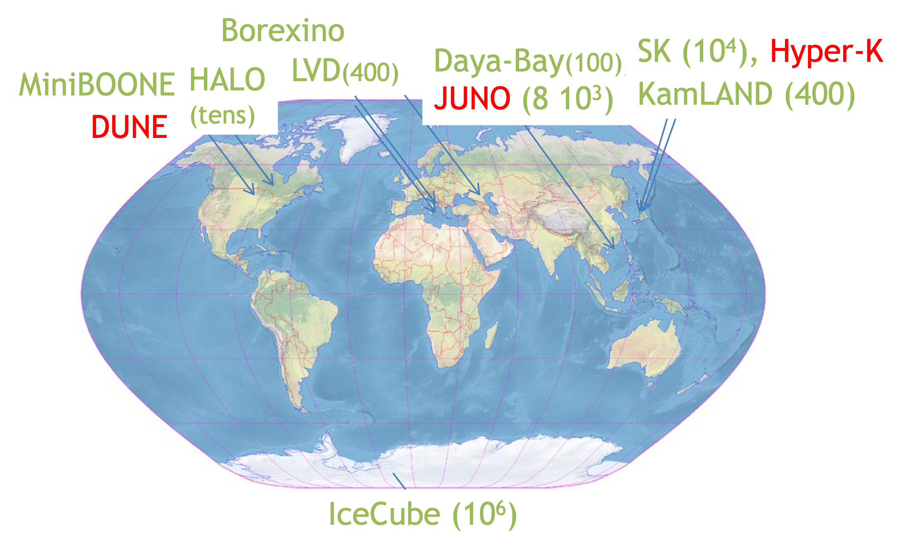
NEUTRINOS from NEXT SUPERNOVA
Supernova Early Warning System (SNEWS 1.0) -
prompt, positive, pointing
Scholberg 1999, 2008; Antonioli et al, 2004
pre-SN neutrinos, dark matter detectors, multimessenger astronomy SNEWS 2.0, 2021
Expected events ( SN at 10 kpc):
540 in HALO-2, hundreds in KamLAND,
3000 in DUNE, 8000 (JUNO), 10000 in Super-K,
10⁵ in Hyper-K, 10⁶ in IceCube.
Sensitivity to electron neutrinos from
neutrino-nucleus inelastic scattering
See also SNEWPY (Baxter et al., 2022).
Dark matter detectors:
120 (Xenon nT, 7 tons), 700 (DARWIN, 40 tons),
336 events (Darkside-20k (50 tons)
,
Sentivity to all flavors, time and energy signal
through nu-electrons, nu-nucleus incoherent,
nu-proton and coherent nu-nucleus scattering
(CE$ν$NS, Akimov, 2017)
Lang et al, 2016; Agnes 2021
Neutrino Oscillation Workshop (NOW) 2024, Otranto

Slide 21
SN NEUTRINO TIME SIGNAL
Pre-SN neutrinos (1-a few days before the SN)
information on the late stages before SN collapse
(stellar evolution theory), on the progenitor and early alert.
Late-time neutrinos from PNS cooling (10-100 s)
about the PNS EOS, fate of the SN, total radiated
energy and lepton number, non-standard cooling
Neutrino emission from e.g. the Si-burning
phase lasts about 2 days (M = 20 Msun).
Odrzylowek et al, Astrop. Phys. (2004);
Patton et al, 2017; Kato et al 2020
Pre-SN neutrinos (3 sigma, 2d before exp.)
could be detected in KamLAND for M = 25 Msun
up to 690 pc.
Asakura et al., Astrophys. Journ. (2016)
250 antinue over 50 s in Super-K,
110 nue over 40 s in DUNE
10 (anti)numu, (anti)tau over 20 s in JUNO
- SN at 10 kpc.
Li, Roberts, Beacom., PRD (2021)
Neutrino Oscillation Workshop (NOW) 2024, Otranto

Slide 22
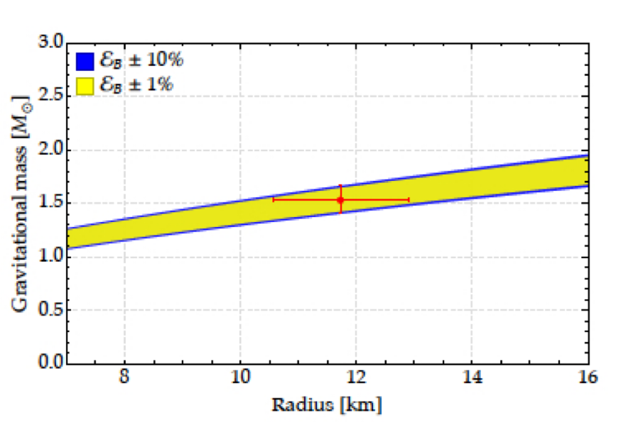
SN NEUTRINO 10 s TIME SIGNAL
Neutronization peak:
> only MSW effect operates
> non-standard properties, ex. decay or NSI
Neutronization
Accretion
Neutron star cooling
De Gouvea et al, PRD101, 2020; Das et al, JCAP
05, 2017; etc…
see talk by Manibrata Sen
Total gravitational energy emitted in
neutrino luminosity ((SN at 10 kpc):
> 11% (SK) and 3% (HK) precision
fit to numerous EOS for NS
Lattimer & Prakash,
Phys. Rep. 2007
A star like SN1987A
Hudepöhl et al PRL, 2011
Detection of each phase crucial
Gallo Rosso, Vissani, Volpe, JCAP 11, 2017
Compactness of newly born neutron star
Neutrino Oscillation Workshop (NOW) 2024, Otranto

Slide 23
SUPERNOVA EXPLOSION MECHANISM
Since a decade, there is an emerging consensus :
the majority of supernovae explodes due to the
delayed neutrino-heating mechanism neutrinos
efficiently reheat the shock aided by convection,
turbulence and hydrodynamic instabilities
(SASI).
see Mezzacappa (2022), arXiv: 2205.13438.
GW signatures (different frequencies) from
core bounce (rotating progenitor);
neutrino-driven convection (PNS);
neutrino-heating in the gain layer;
SASI;
explosion.
Walk et al (2020)
see also Mueller, Janka, Astr. J. (2014),
see e.g. Mezzacappa and Zaolin, 2401.11635,
G. Pagliaroli’s talk at « Neutrino Frontiers » (2023, GGI)
Tamborra et al, Ast. Journ.(2014)
OBSERVING THE NEXT SUPERNOVA CRUCIAL to CONFIRM/REFUTE
Neutrino Oscillation Workshop (NOW) 2024, Otranto

Slide 24
FLAVOR MECHANISMS
First Bayesian analysis to discriminate among
flavor mechanisms.
Supernova distance not know,
neutrino flux parameters not fixed.
,
First Bayesian analysis to explore our capacity
to discriminate among models.
Five (one-dimensional or multi- dimensional)
supernova models from different groups, 500 ms, MSW.
Seven one-dimensional models (different progenitor mass,
EOS), 9s, MSW.
18 2D and 3D supernova models (9 M to 60 M), 300 ms,
MSW
Abe et al, 2021
Olsen and Qian 2022
Saez et al 2024
Abbar and Volpe, 2401.10851
DISCRIMINATING FLAVOR MECHANISMS COULD BE POSSIBLE
Neutrino Oscillation Workshop (NOW) 2024, Otranto

Slide 25
SUPERNOVA SIGNALS
Neutrinos - SN fate (BH vs NS), explosion mechanism,
EOS and compactness of the PNS, PNS cooling,
progenitor structure, stellar evolution (pre-SN neutrinos),
localization via triangulation, flavor mechanisms in dense media,
neutrino properties - magnetic moment, non-radiative decay,…
Optical- localization and distance,
progenitor, …
ex. All Sky Automated Survey
for Supernovae (ASAS-SN)
Gravitational waves - explosion mechanism,
M-R, …

Slide 26
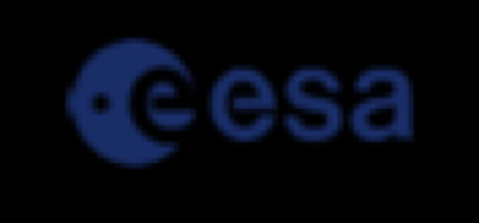
EVOLUTION DE L’UNIVERS
1 seconde après le Big-Bang
DSNB
13.8 milliards
d’années

Slide 27
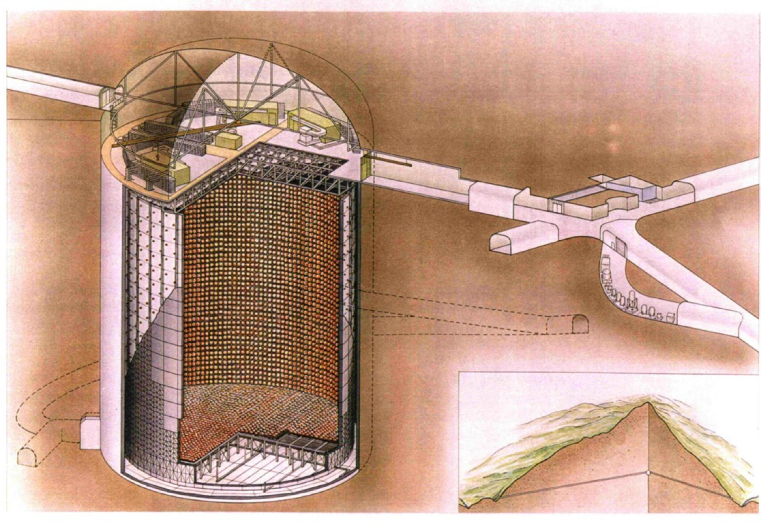
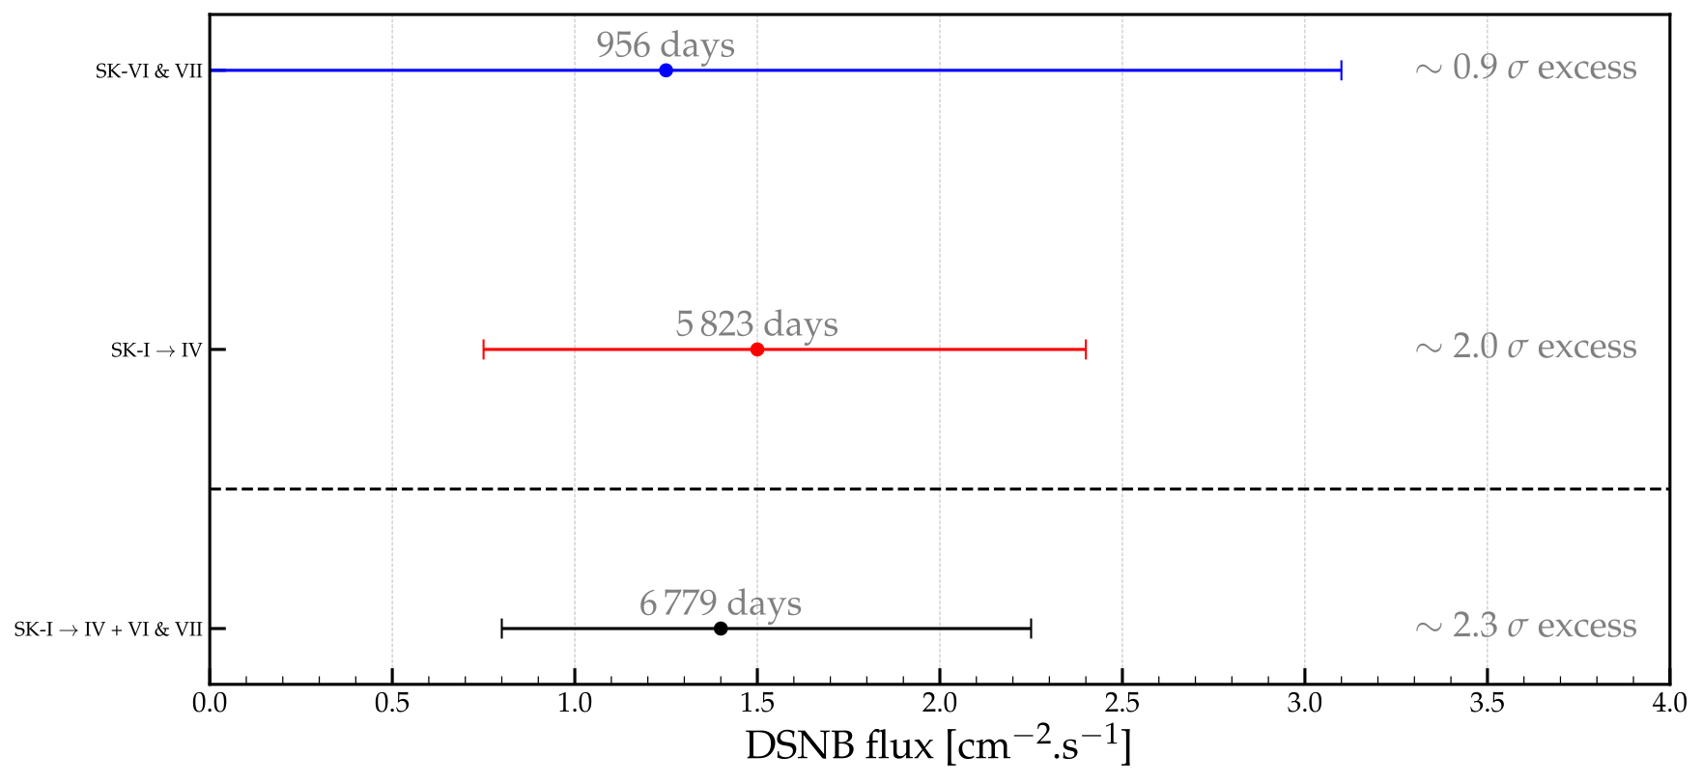
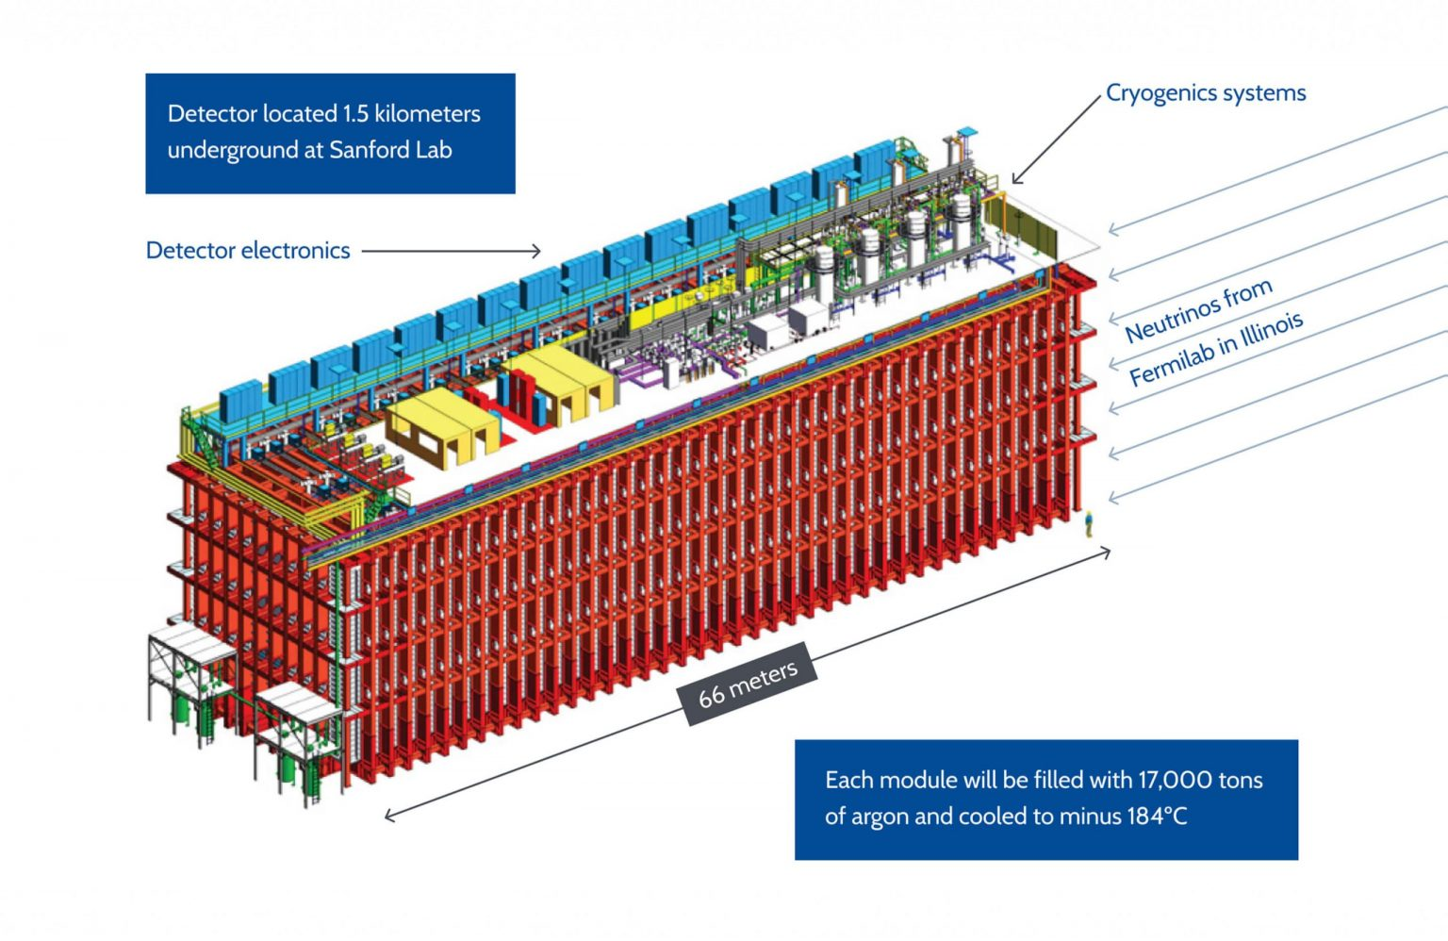
DIFFUSE SUPERNOVA NEUTRINO BACKGROUND
The DSNB flux depends on the evolving core-collapse supernova
rate, the neutrino fluxes from a supernova, integrated over time
See Beauchêne’s talk on Saturday
M - progenitor mass giving a neutron star or a black hole
First results of SK+Gadolinium (SK VI and VII)
Super-Kamiokande
50 kton water (Japan)
Running (2020) + Gd
Hyper-Kamiokande
178 kton (FV) water (Japan)
Starting 2027
Courtesy of A. Beauchêne
DUNE
40 kton
liquid argon
(US)
Starting 2029
JUNO
50 kton scintillator
(China)
starting 2025
Expected DSNB events
10 anti-nue for SK-Gd (10 year), and nue in
DUNE (20 years), 10-40 anti-nue for JUNO (20 years)
hundreds anti-nue for Hyper-Kamiokande (10-20 years)
10 nux (antinux) in dark matter detectors
Neutrino Oscillation Workshop (NOW) 2024, Otranto

Slide 28
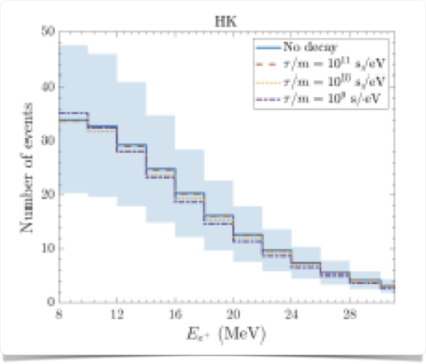
Hyper-Kamiokande
DSNB ENCODES CRUCIAL INFORMATION
The DSNB is sensitive to :
- the cosmic core-collapse supernova rate, the
fraction of failed supernovae, the EOS;
Hyper-Kamiokande
see e.g. Priya and Lunardini 2017,
Moller et al 2018, Kresse et al 2021,
Horiuchi et al 2021, …
Normal mass
ordering and SH
Inverted
mass ordering
- flavor conversion phenomena beyond MSW,
e.g. shock waves and self-interaction.
Event rates can be modified by 10-20 %.
Galais, Kneller, Gava, Volpe, PRD81, 2010
- non-standard neutrino properties such as
neutrino decay.
Ivanez-Ballesteros, Volpe, PRD107 (2023), arXiv:2209.12465
Ando 2003, Lisi et al 2004, De Gouvea et al 2020,
Tabrizi et Horiuchi 2021, Ivanez-Ballesteros, Volpe, 2023.
In case DSNB not observed, it could be
due to neutrino non-radiative two-body decay (IO);
significant degeneracies with no decay case (NO)
Neutrino Oscillation Workshop (NOW) 2024, Otranto

Slide 29
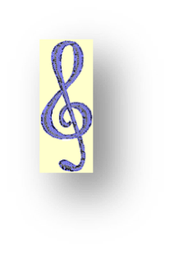
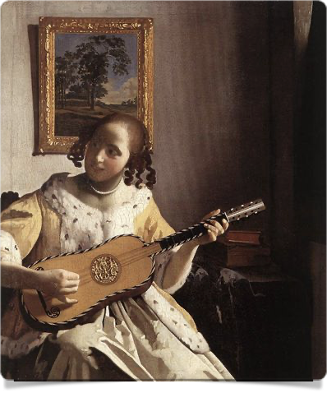
Conclusions and Perspectives
Core-collapse supernova are rare spectacular events and a unique laboratory for astrophysics, particle physics and the search for new physics.
How neutrinos evolve in dense matter is a unique weakly interacting many-body system. Many ongoing developments, e.g. on the impact of fast modes on the explosion, on the role of flavor conversion on stellar nucleosynthesis, on the interplay between flavor terms and collisions, on SN dynamics and many-body correlations.
Two crucial features we might learn - answer the six-decade quest of how massive stars undergoing gravitational collapse explode and how neutrinos change flavor in dense environments.
The upcoming detection of the diffuse supernova neutrino background will open a unique low-energy observational window in neutrino astronomy.
M.C. Volpe, «Neutrinos from dense: flavor mechanisms,
theoretical approaches, observations, new directions »,
Review of Modern Physics . 96 (2024) 2, 025004, arXiv: 2301.11814
« Une femme jouant de guitare », Vermeer, 1672

Slide 30
SN NEUTRINO TIME SIGNAL
Pre-SN neutrinos (1-a few days before the SN)
information on the late stages before SN collapse (stellar evolution theory), on the progenitor and early alert.
First pointed out that neutrino pair emission from e.g. the Si-burning phase lasts about 2 days (M = 20 Msun). Average neutrino energies about 2 MeV (thermal emission). Possible detection of pre-SN neutrinos from 1 kpc.
Odrzylowek et al, Astrop. Phys. (2004)
Weak interactions
Pre-SN neutrinos (3 sigma detection, 48 h before exp.) could be detected in KamLAND for M = 25 Msun up to 690 pc.
Asakura et al., Astrophys. Journ. (2016)
Late-time neutrinos from PNS cooling (10-100 s)
Late time neutrino emission tells us about the PNS, e.g. equation of state, fate of the SN, total radiated energy
and lepton number, new physics.
Li, Roberts, Beacom., PRD (2021)
SN at 10 kpc : 250 antinue over 50 s in Super-K, 110 nue over 40 s in DUNE
10 (anti)numu, (anti)tau over 20 s in JUNO
NS cooling goes through different phases -
1 s after bounce - cooling and contraction of the high entropy, shock
heated outer layers of the PNS (radius from 50 to 10 km)
1-15 s after bounce - inward diffusion of neutrinos and cooling
(T gradient and lepton number)
several tens of s - thermal cooling, neutrinos remove energy from the star
(T gradient)
Neutrino Oscillation Workshop (NOW) 2024, Otranto

Slide 31
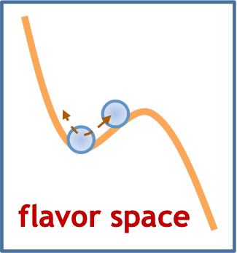
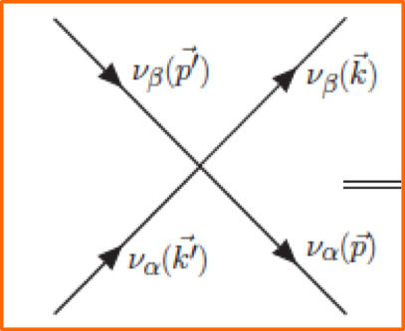
THEORETICAL APPROACHES
Mean-field equations
$$i(∂_{t}+v⋅∇_{x})ρ_{x,p}=[h_{x,p},ρ_{x,p}],$$
Mean-field approximation
Mean-field and extended mean-field
Extended mean-field equations
$$i\overset{·}{ℛ}=[ℋ,ℛ],$$
- pairing correlators
- spin or helicity coherence
Linearised mean-field equations
Linearised equations
Towards the many-body solution
Quantum kinetic equations
Quantum kinetic equations
$$i(∂_{t}+v⋅∇_{x})ρ_{x,p}=[h_{x,p},ρ_{x,p}]+iC[ρ,\overline{ρ}],$$
-full collision term
Neutrino Oscillation Workshop (NOW) 2024, Otranto

Slide 32
DNSB LIMITS
Flux upper limits from SKI-IV and SNO data
Abe et al, 2109.11174
SNO data, Aharmim et al, Astrophys. J. 2006
Peres and Lunardini,. JCAP 2008
The sensitivity of the combined analysis (90 % C.L.)
is on par with 4 predictions.
EXCESS (1.5 sigma) over BACKGROUND OBSERVED
Expected rates, 90% C.L. upper limits, best fit values (1 sig.)
and expected sensitivity from SK-I and SK-IV data
Abe et al, 2109.11174
Neutrino Oscillation Workshop (NOW) 2024, Otranto

Slide 33
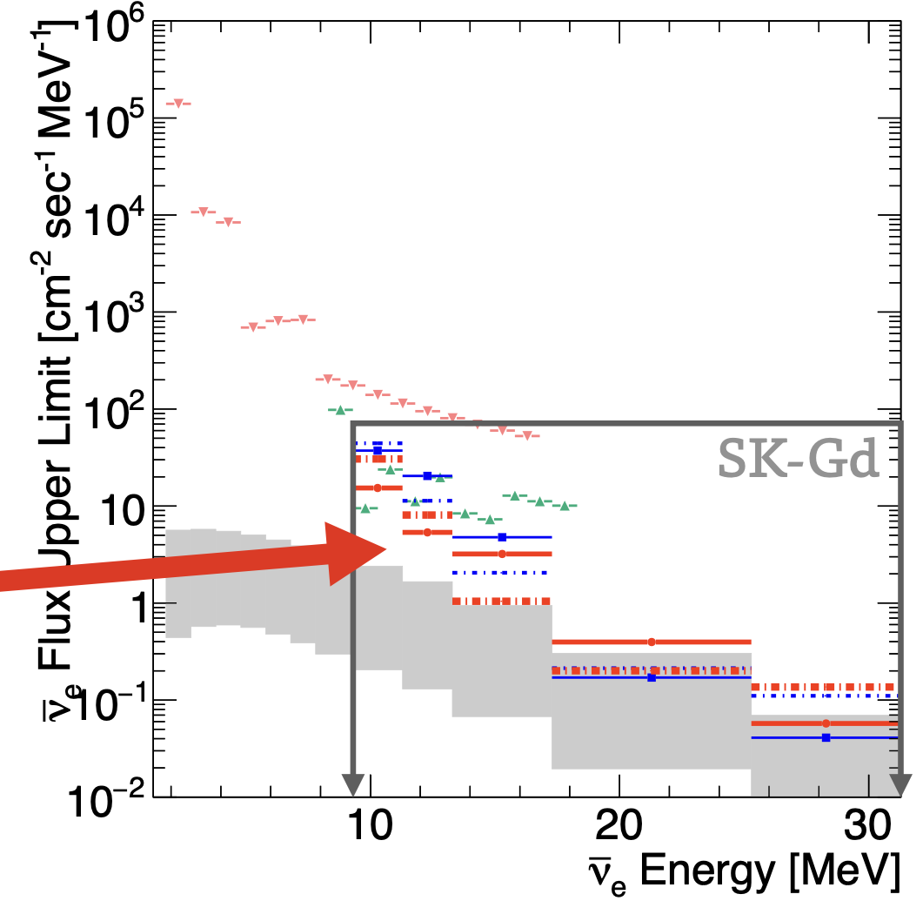
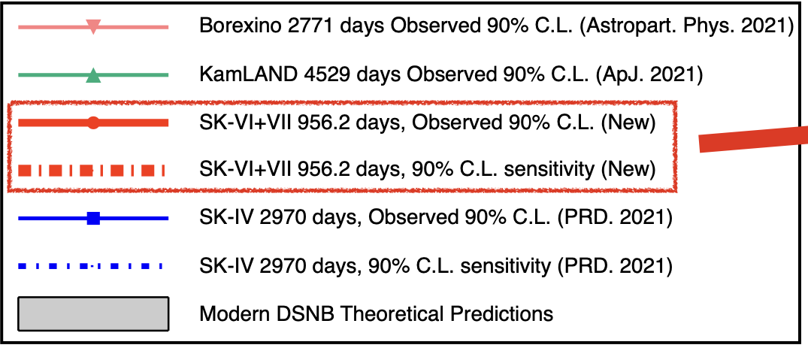
NEUTRINO 2024
First results of SK+Gadolinium
(running since 2020)
From A.Beauchêne
Neutrino Oscillation Workshop (NOW) 2024, Otranto

Slide 34
DIFFUSE SUPERNOVA NEUTRINO BACKGROUND
The DSNB flux depends on the evolving core-collapse supernova
rate, the neutrino fluxes from a supernova, integrated over time
theoretical band
includes uncertainty
on supernova rate
and failed supernovae
redshifted neutrino energies
mass of the supernova progenitor
giving either a neutron star or a black hole
Contribution from failed supernovae (black-hole):
hotter energy spectrum determines the relic flux tail.
The BH fraction is a debated astrophysical input.
SK-limit
Priya and Lunardini JCAP 2017
Lunardini, PRL 2009
Dependence on the cosmological model
DSNB detection window
NEUTRINO FLUX from a SN
of the main UNCERTAINTIES
dark energy and matter cosmic energy densities
Hubble constant
Neutrino Oscillation Workshop (NOW) 2024, Otranto

Slide 35
COSMIC CORE-COLLAPSE SUPERNOVA RATE
The cosmic core-collapse supernova rate history can be deduced from the cosmic star formation rate history.
is the number of stars with
progenitor mass
Salpeter Initial Mass Function (IMF)
Local SN rate uncertain by a factor of 2:
Yuksel et al, i Astrophys. J(2008)
ONE of the main UNCERTAINTIES
relevant for
the DSNB
below detection
threshold
Neutrino Oscillation Workshop (NOW) 2024, Otranto

Slide 36
SN NEUTRINO TIME SIGNAL
Pre-SN neutrinos (1-a few days before the SN)
information on the late stages before SN collapse, on the progenitor and early alert.
First pointed out that neutrino emission from e.g. the Si-burning phase lasts about 2 days (M = 20 Msun). Average neutrino energies about 2 MeV (thermal emission). Possible detection of pre-SN neutrinos from 1 kpc.
Odrzylowek et al, Astrop. Phys. (2004)
Weak interactions
Pre-SN neutrinos could be detected in KamLAND for M = 25 Msun up to 690 pc.
Asakura et al., Astrophys. Journ. (2016)
Super-K
Late-time neutrinos from PNS cooling (10-100 s)
Late time neutrino emission tells us about the PNS, e.g. equation of state, new physics.
NS cooling goes through different phases -
1 s after bounce - cooling and contraction of the high entropy, shock heated outer layers of the PNS (radius from 50 to 10 km)
5-15 s after bounce - inward diffusion of neutrinos heats the PNS, and cooling, tends to zero net neutrino number
several tens of s - thermal cooling, neutrinos remove energy from the star (temperature gradients).
Li, Roberts, Beacom., PRD (2021)

Slide 37
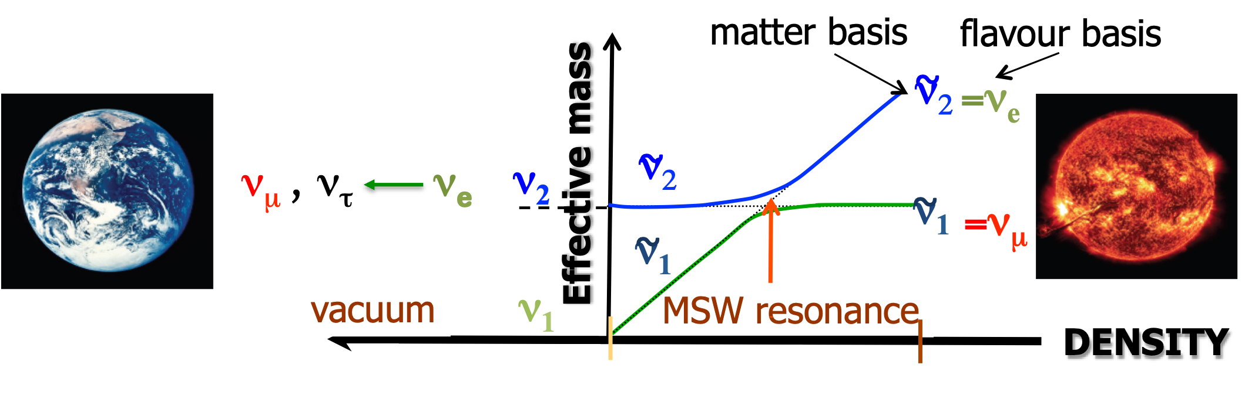
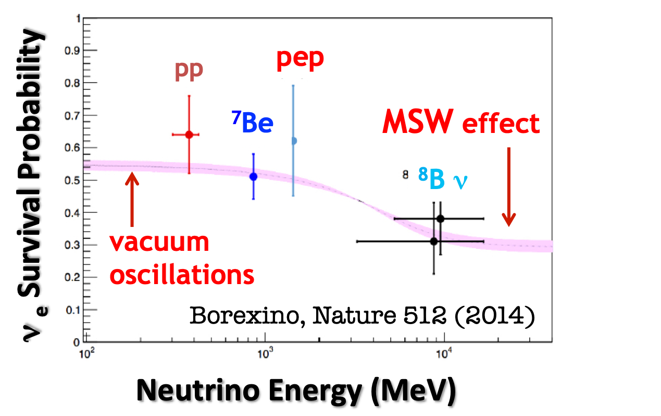
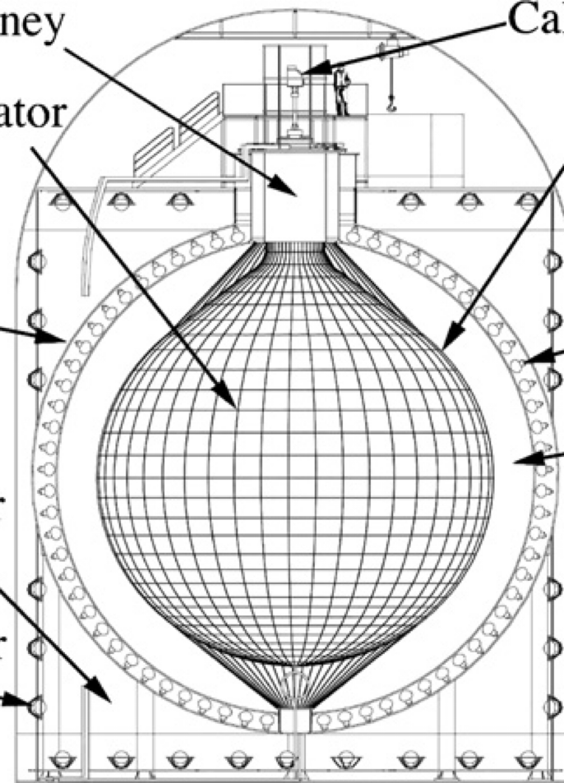
Mikheev-Smirnov-Wolfenstein (MSW) EFFECT
Wolfenstein, 1978; Mikheev and Smirnov, 1985
The neutrino-matter interaction term
responsible for the MSW effect
Established by experiments
Electron neutrinos adiabatically (efficiently)
convert into other flavors at the resonance location
SNO, PRL 87 (2001)
MSW occurs in supernovae, binary neutron
star mergers, Earth and early Universe
KamLAND,
PRL 90 (2003)
LPNHE Seminar, 27th March 2023

Slide 38
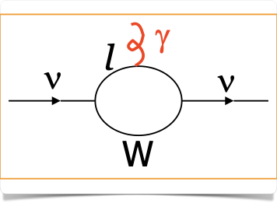
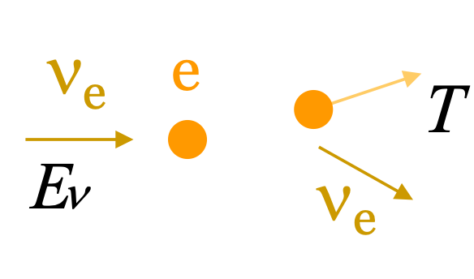
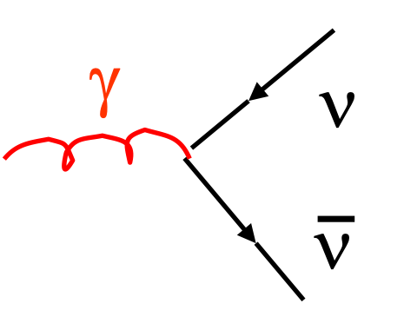
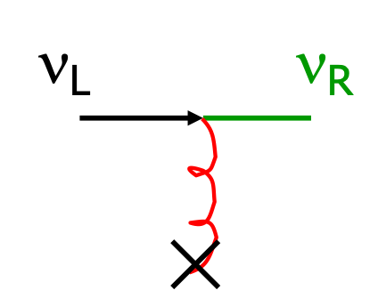
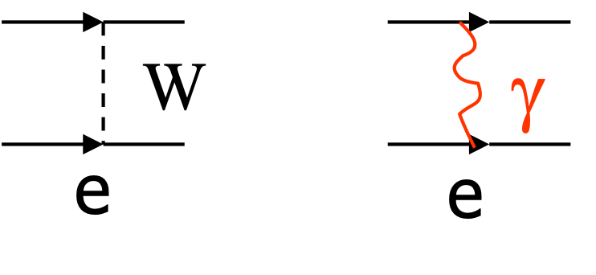
SN1987A: an incredible laboratory for particle physics
Neutrinos have electromagnetic properties from
effective one-photon couplings.
The most general vertex form, consistent with Lorentz
invariance includes
Effective one-photon coupling of
a neutrino with a photon
Magnetic form factor
Limits on the electron neutrino magnetic moment
Neutrino magnetic moment
from quantum loops
to
reactor, accelerator
experiments
SN1987A
Photon decay
Coupling to
magnetic fields
Lattimer and Cooperstein (1988),
Goldman et al. (1988), Notzold (1988),…
stellar cooling
See the review Giunti and Studenikin, RMP 87 (2015)
Numerous limits on non-standard properties,
particles and interactions
LPNHE Seminar, 27th March 2023

Slide 39
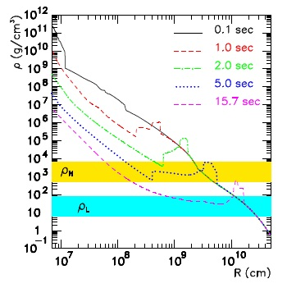
NEUTRINO MASS ORDERING
Time signal in Cherenkov and scintillator detectors of a supernova in our galaxy (10 kpc)
Presence of front and reverse shocks .
scintillator, Cherenkov detectors
Tomas et al, JCAP 09 (2004)
19 MeV
15 MeV
10 MeV
29 MeV
Inverted mass ordering
MSW resonance can be met multiple times.
Gava, Kneller, Volpe, McLaughlin, PRL 103 (2009)
Positron time signal from per unit tonne.
Prediction includes interactions and shock wave effects.
Picture of the shock wave passage in the MSW region. Similar for electron neutrinos in DUNE for NMO.
If the mass ordering determined by experiments, it will confirm/refute that we understand.
LPNHE Seminar, 27th March 2023

Slide 40
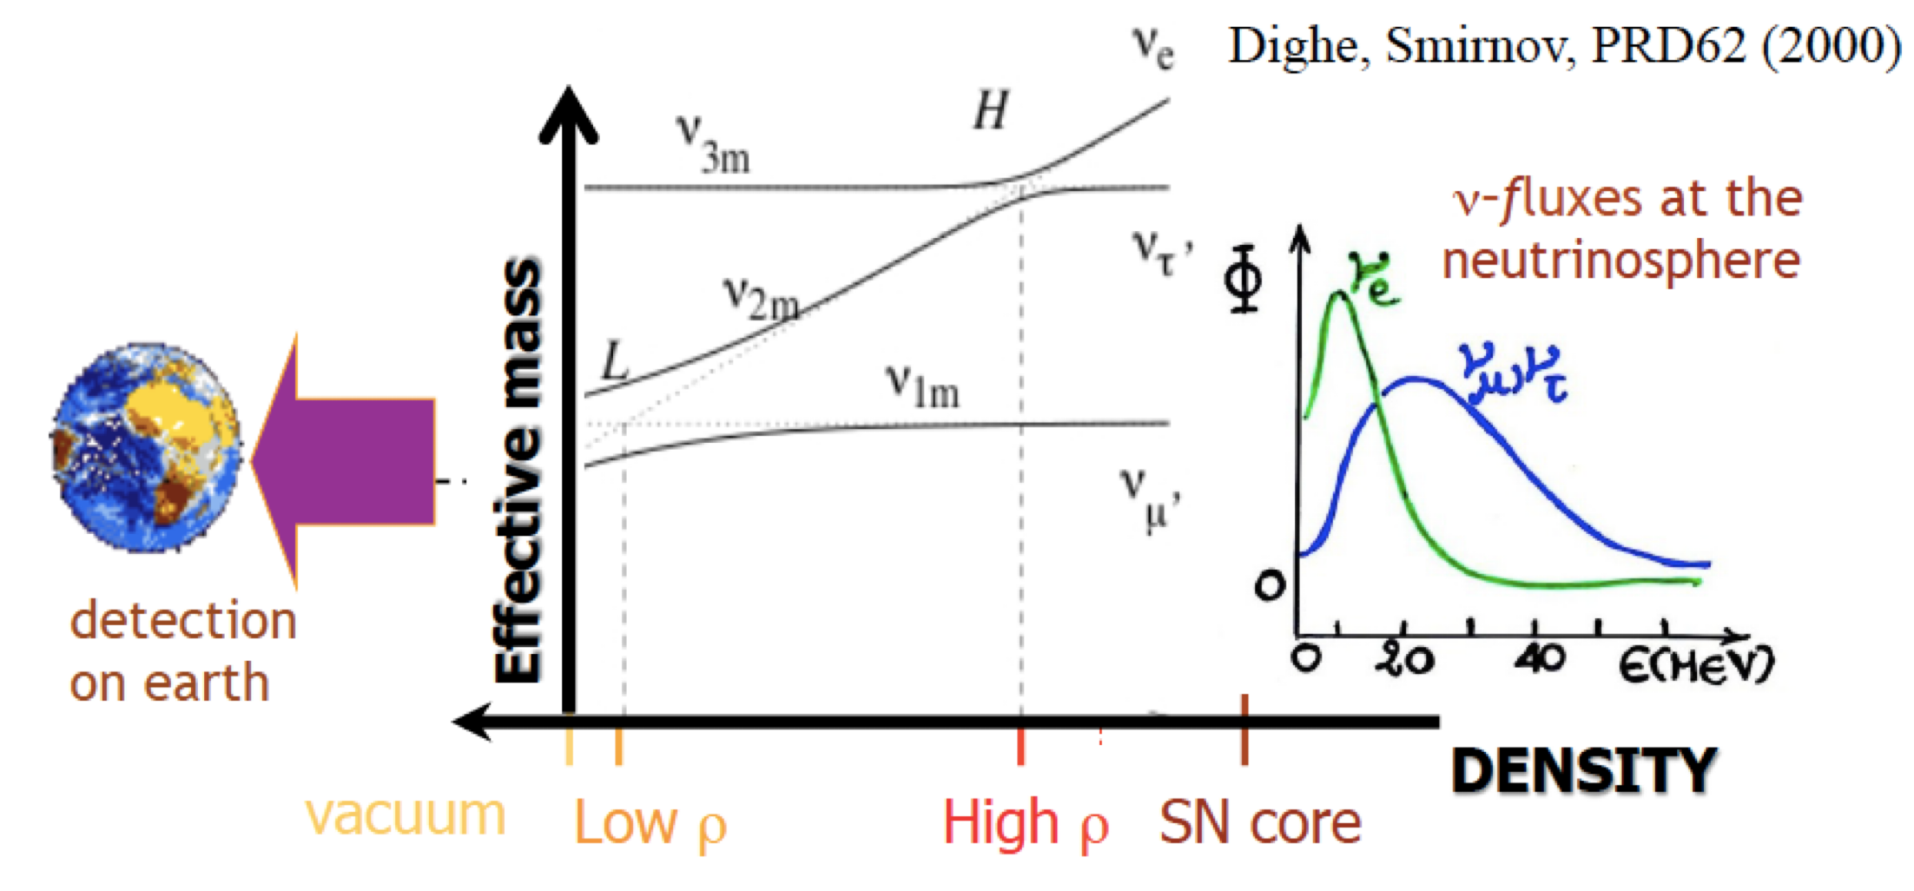
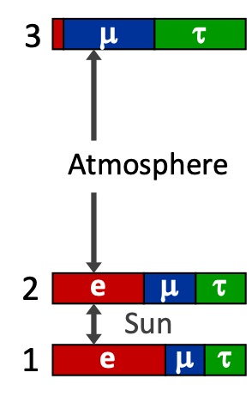
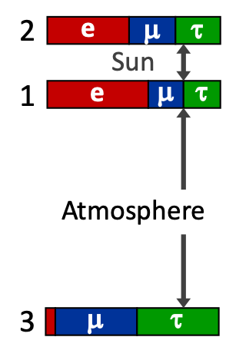
MSW EFFECT IN DENSE MEDIA
NMO
neutrinospheres
exploding supernova
Main resonances :
High (H)
Low (L)
neutrinos
Modifies supernova neutrino spectra
(spectral swapping) and the time
signal
Evolution at the H-resonance
depends on the unknown
sign of
Normal mass ordering (NMO)
Inverted mass ordering (IMO)

Slide 41
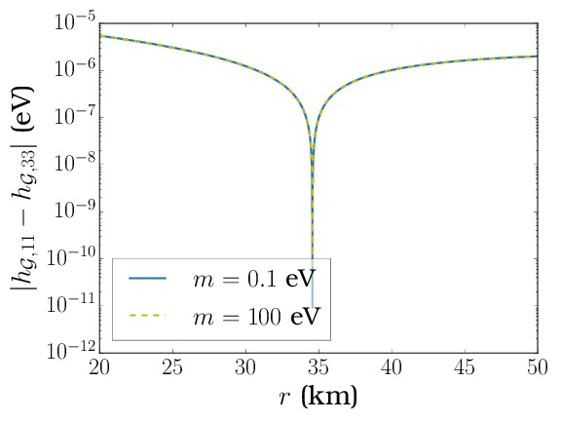
Flavor evolution in presence of helicity coherence
( )
h
F
For Majorana neutrinos, the 2ν Hamiltonian
H =
h
Resonance (MSW-like) conditions :
Helicity Coherence
F*
Matter-Neutrino Resonance
MNR
Resonance conditions met, adiabaticity not enough
contrary to the findings in Vlasenko, Fuller, Cirigliano, 1406.6724

Slide 42
NON-STANDARD INTERACTIONS in Binary Neutron Star Mergers
A large set of neutrino trajectories investigated : an example..
I-resonance locations in a BNS remnant
I
MNR
MNR
I
I
I
Neutrinos
Antineutrinos
Complex patterns of flavor evolution mechanisms emerge,
even for small NSI couplings which produces spectral
modifications, with a possible impact on Ye.
Chatelain and Volpe PRD97 (2018)
electron fraction
Key parameter for the r-proces

Slide 43
IMPACT OF SPECTRAL SWAPPING
In matter (neutrino-driven winds), neutrinos interact with p/n
BNS remnant
The capture rates are modified by spectral swappings
due to flavor mechanisms and neutrino properties :
This determines the electron fraction Ye and the number
of available neutrons (1- Ye).
Frensel et al PRD95 (2017)
Key parameter for the r-proces (elements heavier than iron)
Ye > 0.5 no r-process, Ye < 0.2 strong r-process
Important for the SN dynamics :
Enhanced heating behind the shock.
Flavor evolution and neutrino properties impact
the n/p ratio (nucleosynthesis), neutrino heating (SN dynamics) and observations

Slide 44
SPECTRAL SWAPPING DENSE MEDIA
An example due to the neutrino-neutrino interaction

Slide 45
THE Mikheev-Smirnov-Wolfenstein (MSW) EFFECT
Wolfenstein, 1978; Mikheev and Smirnov, 1985
The total Hamiltonian in 2 neutrino flavors
It can be made diagonal with the rotation (giving the so called « matter basis ») :
MSW resonance
condition
Two-level problem
in quantum mechanics
If the MSW resonance is fulfilled, the resonance width is large and the evolution
through resonance adiabatic, an electron neutrino will come out as a nu2.

Slide 46
SOLUTION OF THE SOLAR NEUTRINO PROBLEM
Borexino experiment (Gran Sasso) measured for the first time solar neutrinos from
pp, pep, 7Be… and the CNO cycle suggested by Bethe (1939) (1% of solar energy).
thanks for Super-Kamionande discovery of neutrino oscillations in vacuum,
SNO measurement of the total solar neutrino flux, KamLAND measurement,
but also thirty years of searches and combined data fit and Borexino results for low
energy solar neutrinos
A reference phenomenon for the study of how neutrinos change flavor in dense media.

Slide 47
A UNIQUE EVENT : GW170817
First measurement of gravitational waves from binary neutron star
mergers, in coincidence with a short gamma ray burst and a kilonova.
Abbot et al, PRL 2017
From the electromagnetic signal, indirect evidence
for r-process elements in the ejecta
Vilar et al, 2017; Tanaka et al, 2017;
Aprahamian et al, 2018;
Nedora et al, 2021, ….
Binary neutron star mergers :
powerful sources of tens of MeV neutrinos
Hubble Space Telescope
Kilonova, gradually fading away, in NGC 4993,
40 Mpc, 140 million light-years

Slide 48
r-PROCESS NUCLEOSYNTHESIS
Key open question in astrophysics :
the origin (i.e. the sites and conditions) of elements
heavier than iron.
Nucleosynthetic abundances in the solar system
Two main mechanisms : s-process (s for slow),
r-process (r for rapid neutron capture) where
neutron rich nuclei capture neutrons faster than
beta-decay to the stability valley.
Main candidate sites : supernovae and
neutron star-neutron star mergers

Slide 49
A UNIQUE EVENT : SN1987A
Water Cherenkov
detector, 2140 tons
First observation of neutrinos from the
death of a massive star: 24 events detected.
Irvine-Michigan-
Brookhaven, Water
Cherenkov, 6800 tons
A wonderful laboratory for
particle physics and astrophysics.
Baksan Scintillator
Telescope, 200 tons

Slide 50
DENSE ENVIRONMENTS: FROM TRAPPED TO FREE-STREAMING
In such environments neutrinos are trapped.
Typical cross section Density Mean free path
Raffelt (2012)
The region where neutrinos start free-streaming is called
the neutrinosphere. It is energy and flavor dependent.
In flavor studies, usually taken as a a sharp boundary.
Neutrinos are emitted with quasi-thermal spectra
(Fermi-Dirac distributions)

Slide 51
Reconstrucing the gravitational binding energy
Gallo Rosso, Vissani, Volpe, arXiv:1708.00760
For a galactic supernova at 10 kpc. Signal in Super-Kamiokande.
Likelihood without any priors
(9 free parameters)
Fluence described by a power-law,
MSW included, NH
Combined IBD, elastic scattering
(100% tagging efficiency on IBD
and ES for E_{thr} = 5 MeV) and
NC on oxygen (Eγ 5−7 MeV)
True parameters used in the
analysis and parameters range
In the analysis
E_{b} reconstructed with 11% accuracy.

Slide 52
Compactness and M-R of the newly born neutron star
Lattimer & Prakash,
Phys. Rep. 2007
fit to numerous EOS for NS

Slide 53
DIFFUSE SUPERNOVA NEUTRINO BACKGROUND
DSNB sensitive to the fraction of failed supernovae, (hotter energy spectrum
determines the relic flux tail)
The DSNB is also sensitive to the EOS,
non-standard neutrino properties
such as neutrino decay.
Lunardini, PRL 2009
Moller et al 2018, De Gouvea et al 2020,
Kresse et al 2021, Horiuchi et al 2021,
Ivanez-Ballesteros and Volpe, 2022…
The fraction of « dark » collapses is debated.
and flavor conversion phenomena beyond MSW,
e.g. shock waves and self-interaction.
Event rates can be modified by 10-20 %.
Galais, Kneller, Gava, Volpe, PRD81 ( 2010)
A laboratory for astrophysics and particle physics,
complementary to one supernova.
Kresse et al 2021
« Une femme jouant de guitare », Vermeer, 1672

