Slide 1
HTS magnets challanges for Muon Collider cooling cells
Marco Statera, INFN-MI LASA

Slide 2
Outline
intro
Motivation
magnets
MuCol
The HTS magnets for International Muon Collider Collaboration and MuCol
Schedule
HTS magnets specific requirements
Selected examples of HTS magnets
Timeline highlights
Conclusions

Slide 3
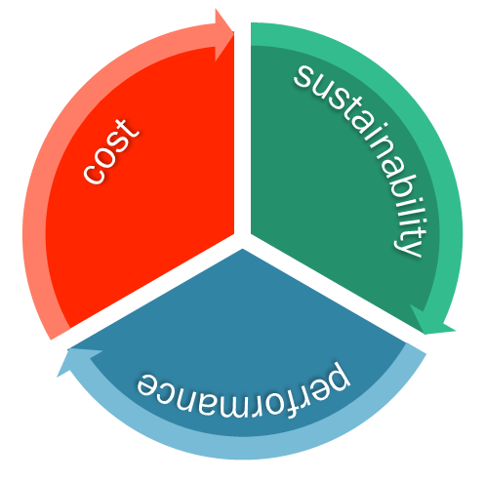
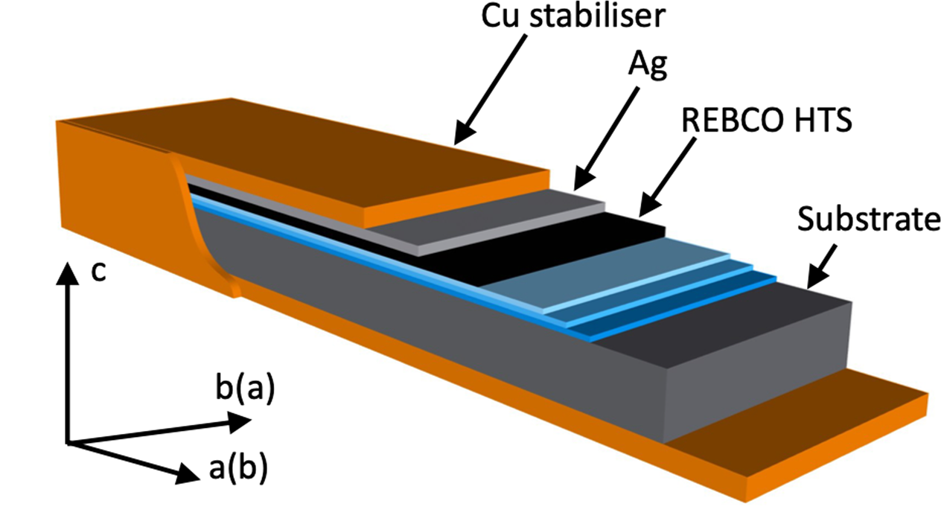
Motivation
Why
Increase performance and/or sustaibability of research institutes
How
High Temperature Superconductors
High current densities at higher temperatures
https://nationalmaglab.org/magnet-development/applied-superconductivity-center/plots

Slide 4
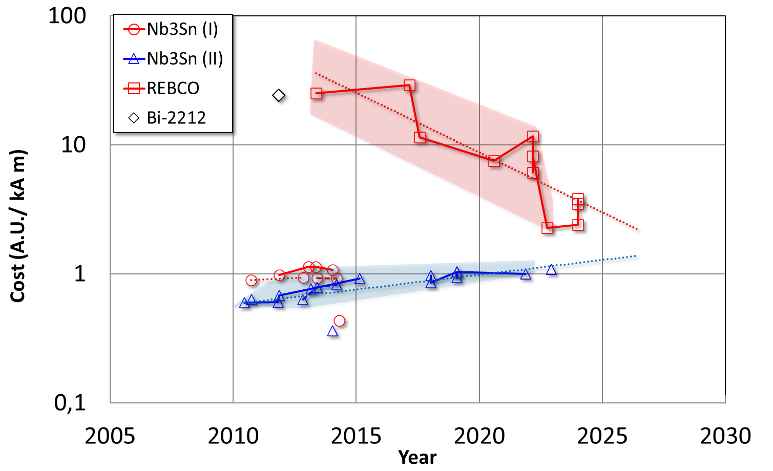
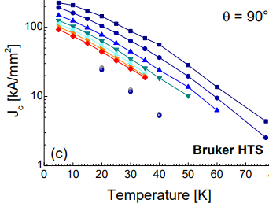
Motivation
Grateful thanks to fusion
0.5 T – 19 T
Lines are not a forecast
C. Senatore et al., Field and temperature scaling of the critical current density in commercial REBCO coated conductors - https://arxiv.org/abs/1512.01930
L. Bottura et al, HFM annual meeting
https://indico.cern.ch/event/1302031

Slide 5
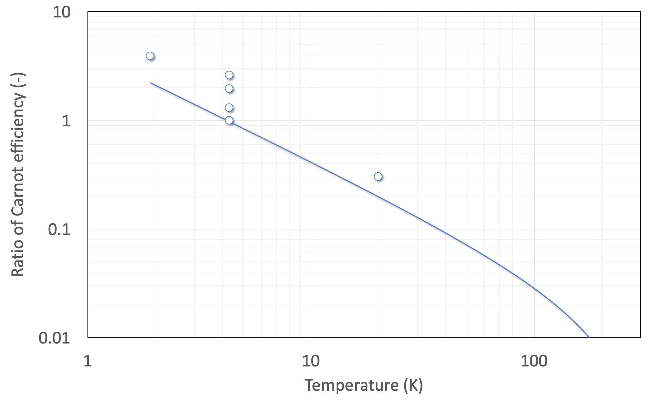
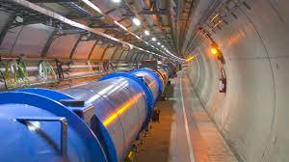
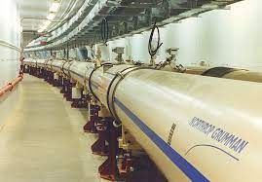
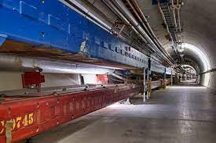
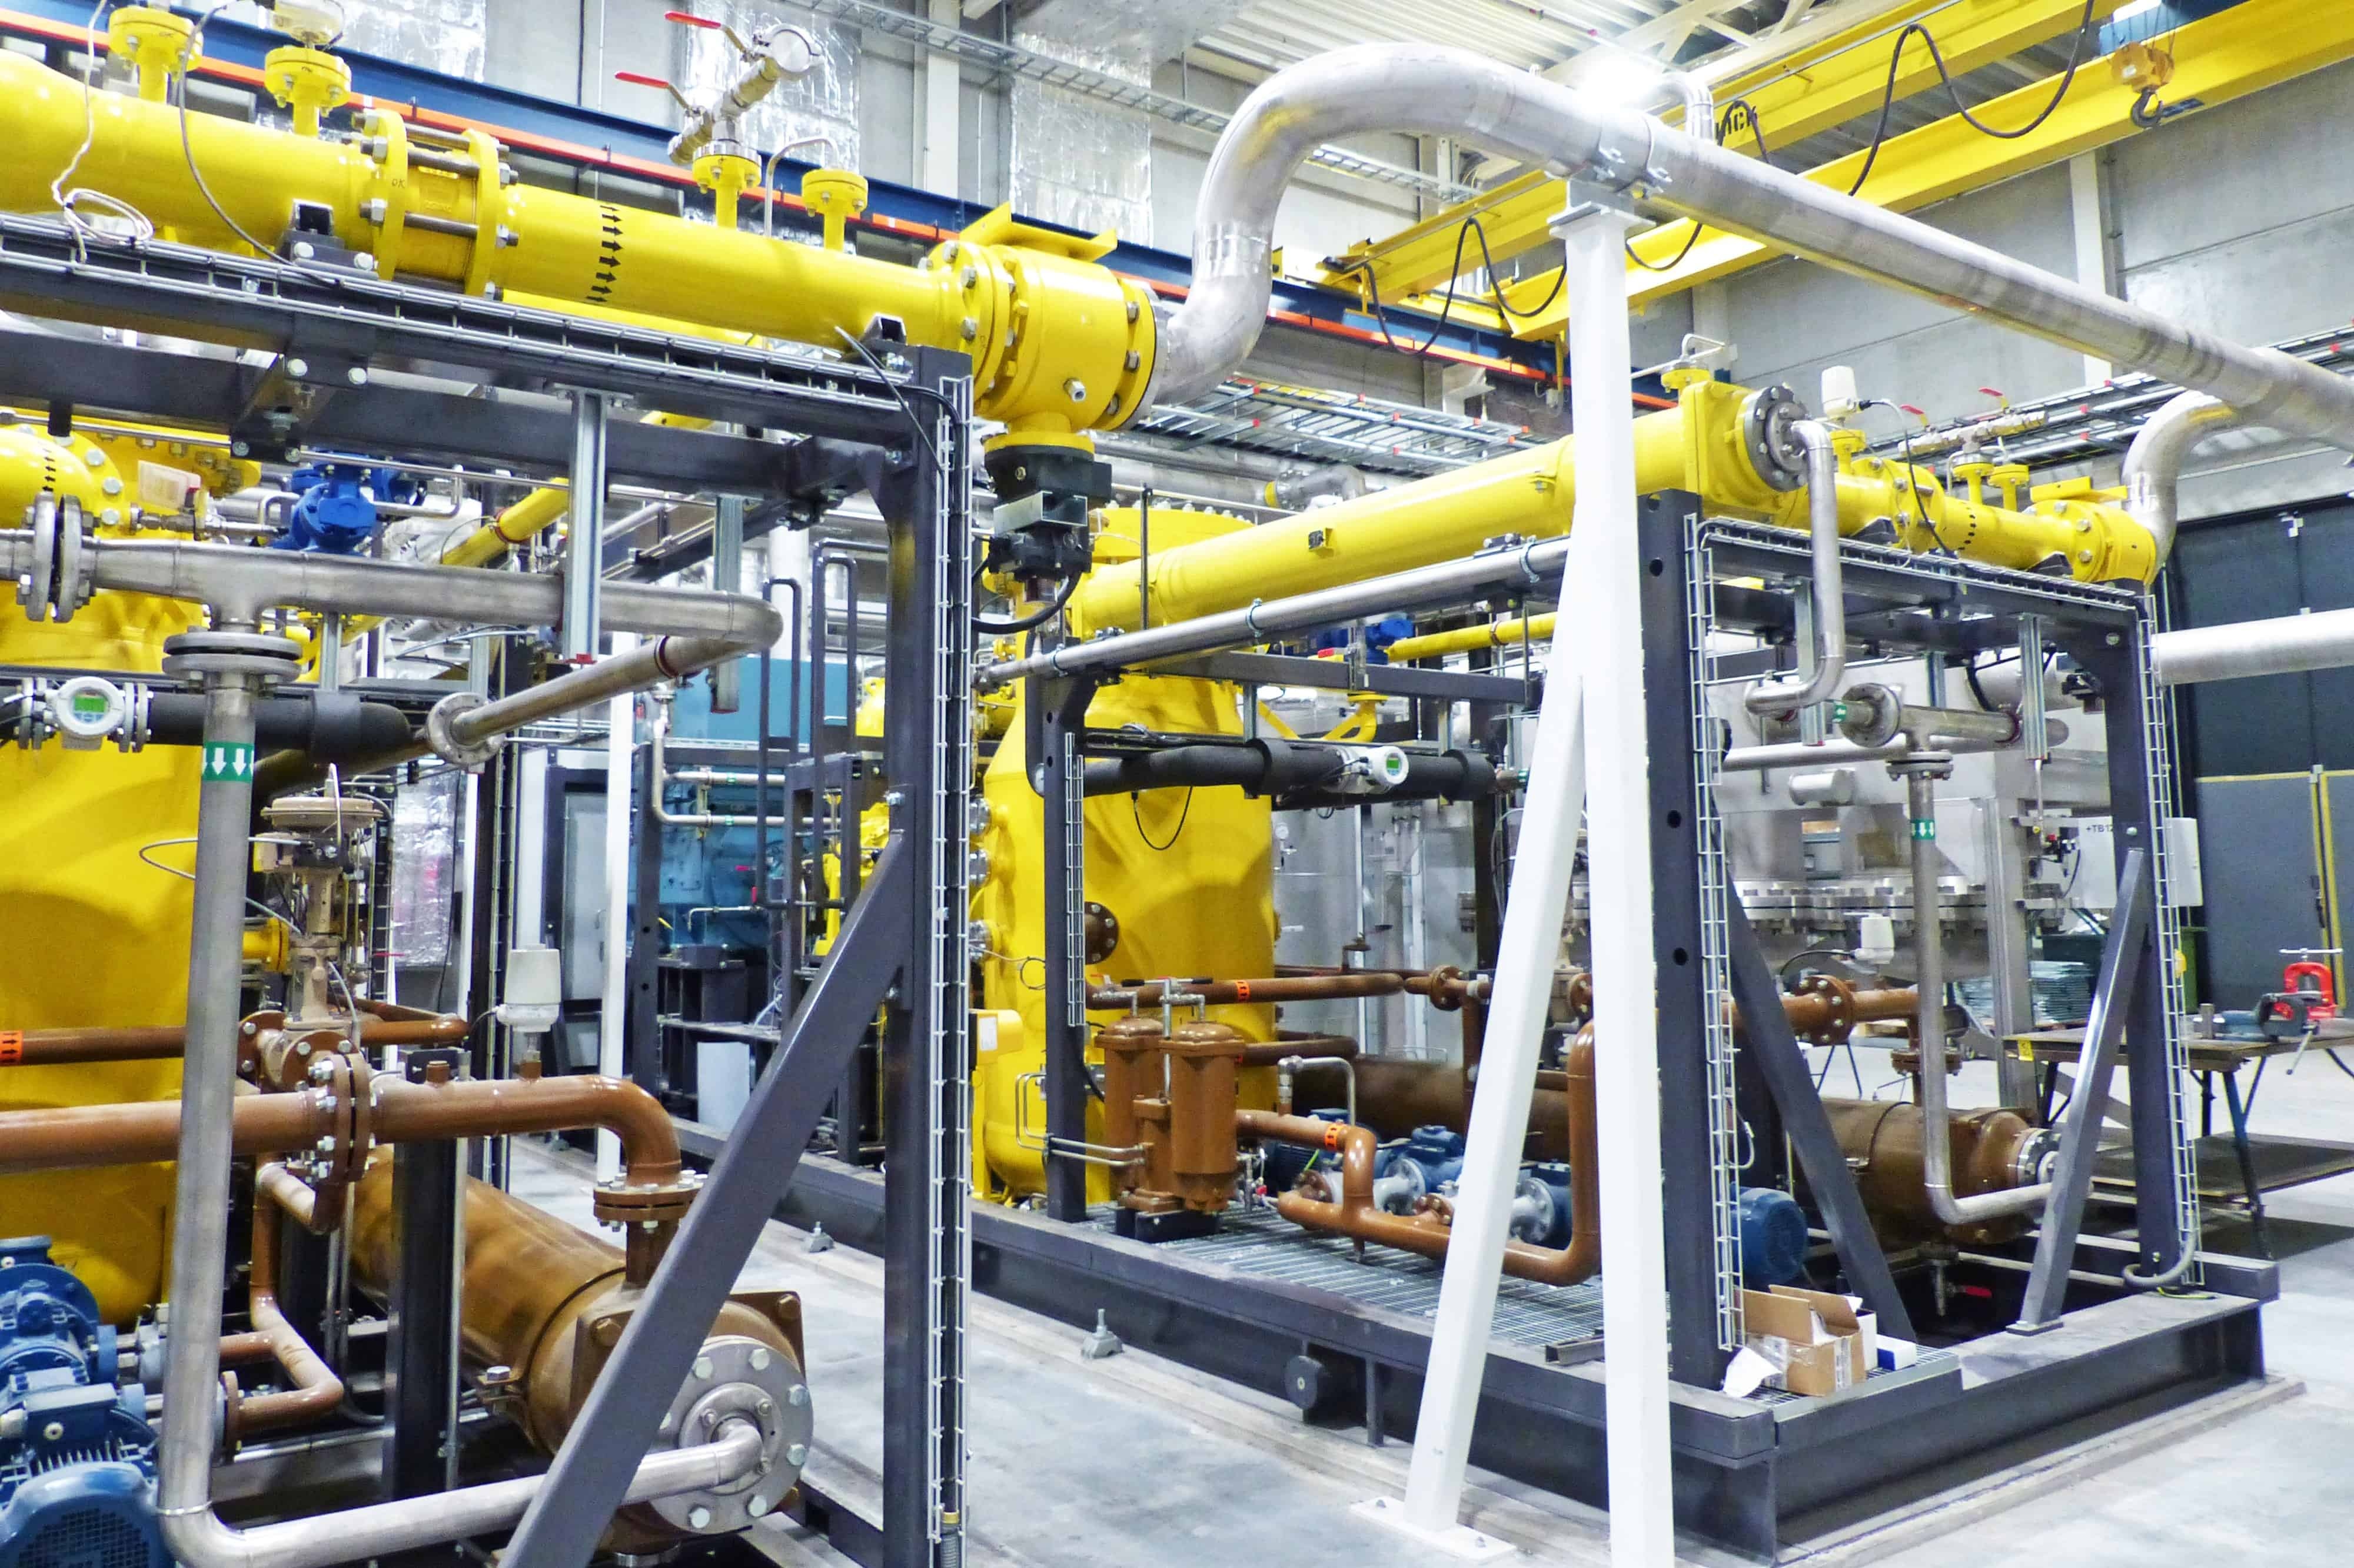
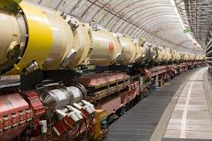
Motivation
Sustainability is a driver for next generation Research Institutes and projects
HTS may be one important option for the future colliders
W/W
LHC
(FCC)
RHIC
Tevatron
HERA
LHC
Nb-Ti
8T
5T
ESS
The 60…80 K range would be a dream…
Nb₃Sn
16T
12…14T
This could be the best range of operating temperature of a future HEP collider
HTS
40…60T
20…40T
a few T
1.9
4.2
77
Credits to P. De Sousa and R. Van Weelderen and L. Bottura, CERN

Slide 6


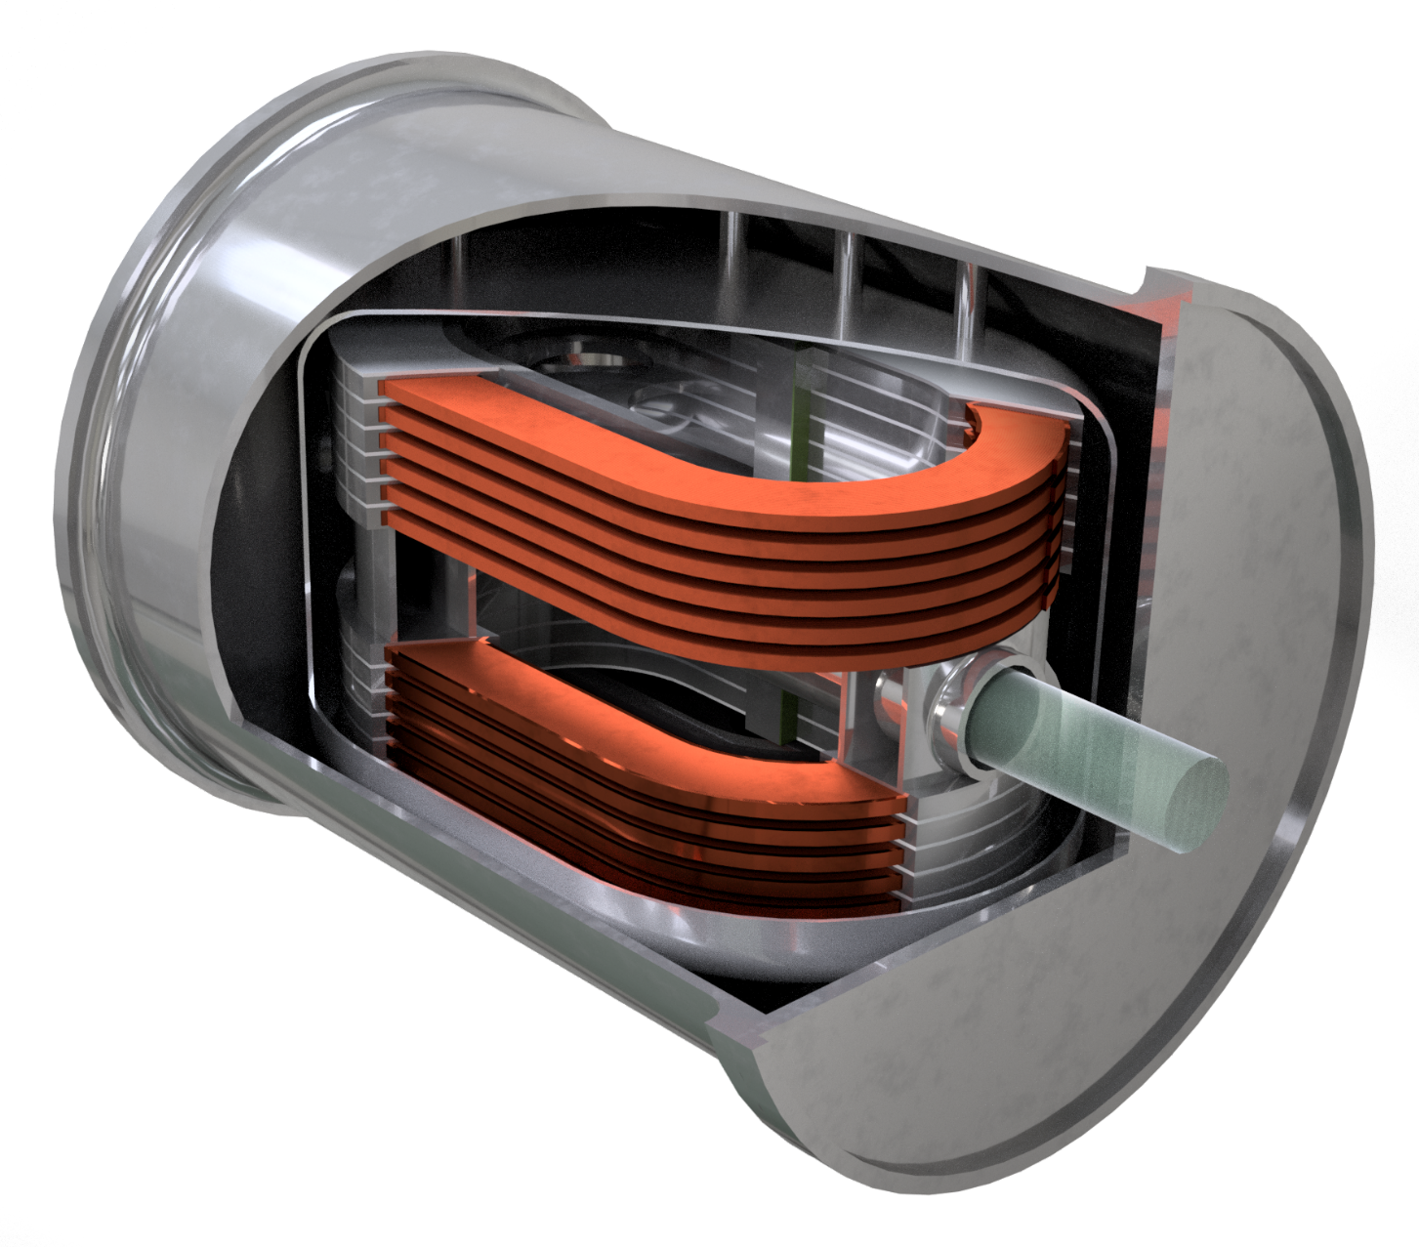
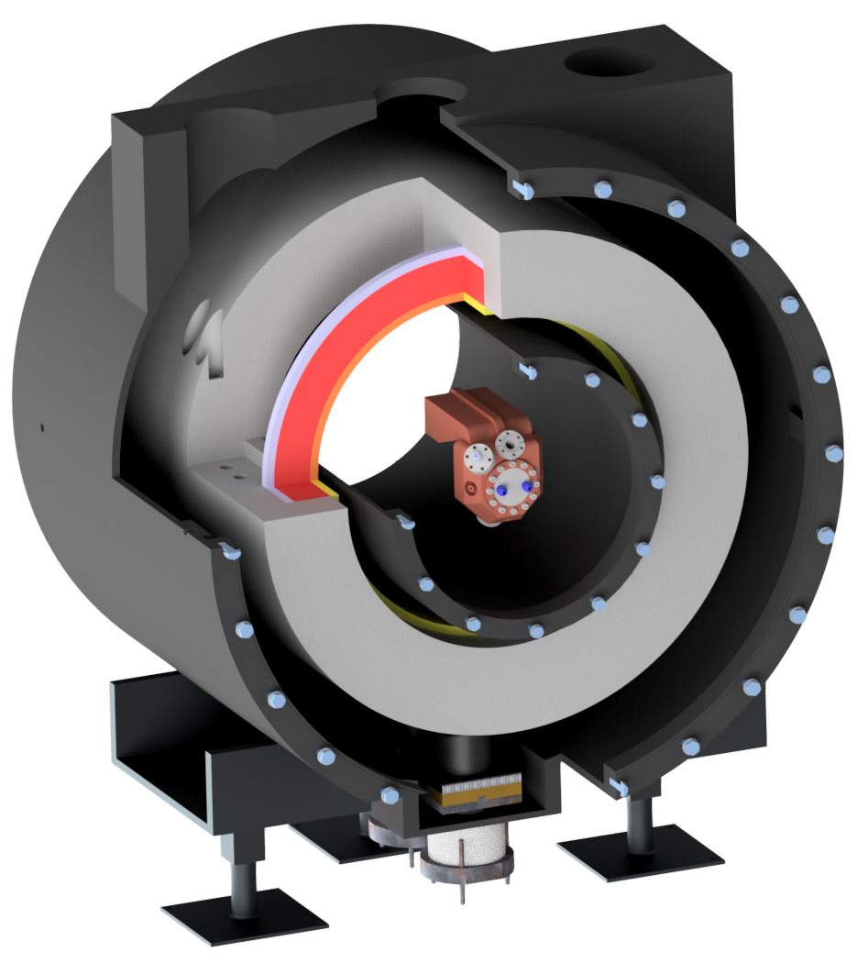



IRIS and Muon Collider are the actual driver for next generation Magnets in HTS
Split Coil - RFMTF
Magnet Test Facility for RF (and other use)
ESMA
Energy Saving MAgnet
10 T dipole
20 K operation
Conduction cooled
70 mm bore
10 T gradient
20 K operation
Conduction cooled
300 mm warm bore
2025
INFRATECH proposal
EUMAHTS: ADVANCING HTS MAGNET TECHNOLOGY FOR EUROPEAN RESEARCH INFRASTRUCTURES
PI L. Bottura, CERN
Common R&D to increase TRL of HTS magnet technology
SCIENCE FOR SUSTAINABILITY

Slide 7
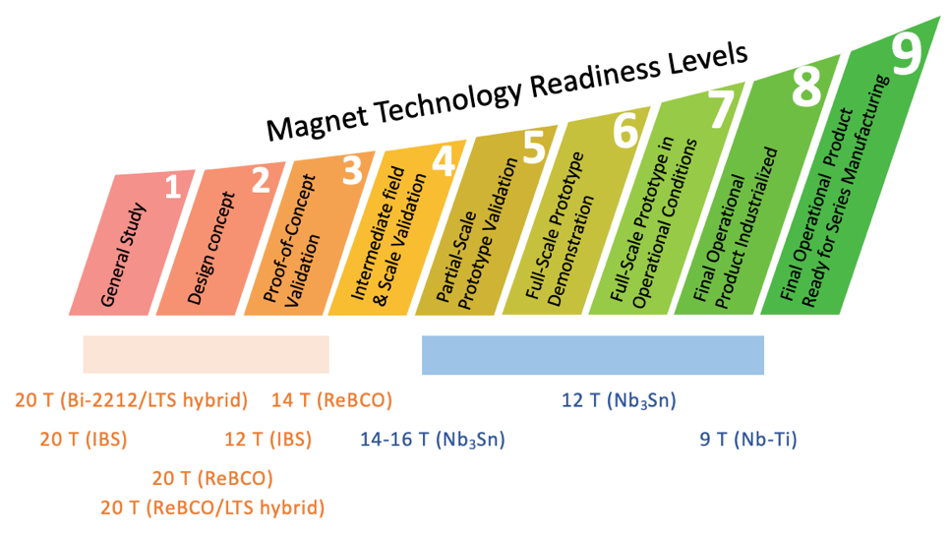
Present R&D Targets of HFM
A ~14 T operational field LTS dipole magnets for FCC-hh
  Establish the operational margins
  Select the magnet design among multiple variants
  Scale to 14-m-long magnets
A ~20 T operational field HTS or hybrid dipole magnet for FCC-hh
  Close Technology-Readiness-Level Gap with LTS
    Establish HTS technology-stack variants
    Demonstrate accelerator quality
  Establish the operational margins
  Select the magnet design among multiple variants
  Scale to 14-m-long magnets
E. Todesco and B. Auchman
ESMA 10T
https://hfm.web.cern.ch/
10 K – 20 K
1.9 K

Slide 8
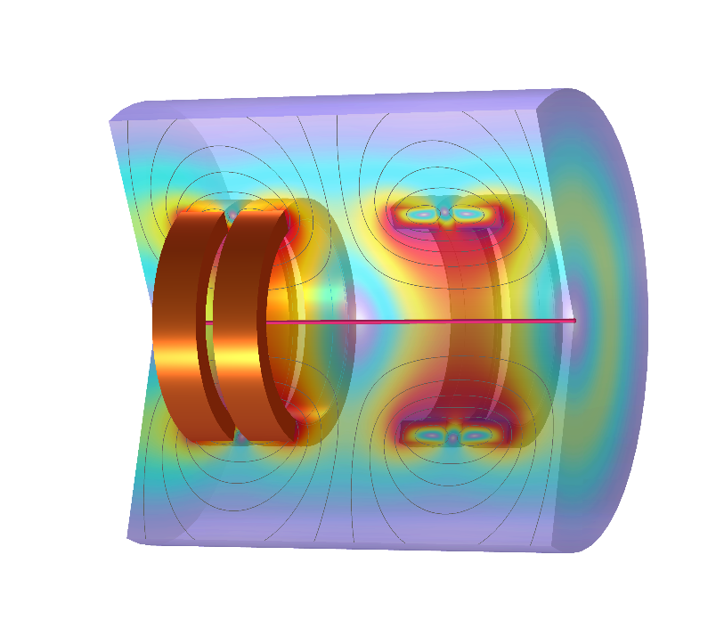
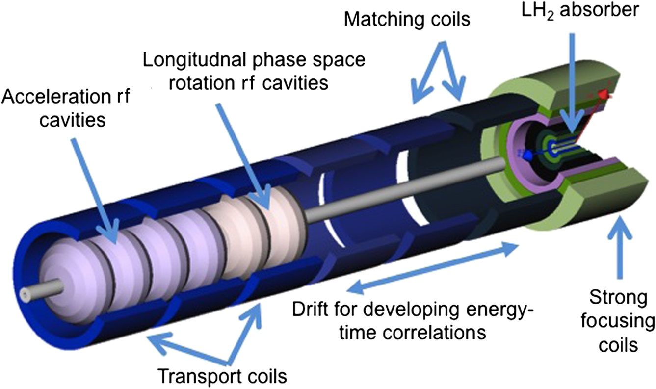
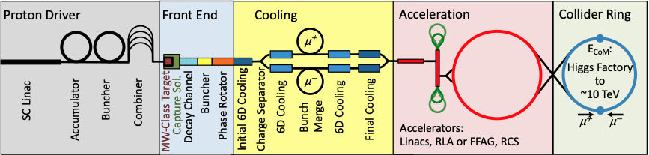
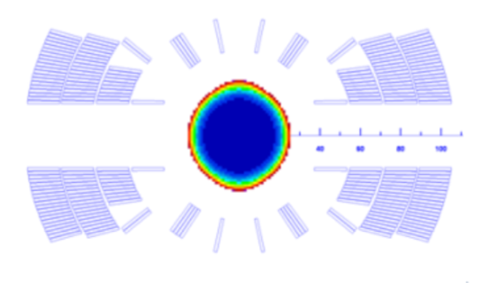
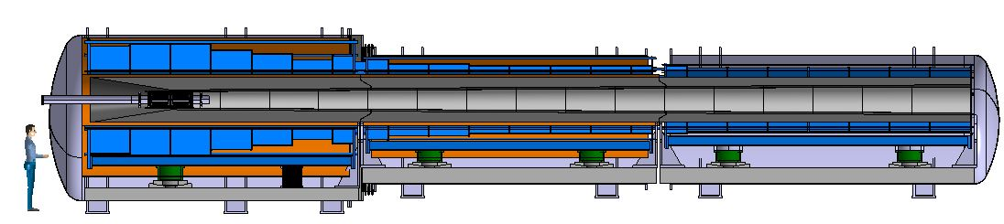
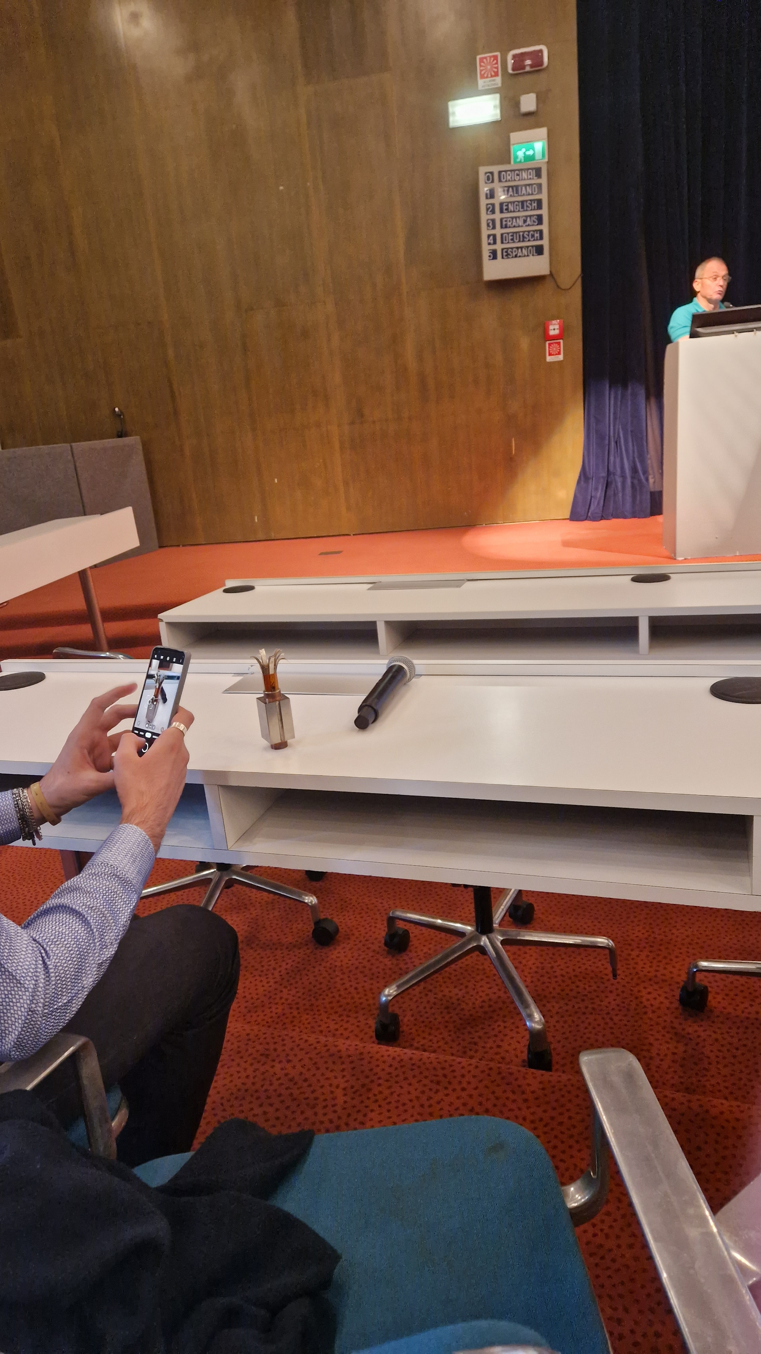
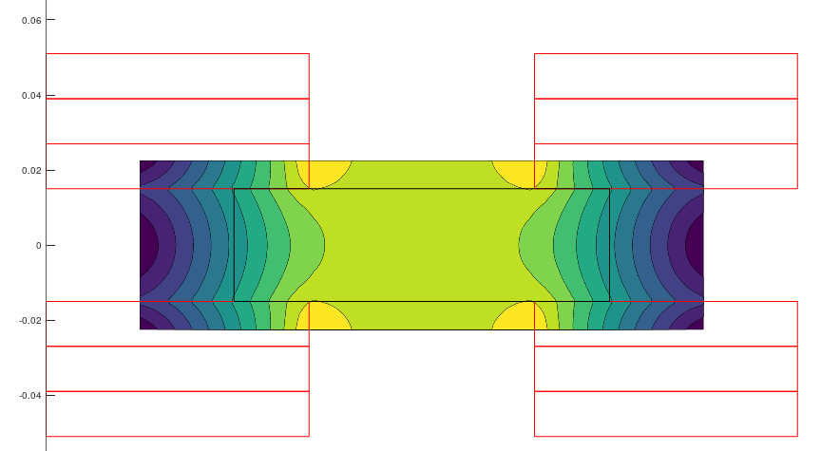
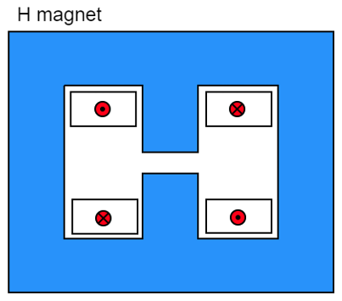
HTS magnets in Muon Collider
1+1 km of solenoids
Field Up to 20 T – 25 T
Controlled Insulation
40 T on axis
4 K
Bore size 50 mm
Non Insulated
16 T
Bore size 150 mm
Insulated - CI
HTS 10 T steady state
30x100 mm aperture
NC +/- 1.8 T up to 4 kT/s
30 x 100 mm aperture
IEEE TAS 34,5 C. Accentura et al.
Field up 20 T, ∅≥ 1.2 m, L ≅ 18 m
Radiation heat load ≈ 5…10 kW Radiation dose: 80 MGy

Slide 9
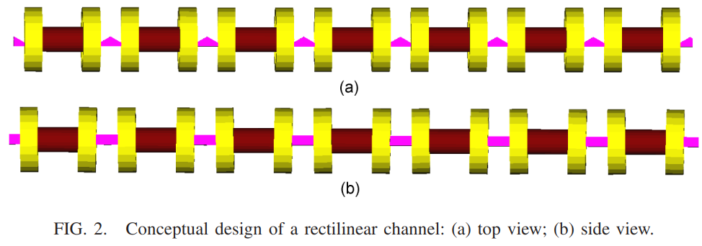
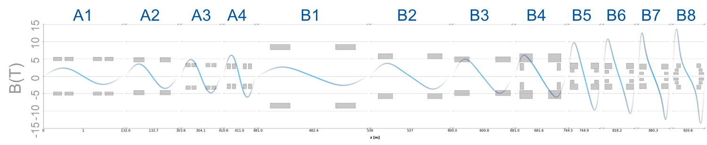
6D cooling
12 unique stages:
  4 cooling stages before bunch recombination (A1-A4)
  8 cooling stages after bunch recombination (B1-B8)
Each stage has a repeating series of a cell type
High field, very compact solenoids
Each cell has symmetric solenoids of opposite polarity
RF
superconducting coil
adsorber

Slide 10
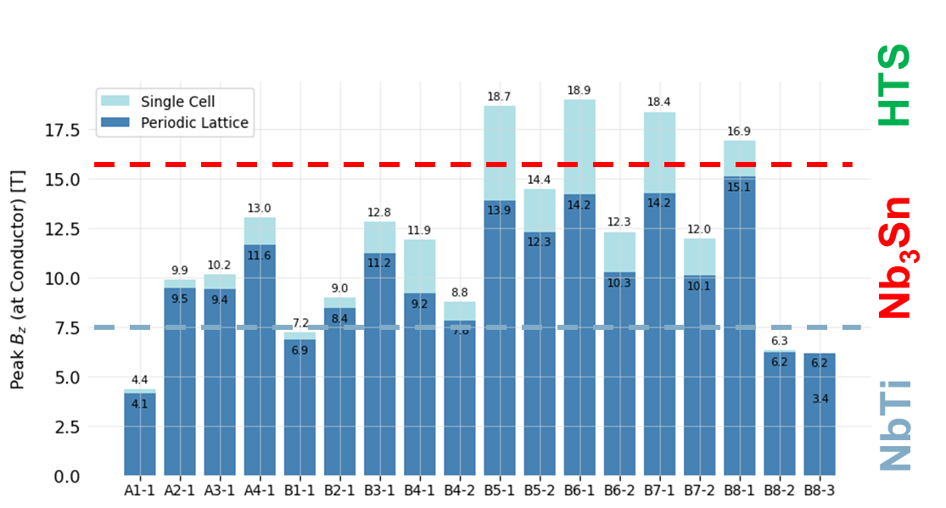
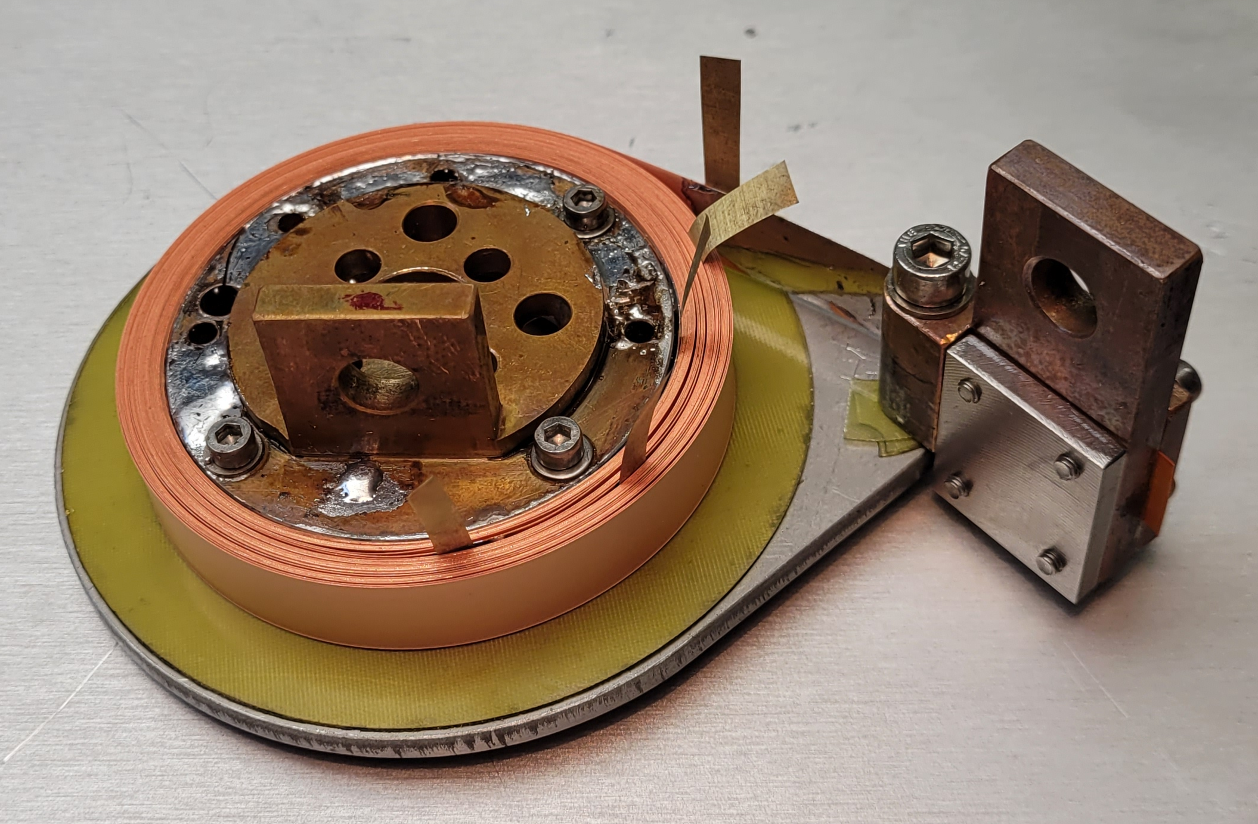
6D cooling solenoids design
based on US MAP original design (field on axis)
Some stats:
Fields on axis: 2 to 15 T
Cell Lengths: 0.8 to 2.7 m
Total length of all Stages: ~ 2 km
Total number of solenoids: 5000
Design challenges
Coils size
Stored energy
Quench protection
Current density
Modeling
Conductor and coil behavior
Mechanics
Stress/Force
Magnetic field
J. Pavan, UMIL and S. Fabbri, CERN
TECHNOLOGY OPTIONS
NbTi
Nb₃Sn @4K
HTS
HTS @20K
R&D ongoing
CERN, INFN , CEA….

Slide 11
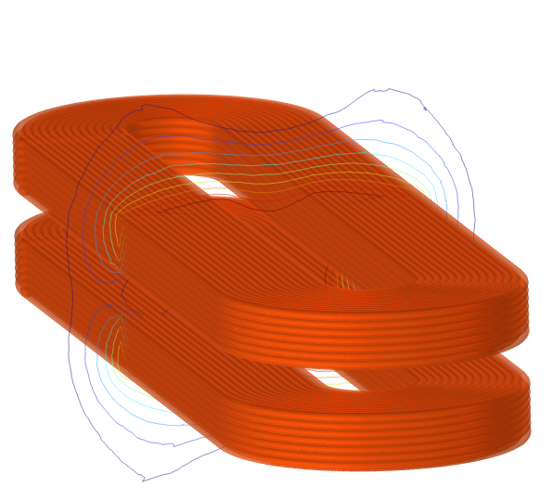
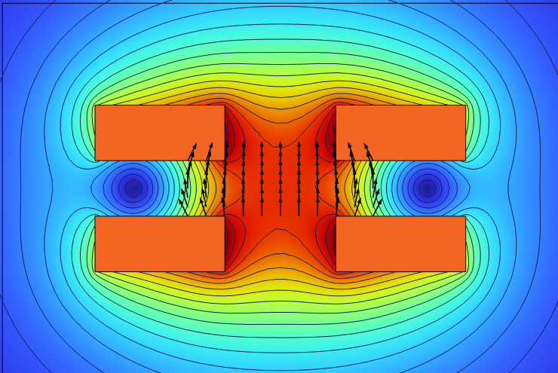
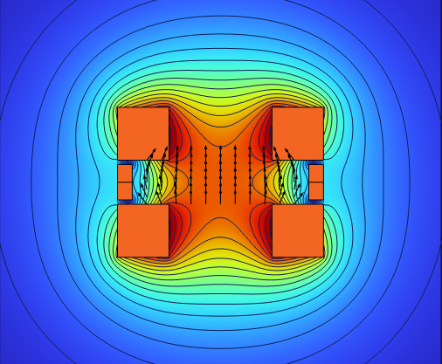
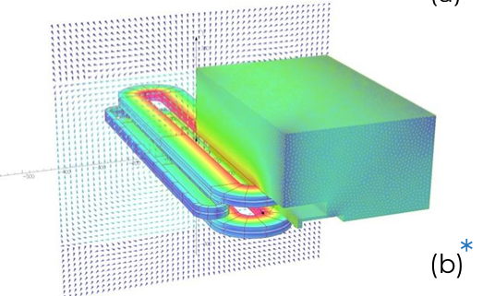

Accelerator Superconducting Magnets
Parameters
10 T at the center
Rectangular aperture 30 mm x 100 mm
Field quality b_{n} < 10 units (TBC) in beam diameter (20 mm)
Same technology used for ESMA and 6D Cooling solenoids
HTS windings (for robustness)
High current density (for cost reasons)
Operation at high temperature (for energy efficiency)
ESMA
good field region
400 x 30 x 50 mm³
1.5% field homogeneity
φ 20 mm – b₃ 20 units
CEA - CERN HFM collaboration
Demonstrator of metal-insulated ReBCO high field coils

Slide 12
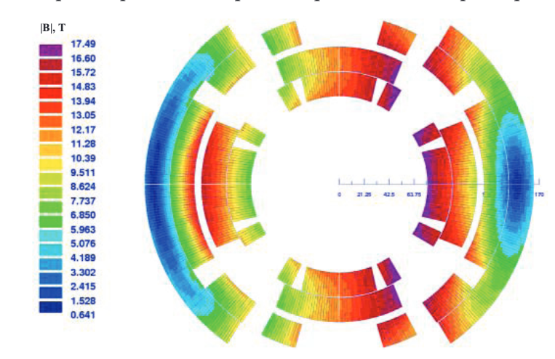
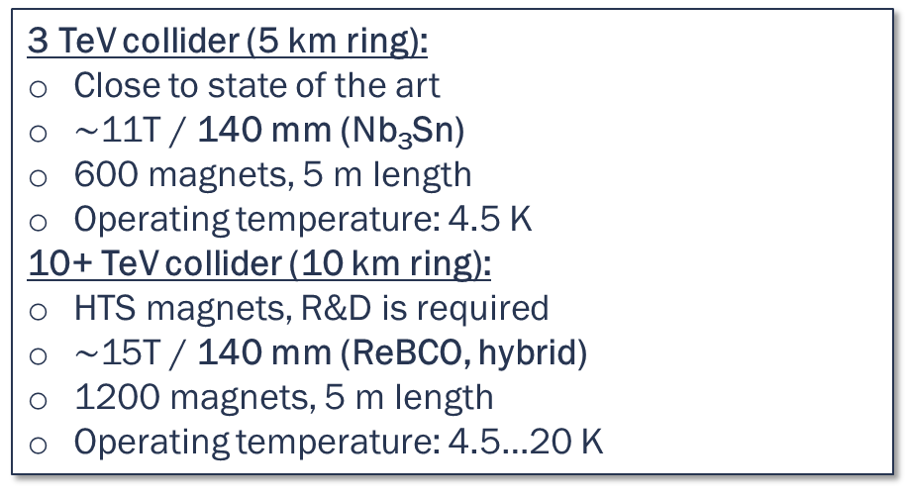
Collider Magnets Requirements
Challenges
High field dipoles to minimize collider ring size and maximize luminosity
Combined function (B1, B2 and B3)
Large aperture shielding (muon decay)
3 TeV collider (5 km ring):
Close to state of the art
$∼$11T / 140 mm (Nb₃Sn)
600 magnets, 5 m length
Operating temperature: 4.5 K
10+ TeV collider (10 km ring):
HTS magnets, R&D is required
$∼$15T / 140 mm (ReBCO, hybrid)
1200 magnets, 5 m length
Operating temperature: 4.5…20 K
V.V. Kashikhin et al.
Proposed solution
Nb₃Sn for the 3 TeV machine and HTS (ReBCO) for the 10 TeV collider.
Constraints
Stress limit, mechanical challenges (conductor, force management)
Margin limit, critical current density and stored magnetic energy (quench protection)
Cost, maximum cost per meter of magnet fixed 400 k€/m (about 2 x Eurocircle)

Slide 13
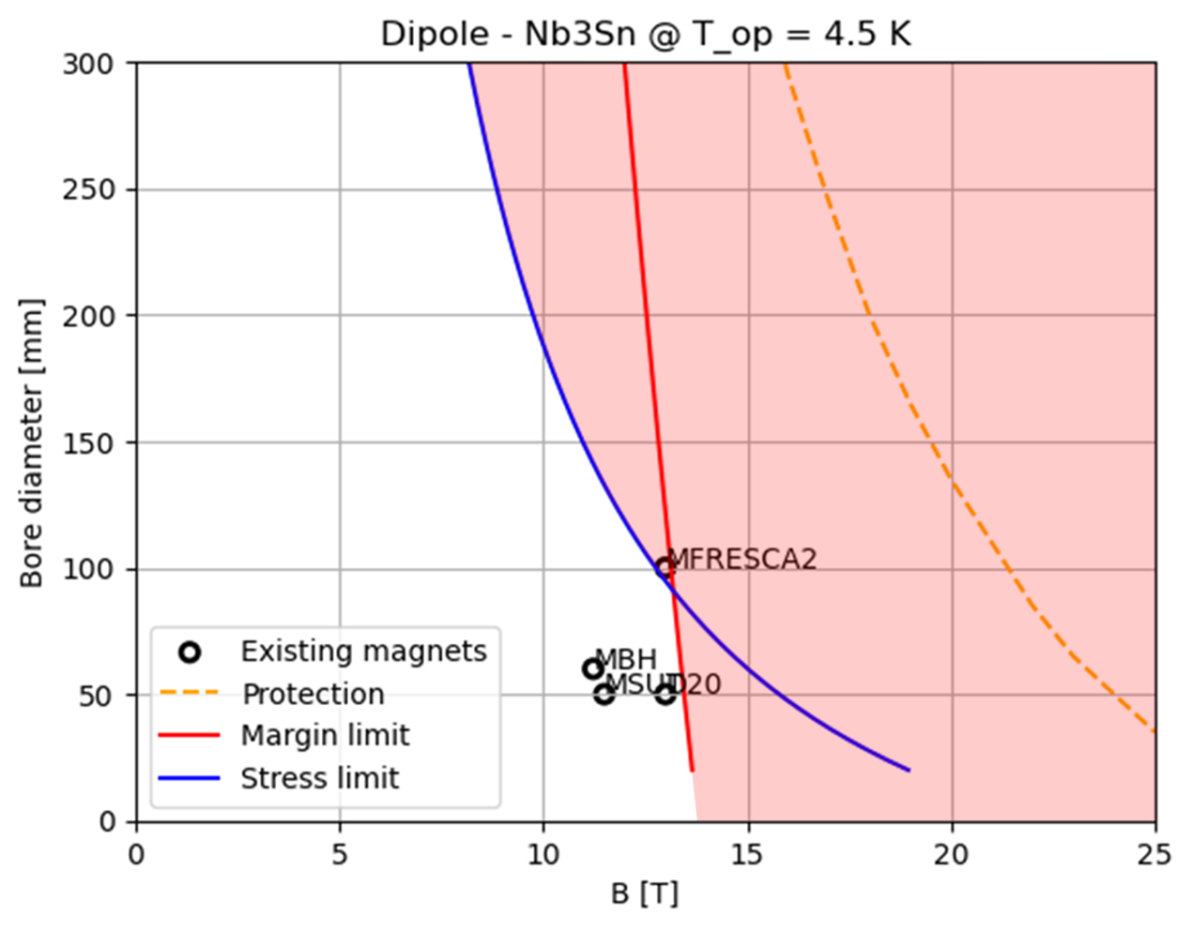
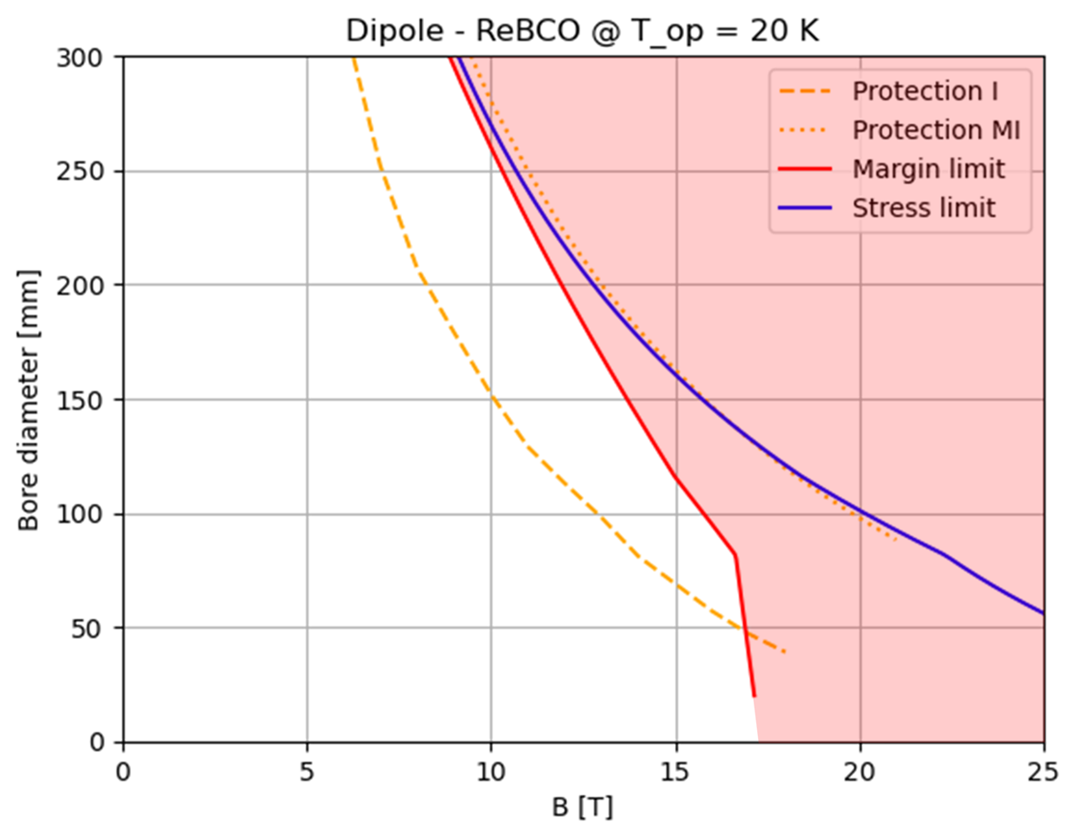
Dipole design charts
Nb₃Sn
HTS
Design target 3 TeV
Design target 10 TeV
Design target 3 TeV
Design target 10 TeV
Nb₃Sn falls short of required performance because of operating margin and peak stress (at affordable cost !)
HTS falls short of required performance with classical insulated coils. Assuming MI or NI magnets, the protection limit becomes comparable with the other limits.

Slide 14
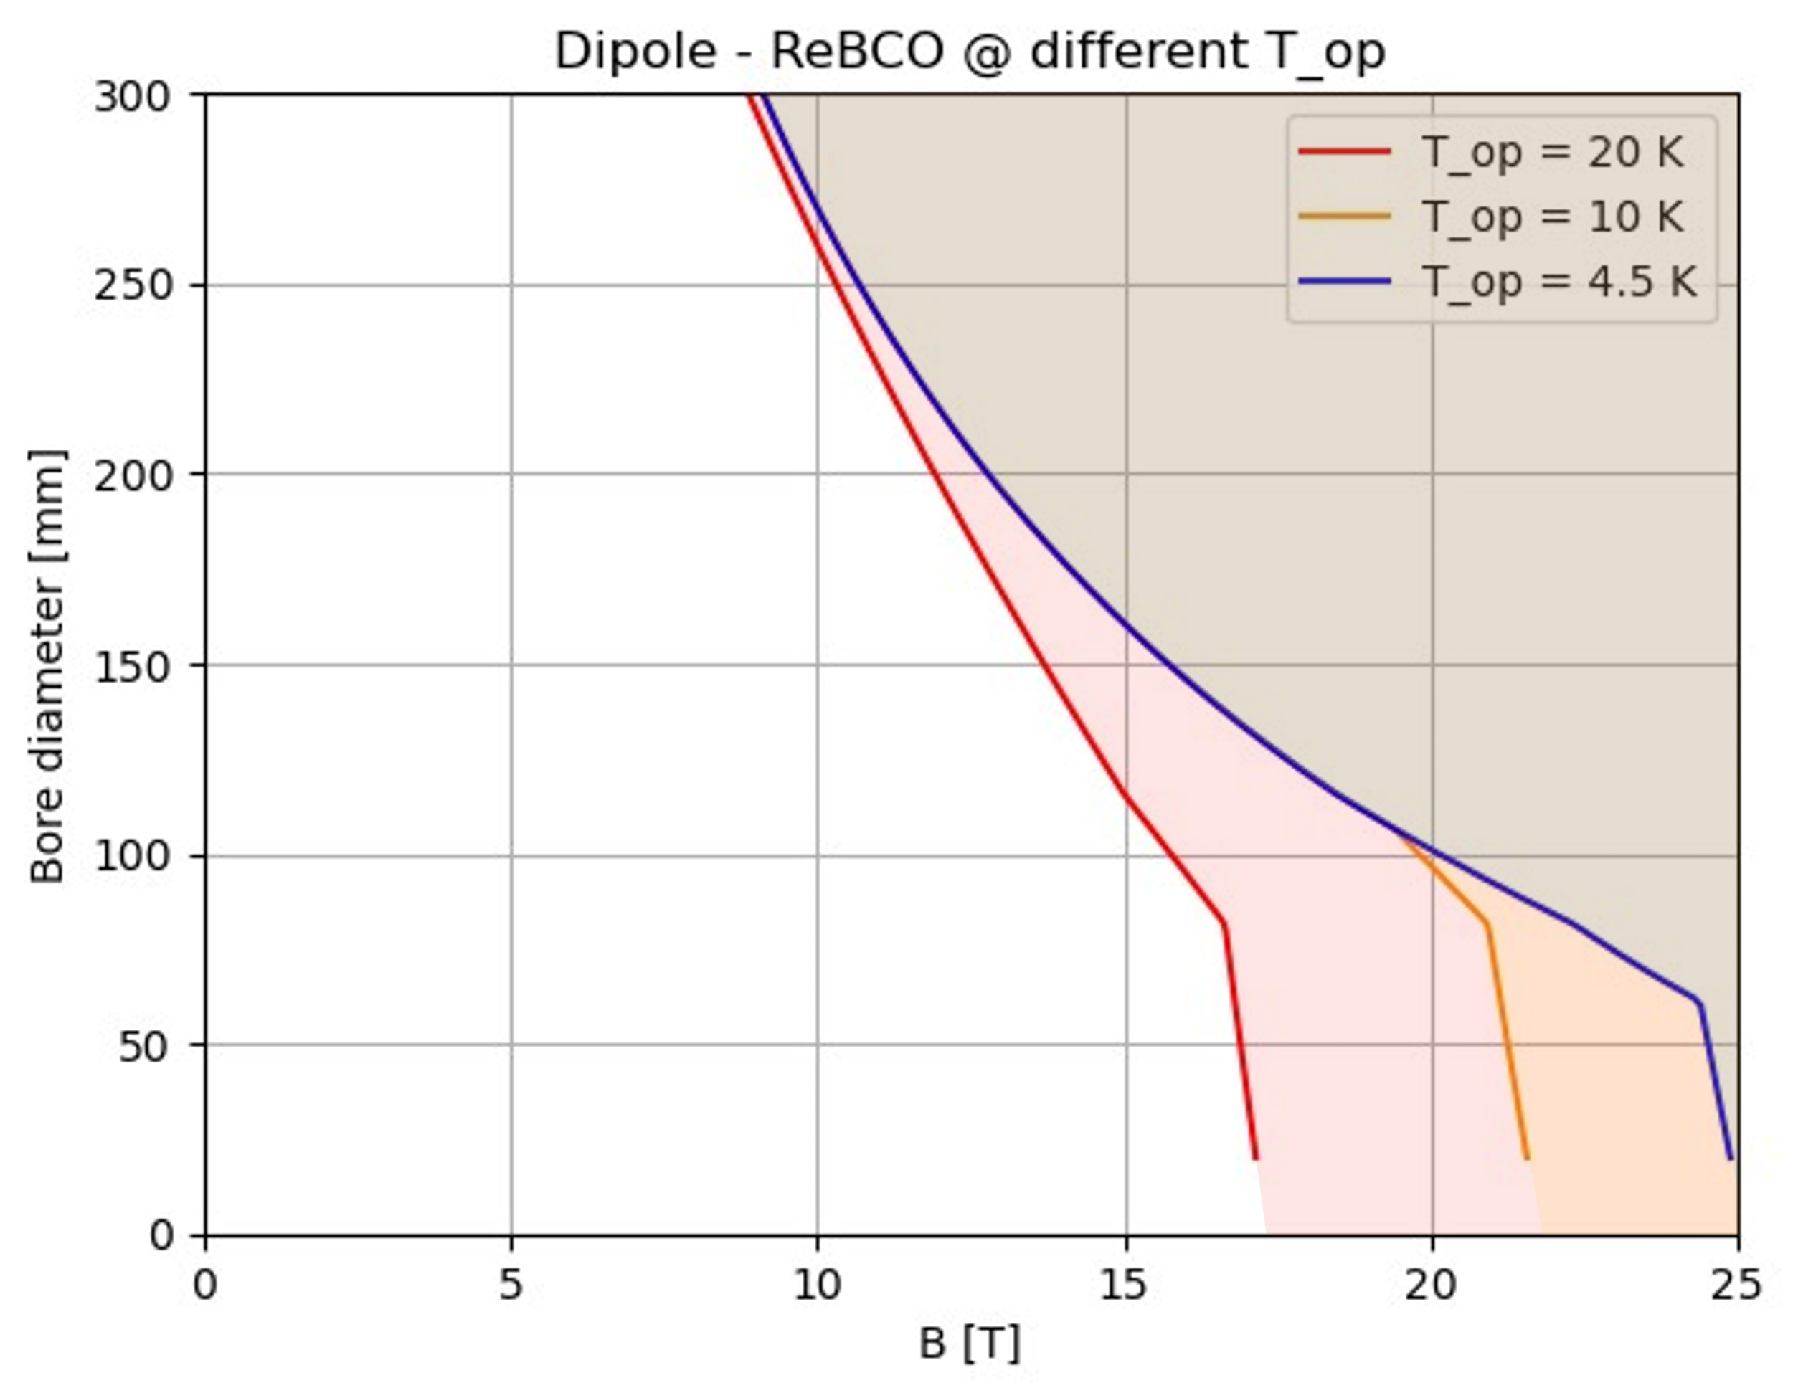
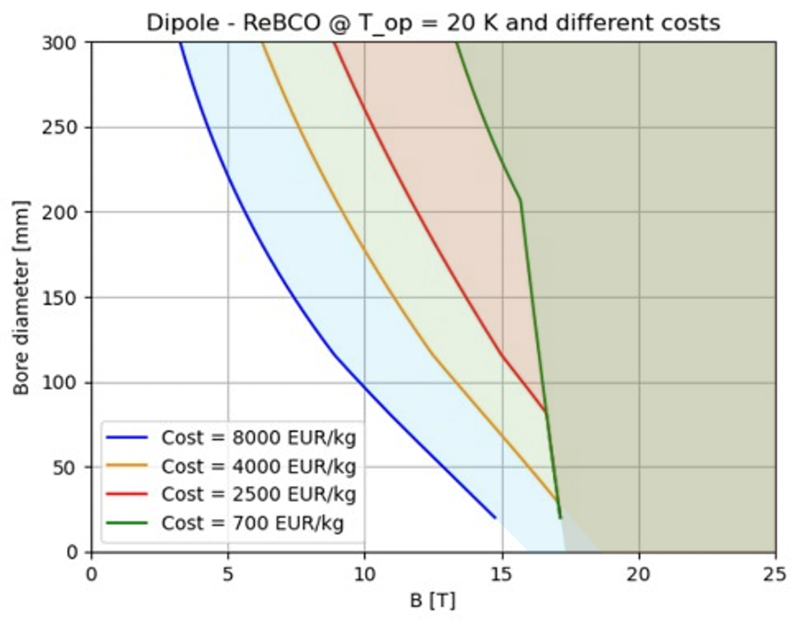

HTS options
What might improve the HTS design?
Fixed the cost per meter of magnet
Cost
reduction
$T_{op}$reduction
A reduction of operating temperature to 10 K
A reduction of HTS cost
(actually driven by fusion market)

Slide 15


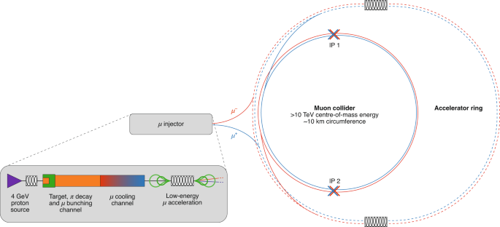
R&D and production schedule
Split Solenoids for RFMFTF
20T/20K solenoid model coil for the target
10 TeV full-length prototypes
3 TeV full-length prototypes
NI UHF solenoid
Series production
0
1
5
10
15
20
26
2024
2044
2050
RCS string test
Fast pulsed NC dipole for RCS
10 TeV HTS short models
6D cooling cell magnets
HCS SC dipole prototypes

Slide 16





Conclusion
HTS magnets are feasibile and sustainable for MC (steady state, high field, high operating temperature)
  Magnetization effects for (slow) ramping and field quality over time are a challenge
  Further modeling, testing and technology development
The 2050 goal may be reasonable considering a strong effort (manpower, R&D and funds)
  The effort involves heavily industry for series production (5k+ magnets)
A promising path for increasing sustainability is 10 K to 20 K operation of HTS magnets
  Intensive R&D and modeling is required to increase the TRL
  Steady state operation is less demanding
Contribution by
CERN: C. Accentura, B. Auchman, B. Bordini, L. Bottura, S. Fabbri, E. Todesco
UMIL: S. Mariotto, J. Pavan, L. Rossi, S. Sorti - INFN: B. Caiffi, D. Novelli, C. Santini - Fusion for Energy: A. Portone
Funded by the European Union (EU). Views and opinions expressed are however those of
the author only and do not necessarily reflect those of the EU or European Research
Executive Agency (REA). Neither the EU nor the REA can be held responsible for them.

Slide 17
spares

Slide 18
Existing plants
Temperature | COP⁻¹ in W_{power}/W_{cool} | Source
250 K | 1 | CO ₂ plant ATLAS IT
100 K | 12 | LN ₂ plant ATLAS
80 K | 16 | LN ₂ plant ATLAS
20 K | 50 | 20 K/50 kW Frey’s plot *
10 K | 150 | LHC cryoplant data
4.5 K | 240 | LHC cryoplant data
2.0 K | 960 | LHC cryoplant data
* Tieftemperatur–Technologie, von H. Frey und R. A. Haefer. Herausgegeben von F. X. Eder. VIII-Verlag, Düsseldorf 1981
Data from:
Cryogenic options for future accelerators: Muon Collider P. Borges de Sousa, M. Rhandi, T. Koettig, R. van Weelderen Muon Collider Magnets WG Meeting 30th March 2023, online

Slide 19
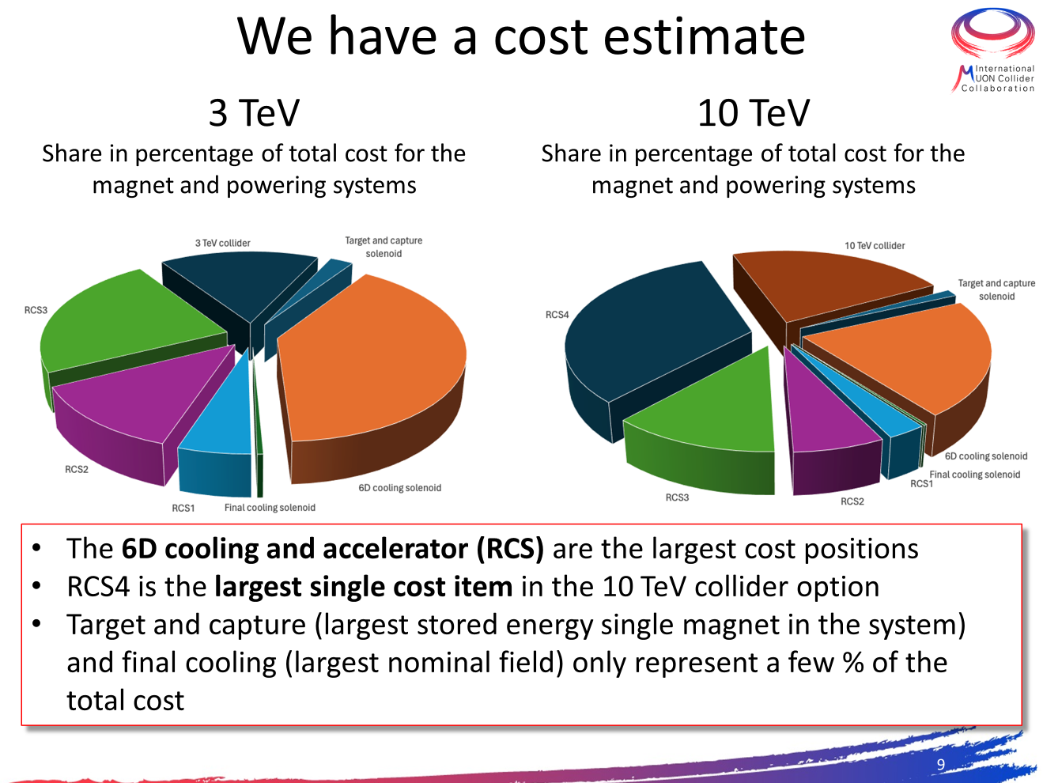
Few considerations on costs
6D cooling solenoids are built once
Acceleration for 10 TeV is the highest relative cost
More challenging single magnets are few % of the total cost (also for cooling)
By L. Bottura

Slide 20
Comments
HTS magnets may increase the performance and the sustainability HEP facilities, research institutes and society falicilities
The cost of HTS tapes is decreasing thanks to higher request (fusion)
TRL of the magnets have to be increased and the performance have to be demonstrated
R&D, modeling and test devices are ongoing and in construction
Dedicated test bed are requested due to the peculiarities of HTS
A dedicated test station at INFN LASA commissioning starting in 2024 and fully operational mid 2025
The HTS R&D is common to different scientific projects (HFM, FCC, MuCol) and paves the road for societal applications
Industry is deeply involved in the construction of new test beds

