Slide 1
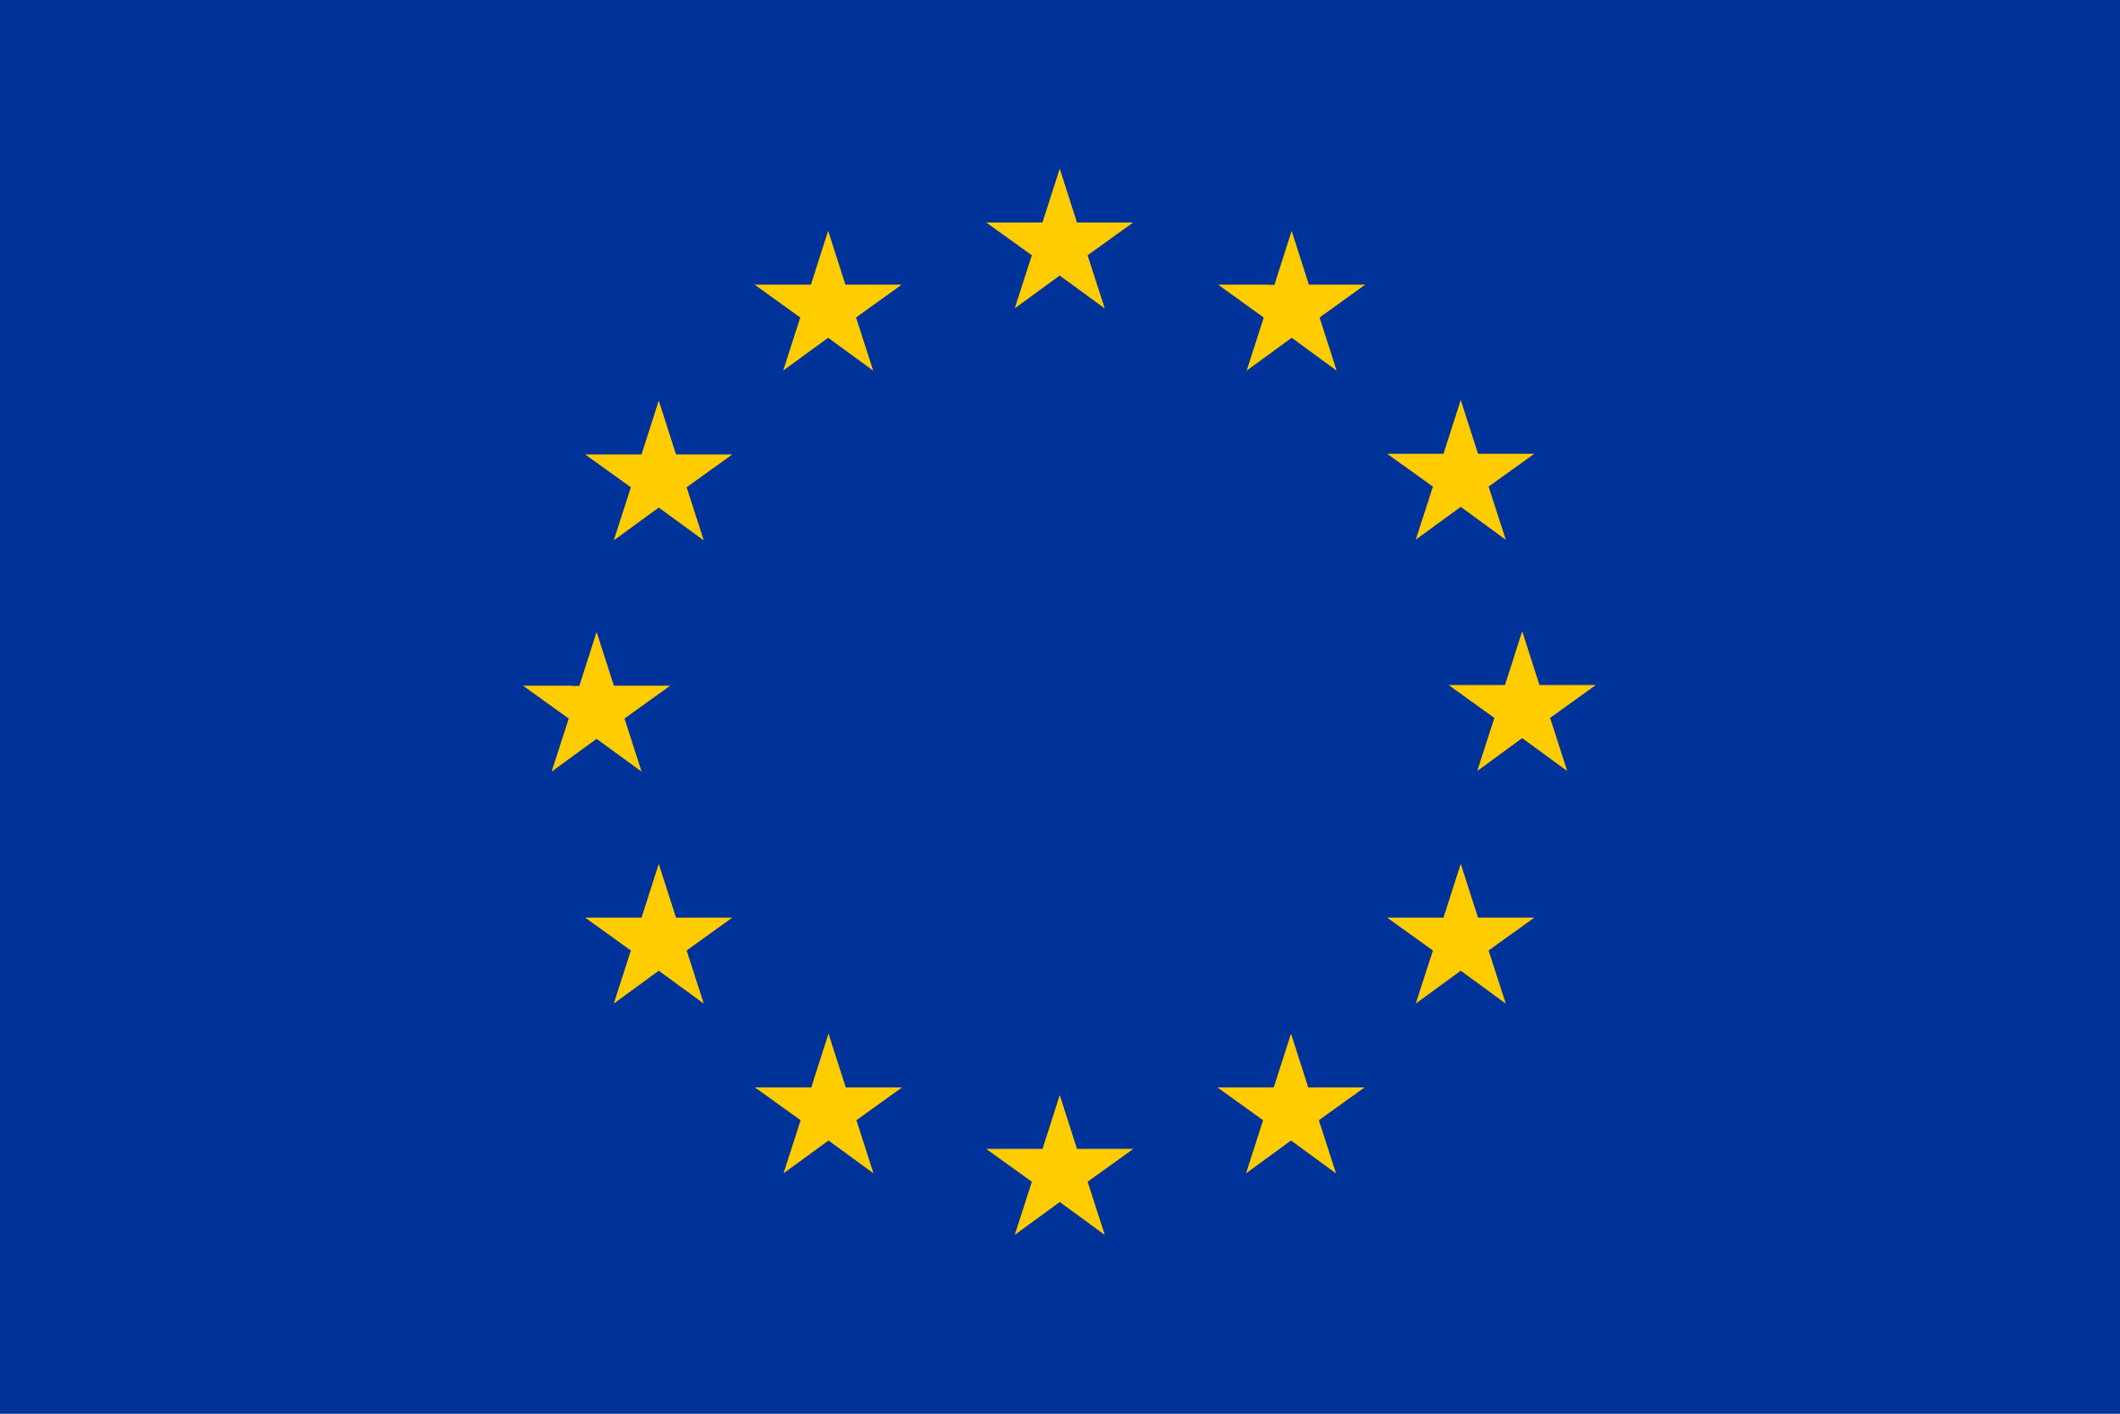
FCC-ee mdi status and next steps
This project has received funding from the European Union's Horizon 2020 research and innovation programme under grant agreement No 951754

Slide 2
Table of contents
FCC-ee IR and MDI region: requirements and challenges
Machine Detector Interface components design
Mockup
Backgrounds assessment
Solenoid compensation scheme
Conclusion

Slide 3
FCC-ee MDI Activity
Convener: Manuela Boscolo (INFN); Deputy: Mike Sullivan (SLAC)
3D engineering design of IR and MDI mechanical layout with integration
INFN (Frascati, Pisa, Perugia), CERN
Beam Backgrounds, beam loss and radiation
CERN, EPFL, INFN (Frascati)
Conceptual design of IR elements/systems
INFN (Frascati, Pisa), BNL, CERN, NBI, SLAC
Alignment tolerances and vibration control
LAPP, CERN, UOX
Heat Load Assessment
INFN (Roma-1, Frascati), SLAC, CERN

Slide 4
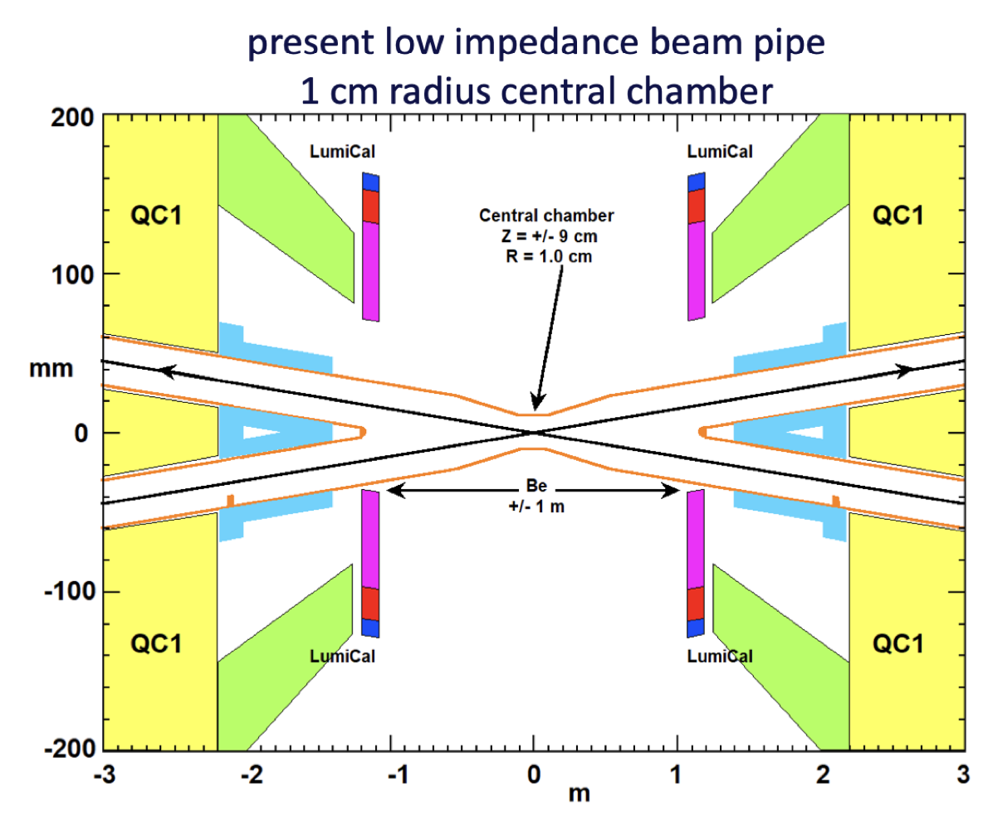
FCC-ee IR and MDI region: requirements and challenges
Common IR for all working points:
2T solenoidal detector field
Crab-waist scheme based on nano-beams and large crossing angle to reach extremely high luminosity O(10³⁶ cm⁻²s⁻¹) at Z-pole.
Solenoid compensation achieved via two anti-solenoids inside the detector.
Luminosity monitor: absolute measurement to 10⁻⁴ with low angle Bhabhas
Strict alignment tolerances
Low material budget in IR mechanical elements
Shieldings for beam induced backgrounds

Slide 5
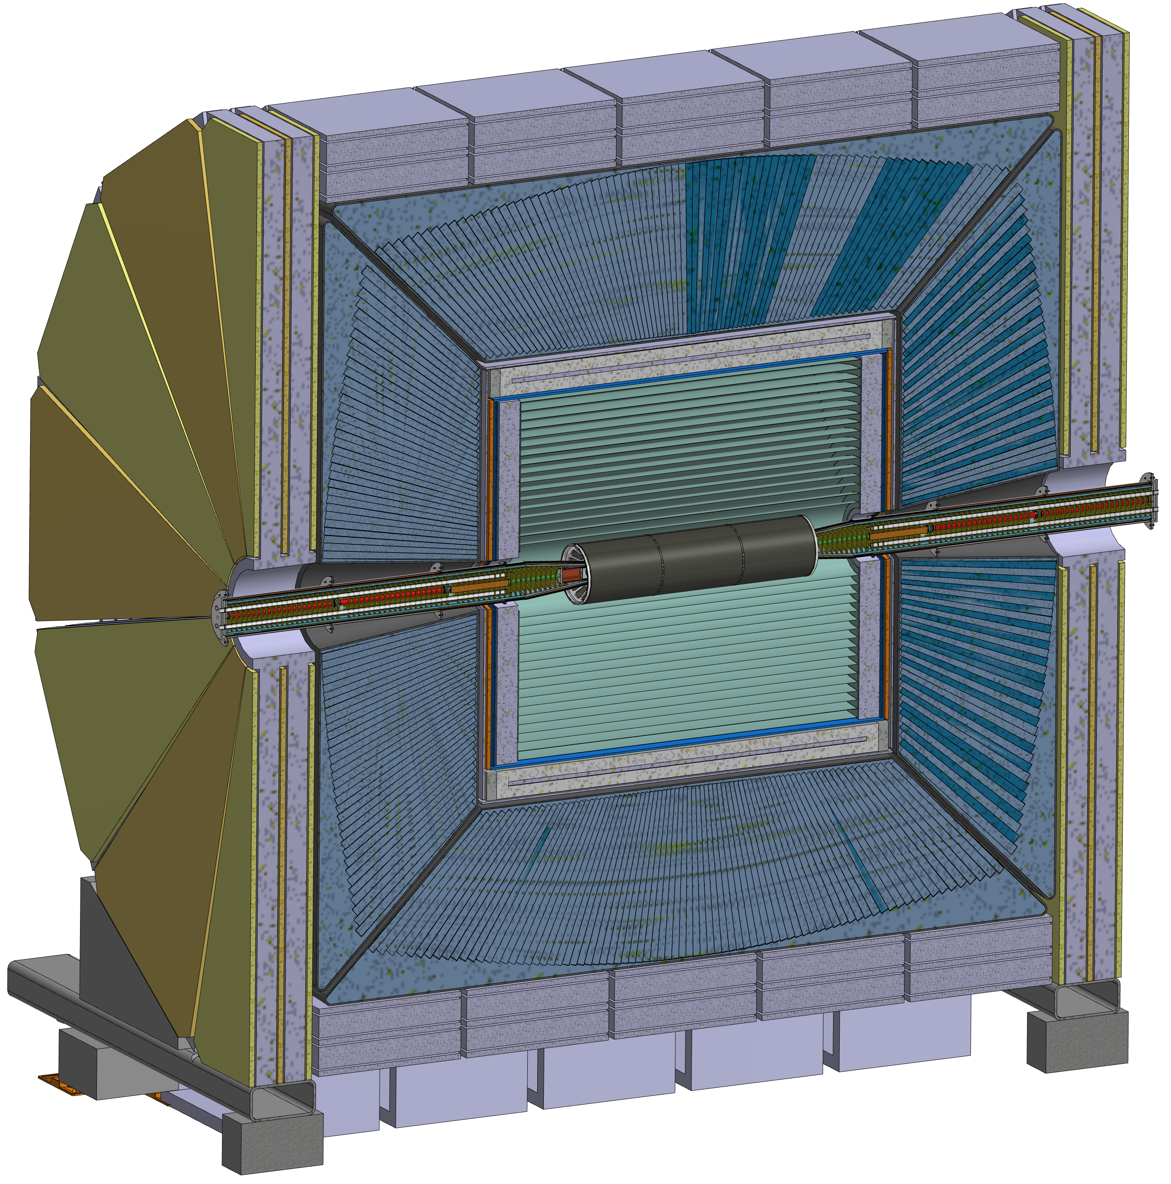
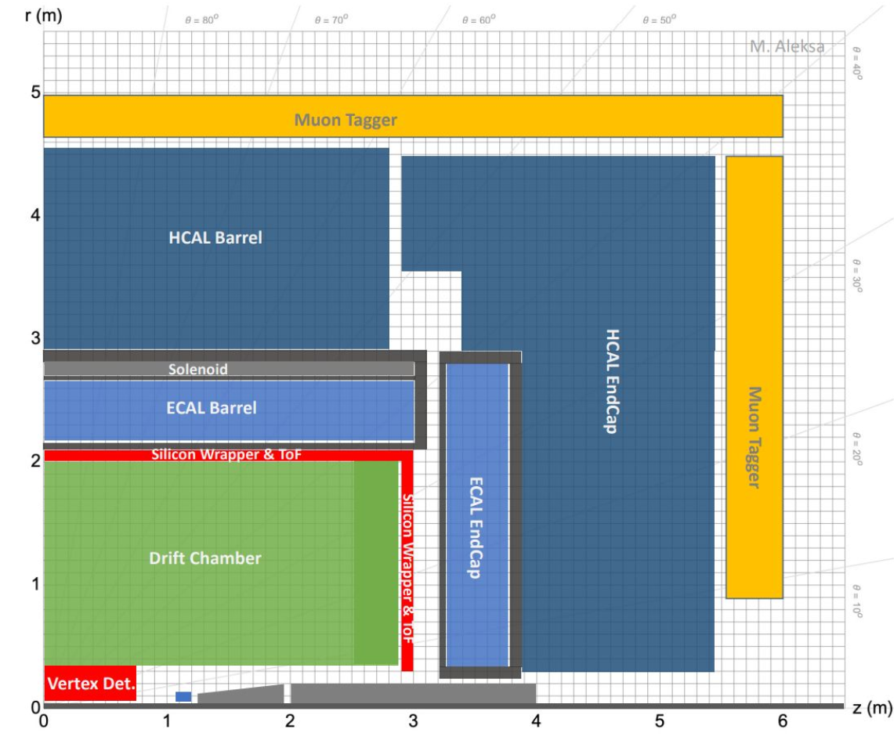
IDEA
FCC-ee IR description
Every design shown in this presentation is based on IDEA detector and is compatible with Allegro, sharing the same vertex detector concept.
Allegro
11 m
13 m

Slide 6
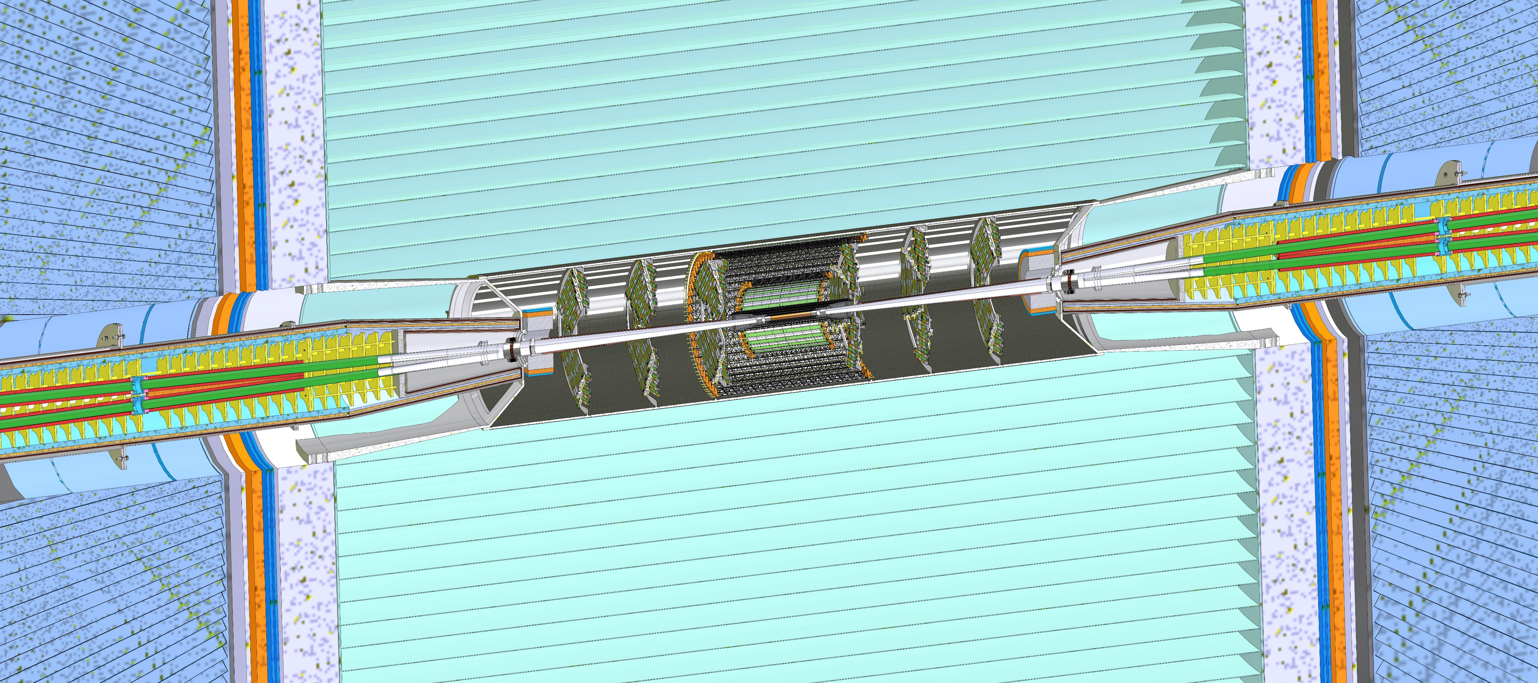
FCC-ee IR description
3 m
Cooling
Inner vertex
Bellows
Cryomagnet
IP
LumiCal
Conical chamber
Disks
Remote vacuum connection
Support tube
Outer and middle vertex
L* = 2.2 m
Central chamber
IDEA detector

Slide 7
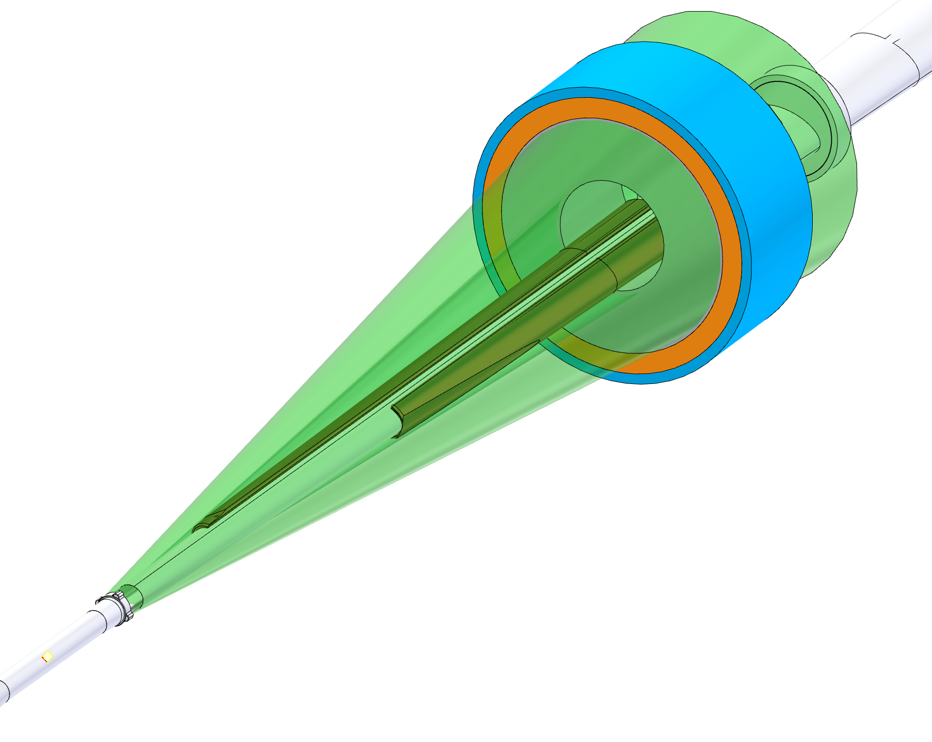
Spatial constraints
To achieve the required performance, it is necessary to have low material budget within the LumiCal acceptance (between 50 mrad and 105 mrad centered on the outgoing beam pipe).
Every component of the MDI must stay inside the 100 mrad detector acceptance cone
105 mrad
50 mrad
100 mrad
Notes:
The components integration and each component (i.e. the conical chamber) have been designed to keep everything out of this range, or the thickness has been optimized to achieve the maximum transparency possible.
This constraint is symmetric and, therefore, is less problematic if compared with the Lumical Constraint

Slide 8
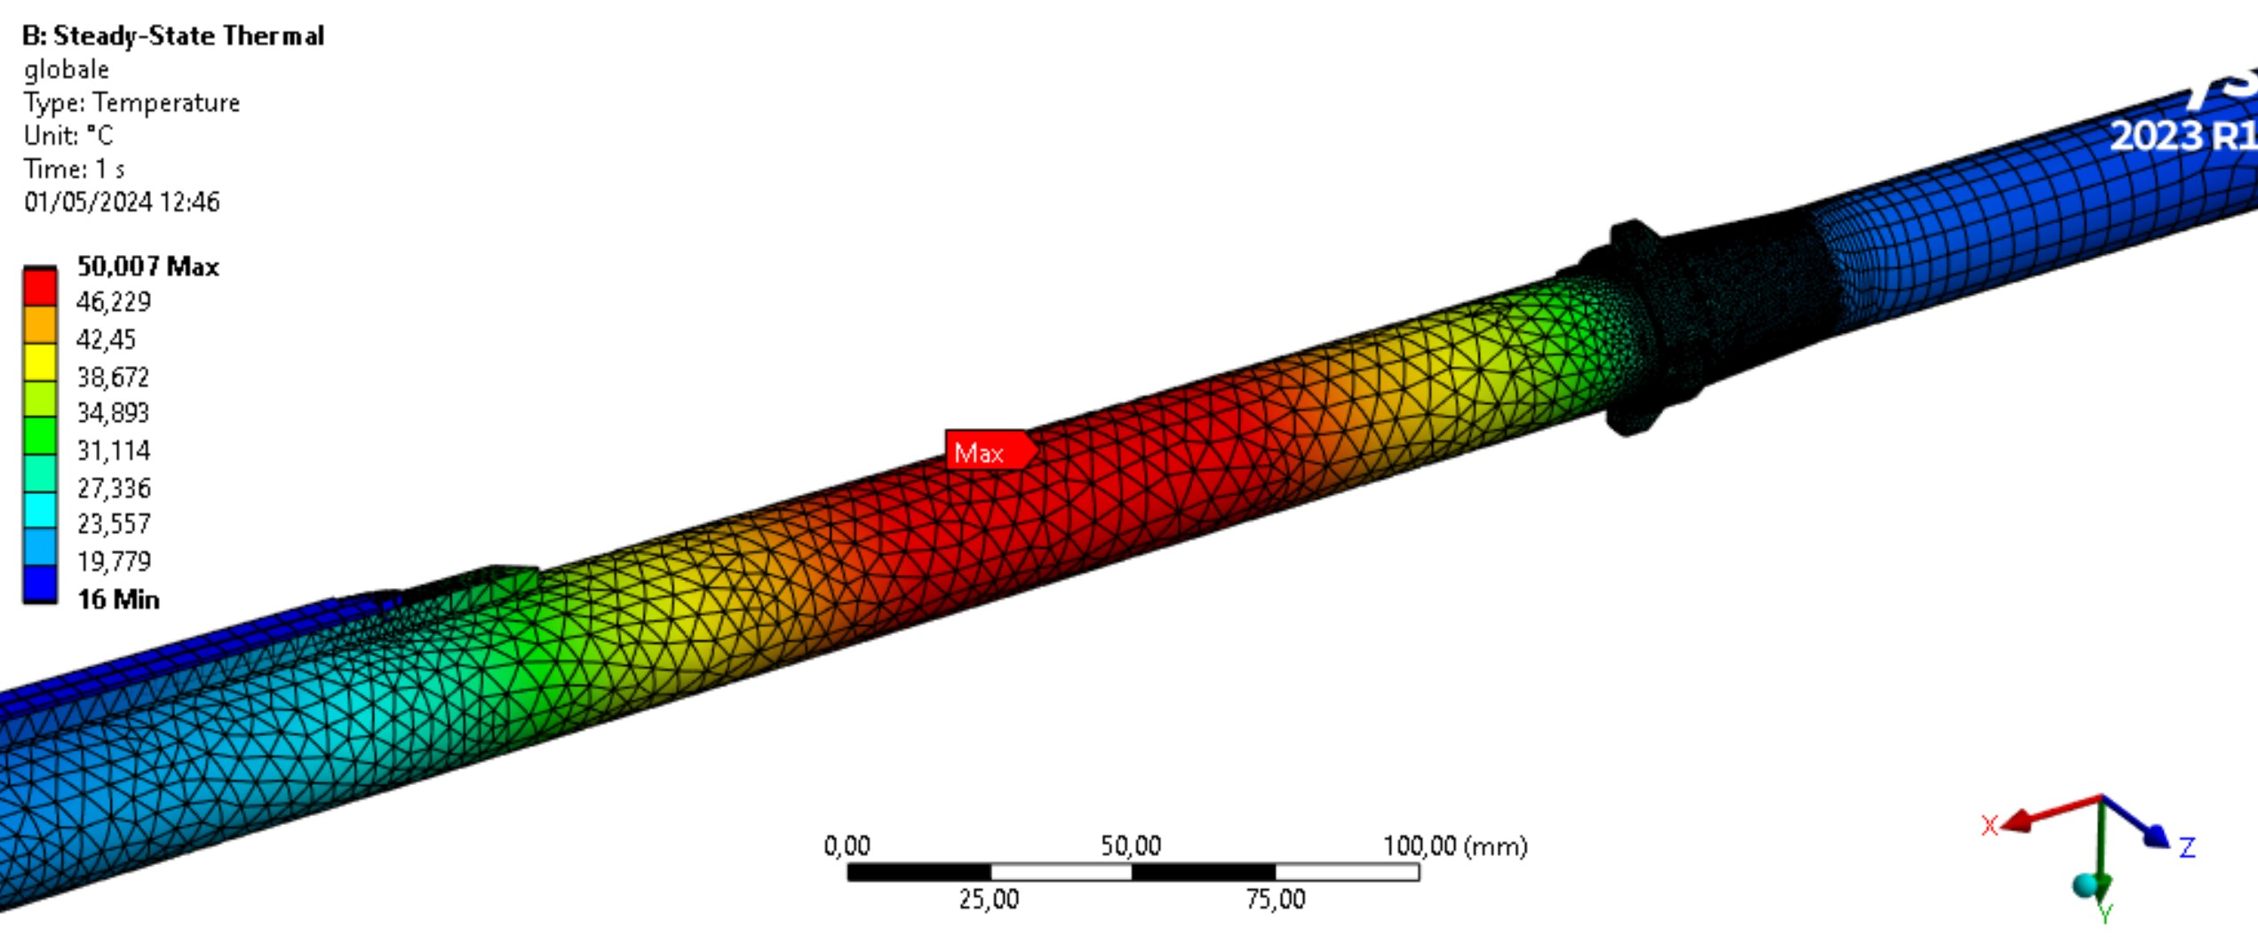
Central chamber
T_{max}=50°C
The central has the following characteristics:
AlBeMet 162 (62% Be, 38 % Al ) as main material
Three layers from –90/+90 mm from IP
0.35 mm of AlBeMet162
1 mm gap for Paraffin
0.35 mm of AlBeMet162
On the central chamber is applied a thermal load of 54W from the wake fields.
Cooling channel
reduction of material budget
Paraffin cooling system
Inlet for paraffin
5 μm gold coating to increase the electrical conductivity
outlet for paraffin
Double layer of AlBEMet162
Section view

Slide 9
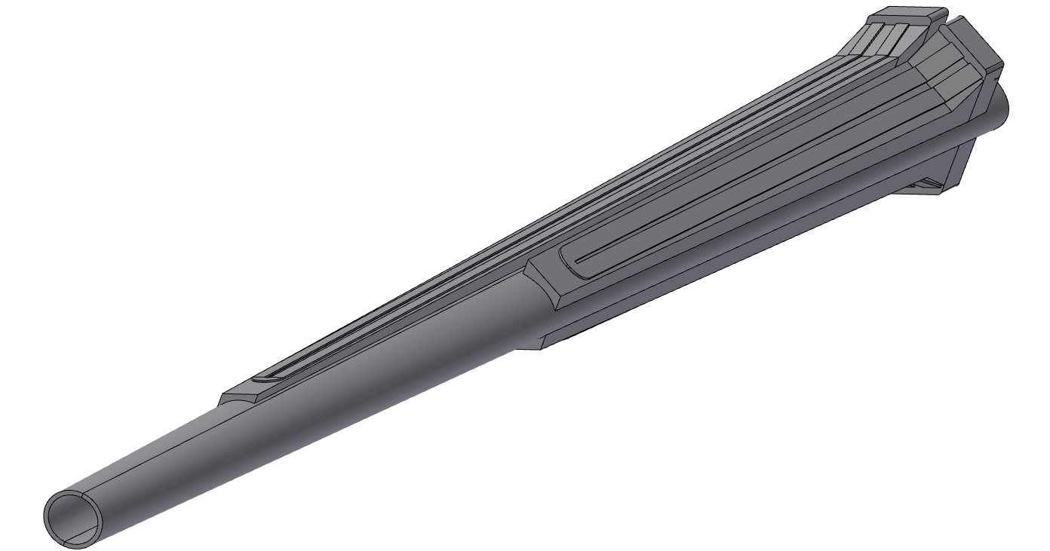
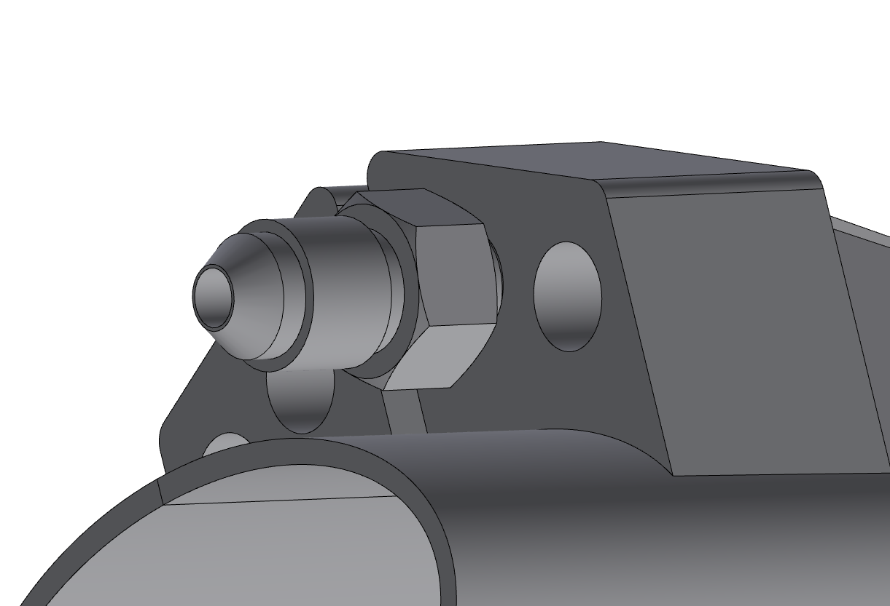
Ellipto-conical chamber
Main characteristics:
Starting from 90 mm to 1190 mm from IP
AlBeMet162 as main material
Chamber in two halves and assembled using electron beam welding (EBW )
Machined cooling system over the chamber
The cooling is based on an asymmetric solution, using the 50 mrad Lumical acceptance cone as the cutting profile.
Homemade connectors are being developed at LNF

Slide 10
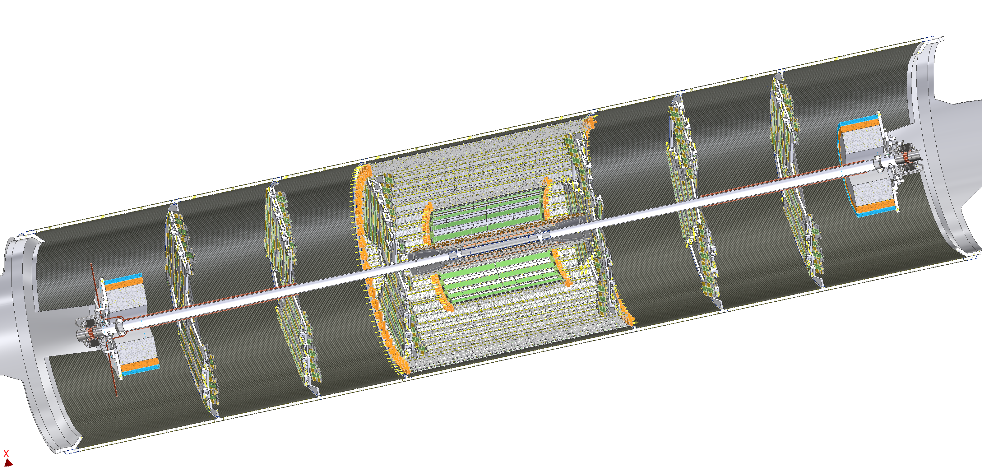
Support tube – description
The support tube aims to :
Provide a cantilevered support for the pipe
Avoid loads on thin-walled central chamber during assembly or due to its own weight
Support LumiCal
Support the outer vertex and disks
Inner vertex
Chamber
Outer vertex
Disks
Middle vertex
LumiCal
The structure is made with a multiple layer structure:
1mm CF + 4mm HC + 1mm CF
To allow the support of the disks are necessary 6 reinforcement ribs.
The cylinder is split in two halves to simplify the assembly procedure
The Aluminium endcaps support the LumiCal and the beampipe
Aluminium ribs
Aluminium endcaps
CF=carbon fibre
HC=honeycomb

Slide 11
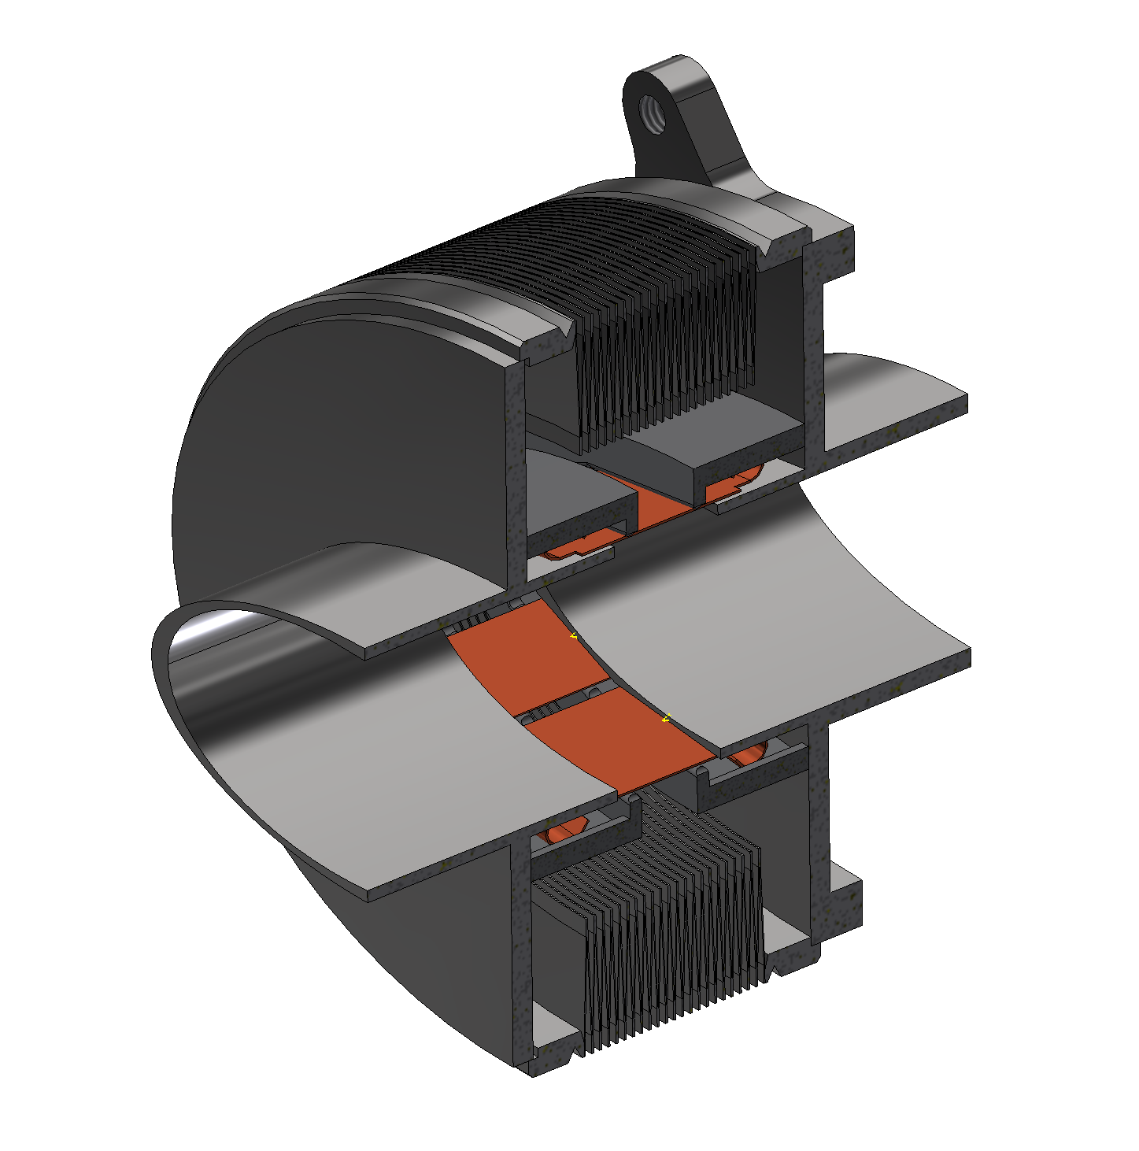
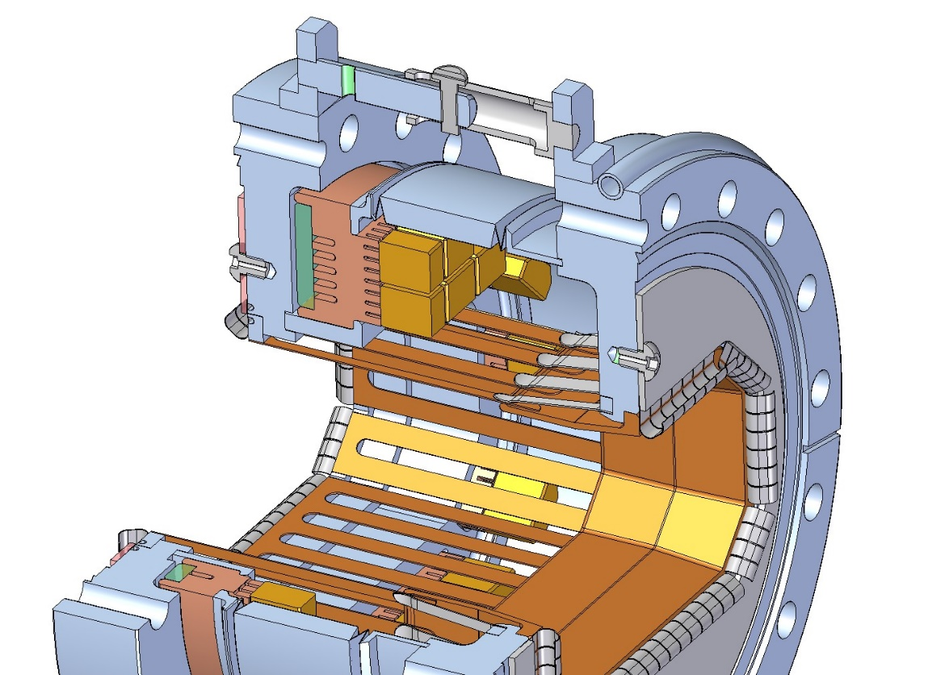
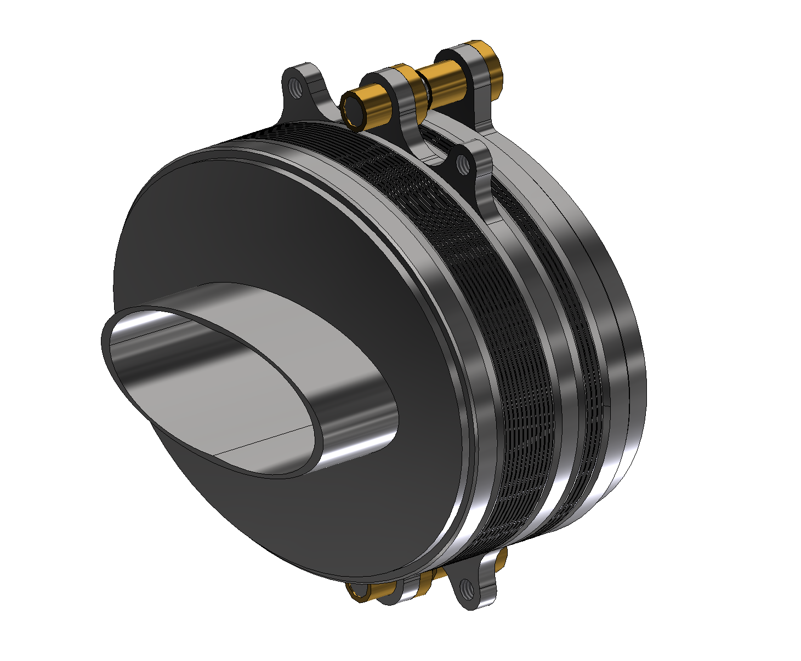
2nd Bellows (Double bellows)
1st Bellows (Single bellows)
Bellows
The design consists of two kind of bellows in order to:
Protect the central chamber during the assembly procedure
Support properly the chamber bellows-to-bellows, containing the deformation
Allow the thermal deformation O(2mm) without compromising the chamber
The design is based on DAFNE and ESRF bellows, modified according to impedance studies.
SLAC PEP-II
Restraint
OFE Cu Prong Body
Welded Bellows
We are working to insert the high order mode (HOM) absorber on the bellows and a prototype will be manifactured and tested at INFN-LNF
Ceralloy Tile
Glidcop Stub
SST Water
Jacket Cover
SST Prong Support
J-Seal
Glidcop RF Fingers
Inconel Spring
Fingers

Slide 12
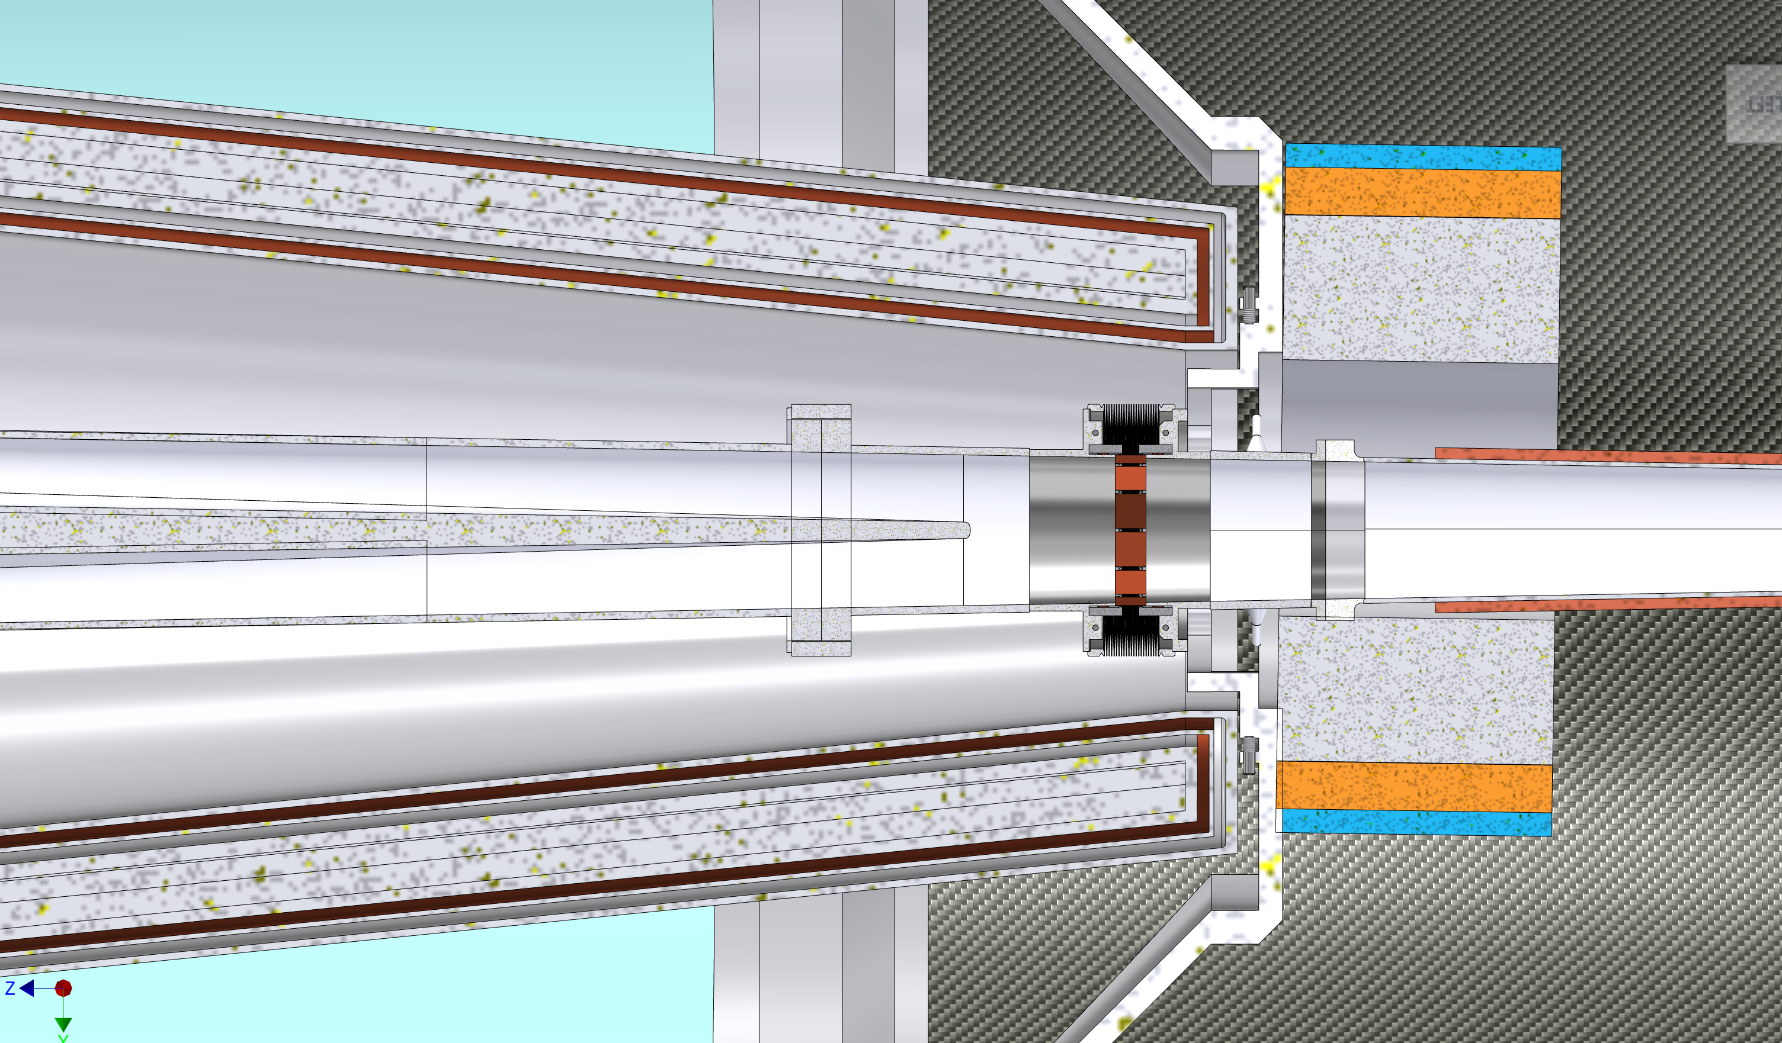
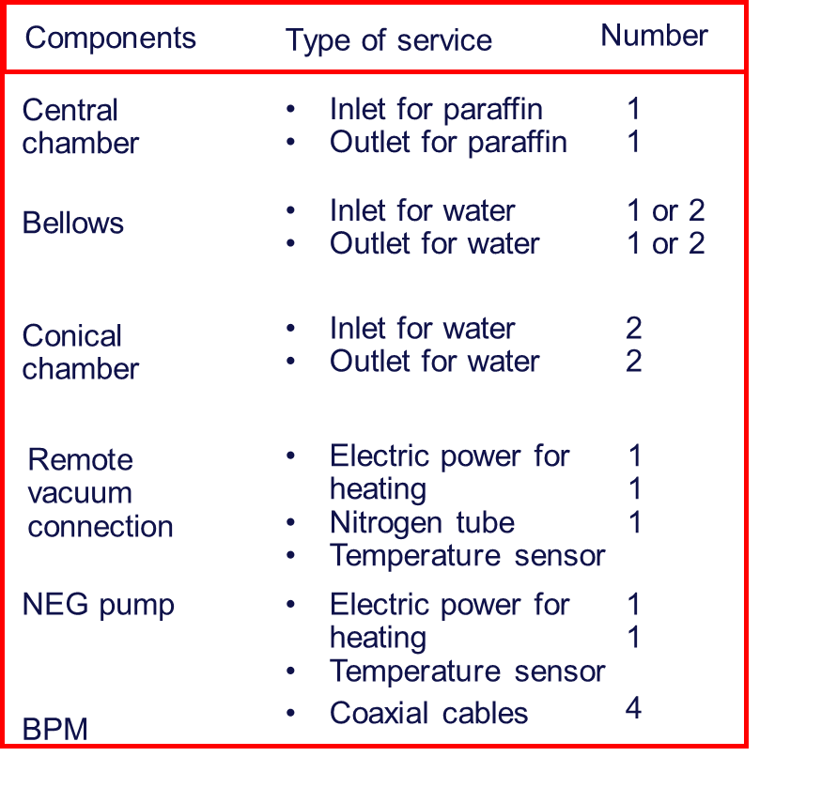
Integration challenge with the cryomagnetic system
NEG PUMP
= Outlet cooling
= Inlet cooling
= Electric cables
= Nitrogen pipe
= Coaxial cable
= Signal cable

Slide 13
Integration challenge of the inner vertex with conical vacuum chamber
Vertex detector support structures are linked with the ellipto-conical chamber.
The positioning of the cables and pipes is delicate and challenging.
Cooling in Layer 3
Cables Out Layer 3
Cooling in Layer 2-1
Cables Out Layer 2-1
Air Cooling
Peek ring 2
Peek ring 1
Paraffin cooling
Cables
Cooling Pipe

Slide 14
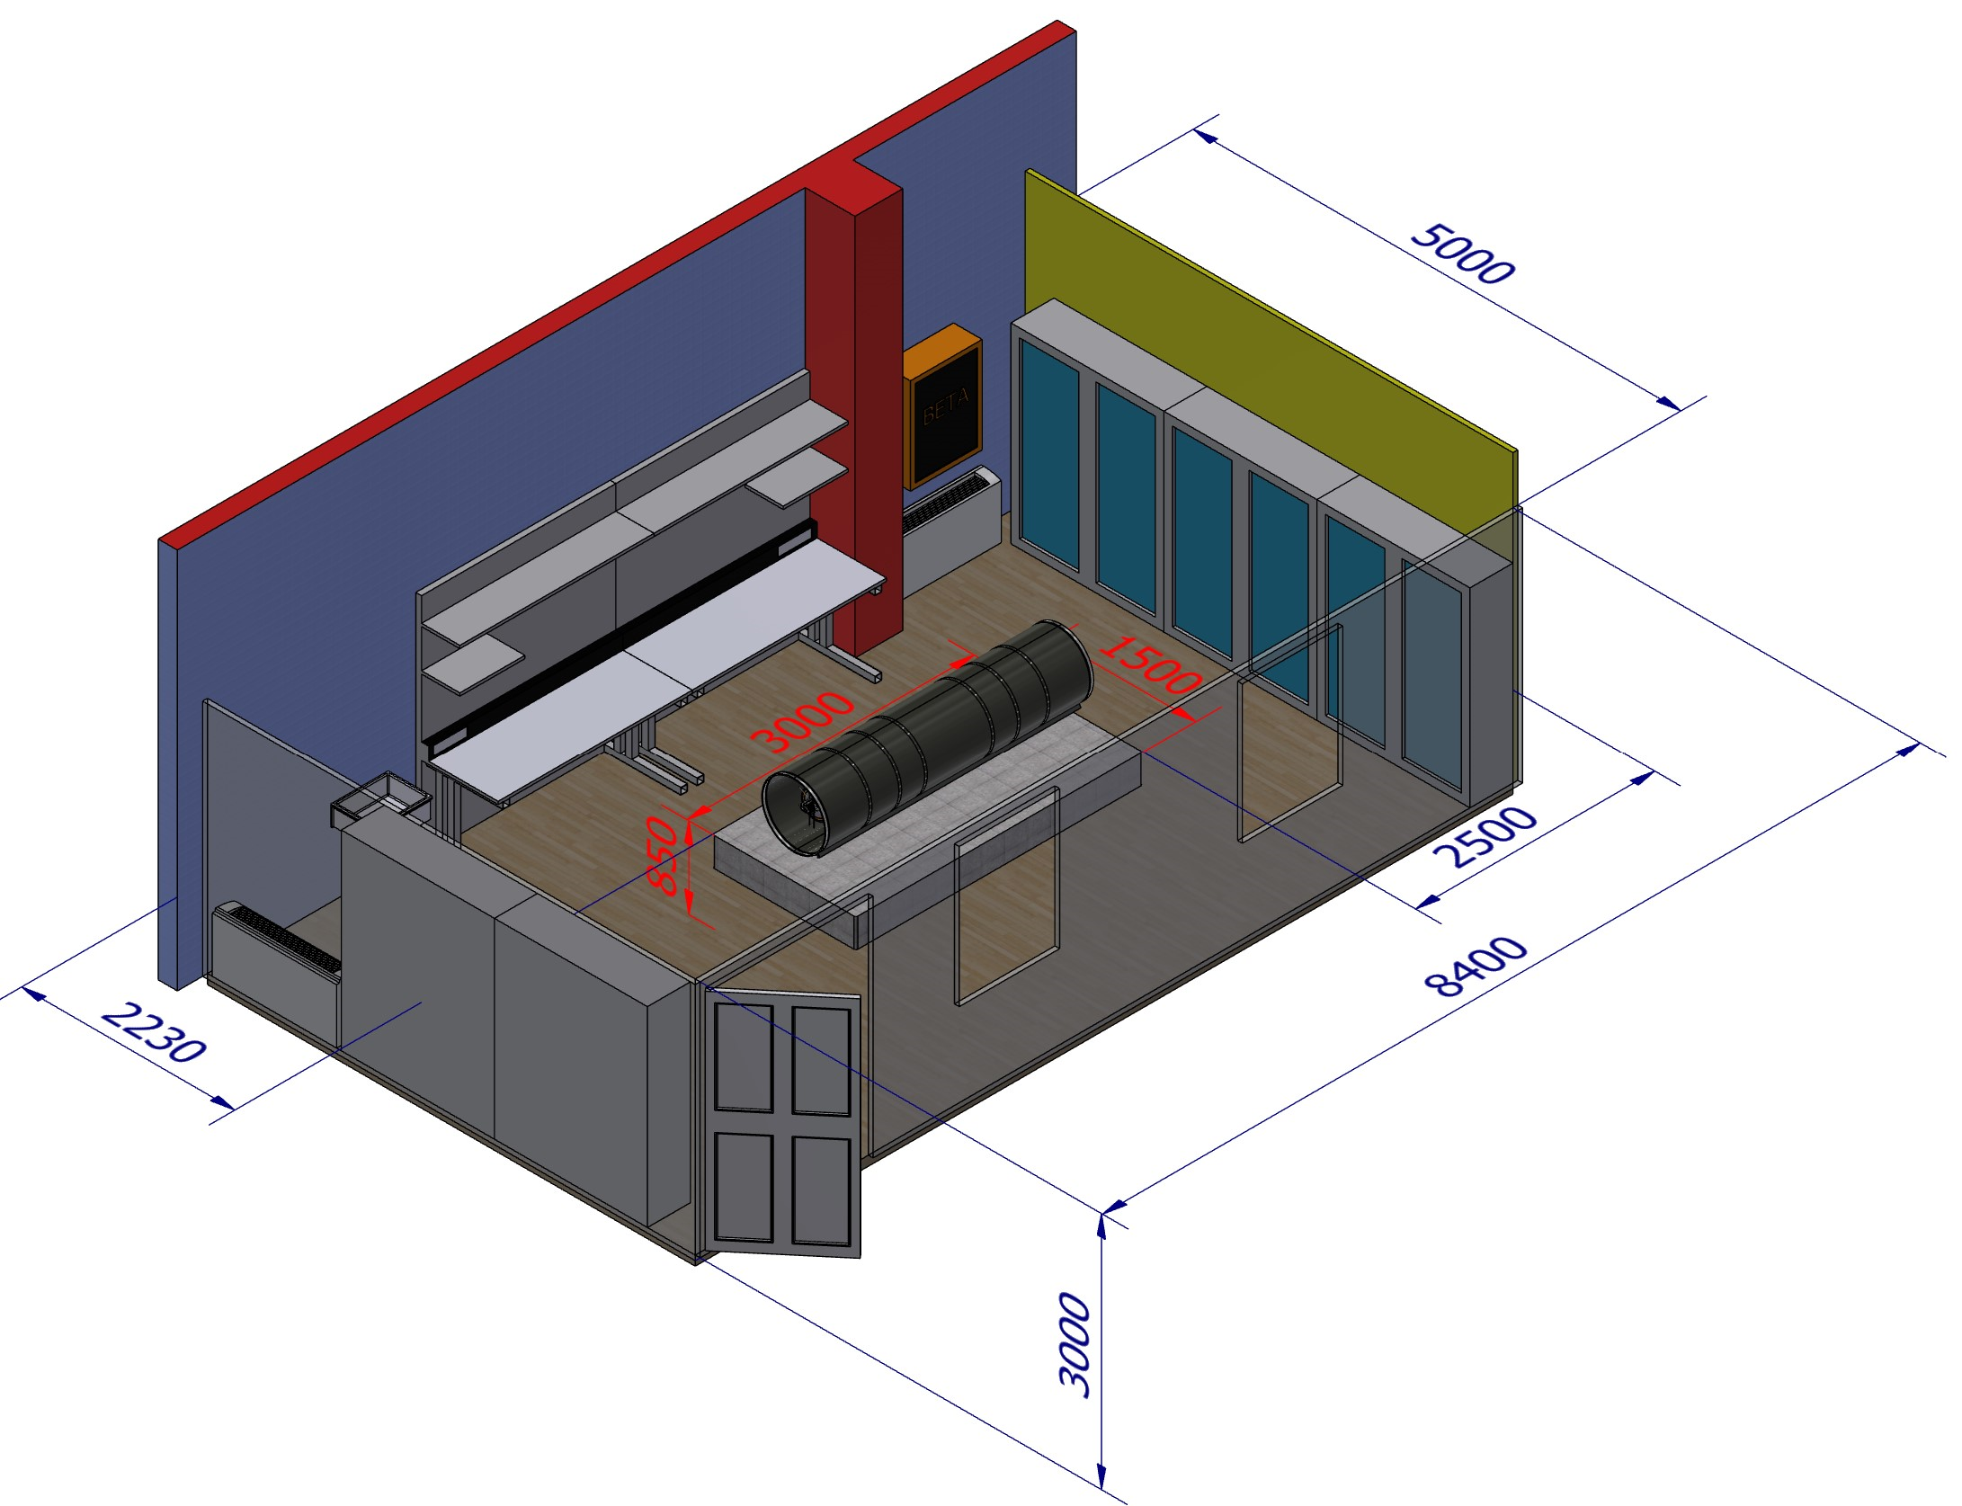
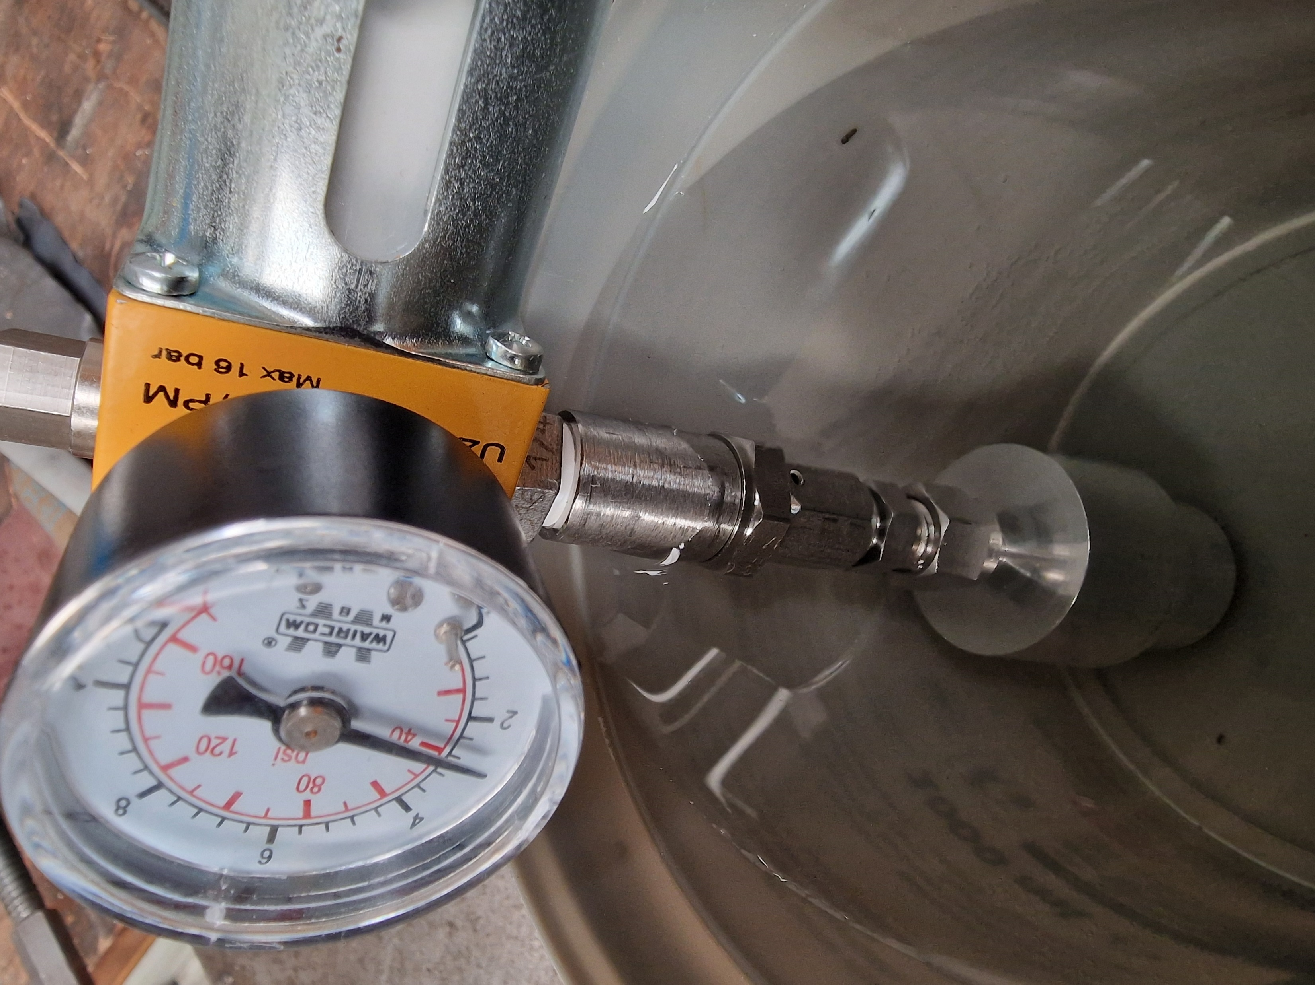
MDI R&D IR Mockup
Activities started for FCC-ee IR mockup to be built at INFN-LNF.
Check assembly strategy feasibility for the single parts of the chamber (central, ellipto-conical) and of whole system (chamber, bellows, inner vertex, outer vertex, middle vertex, disks).
Check the feasibility of the Electron Beam Welding along an elliptical shape.
Test of the cooling systems.
Test the AlBeMet162-Stainless Steel transition
Test the constraint schema and the stiffness of bellows with CuBe blades.
Study of cables and cooling pipes fitting.
Intermediate output will be in support to the next European Particle Physics Strategy Update.
In the next phase for FCC, and when our tests will be concluded, the mockup could be used for further studies, e.g. alignment and vibration tests.
Test of homemade hydraulic fitting

Slide 15
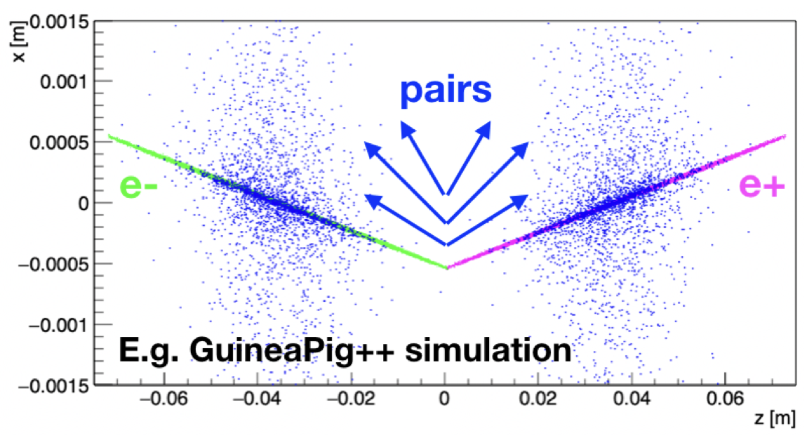
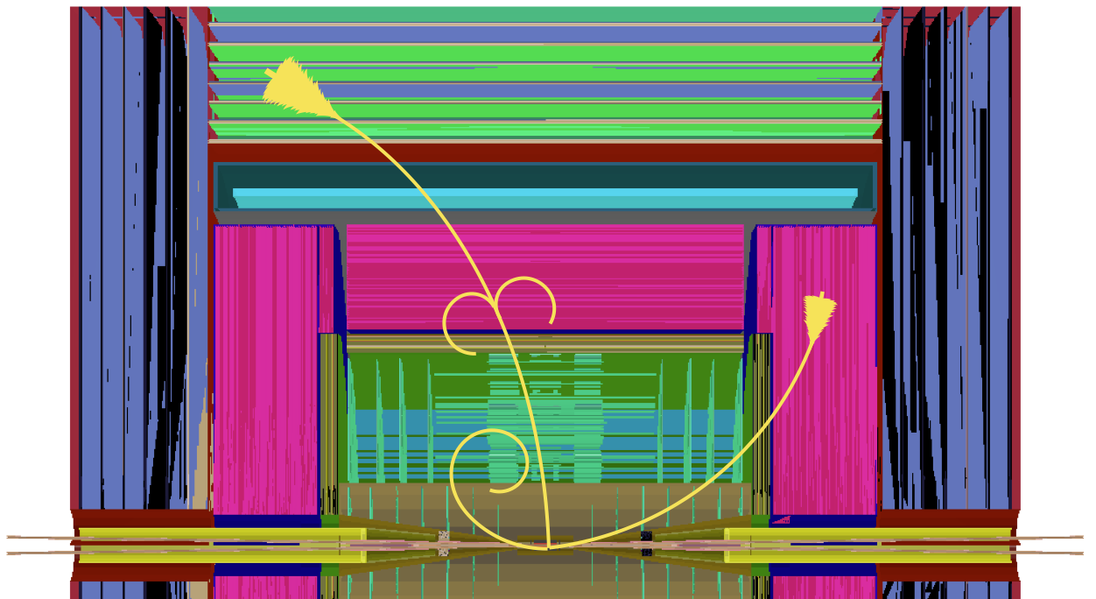
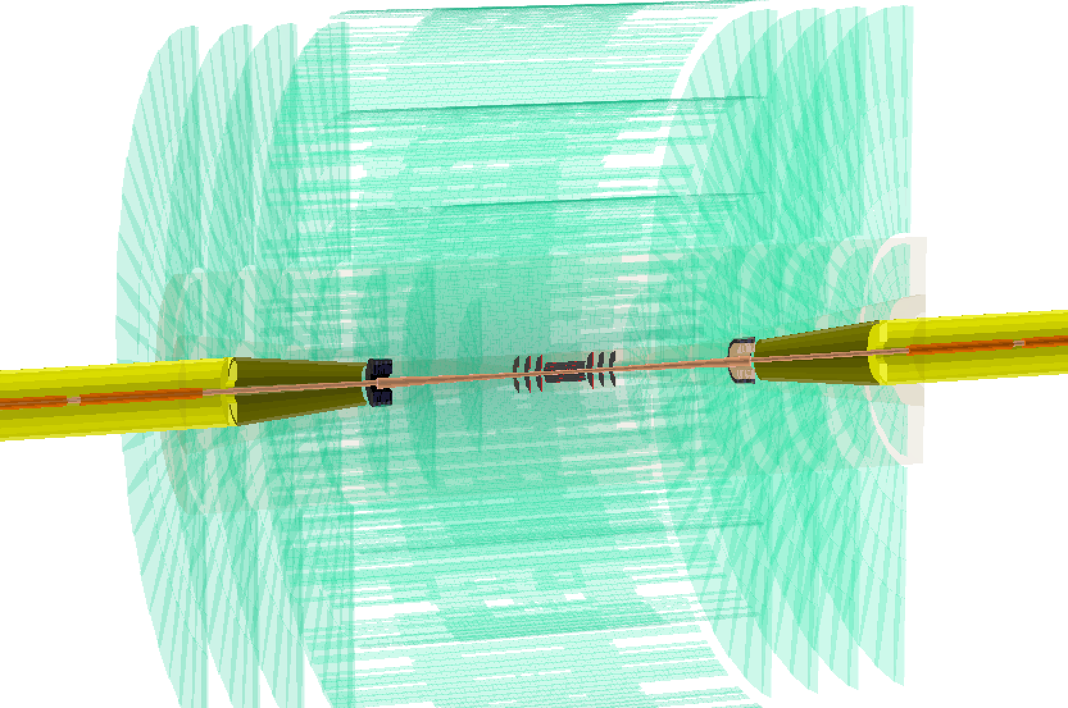
Beam Background assesment at FCC-ee
Characterization of beam induced background is a key element for shielding design and detector optimization (e.g. readout/trigger/DAQ/…)
We carried extensive preliminary studies for start-to-end workflow up to occupancy estimates, in particular for the CLD detector concept. Work ongoing for IDEA and ALLEGRO for the FS report.
Particle tracking in the detector is performed using the Geant4 based framework Key4hep
Primaries produced by external generators
Tracking in key4hep
Detector and MDI description in DD4hep format
CLD
CLD

Slide 16
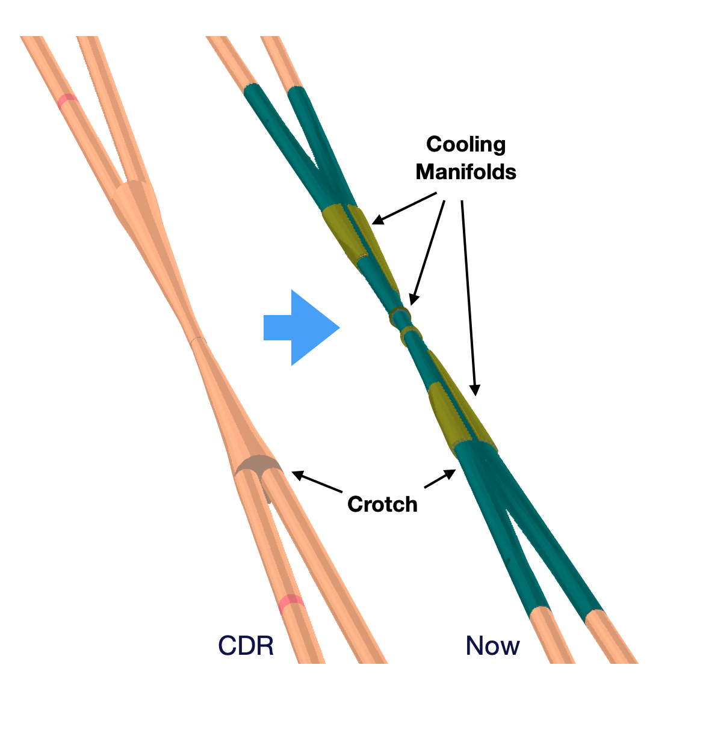
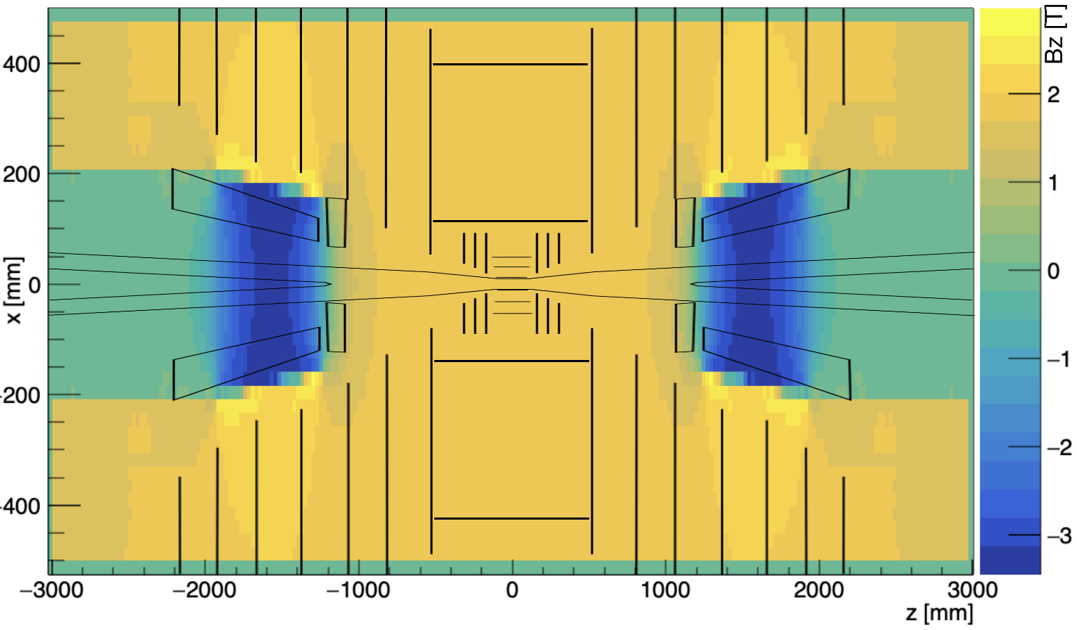
MDI Region Modeling
IR model updated with engineered design evolution:
AlBeMet162 beam pipe
Double-layered central section for paraffin cooling
Cooling manifolds for conical chamber
Beam pipe separation region congruent to impedance studies
SR tungsten masks (-2.1m from IP)
Magnetic fields in the IR model:
Detector solenoid (2T)
Compensating (-5T) and screening (-2T) antisolenoids
Final Focus quadrupoles field

Slide 17
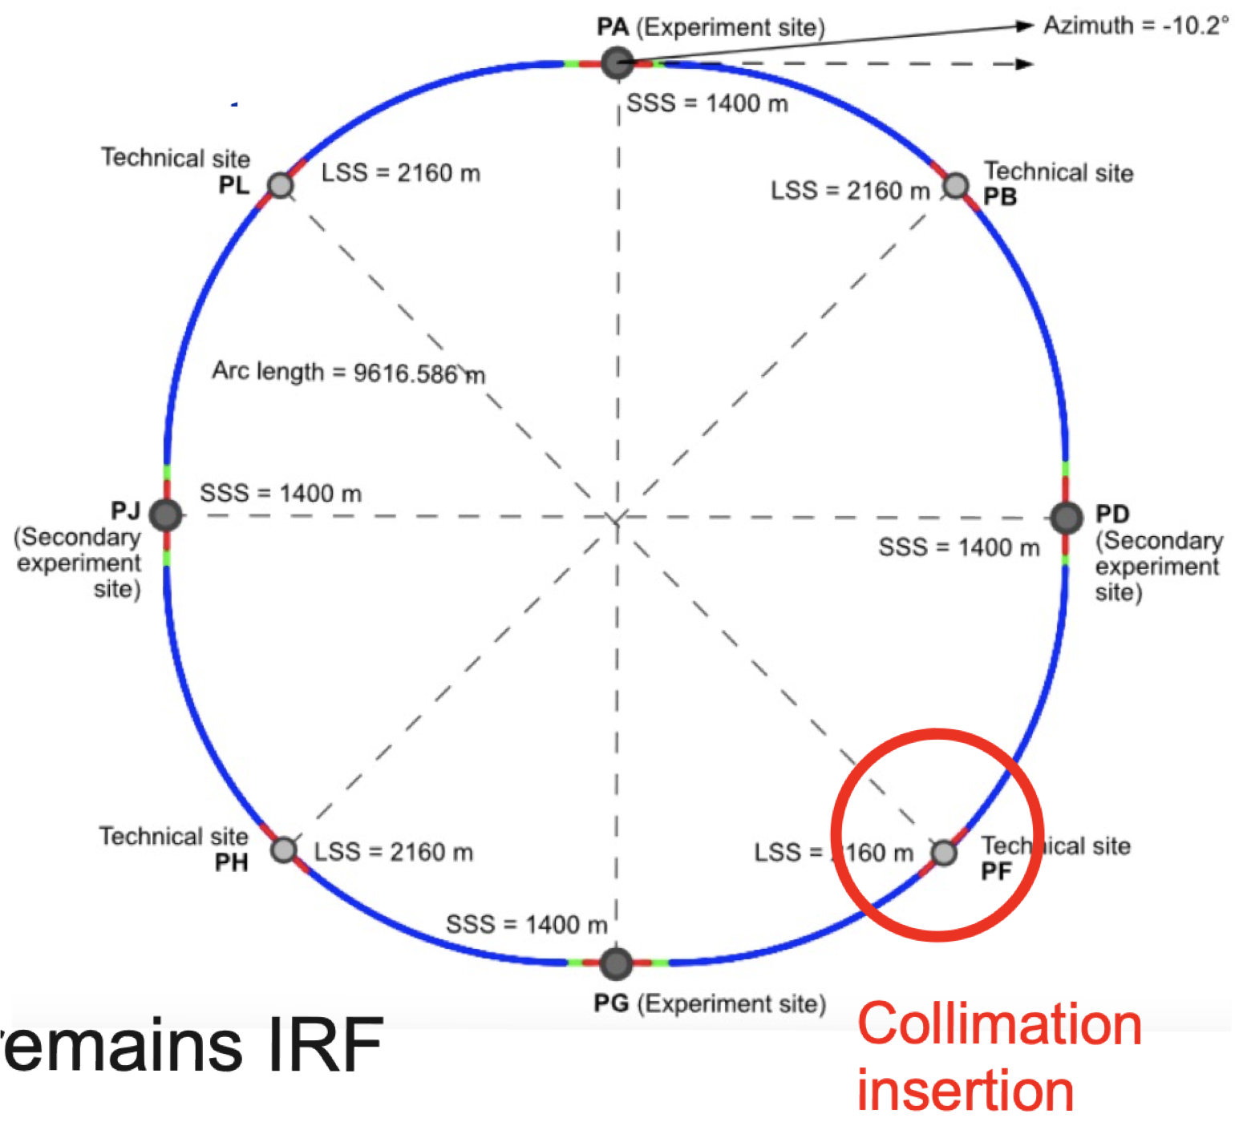
Single beam induced backgrounds
Beam halo collimation scheme protects the IPs from beam losses:
primary/secondary collimators located in PF
tertiary collimators within MDI region - currently under study
Collimators optimization performed using Xsuite/BDSim interface.
Safe values found for beam power losses in the IR.
Unexpected beam lifetime drop may lead to an increase of backgrounds. Work ongoing for loss maps and occupancy estimates production, to be ready for FS report.
Beam-gas (elastic, inelastic), Compton scattering on thermal photons: preliminary studies exist, will be replicated for new beam parameters.

Slide 18
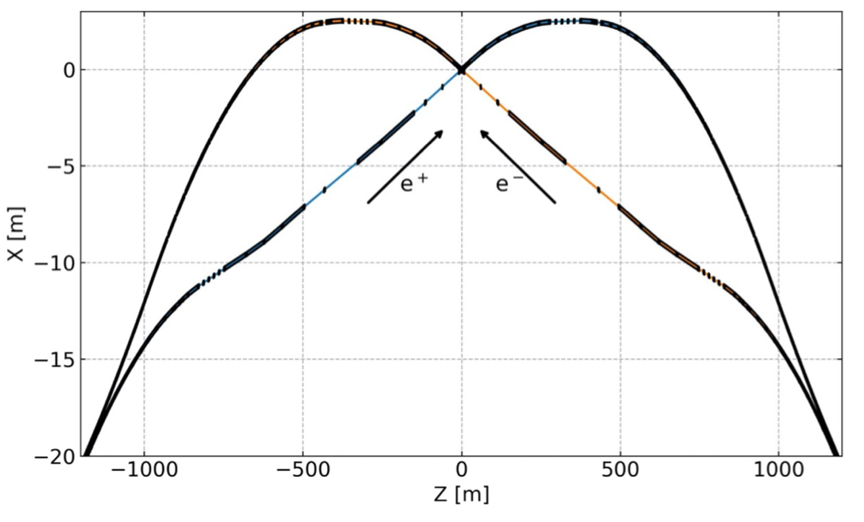
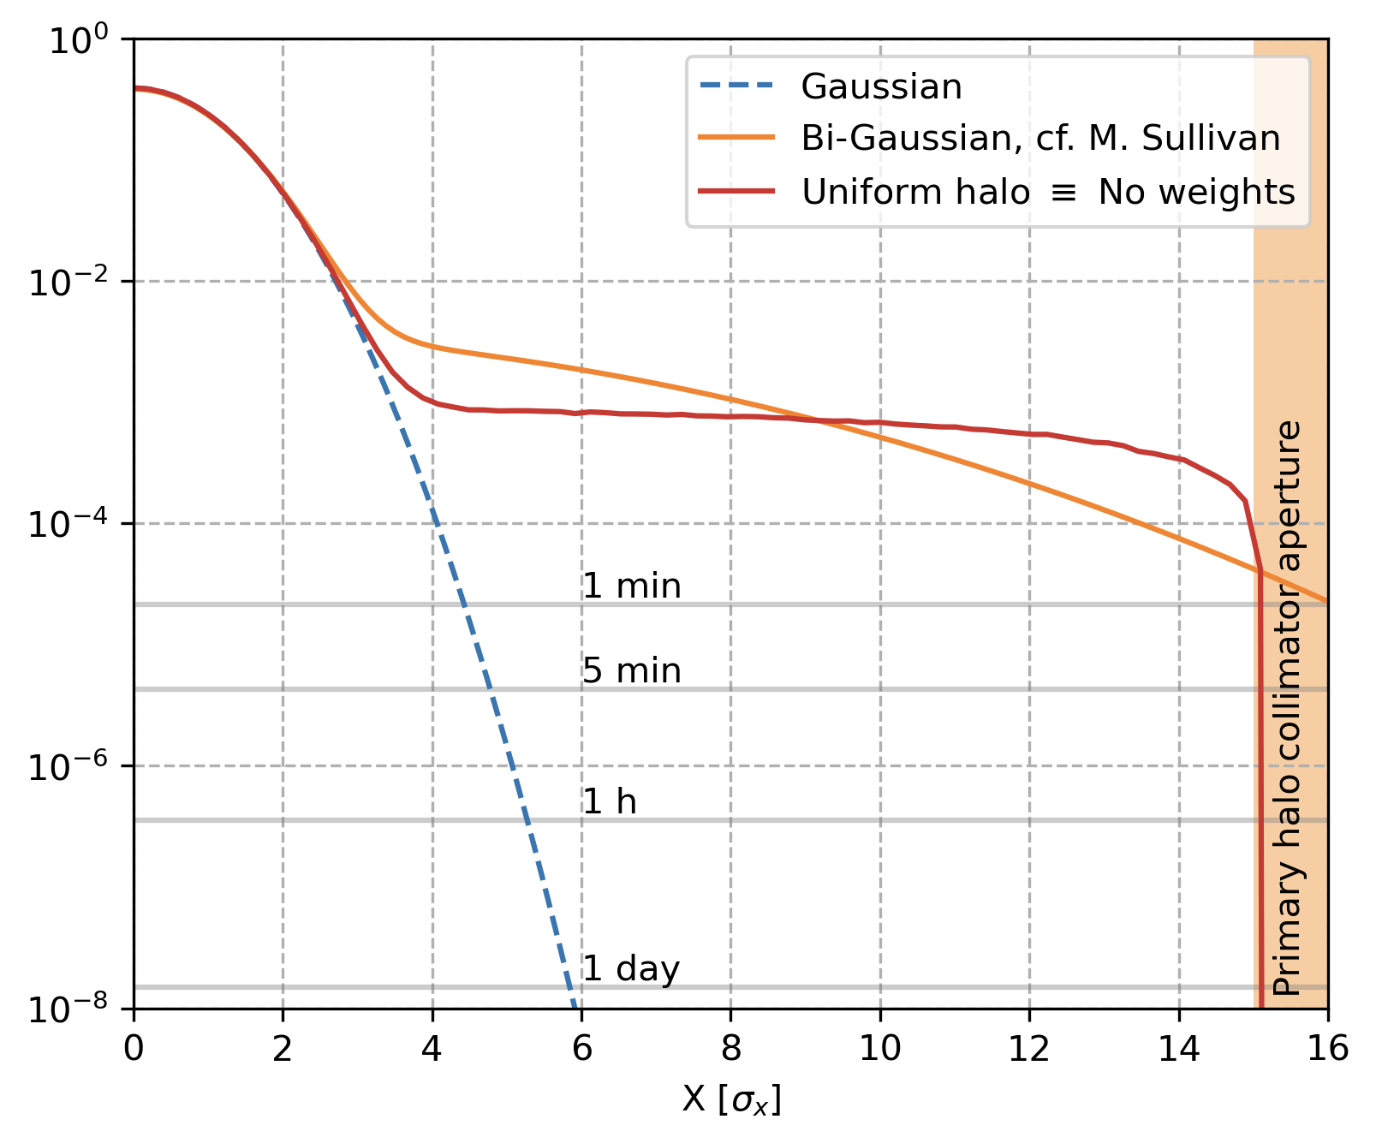
Synchrotron Radiation
SR is the main driver for FCC-ee MDI and lattice design
Asymmetric bend to mitigate SR coming from upstream magnets
Characterization of the SR using Geant4 based tool BDSim
Tungsten SR collimators and masks to protect the IR and absorb radiated power
Asymmetric upstream bends
SR Background coming from the beam core particles is shielded thanks to the tungsten masks. Other contributions currently under study are:
beam halo particles
top-up injection
Characterization of background is essential for dedicated shielding design. This work is ongoing and to be ready for FS report.

Slide 19
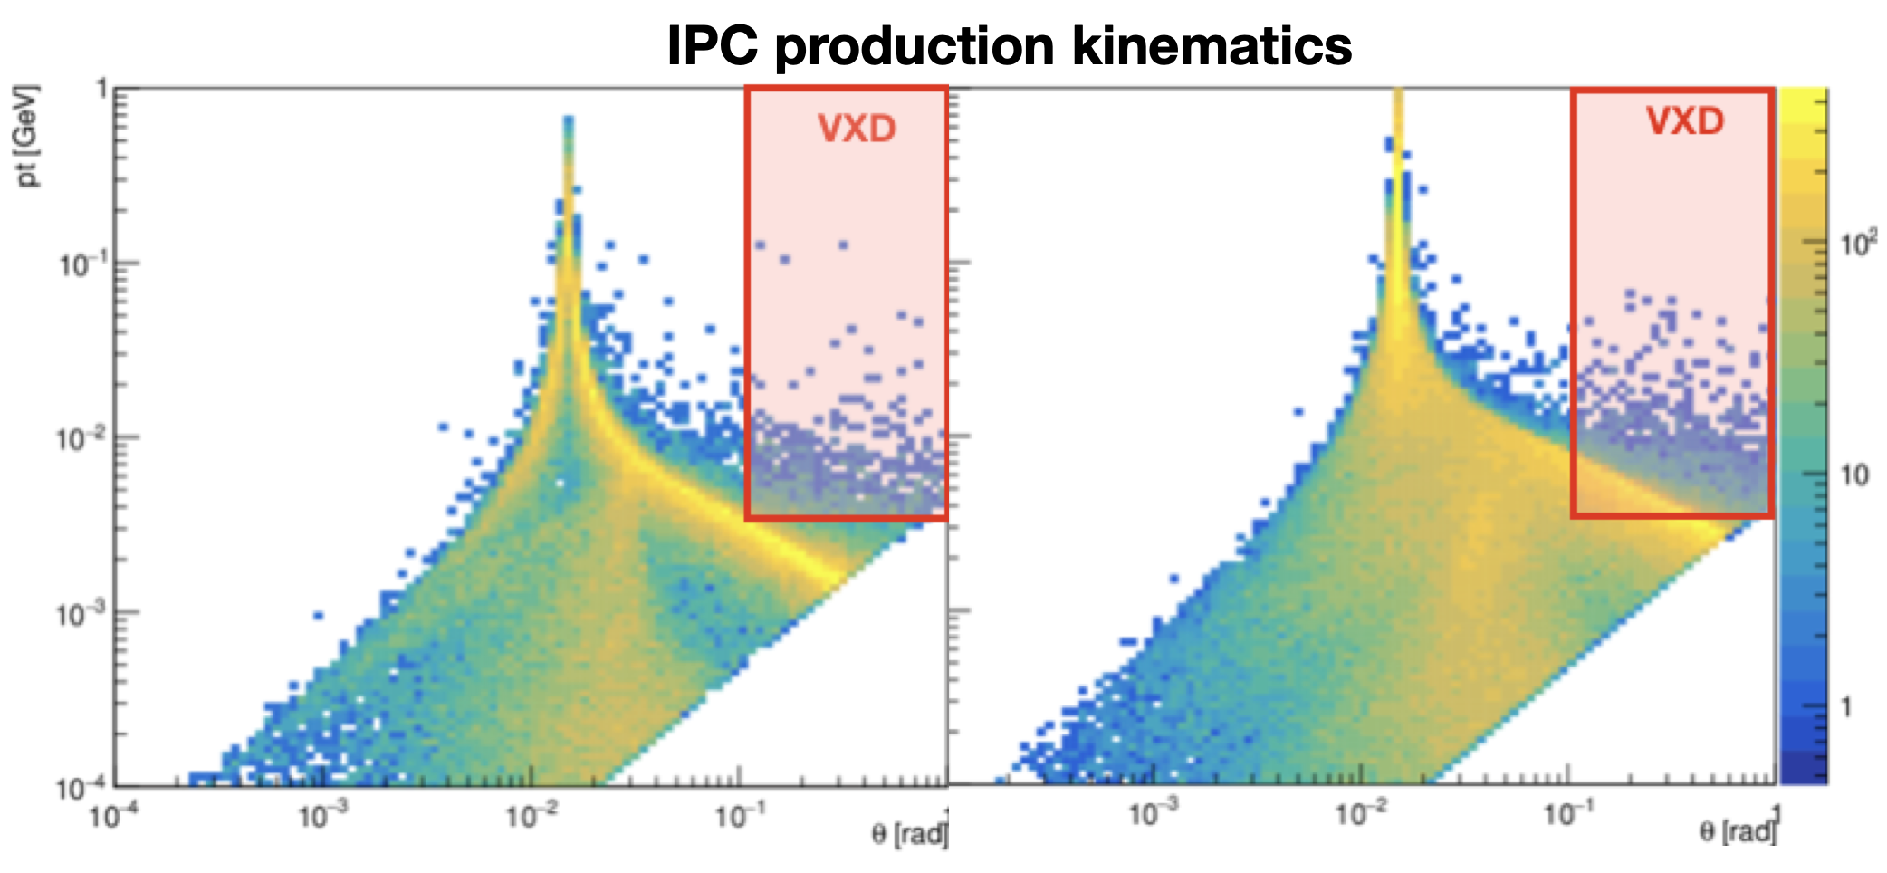
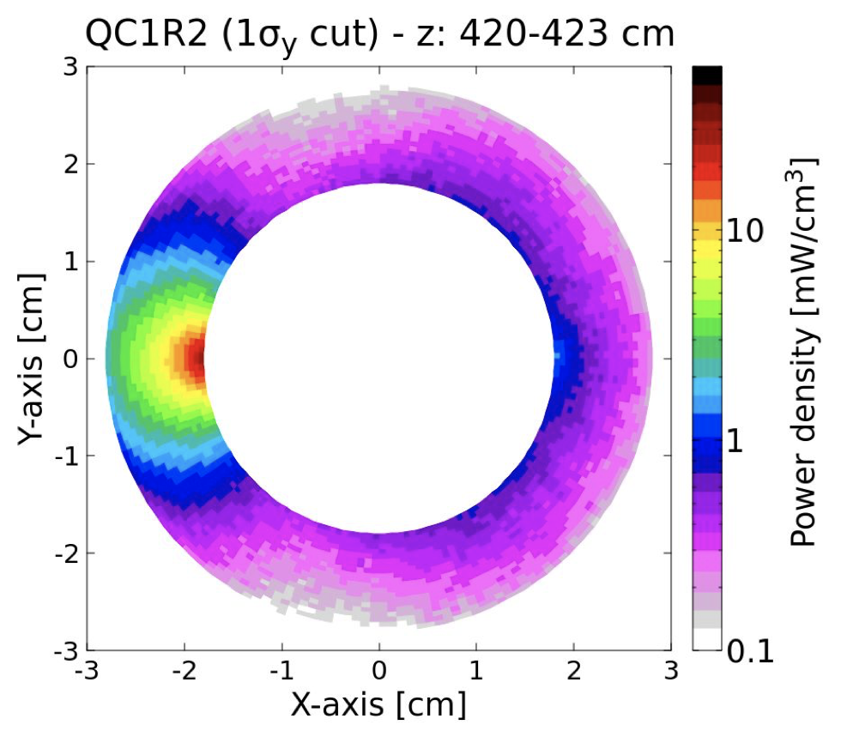
Luminosity Backgrounds
Particles generated directly at the IP during bunch crossing, proportional to the instantaneous luminosity
Incoherent Pairs Creation (GuineaPig ++)
Secondary $e^{+}e^{−}$ pairs produced via the interaction of the beamstrahlung photons at the IP.
Detector acceptance more populated at high energies due to production kinematics
CLD vertex and tracker: occupancy below 1% Ongoing work for IDEA (VTX and DC) and ALLEGRO (EC)
Intense beamstrahlung radiation O(100kW) downstream IPs, dedicated photon dump design in progress.
Z
Top
Power density in QC1L2
Radiative Bhabha (GuineaPig++, BBBREM)
Beam particles radiating energy during bunch crossing can exit the dynamic aperture
Particles lost at downstream Final Focus Quadrupoles may quench the SC elements. - Power deposition studies with Key4hep, BDSIM and FLUKA
Background estimation from local and multi-turn losses ongoing

Slide 20
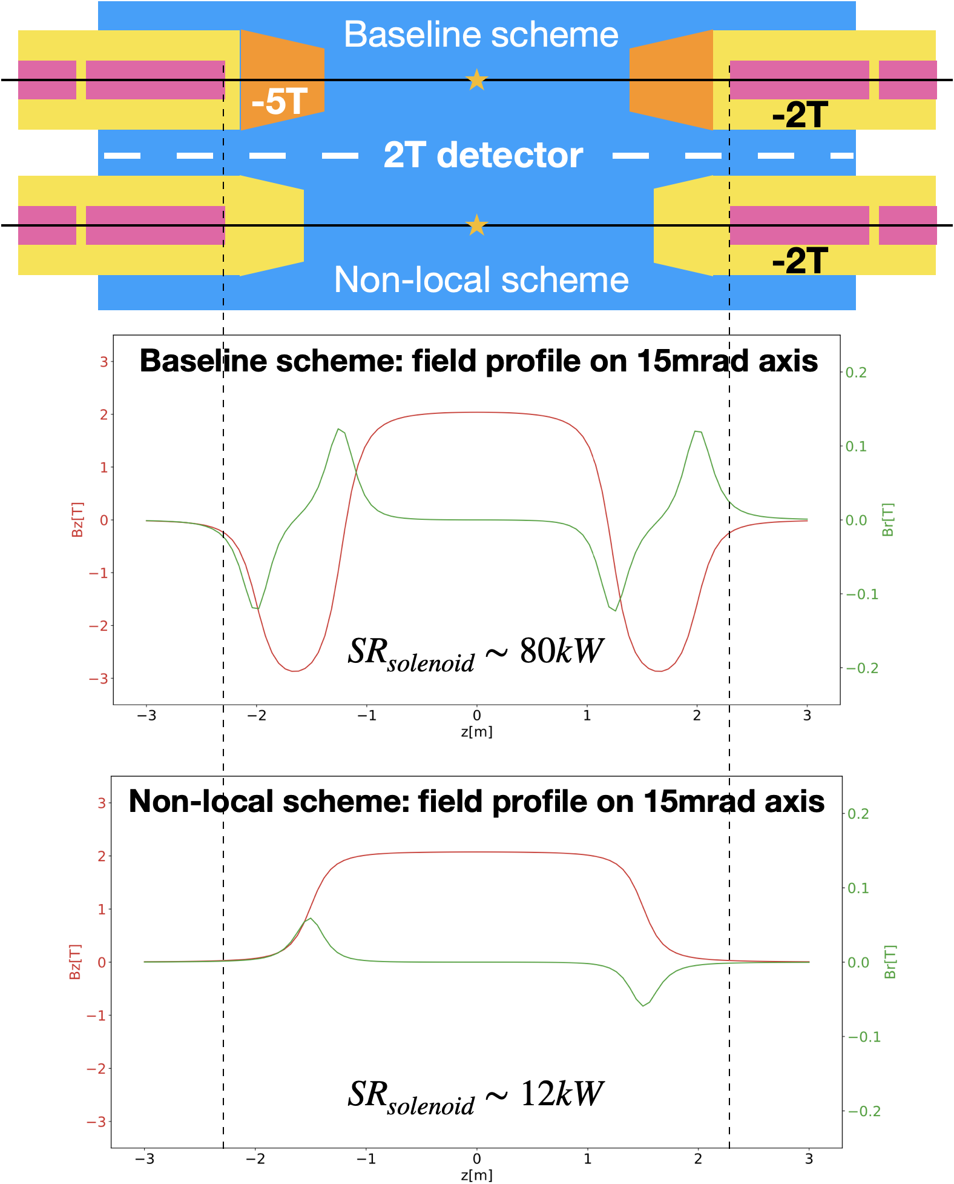
Coupling Correction
Scheme at FCC-ee
The 2T detector solenoids induce coupling in the FCC-ee lattice, causing an increase of vertical emittance $ε_{y}$.
The baseline correction scheme uses:
-5T compensating solenoids to cancel the magnetic field integral
-2T screening solenoids to shield the FFQs from the detector field
A possible alternative non-local correction scheme studied at LNF and proposed by P. Raimondi would allow to remove the compensating solenoids from the IR by adding a skew component to the final focus quadrupoles, similar to DAFNE with KLOE.
Advantages are:
simplified IR and available space
reduction of SR produced at the IR
promising vertical emittance increase mitigation
$${Δε}_{y,coupl}=20\%$$
$${Δε}_{y,coupl}=0.2\%$$

Slide 21
Conclusions
LNF actively contributes to many key activities for the FCC-ee MDI design:
MDI engineered model, following trade-off between Physics and Engineering constraints.
Full-scale IR Mockup to prove the design feasibility.
Beam induced Backgrounds: first occupancy estimates provided, work started for IDEA and ALLEGRO
Study of an alternative solenoid compensation scheme with promising results for vertical emittance growth and SR

Slide 22
Recent and upcoming works
M. Boscolo, F. Palla, F. Bosi, F. Fransesini and S. Lauciani, “Mechanical model for the FCC-ee interaction region”, EPJ Tech. Instrum. 10 (2023) no.1, 16 doi:10.1140/epjti/s40485-023-00103-7
A. Novokhatski, M. Boscolo, F. Fransesini, S. Lauciani and L. Pellegrino, “Estimated heat load and proposed cooling system in the FCC-ee interaction region”, Journal of Physics: Conference Series, Volume 2687, Colliders and other Particle Physics Accelerators DOI 10.1088/1742-6596/2687/2/022031
F. Fransesini, M. Boscolo, P. P. Valentini, S. Lauciani, “Mechanical design of the interaction region of the Future Circular Collider e+e− and support structural optimization”, IL NUOVO CIMENTO C, DOI: 10.1393/ncc/i2024-24119-7
M. Boscolo , A. Ciarma, F. Fransesini, S. Lauciani, F. Bosi, F. Palla, A. Novokhatski, T. Raubenheimer, et. al; “The status of the Interaction region design and machine detector interface of the FCC-ee”, IPAC 2023, Venezia (Italia), https://doi.org/10.18429/JACoW-IPAC2023-MOPA091
M. Boscolo, A. Ciarma, “Characterization of the beamstrahlung radiation at the future high-energy circular collider”, Phys. Rev. Accel. Beams 26, 111002 (2023)
A. Ciarma, G. Ganis, E. Perez, M. Boscolo, “Machine Induced Backgrounds in the FCC-ee MDI Region and Beamstrahlung Radiation”, Proc. 65th ICFA Adv. Beam Dyn. Workshop High Luminosity Circular e+e- Colliders (eeFACT'22)
F. Fransesini, A. Novokhatski, E. Di Pasquale, M. Boscolo, P. P. Valentini, “Mechanical design, structural requirements and optimization of the FCC e+e- interaction region components”, IPAC24 (upcoming)
A. Ciarma, M. Boscolo, H. Burkhardt, P. Raimondi, “Optics design of the solenoid compensation scheme at FCC-ee”, IPAC24 (upcoming)

Slide 27
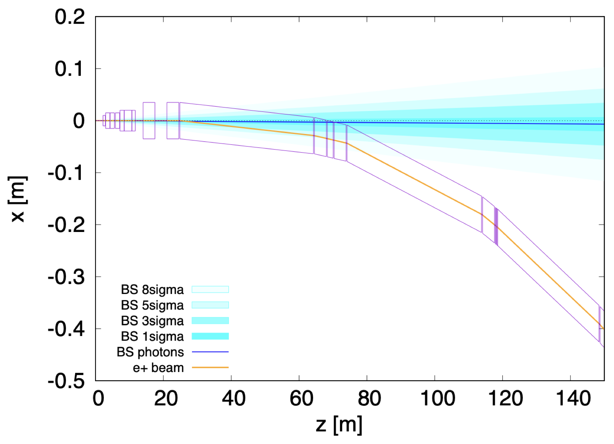
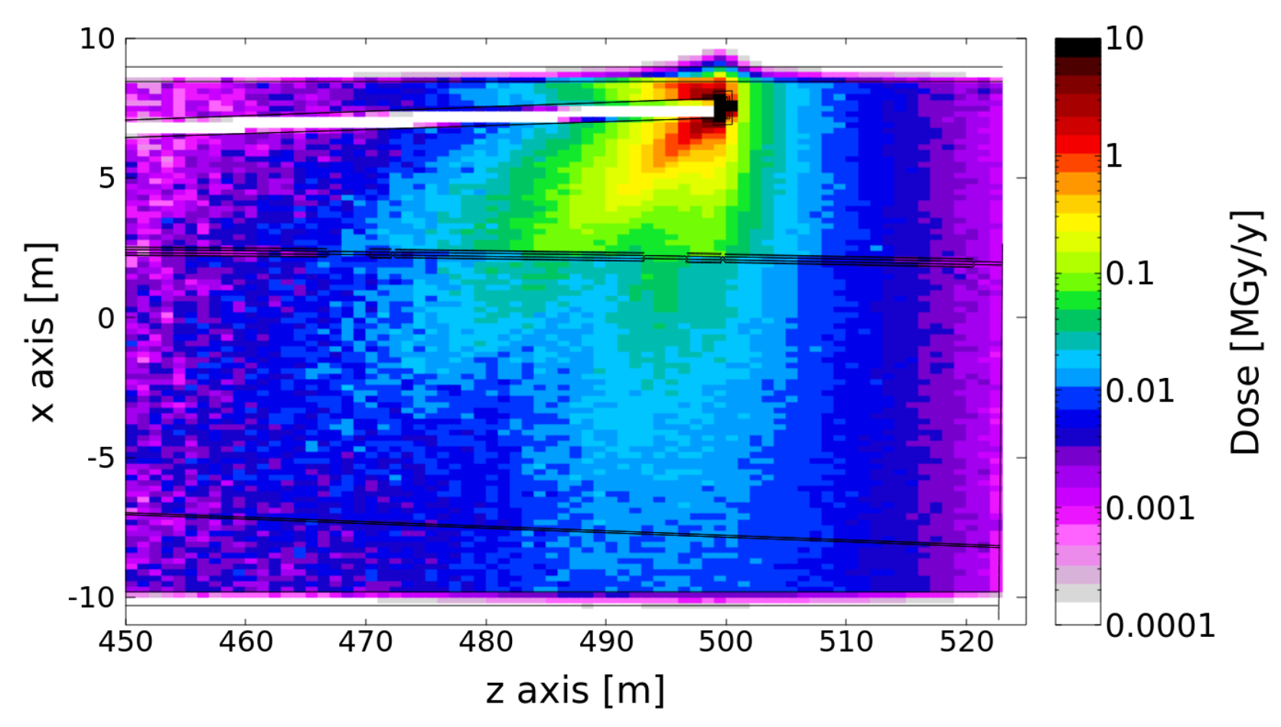
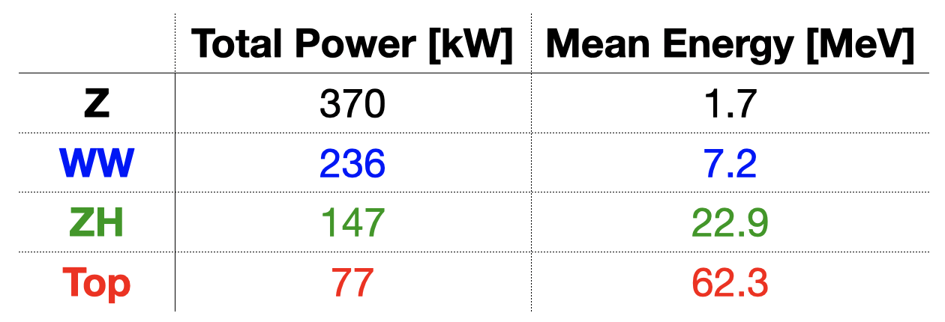
Beamstrahlung radiation characterisation
SR emitted during bunch crossing under the EM field of the opposing bunch.
Extremely intense radiation O(100kW) produced collinear to the outgoing beam.
Dedicated extraction line and photon beam dump for the beamstrahlung photons design currently in progress:
tunnel integration, magnets design, cooling system
liquid lead photon beam dump
FLUKA simulations

