Slide 1


Damping Ring and Transfer Lines for the FCC-ee
pre-Injector Complex
${\text{Simone} \text{Spampinati}}^{a}$, ${\text{Catia} \text{Milardi}}^{a}$, ${\text{Antonio} \text{De} \text{santis}}^{a}$, ${\text{Ozgur} \text{Etiksen}}^{a,b}$
(a) INFN – Laboratori Nazionali di Frascati
(b) Kirikalle University, Turkey
L'INFN e la Strategia Europea per la Fisica delle Particelle 6-7/05/2024
06/05/2024

Slide 2
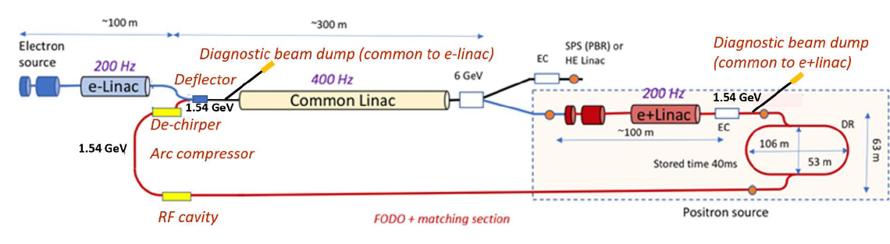
FCC-ee pre-Injector complex layout
This version of the layout has been used as a reference for project feasibility evaluation and cost estimation in the midterm review report
Alternative designs are considered to damp the emittance of both beams
and operate the damping ring at higher energy hence 2.86 GeV
Project structure:
● WP1/2: Electron Source, Electron and Positron Linacs
● WP3: Positron Source: Target and Capture System
● WP4: Damping Ring and Transfer Lines
● WP6: PSI Positron Production (P3) Project

Slide 3
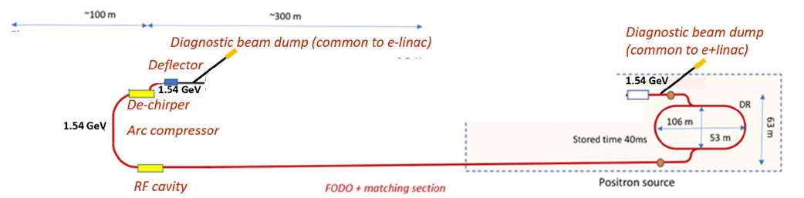
FCC-ee pre-Injector (WP4)
WP4 coordinated by C.Milardi
1) Damping Ring design (coord. C. Milardi)
● A. De Santis, O. Etisken,Y. Dutheil (Injection equipment: septa & kickers)
● CERN collaboration on RF systems.
2) Transfer Lines design (coord. A. De Santis): C. Milardi, S. Spampinati.
3) Energy/Bunch Compression design (coord. S.Spampinati):
● C. Milardi, A. De Santis,
● CERN collaboration (e+ LINAC group)

Slide 4
INJECTOR PARAMETERS
Injector parameters (Z-mode)
4
K. Oide, FCC week 2023 talk
 | SPS | HE Linac | Unit
Injection energy | 6 | 20 | GeV
Bunch charge both species | 4.0* | 4.0* | nC
Repetition rate | 200 | 200 | Hz
Number of bunches | 2 | 2
Bunch spacing | 25 | 25 | ns
Normalized emittance (x, y) (rms) | 10,10 | 10,10 | mm mrad
Bunch length (rms) | ~1 | ~1 | mm
Energy spread (rms) | 0.3 | ~0.1 | %
*Maximum charge to be injected into the collider rings 4 nC (bunch pop. 2.5x10¹⁰ particles)
Target bunch length and energy spread at the linac end, TL from HE linac to booster will include an energy compression (and bunch decompression)
The bunch by bunch intensity will arbitrarily vary from 0 to 100%, depending on the intensity balance between the collider rings
Bunch-by-bunch intensity fluctuation: 5% (Z mode), 3% (WW, ZH, tt)
Notes:
In this table the main parameters are summarized. They are the specifications for the Injector design needed for the Z-mode.
The nominal and maximum charge to be injected into the collider is 4 nC.
In order to meet the specification during the filling from scracth and for the top up, 2 bunches at 200 Hz are requested.
We considered a bunch spacing of 25 ns to estimate the long range wakefield in the linacs.
A normailzed emittance of 10x10 mm mrad and a target bunch length and energy spread at the linac end of 1 mm and 0.1%.
Read the slide
For the injection into the SPS the specifications are the same apart a more relaxed energy spread.

Slide 5
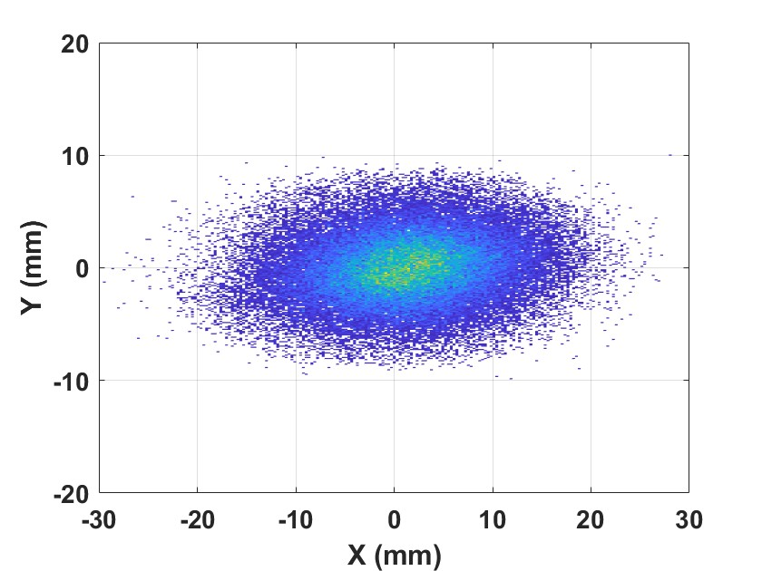
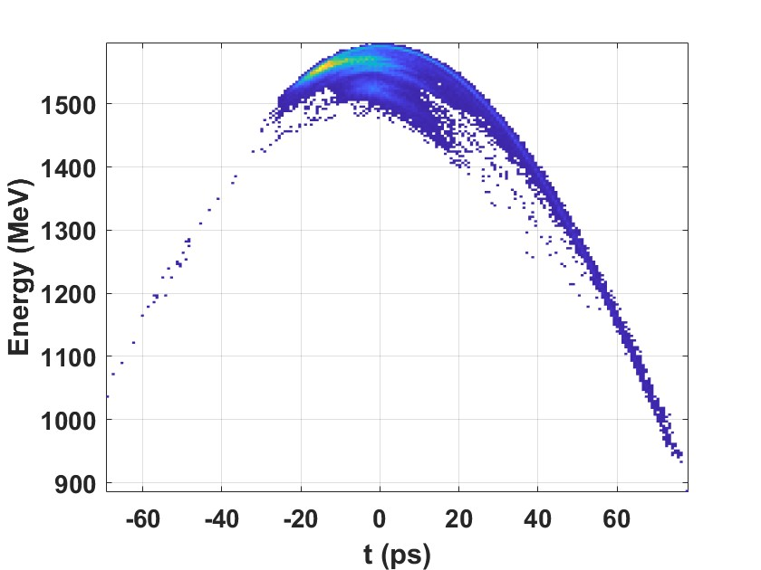
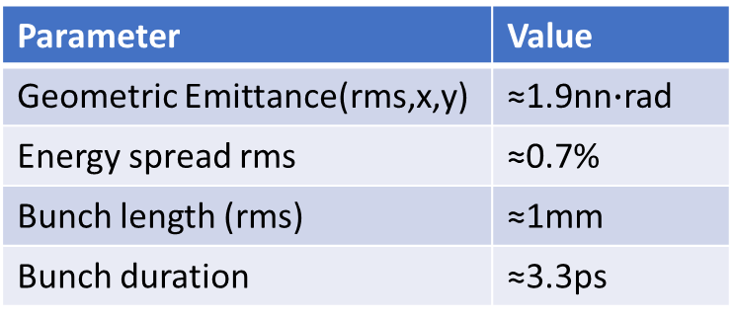
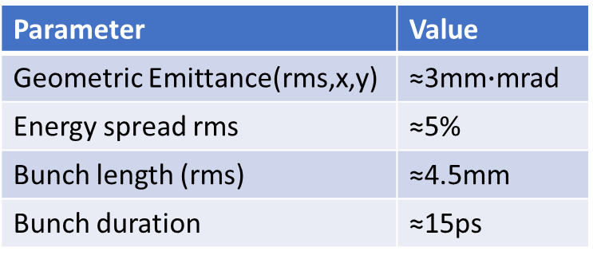
Positron damping ring system (WP4) purposes
Positron beam at the positron linac exit (1.54Gev)
Parameter | Value
Geometric Emittance(rms,x,y) | ≈3mm$∙$mrad
Energy spread rms | ≈5%
Bunch length (rms) | ≈4.5mm
Bunch duration | ≈15ps
Nominal parameters at the entrance of the common linac (1.54Gev)
Parameter | Value
Geometric Emittance(rms,x,y) | ≈1.9nn$∙$rad
Energy spread rms | ≈0.7%
Bunch length (rms) | ≈1mm
Bunch duration | ≈3.3ps
Damping ring
Bunch compressor

Slide 6
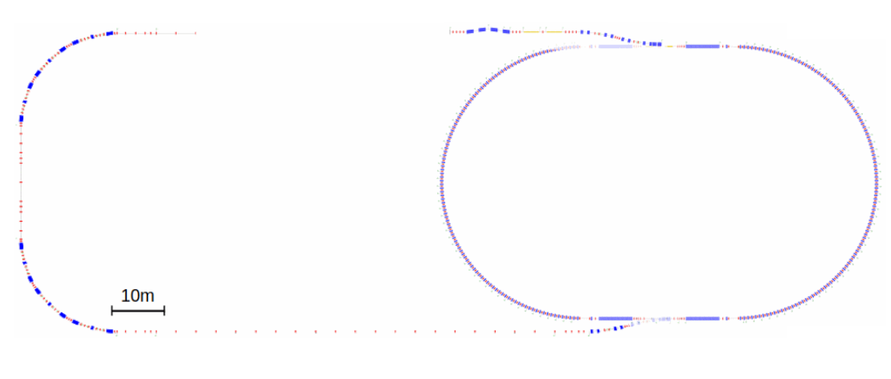
Positron damping ring system (WP4)design status
pTLi: positron transfer line injection in DR
cBD: common diagnostic Beam Damp
pBD: positron diagnostic Beam Damp
pDR: positron Damping Ring
pTLe: positron transfer line extraction from DR

Slide 7
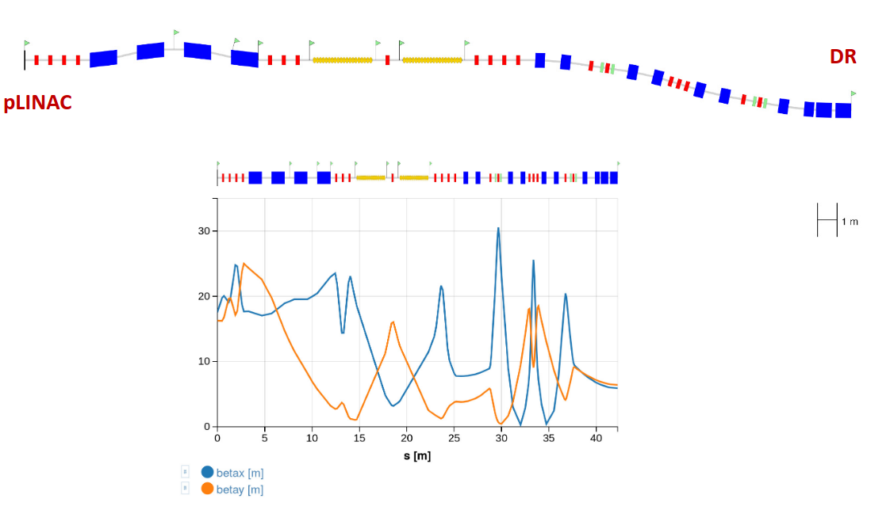

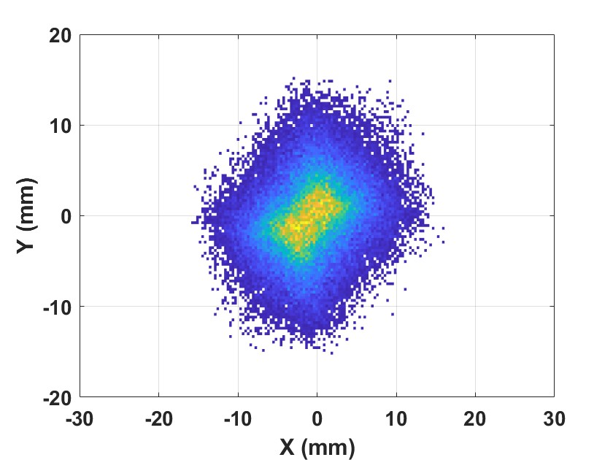
Transfer lines pLINAC - DR
Transverse emittance is preserved in both planes

Slide 8
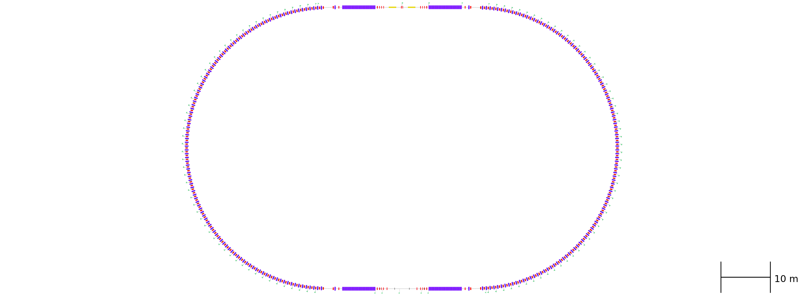
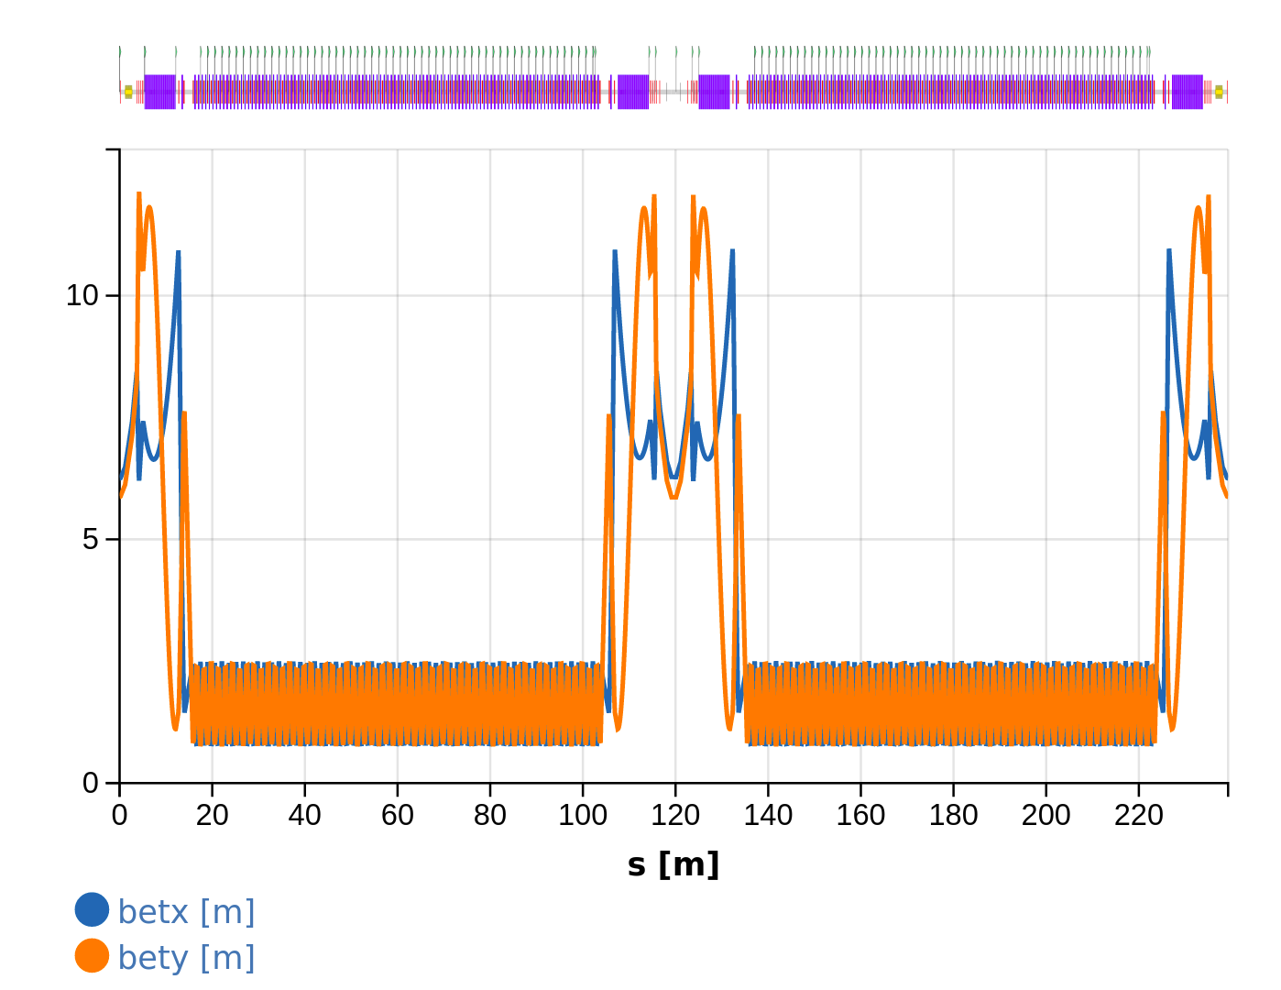
Positron damping ring layout
Parameter | FCC_ee DR
Circumference | 239.2 m
Harmonic number | 319
Eq. Emittance (x/y/z) | 0.96 nm/ - / 1.46 mm
Dipole length, Field | 0.21 m, 0.66 T
Wiggler #,Lenght, Field | 4, 6.64 m, 1.8 T
Cavity #, Lenght, Voltage | 2, 1.5 m, 4 MV
Bunch stored #, charge | 18 , 4.0 nC
Damping Time (x/y/z) | 10.8 / 10.8 / 5.4 ms
Store Time | 42.5 ms
Energy loss per turn | 0.227 MV
SR Power Loss (WGL ) | 15.7 kW
Current DR shopping list:
232 BEND (21 cm each) in the arcs
258 QUADRUPOLE (20 cm each mostly in the arcs)
232 SEXTUPOLE (8 cm each mostly in the arcs)
4 WIGGLER (6.7 m each: 44 poles of 5 cm each)
2 Straight section hosting RF Cavity and Injection/Extraction equipments

Slide 9
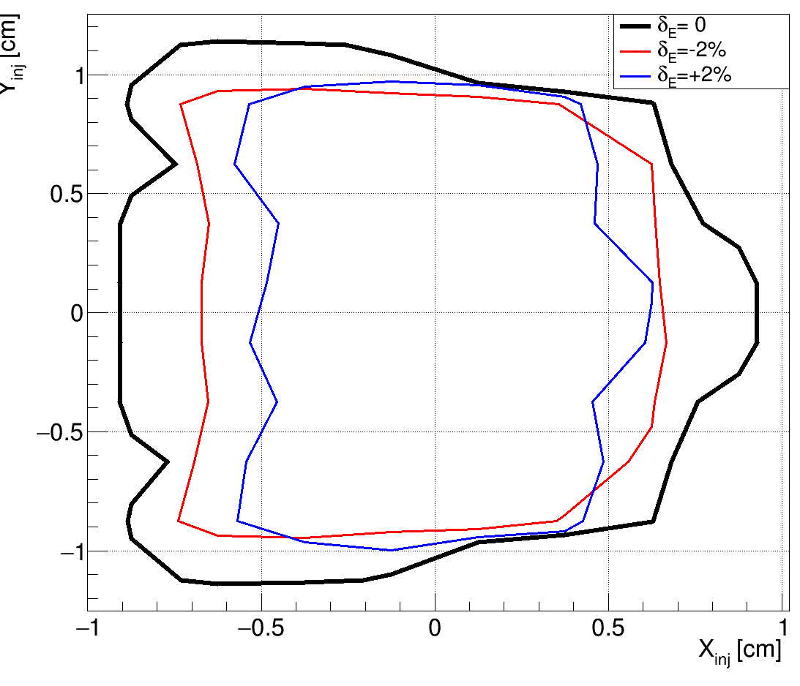
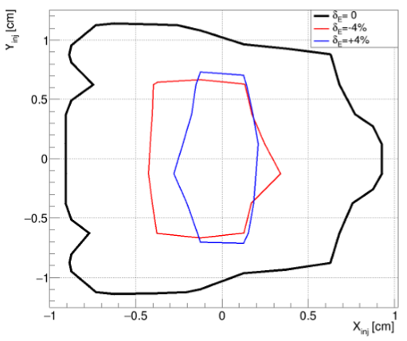
DR dynamical aperture
Tracking has been performed with PTC (MAD-X interface) over ~15% damping time neglecting radiation damping. The estimated loss of accuracy is below 1% at the nominal energy.
The stability region in the transverse plane has been evaluated for different energy
deviations. Contours represent regions where >90% of the initial conditions lead to
successful tracking
The transverse stable region is shown for the nominal beam energy (1.54 GeV - black) and for ±2%(left), ±4%(right) energy relative deviation (blue and blue). The stable region is kept quite constant within 2% energy spread. It shrinks significantly for higher deviations

Slide 10
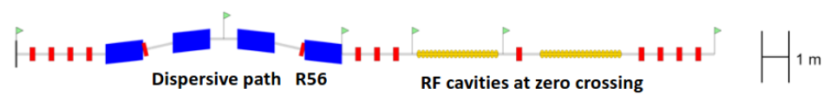
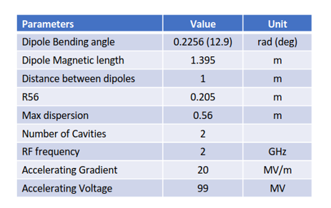
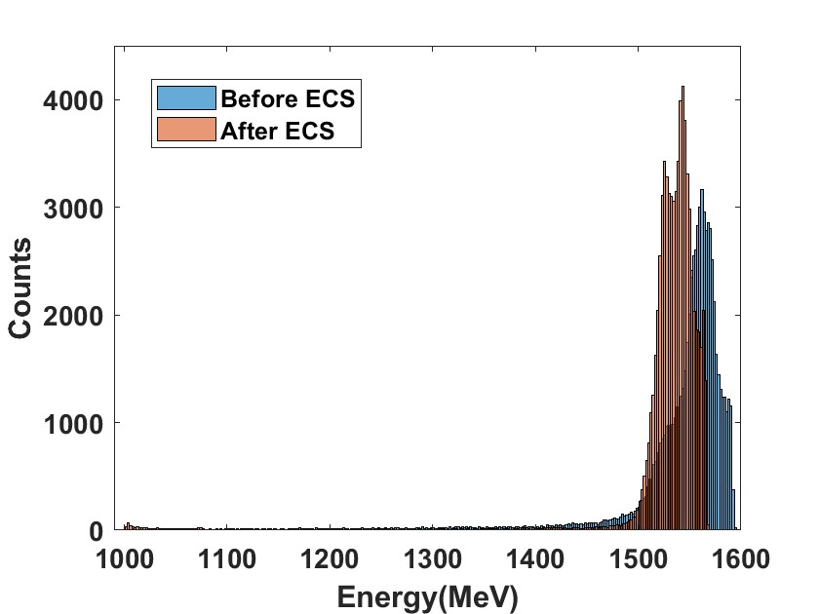
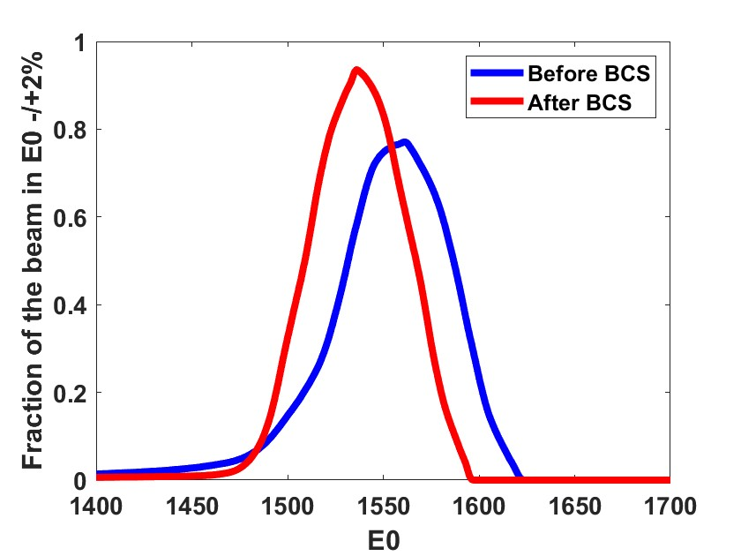
Energy compressor
The aim of the energy compressor is to maximize the number of particles accepted in energy by the DR ( 1.54 -/+ 2% )
A four-bending C-shape chicane. Dispersion and second order dispersion closed by symmetry.
Two cavities of the type used for the positron LINAC ( LINAC 2022) THPOJO08)
Energy distribution
Beam fraction in E0-/+2%

Slide 11
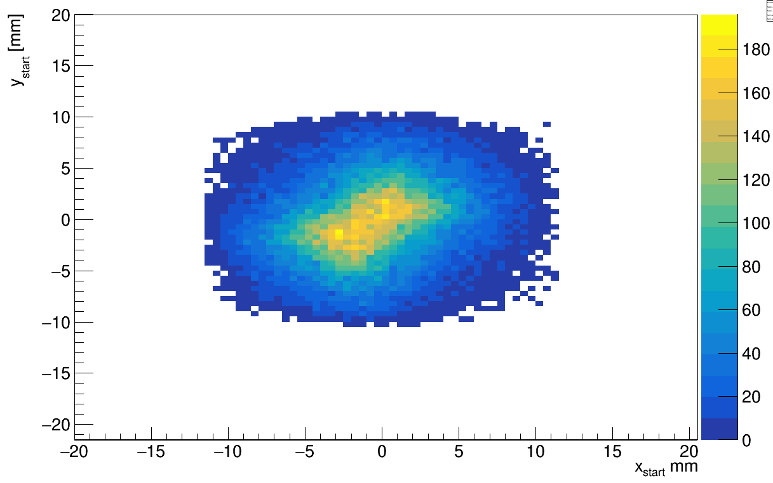
pDR acceptance of the pLINAC particles
Particle beam beam prepared with a start-to-end simulation. Positron linac simulated with RF_TRACK. Energy compressor and injection TF are simulated with elegant
DR acceptance: Survived particles at 10k turns (PTC-MADX): 59794/71800 = 83%
The picture shows the transverse distribution of the survived particles according to their positions at e+ linac exit.
The coordinate of the dead particles can be used to study a possible reduction and collimation of the positron beam coming from the source

Slide 12
Damping ring collective effects
A parametric estimate of DR (current optics/layout) collective effects has been done
No major limitations are expected from longitudinal micro-wave inst. (LMI),
transverse mode coupling instability (TMCI), and coherent synchrotron radiation
(CSR)
• Analytical estimate of the power emitted by SR in the DR.
• FII must be further investigated
• SC-induced tune shift might be an issue
The simulations of e-cloud build-up and instability have started. Simulation of the e-cloud build-up in the DR bending with several patterns considering the actual layout and optics of the damping ring
e-cloud simulation strategies are under testing using DAFNE e+ beam that is the only positron beam in Europe. Measurements have already been taken. This activity will be reported at IPAC 2024 in the contribution WPR008

Slide 13
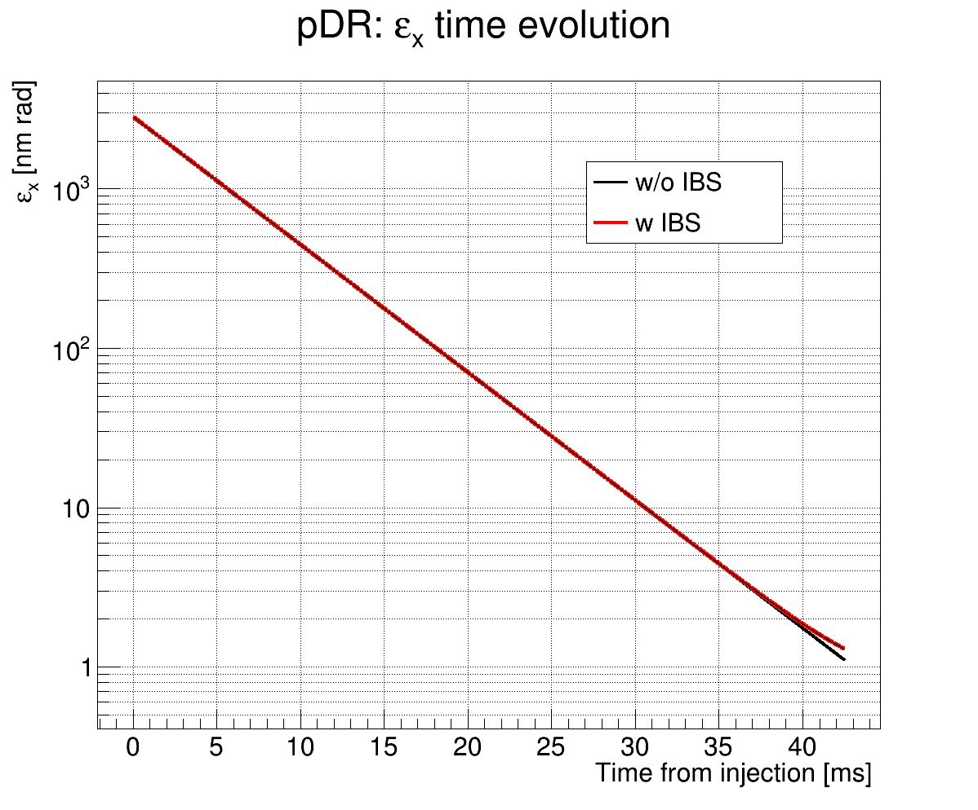
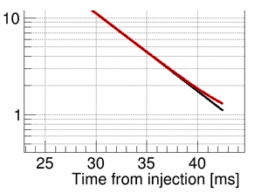

Transverse Emittance evolution in the DR icluding IBS
The transverse emittance in the damping ring is reduced by three orders of magnitude
The initial emittance is ≈3 mm mrad in both planes
The final emittance are ex= 1.29 nm rad, ey= 1.03 nm rad
Emittance dilution from IBS ≈30%. Evaluated with a MAD-X module for a 4pC bunch

Slide 14
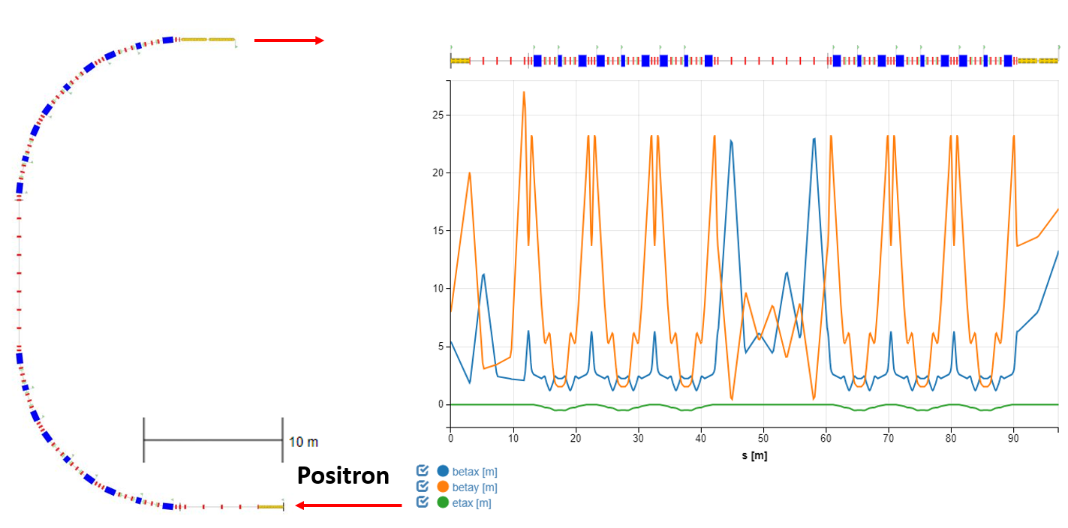
Positron bunch compressor
Six cells
Total R56 =0.40m
π horizontal phase advance between cell 3 and 4, small H in the cells
Sextupoles in the cells: second order disersion compensation and phase space linearization
One cavity to chirp the beam. Accelerating voltage 54 MV (70.5MV available)
Two cavities to remove part of the chirp. Accelerating voltage 110 MV (max140MV)
π phase advance (x)

Slide 15
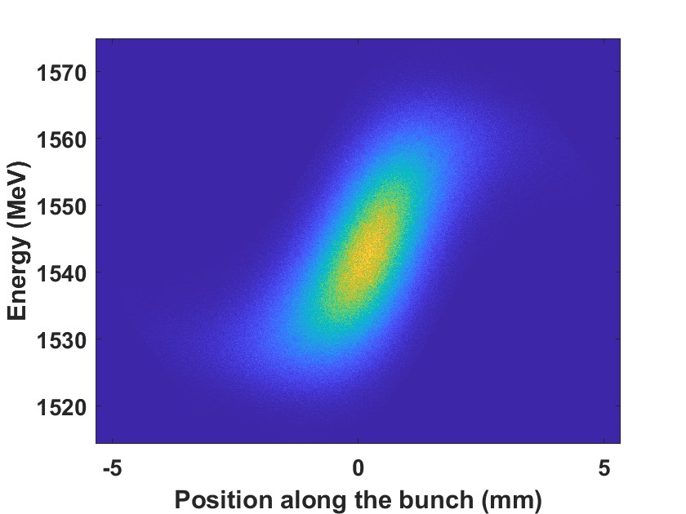
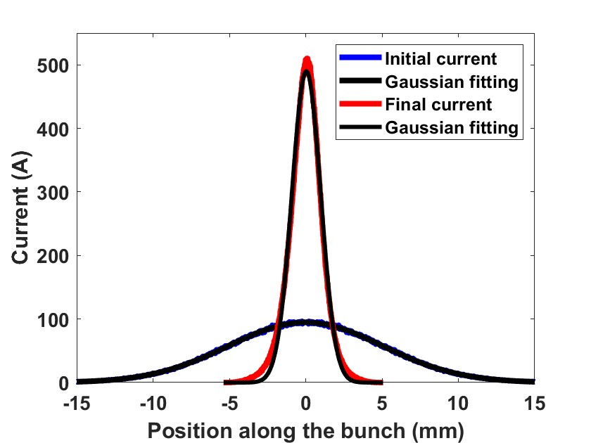
Bunch compressor performances
Bunch compressor performance evaluated with simulation with the code elegant. 1D CSR module, 4M macroparticle.
The compression preserves with good approximation the Gaussian current profile
Phase space dominated by the linear chirp and uncorrelated energy spread
Final rms bunch length ≈ 1.0 mm Compression factor≈5
energy spread 6.5*10^- 3.
Emittance dilution <4% horizontal and <3% vertical
Phase space
Current profile

Slide 16
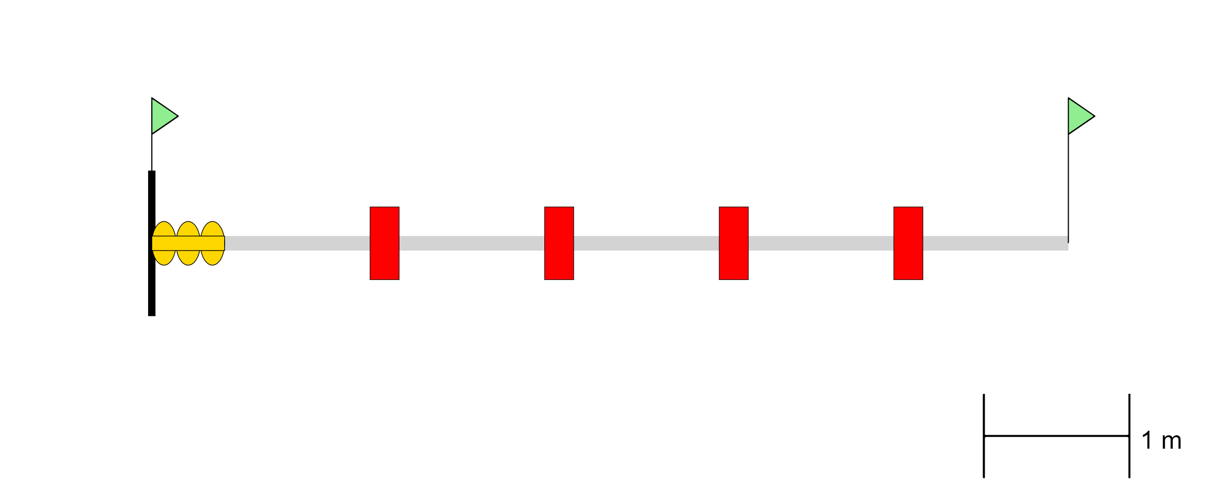
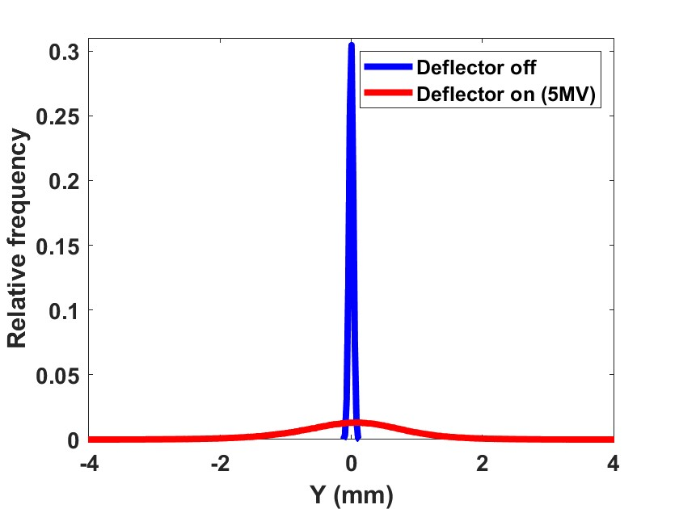
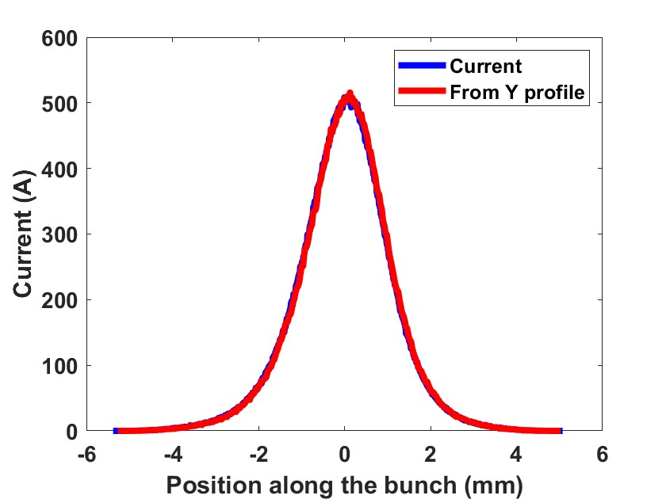
Longitudinal Beam Diagnostics
Deflector length 0.5m
Deflecting voltage 5MV ( 2.8GhZ)
Non-deflected beam Sigma y= 31 μm
Deflected beam sigma y= 877 μm
Rms bunch length reconstructed from y profile 1.07 mm instead of 1.08 mm (0.94 mm from gaussian fit)
RF Deflecting cavity
Quadrupoles
Screen
D
Vertical profile on the screen
Beam current profile

Slide 17
Costs estimation
An estimation of the cost of the systems included in the WP4 has been prepared for the injector baseline
The present design has been used to estimate the costs
The total cost for the systems included in the WP4 is esteemed in 67 MCHF
The esteem of the cost of the damping ring is 43 MCHF
The esteem of the cost of the bunch compressor is 8.8 MCHF
The esteem of the cost of the energy compressor is 2.2 MCHF
The remaining 13MCHF for the FODOs, the MATCHING sections and the diagnostic sections

Slide 18
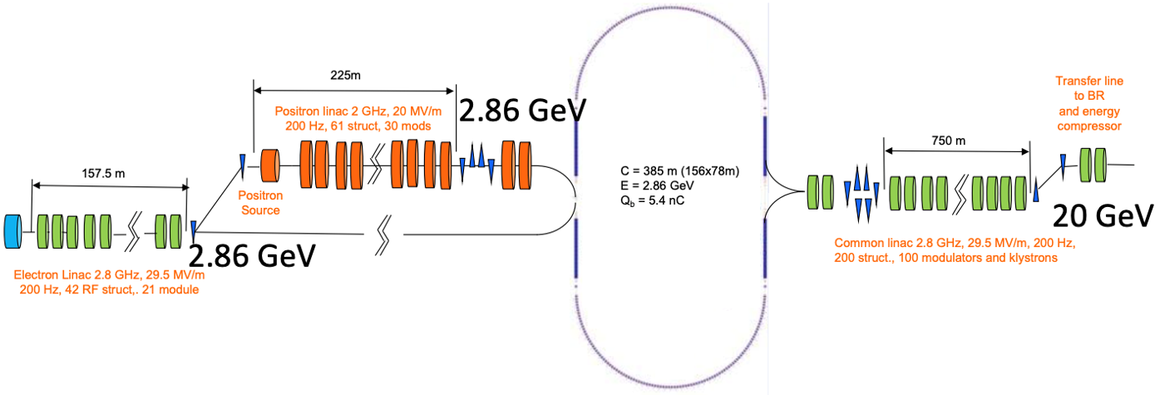
HI
High-energy damping ring design
18
The present positron yield would allow positrons to be generated at a lower electron beam energy.
Common linac: Rep rate 200 Hz instead of 400 Hz less average rf power, higher accelerating gradient, shorter linac.
Dedicated linac for electron and positron
Overall, the cost is expected to remain under control, we are also planning to replace SC RF cavity with NC type
Notes:
C = 242 m, 106 x 53 m
C = 385 m, 156 x 78 m, factor 385/242 = 1.47
Electron linac and HE linac: 34.8 + 180.1 = 214.9 MCHF (-26.85 MCHF)
Positron linac: 51.44 MCHF (+19.44 MCHF)
Damping ring 72.38 MCHF (+26.78 MCHF)
Transfer lines: 11.4 MCHF (-15.2 CHF)
Reduction (hardware): 1.48 MCHF

Slide 19
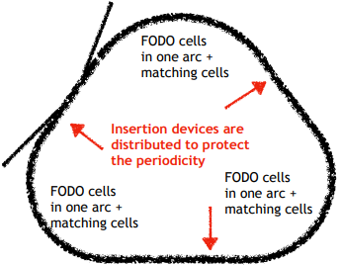
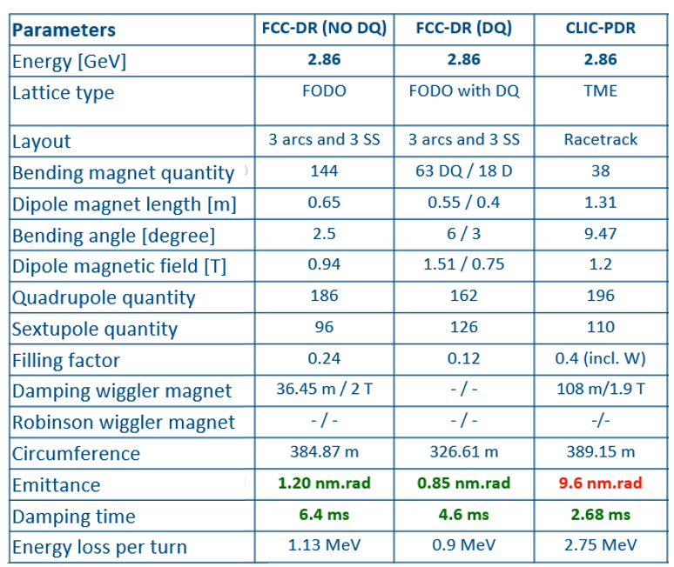
High-energy damping ring design
Two options are considered
The design of the FCC DR is composed of 3 arcs and 3 straight sections
FCC-DR (NO DQ)
Arcs consist of 16 FODO cells and each of the straight sections has 5 FODO cells
Arcs consist of 21 cells and each of the straight sections has 6 FODO cells
FCC-DR (DQ)
Arcs has 6 FODO cell
consist of 21 cells and each of the straight sections
FCC-DR (DQ)

Slide 20
Conclusions
DR and TLs design has been completed
A DR acceptance larger than 80% can be achieved with the help of an ECS installed between the pLINAC and the DR injection line.
A BCS, that can provide maximum compression factor C ~ 5, has been included in the return line from the DR to Common LINAC.
A list of the components used for the different parts and a cost evaluation has been prepared
Evaluation of collective effects ongoing. e-cloud simulation strategies are under testing using DAFNE e+. DAFNE could be used as a test facility. DAFNE as a possible test bench for FCC-ee, C.Milardi, F Zimmerman, FCCIS 2023 WP2 Workshop, Rome
Alternative DR designs are being considered. Now the focus is on a design based on a damping ring at a higher enrgy

Slide 21


Acknowledgment
Many thanks to all the Colleagues of the FCC-ee pre-Injector Collaboration
This work was done under the auspices of CHART (Swiss Accelerator Research and Technology) Collaboration, https://chart.ch
FCCIS: 'This project has received funding from the European Union's Horizon 2020 research and innovation program under the European Union's Horizon 2020 research and innovation program under grant agreement No 951754.'

Slide 22
Feedback from Mid-term review
Main Recommendation: optimize the Injector, especially the linac design and subsequently adjust Technical Infrastructure cost for length and power density
Mitigation of the potential risk due to the common linac operating at 400 Hz
  Reducing the gradients and thus the dissipated rf power – thermo-mechanical simulations to evaluate the cooling system for the rf structures and prototype phase for klystrons, HV modulators and RF structures → common linac at 400 Hz
  Use a DR at higher energy to avoid to accelerate electron and positron bunches in the common linac during positron production → common linac at 200 Hz
Overall reduction of the repetition rate
  considering the option of using four bunches in the injector to reduce the repetition rate from 200/400 Hz to 100/200Hz.
      with DR at higher energy repetition rate 100 Hz!

Slide 23
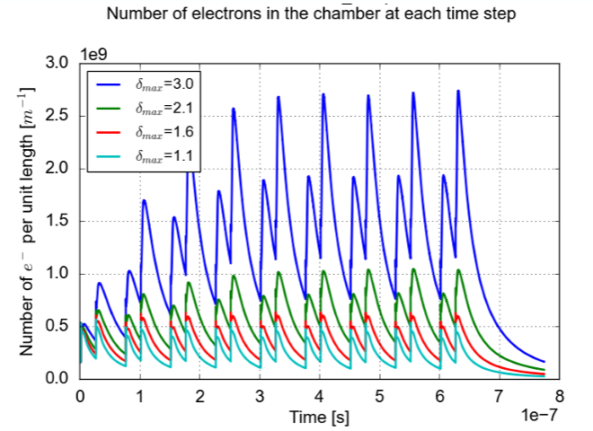
e-CLOUD in the DR
Simulations have been performed for the dipole magnet of the current damping
ring design.
E-cloud build up formation for different SEY curve maximum values.

Slide 24
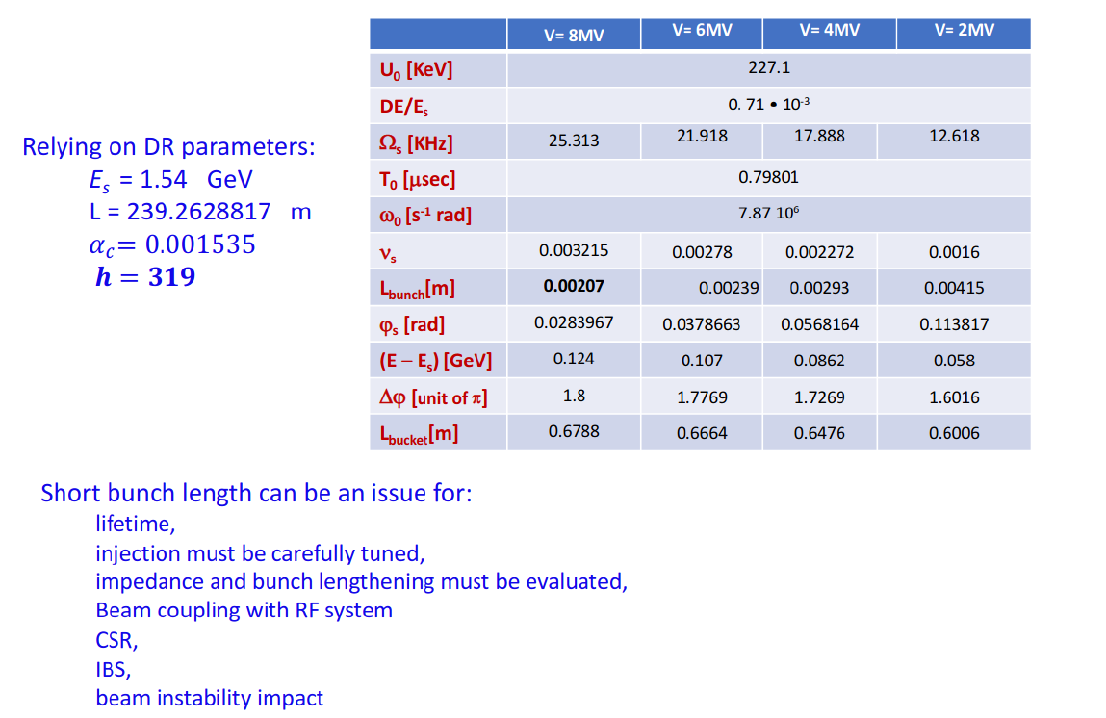
DR dynamic parameter

Slide 25
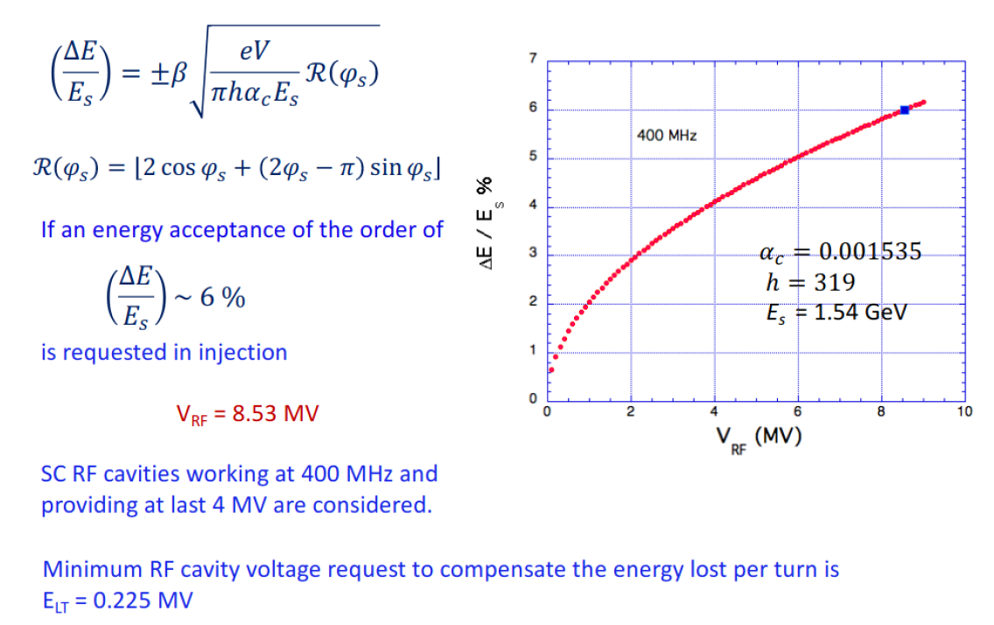
Energy acceptance

Slide 26
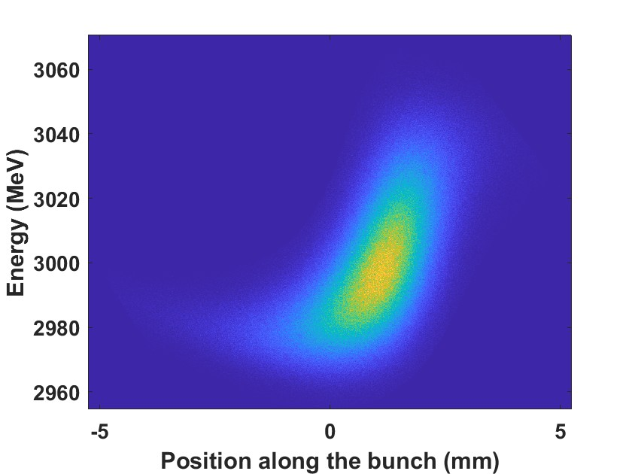
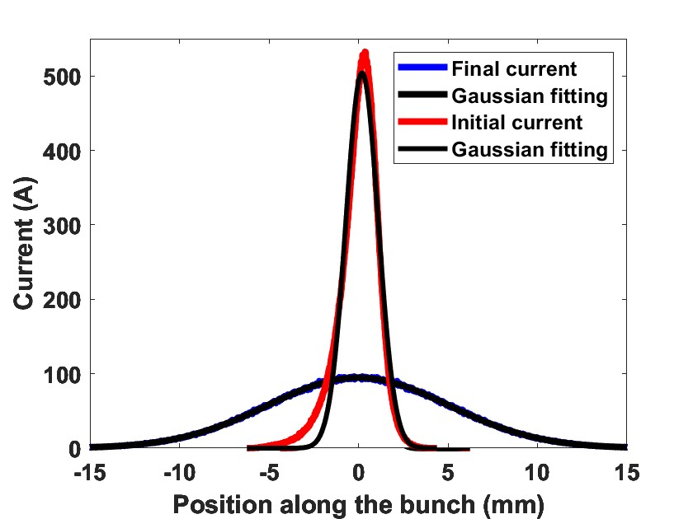
Linearization with sextupoles
Sextupoles optimized to cancel second-order dispersion
Sextupoles at zero

Slide 27
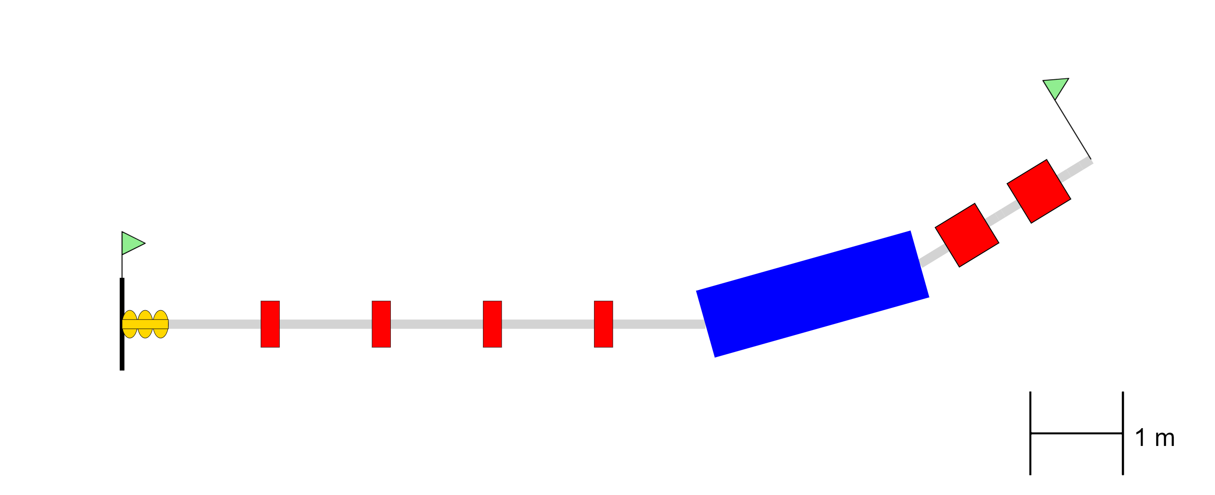

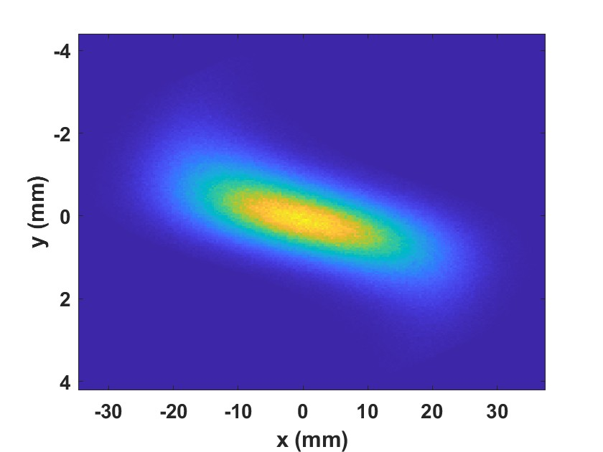
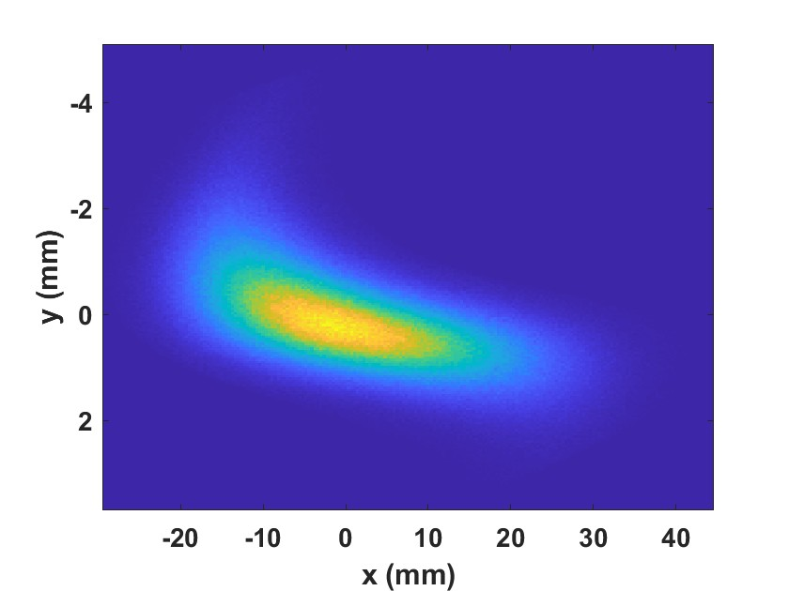
Phase space Beam diagnostics in the DBD
Transverse distribution on screen∝ Phase space
Sextupoles on
Sextupoles off

Slide 28
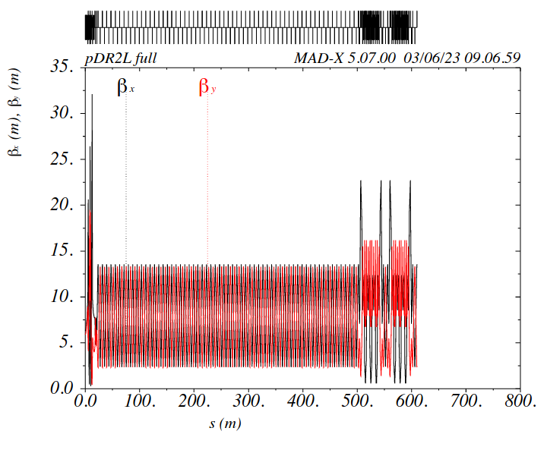
pTLe: Extraction transfer line
TBA
FODO

