Slide 1
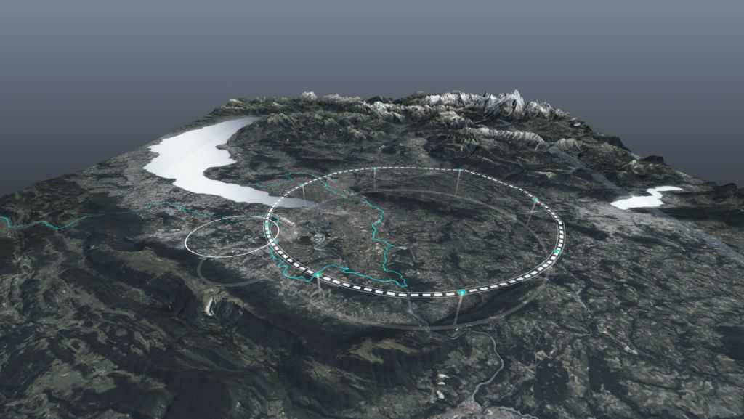









Status of the FCC Feasibility Study
L’INFN e la Strategia Europea per la Fisica delle Particelle, 7 May 2024
Michael Benedikt, CERN
on behalf of FCC collaboration
http://cern.ch/fcc
Work supported by the European Commission under the HORIZON 2020 projects EuroCirCol, grant agreement 654305; EASITrain, grant agreement no. 764879; iFAST, grant agreement 101004730, FCCIS, grant agreement 951754; E-JADE, contract no. 645479; EAJADE, contract number 101086276; and by the Swiss CHART program
photo: J. Wenninger

Slide 2

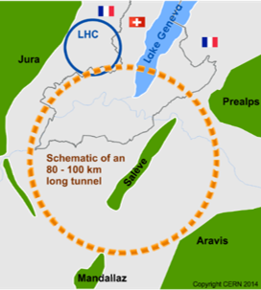
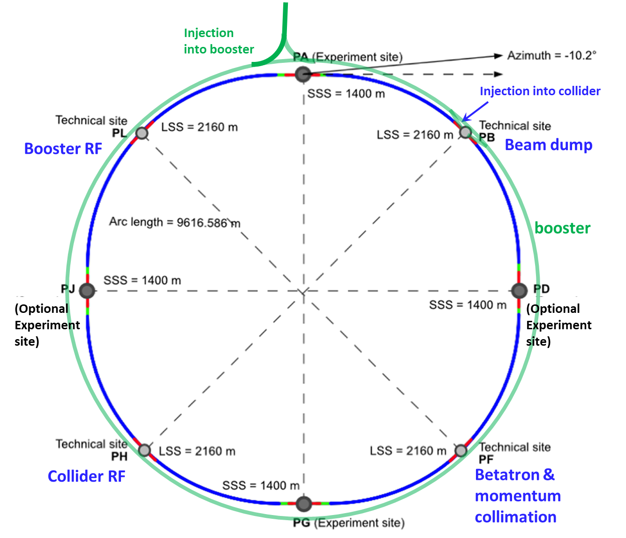
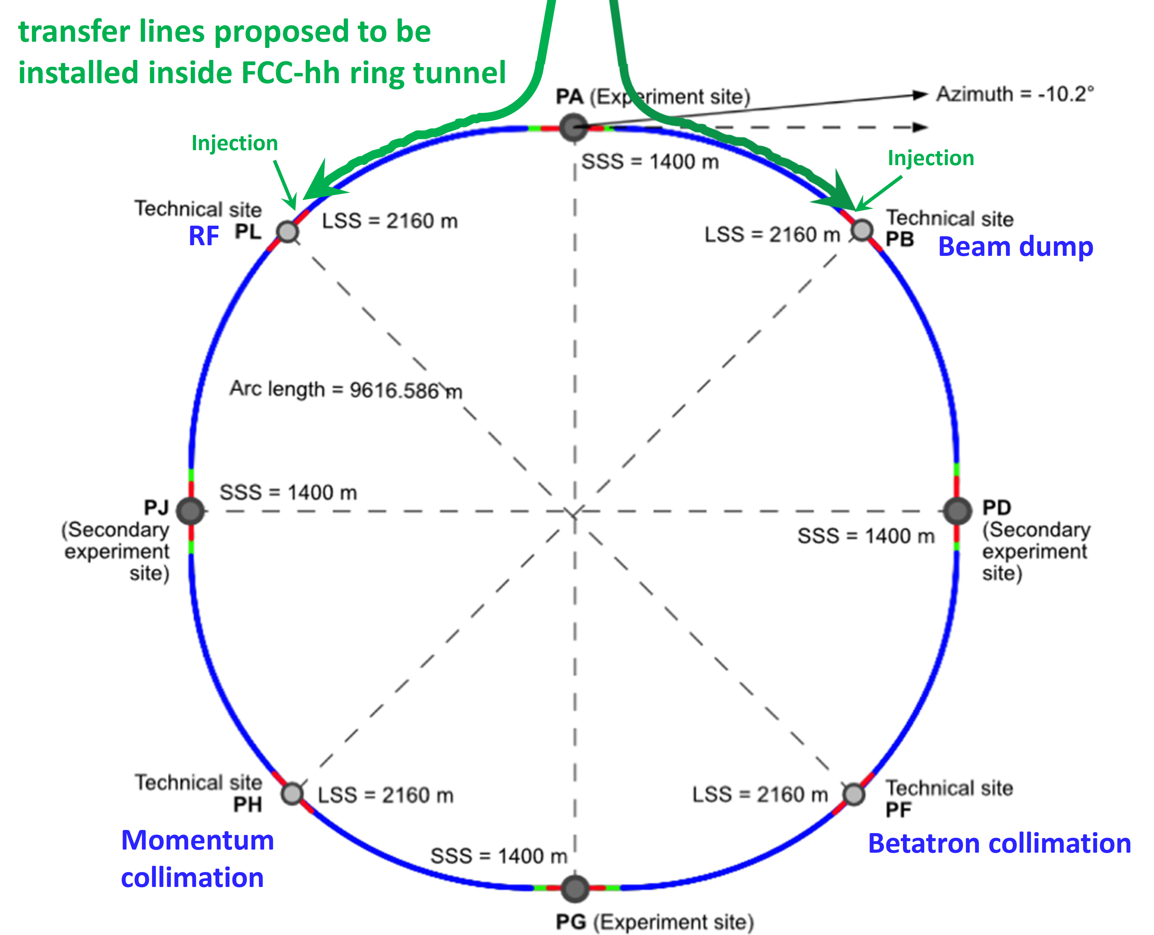
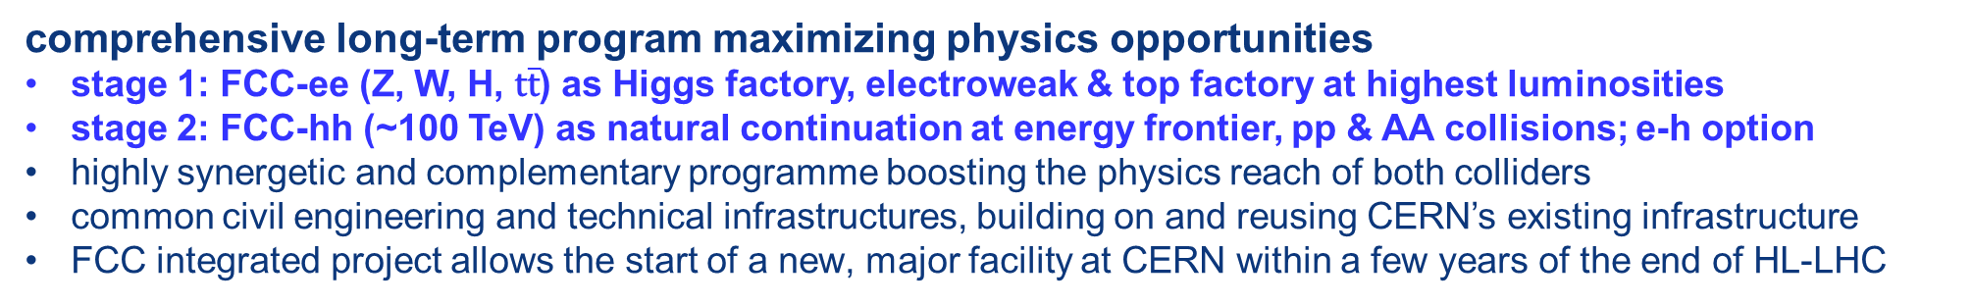
FCC integrated program
comprehensive long-term program maximizing physics opportunities
stage 1: FCC-ee (Z, W, H, $\text{t}\overline{\text{t}}$) as Higgs factory, electroweak & top factory at highest luminosities
stage 2: FCC-hh (~100 TeV) as natural continuation at energy frontier, pp & AA collisions; e-h option
highly synergetic and complementary programme boosting the physics reach of both colliders
common civil engineering and technical infrastructures, building on and reusing CERN’s existing infrastructure
FCC integrated project allows the start of a new, major facility at CERN within a few years of the end of HL-LHC
FCC-ee
FCC-hh

Slide 3
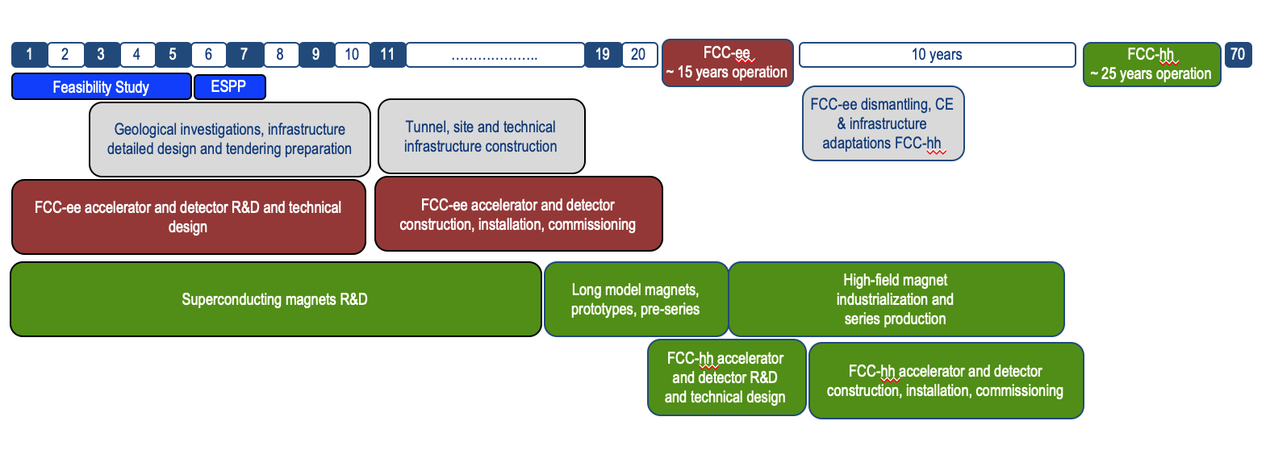
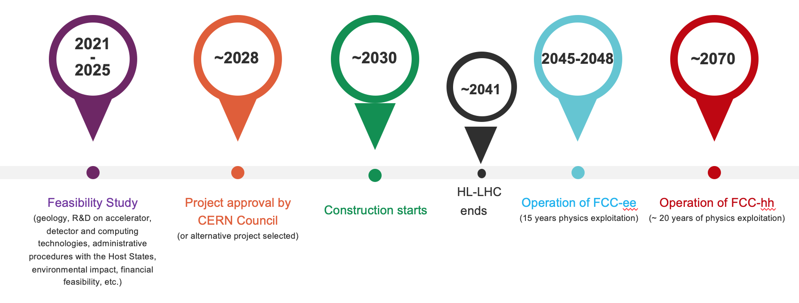
FCC integrated program - timeline
Note: FCC Conceptual Design Study
started in 2014 leading to CDR
in 2018
Ambitious schedule taking into account:
past experience in building colliders at CERN
approval timeline: ESPP, Council decision
that HL-LHC will run until 2041
project preparatory phase with adequate
resources immediately after Feasibility Study
2027/28
~2032
~2045
~2070

Slide 4
FCC Feasibility Study (2021-2025): high-level objectives
demonstration of the geological, technical, environmental and administrative feasibility of the tunnel and surface areas and optimisation of placement and layout of the ring and related infrastructure;
pursuit, together with the Host States, of the preparatory administrative processes required for a potential project approval to identify and remove any showstopper;
optimisation of the design of the colliders and their injector chains, supported by R&D to develop the needed key technologies;
elaboration of a sustainable operational model for the colliders and experiments in terms of human and financial resource needs, as well as environmental aspects and energy efficiency;
development of a consolidated cost estimate, as well as the funding and organisational models needed to enable the project’s technical design completion, implementation and operation;
identification of substantial resources from outside CERN’s budget for the implementation of the first stage of a possible future project (tunnel and FCC-ee);
consolidation of the physics case and detector concepts for both colliders.
Results will be summarised in a Feasibility Study Report to be released by March 2025

Slide 5
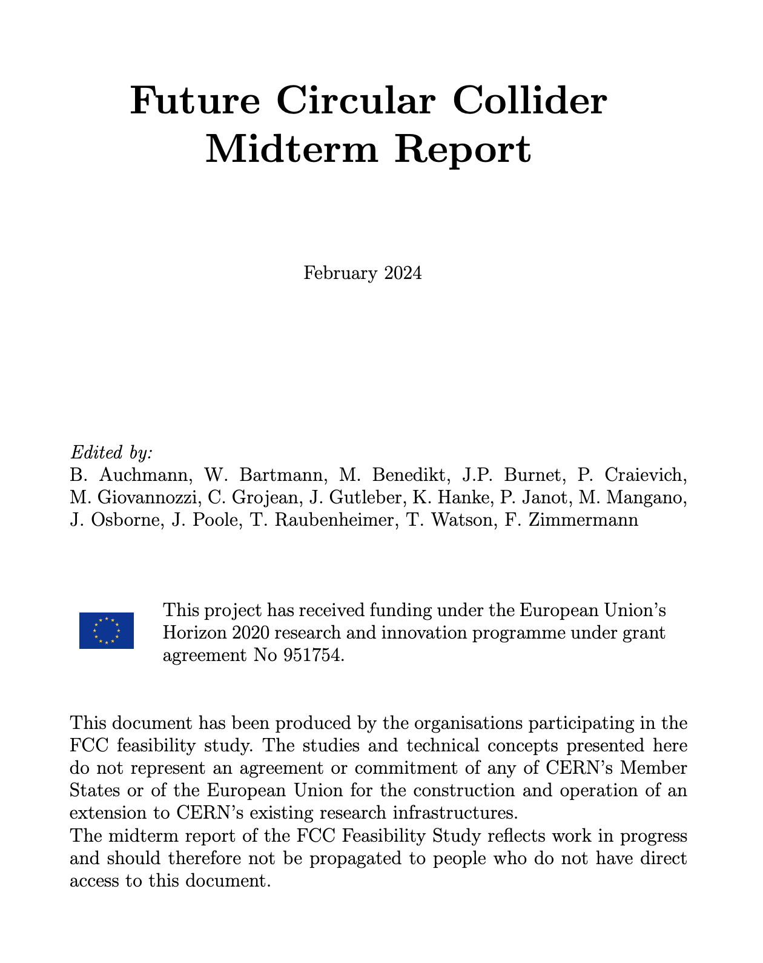
Main goals for 2024/begin 2025
The goal of the FCC FS mid-term review is to assess the progress of the Study towards the final report.
Deliverables approved by the Council in September 2022:
https://indico.cern.ch/event/1197445/contributions/5034859/attachments/2510649/4315140/spc-e-1183-Rev2-c-e-3654-Rev2_FCC_Mid_Term_Review.pdf
Full Report
8 Chapters/Deliverables
~ 700pp document
~ 16 editors
~ 500 contributors
Deliverables:
D1 : Definition of the baseline scenario
D2 : Civil engineering
D3 : Processes and implementation studies with the Host States
D4 : Technical infrastructure
D5 : FCC-ee accelerator
D6: FCC-hh accelerator
D7: Project cost and financial feasibility
D8: Physics, experiments and detectors
Documents:
Mid-term report (all deliverables except D7)
Executive Summary of mid-term report
Updated cost assessment (D7)
Funding model (D7)
Review process:
Oct 2023: Scientific Advisory Committee (scientific and technical aspects)
and Cost Review Panel (ad hoc committee; cost and financial aspects)
Nov 2023: SPC and FC
2 Feb 2024: Council
Many thanks to the SAC, CRP, SPC, FC and the Council for the very useful reviews!

Slide 6
Main goals for 2024/begin 2025
Completion of technical work for Feasibility Study until end 2024
  Implementation of recommendations of the mid-term review
  Focus on “feasibility items” and items with important impact on cost/performance
  Develop a risk register
  Update cost estimate to reach cat 3 level on cost uncertainty.
  Further develop the funding model based on discussions with the Council
  Complete FS by March 2025 as input for ESPP update.
  In parallel, continue work with host states on project definition and responsibilities, authorization procedures, excavation material strategy and regional implementation development.

Slide 7
Pre-TDR phase from April 2025 until end 2027
Main goal is to provide all information to Council to allow taking a decision on the project at the end of 2027 or mid-2028
  further develop the civil engineering and the technical design all major components, so as to provide a more detailed cost estimate with reduced uncertainties
  Continuation ot technical R&D activities.
  Continuation of site investigations and perform an overall integration study to specify requirements of technical infrastructure, accelerators and detectors for subsequent civil engineering design in case the project goes ahead.
  Launch of environmental impact study in 2026
  Work with host states on regional implementation development and authorization procedures.

Slide 8
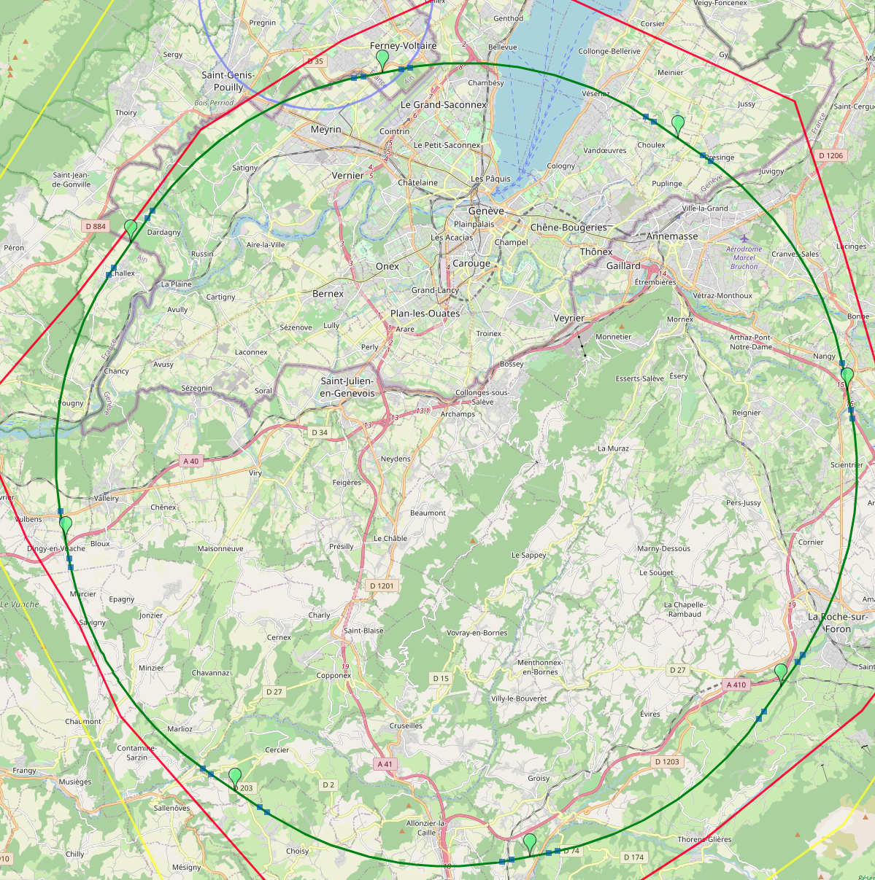
Optimized placement and layout for feasibility study
V. Mertens,
J. Gutleber
Layout chosen out of ~ 100 initial variants, based on geology and
surface constraints (land availability, access to roads, etc.), environment, (protected zones), infrastructure (water, electricity, transport), machine performance etc.
“Avoid-reduce-compensate” principle of EU and French regulations
PA: Experiment
PB: technical
PL: technical
Overall lowest-risk baseline: 90.7 km ring, 8 surface points,
Whole project now adapted to this placement
Number of surface sites | 8
Surface requirements | ~40 ha
LSS@IP (PA, PD, PG, PJ) | 1400 m
LSS@TECH (PB, PF, PH, PL) | 2032 m
Arc length | 9.6 km
Sum of arc lengths | 76.9 m
Total length | 90.7 km
PD: experiment
PJ: experiment
PF: technical
PH: technical
8
PG: experiment

Slide 9
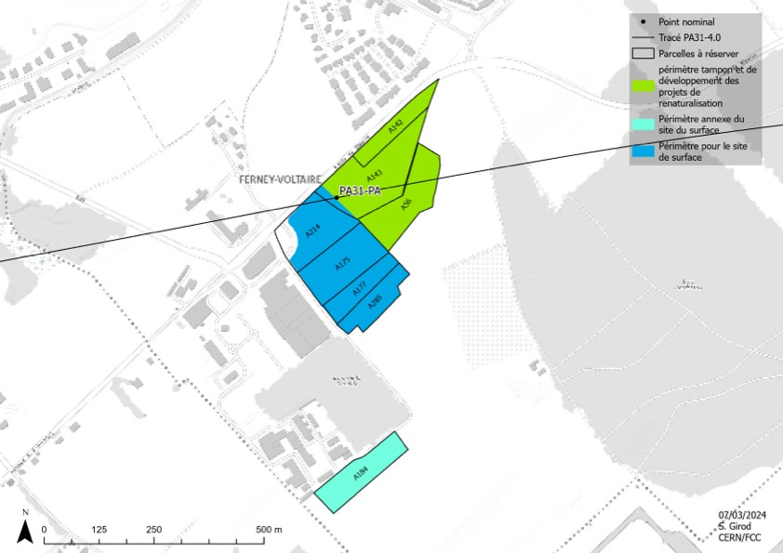
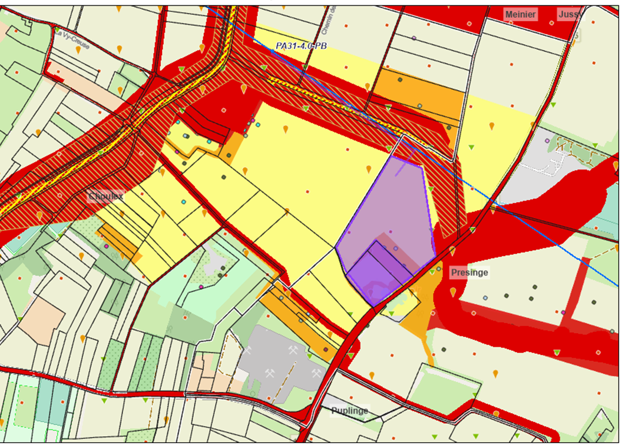
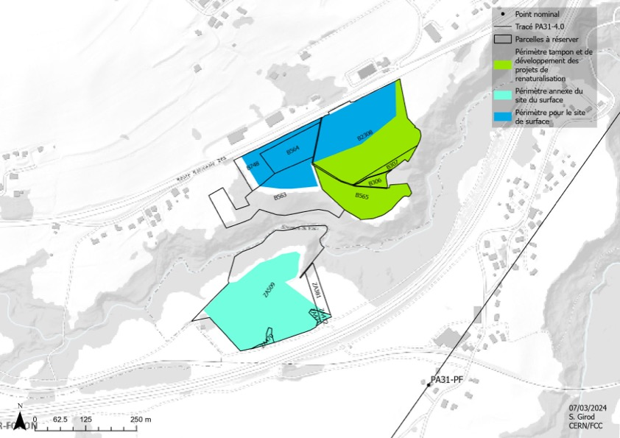
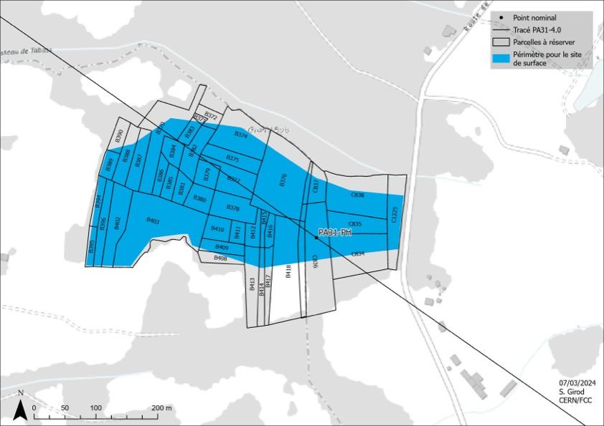
Surface sites development and reservation of land-plots
Meetings ongoing with all communes concerned by surface sites to identify individual land-plots for development of surface site layout and land reservation.
PA : Ferney Voltaire: 01/2024
PB: Choulex : 12/2023
PB: Presinge : 01/2024, plenary session with community council 04/2024
PD : Nangy: 05/2024
PF : Éteaux : 03/2024
PG : Groisy / Charvonnex: 04/2024
PH : Marlioz / Cercier : 02/2024
PJ : Vulbens / Dingy en Vuache : 09/2023, 01/2024
PL : Challex: 03/2024, further meetings in Q2/24 to identify best site location
Green: parcelles identified and agreed
Blue: ongoing
PA : Ferney Voltaire
PB: Choulex
PF : Éteaux
PH : Marlioz / Cercier

Slide 10
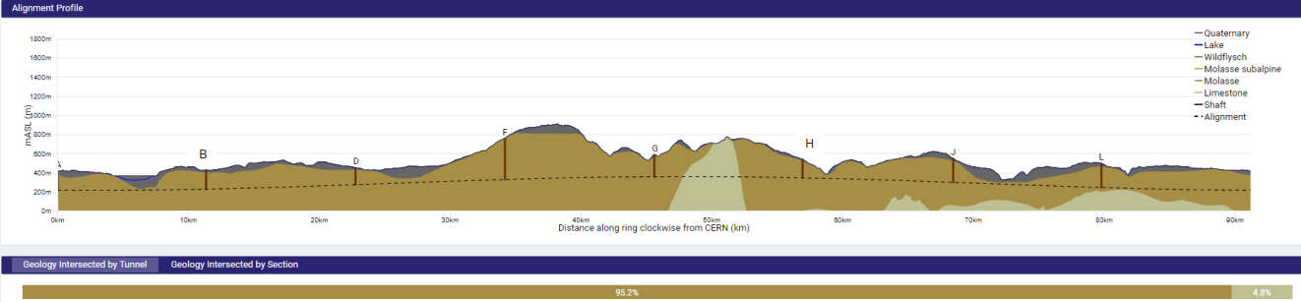
FCC tunnel implementation
Tunnel implementation summary
91 km circumference
95% in molasse geology for minimising tunnel construction risks
Site investigations in zones where tunnel is close to geological interfaces: moraines-molasse-limestone

Slide 11
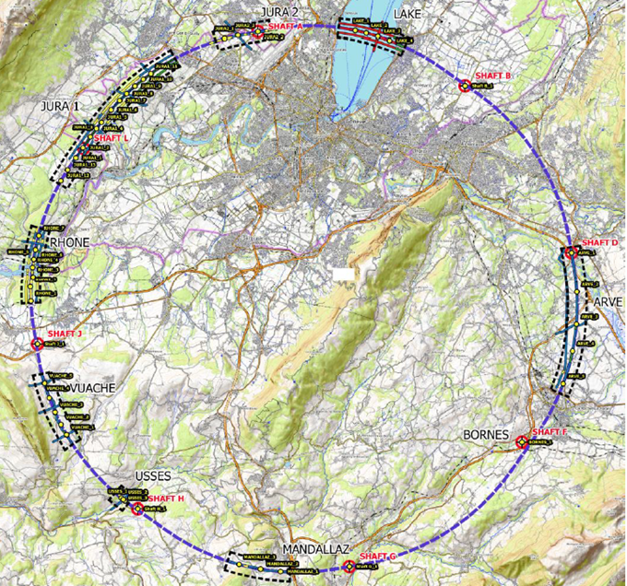
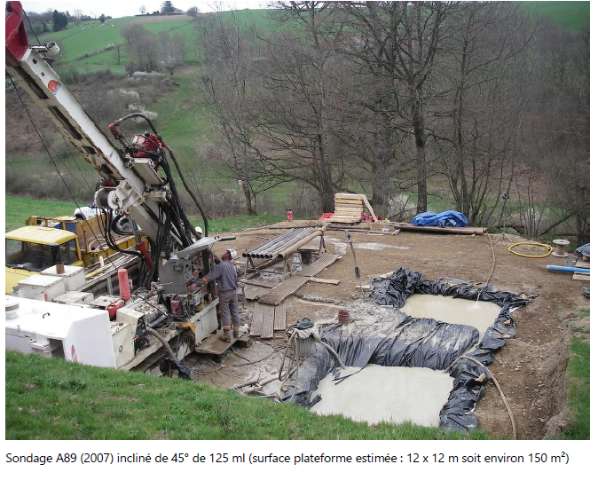
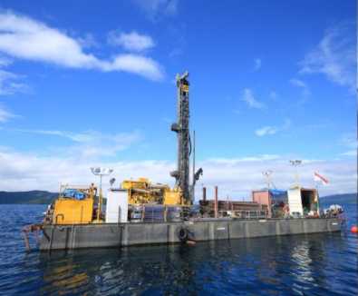
Status site investigations
Site investigations in areas with uncertain geological conditions:
  Optimisation of localisation of drilling locations ongoing with site visits since end 2022.
Contracts Status:
  Contract for engineering services and role of Engineer during works, active since July 2022
  Contracts for drillings and seismics in final negotiation round.
  Start of work in June 2024.
Drilling works on the lake

Slide 12
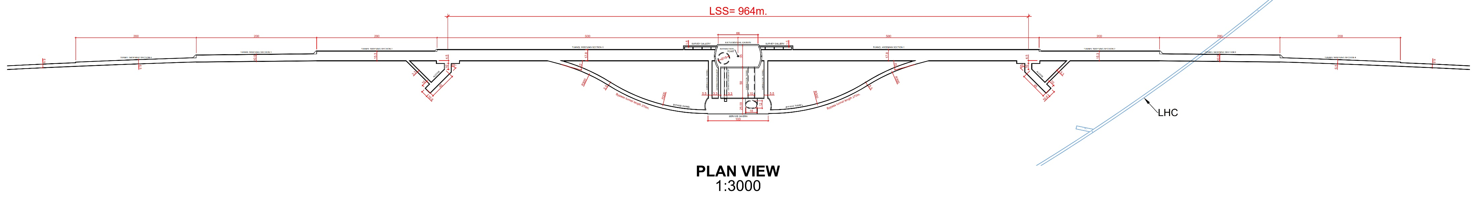
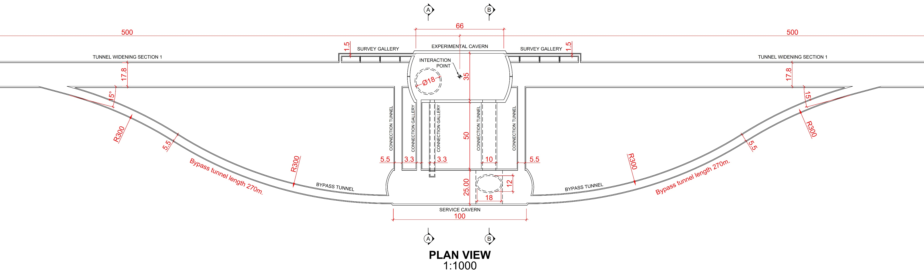
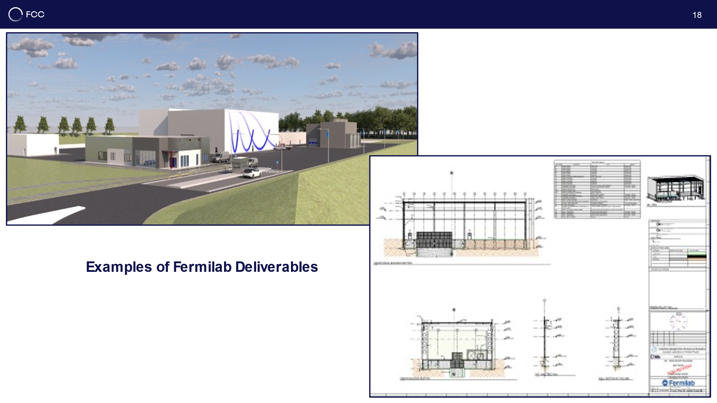
CE underground and surface progress
Full 3D model of all underground structures as basis for costing and scheduling exercises with external consultant.
Experiment Site (PA)
Generic study of experiment site and technical site done by FNAL
bills of quantities extracted from FNAL designs
basis for cost estimate by consultant with experience on industrial constructions in CH-FR area.

Slide 13
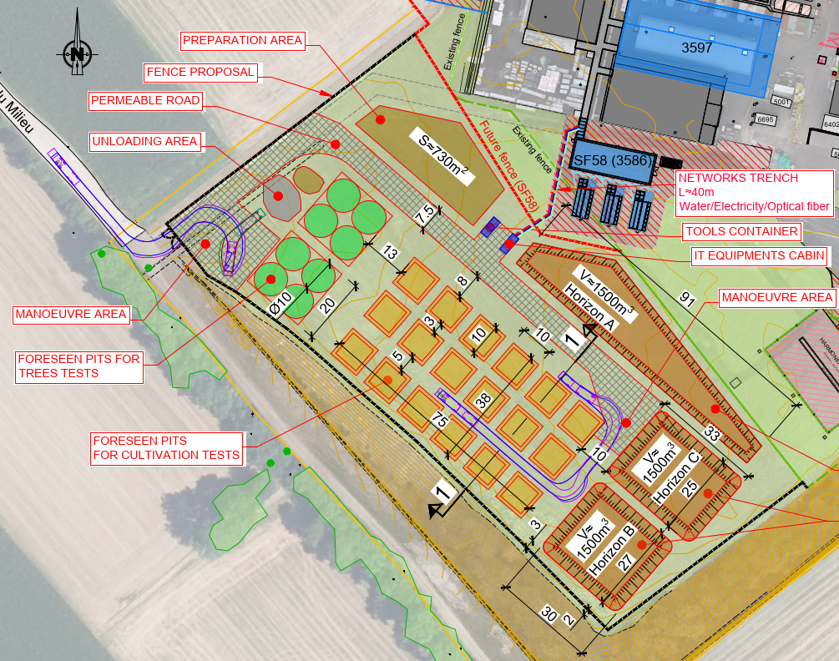
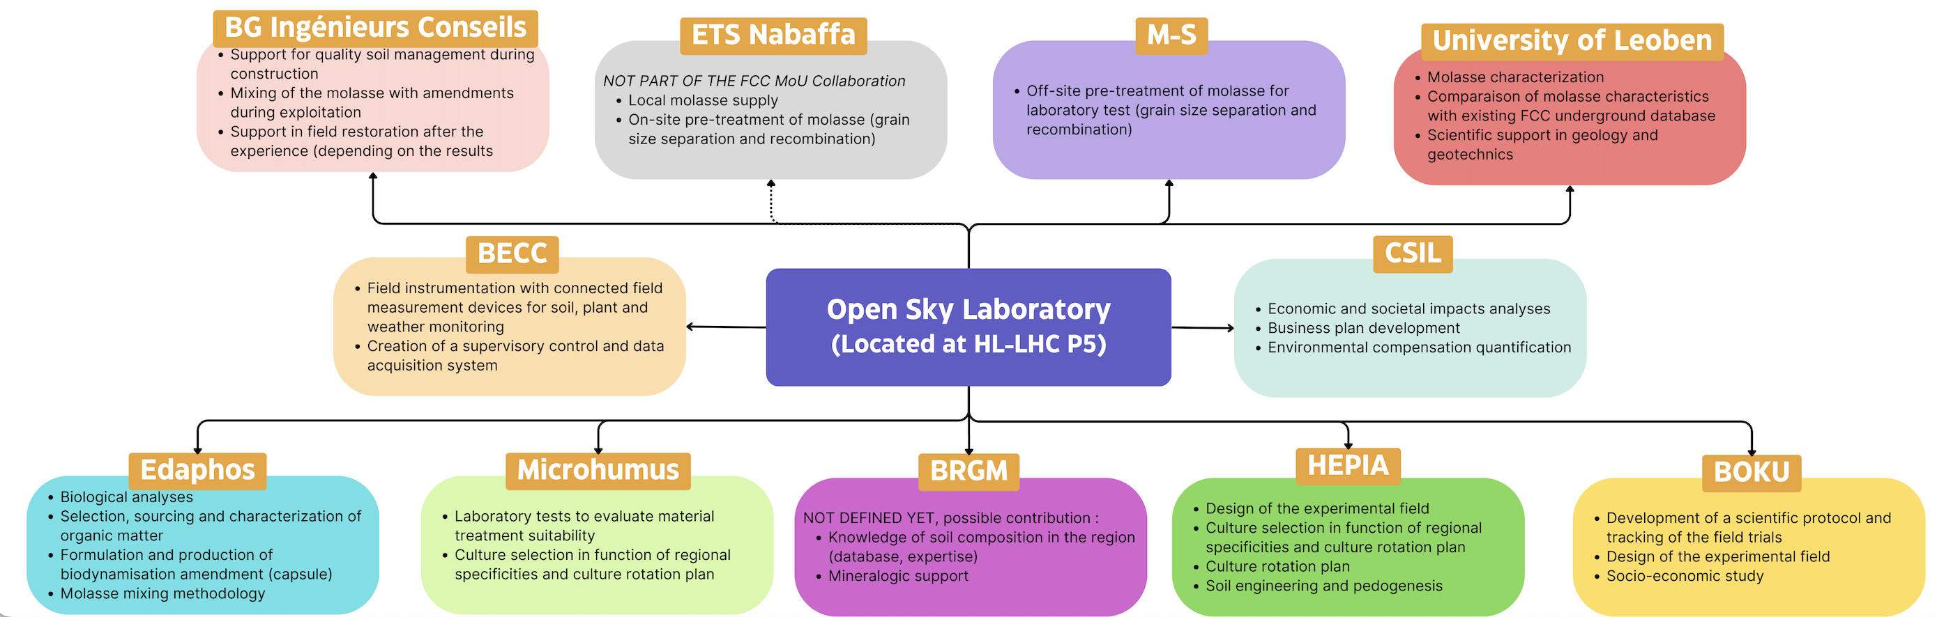
OpenSky Laboratory: demonstrate molasse reuse cases
GOAL: demonstrate the feasibility to transform Molasse (excavated material) into fertile soil.
Project launched in January 2024
10000 m² near LHC P5 in Cessy, France.
Project phases:
1) Laboratory tests to identify the most suitable mix of molasse and amendments.
2) Field tests in a controlled environment (plants selected in function of regional specificities and possible soil reuse cases )
International collaboration with partners from academia and industry specialised in agronomy, soil paedogenesis, phytoremediation
Status - March 2024:
Project approved at CERN level
Collaboration agreements being signed
Definition of the laboratory and field tests

Slide 14
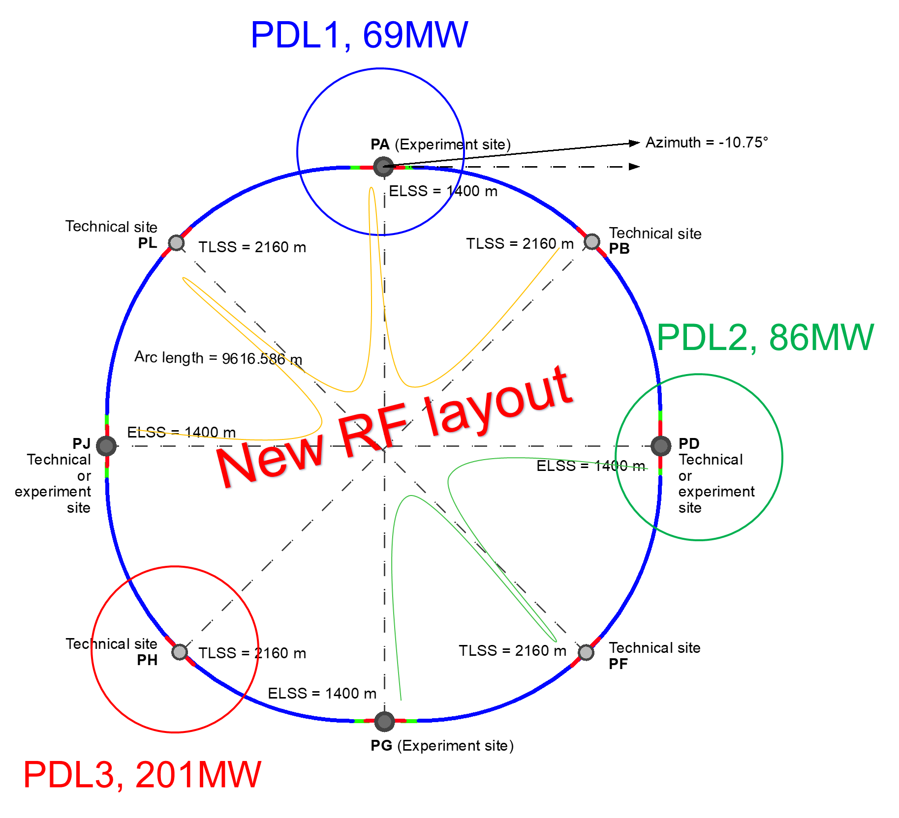
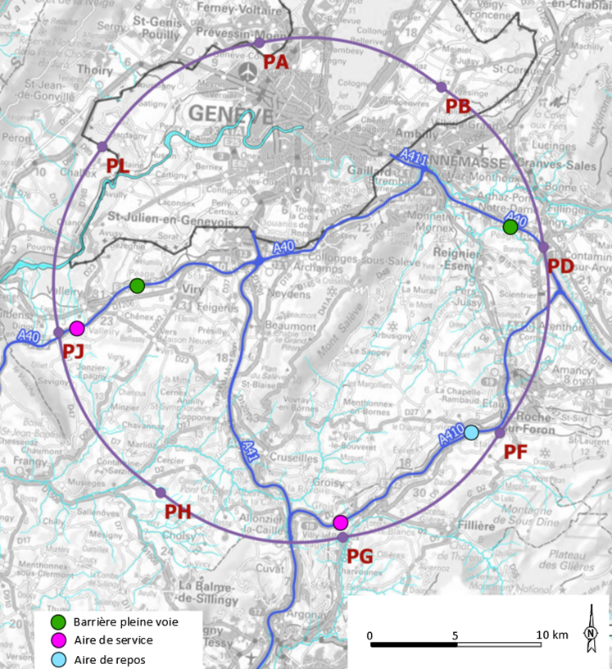
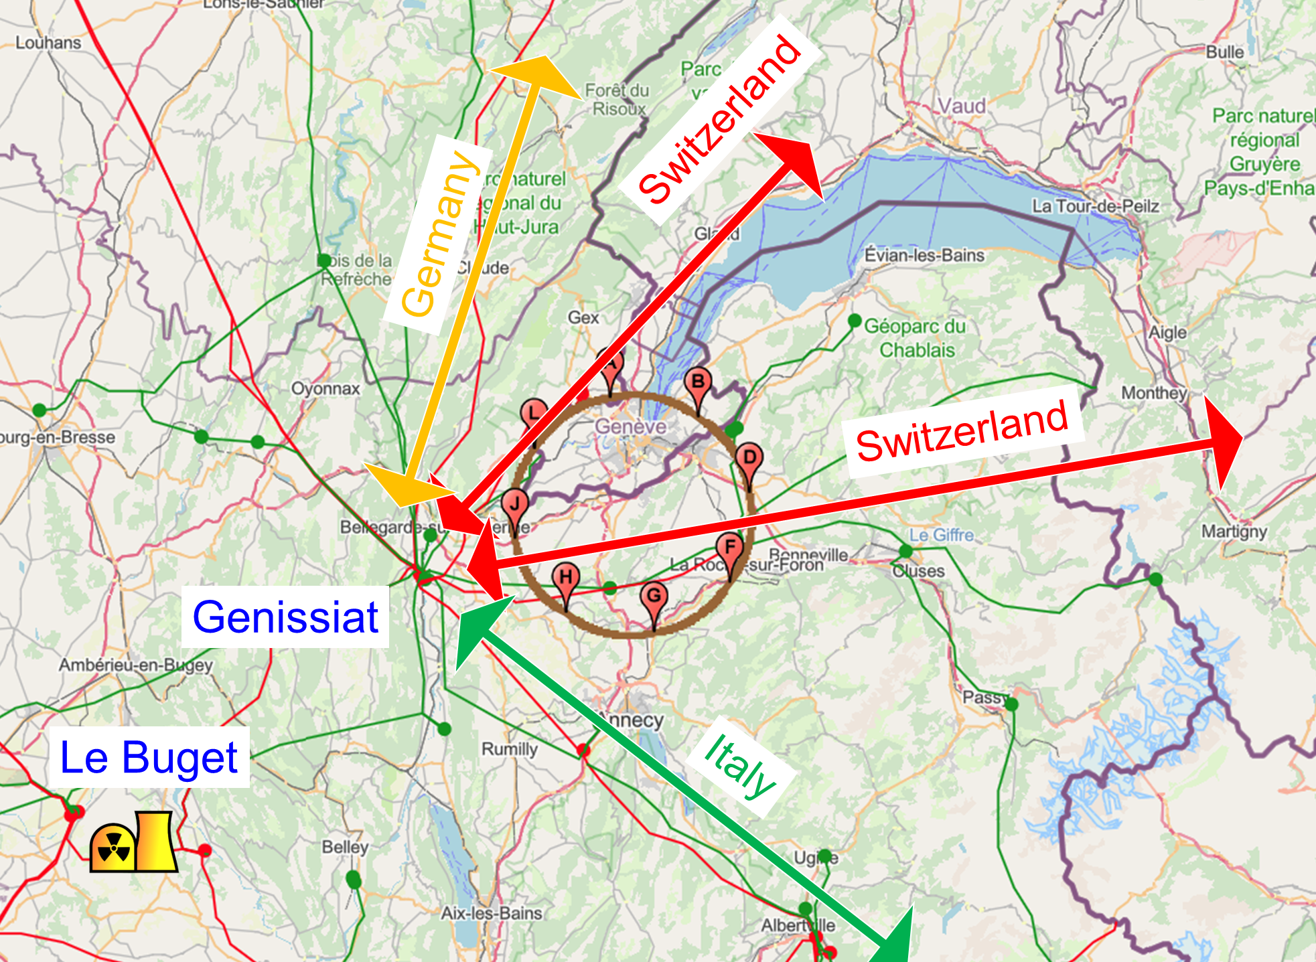
Connections with regional infrastructure
Road accesses developed for all 8 surface sites
Four possible highway connections defined
Less than 4 km new departmental roads required
connections to
French electrical grid
connections with
highway network
Electrical connection concept studied by RTE (French electrical grid operator) ➔ requested loads have no significant impact on grid
Powering concept and power rating of the three sub-stations compatible with FCC-hh
R&D efforts aiming at further reduction of the energy consumption of FCC-ee and FCC-hh

Slide 15
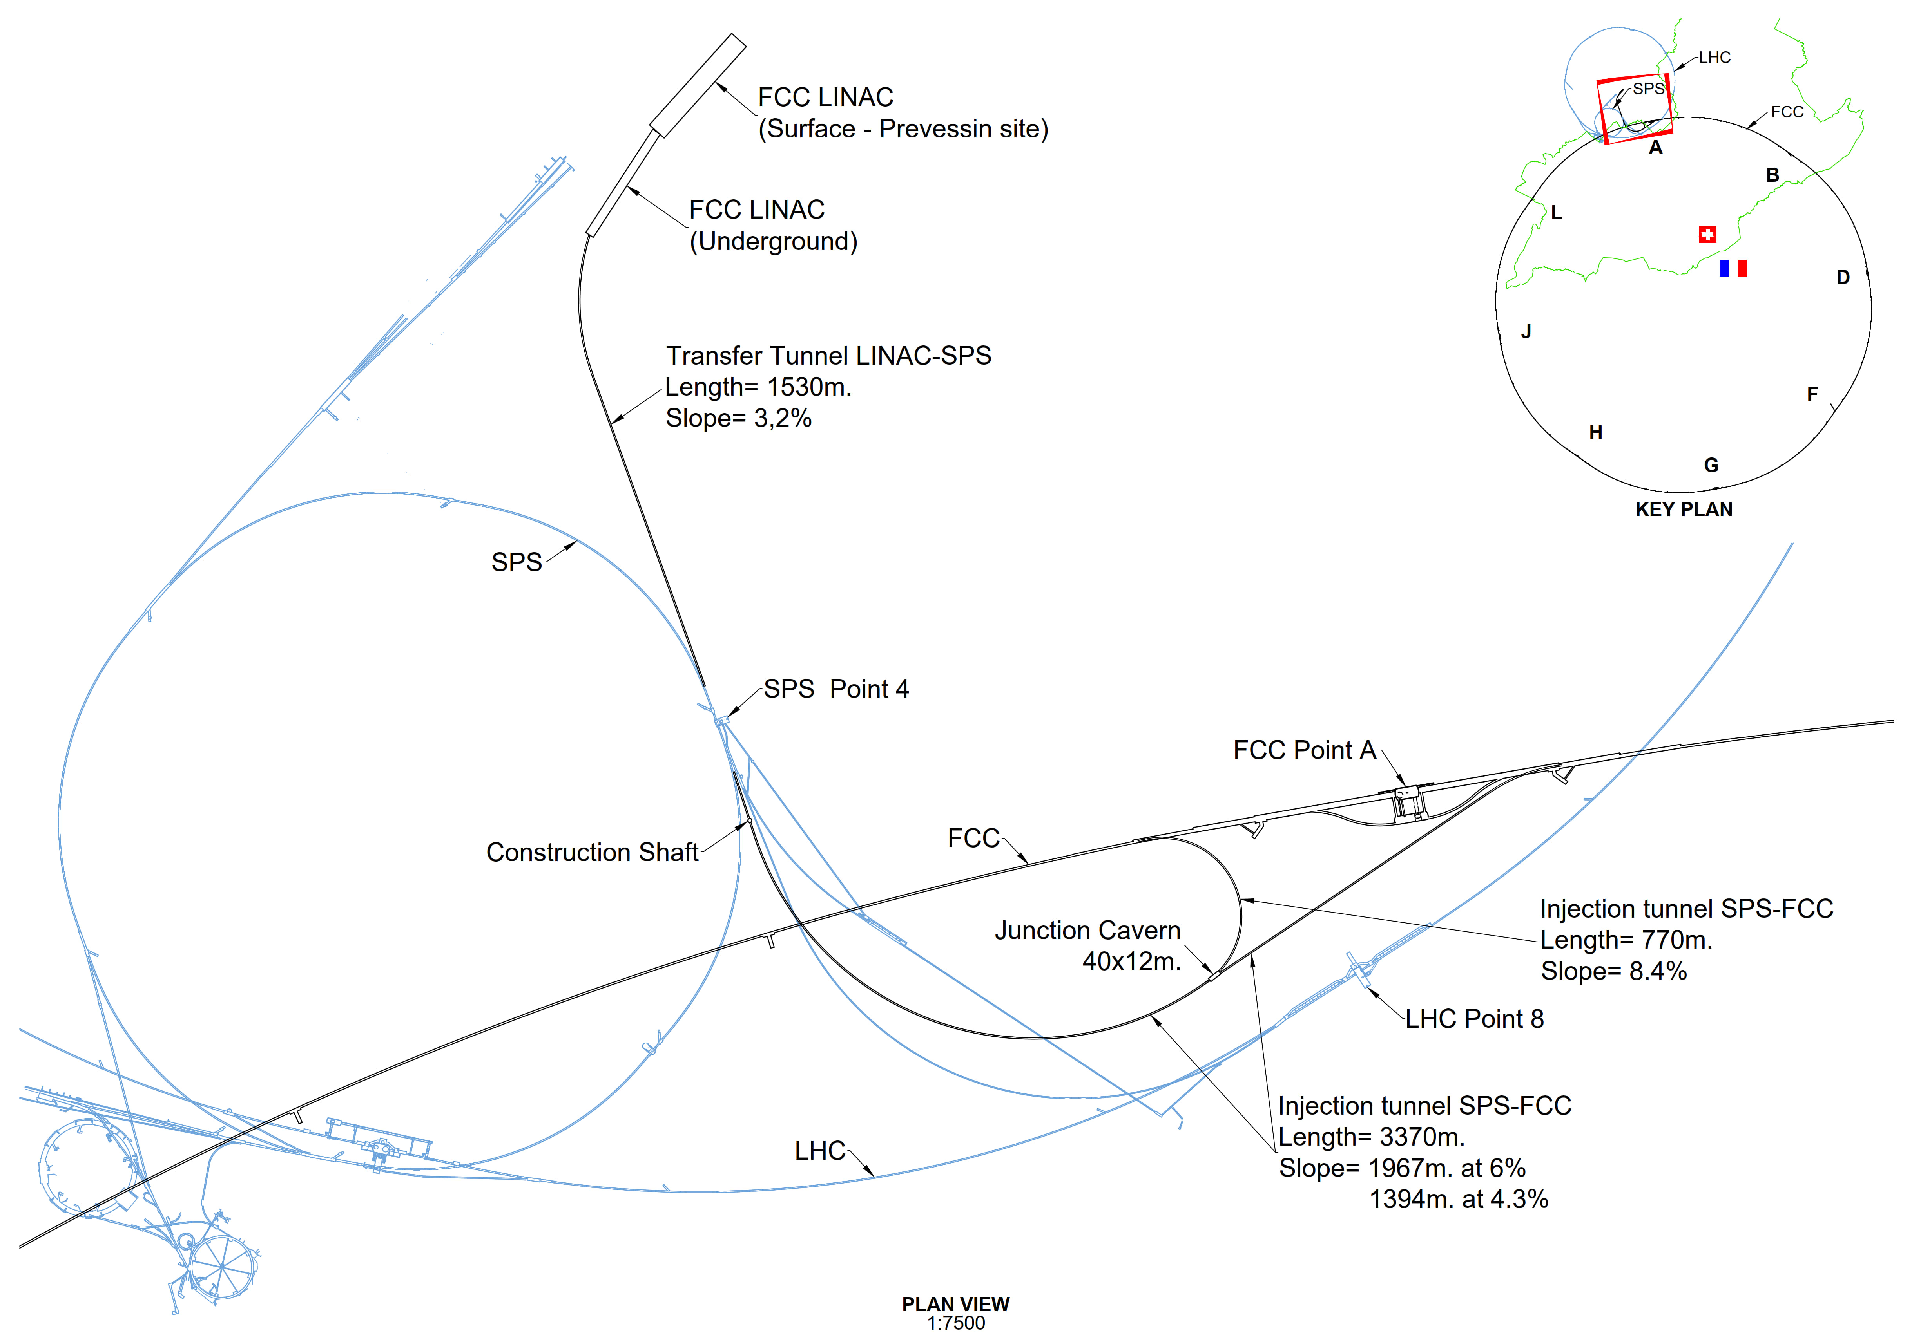
Transfer line FCC-ee (option with SPS for FCC-hh)
LINAC and Injection Tunnels
Injector with ~20 GeV HE Linac sited on surface at CERN-Prevessin
Single transfer tunnel to FCC Booster with spur to enable anti-clockwise injection
Design allows re-use for FCC-hh if injector in the SPS tunnel (SC-SPS option)
  SPS Point 4 to FCC (clockwise)
  SPS Point 6 to FCC (counter-c.w.)

Slide 16
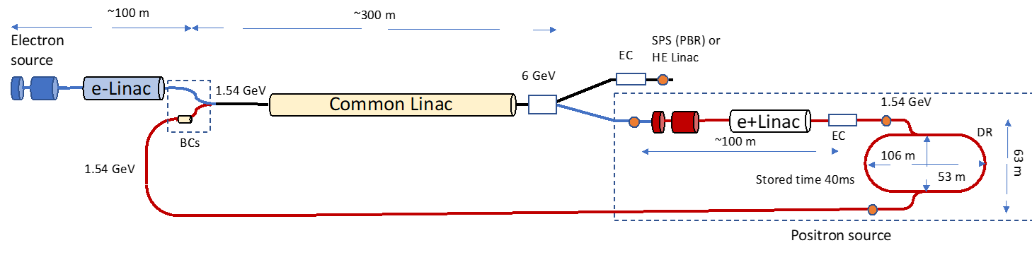

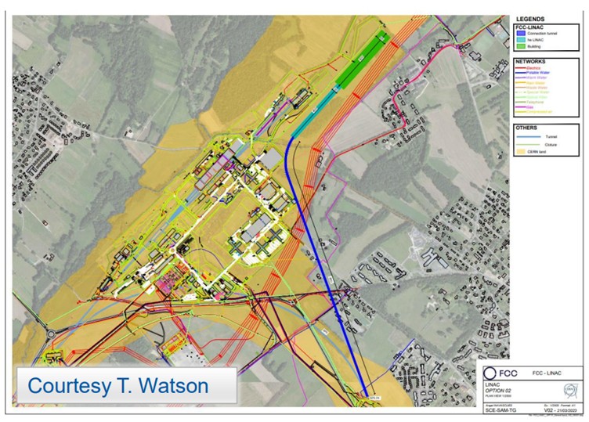
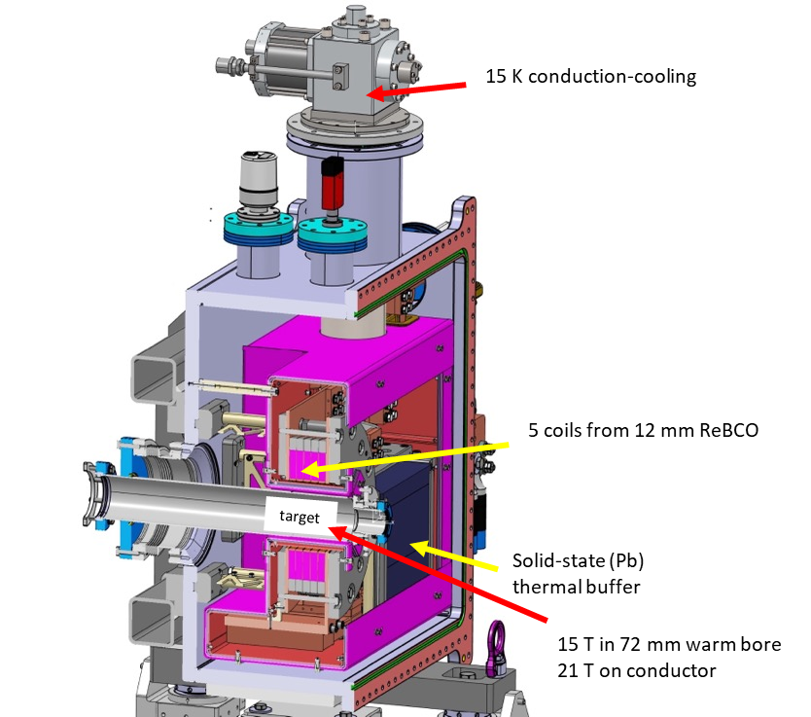
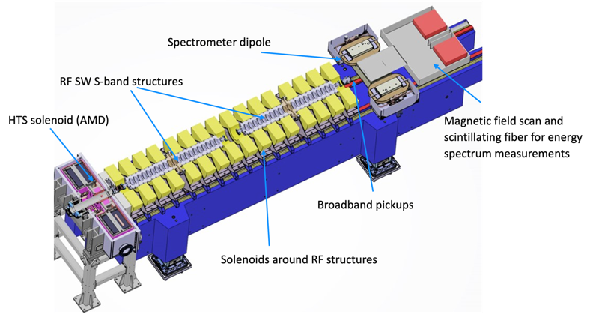
FCC-ee injector layout & implementation
P. Craievich, I. Chaikovska, A. Grudiev, C. Milardi, et al
implementation study on Prevessin site
“Positron production experiment” at PSI’s SwissFEL,
beam tests from 2025/26
6 GeV linac
20 GeV linac
W. Bartmann
HTS NI target solenoid
J. Kosse, T. Michlmayr, H. Rodrigues

Slide 17
FCC-ee: main machine parameters
Parameter | Z | WW | H (ZH) | ttbar
beam energy [GeV] | 45.6 | 80 | 120 | 182.5
beam current [mA] | 1270 | 137 | 26.7 | 4.9
number bunches/beam | 11200 | 1780 | 440 | 60
bunch intensity [10¹¹] | 2.14 | 1.45 | 1.15 | 1.55
SR energy loss / turn [GeV] | 0.0394 | 0.374 | 1.89 | 10.4
total RF voltage 400/800 MHz [GV] | 0.120/0 | 1.0/0 | 2.1/0 | 2.1/9.4
long. damping time [turns] | 1158 | 215 | 64 | 18
horizontal beta* [m] | 0.11 | 0.2 | 0.24 | 1.0
vertical beta* [mm] | 0.7 | 1.0 | 1.0 | 1.6
horizontal geometric emittance [nm] | 0.71 | 2.17 | 0.71 | 1.59
vertical geom. emittance [pm] | 1.9 | 2.2 | 1.4 | 1.6
horizontal rms IP spot size [μm] | 9 | 21 | 13 | 40
vertical rms IP spot size [nm] | 36 | 47 | 40 | 51
beam-beam parameter ξ_{x} / ξ_{y} | 0.002/0.0973 | 0.013/0.128 | 0.010/0.088 | 0.073/0.134
rms bunch length with SR / BS [mm] | 5.6 / 15.5 | 3.5 / 5.4 | 3.4 / 4.7 | 1.8 / 2.2
luminosity per IP [10³⁴ cm⁻²s⁻¹] | 140 | 20 | 5.0 | 1.25
total integrated luminosity / IP / year [ab⁻¹/yr] | 17 | 2.4 | 0.6 | 0.15
beam lifetime rad Bhabha + BS [min] | 15 | 12 | 12 | 11
Design and parameters
dominated by the
choice to allow for
50 MW synchrotron
radiation per beam.
4 years
5 x 10¹² Z
LEP x 10⁵
2 years
> 10⁸ WW
LEP x 10⁴
3 years
2 x 10⁶ H
5 years
2 x 10⁶ tt pairs
x 10-50 improvements on all EW observables
up to x 10 improvement on Higgs coupling (model-indep.) measurements over HL-LHC
x10 Belle II statistics for b, c, τ
indirect discovery potential up to ~ 70 TeV
direct discovery potential for feebly-interacting particles over 5-100 GeV mass range
Up to 4 interaction points → robustness,
statistics, possibility of specialised detectors
to maximise physics output
F. Gianotti

Slide 18
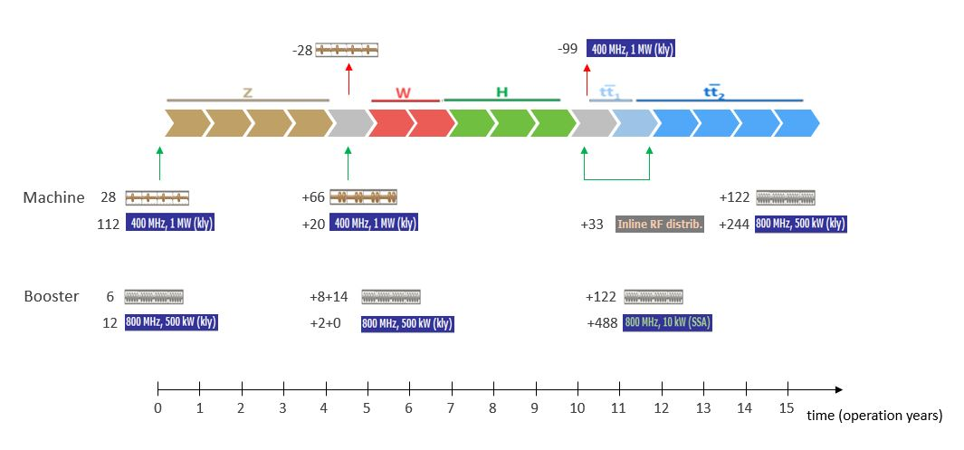
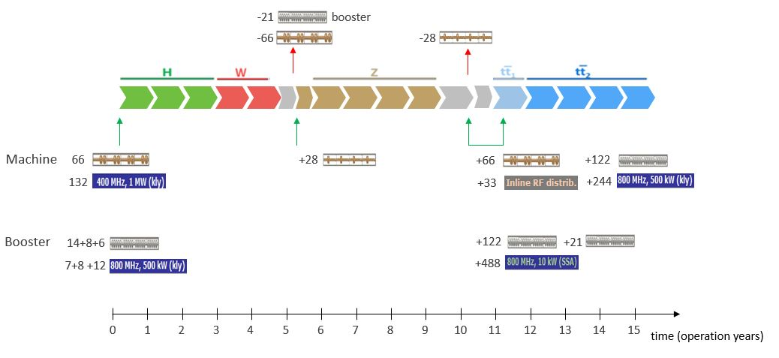
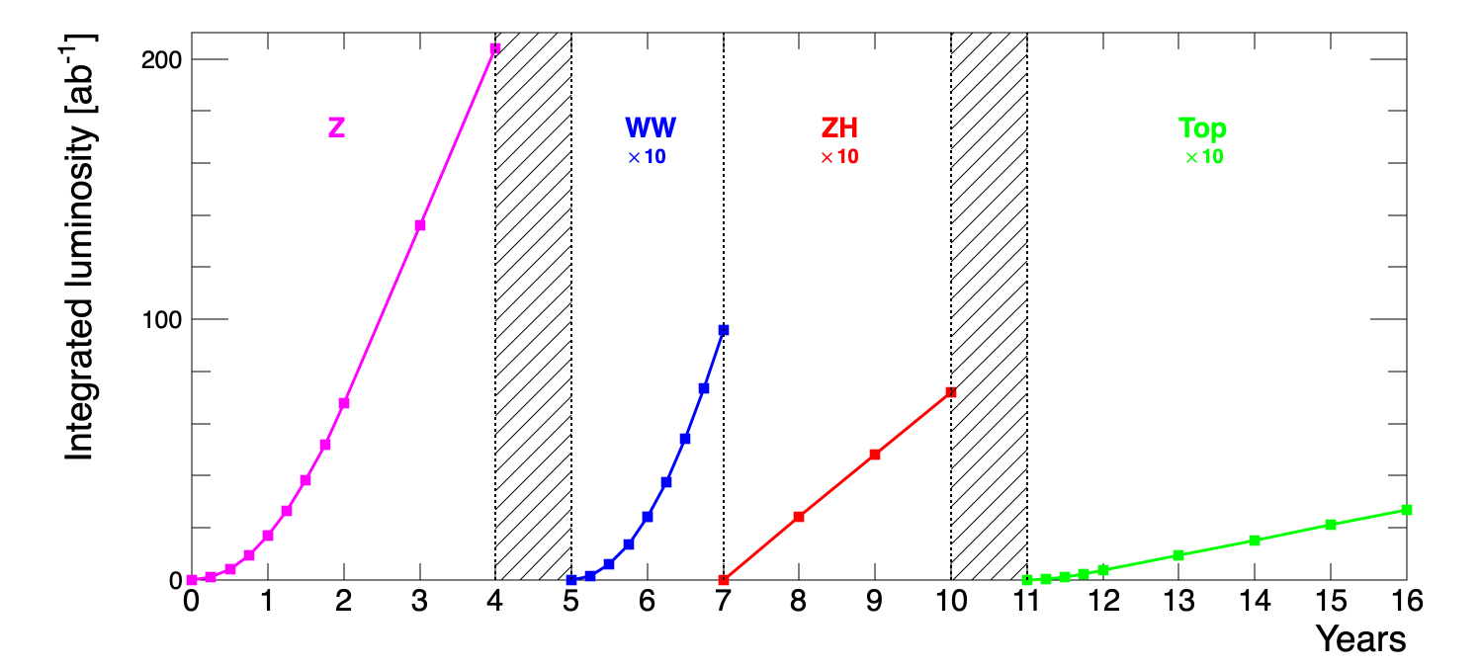
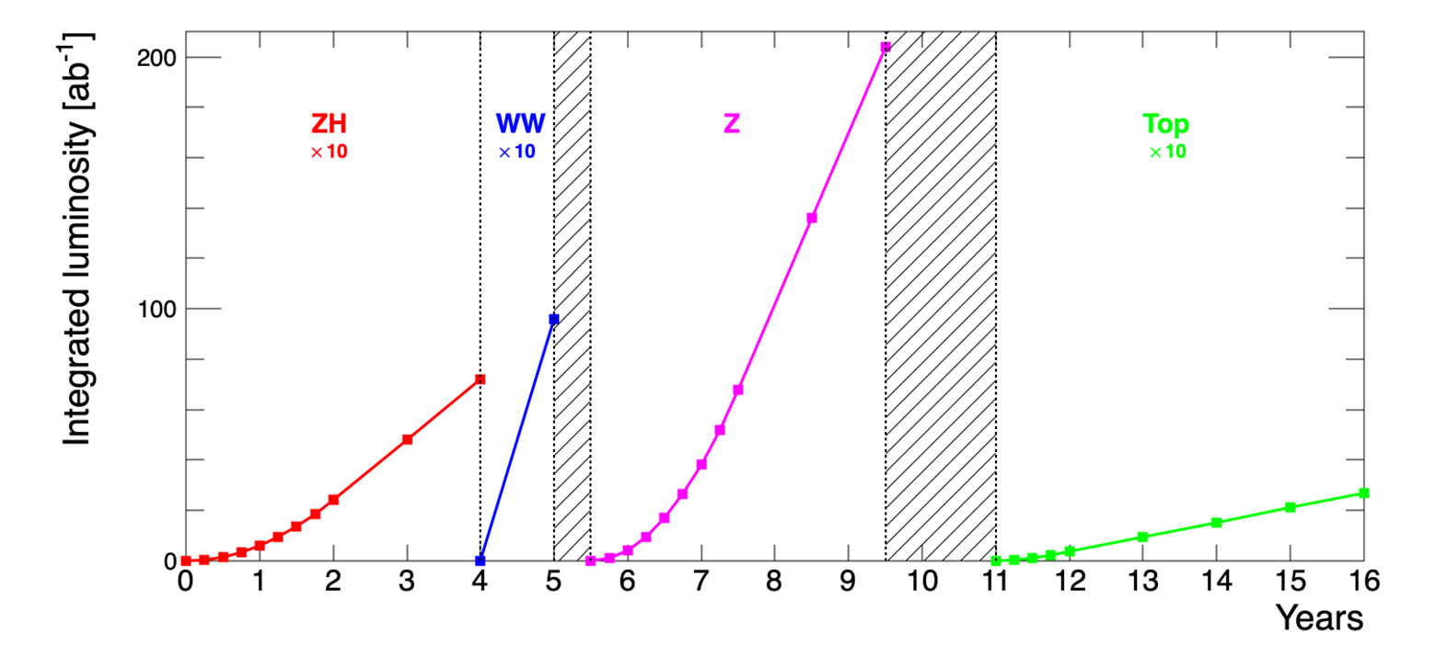
Operation sequences for FCC-ee and RF configuration
Evolution of RF configuration of collider and booster with beam energies and physics operation points
Long-term R&D for SRF, in particular for the 800 MHz system

Slide 19
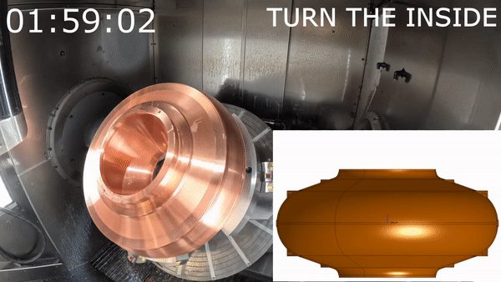
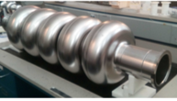
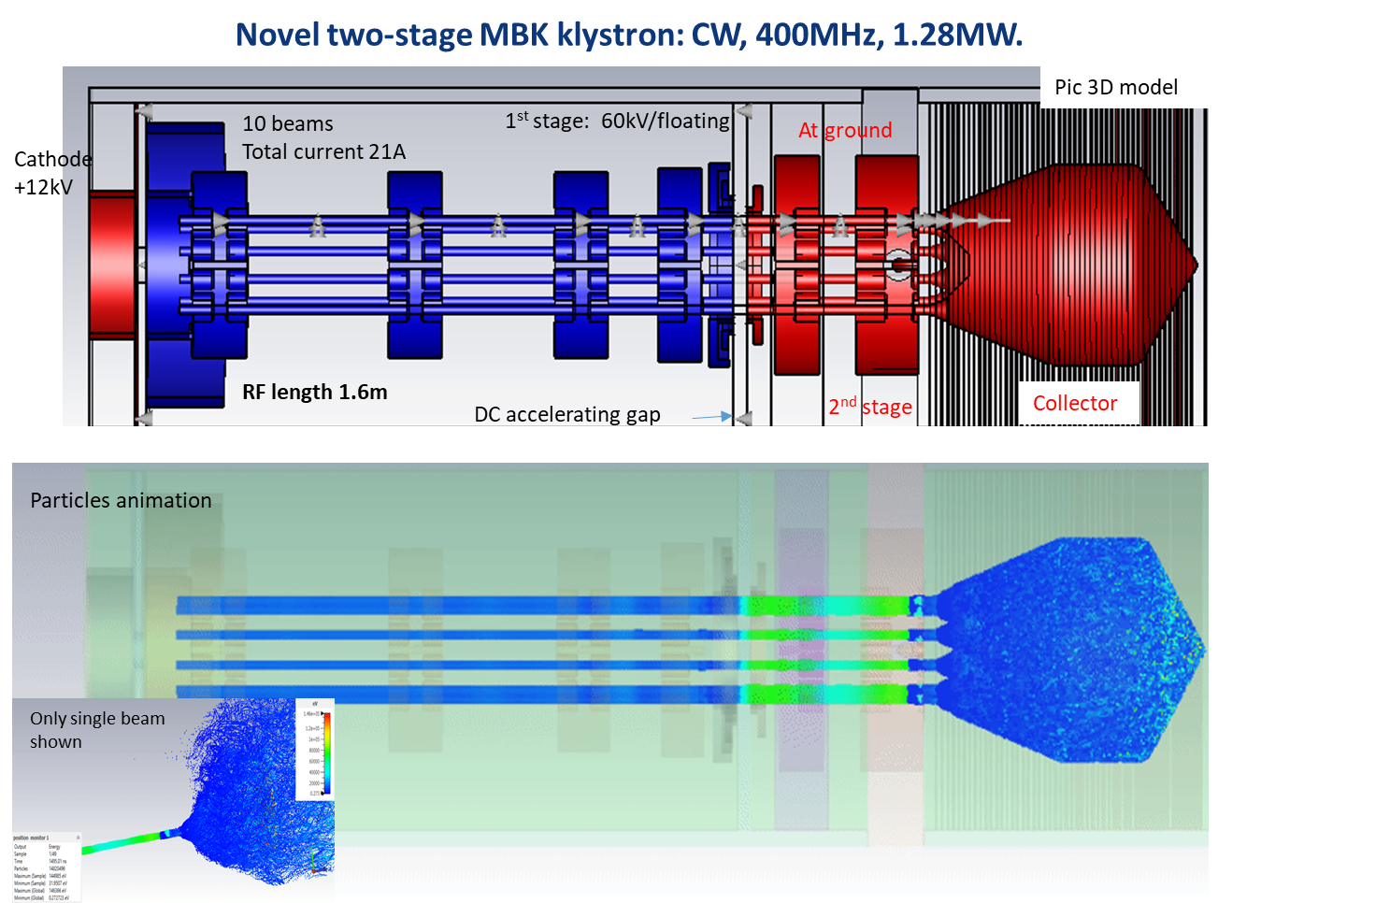
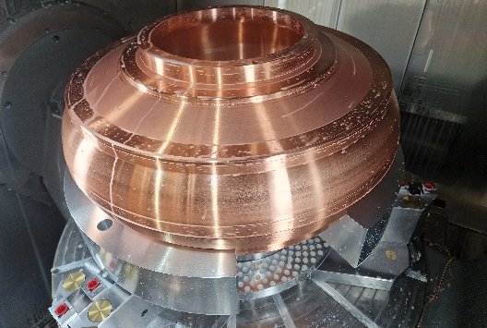
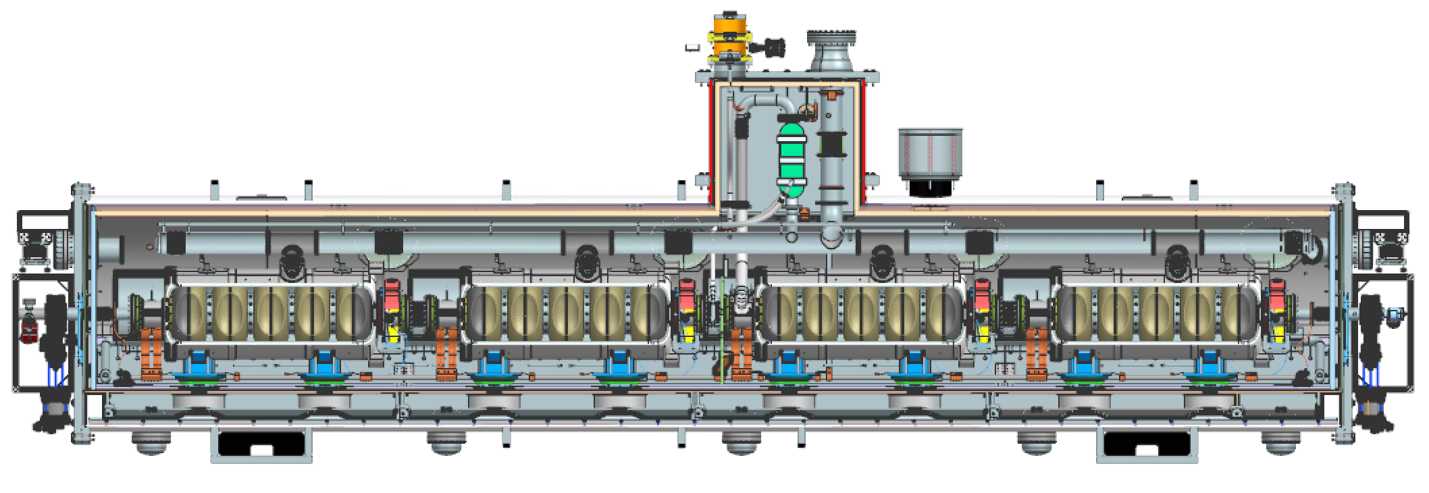
RF R&D activities
RF system R&D is key for increasing energy efficiency of FCC-ee
Nb on Cu 400 MHz cavities, seamless cavity production, coating techniques
Bulk Nb 800 MHz cavities, surface treatment techniques, cryomodule design
RF power source R&D in synergy with HL-LHC.
800 MHz cavity and CM design collaborations with JLAB and FNAL
high-efficiency klystron R&D
in collaborations with THALES & CANON
400 MHz cavity production
in collaboration with KEK
800 MHz segmented design, based on PIP-II
~7 m
monoblock prototype

Slide 20

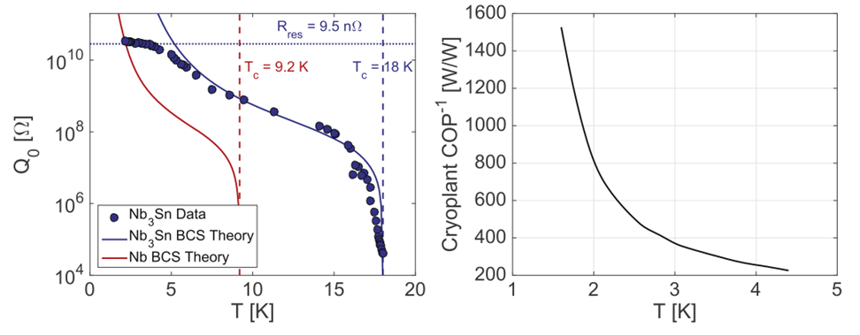
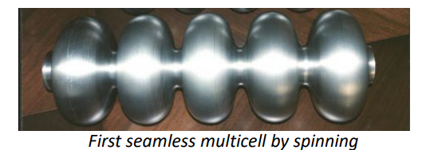
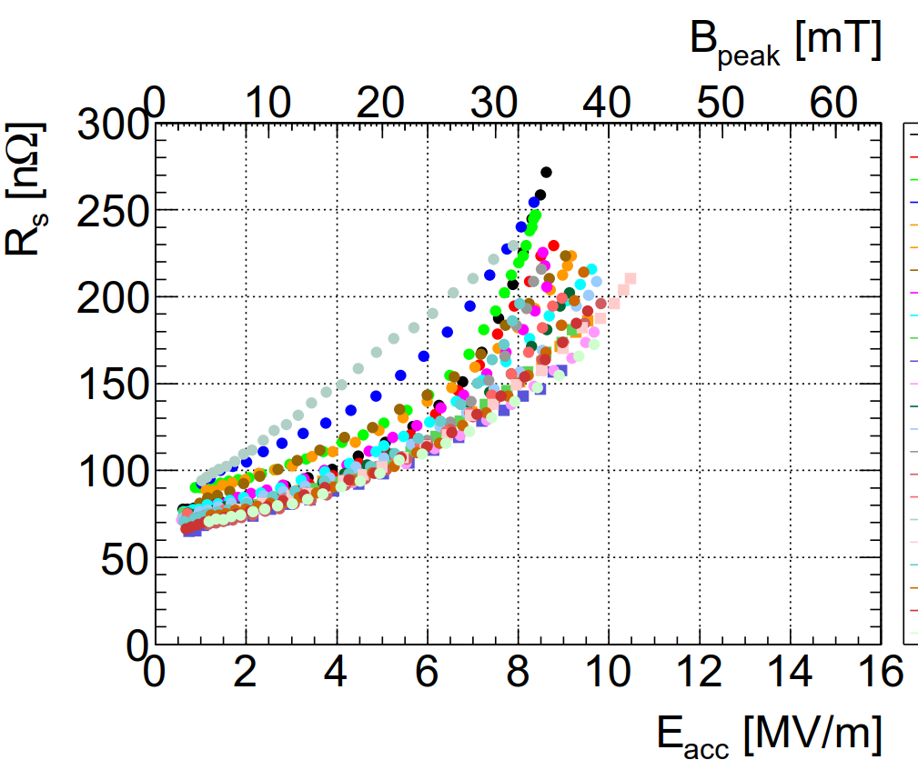
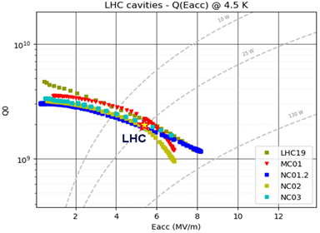
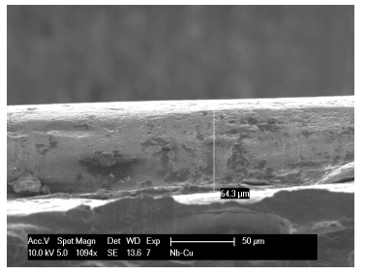
SRF: seamless cavities & thin film coating
C. Pira
Seamless production
Move from Nb @2K to Nb₃Sn @4.5 K would reduce cryogenic power by a factor of 3
Nb₃Sn on Cu coating
Nb on Cu coating
(FCC baseline)
PRELIMINARY RESULTS
G=216 Ω
4.5 K
4.5 K
QPR Nb₃Sn
FCC 1 cell
QPR Nb₃Sn
Equivalent to a Q of 9*10⁹ @5 MV/m @4.5 K
Almost 1 order of magnitude better than LHC !
Room for improvement
SEM micrograph of the film cross section

Slide 21
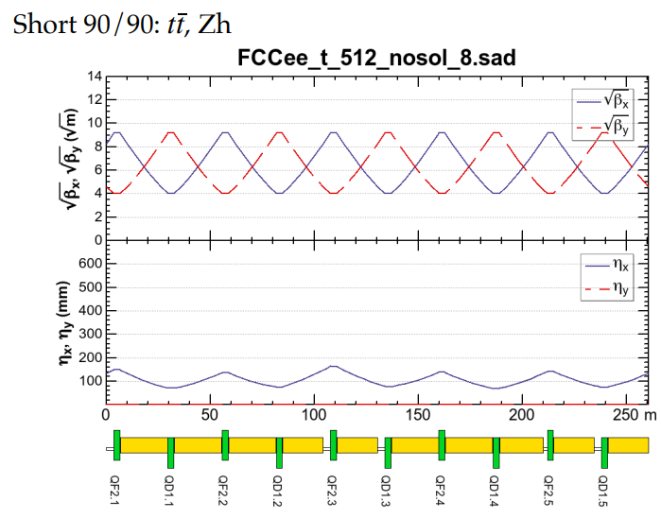
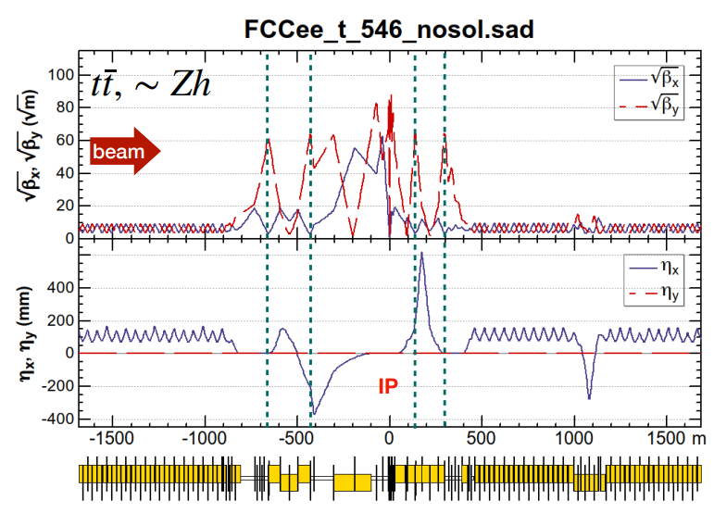
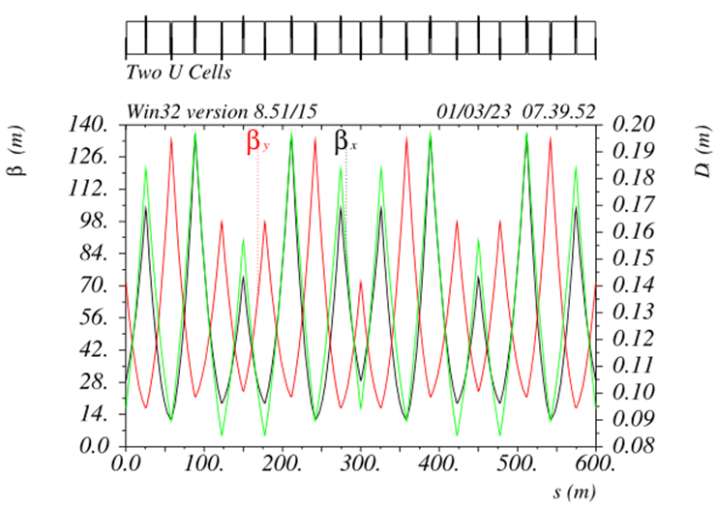
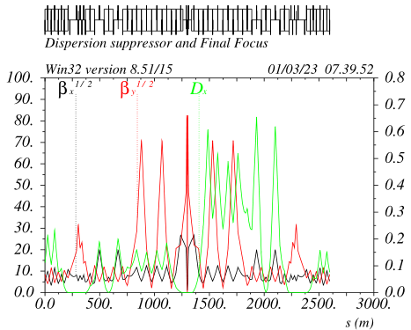
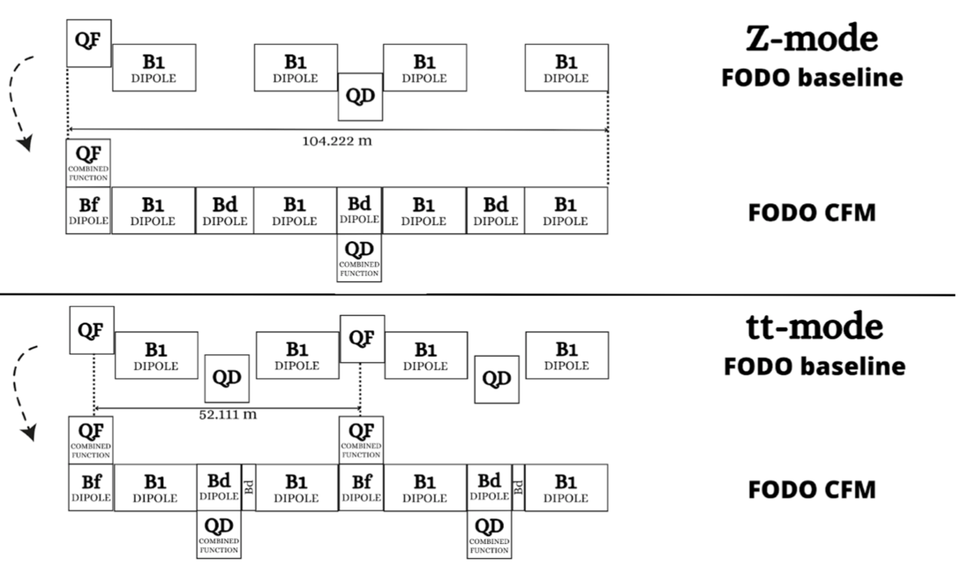
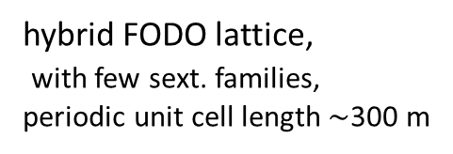

FCC-ee optics baseline & further evolution(s)
regular arc
K. Oide
interaction region
K. Oide
optimisation goals:
reduced power consumption
lower SR energy loss
increased momentum acceptance
relaxed tolerances
larger dynamic aperture
simplified powering schemes
FODO lattice, many -I sext pairs; periodic unit cell length $\sim$260 m
“1.5” sext.s per final focus,
asymmetric
P. Raimondi
P. Raimondi
hybrid FODO lattice,
with few sext. families,
periodic unit cell length$\sim$300 m
5 sext.s per final focus, modular
C. Garcia,
R. Tomas, et al.

Slide 22





FCC-ee Beam Impedance & Collective Effects
M. Migliorati
et al.
Longitudinal impedance
Transverse coupled bunch instability and feedback
Bellows
SuperKEKB model
damping time ~ 1 ms needed (3 turns !)
HL-LHC model
Transverse Mode Coupling instability
Transverse dipolar wake potential
30 mm pipe radius
Longitudinal impedance

Slide 23

Proposed DAΦNE Collider Test Facility
C. Milardi
Highlight assets:
“crab-waist collisions”, developed at DAΦNE, key for FCC-ee
monochromatised beam collisions, concept invented at LNF, proposed for FCC-ee
highest electron and positron beam currents in the world
only operating electron-positron collider in Europe (& none in the United States)
Example studies:
Testing advanced optics measurements, beam-based alignment, and machine tuning;
Studying luminosity performance through tune scans in crab-waist collision - importance of synchro-betatron resonances ?;
Exploring the interplay of beam-beam forces and wakefields;
Demonstrating monochromatized collisions;
Test of advanced beam diagnostics, e.g. prototype BPMs and IR bellows for the FCC-ee;
Development and testing of advanced beam feedback systems;
Beam test of prototype FCC-ee collimators;
Code benchmarking for electron-cloud and ion effects, as well as for collimation simulation tools;
Beam tests of prototype FCC-ee magnets and SRF cavities.
Continuing the operation of DAΦNE as a test facility is an unique opportunity not to be missed.
Schematic of the DAΦNE collider complex in Frascati, which could become a formidable test facility for the design of the FCC-ee

Slide 24


Arc layout and integration optimisation
Arc cell optimisation – 80 km total system length, dedicated working group active.
Including support, girder and alignment systems, shielding systems
vacuum system with antechamber + pumps, dipole, quadrupole + sext. magnets, BPMs,
cabling, cooling & technical infrastructure interfaces.
Safety aspects, access and transport concept,
FCC-ee arc half-cell mock up

Slide 25




prototypes of FCC-ee low-power magnets
Twin-dipole design with 2× power saving
16 MW (at 175 GeV), with Al busbars
Twin F/D arc quad design with 2× power saving
25 MW (at 175 GeV), with Cu conductor
prototype
prototype
even more efficient alternative magnet designs are being explored

Slide 26





HTS option for FCC-ee arc quads and sextupoles
CDR: 2900 quads & 4700 sextupoles
Normal conducting, ~50 MW @ ttbar
3 different types of short straight sections
“HTS4” project within CHART collaboration
Nested SC sextupole and quadrupole.
HTS conductors operating at around 40K.
Cryo-cooler supplied cryostat
Produce a $\sim$1m prototype by 2026
CDR arc lattice
CAD design of HTS short
sextupole demonstrator based on CCT coils
HTS option proposal
“HTS4” potential
Power saving
Reduced length and increased dipole filling factor
Optics flexibility
M. Koratzinos, B. Auchmann

Slide 27










Prototype Q1 (left) & Interaction Region Mock-Up (right)
Testing at cold in SM18 (CERN),
27-31 October 2023
INFN-LNF, CERN and INFN-Pisa collaboration
warm
FCC-ee IR mock-up assembly & test lab at INFN Frascati
field quality:
all multipole errors
<1 unit !
cold
CERN-PSI collaboration

Slide 28
FCC-hh parameters
parameter | FCC-hh | HL-LHC | LHC
collision energy cms [TeV] | 81 - 115 | 14 | 14
dipole field [T] | 14 - 20 | 8.33 | 8.33
circumference [km] | 90.7 | 26.7 | 26.7
arc length [km] | 76.9 | 22.5
beam current [A] | 0.5 | 1.1 | 0.58
bunch intensity [10¹¹] | 1 | 2.2 | 1.15
bunch spacing [ns] | 25 | 25 | 25
synchr. rad. power / ring [kW] | 1020 - 4250 | 7.3 | 3.6
SR power / length [W/m/ap.] | 13 - 54 | 0.33 | 0.17
long. emit. damping time [h] | 0.77 – 0.26 | 12.9 | 12.9
peak luminosity [10³⁴ cm⁻²s⁻¹] | ~30 | 5 (lev.) | 1
events/bunch crossing | ~1000 | 132 | 27
stored energy/beam [GJ] | 6.1 - 8.9 | 0.7 | 0.36
Integrated luminosity/main IP [fb⁻¹] | 20000 | 3000 | 300
With FCC-hh after FCC-ee: significantly
more time for high-field magnet R&D
aiming at highest possible energies
Formidable challenges:
high-field superconducting magnets: 14 - 20 T
power load in arcs from synchrotron radiation: 4 MW → cryogenics, vacuum
stored beam energy: ~ 9 GJ → machine protection
pile-up in the detectors: ~1000 events/xing
energy consumption: 4 TWh/year → R&D on cryo, HTS, beam current, …
Formidable physics reach, including:
Direct discovery potential up to ~ 40 TeV
Measurement of Higgs self to ~ 5% and ttH to ~ 1%
High-precision and model-indep (with FCC-ee input)
measurements of rare Higgs decays (𝛄𝛄, Z𝛄, µµ)
Final word about WIMP dark matter
F. Gianotti

Slide 29



Key activities on FCC-hh: cryo magnet system, optics design
Optics design activities:
adaptation to new layout and geometry
shrink β collimation & extraction by ~30%
optics optimisation (filling factor etc.)
High-field cryo-magnet system activities
Conceptual study of cryogenics concept and temperature layout for LTS and HTS based magnets, in view of electrical consumption.
HFM R&D (LTS and HTS) on technology and magnet design, aiming also at bridging the TRL gap between HTS and Nb₃Sn.
Integration studies for HFM designs (LTS and HTS) to ensure compatibility with tunnel.
betatron collimation straight
experimental straight

Slide 30

Status of FCC global collaboration
The CERN Council reviewed the work undertaken in a fruitful meeting on 2 February 2024.
It congratulated and thanked all the teams involved in the study for the excellent and significant work done so far and for the impressive progress, and looks forward to receiving the final report in 2025.
150
Institutes
32
Companies
33
Countries
EC
H2020
FCC Feasibility Study: Aim is to increase further the collaboration, on all aspects,
in particular, on Accelerator and Particle/Experiments/Detectors (PED).

Slide 31



Progress on international collaboration
26 April 2024
White House Office of Science and Technology Policy Principal Deputy U.S. Chief Technology Officer Deirdre Mulligan signed for the United States while Director-General Fabiola Gianotti signed for CERN.

Slide 32

First FCC Public Information Event – Science Gateway
Date: 24 April 2024
Venue: Science Gateway
FCC Physics, FCC Regional Implementation
Round table with CH and FR representatives
Questions & Answers
Attendance: Full room (400 people). 350 members of the general public, 10 journalists/photoreporters, 40 invited guests.
Live webcast (200 online) and recording to become publicly available. Increased compared to other cases.
This event was the first in a series of upcoming public meetings to be held closer to the regions to enrich the dialogue with CERN.

Slide 33
FCC Feasibility Study – summary and outlook
The first part of the FCC Feasibility Study has been completed with the mid-term review
  placement & layout was defined, and entire project adapted to the new geometry
  dialogue with local-regional actors and stakeholders for implementation established and ongoing
  all deliverables met, list of recommendations from committees towards final Feasibility Study
Progress was made possible by a fruitful collaboration between scientific & technical actors, in close cooperation with the host state services concerned.
Next milestone is completion of the FCC Feasibility Study by March 2025 to enable advancing project decision and project start date.
By 2027-2028, possible project approval, possible start of CE design contract:
By 2031-32, possible start of CE construction:
  CE groundbreaking
  TDR to enable prototyping, industrialization towards component production

Slide 34

FCC Week 2024
Future Circular Collider (FCC) Week 2024, at the Westin St. Francis in San Francisco.
From Monday 10 June to Friday 14 June 2024.
Registration is open !
We look forward to welcoming you in
San Francisco for what promises to be an exciting and informative event!
https://fccweek2024.web.cern.ch/

